Slide 1
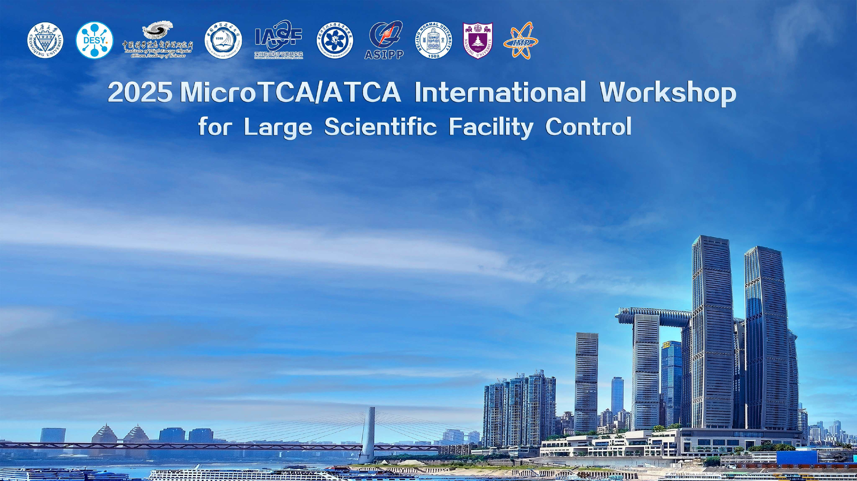
Welcome Speech

Slide 2
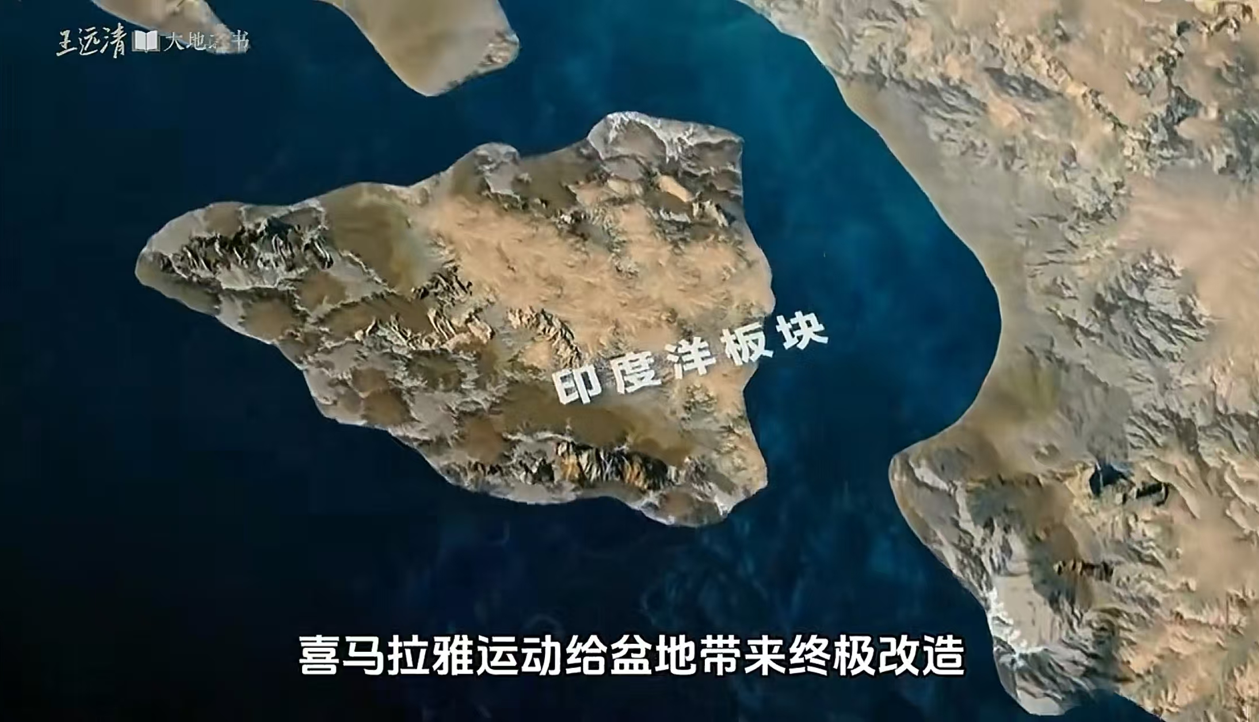
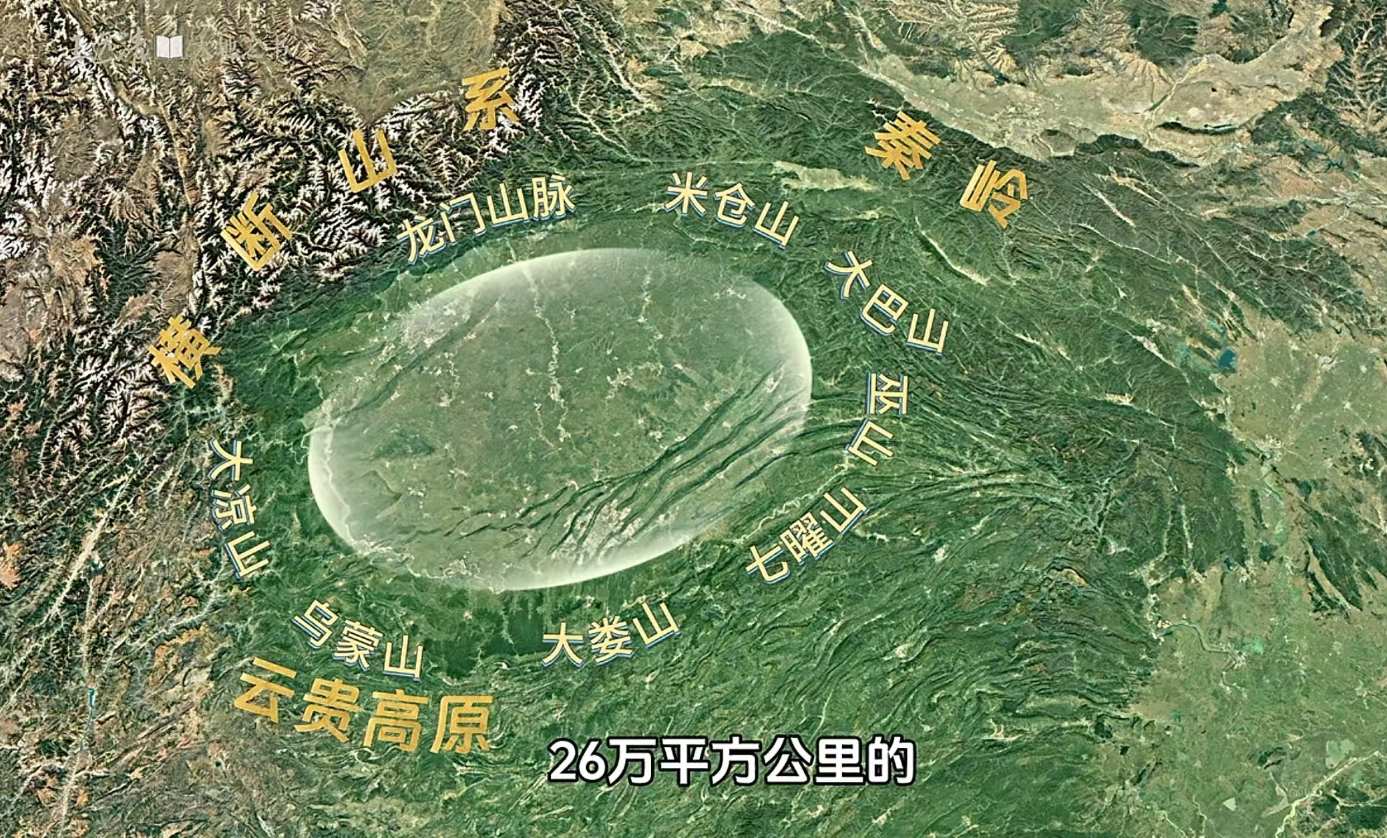
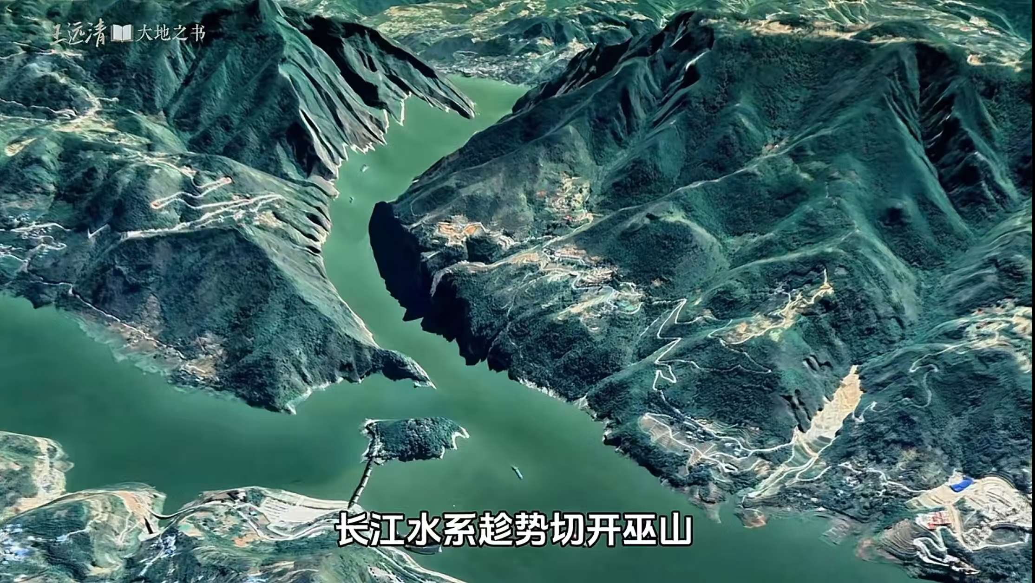
Welcome to Chongqing
Sixty million years ago, after hundreds of millions of years of a mutual journey, the collision between the Indian Ocean Plate and the Yangtze Plate gave rise to the towering Himalayas and the vast Tibetan Plateau. Riding on this momentum, the Yangtze River system carved through the Three Gorges, shaping the Sichuan Basin as we know it today

Slide 3
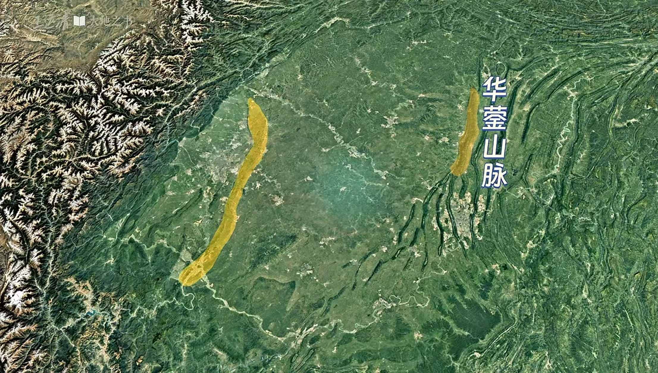
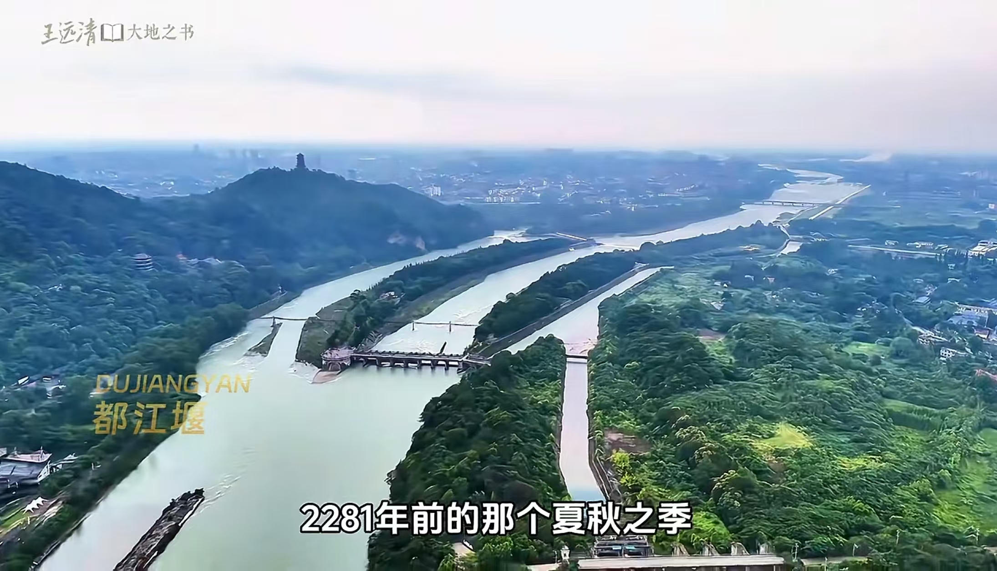
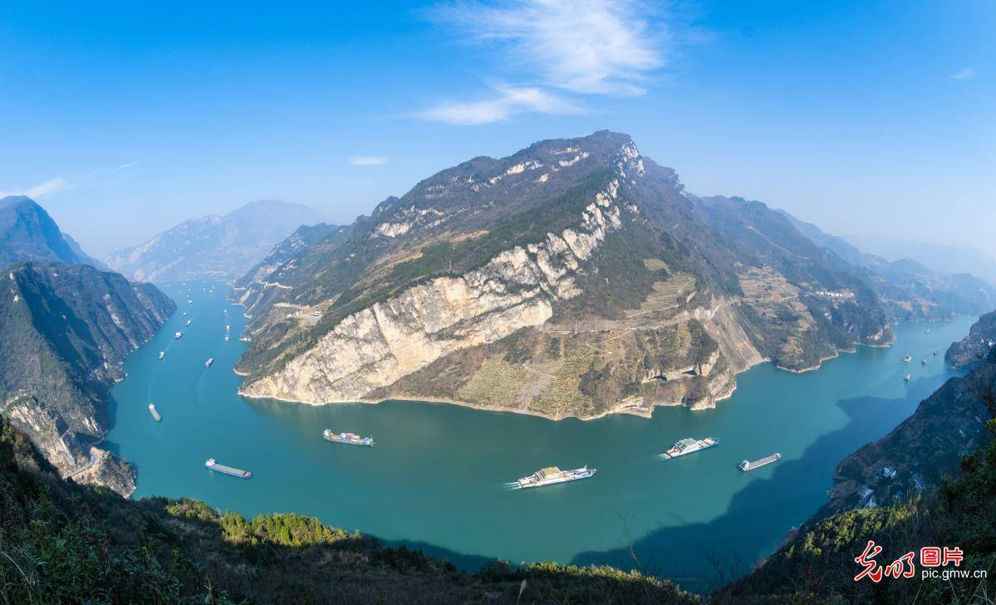
Welcome to Chongqing
Chengdu
龙泉山脉
Chongqing
Dujiangyan
Yangtze River shipping
Chongqing and Chengdu sit on the eastern and western edges of the Sichuan Basin. The Huaying Mountains, like the graceful hand of a goddess, pluck the strings of the earth to compose the magnificent landscape of parallel ridges and valleys, where the heroic people of Chongqing carved mountains and built bridges to create their city.
Over two thousand years ago, Li Bing and his son built the Dujiangyan irrigation system, watering vast fertile fields and weaving the reputation of the Sichuan Basin as the 'Land of Abundance.' Chongqing, meanwhile, emerged as the starting point of the golden waterway of the Yangtze River, linking the inland with the outside world.

Slide 4
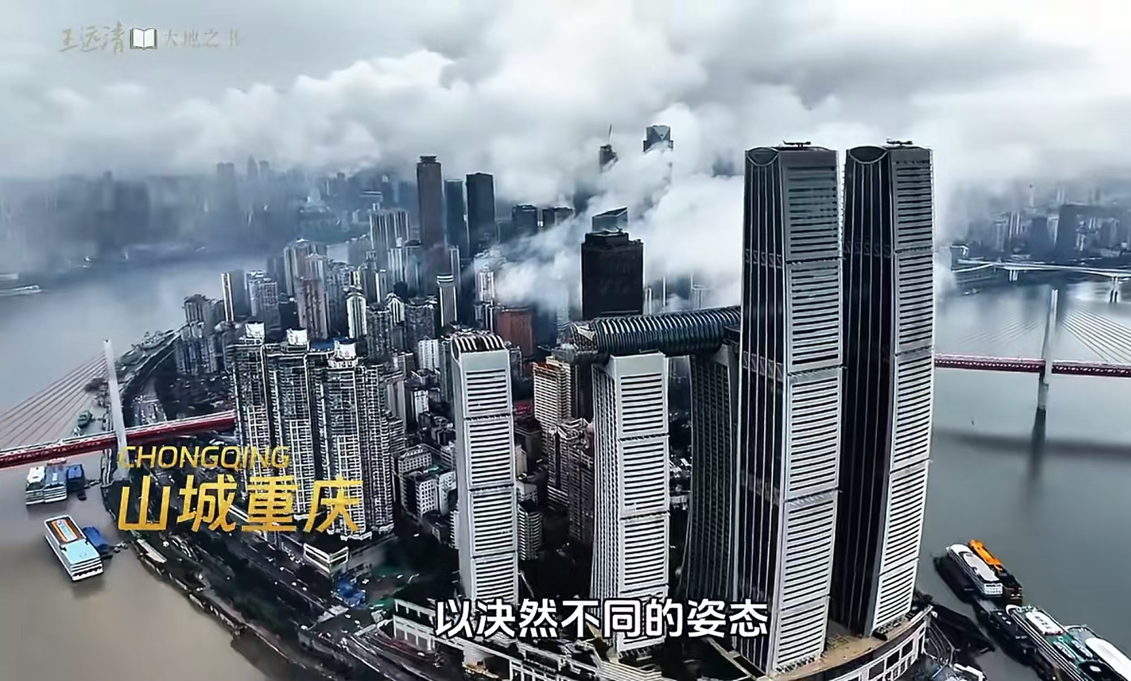
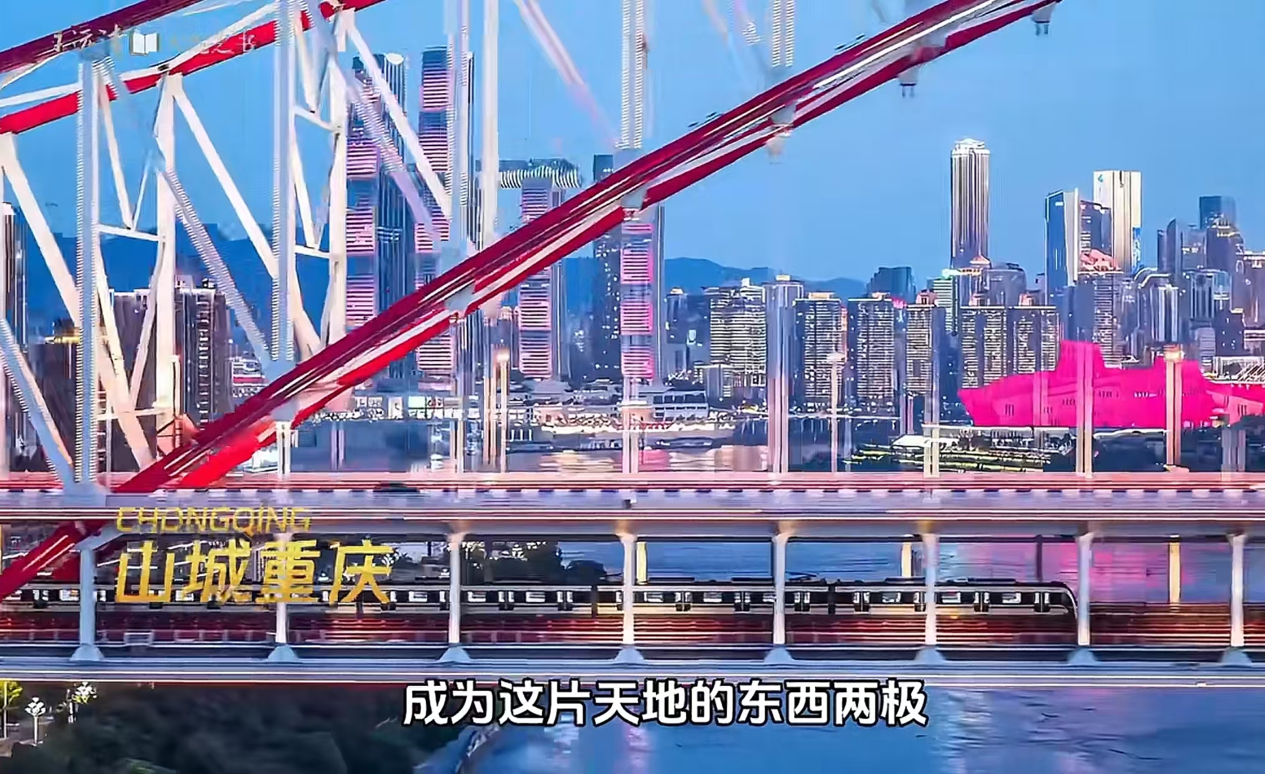
Welcome to Chongqing
Chongqing, a city unlike any other, is marked by its unyielding character. Fearless of towering mountains and mighty rivers, it has woven an 8D magical world and proudly embraces the title of the 'Mountain City.' Its warm and hospitable people welcome visitors from all directions, making Chongqing a popular destination for travelers.

Slide 5
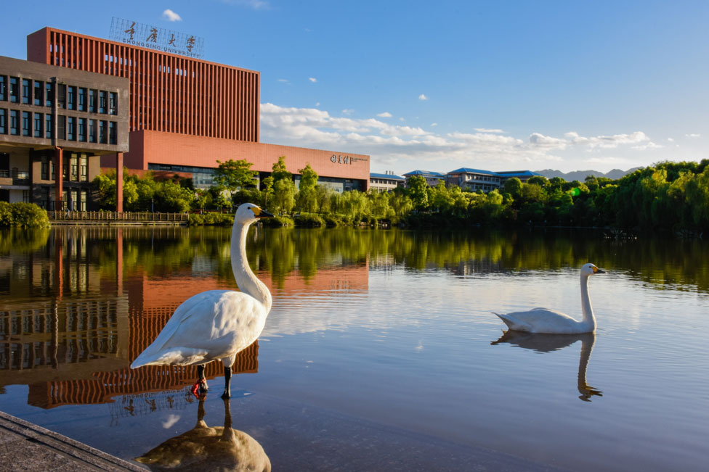
Welcome to Chongqing University
Chongqing University as the most important university in Chongqing was founded in 1929. In 1998, the university was approved as a university for key construction under the state “Project 211”. In 2001, it became a university for key construction under the state “Project 985”. The campuses occupy a total land area of over 5,300 mu (approximately 3.5 km²), consisting of 5 Campuses.
Chongqing University has a full range of disciplines, covering 11 categories, namely science, engineering, economics, management, jurisprudence, literature, history, philosophy, medicine, education, and art. The number of staff is over 5,300 persons, the student population is over 50,000 persons.

Slide 6
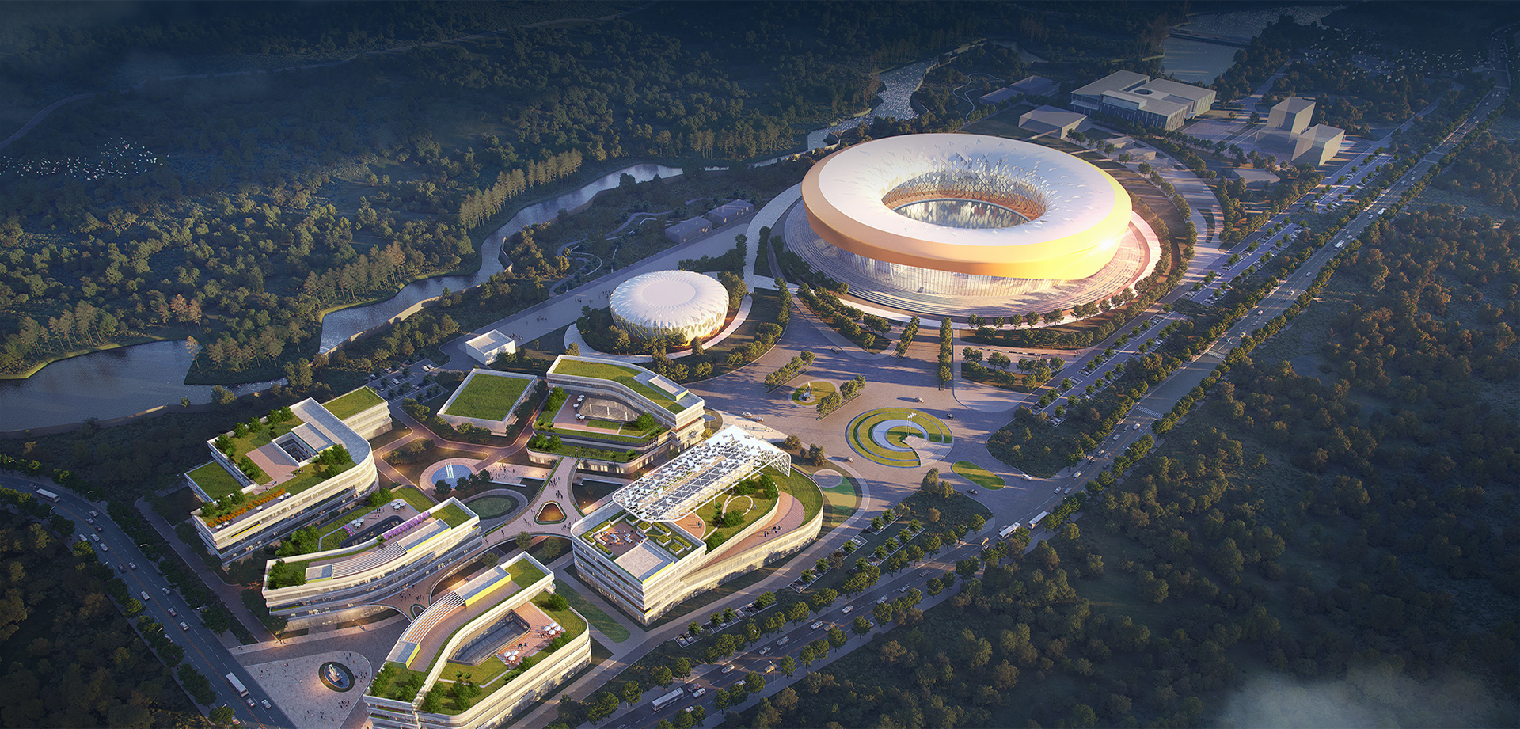
Ultrafast Transient Experimental Facility (UTEF)
Phase II
3GeV Light Source
Electron
microscope
cluster
Phase I
500MeV
Light Source
Electron
microscope platform

Slide 7
The purpose of the workshop
The workshop promotes and coordinates the development of MicroTCA/ATCA standards and systems in China and East Asia, especially in data acquisition, digital signal processing, measurements, instrumentations, controls, and analog circuit (Microwave/RF) applications in research facilities and industry. The workshop also provides a platform to discuss technologies and collaborations.

Slide 8


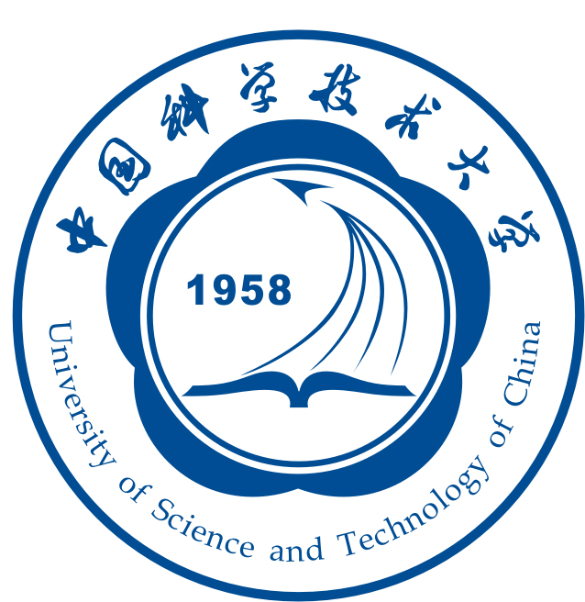
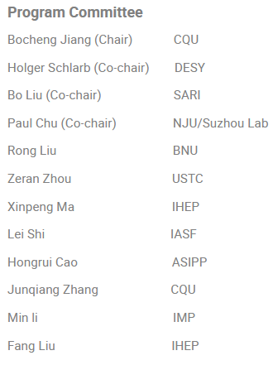
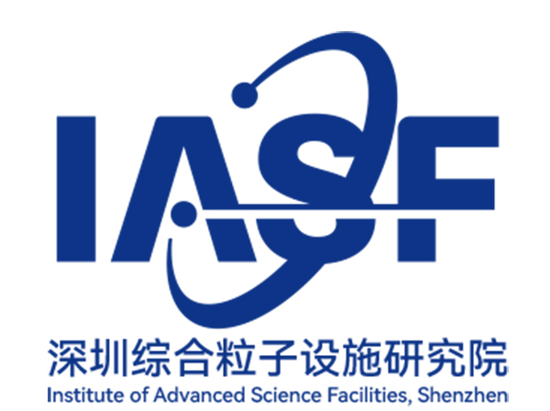
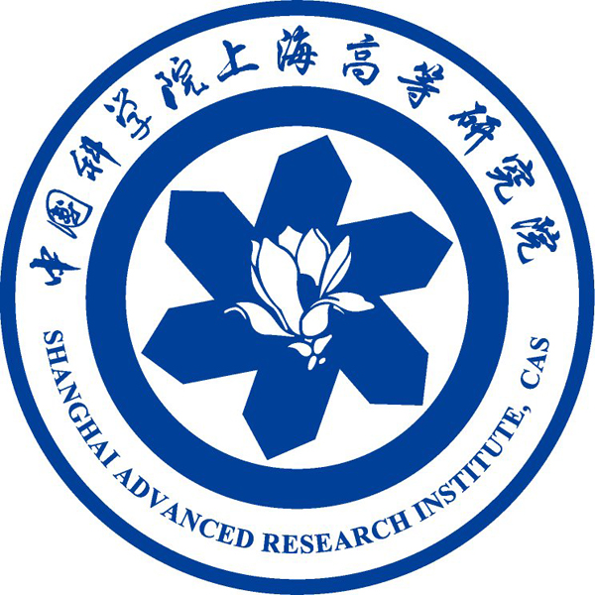





Special thanks to

Slide 9









Special thanks to

Slide 10
Special thanks to
All participants on-site and on-line

Slide 11
Thank you

