Slide 1

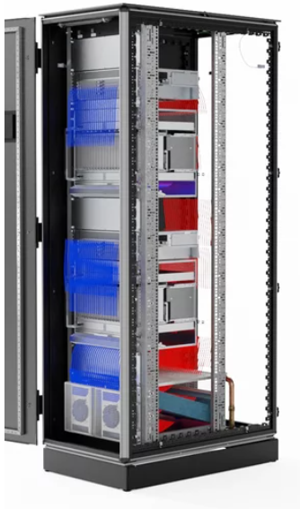
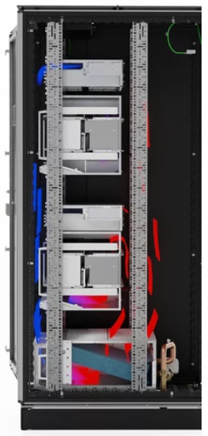
Liquid Heat-Exchanger (LHX)
by nVent SCHROFF
MTCA
MTCA
Alex Mao
nVent / Schroff Global Product Marketing
09-2025
LHX

Slide 2
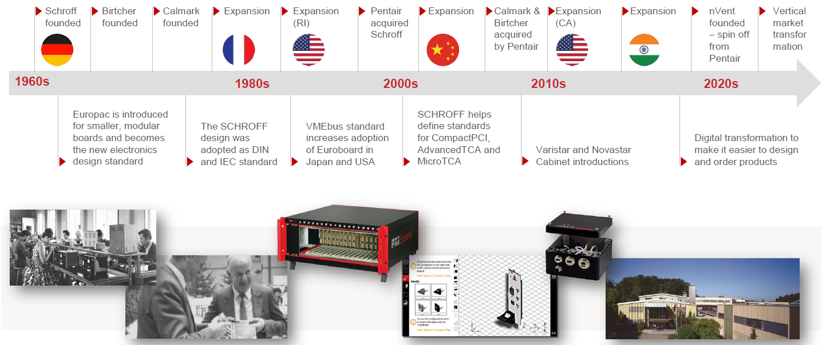
Schroff Evolution
60 Years of Electronics Connection and Protection

Slide 3
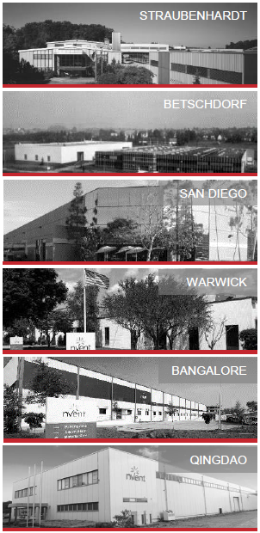

Global Footprint
Local design, support and production - globally.

Slide 4
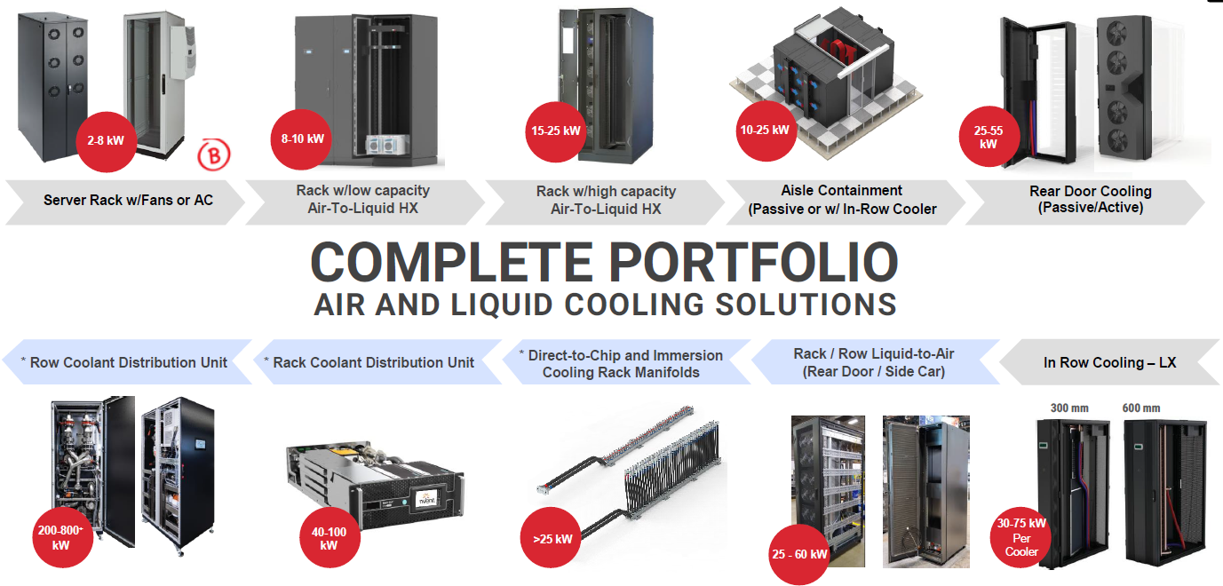
nVent │SCHROFF Cooling Solution
Provides Coolant distribution for Rack and Direct to Chip Liquid Cooling

Slide 5
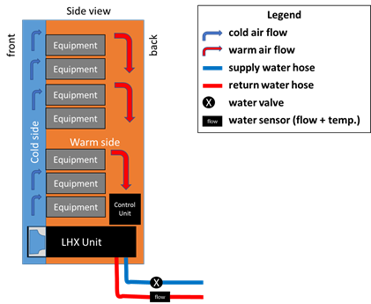
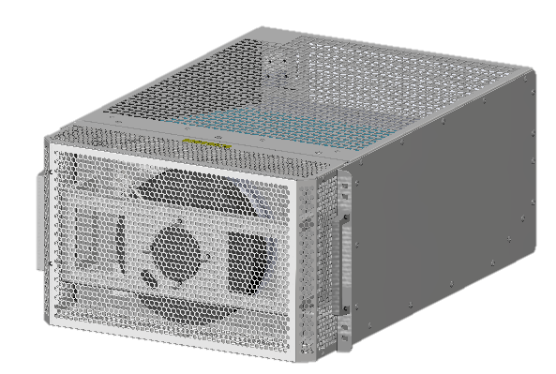
Design Concept and Operating Principle
DESGIN CONCPET
Design based on an independent thermal management system, performance not affected by external environment.
The fan speed of the LHX series can be adjusted as needed to effectively save energy consumption and ensure precise thermal control
Heat exchanger located at the bottom of the cabinet, the LHX series does not pose a risk of condensation
OPERATION PRINCIPLE
Cold air blows directly upward by fan modules, while hot air is drawn in from the opposite side and downward into the heat exchanger.
Cooling water enters the coils of the heat exchanger, absorbing heat from the hot air inside the cabinet. At the same time, the hot air is cooled by the cooling water, transforming into cold air, which returns to the cabinet

Slide 6
LHX – Components Composition
MONITORING
CABINET SPECIFICATION
Controller
Separate compact 19″ control unit (2 U, with 1 U space usage) in the upper cabinet area
Clearly marked plug & play sensor connections
Cabinet dimensions 600 W x 800 D or 1000 D
Lever handle, locks with 333 profile half-cylinder
Effective cable ducting without negative effect on high IP or EMC functions
Sensor
Temperature regulation accuracy of +/- 0.1 K
Differential pressure sensor for fan speed control as standard
Optional coolant flow and temperature monitoring
COOLING
19-inch heat exchanger (6 U) installed in lower cabinet section
Scalable cooling performance : 5KW / 10KW
The fan units can be exchanged without having to replace the heat exchanger
Air flow volume of ~ 100/1800 m³/h
Water flow temperature from 6°C to 25°C
Ambient temperature from 5°C to 50°C
ACCESS
Terminal with display and keyboard on front door for control without opening the door
Ethernet interface for access to the cooling unit via web interface, SNMP, Modbus TCP
Serial interface (RS485) for Modbus RTU
Communication with guardian gateway management solution possible

Slide 7


APPLICATION CASE
CHALLENGING
CHALLENGING
Intercontinental Deployment
Long-Life Support, solid Product Change Management
Differentiated thermal performance ( 1KW ~ 10KW ) by one SKU
Rapid attainment of steady-state temperature after Power-Up
Limited Installation Space
Harsh Environment, anti-corrosion
Quick Install / Uninstallation in the field
SOLUTION
SOLUTION
Customized LHX+10KW
Optimized Liquid Piping
Quick Connector for water piping deployed
Enhanced Mechanical Enclosure
Optimized Cable Harness and Silk-Screen on Front Panel
Complete Documentation of Installation and Service
LHX+10KW + customized controller SW
Three Production Location, 10+ Service Office
Future-proofed LHX Roadmap
Solid Product Change Management Process

Slide 8

FURTURE ORIENTATION
FUNCTION – PERFORMANCE
VERTICAL MARTKET
Small Form-Factor
Smarter and Easy for Use
Rugged
T&M – Advance Physics, Semi-Conductor
Medical
Aerospace & Defense
GLOBAL COORDATION
国防航空
医疗
高能物理 基础科学研究
数据中心
测试测量
半导体

Slide 9
Thank You!

