Slide 1

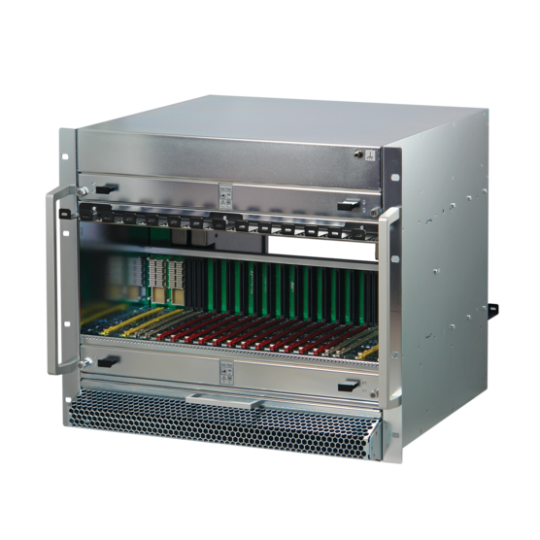


New MTCA.4 Crate
in accordance to Revision 3.0 of MTCA.0 Standard
Alphonso Liu | 刘扬
2025-9-17

Slide 2


The Challenge of the Measurement & Control System in Large Science
Managing unprecedented data volumes & rates
Extreme timing & synchronization requirements (nanoseconds)
Reliable operation in harsh environments radiation, EM interference, unstable temperature, vibration etc
The need for modularity and scalability over decades-long project lifecycles
Multiple industrial computer platforms

Slide 3
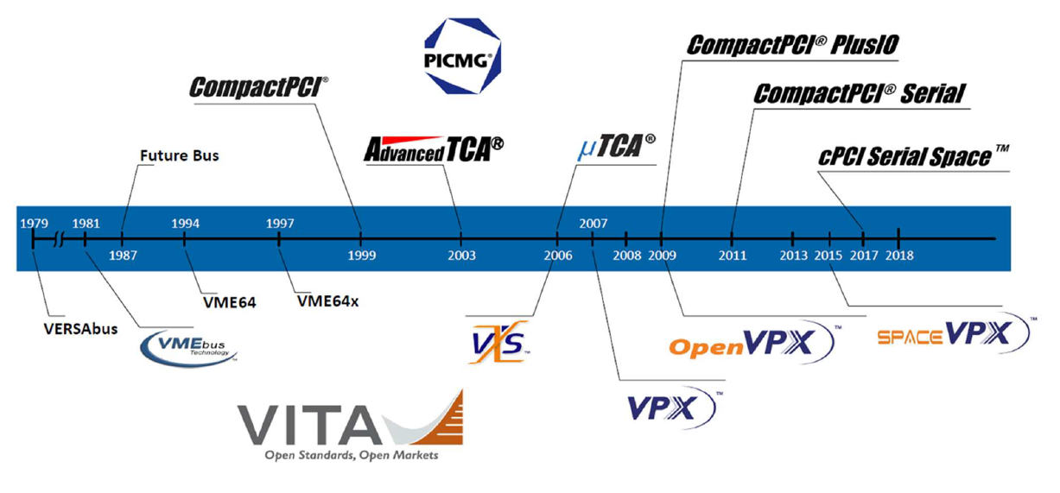
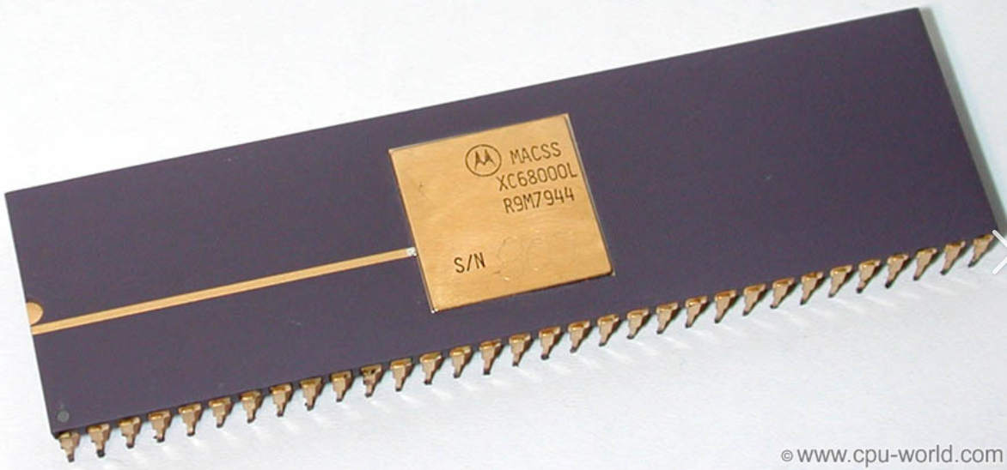
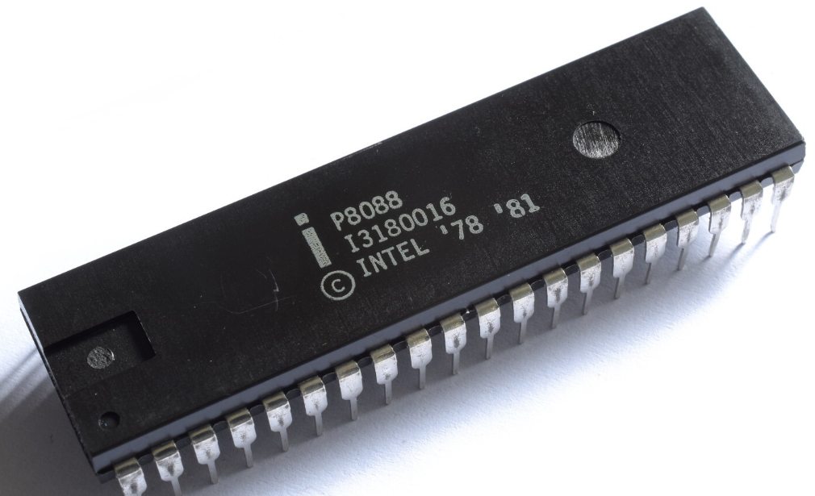
Modular Industrial Computer Platform - Started From Versa Module Eurocard
Intel PCI
1992
16-bit asynchronous
Motorola 68000
Intel 8088---- IBM ISA

Slide 4
What is xTCA?
xTCA
ATCA
MTCA
Advanced
Telecom
Computing
Architecture
Micro
Telecom
Computing
Architecture
AMC
Advanced
Mezzanine
Card

Slide 5
What is MTCA.4?
MTCA.0
Micro Telecommunications Computing Architecture Base Specification
MicroTCA Specification Family Tree
MTCA.1
Air Cooled Rugged MicroTCA Specification
MTCA.4
AMC.0
MicroTCA Enhancements for Rear I/O and Precision Timing
Advanced Mezzanine Card Base Specification
MTCA.2
Hardened Air Cooled MicroTCA Specification
MTCA.3
Hardened Conduction Cooled MicroTCA Specification

Slide 6
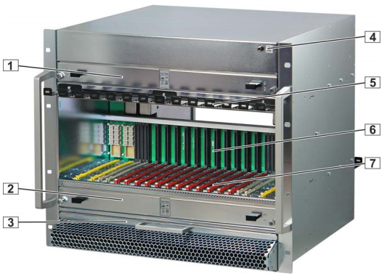
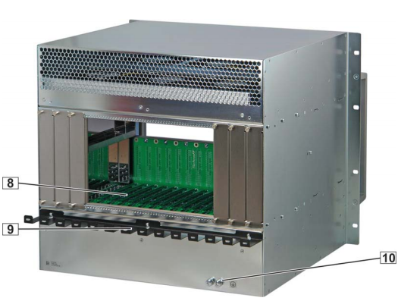
Typical MTCA.4 Crate
1 Upper Cooling Unit (CU1)
2 Lower Cooling
3 Air filter
4 ESD Wrist Strap Terminal
5 Cable Tray Unit (CU2)
6 Backplane
7 Card cage
8 Rear card cage
9 Cable Tray
10 Ground Terminal

Slide 7
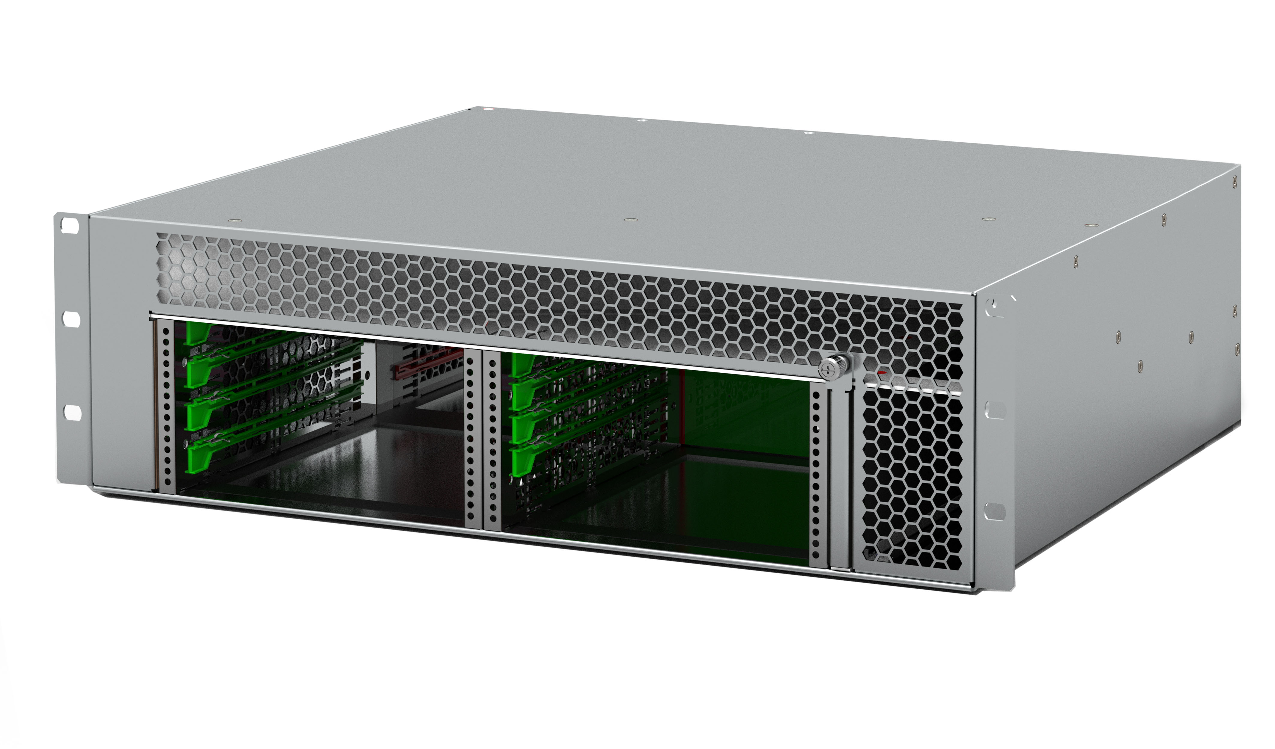
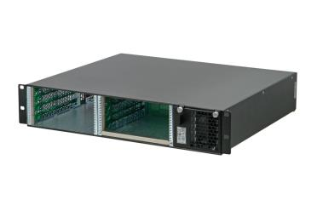
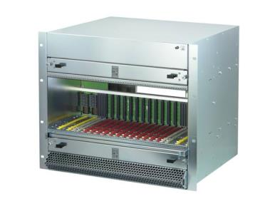
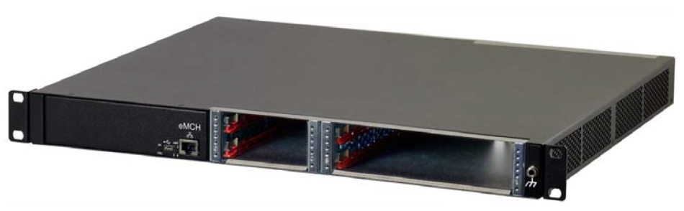
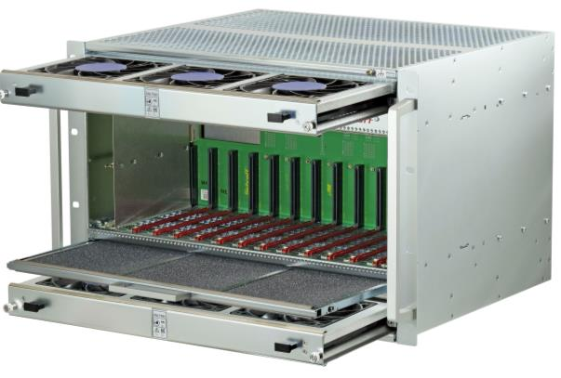
nVent Schroff MTCA.4 Crates
nVent SCHROFF
MTCA.4 Crates

Slide 8
NEW MTCA.0 Rev 3.0 compliant backplane
Signal Integrity, compatibility and differences

Slide 9
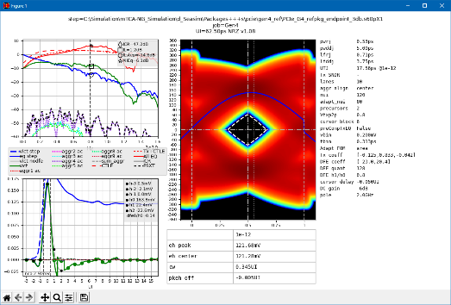
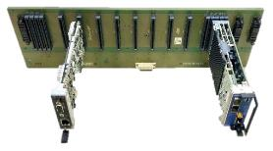
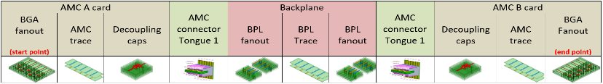
Next Generation MicroTCA
MTCA.0 Rev 3.0
NEW FEATURES
Supports PCI Express Gen 4 & 5
Supports 100 Gb Ethernet (100GBASE-KR4)
MCH with new management features
MCH slot gets 110 W of power to support 100 GbE or PCIe Gen 4 / 5 switches
Power Module with 110 W channels for MCH and CU

Slide 10
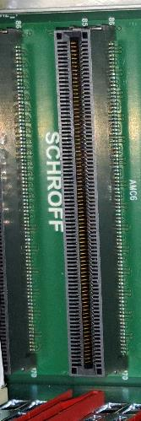


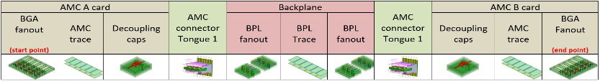
New Backplane Design
Connectors changed from Press Fit to Surface Mount to minimize the losses in the through holes
Connectors are downward compatible
Low loss material and new routing strategy for pcb to improve the signal integrity
Data transmission channel from PCI-SIG and IEEE divided into sections, with limits defined for MCH, AMC and Backplane
The backplane in the NEW nVent SCHROFF MTCA.4 crate meets the requirements of the MTCA.0 Rev. 3.0 Standard for PCIe Gen 4 & (5) and 100GBASE-KR4
Rx/Tx
Chip
Tx/Rx
Chip
transmission channel

Slide 11
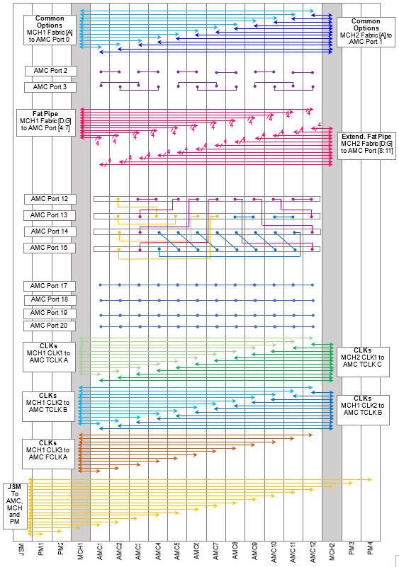
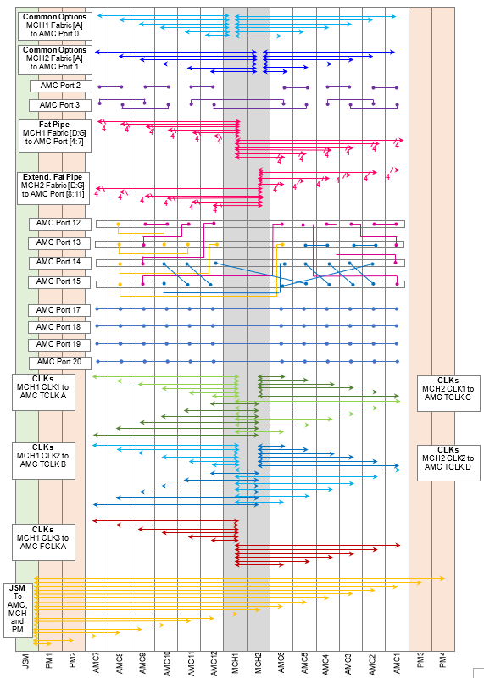
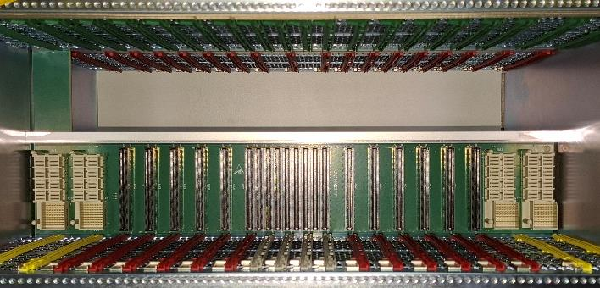
Similar Backplane Topology BUT different physical AMC locations
New MCH location required new optimized routing strategy
NEW AMC module order is (from left to right):
old topology
NEW topology

Slide 12
Cooling Unit update

Slide 13
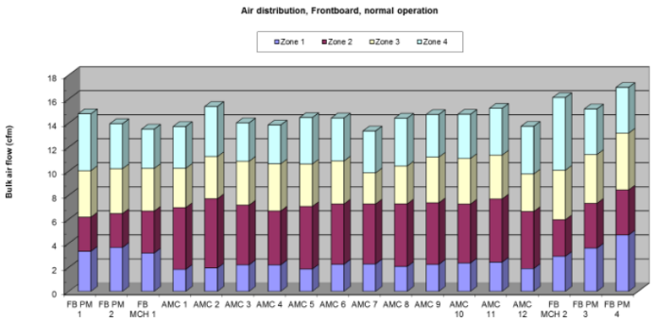
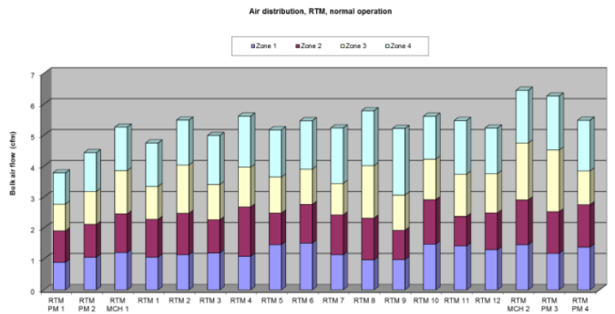
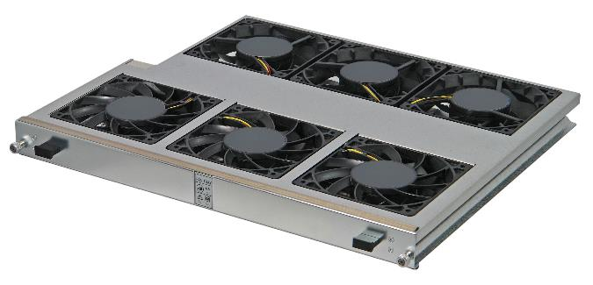
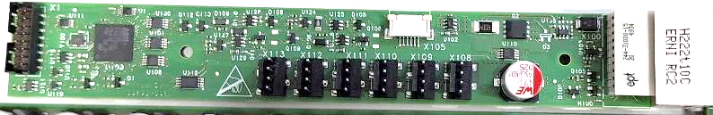
Current nVent SCHROFF Cooling Unit
MTCA.0 Rev3: Cooling Unit Power Channel enhancement: 80 W -> 110 W
  Already using the strongest 120 mm, 12 V DC fans available in the front
  Rear fans are upgraded to improve air flow in the RTM section
  No cooling improvement of front card cage possible with current System architecture
New Cooling Unit Manager:
  The Cooling Unit Manager has been redesigned, now using the STMicro STM 32 controller

Slide 14
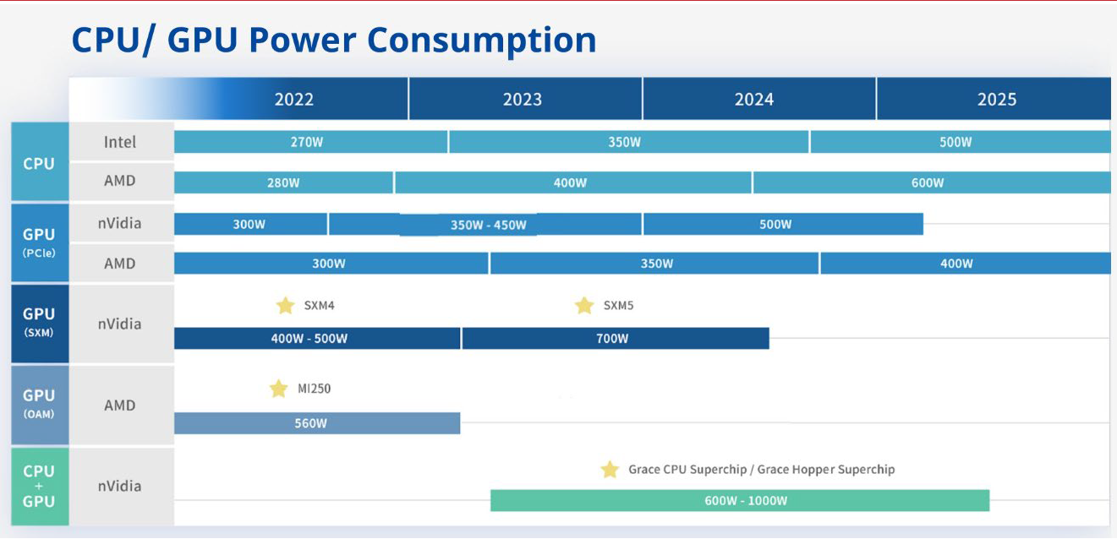
Increases in Computer Power – More Heat

Slide 15



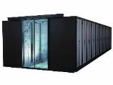
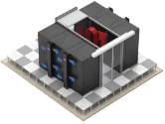


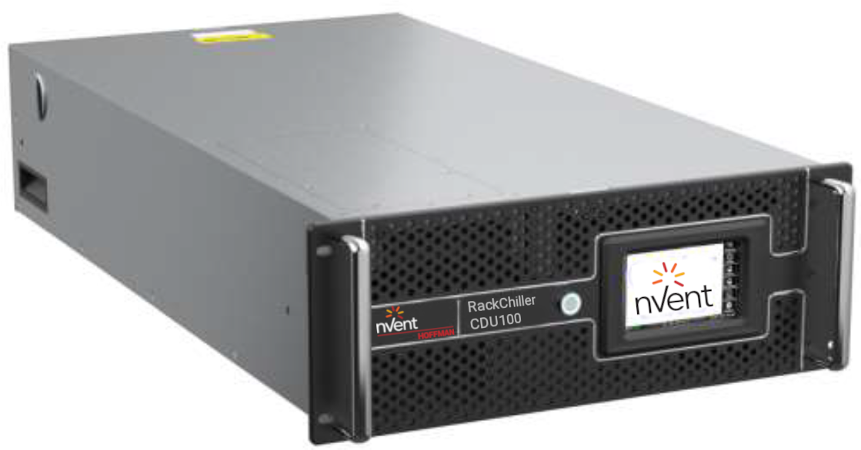
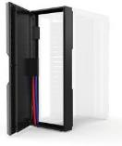
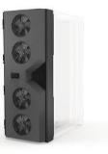



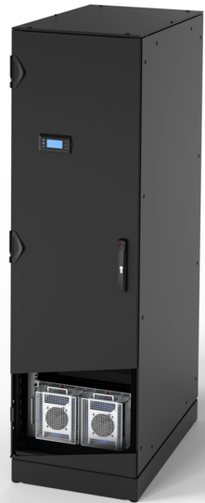
Cooling MTCA Crates Inside the Cabinet
2-4 kW
4-6 kW
6-8 kW
10-25 kW
8-12 kW
10-25 kW
Server Rack
Server Rack w/Fans
Server Rack w/AC
Row Aisle Containment (Passive)
Row Aisle Containment
(Active w/IRC)
COMPLETE PORTFOLIO
AIR AND LIQUID COOLING SOLUTIONS
Chassis Level Immersion Cooling
Row and Rack Coolant Distribution Unit (CDU) & Rack Manifolds
Rear Door Cooling (Passive/Active)
In Row Cooling – LX
Rack w/Integrated LX Cooling (MicroEdge)
300 mm
600 mm
3.2 kW
per
chassis
40-800⁺
kW
40-800⁺
kW
25-55 kW
30-75 kW
per
cooler
15-25 kW
COOLING SOLUTIONS FOR ALL REQUIREMTS
15
Notes:
Marc/Stefan Djuranec

Slide 16
Thank You!

