Slide 1
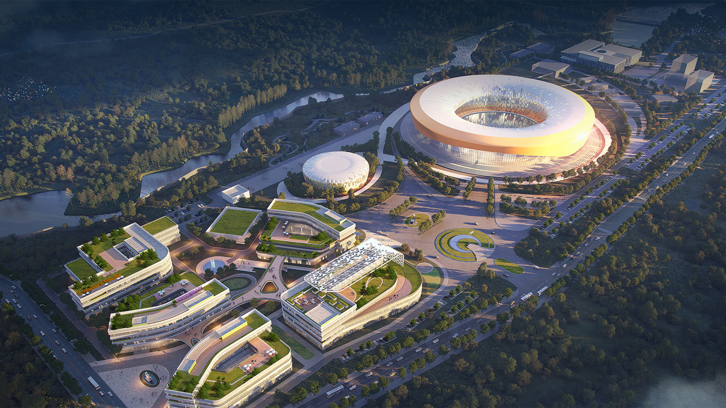


The design and development of control system in the UTEF
Mingtao Kang, Hong Chen
September 17th, 2025

Slide 2
Outline
Requirements
Design and Status
  Data center: machine room, server cluster, storage and networking
  High-level applications(HLA)
  Low-level applications(LLA)
Prototype
  Electron gun test stand
  Magnetic field measurement
Plan
  Fast protection system
  Post-Mortem System
Summary

Slide 3
Requirements
To perform basic control functions: device and instrument control, monitoring
To improve operation efficiency
To provide control, communication platform
To provide data archiving and database service
To provide scientific data storage

Slide 4
Requirements
List of controlled devices for injector in phase I
No. | System | Controlled devices | Qt. (sets) | Interface Type
1 | Electron gun | Electron gun | 1 | Modbus TCP/IP
2 | Radio frequency | Modulator | 5 | Modbus TCP/IP
3 |  | Water temperature | 78 | Wire
4 |  | Water flow | 78 | Wire
5 | Power supply | Power supply | 102 | Modbus TCP/IP
6 | Vacuum | Ion pump | 50 | RS-485 serial port
7 |  | Gauge | 14 | RS-485、wire
8 |  | Gate valve | 6 | Wire
9 | Beam diagnostics | BPM | 15 | Channel Access
10 |  | ICT | 4 | Channel Access
11 |  | Beam profile | 17 | Channel Access
12 |  | Energy spread | 2 | Channel Access

Slide 5
Requirements
List of controlled devices for storage ring in phase I
No. | System | Controlled devices | Qt. (sets) | Interface Type
1 | Pulse power supply | Pulse power supply | 1 | Modbus TCP/IP
2 | Power supply | Power supply | 175 | RS-485 serial port
3 | Vacuum | Ion pump | 95 | RS-485 serial port
4 |  | Gauge | 12 | RS-485、wire
5 |  | Gate valve | 10 | Wire
6 | Beam diagnostics | BPM | 27 | Channel Access
7 |  | Beam profile | 2 | Channel Access
8 |  | DCCT | 1 | Channel Access
9 |  | Synchronized light profile | 1 | Channel Access
10 |  | BXB feedback | 1 | Channel Access
11 |  | Collimator | 2 | Channel Access
12 |  | BCM | 1 | Channel Access
13 | Insertion Device | Insertion Device | 1 | Modbus TCP/IP

Slide 6














Architecture/Design and Status
Large Display
Operator Consoles
State Notation Language
C++
Control Network
High-Speed Gigabit Network
Customized Development
File Server
Web Server
Database Server
Application Server
SAN Storage
Visualize
Computer
Serial port server
Industrial controller
RTOS
PLC
HTTP
Timing
Electron Gun Cooling Water
Vacuum、MPS
Pulse Power Supply Power Supply
Vacuum
Vacuum
Instrument
EPICS 7
Wire & industry ethernet

Slide 7





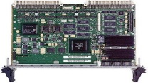

Hardware/Design and Status
xFusion tower server
H3C for networking
PLCs for electron gun, vacuum, cooling water, interlocks
Beijer touch screen for PLCs
MRF EVG/EVR for timing system with cPCI modules
Motion controller and driver
Industrial controller for instrument

Slide 8
Subystem/Design and Status
Data center
  Machine room
  Servers cluster
  Storage
  Networking
High-level applications
  Archiver appliance, alarm, clog, related database, etc.
  Scientific data storage
Low-level applications
    Electron gun
    Timing
    Vacuum
    Cooling water
    Power Supply/pulse power supply
    Machine protection
    Beam diagnostics
    Insertion device
    Instrument control and monitoring

Slide 9
Machine Room/Data center
  The floor space: 50㎡
    18 racks(Server, Storage, Networking...resources)
  IT Load
    Dual power supply: UPS + Civil power supply
    Each power supply can afford all the IT loads
  Dual power supply:
    From two independent transformers to improve stability
  Total Power Capacity: 100kW
  UPS
    Modular equipment: expandable
    Total capacity:10KVA
    Backup time: 0.5 hour

Slide 10
Server Cluster and storage/Data center
  The central computer system is a large and complex infrastructure.
  It consists of servers computers disk arrays client terminals and so on.
  PVE virtualization server cluster
  Development, applications
  Relational database, network management
  Data archiving and viewer, alarm management
  Error logging, logging services and IOC booting.
No. | computing | Storage | comments
1 | 3*24 Core | Disk:3*4*16=192TB | Installed
2 | 6*24 Core | Disk:6*4*16TB | To be installed

Slide 11
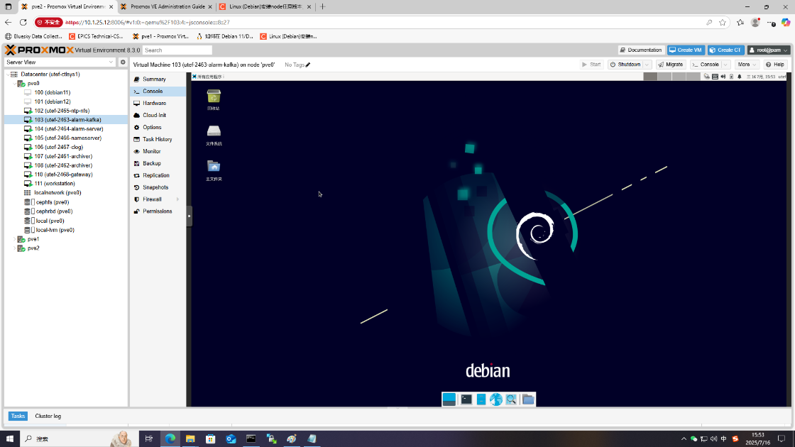
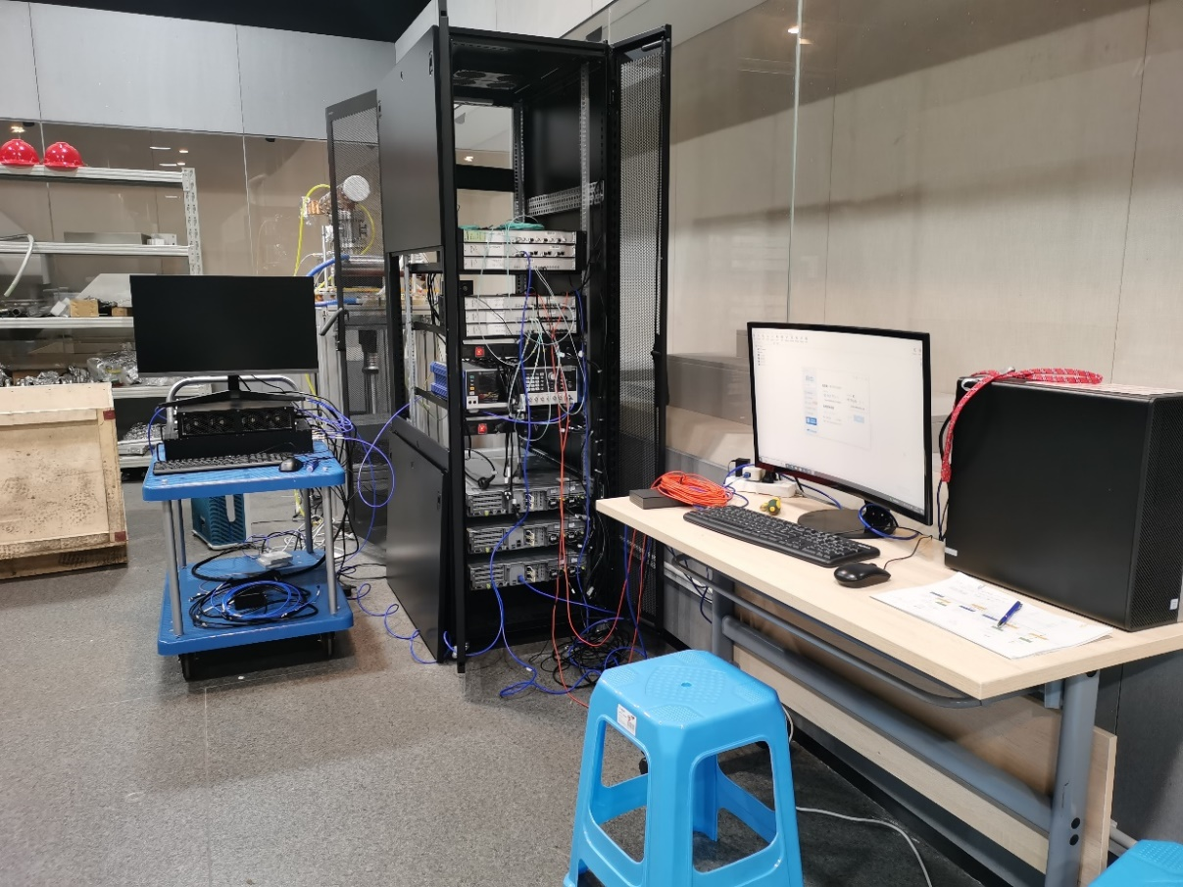
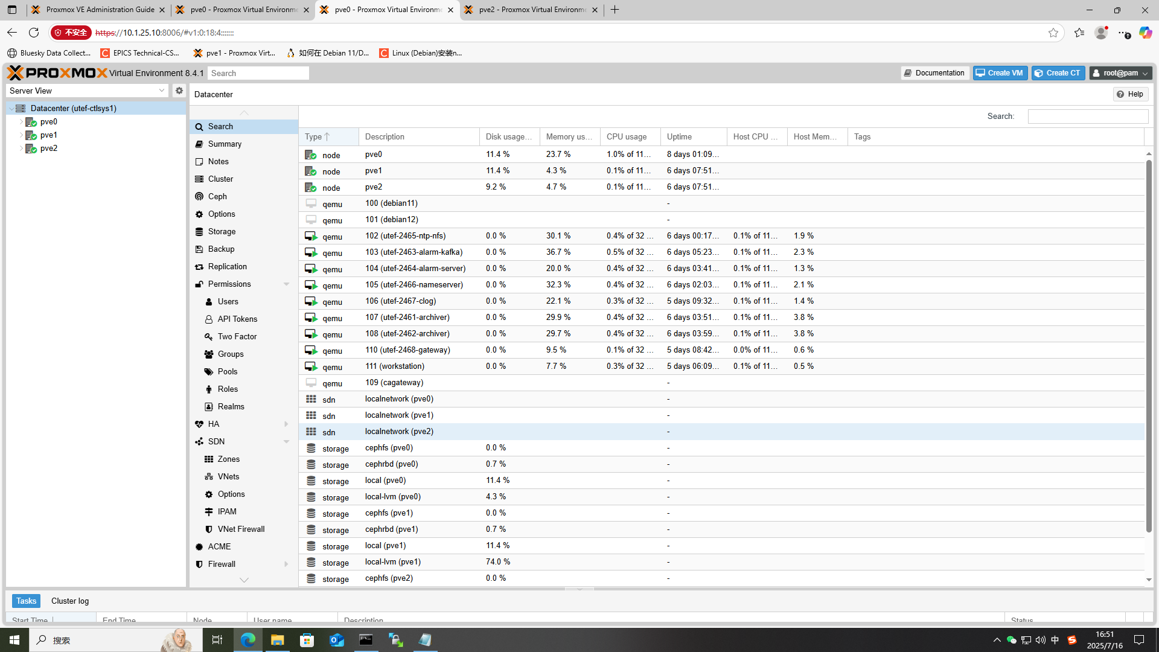
Server cluster and storage/Data center
Console and Proxmox Virtual
Environment (PVE) GUIs

Slide 12
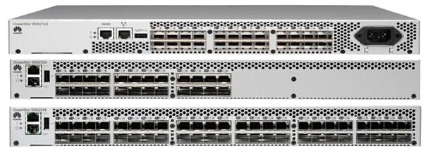
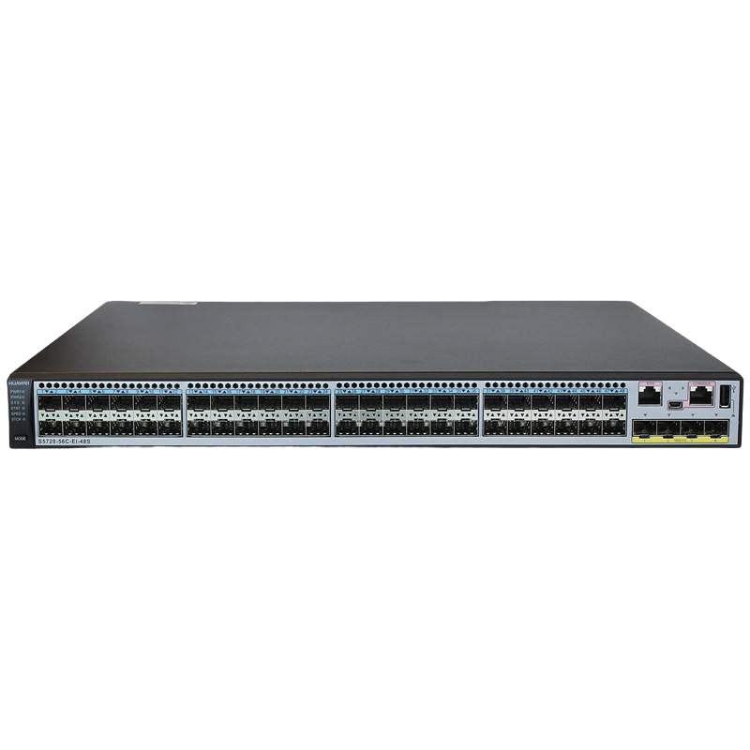
Networking/Data center
2-layer intranet network structure
100Gb/s link
distribution layer
40Gb/s link
1Gb/s link
access layer

Slide 13






Software tools/HLA
EPICS Base7.0.2 as overall software platform
CS-Studio "Phoebus" and QT as OPI development tool
MySQL for RDB based Apps
Debian 11/12 Linux for OS
Python/MATLAB scripting support
Proxmox VE for virtualization

Slide 14
Architecture/HLA
Physics Applications, Beam Study Tools
EPICS Extensions
Phoebus, alh, StripTool, …
Save/Compare/Restore,
Archiving, Post Mortem System, …
Others
Matlab-Python-EPICS 7 Toolkit
Network
Naming &
Directory
Service
Component
DB
Infrastructure
Monitoring
Machine Learning Data mining …
Historian
data
olog
Alarm
Service
Save/Set/
Restore
Display Manager
collaborate with the EPICS Community
Database
EPICS IOC
HTTP
EPICS IOCs
Soft Records
（run control, etc.)
EPICS 7
Technical Systems

Slide 15
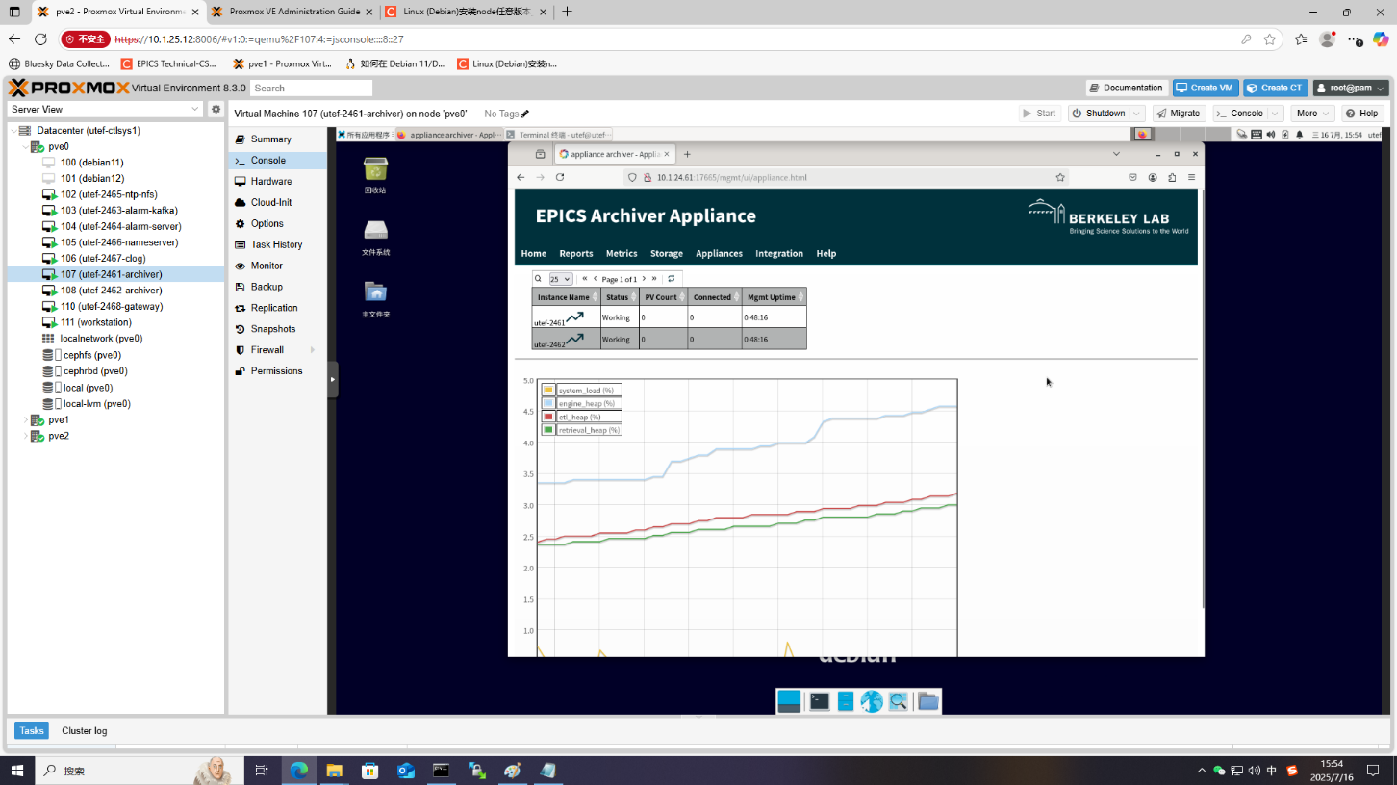
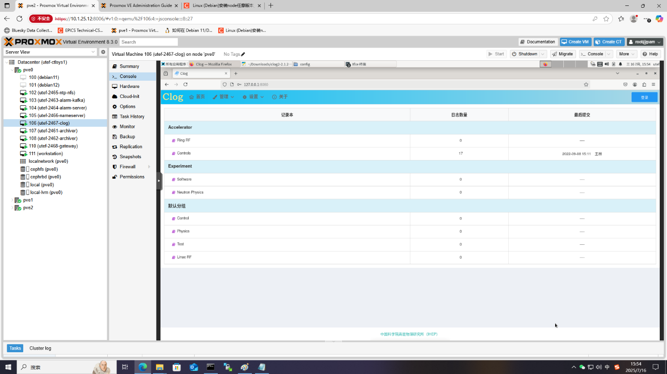
High-level applications
Archiver appliance GUI
Clog GUI

Slide 16
Timing System/LLA
Event timing adopt by many synchrotron light sources.
Performance and functionality are pretty well for synchrotron light source applications.
Storage Ring
Linac
Notes:
Select event system are very nature!

Slide 17
Timing System/LLA
Provide timing for accelerator systems, beamlines and experiments
  Provide accurate timing sequences to trig e-Gun, klystrons, injection, ramping, extraction, etc.
  synchronizing clocks to beam instrumentations, power supplies, beam-line experiments, etc.
  Provide timestamps to most equipment controls
Overall time accuracy better than 10ns, critical equipment can reach 10 ps accuracy

Slide 18
Power supply Control/LLA
Based on PVE virtual machine to implement the communication protocol between the IOC and the power supply interface board.
distribution layer
40G Ethernet
access layer
1G Ethernet
…
Server
Server
PS
Backup server
Backup server
PS
PS
…
PS
PS
PVE cluster

Slide 19
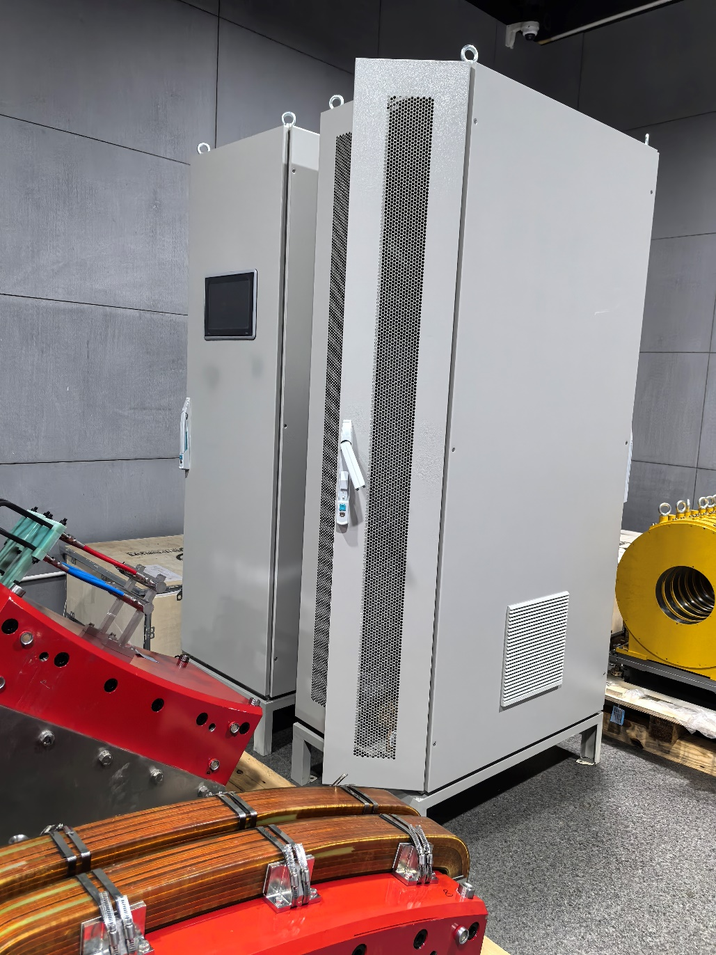
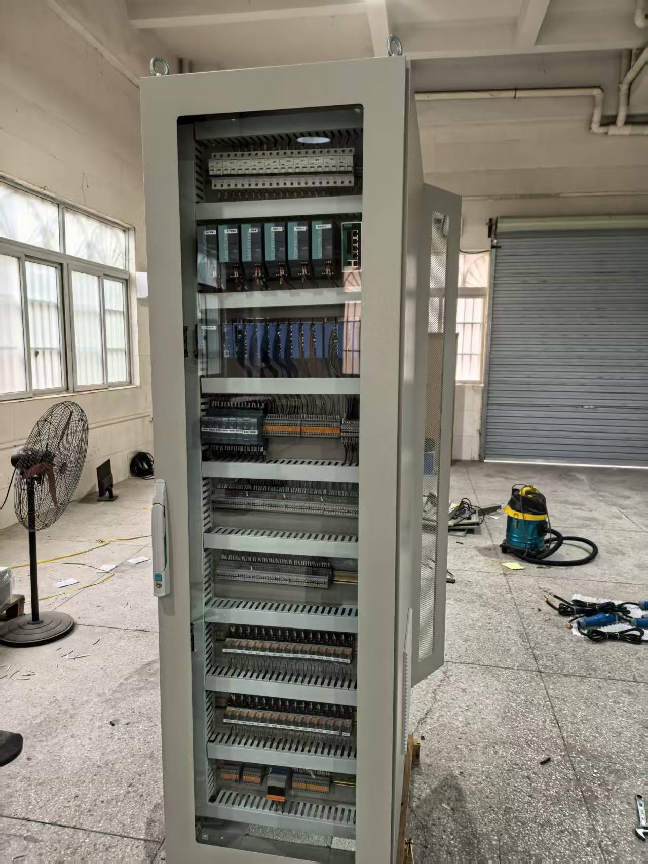
Vacuum Control/LLA
Development of PLC interlock program completed
Software design and development for touch panel in good progress.

Slide 20
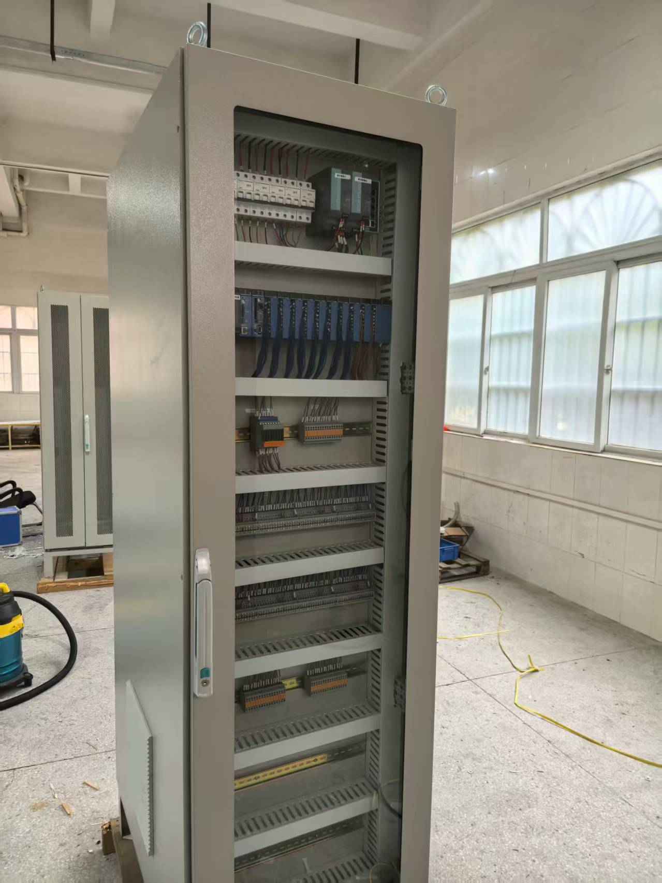
Machine Protection System/LLA
In order to prevent damage to accelerator components in case of failure, highly reliable Machine Protection System(MPS) is indispensable.
it can deliver less than 20 msec reaction time, and guarantee UTEF running safely and easy to operate, set the machine modes together with Personnel Protection System(PPS).

Slide 21
Electron gun test stand/Prototype
Summary for EPICS and Device interface of electron gun test stand
Electron Gun | Siemens PLC(Ethernet)->IOC | Tested
Cooling water，valve interlock，machine protection | Yokogawa FA-M3 PLC(backplane)-> Yokogawa RP61(IOC) | Tested
Vacuum Pump, vacuum gauge | Vacuum Pump(RS485)->IOC Vacuum gauge(RS485)->IOC | Tested
Power supply | Power supply (Ethernet)->IOC | Tested
Beam Image | Camera(Ethernet)->IOC | Tested with Camera and Python
DAQ | Channel access | Tested

Slide 22
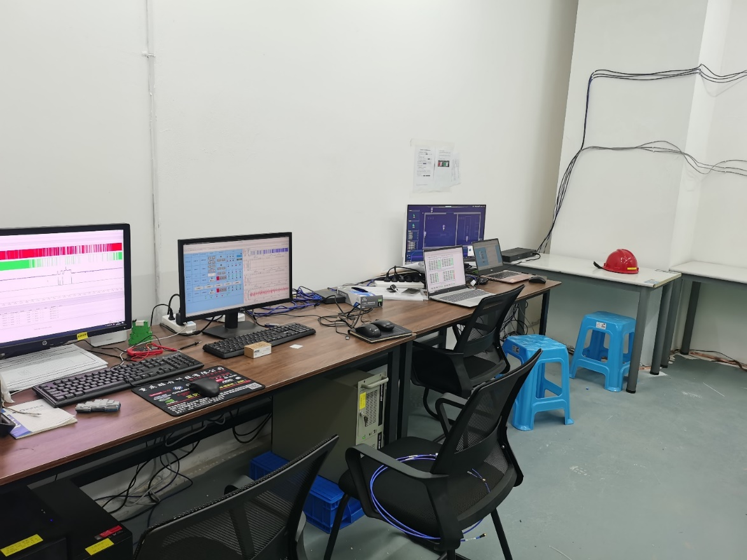
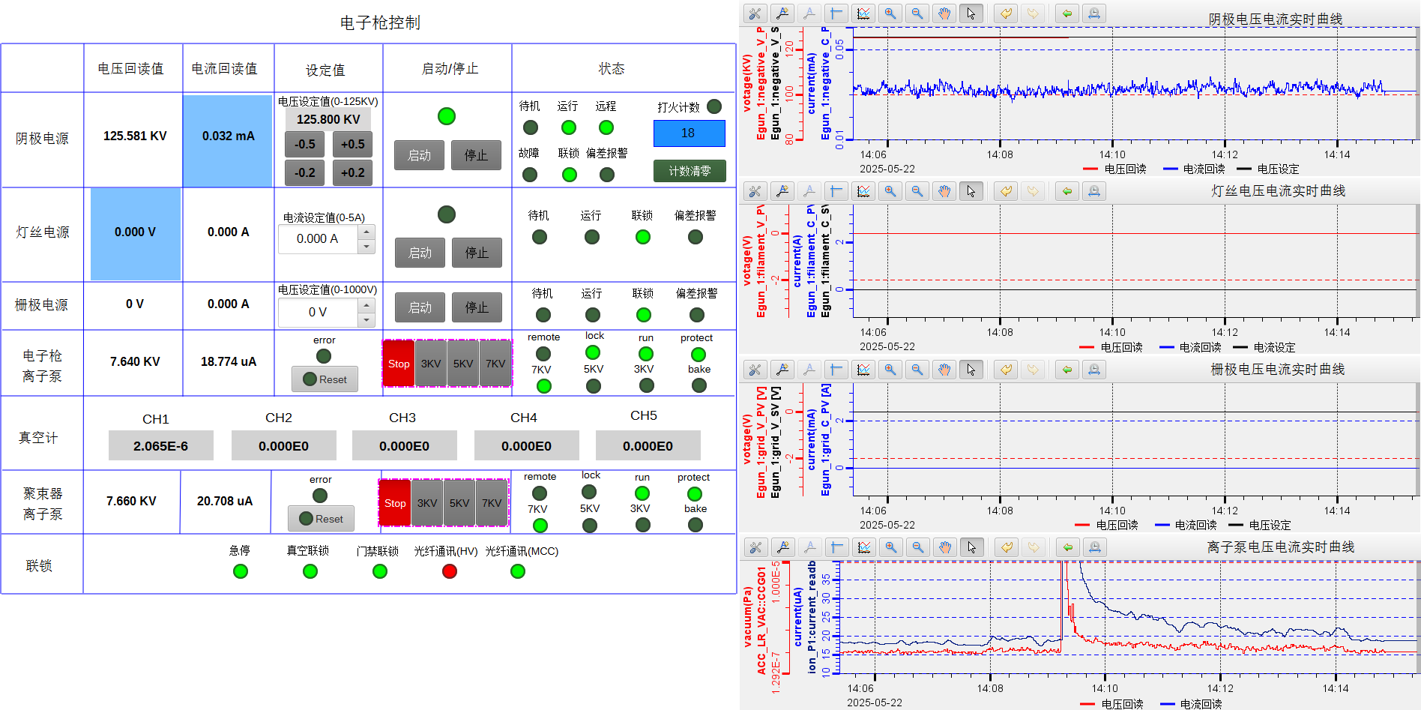
Electron gun test stand/Prototype
Console
Electron gun OPI

Slide 23
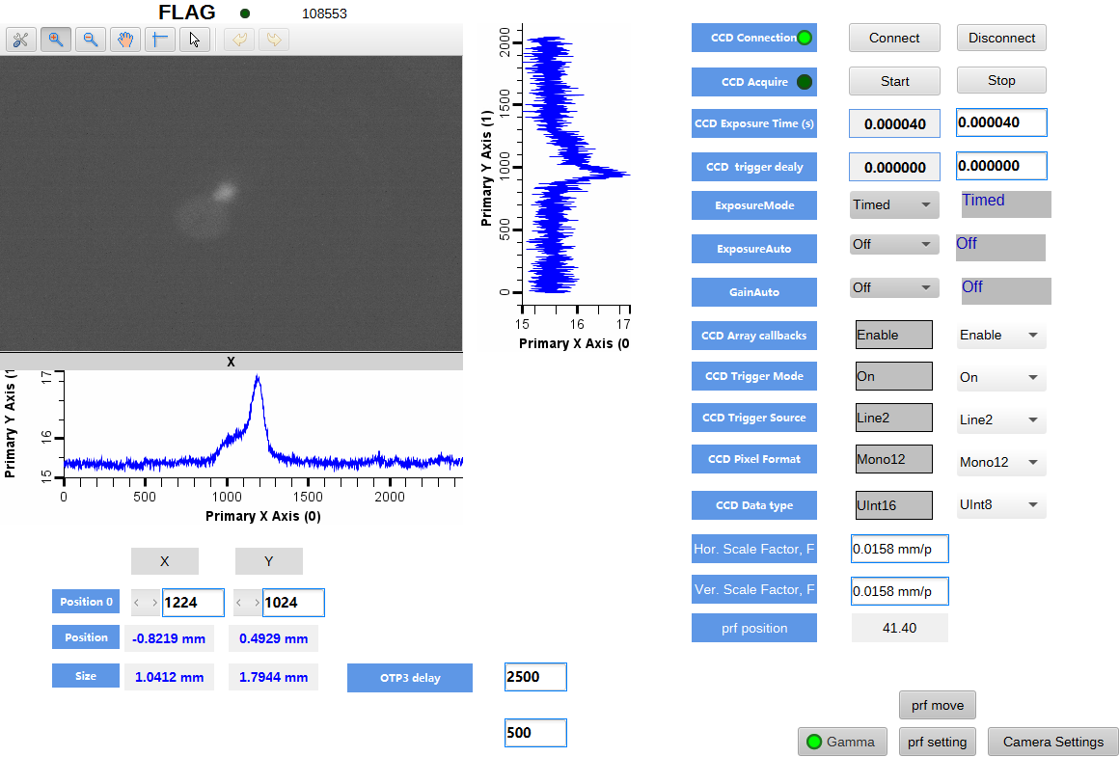
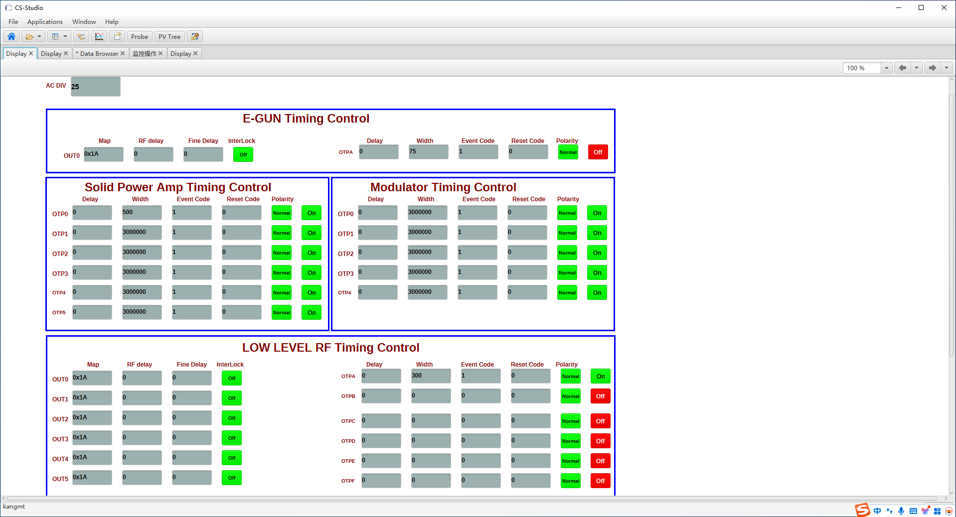
Electron gun test stand/Prototype
Timing OPI
Fluorescent target OPI

Slide 24
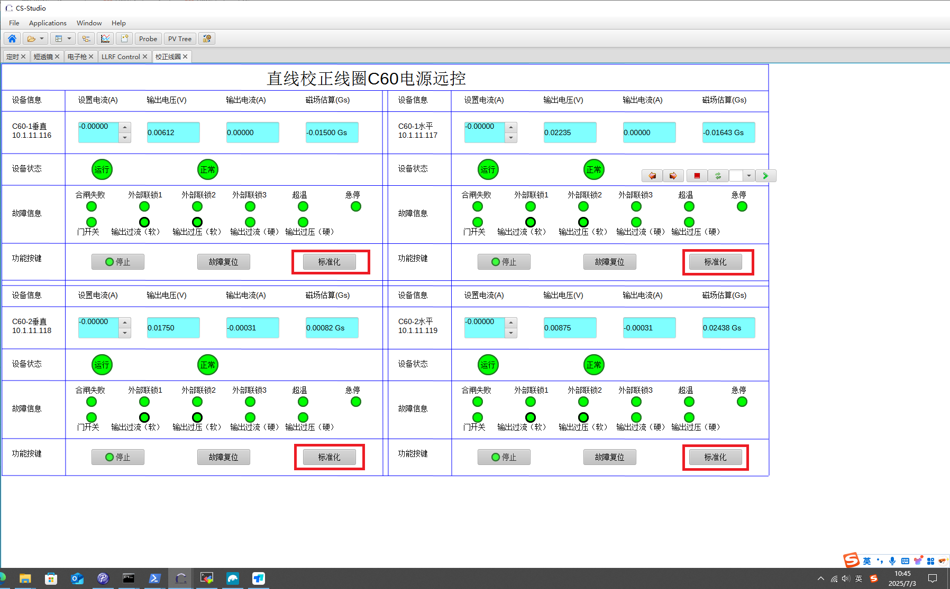
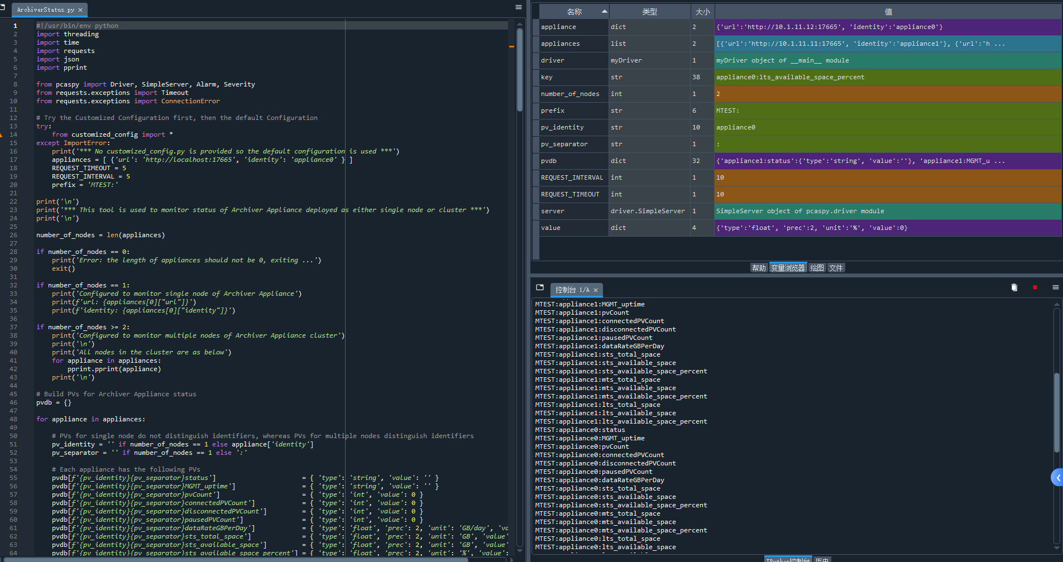
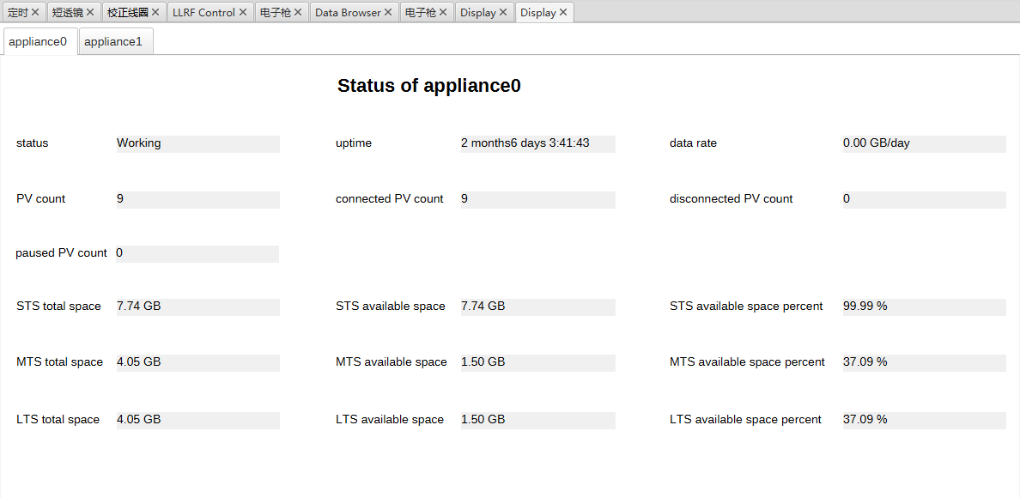
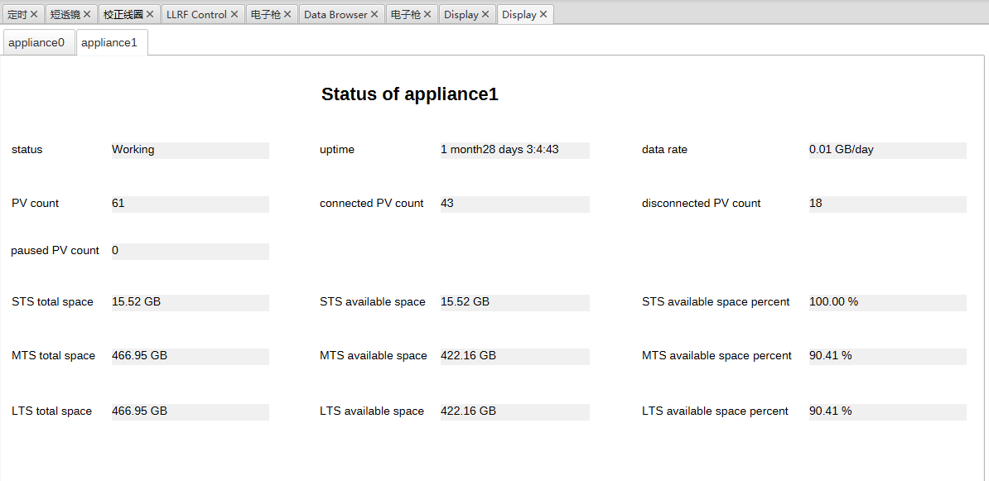
Electron gun test stand/Prototype
Power supply OPI
Pcaspy-based IOC
2 archiver appliances status OPIs

Slide 25
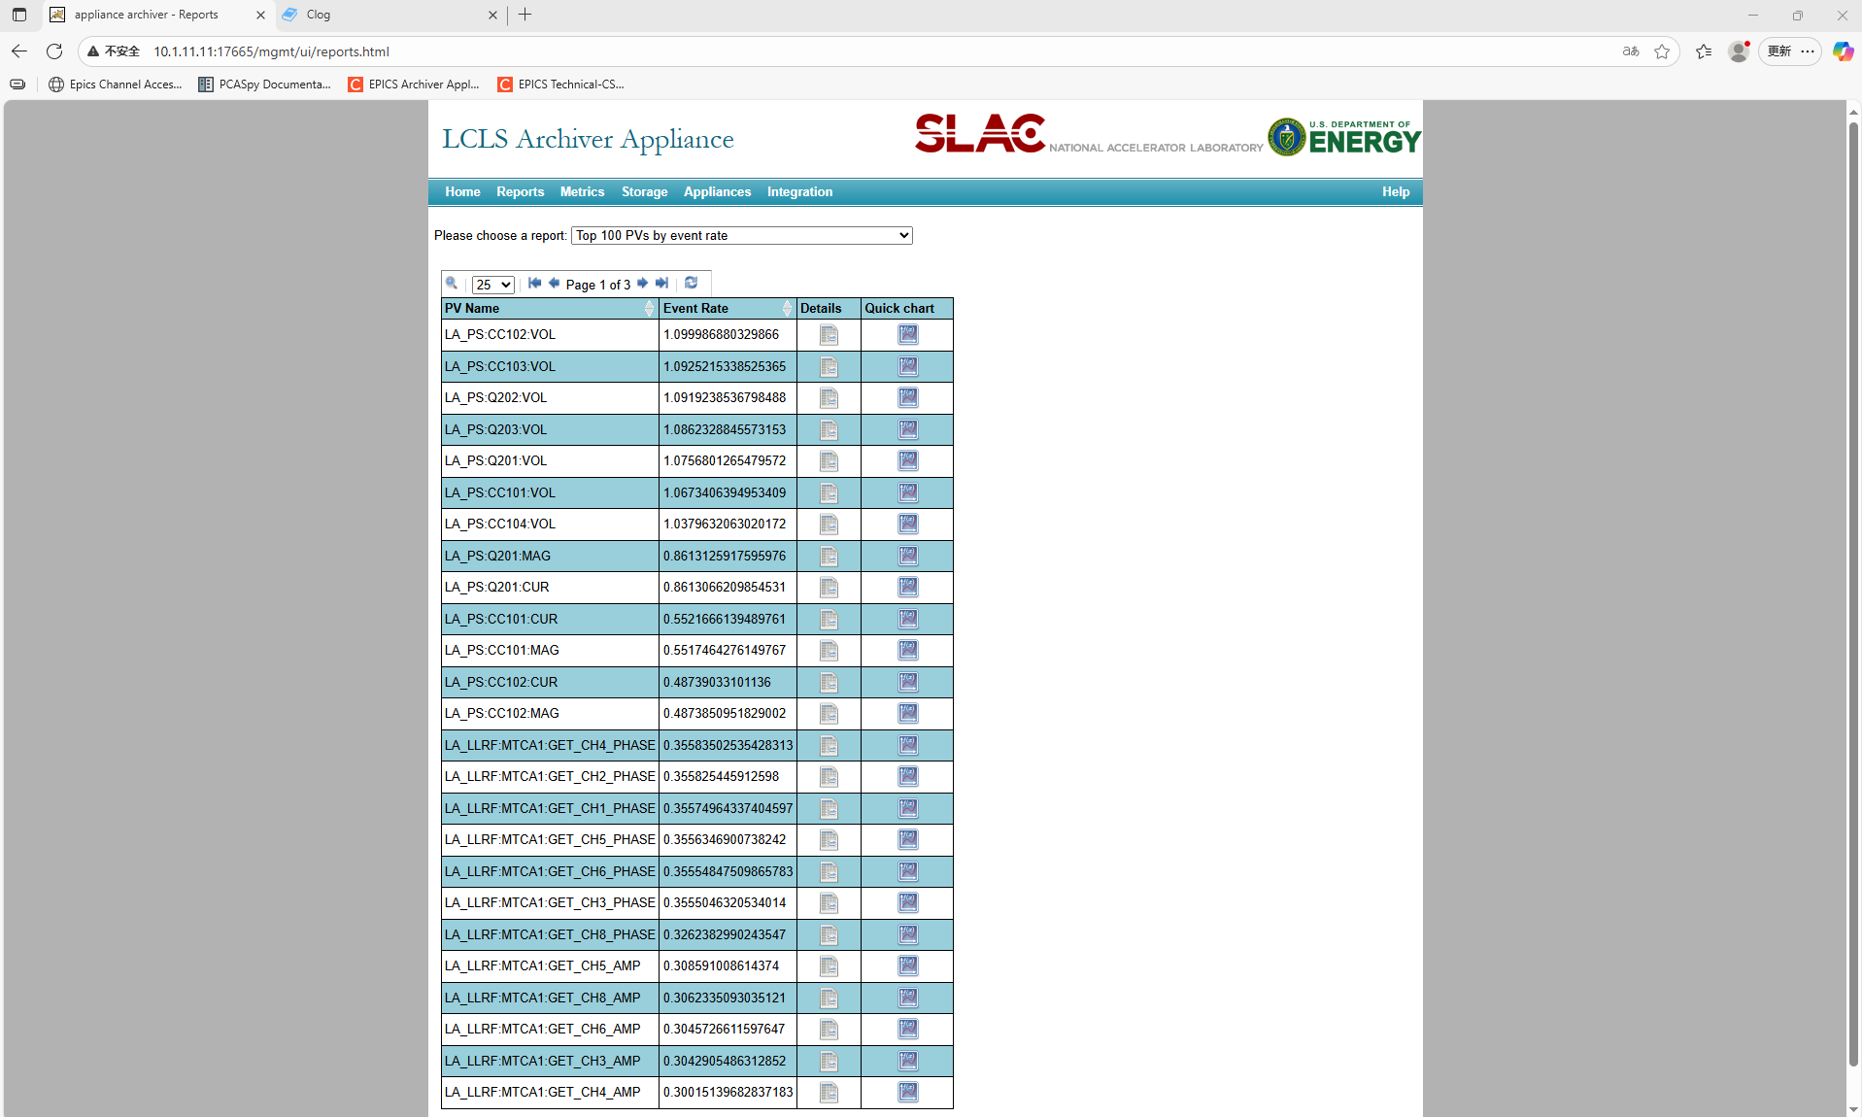
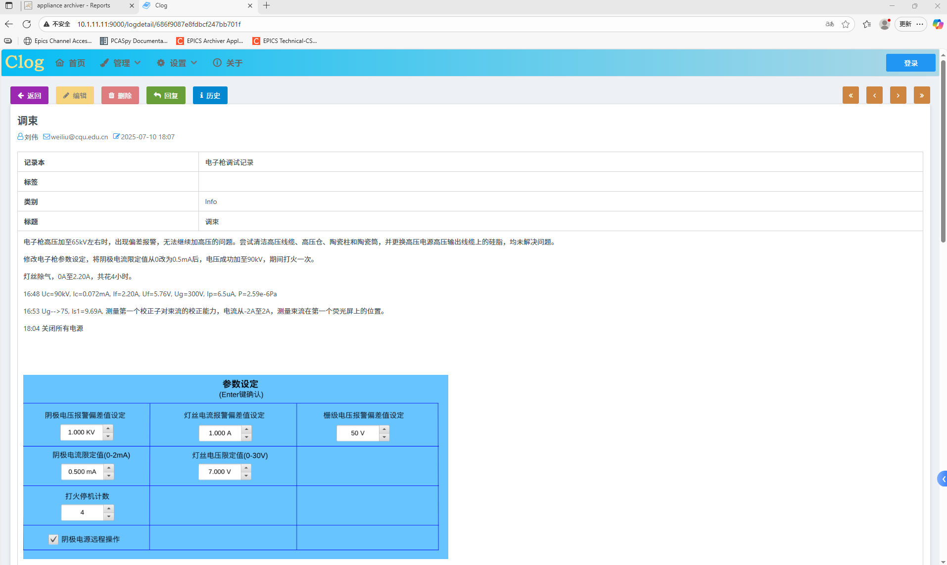
Electron gun test stand/Prototype
Archiver appliances and Clog GUI by workstation

Slide 26
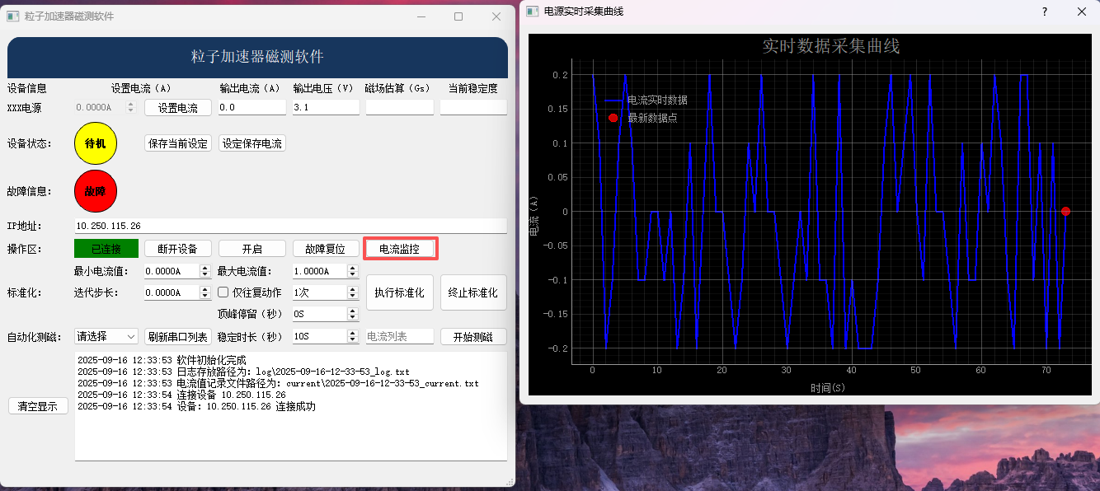
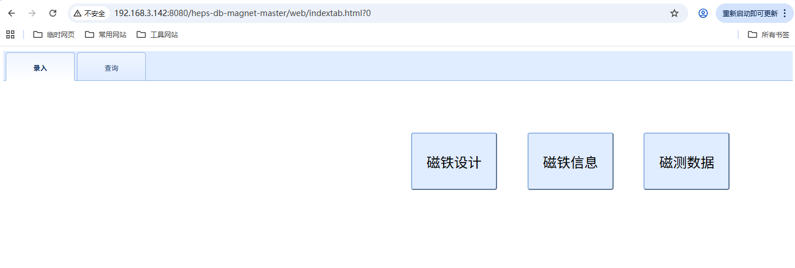
Magnetic field measurement/Prototype
Magnetic field measurement GUI based QT for python
MySQL for RDB based Apps
Magnetic field measurement and database using MySQL GUI

Slide 27
Fast Protection system/Plan
Timing system can be used to transmit fast event to actuator.
  EVR modules have uplink event generation capability.
  Fan out concentrator modules can concentrate signals form eight EVRs/downstream and forward the signals upstream.
  EVG module has external input to enable 8 event triggers.
Fast Protection system
Fast event
(Trip RF signal)
Timing system
EVR
Timing system
EVR
Actuator
(RF station)
Slow Protection system
MPS system
PLC
MPS system
PLC

Slide 28
Post-Mortem System/Plan
Important tool to analyze the cause of beam trip
  Generation and distribution of the trigger signal
  Storage of relevant signals
  RF, BPM, PS, etc.
  Data Recorder
  BPM platform, Oscilloscope, Data Recorder, etc.

Slide 29
Summary
Controls overall architecture set
Timing work started
Early database work in progress
High-level application framework and platform set
The overall system is going ahead in good progress with no obvious barriers
The rest work is scheduled properly
Still further tight cooperation with the other systems is needed to push the whole work forward

Slide 30

THANK YOU！
All Suggestions are welcomed！

