Slide 1

Development Progress of the Digital Low-Level RF System for the Hefei Advanced Light Facility (HALF)
Name: Kunlin WU, Baiting DU,
Shancai ZHANG, Jian PANG
Institute: National Synchrotron
Radiation Laboratory (NSRL)
Notes:
Good afternoon, esteemed([ɪˈstiːmd]) teachers and students. I am Wu Kunlin from the National Synchrotron Radiation Laboratory at the University of Science and Technology of China.
On behalf of the project team members, I will present the Development Progress of the Digital Low-Level RF System for the Hefei Advanced Light Facility (HALF).

Slide 2
Overview
1.
HALF Injector Microwave System
Hefei Advanced Light Facility (HALF) Introduction
Microwave System Layout
Reference Signal Distribution System Layout
2.
Digital Low-Level RF (LLRF) System Design
RF Station Configuration​
LLRF Hardware Composition
IOC and Control Interface
FPGA Algorithm Architecture and Core Algorithms
3.
Test Platform Setup and Test Results
Offline Testing
Online High Power Testing
Notes:
My presentation is divided into three parts. First, I will provide a brief introduction to the HALF injector system. Then, I will discuss the design and core algorithmic([ˌælgə'rɪðmɪk]) functions of the digital LLRF system. Finally, I will present the test results of this system.

Slide 3
Overview
1.
HALF Injector Microwave System
Hefei Advanced Light Facility (HALF) Introduction
Microwave System Layout
Reference Signal Distribution System Layout
2.
Digital Low-Level RF (LLRF) System Design
RF Station Configuration​
LLRF Hardware Composition
IOC and Control Interface
FPGA Algorithm Architecture and Core Algorithms
3.
Test Platform Setup and Test Results
Offline Testing
Online High Power Testing
Notes:
First, allow me to introduce the HALF project.

Slide 4

1. Hefei Advanced Light Facility (HALF) Introduction
HALF is a fourth-generation synchrotron radiation facility based on diffraction-limited storage ring, operating in the low-energy region (2.2 GeV).
Main Parameters of the
HALF Storage Ring
Parameter | Value
Energy [GeV] | 2.2
Current [mA] | 350
Circumference [m] | 479.86
Natural emittance [pm·rad] | 85.8
RF frequency [MHz] | 499.8
Hefei Advanced Light Facility - HALF
Notes:
The HALF is a fourth-generation synchrotron radiation light source in the low-energy region/ˈriːdʒən/. The project is currently under construction and is expected to be completed by 2028. The parameters(/pəˈræmɪtərs/) of the storage ring are listed in the table.

Slide 5
1. HALF Injector - Microwave System Layout
Top-off injection with 2.2 GeV electron beam from injector​
RF Stations: 11 units total
Pre-bunching Section:
  Thermionic electron gun
  476 MHz pre-buncher (PB)
  2856 MHz buncher (B)
  Two 2856 MHz accelerating tubes(ACC-L01)
Accelerating Section​:
  19 groups of accelerating tubes
  Each group: two 2856 MHz tubes
LLRF System：
  Stabilizes amplitude/phase of microwave fields in accelerating tubes
  Closed-loop stability specification: 0.2% / 0.2 ° (RMS)
120 MeV
2.2 GeV
Storage
Ring
Pre-injector
Acceleration Section
HALF Injector Microwave System Layout​
Notes:
The HALF storage ring adopts a Top-off恒流模式 injection scheme. The injector provides a 2.2 GeV electron beam to the storage ring.
The layout of the injector is shown in the figure.
The injector can be divided into two sections: the pre-injector section and the acceleration section.
The pre-injector section includes an electron gun, a 476 MHz pre-buncher, a 2856 MHz buncher, and two accelerating tubes.
This section is equipped with one RF station, which includes one set of 476 MHz LLRF and one set of 2856 MHz LLRF.
The acceleration section consists of 19 groups of accelerating tubes, with each group containing two 3-meter accelerating tubes. One 80 MW klystron drives two accelerating tubes.
Every two groups, i.e., two klystrons and four accelerating tubes, are supported by one RF station, which includes two sets of LLRF. The acceptance(/əkˈseptəns/) criteria/kraɪˈtɪrɪə/ for the closed-loop amplitude and phase stability of the LLRF are 0.2% RMS and 0.2° RMS, respectively.

Slide 6
1. HALF Injector - Reference Signal Distribution System
RF Reference Signal Distribution System and Microwave System Layout​
2856 MHz Reference Signal for Injector​​：
  Transmitted length: ~200 m
  Amplified by ​​three 10 W CW amplifiers​
  Added phase noise of amplifier : ​​≤2 fs​
  Synchronized with storage ring source via ​​100 MHz signal​​ (sync cable ~ 500 m)
  Reference cable is installed in ​​±0.1°C constant-temperature water bath
  Optical synchronization systems​​ at injector entry & exit for drift monitoring
Notes:
The reference signal distribution system for the injector is shown in the figure.
The reference signal is 2856 MHz, with a total transmitted length of approximately 200 meters.
Three 10 W continuous-wave solid-state amplifiers are used for relay amplification.
The injector and storage ring signal sources are synchronized using a 100 MHz signal.
The reference cables are placed in a constant-temperature water bath/bæθ/ maintained at ±0.1°C​​(Plus or minus zero point one degrees Celsius​/ˈselsiəs/).
Additionally, an optical signal synchronization system is deployed to detect drift in the reference signal.

Slide 7
Overview
1.
HALF Injector Microwave System
Hefei Advanced Light Facility (HALF) Introduction
Microwave System Layout
Reference Signal Distribution System Layout
2.
Digital Low-Level RF (LLRF) System Design
RF Station Configuration​
LLRF Hardware Composition
IOC & Control Interface
FPGA Algorithm Architecture & Core Algorithms
3.
Test Platform Setup and Test Results
Offline Testing
Online High Power Testing
Notes:
Next, I will introduce the LLRF system design/dɪˈzaɪn/.

Slide 8
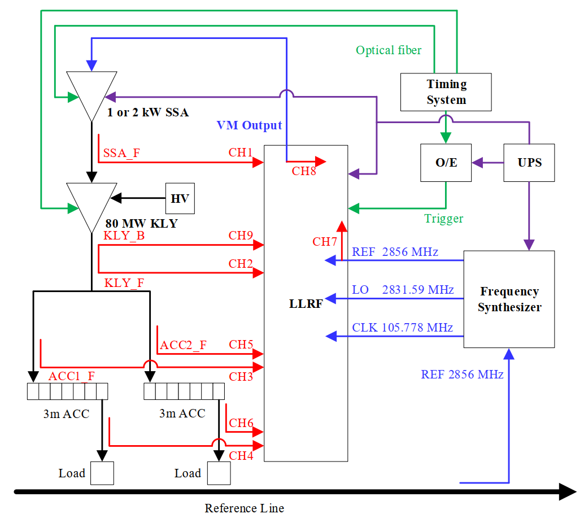
2. LLRF System Design - RF Station Configuration​
RF Station​​:
  1 LLRF system + 1 Klystron (KLY) + 2 accelerating tubes (ACC)
LLRF Monitoring (9 channels, incl. 1 DC signal)​​:
  Solid-state amp (SSA) forward output
  KLY forward/reflected (DC, for reflection protection)
  Forward inputs of 2 ACCs
  Forward inputs of terminal loads of 2 ACCs
  Control signal​​: Forward input of 1st ACC ​​OR​​ vector sum of both tubes
Frequency Synthesizer​​:
  Accepts injector reference signal
  Provides REF/LO/CLK signals to LLRF
​​RF Station Block Diagram​
Notes:
The structure within the RF station is shown in the figure.
Each set of LLRF controls one klystron and two accelerating tubes, monitoring nine signals: solid-state amplifier output, klystron output and reflect, accelerating tube input forward, and the input forward of the matched load.
Closed-loop control is implemented using the input forward wave of the first tube or the vector sum of the input forward waves of the two tubes.

Slide 9
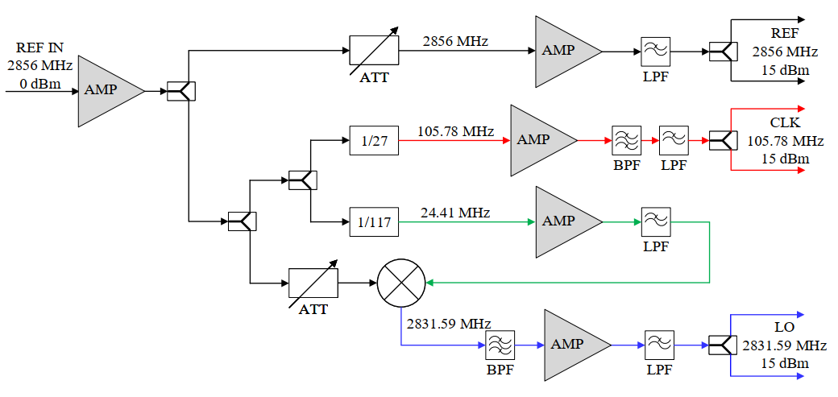
2. LLRF System Design - Frequency Synthesizer (FS)​
Outputs: REF (2856 MHz) ×2, CLK (105.78 MHz) ×2, LO (2831.59 MHz) ×2
Two LLRF systems share one FS
CLK phase noise improved from ​​110 fs​​ to ​​30 fs​​ (Integration range: ​​10 Hz–10 MHz​​)
 | Frequency [MHz] | ​​Jitter – Before Optimization​ [fs] | ​​Jitter – After Optimization​ [fs]
Reference Signal​ | 2856 | 13.370
CLK-1 | 105.78 | 107.539 | 29.109
CLK-2 | 105.78 | 112.897 | 29.208
LO-1 | 2831.59 | 17.834 | 13.602
LO-2 | 2831.59 | 17.948 | 13.655
REF-1 | 2856 | 17.290 | 13.581
REF-2 | 2856 | 16.949 | 13.502
​​Non-I/Q Frequency Synthesizer
Block Diagram​
Non-I/Q Frequency Synthesizer
Phase Noise Test Results​
Notes:
Each RF station is equipped with a frequency Synthesizer that provides reference, clock, and local oscillator signals for the two sets of LLRF in the station.
During development, we optimized the frequency synthesizer (by adding low-pass filters and replacing power dividers with higher-performance components),
reducing the phase noise of the clock signal generated by the synthesizer from 110 fs (femtosecond) to 30 fs.

Slide 10
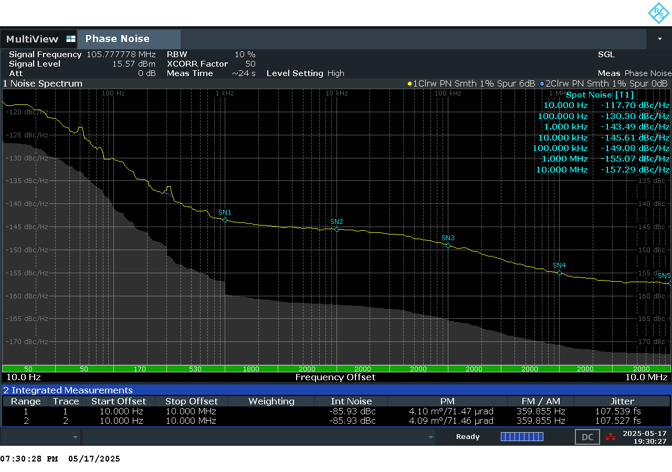
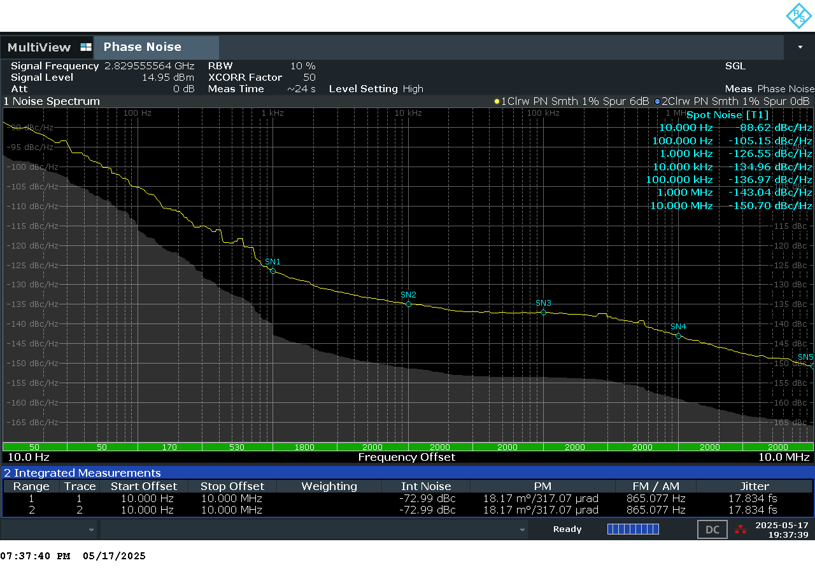
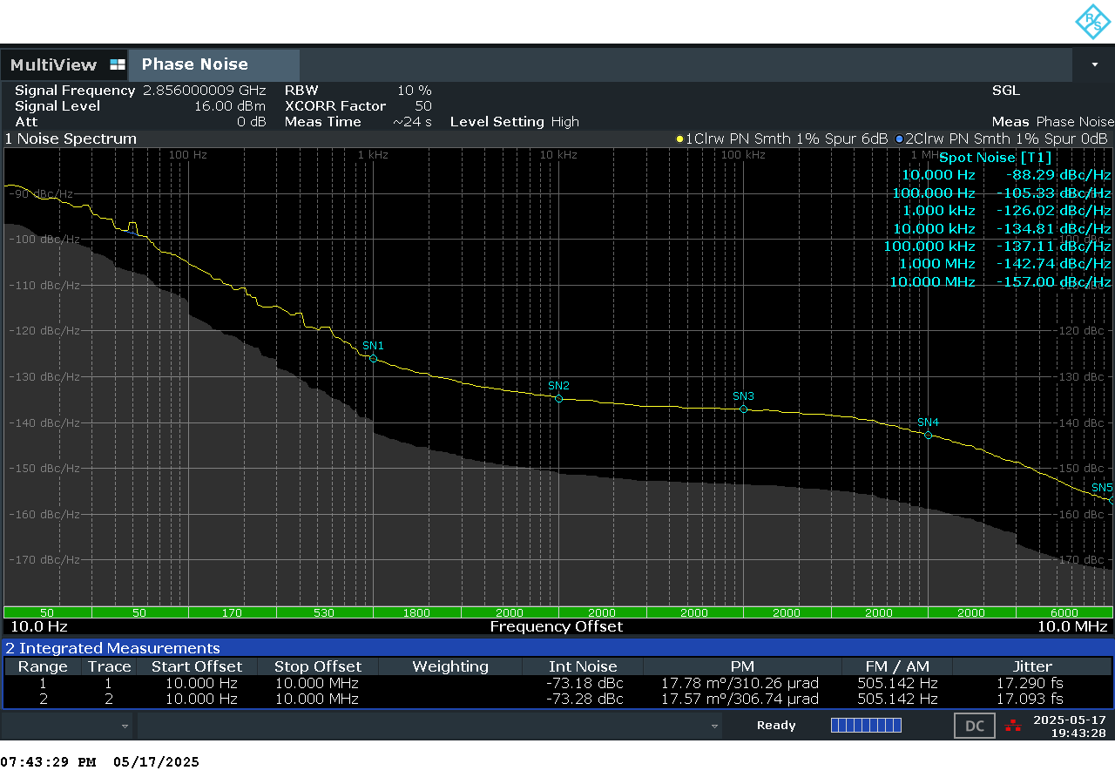
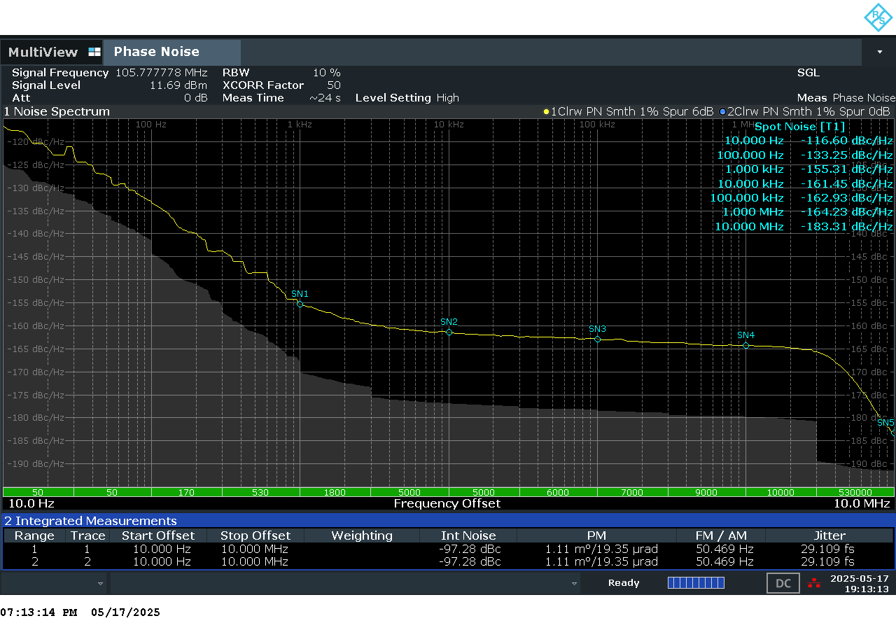
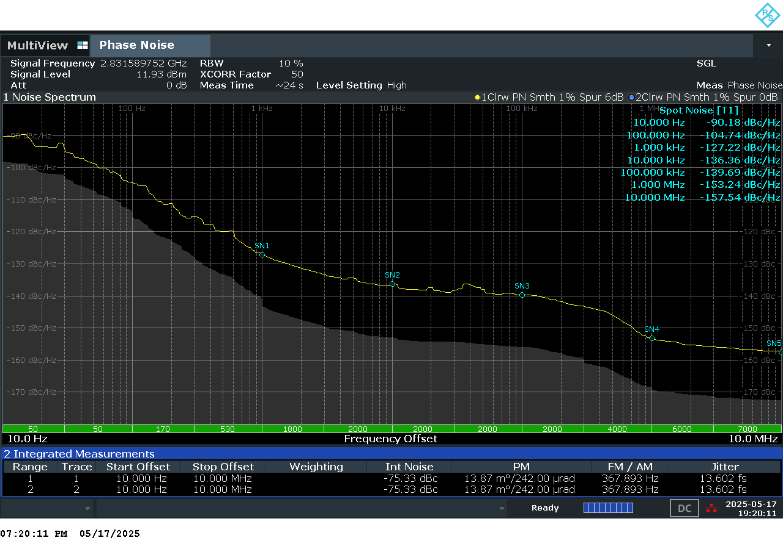
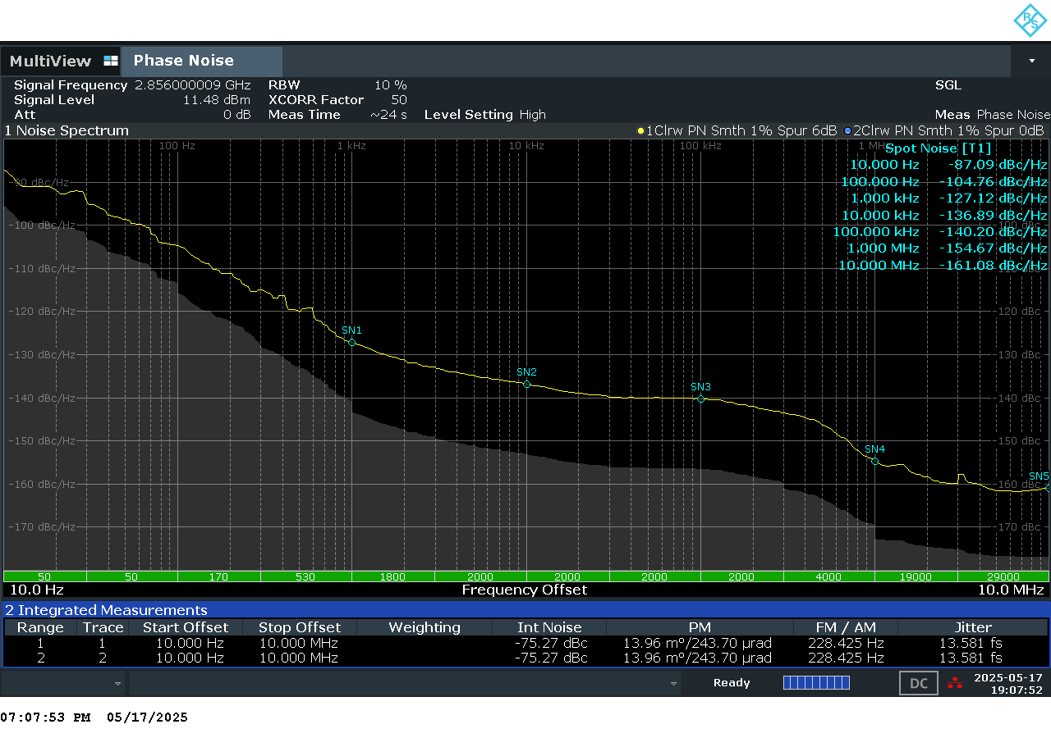
2. LLRF System Design - Frequency Synthesizer (FS)​
CLK-Before Optimization
Jitter 107.539 fs
LO-Before Optimization
Jitter 17.834 fs
REF-Before Optimization
Jitter 17.290 fs
CLK-After Optimization
Jitter 29.109 fs
LO-After Optimization
Jitter 13.602 fs
REF-After Optimization
Jitter 13.581 fs
Notes:
This page displays some of the phase noise analyzer test results.

Slide 11
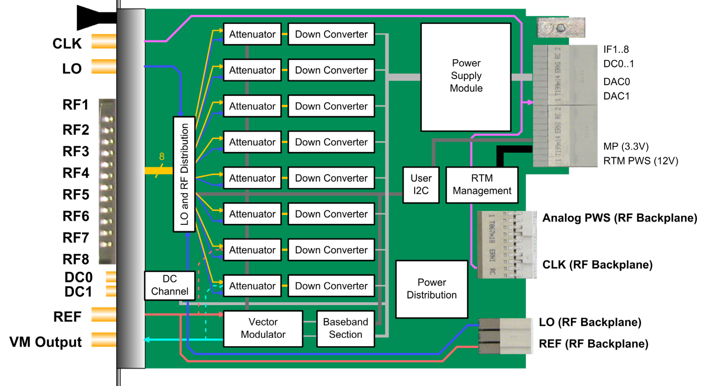
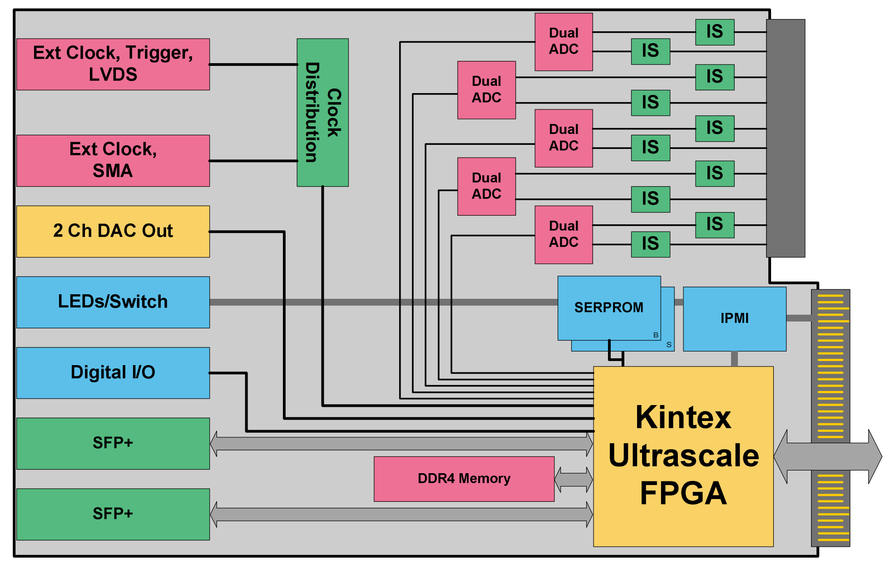
2. LLRF System Design - Hardware Composition​
MTCA.4 RF Board (DWC8VM1)
MTCA.4 Digital Board (SIS8300-KU)
Commercial MTCA.4 boards (Struck Innovative Systeme)
RF Board: 8 ch microwave attenuation & down-conversion, 1 ch vector modulator (VM) output (2856/476 MHz), 2 ch DC signal inputs
Digital Board: 10×16-bit ADC, 2×16-bit DAC, 1 FPGA, DDR4 data buffer
Notes:
For the hardware design of the LLRF system, we adopted STRUCK’s Commercial /kəˈmɜːrʃl/ MTCA dot four​ boards .
The RF board features eight channels of microwave signal attenuation and down-conversion, one channel of vector-modulator microwave signal output, and two channels of DC signal input.
The digital board includes ten 16-bit ADC channels, two 16-bit DAC channels, one Xilinx FPGA chip, and one DDR four chip for data caching/kæʃing/.

Slide 12
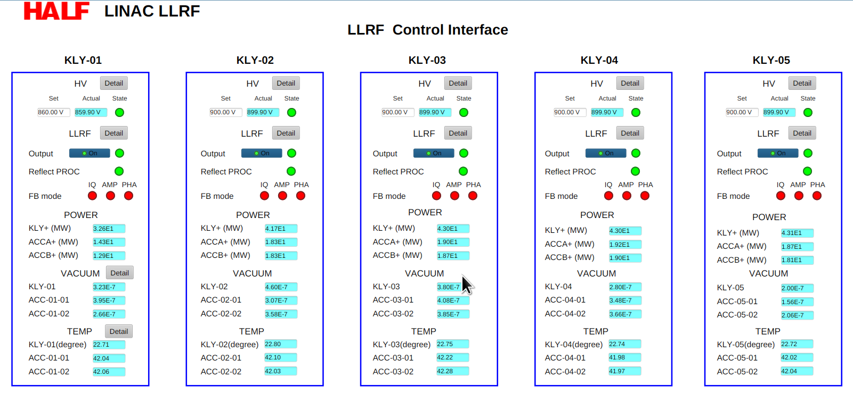
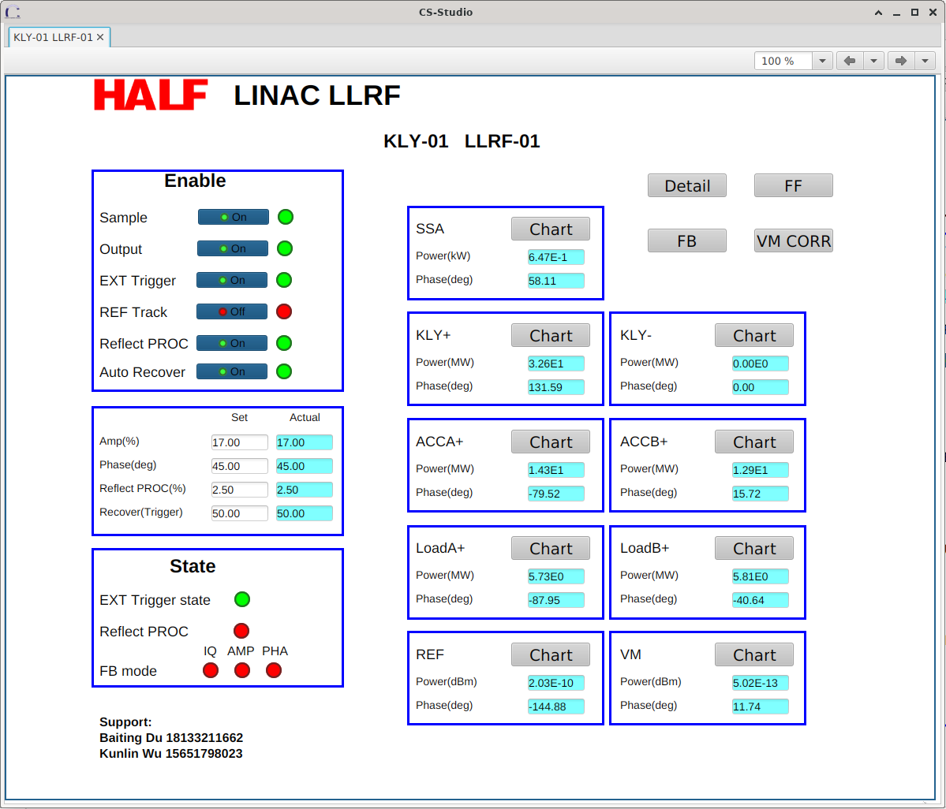
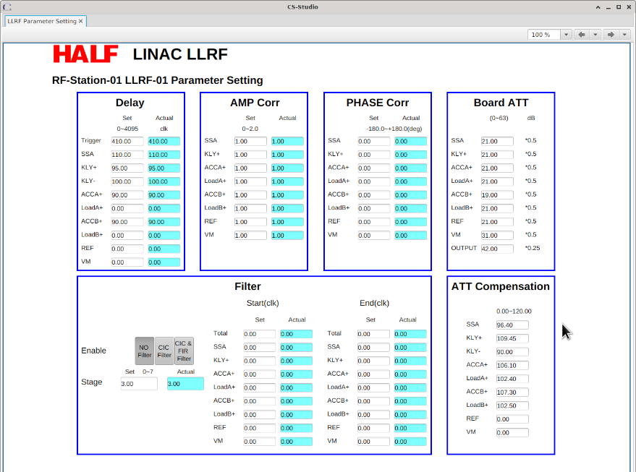
2. LLRF System Design - IOC & Control Interface​
HALF Conditioning Platform:
5 LLRF Systems​​ Control
Interface - User Interface​
Single LLRF Control Interface​
LLRF Parameter Setting Interface​
Specialized Interface​
IOC & Control Interface: Debian 11+EPICS 7+Phoebus(GUI)
  ​​Dual Interfaces​​:
  ​​User Interface​​: Links to HV modulator, vacuum & cooling PVs for user convenience
  ​​Specialized Interface​​: For detailed LLRF parameters
Notes:
For the software component, we designed the IOC and UI interface based on EPICS 7 and Phoebus on the Debian 11 system.
A simplified user interface and a Specialized/'spɛʃə'laɪzd/ interface for microwave system operators were specifically/spəˈsɪfɪkli/ designed.
The user interface also integrates supporting high-voltage modulator, vacuum, and cooling water process variables /ˈveriəbls/ (PVs) for convenient/kənˈviːniənt/ monitoring during operation.

Slide 13
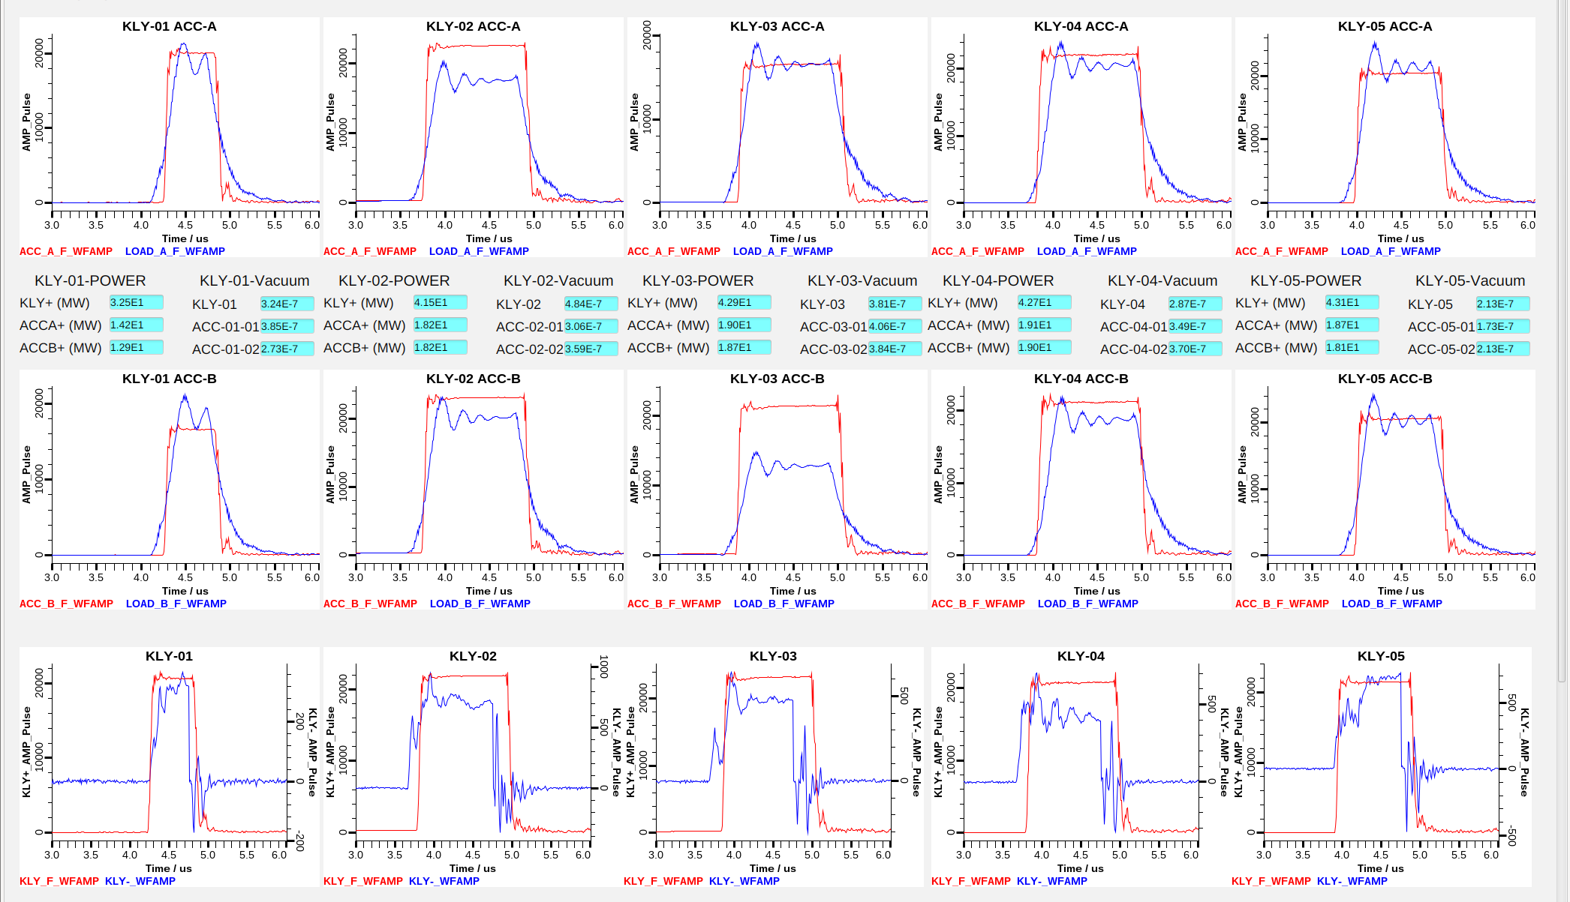
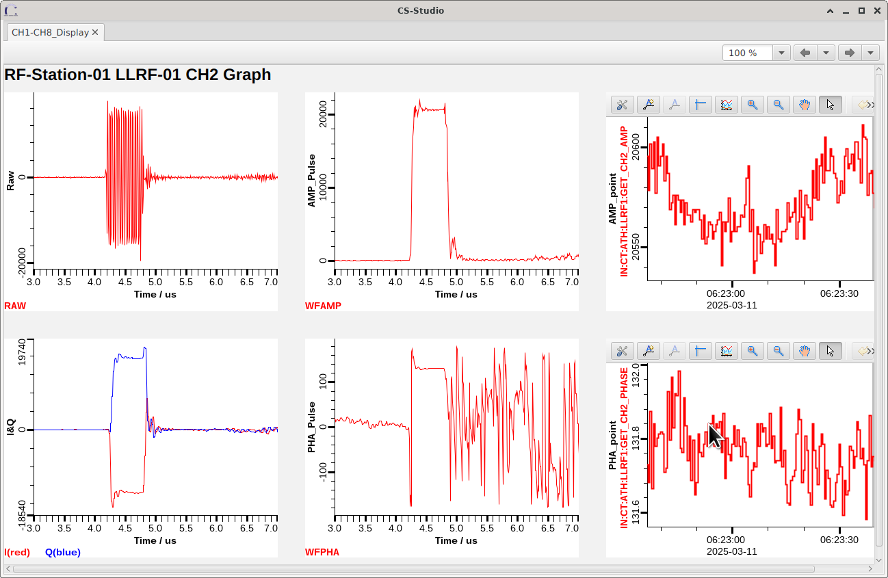
2. LLRF System Design - IOC & Control Interface​
Single-Channel Waveform
Waveform Summary Interface of
the Conditioning Platform
Notes:
Here, we showcase the waveform summary interface designed for the HALF accelerating tube conditioning platform,
which facilitates/fəˈsɪlɪteɪts/ simultaneous /ˌsaɪmlˈteɪniəs/ driving of five sets of klystrons for accelerating tube conditioning.

Slide 14
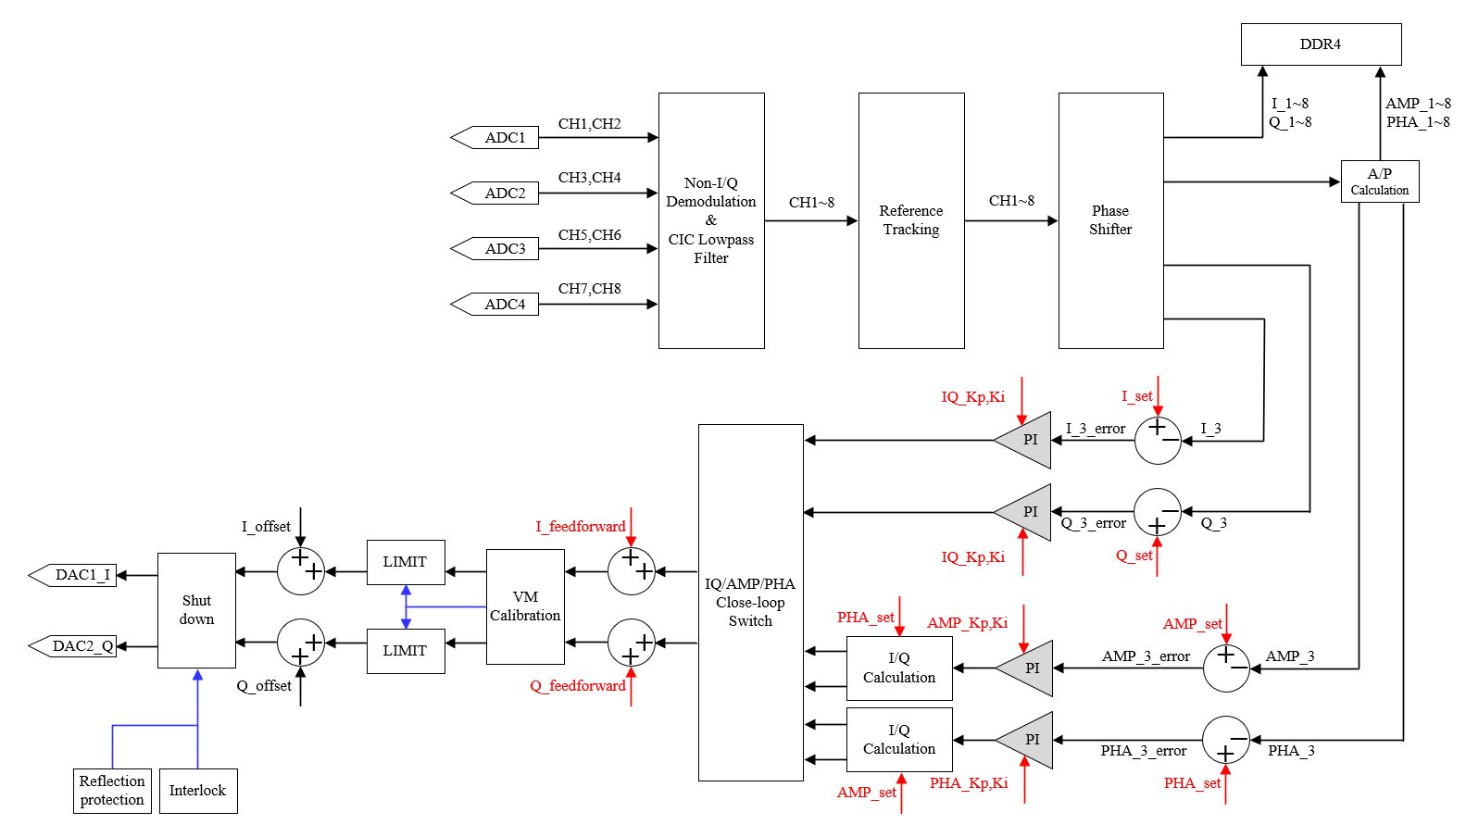
2. LLRF System Design - FPGA Algorithm Architecture​
13/3 Non-I/Q Demodulation: IF 2856/117=24.410 MHz; CLK 2856/27=105.778 MHz
CIC Filtering: Suppresses separated high-order harmonics and reduces FPGA resource occupancy
Reference Tracking: Suppresses jitter in ADC sampling clock and slow pulse-to-pulse phase drift (FS, cabinet cables, etc.)）
VM Calibration: Corrects elliptical polarization output and improves amplitude-phase accuracy
Feedback: Based on I/Q or independent amplitude-phase feedback (online switchable)
FPGA Algorithm Architecture
Notes:
Next, I will introduce the FPGA algorithm Architecture and core functional algorithms of our LLRF system.
The algorithm Architecture is shown in the figure and primarily/praɪˈmerəli/ includes Thirteen over three​ non-I/Q demodulation, CIC filtering, reference phase tracking, digital phase shifting, feedback, VM calibration, and reflection protection.
幅相独立反馈：正式运行时速调管将会工作在饱和区，以提升幅度稳定性，此时IQ闭环失效，将采用相位独立闭环反馈
Amplitude-phase independent feedback: During formal operation, the klystron will operate in the saturation/'sætʃə'reʃən/ region/ˈriːdʒən/ to enhance amplitude stability. In this case, the IQ closed-loop control becomes ineffective, and a phase-independent closed-loop feedback will be adopted.

Slide 15
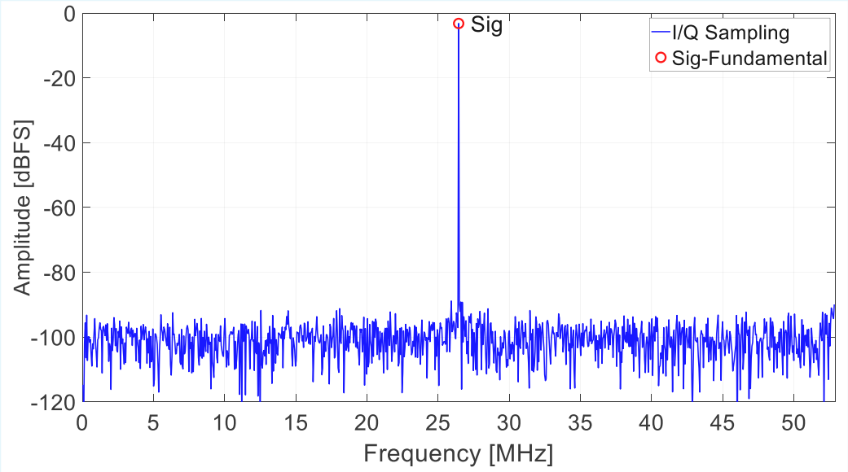
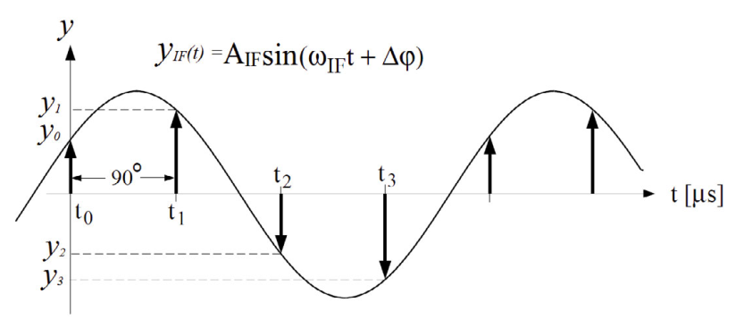
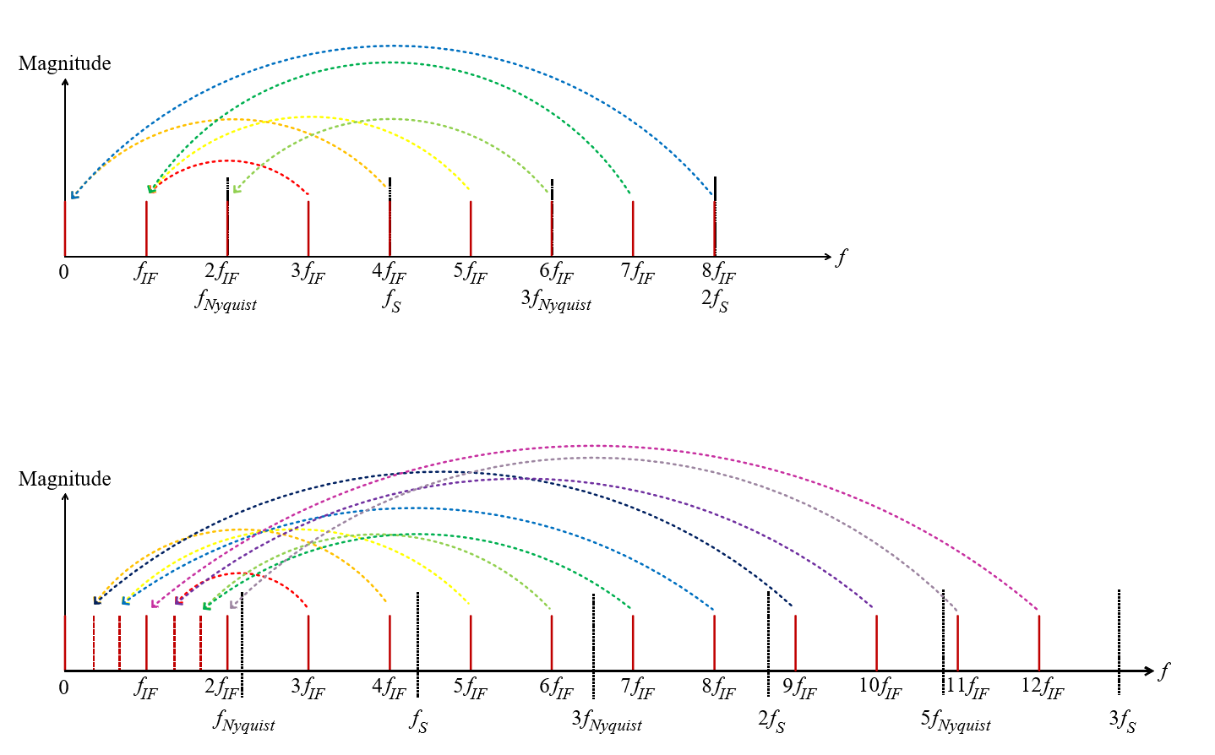
2. LLRF System Design - Non-I/Q Demodulation & CIC Filter​
I/Q Demodulation
I/Q Sampling - Spectral Aliasing
I/Q Sampling - ADC Sampling Result Spectrum
I/Q Demodulation: Simple algorithm, but causes unfilterable aliasing between odd-order harmonics and fundamental frequency
Notes:
First, I will explain non-I/Q demodulation and CIC filtering.
Traditional I/Q sampling and demodulation schemes are algorithmically simple, but odd-order harmonics /hɑːrˈmɑːnɪks/ of the fundamental frequency alias/'elɪəs/ onto the fundamental frequency during spectral shifting.
These harmonics /hɑːrˈmɑːnɪks/ cannot be separated or filtered out in subsequent processing, leading to errors in the calculated signal amplitude and phase.

Slide 16
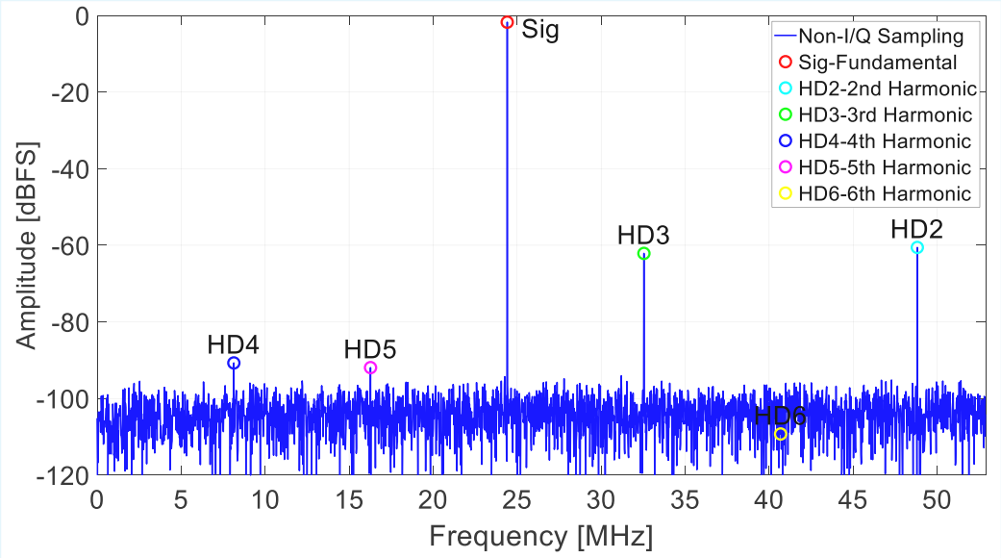
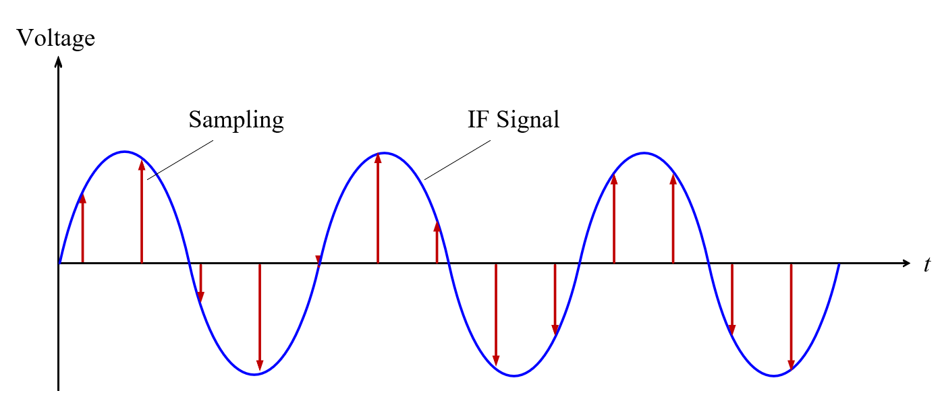

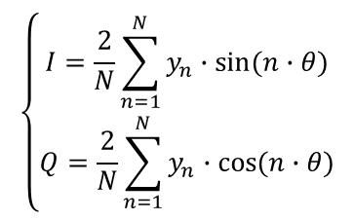
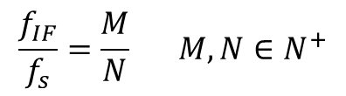

2. LLRF System Design - Non-I/Q Demodulation & CIC Filter​
Non-I/Q Demodulation
Non-I/Q Sampling –
ADC Sampling Result Spectrum
$$\left\{\begin{aligned}I=\frac{2}{N}\sum_{n=1}^{N}{y_{n}∙\sin{(n∙θ)}} \\ Q=\frac{2}{N}\sum_{n=1}^{N}{y_{n}∙\cos{(n∙θ)}}\end{aligned}\right.$$
$$\frac{f_{IF}}{f_{s}}=\frac{M}{N} M,N∈N^{+}$$
$$I≔A\cos{φ}$$
Non-I/Q Demodulation: IF/CLK=M/N, capable of separating harmonics below (N-1)th order
N/M=13/3 solution: harmonics up to 12th order are separated, with 6th harmonic reduced to noise level
$$Q≔A\sin{φ}$$
13/3 Non-I/Q Sampling - Spectral Aliasing
Notes:
Using a non-I/Q sampling scheme, some odd-order harmonics/hɑːrˈmɑːnɪks/ can be separated from the fundamental frequency. We adopted a sampling scheme with a clock-to-intermediate frequency ratio /ˈreɪʃioʊ/ of Thirteen over three​ . Under this scheme, harmonics below the 12th order can be separated.
13/3方案采用的中频是24.41MHz，该中频不至于过小导致LO信号无法滤波。
频综产生的LO是用中频和REF混频后用带通滤波器产生的，如果中频太小，混频时参考减中频、参考加中频与参考信号三个信号的频率会靠的很近，需要将带通滤波器带宽减小才能滤出LO，滤波器带宽越小衰减会变大
IF的选择需综合考虑频综中带通滤波器带宽。IQ解调方案IF为26.444，Non-I/Q方案IF为24.41
为使谐波搬移后与中频较远，同时对频综改动较小，综合考虑后采用N/M=13/3方案，时钟频率不变保持2856/27=105.778，
LO频率从I/Q解调的2856-(CLK/4)=2829.556 改为2856-(CLK/13*3)=2831.59
The intermediate frequency (IF) adopted in the 13/3 scheme is 24.41 MHz, which is sufficiently large to prevent the LO signal from being unfilterable due to an excessively/ɪkˈsesɪvli/ small value.
The local oscillator (LO) generated by the frequency synthesizer is produced by mixing the IF with the reference (REF) signal, followed by bandpass filtering. If the IF is too small, the frequencies of the three signals—reference minus IF, reference plus IF, and the reference signal itself—would be too close after mixing. This would necessitate a narrower bandpass filter bandwidth to isolate/ˈaɪsəleɪt/ the LO signal. However, a smaller filter bandwidth results in increased attenuation.
The selection of the IF must comprehensively consider the bandwidth of the bandpass filter in the frequency synthesizer. For the IQ demodulation scheme, the IF is 26.444 MHz, while for the Non-I/Q scheme, it is 24.41 MHz.
To ensure that the harmonics are sufficiently distant from the IF after frequency translation and to minimize modifications to the frequency synthesizer, the N/M = 13/3 scheme was adopted after comprehensive consideration. The clock frequency remains unchanged at 2856/27 = 105.778 MHz.
The LO frequency has been adjusted from 2856 - (CLK/4) = 2829.556 MHz in the IQ demodulation scheme to 2856 - (CLK/13 × 3) = 2831.59 MHz in the current scheme.

Slide 17
2. LLRF System Design - Non-I/Q Demodulation & CIC Filter​
Non-I/Q Demodulation
Non-I/Q Sampling –
ADC Sampling Result Spectrum
Signal | Frequency [MHz] | dBFS
Fundamental (Sig) | 24.41 | -1.75
2nd Harmonic (HD2) | 48.82 | -60.56
3rd Harmonic (HD3) | 32.55 | -62.12
4th Harmonic (HD4) | 8.14 | -90.71
5th Harmonic (HD5) | 16.27 | -91.94
6th Harmonic (HD6) | 40.68 | -109.27
Non-I/Q Demodulation: IF/CLK=M/N, capable of separating harmonics below (N-1)th order
N/M=13/3 solution: harmonics up to 12th order are separated, with 6th harmonic reduced to noise level
13/3 Non-I/Q Sampling - Spectral Aliasing
Notes:
This table lists the power corresponding/ˌkɔːrəˈspɑːndɪŋ/ to several points on the spectrum of the REF signal sampled using the Thirteen over three scheme.
The 6th harmonic/hɑːrˈmɑːnɪk/ is already comparable/ˈkɑːmpərəbl/ to the noise level.

Slide 18
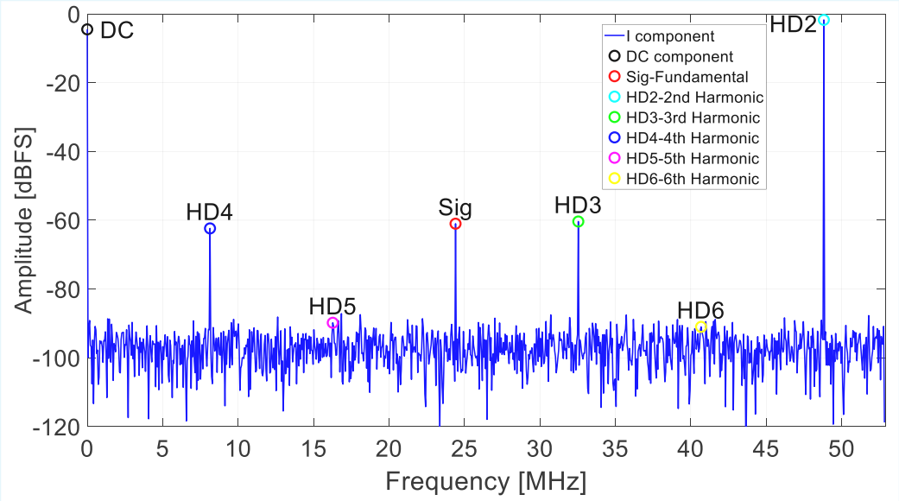
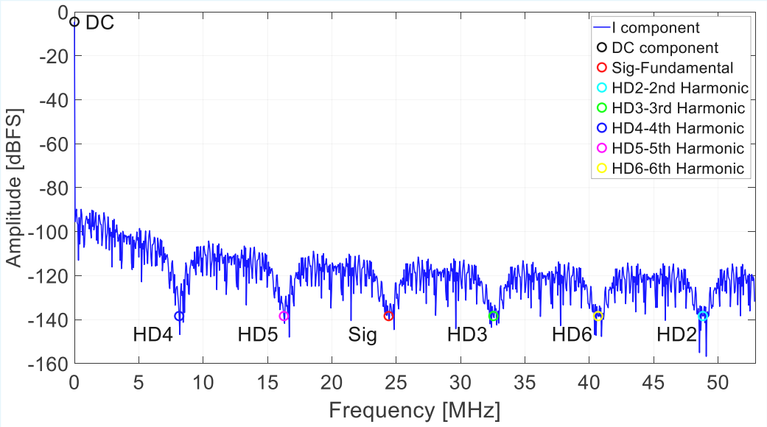
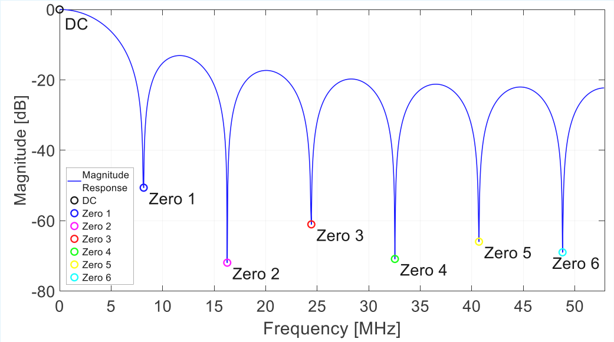
2. LLRF System Design - Non-I/Q Demodulation & CIC Filter​
13/3 I-component Digital Mixing Spectrum
I-component Filtered Spectrum
Digital Mixing and CIC Filtering Yield Demodulated I and Q Components
Magnitude Response Diagram of First-Order CIC Filter
(with 13-Point Moving Average Decimation)
Notes:
The filter after digital mixing is a first-order CIC filter with a 13-point moving average decimation/ˌd ɛsəˈmeʃən/.
Its Magnitude Response is shown in the lower-left image. It suppresses the harmonic components separated after digital mixing while retaining /rɪˈteɪning/ the required I/Q DC components.

Slide 19
2. LLRF System Design - Non-I/Q Demodulation & CIC Filter​
13/3 I-component Digital Mixing Spectrum
I-component Filtered Spectrum
Signal | Pre-Filtering [dBFS] | Post-Filtering [dBFS]
DC Component（DC） | -4.50 | -4.50
Fundamental (Sig) | -61.01 | -138.39
2nd Harmonic (HD2) | -1.74 | -138.39
3rd Harmonic (HD3) | -60.37 | -138.39
4th Harmonic (HD4) | -62.37 | -138.39
5th Harmonic (HD5) | -89.82 | -138.39
6th Harmonic (HD6) | -91.01 | -138.39
Digital Mixing and CIC Filtering Yield Demodulated I and Q Components
Notes:
The table in the lower-left shows the power corresponding /ˌkɔːrəˈspɑːndɪŋ/ to various /ˈveriəs/ points on the I-component spectrum before and after filtering.
It can be observed that after filtering, the power at harmonic frequencies is sufficiently suppressed, while the DC component remains unaffected. Through this non-I/Q sampling, demodulation, and CIC filtering scheme, we obtain more accurate I/Q digital components, thereby improving the control precision/prɪˈsɪʒn/ of the LLRF system.

Slide 20
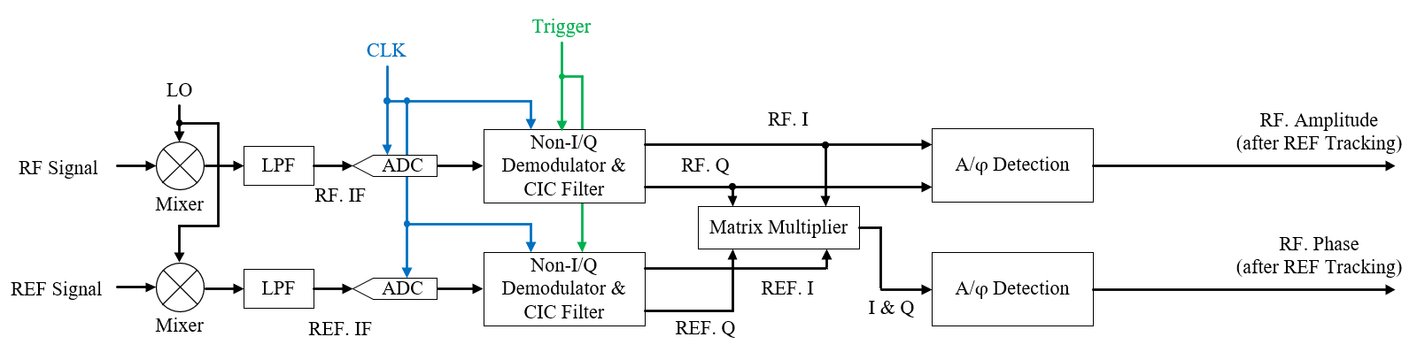
2. LLRF System Design - Reference Tracking​
Reference Tracking Schematic Diagram
Phase Measurement Error Sources:
  Phase slow drift from FS and cables due to environmental temperature variations
  Clock signal jitter
Intra-pulse Reference Tracking:
  Achieves point-by-point reference tracking through vector rotation via matrix multiplication
  Multiplies measurement channel I/Q matrix by reference's normalized I/Q matrix
  Simultaneously suppresses phase slow drift and clock jitter
Notes:
After addressing the errors in sampling and demodulation, we designed a reference phase tracking algorithm to reduce phase measurement/'mɛʒɚmənt/ errors.
The main sources of phase measurement errors include phase slow drift due to environmental temperature changes in the frequency synthesizer and microwave signal cables, as well as jitter in the clock signal itself.
Using a vector rotation method based on matrix/'metrɪks/ multiplication/'mʌltəplə'keʃən/, we achieved point-by-point reference phase tracking, which suppresses the aforementioned/ə,fɔr'mɛnʃənd/ phase errors.

Slide 21
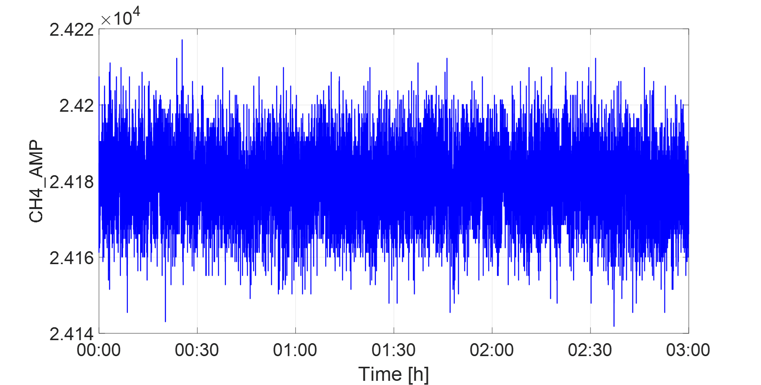
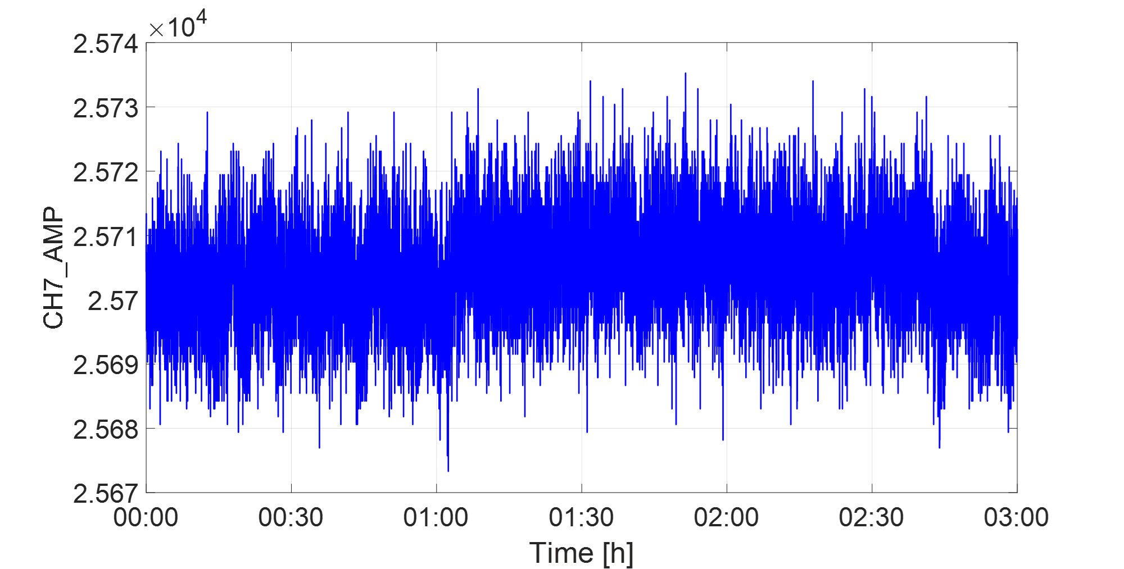
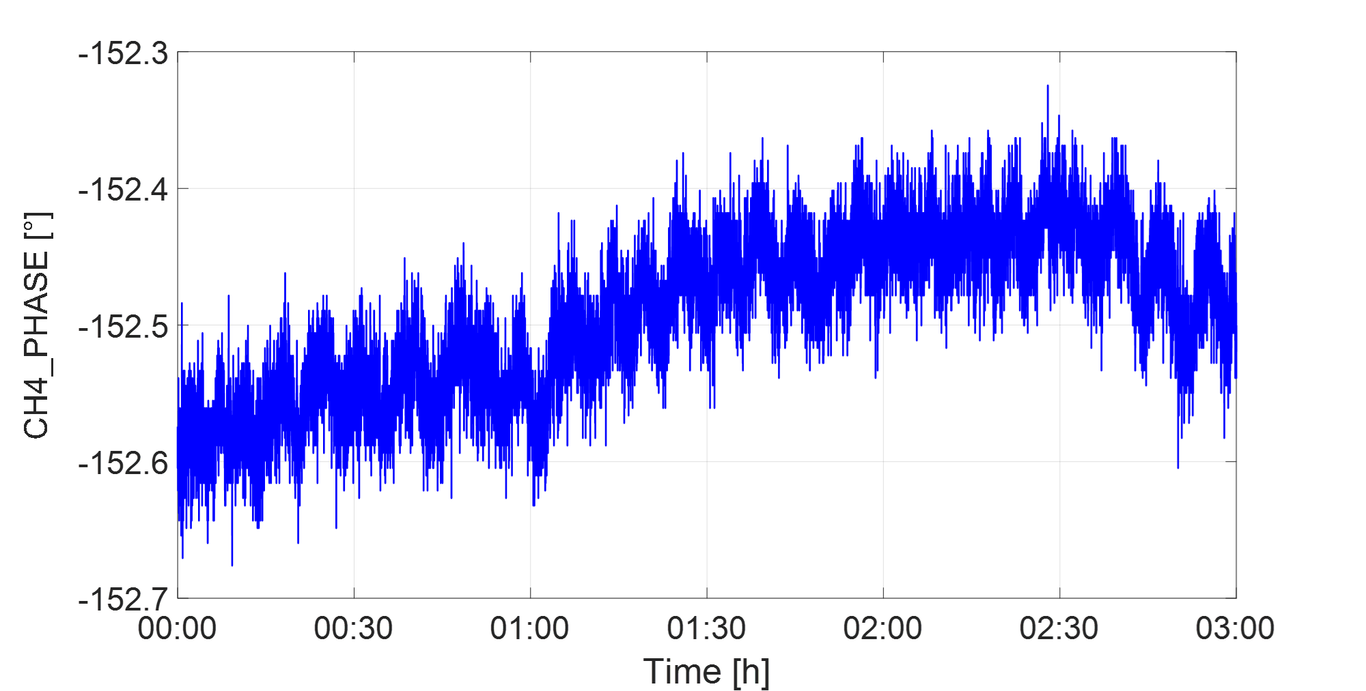
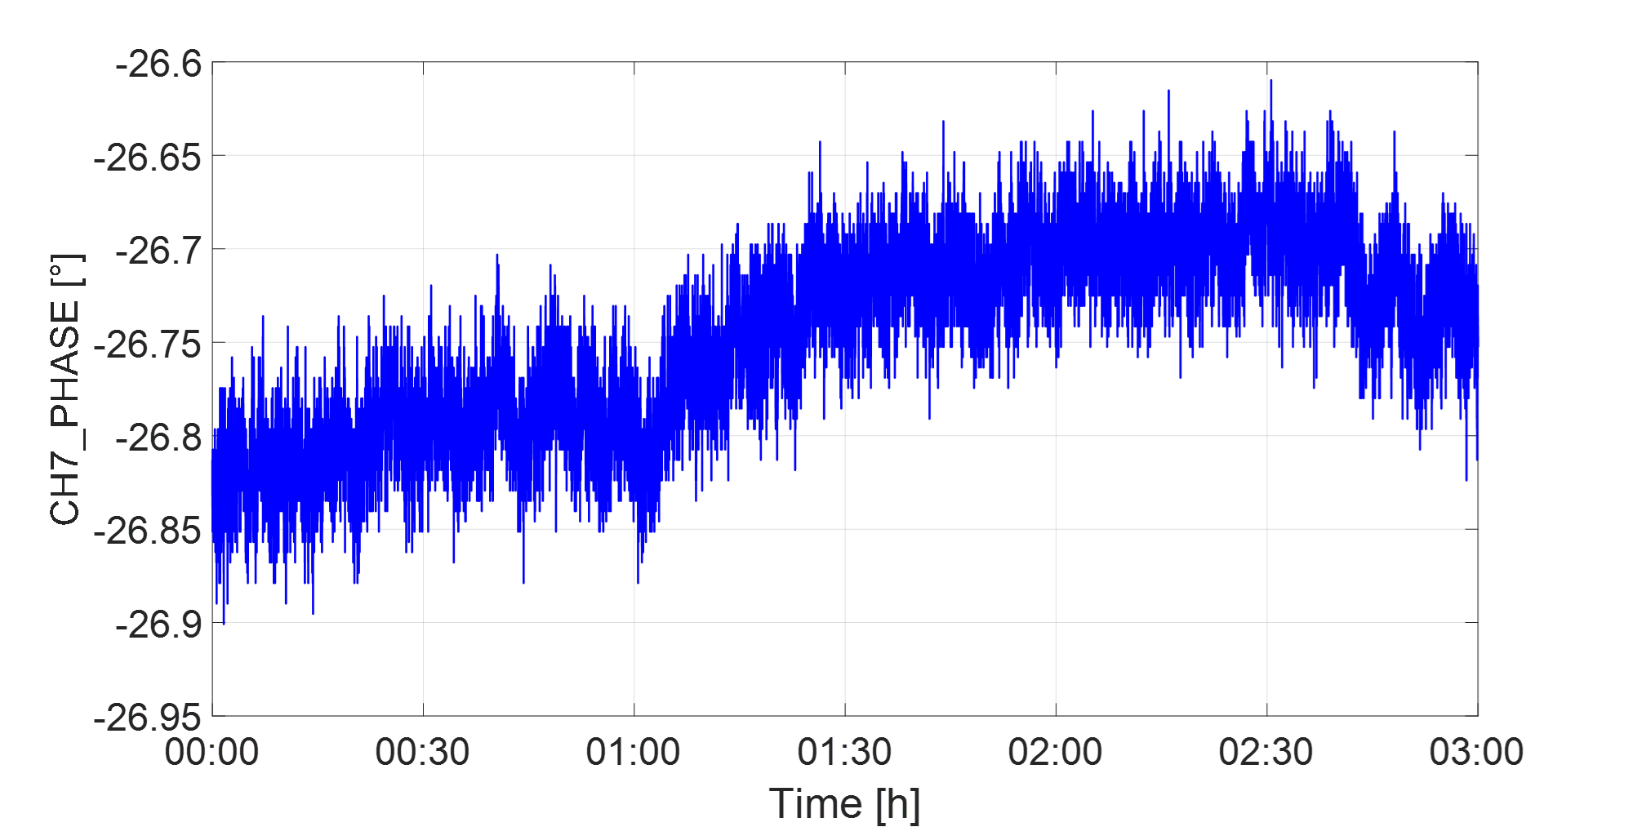
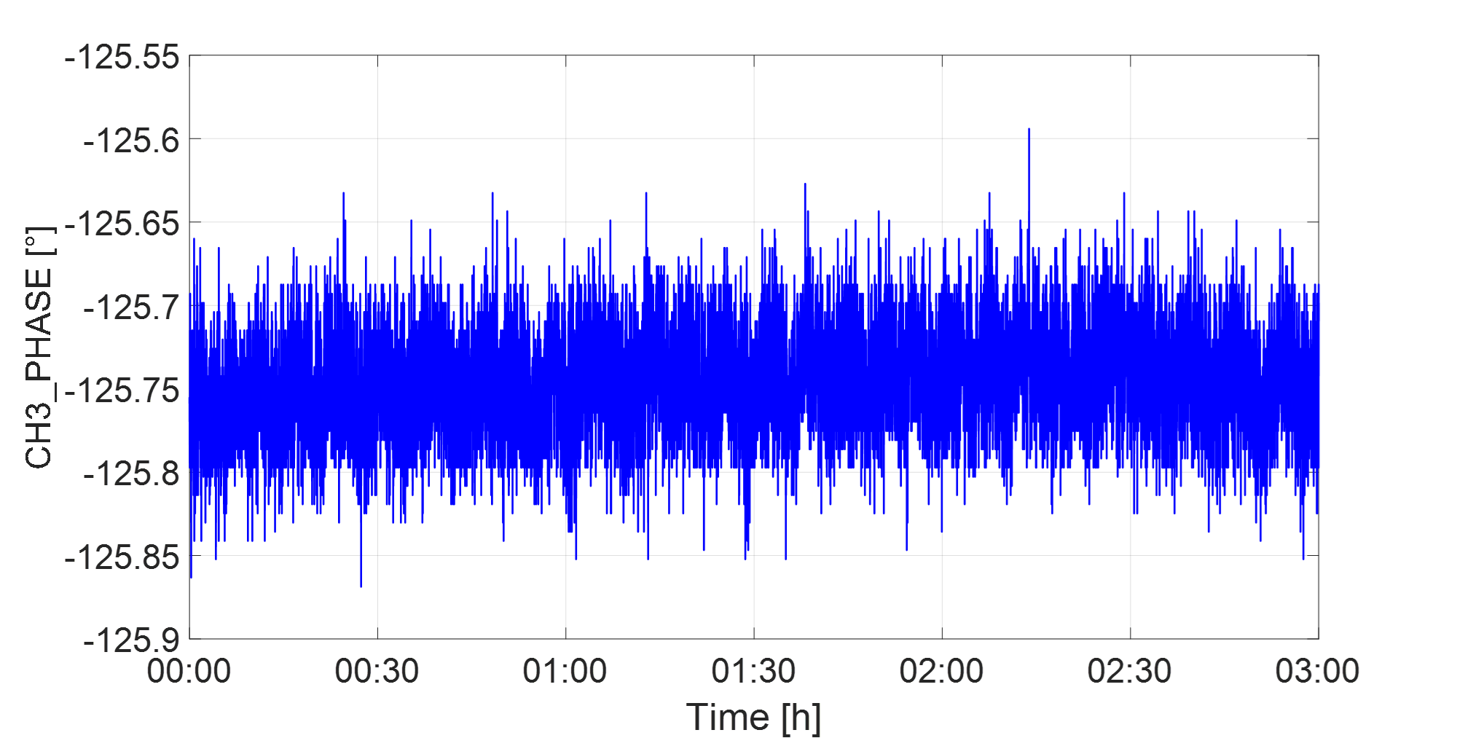
2. LLRF System Design - Reference Tracking​
CH4-Reference Tracking Disabled
Amplitude RMS 0.041 %
Reference Signal
Amplitude RMS 0.033 %
CH3-Reference Tracking Enabled
Amplitude RMS 0.041 %
Phase RMS 0.059°
Phase RMS 0.051°
Phase RMS 0.032°
Reference Tracking Test (Open-loop, 3h) - Effectively suppresses slow drift and jitter
Notes:
This page displays the open-loop test results after deploying the reference tracking algorithm. Channels 3 and 4 in the figure represent the same input RF signal,
split into two paths during FPGA digital processing: one without reference tracking and one with reference tracking.
It can be seen that with reference tracking, the slow phase drift of the RF signal is effectively suppressed.

Slide 22
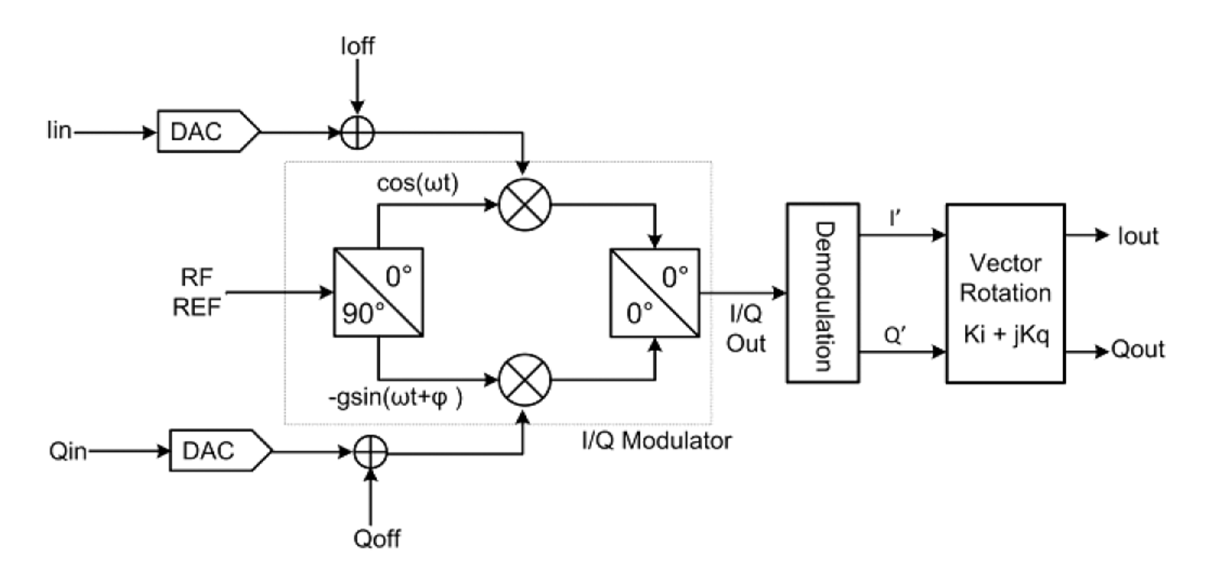
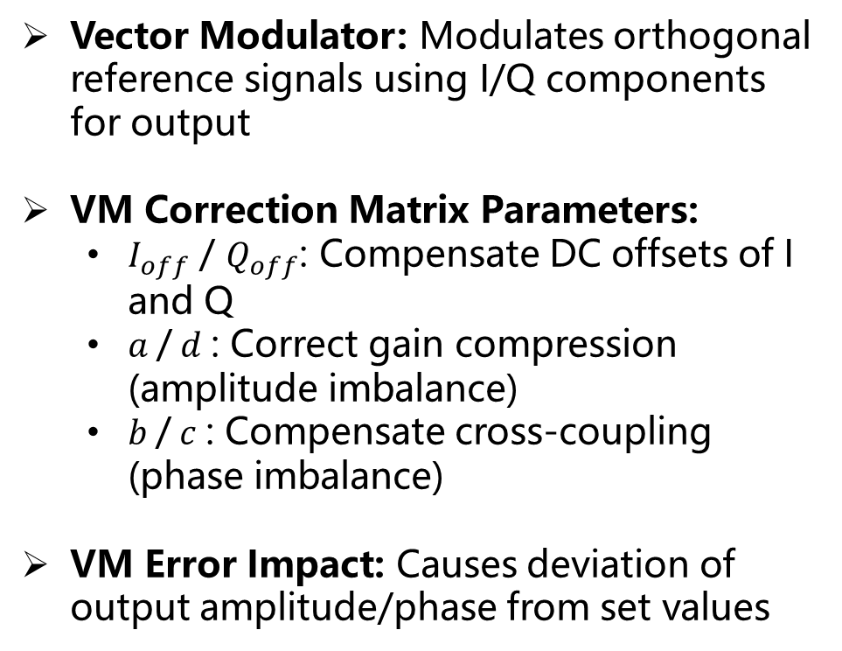
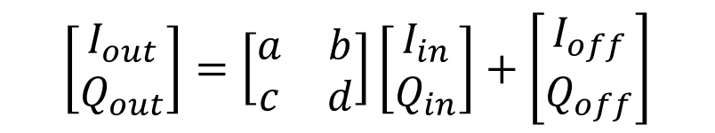
2. LLRF System Design – VM Calibration​
VM Error Model
Vector Modulator:​​ Modulates orthogonal reference signals using I/Q components for output
VM Correction Matrix Parameters:
  $I_{off}$ / $Q_{off}$: Compensate DC offsets of I and Q
  $a$/ $d$: Correct gain compression (amplitude imbalance)
  $b$/ $c$: Compensate cross-coupling (phase imbalance)
VM Error Impact:​​ Causes deviation of output amplitude/phase from set values
$$\left[\begin{matrix}I_{out} \\ Q_{out}\end{matrix}\right]=\left[\begin{matrix}a & b \\ c & d\end{matrix}\right]\left[\begin{matrix}I_{in} \\ Q_{in}\end{matrix}\right]+\left[\begin{matrix}I_{off} \\ Q_{off}\end{matrix}\right]$$
Reference：S. Simrock, Z. Geng. Low-level radio frequency systems. Springer Nature, 2022.
Notes:
The RF board features a vector modulator (VM) for outputting excitation/ˌɛksaɪ‘teʃən/ signals.
Due to performance variations/ˌveriˈeɪʃns/ in power dividers, mixers, and other components within the VM, as well as changes in environmental temperature or prolonged/pro’lɔŋd/长期的 operation, the output signal generated by the VM may deviate/ˈdiːvieɪt/ from the input amplitude and phase setpoints.
We developed an automatic VM scanning and calibration algorithm.

Slide 23
2. LLRF System Design – VM Calibration​
I/Q Set vs Measured Values
(Pre-calibration)
I/Q Set vs Measured Values
(Post-calibration)
Automatic Program Scanning & Calibration Parameter Calculation​
Single scan duration: ~7 min
Pre-calibration static power: -30~-35 dBm
Post-calibration static power: -45~-50 dBm
Amp Setting [%] | Power Pre-calibration [dBm] | Power Post-calibration [dBm]
0 | -30.39 | -46.31
VM Output Power
(Pre/Post-calibration)​
Notes:
This page demonstrates/ˈdemənstreɪts/ the effectiveness/ɪˈfektɪvnəs/ of VM calibration. The left image shows deviations /ˌdiːviˈeɪʃns/ between the setpoints and VM output values before calibration. After calibration, the setpoints and output values nearly coincide. When the amplitude setpoint is 0, the VM output power before and after calibration is shown in the table.

Slide 24
Overview
1.
HALF Injector Microwave System
Hefei Advanced Light Facility (HALF) Introduction
Microwave System Layout
Reference Signal Distribution System Layout
2.
Digital Low-Level RF (LLRF) System Design
RF Station Configuration​
LLRF Hardware Composition
IOC & Control Interface
FPGA Algorithm Architecture & Core Algorithms
3.
Test Platform Setup and Test Results
Offline Testing
Online High Power Testing
Notes:
Finally, I present the test results of this system.

Slide 25
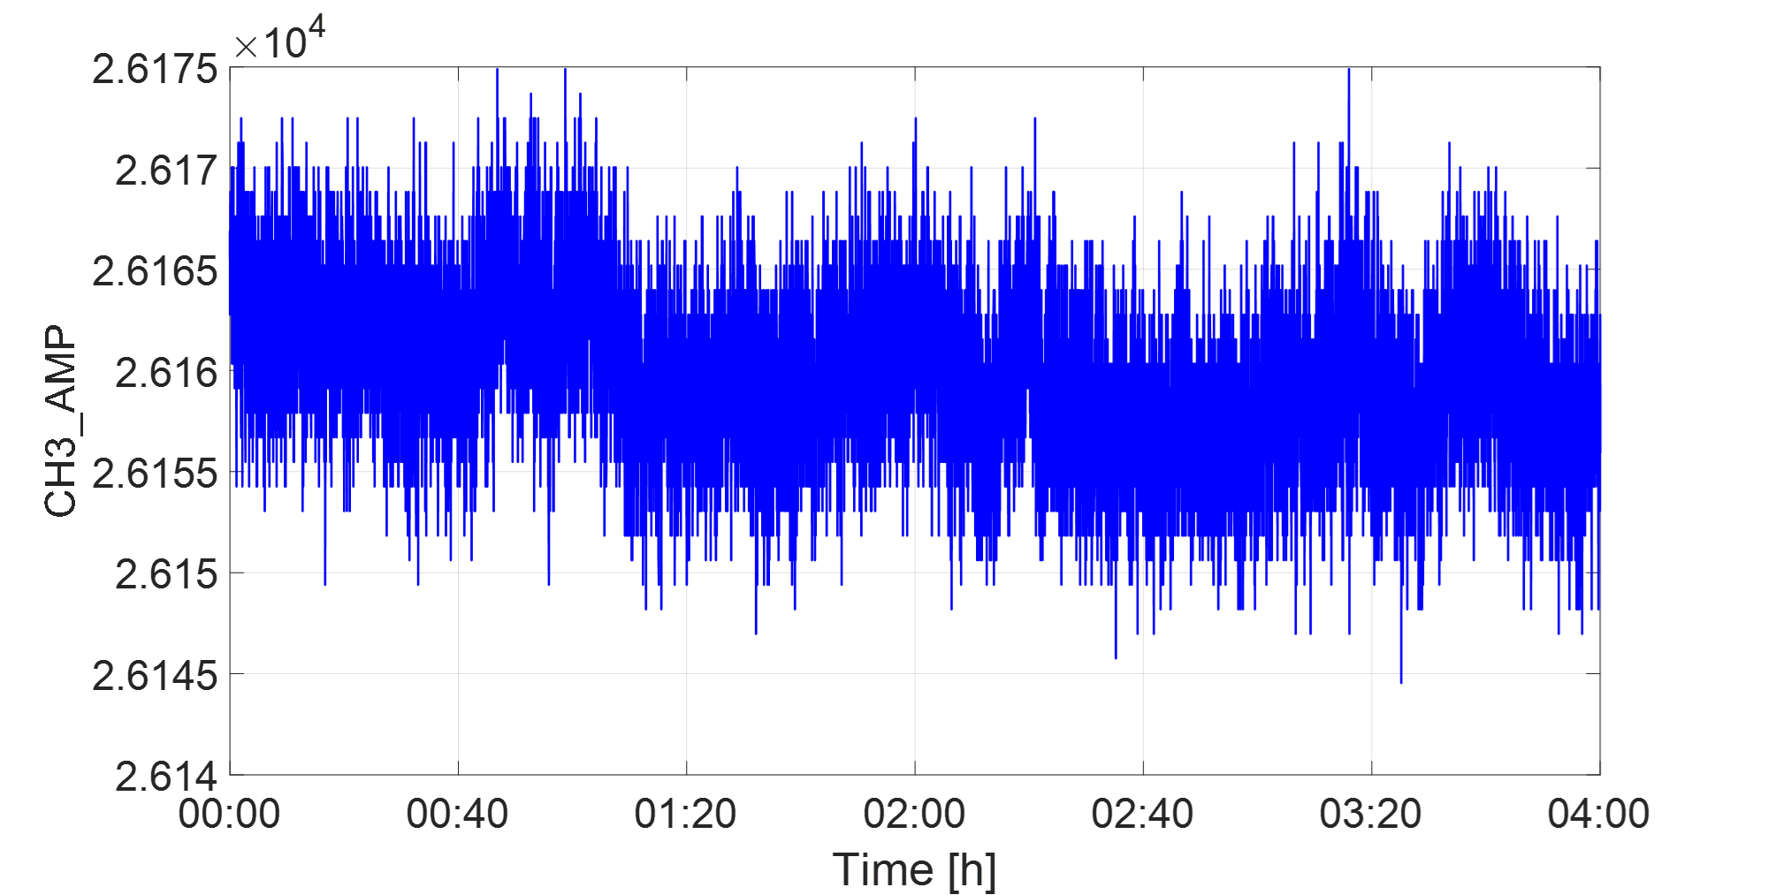
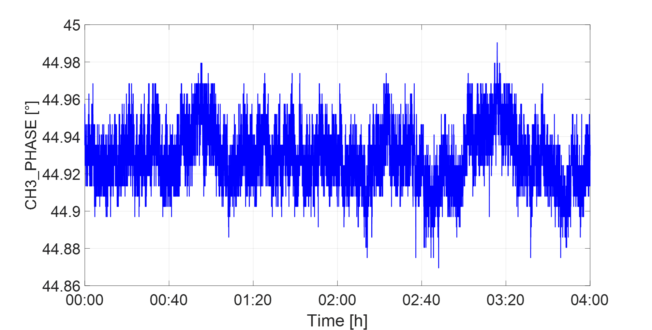
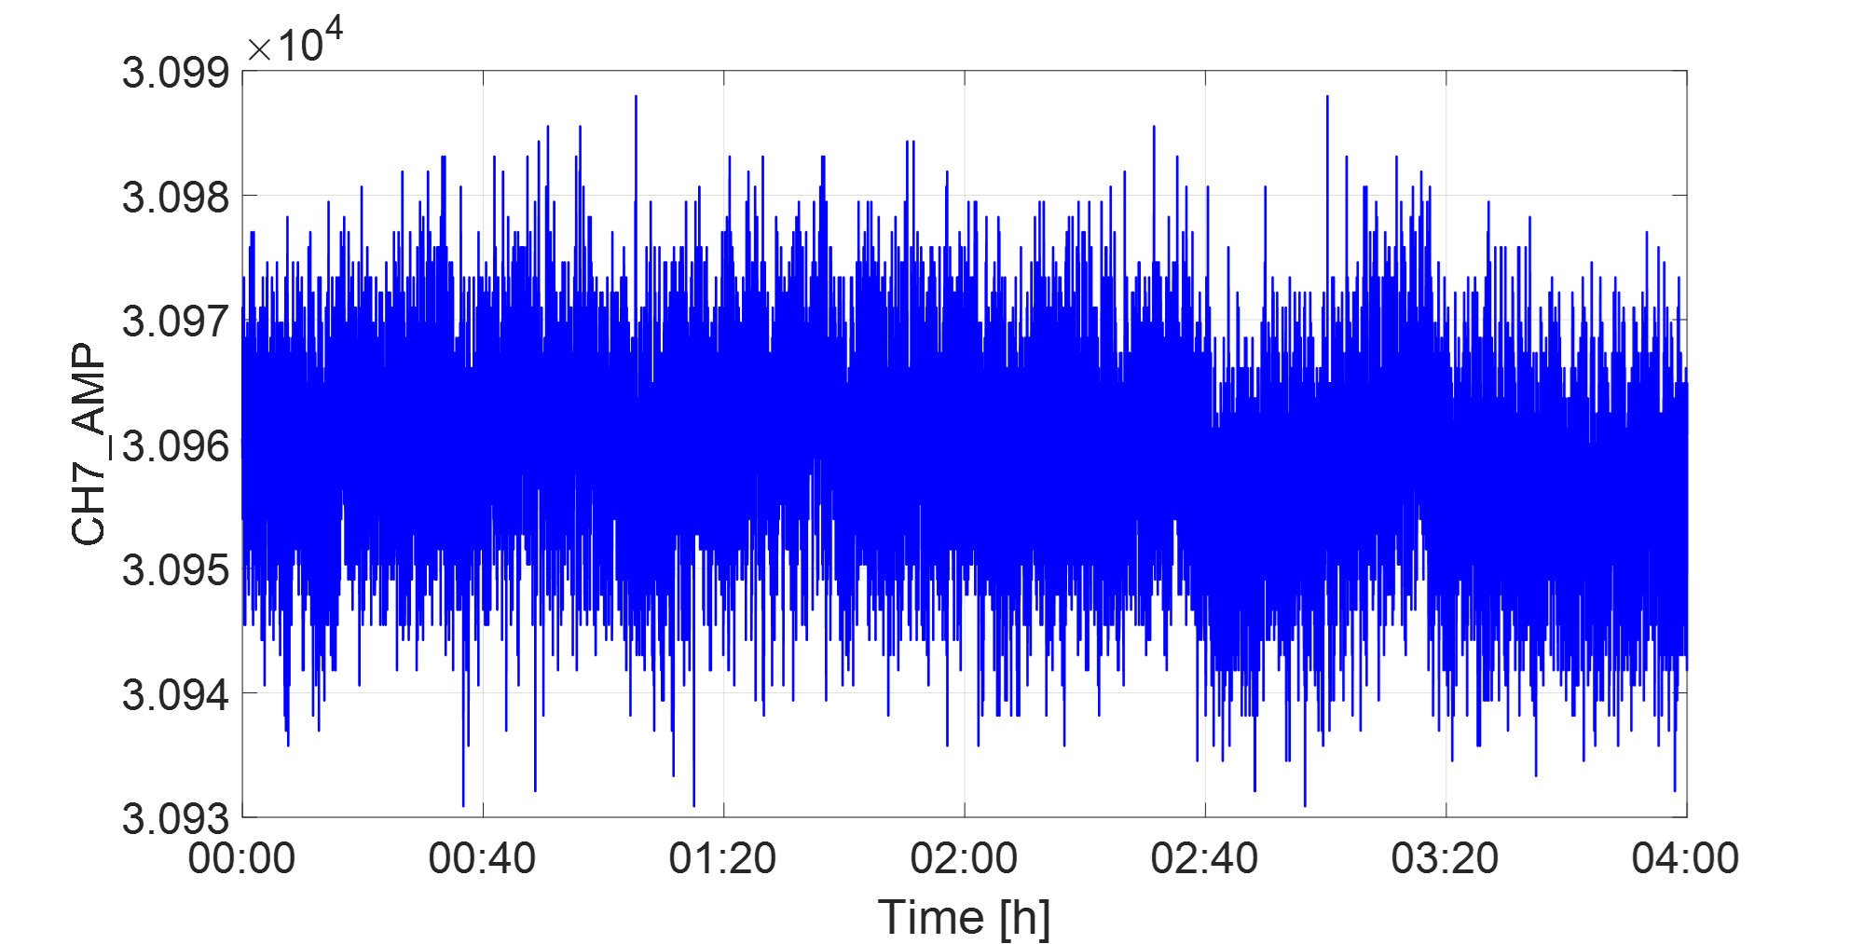
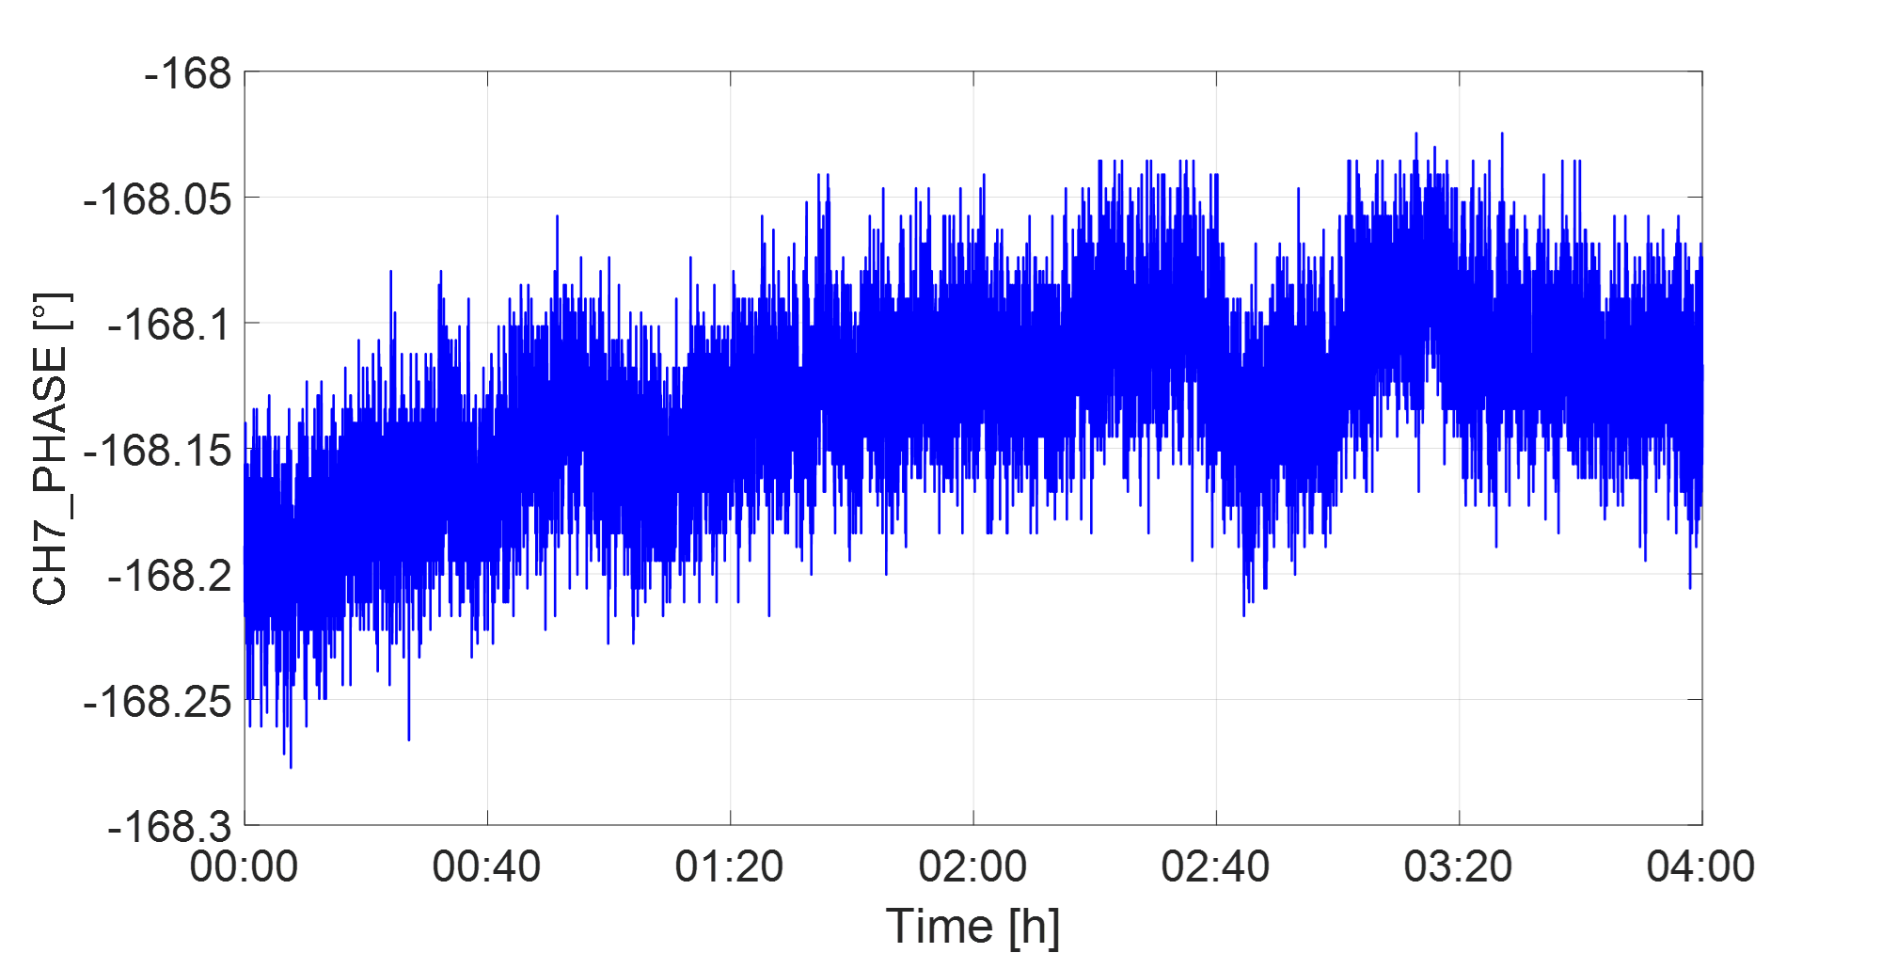
3. LLRF Test Results - Offline Testing​
Offline Closed-Loop Test with SSA
(IQ Closed-Loop-4 h)
SSA AMP：0.016%（RMS），PHA：0.016°（RMS）
REF AMP：0.025%（RMS），PHA：0.036°（RMS）
SSA AMP
SSA PHA
REF AMP
REF PHA
Notes:
In the solid-state amplifier offline closed-loop test, the amplitude and phase stability reached 0.016% and 0.016°, respectively.
带有固态放大器的，离线测试结果如图所示

Slide 26
3. LLRF Test Results - Online High Power Testing
Pre-Optimization​
High-Quality Electron Source (HQES) Platform​​
​​High Power Closed-Loop Test (with Klystron)​
(IQ Closed-Loop- 6h)
ACC+ AMP：0.042%（RMS），PHA：0.064°（RMS）
REF AMP：0.041%（RMS），PHA：0.082°（RMS）
ACC+ AMP
ACC+ PHA
REF AMP
REF PHA
Notes:
Partial accelerating tube conditioning was conducted on the high-quality electron source test platform in our laboratory.
After conditioning, high-power tests were performed with accelerating tubes and klystrons, with the accelerating tube input power reaching 30 MW.
Under IQ closed-loop control, the amplitude and phase stability in the accelerating tube reached 0.042% and 0.064°, respectively.

Slide 27
3. LLRF Test Results - Online High Power Testing
Pre-Optimization​
HQES Platform​​
​​High Power Closed-Loop Test (with Klystron)​
(Amplitude-Independent Closed-Loop- 1h)
ACC+ AMP：0.035%（RMS），PHA：0.413°（RMS）
REF AMP：0.023%（RMS），PHA：0.037°（RMS）
ACC+ AMP
ACC+ PHA
REF AMP
REF PHA
Notes:
Under Amplitude-Independent closed-loop control, the amplitude and phase stability reached 0.035% and 0.413°, respectively.

Slide 28
3. LLRF Test Results - Online High Power Testing
Pre-Optimization​
HQES Platform​​
​​High-Power Closed-Loop Test (with Klystron)​
(Phase-Independent Closed-Loop- 4h)
ACC+ AMP：0.063%（RMS），PHA：0.065°（RMS）
REF AMP：0.043%（RMS），PHA：0.086°（RMS）
ACC+ AMP
ACC+ PHA
REF AMP
REF PHA
Notes:
Under Phase-Independent closed-loop control, the amplitude and phase stability reached 0.063% and 0.065°, respectively.

Slide 29
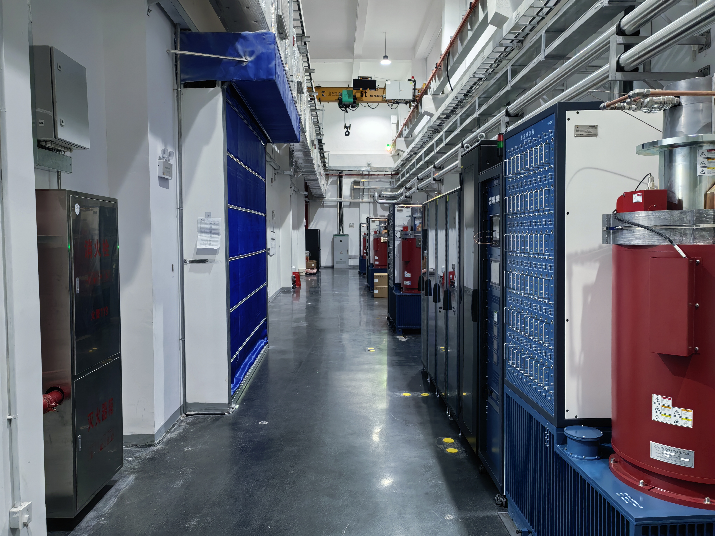
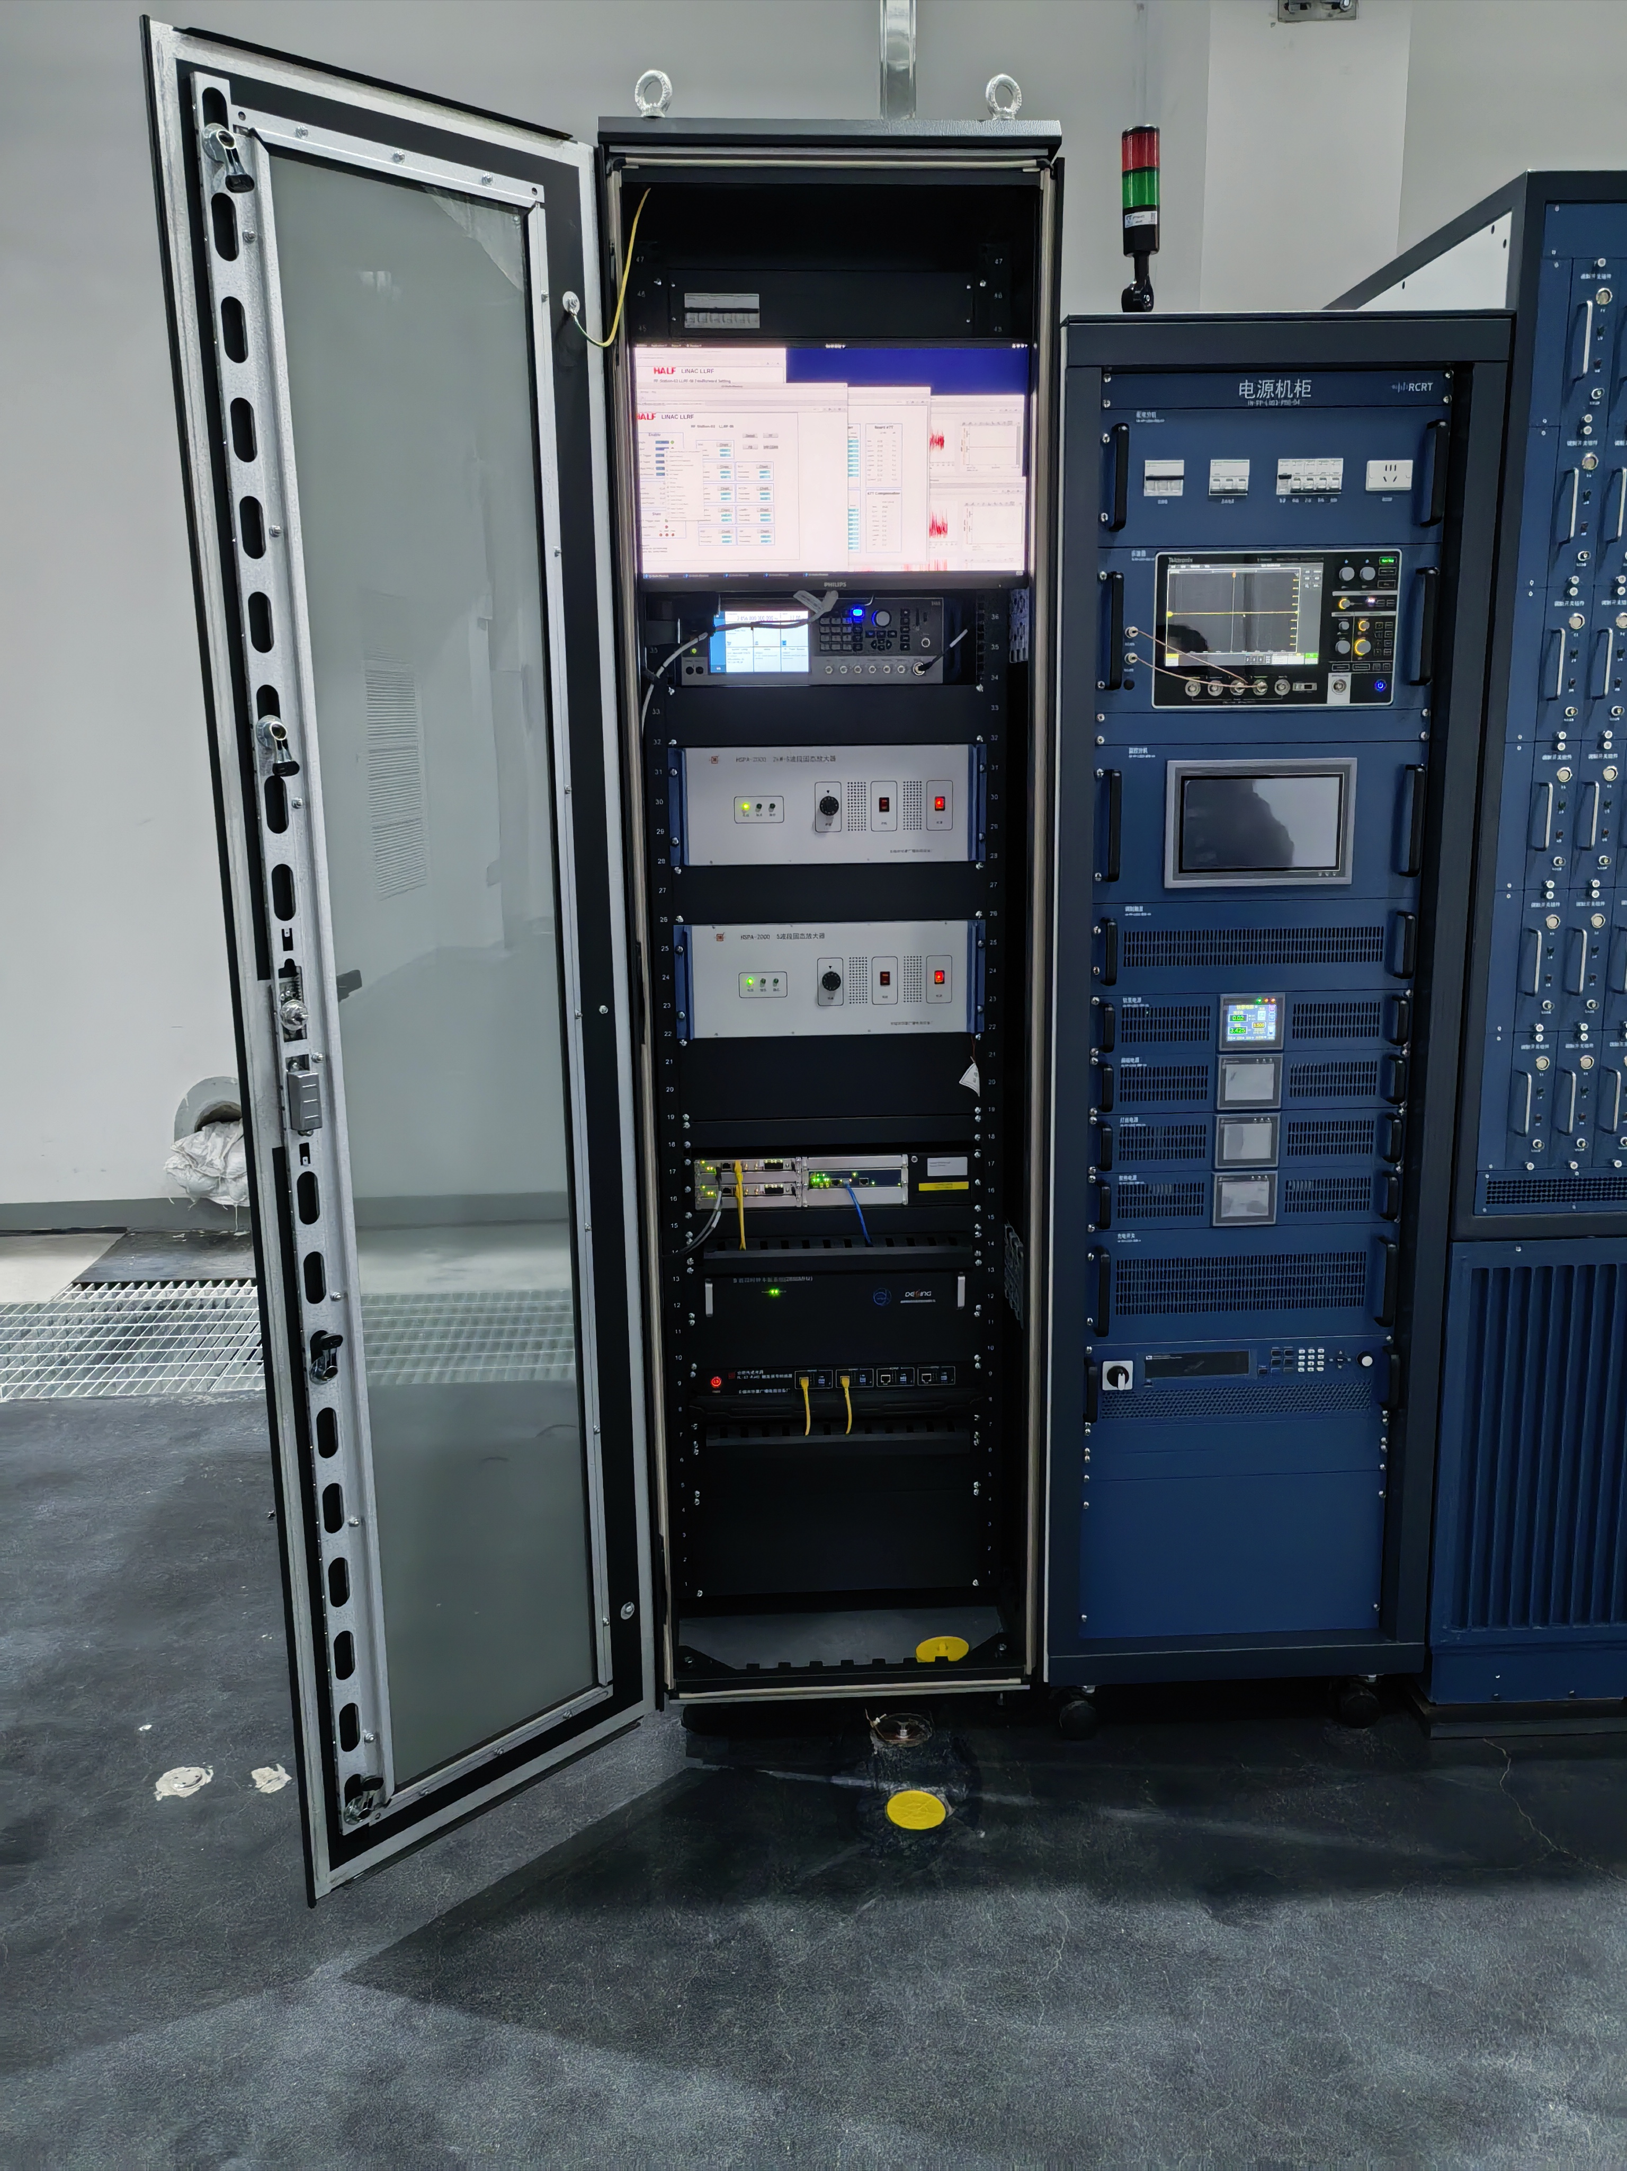
3. Test Platform Setup - Conditioning Platform​
HALF Accelerator Tube Conditioning Platform (ATCP)​
​​Klystron Gallery​
Microwave Control Cabinet
Notes:
We have completed the construction of the HALF ancillary/ˈænsəleri/ project, the accelerating tube conditioning platform. HALF requires more than 40 accelerating tubes. The HQES platform only has a 50 MW klystron, which can condition only one tube at a time, making it impossible to complete the conditioning on schedule. Most of the subsequent accelerating tubes will be conditioned on this platform.

Slide 30
3. LLRF Test Results - Online High Power Testing
Post-Optimization
ATCP​​
​​High Power Closed-Loop Test (with Klystron)​
(IQ Closed-Loop- 4h)
ACC+ AMP：0.035%（RMS），PHA：0.035°（RMS）
REF AMP：0.030%（RMS），PHA：0.079°（RMS）
ACC+ AMP
ACC+ PHA
REF AMP
REF PHA
Notes:
On ATCP, after applying the LLRF system with reference phase tracking, VM calibration, and automatic PI parameter optimization algorithms, and simultaneously/saɪməlˈtenɪəslɪ/ replacing the signal source with a new, higher-performance one, along with improvements to the water cooling system, the closed-loop performance of the LLRF system was further enhanced. After optimization, under IQ closed-loop control, the amplitude and phase stability reached 0.035% and 0.035°, respectively.
应用参考相位追踪，VM矫正，自动PI参数优化这些低电平优化算法之后，测试得到了更优的闭环结果
同时更换了一台全新，性能指标更好的信号源、水冷系统也进行了改进

Slide 31
3. LLRF Test Results - Online High Power Testing
Post-Optimization
ATCP
​​High Power Closed-Loop Test (with Klystron)​
(Amplitude-Independent Closed-Loop- 1.5h)
ACC+ AMP：0.022%（RMS），PHA：0.264°（RMS）
REF AMP：0.056%（RMS），PHA：0.126°（RMS）
ACC+ AMP
ACC+ PHA
REF AMP
REF PHA
Notes:
Under Amplitude-Independent closed-loop control, the amplitude and phase stability at the accelerating tube input forward wave reached 0.022% and 0.264°, respectively.

Slide 32
3. LLRF Test Results - Online High Power Testing
Post-Optimization
HQES Platform​​
​​High-Power Closed-Loop Test (with Klystron)​
(Phase-Independent Closed-Loop- 1h)
ACC+ AMP：0.029%（RMS），PHA：0.038°（RMS）
REF AMP：0.022%（RMS），PHA：0.036°（RMS）
ACC+ AMP
ACC+ PHA
REF AMP
REF PHA
Notes:
Under Phase-Independent closed-loop control, the amplitude and phase stability at the accelerating tube input forward wave reached 0.029% and 0.038°, respectively.

Slide 33
3. LLRF Test Results - Online High Power Testing
​​HQES and ATCP: LLRF Algorithm Performance Comparison (Pre- vs Post-Optimization)​
Closed-Loop Type​ |  | HQES Pre-Optimization | ATCP Post-Optimization
IQ | Amplitude Stability​ AMP /% (RMS) | 0.042 | 0.035
 | Phase Stability​ PHA /° (RMS) | 0.064 | 0.035
Amplitude-Independent | Amplitude Stability​ AMP /% (RMS) | 0.035 | 0.022
 | Phase Stability​ PHA /° (RMS) | 0.413 | 0.264
Phase-Independent | Amplitude Stability​ AMP /% (RMS) | 0.063 | 0.029
 | Phase Stability​ PHA /° (RMS) | 0.065 | 0.038
Notes:
This table lists the comparison/kəmˈpærɪsn/ of results before and after optimization.
This concludes /kənˈkluːds/ my presentation. Thank you for your attention.

Slide 34
Thanks for your attention!

