Slide 1
Research and development of the timing system for CSNS-II accelerator
Peng Zhu, Sinong Cheng*, Yuliang Zhang
The MicroTCA/ATCA for Large Scientific Facility Control Workshop
Sep.15-Sep.17 2025, Chongqing, China

Slide 2
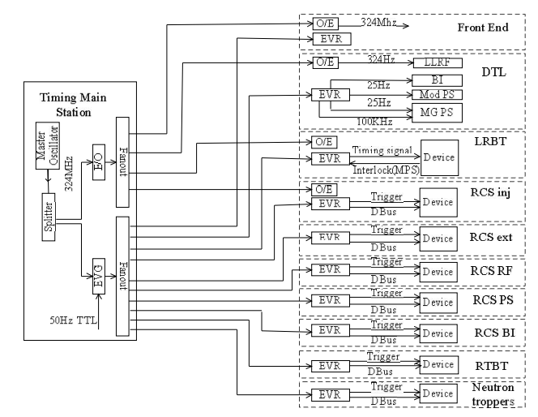
CSNS Timing System
Standard VME architecture @ MRF
The timing system using an Event system, that the event generator (EVG) and event receivers (EVR) as the main structures of a multi-level star structure.

Slide 3

Requirements of CSNS-II Timing System
CSNS & CSNS II
LINAC LLRF → add
80MeV
324MHz Spoke
Cavities
648MHz elliptical
Cavities
303MeV
154MeV
To rise the beam power
RCS LLRF → upgrade
3 additional 2nd harmonic (MA) cavities
1st harmonic cavity
1.6GeV
2nd harmonic cavity
Notes:
CSNS II工程已通过国家审批，今年正式开工建设。直线加速器采用低温超导加速技术将负氢粒子从80MeV提升至300MeV，快同步循环加速器增加多个磁合金腔，进一步提高束流通过率和降低束流损失，由此看出，高频系统的LLRF是CSNS II加速器稳定运行的关键之一，为此，定时系统的顶层方案设计应符合主流架构基础上优先考虑LLRF需求。

Slide 4
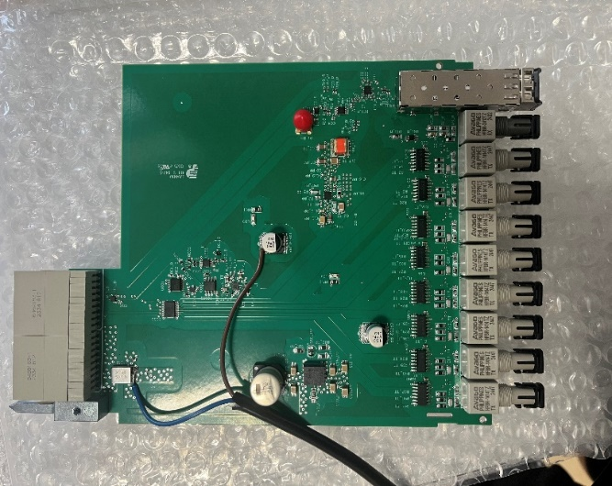
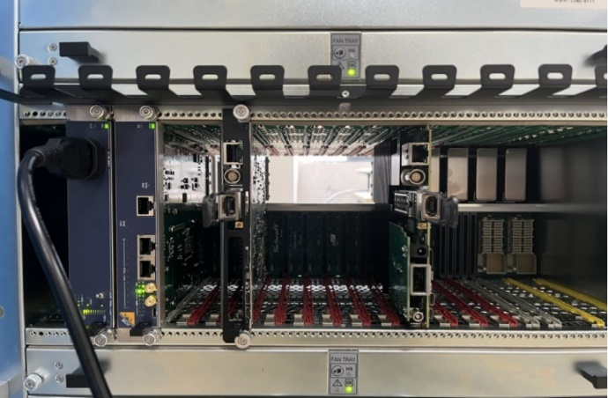
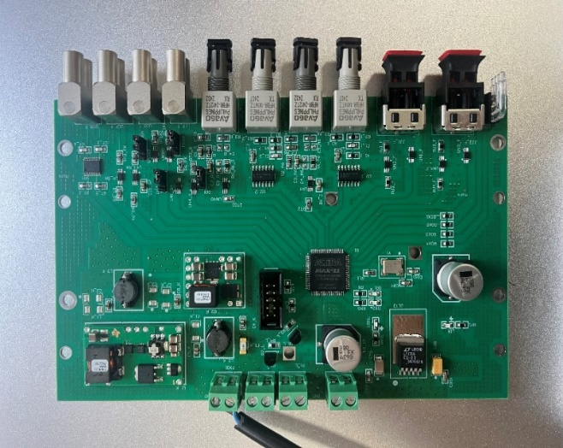
General design of CSNS-II Timing System
TM for RF Ion Source
TM for BI
8-channel
Zone
Zone
QSFP
QSFP
Zynq
Zynq
MMC
MMC
FMC
FMC
RTM
from EVG
RTM output 8*2 channel
TM*2
6路
6路
OE
OE

Slide 5
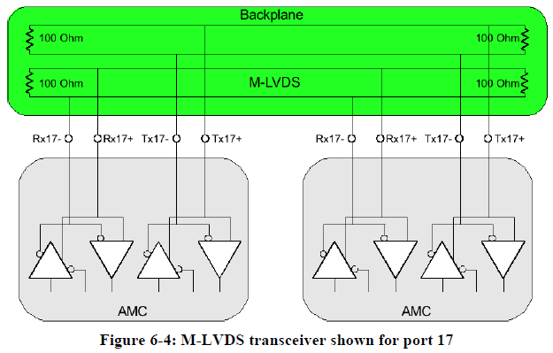

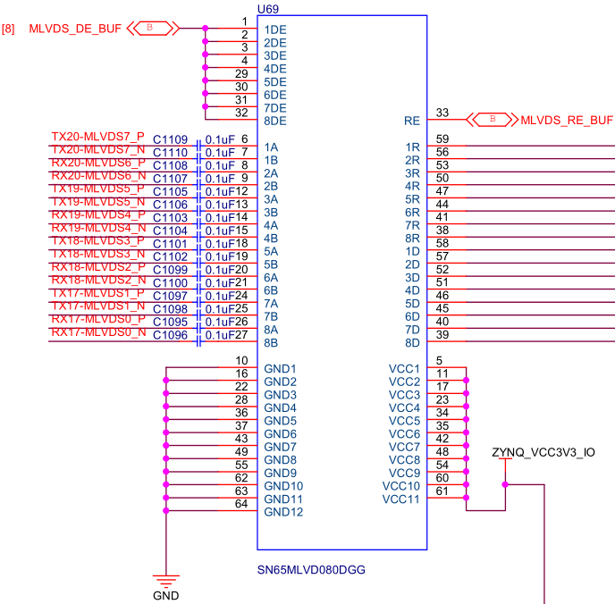
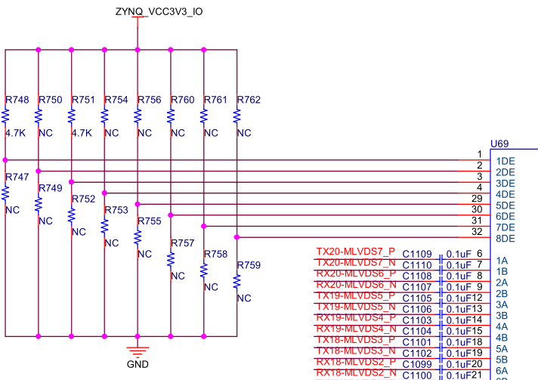
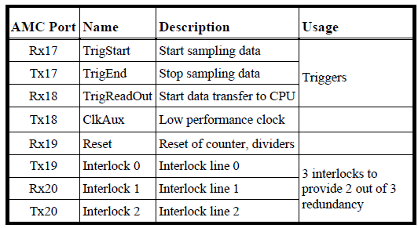
Design of LLRF Timing
LLRF + TM
LLRF & TM
AMC(LLRF)
AMC(TM & FPS)
MCH
QSFP
M-LVDS(8bit)
IPMB-L
MCMC
MMC
FMC
Notes:
CSNS II加速器技术部相关课题组根据实际需求，经过多年努力，已研制出自主知识产权的mTCA机箱和AMC、RTM板卡等，且均兼容MicroTCA.4标准。为了满足高频系统LLRF定时需求，我们拟定了“LLRF +TM”方案，即在一个mTCA机箱同时插入LLRF板卡和定时板卡，并独立运行各自逻辑，各LLRF板卡与定时板卡采用背板的8路mLVDS通道进行信号交互，这种交互方法相比于与传统方法，信号交互链路更简单、明了，也节约经费。此外，LLRF板卡可以基于片上系统或MCH与上位机数据交互，定时板卡则直接基于片上系统与上位机数据交互。

Slide 6
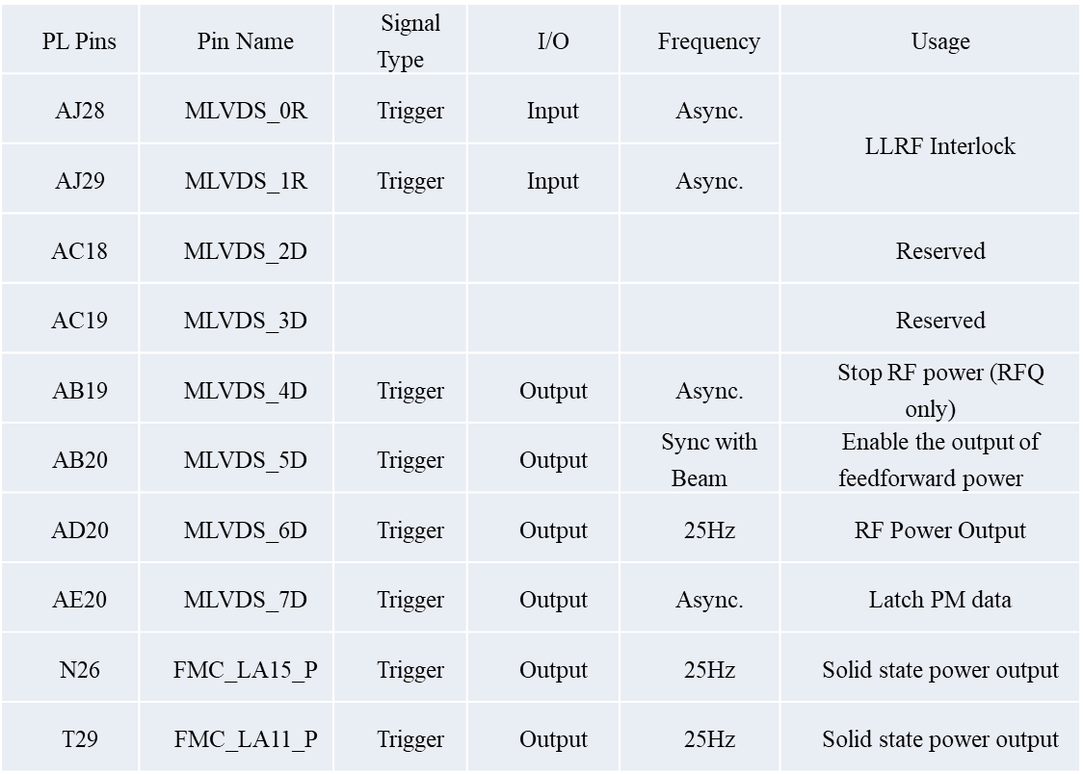
LINAC RF Timing Solution
MCH
AMC(LLRF)
AMC(TM & FPS)
QSFP
M-LVDS(8bit)
IPMB-L
MCMC
MMC
FMC
Spoke Cavity: 10 series
Ellipsoidal cavity: 12 series
beam dispersing cavity: 1 series
RFQ + buncher + DTL：4 series
Notes:
CSNS II直线高频LLRF与定时的布局和信号交互表，背板8路mLVDS在满足现有的需求下，还有备用通道。

Slide 7
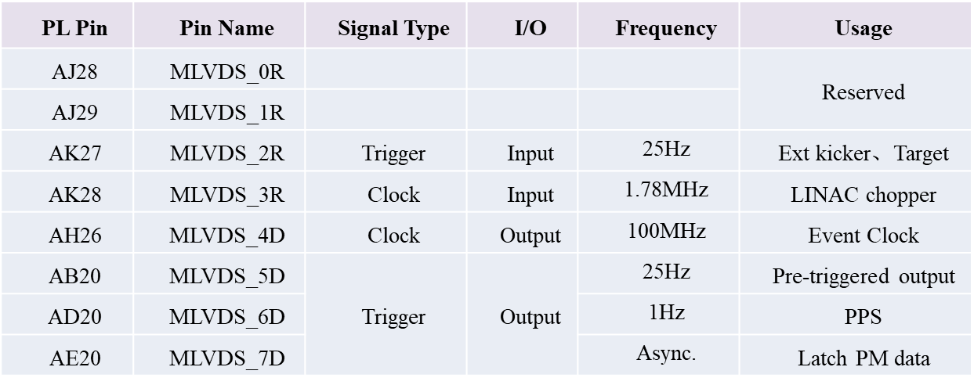
RCS RF Timing Solution
AMC（LLRF）
MCH
AMC(TM & FPS)
QSFP
M-LVDS(8bit)
IPMB-L
MCMC
MMC
FMC
RCS RF: 1 series
Notes:
CSNS II RCS高频LLRF与定时的布局和信号交互表，背板8路mLVDS在满足现有的需求下，还有备用通道。

Slide 8
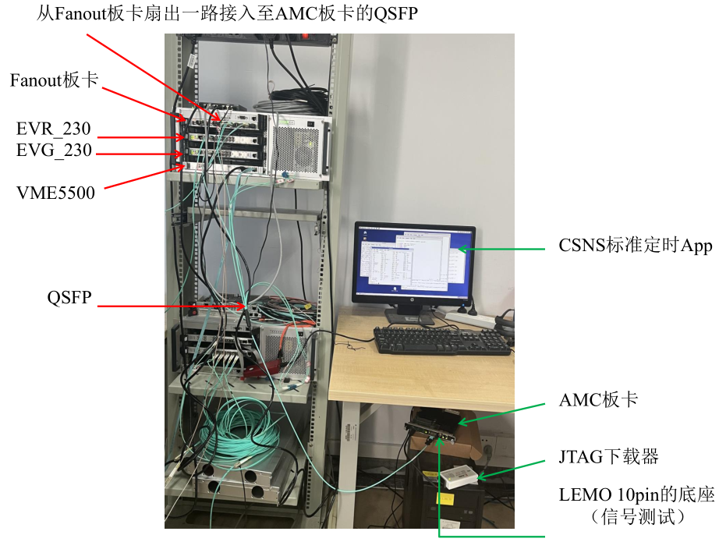
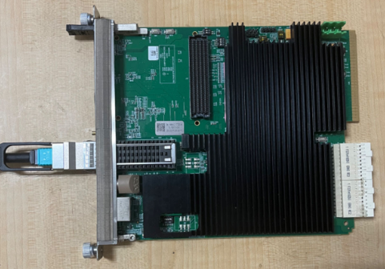
R&D of synchronous timing based on AMC
Notes:
目前，基于AMC板卡的同步定时逻辑已经完成开发和测试。

Slide 9
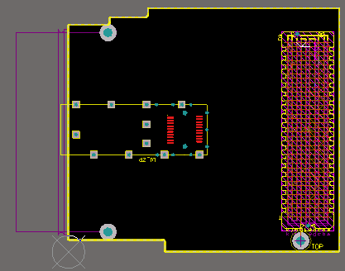
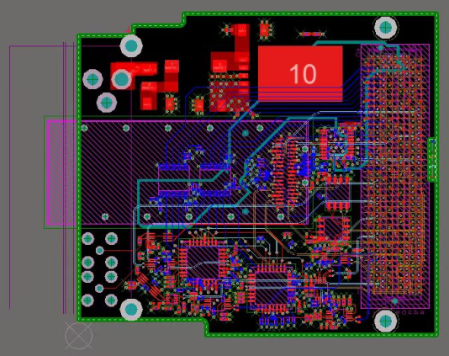
Main functions of FMC
1. The FMC_QSFP signal reserved by AMC is used for Timing/FPS interface or standby;
2. Two linear delay chips, which are used for fine adjustment of Timing signal and subsequent research on global timing delay compensation;
3. 4-way single LEMO for Timing/FPS and associated signal debugging and performance testing.
Linear delay chip
LEMO
（10ps/1024 steps）
QSFP
LEMO
Linear delay chip
（5ns/256 steps）
Notes:
研制了标准FMC载板，主要用于在开发同步定时逻辑时将时序信号引出，便于性能测试，同时也考虑到后续调束过程中对精细步长调节的需求，增加了对触发信号进行高精度线性延迟在线可调的功能。另外，FMC设计了QSFP接口，可用于与LLRF进行实时、高速数据交互，使LLRF原始数据具有高精度时间戳，建立与其它系统的数据关联，为快速诊断提供强劲依据。

Slide 10
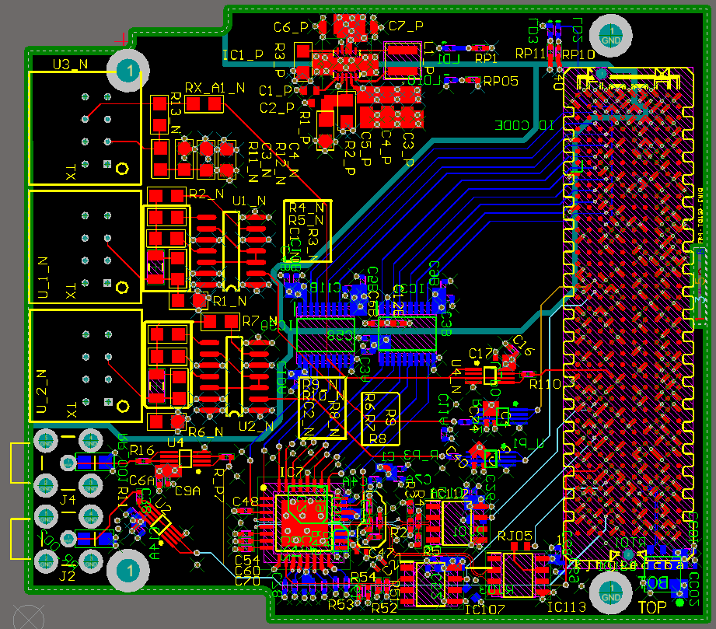
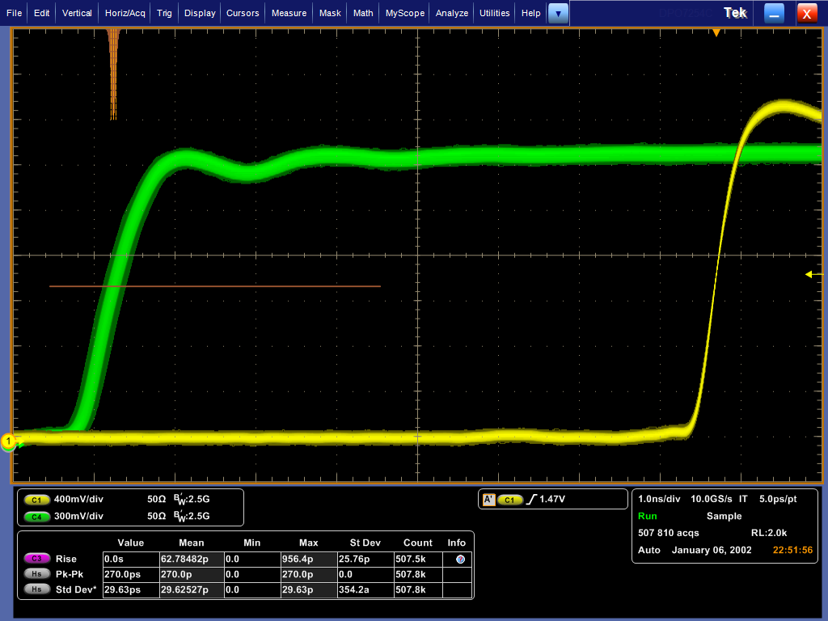
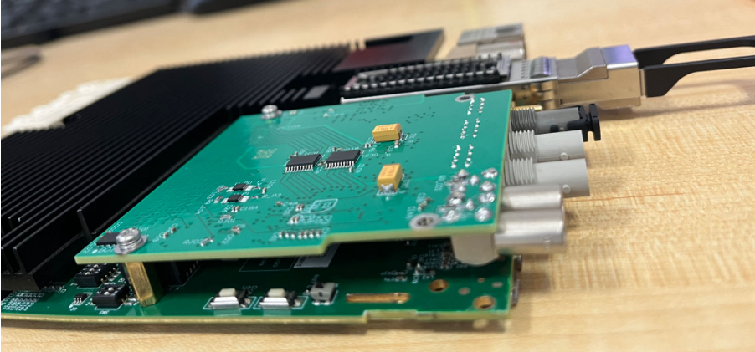
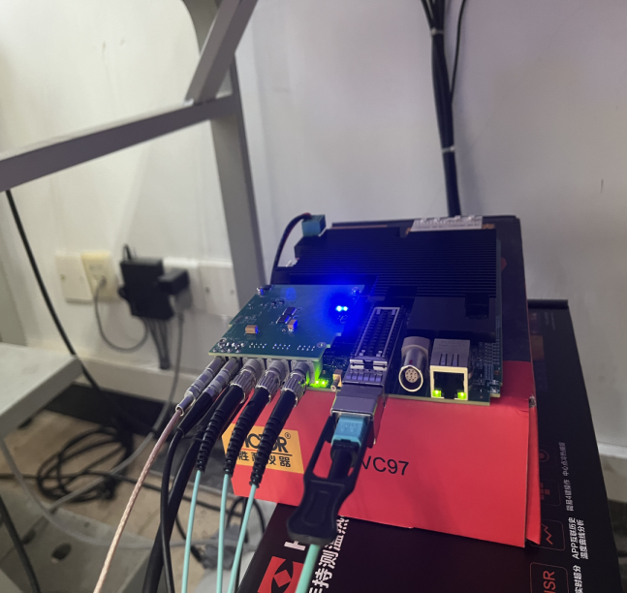
FMC Performance Testing
FMC
2412T
1414T
LEMO
Pk-Pk：270ps
Notes:
完成FMC载板的原理图设计和PCB制作、焊接，测试结果：同步信号Pk-Pk为270ps（50万次，晃动形状符合正态分布）。

Slide 11
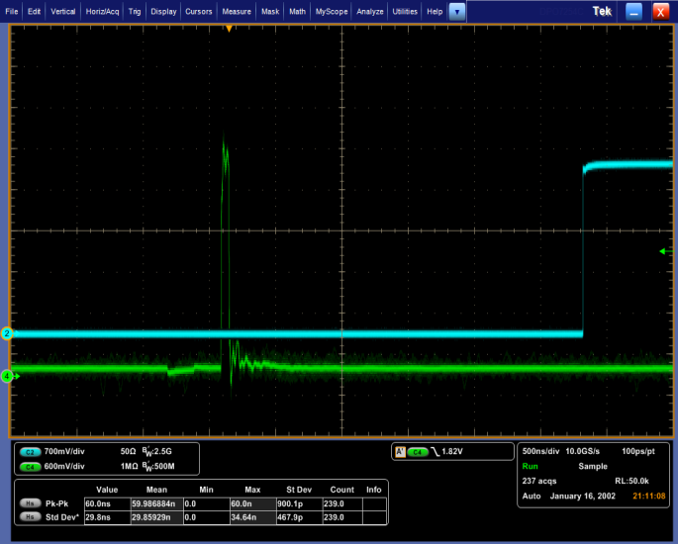
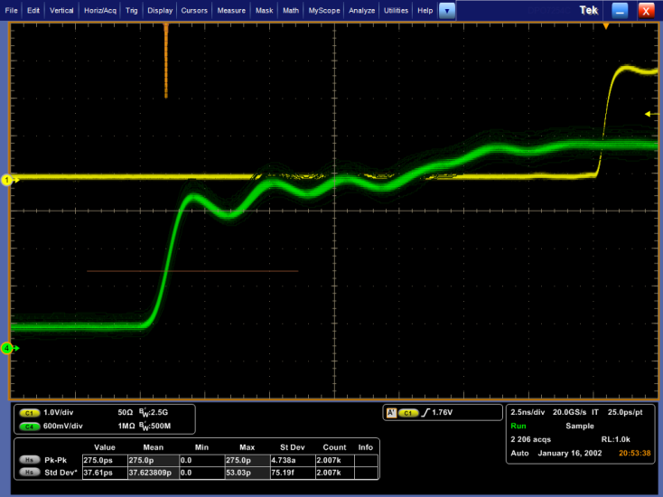
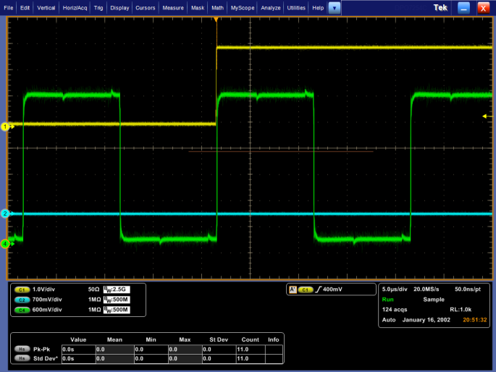
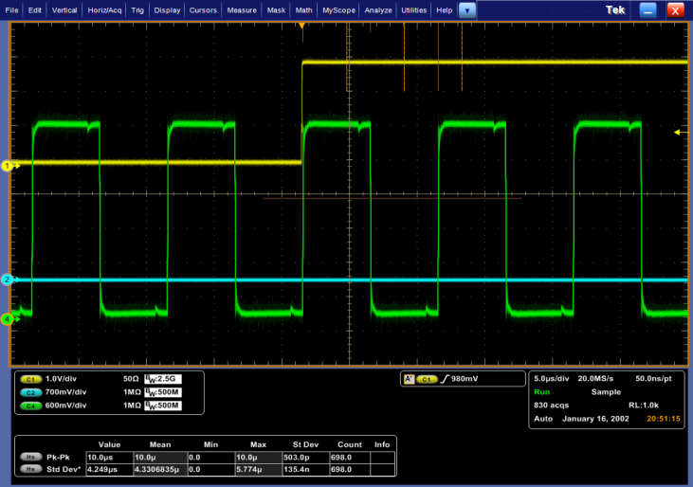
AMC Performance Testing
Pulse With: 50ns
pk-pk: 280ps(use probe)
A pulse signal triggered after receiving an event code from the timing system
Sync Clock: 200kHz
Sync Clock: 100kHz
A clock signal that is synchronized with the RF signal is received from the timing system
Notes:
进行窄脉冲和分布式时钟性能测试，进一步验证同步时序的逻辑正确

Slide 12
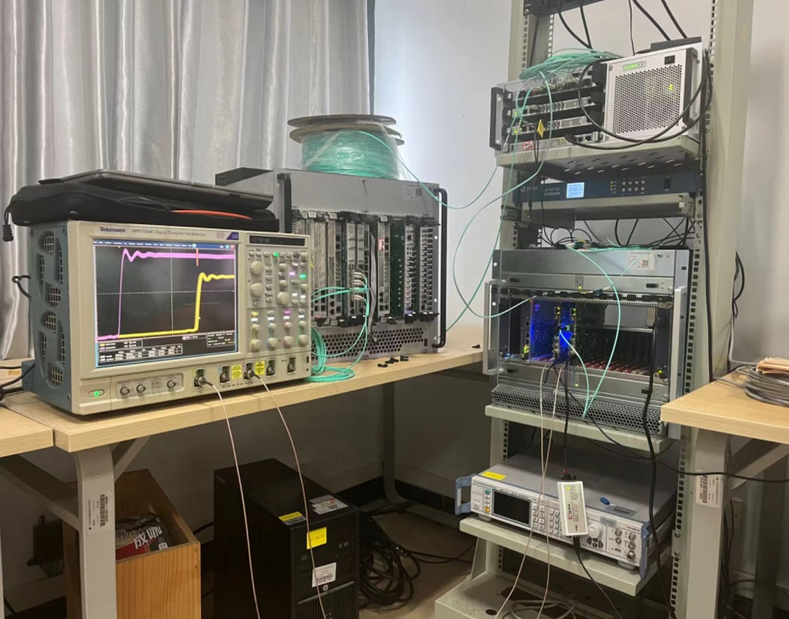
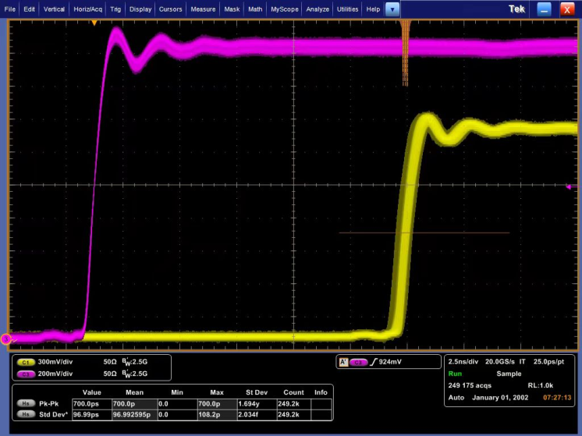
AMC Performance Testing
MLVDS Backplane Interaction Test of Dual AMC Cards
LLRF
TM
Pk-Pk：700ps
Notes:
采用两块AMC板卡，自设板卡与背板mLVDS收发端口定义，焊接不同通道电阻，进行mLVDS信号交互测试，测试结果：mLVDS收发信号的Pk-Pk为700ps（近25万次，晃动形状符合正态分布）。

Slide 13
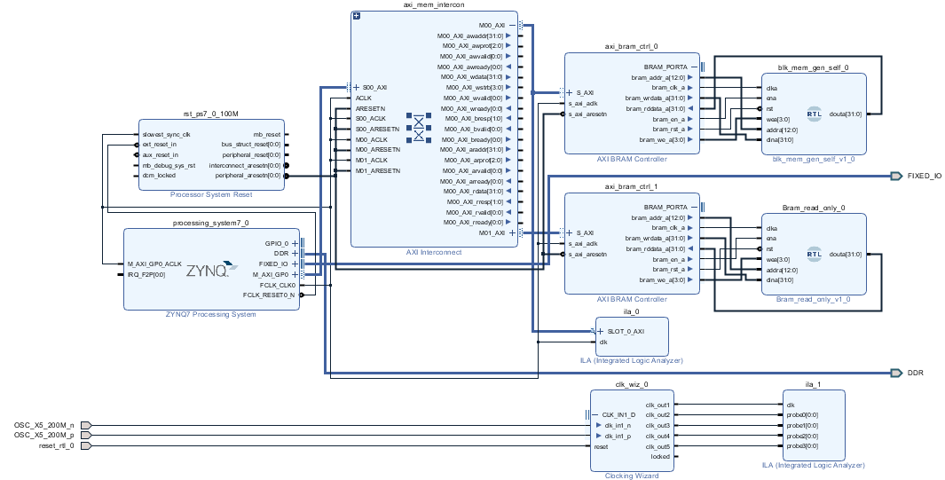
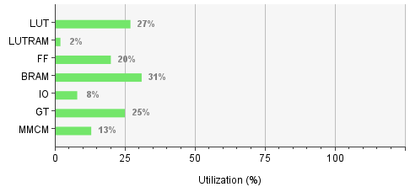
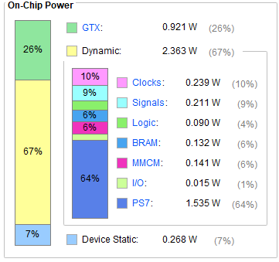
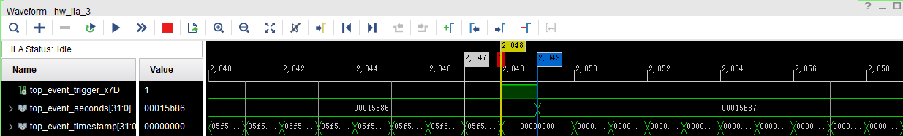
Realized Register Read and Write Function
The read and write function of a single 32-bit register has been implemented.
Read and Write
Read Only
Zynq7045
seconds
nanoseconds

Slide 14
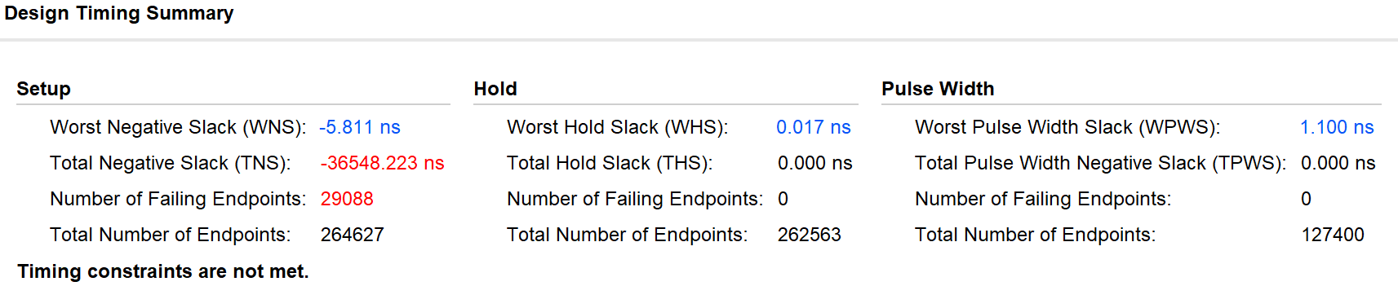
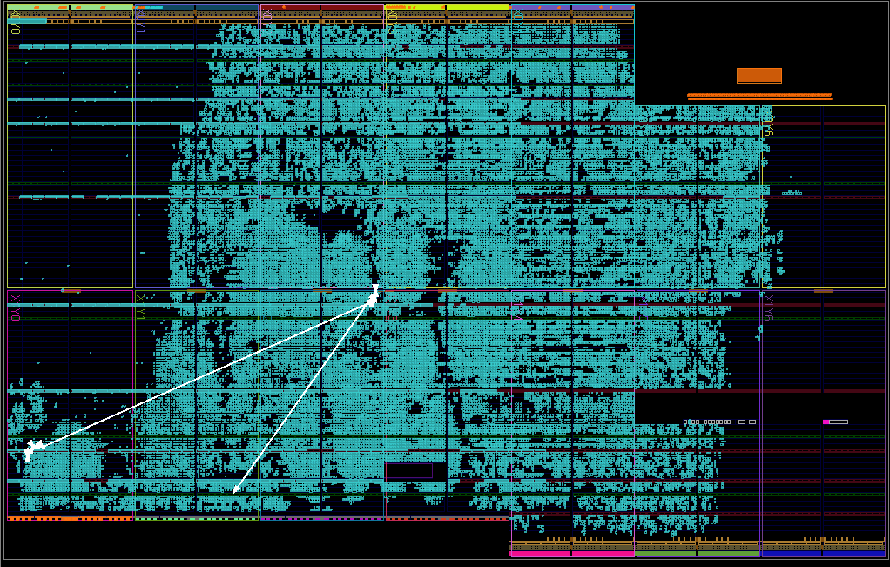
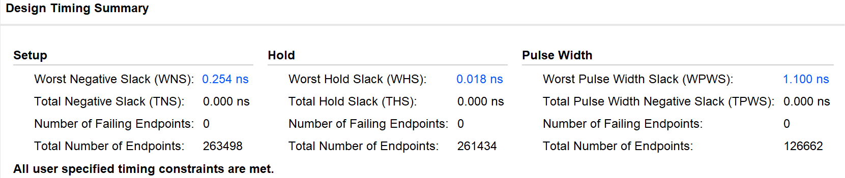
Realized Register Read and Write Function
Make the time sequence converge.

Slide 15
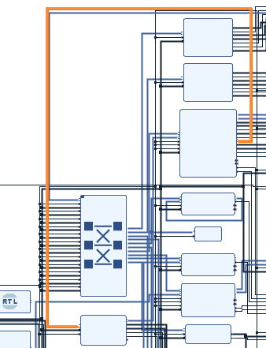
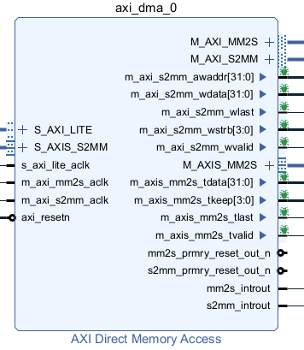
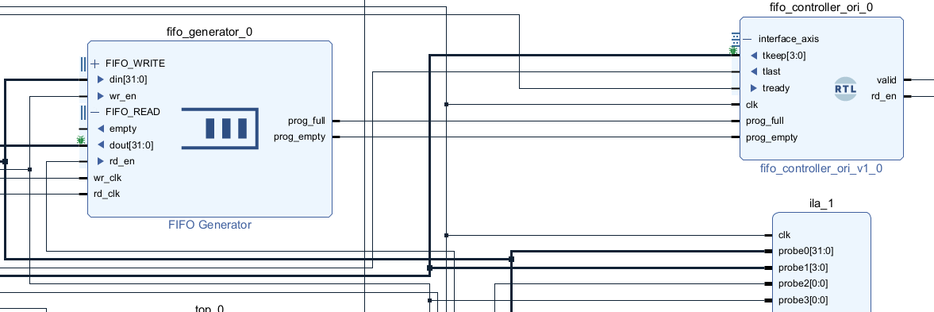
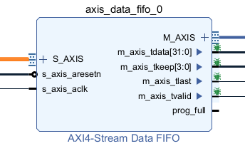
Realized Register Read and Write Function
Complete DMA for batch data loop testing.
DMA closed loop
DMA open loop

Slide 16
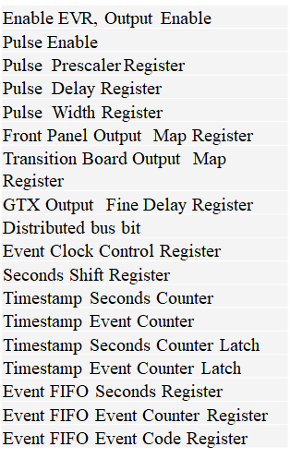
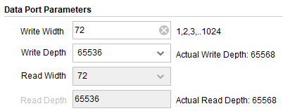
Realized Register Read and Write Function
MRF Registers
read_write_addra(12 downto 0) = x“000"&'0'
event_code
read_write_addra(12 downto 0) = x“0FF"&'0'
read_write_addra(12 downto 0) = x“100"&'0'
event_code_cnt
read_write_addra(12 downto 0) = x“1FF"&'0'
read_write_addra(12 downto 0) = x“200"&'0'
event_Front_panel_switch
read_write_addra(12 downto 0) = x“2FF"&'0'
read_write_addra(12 downto 0) = x“320"&'0'
read_write_addra(12 downto 0) = x“49E"&'0'
event_trigger_width / dly / enable
read_write_addra(12 downto 0) = x"A20"&'0'
event_trigger_timestamping
Registers
read_write_addra(12 downto 0) = x"B9E"&'0'
Timestamp
72bit
72bit
FIFO
read_write_addra(12 downto 0) = x“F00"&'0'
full / empty
16

Slide 17
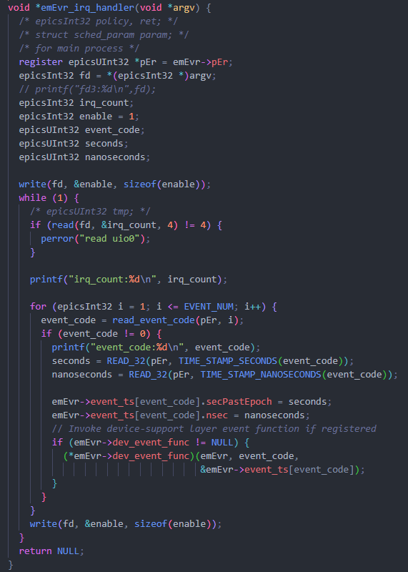
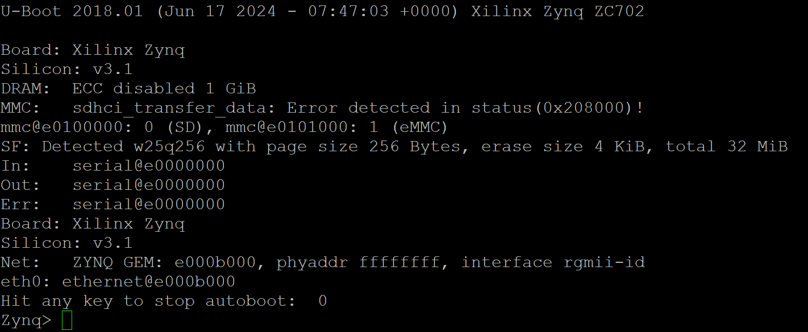
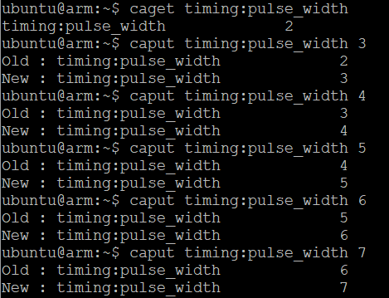
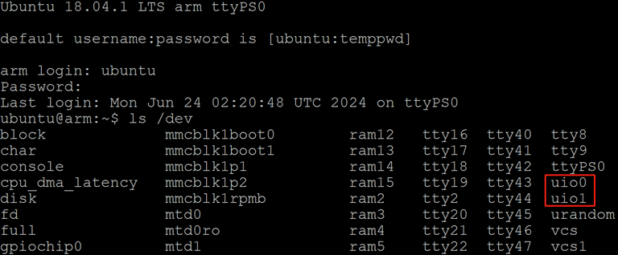
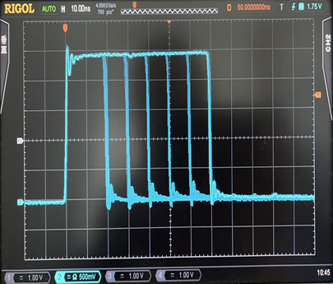
Control Registers Via EPICS 7
Start U-Boot:
Set Register to adjust pulse width:
Start Ubuntu:
Using UIO to control the reading, writing and interrupt of registers.
10ns/steps

Slide 18
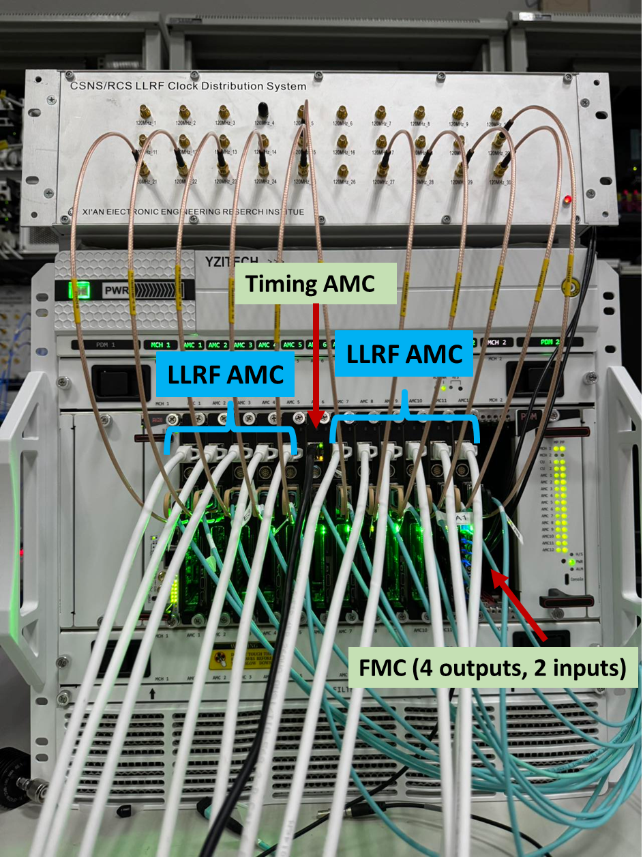
Using the Timing AMC in LLRF substation
The AMC board is based on Zynq's IOC, and there is no need to set MCH or CPU.
Signal interaction between LLRF board and timing board:
(1) 8 pairs of backplane mLVDS;
(2) FMC carrier board.
Currently, these are operating online at CSNS-II.

Slide 19
Thanks for your attention!

