Slide 1

Low-Level Radio Frequency Control System
for HUST-UED
Reporter: Changda Peng
Huazhong University of Science and Technology

Slide 2
1
HUST-UED RF Requirements
2
Development of LLRF System
3
Laser-RF Synchronization
4
Experimental Results
5
Summary
Notes:
接下来我将分为5个部分进行汇报

Slide 3
1
HUST-UED RF Requirements
Notes:
接下来我将分为5个部分进行汇报

Slide 4

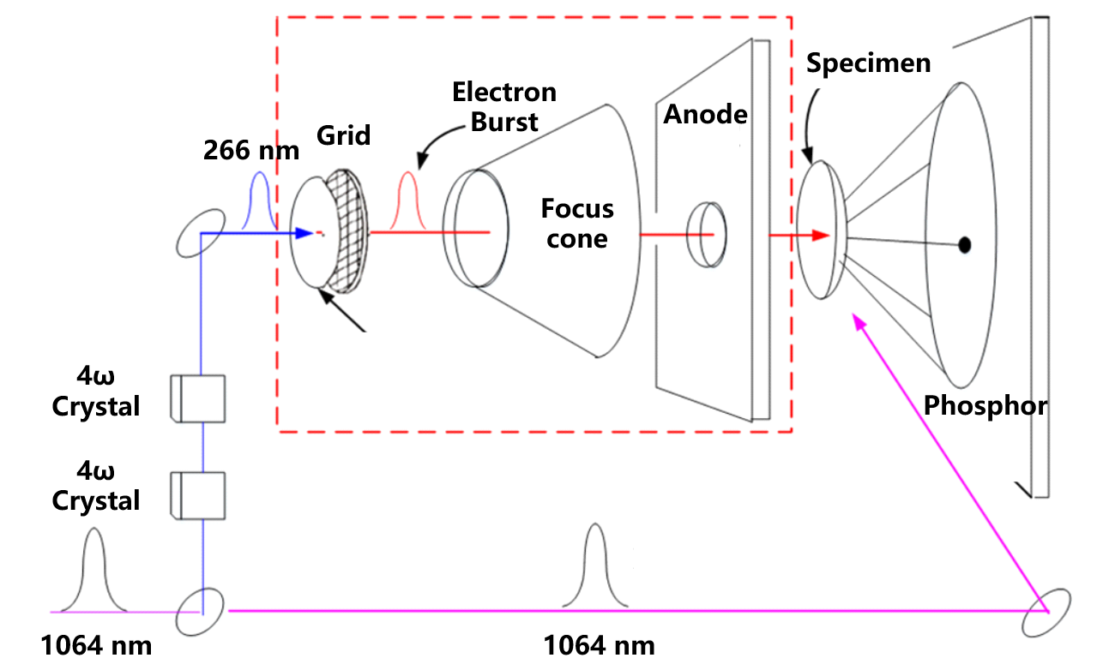
Ultrafast Electron Diffraction Technique
Pump-Probe Technique
Femtosecond laser pump
Ultrashort electron probe
Diffraction patterns
Femtosecond
Timescale Resolution
Sub-nanometer-scale
Spatial Resolution
τ_{probe} | Temporal length of the electron probe
τ_{pump} | Temporal length of the pump laser
τ_{vm} | Velocity mismatch-induced temporal jitter
τ_{jitter} | Electron beam arrival temporal jitter
Atomic motion in matter ≈ 100 fs
Temporal resolution for UED facility < 100 fs
Notes:
Ultrafast electron diffraction (UED) employs a pump-probe strategy, where a femtosecond laser pump transiently excites the sample and an ultrashort electron beam serves as the probe to capture instantaneous diffraction patterns.
This approach simultaneously achieves femtosecond-level temporal resolution and sub-nanometer-scale spatial resolution.
The characteristic timescale of atomic motion in matter is approximately 100 femtoseconds. Therefore, to accurately observe the dynamic processes of structural changes, the temporal resolution of a UED setup must be better than 100 fs.

Slide 5
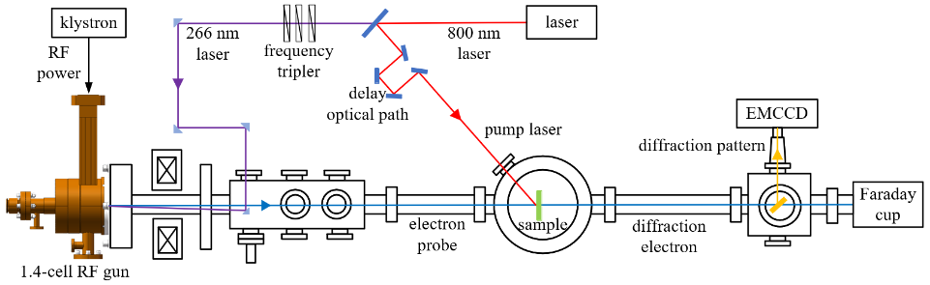
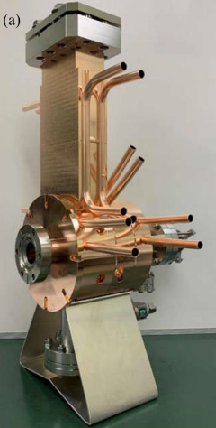
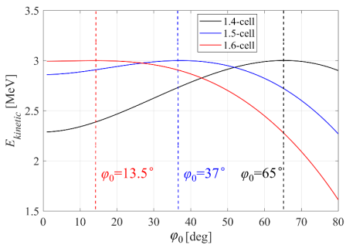
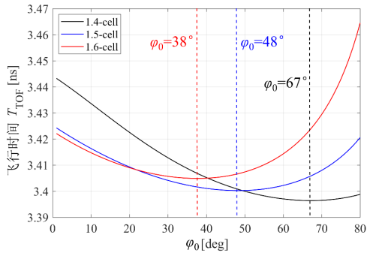
HUST-UED Pump-probe Experiment
UV laser(266 nm)
Photocathode
1.4-cell RF gun
Electron bunch
Beam energy 3 MeV
1.4-cell RF gun:
Acceleration field gradient 76.6 MV/m
Optimal injection phase 65°
Resonant frequency 2856MHz
Suppress space charge effects and compressing the arrival temporal jitter
Amplitude and phase of the RF electromagnetic field are controlled by LLRF control system
Notes:
UV laser irradiation of the photocathode
The high-gradient electric field rapidly accelerates the electron beam to relativistic speeds, suppressing the space charge effect

Slide 6
HUST-UED RF System
Klystron
Microwave
Power Source
Phase shifter compensates
for phase shifts
Adjust the delay between signals to enable the low-level chassis to synchronously sample the RF power
Waveguide
RF Power Transmission
Directional couplers to
monitor RF power
Electron Gun
Generate
electron beam
Notes:
The microwave power is generated by a klystron and transmitted to the electron gun via a waveguide..

Slide 7
2
Development of LLRF System
Notes:
接下来我将分为5个部分进行汇报

Slide 8
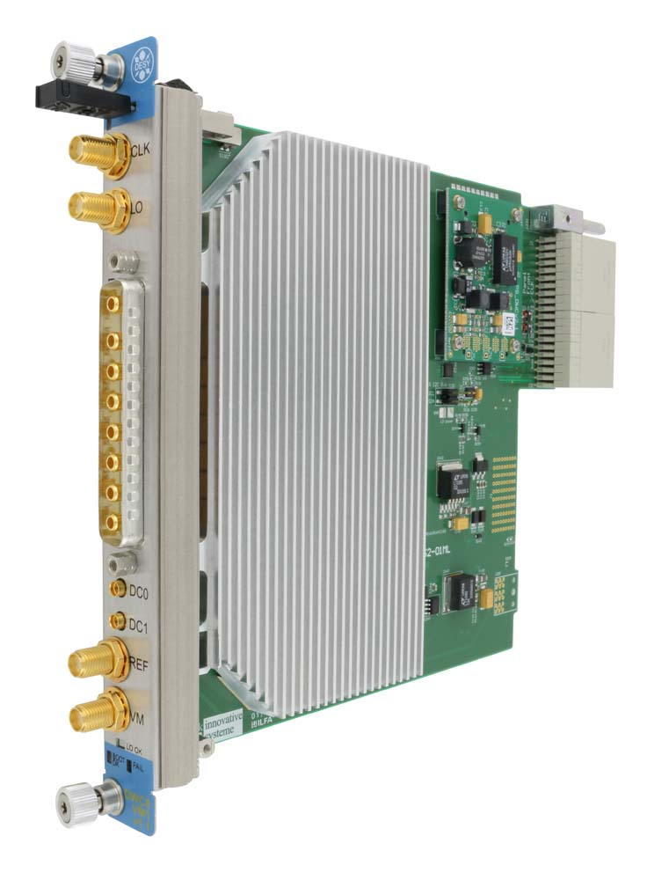
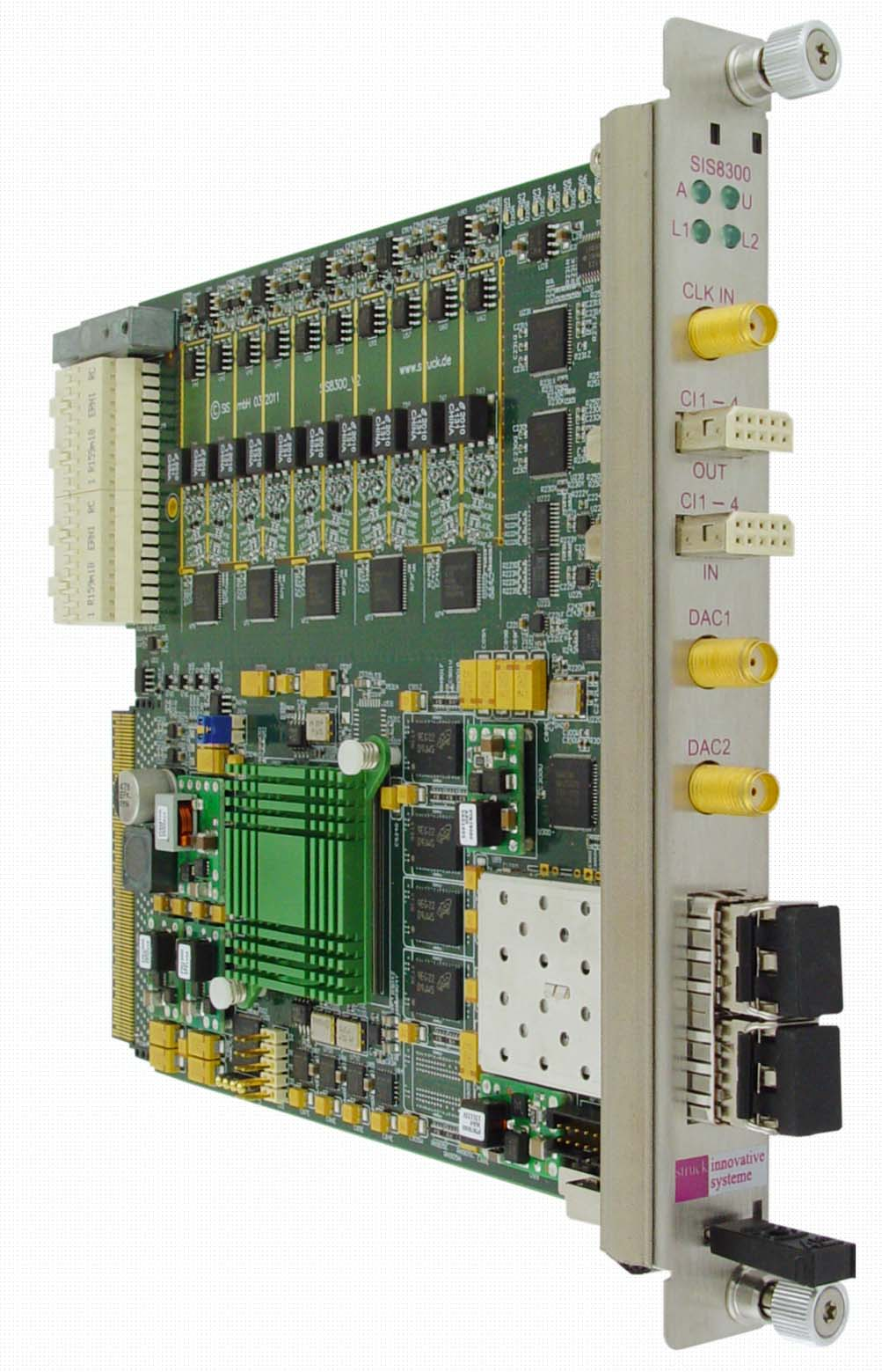
HUST-UED LLRF Control Platform
MTCA.4 architecture
AMC and RTM enable the acquisition, processing, and feedback control of RF signals
Notes:
Based on requirements and simulations, we have developed an LLRF control platform.

Slide 9
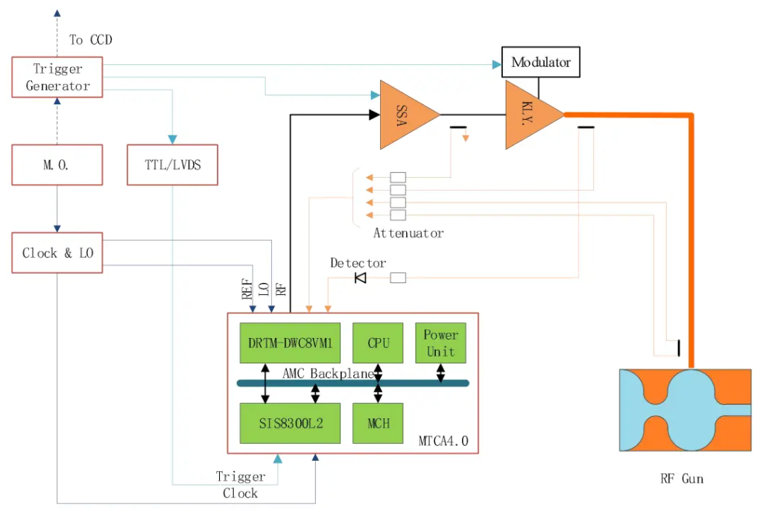
HUST-UED LLRF Control Platform
AMC and RTM are combined via the data transmission interface Zone3
The output signal frequency is 2856 MHz, consistent with the operating frequency of the RF system
Notes:
Based on requirements and simulations, we have developed an LLRF control platform.

Slide 10
HUST-UED LLRF Control Platform
RF front-end module:
Down-conversion of RF signals, Output signal conditioning, Signal attenuation
Digital signal processing module :
High-speed signal acquisition, Amplitude and phase calculation, Feedback control
Notes:
Based on requirements and simulations, we have developed an LLRF control platform.

Slide 11
Signal Processing Algorithm
Decompose the signal into I and Q components
Mix RF Signal with LO Signal
Clockwise rotation of the IQ vector
Down-conversion
IQ Modulation
CORDIC
PI
Generate correction value
Conversion from I/Q signals to a sinusoidal signal
Vector Modulator
Vector Rotation
Adjust the vector angle based on the received Φ
Notes:
Based on requirements and simulations, we have developed an LLRF control platform.

Slide 12
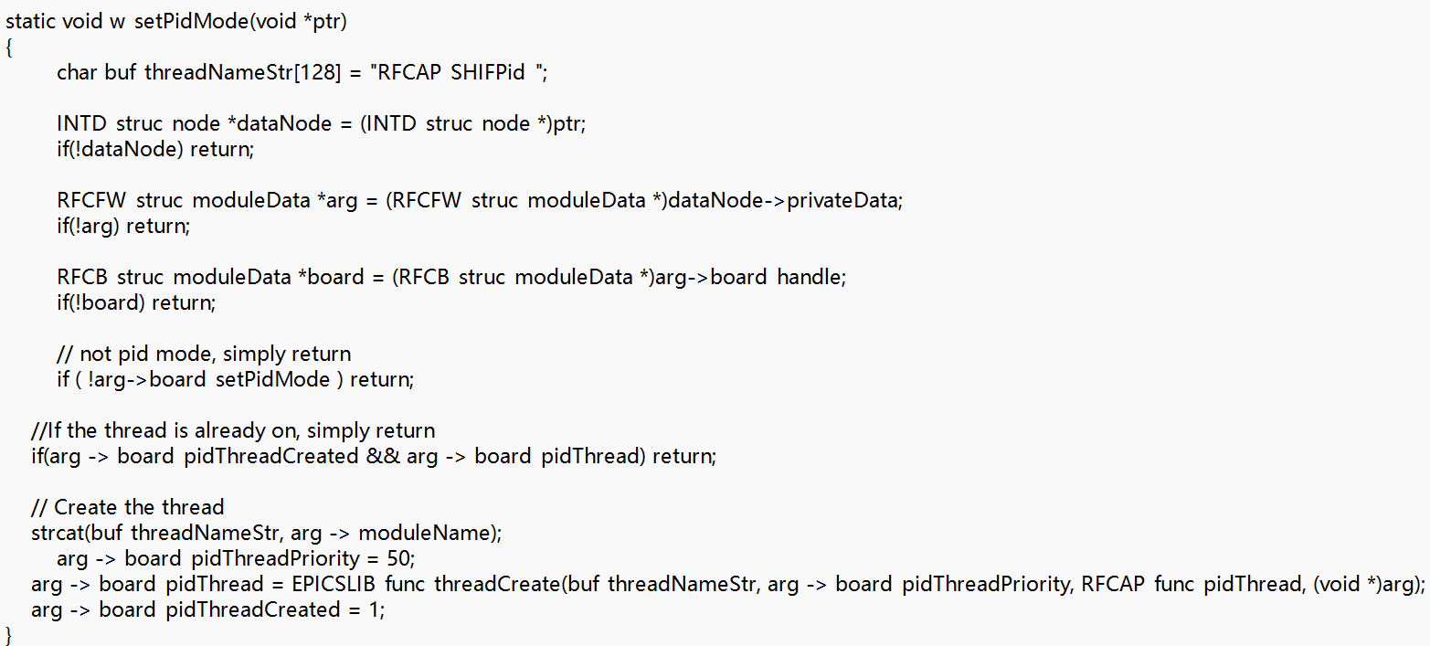
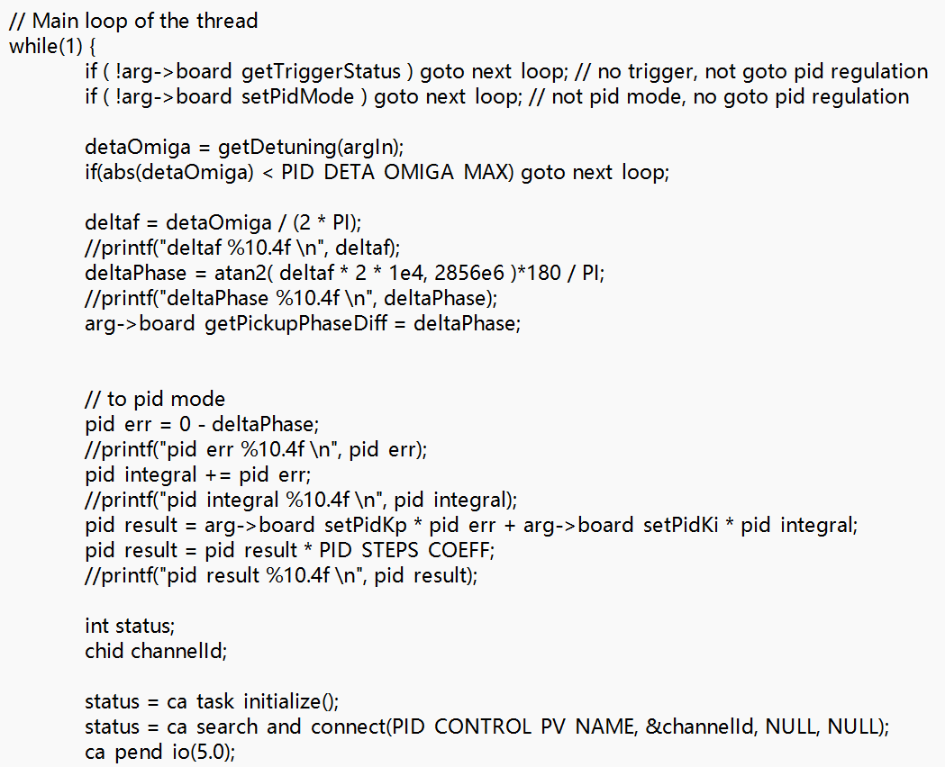
Two-Stage PI Closed-Loop Control
"Slow Loop" running on CPU
Addressing RF Cavity Detuning
"Fast Loop" running on FPGA
Direct I/Q vector control for real-time RF field stabilization
Notes:
The amplitude and phase stability of the VM signal generated by the LLRF system are relatively poor in open-loop control mode, as it is susceptible to environmental factors (e.g., temperature, humidity) and internal equipment noise.
We introduced drift and jitter in the simulation to emulate real-world conditions.
The resonant frequency drift is converted into a phase drift slope, which is computed by the CPU to adjust the water-cooling temperature for fine-tuning the cavity dimensions, thereby achieving resonant frequency tunning.

Slide 13
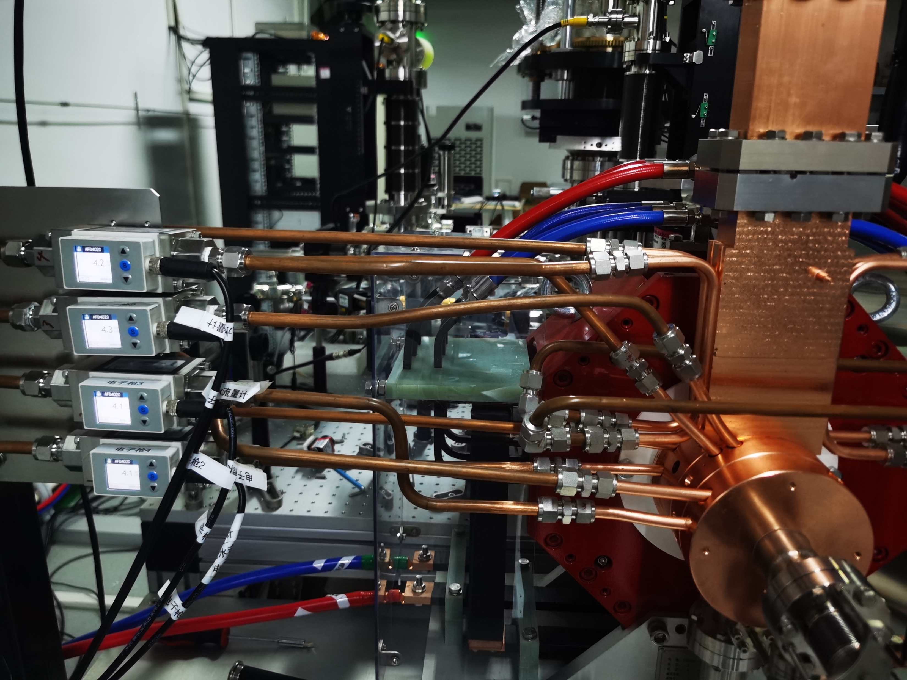
Two-Stage PI Closed-Loop Control
"Slow Loop" running on CPU
Address RF Cavity Detuning
The thread sleeps for 2 seconds after completing a full measurement and control cycle
"Fast Loop" running on FPGA
Direct I/Q vector control for real-time RF field stabilization
Notes:
The amplitude and phase stability of the VM signal generated by the LLRF system are relatively poor in open-loop control mode, as it is susceptible to environmental factors (e.g., temperature, humidity) and internal equipment noise.
We introduced drift and jitter in the simulation to emulate real-world conditions.
The resonant frequency drift is converted into a phase drift slope, which is computed by the CPU to adjust the water-cooling temperature for fine-tuning the cavity dimensions, thereby achieving resonant frequency tunning.

Slide 14
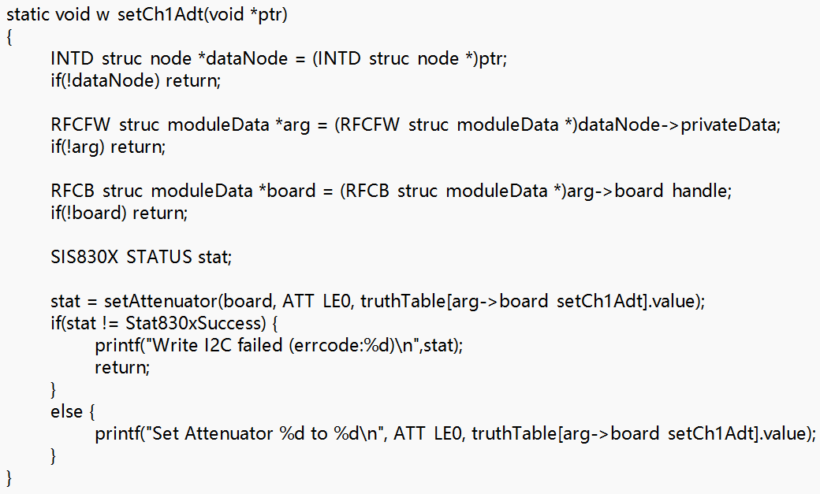
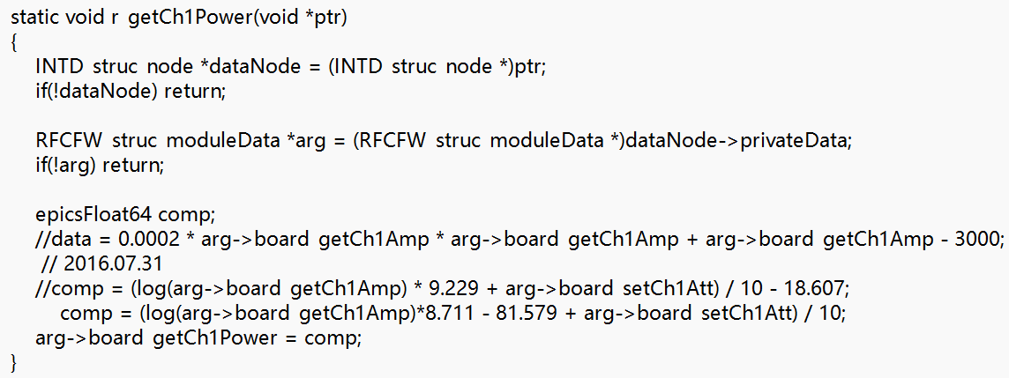
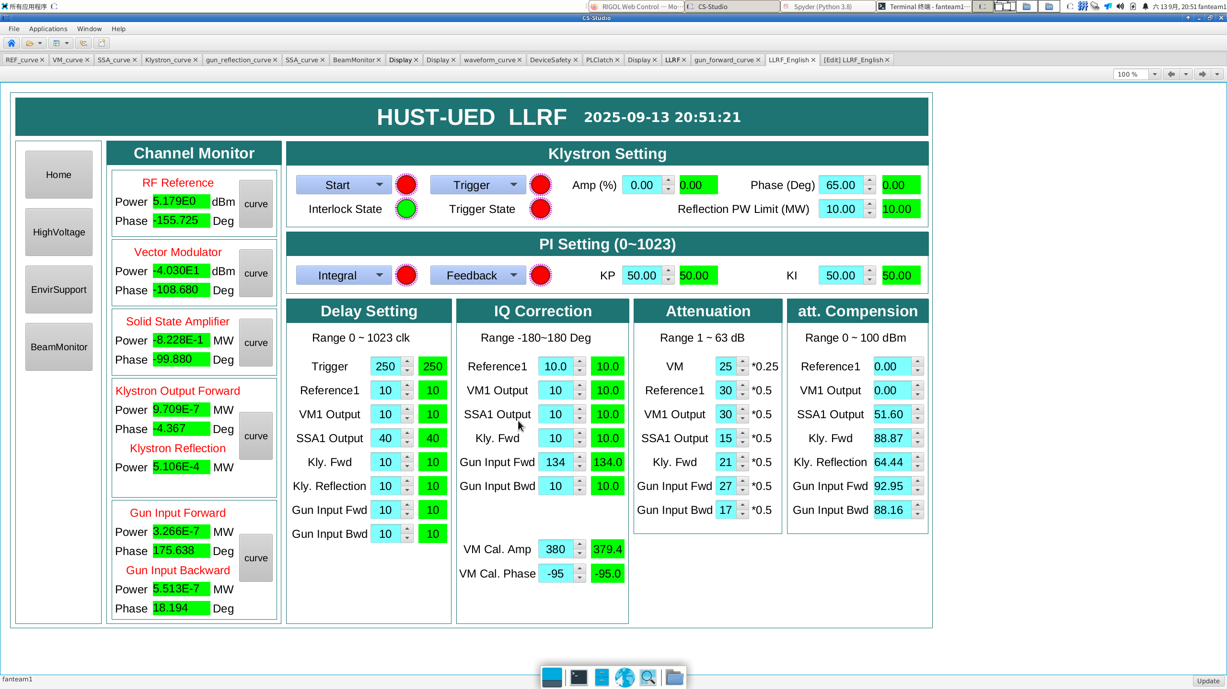
Signal Attenuation Calibration and Matching
Digital attenuation
Logarithmic detector
Provides accurate mathematical basis for real-time power feedback and closed-loop control
Digital attenuation limits all channels to within input range
Digital attenuation
Attenuation compensation
Real-time attenuation compensation with embedded algorithms
Notes:
The three-stage attenuation link, composed of a directional coupler, RF Cable, and attenuator, acquires RF signals.

Slide 15
3
Laser-RF Synchronization
Notes:
接下来我将分为5个部分进行汇报

Slide 16
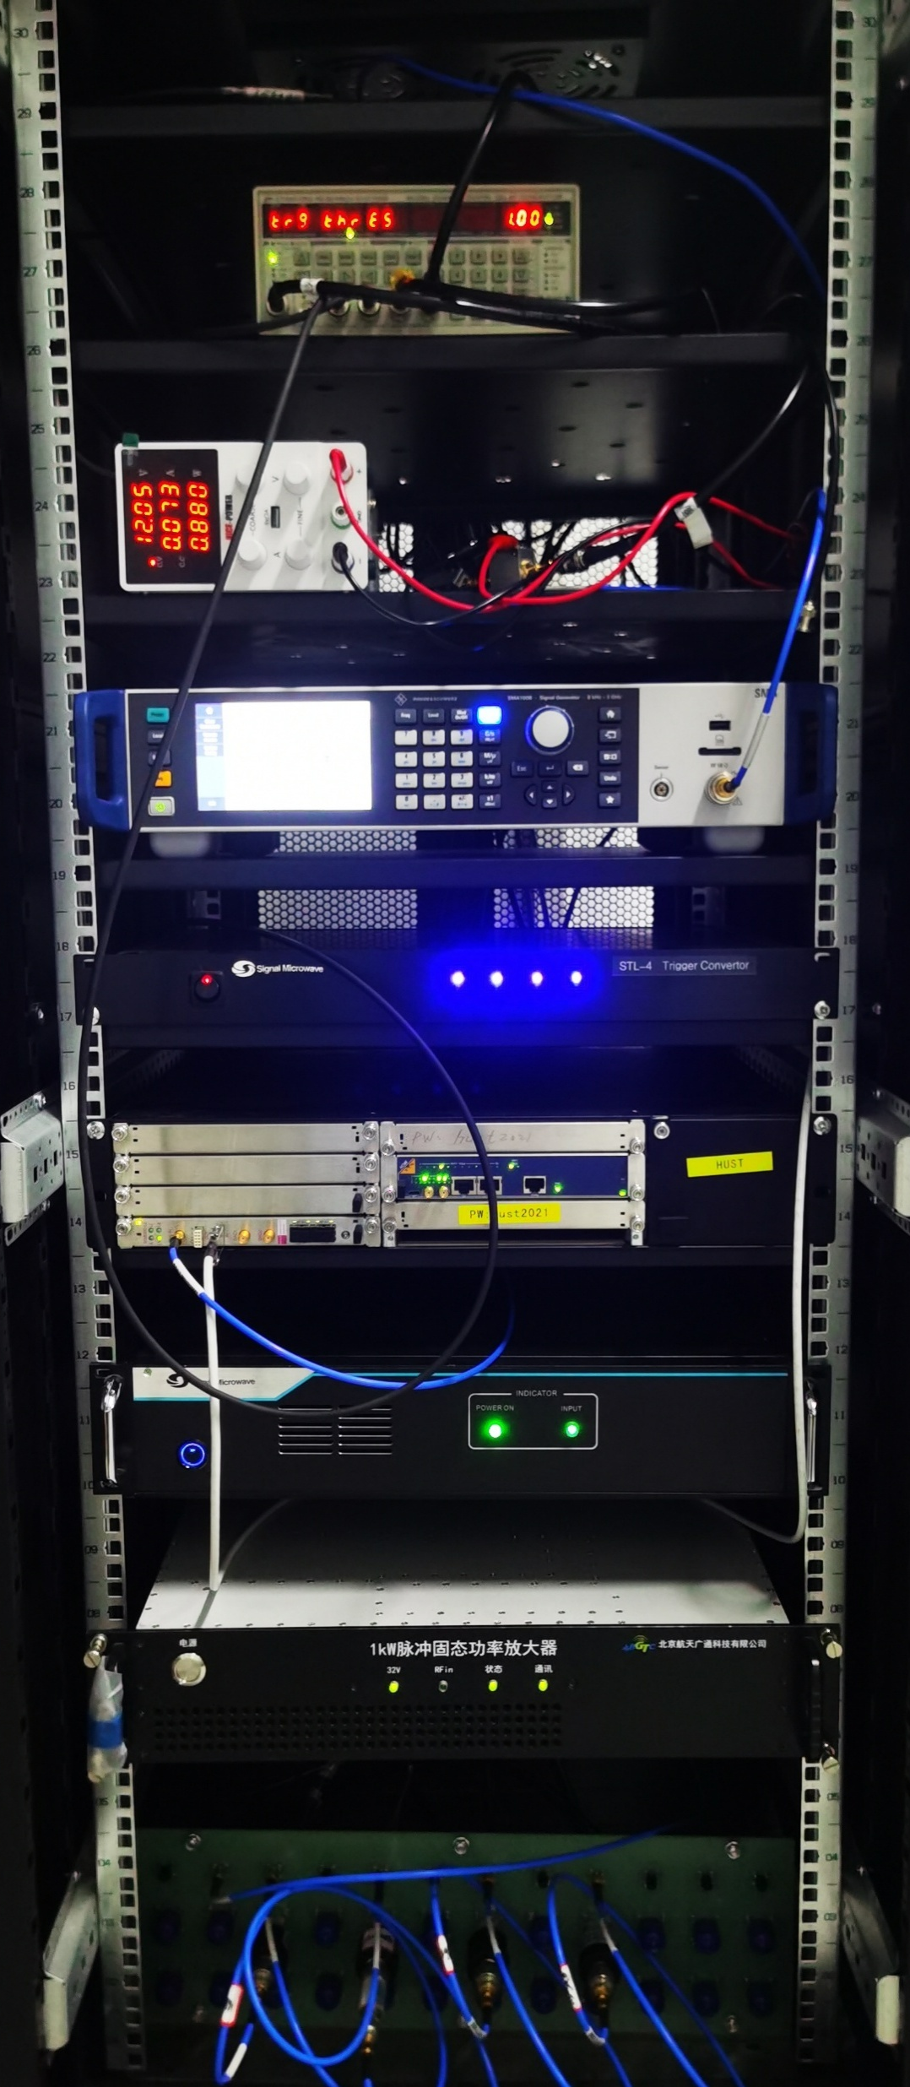
HUST-UED Laser-RF Synchronization
Laser-RF System Signal Connection
HUST-UED LLRF Rack
Laser System
DG645
1/36 Frequency
Divider
Signal Source
RF System
LLRF System
Trigger Transition
Low-level chassis
Clock & local oscillator
Laser Phase
RF Phase
Solid-State
Amplifier
RF Front-End
Notes:
The laser pulse must be synchronized to irradiate the photocathode precisely when the RF field in the accelerating cavity reaches the optimal injection phase. This enables the electron beam to achieve higher acceleration energy while simultaneously compressing its time-of-flight (TOF) to nearly the minimum value.

Slide 17
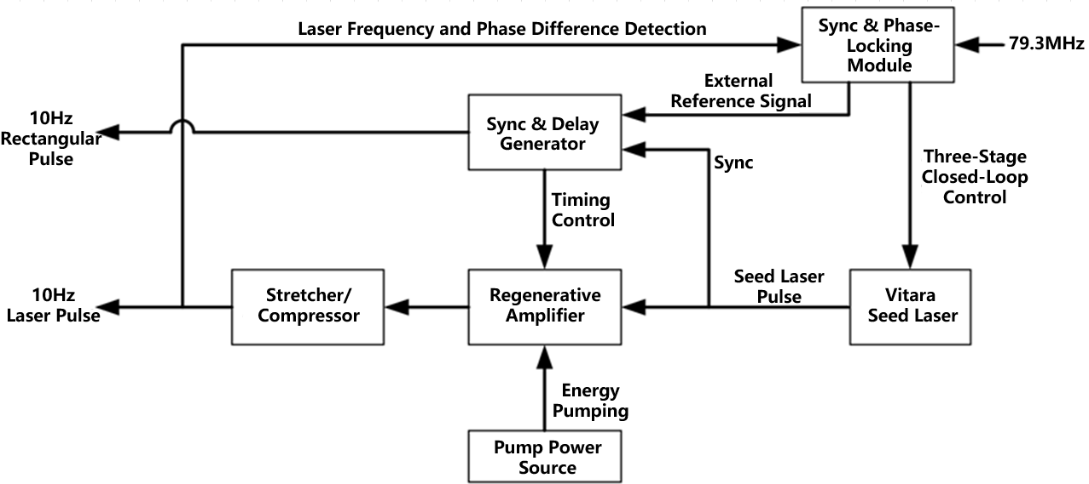
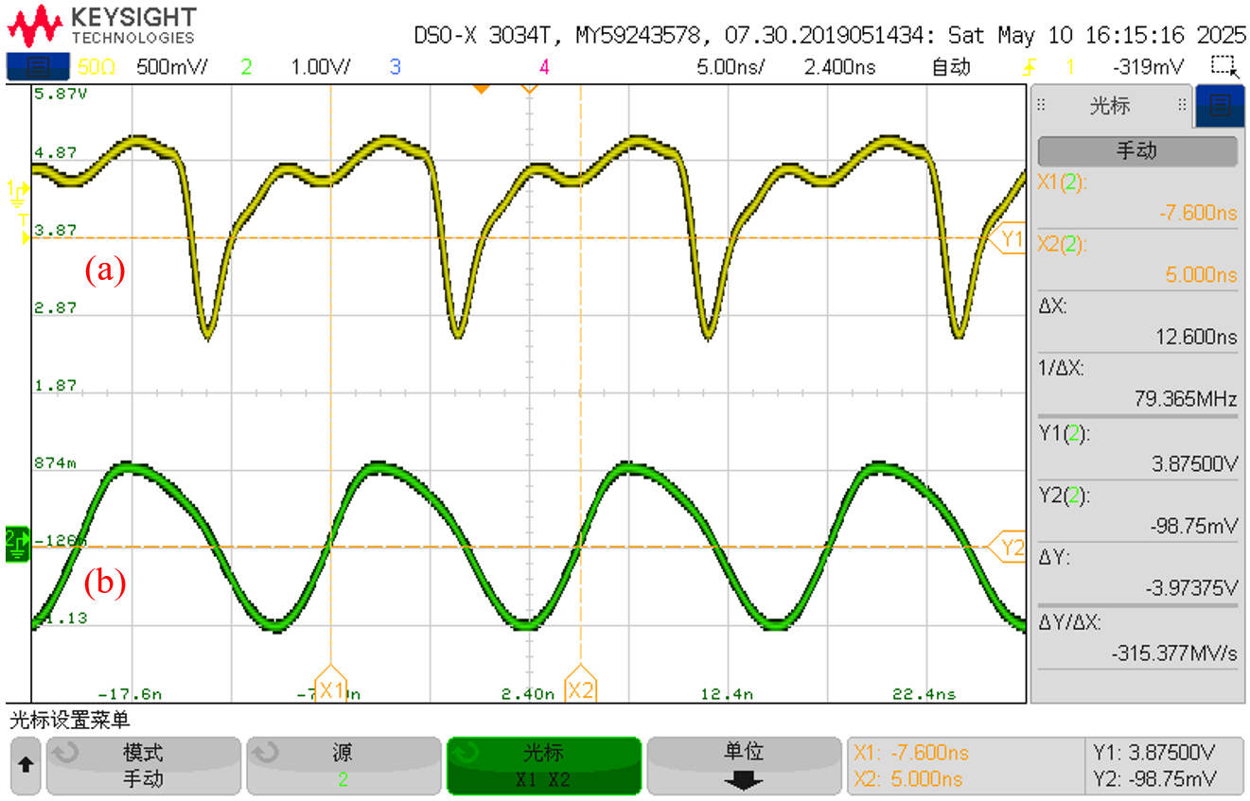
HUST-UED Laser-RF Synchronization
Laser-RF System Signal Connection
Laser System Synchronization
Use photodiode to detect the frequency and phase difference
Laser Internal Oscillator Signal
1/36 Frequency Division Signal
Notes:
A 2856 MHz signal from the master oscillator's power divider output is divided by 36 to 79.3 MHz, which is then used for phase-locking with the Vitara seed source inside the laser system. This signal achieves precise synchronization with the Ti:sapphire oscillator's optical pulses through a three-stage closed-loop system.

Slide 18
HUST-UED Laser-RF Synchronization
Laser-RF System Signal Connection
LLRF System Synchronization
Trigger Pulse
SSA Output
Pulse width strictly follows that of the trigger signal
Notes:
A 2856 MHz signal from the master oscillator's power divider output is divided by 36 to 79.3 MHz, which is then used for phase-locking with the Vitara seed source inside the laser system. This signal achieves precise synchronization with the Ti:sapphire oscillator's optical pulses through a three-stage closed-loop system.

Slide 19
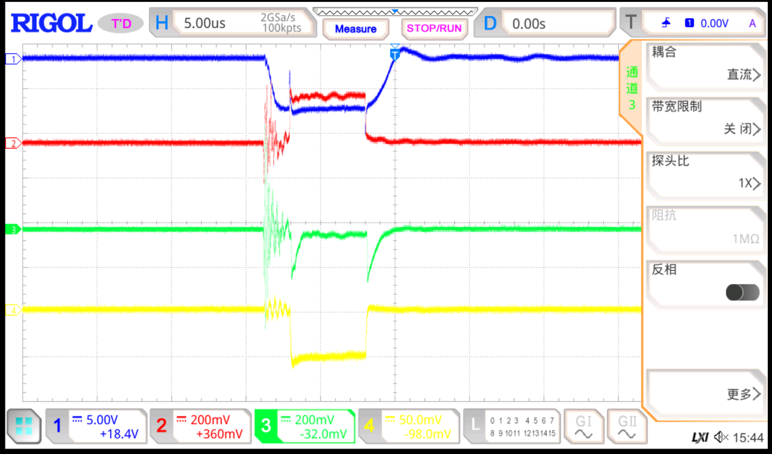
HUST-UED Laser-RF Synchronization
Laser-RF System Signal Connection
Laser-RF Synchronization
Laser
RF gun
RF System Synchronization
Meet the waveform requirements for the input RF power
Modulator
Klystron
Circulator
RF gun input
Notes:
The pulse width of the output trigger signal from the DG645 delay generator is adjusted.
The output signal waveform precisely follows variations in the trigger pulse width while maintaining high temporal synchronization.

Slide 20
4
Experimental Results
Notes:
接下来我将分为5个部分进行汇报

Slide 21
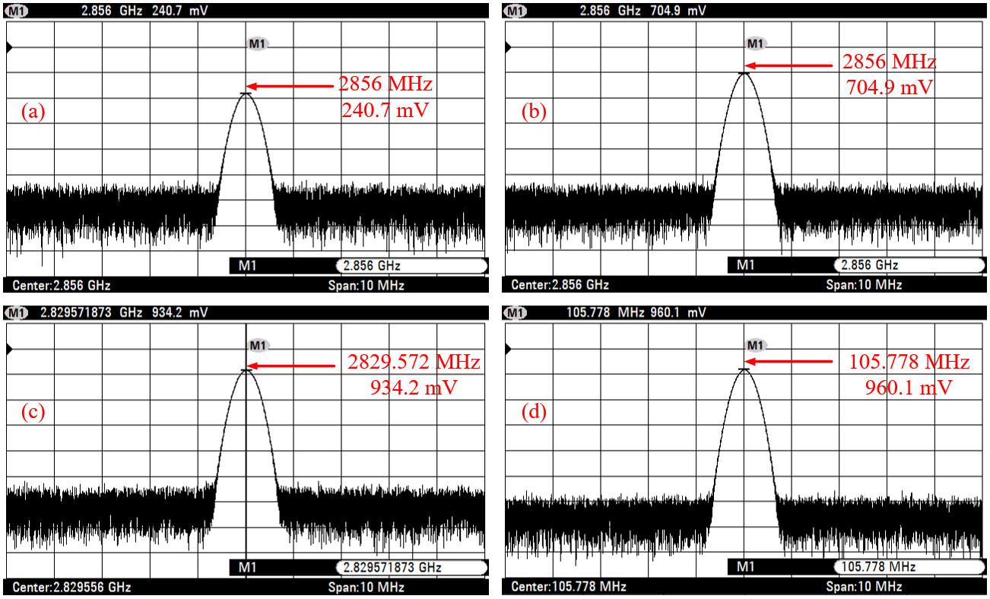
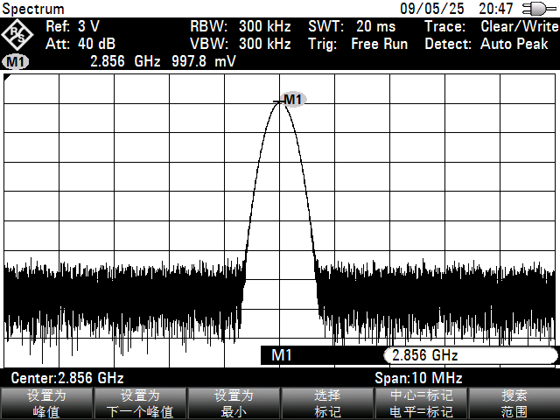
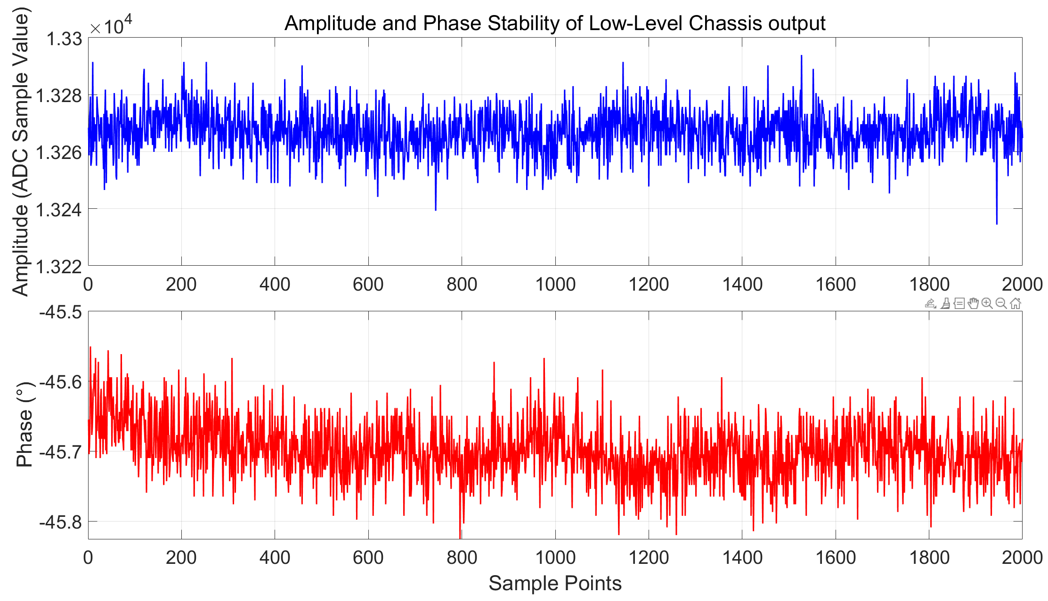
Low-Level Chassis Test Results
Input Test
Output Test
Output signal frequency of the low-level chassis is 2856 MHz, maintaining consistency with the REF signal.
RMS Amplitude Stability
0.0513 %
Input Signal
LO Signal
REF Signal
CLK Signal
RMS Phase Stability
0.0375°
Input signals of the low-level chassis meet both the frequency requirements and the power constraints

Slide 22
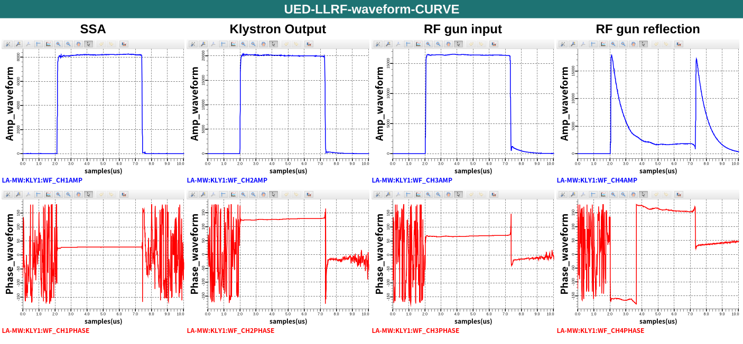
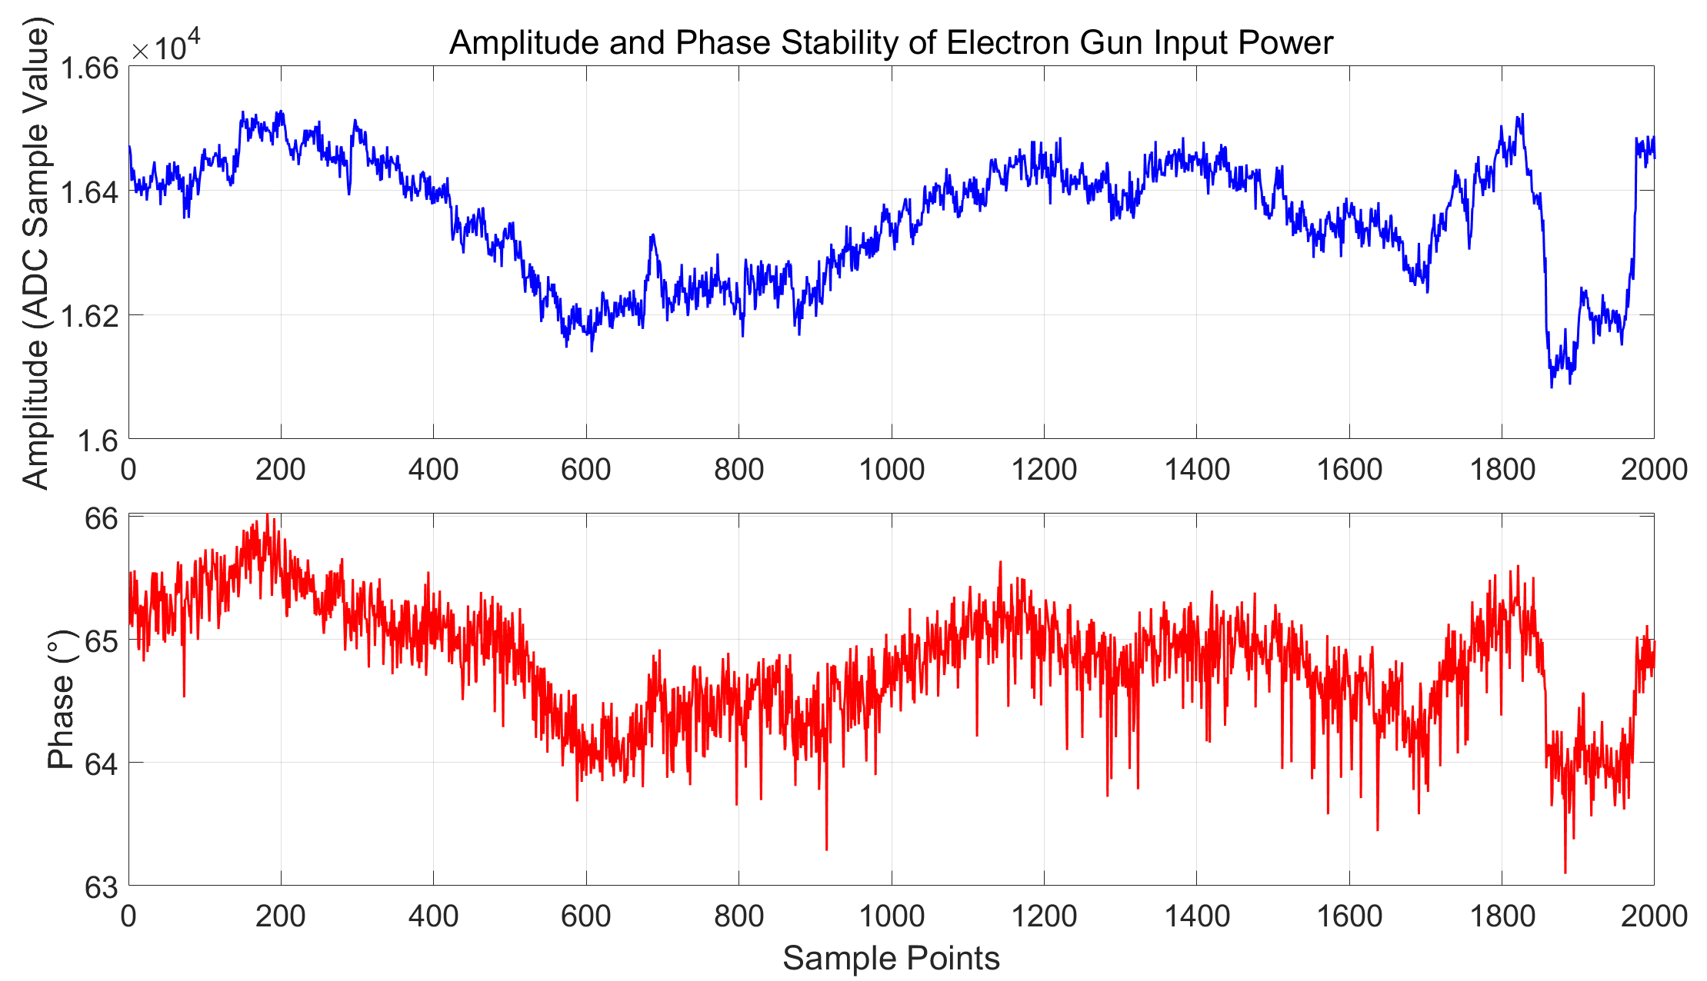
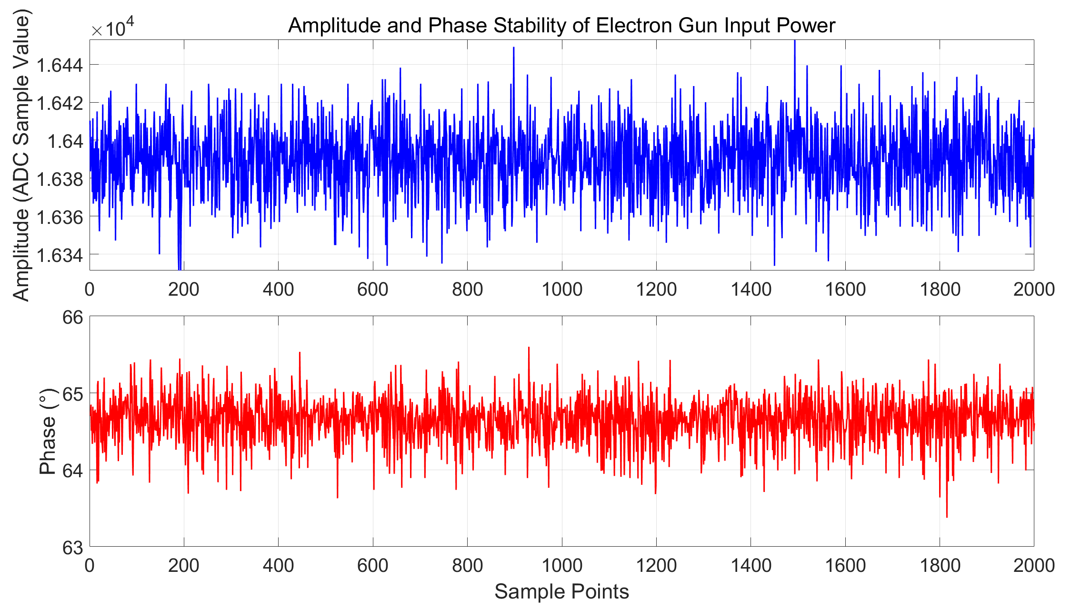
HUST-UED Experimental Test Results
Amplitude and Phase Waveform Detection
Test Signal RMS Stability
Test signal | RMS Amplitude Stability | RMS Phase Stability
VM | 0.0513 % | 0.0375°
Klystron | 0.4866 % | 0.2981°
Open-Loop Input | 0.5007% | 0.2806°
Close-Loop Input | 0.0895 % | 0.1349°
Open-Loop
Close-Loop
Closed-loop control significantly improves RF power stability, thus stabilizing the accelerating field
Notes:
The fed power is largely absorbed by the electron gun and is subsequently released after the feeding process is completed.

Slide 23
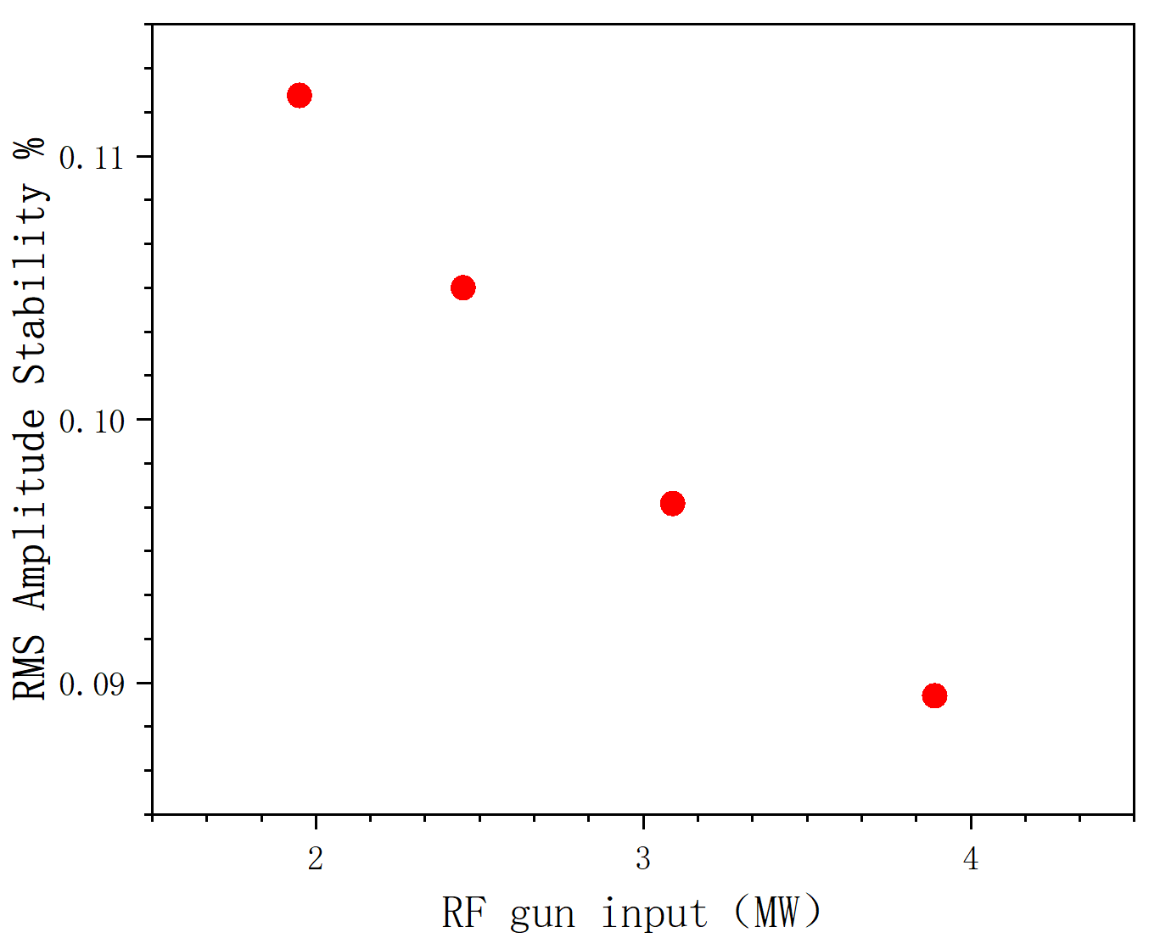
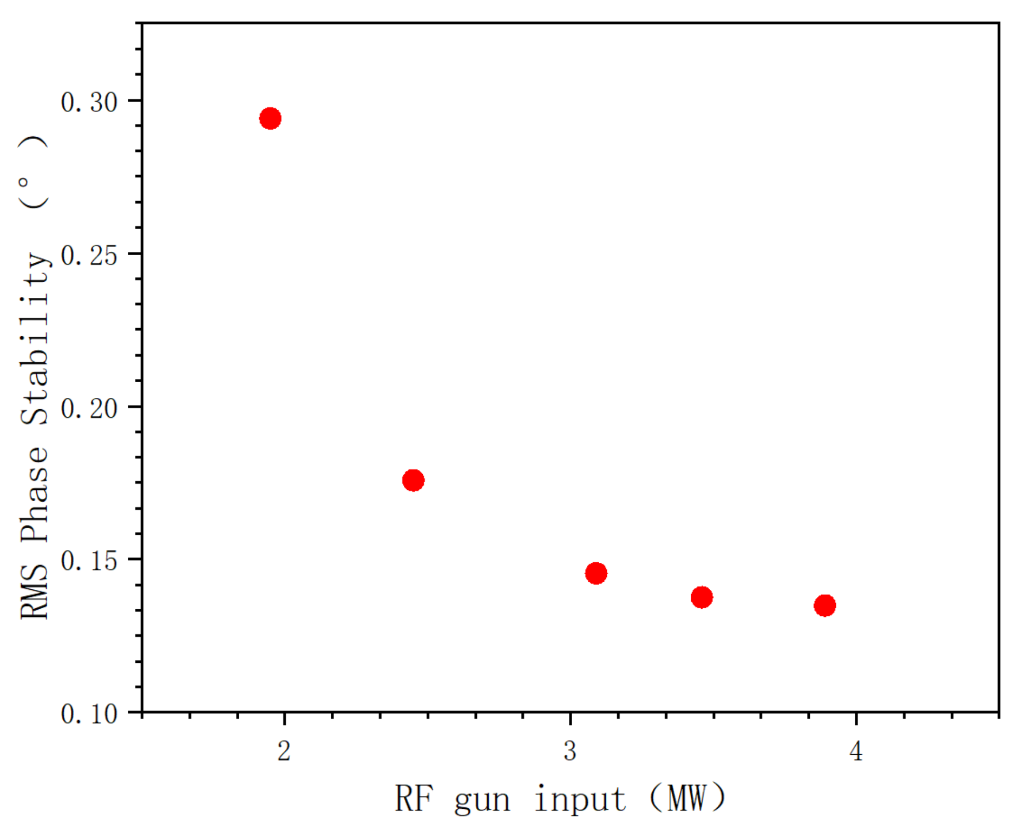
HUST-UED Experimental Test Results
Amplitude and Phase Waveform Detection
Test Signal RMS Stability
Amp Stability
Phase Stability
As the input power increases, the RMS signal stability improves
Notes:
Root Mean Square

Slide 24
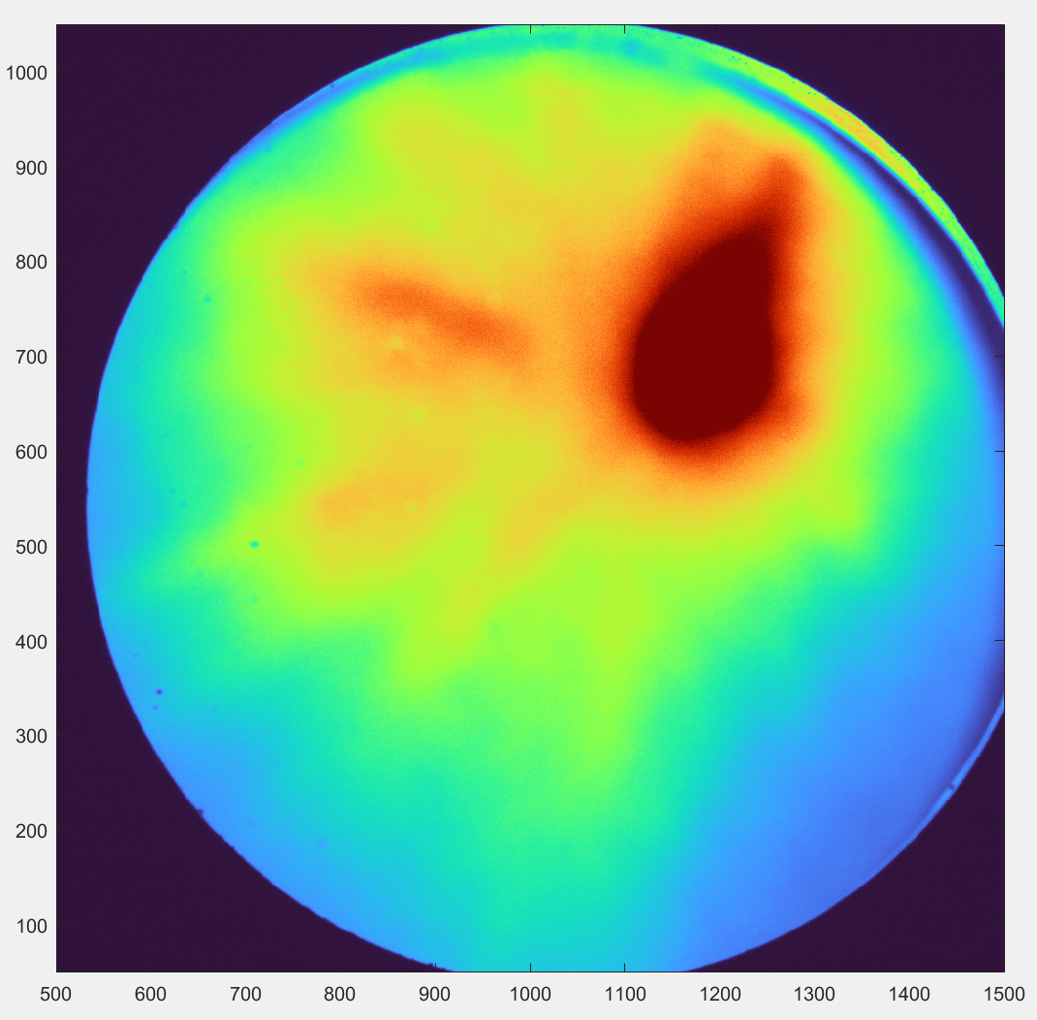
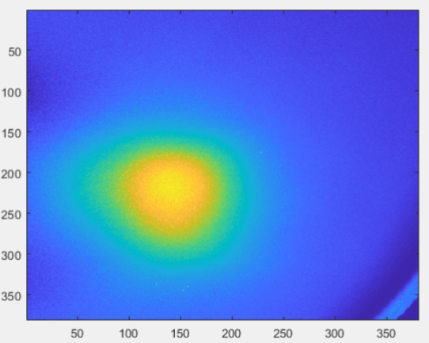
HUST-UED Experimental Test Results
Amplitude and Phase Waveform Detection
Dark Current Observation
Main Current Observation
The electron beam focused by the solenoid coil can be observed on the fluorescent screen

Slide 25
5
Summary
Notes:
接下来我将分为5个部分进行汇报

Slide 26
Summary
High-precision and high-stability LLRF control system developed for HUST-UED
LLRF system employs an MTCA architecture
Integrate RF front-end and digital processing modules
Enable RF signal acquisition, processing, and closed-loop feedback control
Output signal amplitude and phase exhibit high stability
Meet electron beam commissioning requirements！

Slide 27
THANKS FOR YOUR LISTENING

