Slide 1
The Design of Timing System for the S³FEL
Liu Ting(刘婷)
2025.09.16
Institute of Advanced Light Source Facilities, Shenzhen
Notes:
My name is Liu Ting, from the Institute of Advanced Light Source Facilities in Shenzhen.
I will present the design of the timing system for the S³FEL.

Slide 2
01
Project Introduction
02
Timing system
CONTENTS
03
Fast Protection Based on Timing
04
Timestamp Based on Timing
05
Summary
Notes:
The presentation will cover the project introduction, timing system, fast protection & timestamp Based on Timing, and a summary

Slide 3
01
Project Introduction
Notes:
Part one, Project Introduction

Slide 4

Project Introduction
Shenzhen superconducting soft-X-ray free electron laser(S³FEL)
Parameter | Value
beam energy/ GeV | 2.5
Length / m | 1700
wavelength/ nm | 1-30
Repetition rate / MHz | 1
emittance/ mm-mrad | 0.5
MHz repetition-rate soft X-ray FEL
Injector
LTU
SRF LINAC
Undulator
BL
ES
Notes:
S³FEL is a superconducting soft-X-ray free electron laser facility.
Key Parameter: Length 1700 meters, Repetition rate 1Megahertz (/ˈmeɡəhɜːrts/ )
It consists of Injector, SRF LINAC, LTU, Undulator ,Beamline and End station

Slide 5
Project Introduction
Application of MTCA Architecture in the S³FEL Project: LLRF, BPM,Timing system
System type | Name | Equipment functions
Timing System | Event Generation (EVG) | Generate events
 | Event Receiver (EVR) | Receive events
LLRF | Microwave Low-Level RF controller (LLRF) | Microwave signal acquisition and control
BPM | Stripe beam position monitoring (SBPM) | Beam position monitoring
 | Cavity beam position monitoring (CBPM) | Beam position monitoring
 | Beam Charge Monitoring (ICT) | Beam charge monitoring
 | Beam Loss Monitoring (BLM) | Beam loss position monitoring
Notes:
The facility adopts the MTCA architecture for key systems such as LLRF, BPM, and the timing system，as shown in the table

Slide 6
02
Timing system

Slide 7
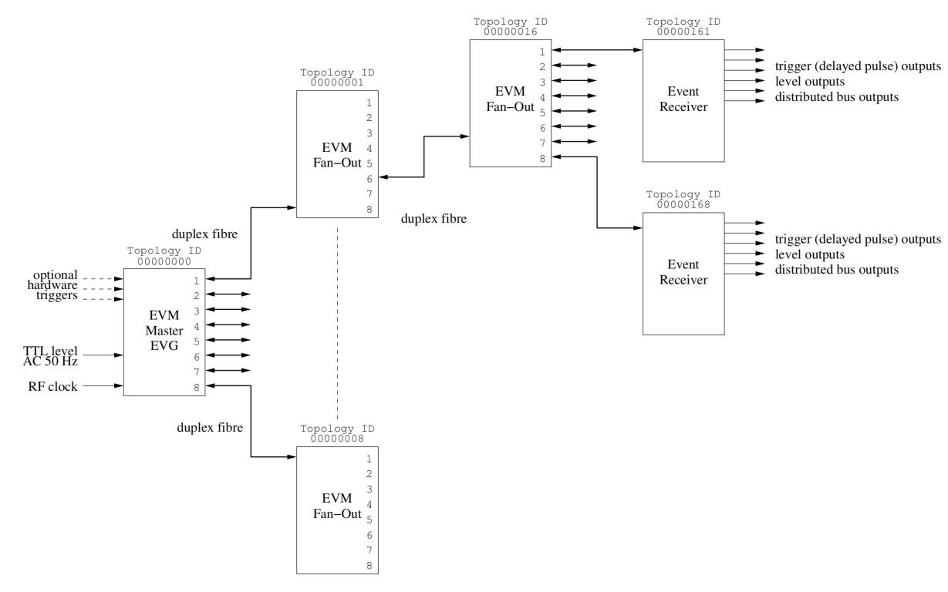
Event Timing System Architecture
Timing System：distributing trigger signals for gun,SSA,LLRF,BI system,power supply ,etc
Event Timing System
Event Generator (EVG/EVM): Broadcasts event codes via fiber optic
Event Receiver, EVR：receive the event and react to it by generating a pulse.
The timing network topology is tree based.
Different sub-nodes can be connected: event receivers (EVO-EVR, EVE, or PLC-EVR), fanouts (EVO-FOUT)
Event Timing System
Notes:
Timing System distribute trigger signals for gun,SSA,LLRF,BI system,power supply ,etc
The system uses a tree-based network with an Event Generator (EVG) broadcasting event codes via fiber. Event Receivers (EVRs) decode these codes to generate triggers. Sub-nodes include EVR, FOUT, and PLC-EVR modules."

Slide 8
S³FEL Timing Requirements
Requirements
~1200 trigger channels
Trigger jitter < 100ps
Interlock protection interface
Hardware timestamp.
  Trigger signals synchronized with 1.3GHz microwave.
  Cover distances up to 1.8km.
  Based on the MTCA architecture
System | Quantity | Jitter
LLRF | 176 | <100 ps
SSA | 176 | <1 ns
Seed Laser | 10 | <1 ns
Drive Laser | 10 | <1 ns
Laser Heater | 10 | <1 ns
CBPM | 102 | <1 ns
BBPM | 21 | <1 ns
ICT | 24 | <1 ns
BAM | 11 | <1 ns
PRF | 238 | <1 ns
SBPM | 180 | <1 ns
WS | 46 | <1 ns
Kicker Magnet | 20 | <1 ns
Beam line | 200 | <100 ps
total： | 1224
Notes:
The timing system will support oveer 1000 trigger channels with jitter below 100 picoseconds, provide interlock protection, and hardware timestamping

Slide 9
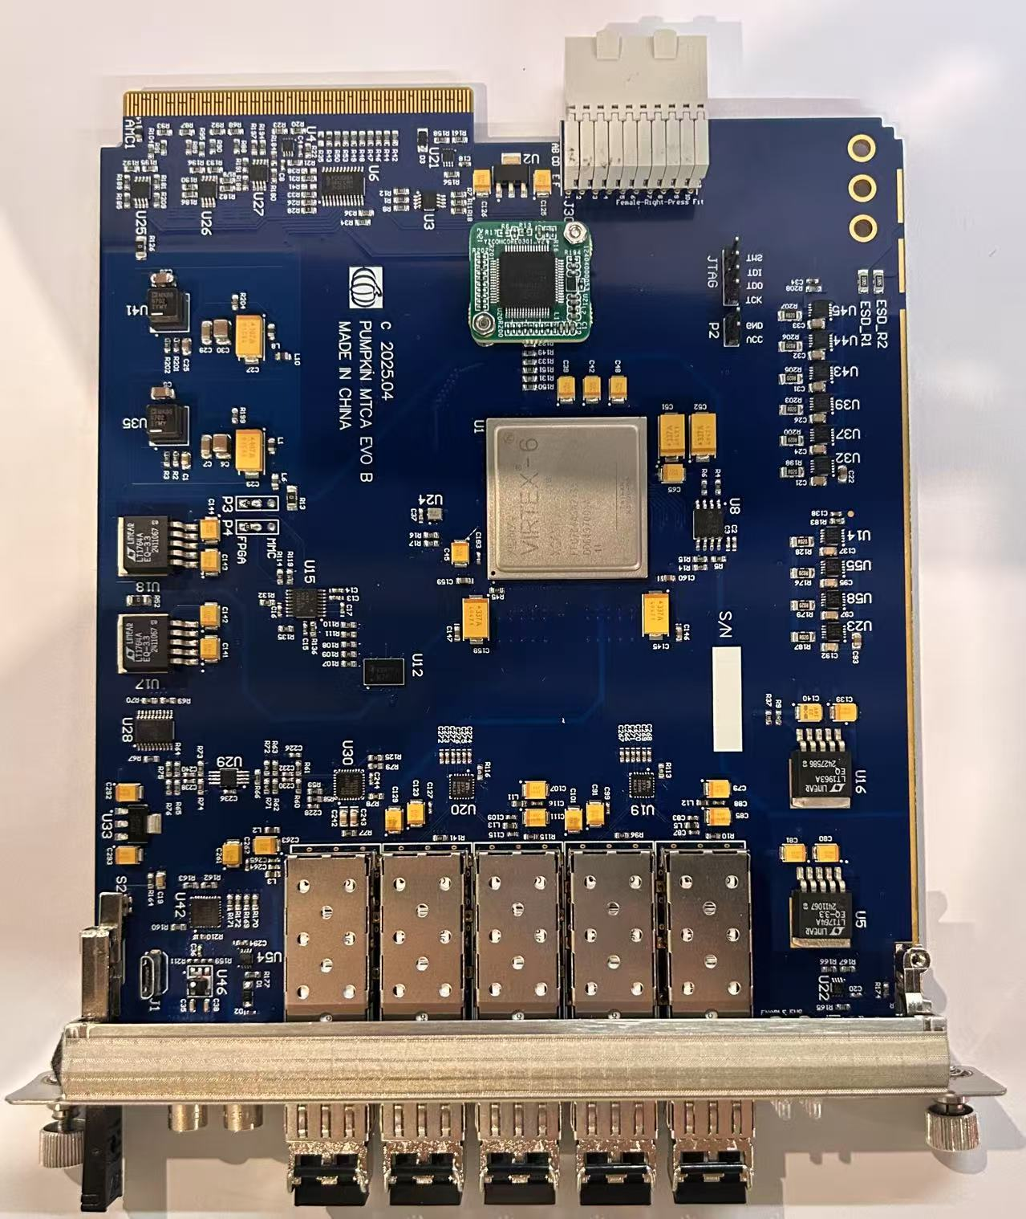
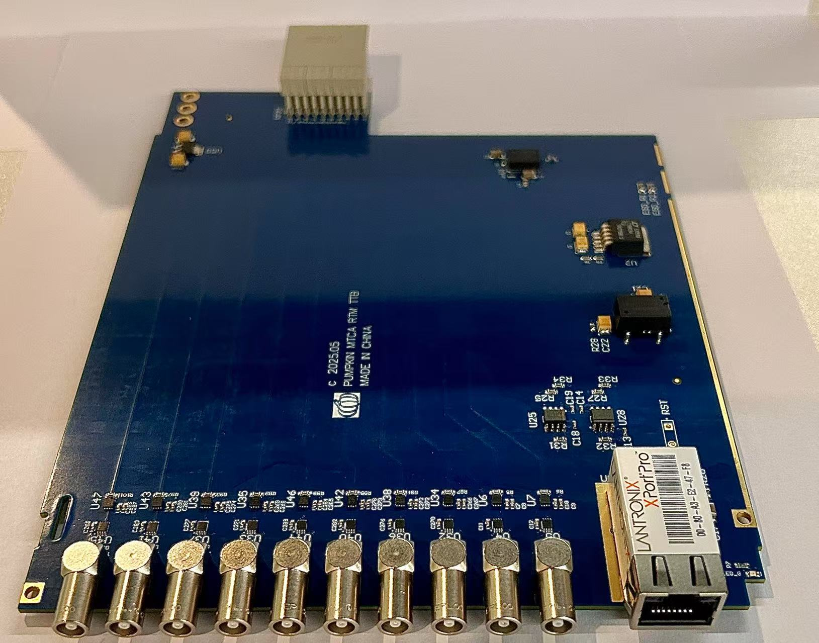
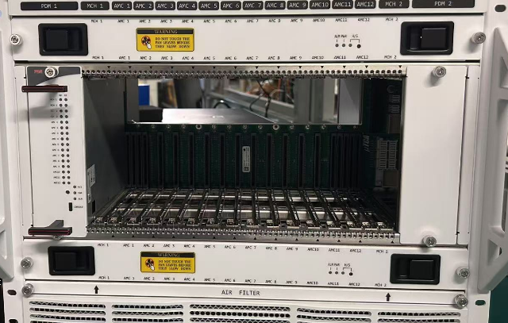
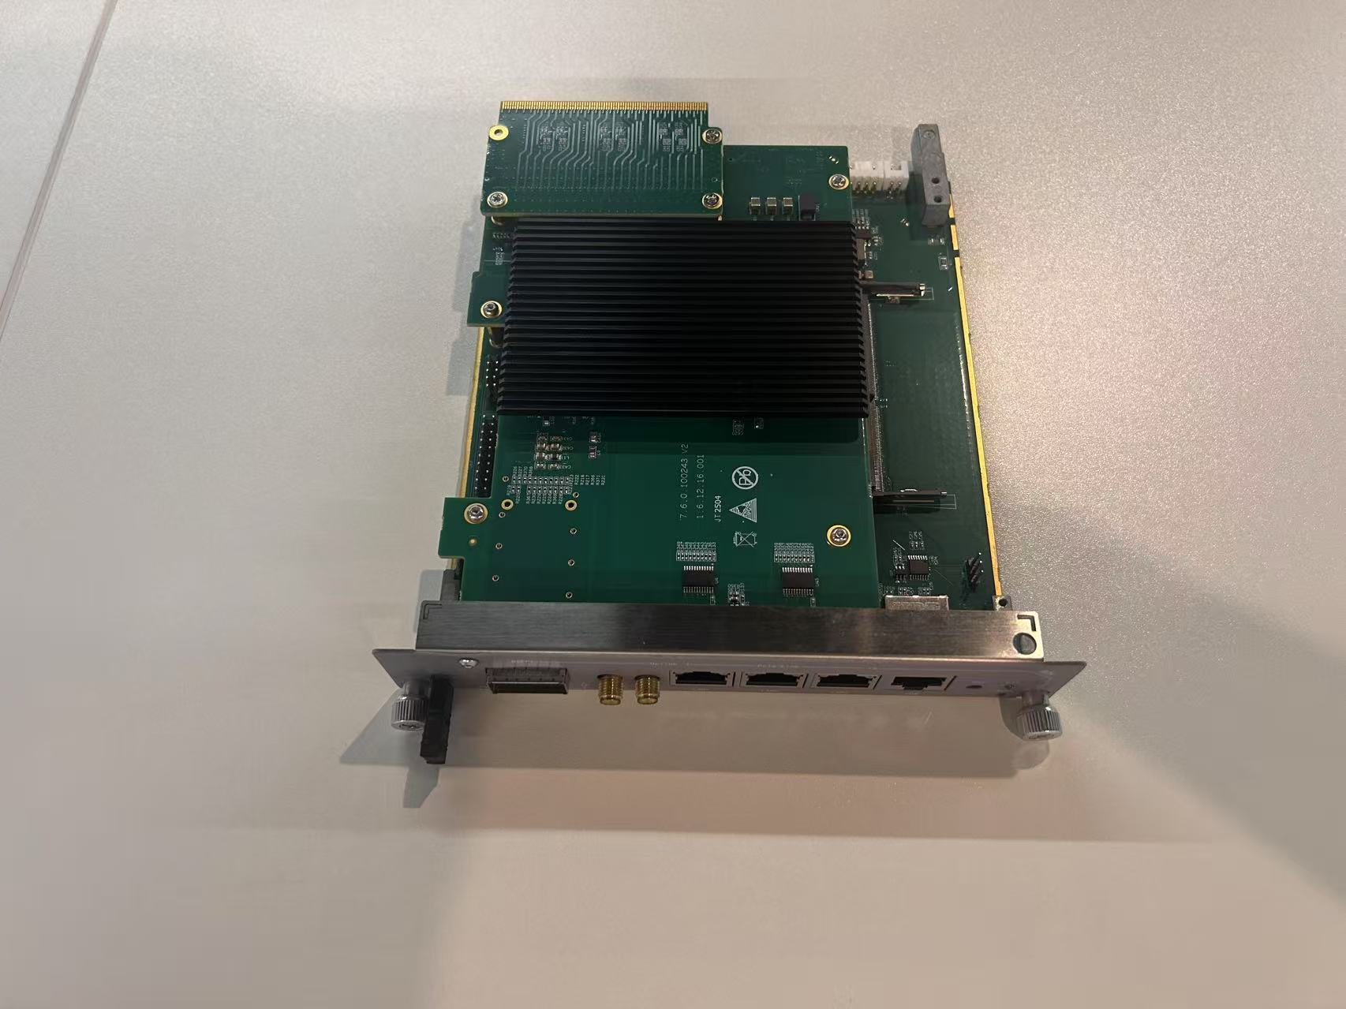
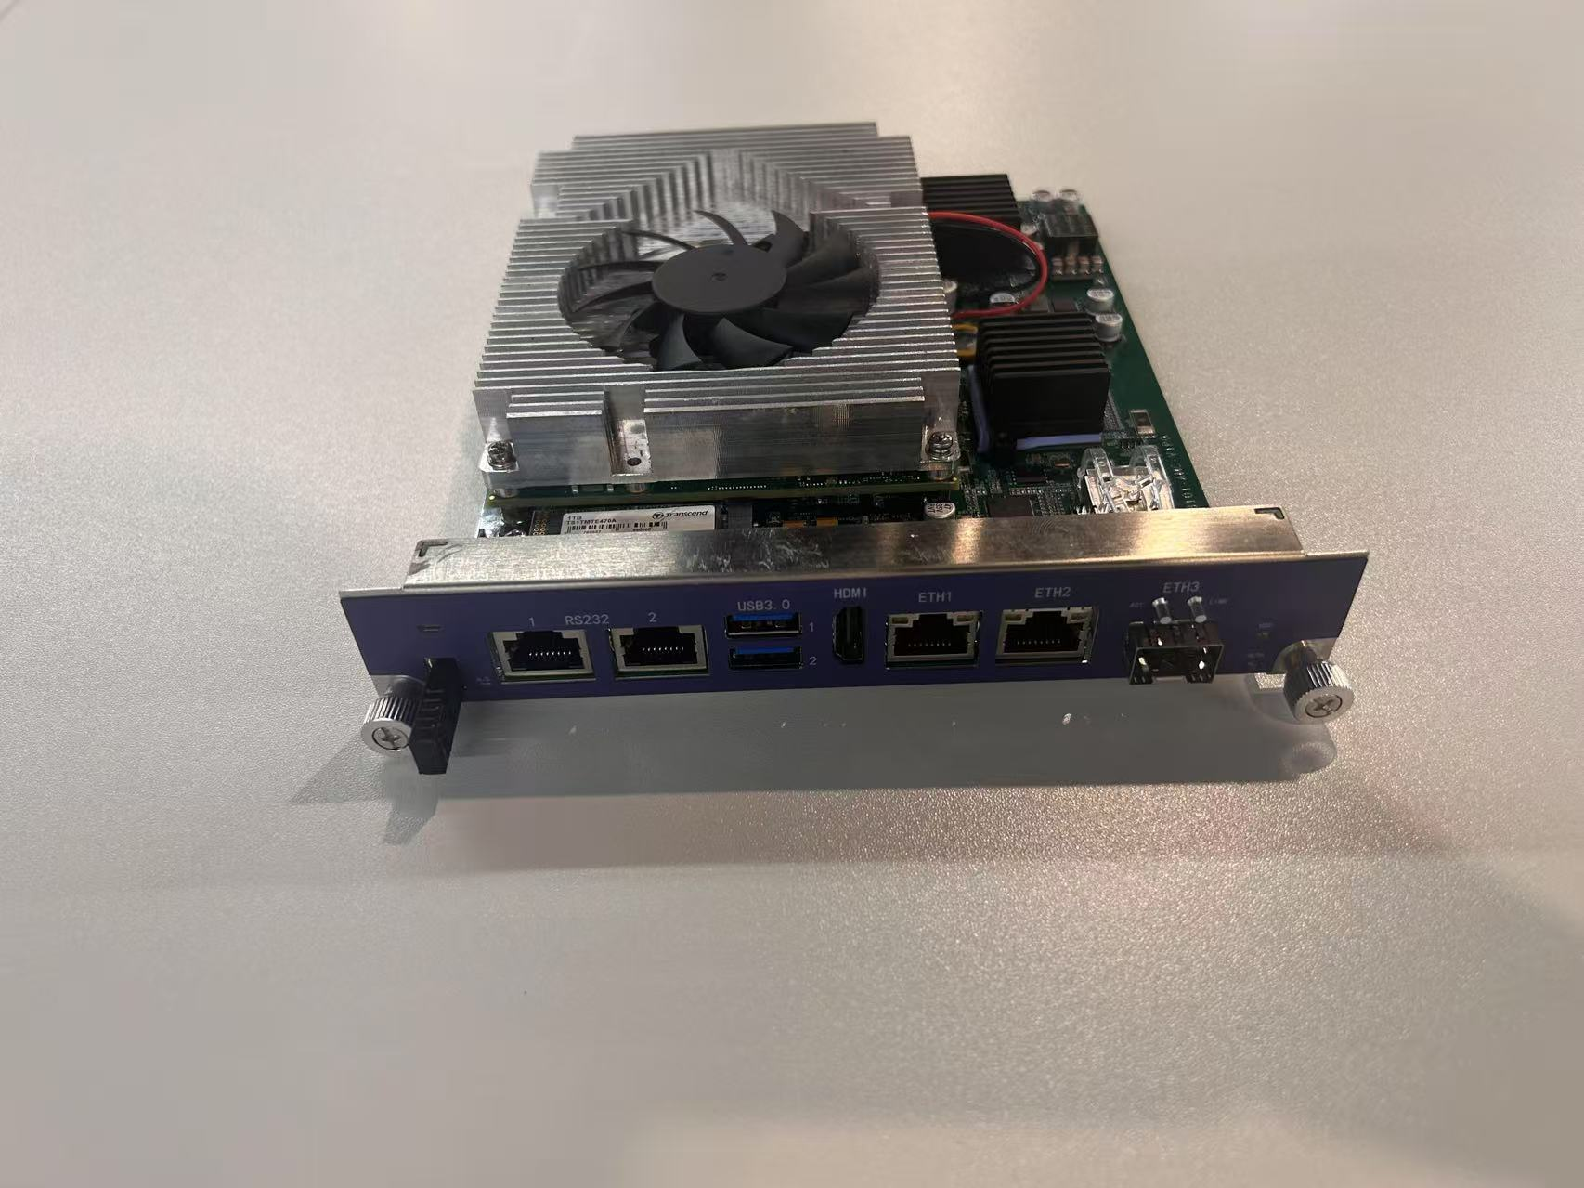
Developed MTCA Modules
Core Modules: developed MTCA-EVO / MTCA-EVR.
Key Features
  Based on MTCA.4 architecture
  Event Clock: 108.333 MHz
  EVO configurable as EVG/FOUT/EVR
  Delay: 9.2ns, Fine 5ps
  compatibility with both international and domestic MTCA crates
MTCA-EVO
MTCA-EVR
These modules form the universal MTCA platform.
Modules procured from domestic suppliers
MCH
CPU
12 Slots Crate
Notes:
As shown in the figure above：Our core modules include MTCA-EVO and MTCA-EVR, supporting event clock of 108 MHz, fine delay adjustment of 5 picoseconds.
As shown in the figure below：Modules procured from domestic suppliers，include Crate，MCH,CPU
These modules form the universal MTCA platform.

Slide 10
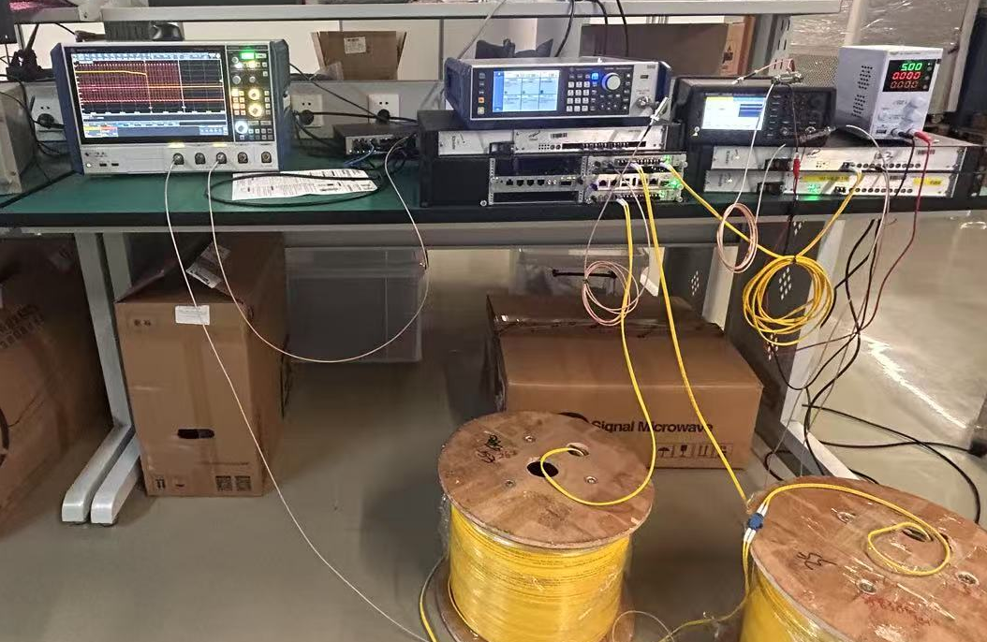
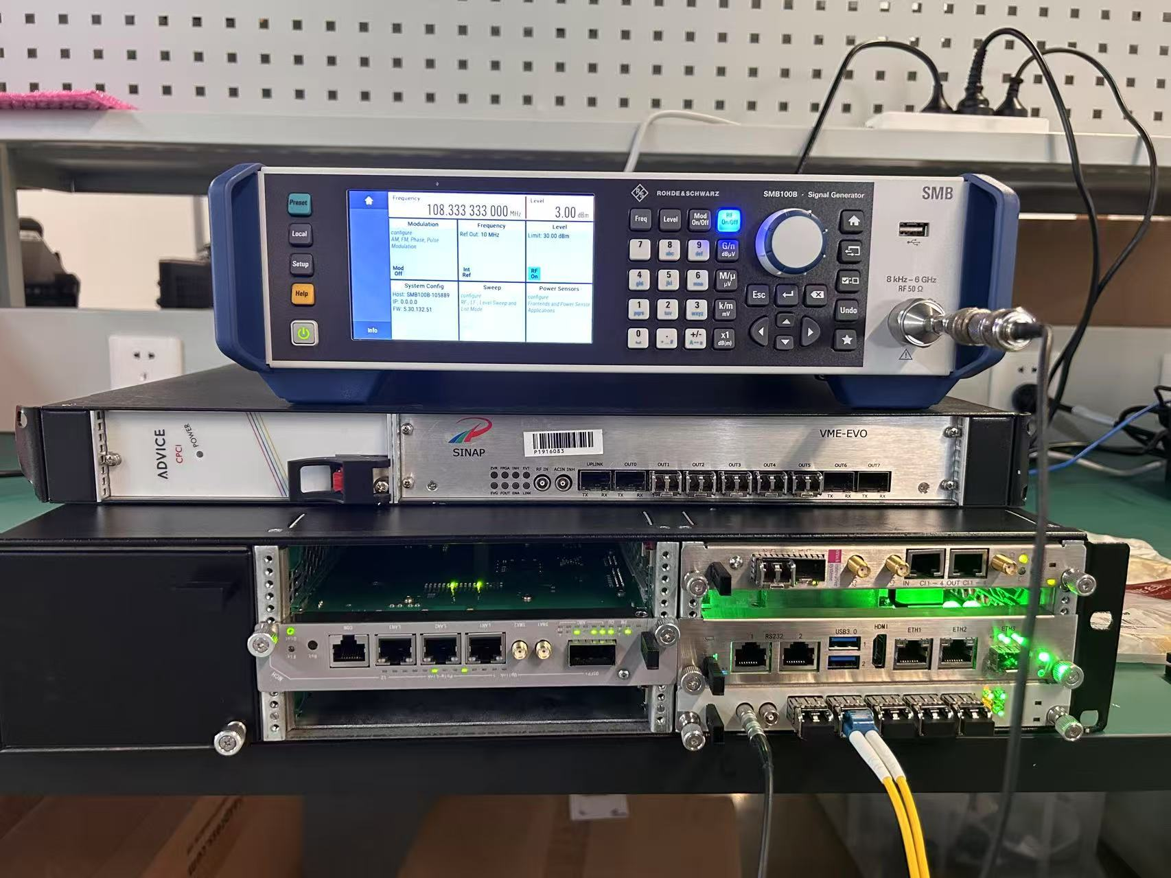
Core Timing Performance Tests of the Prototype
Oscilloscope
Fiber
Signal source
PS
MTCA Modules：
MTCA-EVG
MTCA-EVR
MCH
CPU
Timing System prototype
Prototype test platform
Oscilloscope：RS RTP044B,4GHz，40GSa/s
Signal source：RS SMB100B 8kHz-6GHz
Notes:
Core Timing Performance Tests of the Prototype

Slide 11
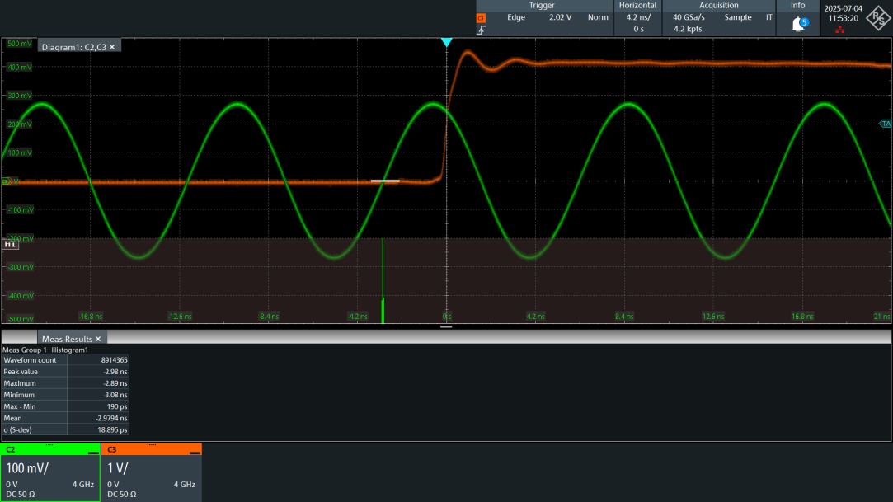
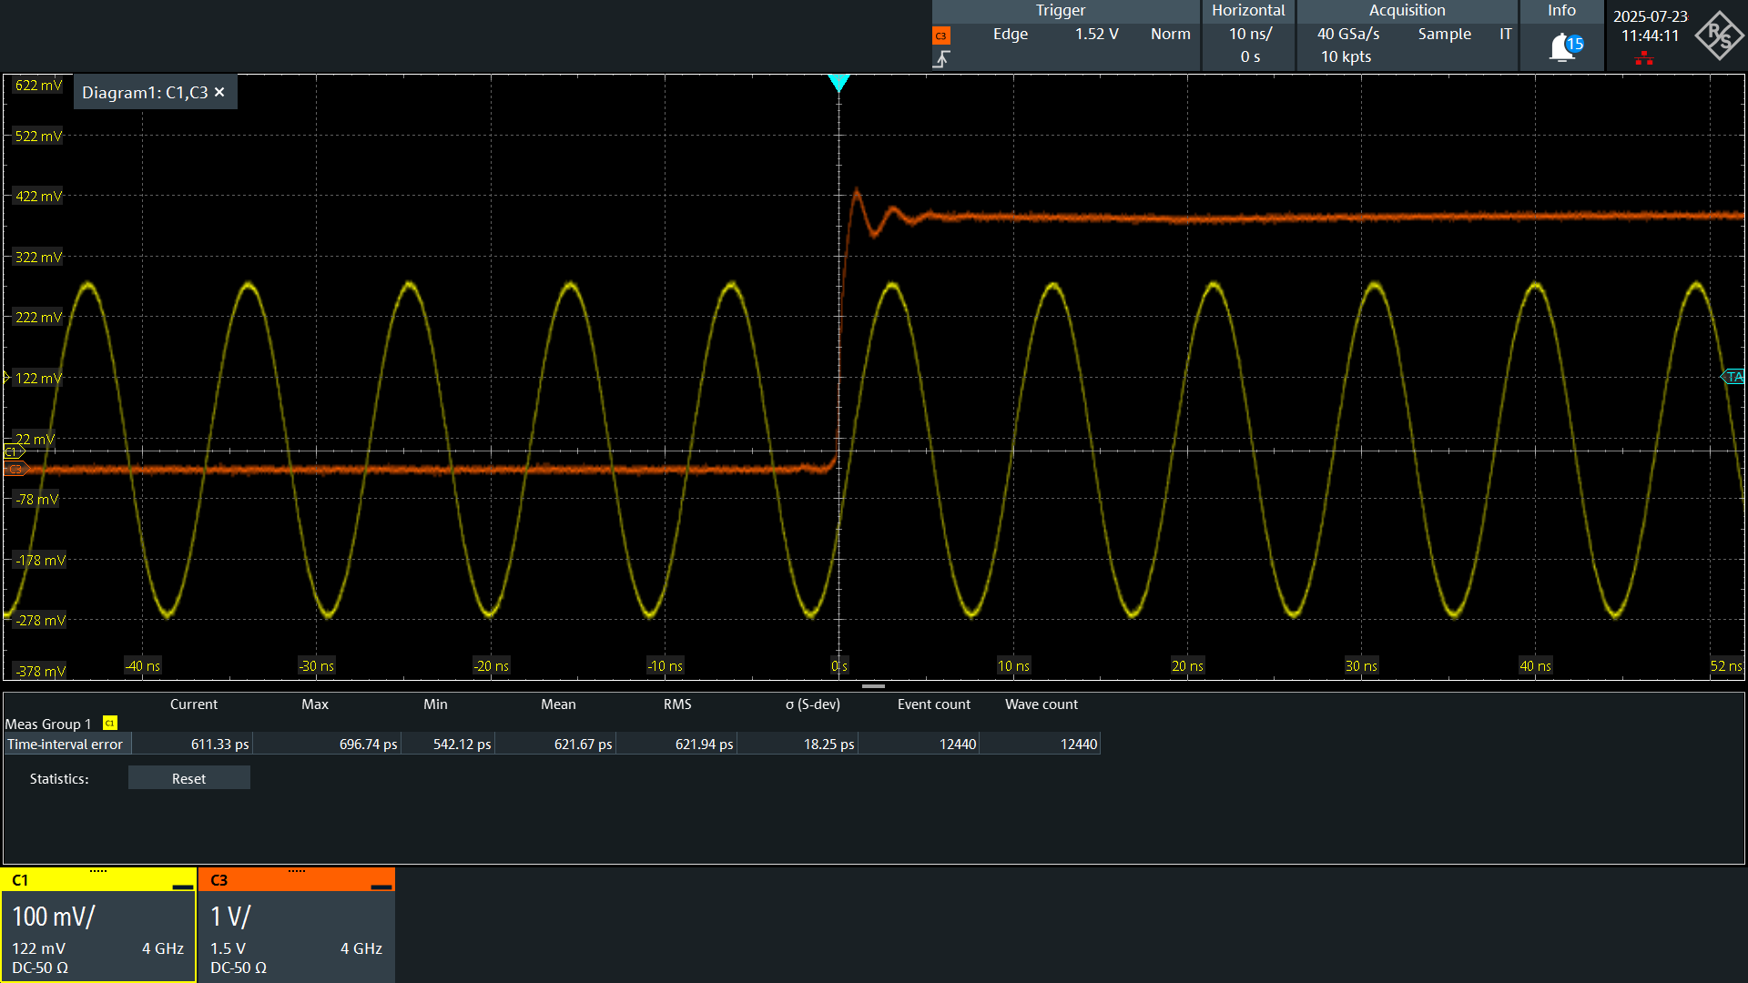
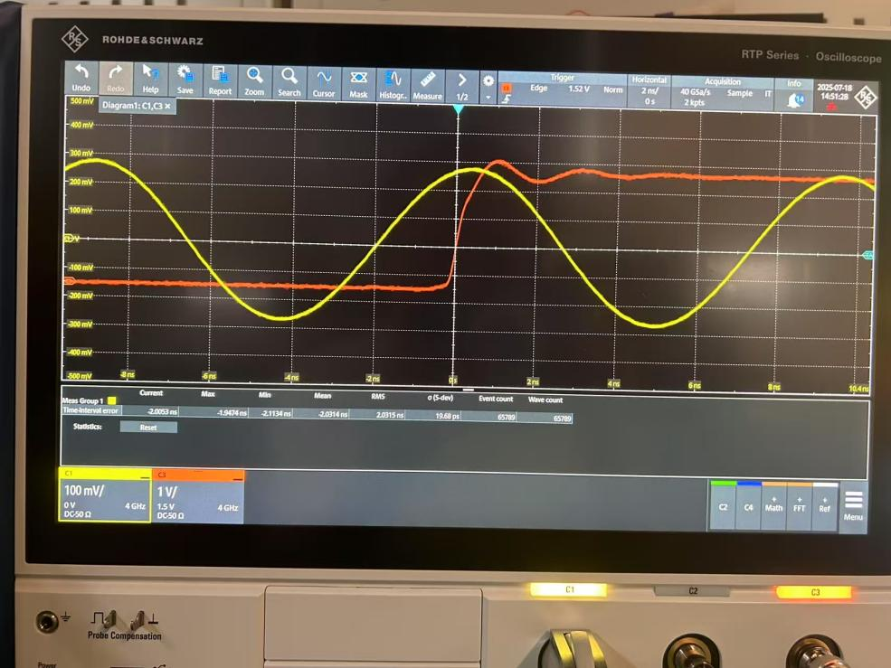
Test - Jitter
Trigger jitter test
Fiber Length: 1000m STD Jitter 18.89ps
Fiber Length: 3m STD Jitter 18.25ps
Fiber Length: 2000m STD Jitter 19.68ps
  The test results show that
    STD Jitter< 20ps
    The 2000-meters fiber optic cable supports effective data signal transmission.
    The length of the fiber has little effect on the jitter
Notes:
Jitter tests were conducted with fiber lengths from 3m to 2000m. The standard deviation of jitter remained below 20ps, demonstrating that fiber length has minimal impact on jitter."

Slide 12
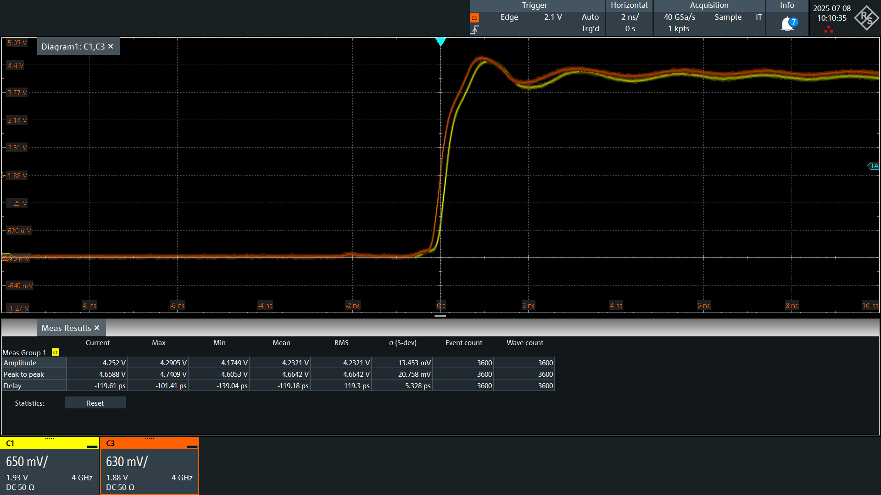
Test - Delay Adjustment
Delay Adjustment test: 5ps adjustment accuracy is tested
119ps
20 steps Δdelay=100ps（ Initial delay: ~20ps ）
    Per delay step is 5ps. The delay between the two EVR channels was set to 20 steps (100 ps).
    The measured delay between the two channels was ~119 ps, Δdelay=100ps. (Subtract the initial 20ps)
    Adjustment accuracy meets the requirement.
Notes:
Delay Adjustment test: 5 picoseconds adjustment accuracy is tested
Per step is 5ps. The delay between the two EVR channels was set to 20 steps (100 ps).
The measured delay between the two channels was ~119 ps, Δdelay=100ps. (Subtract the initial 20ps)
Adjustment accuracy meets the requirement.

Slide 13
Global Timing System Network Layout
Three-layer Network Structure
Master Station，location near kicker
FOUT Station: 4
  Linac F01
  LTU F02
  UND F03
  FEL F04
Slave Station: 15
  Linac 8： R01-08
  LTU 3：R09-11
  UND 2：R12-R13
  FEL 2：R14-15
G00
EVG
F01
FOUTs
F02
FOUTs
F03
FOUTs
F04
FOUTs
R01
EVRx6
R02
EVRx3
R03
EVRx6
R04
EVRx10
R09
EVRx7
R12
EVRx9
UND4
R14
EVRx7
FEL4
LTU4
INJ
L1
L2
L3
R10
EVRx11
LTD
R11
EVRx8
R13
EVRx9
UND3
R15
EVRx7
FEL3
INJ1-CM01,02
INJ2-CM01,02
CM02,03
CMH01,02
CM04-08
CM09-17
INJ
L1
L2
L3
LTU3
R05
EVRx8
R06
EVRx8
R07
EVRx10
R08
EVRx18
Timing System Network Layout
Notes:
The timing network is structured in three layers:
one master station, four fanout stations, and 15 slave stations distributed across Linac, LTU, UND, and FEL sections."

Slide 14
Global Timing System Network Layout
NO. | Station Name | Location | Modules
G00 | TS Master Station | Kicker | EVG+FOUT
F01 | LINAC FOUT Station | LINAC | FOUT
F02 | LTU FOUT Station | LTU | FOUT
F03 | UND FOUT Station | UND | FOUT
F04 | BL&ES FOUT Station | BL&ES | FOUT
R01 | INJ BPM Slave Station | INJ | EVR*6
R02 | L1 BPM | L1 | EVR*3
R03 | L2 BPM | L2 | EVR*6
R04 | L3 BPM | L3 | EVR*10
NO. | Station Name | Location | Modules
R05 | INJ CM | INJ | EVR*8
R06 | L1 CM | CM02,03 CMH01,02 | EVR*8
R07 | L2 CM | CM04-08 | EVR*10
R08 | L3 CM | CM09-17 | EVR*18
R09 | LTD BPM | LTD | EVR*7
R10 | LTU4 BPM | LTU4 | EVR*11
R11 | LTU 3 BPM | LTU 3 | EVR*8
R12 | UND4 BPM | UND4 | EVR*9
R13 | UND3 BPM | UND3 | EVR*9
R14 | FEL4 | FEL4 | EVR*7
R15 | FEL3 | FEL3 | EVR*7
MTCA-EVR*130 MTCA-CTATES*130 MTCA-FOUT*20
Notes:
The table shows the detailed distribution of stations,like station name ,location ,and modules
LLRF/SSA: 2 EVR for each CM，CM*22---- EVR*44
EVR*130
BI: BPM triggers* 611 ，64 BI Ctates----EVR* 64
Others：EVR* 20

Slide 15
03
Fast Protection Based on Timing

Slide 16
Fast Protection Requirements
Chllenge
  An uncontrolled high-repetition-rate beam can rapidly break down the cavity and damage equipments.
  The fast protection system must react within an extremely short time
Requirements:
  Beam deviation: FPS cut the beam within 25μs.
  Arc: Stop RF within 10μs.
Solution
  Based on the existing timing network, an additional safety protection mechanism can be implemented without the need for any additional hardware
  Trigger will be halted by stopping the broadcast of event codes from the Event Generator (EVG).
Notes:
us （microseconds）

Slide 17
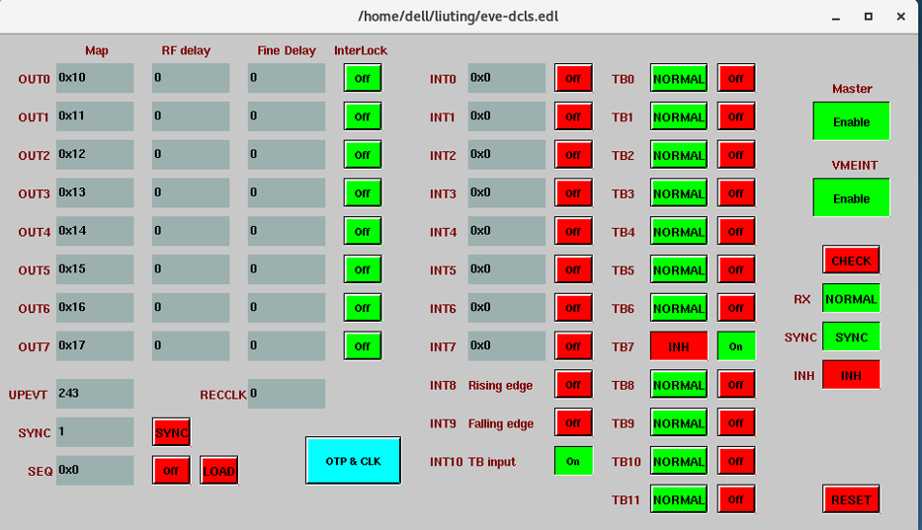
Technical Scheme: Timing -Based Interlock
Interlock Logic
Interlock input
Interlock event code
EVG stops broadcasting the corresponding event code.
Input Signal
MIS
BLM
BPM
Interlock signals are transmitted via the MicroTCA backplane
Notes:
We leverage the existing timing network for interlock protection.
When Interlock input to EVR,
the interlock event code will be transmited to the EVG.
The EVG stops broadcasting event codes to halt triggers, without additional hardware.
Interlock signals from MIS, BLM, and BPM are transmitted via the MicroTCA backplane.

Slide 18
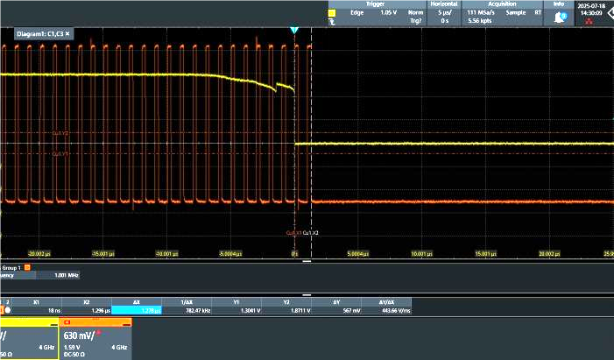
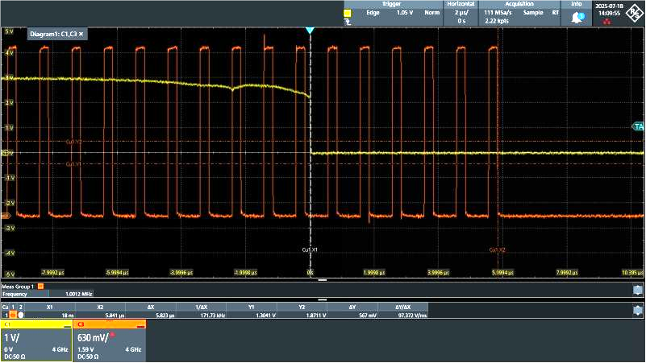
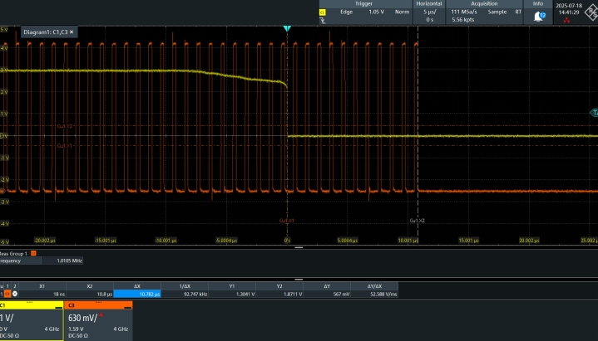
Fast Protection Response Test
Response time Test
Fiber L2
Fiber L1
L1=1000m L2=3m Response: 5.8us
L1=3m L2=3m Response:1.28us
  The test results show that
    The response time with a 2000m fiber link is less than 12 μs , below the 25 μs requirement — and thus meets the specification.
    The response time of the card itself is less than 1.5 μs.
L1=3m L2=2000m Response: 10.8us
Notes:
As show in the left picture ,when fiber length are both 3 meters,response time is 1.28(One point two eight microseconds) microseconds
The test results show that
The response time with a 2000m fiber link is less than 12 μs , below the 25 μs requirement — and thus meets the specification.
The response time of the card itself is less than 1.5 μs.

Slide 19
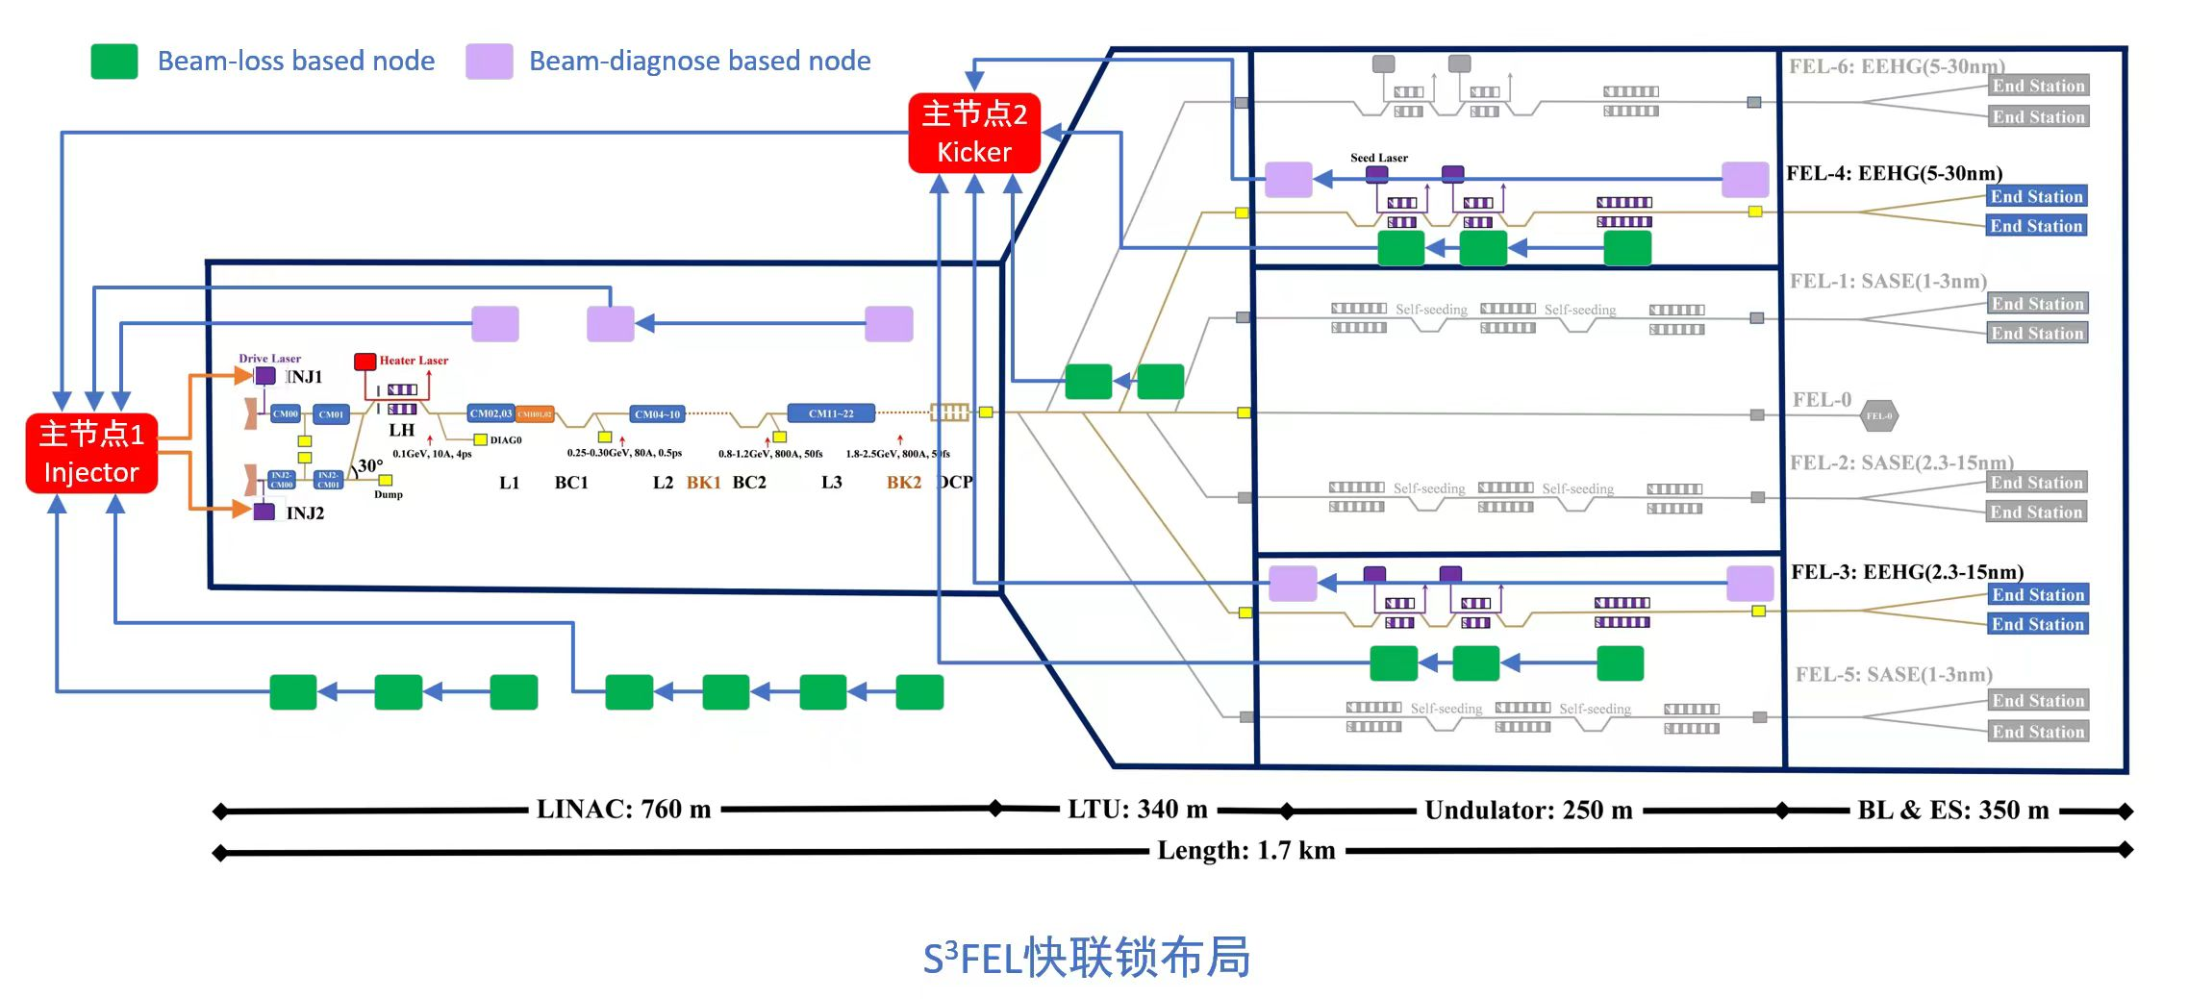
FPS Network Layout
Master Node Scheme
Scheme 1 ：Single-Master at Injector; Beam stopped by halting charge injection via Master1.
Scheme 2：Dual-Master Configuration: Master1 at the Injector; Master2 at the Kicker.
  Beam loss in the undulator line: Beam stopped by halting beam distribution via Master2 .
  Beam loss in the accelerator section: Beam stopped by halting charge injection via Master1.
Master 2
Master 1
Notes:
We designed the network layout.
A key task was the Master Node Scheme
Scheme 1 ：Single-Master at Injector; Beam stopped by halting charge injection via Master1.
Scheme 2：Dual-Master Configuration: Master1 at the Injector; Master2 at the Kicker.
Beam loss in the undulator line: Beam stopped by halting beam distribution via Master2 .
Beam loss in the accelerator section: Beam stopped by halting charge injection via Master1.
To make a reasonable choice, we calculated the number of lost bunches for both schemes.

Slide 20
Calculation of Response Time and Number of Lost Bunches
Repetition rate : 1 MHz
Bunch velocity: c
Signal velocity in optical fiber :2/3c
1.5us
Alarm out
FPS
Alarm in
Response Time and Number of Lost Bunches
Beam loss location | Distance M1 | Distance M2 | FPS response time |  |  | Scheme 1 Min num. of lost bunches | Scheme 2 Min num. of lost bunches
 |  |  | Fiber Scheme 1 | Fiber Scheme 2 | FPS
Injector | 0m | / | / | / | / | / | /
Linac dump | 760m | / | 3.8us | 3.8us | 1.5us | 8 | 8
Last undulator | 1350m | 650 | 6.75us | 3.25us | 1.5us | 14 | 8
Conclusion：
  Single-Master， Lost Bunches at end undulator: 14
  Dual-Master， Lost Bunches at end undulator : 8 ✅
  In conclusion, the dual-master effectively reduces the risk of facility damage.
Notes:
We compared single-master and dual-master , The dual-master setup reduces lost bunches from 14 to 8 at the undulator end, effectively reduces the risk of facility damage.

Slide 21
04
Timestamp Based on Timing

Slide 22
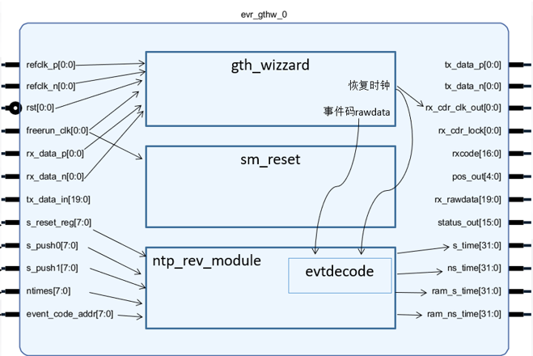
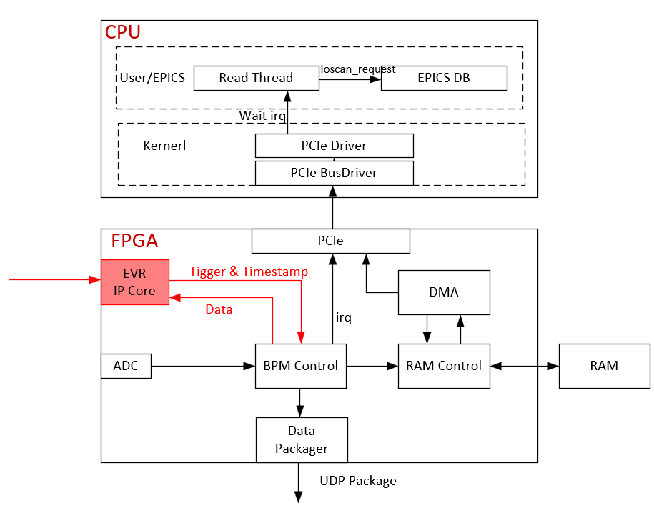
Timstamp
  Accurate time-stamped data is important for pulse-to-pulse diagnostics and data integration
  NTP: microseconds of time accuracy, fails to meet the requirements at 1MHz
  We use a modified event timing system IP core to provide nanosecond-precision timestamps.
Event timing IP core
BPM Signal Processor
Notes:
Accurate time-stamped data is important for pulse-to-pulse diagnostics and data integration
NTP: microseconds of time accuracy, fails to meet the requirements at 1MHz
We use a modified event timing system IP core to provide nanosecond-precision timestamps

Slide 23
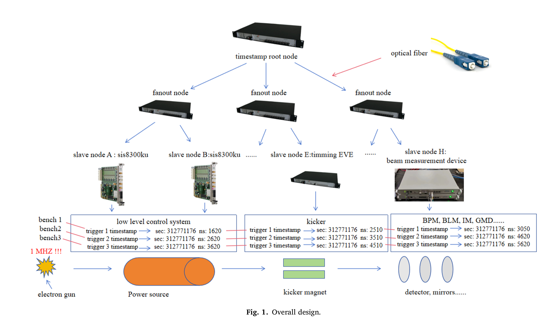
Overall Design of Timestamp
The overall design is a one-master-multi-slave structure.
The timestamp root node send the timestamp-related information in the form of event code from the fiber.
In the middle, FANOUT nodes are assigned for secondary broadcasting as needed.
Finally the slave nodes generate timestamps, by decoding these specified event codes
MTCA-EVO

Slide 24
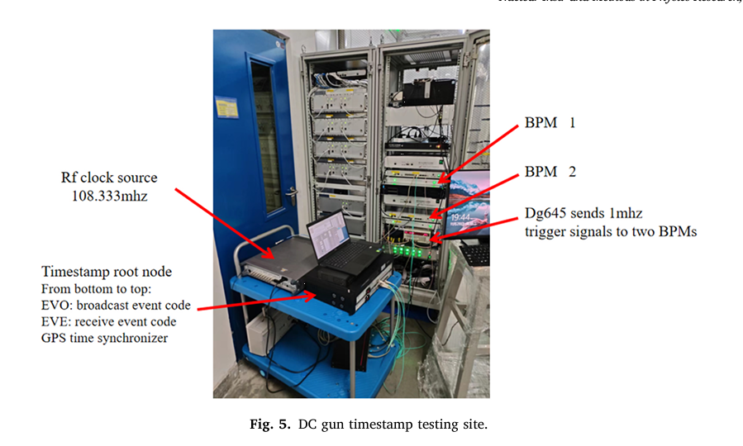
Test
Combined with the test data and correlation analysis of this study on Dalian DC gun
At 1 MHz triggering condition
The timestamp based on event timing system has been able to provide timestamps up to 10 ns accuracy.

Slide 25
05
Summary

Slide 26
Summary
The project implemented a high-precision timing system based on the MTCA.4 architecture,
achieving the following key results:
✅ High-Performance Trigger : with jitter below 20ps and delay accuracy of 5ps
✅ Fast Protection : Utilizes the timing network to achieve microsecond-level fast protection response
✅ High-Precision Timestamp : Based on timing IP core, it provides nanosecond-level timestamp accuracy,
Notes:
The timing system achieve the following key results:High-Performance Trigger , Fast Protection , High-Precision Timestamp

Slide 27
THANK YOU

