Slide 1

Introduction to Beamline Control and Data Acquisition Systems at SSRF
SSRF Beamline Control Group-Ying Zhao
2025.09.16

Slide 2
Presentation Outline
1. SSRF-Beamline Control Group
2. SSRF Beamline Control
3. Data Acquisation Systems for Experimental Stations

Slide 3

01
SSRF-Beamline Control Group

Slide 4
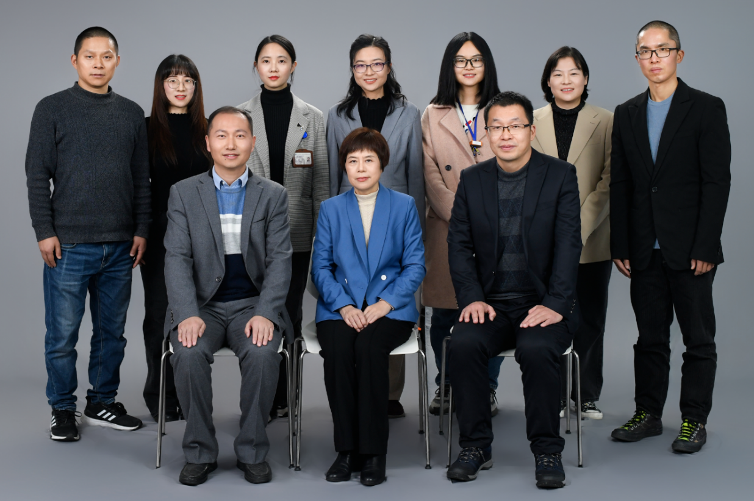
Introduction of SSRF beamline control group
Team size：10
  Senior titles：6
  Ph.D.s : 6, Masters:4
  Group Leader : Zhaohong Zhang, Jian He
Job Content :
  Beamline Control
  Control and DAQ for some experimental stations

Slide 5
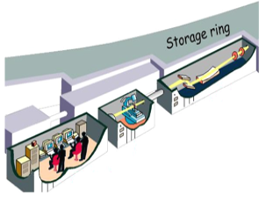
Beamline Equipment：
  Beam transmission: deflector mirror, monochromator, focusing mirror
  Beam adjustment: slit, aperture, attenuator
Beamline Control：Complete the electric adjustment of the equipment's spatial orientation to ensure the brightness and size of the light spot.
Beamline
Experimental Station
Experimental Stations Equipment：
  Sample stage, robotic arm, ionization chamber, SDD, Mython, Pilatus...
Experimental Stations Control
DAQ
Experimental Stations DAQ： Interact with users, implement experimental logic, and obtain experimental data
Notes:
我的报告分为六个部分，首先是上海光源束线控制组介绍

Slide 6
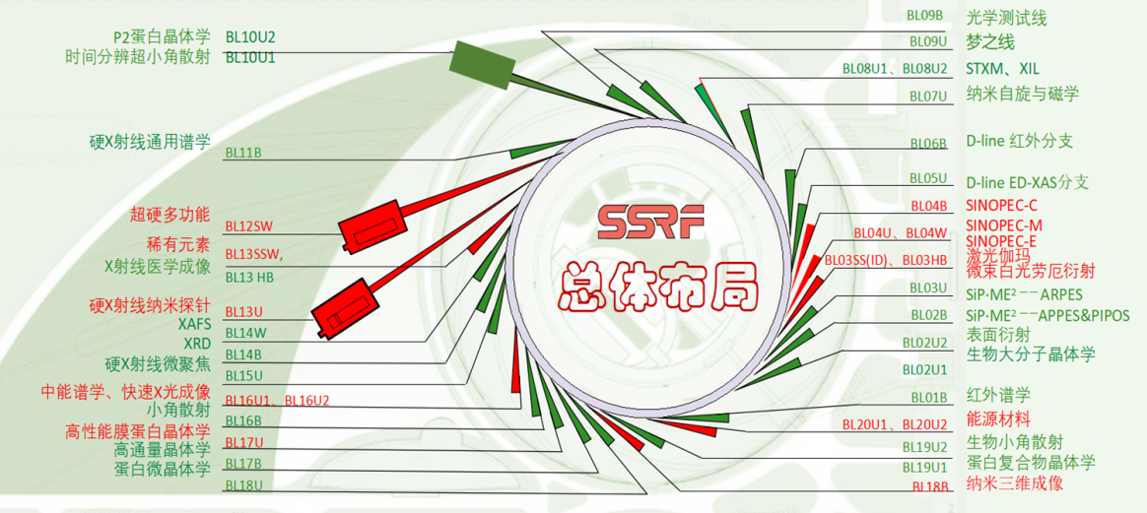
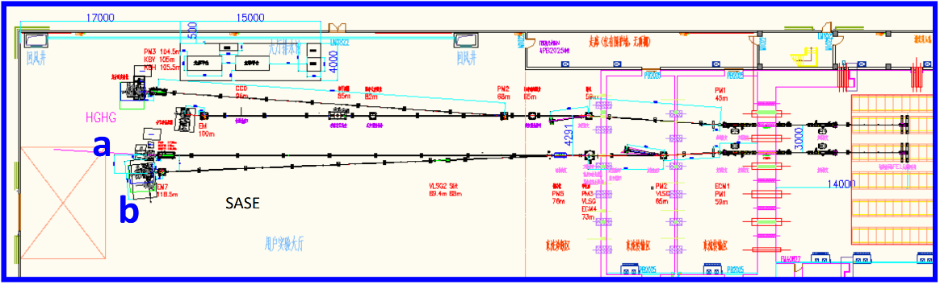
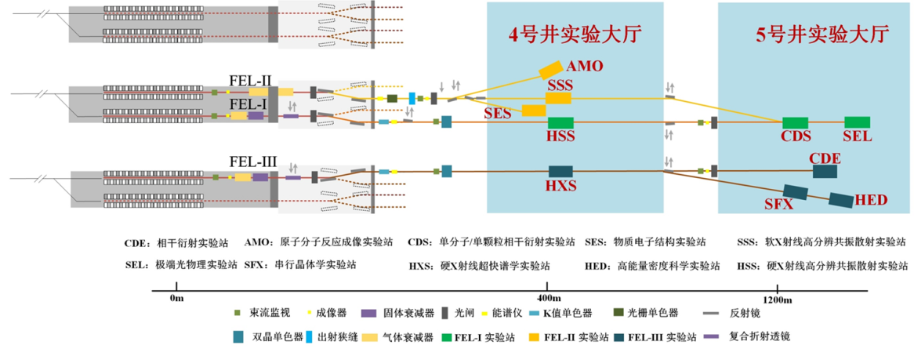
Team Work Tasks
①SSRF-I
7条线
Beamline Control
②5线6站等
9条线
③SSRF-II
16+3条线
④SSRF后续项目
6条线
⑤SXFEL
2+1条线
⑥SHINE
3条线
DAQ-SSRF:4条线

Slide 7
02
SSRF Beamline Control

Slide 8
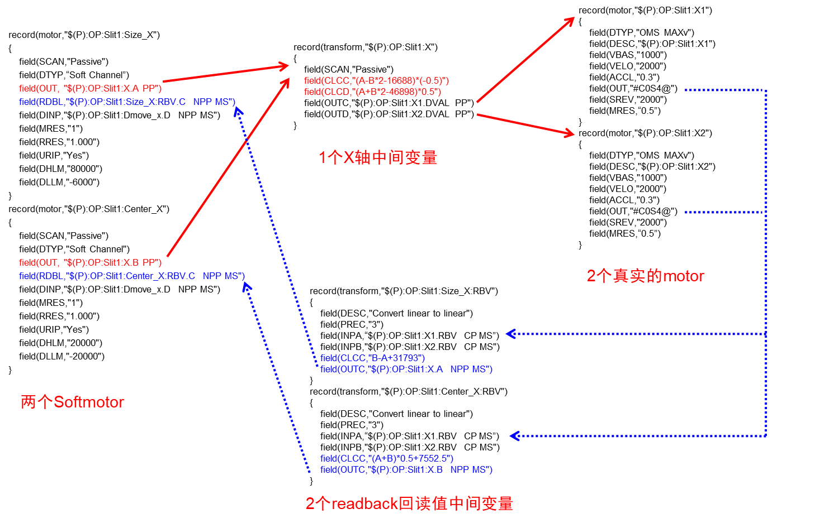
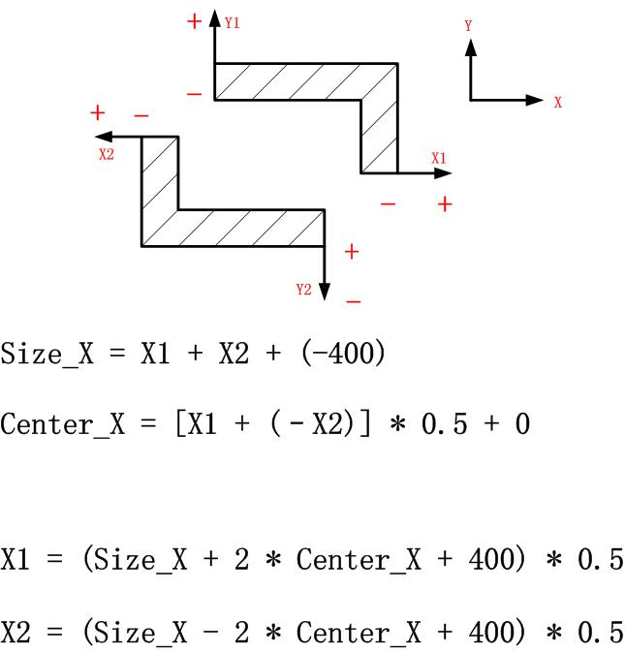
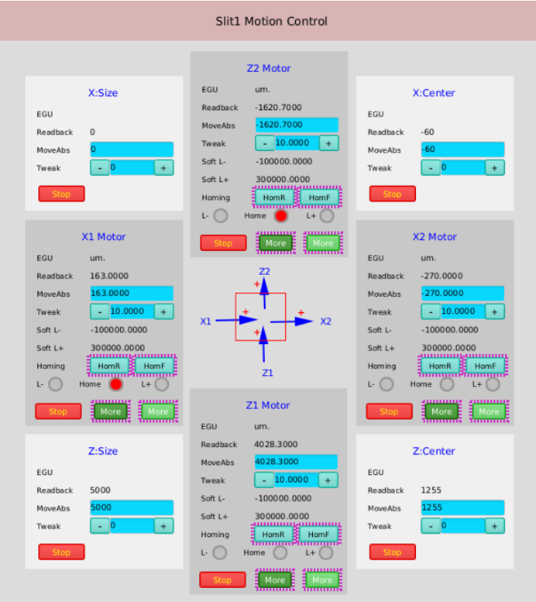
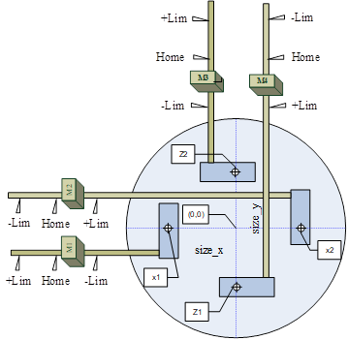
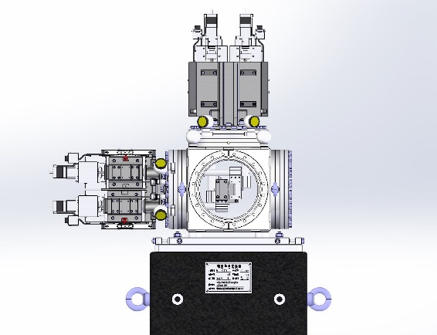
Control of Slit System
Slits : white light slits 、monochromatic light slits.
Brands： two domestic ones, ADC, JJ, HUBER, etc

Slide 9
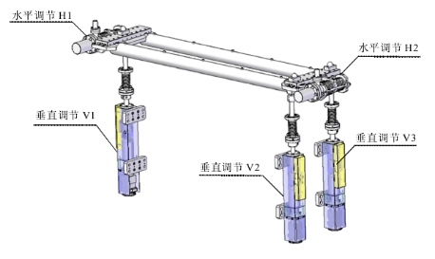
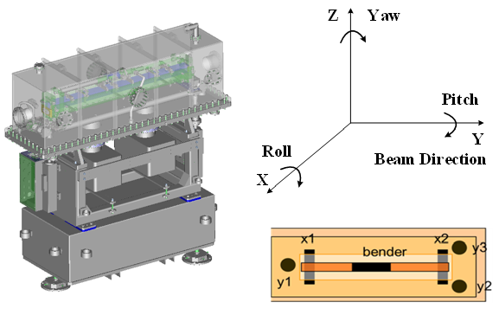
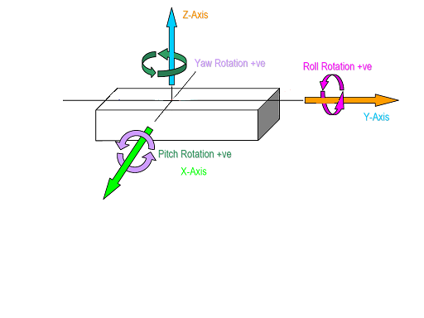
Control of Mirror Box System
Types：deflection, horizontal focusing, vertical focusing, KB, CRL, planar, cylindrical.
Multi-physical quantity engineering quantity conversion
Multisignal processing
被控量 | 前向动力学关系 | 运动方式
X | X=(x₁+x₂)/2 | x₁和x₂同方向、同位移转动
Y | Y=(2*y₁+y₂+y₃)/4 | y₁、y₂和y₃同方向、同位移转动
Pitch | Pitch=atg(((y₂+y₃)-2y₁)/2) | y₁与y₂、y₃反方向、同位移转动
Roll | Roll=atg((y₃-y₂)/W) | y₂和y₃反方向、同位移转动
Yaw | Yaw=atg((x₂-x₁)/L) | x₁和x₂反方向、同位移转动

Slide 10
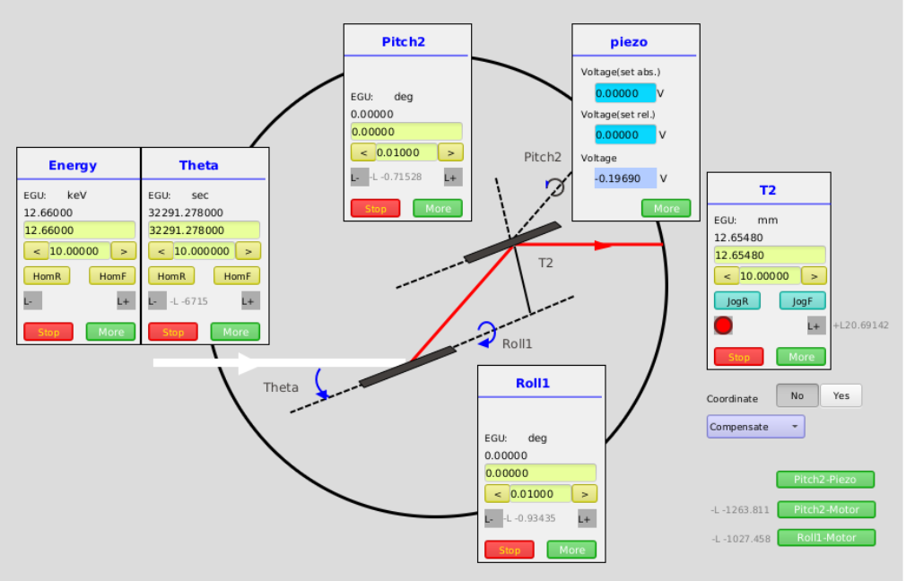
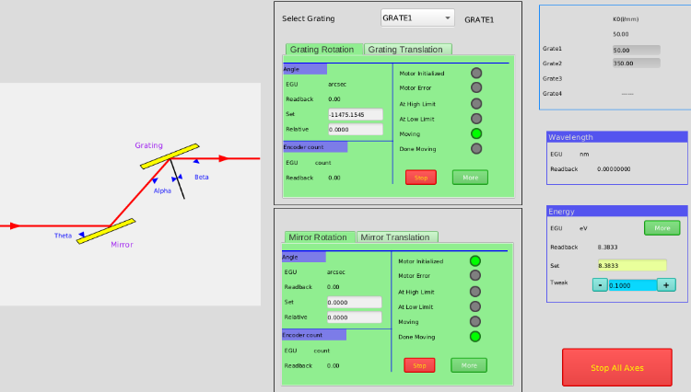
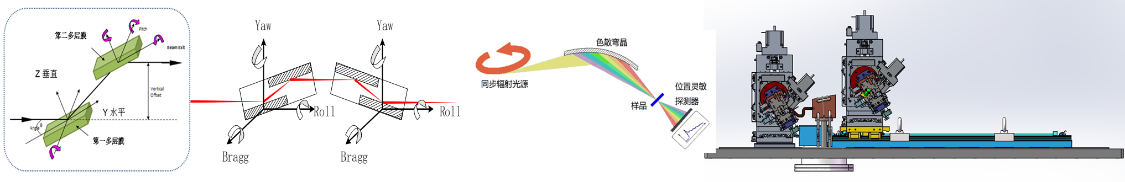
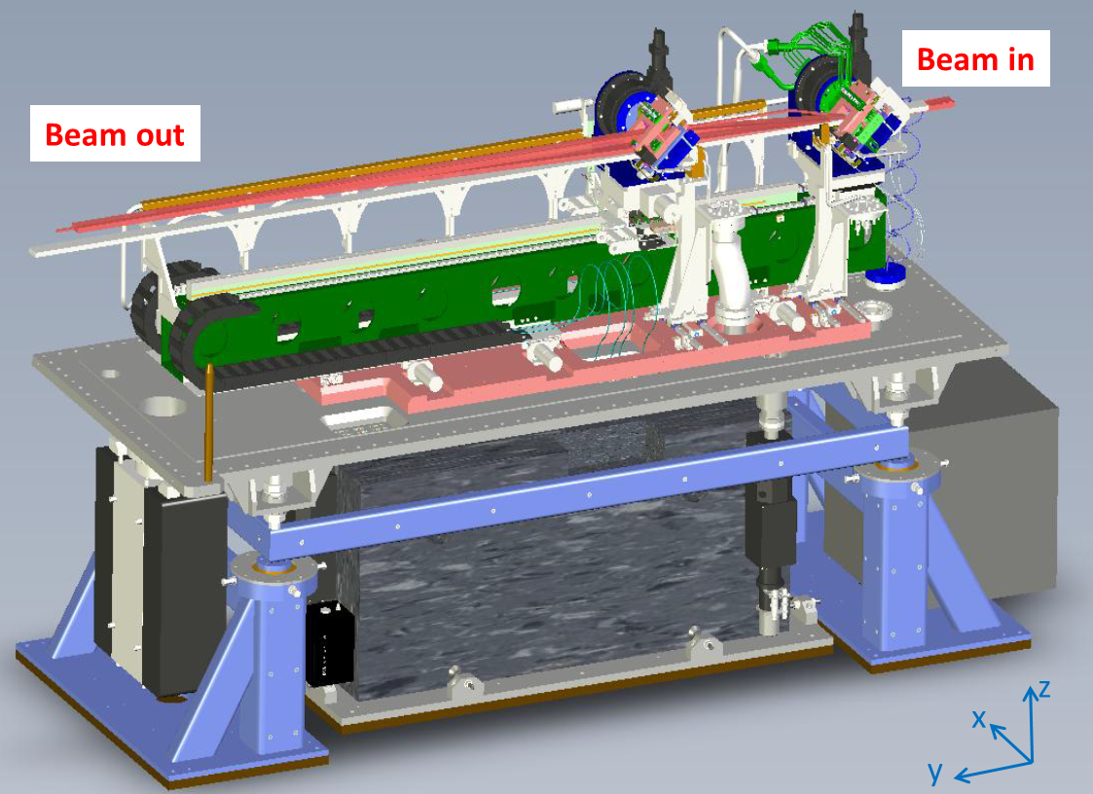
Control of Monochromator System
Types：double crystal, four crystal, multilayer film, grating, Laue, dispersion birefringent crystal.
Types of motors： stepper motors, servo motors, piezoelectric motors.

Slide 11
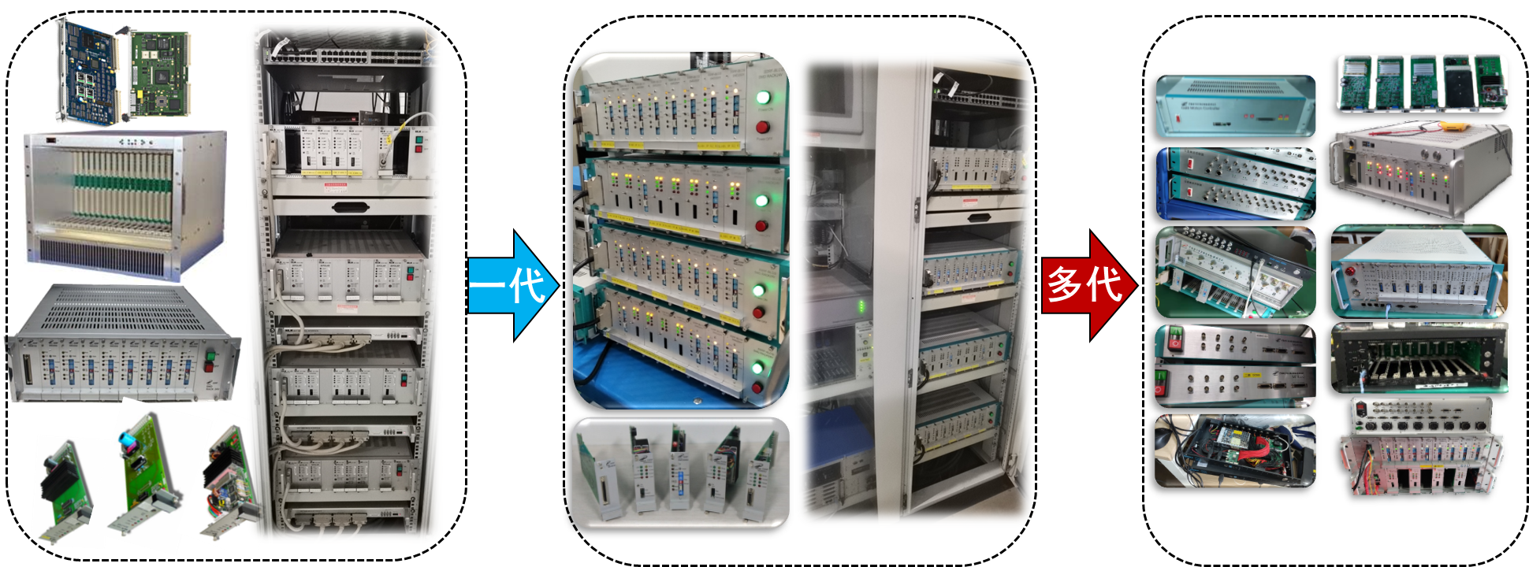
Development Process of the Control System
Controller：Imported, Integrated, Self-developed（VME\GALIL\Deltatau\Maxnet\ACS\ARM+FPGA）；
Driver： Imported, Integrated, Self-developed （Phytron/Melec/Picomotor/）；
一代
多代

Slide 12
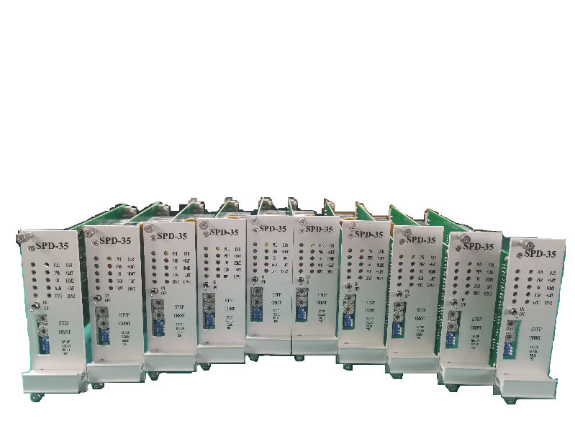
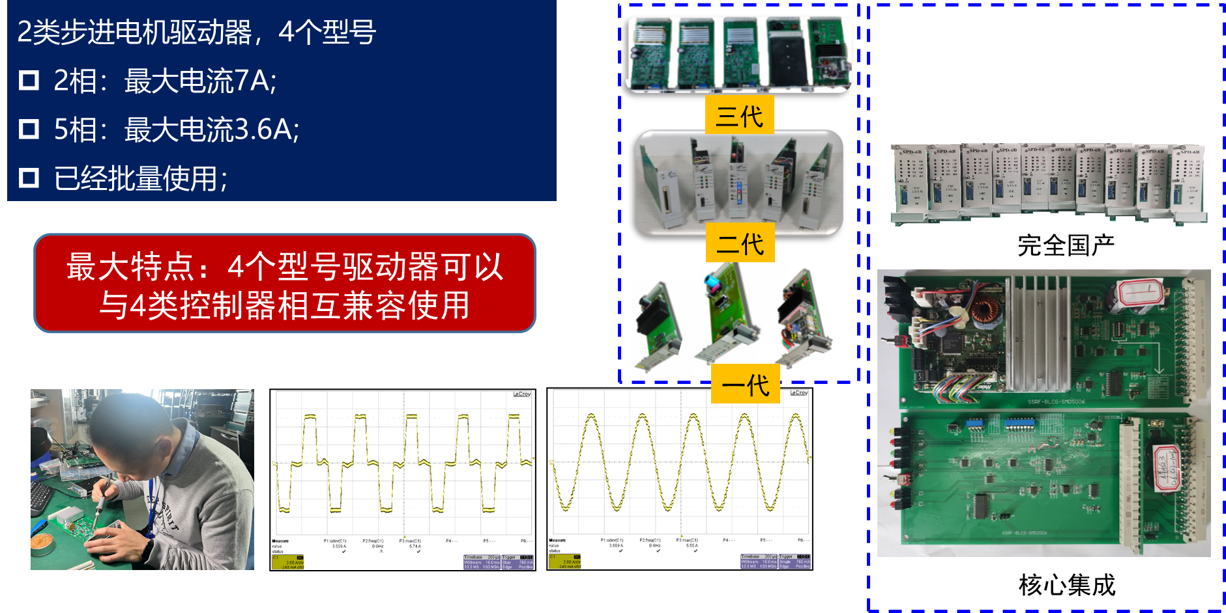
Stepper Motor Driver
  2 types of stepper motor drivers, 4 models：
  2nd phase：Maximum current 7A
  5nd phase： Maximum current 3.6A
  Has been used in bulk
三代
二代
一代

Slide 13
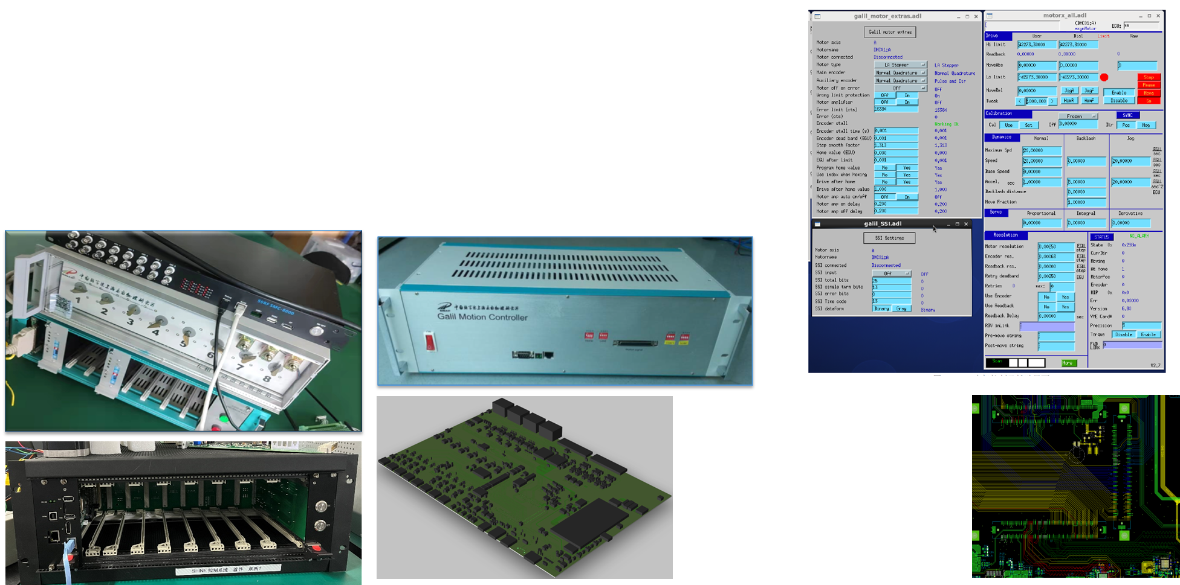
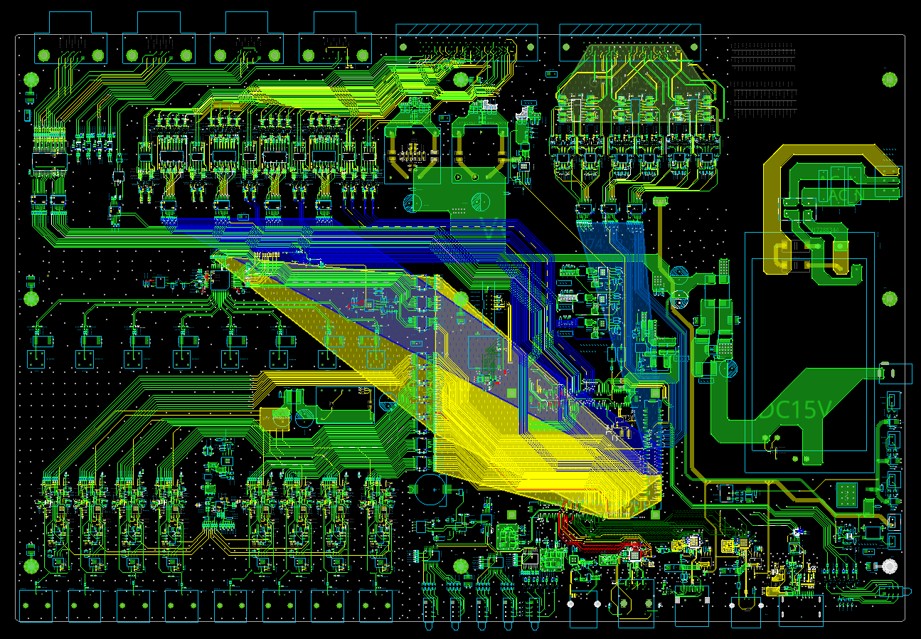
Controller--STMC-8/Galil
1U/3.5U universal controller; with 8-axis stepper control channels;
8 channels of 18-bit ADC, 8 channels of 18-bit DAC and 20 channels of general digital I/O;
Based on the latest Ultroscale+ Zinc chip from Xinlinx, ARM + FPGA;
Using the 8-axis controller from Galil Company, integrated control hardware;

Slide 14
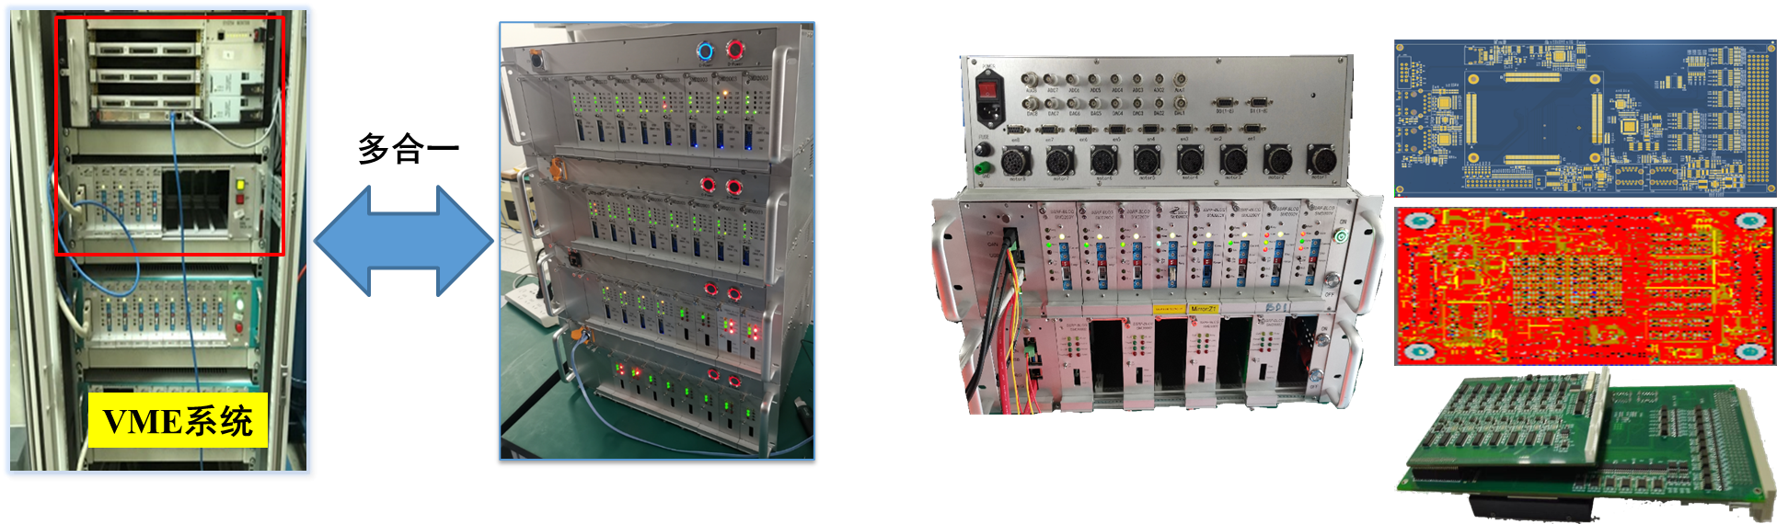
Controller——MSC-8\STMC-16
  Linux + Soft IOC, replacing the commercialized vxWorks operating system
  The control instructions are fully compatible with the original VME bus controller
  No longer needed VME chassis and MVME5500 single-board computer
  Integrated drive and control, the hardware interface is the same, making installation and debugging more convenient
以Xilinx公司的Ultroscale+ SOC芯片为核心，采用FPGA+ARM整体架构，FPGA实现实时算法，ARM实现嵌入式Linux和EPICS应用，完全自主开发，摆脱对进口控制器的依赖。

Slide 15
03
Data Acquisation Systems for Experimental Stations

Slide 16
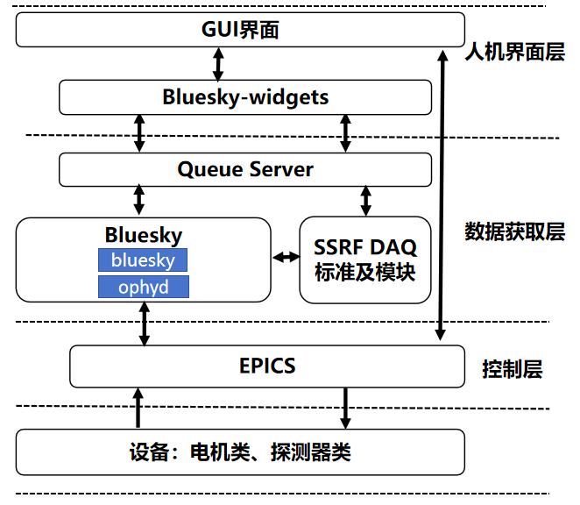
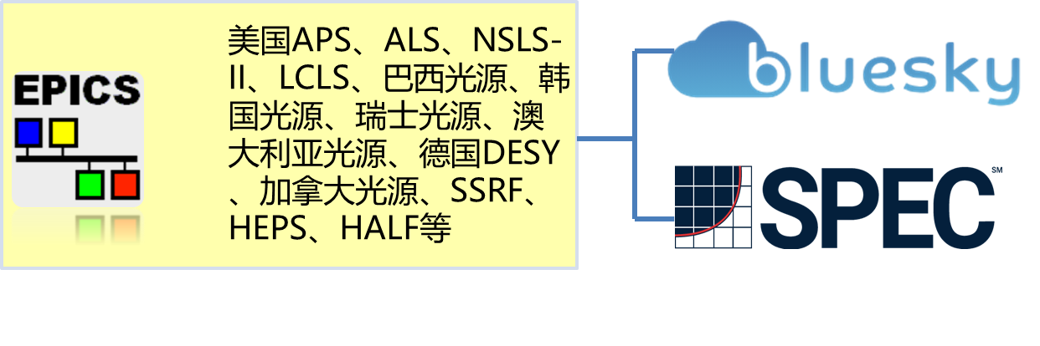
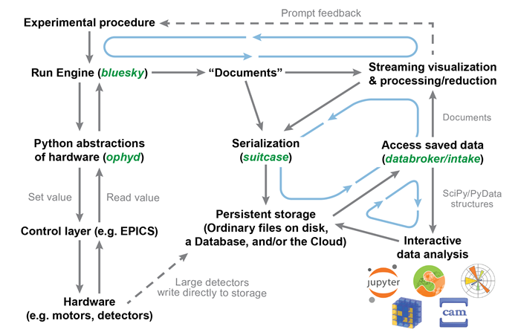
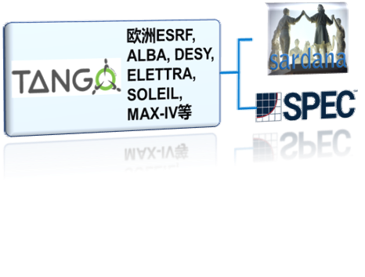
Data Acquisation Systems for Experimental Stations
One of the tasks of SSRF-II project: to develop a universal control and data acquisition system for the experimental station.
Data collection framework camp (with underlying control based on EPICS)
Bluesky
Data collection framework camp (with underlying control based on Tango)
SSRF-DAQ Framework : Jasmine

Slide 17
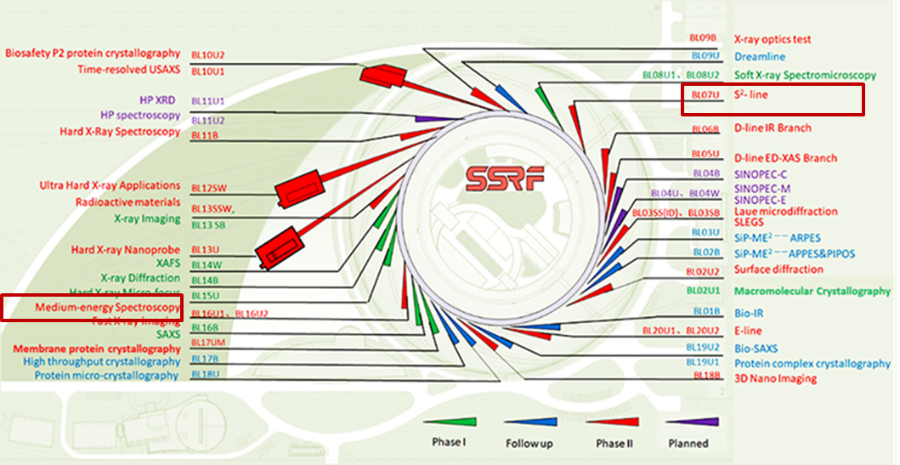
DAQ Systems Based on Jasmine
Has been applied to：BL16U1、BL07U、SinopecC
In the next two years：7 Beamlines built in SSRF-I （BL02U1、BL08U1A、BL13HB、BL14B1、BL14W1、BL15U、BL16B1、BL13U、BL07U、BL16U1）

Slide 18
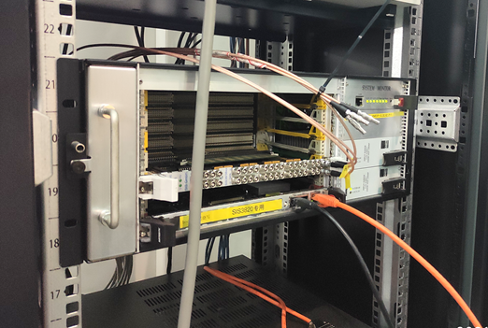

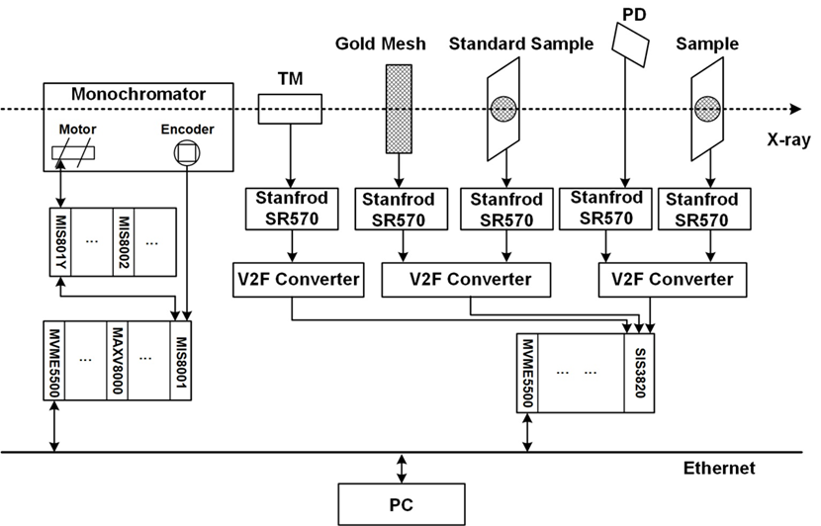
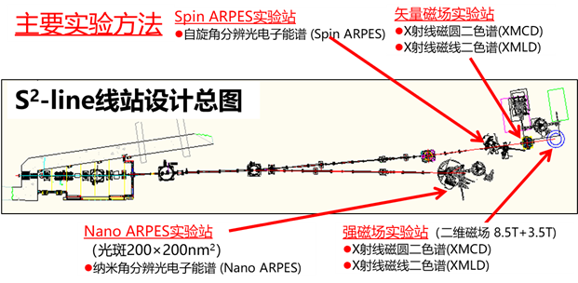
BL07U DAQ System
BL07U——combination of Nano-ARPES and Spin-ARPES (S2) beamline： Studying the spin-resolved electronic structure of materials at the nanoscale
Application fields: Topological insulators, iron-based superconductors, magnetic materials, new mesoscopic materials, multiferroic materials, etc.
DAQ硬件架构

Slide 19
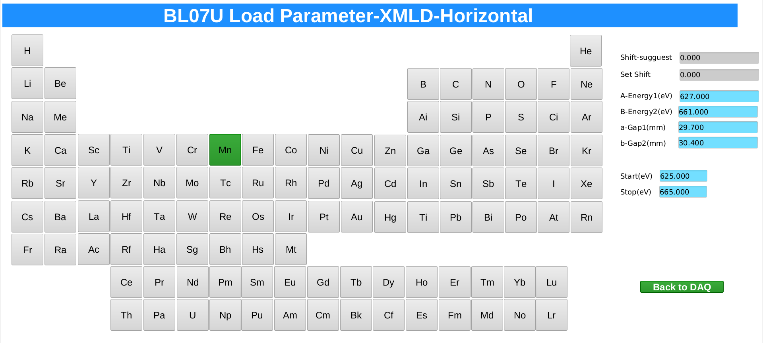
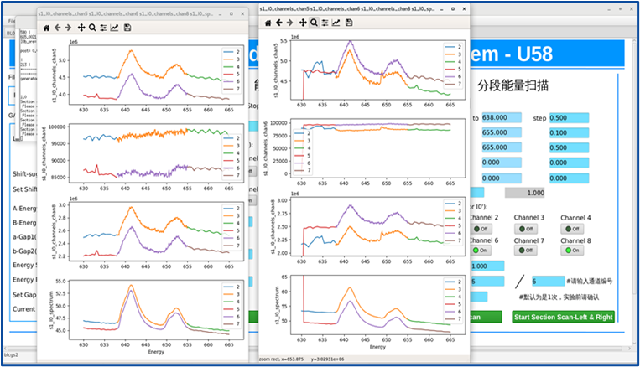
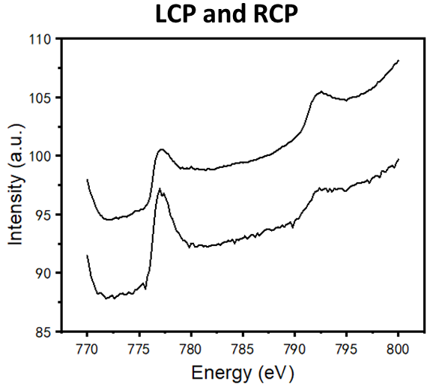
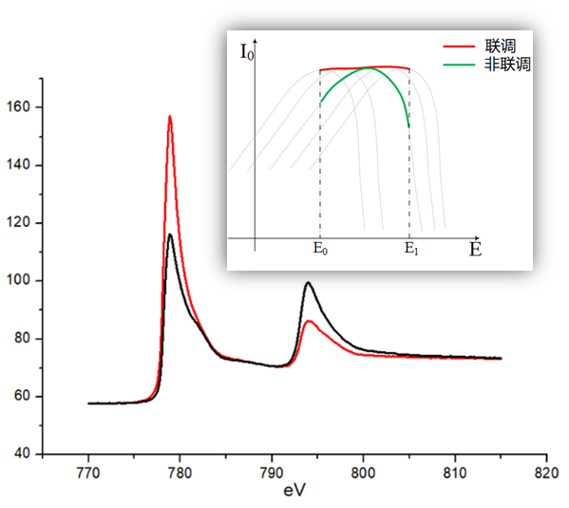
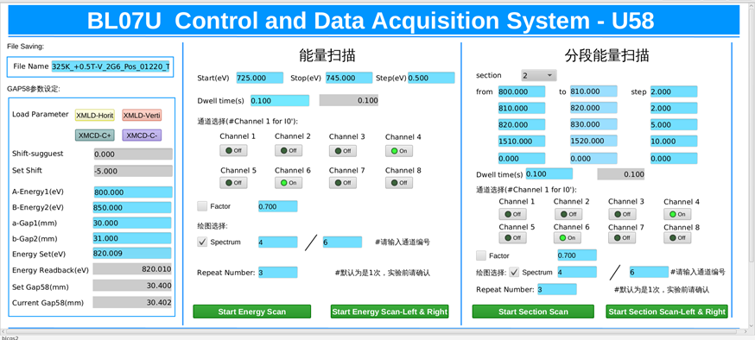
BL07U DAQ System
It covers 4 experimental methods: TEY, TFY, magnetic circular dichroism (XMCD), and magnetic linear dichroism (XMLD).
It supports the linkage of EPU and monochromator, with spectral stability better than 0.5%. It supports up to 400 users and can operate stably for three years.
User-friendly: It supports automatic switching between left and right rotation and automatic repetitive scanning (25 repetitions, ~9 hours, system stable)
普通模式与联动模式对比
Co磁圆二色谱-基线斜移
Co磁圆二色谱-南大陆显扬
联调模式+左右旋切换+连续/分段多次扫描—单次设定全自动完成
Zhao Y, et al. "Data Acquisition System Based on the Bluesky Suite in the Shanghai Synchrotron Radiation Facility." Applied Sciences 13.10 (2023): 5829.
Zhao Y, et al. Git-based Version Control for Beamline Control System at the Shanghai Synchrotron Radiation Facility. 2018 5th International Conference on Systems and Informatics (ICSAI). IEEE, 2019.

Slide 20
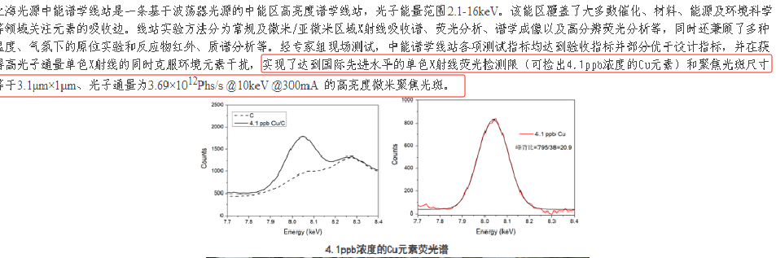
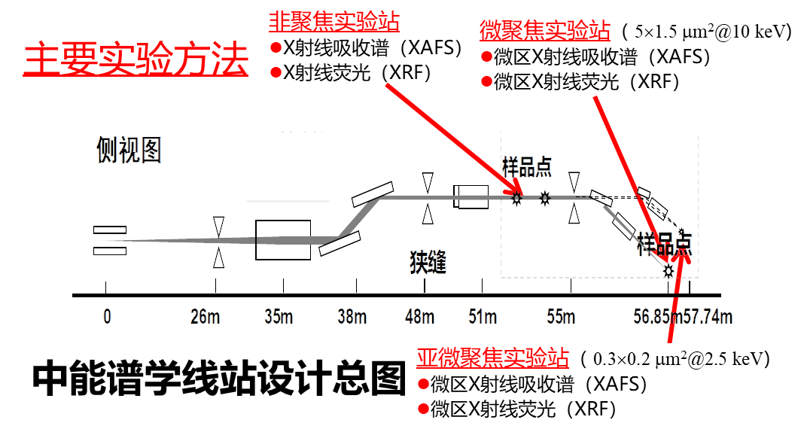
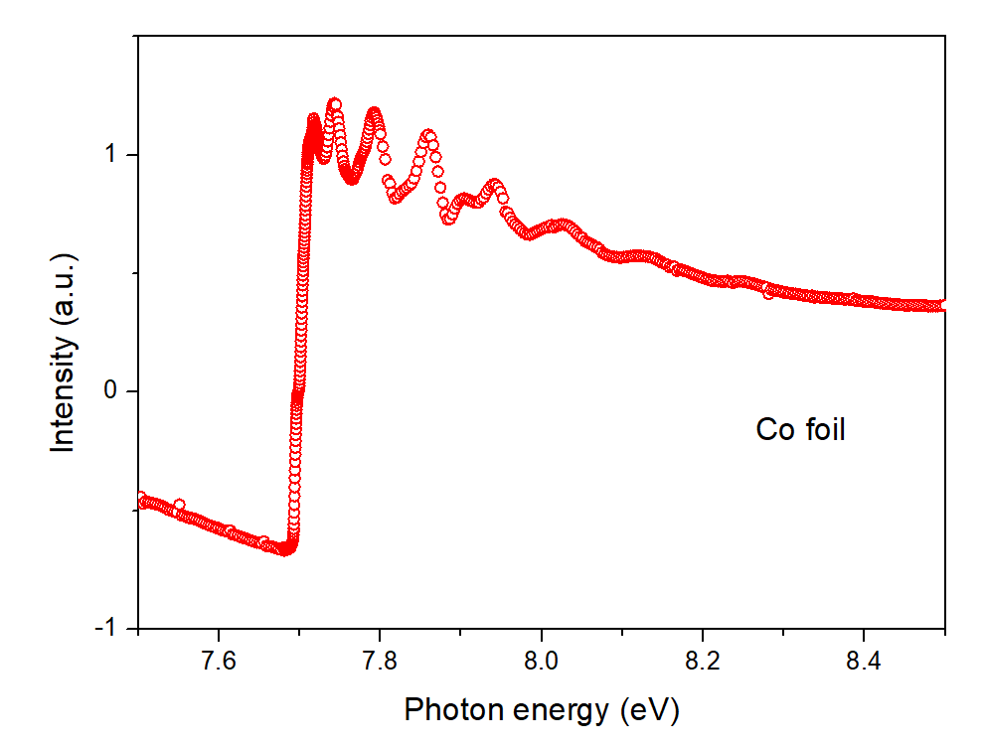
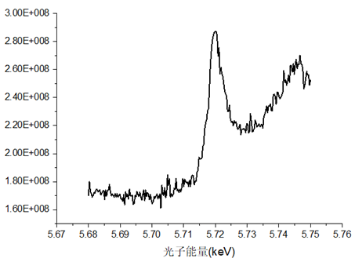
BL16U1 DAQ System
Tender Energy Spectroscopy：beam energy range 2.1 - 16 KeV. Analyzing the impact and removal mechanism of environmental pollutants at the microscopic scale.
Application fields: Environmental science, energy, catalysis, materials, etc.
中能谱学线站（2.1-16 keV）谱学测量方法对用户开放
  Co标准样品透射吸收谱
  百ppm Ce L3边的荧光吸收谱(近边谱)

Slide 21
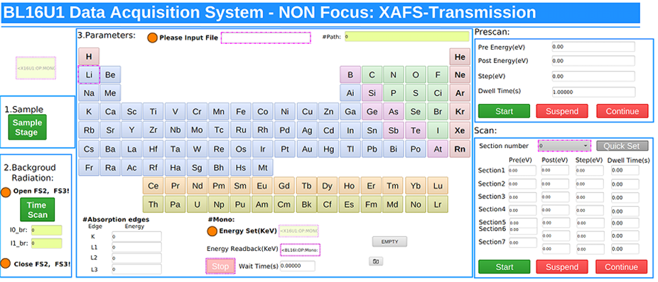
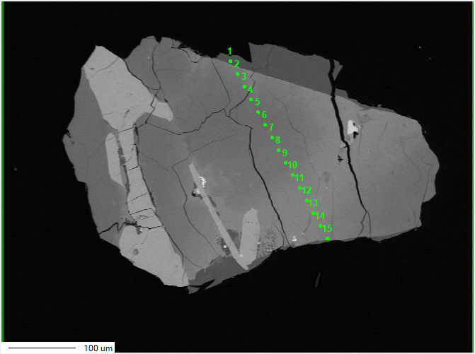
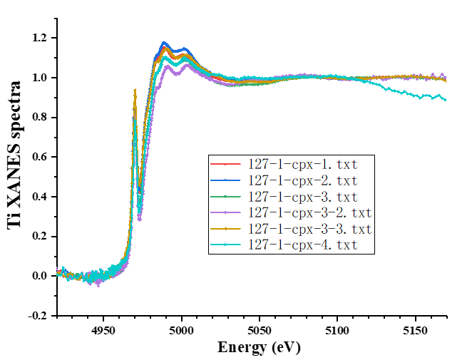
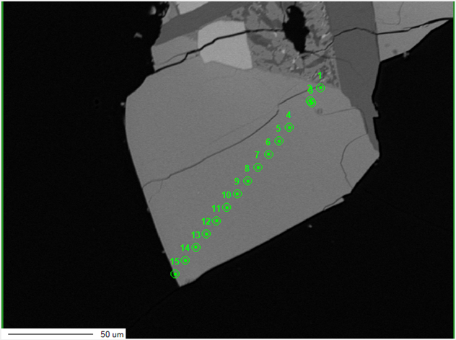
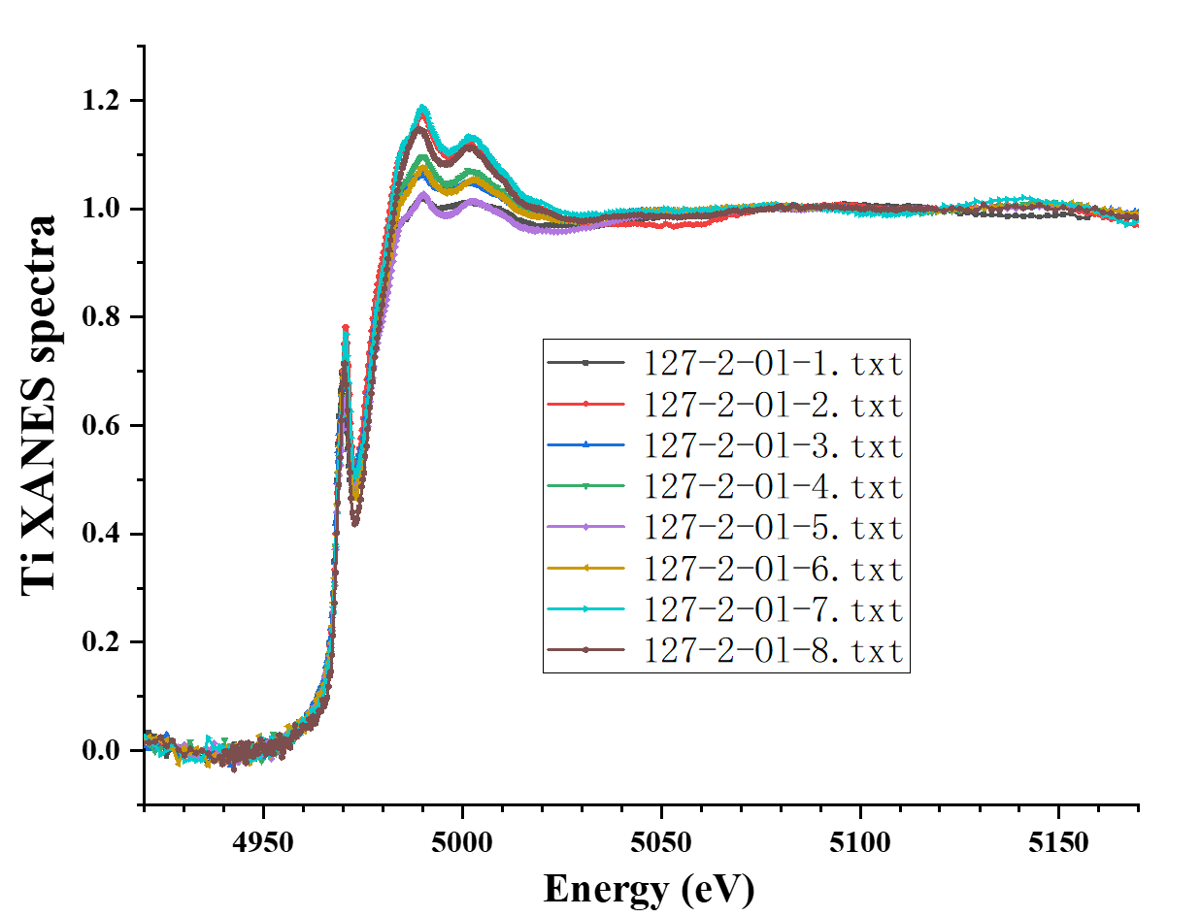
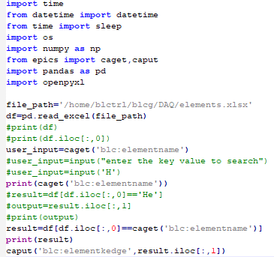
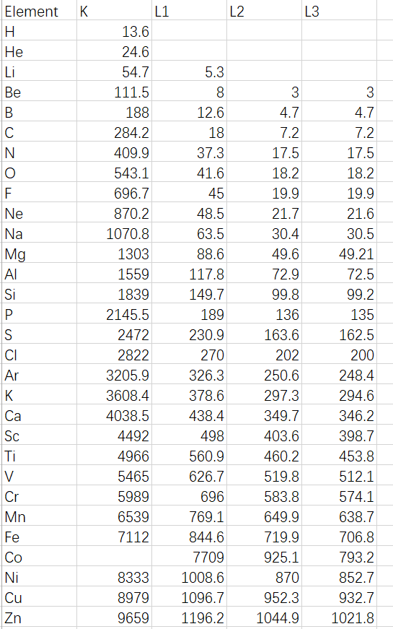
BL16U1 DAQ System
It covers five experimental methods: fluorescence XAFS, transmission XAFS, XRF, TEY, and two-dimensional mapping.
The SIS3820 generates TTL signals to hard-synchronously trigger the SDD, ensuring high data quality for two-dimensional Mapping and transmission XAFS experiments.
It has been operating stably for one year and supports all nearly a hundred sets of users.
嫦娥五号月球科研样品——Ti价态测定
1
2
86个元素的K、L1、L2、L3吸收边能量界面一键点选

Slide 22

Thank you for your attention!
Zhaohong Zhang：13585879823
Jian He：13636353221

