Slide 1
Cosmic ray data taking with HV
Mingyi Dong
2025-04-21

Slide 2
Cosmic –ray test
HV of CGEM and other sub detector were powered on
BESIII normal trigger configuration, trigger rate : ~370Hz
From April 19 to April 21

Slide 3
Check results
Run No | start | stop | BESIII event number | CGEM uniq trigger number | CGEM Last trigger number | CGEM check error | event rate (HZ)
85160 | 2025.4.19 11:27 |  | 1264176 | 1264176 | 1264176 | No | 370
85161 | 12:31 |  | 1706581 | 1706581 | 1706581 | No | 370
85162 | 13:51 |  | 1558112 | 1558112 | 1558112 | No | 370
85163 | 15:04 |  | 2749600 | 2749600 | 2749600 | No | 370
85164 | 17:07 |  | 3020543 | 3020543 | 3020543 | No | 370
85165 | 19:22 |  | 2622562 | 2622556 | 2622556 | No | 370
85172 | 2025.4.209:40 |  | 1332482 | 1332482 | 1332482 | No | 370
85173 | 10:45 | DAQ crash | 784266 | 784266 | 784266 | No | 370
85174 | 11:22 |  | 2338266 | 2338266 | 2338266 | No | 370
85175 | 13:11 |  | 2591929 | 2591929 | 2591929 | No | 370
85176 | 15:09 |  | 2053945 | 2053945 | 2053945 | No | 370
85177 | 16:40 | GEMROC 16 error | 47141 | 47141 | 47141 | No | 370
85178 | 16:46 |  | 2456963 | 2456963 | 2456963 | No | 370
85179 | 18:38 |  | 2210107 | 2210107 | 2210107 | No | 370
85180 | 20.21 |  | 2153024 | 2153024 | 2153024 | No | 370

Slide 4
Check results
Run No | start | stop | BESIII event number | CGEM uniq trigger number | CGEM Last trigger number | CGEM check error | event rate (HZ)
85188 | 2025.4.21 11:28 |  | 1337043 | 1337042 | 1337042 | No | 370
85189 | 12:31 | DAQ crash due to CGEM | 256527 | 256527 | 256527 | No | 370
85190 | 13:51 |  | 2076353 | 2076353 | 2076353 | No | 370
85191 | 17:07 |  | 2570047 | 2570047 | 2570047 | No | 370
85192 | 19:22 |  | 2355342 | 2355342 | 2355342 | No | 370

Slide 5
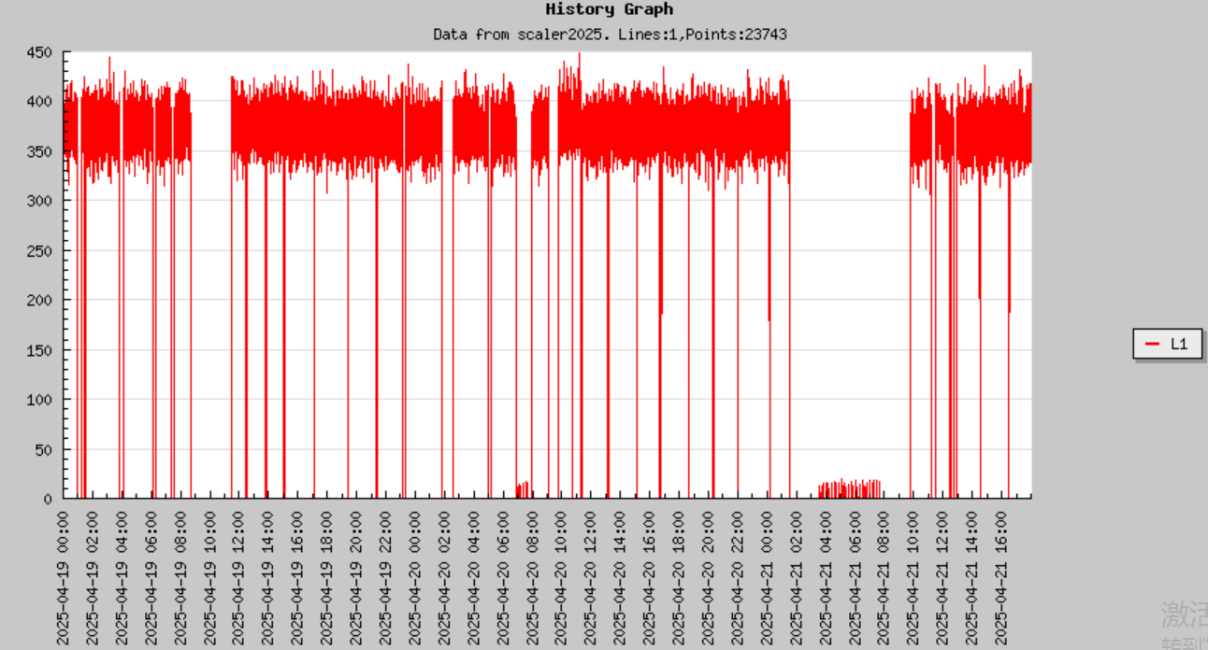
L1 trigger rate on April 19-21

