Slide 1
Validation of Run4/5
Goodness of fit test(with full systematic)

Slide 2
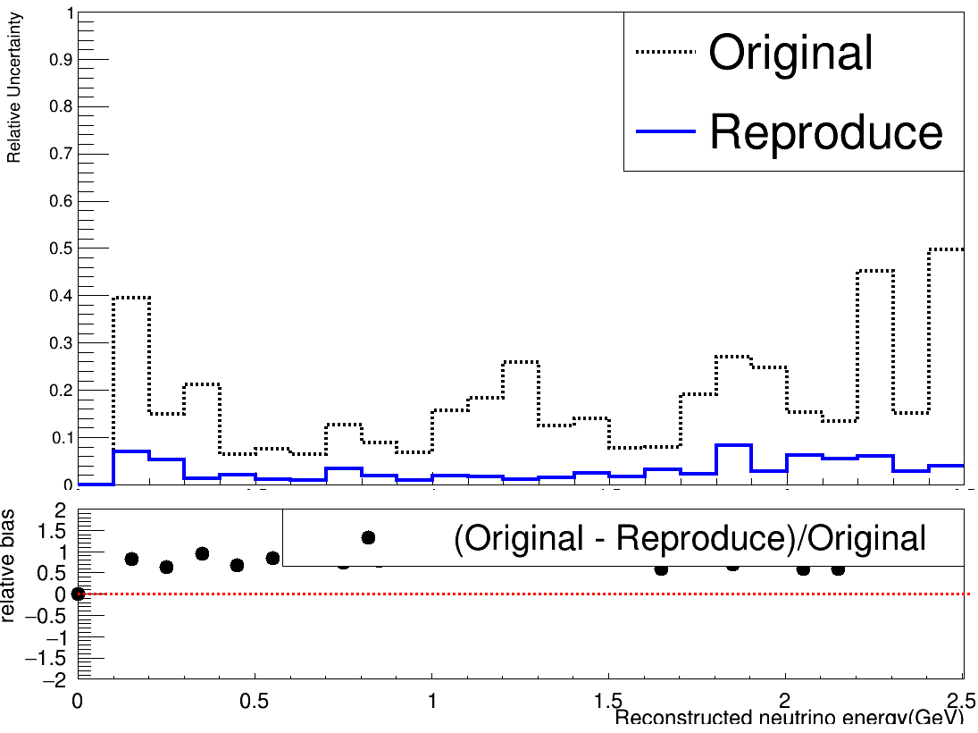
Previous：Relative uncertainty of Run4 WMYZ
 | POT(before merging)
Original | 4.16706e+21
Reproduced | 1.26094e+23
FC $v_{e}$CC
Relative uncertainty of original and reproduce sample have a big difference.

Slide 3
What I did
Recaluculated detector systematic uncertainty with new Run4 $v_{e}$ WMYZ and Run5 $ν$ WMYZ sample.
Calculated $χ^{2}$ with full systematic uncertainty($χ^{2}$ of Run2 is calculated with Run1 detector sample) and corresponding p-value.

Slide 4
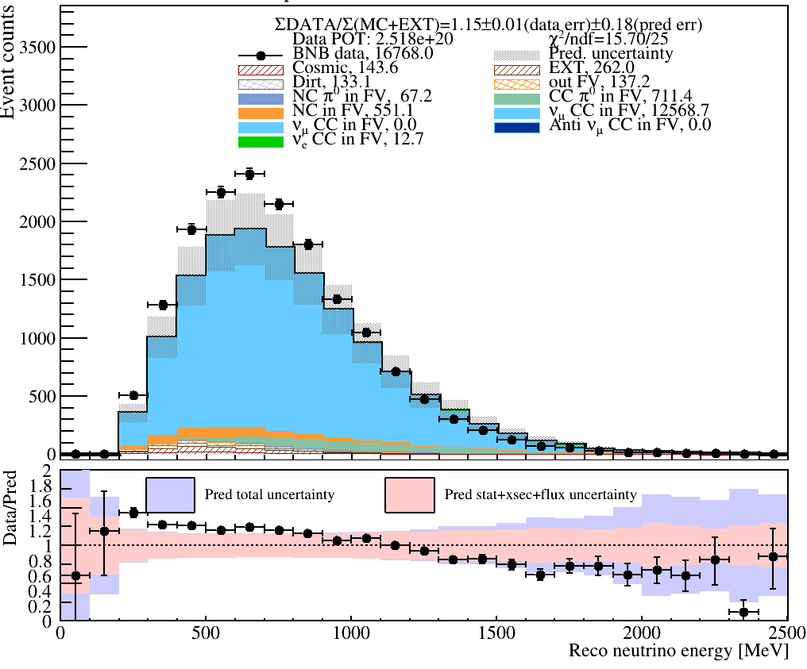
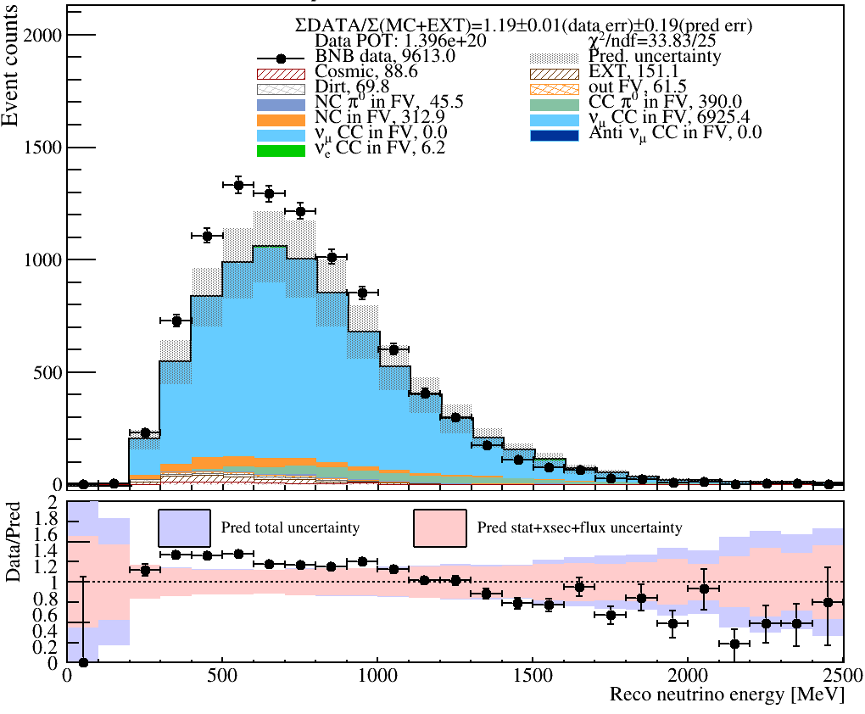
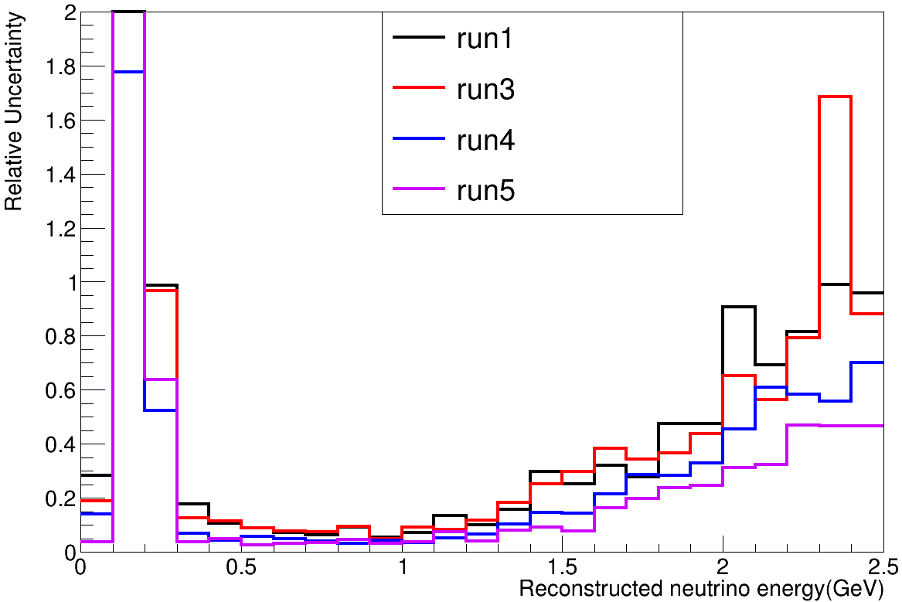
FC $ν_{μ}$CC
Run4
Run5
Period | $χ^{2}$ without constraint(25 bin)
Run1 | 7.14
Run3 | 8.81
Run4 | 15.70
Run5 | 33.83
$χ^{2}$ value have an obvious bias between Run1/3 and Run4/5.
Detector relative uncertainty

Slide 5
Comparison of $χ^{2}$ for each run
Channel | $χ^{2}$ without constraint(p-value)
 | Run1 | Run2 | Run3 | Run4 | Run5
FC $ν_{μ}$CC(25 bin) | 7.14(0.9998) | 11.11(0.9924) | 8.81(0.9988) | 15.70(0.9235) | 33.83(0.1116)
PC $ν_{μ}$CC(25 bin) | 7.59(0.9997) | 6.46(0.9999) | 6.67(0.9999) | 27.03(0.3544) | 19.66(0.7644)
FC$π^{0}$CC(10 bin) | 4.11(0.9422) | 2.87(0.9843) | 2.61(0.9891) | 7.37(0.6901) | 15.50(0.1149)
PC$π^{0}$CC(10 bin) | 1.89(0.9971) | 2.39(0.9924) | 5.99(0.8161) | 6.64(0.7589) | 9.69(0.4681)
NC$π^{0}$(10 bin) | 2.22(0.9944) | 1.35(0.9993) | 5.63(0.8453) | 4.65(0.9133) | 4.64(0.9139)
There is consistency among each run in each channel.

Slide 6
Back Up

Slide 7
Channel | $χ^{2}$ without constraint(with constraint)
 | Run1 | Run3 | Run4 | Run5
FC $ν_{μ}$CC(25 bin) | 7.14 | 8.81 | 15.70 | 33.83
PC $ν_{μ}$CC(25 bin) | 7.59 (8.10) | 6.67(6.83) | 27.03(26.77) | 19.66(11.02)
FC$π^{0}$CC(10 bin) | 4.11(5.59) | 2.61(3.77) | 7.37(12.06) | 15.50(17.12)
PC$π^{0}$CC(10 bin) | 1.89(2.51) | 5.99(7.19) | 6.64 (9.76) | 9.69(23.17)
NC$π^{0}$(10 bin) | 2.22(4.83) | 5.63(7.67) | 4.64(4.53) | 4.64(4.80)

Slide 8
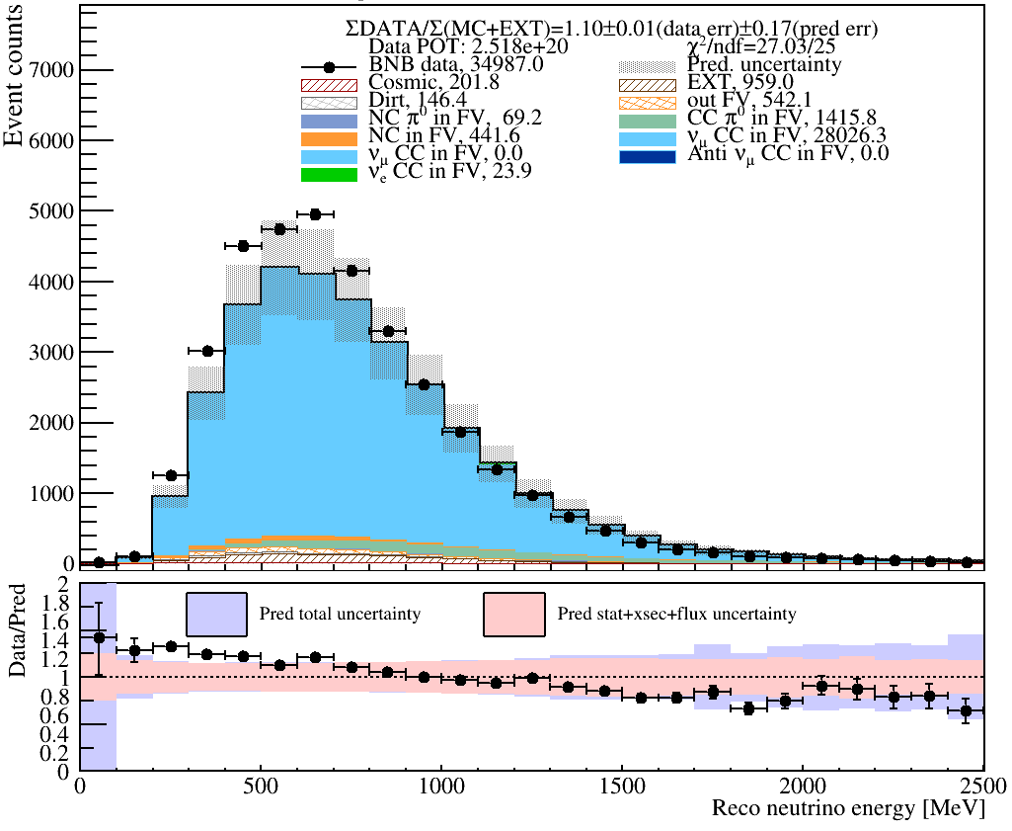
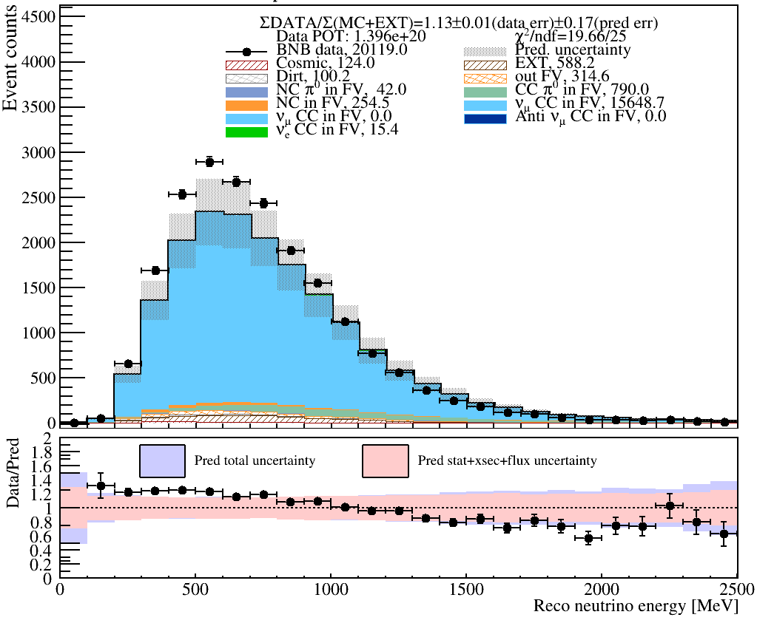
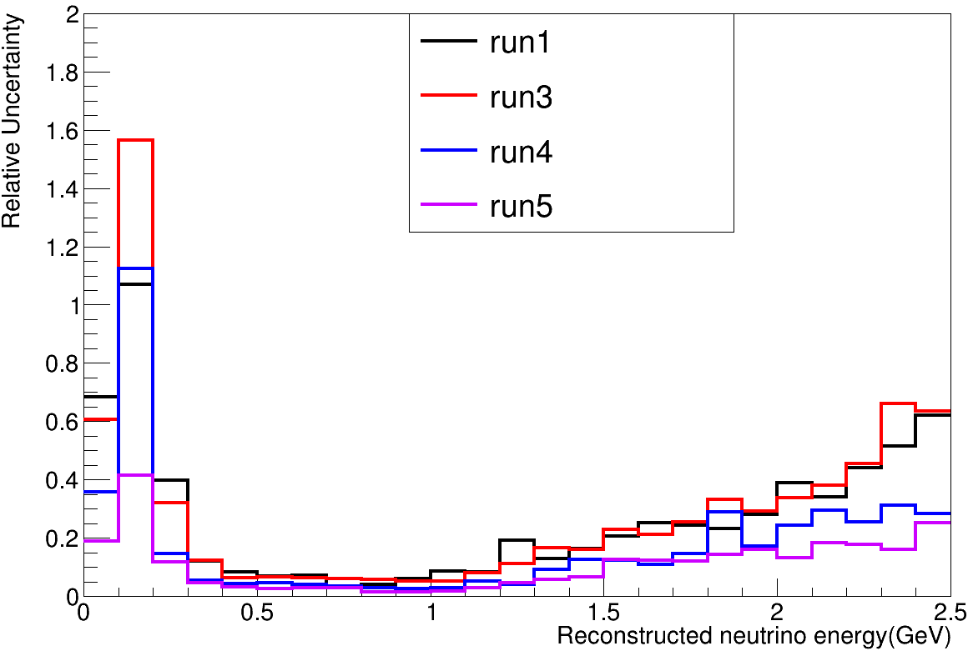
PC $ν_{μ}$CC
Run4
Run5
Period | $χ^{2}$ without constraint(25 bin)
Run1 | 7.59
Run3 | 6.67
Run4 | 27.03
Run5 | 19.66
Detector relative uncertainty

Slide 9
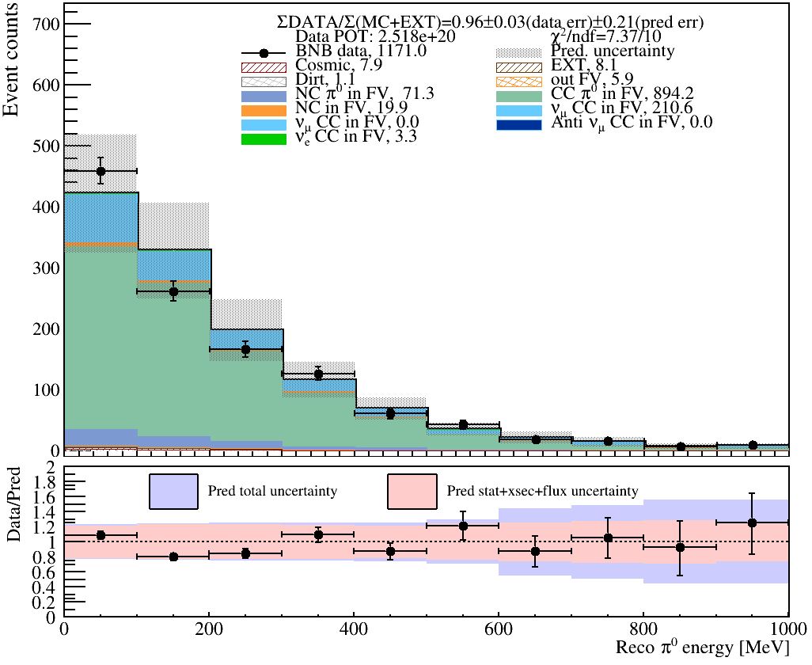
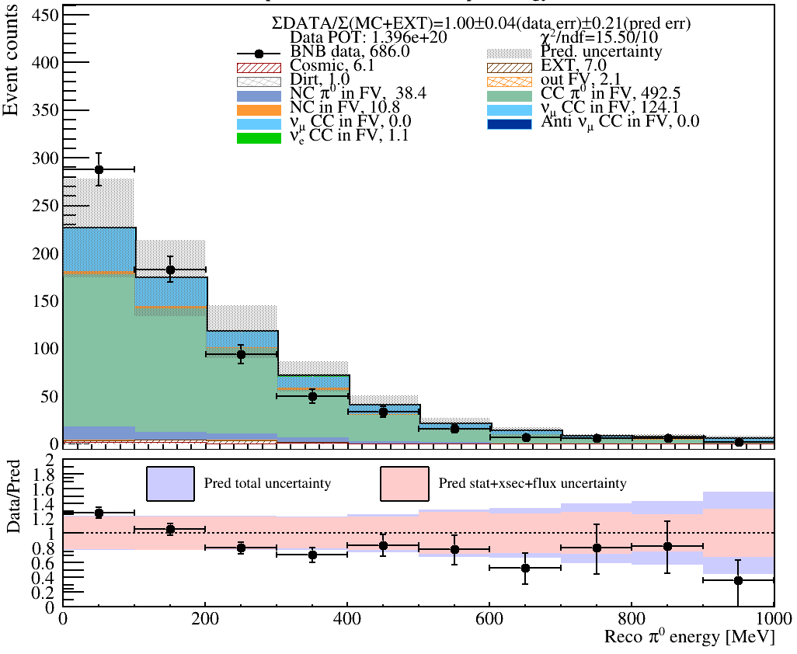
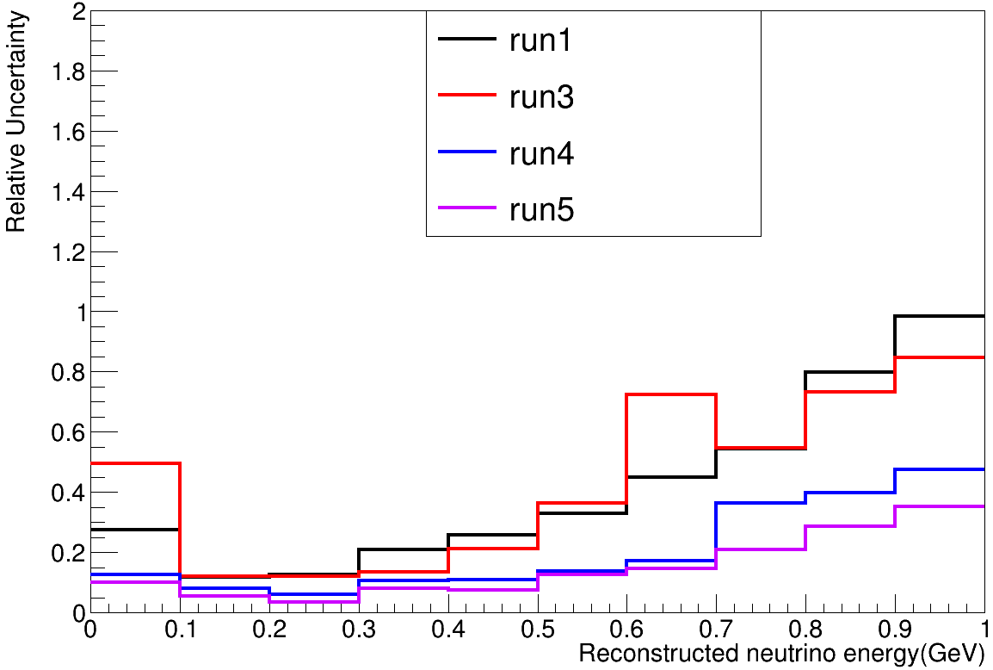
FC CC$π^{0}$
Run4
Run5
Priod | $χ^{2}$ without constraint(10 bin)
Run1 | 4.11
Run3 | 2.61
Run4 | 7.37
Run5 | 15.50
Detector relative uncertainty

Slide 10
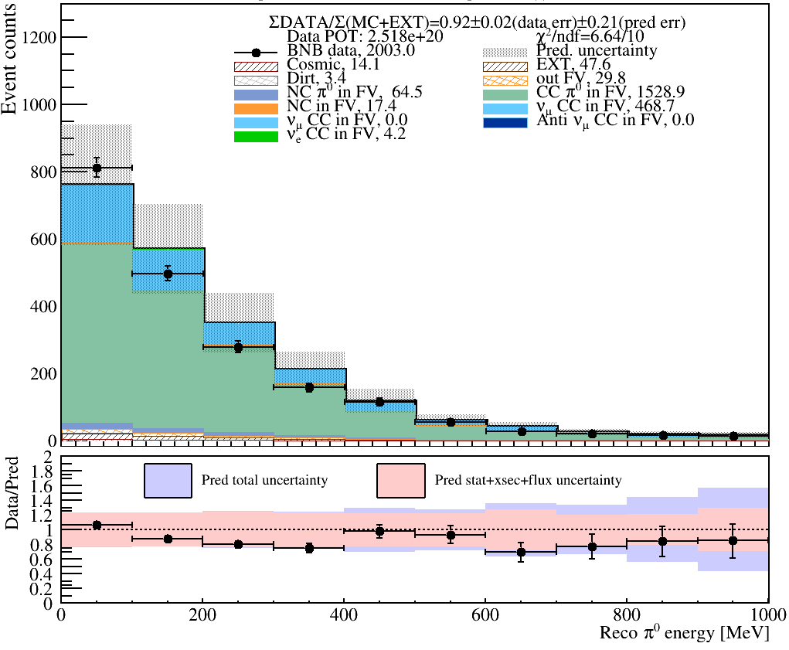
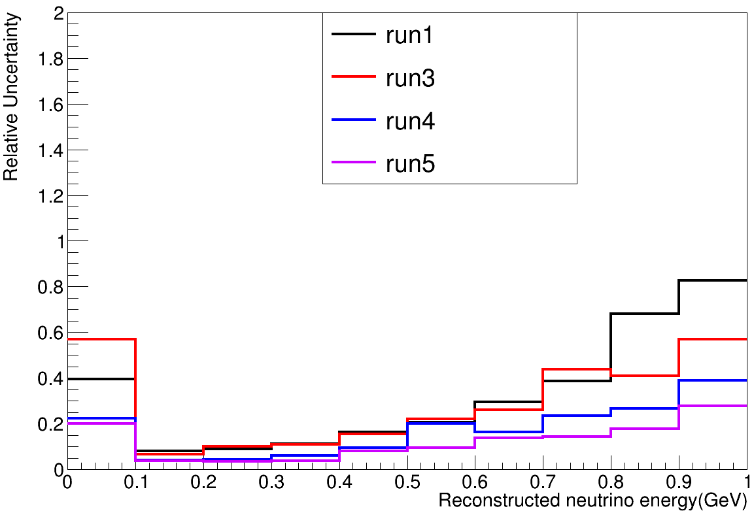
PC CC$π^{0}$
Run4
Run5
Period | $χ^{2}$ without constraint(25 bin)
Run1 | 1.89
Run3 | 5.99
Run4 | 6.64
Run5 | 9.69
Detector relative uncertainty

Slide 11
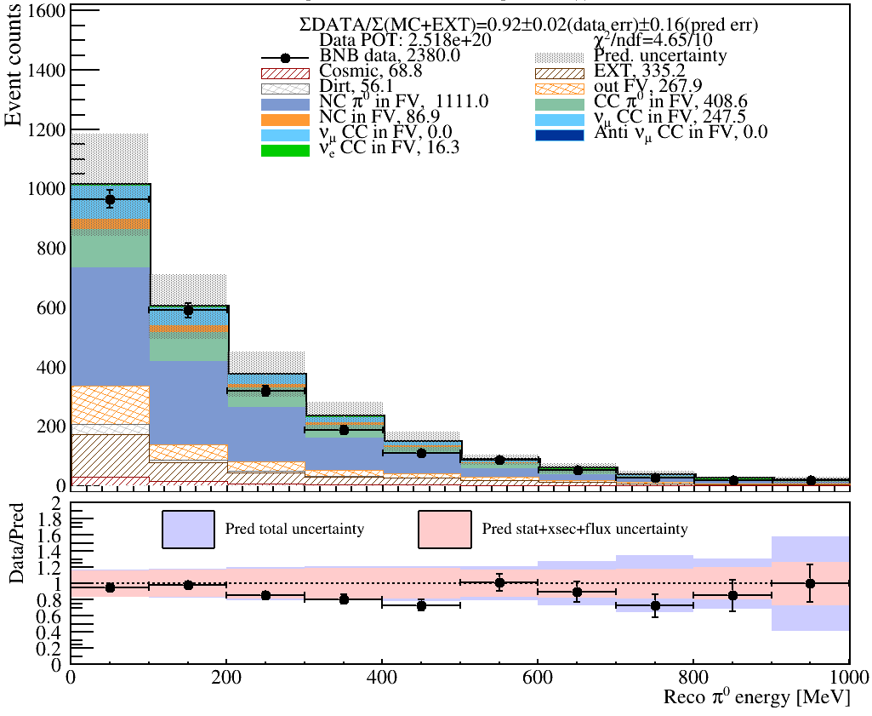
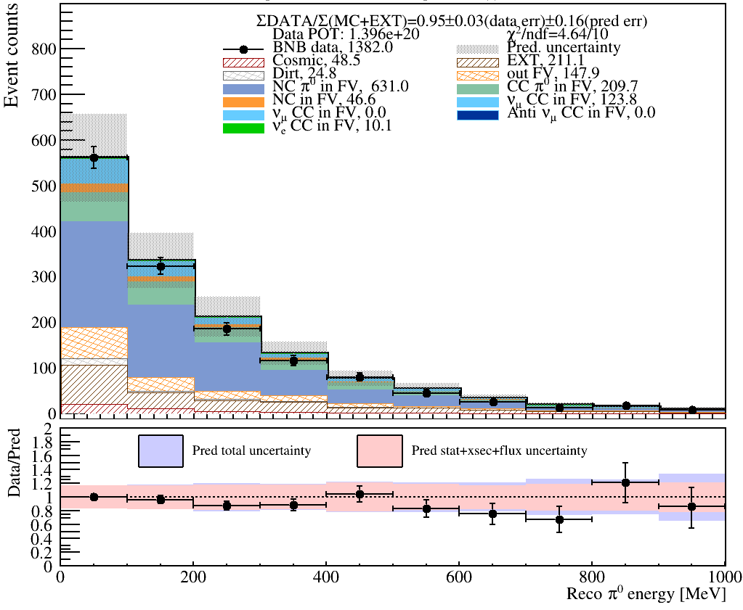
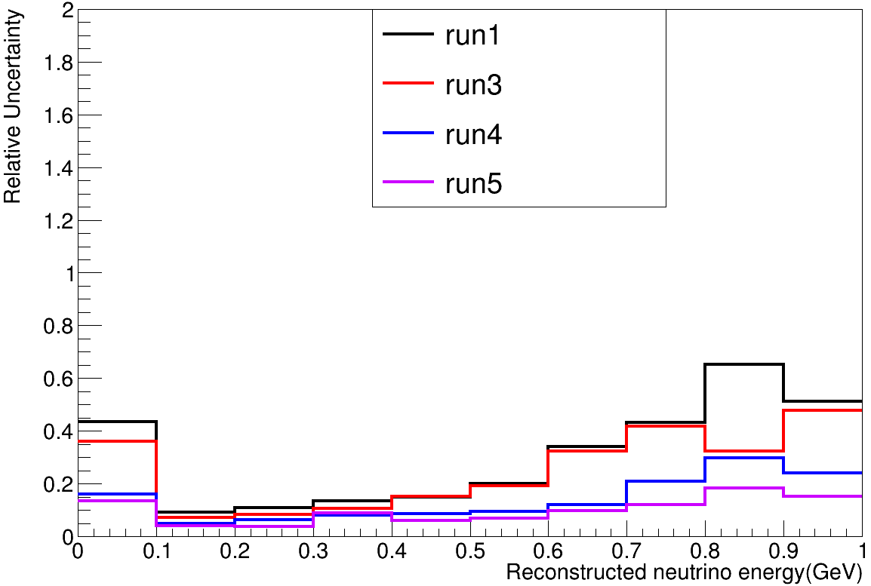
NC$π^{0}$
Run4
Run5
Period | $χ^{2}$ without constraint(25 bin)
Run1 | 2.22
Run3 | 5.63
Run4 | 4.65
Run5 | 4.64
Detector relative uncertainty

Slide 12
Comparison of $χ^{2}$ for each run
Channel | $χ^{2}$ without constraint(with constraint)
 | Run1 | Run3 | Run4 | Run5
FC $ν_{μ}$CC(25 bin) | 7.14 | 8.81 | 15.70 | 33.83
PC $ν_{μ}$CC(25 bin) | 7.59 | 6.67 | 27.03 | 19.66
FC$π^{0}$CC(10 bin) | 4.11 | 2.61 | 7.37 | 15.50
PC$π^{0}$CC(10 bin) | 1.89 | 5.99 | 6.64 | 9.69
NC$π^{0}$(10 bin) | 2.22 | 5.63 | 4.64 | 4.64
Consistence observed only in PC$π^{0}$CC and NC$π^{0}$.

Slide 13
FC $ν_{μ}$CC
PC $ν_{μ}$CC
Run4: spectrum
FC CC$π^{0}$
PC CC$π^{0}$
NC$π^{0}$

Slide 14
FC $ν_{μ}$CC
PC $ν_{μ}$CC
Run5: spectrum
FC CC$π^{0}$
PC CC$π^{0}$
NC$π^{0}$

Slide 15
FC $ν_{μ}$CC: $χ^{2}$
Period | $χ^{2}$ without constraint(25 bin)
Run1 | 7.14
Run3 | 8.81
Run4 | 15.70
Run5 | 33.83
Detector relative uncertainty

Slide 16
PC $ν_{μ}$CC: $χ^{2}$
Period | $χ^{2}$ without constraint(25 bin)
Run1 | 7.59
Run3 | 6.67
Run4 | 27.03
Run5 | 19.66
Detector relative uncertainty

Slide 17
FC CC$π^{0}$: $χ^{2}$
Period | $χ^{2}$ without constraint(10 bin)
Run1 | 4.11
Run3 | 2.61
Run4 | 7.37
Run5 | 15.50
Detector relative uncertainty

Slide 18
PC CC$π^{0}$: $χ^{2}$
Period | $χ^{2}$ without constraint(25 bin)
Run1 | 1.89
Run3 | 5.99
Run4 | 6.64
Run5 | 9.69
Detector relative uncertainty

Slide 19
NC $π^{0}$: $χ^{2}$
Period | $χ^{2}$ without constraint(25 bin)
Run1 | 2.22
Run3 | 5.63
Run4 | 4.65
Run5 | 4.64
Detector relative uncertainty

