Slide 1
2025.4.22 weekly group meeting
Yunhe Yang¹,
¹NanKai University

Slide 2
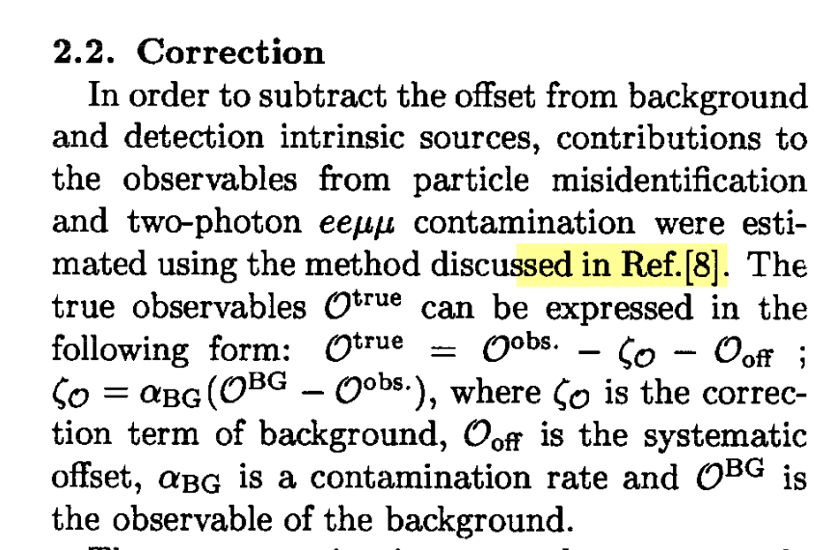
Offset or uncertainty?
correction terms of the background($ζ_{𝒪}$)
$$ζ_{𝒪}=α_{BG}(𝒪^{BG}−𝒪^{obs})$$
$α_{BG}$ is a contamination rate and $𝒪^{BG}$ is the observable of the background
systematic offset($𝒪_{off}$)
Belle is an asymmetric collision but BES is a symmetric collision. Do we need systematic offset?

