Slide 1
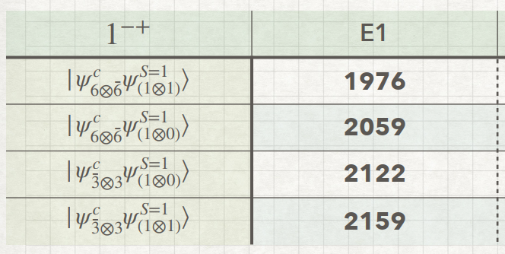
Results

Slide 2
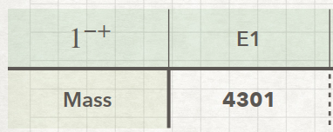

Slide 3
Predictions
0-+
1++
0-+
1+-
1+-

Slide 4
Studying Plan
2025.04.22
Current working:
1. Discuss results and prediction.
Next planning:
1. Keep writing thesis.

