Slide 1
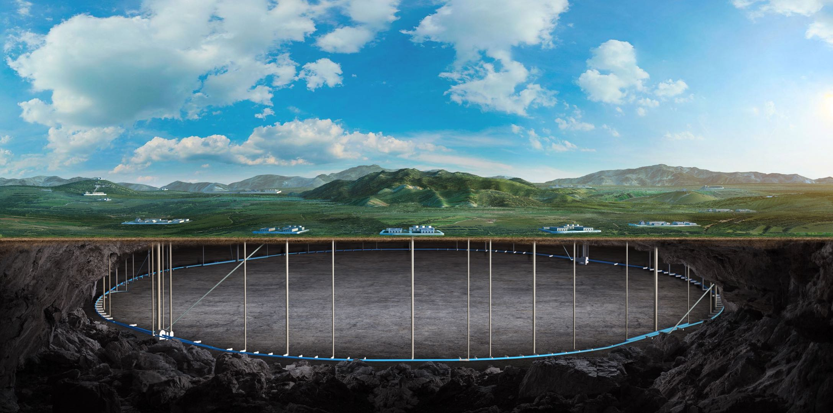
Higher-order field error sensitivity analysis and requirements
Bin Wang
(on the behalf of the CEPC error correction team)
institute of high energy physics
2025.05.23
CEPC Day (MAY 23, 2025)

Slide 2
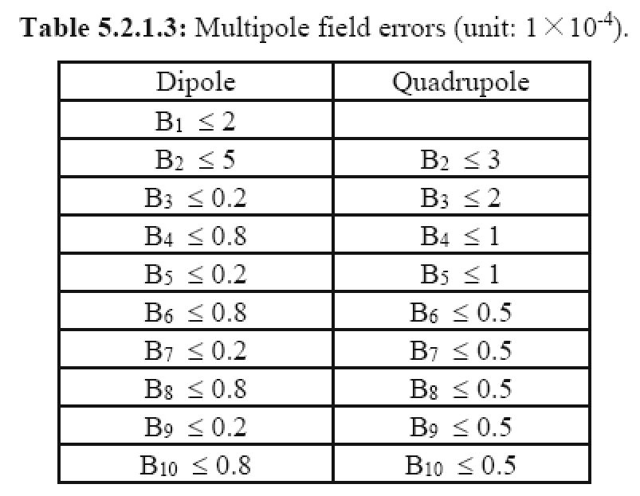
Introduction
B2 ~ B10 of the Quadrupole is considered. Higgs Lattice with error correction is used.
Multipole errors in the magnet are calculated on reference radius Rref = 12 mm.
Using ${10}^{−6}$ as the unit, we scan the multipole field errors from ${10}^{−5}$ to ${10}^{−3}$.
The requirement is to preliminarily determine the value at the onset of dynamic aperture reduction.
The field errors in IR region and arc region are studied independently.
CEPC TDR
2

Slide 3
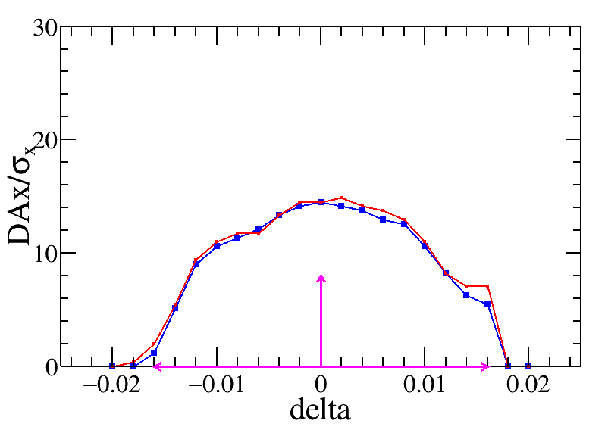
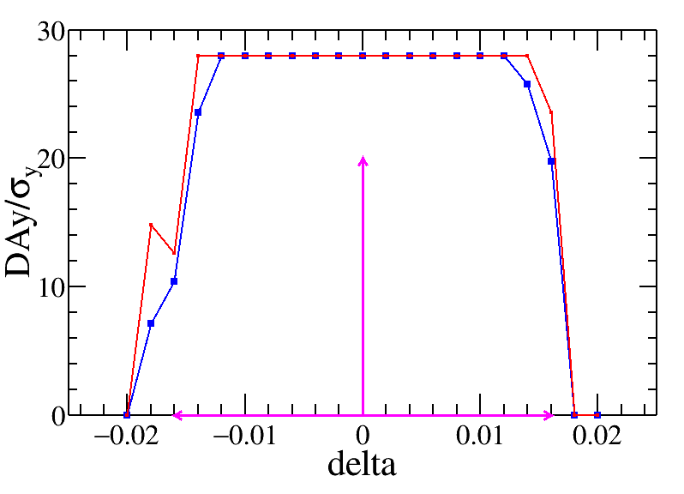
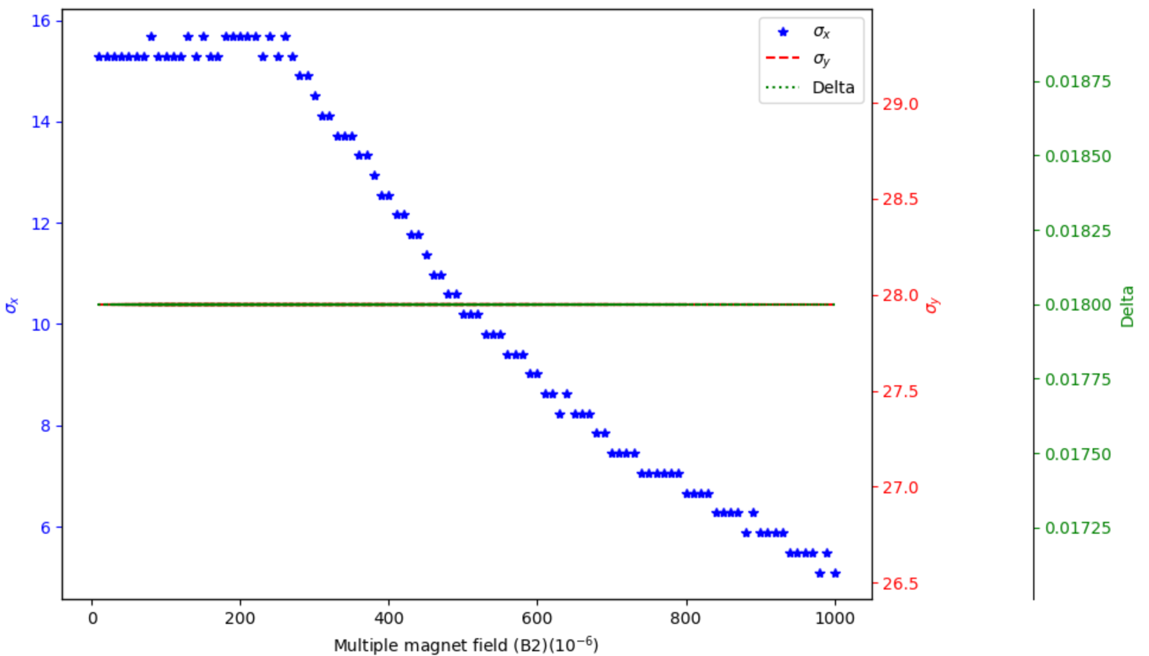
B2 in IR quadrupole
$$3×{10}^{−4}$$
The red and blue curves show the DAs without and with higher-order field error.
‌The scanning results indicate a gradual reduction in horizontal DA with increasing higher-order field errors, while the vertical DA and the momentum acceptance are stable.
‌$3×{10}^{−4}$ is preliminarily set to the requirement of B2 in the IR quadrupole magnets.
3

Slide 4
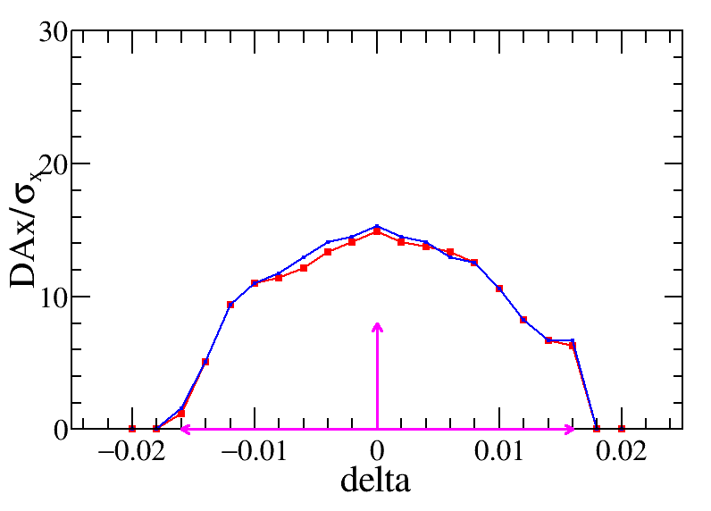
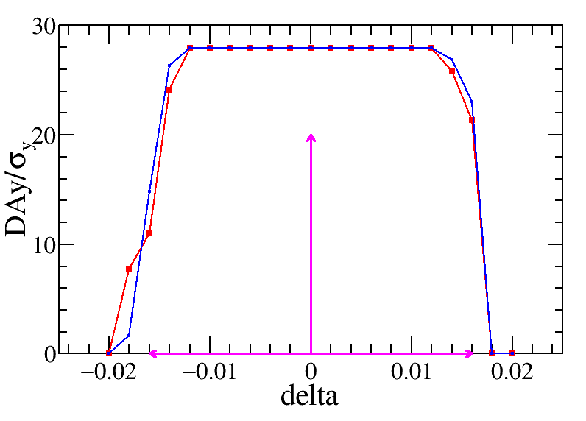
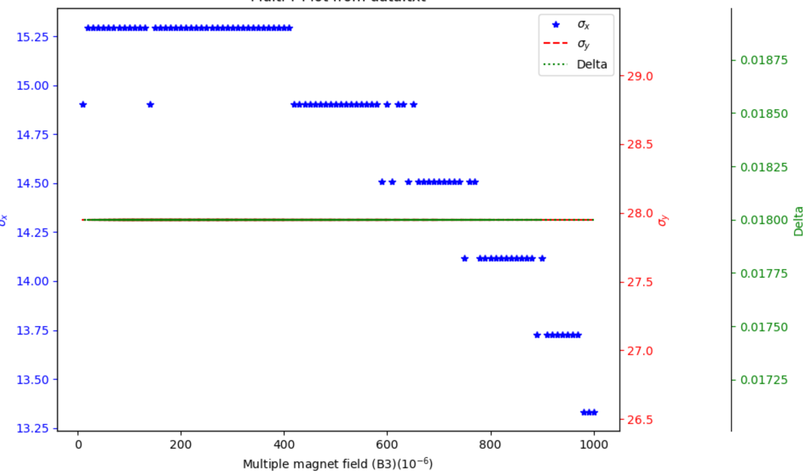
B3 in IR quadrupole
$$4×{10}^{−4}$$
‌$4×{10}^{−4}$ is preliminarily set to the requirement of B3 in the arc quadrupole magnets.
4

Slide 5
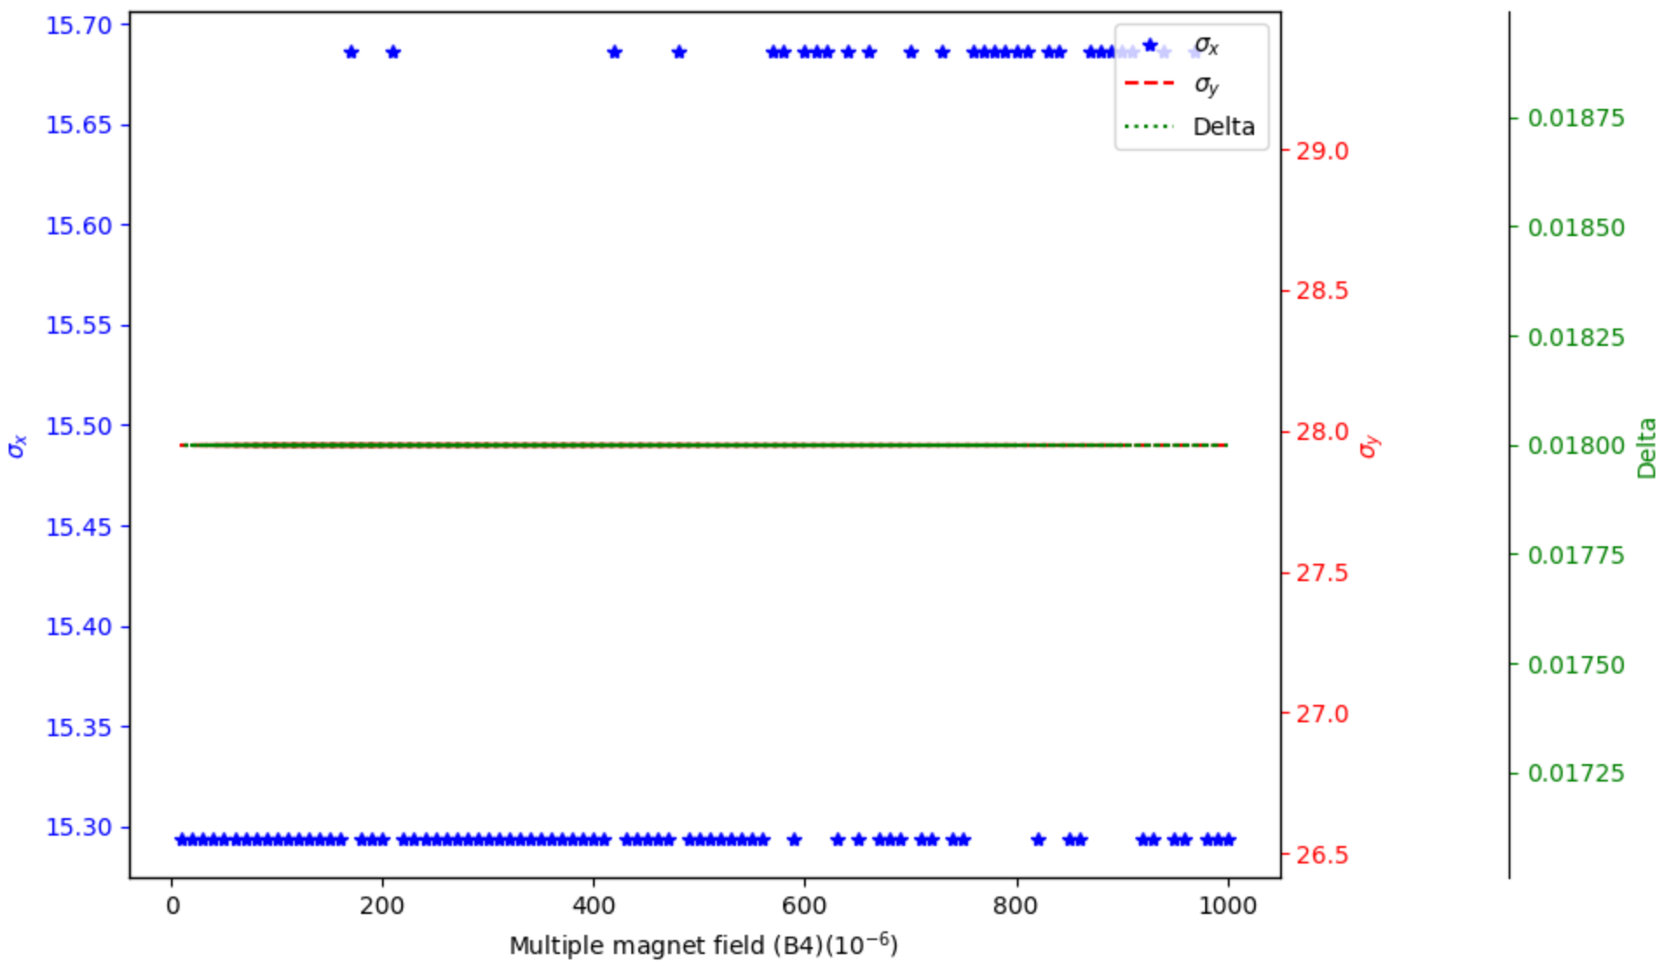
B4 in IR quadrupole
$$4×{10}^{−4}$$
‌No obvious DA reduction with adding the B4 – B10 in IR quadrupole.
By check the detail DA plots, conservatively, $4×{10}^{−4}$ is preliminarily set to the requirement of B4 in the arc quadrupole magnets.
5

Slide 6
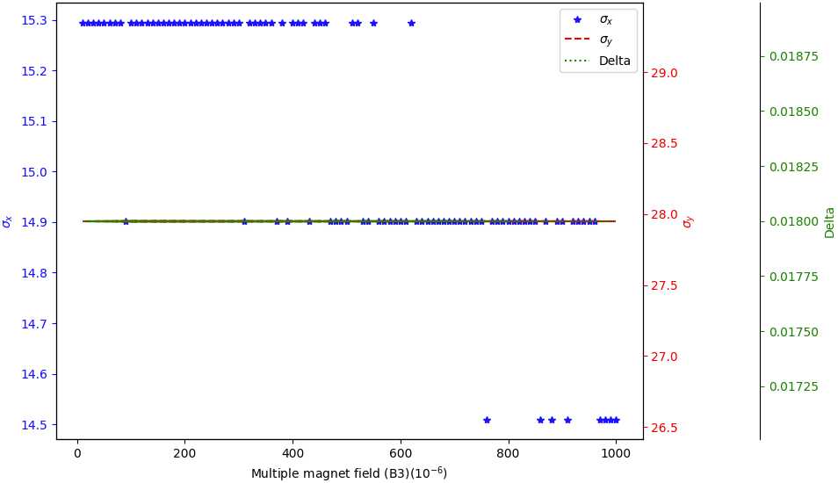
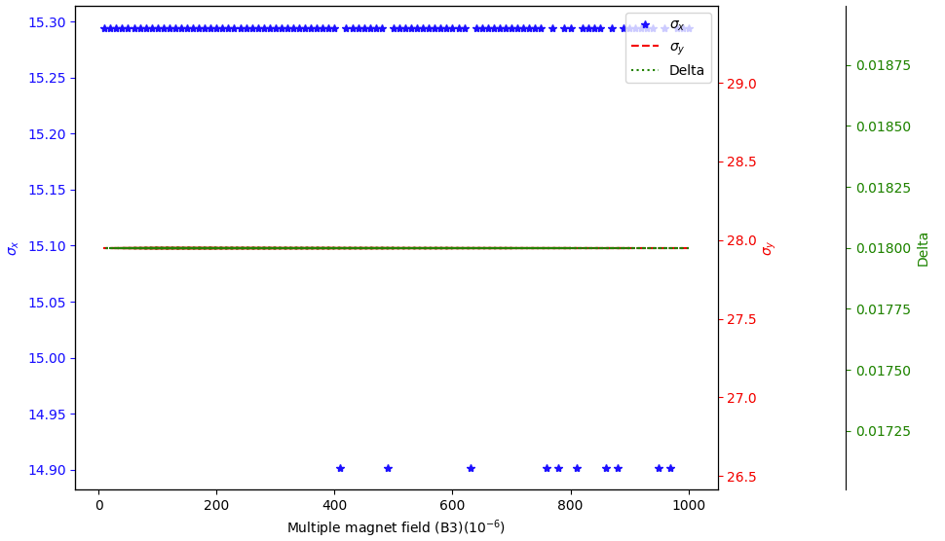
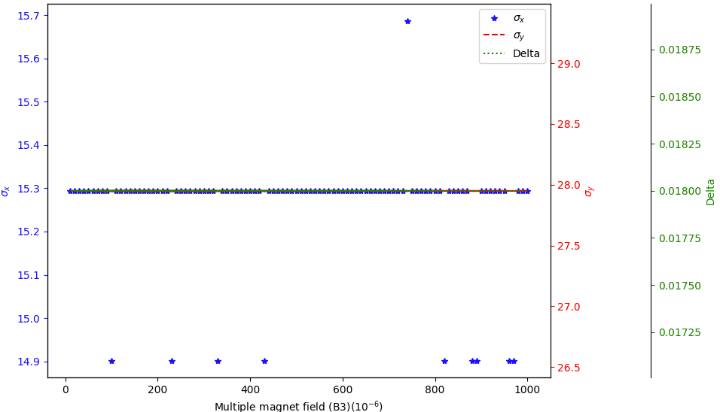
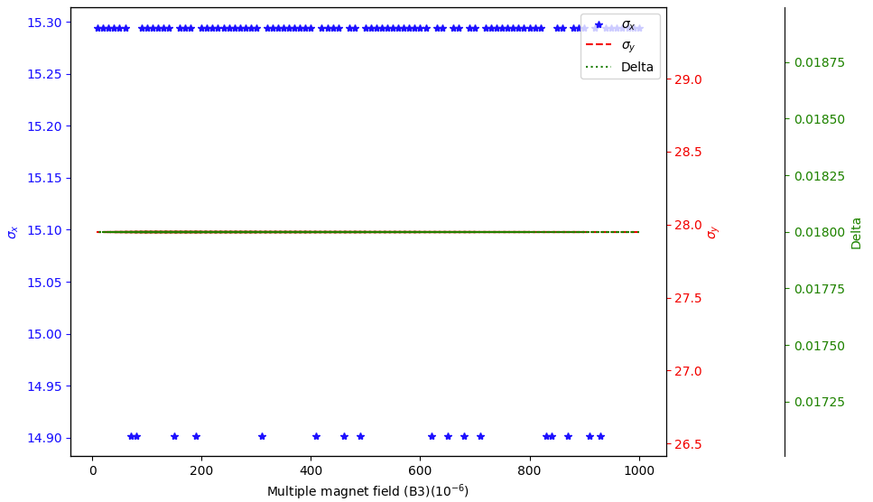
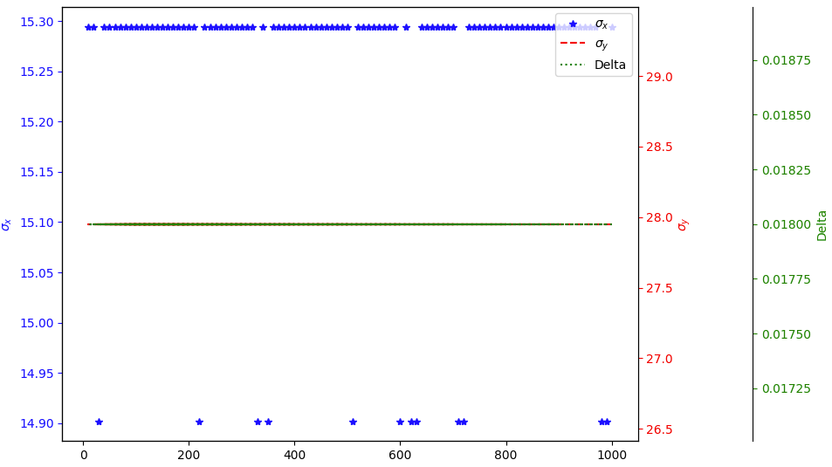
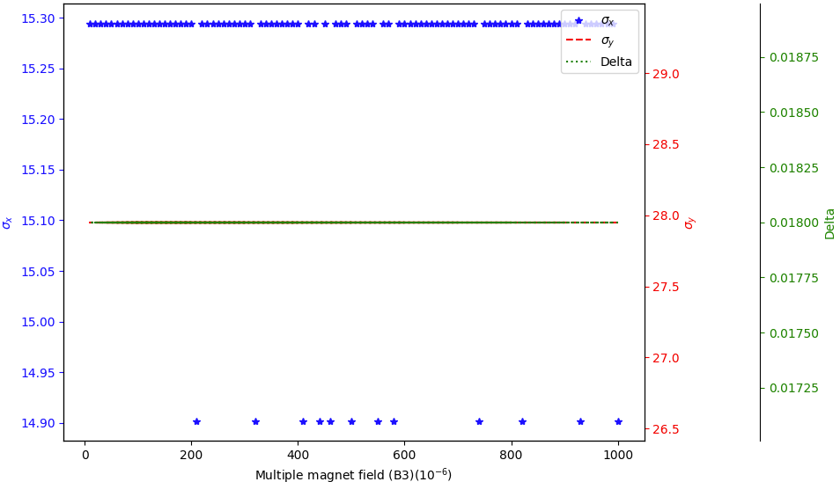
B5-B10 in IR quadrupole
B5
B6
B7
B8
B9
B10
6

Slide 7
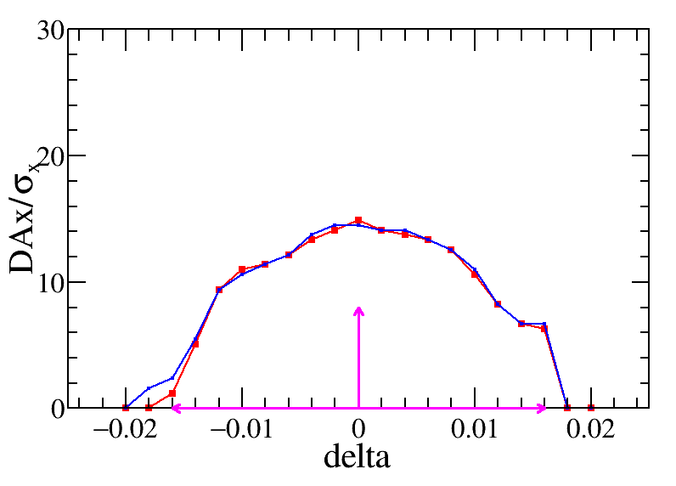
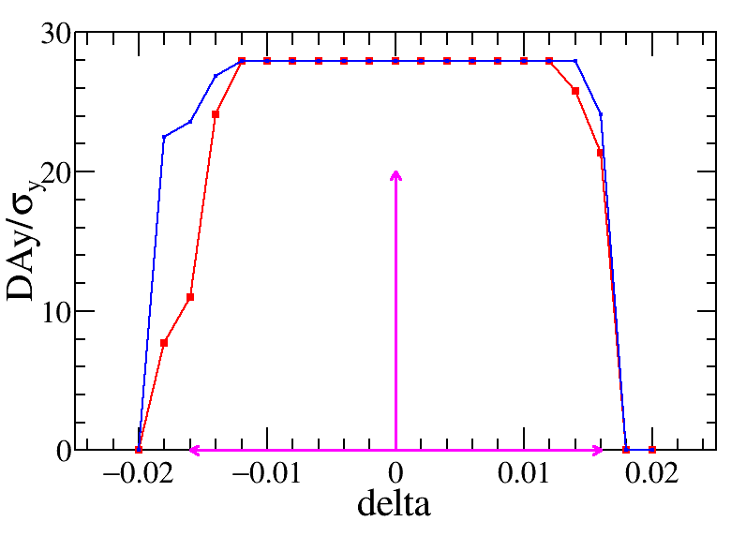
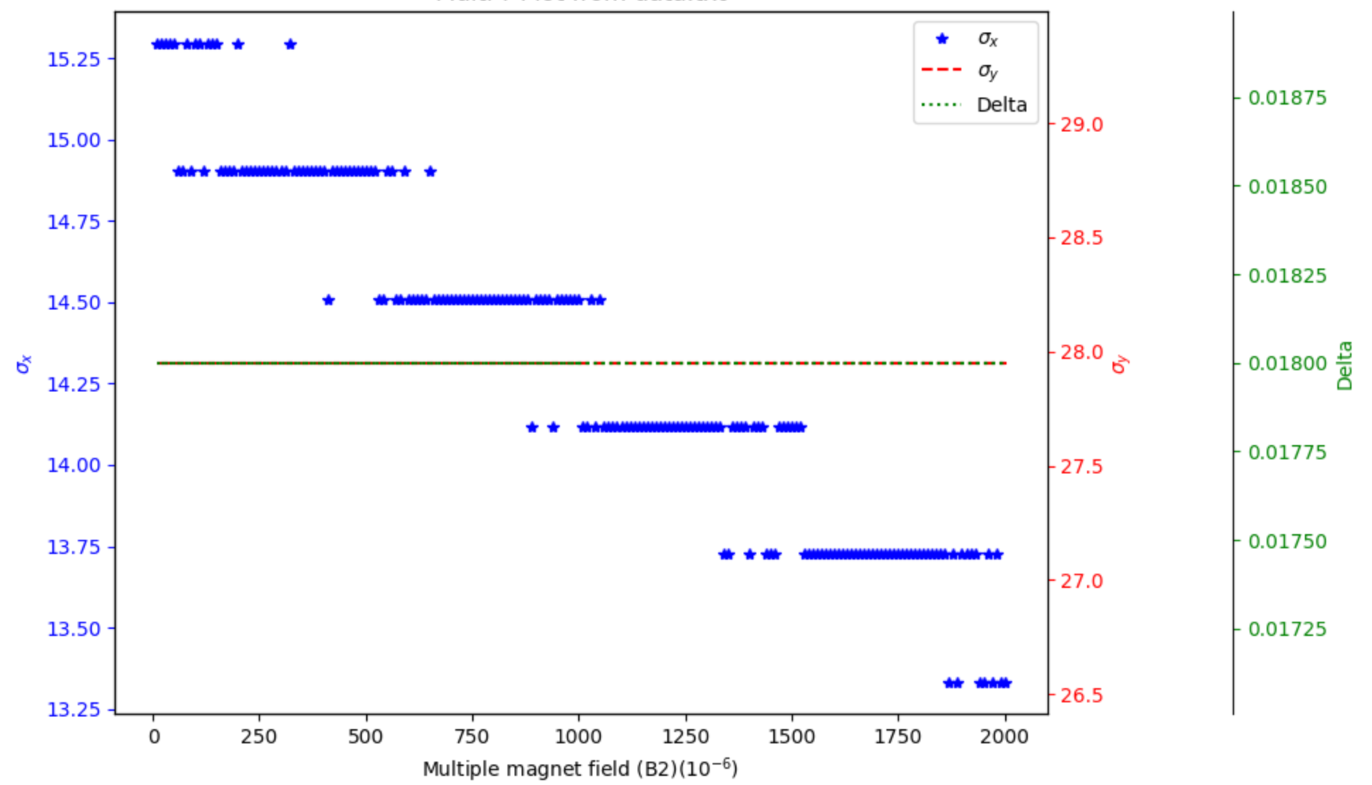
B2 in ARC quadrupole
$$4×{10}^{−4}$$
‌$4×{10}^{−4}$ is preliminarily set to the requirement of B3 in the arc quadrupole magnets.
7

Slide 8
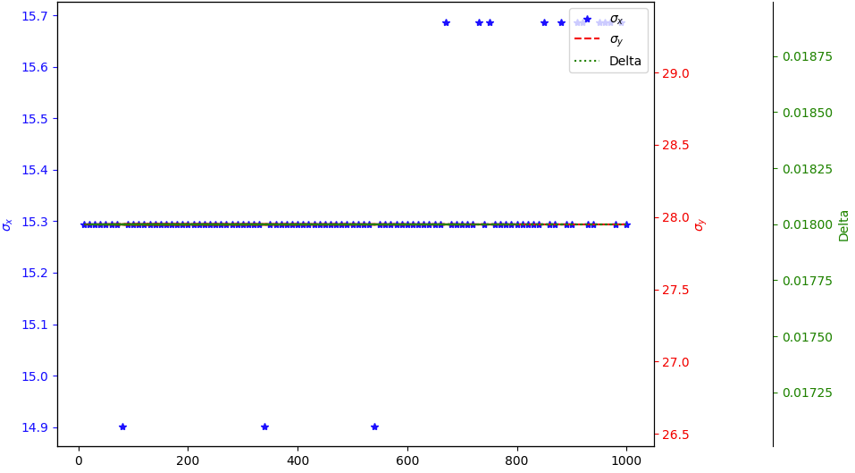
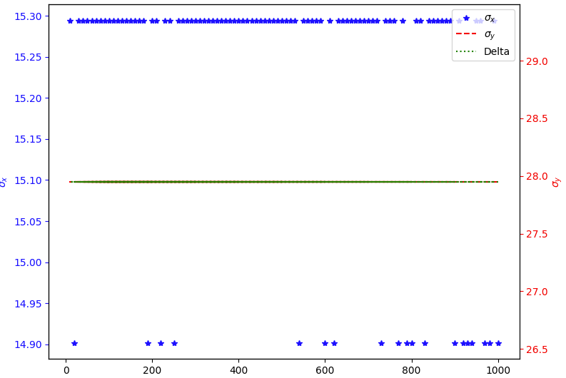
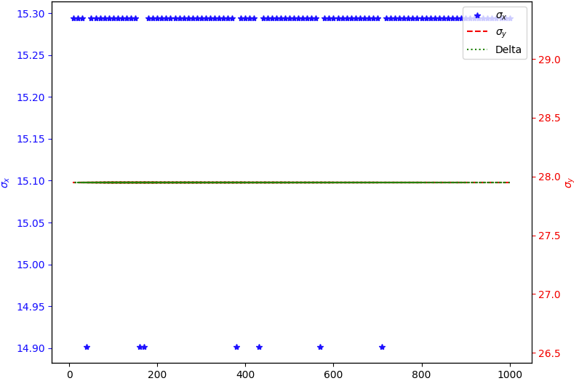
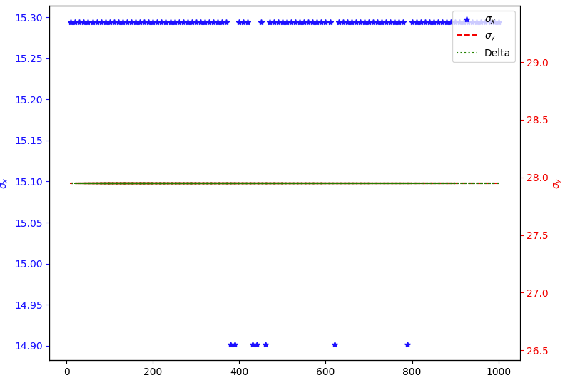
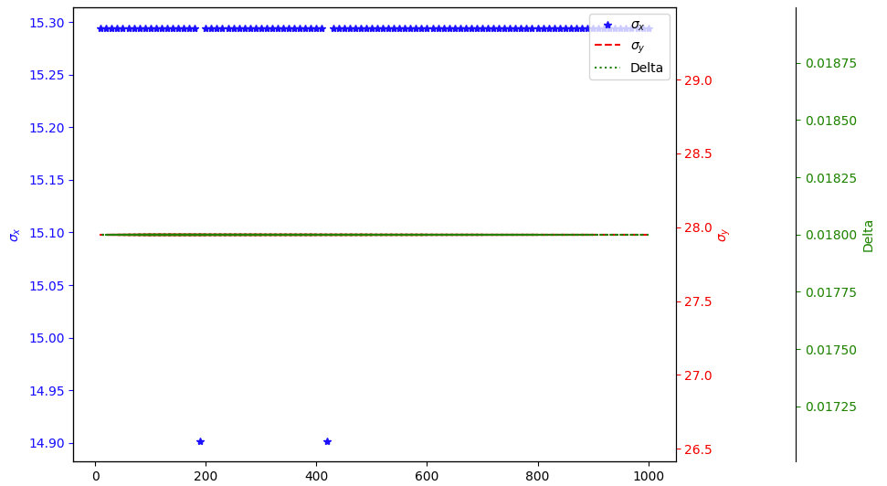
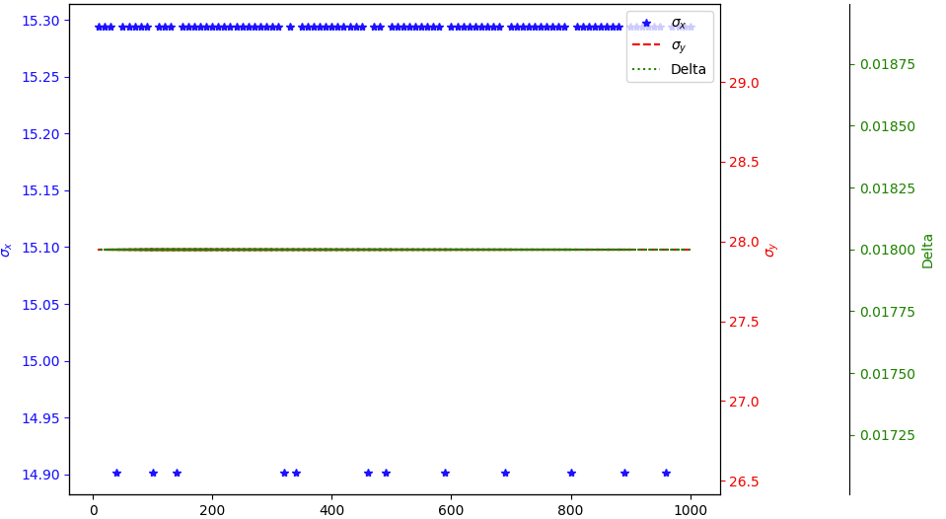
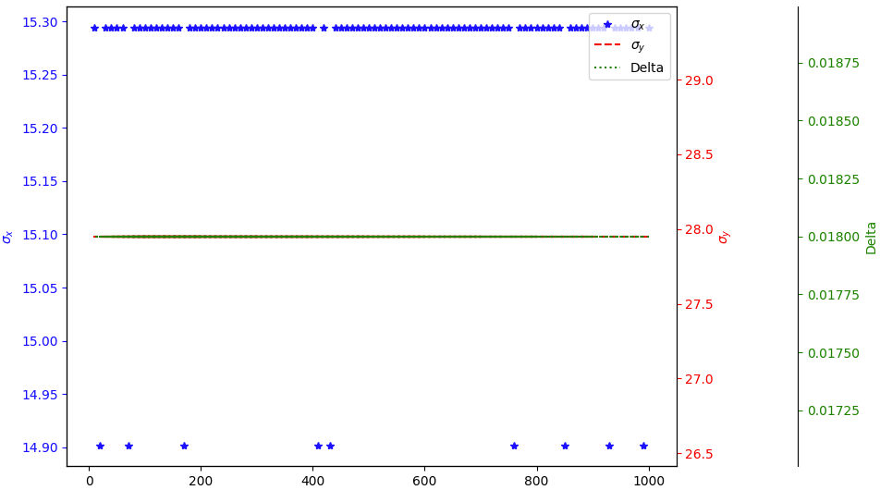
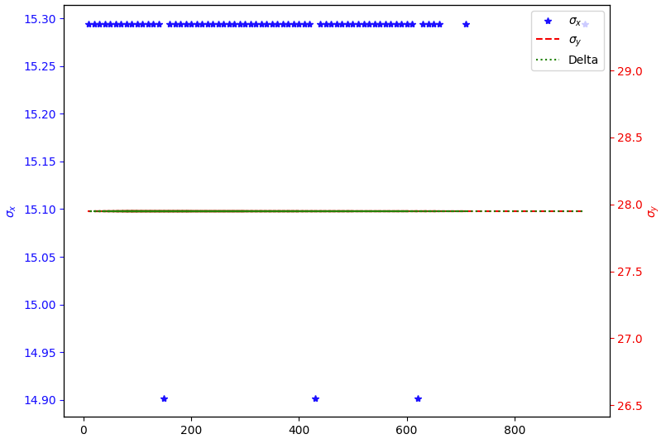
B3-B10 in ARC quadrupole
8

Slide 9
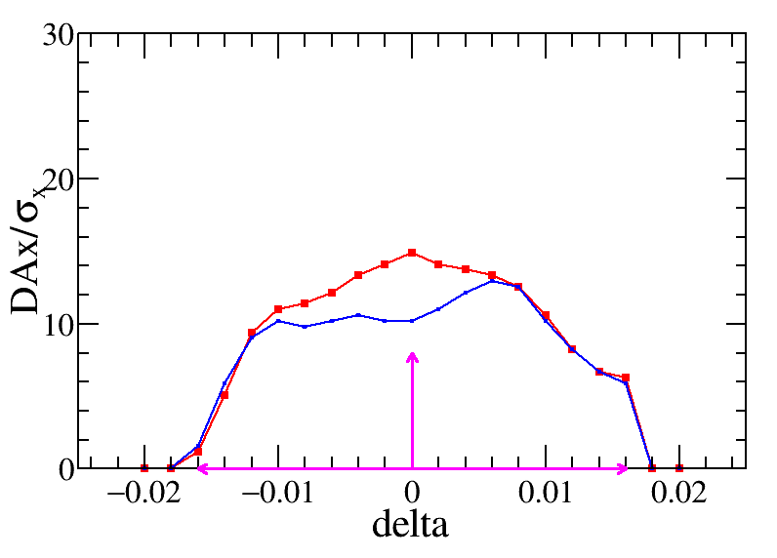
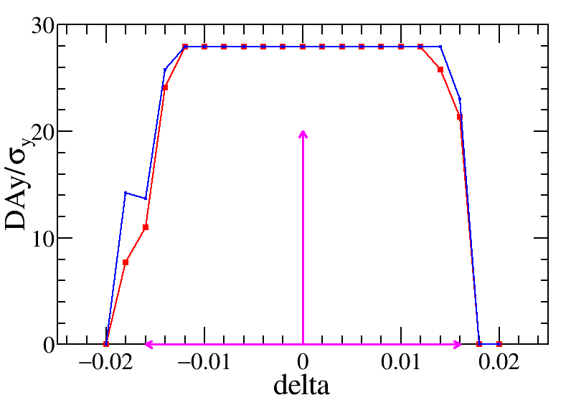
DA result with all higher-order field errors in quadrupole magnets
Quadrupole field errors | IR (${10}^{−4}$) | ARC (${10}^{−4}$)
B2 | $$≤3$$ | $$≤3$$
B3 | $$≤2$$ | $$≤2$$
B4 | $$≤1$$ | $$≤1$$
B5 | $$≤1$$ | $$≤1$$
B6 | $$≤0.5$$ | $$≤0.5$$
B7 | $$≤0.5$$ | $$≤0.5$$
B8 | $$≤0.5$$ | $$≤0.5$$
B9 | $$≤0.5$$ | $$≤0.5$$
B10 | $$≤0.5$$ | $$≤0.5$$
Clear horizontal DA reduction with higher-order field errors in quadrupole magnets.
9

Slide 10
Summary and To-do list
The higher-order magnet fields in the quadrupole magnets are detailed analyzed.
The horizontal DA clearly decrease with increasing higher-order field errors, while the vertical DA and momentum acceptance are stable, further check is necessary.
The results show that the B2 and B3 of quadrupole exhibit higher sensitivity to dynamic aperture.
An preliminary requirement of higher-order fields is released, the DA with this requirement shows
More detail analyze as well as for dipole and sextupole higher-order fields are ongoing, the corresponding tec. Note is under preparation.
10

Slide 11
Thank you for your attention
E-mail:
wangbin@ihep.ac.cn

