Slide 1
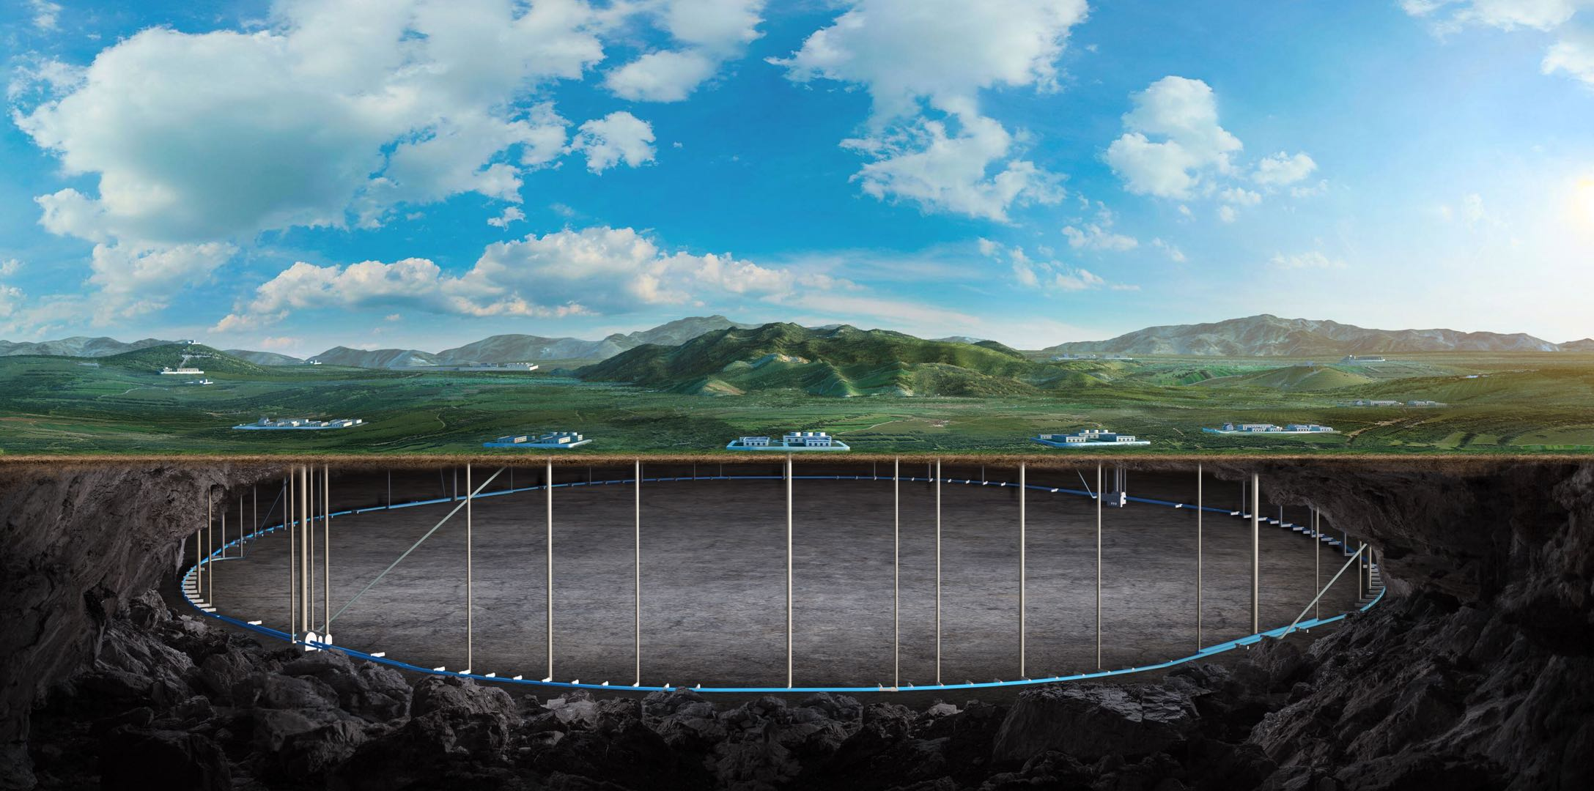
Higher-order field error sensitivity analysis and requirements
Bin Wang
(on the behalf of the CEPC error correction team)
institute of high energy physics
2025.05.23
CEPC Day (MAY 23, 2025)

Slide 2
Introduction
B2 ~ B10 of the Quadrupole is considered.
The Higgs Lattice with error correction is used.
Multipole errors in the magnet are calculated on reference radius Rref = 12 mm.
Using ${10}^{−6}$ as the unit, we scan the multipole field errors from ${10}^{−5}$ to ${10}^{−3}$.
The higher filed requirement is configured as the initial value when dynamic aperture reduction begins. The higher field errors in IR region and arc region are studied independently.
Dipole | Quadrupole | Sextupole
B₂/B₀≤4×10⁻⁴ B₃/B₀≤0.8×10⁻⁴ B₄/B₀≤0.2×10⁻⁴ B_{n}(n>4)/B₀≤0.8×10⁻⁴ | B₂/B₁≤4×10⁻⁴ B₃/B₁≤4×10⁻⁴ B₄/B₁≤2×10⁻⁴ B_{n}(n>4)/B₁≤1×10⁻⁴ | B₃/B₂≤20×10⁻⁴ B₄/B₂≤3×10⁻⁴ B₅/B₂≤20×10⁻⁴ B_{n}(n>5)/B₂≤10×10⁻⁴
C. H. Yu, High luminosity scheme at Higgs energy, The 2020 international workshop on the high energy Circular Electron-Positron Collider, ShangHai, Oct. 26-28, 2020
2

Slide 3
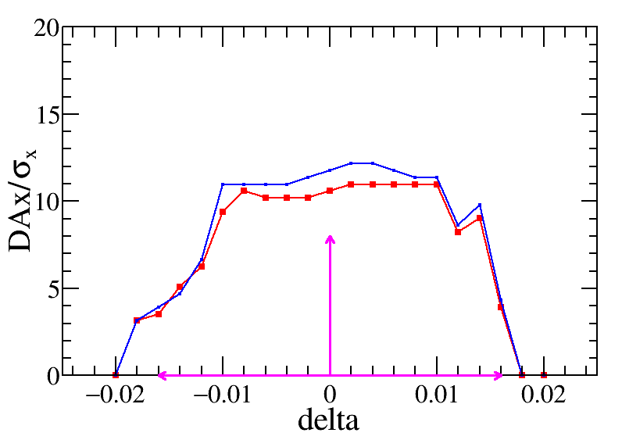
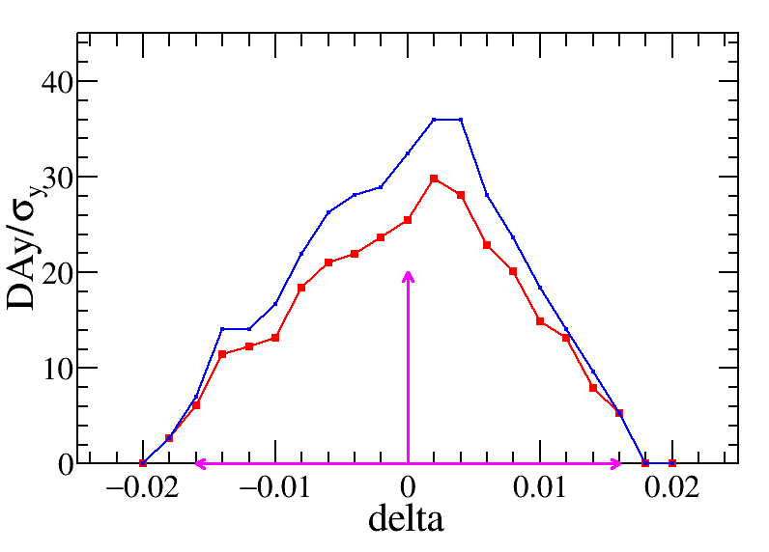
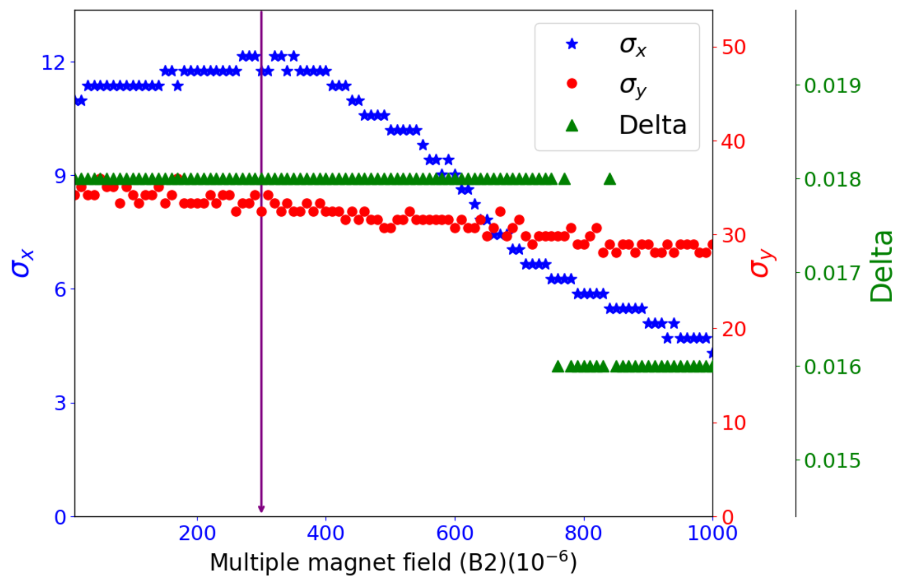
B2 in IR quadrupole
$$3×{10}^{−4}$$
For the left and middle plots, the red and blue curves show the DAs without and with higher-order field error, the pink arrows show the DA requirement.
‌The scanning results indicate a gradual reduction in horizontal DA with increasing higher-order field errors, while the vertical DA and the momentum acceptance are stable.
‌$3×{10}^{−4}$ is preliminarily set to the requirement of B2 in the IR quadrupole magnets.
3

Slide 4
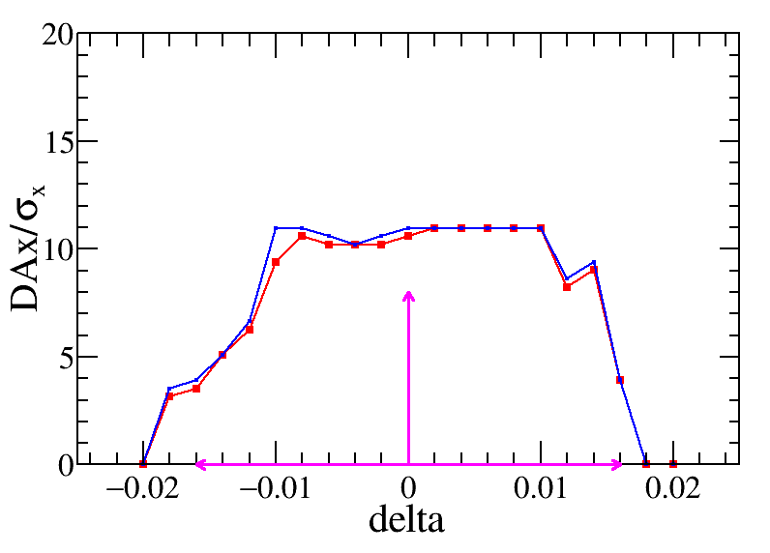
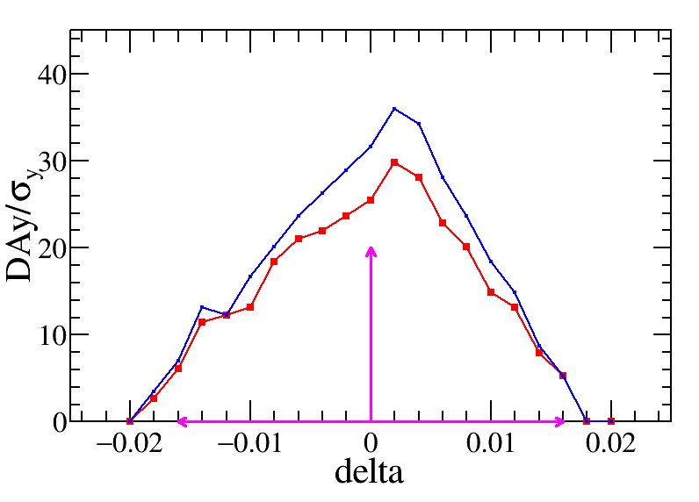
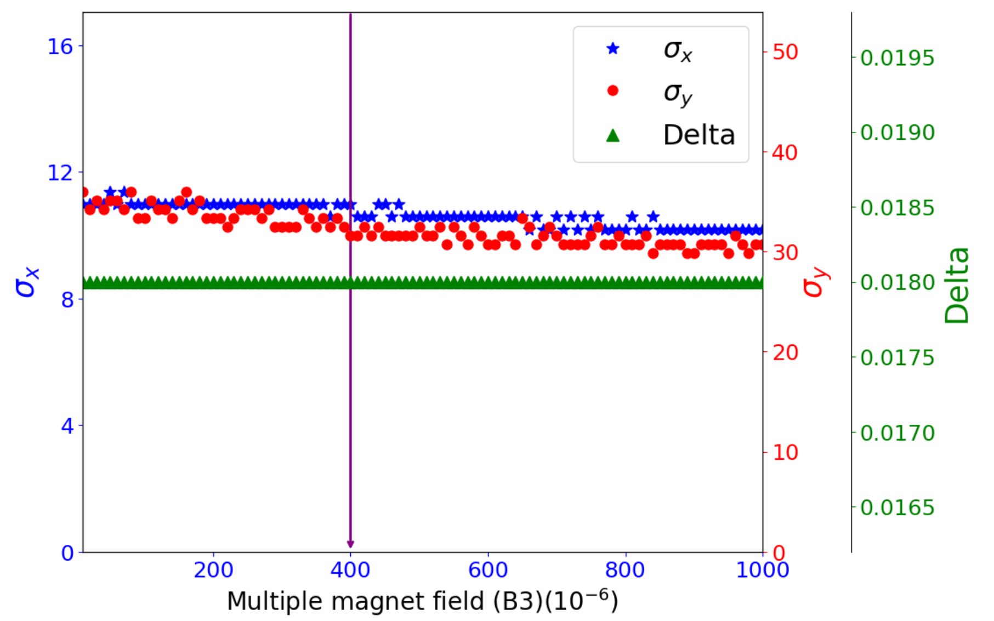
B3 in IR quadrupole
$$4×{10}^{−4}$$
‌$4×{10}^{−4}$ is preliminarily set to the requirement of B3 in the arc quadrupole magnets.
4

Slide 5
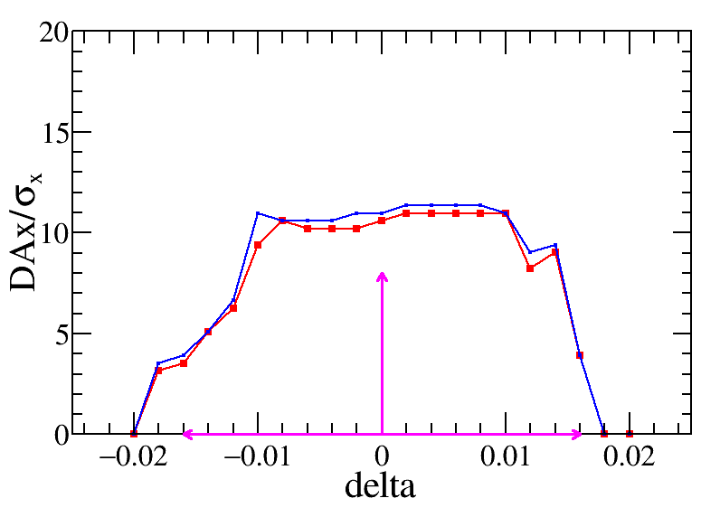
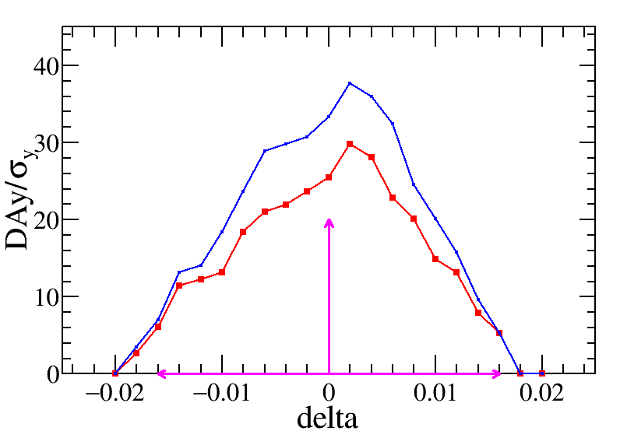
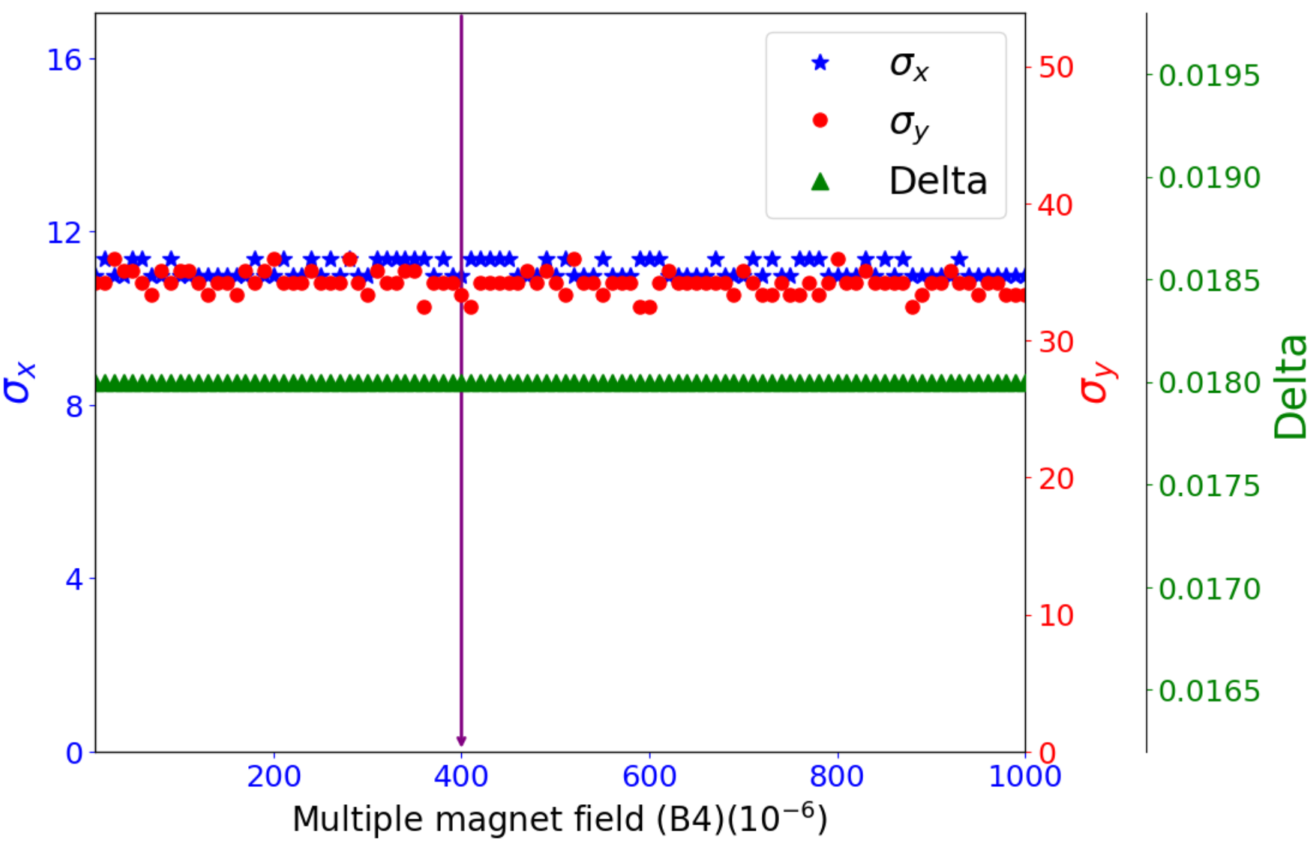
B4 in IR quadrupole
$$4×{10}^{−4}$$
‌No obvious DA reduction with adding the B4 – B10 in IR quadrupole.
By check the detail DA plots, conservatively, $4×{10}^{−4}$ is preliminarily set to the requirement of B4 in the arc quadrupole magnets.
5

Slide 6
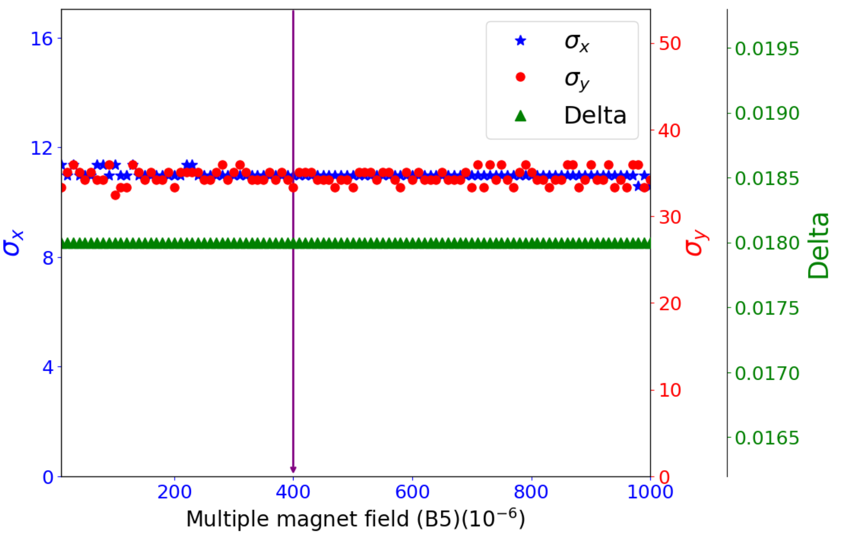
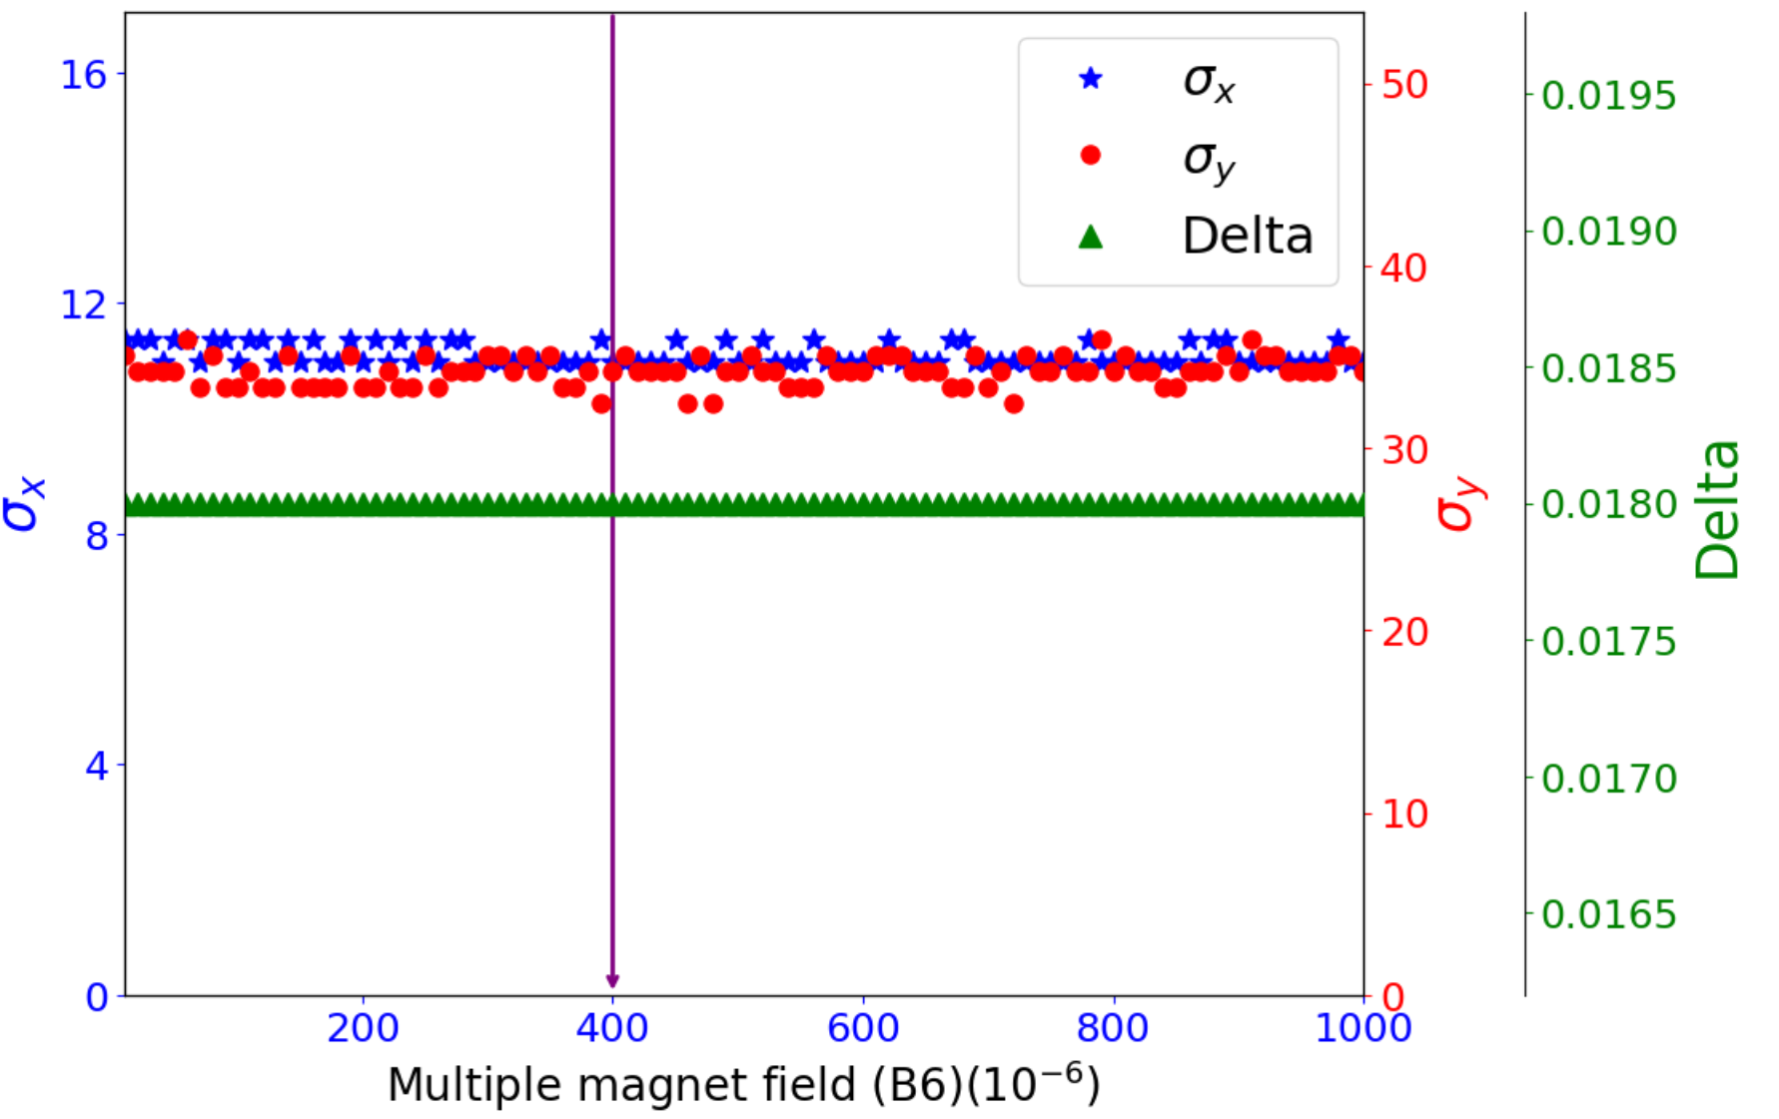
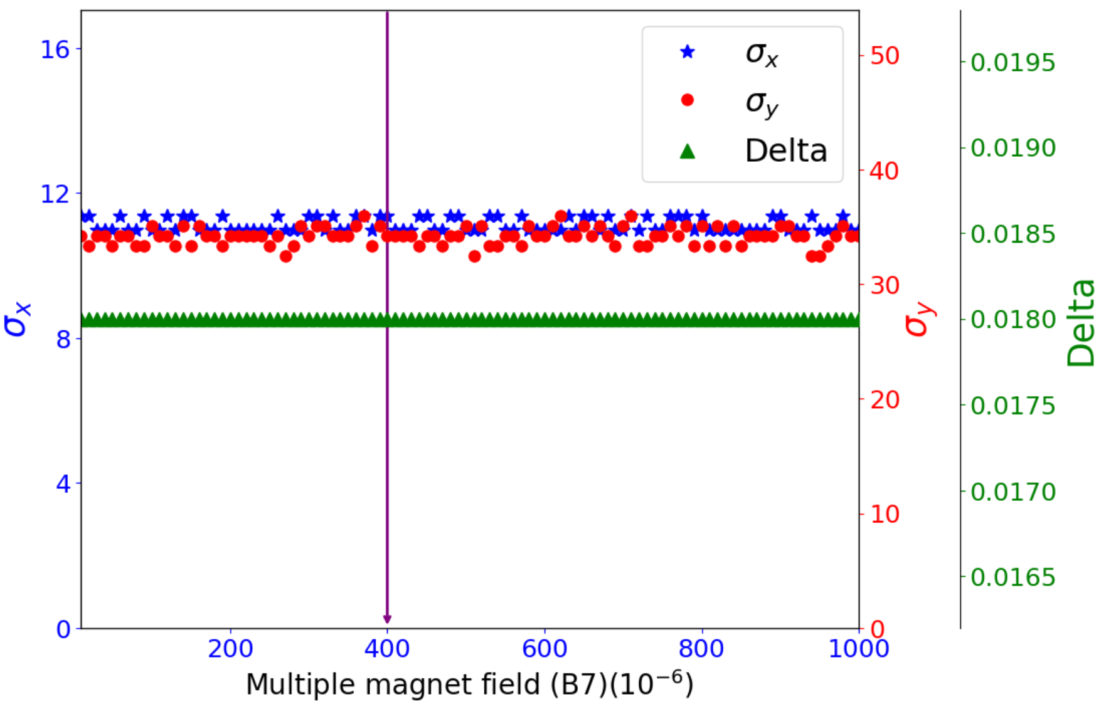
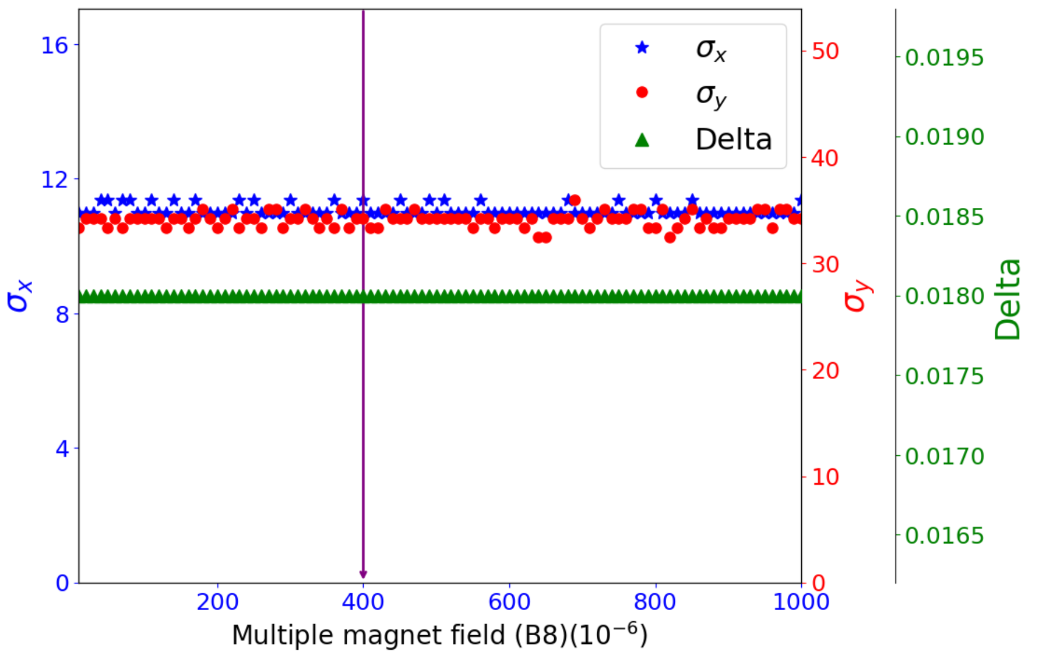
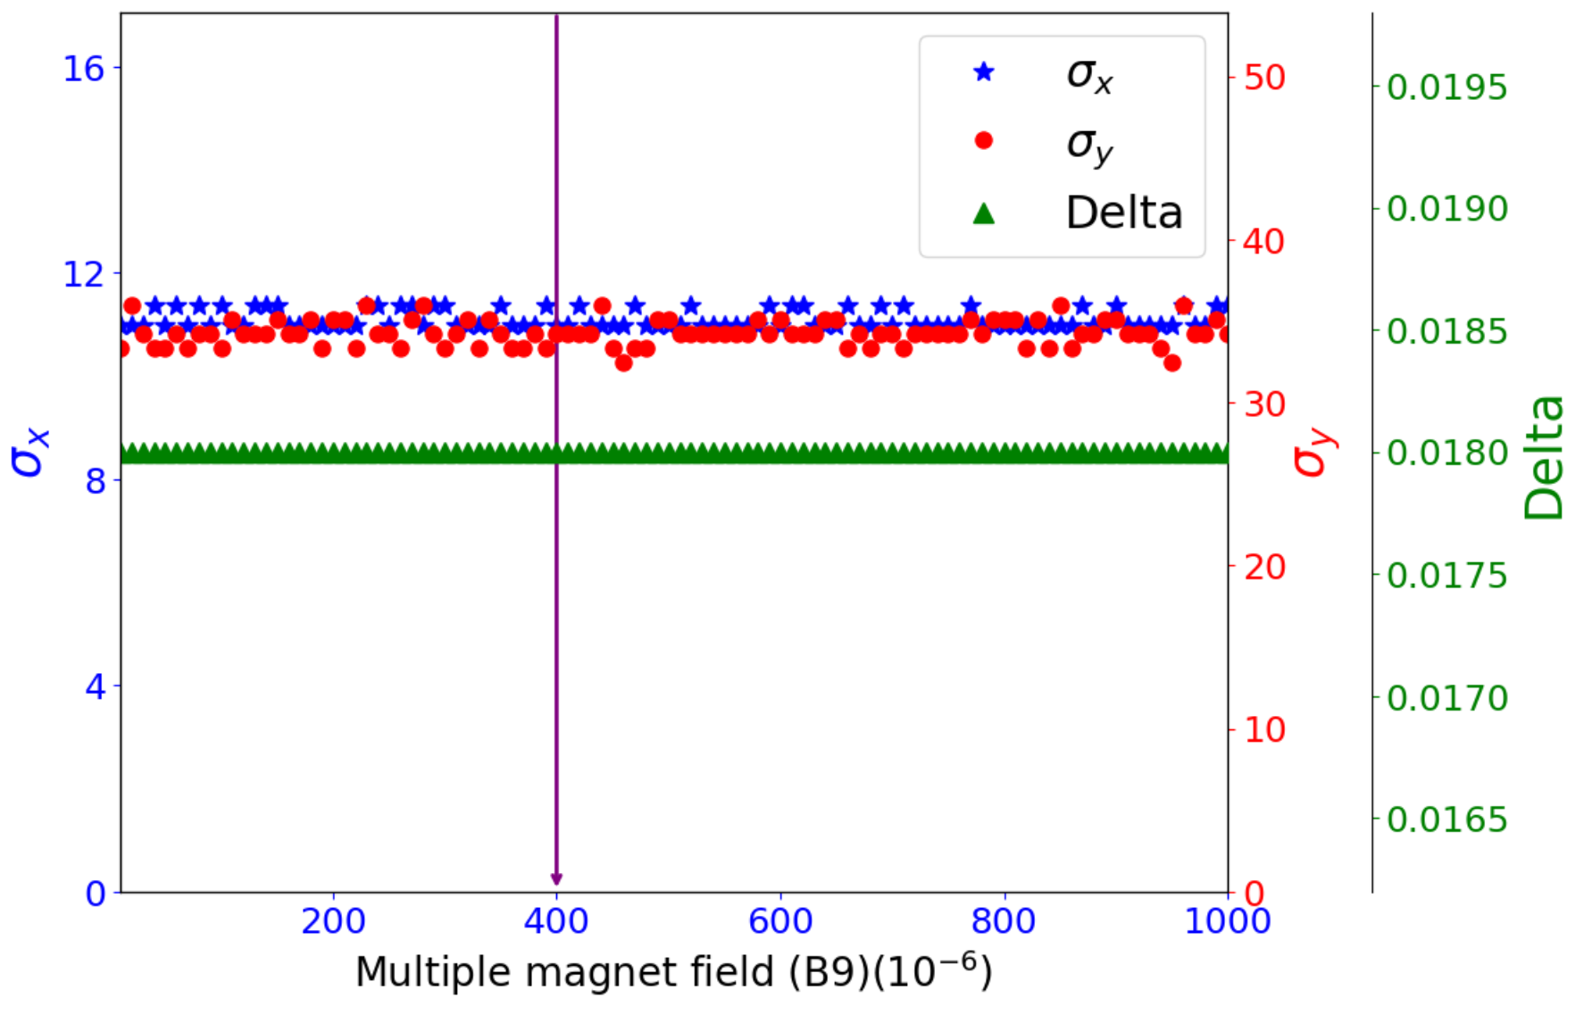
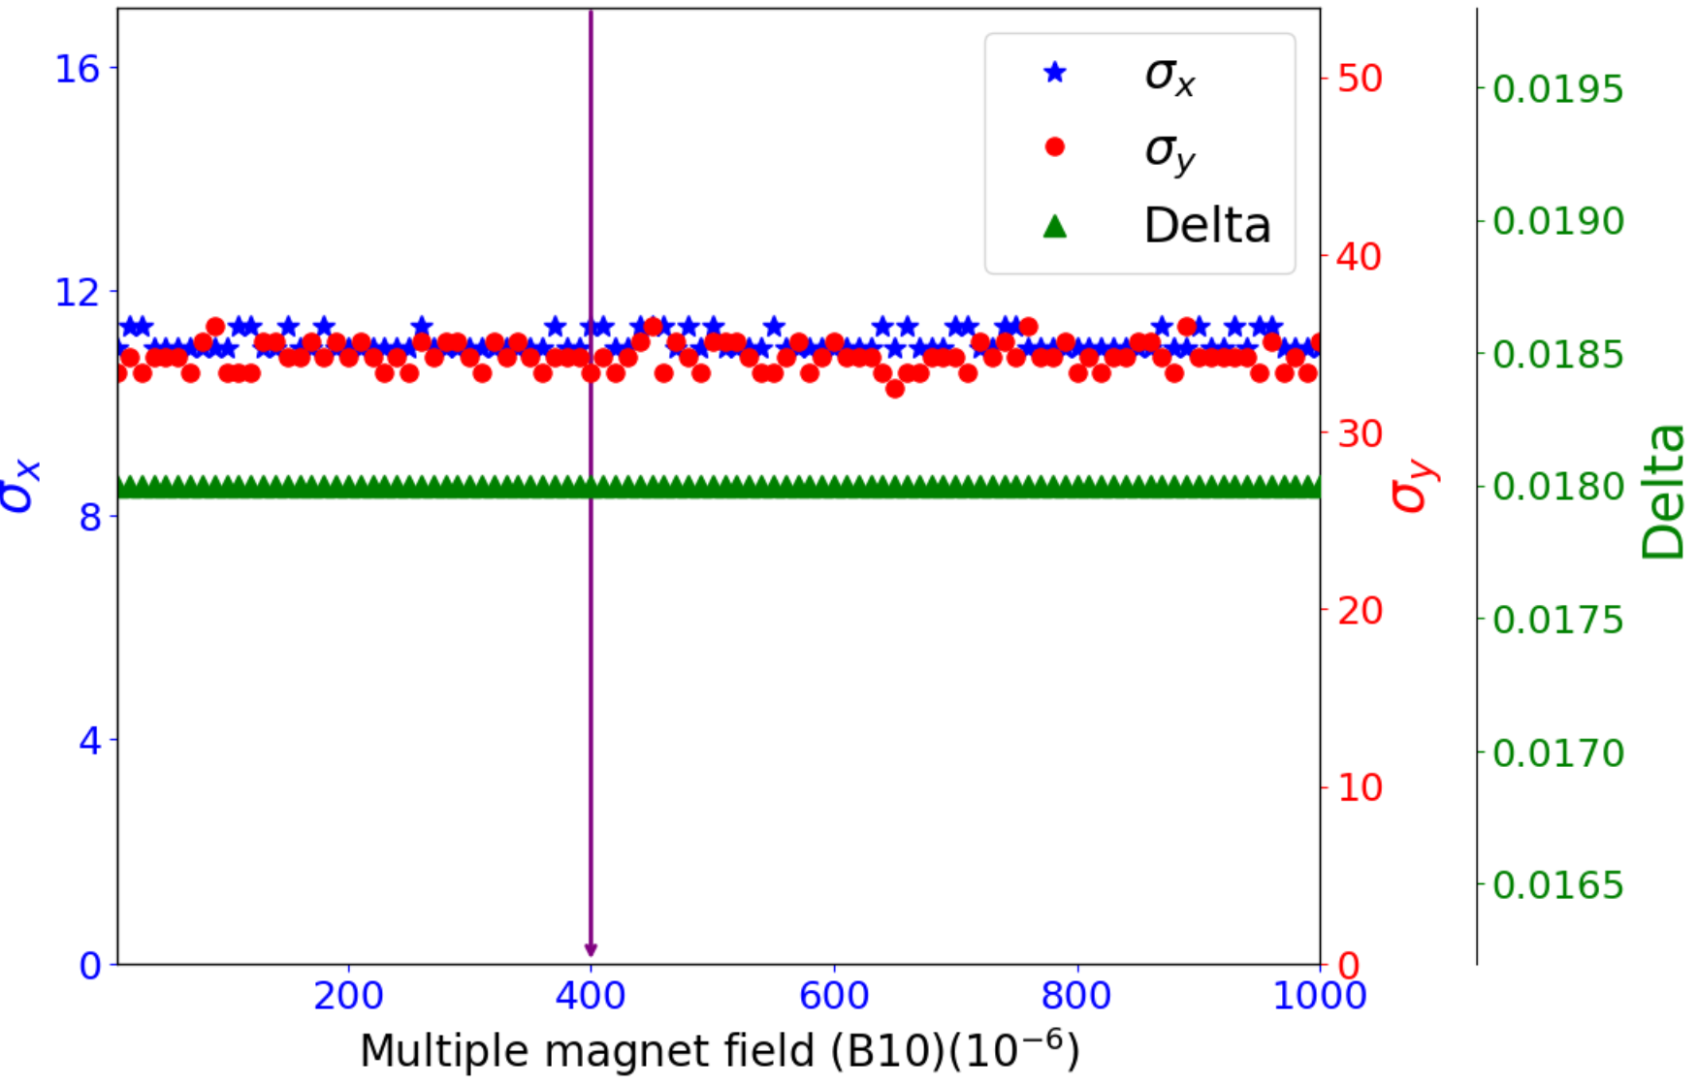
B5-B10 in IR quadrupole
B5
B6
B7
B8
B9
B10
6

Slide 7
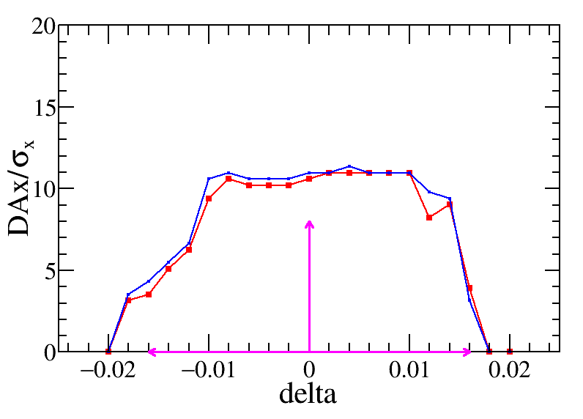
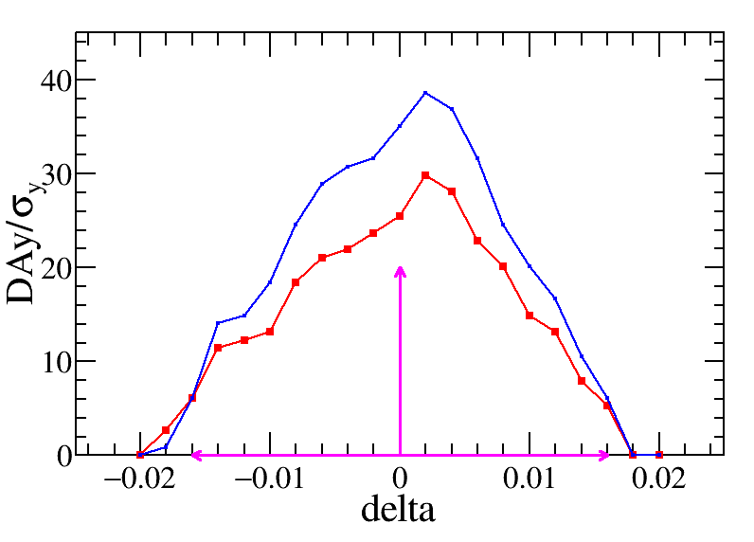
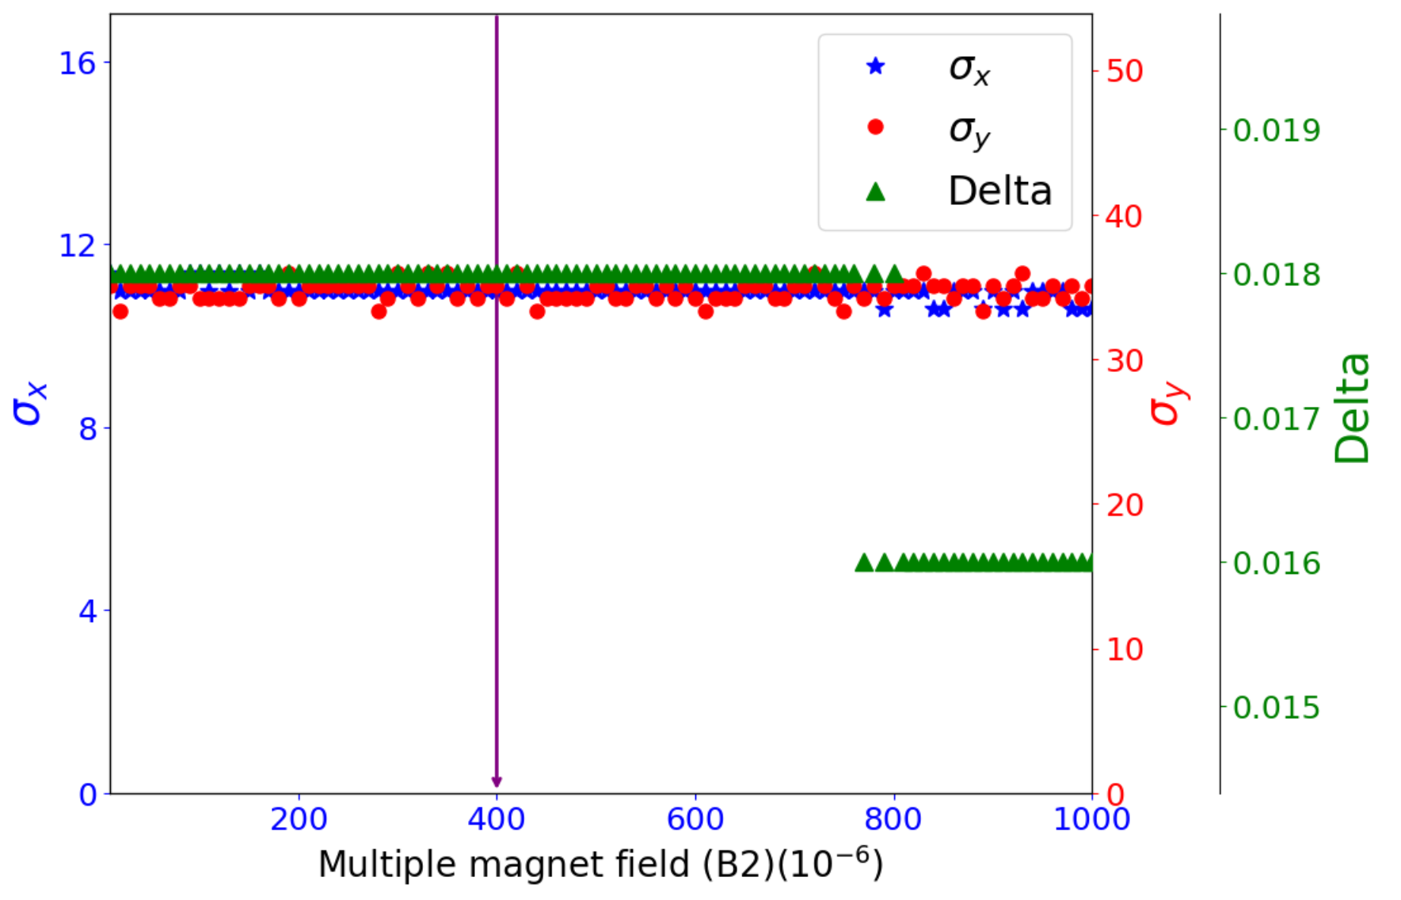
B2 in ARC quadrupole
$$4×{10}^{−4}$$
‌$4×{10}^{−4}$ is preliminarily set to the requirement of B2 in the arc quadrupole magnets.
7

Slide 8
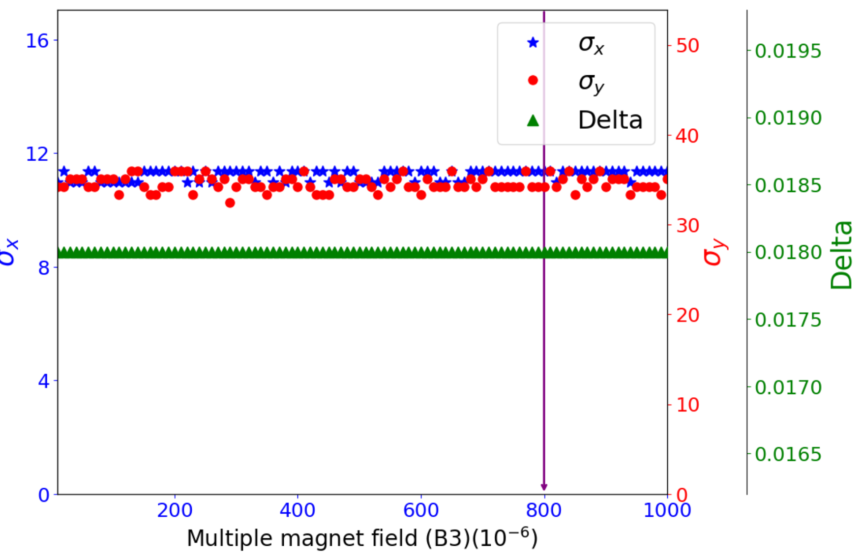
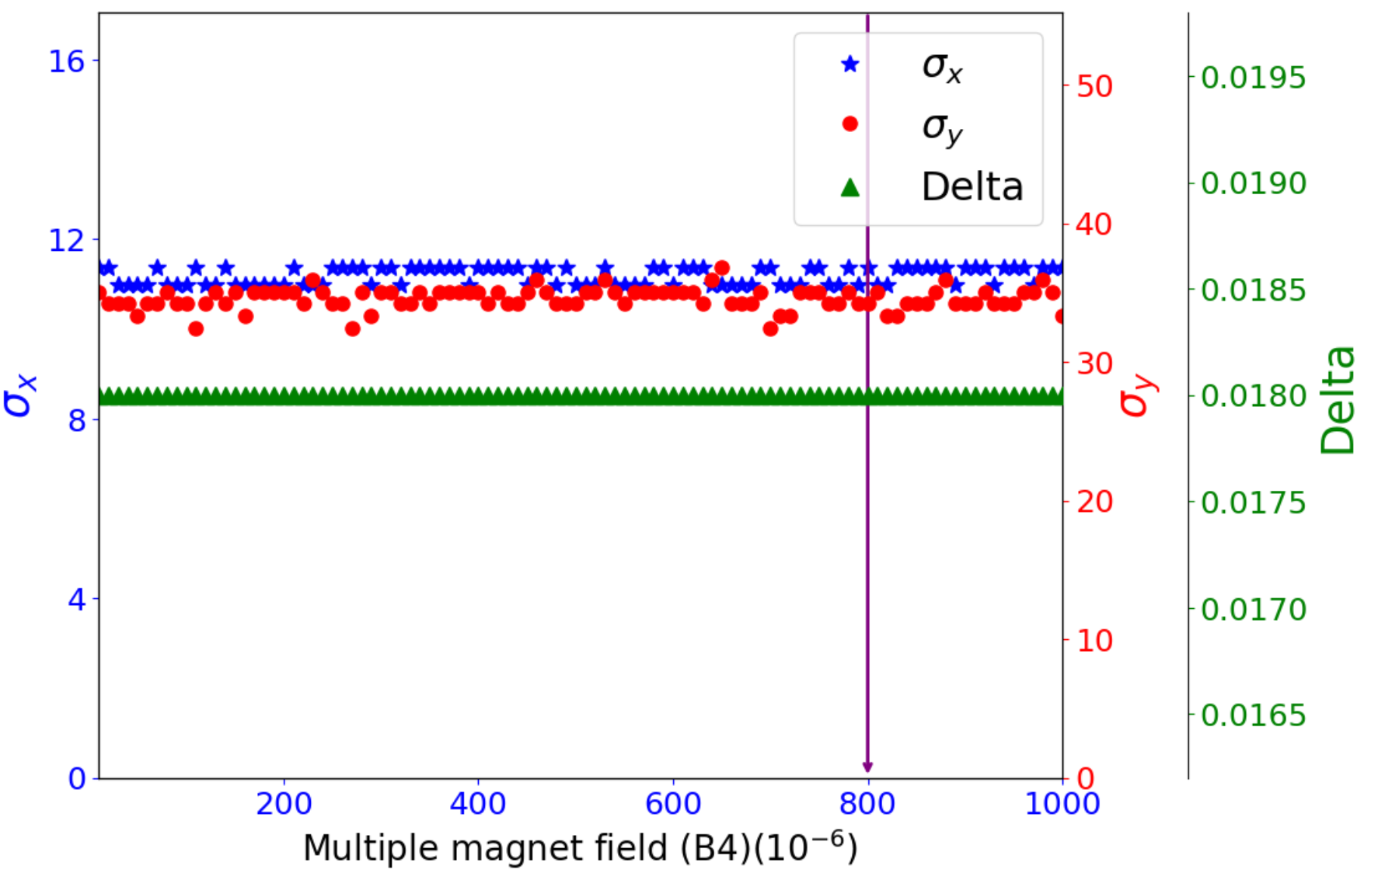
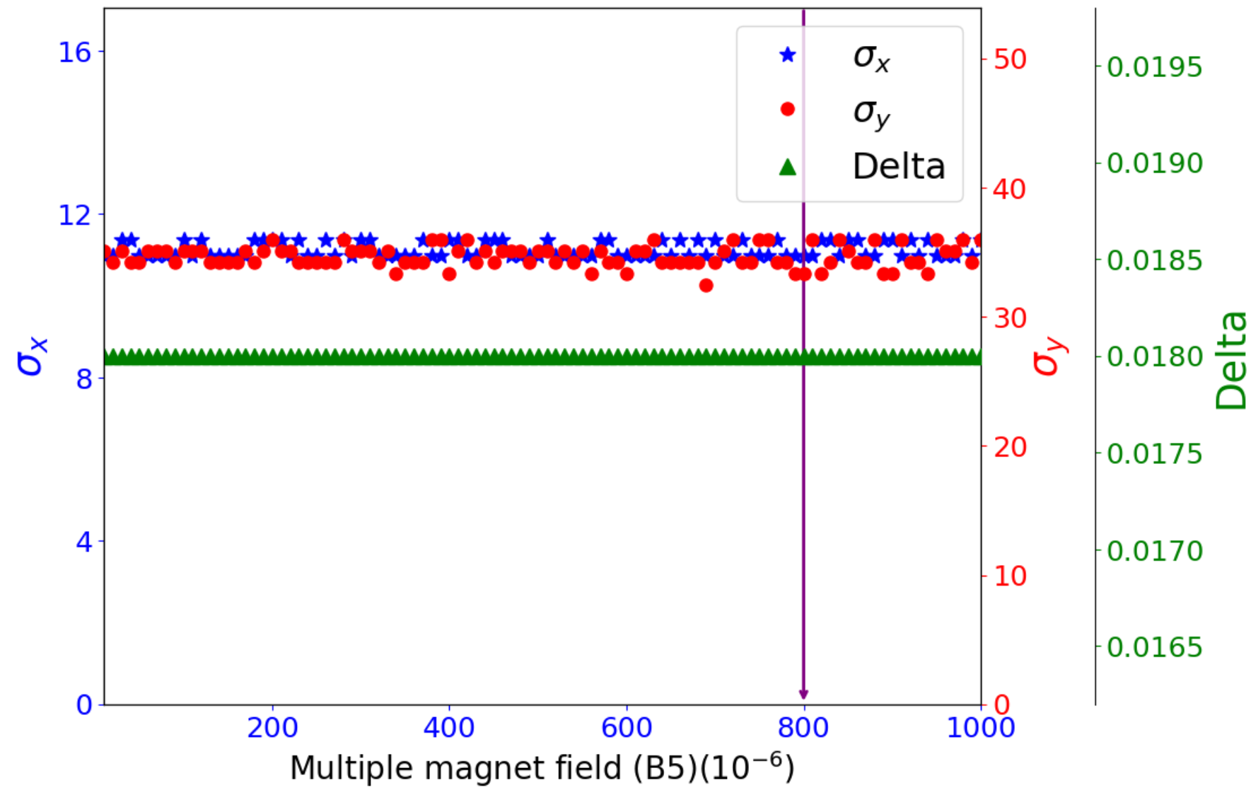
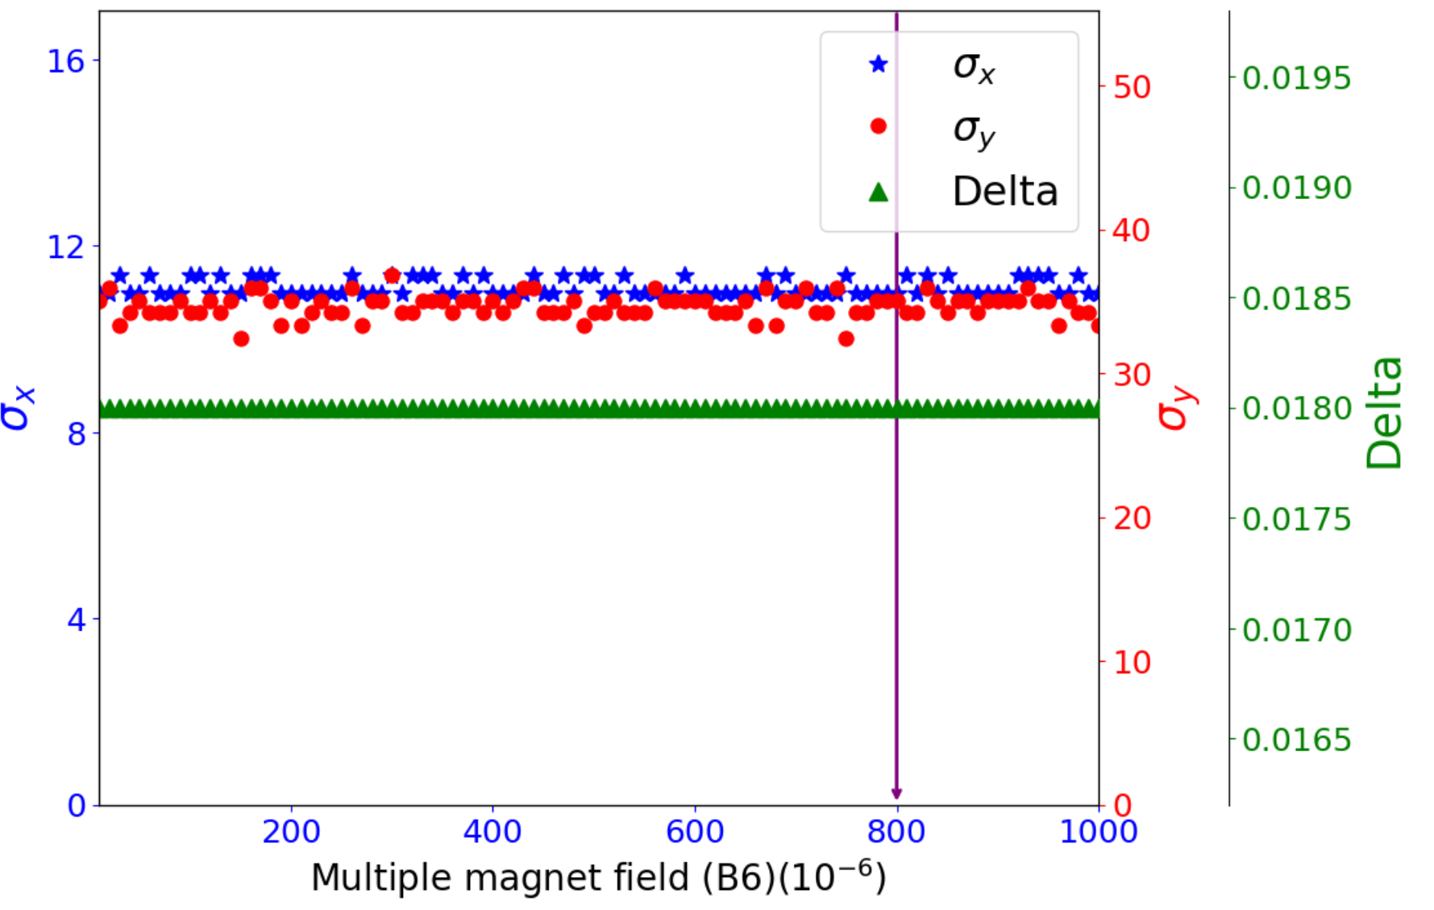
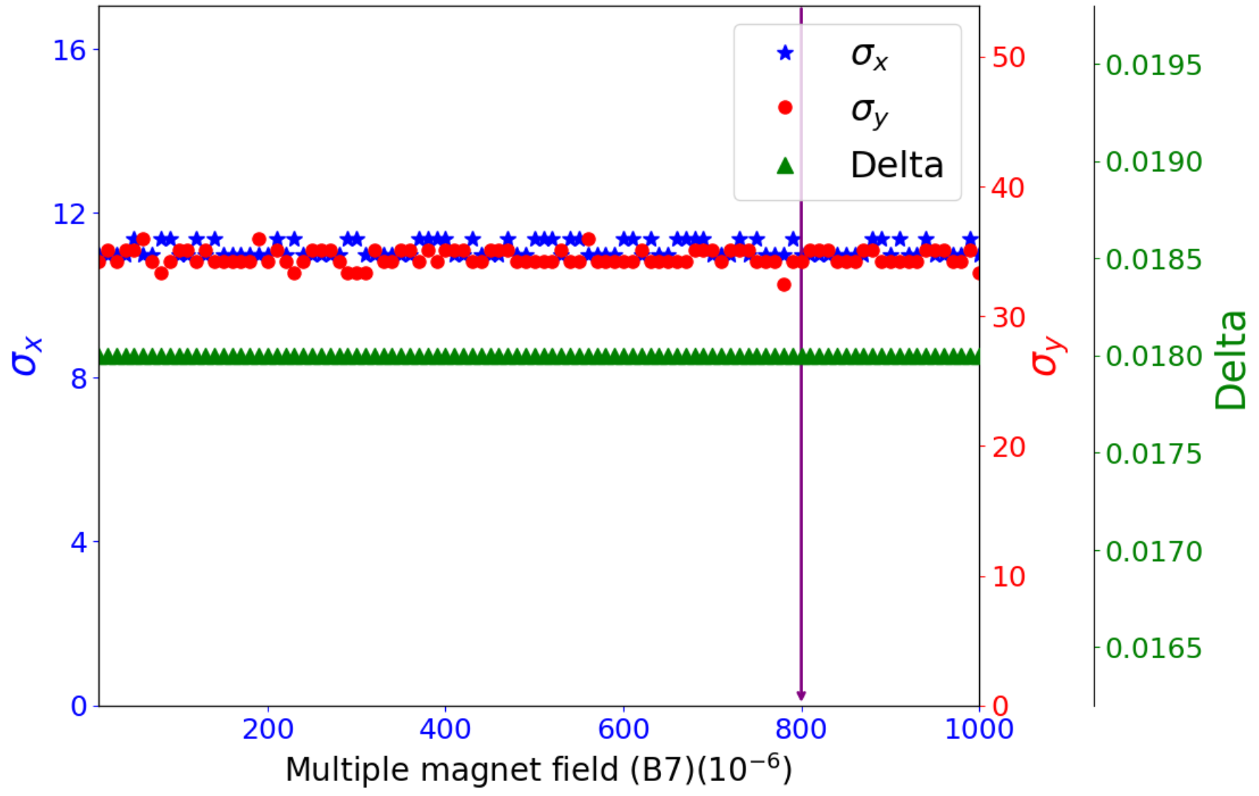
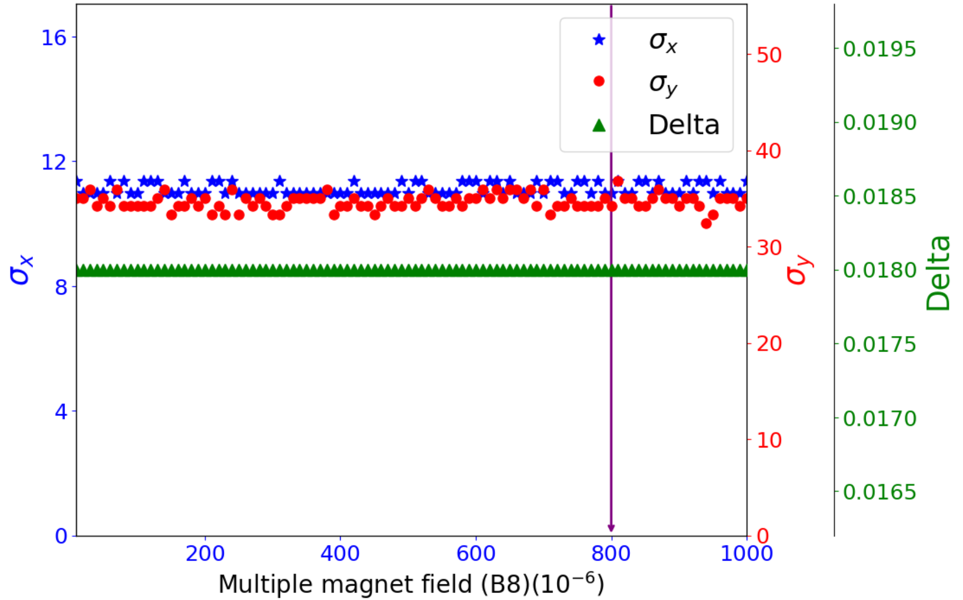
B3-B10 in ARC quadrupole
‌$8×{10}^{−4}$ is preliminarily set to the requirement of B3-B10 in the arc quadrupole magnets.
8

Slide 9
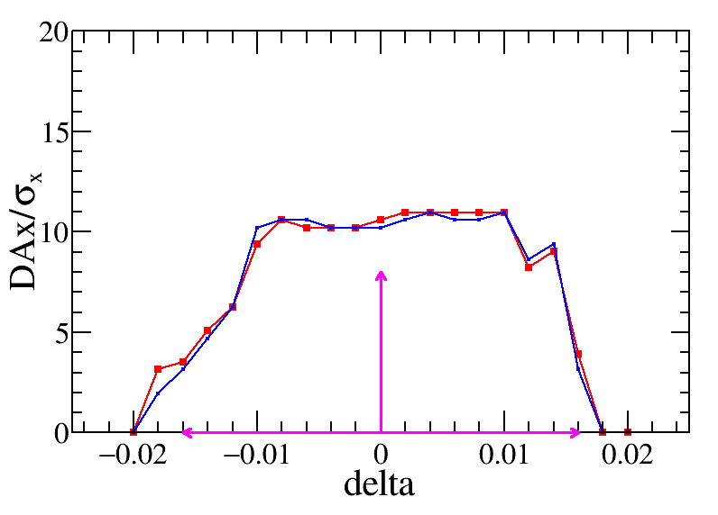
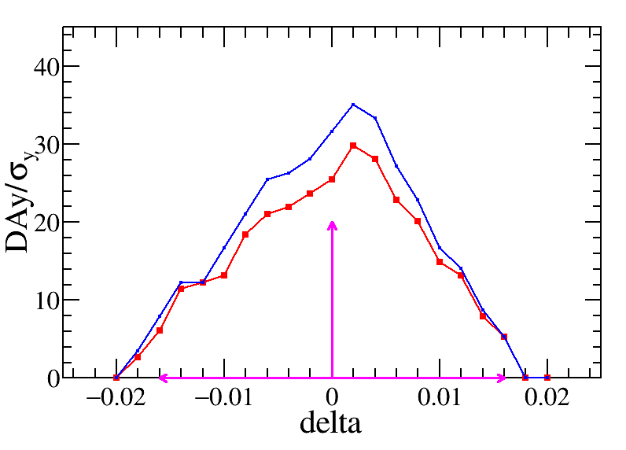
DA result with all higher-order field errors in quadrupole magnets
Quadrupole field errors | IR (${10}^{−4}$) | ARC (${10}^{−4}$)
B2 | $$≤3$$ | $$≤4$$
B3 | $$≤4$$ | $$≤8$$
B4 | $$≤4$$ | $$≤8$$
B5 | $$≤4$$ | $$≤8$$
B6 | $$≤4$$ | $$≤8$$
B7 | $$≤4$$ | $$≤8$$
B8 | $$≤4$$ | $$≤8$$
B9 | $$≤4$$ | $$≤8$$
B10 | $$≤4$$ | $$≤8$$
Preliminary requirements
Based on the setting values of higher-order field errors in the table, ‌no significant reduction in aperture is observed‌.
9

Slide 10
Summary and To-do list
The higher-order magnet fields in the quadrupole magnets are detailed analyzed.
The results show that quadrupole fields B2 and B3 significantly impact dynamic aperture sensitivity, whereas higher-order field errors (B4-B10) show negligible influence. Further investigation is required to verify the underlying mechanisms.
An preliminary requirement of higher-order fields is released, the DA with this requirement shows no obvious reduction.
More detail analyze as well as for dipole and sextupole higher-order fields are ongoing, the corresponding tec. Note is under preparation.
10

Slide 11
Thank you for your attention
E-mail:
wangbin@ihep.ac.cn

