Slide 1
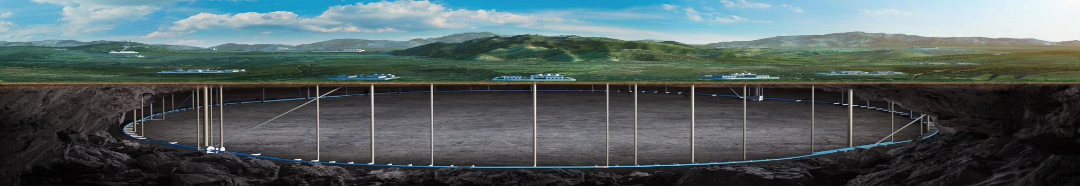


CEPC accelerator
whole survey status
Haijing Wang
On behalf of CEPC survey, layout and naming colleagues
CEPC DAY
2025.5.23

Slide 2
Content
Introduction
EDR accelerator survey and layout progress
  Survey progress
  2D/3D layout design
Naming
Summary

Slide 3
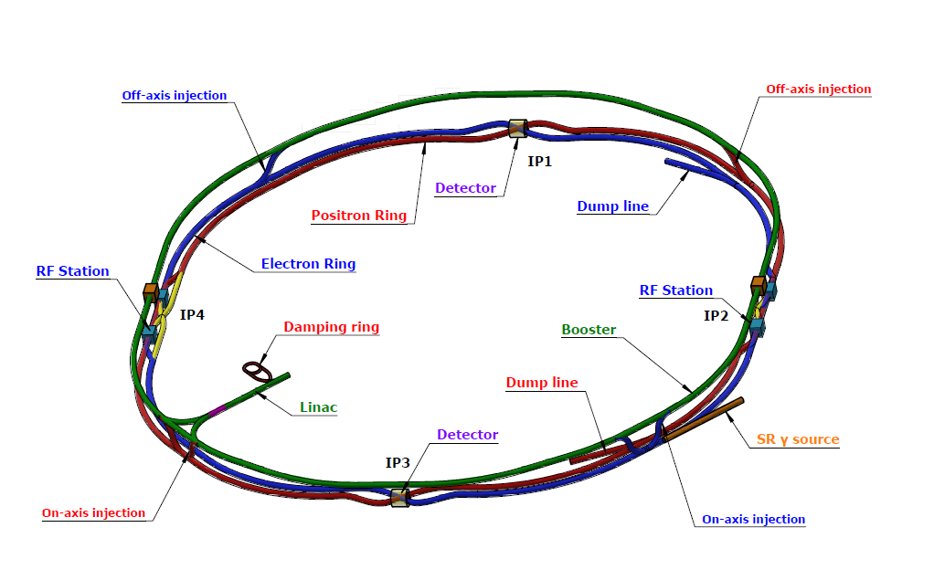
Introduction
The layout is the basis for the engineering design of each equipment.
Physics survey
Equipment model design
Layout design

Slide 4
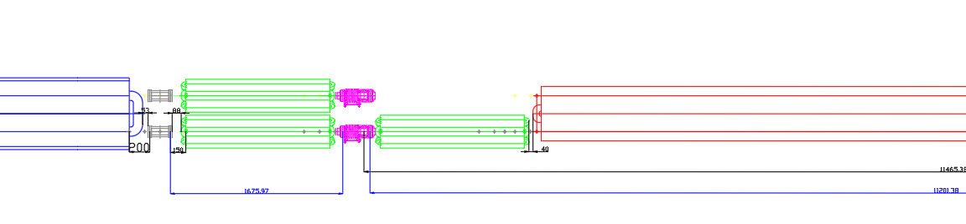
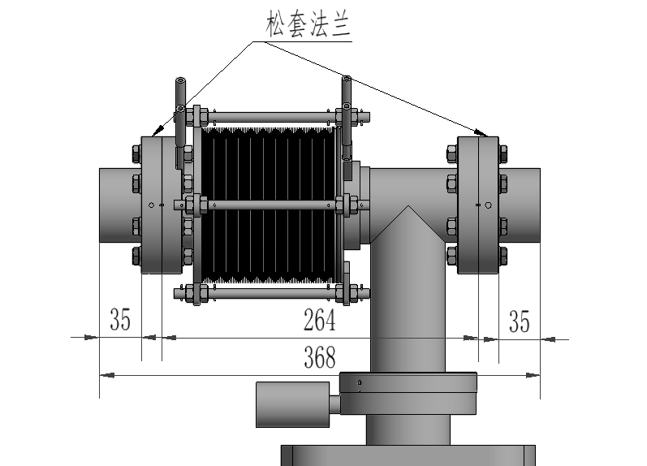
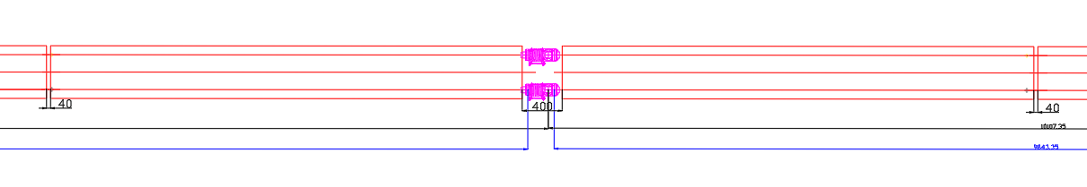
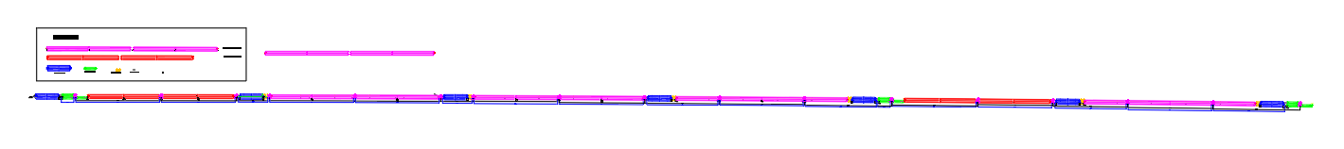
Introduction
Layout design from EDR beginning to 24.10
Quadrupole
BPM
sextupole
dipole
Vacuum connection part
dipole
Vacuum connection part
dipole
Progress from 24.10 to now
  A updated survey of Collider(25.2.14), Booster (25.3.1), Linac, DR, TLs (25.3.7)
  The realization of 2D/3D linkage design
  Typical section layout of Collider and Booster

Slide 5
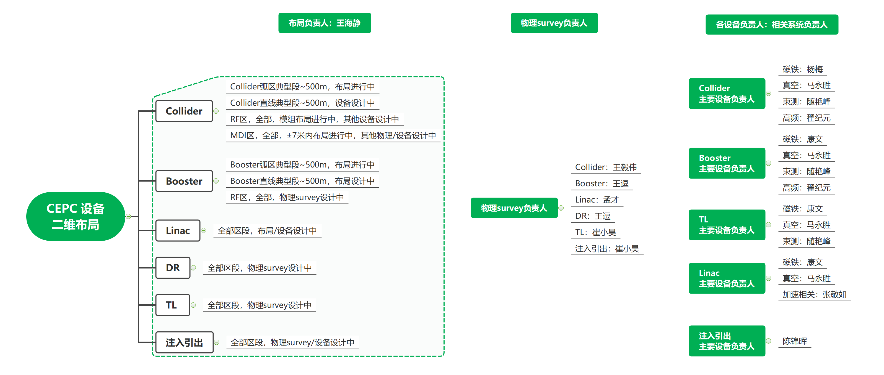
EDR accelerator survey and layout progress

Slide 6
Survey progress
2025.2 Collider and Booster perimeters updated to 99,955.418 m, the preliminary survey data of all accelerators sent to Huadongyuan.
2025.2 Confirmed the data format of the Collider survey , commenced the Collider layout, and implemented the 2D/3D linkage layout design.
  For each magnet, the entry and exit points should be defined.
  For cryomodules, the coordinate point can be defined as the center point.
  The position accuracy of the coordinate points reaches the micrometer level.
2025.4 Confirmed the data format of other accelerators.
By now, the survey is under intense design.

Slide 7
Survey progress
Survey and layout status (overall)
Accelerator | Have survey data? | Finish survey design? | Have model design? | Have layout demo? | Complete survey naming?
Collider | √ | × (note 2) | Partial | √ | ×
Booster | √ | × (note 3) | Partial | √ | ×
Linac | √ | √ | Partial | × | √
Damping Ring | √ | × (note 4) | Partial | × | ×
Transport lines | 10/14 (note 1) | × | Partial | × | ×
  Note 1, 14 lines, 10 line have survey data (TLs between Collider and Booster, Linac and DR, Linac and Booster). ~middle in June, 2025
  Note 2, unfinished: single-aperture dipoles, correctors, beam instruments, bellows, valves. ~end of July, 2025
  Note 3, unfinished: all adjacent dipoles except ~230 m demo, correctors, beam instruments, bellows, valve. ~middle in June, 2025
  Note 4, unfinished: beam instruments, bellows, valve.

Slide 8
Survey progress
Survey and layout status (equipment status*)
Accelerator | Equipment types | Survey design completed | Physics design completed | 3D model design completed | Layout length can be done** (km) | Layout section can be done**
Collider | 97 | 73 | 12 | 12 | ~ 80km | Arc section Higgs CM
Booster | 29 | 18 | 16 | 8 | ~230m | 230 m arc section Higgs CM
Linac | 59 | 59 | 14
Damping Ring | 16 | 9 | 1 | 1
Transport lines
*, These data are based on the designs currently available to the layout personnel, the statistics is still in progress.
**, it means the 2D and 3D layouts with detailed designs

Slide 9
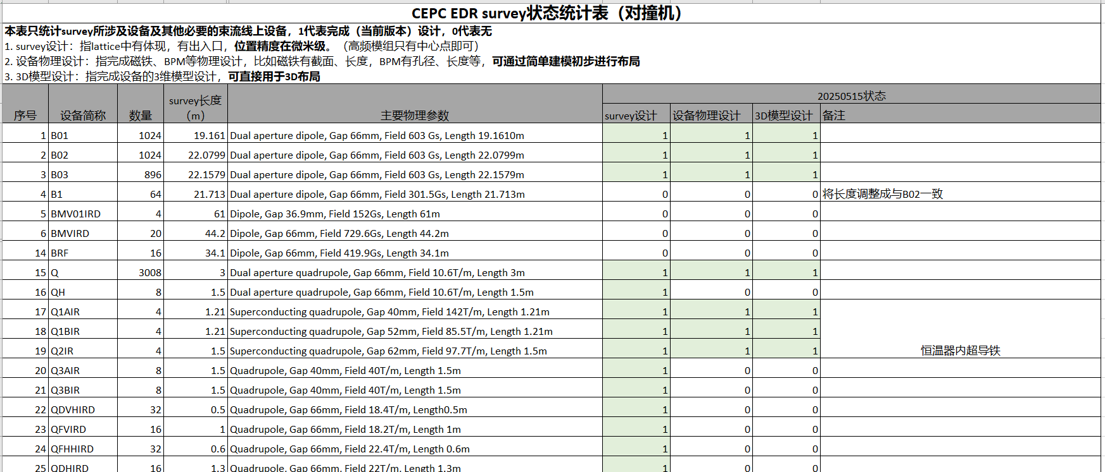
Survey progress
Survey and layout status (equipment list, example)
（Equipment along the beam, including magnets, cryomodules, beam instruments, kickers, lambertson, bellows, valves.

Slide 10
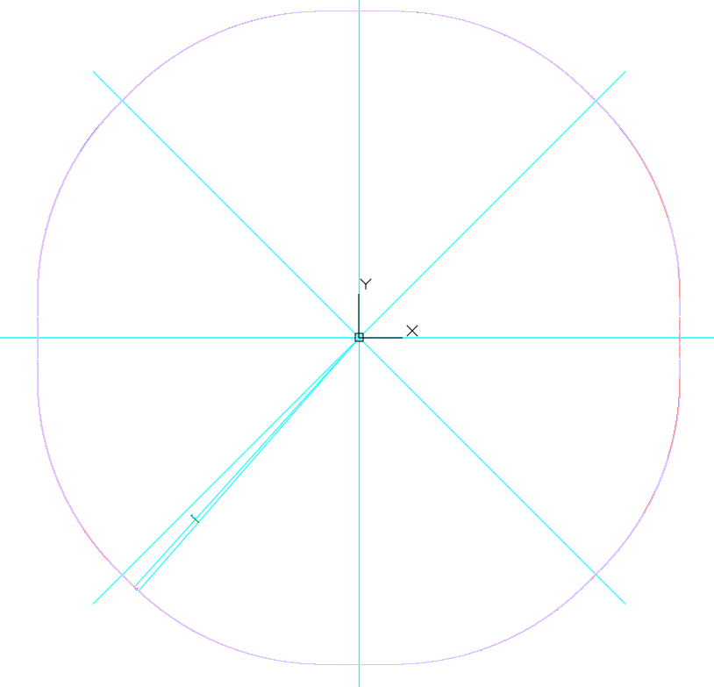
2D/3D Layout design
The coordinate origins of all the accelerator has been unified. The (0,0) point is at the symmetric center of the Collider.
The accelerator layouts before CEPC (HEPS\BEPC\CSNS…), the 2D and 3D layouts are designed separately and has no direct linkage
  More workloads
  Easily to have inconsistencies between 2D and 3D layout
2D and 3D layouts of CEPC are being built simultaneously.
(0,0)
We begin from here

Slide 11
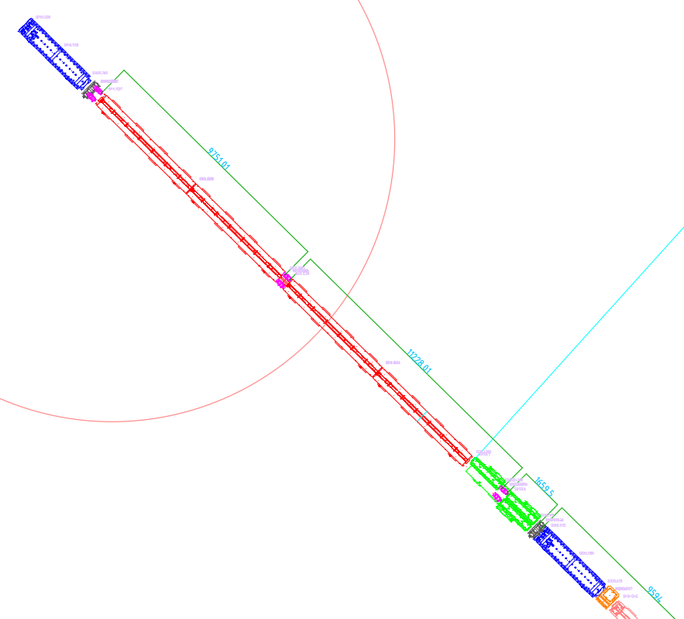
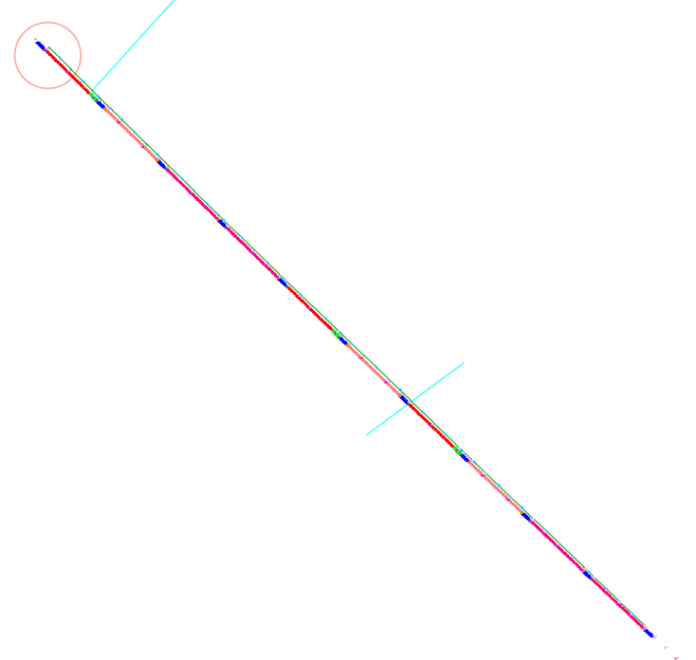
2D/3D Layout design
An arc section of 276 m layout has been made, with all the components along the beam.
四极铁
BPM
B01
环内，靠墙
真空连接段
真空连接段
真空连接段
环外，靠过道
BPM
六极铁
四极铁
校正铁

Slide 12
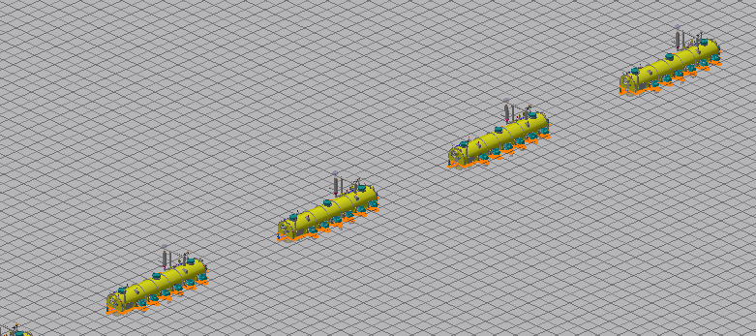
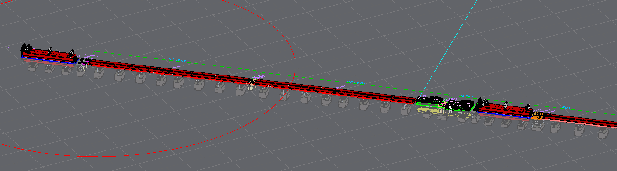
2D/3D Layout design
2D/3D linkage design for CEPC
  If the 3D model is changed or replaced, the 2D model will be updated.
  If the 2D model is replaced or its location is changed, the 3D model will be updated.
Part of Collider RF section
Part of Collider arc section

Slide 13
2D/3D Layout design
Three vacuum layout has been compared considering the installation of dipoles.
  The compared section is 164 m, a typical cycle period
  Aim: to discuss the feasibility of two dipole cores transported and installed together. (pre-installed outside, less workload in the tunnel)
  For vacuum tube installation and coils installation, the upper cores of magnets need to be disassembled and reassembled.
Design principles
  Pump distance ≤12.5m
  Number of vacuum tubes as small as possible

Slide 14
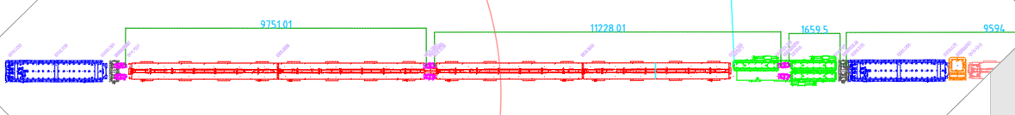
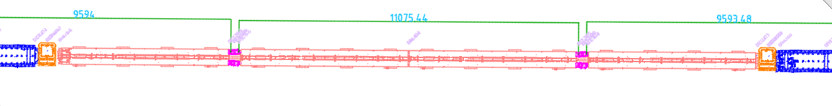
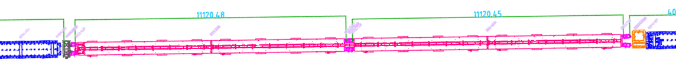
2D/3D Layout design
Three vacuum layout has been compared considering the installation of dipoles.
V1: 18 vacuum tubes in one ring, 10 can be pre-installed with magnets

Slide 15
2D/3D Layout design
Three vacuum layout has been compared considering the installation of dipoles.
V2: 20 vacuum tubes in one ring, 14 can be pre-installed with magnets

Slide 16
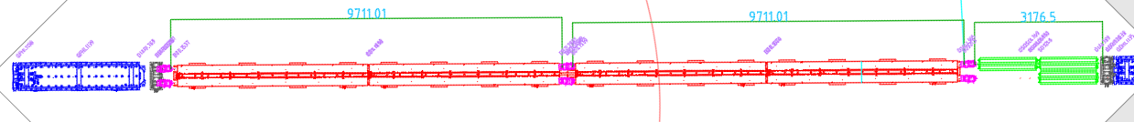
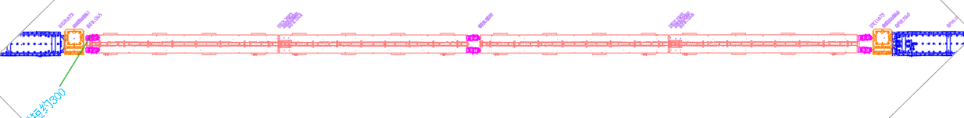
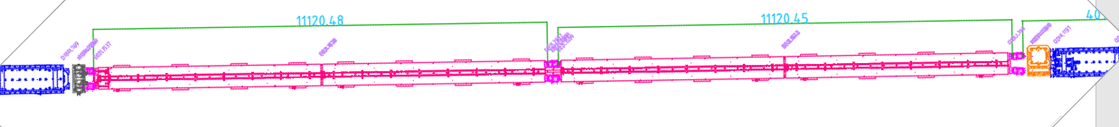
2D/3D Layout design
Three vacuum layout has been compared considering the installation of dipoles.
V3: 20 vacuum tubes in one ring, 14 can be pre-installed with magnets

Slide 17
2D/3D Layout design
Three vacuum layout has been compared considering the installation of dipoles.
 | V1 | V2 | V3
No. of vacuum tubes | 18 | 20 | 20
No. of vacuum tubes can be pre-installed outside | 10 | 14 | 14
No. of dipole core can be pre-installed outside (total of 24) | 16 | 20 | 24
No. of vacuum connection parts (bellows & pumps) | 16 | 16 | 18
Others |  |  | Dipole length decease ~600mm/164m
Whether pre-install the dipoles has benefits should be discussed further.

Slide 18
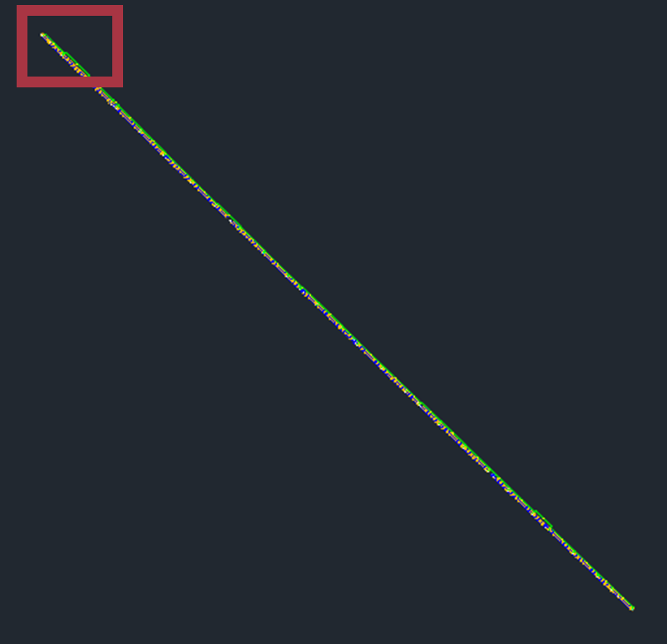
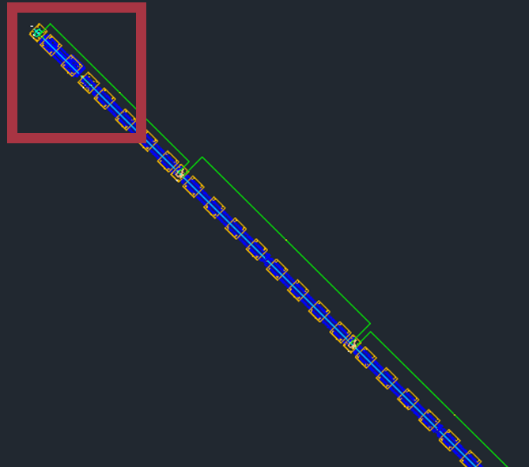
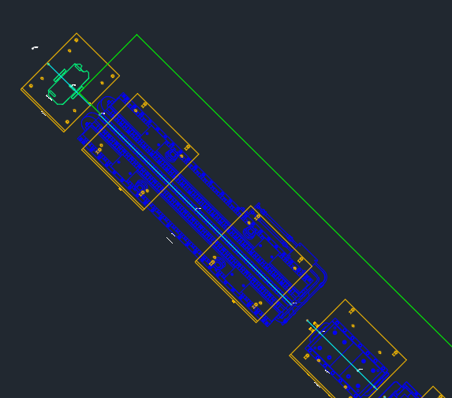
2D/3D Layout design
Booster layout
  A preliminary layout has been made, about 230m.
  Format has been discussed with Dou Wang, the updating is under-going.

Slide 19

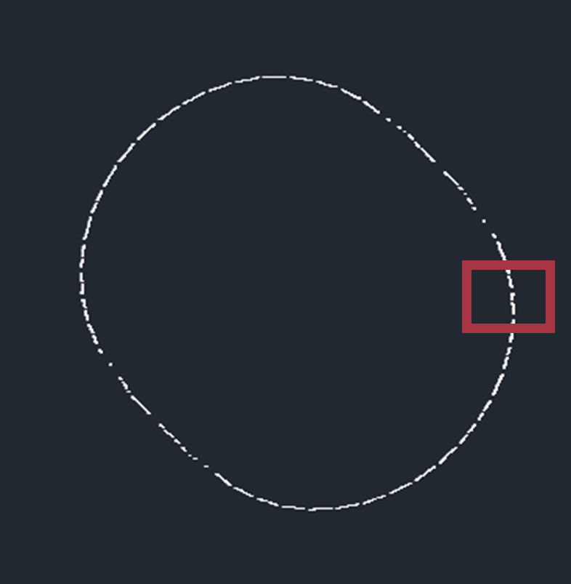
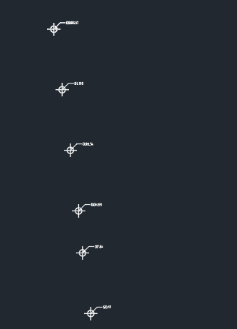
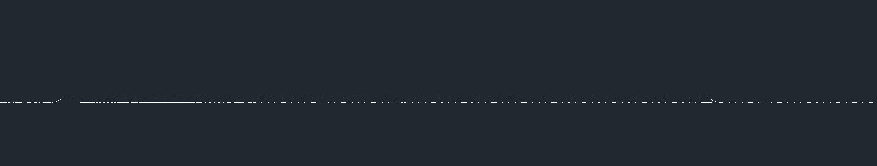
2D/3D Layout design
Linac layout (points only now)
Damping ring layout (points only now)
电子旁路输运线 BTL
第一加速段FAS、正电子源及与加速段PSA、第二加速段SAS

Slide 20
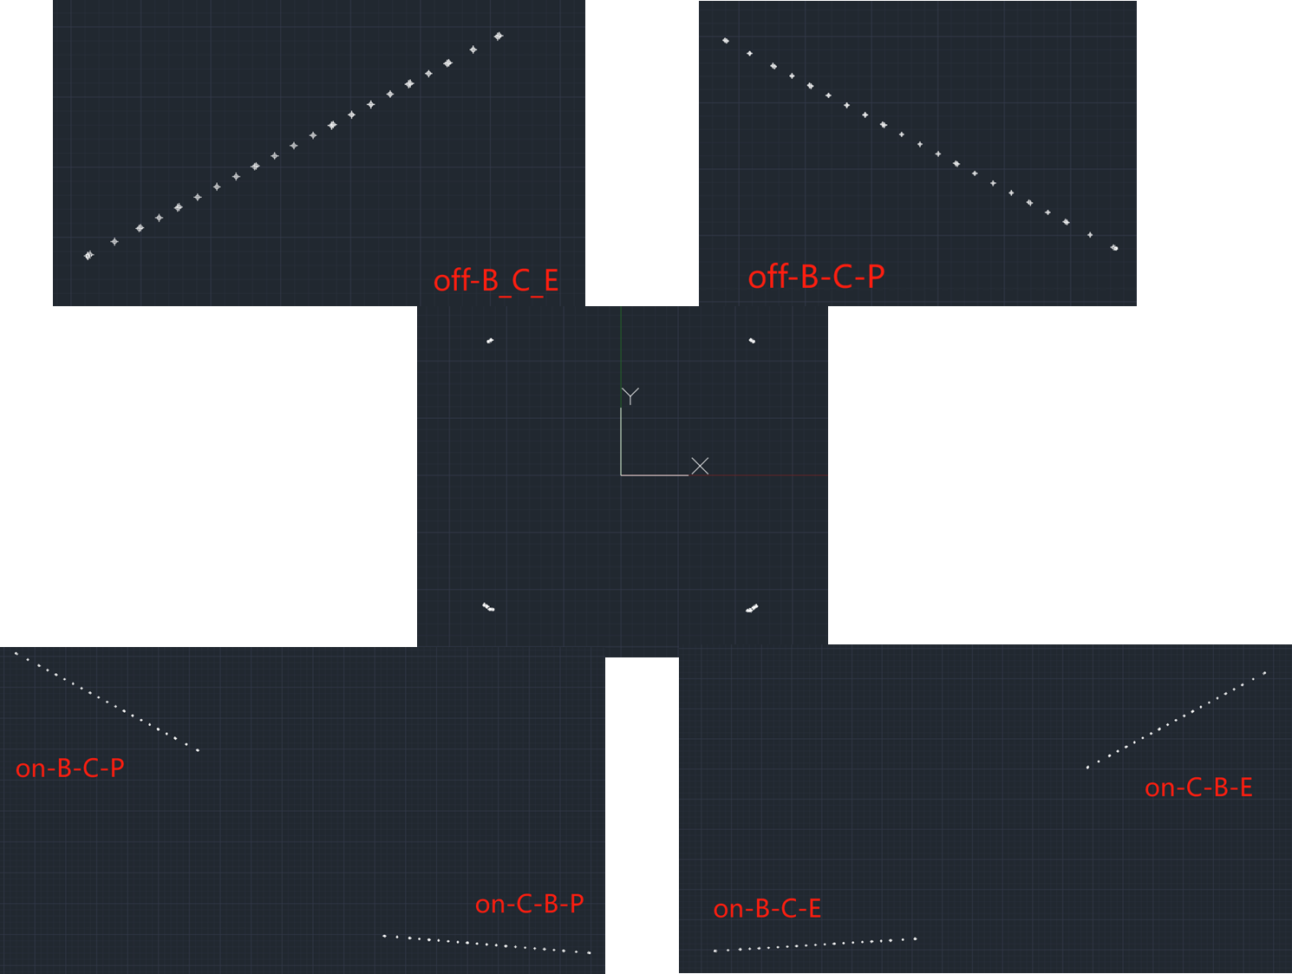


2D/3D Layout design
Transport lines (points only now)
Linac to Booster (Top view)
Linac to Booster (side view)

Slide 21
EDR accelerator survey and layout progress
Problems and solutions
  How to name the equipment
  → We have recently focused on discussing the naming conventions and have formulated preliminary opinions.
  We tried to use BIM to make the model more lighter, but it may hide some important components such as adjusting mechanics.
  →We have discussed it with Huadongyuan, They suggested not to employ BIM, but instead to utilize some external interfaces to directly generate three-dimensional models.
  → We have conducted research on NVIDIA's USD (Universal Scene Description) file format and the Omniverse platform, which can encompass models, animations, lighting, materials... With compact file size and high compatibility (have requirements on computers).
  CEPC is such a big project. The layout is big too. Computer lag reduces work efficiency.
  → We require better workstations.

Slide 22
Naming
We have discussed three times for the naming, mainly about the equipment along the beam.
We have formulated preliminary opinions.
  The CEPC equipment name consists of four parts: accelerator code + zone code + equipment code + sequence number.

Slide 23
Naming
Accelerator Code: Uniformly named.
Zone Code: Uniformly named.
Equipment Code: Assigned by each subsystem, adhering as closely as possible to international standards.
Sequence Number: Assigned by each subsystem according to unified rules
  Within the same accelerator code and area code, equipment with the same equipment code is numbered sequentially, starting from the beginning and incrementing accordingly.
  The number of digits in the sequence number is determined by the total quantity of equipment. Equipment quantity ≤9, 1 digit starting from 1; 10≤Equipment quantity ≤99, 2 digits starting from 01; and so on.
If additional equipment is added later, it can be appended with "P + new sequence number" following the sequence of the upstream equipment with the same equipment code.

Slide 24
Naming
Accelerator Code
  对撞机 C（Collider）
  增强器 B（Booster）
  直线L（Linac）
  阻尼环D（Damping ring）
  输运线T(Tansport lines)

Slide 25
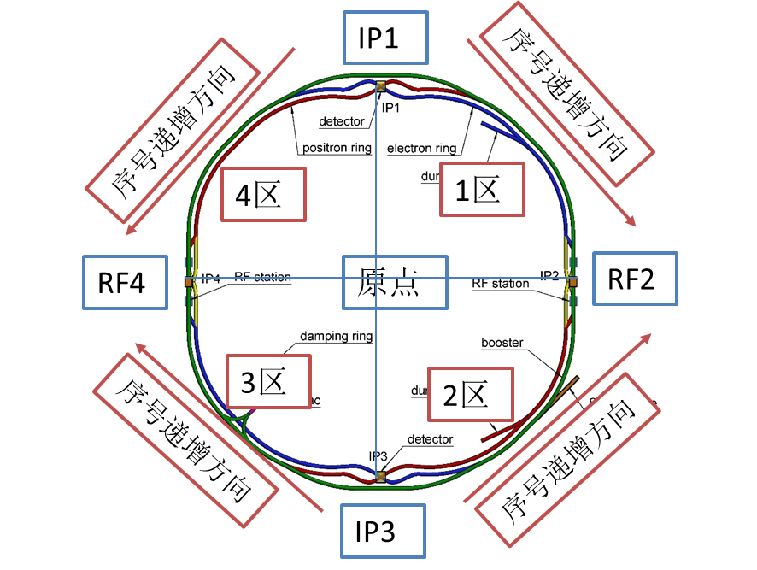
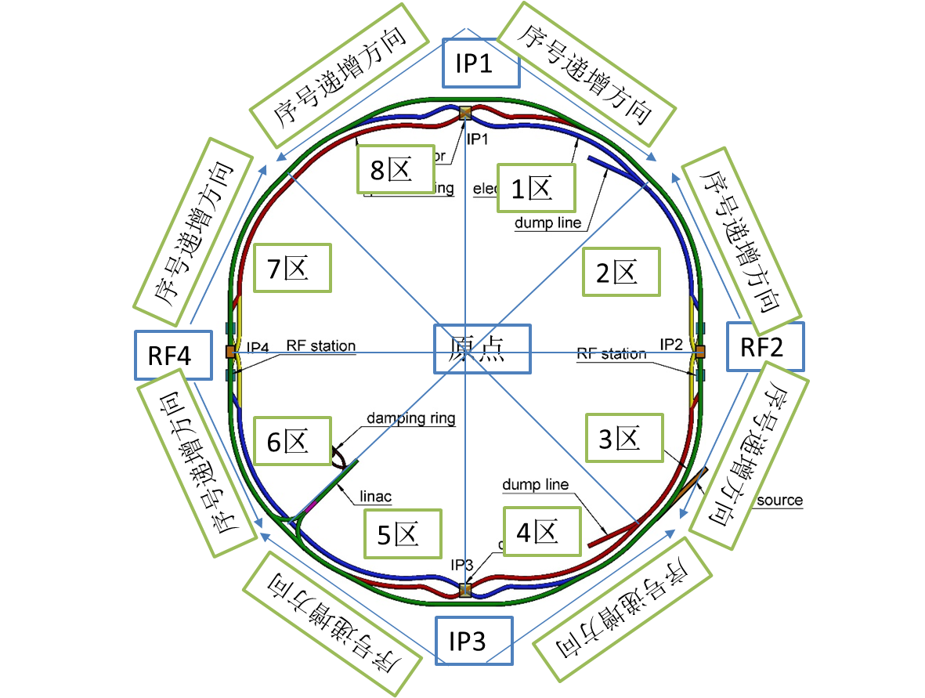
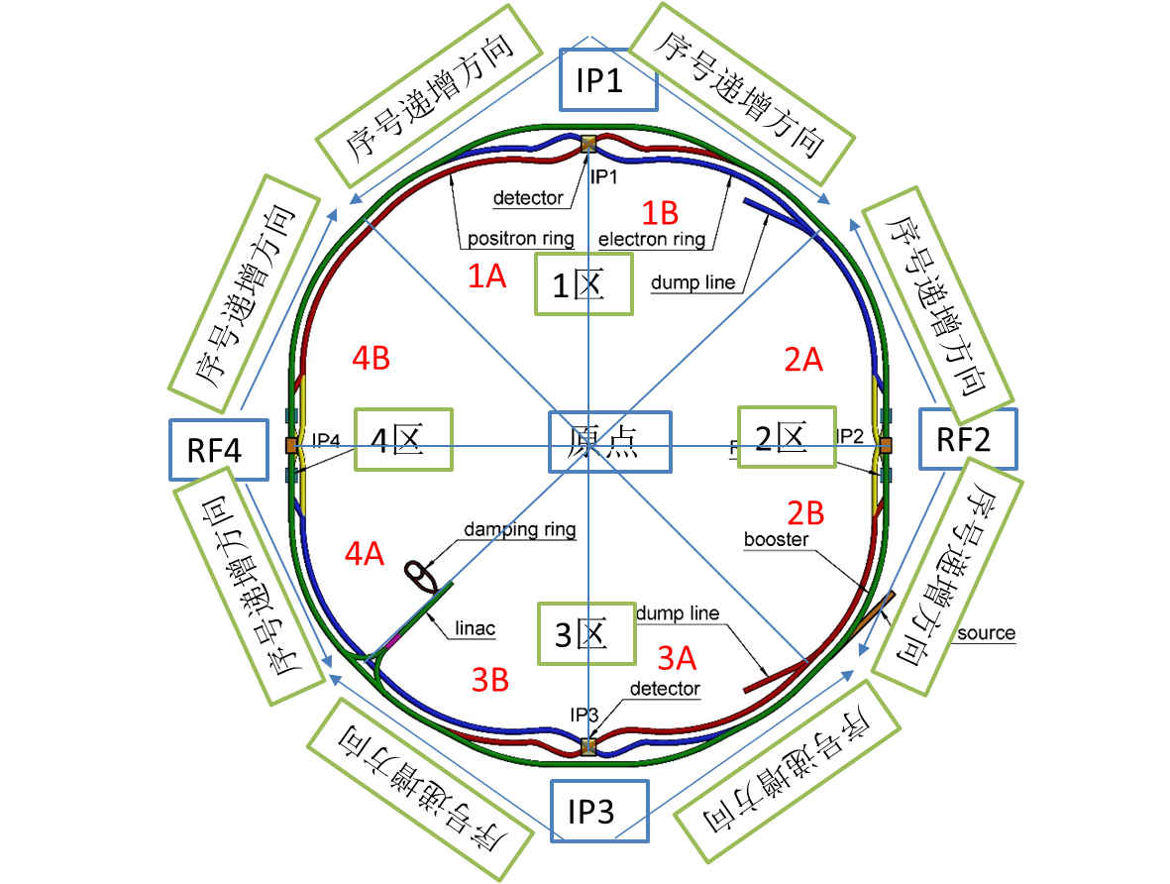
Naming
We have deliberated on three partitioning schemes for the collider and the booster, and have decided to adopt the third scheme.
 | Scheme 1 | Scheme 2 | Scheme 3
IPs correspond to the zones | ☺ | ☹ | ☺
CEPC and SPPC have the same sequential numbering trend | ☹ | ☺ | ☺

Slide 26
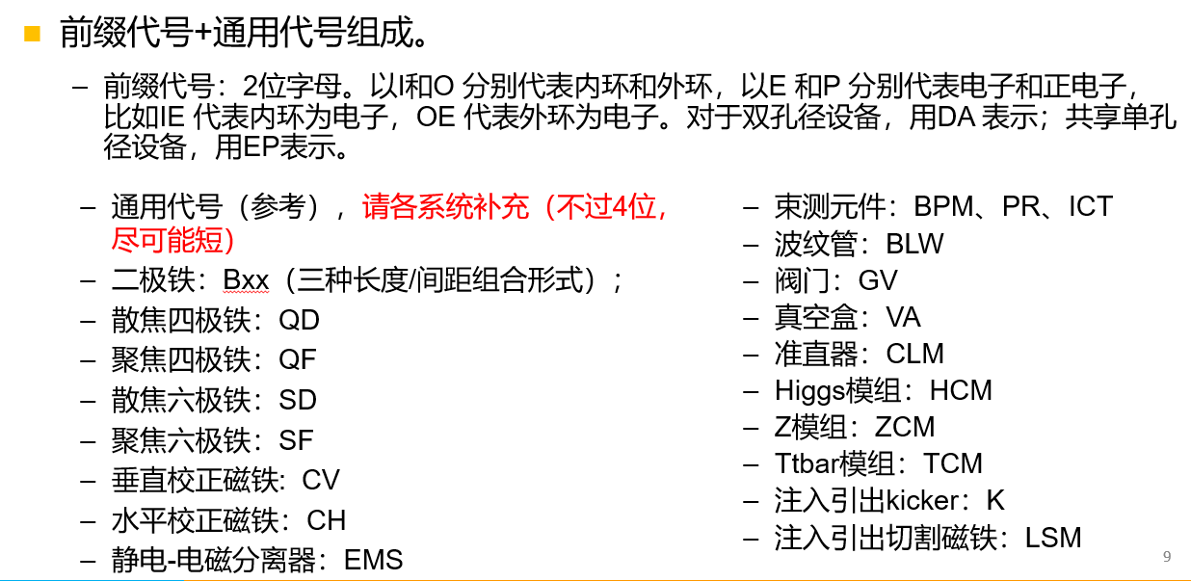
Naming
Collider equipment code

Slide 27
Naming
Collider naming examples
  C.3A.OE.QD.001:对撞机.3A区.外环电子.散焦四极磁铁.第1台
  C.3B.OP.QD.001:对撞机.3B区.外环正电子.散焦四极磁铁.第1台
  C.3B.DA.QD.001:对撞机.3B区.双孔径.散焦四极铁.第1台（极性对应外环）
  C.3B.DA.B.001.1:对撞机.3B区.双孔径.二极铁.第1台.第1个铁芯
  C.3B.DA.B.001.OTPS:对撞机.3B区.双孔径.二极铁.第1台.外环辅助线圈电源
  C.2B.EP.EMS.01:对撞机.2B区.共享单孔径.静电-电磁分离器.第1台
  C.2B.EP.QD.01:对撞机.2B区.共享单孔径.四极铁.第1台
  C.2A.HCM.01.1:对撞机.2A区.Higgs模组.第1台.第1个腔
  C.2A.HCM.01.KLY3:对撞机.2A区. Higgs模组.第1台.第3个速调管
  C.3B.OP.BPM.001:对撞机.3B区.外环正电子.BPM.第1台。
  C.3B.OP.BLW.001:对撞机.3B区.外环正电子.波纹管.第1台。

Slide 28
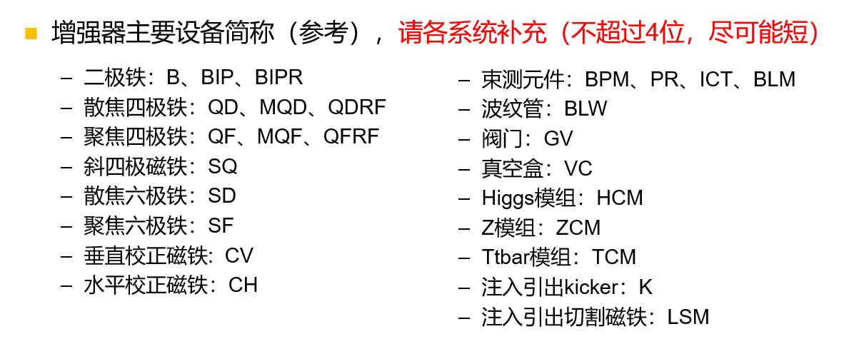
Naming
Booster equipment code
Booster naming examples
  B.3A.QD.001:增强器.3A区.散焦四极磁铁.第1台
  B.3B.BIP.001:增强器.3B区.IP二极铁.第1台
  B.2B.HCM.01.1:增强器.2B区.Higgs模组.第1台.第1个加速腔
  B.2B.HCM.01.SSA1:增强器.2B区.Higgs模组.第1台.第1个加速腔固放。

Slide 29
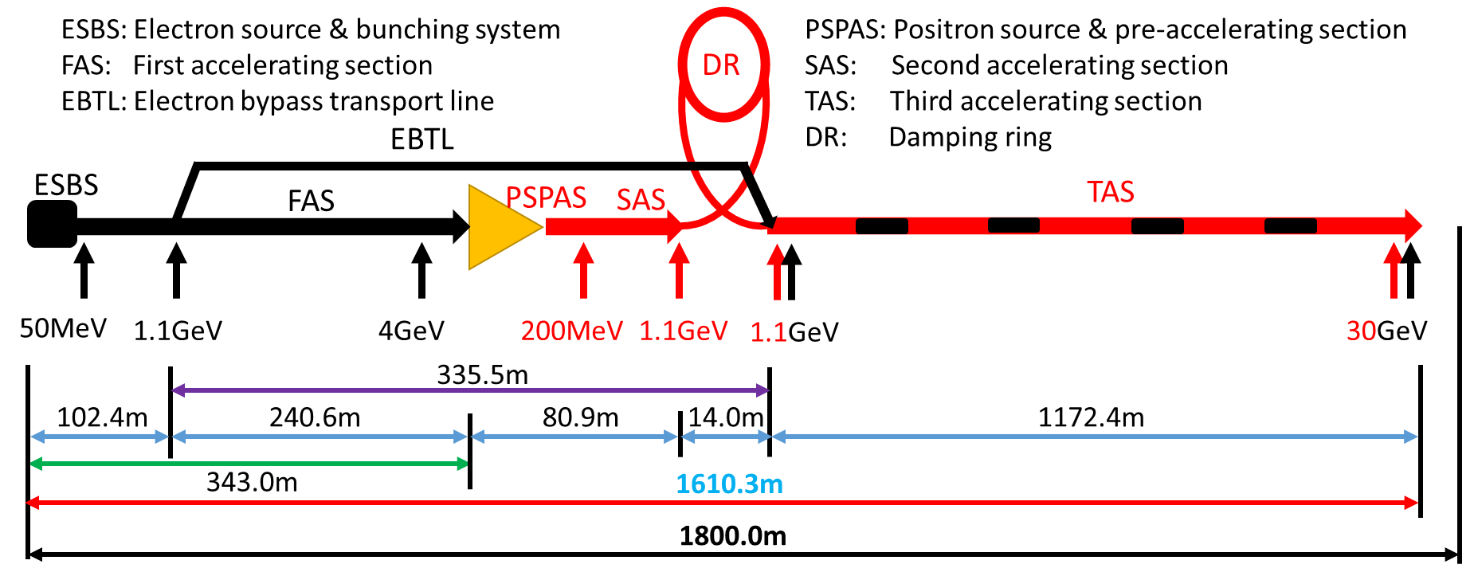
Naming
Linac zone code
  电子源及聚束系统：EBS
  第一加速段：FAS
  电子旁路输运线：BTL
  正电子源及预加速段：PSA
  第二加速段：SAS
  第三加速段：TAS
Linac sequence number
  increase along the direction of beam movement (from the electron gun to the transport line)

Slide 30
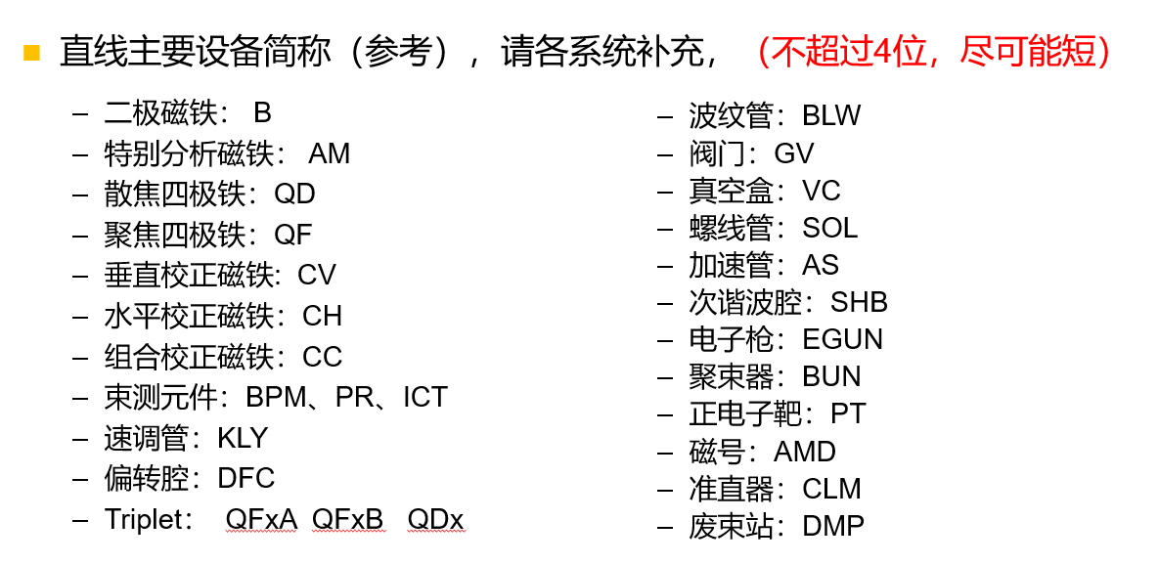
Naming
Linac equipment code
Linac naming examples
  L.EBS.SHB.2，直线.聚束系统. 次谐波腔.第2台
  L.BTL.CH.03，直线.旁路传输线.水平校正磁铁.第3台
  L.FAS.AS.001，直线.第一加速段.加速腔.第1台
  L.FAS.KLY.001直线.第一加速段.速调管.第1台

Slide 31
Naming
Linac zone code: 1/2
Damping ring sequence number
  increase along the direction of beam movement (from injection to exjection)
DR主要设备简称（参考），请各系统补充（不超过4位，尽可能短）
  二极磁铁： B、BR
  散焦四极铁：QD
  聚焦四极铁：QF
  束测元件：BPM、BLM、PR
Damping ring naming examples
  D.1.B.11，阻尼环.1区. 二极铁.第11台
1区
2区

Slide 32
Naming
Transport line zone codes
  增强器到对撞机正电子在轴注入输运线，BCNP（Booster to Collider e+ on-axis TL）
  增强器到对撞机负电子在轴注入输运线，BCNE（Booster to Collider e- on-axis TL）
  增强器到对撞机正电子离轴注入输运线，BCFP（Booster to Collider e+ off-axis TL）
  增强器到对撞机负电子离轴注入输运线，BCFE（Booster to Collider e- off-axis TL）
  对撞机到增强器正电子输运线，CBP（Collider to Booster e+ TL ）
  对撞机到增强器负电子输运线，CBE（Collider to Booster e- TL ）
  直线到增强器正电子输运线，LBP（Linac to Booster e+ TL）
  直线到增强器负电子输运线，LBE（Linac to Booster e- TL）
  直线到阻尼环正电子输运线，LD（Linac to Damping ring e+ TL）
  阻尼环到直线正电子输运线，DL（Damping ring to Linac e+ TL）
  对撞机到废束站正电子输运线，CDPP（Collider to dump e+ TL）
  对撞机到废束站负电子输运线，CDPE（ Collider to dump e- TL ）
  增强器到废束站正电子输运线，BDPP（Booster to dump e+ TL）
  增强器到废束站负电子输运线，BDPE（Booster to dump e- TL

Slide 33
Naming
输运线主要设备简称（参考），请各系统补充（不超过4位，尽可能短）
  二极铁：B
  散焦四极铁：QD
  聚焦四极铁：QF
  束测元件：BPM、PR、ICT
Damping ring naming examples
  T.BCNP.Q.11：输运线.增强器到对撞机在轴正电子.四极铁.第1台
  T.LD.B.05：输运线.直线到阻尼环.二极铁.第5台
  T. BDPP. B.1:输运线.增强器到废束站正电子.二极铁.第1台
  波纹管：BLW
  阀门：GV
  真空盒：VC

Slide 34
Summary
We have completed the geometric design for the survey of the accelerator equipment and have sent it to the Huadongyuan. The detailed equipment-level survey is currently underway, and the initial draft is expected to be completed within three months.
The 2D/3D layout linkage design is under-going with the survey.
We have formulated preliminary opinions on equipment naming.
We have recently established a relevant working group to undertake the naming and layout of CEPC equipment, and have initiated regular meetings. By now, we have conducted 5 meetings.

Slide 35
Thanks for your attention!

