Slide 1


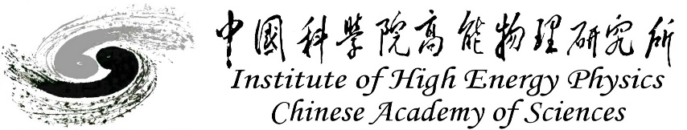
CEPC MDI SC full cryomodule optimization design
Xiaochen Yang, Xiangzhen Zhang
2025.5.23
Cryogenics Group, Accelerator Research Center
Institute of High Energy Physics(IHEP)

Slide 2
Content
Introduction
Stucture and Weight optimization
Temperature field and heat load
Current lead design for MDI SC magnet
MDI cryogenic system layout
Possible scheme of 2K cryogenic system

Slide 3
  1. Introduction
In CEPC, there are two combined-function Superconducting magnets in MDI.
Each combined-function magnet includes double aperture high gradient quadrupole (Q1a, Q1b, Q2) and anti-solenoid, around each side of the IP point.
The cryostat is used to provide the cryogenic environment for SC magnets, which is below 5.0 K.
ITEM | Q1a | Q1b | Q2 | Anti-solenoid
Central field gradient (T/m) | 142.3 | 85.4 | 96.7
Cooling type | LHe | LHe | LHe | LHe
Operating current (A) | 780 | 650 | 770 | 1300
Magnetic storage energy (KJ) | 16.7 | 15.2 | 32.1 | 730
Cross section parameter (mm) | Φ40~61 | Φ52~78 | Φ62~88 | 70 sections
Magnet mechanical length (m) | 1.23 | 1.23 | 1.53 | 5.1
Net weight (Kg) | 25 | 32 | 43 | 302
Total weight of magnets (Kg) |  |  |  | 402
From Yingshun Zhu

Slide 4
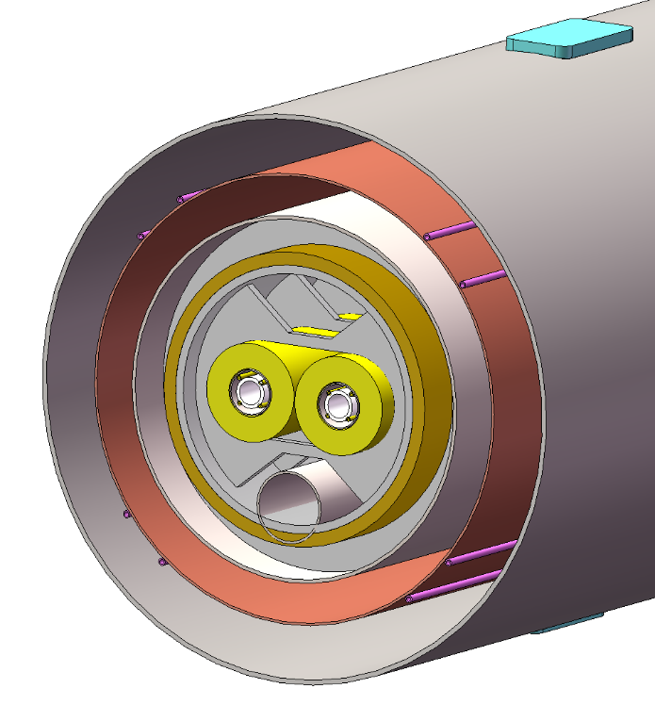
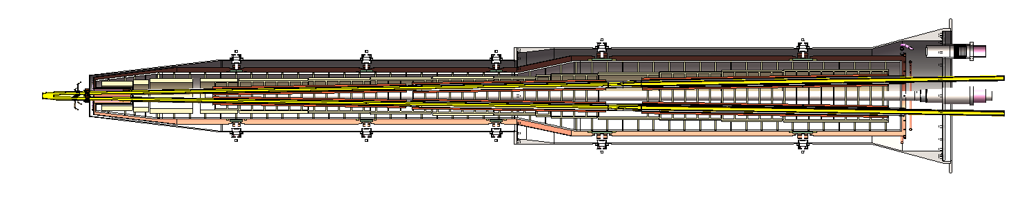
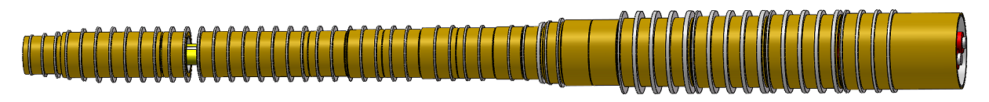
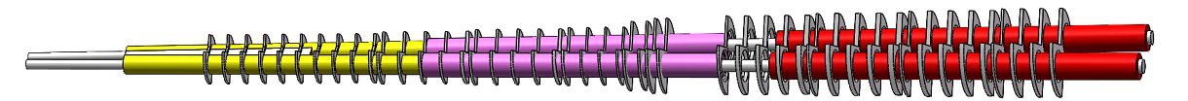
  1. Introduction
Cryostat of SC magnet
The superconducting magnets Q1a,Q1b and Q2 are supported on the inner wall of the solenoid.
The anti-solenoid is supported by a ring on the inner wall of the helium tank.
Vacuum
Thermal shield
855mm
LHe tank
1915mm
Support
Anti-solenoid
2885mm
Anti-solenoid
Q1a
Beam chamber
Q1a
Q1b
Q2
Notes:
标注尺寸

Slide 5
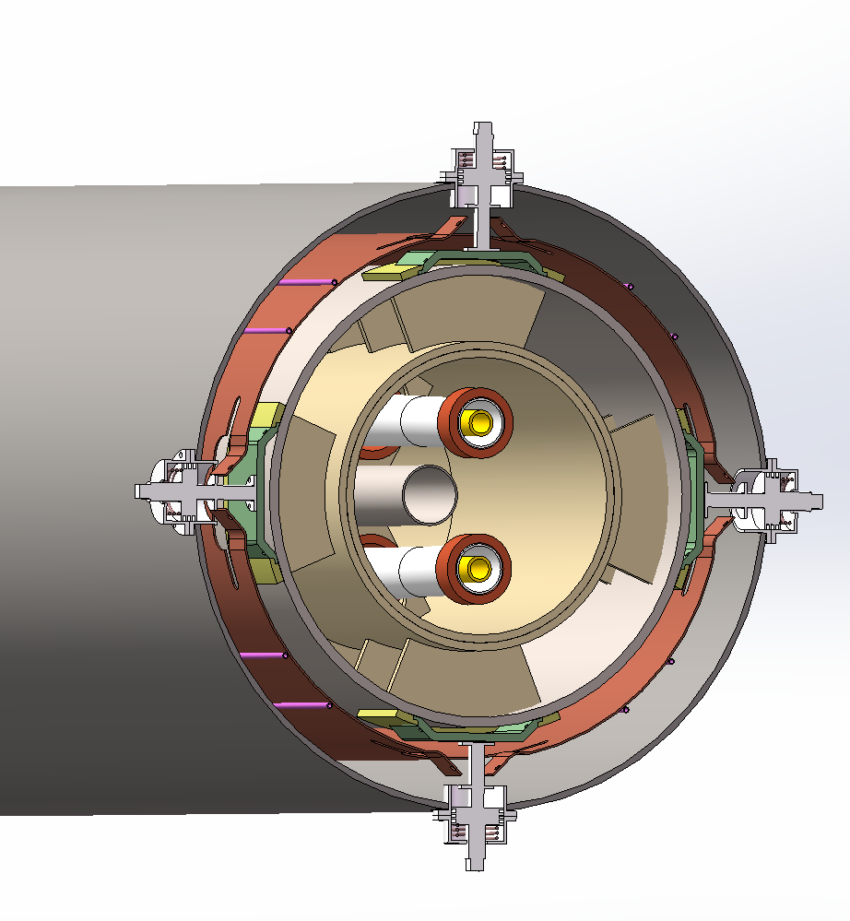
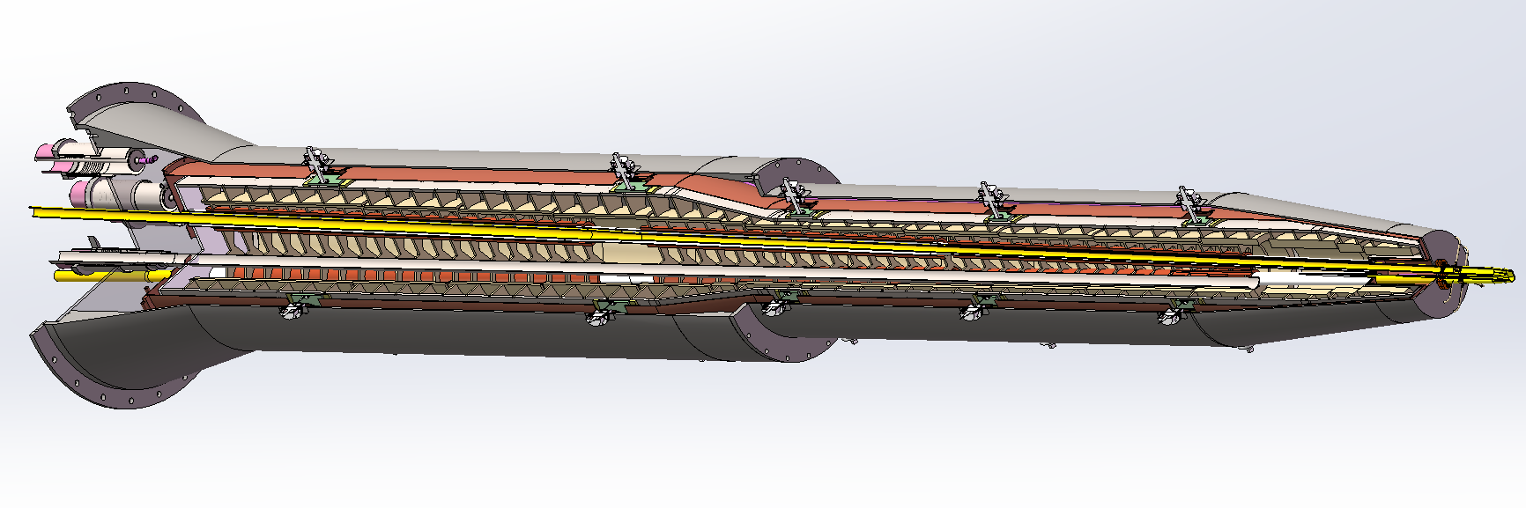
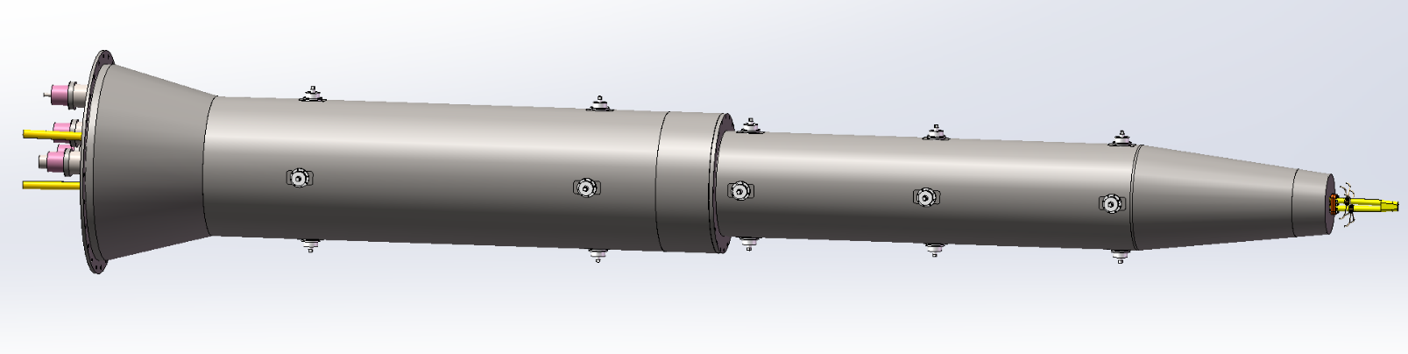
2. Stucture and Weight optimization
supports
supports
20 supports, achieving three-dimensional adjustment.
The adjustment amount is ±8 mm.
Notes:
标注尺寸

Slide 6
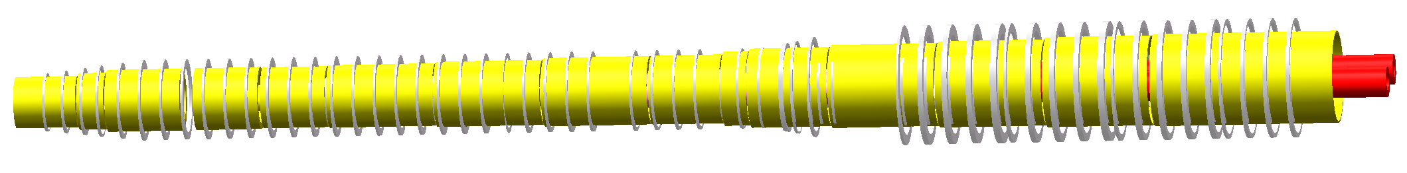
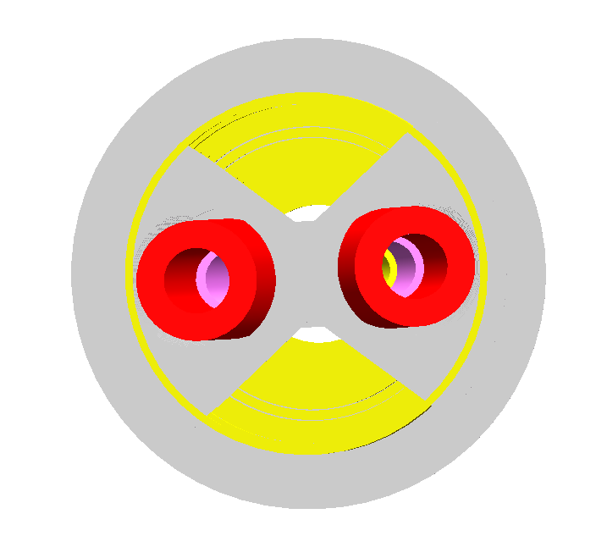
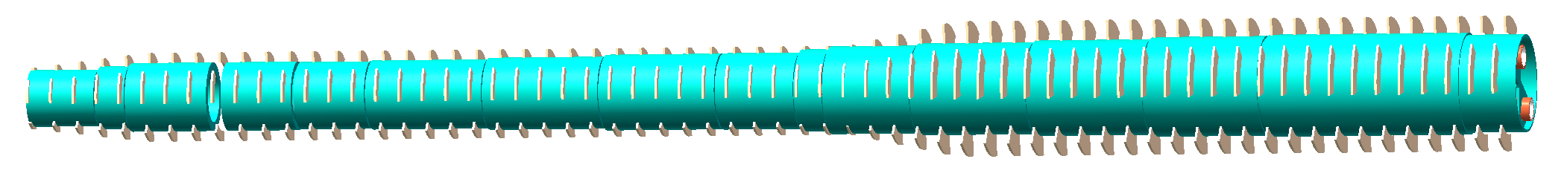
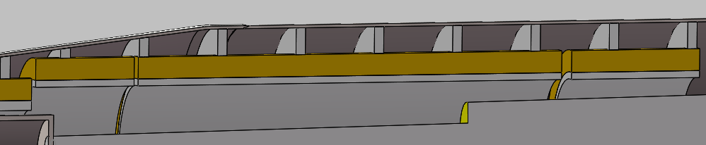
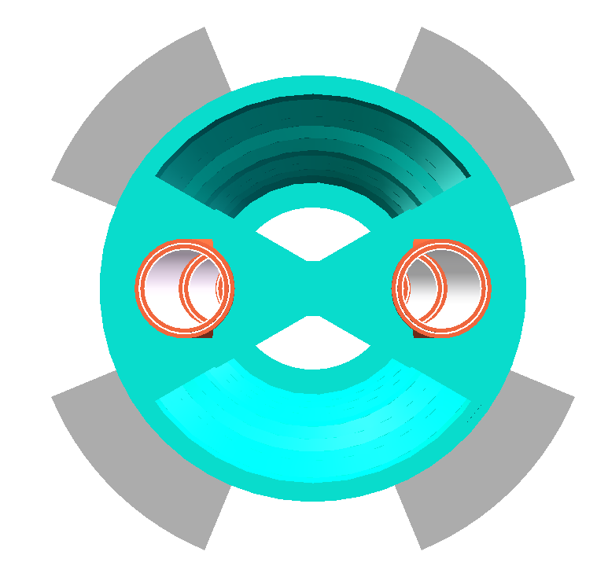
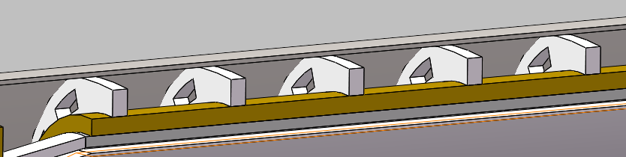
2. Stucture and Weight optimization
The Anti-solenoid is supported by a ring on the inner wall of the helium pool.
The superconducting magnets Q1a,Q1b and Q2 are supported on the inner wall of the reverse solenoid assembly;
Skeleton supports Weight: 142kg
Skeleton supports Weight: 92kg
Supports:
befor：
optimized：

Slide 7
2. Stucture and Weight optimization
Items | Weight (kg) | Main materials
Vacuum vessel | 869 | SS
Helium Vessel | 510 | SS
Thermal shield and pipes | 43 | Aluminum
SC quadrupoles | 100 | Copper & Aluminum
Anti-solenoids | 302 | Copper & Aluminum
Skeleton supports | 92 | Aluminum
Liquid Helium | 504 | Liquid Helium
Total weight | 2420
Cryostat length: 5.75 m
Total weight: 2.42 ton
The vacuum vessel is the primary optimization target.
Notes:
标注尺寸

Slide 8
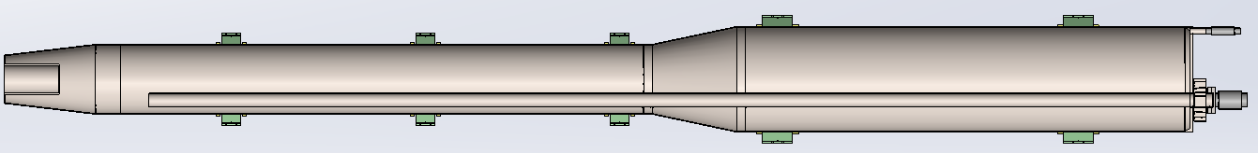
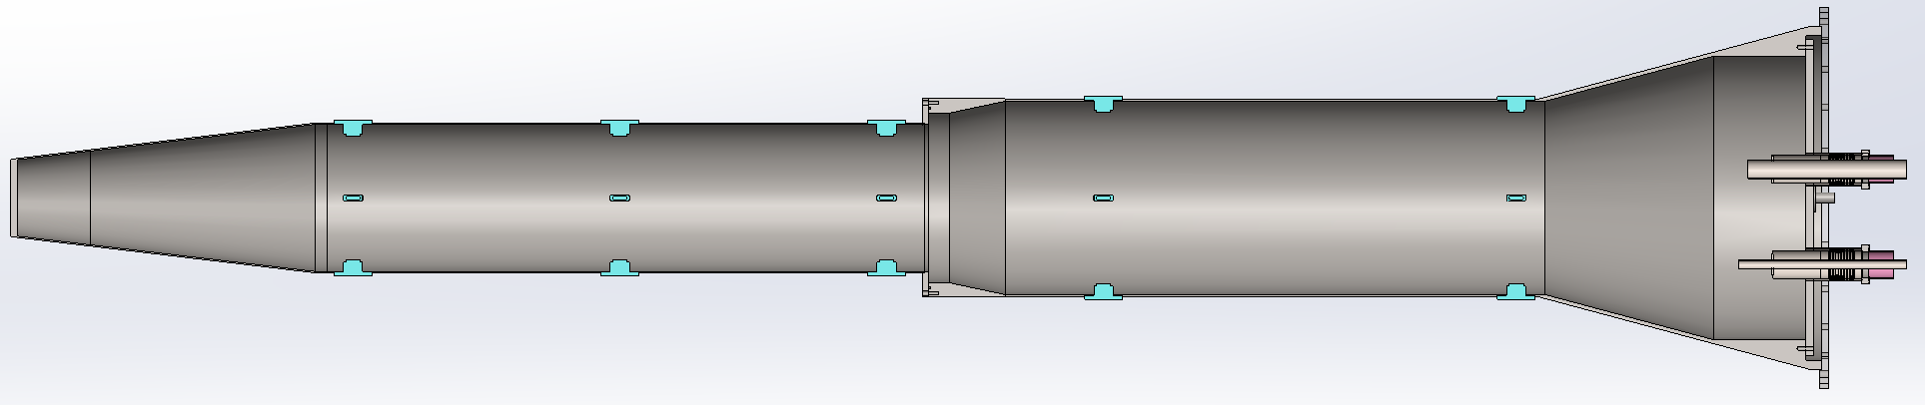



2. Stucture and Weight optimization
根据GB/T 150.3-2011压力容器厚度的计算
计算厚度：$δ=\frac{{ p}_{c}D_{i}}{2\left[σ\right]∅−{ p}_{c}}=2.29/3.4$
名义厚度：$δ_{n}=10/6$
有效厚度：$δ_{e}=δ_{n}$- $c_{1}$- $c_{2}=9.4/5.7$
2800mm
2300mm
298mm
454mm
10mm
10mm
Materials: SS
Weight: 510kg
8
855mm
1915mm
2885mm
472mm
626mm
Vacuum vessel
6mm
6mm
Materials: SS
Weight: 869kg
Notes:
标注尺寸

Slide 9
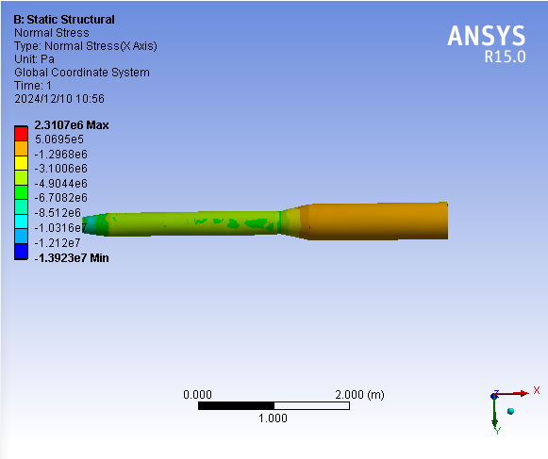
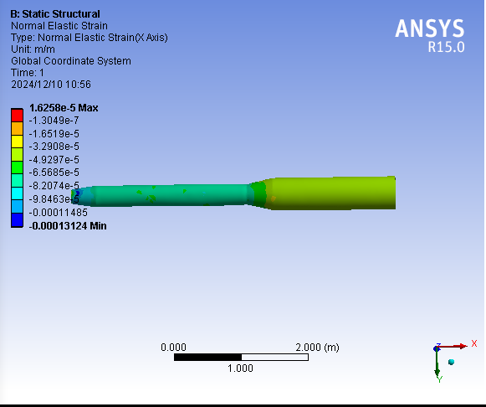
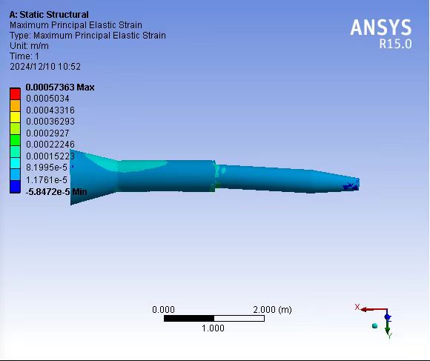
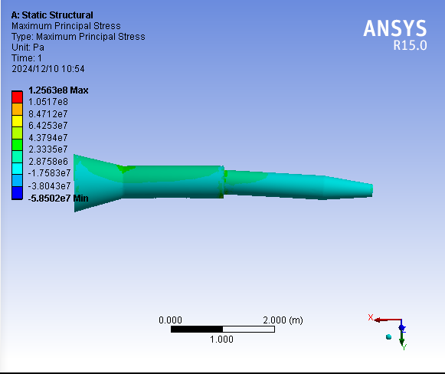
2. Stucture and Weight optimization
Helium tank
Max stress:
96MPa
Max strain:
0.00016m/m
Thickness:10mm
Vacuum vessel
Max stress:
126MPa
Max strain:
0.0004m/m
Thickness:6mm
Notes:
标注尺寸

Slide 10
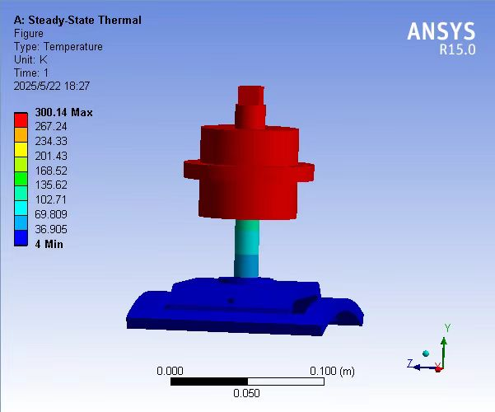
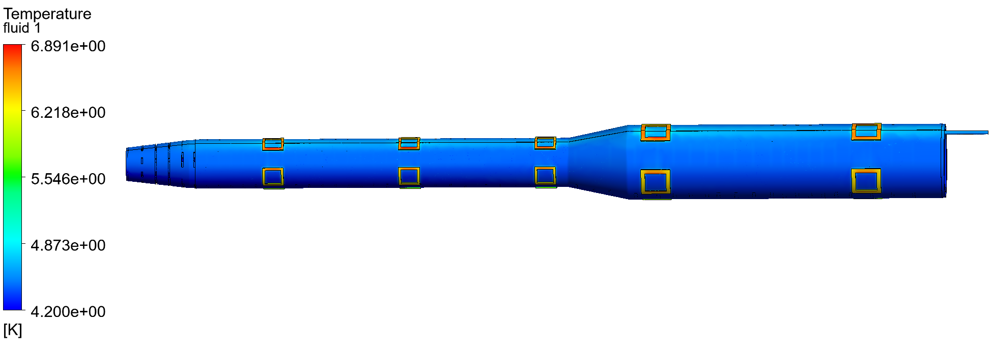
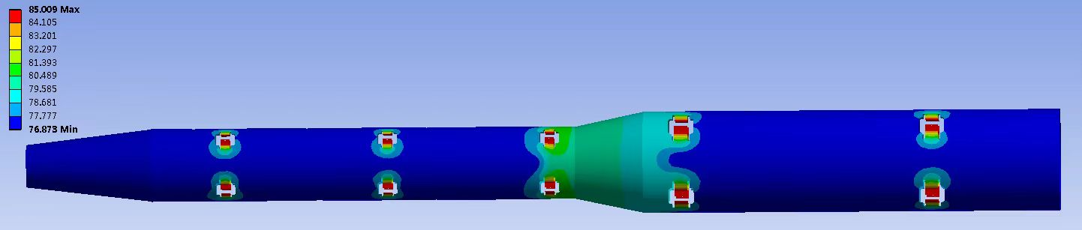
2. Stucture and Weight optimization
Thermal shield
Materials: Aluminum
Temperature difference less than 8K
Notes:
标注尺寸

Slide 11
3.Temperature field and heat load
Heat load of Radiation and conduction
Position | 80K (w) | 4&2K(w)
LHe tank supports(w) | 39.63 | 29.45
AL shield supports(w) | 24.56 | ---
LHe pipe (w) | --- | 6.54
LN2 pipe （w） | 8.79 | ---
Radiation（w） | 9.45 | 0.61
Current leats（w） | --- | 0.15
Total | 82.43 | 36.75
According to the empirical formula of multilayer insulation material
The radiation heat load is 0.61W
Notes:
标注尺寸

Slide 12
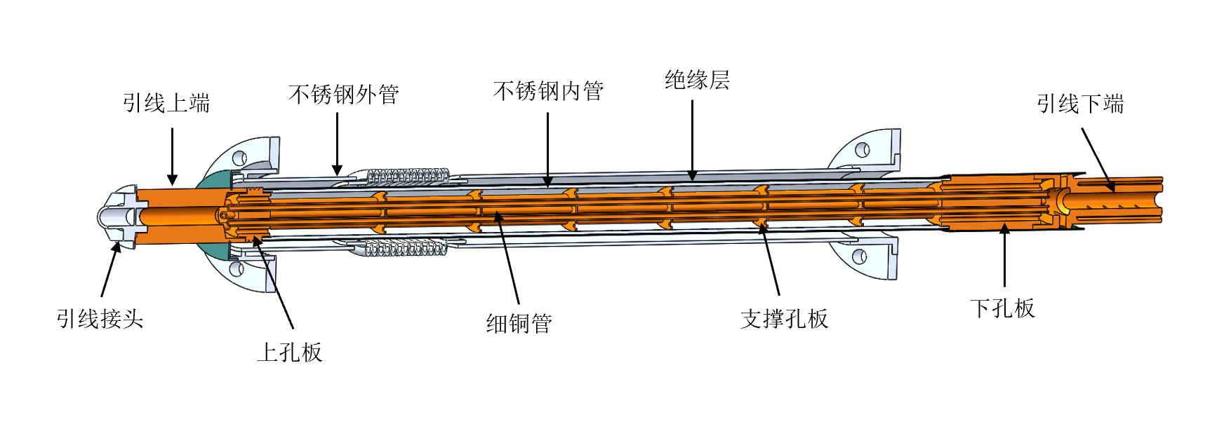
4. Current lead design for MDI SC magnet
MDI superconducting anti-solenoid magnet need to develop 1.3 kA level current leads;
The traditional pure copper leads are not easy to meet the requirements, and the current feasible solution is to use binary current leads based on high-temperature superconductivity;
The superconducting wire welding resistance optimization, safe protection and low-temperature insulation and other issues are considered;
Current lead in BEPC2
Current lead in KIT
Notes:
标注尺寸

Slide 13
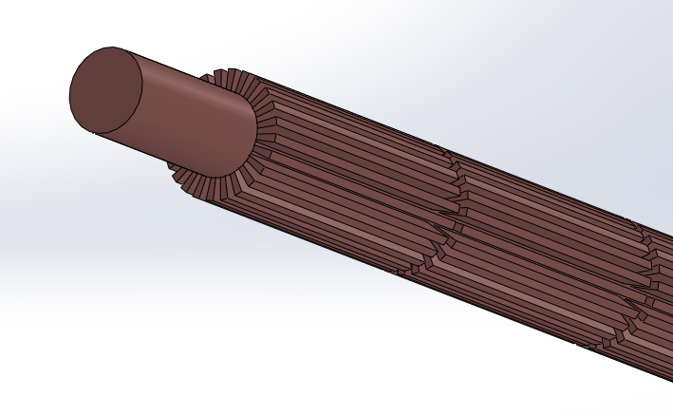
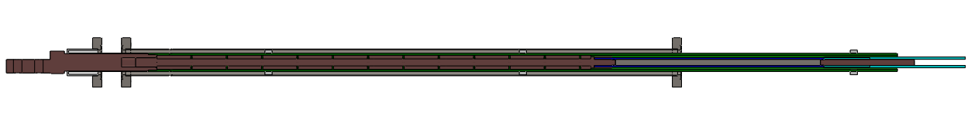
4. Current lead design for MDI SC magnet
HTS current lead
2KA HTS current lead cooled by helium gas
高纯无氧铜
高温超导+分流器
低温超导
 | 1300A电流引线 |  | 800A电流引线
引线段 | HTS | 铜引线 | HTS | 铜引线
冷却 | 5K氦气迫流 | 5K氦气迫流 | 5K氦气迫流 | 5K氦气迫流
结构 | Bi-2223银金高温超导带 | RRR40的高纯无氧铜 | Bi-2223银金高温超导带 | RRR40的高纯无氧铜
长度mm | 390 | 619 | 390 | 619
截面 | 12层 | 直径20mm，翅高5mm | 6层 | 直径20mm，翅高5mm
工作温区 | ＜60K | ＜60K-300K | ＜60K | ＜60K-300K
载流A | 1500+ | / | 900+ | /
低温漏热 | ＜0.15 | / | ＜0.1 | /
氦气g/s | / | 预估＜0.1 | / | 预估＜0.05
New heat exchange method
Current leads cooled by liquid nitrogen or helium are designed based on Bi-2223 high-temperature superconductor and high-purity copper;
With the help of numerical simulation, for the cooling of the copper section is designed; An enhanced heat transfer scheme is proposed；
Notes:
标注尺寸

Slide 14
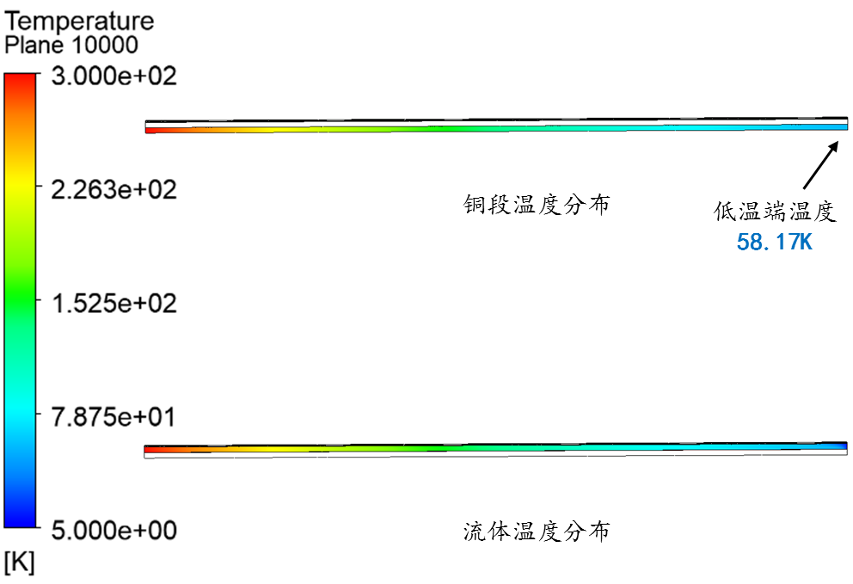
4. Current lead design for MDI SC magnet
计算得到铜的温度场，在0.06g/s氦气流量下，可满足要求。工艺更简单，流量可更小，绝缘更容易实现。
序号 | 项目 | 描述
1 | 载流能力 | 77K最大1800A @AS1，900A @SCQ。
2 | 铜段加工 | 翅片铜柱，工艺简单可靠，并大幅缩短制作周期。
3 | HTS | 有效提高铜段低温端温度，极低漏热，使得低温超导处的温度容易控制。
4 | 电绝缘 | 室温陶瓷，沿程G10套管，综合耐压可达1000V+。
5 | 低温漏热 | 大幅减小，小于一元引线情况的1/10。
二元电流引线的技术特点：
Notes:
标注尺寸

Slide 15
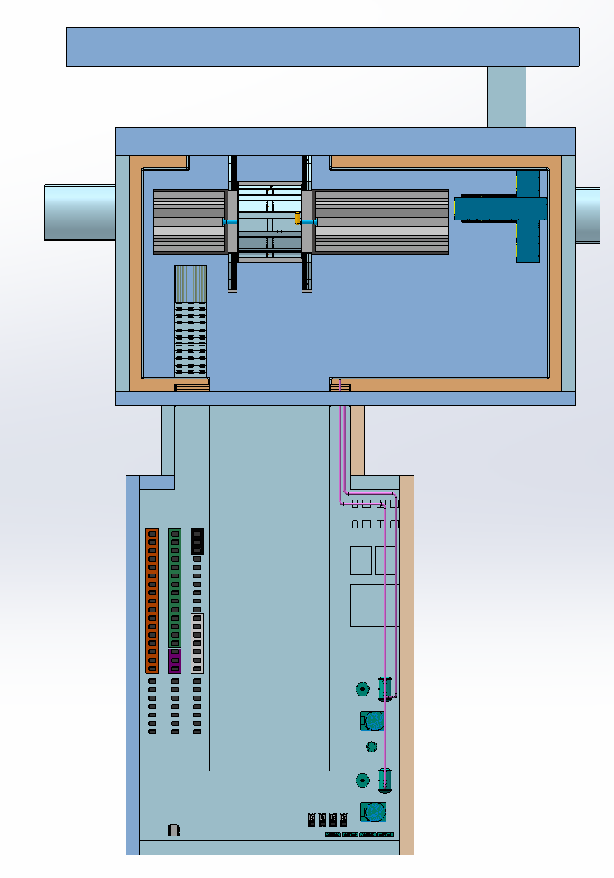
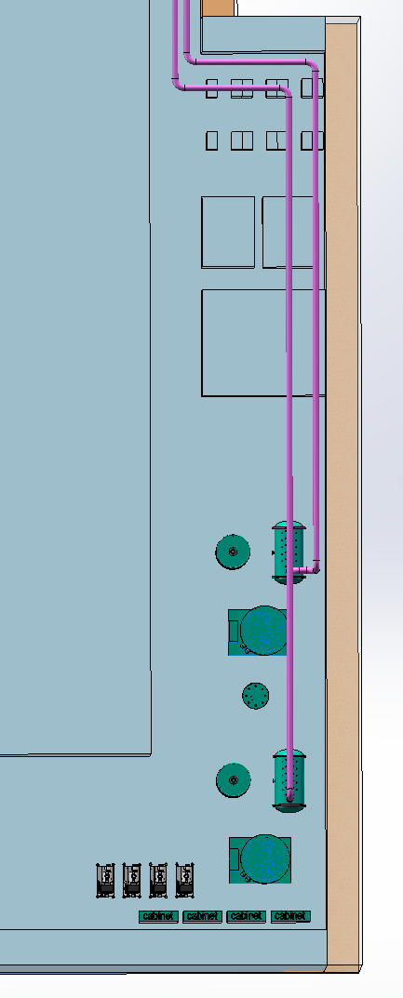
5. MDI cryogenic system layout
22m
Cryogenic pipeline
6.3m
SC magnet Cryogenic system
Detector Cryogenic system
18m
Layout of the cryogenic system; plan view
Notes:
标注尺寸

Slide 16
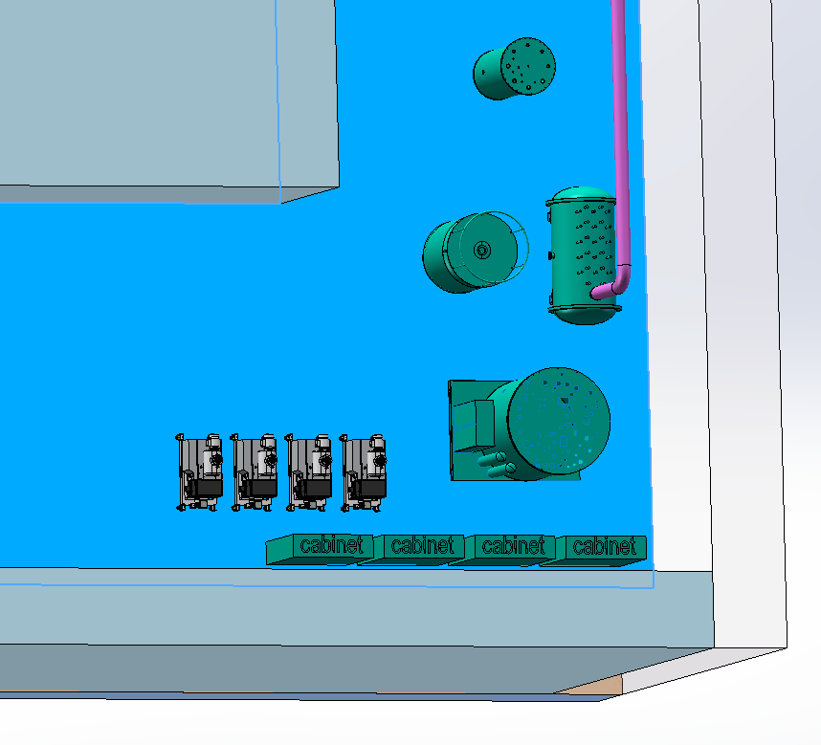
5. MDI cryogenic system layout
Phase separator
dewar
Valve box
2K pumps
cold box
Notes:
标注尺寸

Slide 17
6. Possible scheme of 2K cryogenic system
研究背景：
Q1a超导磁体技术难度极大，为了在有限的径向空间内满足 Q1a 的高磁场梯度（142.3T/m），需要具有高载流性能的超导体，需要在当前4K温度的参数基础之上，继续降低温度以提高技术性能（约20%）；
MDI超导磁体恒温器内部，结构紧凑，磁体冷却较为困难，尤其是小间隙位置；
KEK用4K低温方案，FCC采用2K低温方案；
2K与4K液氦冷却的区别：
2K温度，液氦进入超流状态，流动无阻力，可以浸润到小间隙，适合现在情况；
2K温度，超流氦传热系数扩大几百万倍，传热机理本质改变，利于冷却；
4K温度，超导磁体容易积累气泡，局部失超风险高(KEK初期调试遇到较多困难)；
4K温度，成本较低。
Notes:
标注尺寸

Slide 18
6. Possible scheme of 2K cryogenic system
2K低温冷却初步方案
2K低温系统方案特点（相比较原4K方案）：
恒温器运行在负压，需要增加减压降温系统，目前技术上已经有储备；
电流引线单独设置冷却路，可升级为传导冷却（需要技术验证）；
制冷机需要升级制冷能力，因2K下制冷量降低到4K时的20%以下；
恒温器主体结构不用改变，主要问题是成本会较大幅度增加，预计千万量级。
Notes:
标注尺寸

Slide 19
Thanks for your attention!

