Slide 1
Analysis of the Impact of Micro-vibration on Beam Stability in the CEPC Interaction Region
YAN Fang, TAN Xiangyu, WANG Yiwei, Wang Haijing, Wang Zihao
HEPS ground motion system / Accelerator center
20250523
CEPC Day

Slide 2
Outlines
1
CEPC Vibration specification considerations
2
Vibration specifications for ground of the CEPC interaction region
3
Vibration specifications for girders of the CEPC interaction region
4
Vibration specifications for ground of the CEPC arc area
5
Vibration specifications for the inner & outside vibration sources
6
Vibration parameters on the CPEC site needed to be defined
7
Summary

Slide 3
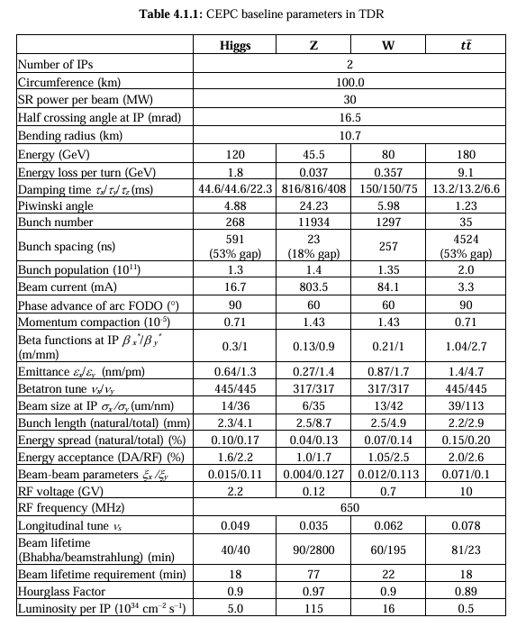
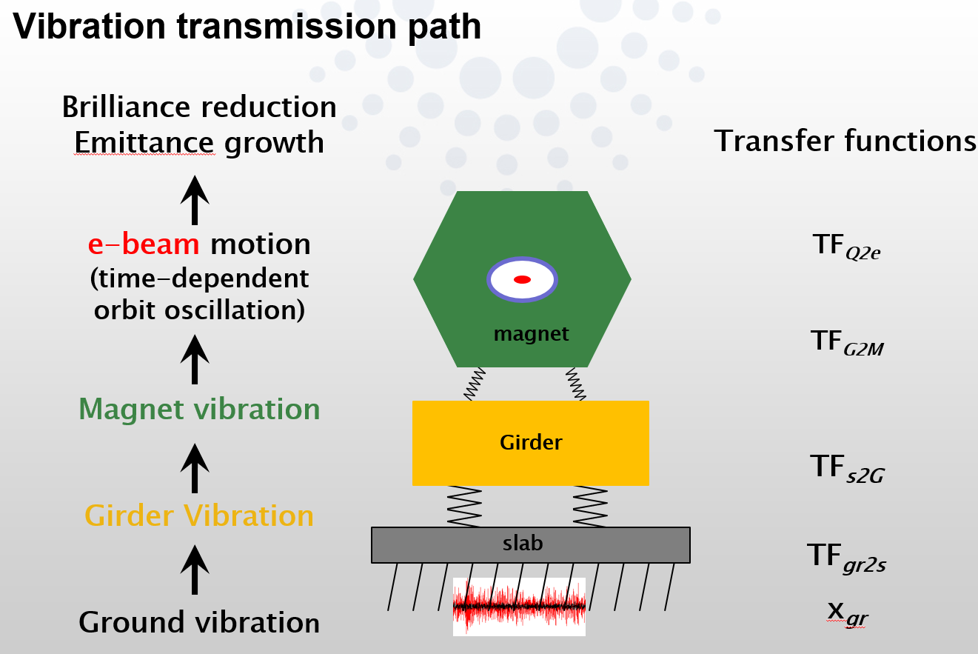
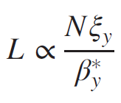



1. CEPC vibration specifications considerations
Why vibration is so important for CEPC and where does it come from?
Higgs mode beam size @ IP: $σ_{y}=36nm$
$$\frac{ΔL}{L}≈−\frac{{Δy}^{2}}{4σ_{y}^{2}}$$
$\text{L}\text{: 2\%} ∆y @$IP: 10nm
→
Courtesy of Lin Zhang, Beam stability consideration for low emittance storage ring, Workshop on ambient ground motion and vibration suppression for low emittance storage ring, GM2017, Beijing, China, 11 - 13 December 2017.10.

Slide 4
1. CEPC vibration specifications considerations
Ground vibration：
Site selection: 25nm of 1-100Hz RMS integral (HEPS)
Interaction region & arc area
Internal vibration sources: e.g., utilities / dominate on SR slab <1nm (HEPS)
External vibration sources: traffic
Girder vibration：
No amplification of the ground vibration / 54Hz (HEPS)
Magnet vibration:
Cooling water vibrations
Pipe vibrations

Slide 5
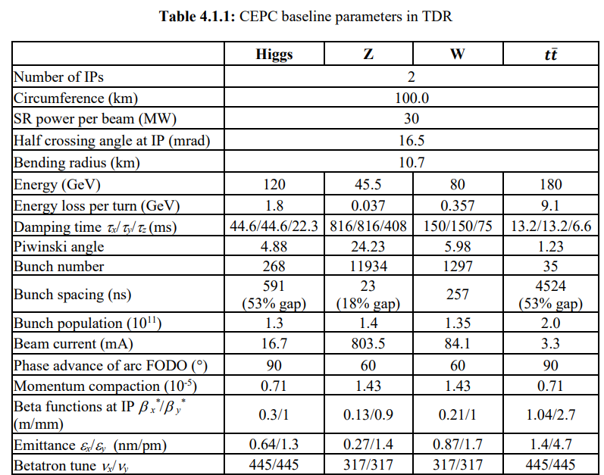
1. CEPC vibration specifications considerations
The lower frequency limit of ground motion
The characteristic wavelengths of slow ground motions are far greater than betatron wavelength, the dynamic effects to the beam can be neglected：[courtesy of June-Rong Chen/NSRRC MEDSI2014]
--CEPC Betatron wavelength:
λ_{βy}= C / ν_{y}= 100km / 445(Higgs mode) = 224.7 m
--Assume the wave velocity of CEPC site is: ν_{y}=2000 m/s
--Consider vibrations with wavelength one magnitude higher than
the betatron wavelength, the characteristic frequency is:
f_{βy} = ν_{βy1} / λ_{βy}= 2000 / 2247 = 0.89Hz ≈ 1Hz
For characteristic frequency of ground vibrations smaller than 1Hz, the dynamic effect to the beam can be neglected. Therefore, 1Hz is treated as the lower limit of the ground motion Spec.

Slide 6
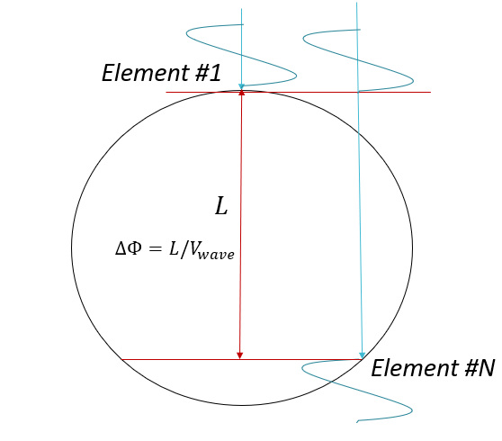
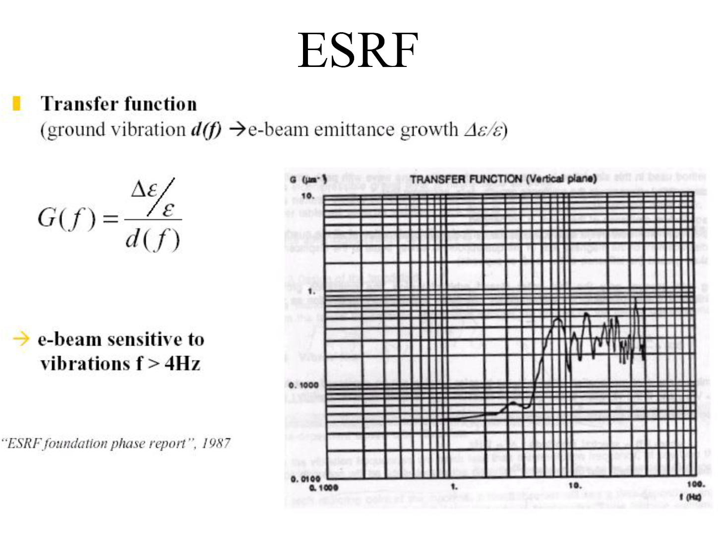



1. CEPC vibration specifications considerations
The lower frequency limit of ground motion
*$2πf$
For f=1Hz:
$d=\frac{C}{π}=100km/π$=31.8km
Within the length of diameter of CEPC, 1Hz could transport 16 waves, assuming the wave velocity of 2000m/s.
So 1-100Hz is treated as uncorrelated vibrations currently, need to be checked.
$h=d/V_{wave}$*f=d/2000m/s=16

Slide 7
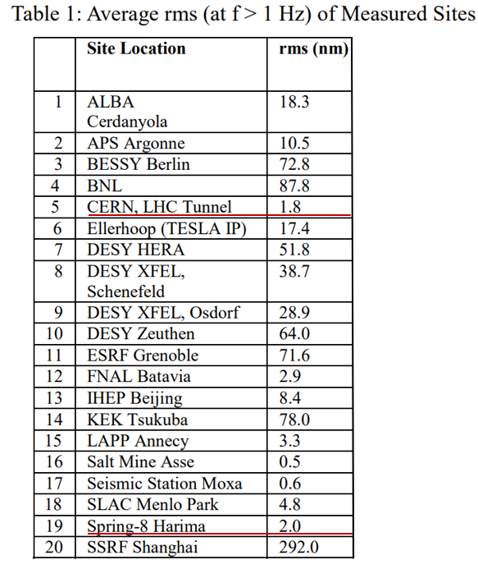
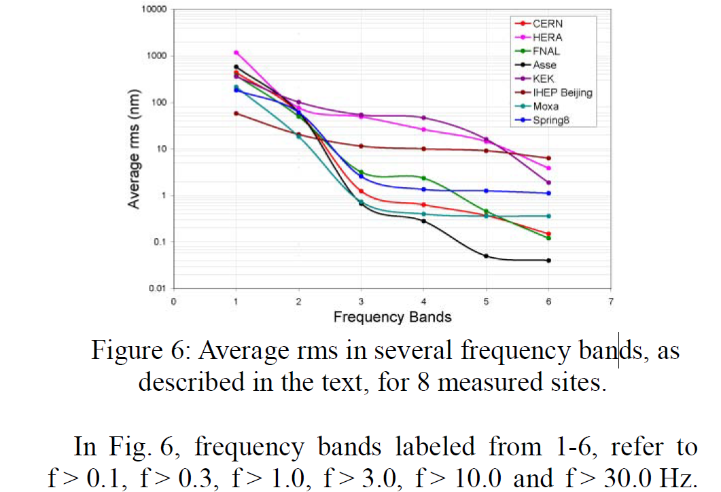
2. Vibration specifications for ground of the CEPC interaction region
What the vibration specification should be and what is the reality?
Courtesy of Wilhelm Bialowons, MEASUREMENT OF GROUND MOTION IN VARIOUS SITES, EPAC2006 proceedings.
Notes:
基于higgs模式为什么？？？

Slide 8
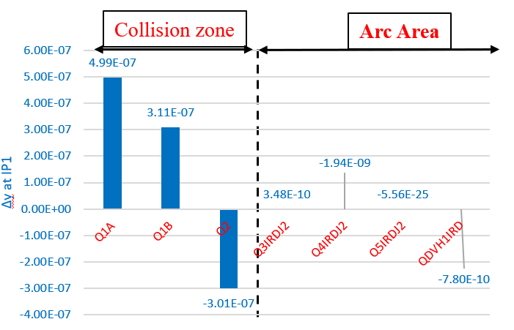
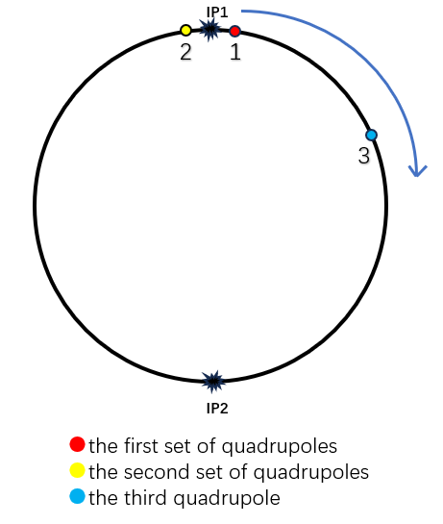
2. Vibration specifications for ground of the CEPC interaction region
What the vibration specification should be and what is the reality?
Input Displacement Error | Displacement @ IP1
7nm @Position 1 | 3.6nm
7nm @Position 2 | 3.6nm
3.6nm @Position 1&2 (opposite) | 3.6nm
IP1
IP2
1µm displacement on each magnet;
The induced displacement on IP1 position by magnets on
collision zone are three order magnitude higher than by
magnets on arc area.
The specification of the ground motion level on the interaction region can be set to be 4nm (displacement RMS integral:1-100Hz).
The ground motion level of the arc area is not included.
Notes:
基于higgs模式为什么？？？

Slide 9
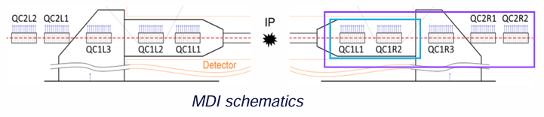
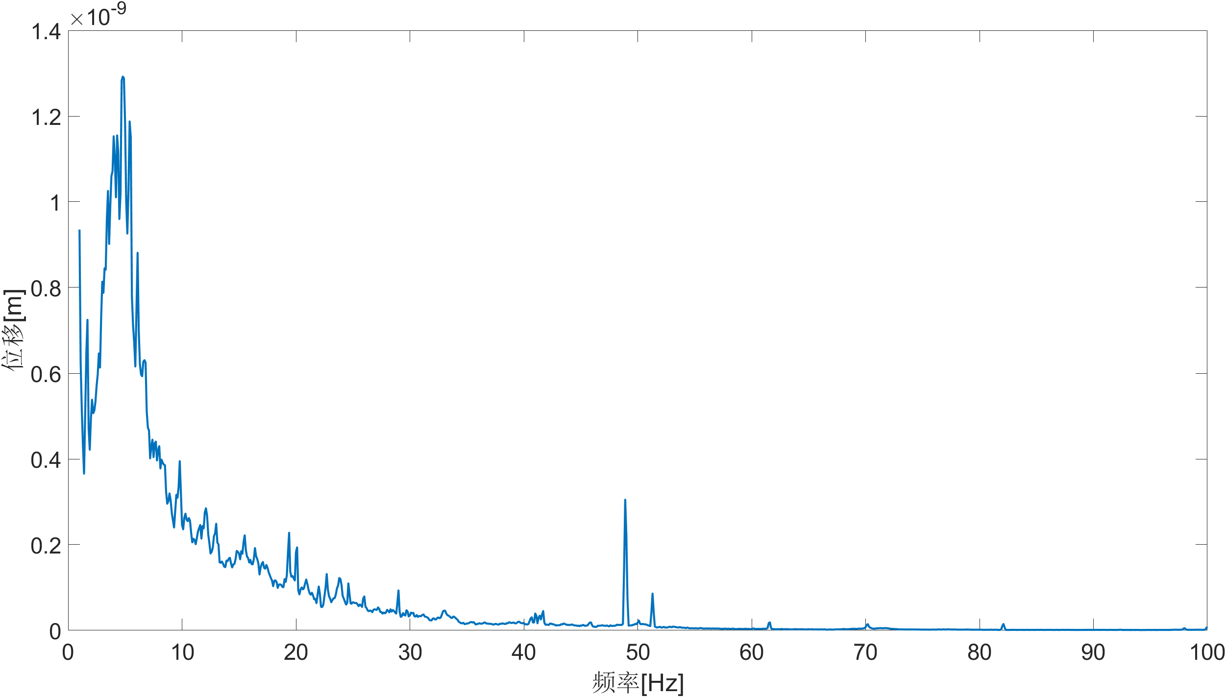
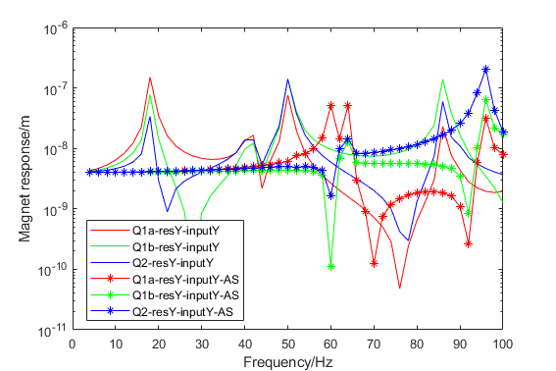
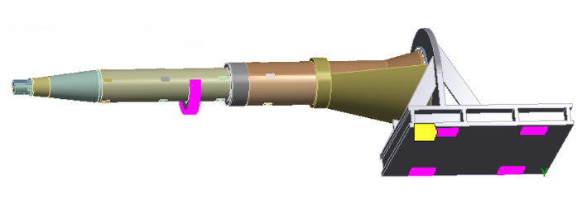
3. Vibration specifications for girder of the CEPC interaction region
CEPC对撞区磁铁支架的稳定性研究
HEPS night vibration as input on ground of interaction region
RMS: 4.2nm
Dominated f: 4.8Hz
Frequency Response Function
of a Cantilever Structure
 | Displacement @IP1 | Amplification factor
No support | 5.72nm | 1.43
With support | 3.59nm | 0.9
Support position
The auxiliary support design can effectively improve the amplification of ground vibrations comparing with without support:
It is assumed that the auxiliary support is rigidly connected to the ground.
The detector underneath connecting with the auxiliary support can’t magnified the ground vibrations (>54Hz).

Slide 10
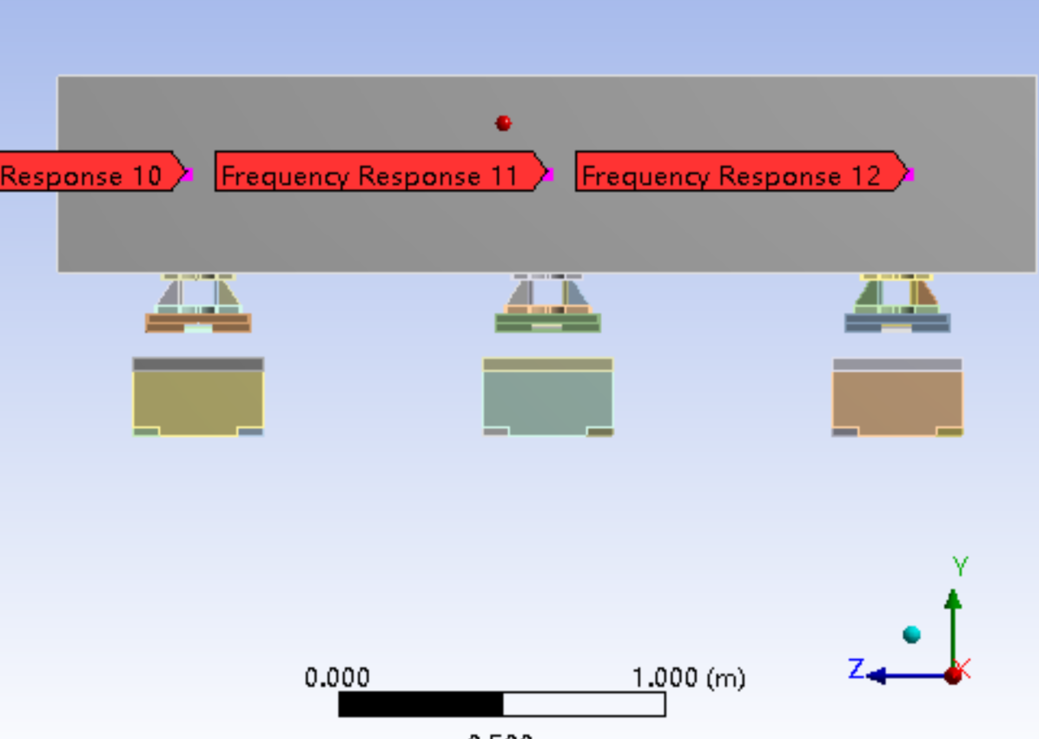
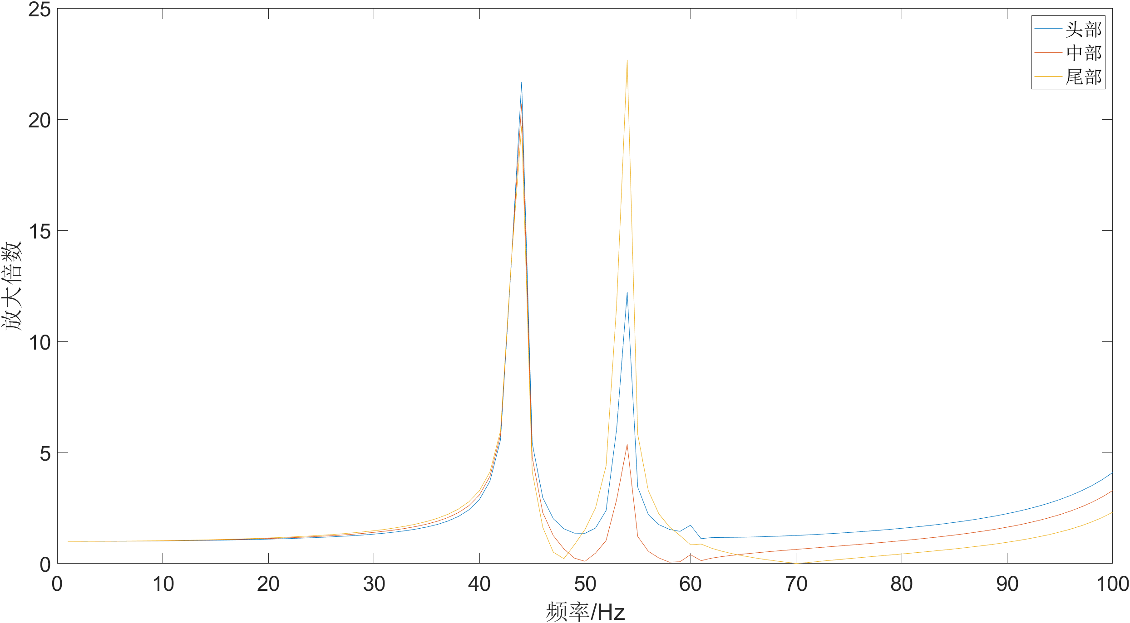
4. Vibration specifications for ground of the CEPC arc area
Random ground motion vibrations of 25 nm in the arc area are combined with 4 nm vibrations on the interaction region magnet within the lattice. The cumulative effect of these vibrations on the IP position is 10 nm, resulting in a 2% decrease in luminosity.
Vibration on IP magnets | Random vibration on arc magnet | Orbit displacement at IP1/IP2 respectively
4nm | 25nm | 10nm / 10nm
CEPC对撞区磁铁支架的稳定性研究
Magnet girder of arc area

Slide 11



5. Vibration Spec. for the inner and outside vibration sources
HEPS floor vibration spec. 25nm, inner and outside vibration spec. 1nm is defined on basis of:
For CEPC, 4nm on ground of interaction region, <0.2nm domination on ground of the IP position?
Once the vibration domination on ground by inner and outside vibration source is defined, the vibration level of the sources could be estimated using vibration attenuation formula.
$$D_{floor}=\sqrt{{{(D}_{ground})}^{2}+{{(D}_{ambient1})}^{2}+…{{(D}_{ambientn})}^{2}}$$
$D_{floor}=\sqrt{{(4nm)}^{2}+{(0.4)}^{2}∗100}$=5.6nm
$D_{floor}=\sqrt{{(4nm)}^{2}+{(0.2)}^{2}∗100}$=4.5nm

Slide 12
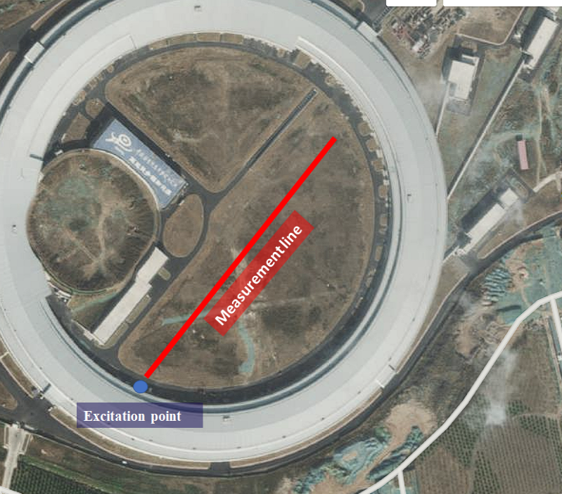
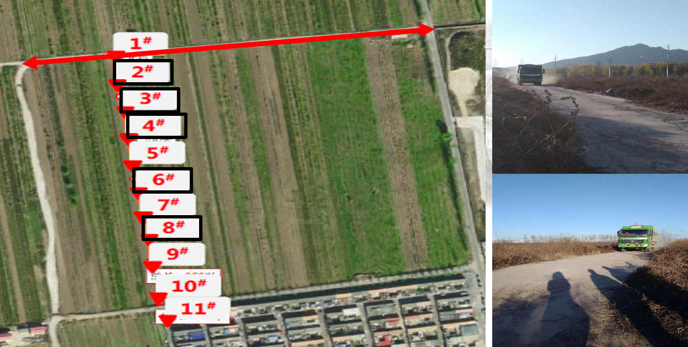
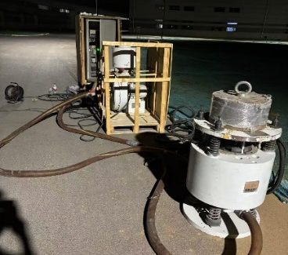
6. Vibration parameters on the CPEC site needed to be defined
Measurements of vibration attenuation characteristics on HEPS conducted for three times:
It is recommended to review the test plan before conducting the tests for CEPC.
1st: narrow vibration f band
2nd : The test points are not densely
distributed enough.
3rd test

Slide 13
6. Vibration parameters on the CPEC site needed to be defined
Besides the vibration characteristic of CEPC site, there are also other vibration parameters need to be defined:
Wave velocity → Complete the vibration beam dynamics model, assess the vibration influence of vibration sources inner and outside CEPC site
Vibration level on collision zone → Complete the vibration assessment on collision position
Vibration level on arc area → Complete the vibration influence on collision position

Slide 14
7. Summary
The frequency range relevant to the CEPC lattice is defined as 1-100 Hz.
The vibration specification on the ground of the interaction region is set to be 4 nm (1-100 Hz).
A comparison is made between the girder designs of the interaction region magnet with and without a cantilever structure. The latter design does not amplify ground motions; however, the detector connected to the cantilever support must be sufficiently rigid.
All evaluations are not based on actual site measurement results. Vibration parameters, including vibration characteristics, wave velocity, and vibration levels at the interaction region and arc area, need to be defined.

