Slide 1
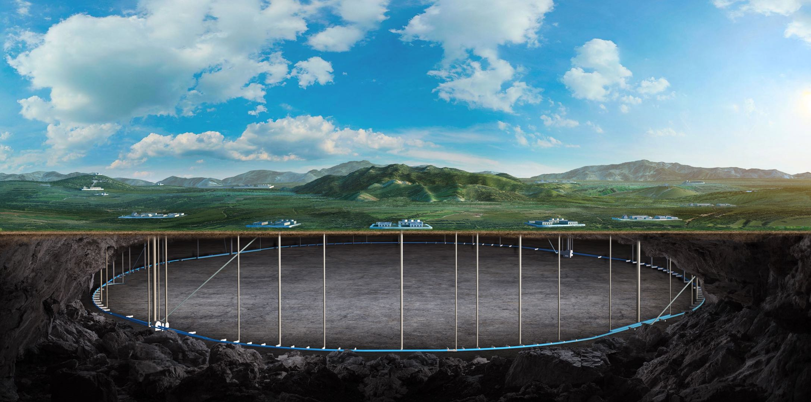
CEPC C-band test bench and C3 structure development status
ZHANG Jingru, Zhang Hui, Yang Xiaochen, Shi Hua
23 May, 2025, CEPC day

Slide 2
Content
C-band accelerating unit test bench
Parallel coupling cool copper structure development status
Summary

Slide 3
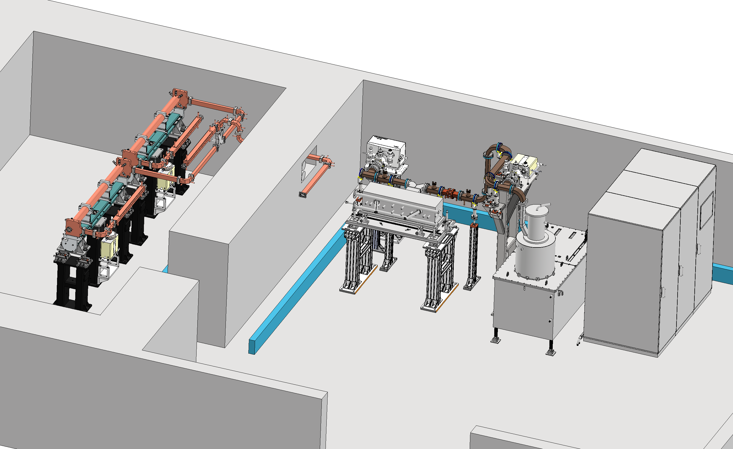
C-band accelerating unit test bench
The C-band high power test bench will utilize the test room at the end of the HEPS linac
Microwave components: power splitters, highly directional couplers, pulse compressors, accelerator tube
Vacuum equipment, mechanical supports, LLRF and high power performance diagnostics

Slide 4
accelerating struture
TW
Completion of the commissioning of the existing accelerated structure
New design
Further reduction of Esmax/E₀ improves power utilization efficiency
Improvement of power utilization efficiency
 | IHEP | SARI | RIKEN | INFN | PSI
Frequency(MHz) | 5712 | 5712 | 5712 | 5712 | 5712
Mode | 3π/4 | 4π/5 | 2π/3 | 2π/3 | 2π/3
Length (m) | 1.8 | 1.8 | 2 | 1.4 | 2
Gradient at high power test bench(MV/m) | - | 50 | 50.1 | 36 | 52
Operating gradient with beam (MV/m) | - | 41.7 | 41.4 | 36 | 28

Slide 5
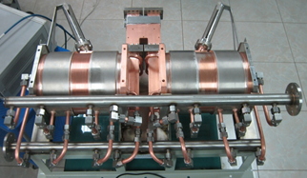
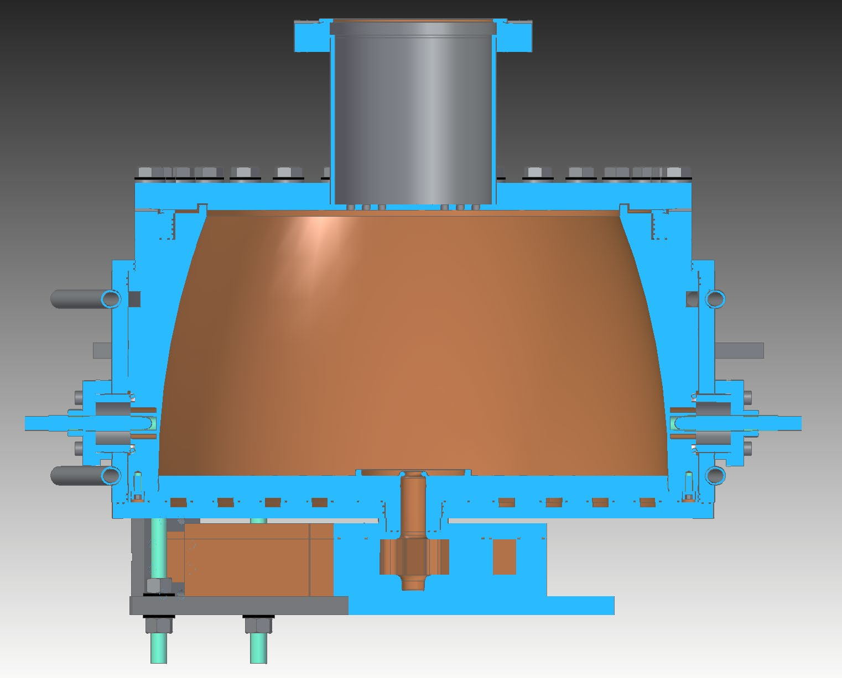
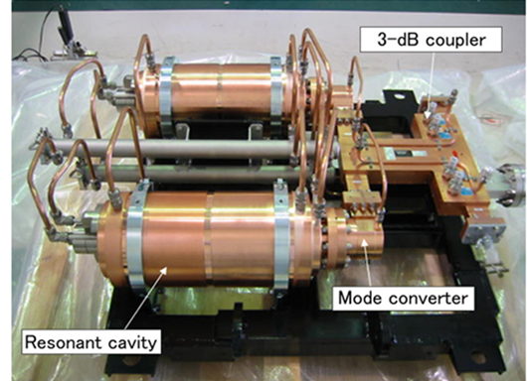
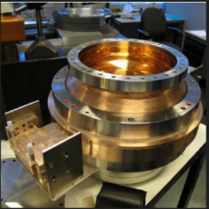
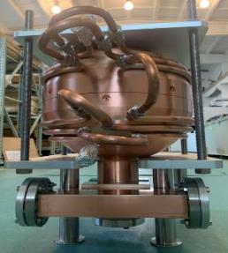
Pulse compressor
Successful operation of 2 types （C-band）
TWO cavity type (TE_{0,3,8}\TE_{0,1,15})
BOC type
Spherical type（TE_{1,1,3}\TE_{1,1,4}）
Bowl-shaped

Slide 6
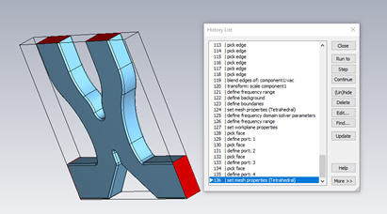
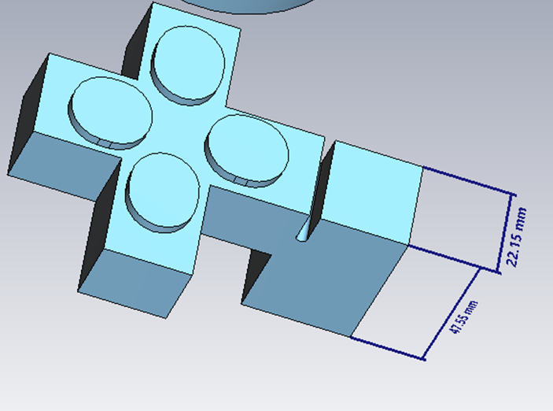
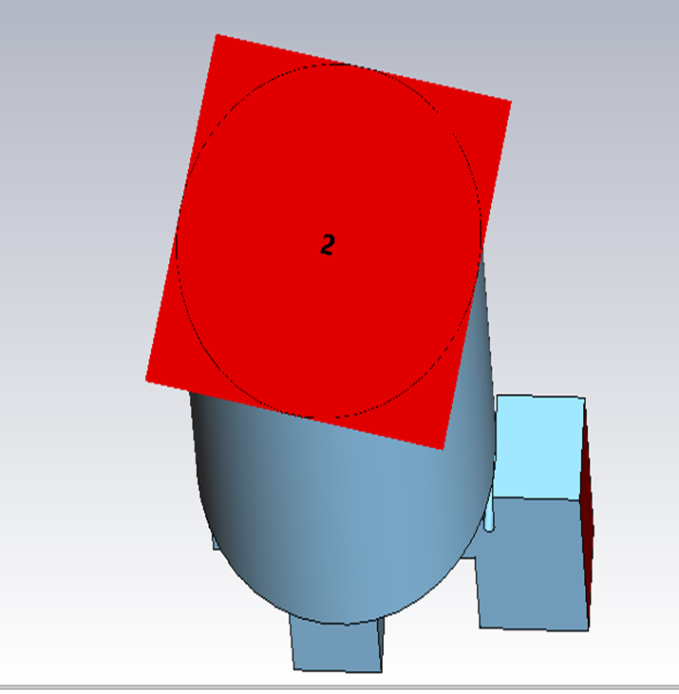
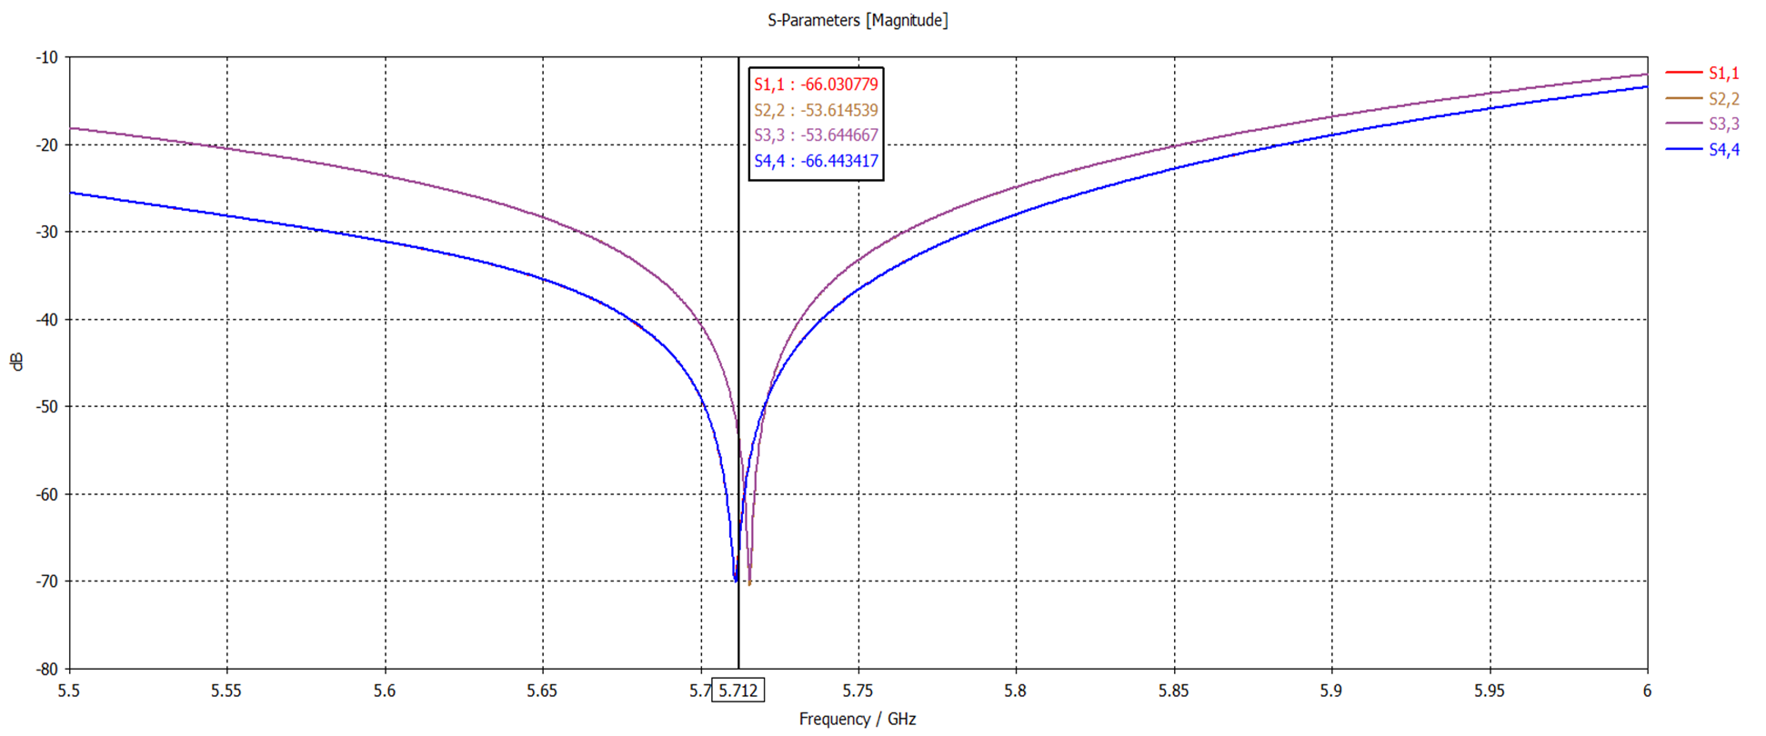
Pulse compressor (1)
Currently focused on the mode converter design, aiming to optimize matching and reduce reflection losses.
The 3-dB power divider has been successfully designed and validated with good simulation results.
Further work will integrate the optimized converter with the complete system to evaluate overall efficiency and power multiplication.
Reference image of a C-band RF pulse compressor system consisting of two resonant cavities, a 3-dB coupler, and a mode converter.
S-Parameter Results for 3-dB Power Divider (Matching at 5.712 GHz)
CST model showing mode converter geometry, port setup, and meshing.

Slide 7
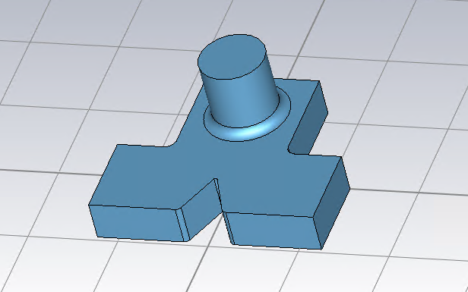
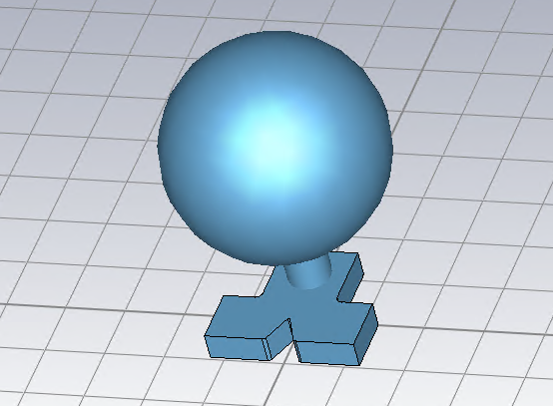
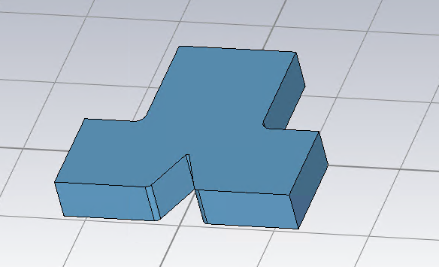
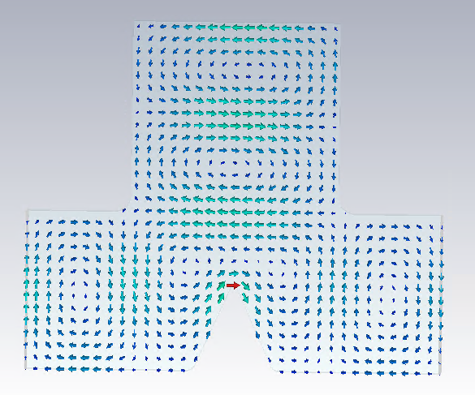
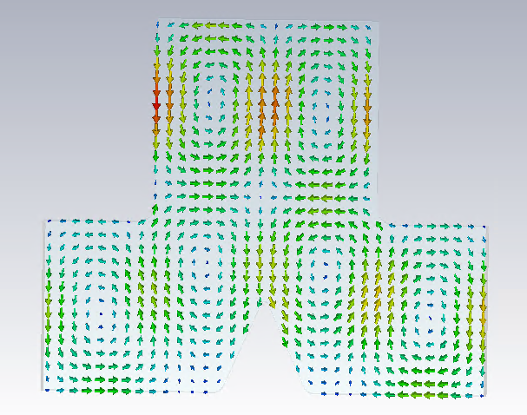
Pulse compressor (2)
Spherical type
TE10 TE20
TE113

Slide 8
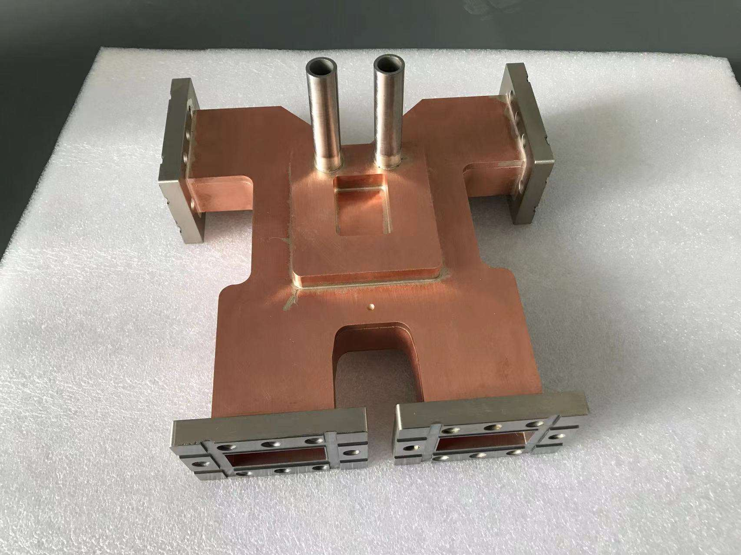
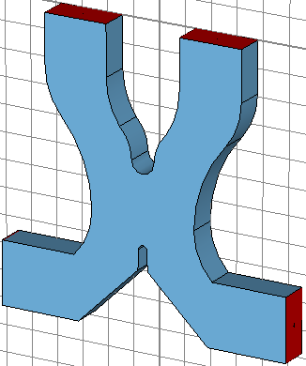
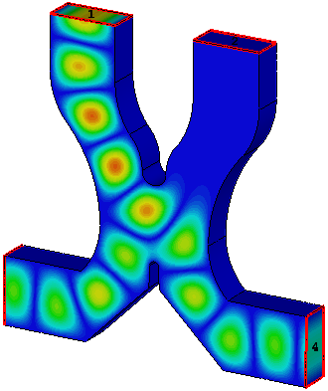
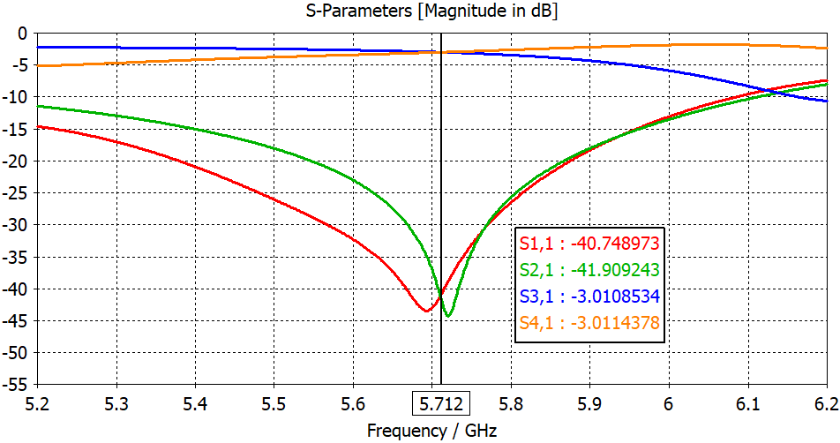
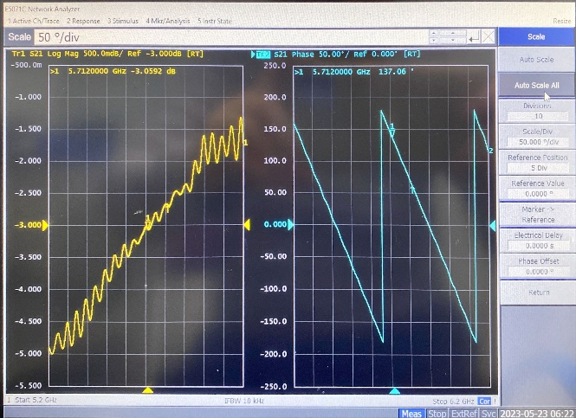
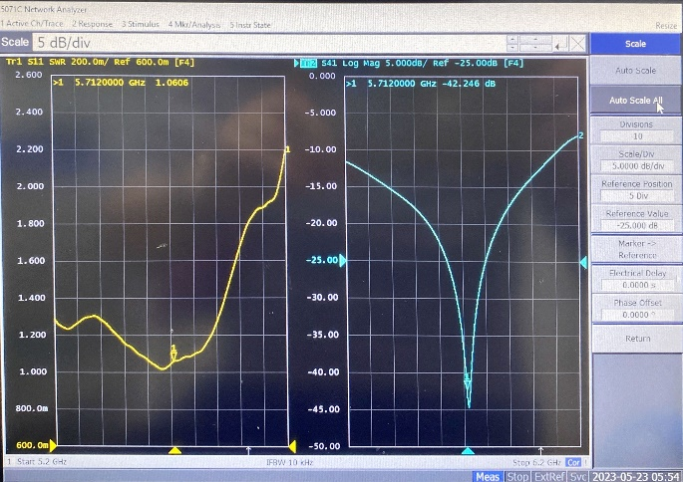
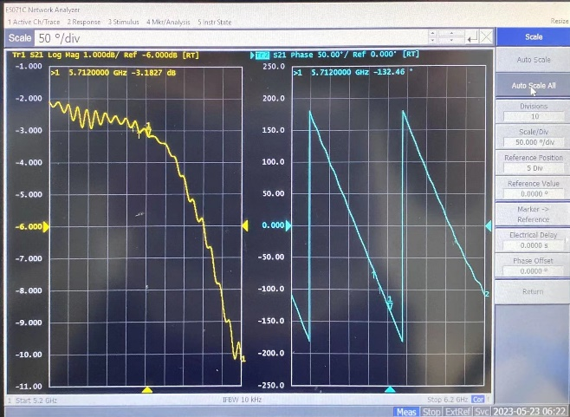
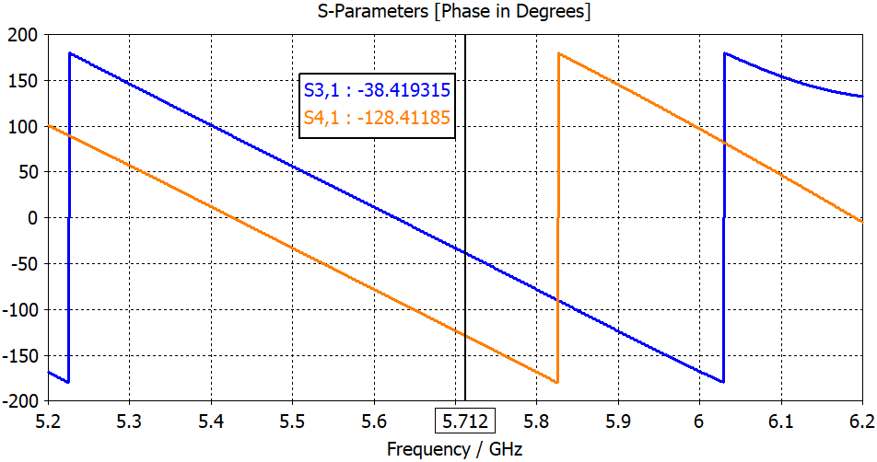
3dB hybrid power divider
VSWR：1.06
Amplitude imbanlance: -0.13dB
Phase imbalance degree: 0.48°
 | Amplitude |  |  |  | Phase
 | S11 | S21 | S31 | S41 | S31 | S41 | Phase difference
Designed | -40.7 | -41.9 | -3.01 | -3.01 | -30.4 | -120.4 | 90
Measured | -20.9 | -42.2 | -3.05 | -3.18 | 137 | -132.5 | 90.48

Slide 9
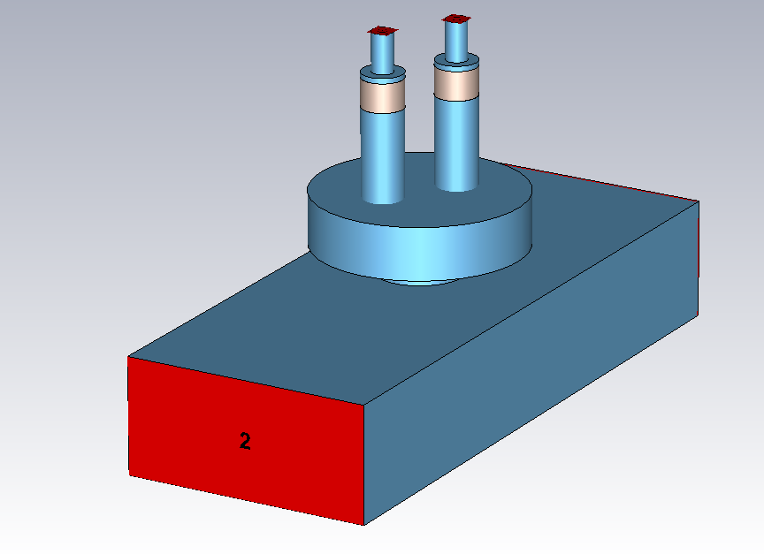
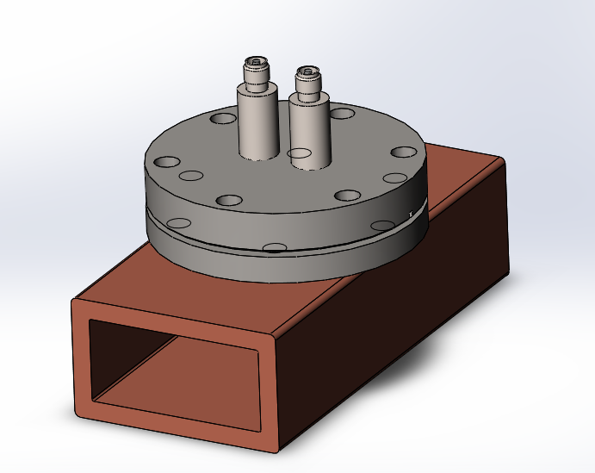
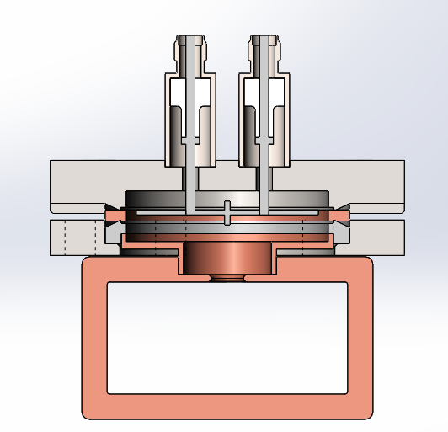
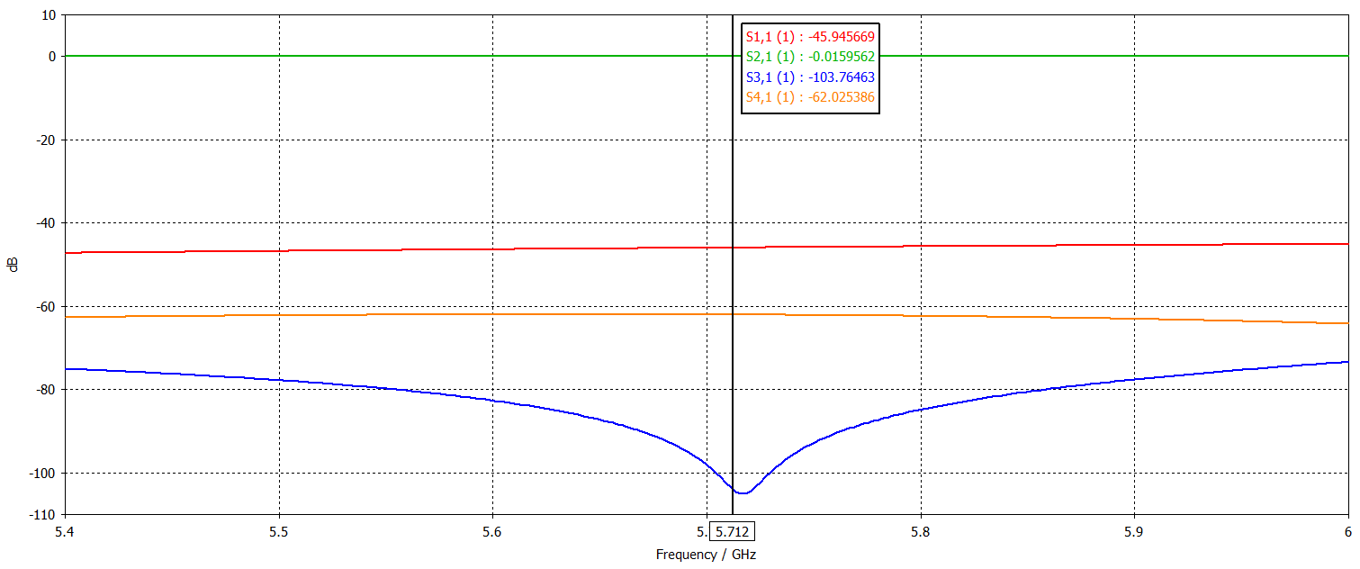
High directional coupler
Bethy hole type directional coupler
CF35 flage, SMA feedthrough
The coupling is 62dB and the directionality is 41.8dB
SMA feedthrough
CF35 flage
S11 (dB) | S12 (dB) | S13 (dB) | S14 (dB)
-45.9 | 0.016 | -103.8 | -62

Slide 10
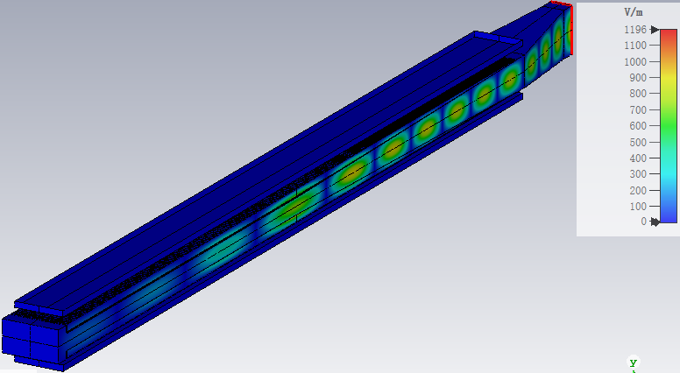
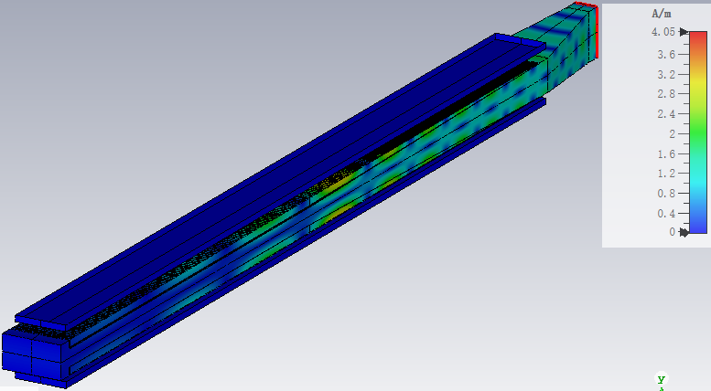
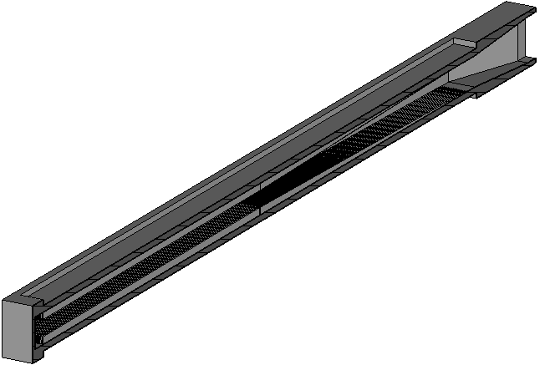
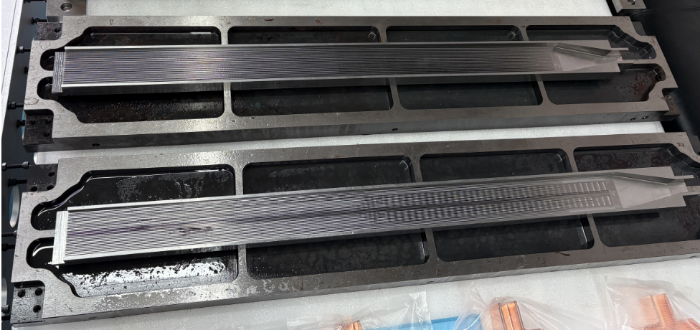
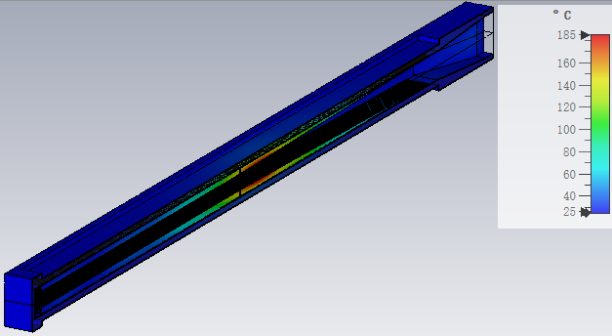
Load
Pure SS430 load with BJ48 input port, composed of waveguide taper, match section, regular section and end cavity. 1.02 VSWR in 5712 MHz working frequency, and >400 MHz bandwidth (S11<-20 dB)
Distribution of the electric and magnetic field, Emax ~ 30 MV/m with 300 MW peak input power
Electric field
Magnetic field
Waveguide taper
BJ48
Tmax ~ 185 °C with 10 kW average input power, 30 L/min cooling water flow
End cavity
Match section
Regular section
Distribution of temperature

Slide 11
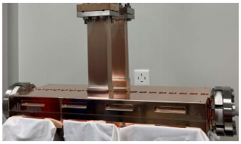
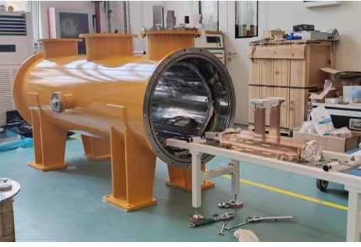
被测腔体性能

Slide 12
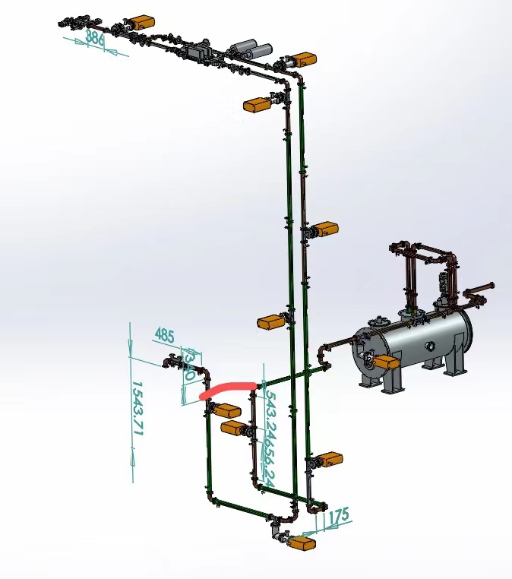
C波段低温铜腔测试高频系统
张辉、叶斌、李晓等
高频系统包括：速调管、环行器、定向耦合器、波导、波导窗。波导真空为6e-7左右，环行器充0.4MPaSF6气体。环行器两端用波导窗隔离真空和SF6。功率采样通过定向耦合器送出射频信号，定向耦合器安装于速调管输出位置及低温铜腔3dB电桥输入端前。环行器承受峰值功率20MW。液氮温度保持在77K左右。
速调管输出

Slide 13
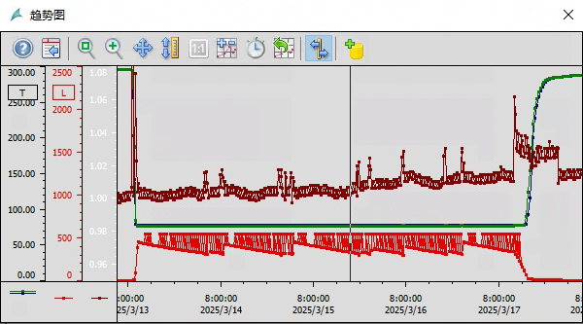
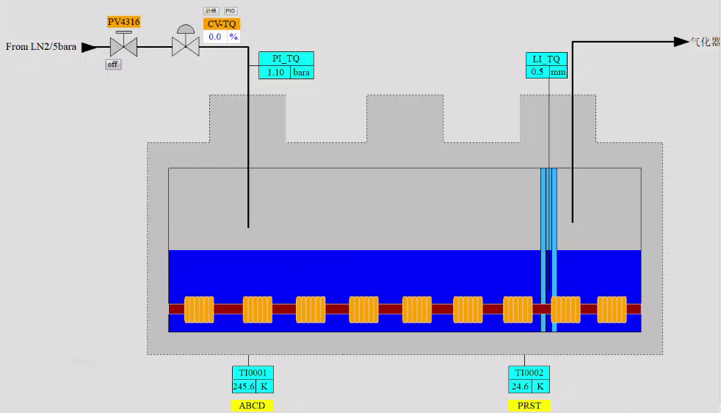
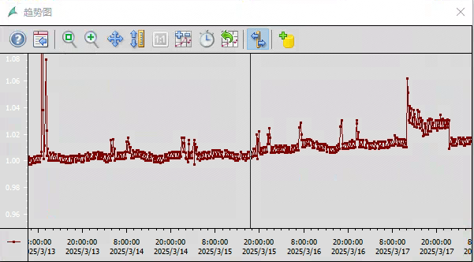
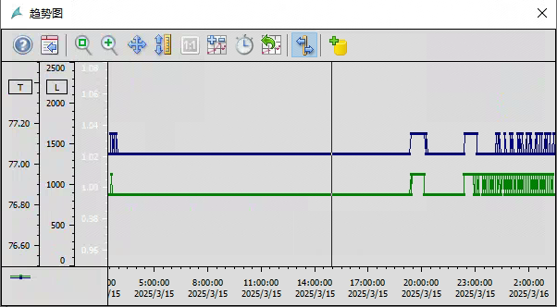
恒温器低温性能测试
低温实验控制界面
低温参数采集
压力波动小于1.2KPa
压力波动小于0.1K
在目标液位500mm下，馈入功率氮池内压力波动小于1.2KPa；
高功率试验下温度波动小于0.1K；(10Hz,20MW) 设计目标(100Hz,50MW)

Slide 14
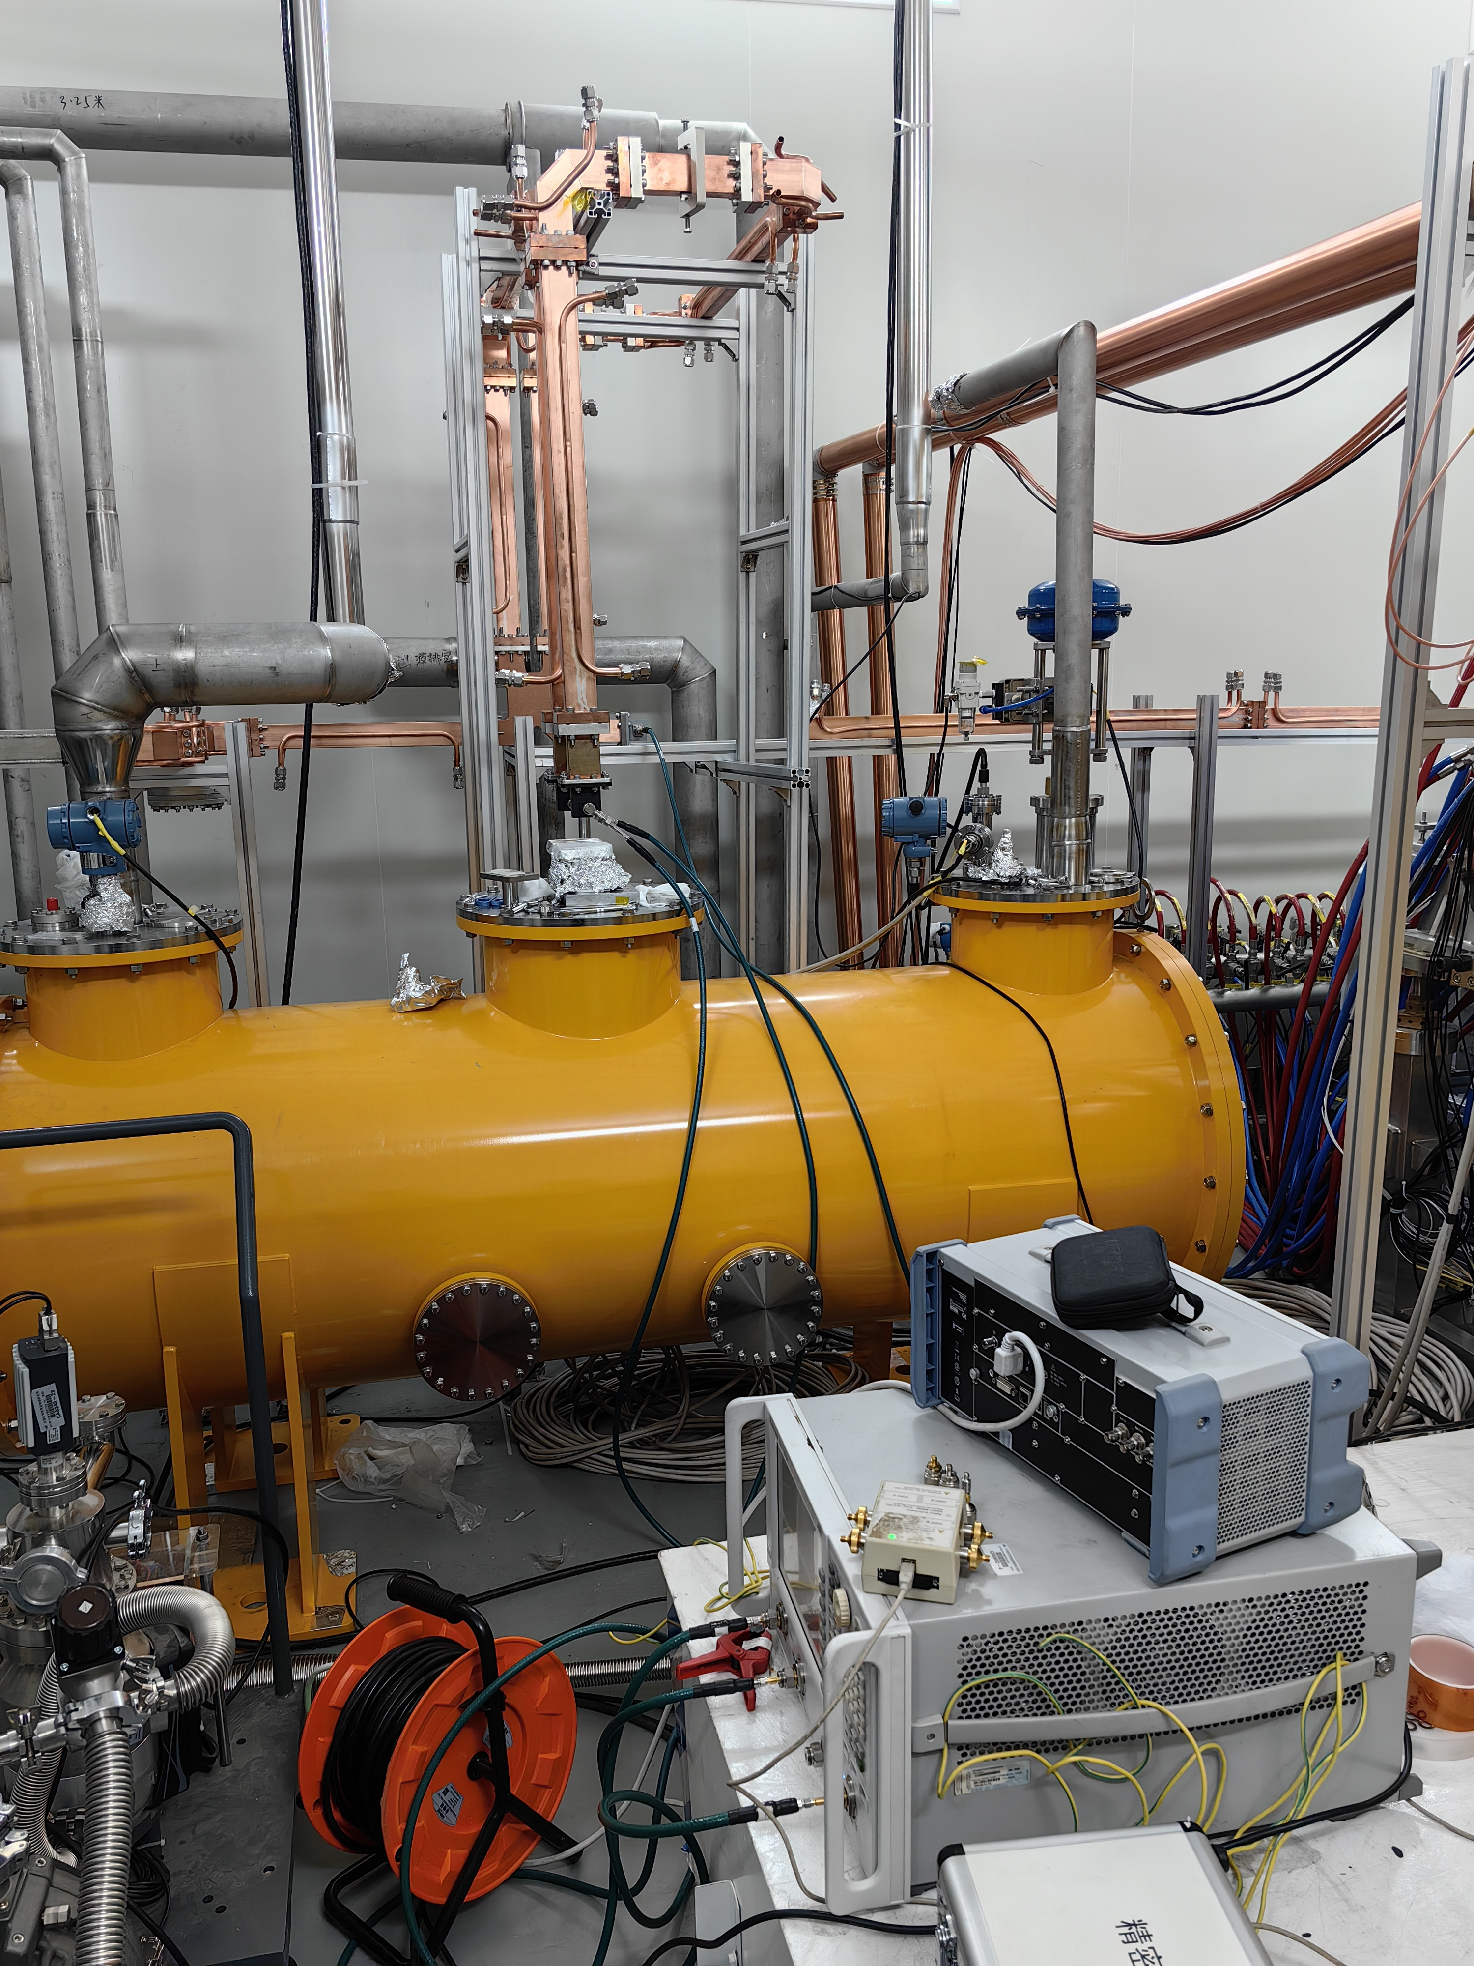
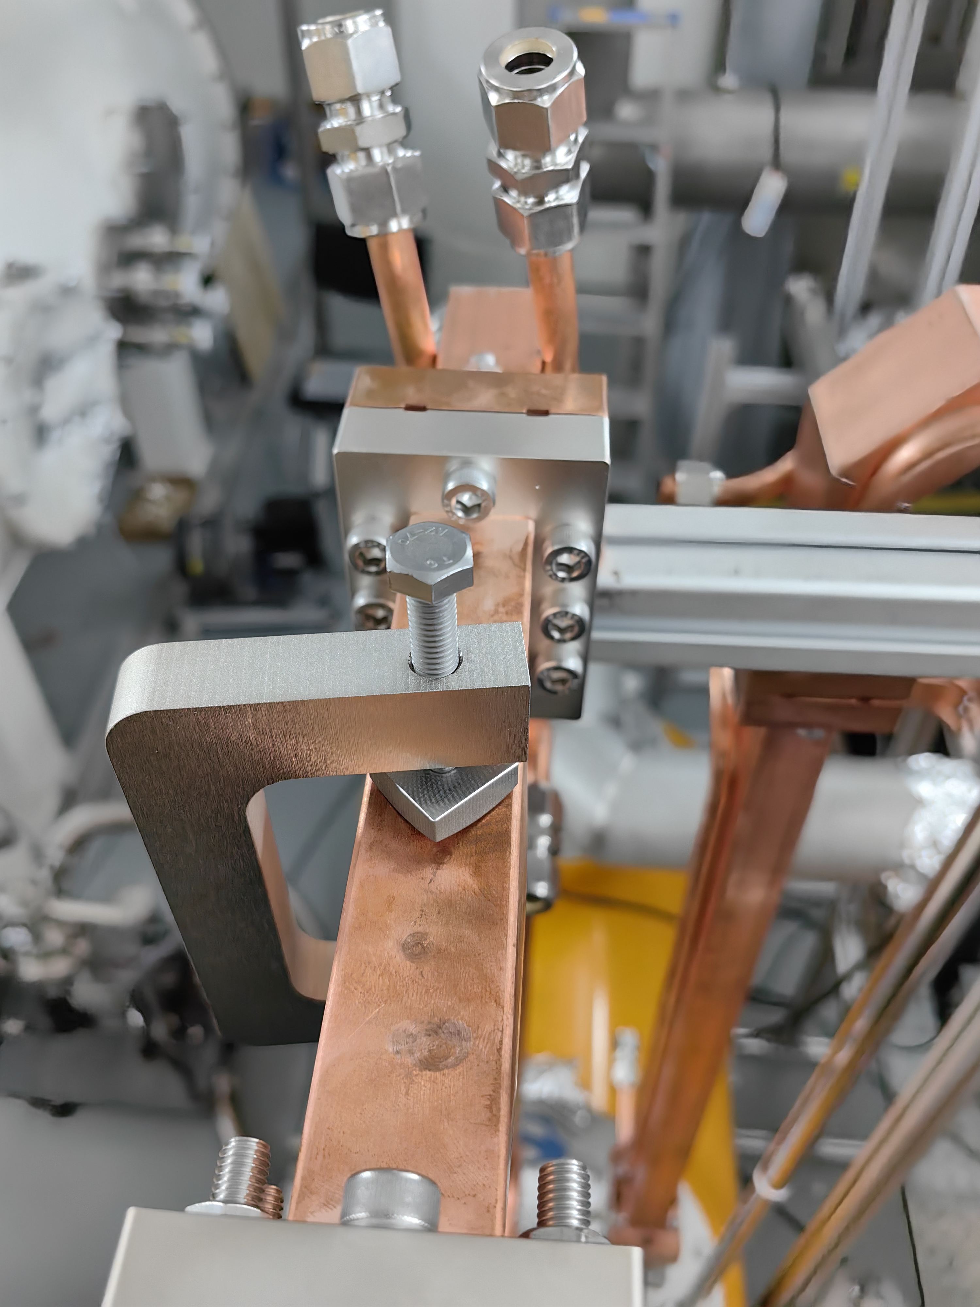
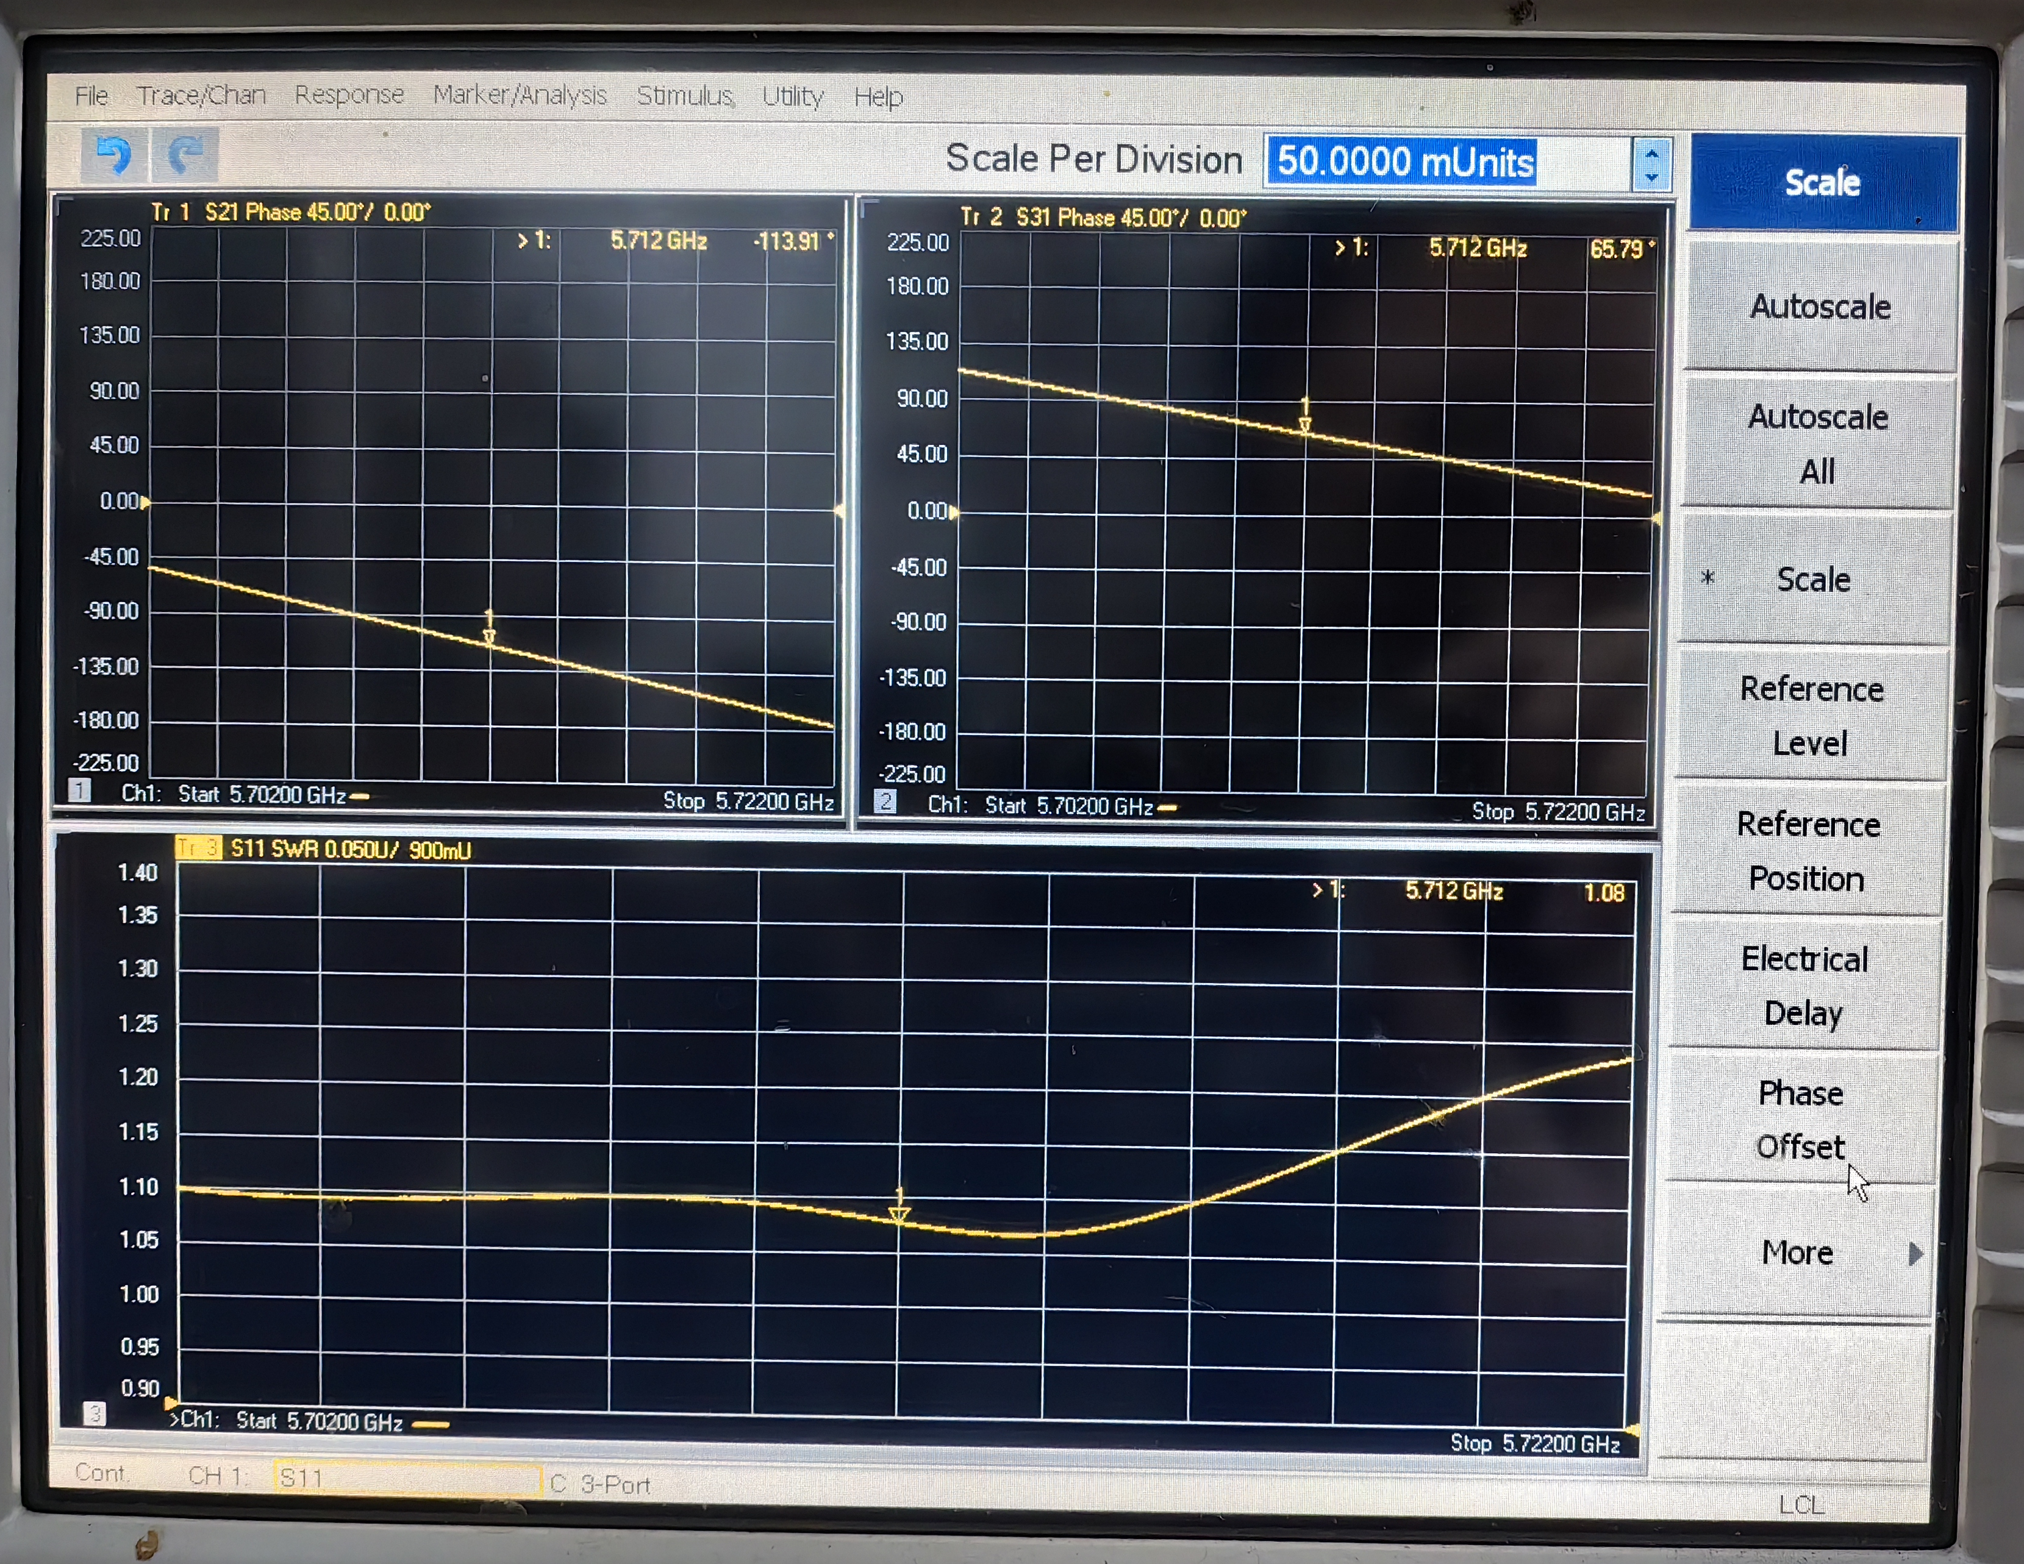
C波段低温铜腔输入相位测试
低温铜腔两路输入信号通过3dB电桥后连接的波导长度差来保持180度相位差。利用调节螺钉来挤压WR187波导的窄边微调两路波导的相位，最终将两路信号的相位差调到180度。

Slide 15
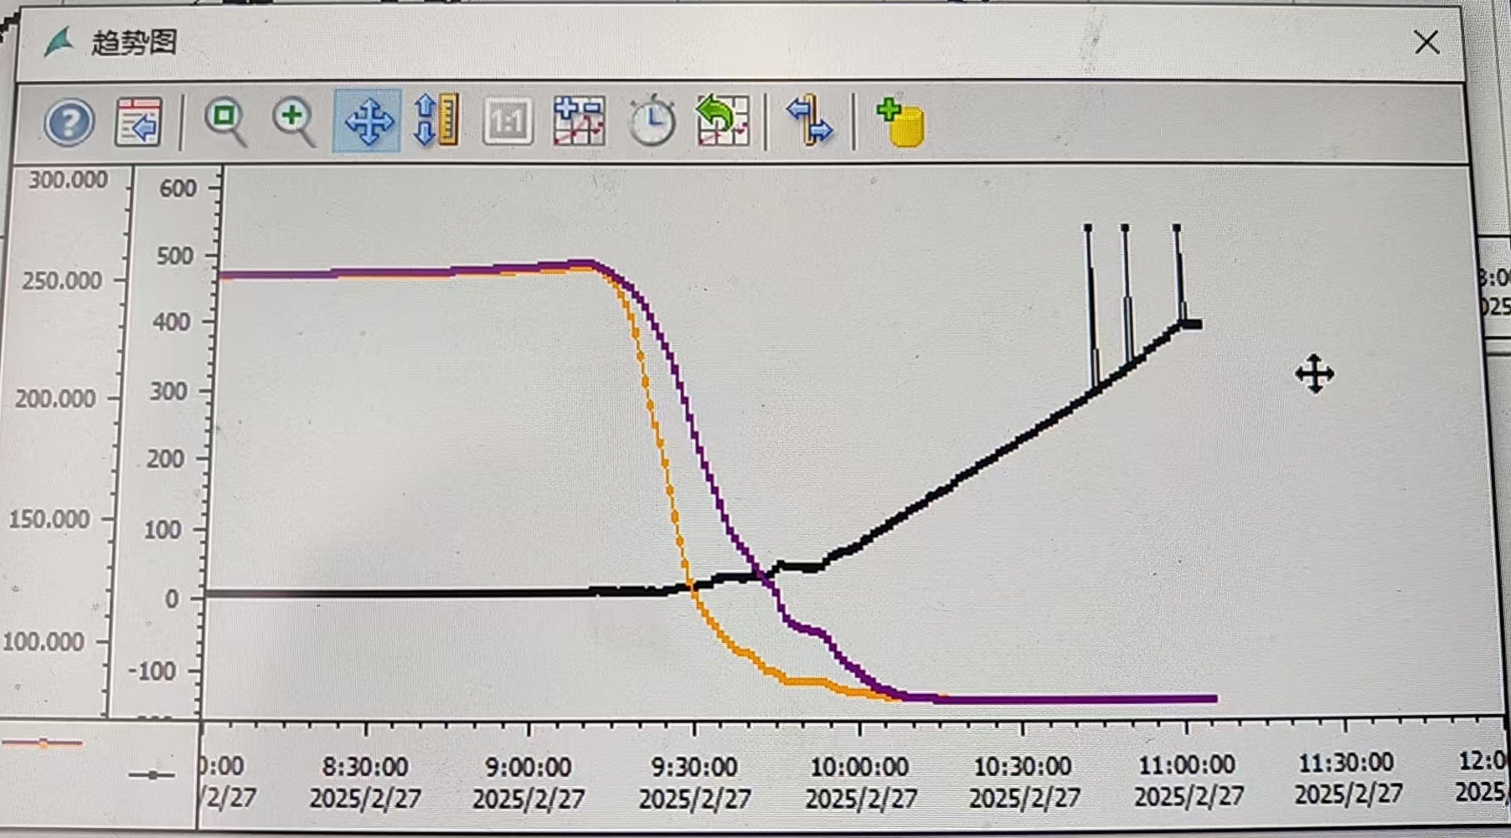
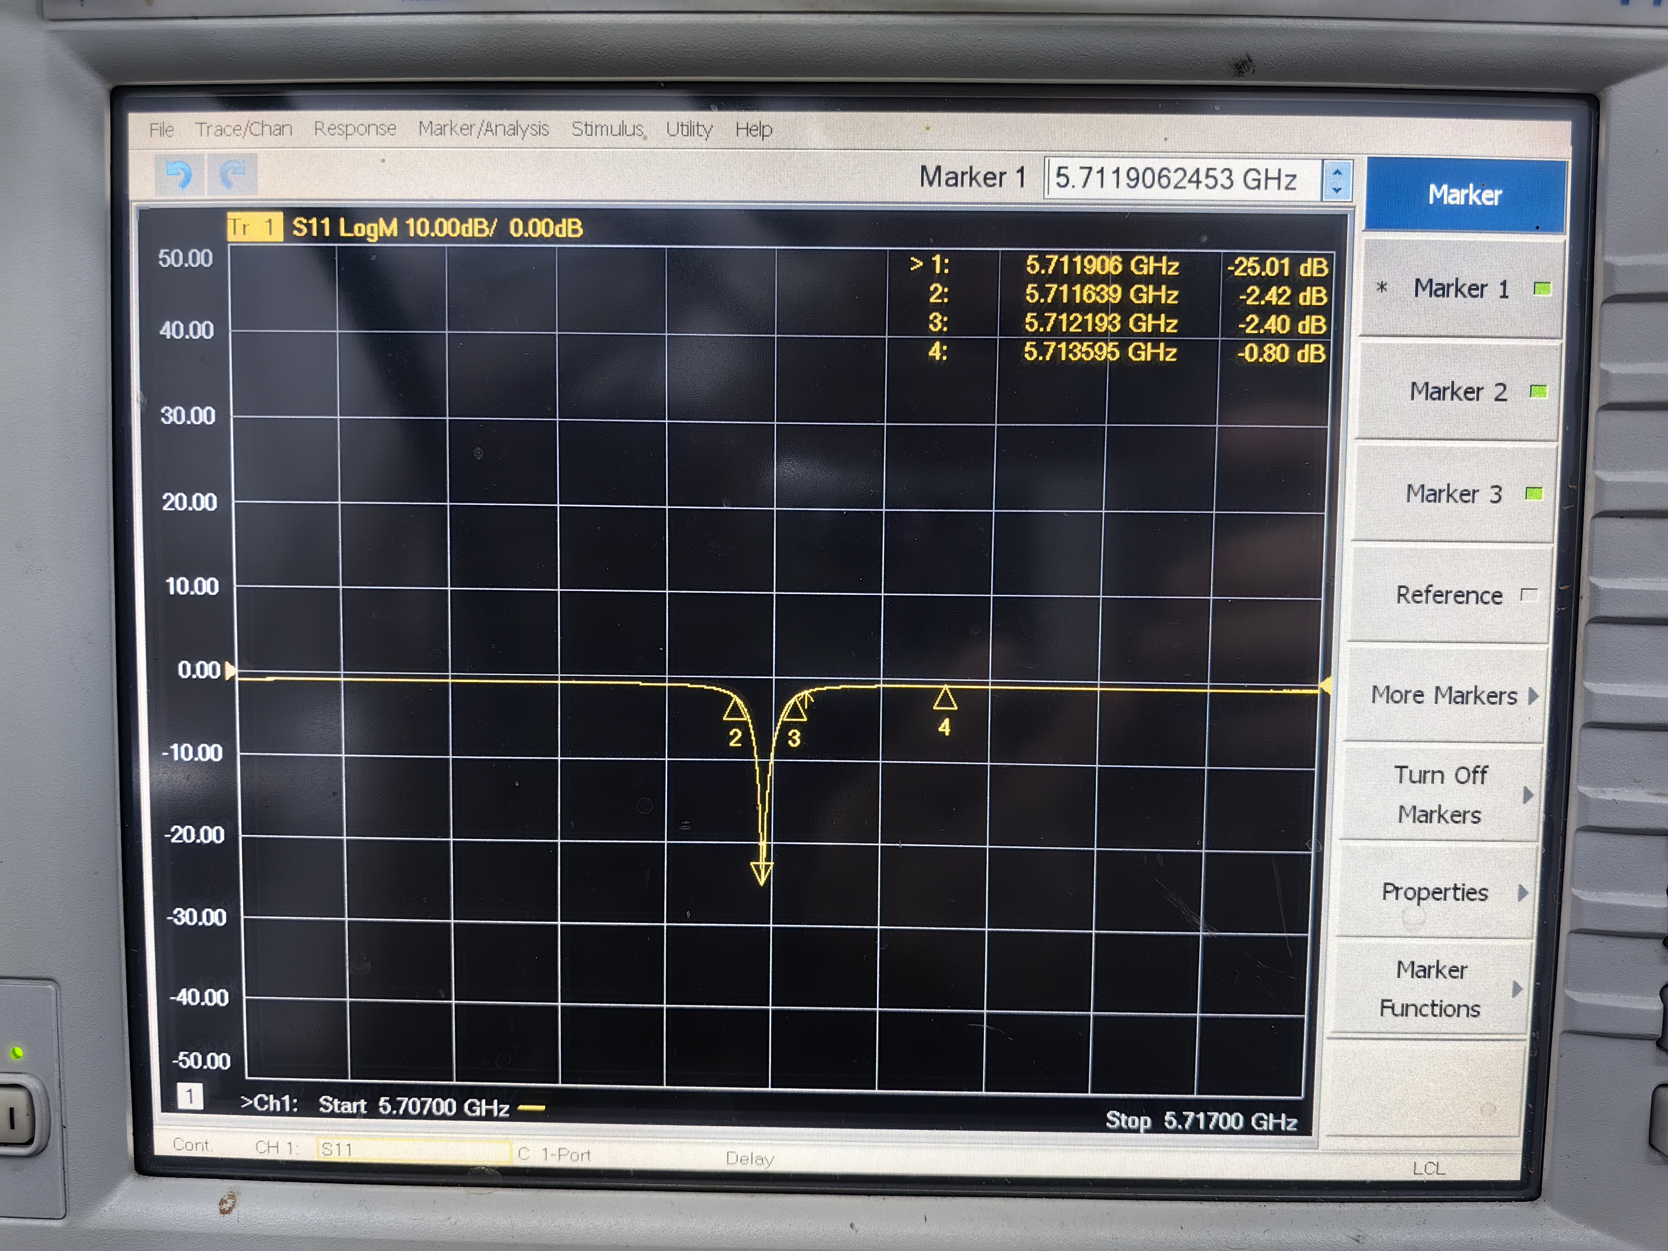
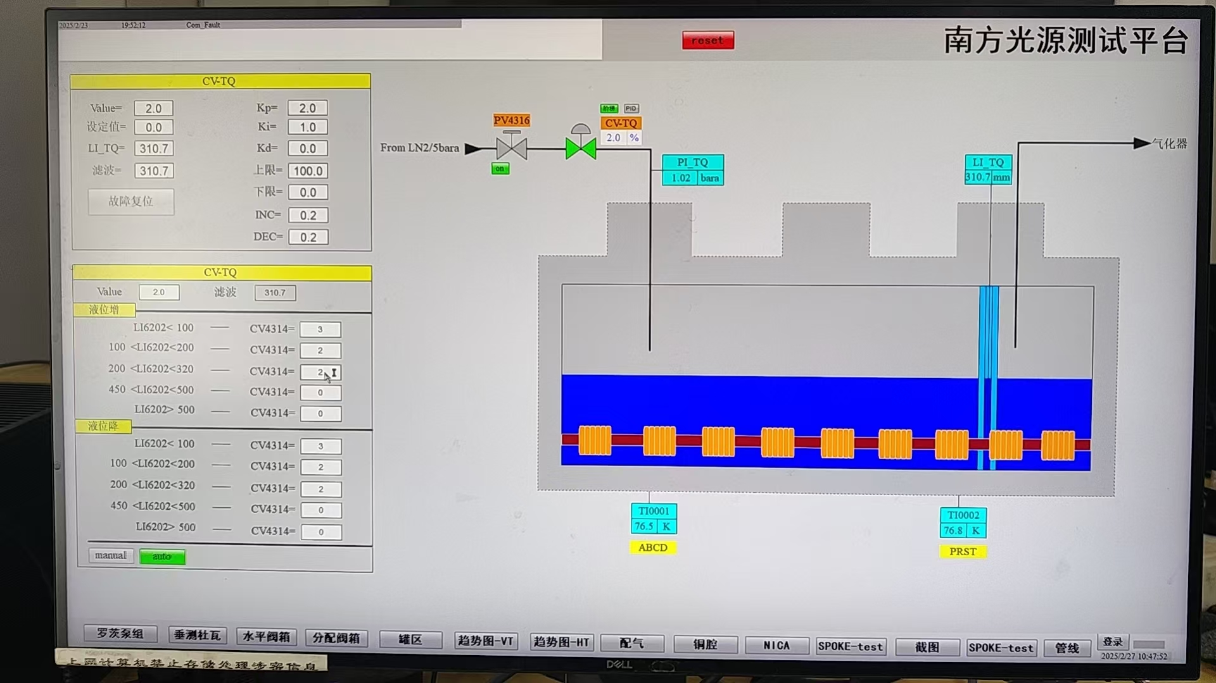
C波段低温铜腔降温测试
在低温系统降温过程中低温铜腔的频率变化进行测试，液位310mm左右时温度达到77K，此时频率为5.711906GHz。

Slide 16
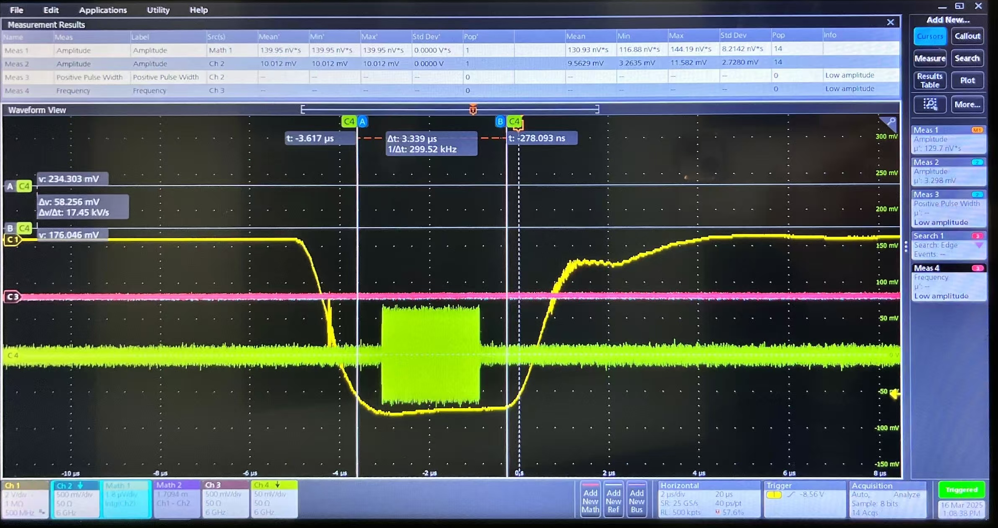
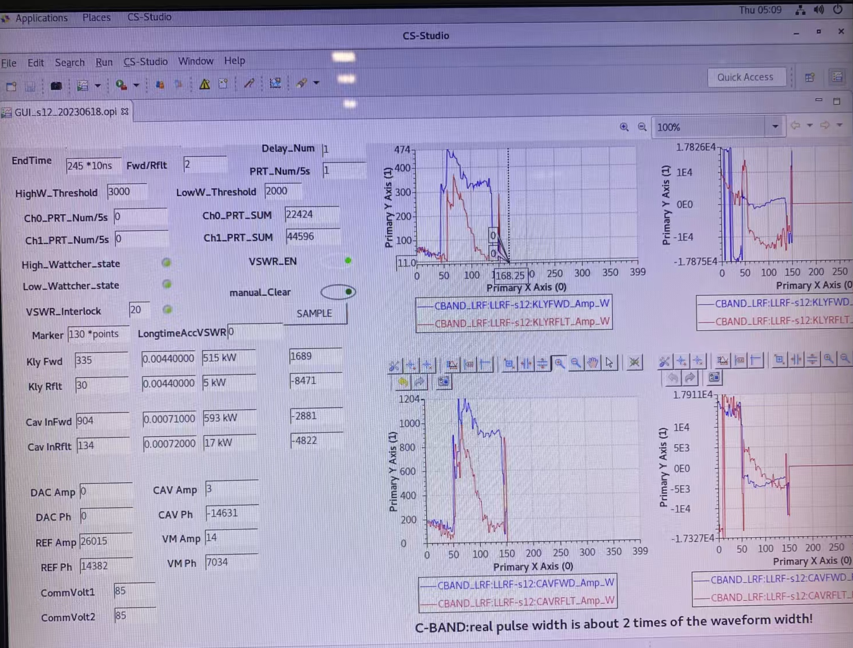
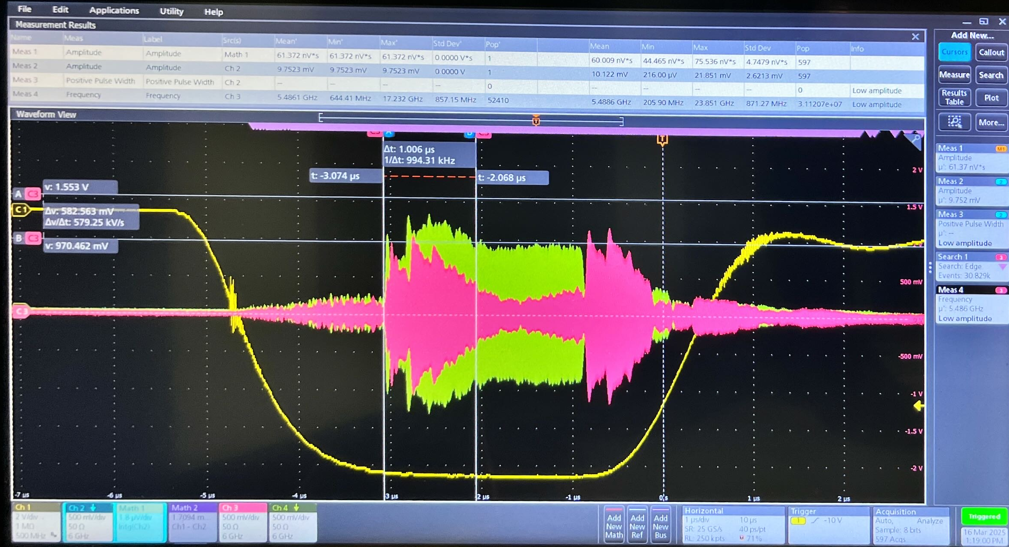
C波段低温铜腔不加环行器测试
完成降温后，对低温铜腔馈入射频功率。对各个信号的脉宽和时序进行了测试。高压脉冲信号能够将LLRF信号、速调管输出信号都包住。由于低温铜腔在馈入功率的起始阶段是全反射状态，而速调管能够承受的最大反射功率为:工作比10Hz,2.5us,功率小于2MW。所以功率加到2MW就停止测试了。
LLRF信号
高压脉冲信号
RF正向信号
RF反向信号
高压脉冲信号

Slide 17
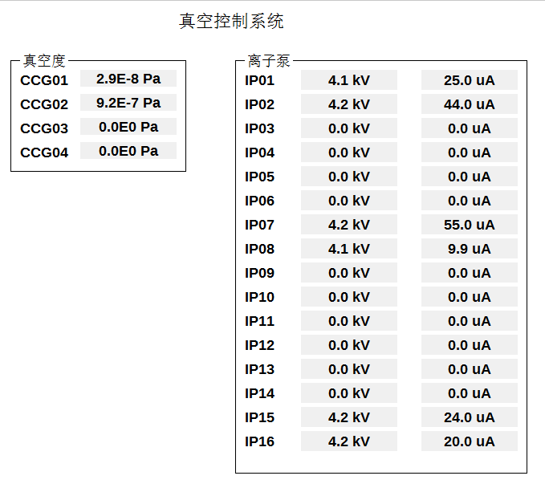
C波段低温铜腔加环行器测试
安装环行器后，设置高压脉宽3uS，射频脉宽2uS，功率推到20MW。

Slide 18
C波段低温铜腔加环行器测试
温度保持在77K，腔体频率为:5.7119074GHz。

Slide 19
C波段低温铜腔加环行器测试
低温铜腔老练过程中波导和腔内会随着功率增大而打火，经过3天老练功率加到20MW，反射最低点功率小于10kW。
波导真空1
波导真空2
腔内真空1
腔内真空2
腔前反射功率
速调管输出功率
腔前入射功率
阴极高压

Slide 20
C波段低温铜腔测试出现的问题
入腔功率20MW时运行了2小时左右出现环行器前波导窗破裂情况。SF6进入低温铜腔内部，真空急剧变差，测试停止。
波导窗破裂原因可能是20MW正向功率叠加20MW的反向功率，导致打火破裂。波导窗指标：功率25MW，脉宽2.5us，重频60Hz。从击穿电场角度，单个窗为40MW峰值功率。
20MW是入腔功率最近的定向耦合器测试值
波导窗
$G=\sqrt{Rs∗L∗P} /L (MV/m$)
$Rs$=303MΩ/m (理论设计值)
P=20MW
L=0.5m
G=110MV/m

Slide 21
下一步测试计划
在3dB电桥前安装30MW的环行器，3dB电桥两路输出上分别安装一个波导窗，这样每路输入功率15MW。
SF6

Slide 22
下一步测试计划
30MW环行器长度1066mm，20MW环行器长度700mm，需要对连接波导进行长度适配。

Slide 23
下一步测试计划
波导窗高度130mm，安装在3dB电桥后面，这样就需要将3dB电桥、波导、支架都向下移130mm。
波导窗
波导窗
130mm
130mm
130mm

Slide 24
Big hole Parallel coupling cool copper structure
6月会完成主要部件的加工
准备焊前测试

Slide 25
SLAC在平行耦合结构的进展

Slide 26
Summary
C-band test bench being prepared
High-power experiments on cryogenic copper-accelerated structures with a stage of gradient 110MV/m (theoretically). The next round of experiments will be conducted at an opportune time

Slide 27
Thank you for your attention!

Slide 28
Introduction: CEPC Linac
Parameter | Symbol | Unit | Baseline
Energy | E_{e-}/E_{e+} | GeV | 30
Repetition rate | f_{rep} | Hz | 100
Bunch number per pulse |  |  | 1 or 2
Bunch charge |  | nC | 1.5 (3)
Energy spread | σ_{E} |  | 1.5×10⁻³
Emittance | ε_{r} | nm | 6.5
Switch time for electron and positron |  | s | 3.0
Linac design
Meet requirements
High availability
Reserve upgrade potential
High energy electron and positron linear accelerator with S-band and C-band accelerating structure
A large number of C-band accelerator structures (TAS)
The physics design has been completed in the TDR, now we are moving forward with the EDR phase

Slide 29
Introduction: CEPC Linac Source &RF system
Electron gun & positron source & bunching system
RF distribution of the 30 GeV Linac
S-band, 80 MW klystron, the number of S-band Acc. structure is 93, big hole s-band structure after the positron source is 16. the number of pulse compressor is 33
1-1(ESBS), 1 accelerating structure, 22MV/m
1-4 (FAS), 21 sets, 84 standard accelerating structures, with pulse compressor, 22MV/m
1-2(PSPAS), 8 sets, 16 big hole accelerating structures, 22MV/m, with pulse compressor
1-2(SAS), 4 sets, 8 accelerating structures, 27MV/m , with pulse compressor
C-band, 50 MW klystron, C-band structures: 470, with 235 pulse compressors
1.1GeV-30GeV, 1-2(TAS), 235 sets, 470 accelerating structures, ~40MV/m
Damping ring copper cavity (2)
Transport line S-band ACC. structure (2)
Parameter | Unit | S-band |  | C-band
Frequency | MHz | 2860 |  | 5720
Length | m | 3.1 | 2.0 | 1.8
Cavity mode |  | 2π/3 |  | 3π/4
Aperture | mm | 19~26 | 25 | 12~16
Gradient | MV/m | 22/27 | 22 | 40
Cells (include coupler cells) |  | 86 | 55 | 89
Number of Acc. Stru. |  | 93 | 16 | 470
Number of Klystron |  | 33 |  | 236
Klystron Power | MW | 80 |  | 50

