Slide 1
2025.04.29 group meeting
陈伟文

Slide 2
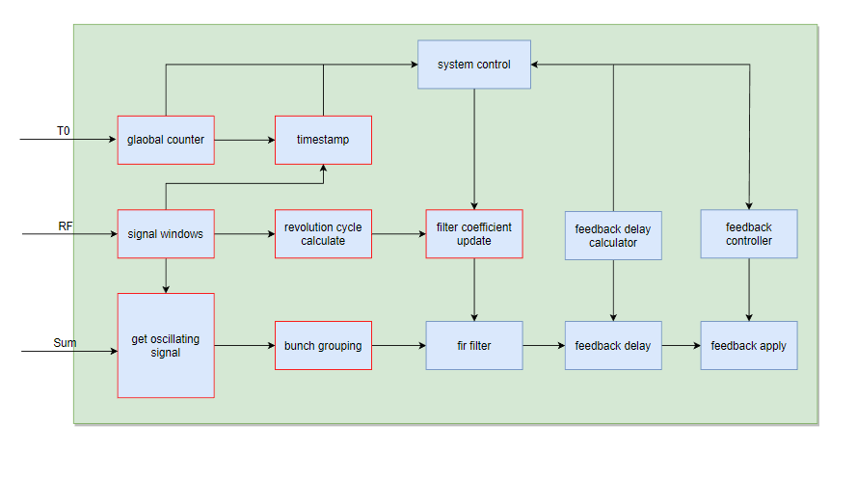
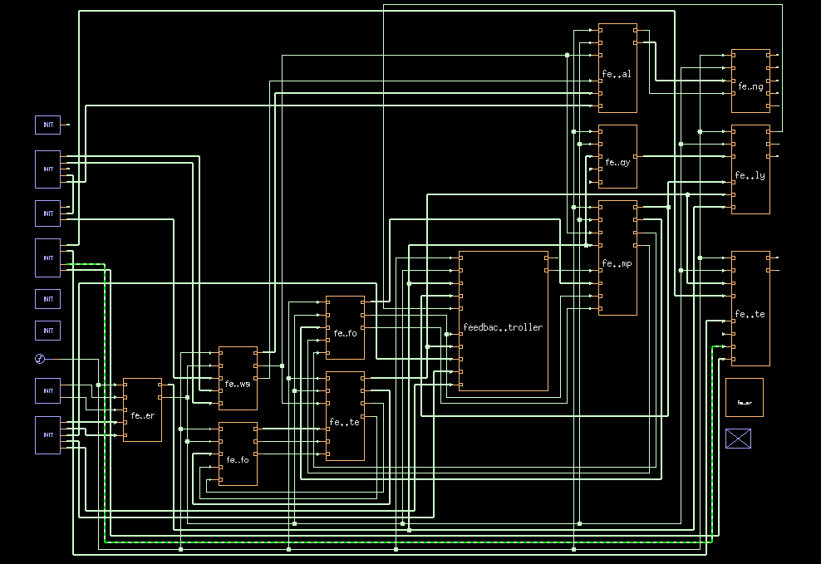
Feedback electronic
The connection of the overall functional modules
Error occur in fir filter

Slide 3
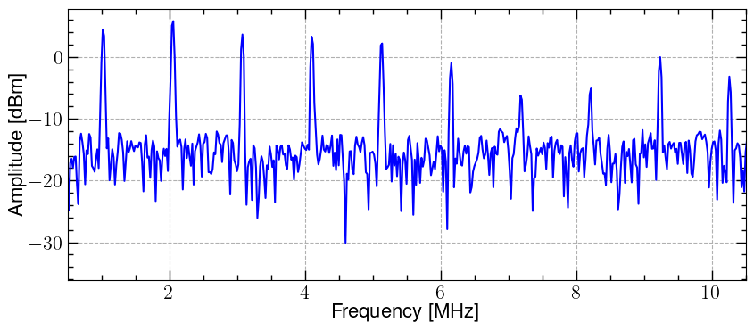
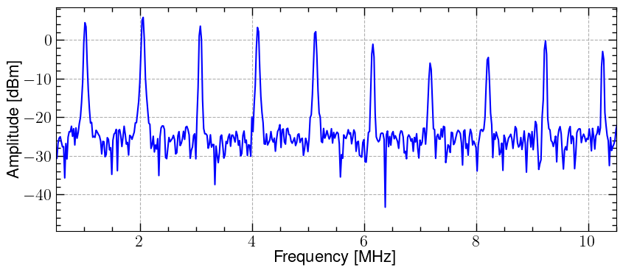
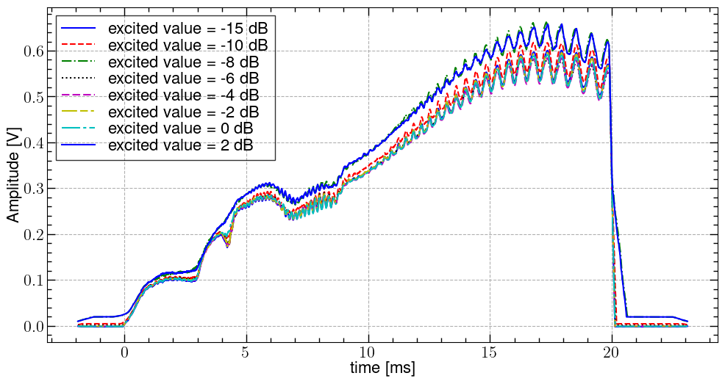
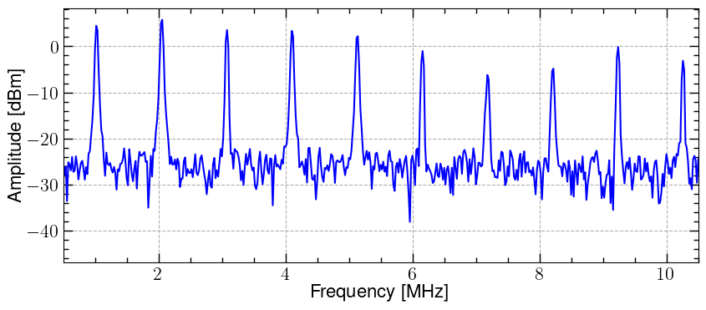
Excitation test
The beam oscillation conditions under different white noise excitations were tested by using the existing signal generator and power amplifier
excite signal = 2 dB
Signal generator
Power amplifier
Kicker
Beam
BPM
attenuator
Oscilloscope
Take the peak value of the BPM signal to observe the variation of the beam oscillation envelope
No obvious beta oscillation frequency was observed in frequency spectrum
excite signal = 0 dB
Find peak and Moving Average Filtering（100 turns）
excite signal = -2 dB

Slide 4
Other and next plan
MTCA4 develops feedback electronic
Develop a signal generator module for a power amplifier test and an excitation test.
Debug the FPGA for the feedback functionality.

