Slide 1




Task 1: High Granularity Timing Detector
Zhijun Liang (IHEP)
梁志均 （中国科学院高能物理研究所）
代表课题1

Slide 2
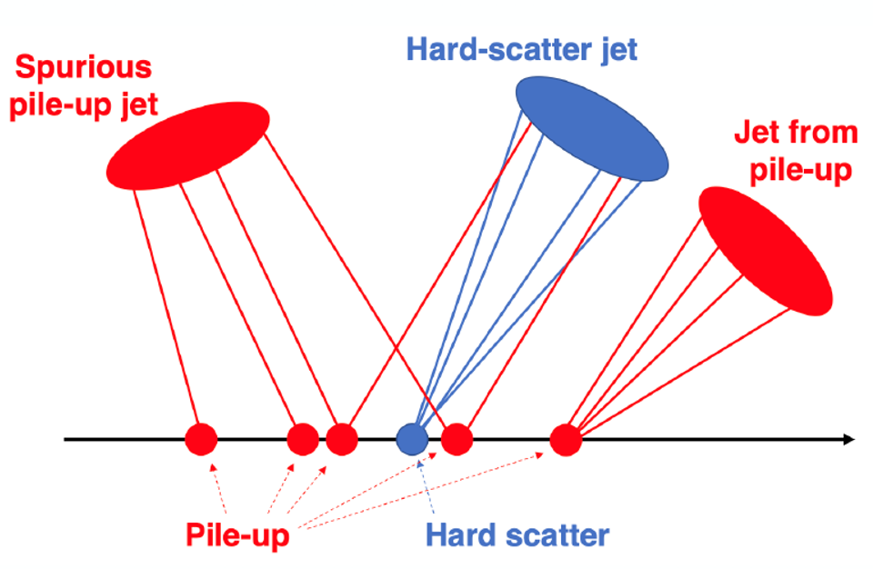
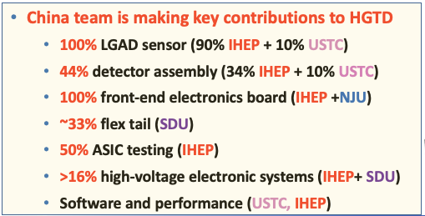
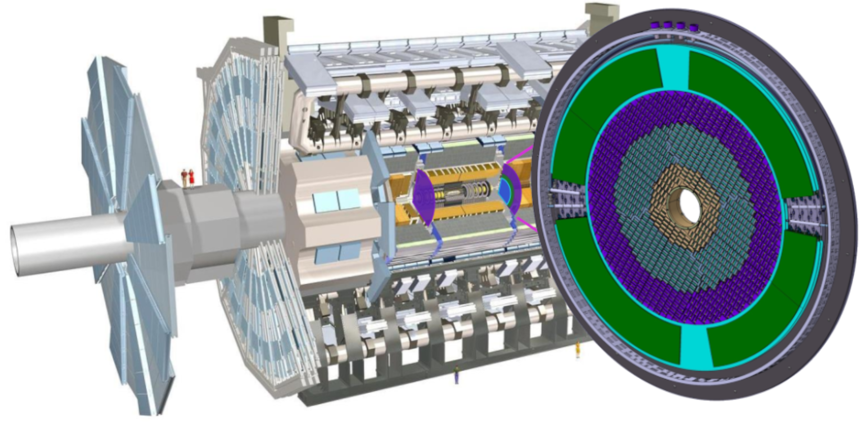
High Granularity Timing Detector (HGTD)
HGTD aim to reduce pileup contribution at HL-LHC
  Timing resolution is better than 30 ps (start) - 50 ps (end) ps per track
  6.4 m² area silicon detector and ~ 3.6 × 10⁶ channels
第一个用于对撞机实验的硅基高精度时间探测器
First silicon-based timing detector in particle physics

Slide 3
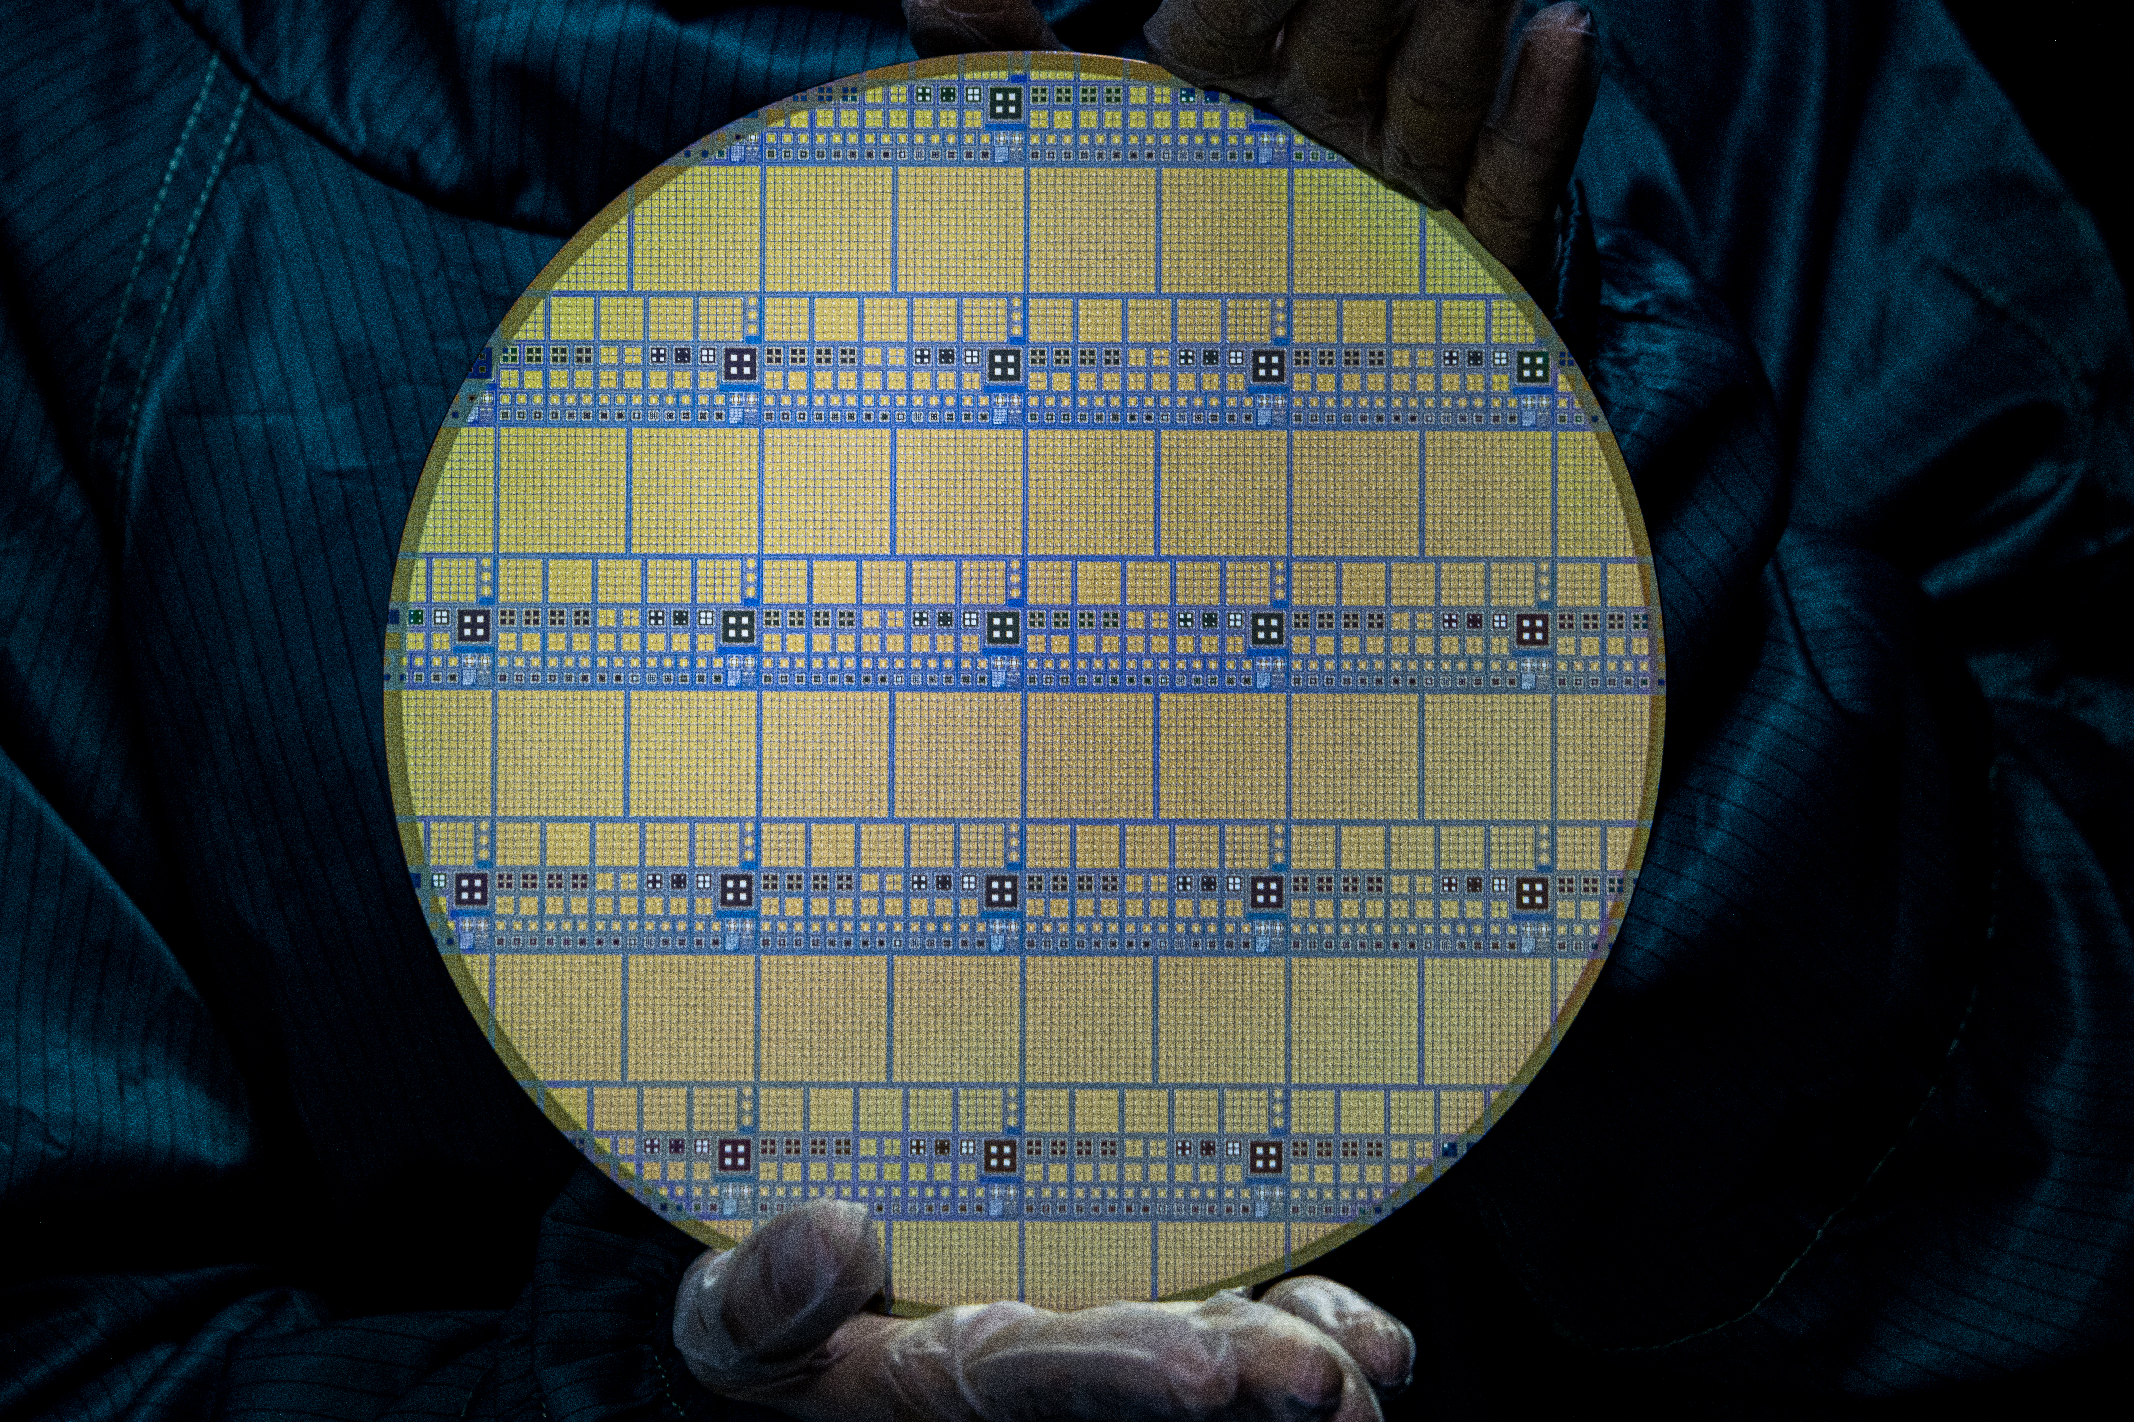
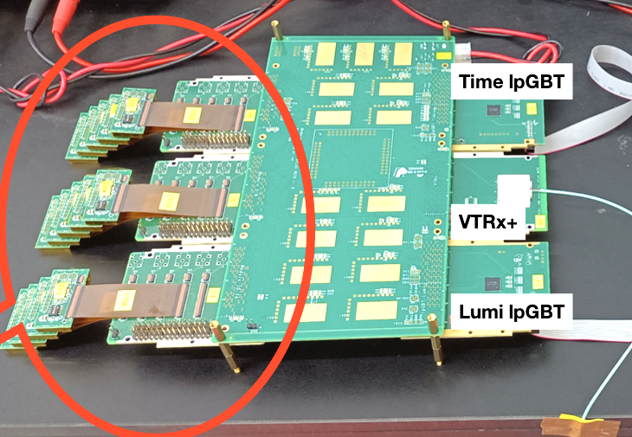
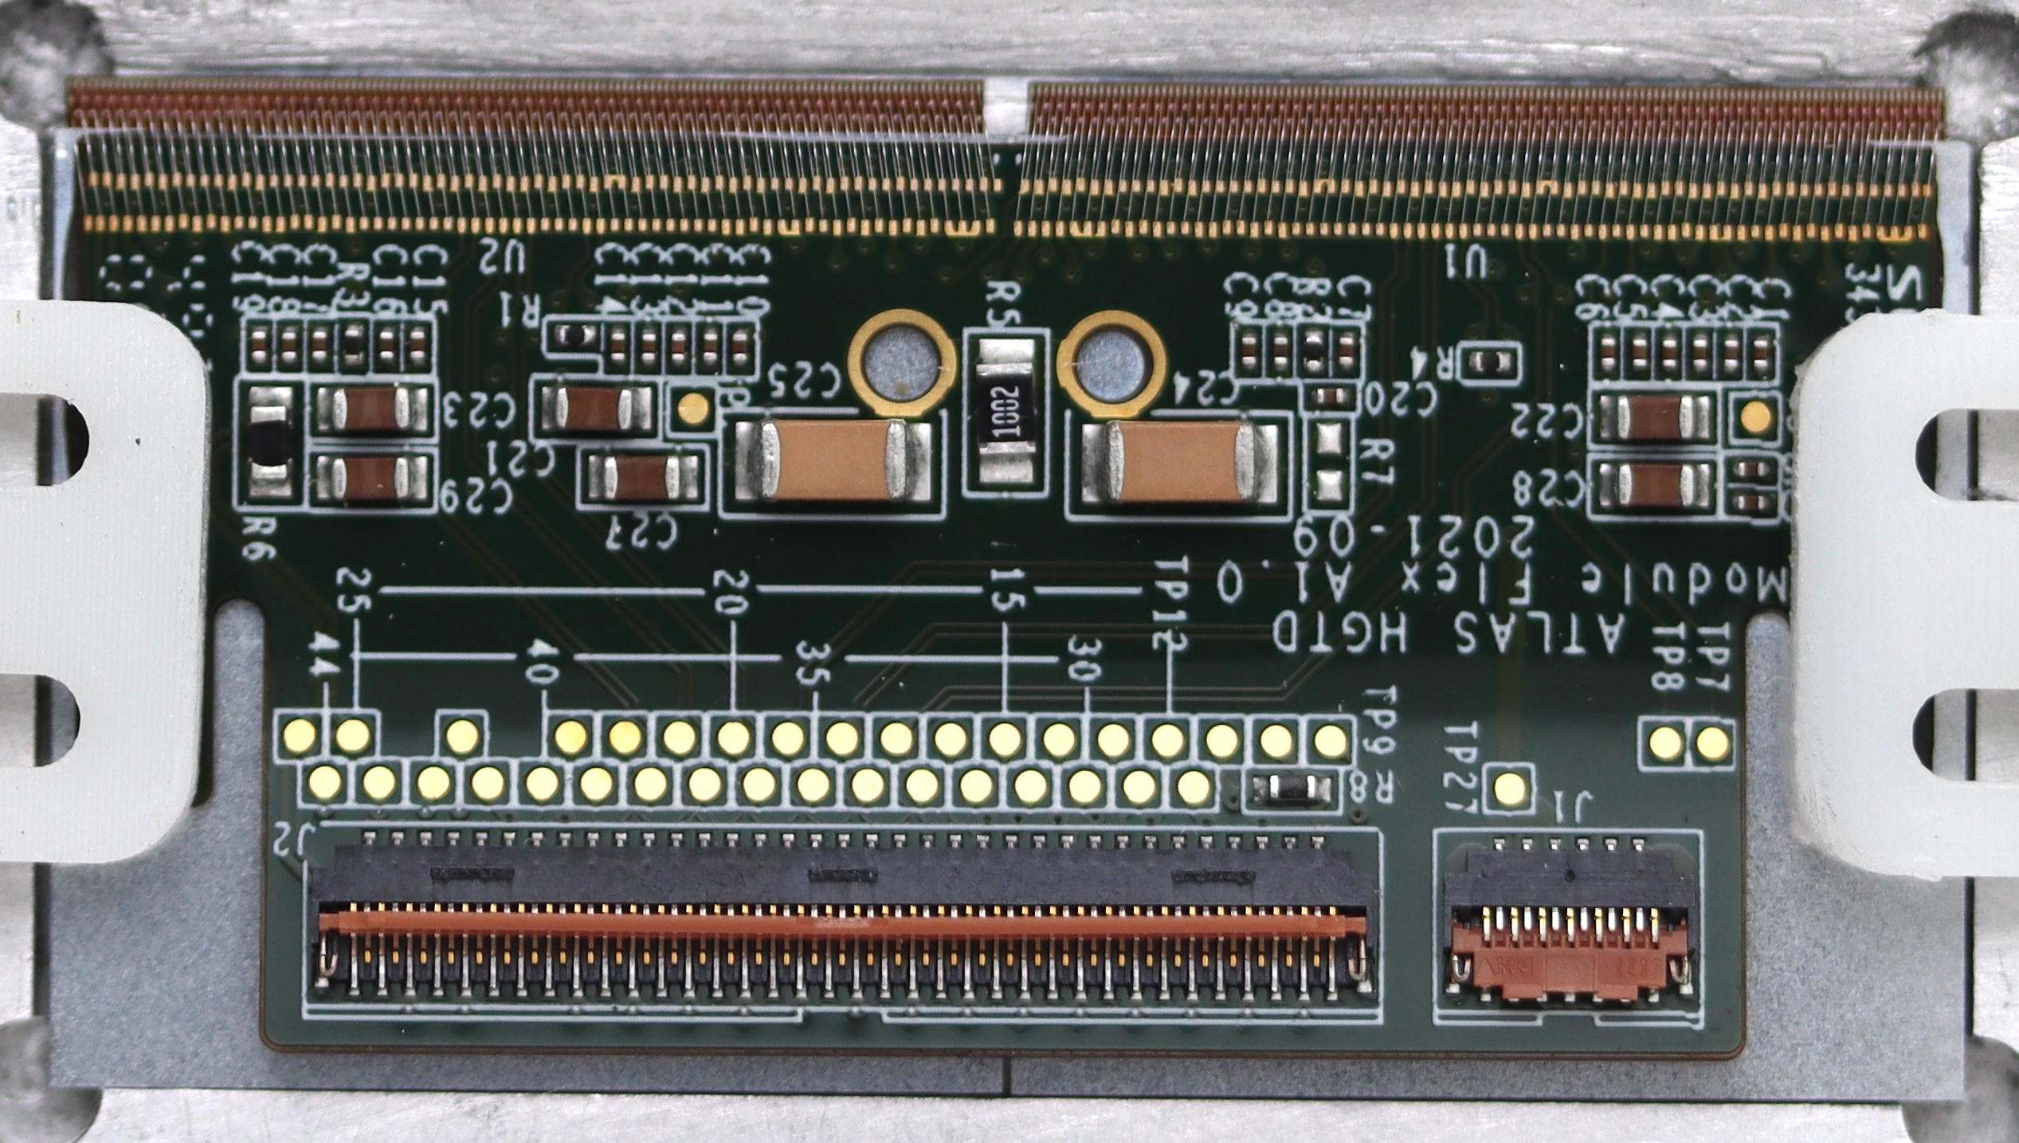
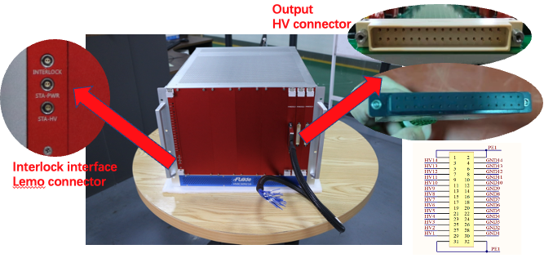
Research Content, Assessment Index (考核指标，研究内容)
研究内容： Develop all key components for the Timing Detector
  Developed radiation hard LGAD silicon sensor
  Build large-area ASIC+Sensor Module with robot
  Develop Front-end electronics, high voltage system, flexible cable
Assessment index （考核指标）:
  Sensor and detector module time resolution reach 30-50 ps
LGAD sensor
Electronics
Module
ASIC+LGAD
High Voltage supply
Notes:
Add blue box on top

Slide 4

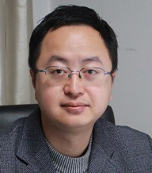
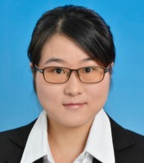
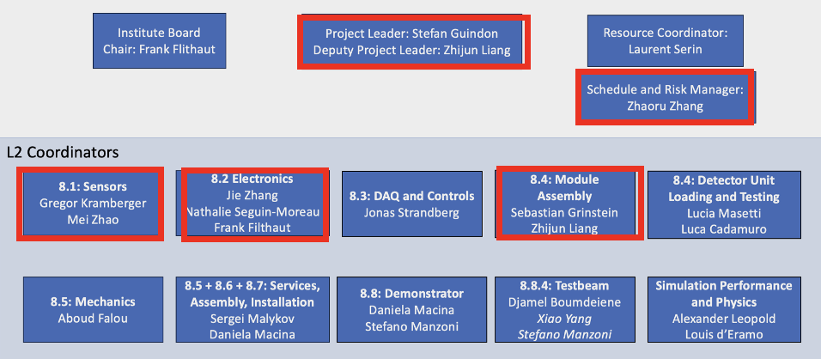

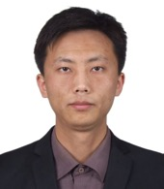
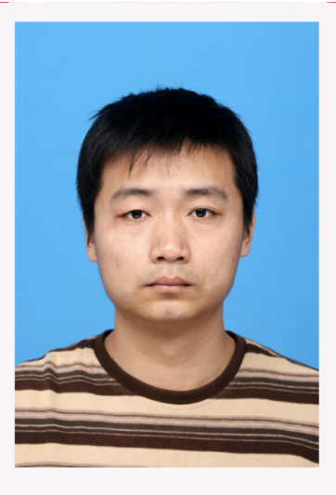
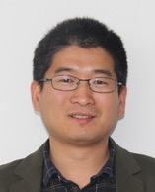


China team in HGTD management
ATLAS China team played an important role in HGTD management team
  Mar. 2021- Feb 2025 , Joao was HGTD project leader, 1st PL in China LHC community
  Mar 2023 - Feb 2027, Zhijun is serving as deputy project leader
  5 person as L2 conveners (Jie Zhang, Mei Zhao, Zhaoru, Zhijun,Yusheng)
  3 person as Level-3 convener （Yunyun,Jie, Lei Fan ）
  1 person as speaker committee (Yanwen)
Latest HGTD management

Slide 5
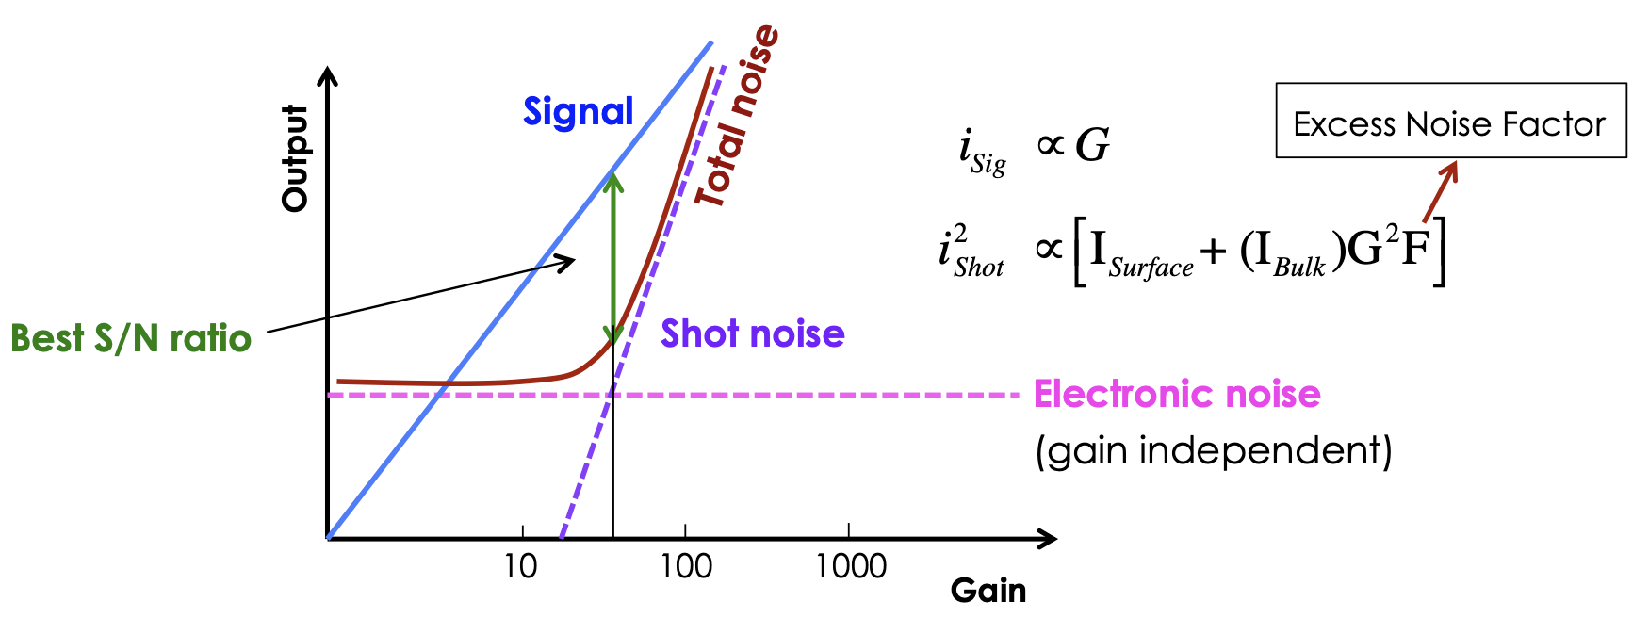
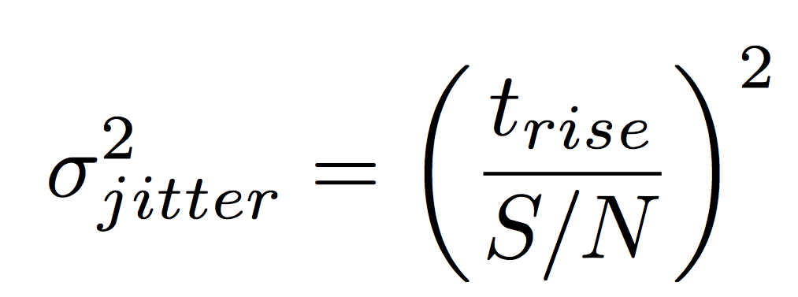
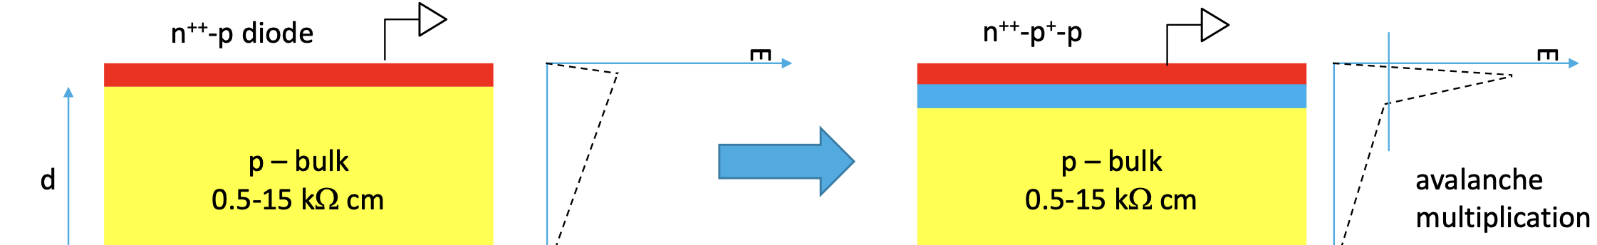
Low Gain Avalanche Detectors (LGAD)
  Compared to APD and SiPM, LGAD has modest gain (10-50)
  High drift velocity, thin active layer ( fast timing)
  High S/B, no self-triggering
  Modest gain to increase S/N
  Thin detector to reduce t_{rise}
LGAD
P+ gain layer on top of PIN diode
Conventional PiN diode

Slide 6
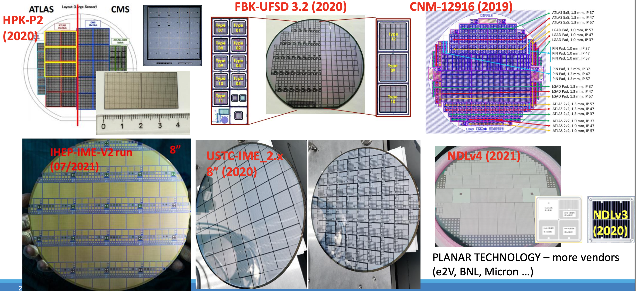
国际形势： strong completion in LGAD development
Lots of prototypes R & D in LGAD in last few years, active vendors includes:
  IHEP-IME (China), USTC-IME (China), IHEP-NDL(China), FBK (Italy), CNM (Spain), HPK (Japan) …

Slide 7
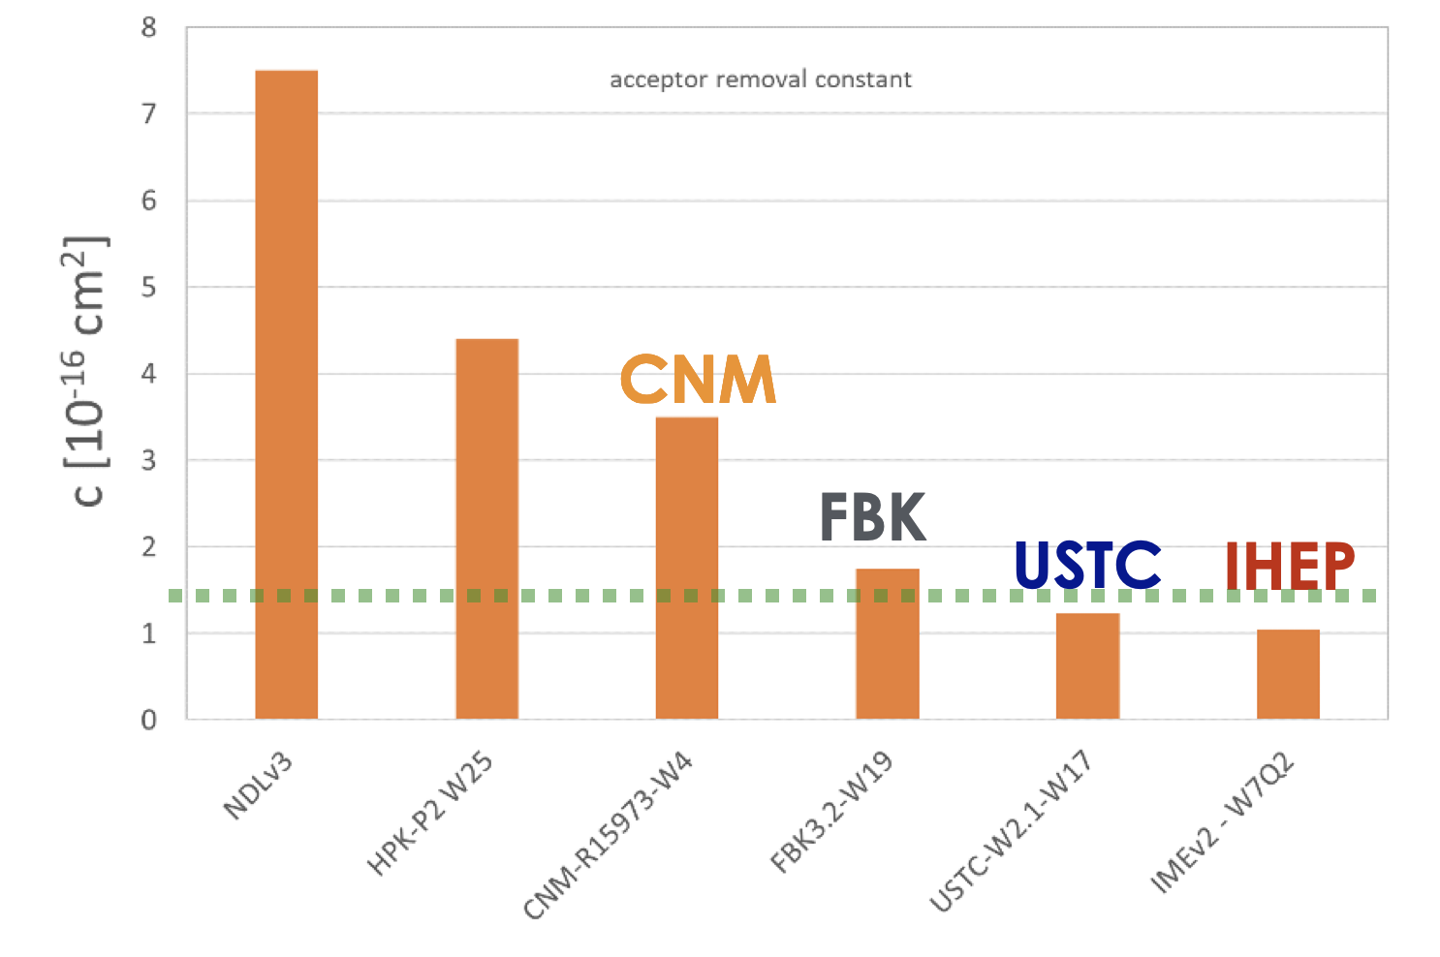
LGAD sensor after Irradiation
挑战：LGAD超快硅传感器技术首次用在对撞机实验，抗辐照能力是最大难点
IHEP-IME and USTC-IME LGAD with carbon-enriched doping
  Significantly lower acceptor removal ratio, the most radiation hard
After 2.5×10¹⁵ n_{eq}/cm² , LGADs can operated below 550 V → avoid single event breakdown
Acceptor Removal Ratio
Lower ratio, more radiation hard
70 ps
USTC
IHEP

Slide 8
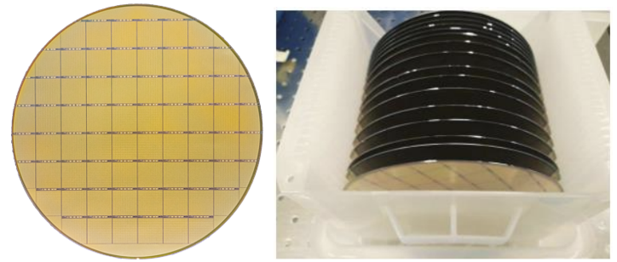
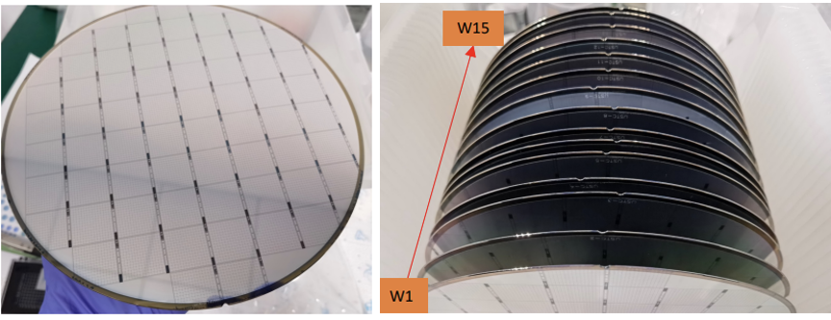
LGAD sensors pre-production
CERN chosen IHEP-IME sensor in tendering, contract signed in Feb 2025
  IHEP-IME, FBK(Italy) and HPK(Japan) were completing in CERN contract
The sensor production will be 100% done by China
  First time domestic silicon sensor was used by CERN in LHC experiment
  IHEP-IME: 90% (66% from CERN tendering+24% in-kind contribution): ~8 m²
  USTC-IME: 10% in-kind contribution (~0.8 m² )
Production status
  IHEP
    1.7k sensor fabricated in pre-production
    0.4k sensor fabricated in Production
  USTC
    0.27k sensor fabricated in pre-production
  Overall status:
    PRR review passed at July 25, 2024
    Production is on-going
    Pushing for the in-kind sensor contract
Pre-production LGAD sensors from China
IHEP-IME
Pre-production
USTC-IME
Pre-production

Slide 9
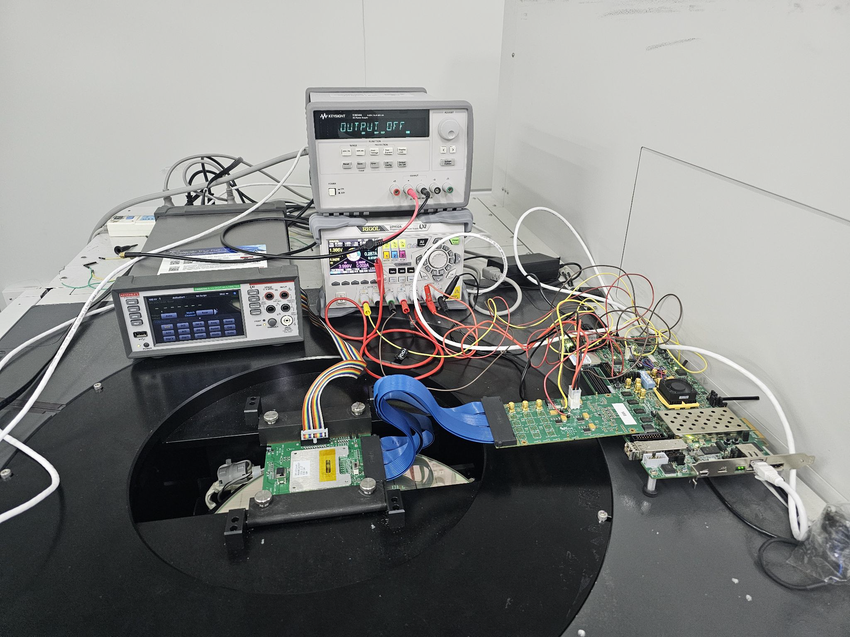
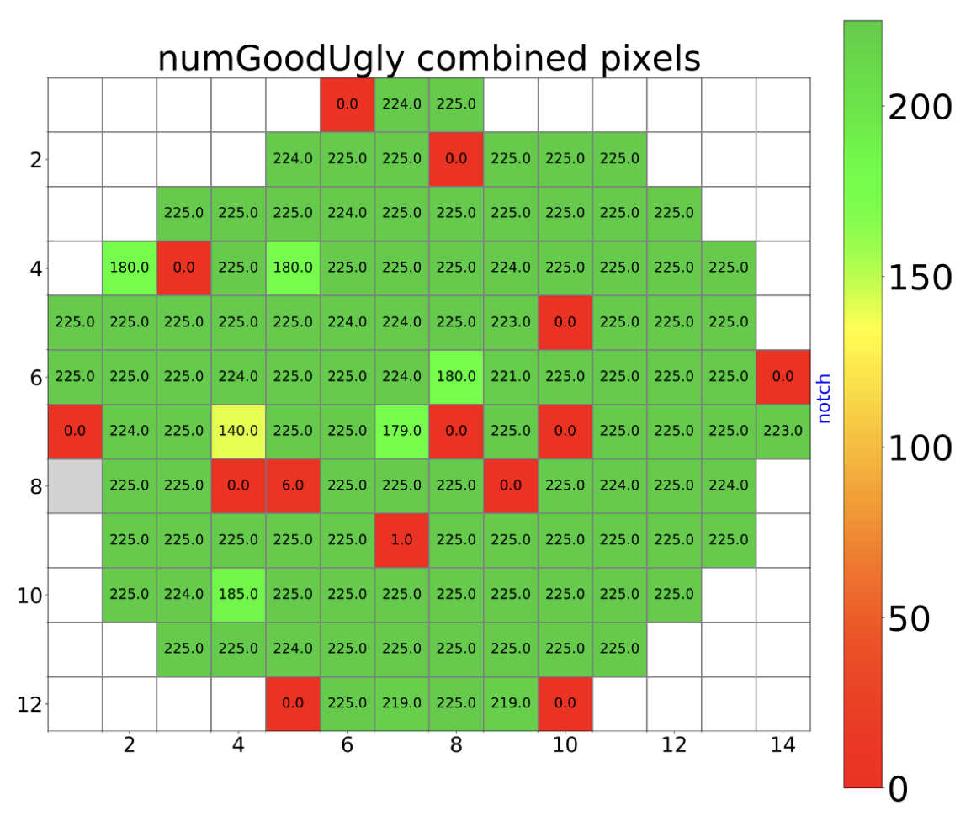
ALTIROC ASIC wafer process
IHEP and IJClab/Omega share 50% of wafer probe test（~225 wafers )
  Agreements was probe cards, and evaluation criteria should have been defined by IJCLab
  IHEP is now much advanced compared to IJClab, leading in probe tests
Probing full ASIC wafers before moving into production is essential.
  挑战：Has been the bottle neck for the project for sometime (in critical path)
  FDR was scheduled at Oct 2024, now delayed to June 2025 ( delayed by 8+ months)
  Need to probe at least 10 wafer before ASIC PRR review
    IHEP probed 7 wafers, IJClab has not probed a full wafer yet
ASIC Yield is 70 ~ 80%

Slide 10
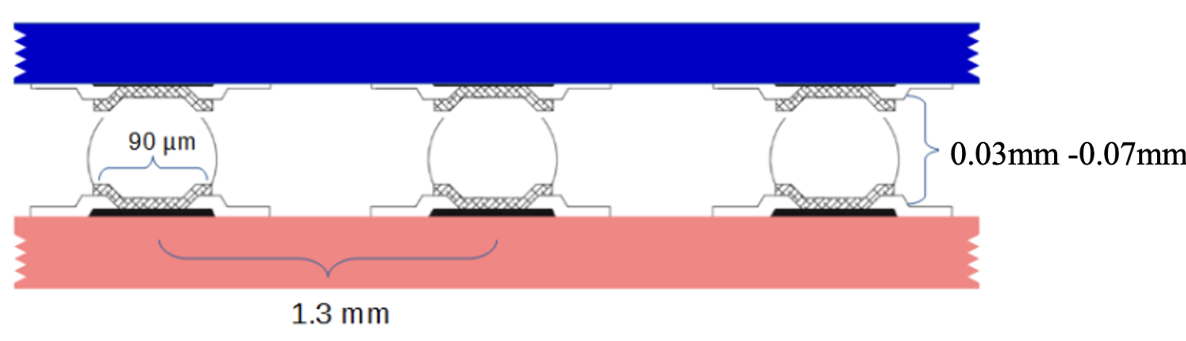
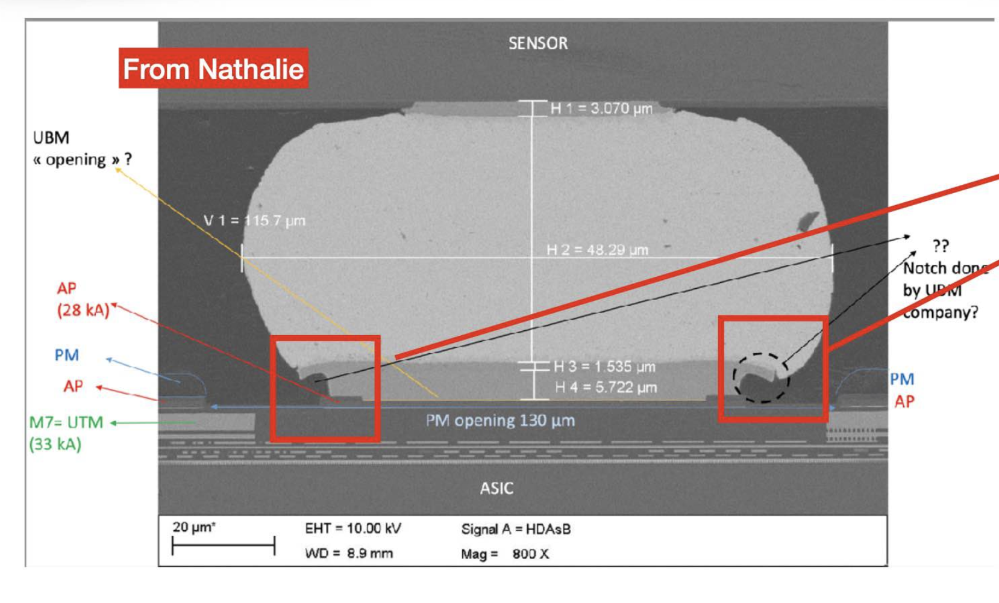
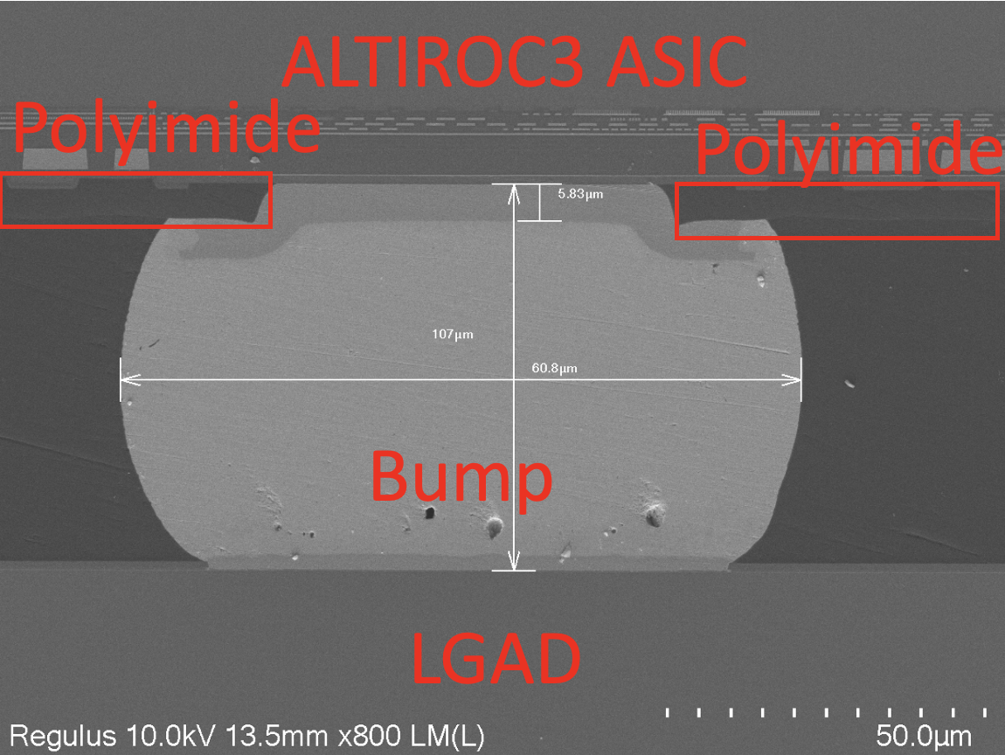
Sensor + ASIC Hybrid
IHEP is in charge of 50% of hybrids assembly
挑战：ATLAS ITK pixel has hybrid bump delamination issue, was delaying HL-LHC
IHEP solved the bump delamination issue in old ALTIROC2 hybrids, addressed by
  Switch to using thick sPolyimide layer for ALTIROC3/ALTIROC-A wafer → Softer with correct opening
  ensor as baseline (775um), instead of thin sensor (300um)
All ASIC wafers will send to IHEP for Polyimide layer deposition
ALTIROC2 hybrid incorrect Polyimide
by TSMC
ALTIROC3 hybrids with
correct Polyimide by IHEP/NCAP
Notes:
Check Polyimide

Slide 11
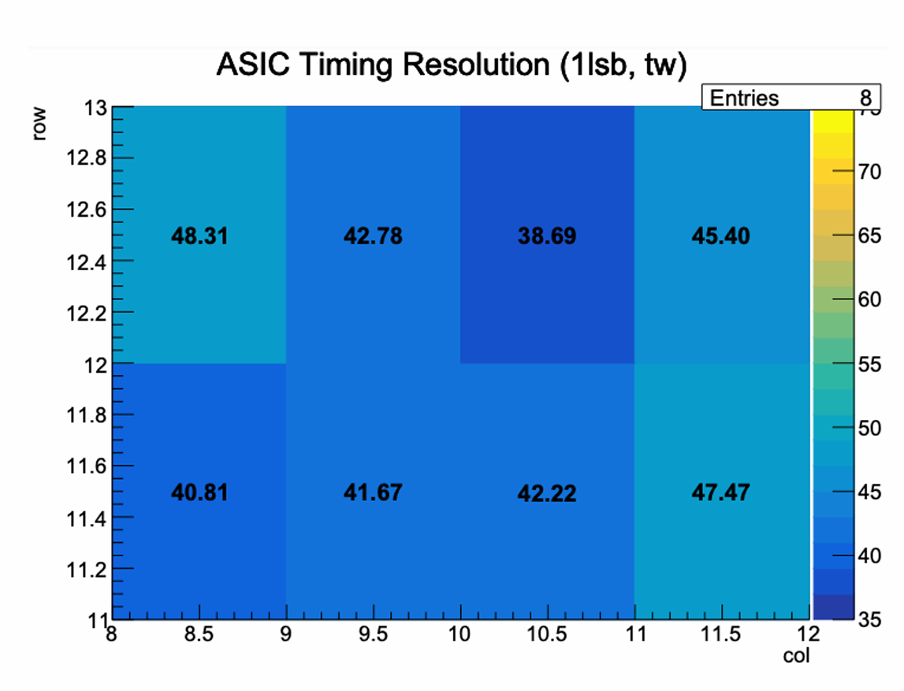
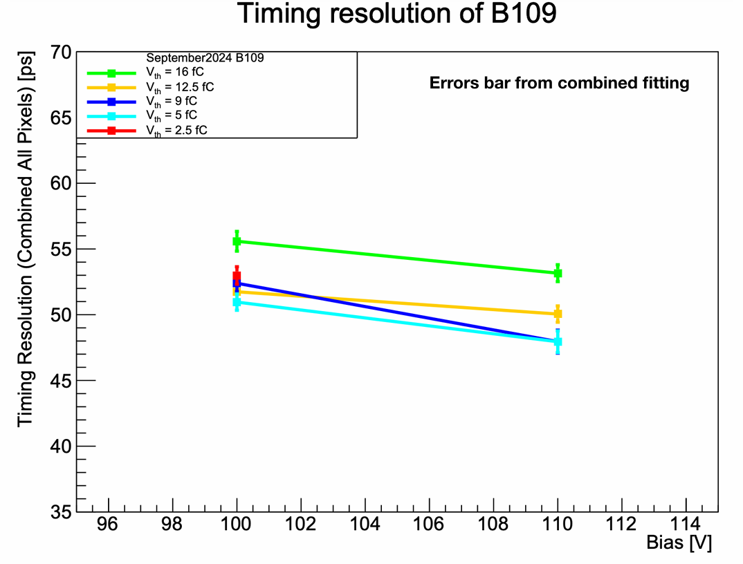
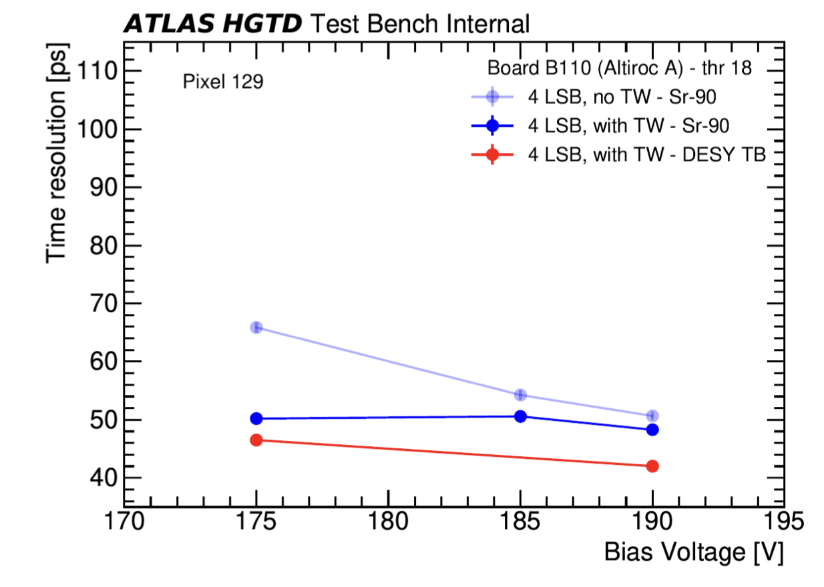

Hybrid (bare module) performance
IHEP and USTC made key contribution to test beam,
  IHEP member is the editor of HGTD sensor testbeam paper
Pre-production sensor+ ASIC(Altiroc3 and AltirocA) hybridization tested
  at CERN and DESY test beam.
The timing resolution can reach <50ps.
Irradiated IHEP LGAD
+ ALTIROCA
USTC LGAD+ ALTIROCA
IHEP LGAD+ ALTIROCA
Irradiated sensors(2.5e15 n_{eq}/cm²) with AltirocA
Best time resolution:~43ps
best time resolution reached O(48 ps)
best time resolution reached O(42 ps)

Slide 12
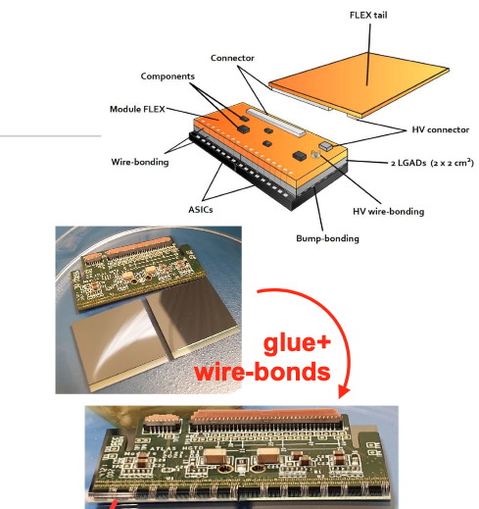
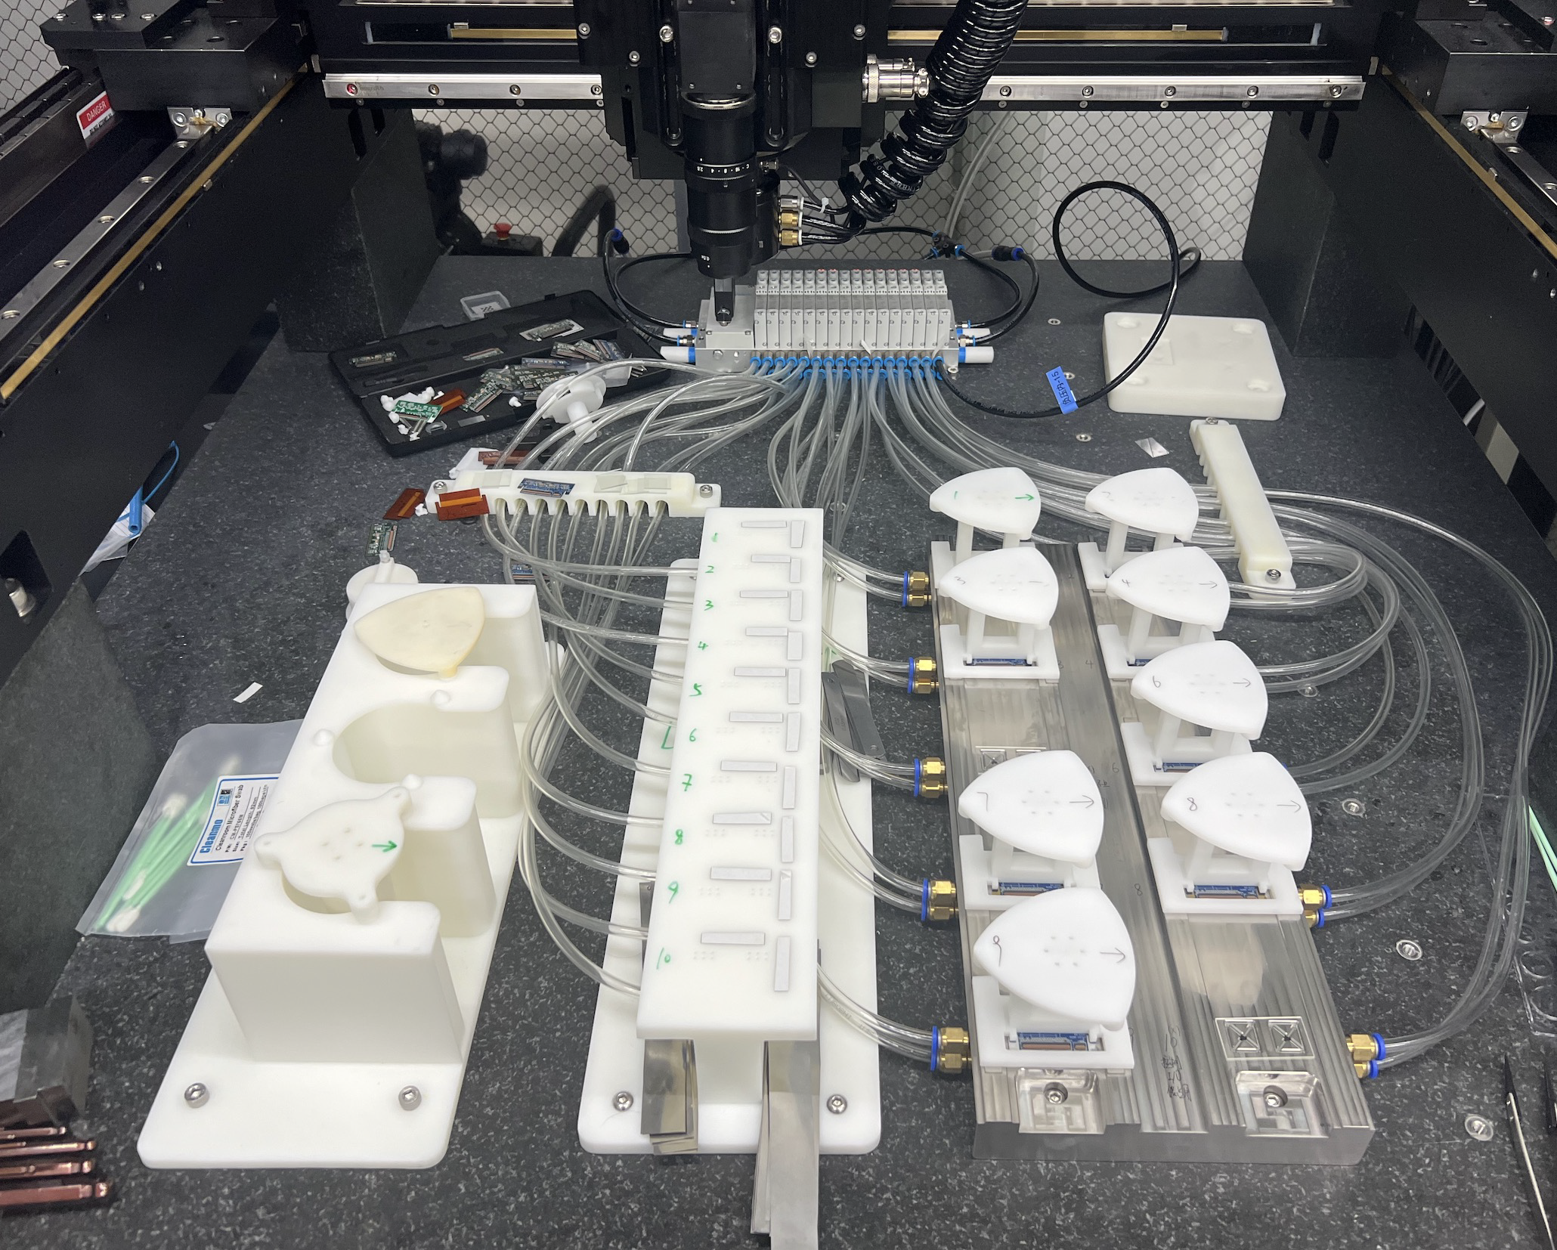
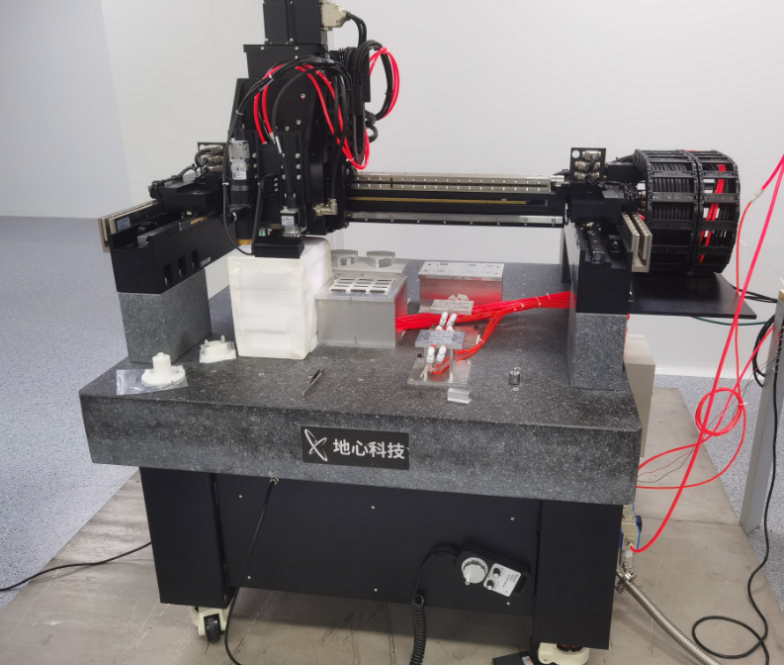
HGTD module assembly
6 module assembly site at HGTD (IHEP, USTC, Mainz, France, IFAE, Morocco )
  IHEP is largest site, 34% of module (~3000)
  USTC, 10% of module (~1000)
IHEP designed and fabricated module flex
IHEP and USTC developed gantry robot for automatic assembly
  IHEP has set up for production, will produce 10 modules each time
  USTC completed preparation, but can not get ASIC (US restriction)
    Plan to do assemble at IHEP (share gantries, detailed plan being workded out with IHEP)
Gantry robot @USTC
Gantry robot @IHEP

Slide 13
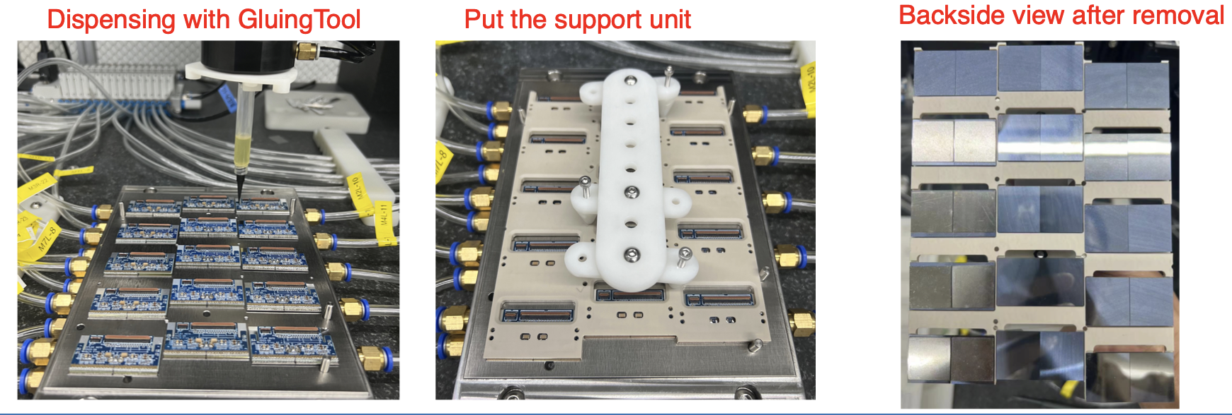
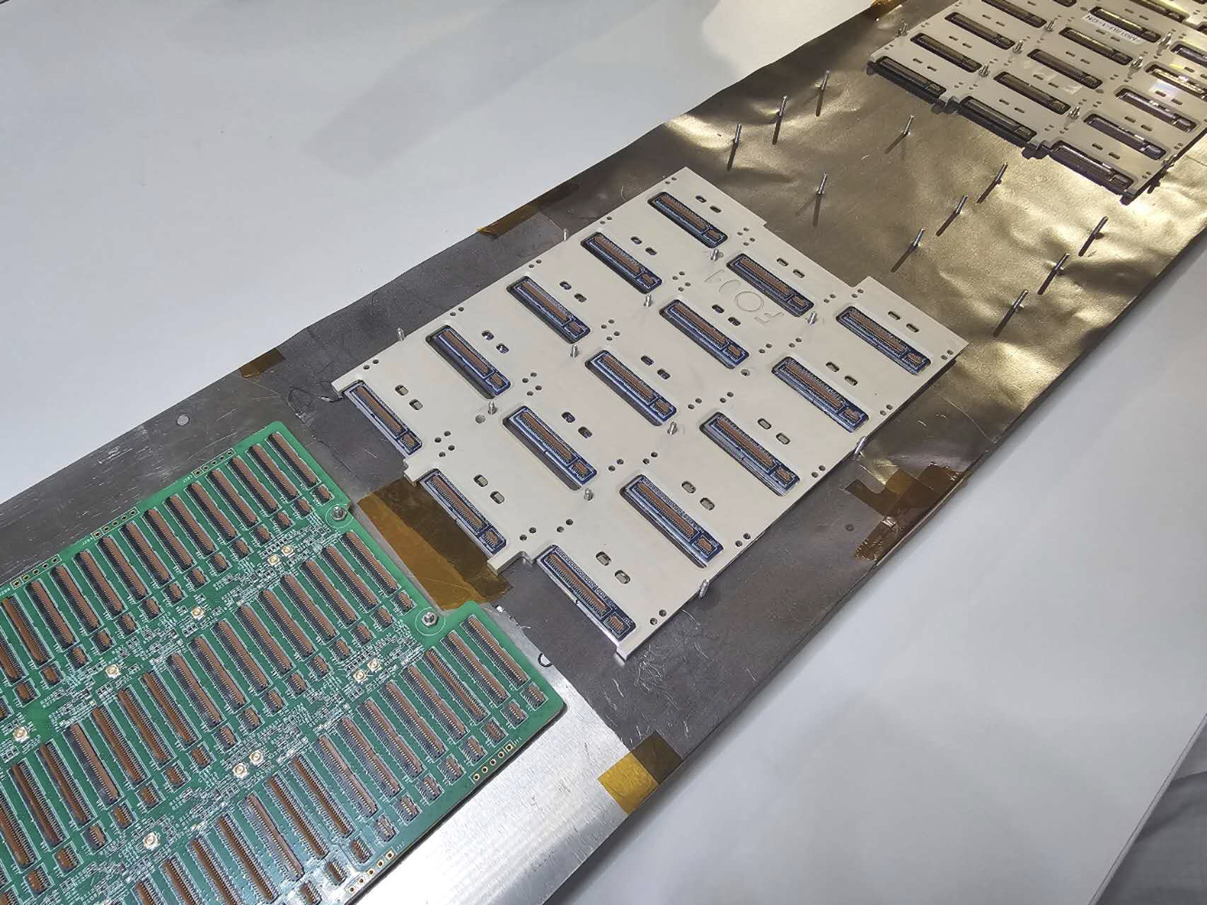
HGTD module loading
Achievement: IHEP made the first two ALTIROC3 detector unit
  Use Gantry robot system to position all 15 modules and glue dispending
USTC assembled detector unit with dummy modules.
IHEP/LPNHE-Paris shared 50% of support unit (PEEK) manufacture
  Support unit 100% fabricated in Chinese company
Detector unit shipped
to CERN

Slide 14
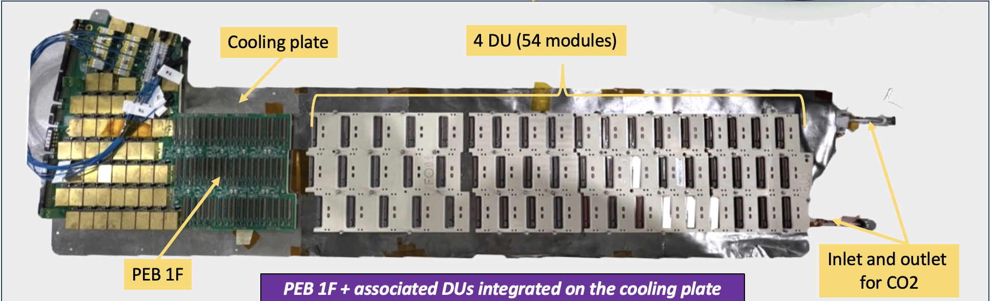
#Modules for ALTIROC-A/ALTIROC3/ALTIROC2
  54 modules (4 detector units) installed in demonstrator
    IHEP is leading module and detector unit prototyping
    Contributed two detector units with ALTIORC3 modules
 | # Hybrids | #modules | Usage
ALTIROC-A | 25 (23 by IHEP) | 7 | Test beams, hybrids irradiation
ALTIROC-3 | 219 (121 by IHEP) | 106 | Demonstrator, thermal cycle study, test beam, irradiations

Slide 15
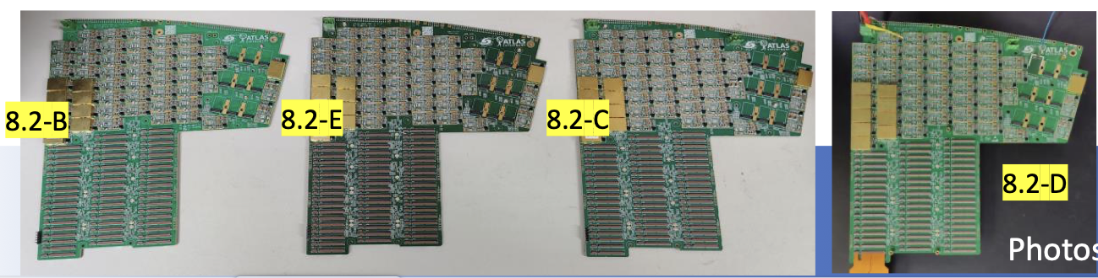
Peripheral Electronics Boards (PEB)
IHEP and NJU is responsible for 100% PEB production .
PEB is very challenging, Comments from P2UG review 2023 about PEB :
  Comparable with the most difficult boards for HEP projects
IHEP and NJU developed 1st Peripheral Electronics Boards at early 2024
  IHEP led designed PEB 1F, NJU manufactured 4 PEB prototyping
  Selected the best company for production
PEB FDR review in (May 2025), conditional passed
PEB design in next step
  Design: PEB 1B/2F/2B by IHEP; PEB 3B by NJU; PEB 3F by Morocco
    IHEP/ Jie Zhang will coordinate and verify all the designs

Slide 16
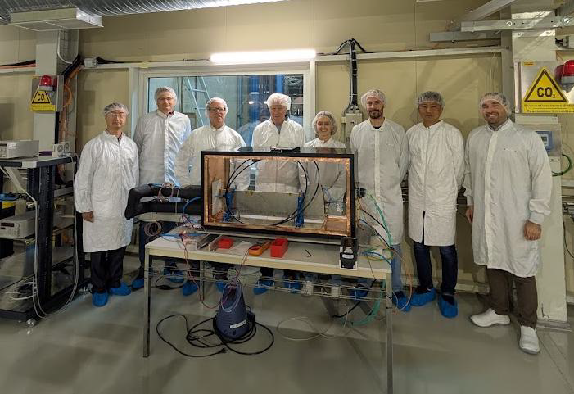
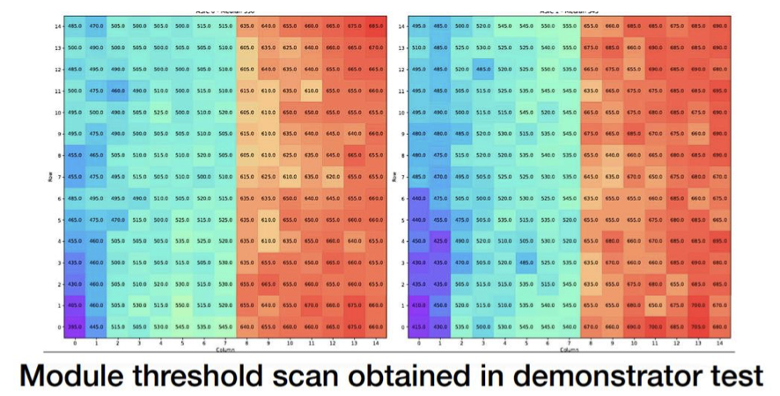
Demonstrator (大规模时间探测器样机）
IHEP and NJU played important role testing demonstrator system at CERN
  Noise levels were measured with 54 modules, no major problem
  挑战： 1st time to demonstrate that in large-scale system level
ALTIROC3 detector units

Slide 17
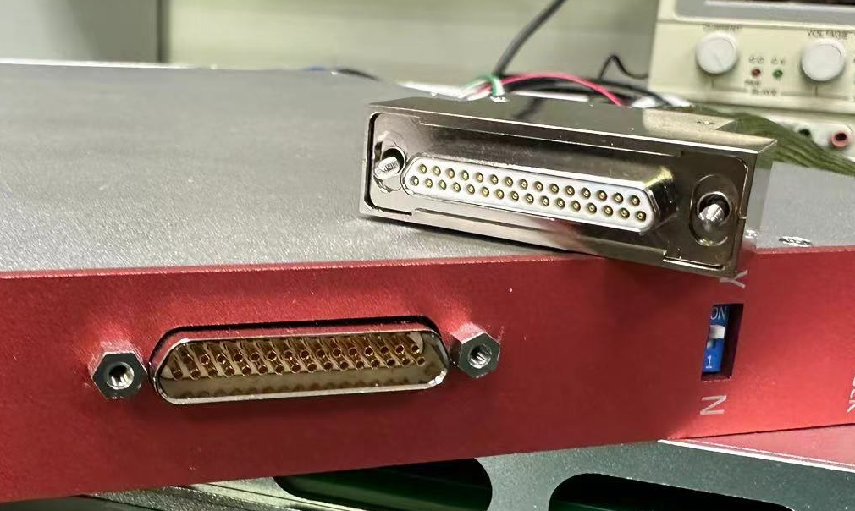
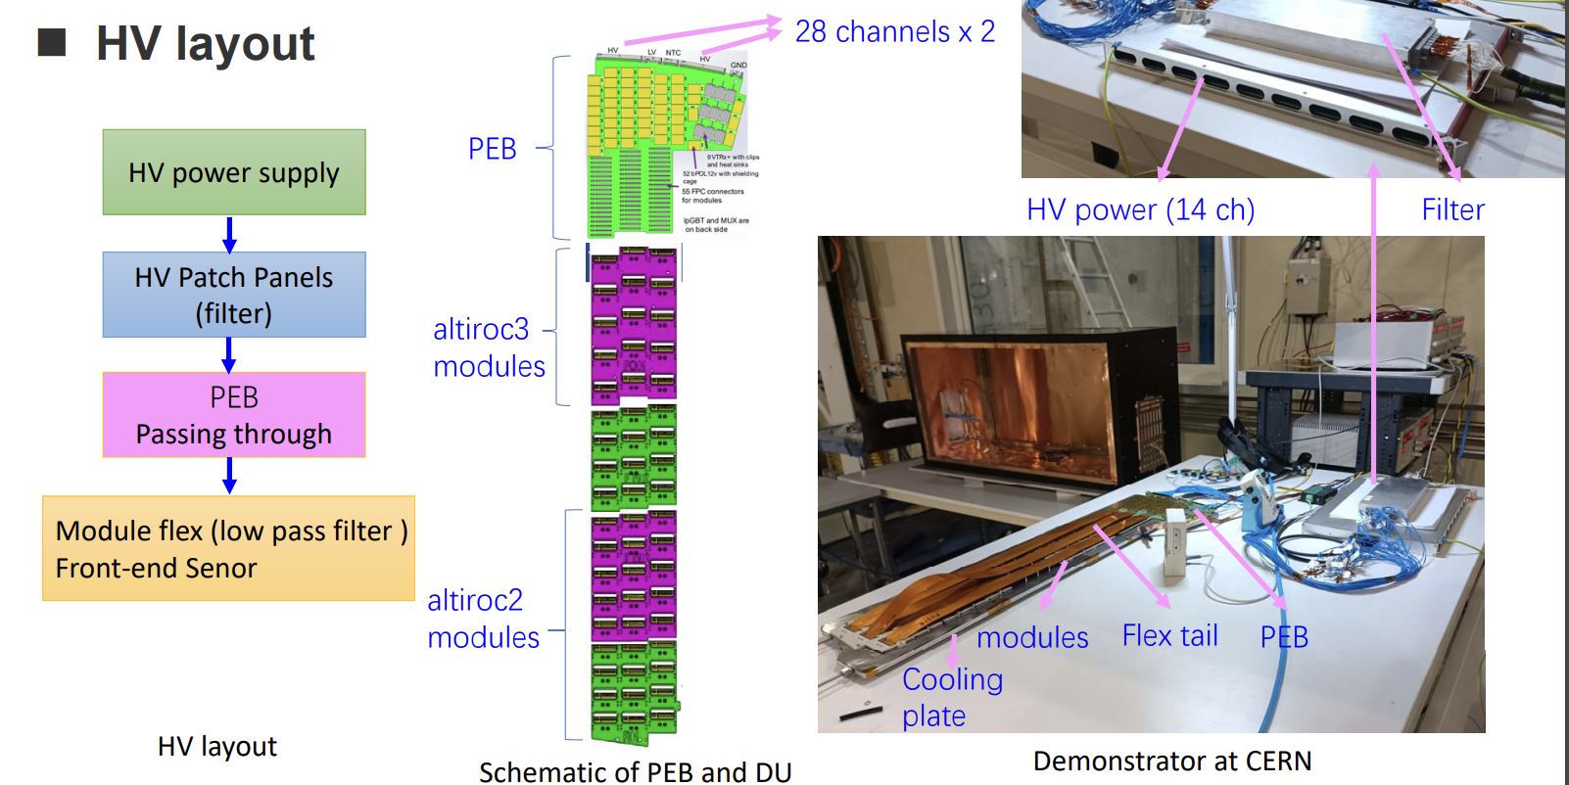
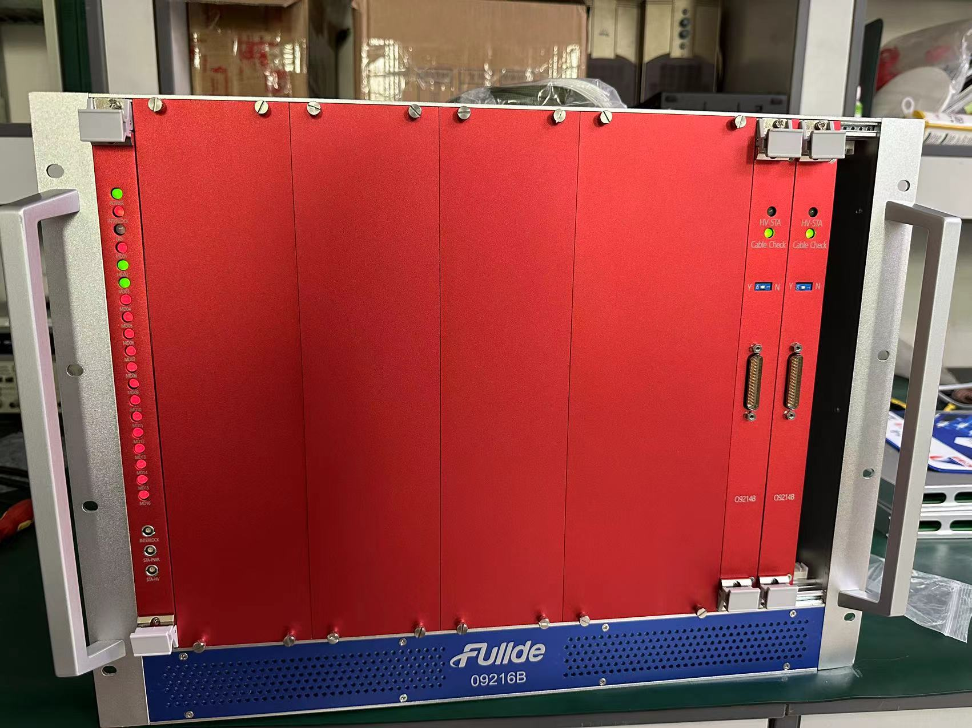
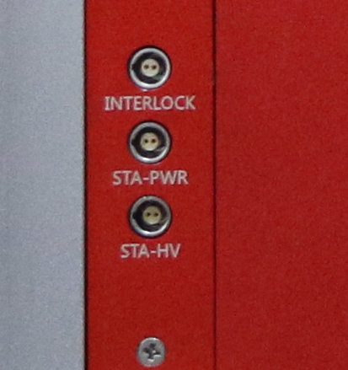
High voltage power supply for HGTD
IHEP developed HV power supplies with FULLDE Chinese company
  Tested at IHEP and CERN, Passed FDR, now in pre-production
  挑战：100nA current precision, completion with CANE
100% contract of HV assigned to FULLDE.
  IHEP/SDU will contribute to 17.7% of the cost, including testing
HV supply testing setup at HGTD demonstrator
Interlock interface
Lemo connector
HV connector

Slide 18
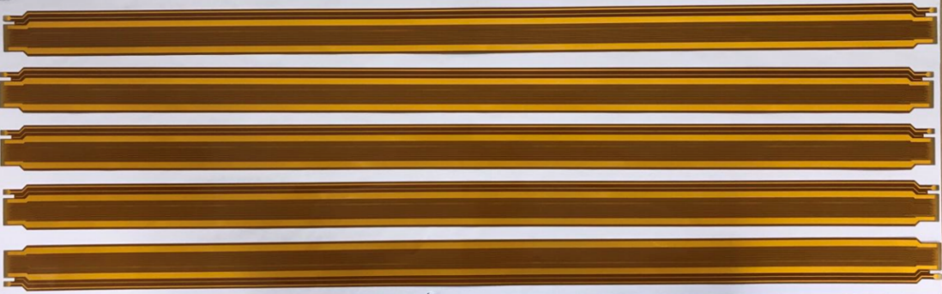
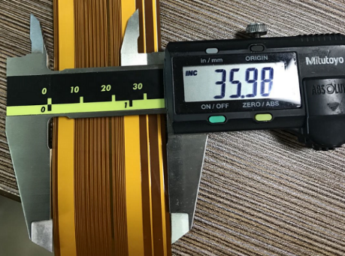
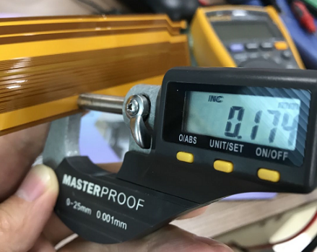
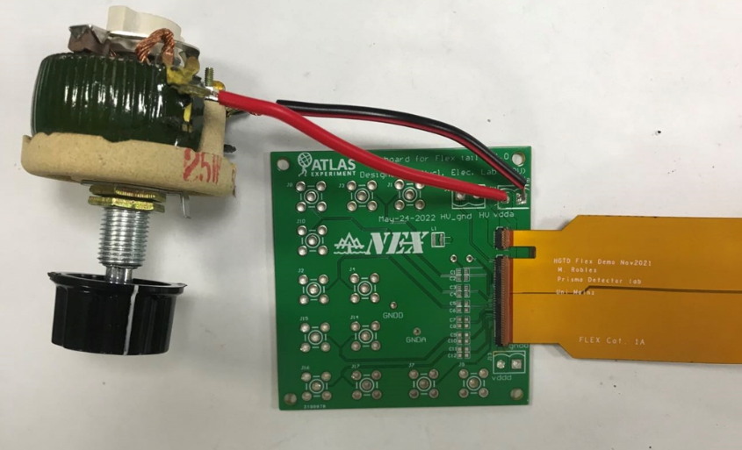
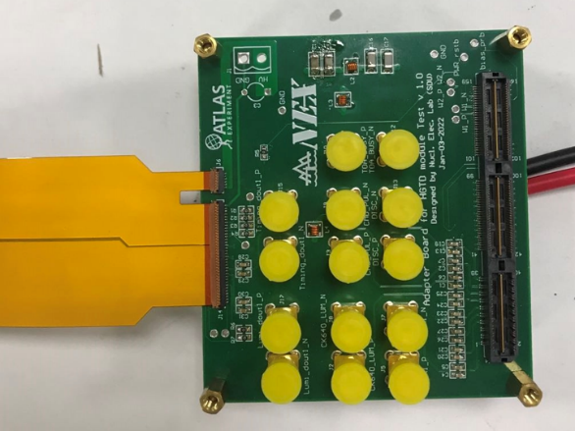
Flex tails（柔性电子学尾板）
SDU is responsible for 33% of flex tails production
Prototype has been made, and satisficed the requirement
Ready for pre-production
caliper
micrometer
High power BC1 adjustable sliding resistor
B
A
~ 46 mΩ for vdda and ~22 mΩ for gnda.
Flex tail
C
D
gnda
Adapter
board v1
Simple Test board

Slide 19
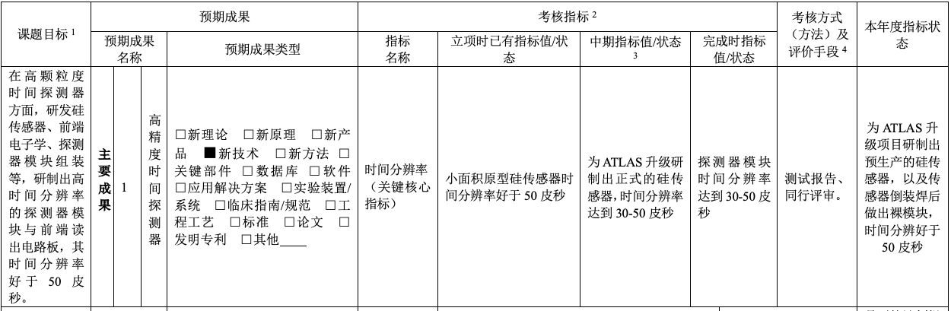
Assessment index status （考核指标）:
Final goal:
  Final production sensor and detector module time resolution 30-50 ps
This year (1st year):
  pre-production sensor and hybrids resolution better than 50ps
    Irradiated sensor +ASIC hybrids can reach 43ps in test beam

Slide 20
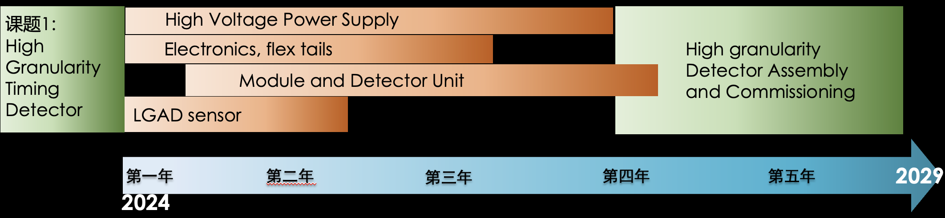
Summary and plan
Summary :
  Sensor pre-production done, passed CERN review, production on-going
  Prototyping done for Module and Electronics Boards , HV power, flex tails
Next Milestones
  Sensor production finished in 2026
  Electronics boards and flex tails completed in 2027
  Module and detector unit and HV power supply completed in 2028
  Detector assembly and Commissioning at CERN (2026 -2029 )

