Slide 1
Development of RPC detector for ATLAS Muon Phase-II upgrade
-- progress report
Yongjie Sun (孙勇杰)
On behalf of the ATLAS China Muon team
University of Science and Technology of China

Slide 2
Introduction – towards HL-LHC
Higgs. discovery
LHC construction
1998-2008
Run-1
2009-2012
LS-1
2013-2014
Run-2
2015-2018
7,8 TeV
30 fb⁻¹
13 TeV
190 fb⁻¹
13.6 TeV
450 fb⁻¹
13.6-14 TeV
3000-4000 fb⁻¹
LS-2
2019-2021
Run-3
2022-2026
LS-3
2026-2029
Run-4，5
2030-2040
*Latest schedule released in Oct. 2024
LHC will upgrade to HL-LHC with 5 - 7.5 times higher luminosity.
ATLAS will collect 90% of its physics data during the HL-LHC period
→ Unprecedented opportunities to search for new physics at energy frontier and measurement of the SM, e.g. Higgs boson properties
ATLAS detector is undergoing Phase-II upgrades accordingly.

Slide 3
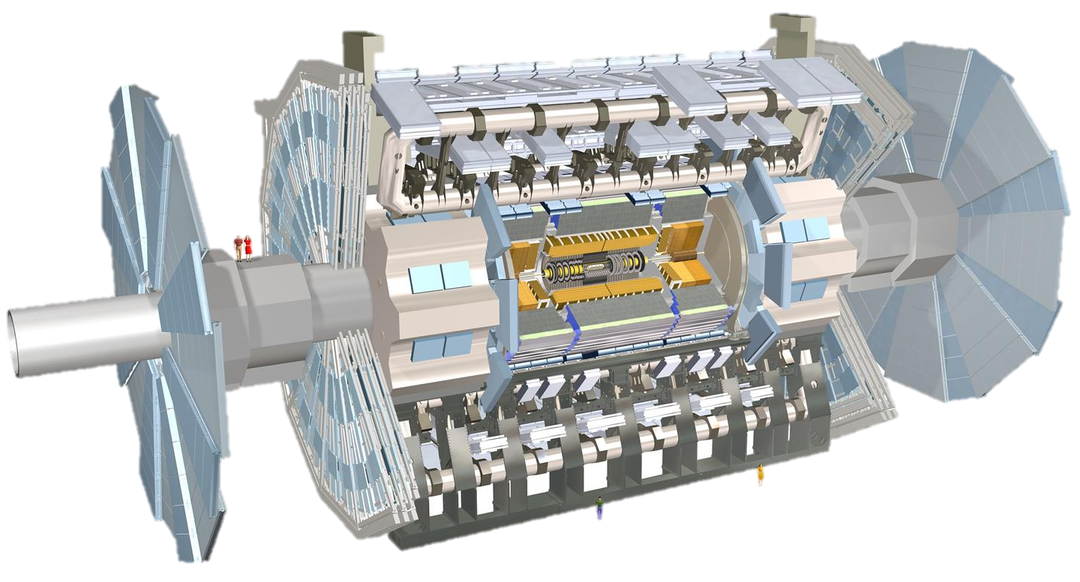
Upgrade of the ATLAS detector
Phase-I upgrade
New Small Wheel (NSW)
Phase-II upgrade
Silicon Inner Tracking system
Main goals:
Higher radiation hardness/rate capability
Higher spatial/time resolution
Faster response time
Higher data acquisition rate
Phase-II upgrade
Trigger and Data Acquisition - TDAQ
Phase-II upgrade
High Granularity Timing Detector HGTD
Phase-II upgrade
Thin-gap RPC (barrel muon trigger, very crucial for physics) ,
sMDT, electronics

Slide 4
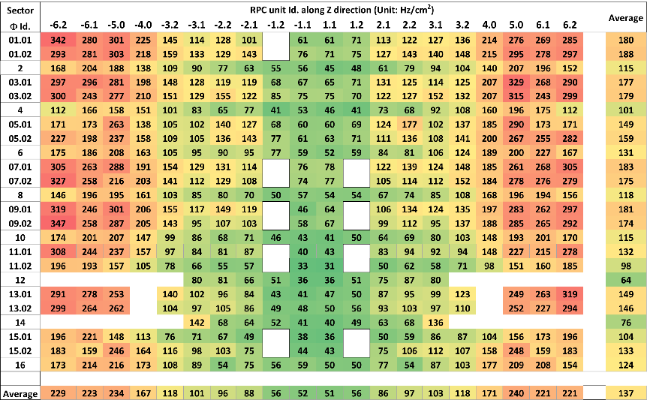
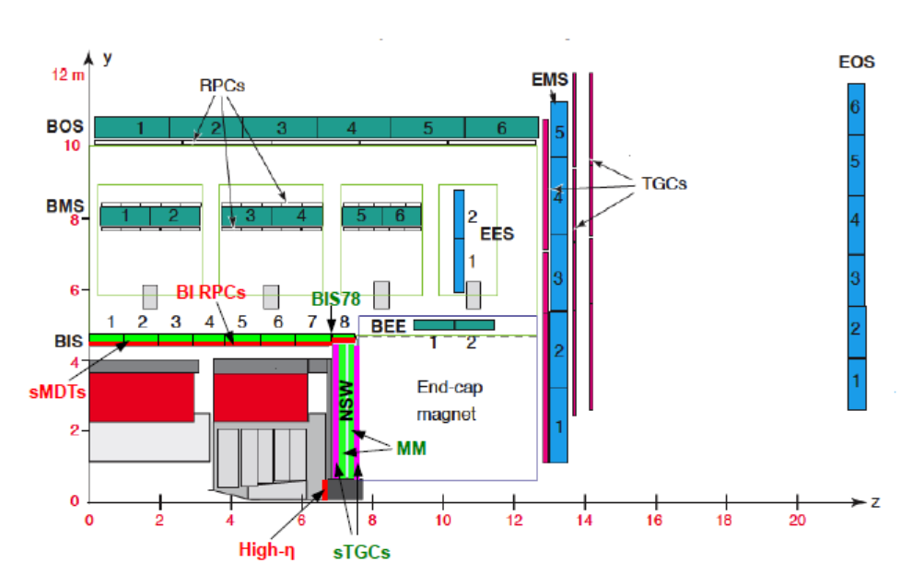
The Phase-II Upgrade of Muon RPC
L=7.5×10³⁴cm⁻²s⁻¹@13TeV
Current RPC system and its limitation
  The limited rate capability: ~ 100 Hz/cm² → 1 kHz/cm²
  Reaching the lifetime of 10 years @ LHC → lower efficiency
  The acceptance holes due to support structures
The desire for additional BI layers for HL-LHC
  Three layers of new RPC in the BI region
  Thin-gap design with higher rate capability and longevity
  Fix most of the acceptance holes

Slide 5
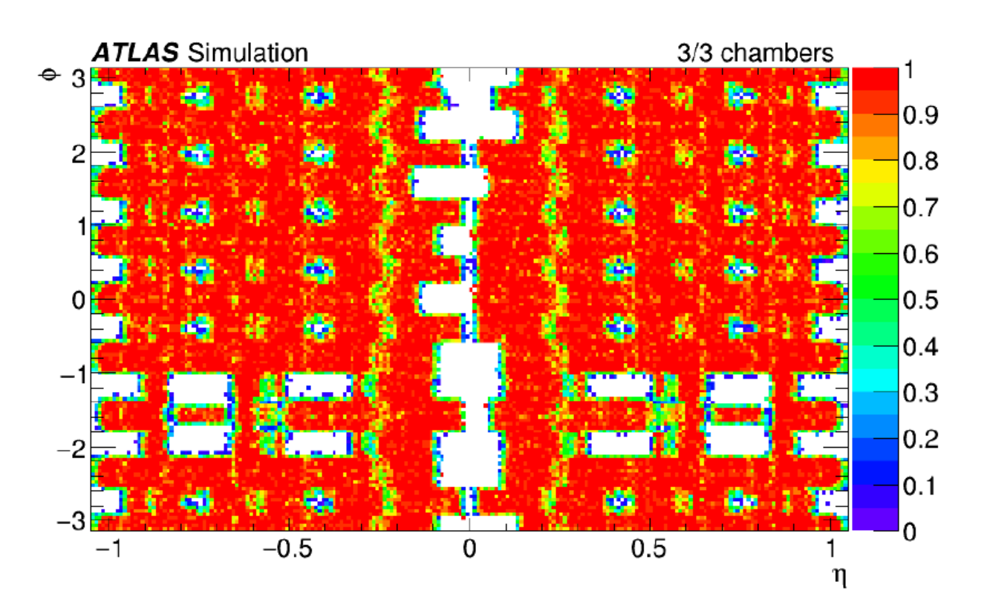
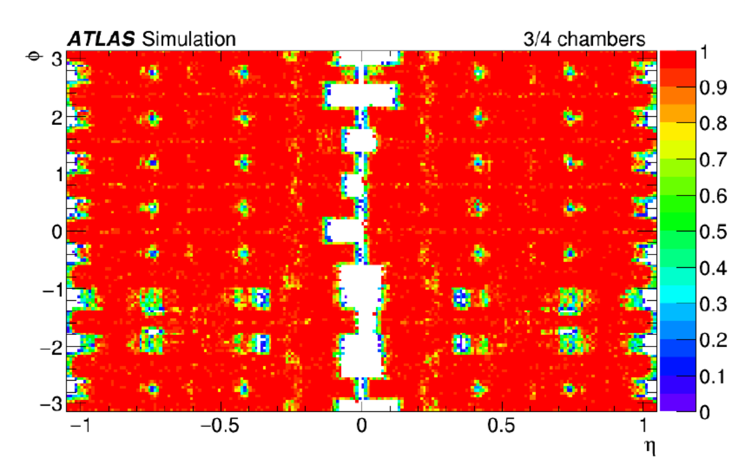
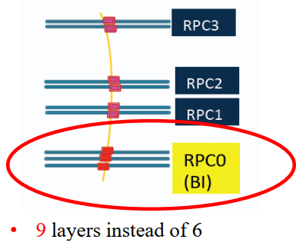
Advantages of the BI RPC Upgrade
Current trigger eff. ~ 70%
The new BI RPC fixed most of the acceptance holes.
Flexible trigger logic increases the trigger efficiency: 70% → 90%
Improved muon coverage important for offline analysis for physics with muon signature
High time resolution (order of 1 ns) with thin gas gap can be exploited for new physics searches
Expected trigger eff. with BI upgrade ~ 90%

Slide 6
Technical design: Thin-gap RPC
Thinner bakelite:
  Less voltage drop in bakelite → improve the rate capability, larger induced signals
Thinner gas gap:
  Less charge produced per event → improve rate capability and longevity
  Higher field → better time resolution
Improved readout panel
  Better mechanics flatness and hardness → better signal transmission and spatial resolution.
New generation FE electronic:
  Higher amplification factor and high S/N ratio to compensate the lost gas amplification.
Specifications:
High rate capability: → kHz/cm²
Longer longevity: >10 years@HL-LHC
Higher spatial resolution: <1 cm
Higher time resolution: ~ 0.5 ns
→ First application in large scale experiment
Low ε_{r} filler
Bakelite: 2 mm→1.5 mm
Gap size: 2 mm→1 mm
Readout panel
Copper strip/GND
Bakelite electrode
Gas gap

Slide 7
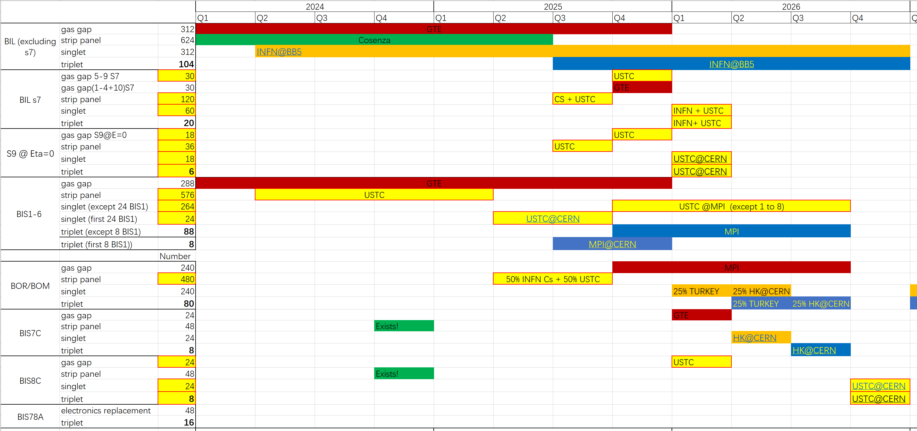
Tasks of the Chinese team
China contributions
We are here
Gas gap: 72 (~10%)
Readout panel: 912 (~50%)
FE board: 5000 (>50%)
Singlet: 360 (~50%)
Installation & commissioning

Slide 8
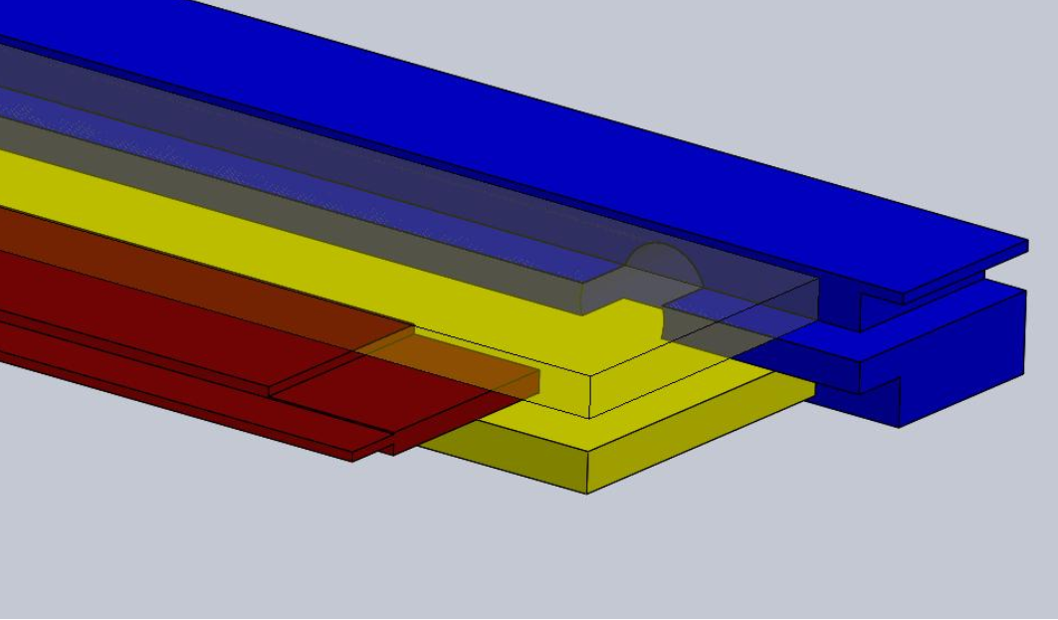
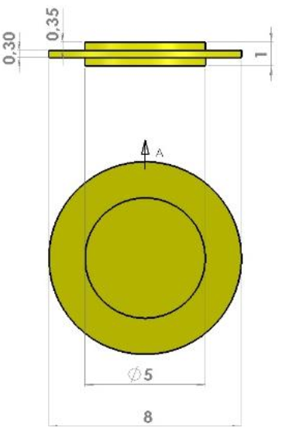
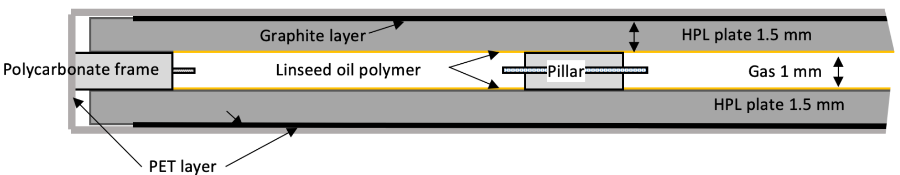
The thin gas gap production
Typical BIL: 2500 x 680 mm
Size: ~1.7m²
The largest gaseous detector with strict requirements on structure precision
  Length / thickness = 2500 / 1
  Spacer: 1 mm ± 10 μm
  Frames: 1 mm ± 30 μm
  Gap size: 1 mm ± 100 μm in 7×7 cm
Typical BIS: 1700 x 1100 mm
Size: ~1.9 m²

Slide 9
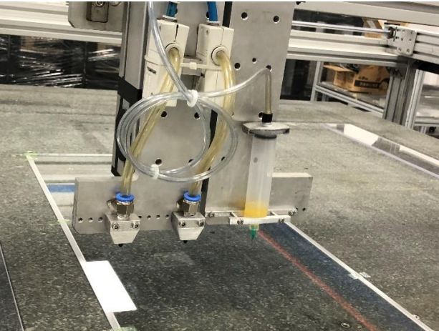
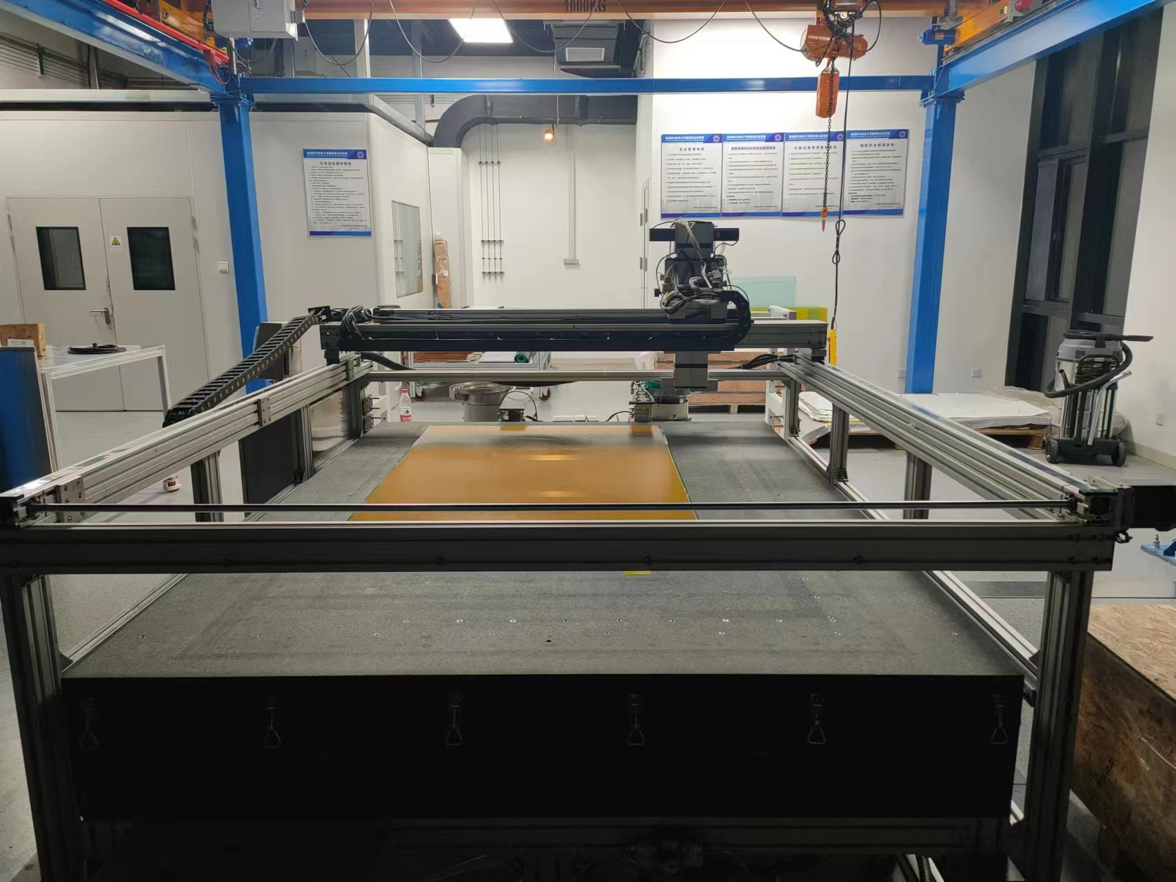
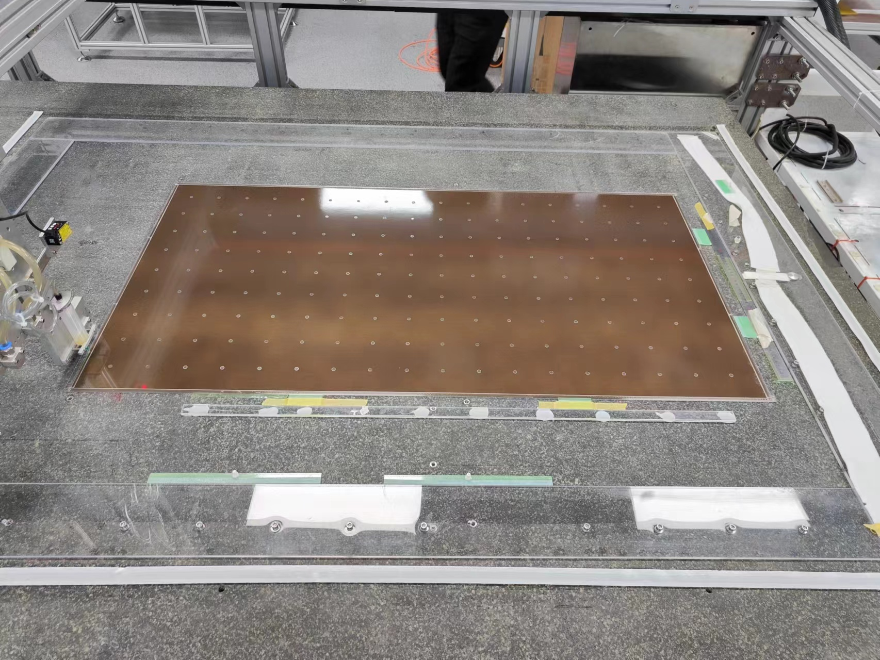
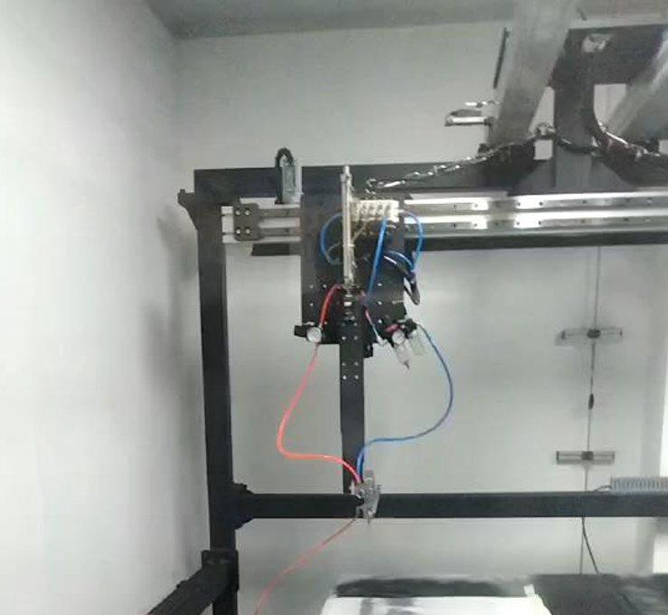
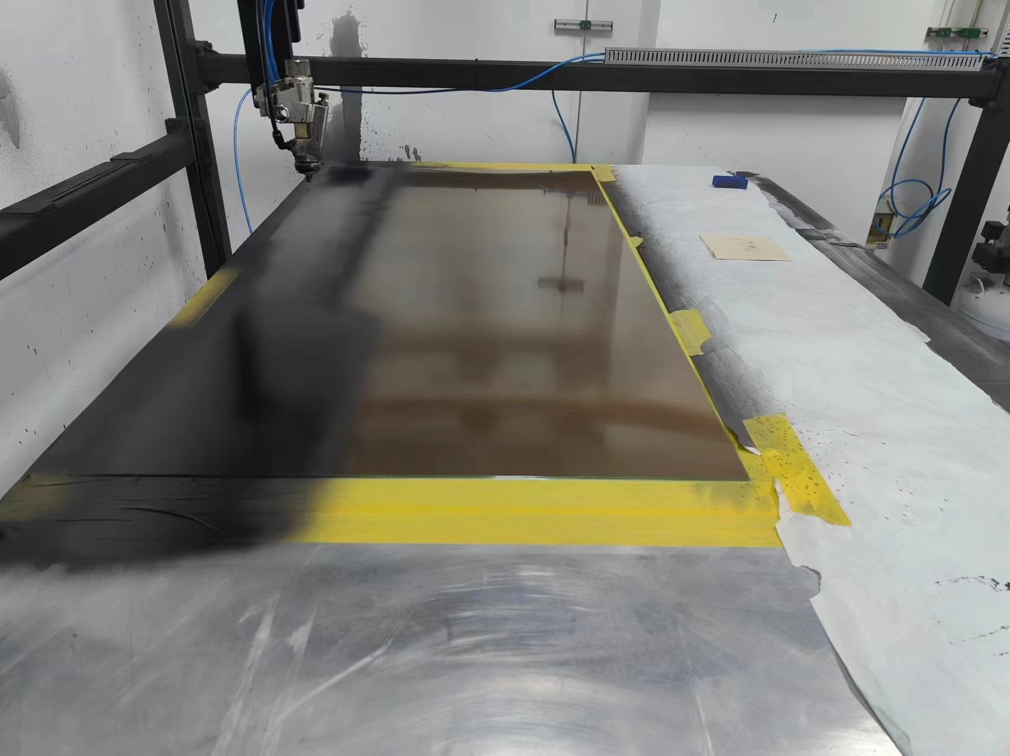
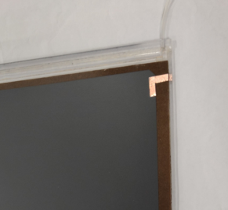
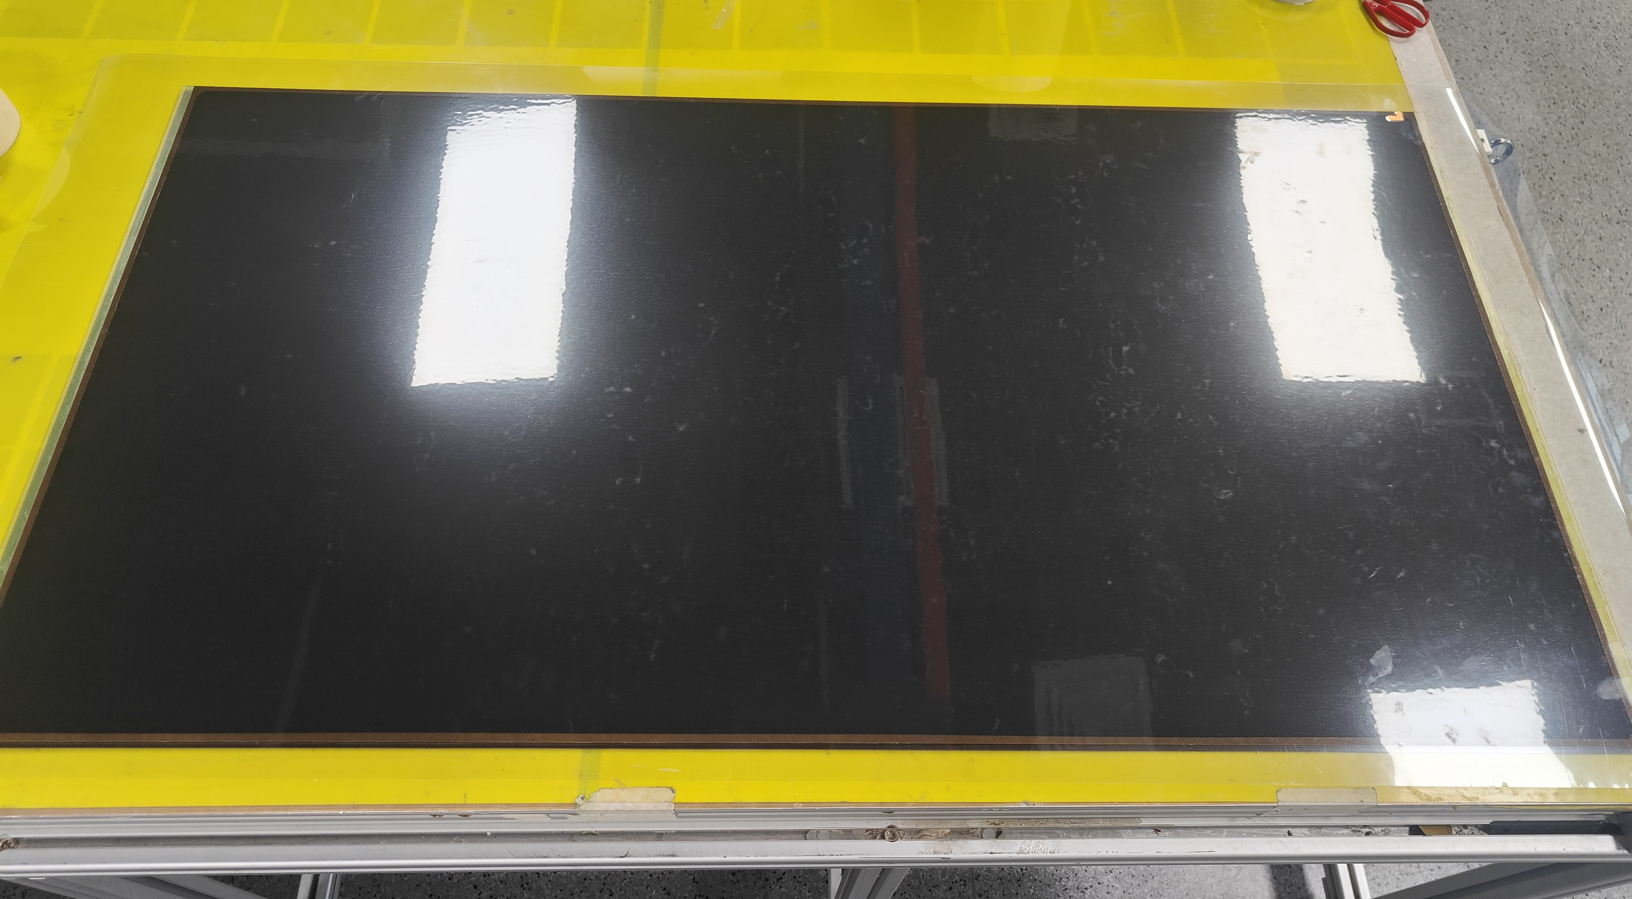
China gas gap production site
Full production line established
8 prototypes produced
  Size = 1300 x 680 mm²
Procedures are under optimization
Getting ready for mass production
Spacers placed
Spacer gluing platform
Finished gas gap
HV electrode
Graphite painting machine
Details can be found in Dongshuo’s talk

Slide 10
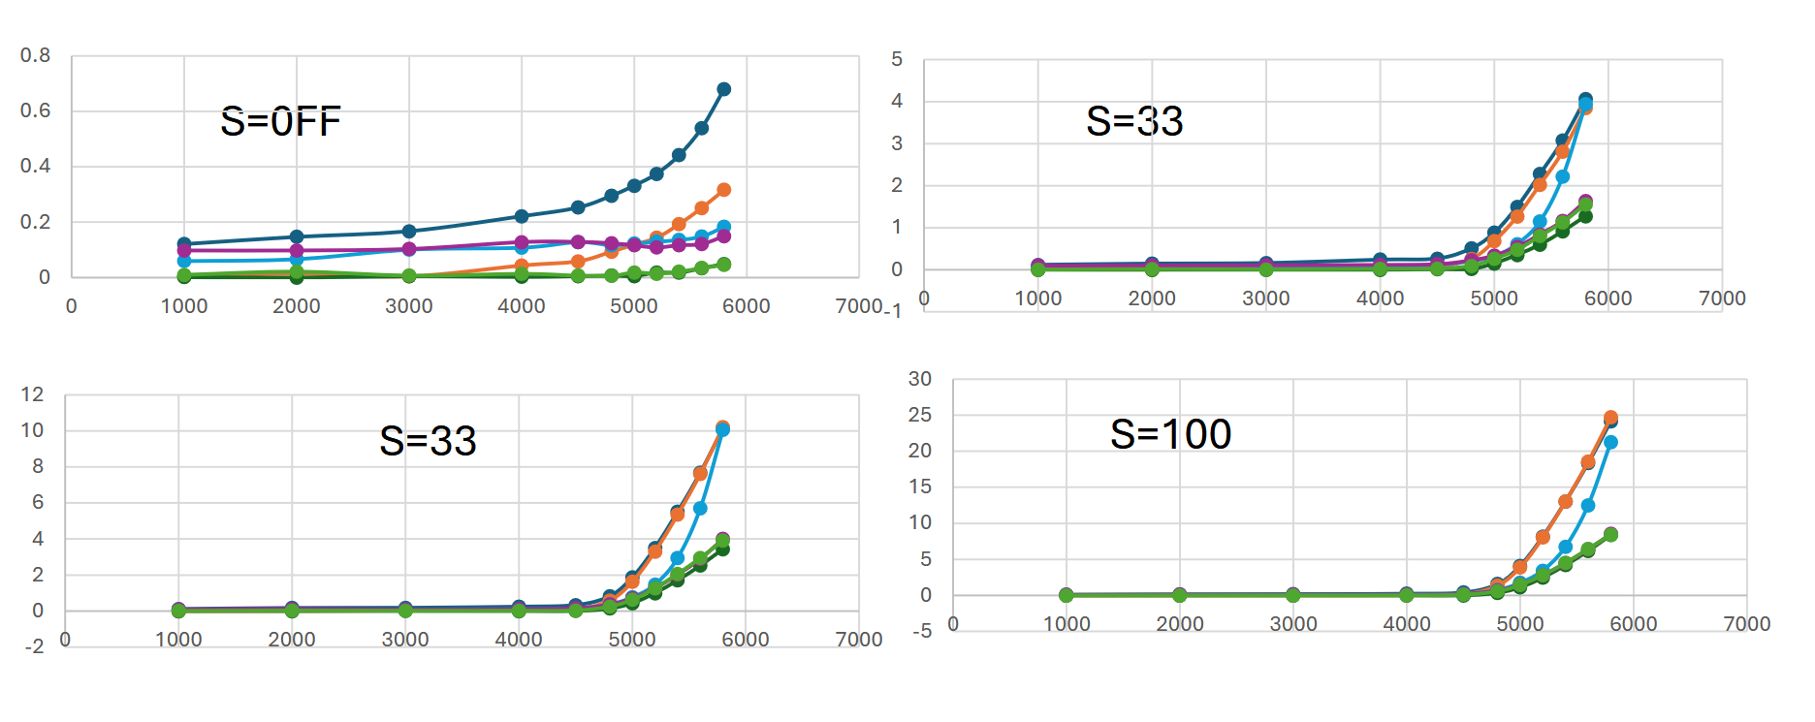
Aging test of gas gaps at GIF++
First scan at GIF++ with full source
First scan at CERN
Scan with different filters
Prototypes are under aging test at GIF++
Very low current observed
Normal behavior under irradiation
S=OFF
S=10
S=33
S=100

Slide 11
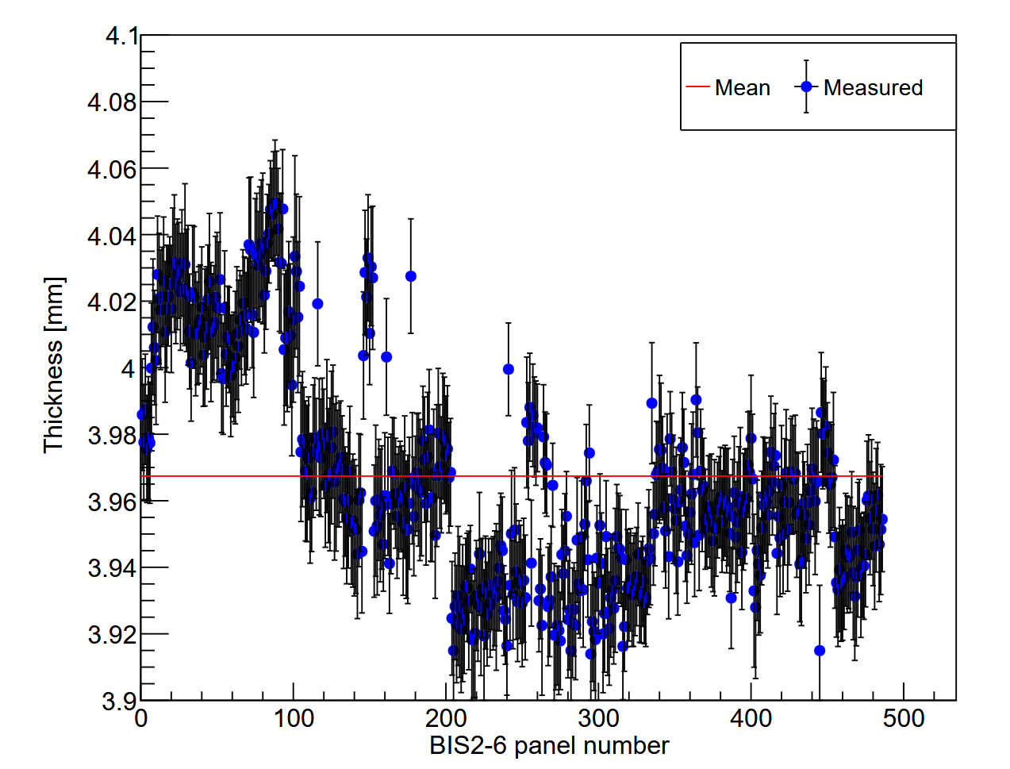
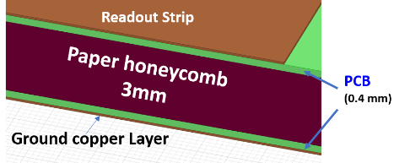
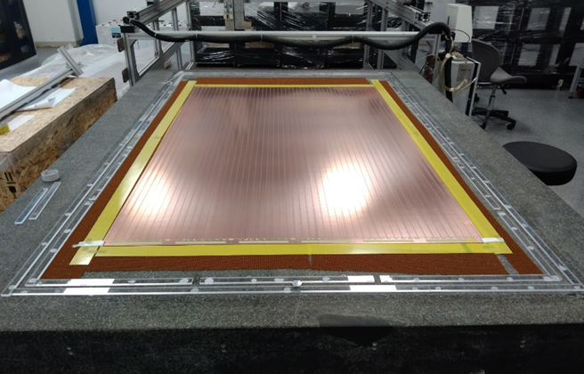
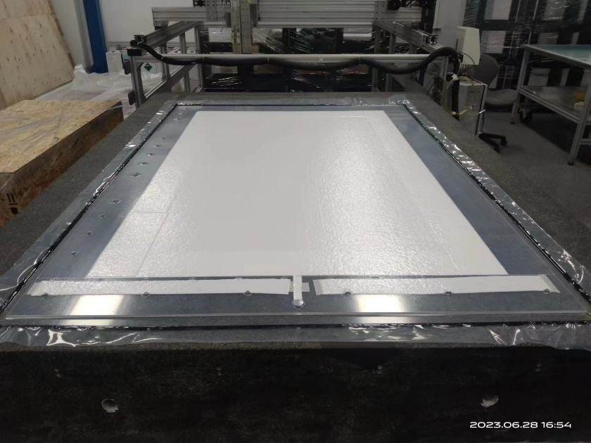
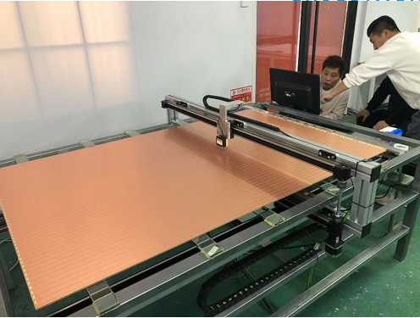
The readout panel production
Details can be found in Dongshuo’s talk
Large size PCB → BIS = 1705 x 1072 mm
Flatness control → ± 100 μm in 7×7 cm
Developed vacuum bag production method
Qualification method → 400 measurement points/panel
All BIS panel production finished (~580 panels).
1.7m
1.1m
Large size PCB
Vacuum bag pressing
Automatic thickness scan

Slide 12
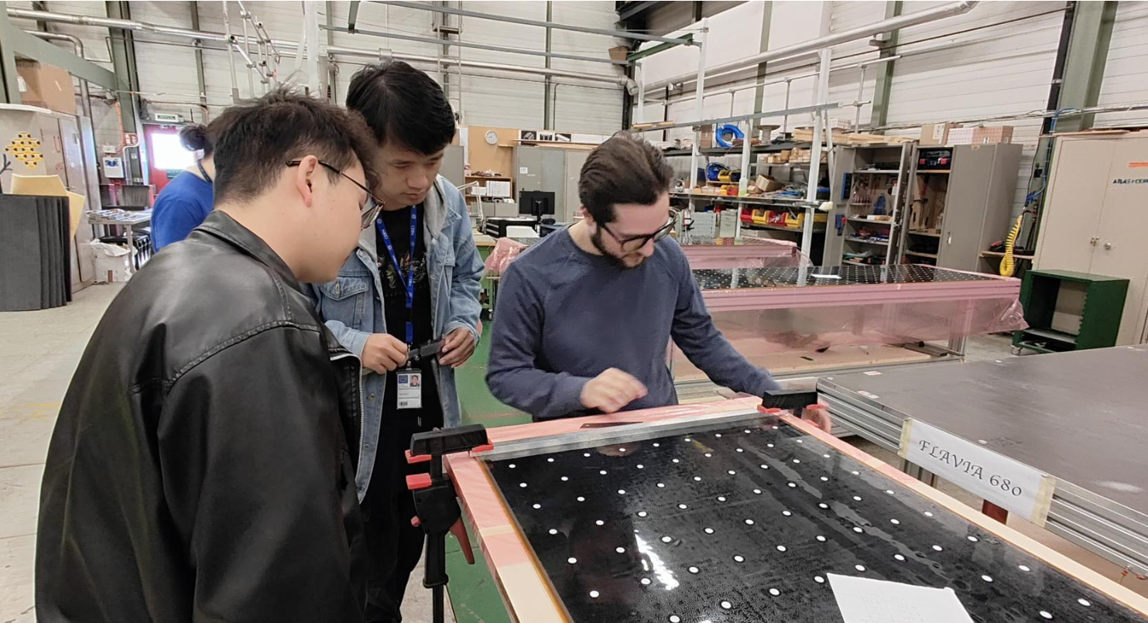
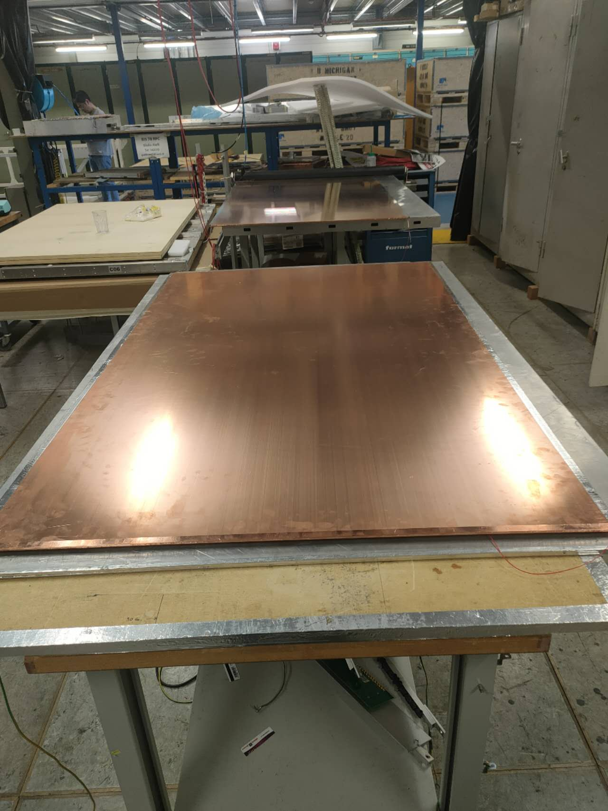
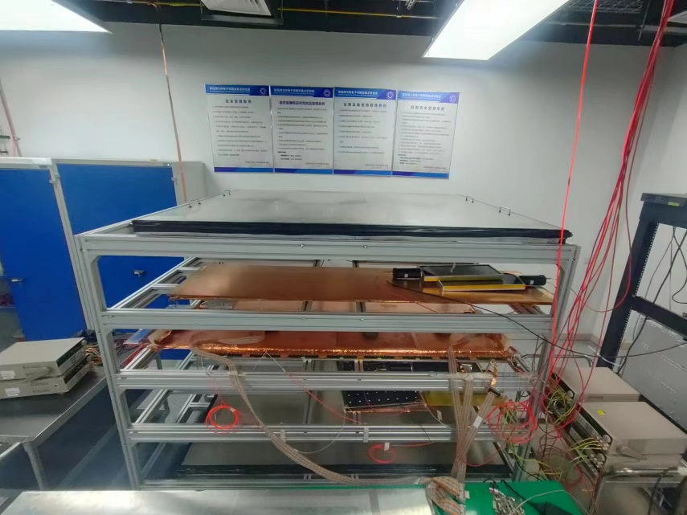
The singlet assembly and qualification
Details can be found in Francois’s talk
Technical challenge of building large & thin Barrel Inner RPC singlet
The basic functional unit of RPC, Quality Assurance needed
  gas tightness
  electrical connectivity
  leakage current
  efficiency
Large area, large quantity, systematic test
large-scale multi-layer test station and data acquisition system
Joined the training at CERN for singlet assembly. (18 BIS-1 singlet built with good qualities.)
RPC singlet assembly
RPC singlet test station

Slide 13
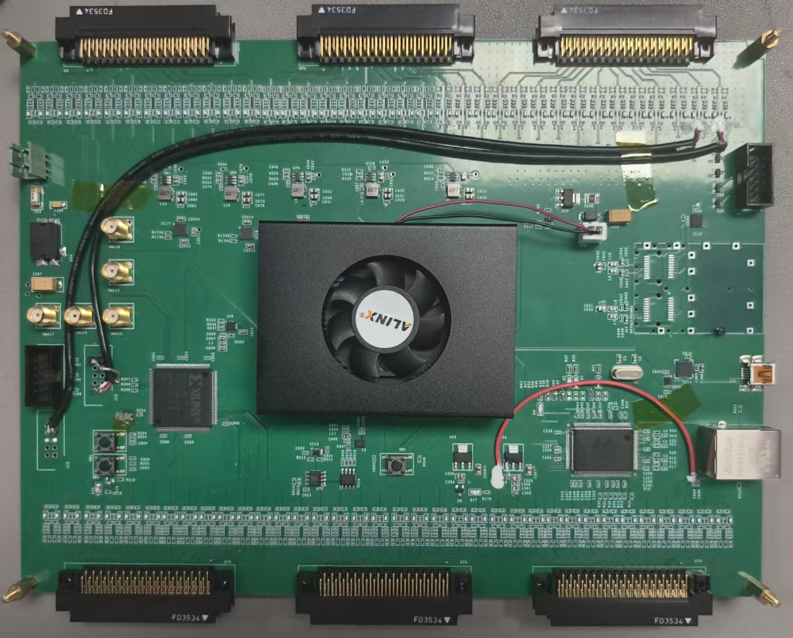
DAQ system for FEE test and for singlet qualification
Initially designed for the New front-end electronics (FEE) with a specialized Manchester encoding for data transmission (“the baseline solution”)
Quickly modified to the TDC mode for the test of “the backup solution”
DAQ functions：
  Provide 40MHz clock for FEE
  144 channels decode or TDC
  Trigger mode: External/self/master-slave
  Data package & upload
Made significant contribution to the test of the FEE boards.
Details can be found in Jiaxuan’s talk

Slide 14
Issue addressing
Quality of gas gaps produced in Italy company (GTE)
  Issue: gas leak → refurbishment produced gaps & modification of the gap design
  Issue: current drifting → pre-washing and re-oiling, bakelite inspections, etc., still under investigation.
The FEE
  Delay of the board design and test → USTC offered an FPGA readout system for FEE test
  Restrictions of chips to USTC → FE board procured by USTC & chip bonding by HK
  Pre-production of 500 FE boards started.
The singlet
  Restrictions of FE boards with chips, singlet with electronics can not be assembled and tested in USTC
  → Move the BIS singlet assembly line to MPI

Slide 15
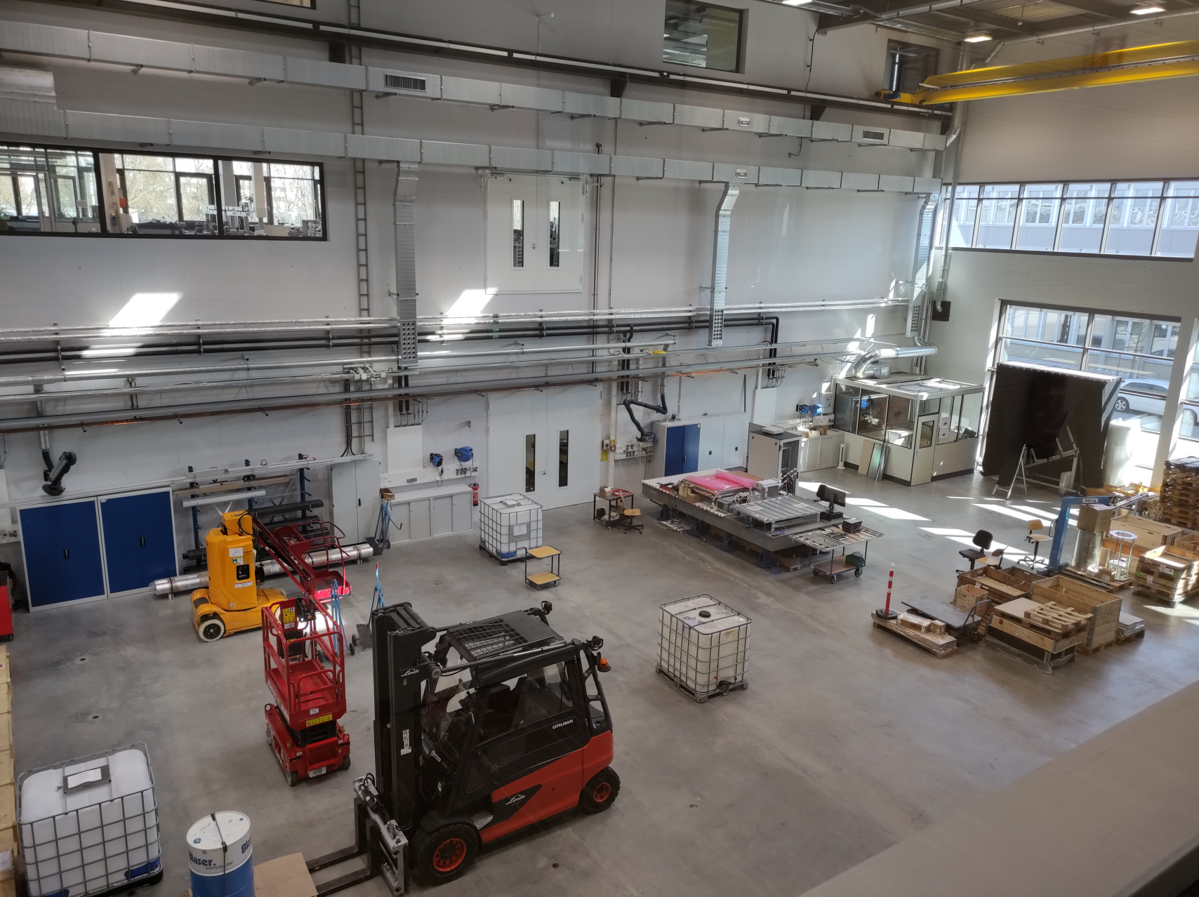
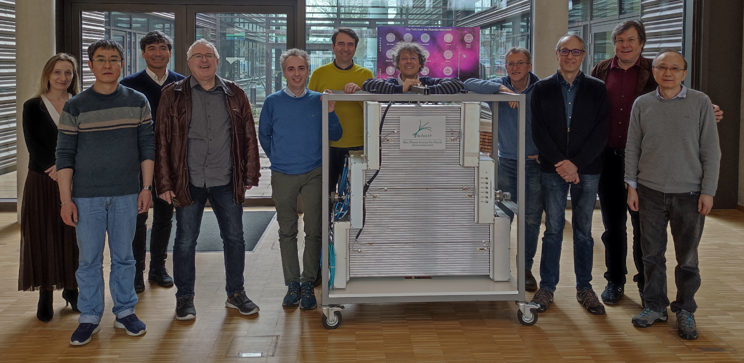
Decision made in MPI
Infrastructure and production
MPI tasks
  BIS triplets
  assembly equipment
  power supplies
  Oiling station
USTC tasks
  BIS singlets
  Monitoring instrumentation
  Data acquisition system
Schedule
June/July: Preparation of the assembly lines
September: Start of the singlet assembly
Oiling station
Intermediate storage
Triplet assembly
and test stands
Singlet assembly

Slide 16
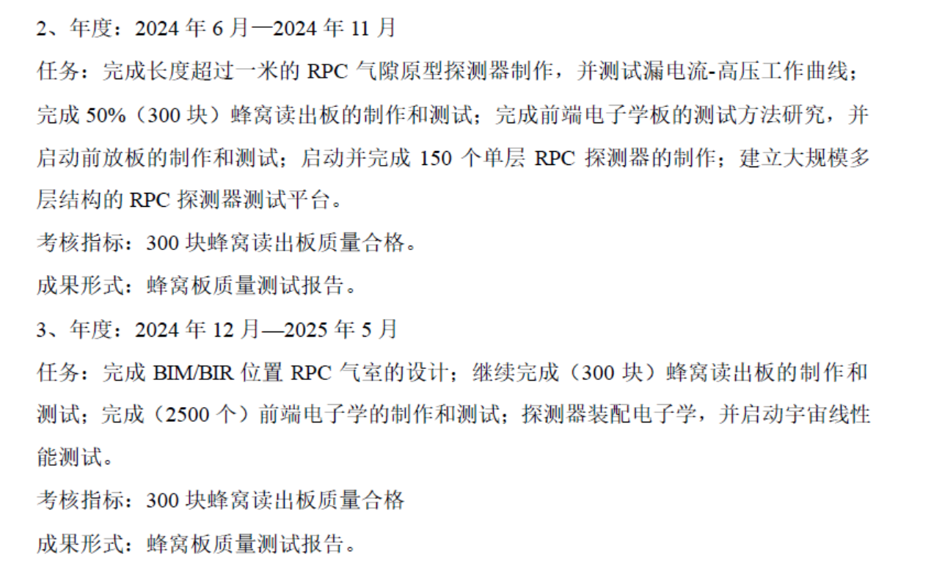
Timeline and milestones
RPC gas gap prototype construction and test – Done
BIS readout panel production and qualification – Done
Qualification method of the FEE – Done
FEE production and qualification – 500 boards submitted.
  Mass production will start after the Review in June.
BIS singlet assembly – delayed
  Mass production planned from September
Cosmic ray test station – under design
BOM/BOR panel design – in progress

Slide 17
Summary
RPC gas gap prototypes (130 x 68 cm²) built successfully in USTC
Mass production and qualification of BIS readout panels (580 pieces) finished
Singlets (without FEE) assembly and test at CERN
An FPGA-based readout system developed for FEE test and singlet qualification
Getting ready for mass production and commissioning.
Chinese team covers most parts of the RPC production and makes significant contributions to ATLAS Muon upgrade
Chinese team makes necessary adjustments to fulfill the project

Slide 18
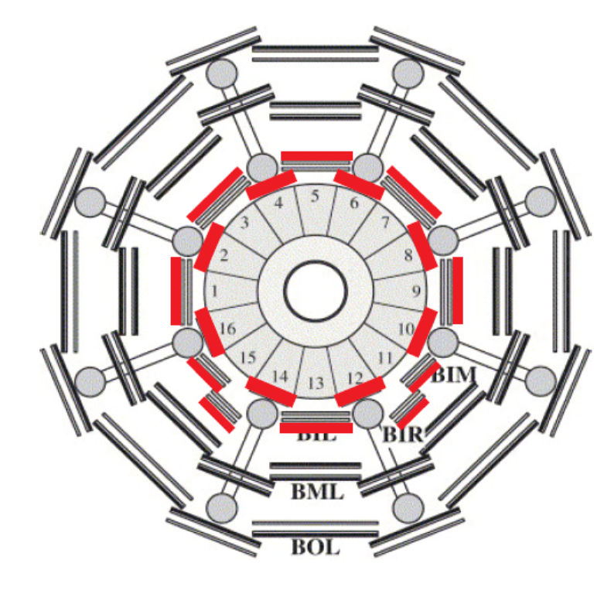
BIS
BIL
BOM/BOR

