Slide 1
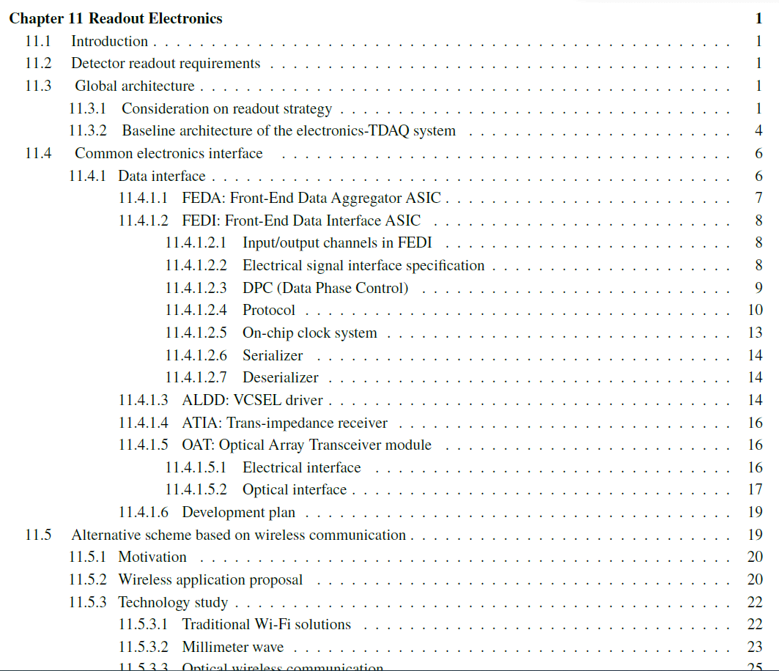
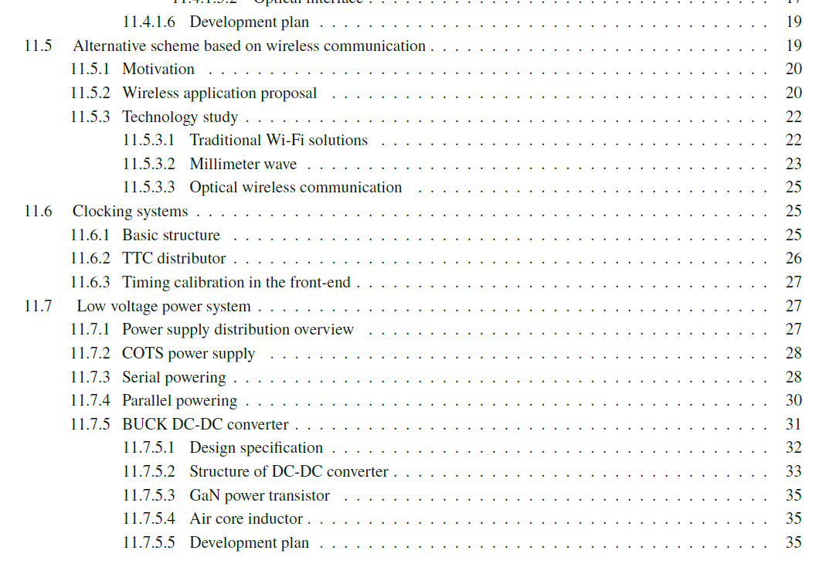
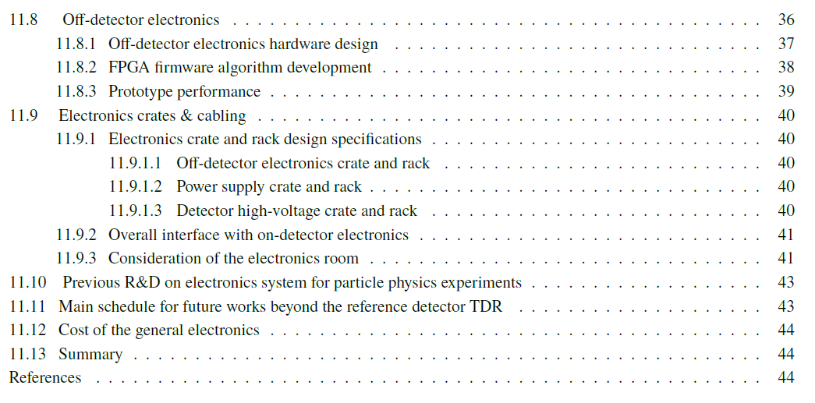
Ref-TDR modification of electronics chapter
Structure
SiPM ASIC moved into the ECAL section
Others unchanged
Total length from 69 -> 45 pages (65% currently)
More effort to shrink the length is in progress

