Slide 1
Investigation of Diagonal Cut-Plane BPM Performance in the CSNS RCS
M. A. Rehman, Xu Zhihong, Qiu Ruiyang, Renjun Yang, Yang Rui
2025-05-06

Slide 2
Content
Reveal the Edge Effect in RCS BPM
The beam pipe and BPM cross sections/shapes are different
The electromagnetic field of the beam is distorted in the vicinity of the edges of the BPM
Analytical results, first order [1]
J-PARC MR also reported a similar issue [2, 3]
We use CST simulation to reveal the edge effect
Calibration of the BPM with wire mapping
Alignment of BPM with wire
Mover precision
Mapping precision (17 times repeated)
Mapping with different frequencies
[1] J. H. Cupérus, NIM145 (1977) 233-243
[2] T. Toyama, IPAC10 MOPE012
[3] ] T. Toyama, OHO School 2009 (Japanese)

Slide 3
Edge Effect in BPM
The beam pipe and BPM cross sections/shapes are different
The electromagnetic field of the beam is distorted in the vicinity of the edges of the BPM
Design a BPM in such a way as to prevent the edge effect
Guard rings in an upstream and downstream direction to prevent the edge effect
The longitudinal space is limited!
Wire Mapping
The wire is a constant-potential surface
For the beam, the potential along its length depends on the charge of the beam and the cross-section of the beam pipe
Mapping with Beam [only one such setup at ANL ZGS (J. R. Simanton, 1969)]!
Expensive and difficult to realize the installation
Analytical formulae
Less accurate, valid only for simple geometries
FEM simulations CST
Wake field solver line charge only→ few weeks!
PIC solver beam transverse cross-section→ few months
[1] J. H. Cupérus, NIM145 (1977) 233-243
[2] T. Toyama, IPAC10 MOPE012

Slide 4
CST Simulations
Only BPM
Bunch charge 1 µC, Bunch Length 3000 mm/1σ (10 ns/1σ), β = 1
¼ Region, 0 to x/y:60 mm, with 10 mm step
Bunch charge 1 µC, Bunch Length 7000 mm/1σ (24 ns/1σ ), β = 1
¼ Region, 0 to x/y:60 mm, with 10 mm step
BPM with Upstream Bending Magnet Pipe
Bunch charge 1 µC, Bunch Length 3000 mm, β = 1
¼ Region, 0 to x:60 mm, y: 40 mm, with 10 mm step
Realistic: BPM with Upstream Bellows and Bending Magnet Pipe
Bunch charge 1 µC, Bunch Length 7000 mm, β = 1
¼ Region, 0 to x:60 mm, y: 40 mm, with 10 mm step
Wire Calibration
Mapping Data 1 MHz, Step size 1 mm, 17× Repeat
Mapping Data (0.5, 1, 1.5, 2.0, 2.5, 3, 4, 5, 6, 7, 8, 9, 10) MHz, Step size 1 mm, Repeat 1, W/ Temp. Monitoring

Slide 5
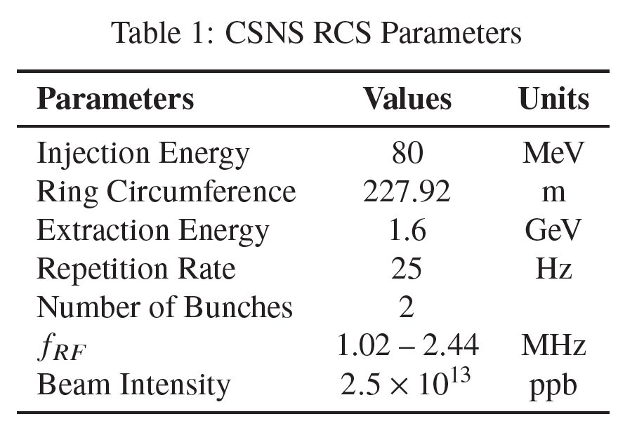
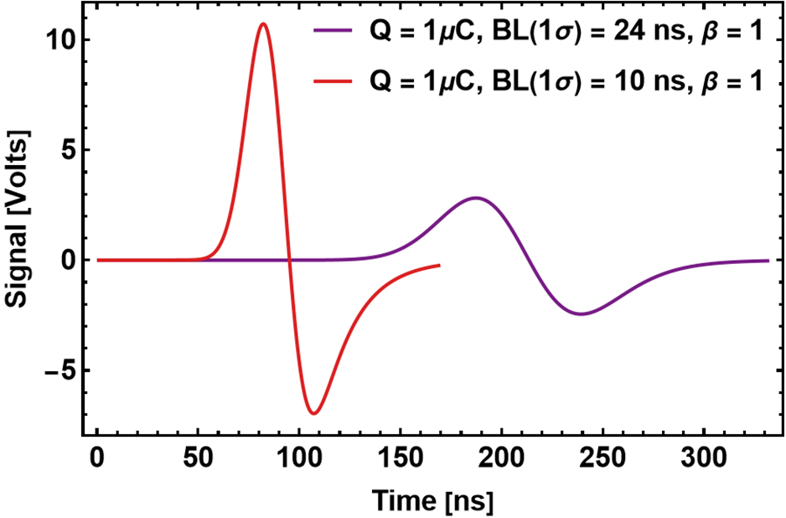
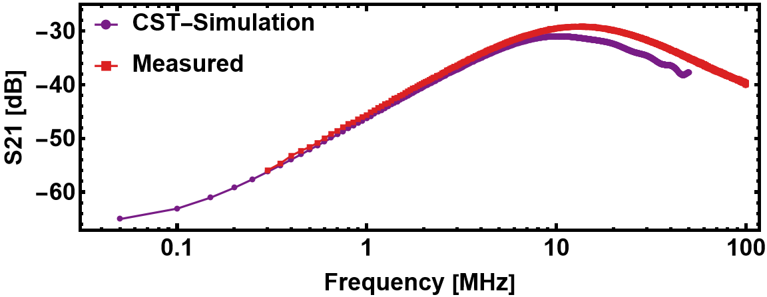
CST Simulations: Capacitance and S-Parameters
RCS BPM Model
226 mm
220 mm
Electrode Isolation
Capacitance Matrix
(
(
C11 C12 C13 C14
C21 C22 C23 C24
C31 C32 C33 C34
C41 C42 C43 C44
296.62 pF -8.56 pF -3.07 pF -1.40 pF
-8.56 pF 300.1 pF -7.50 pF -3.07 pF
-3.07 pF -7.50 pF 300.44 pF -8.54 pF
-1.40 pF -3.07 pF -8.54 pF 296.60 pF
=

Slide 6
CST Simulated Models

Slide 7
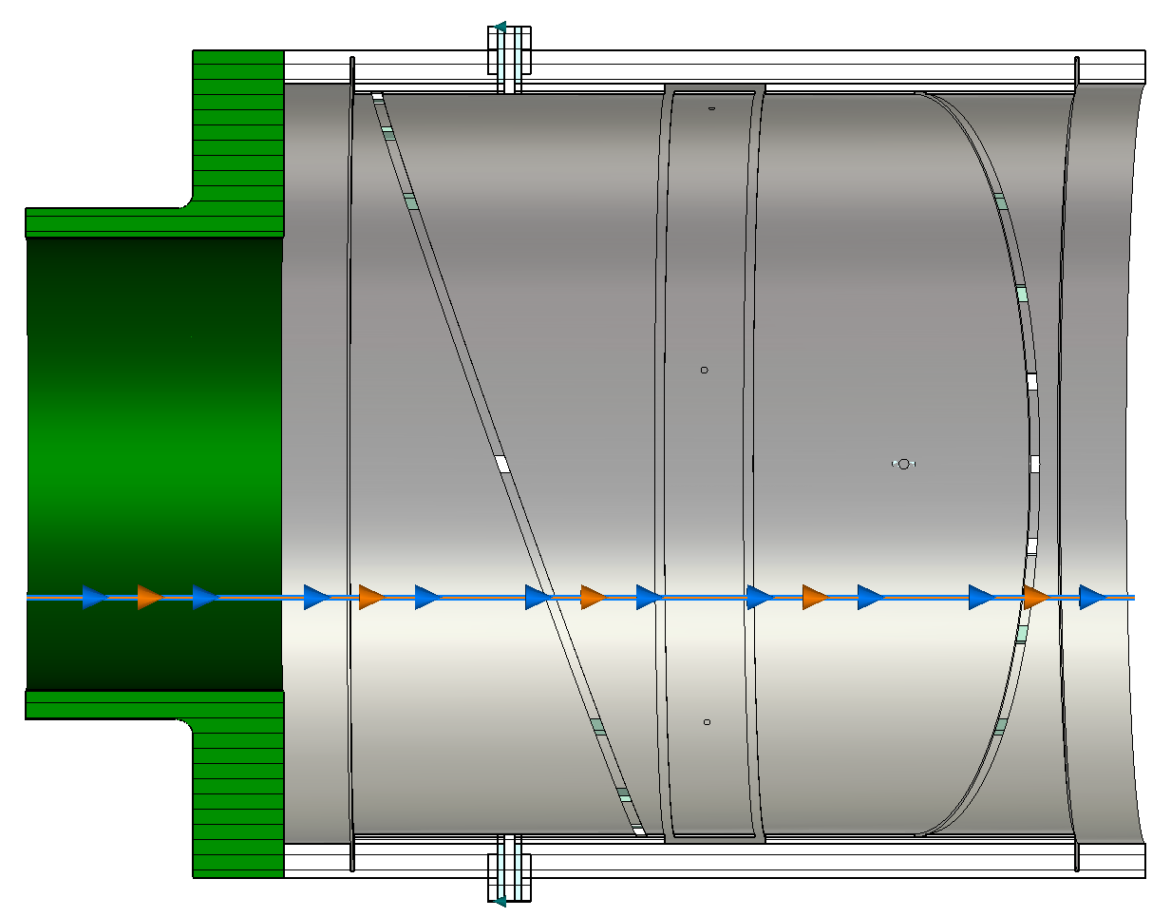
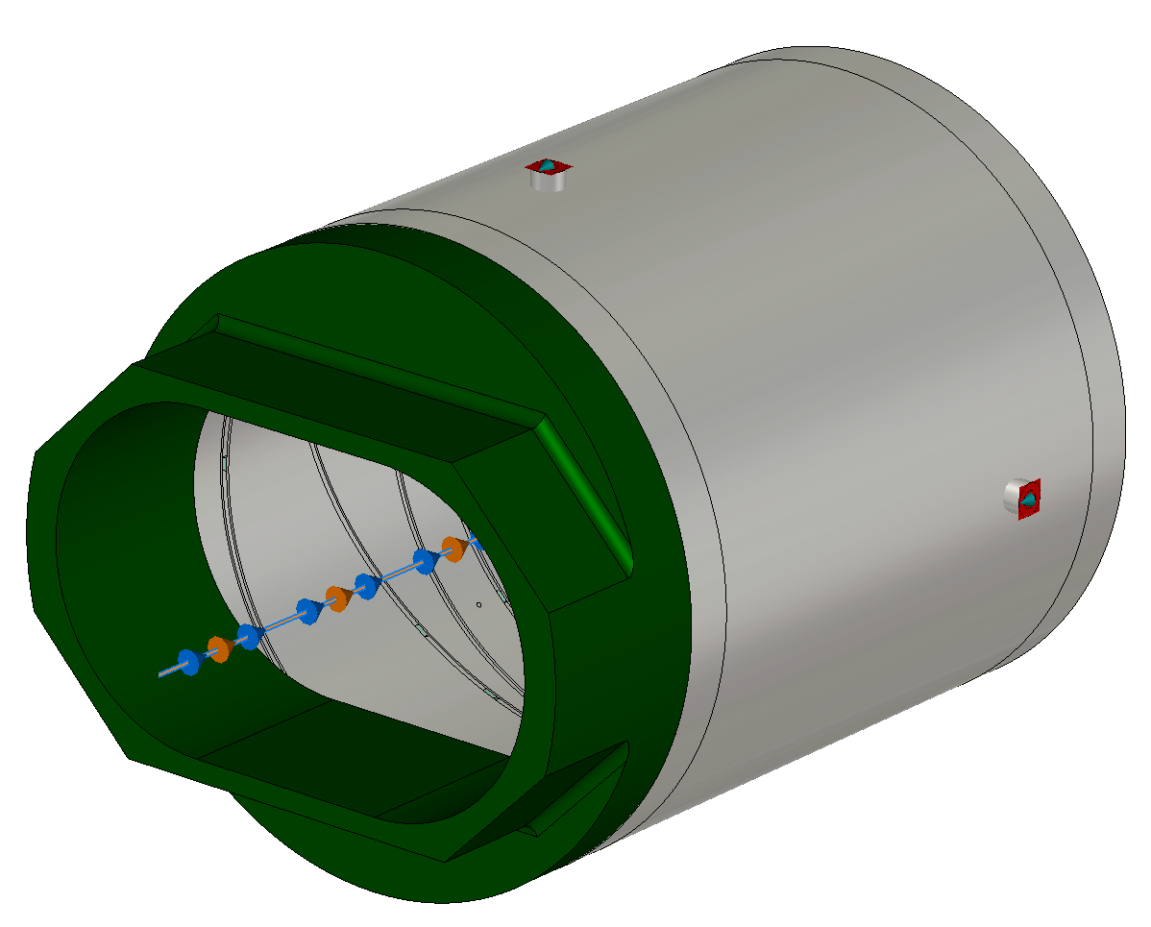
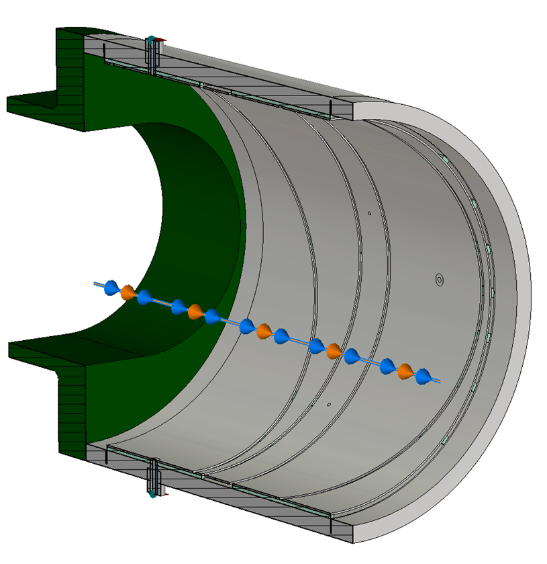
BPM with Pipe only
Simple but not realistic
Only BPM
135 mm
3 mm
83.96 mm
77 mm
226 mm
24 mm
220 mm
218 mm

Slide 8
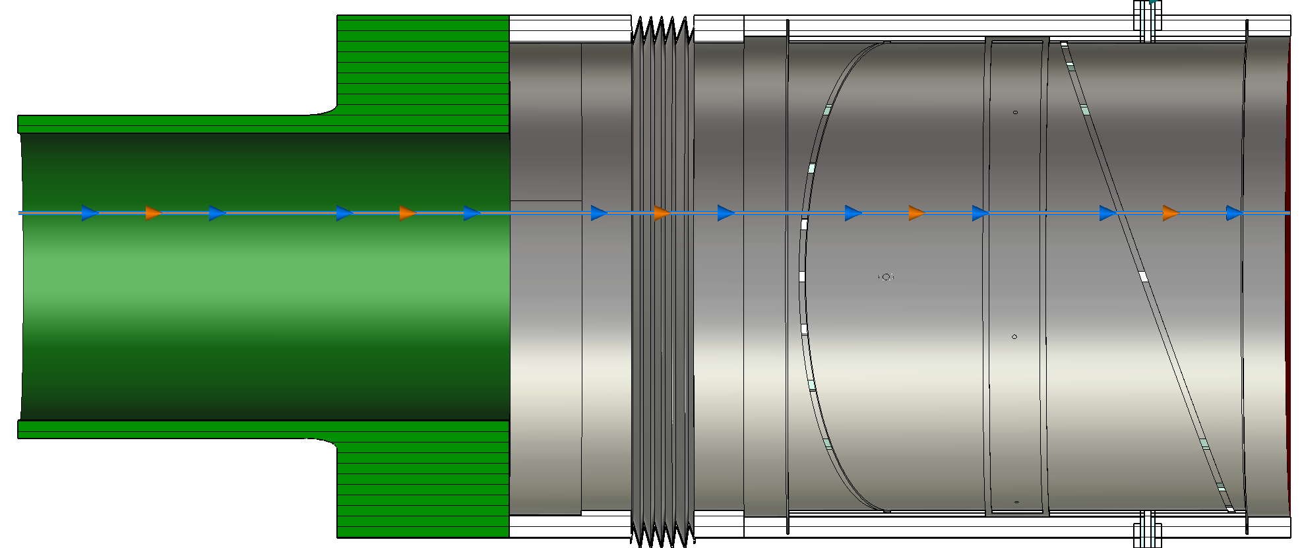
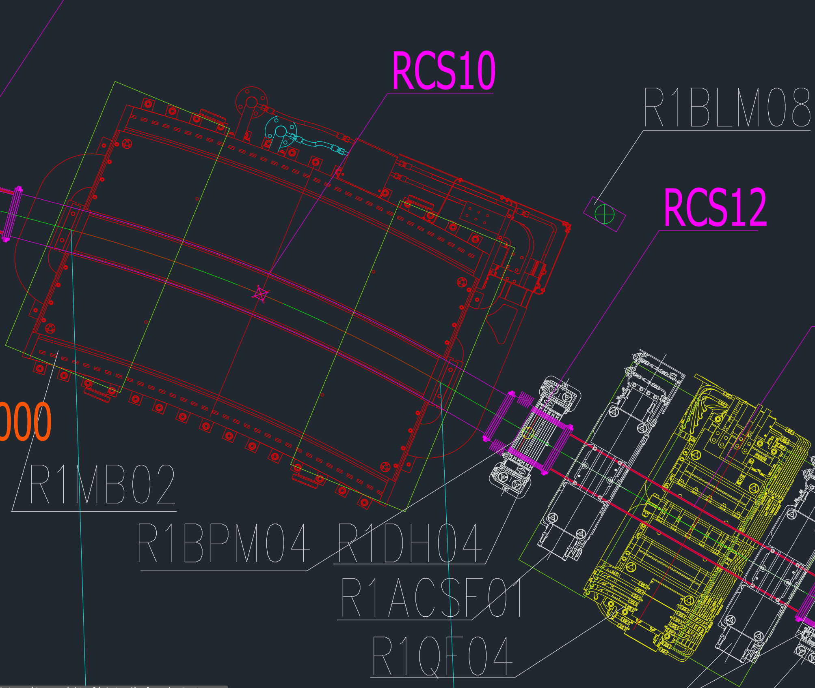
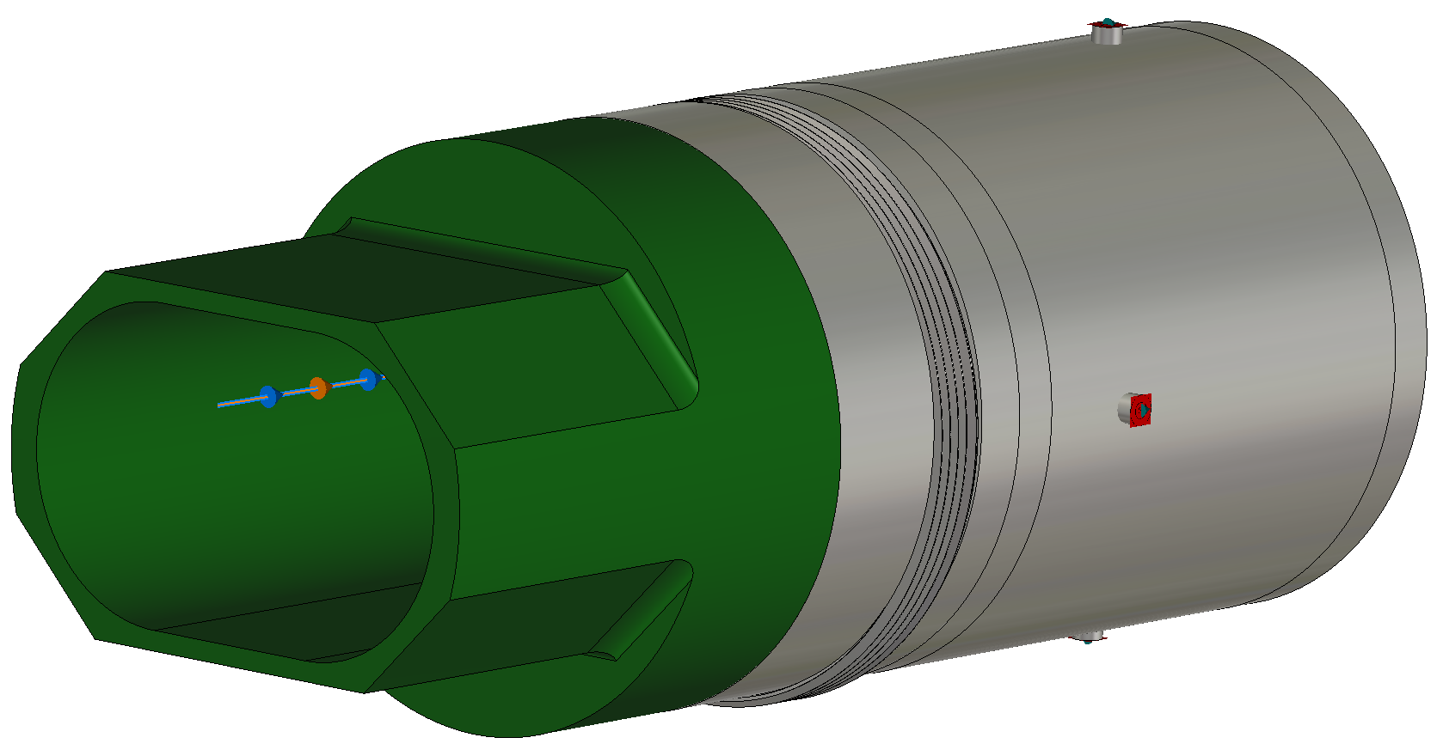
Realistic Model
BPM + Pipe + Bellows
Dipole
Magnet
Pipe
231 mm
110.5 mm
Dipole
Magnet
Bellows
BPM
Dipole
Magnet
Vacuum Duct
Bellows
BPM

Slide 9
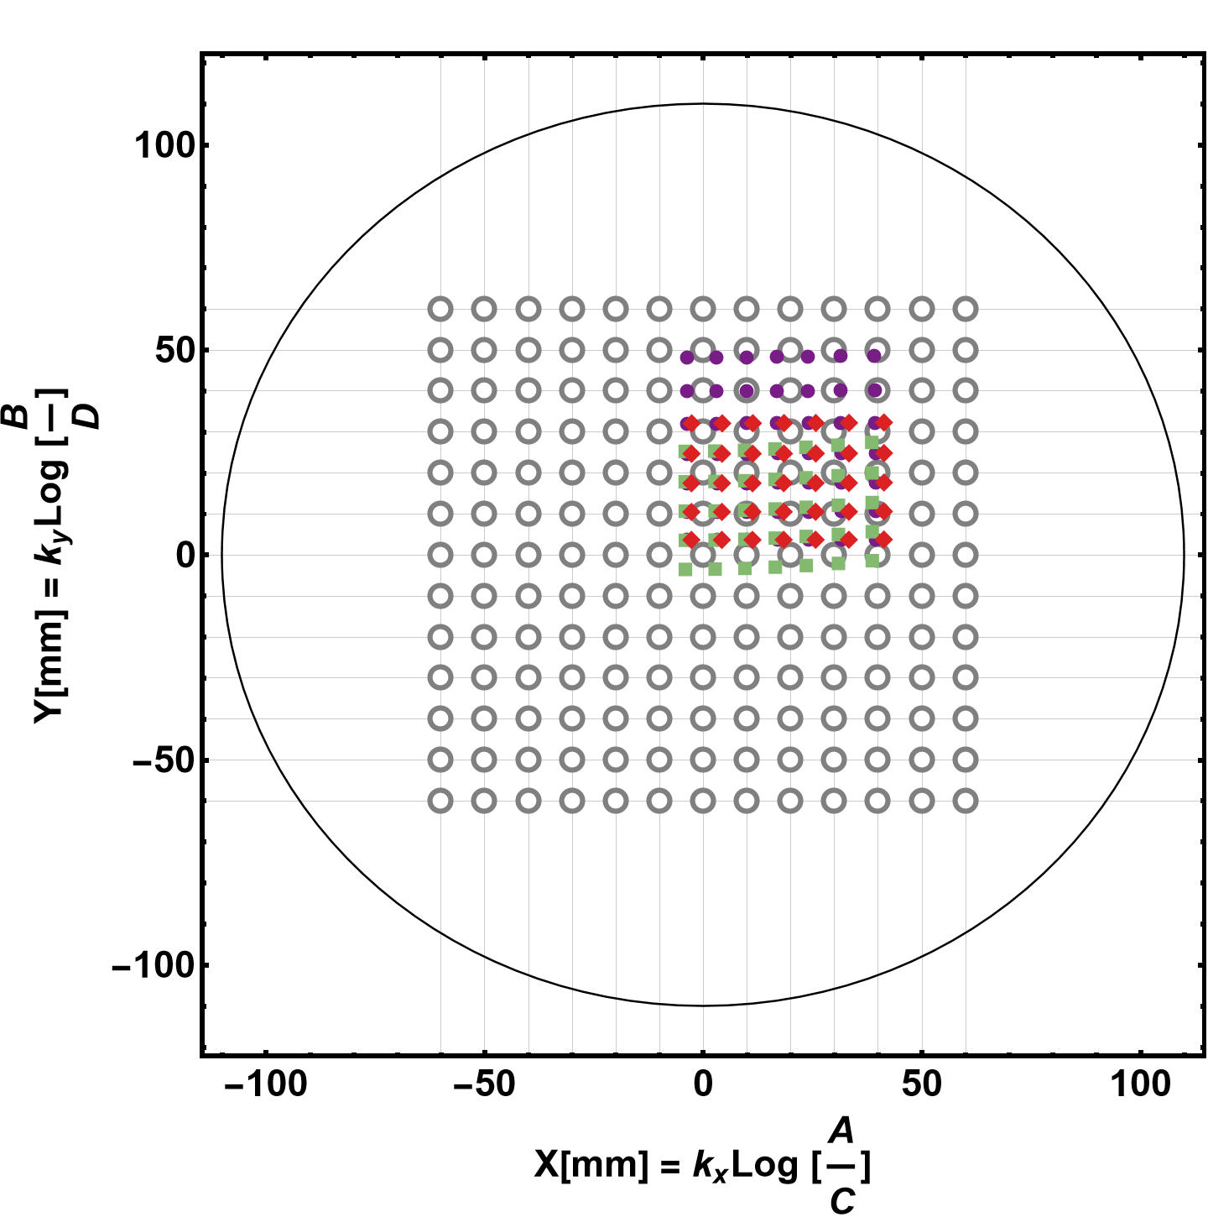
a. Mapping in CST Only with BPM
Similar condition with the Mapping setup
In the CST simulation, Ports are closed at the upstream and downstream ends. However, in Mapping, no dummy is used! Details will come later
b. Exaggerated condition!
Amplify Edge effect! Due to an abrupt change in the Beam Duct Diameter. No Linearities and a large offset are observed
c. Realistic Case as in RCS!
a
b
c
K_{x/y} =110 mm
Only ¼ region
is solved

Slide 10
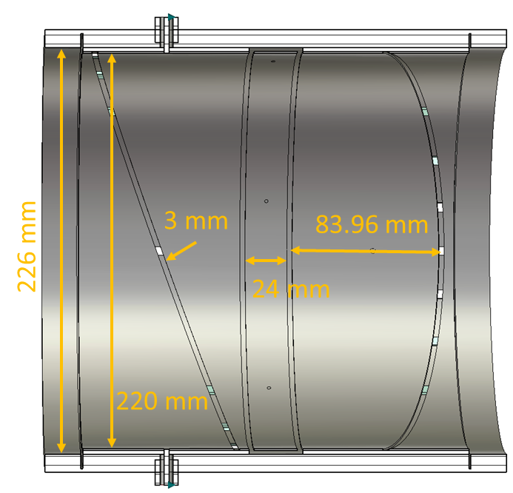
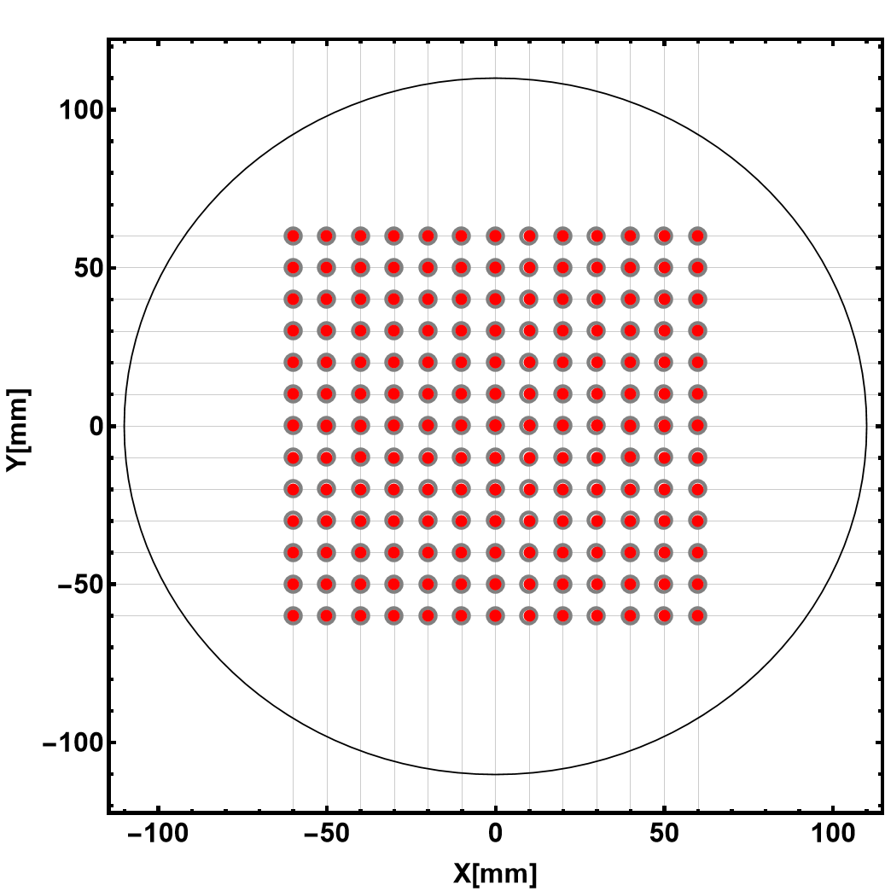
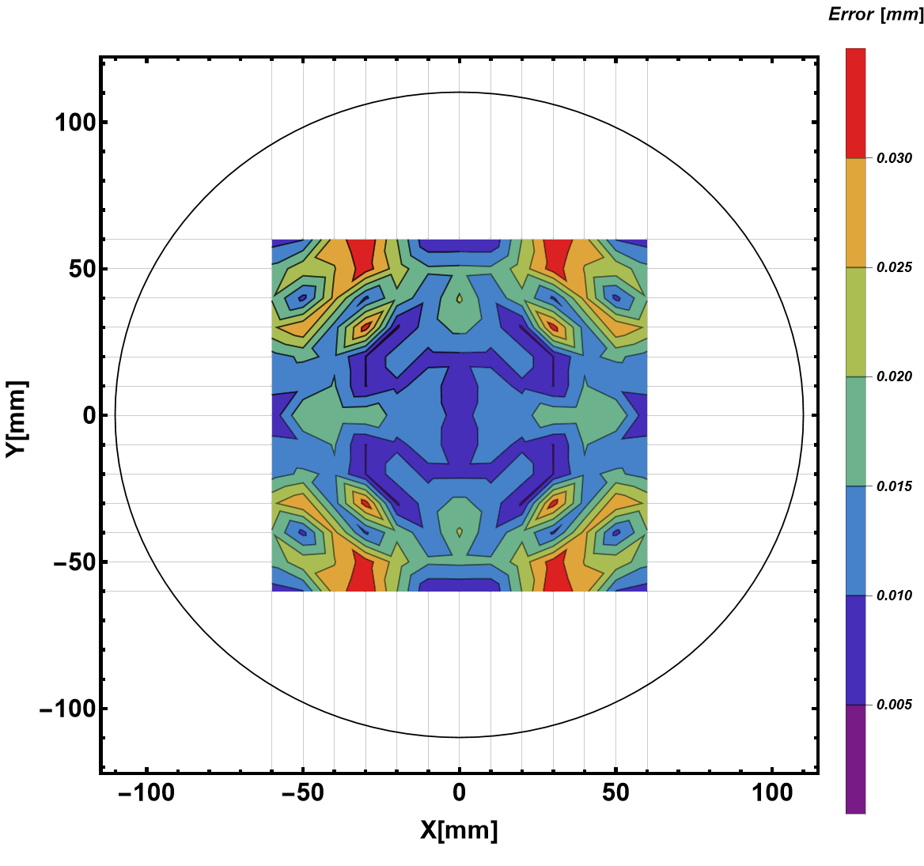
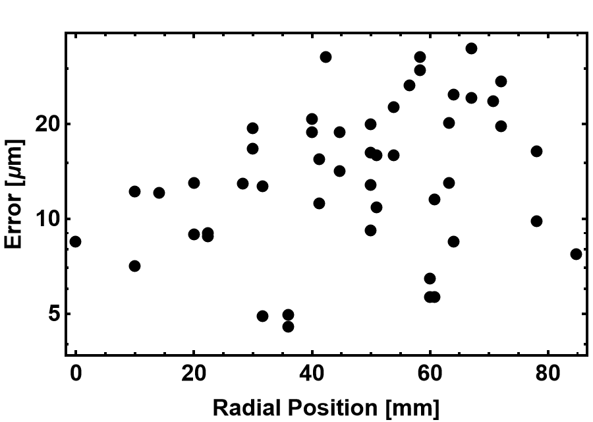
CST Mapping: Only BPM
Fitting with 3rd Order Polynomial
C_{00,x} [mm] | C_{00,y} [mm] | C_{10,x} [mm] | C_{01,y} [mm]
5.45 | -5.42 | 161.30 | 161.73
BPM’s Intrinsic transverse offset correction with a polynomial fit is about 5.5 mm.
Transverse offsets are nearly symmetric

Slide 11
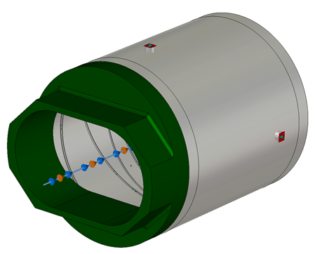
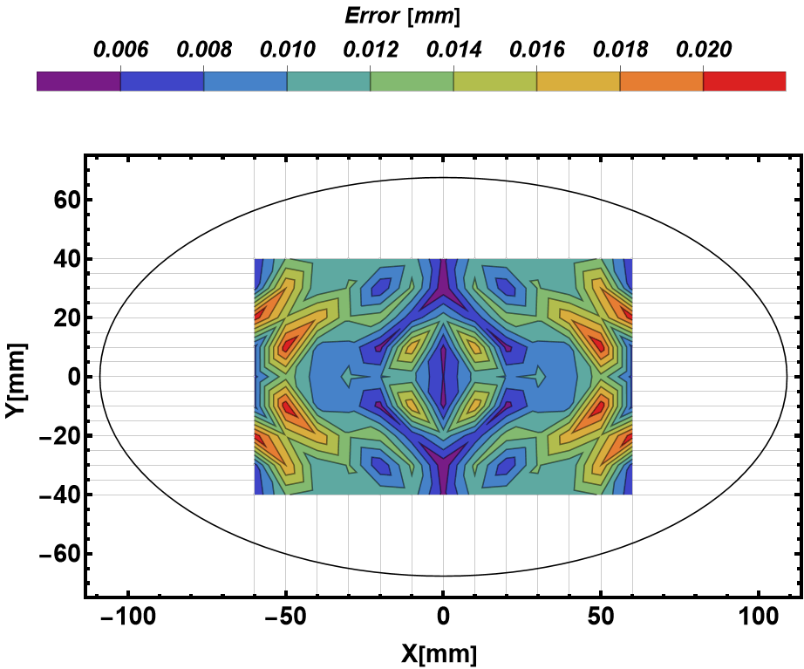
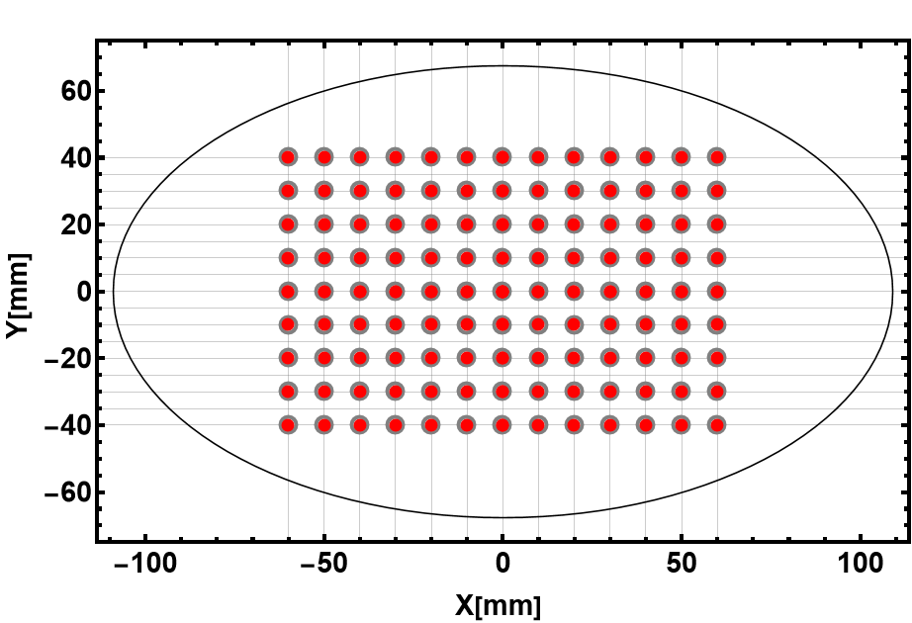
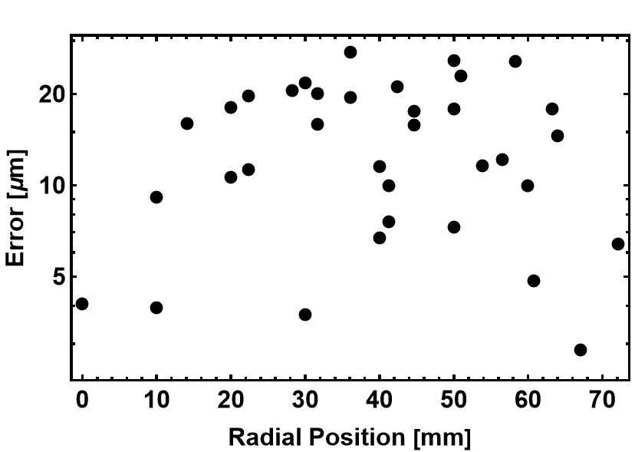
CST Mapping: BPM and Pipe (Exaggerated Condition)
C_{00,x} [mm] | C_{00,y} [mm] | C_{10,x} [mm] | C_{01,y} [mm]
6.05 | 4.88 | 162.11 | 155.02
Transverse offsets are NOT Symmetric!
Due to the upstream vacuum duct!!

Slide 12
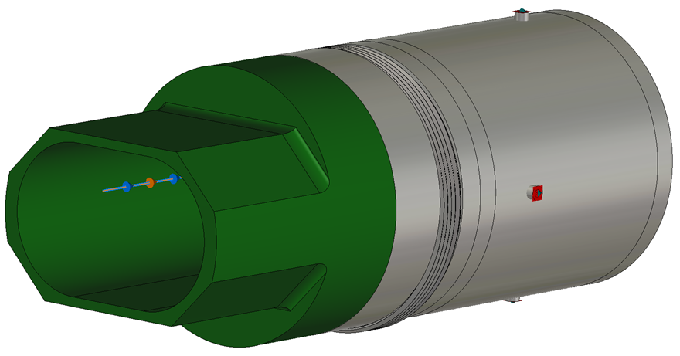
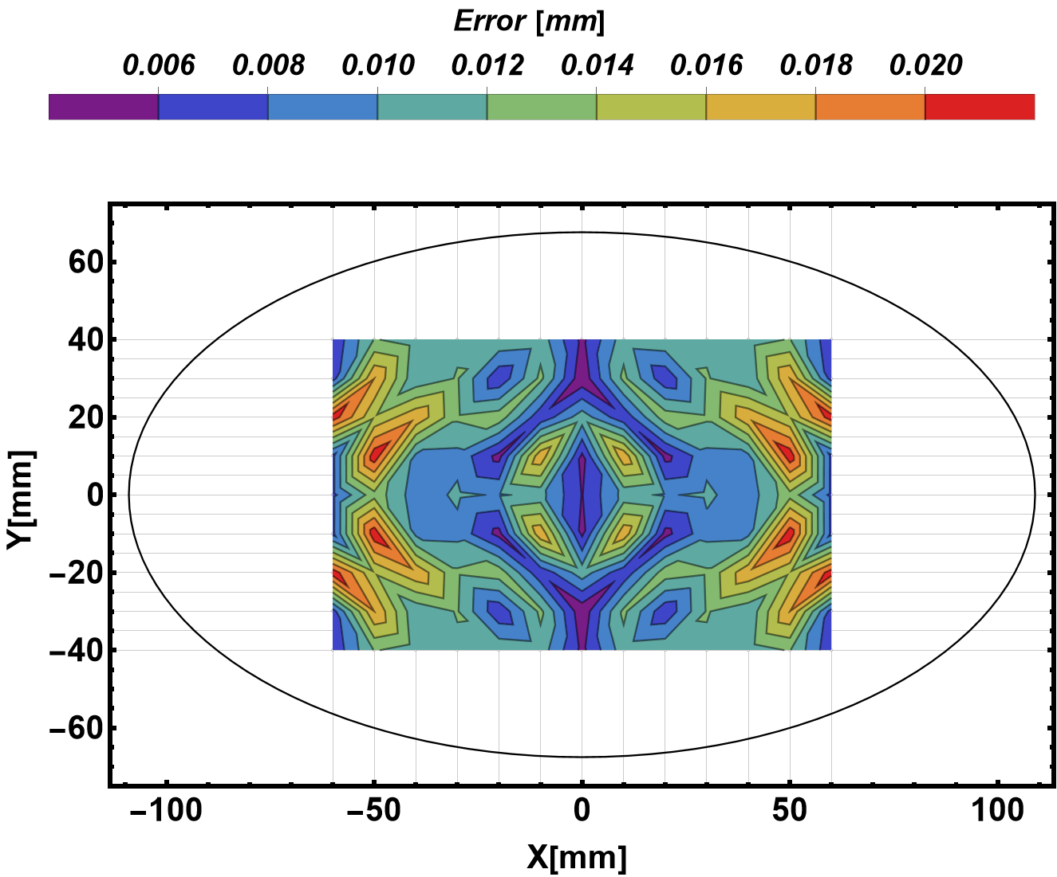
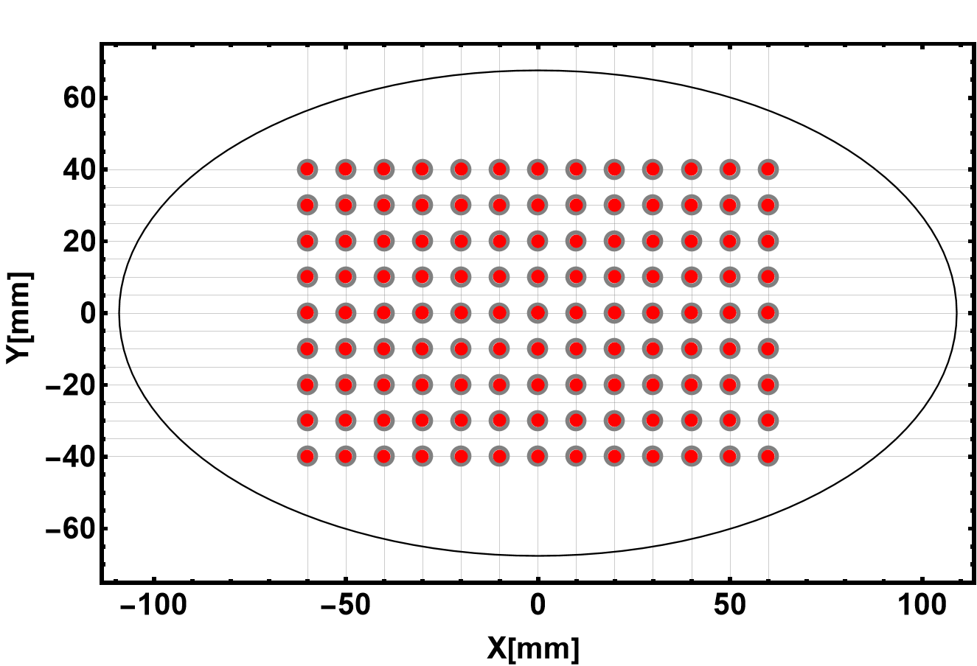
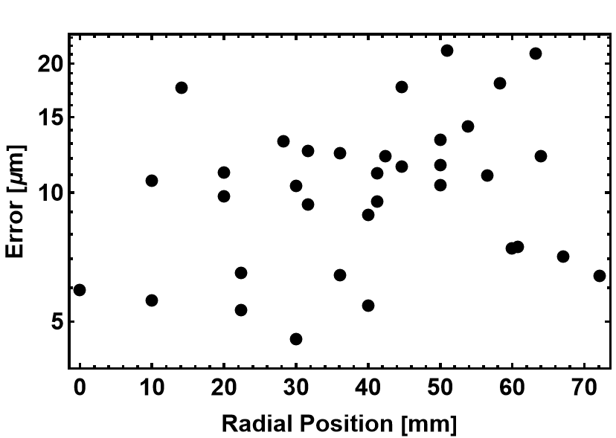
CST Mapping: BPM, Bellows and Pipe (Realistic Condition)
C_{00,x} [mm] | C_{00,y} [mm] | C_{10,x} [mm] | C_{01,y} [mm]
3.94 | -5.54 | 157.91 | 165.11
Transverse offsets are NOT Symmetric!
Due to the upstream vacuum duct!!

Slide 13
What do we measure at RCS?
The mapping function is obtained from the wire mapping only with the BPM
In the RCS BPM upstream, the bellows and dipole magnet vacuum duct (sort of elliptical shape) is not considered!
The edge effect in BPM due to the vacuum duct shape is not considered
Results in huge errors?
 | C_{00,x} [mm] | C_{00,y} [mm] | C_{10,x} [mm] | C_{01,y} [mm]
BPM | 5.45 | -5.42 | 161.30 | 161.73
BPM + Pipe | 6.05 | 4.88 | 162.11 | 155.02
BPM + Bellows + Pipe | 3.94 | -5.54 | 157.91 | 165.11
To estimate these errors in CST Simulation: Let’s consider the X_{raw} = Log[A/C] and Y_{raw}=Log[B/D] from the case BPM + Bellows + Pipe, but the Fitting function from the BPM only!!

Slide 14
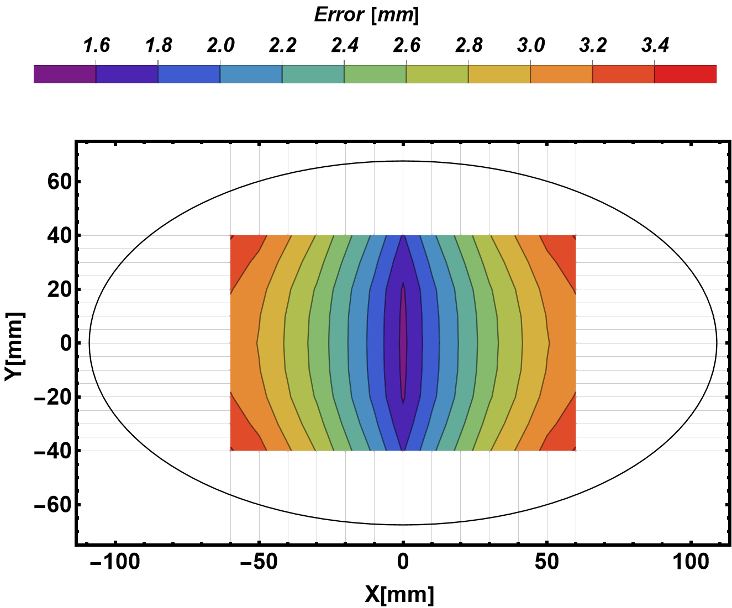
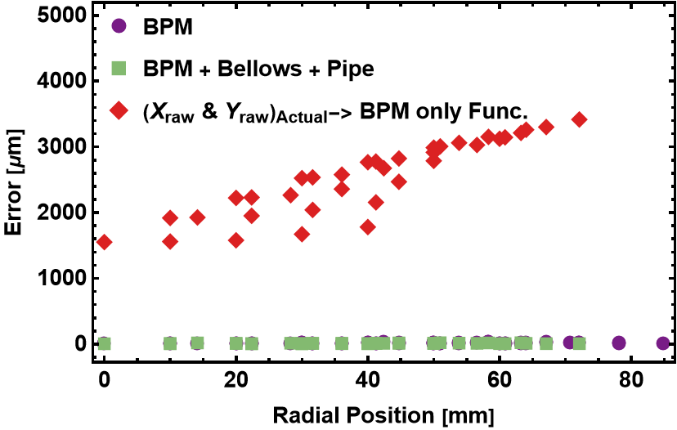
X_{raw} and Y_{raw} from the realistic case, but the Fitting function from the BPM only!! The error is 1.6 mm to 3.5 mm within the measurement range from 0 mm to ±55 mm
Error estimation

Slide 15
Wire Mapping

Slide 16
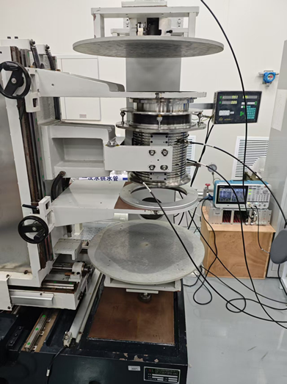
Wire Mapping System
BPM and wire (Molybdenum: Ø_{d}=100 µm) aligned with accuracy of 100 µm
Meaning: The mechanical center of BPM is known within 100 µm uncertainty
Transverse mover precision is 5 µm (Measured)
Transverse mapping range is ±60 mm
Tektronix signal generator (AFG31000)
V_{pp}=5 V, Frequency = 1 MHz (Varied)
Bergoz-BB Electronics is used
Dynamic range: -70 dBm to +5 dBm
BW: 10 MHz
ADC Bit: NI Digitizer 16-bit
A thermocouple is attached to the outer body of BPM to monitor temperature
Bellows
BPM
X/Y Mover

Slide 17
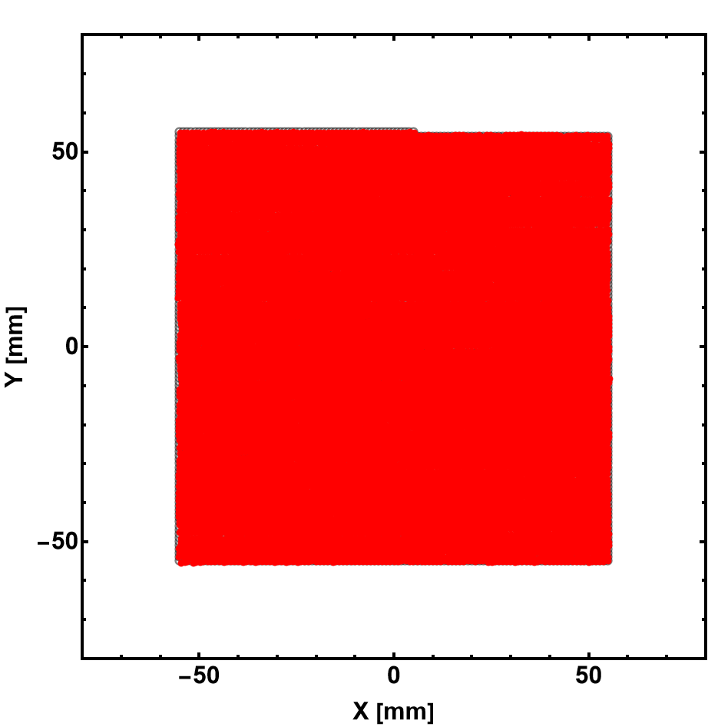
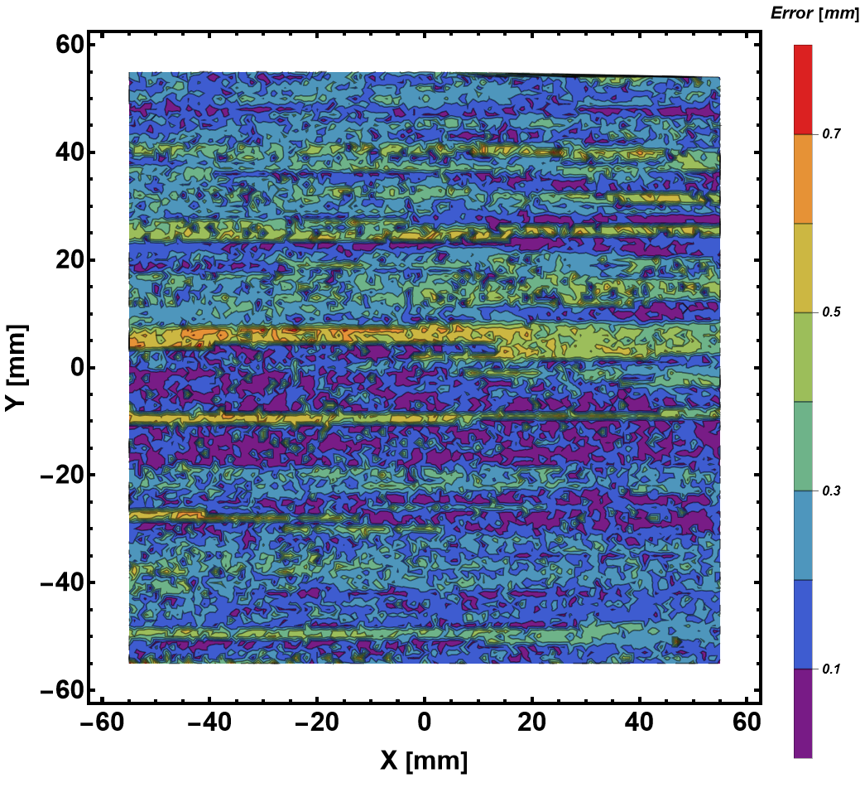
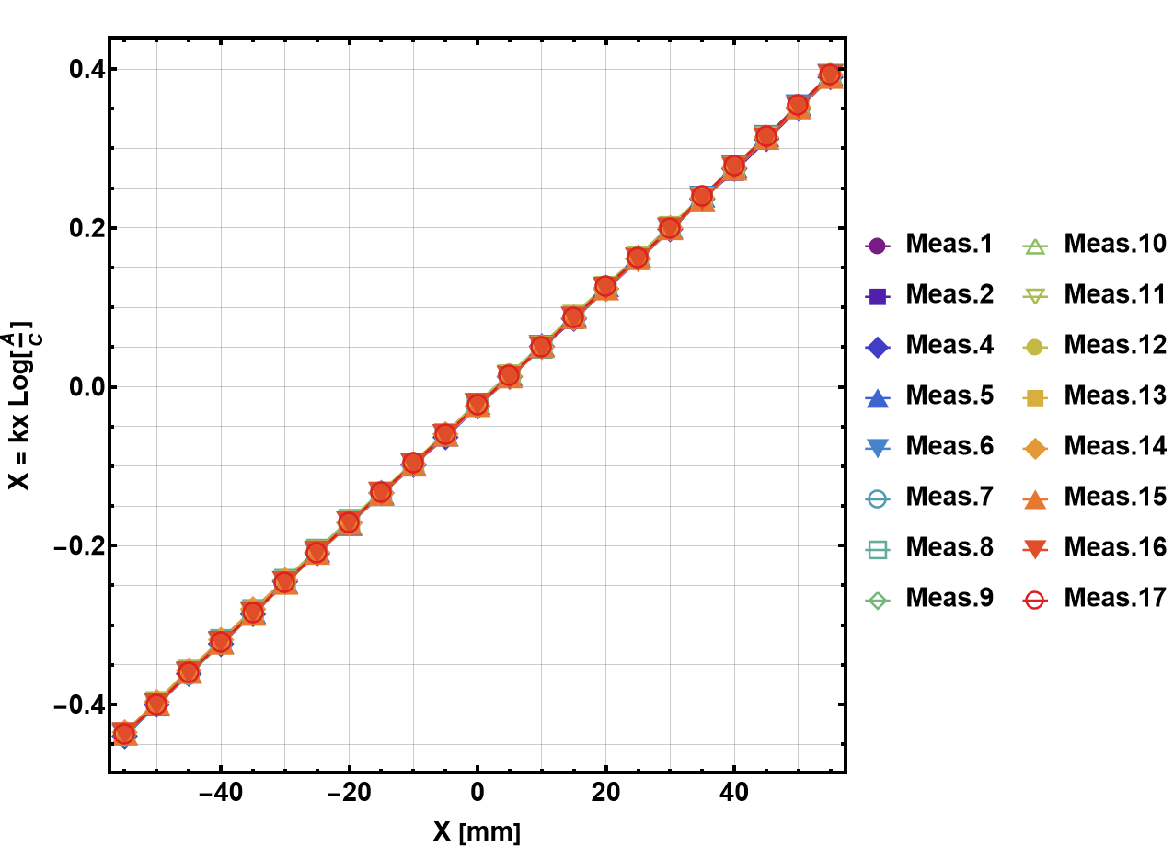
Wire Mapping: 17× Repetition
Step size: 1 mm
Frequency: 1 MHz
Repeat 17 Times
The precision of the mapping system? 300 µm
C_{00,x} [mm] | C_{00,y} [mm] | C_{10,x} [mm] | C_{01,y} [mm]
$$3.23±0.06$$ | $$5.95±0.19$$ | $$135.74±0.07$$ | $$136.20±0.30$$

Slide 18
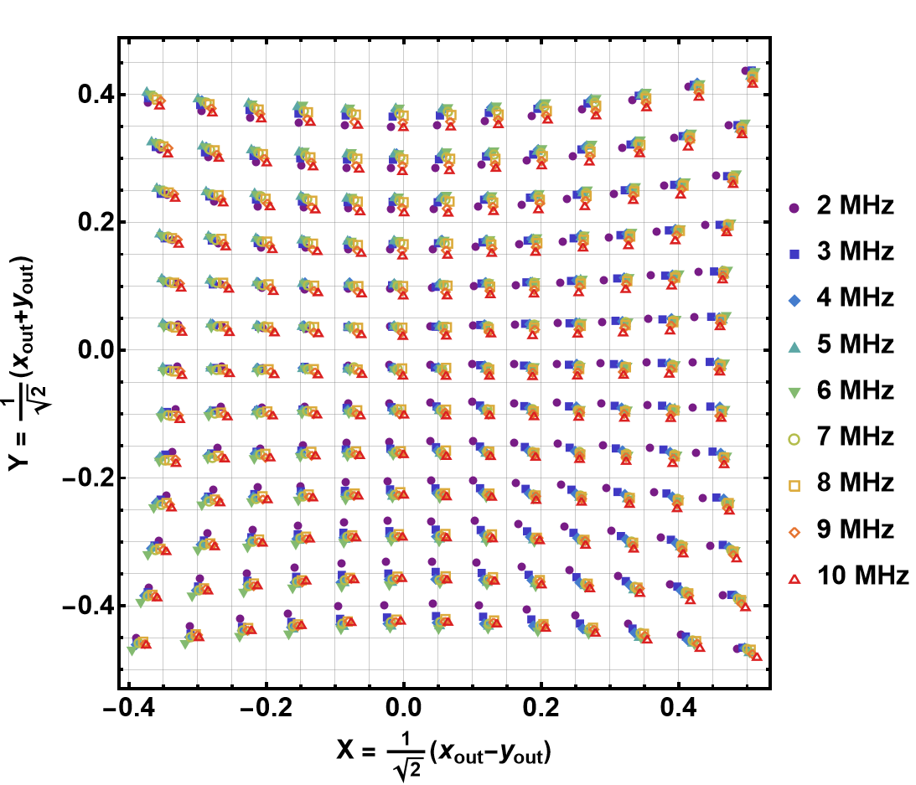
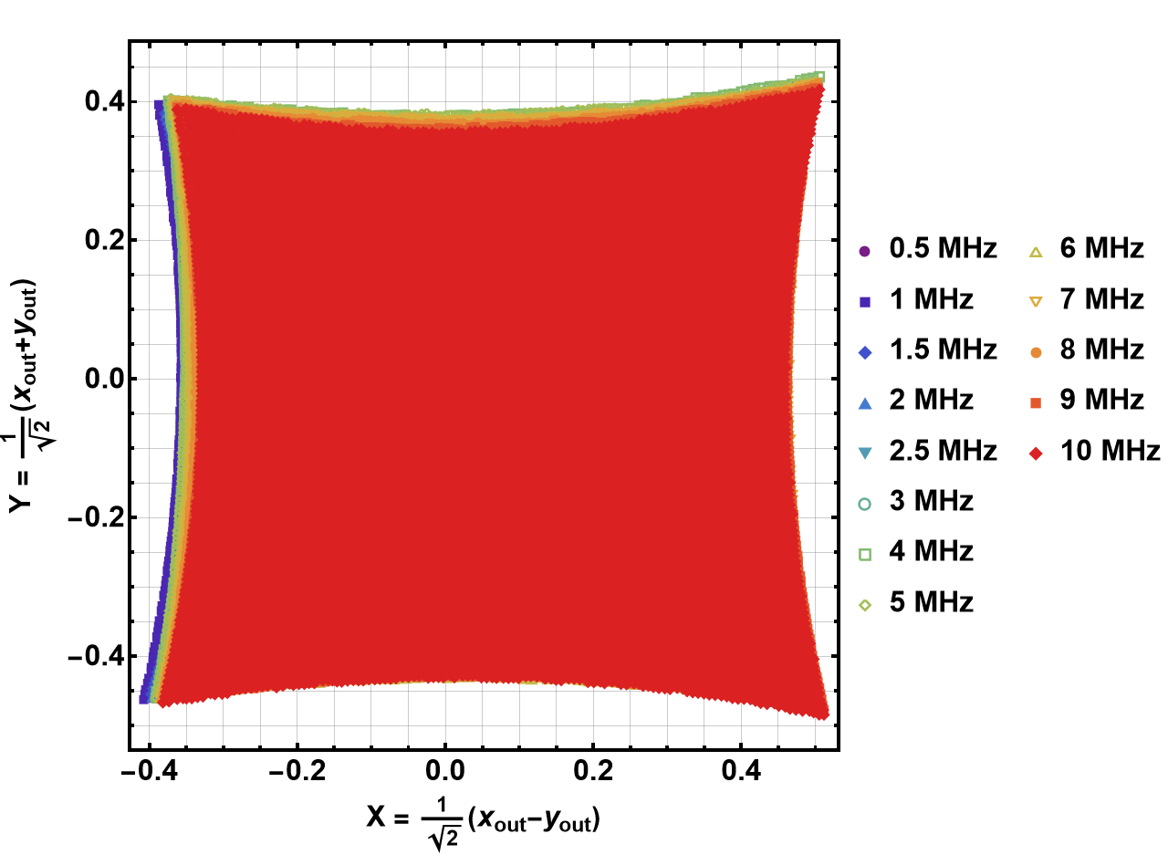
Wire Mapping: Frequency Dependence
Old Data with 10 mm step
New Data with 1 mm step

Slide 19
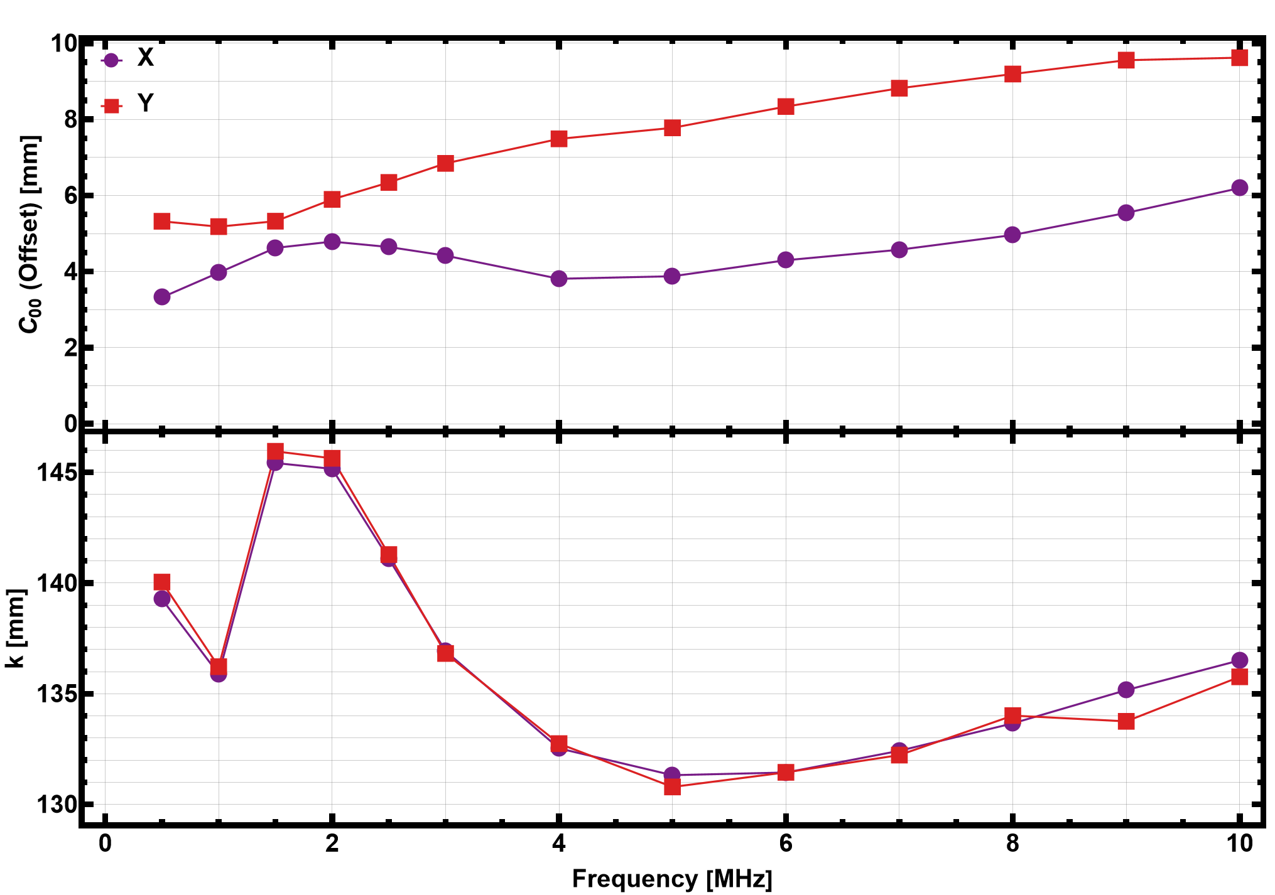
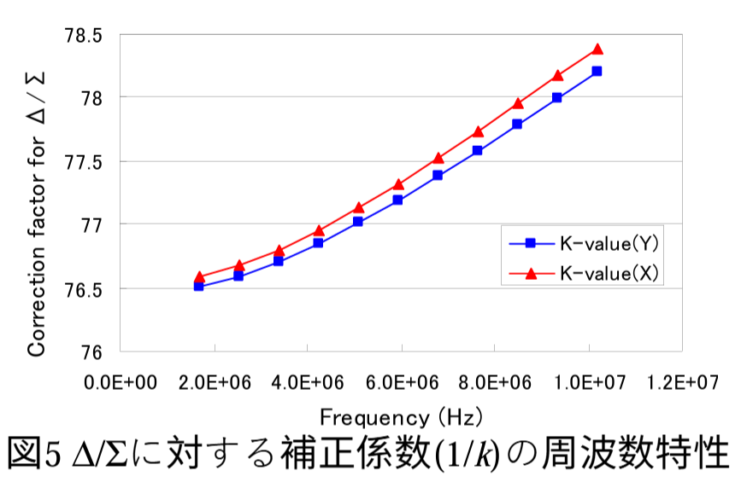
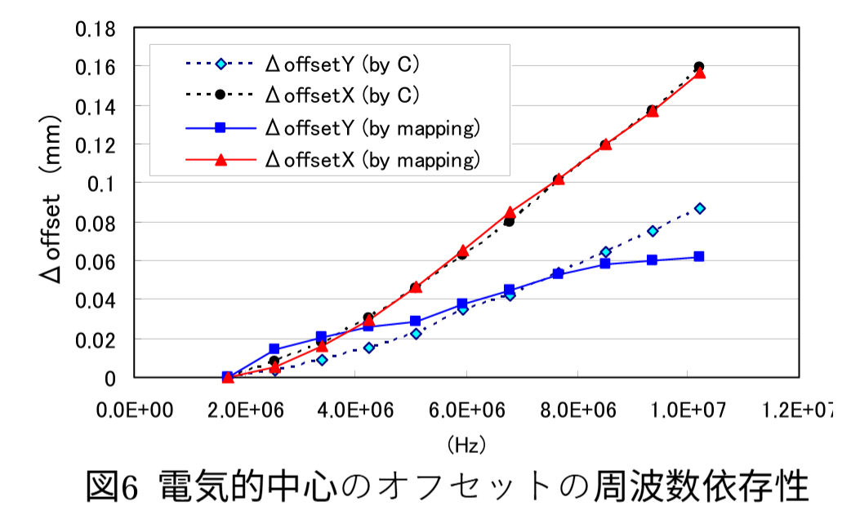
Wire Mapping: Frequency Dependence
f_{RF} varies from 1.02 to 2.44 MHz
Signal Generator Freq. varied to measure the BPM response
Strong frequency dependence is observed
Offset(y) varies from 5.5 to 10 mm in Freq. range 0.5 to 10 MHz
3rd order Polynomial Fit
T. Miura, PASJ2006, WP67
High frequency results in reduced isolation between electrodes
Consequently, a bigger transverse offset
Asymmetric, transverse offset due to the bellows in the horizontal direction

Slide 20
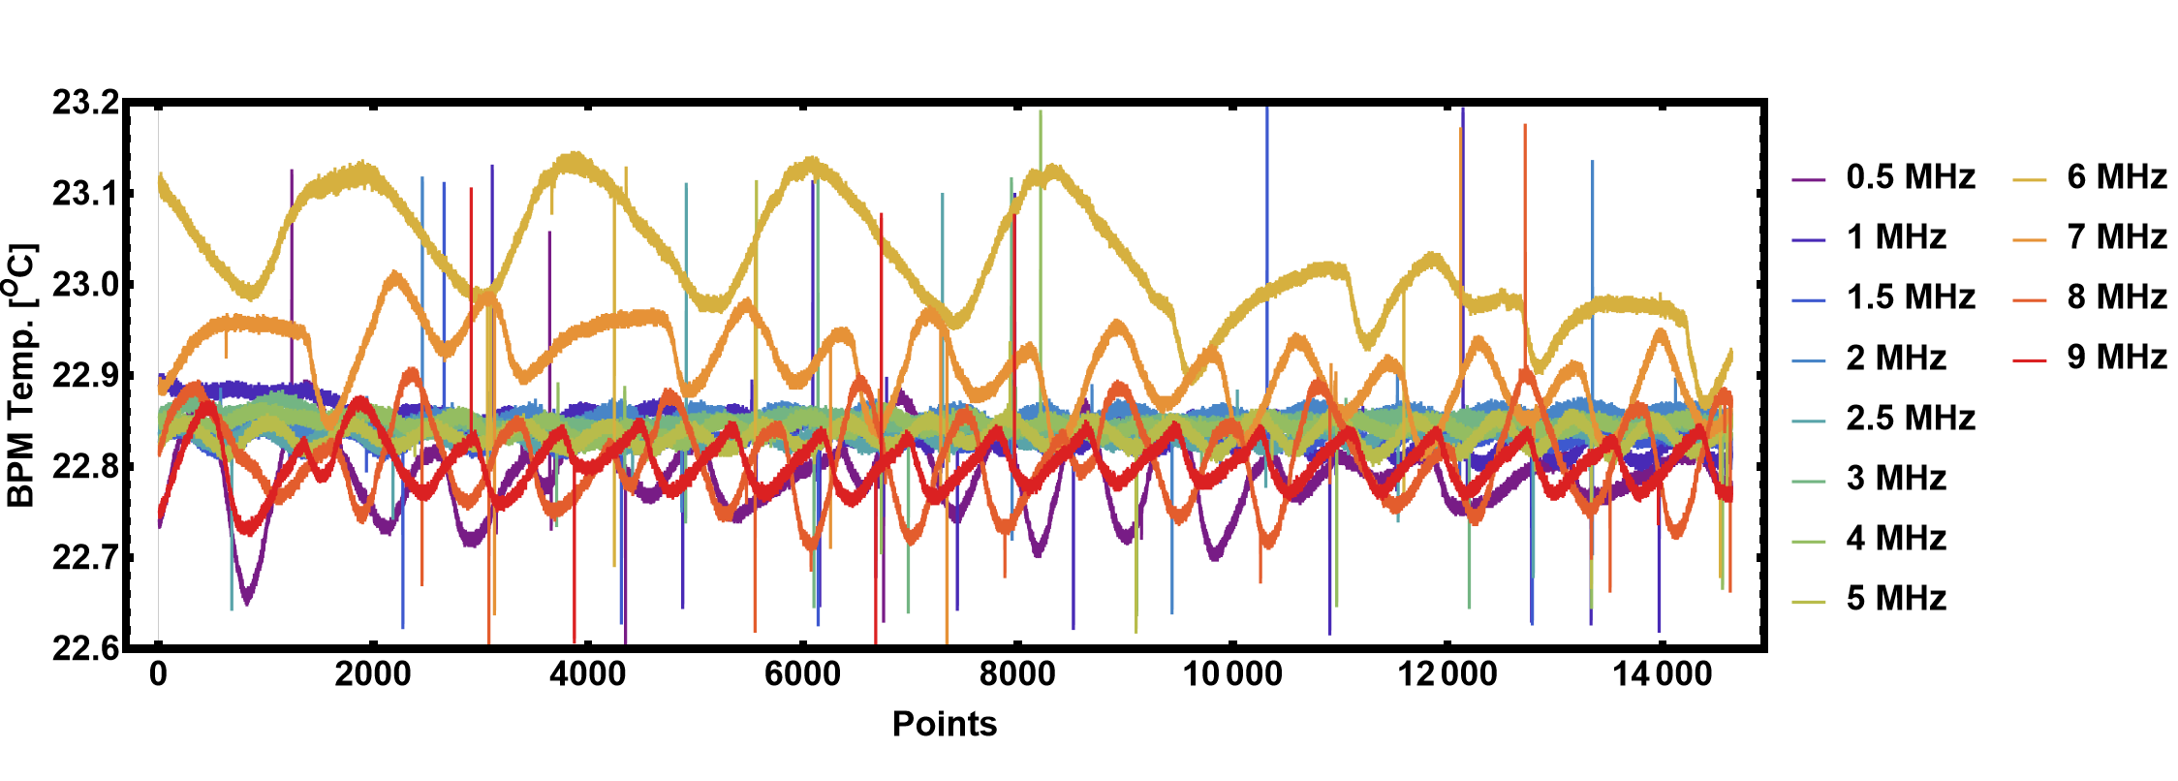
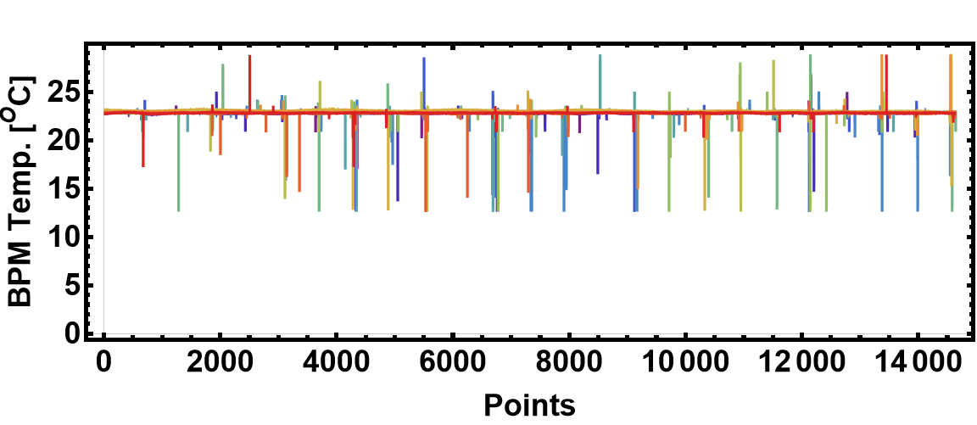
Wire Mapping: Temperature Logging during mapping
Temperature variation within one measurement is 0.1 ^{O}C
Spikes due to DAQ troubles?

Slide 21
Source of Errors in Transverse Position Measurement by Diagonal Cut-Plane BPM
Asymmetric Transition between Vacuum Duct and BPM
Edge Effect
Frequency De

Slide 22
Back up

Slide 23
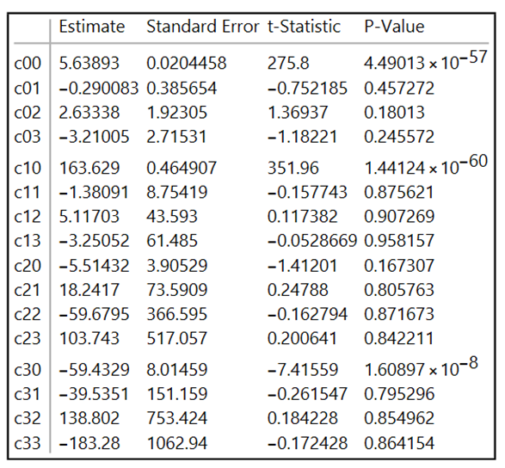
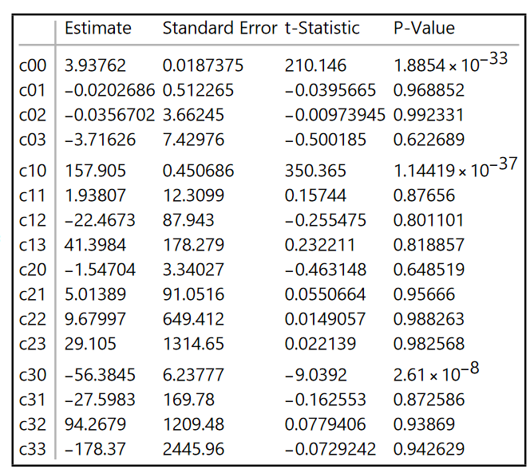
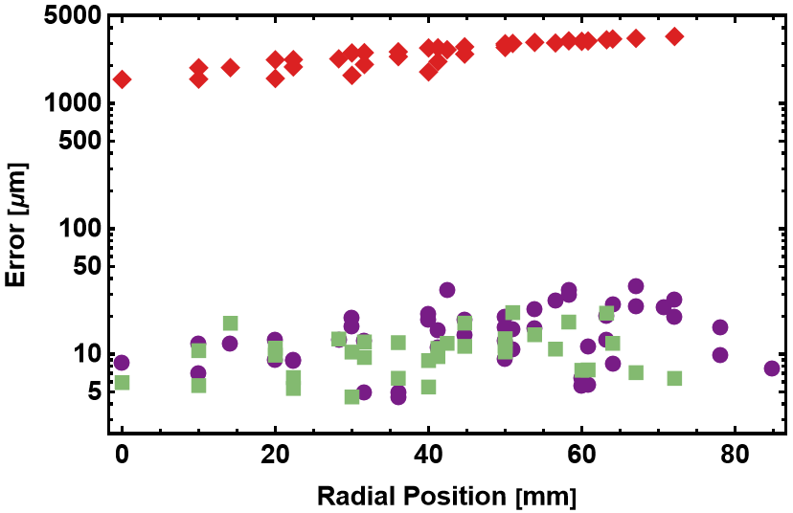

Slide 24
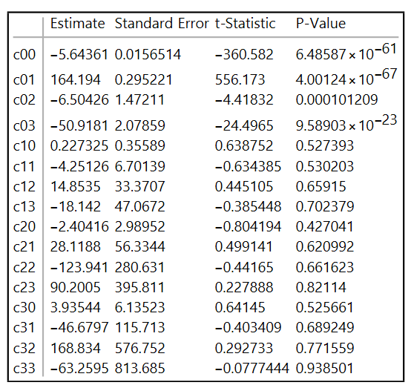
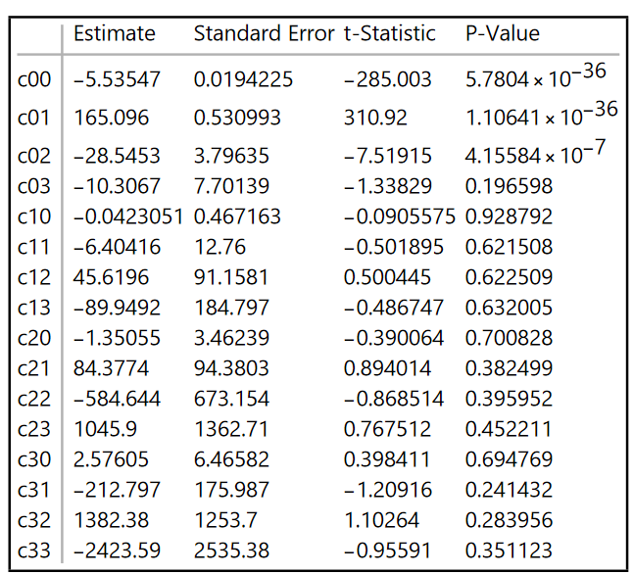

Slide 25
0.5 MHz 1 MHz 1.5 MHz 2 MHz 2.5 MHz 3 MHz 4 MHz 5 MHz 6 MHz 7 MHz 8 MHz 9 MHz 10 MHz

Slide 26
0.5 MHz 1 MHz 1.5 MHz 2 MHz 2.5 MHz 3 MHz 4 MHz 5 MHz 6 MHz 7 MHz 8 MHz 9 MHz 10 MHz

