Slide 1
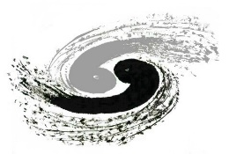
Physical design of CEPC detector magnet
Menglin Wang
IHEP,CAS
The internal review meeting for CEPC detector magnet
IHEP
16/5/2025
Notes:
Let me first introduce the physical design of the magnet of the CEPC detector

Slide 2
CONTENTS
CEPC Detector SC Magnet overview
Magnetic field design
Cable structure and stress
Quench Protection
Response to the IDRC comments

Slide 3
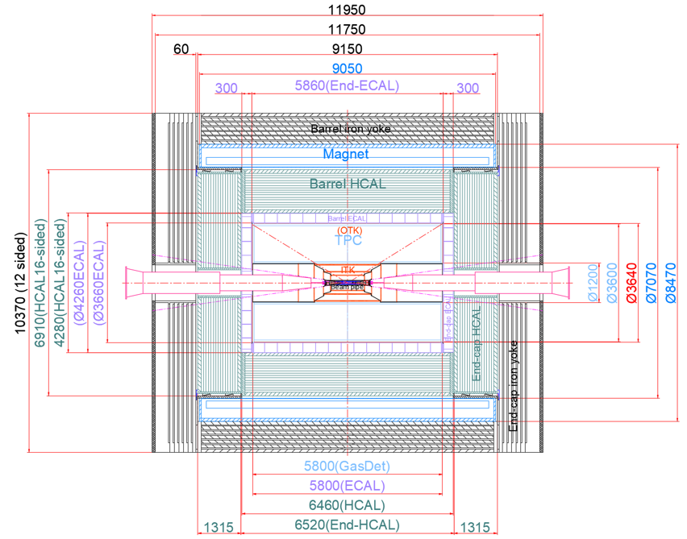
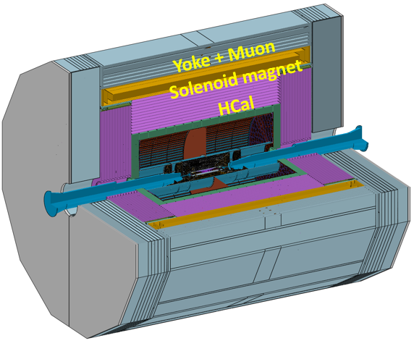
CEPC Detector SC Magnet
Position
Overview
9 m long coil, 7.07 m room temperatur bore diameter, 3T field
Operating Temperature 4.5 K
Conductor: Al stabilized NbTi/Cu Rutherford Cable
Notes:
The positioning of the magnet is outside the hadronic calorimeter and the electromagnetic calorimeter, while being nested inside the muon detector and the yoke. The inner diameter of the entire magnet is 7070 mm, and I will not go into further detail regarding specific dimensions, as Dr Ning Feipeng has provided a clear introduction in his earlier presentation.

Slide 4
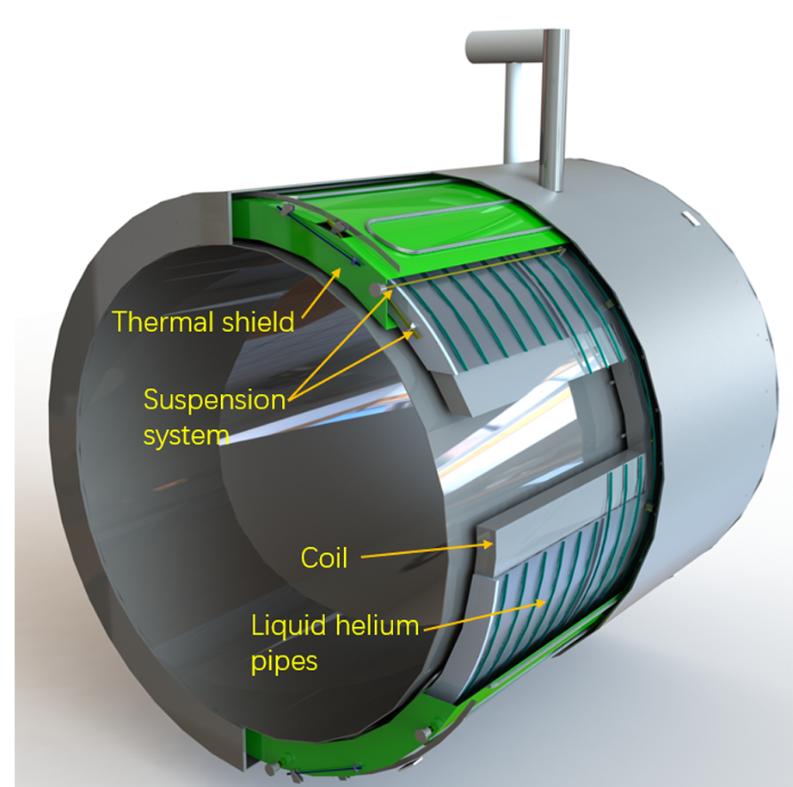
Layout and parameters
Coil Inner diameter | 7300 mm
Coil Outer diameter | 7916 mm
Coil length | 8150 mm
B@(0,0,0) | 3 T
Operating current | 17 kA
Coil Module gap | 50 mm
Inductance | 11 H
Stored Energy | 1.54 GJ
Inductance matrix / H
 | Coil 1 | Coil 2 | Coil 3
Coil 1 | 2.01 | 0.73 | 0.27
Coil 2 | 0.73 | 1.75 | 0.73
Coil 3 | 0.27 | 0.73 | 2.01
Notes:
This picture shows the structure of the magnet, including the main coil, the external heat screen, the liquid helium pipeline, the hanging structure and the vacuum . The coil consists of four layers with a total of 1,400 turns, organized into three modules with a 50 mm gap between each module.
Here, we present some key coil parameters and the inductance matrix.

Slide 5
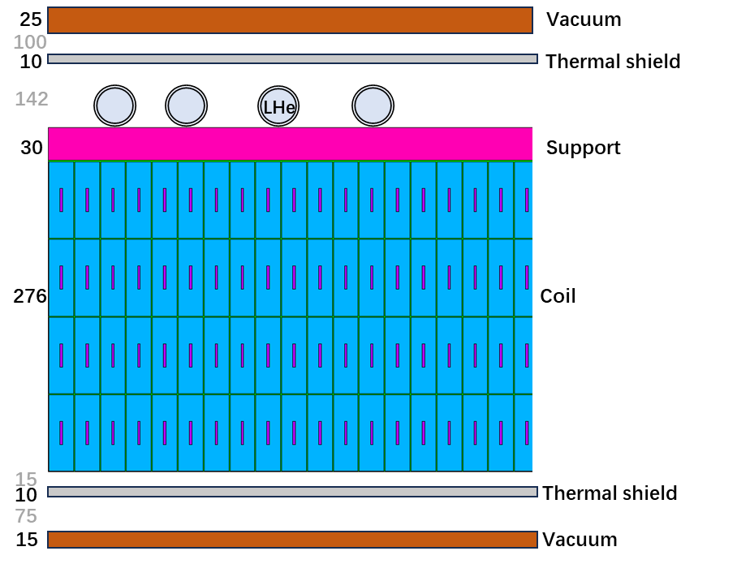
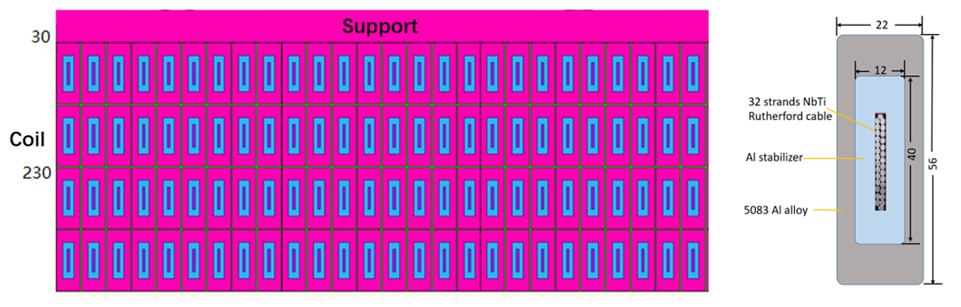
Layout and parameters
Coil Inner diameter | 7300 mm
Coil Outer diameter | 7916 mm
Coil length | 8150 mm
B@(0,0,0) | 3 T
Operating current | 17 kA
Coil Module gap | 50 mm
Inductance | 11 H
Stored Energy | 1.54 GJ
Inductance matrix / H
 | Coil 1 | Coil 2 | Coil 3
Coil 1 | 2.01 | 0.73 | 0.27
Coil 2 | 0.73 | 1.75 | 0.73
Coil 3 | 0.27 | 0.73 | 2.01
Notes:
This picture shows the structure of the magnet, including the main coil, the external heat screen, the liquid helium pipeline, the hanging structure and the vacuum . The coil consists of four layers with a total of 1,400 turns, organized into three modules with a 50 mm gap between each module.
Here, we present some key coil parameters and the inductance matrix.

Slide 6
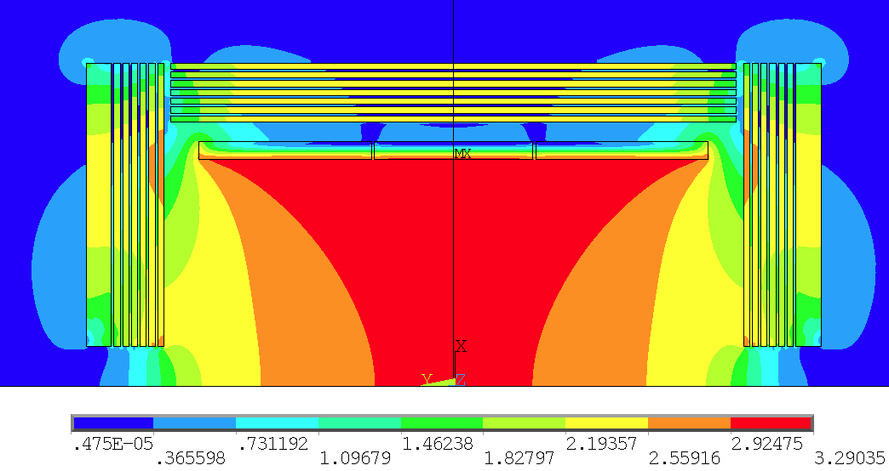
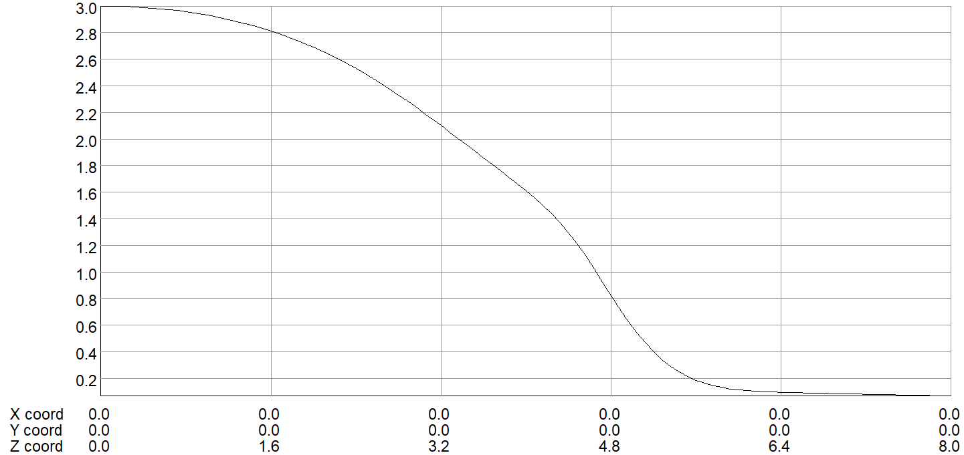
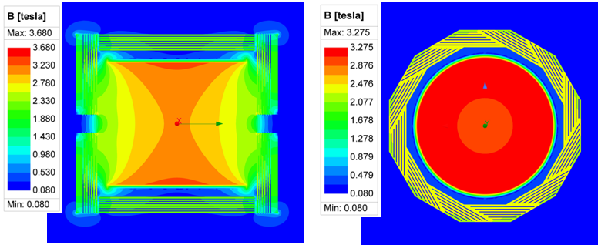
Magnetic field design
Bcenter=3.0T，Bpeak on cable: 3.29T
2D Magnetic field distribution
B along Z axis / T
3D Magnetic field simulation
Notes:
The central magnetic field strength is 3 T, and we can observe the three-dimensional magnetic field distribution with the maximum field on the coils reaching 3.29 T.

Slide 7
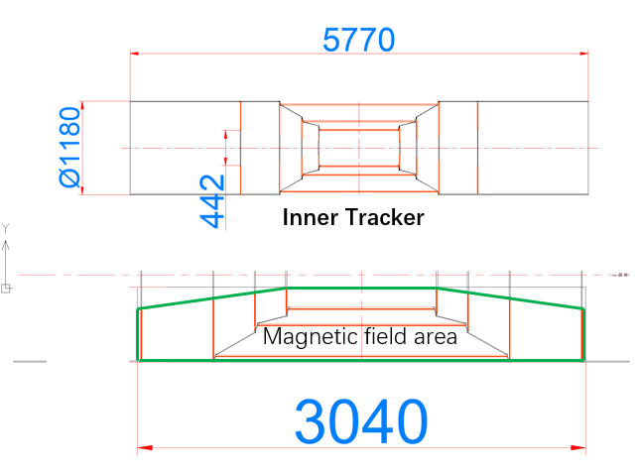
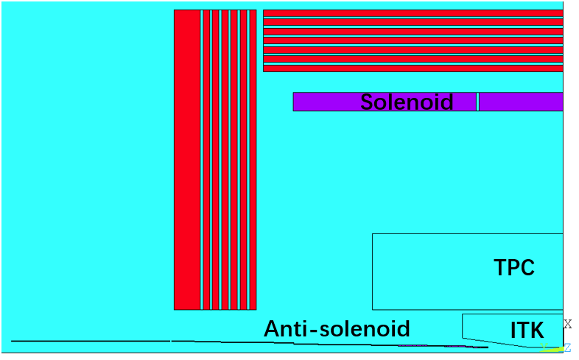
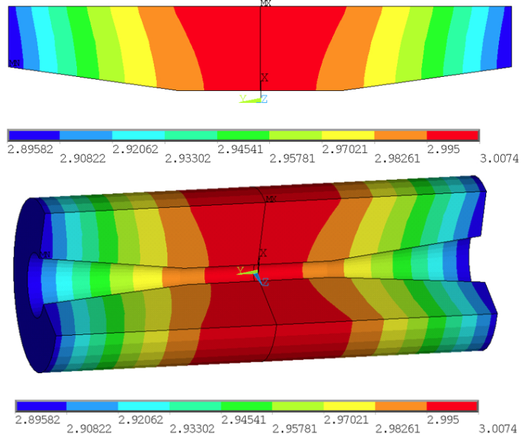
Magnetic field design
Field distribution and uniformity
Inner Tracker region
Schematic diagram of solenoid coil, anti-solenoid coil, TPC and ITK position
∆B=0.11 T
Notes:
This is the part that the reviewers are more concerned about,

Slide 8
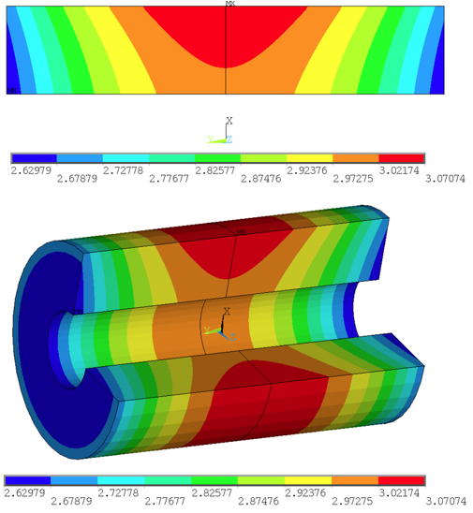
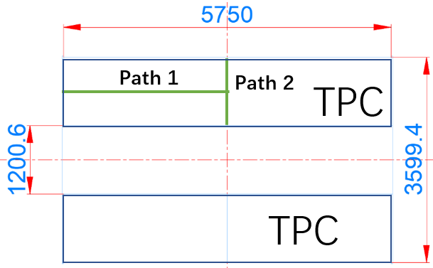
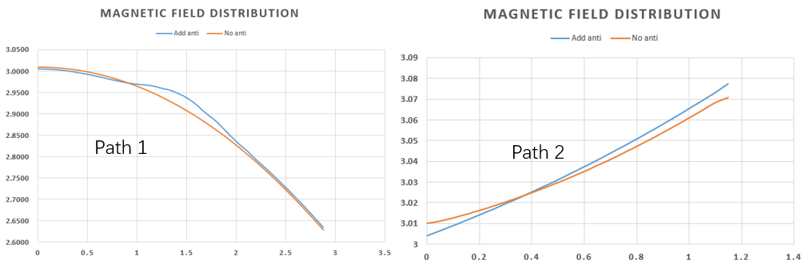
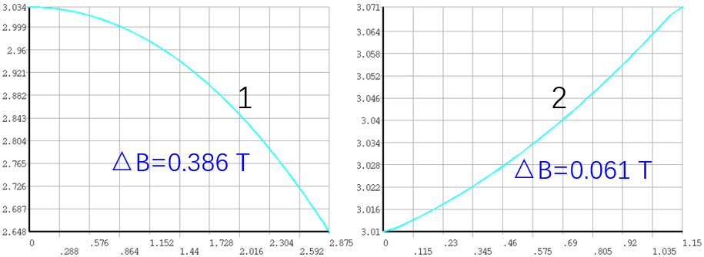
Magnetic field design
Field distribution and uniformity
TPC region
With anti-solenoid
Through the comparison of magnetic field distribution on path 1 and path 2, we found that the anti-solenoid has a relatively small impact on the magnetic field homogeneity of the TPC.
Notes:
The peak-to-peak difference of axial path 1 is

Slide 9
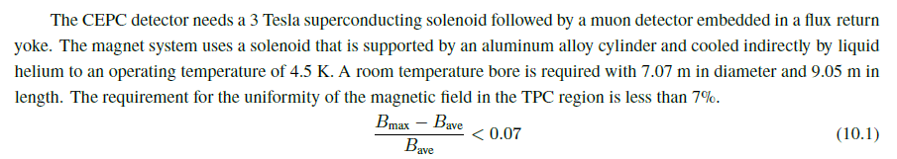
Magnetic field design
Field distribution and uniformity
IDRC comments:
Magnetic field design may be further optimized to optimize the field quality and the peak field to be suppressed.
Confirm the field quality / uniformity enabling to satisfy necessary field quality required for the TPC region under the current iron yoke (HCAL) and the final focusing magnet including the compensation solenoid.
Requirements：
Response：
Now the field uniformity is slightly beyond the required value，7.7%。
The more important are the gradient, magnetic field mapping accuracy and density.
Based on the current detector layout, there is not enough and appropriate space to add yoke or coils.
Notes:
The definition of this uniformity is the peak field minus the average field divided by the average field.
our colleagues in the physics group have communicated many times. Compared with the uniformity, the gradient, magnetic field mapping accuracy and density are more important. Because our magnetic field curve is very smooth, it is acceptable if we can achieve magnetic field mapping with an accuracy of one ten-thousandth at a density of 5cm. We communicated with Teacher Chen about this and confirmed that the current magnetic field measurement technology can achieve it.
According to the current detector layout, there is no space to arrange more yokes or coils to adjust the field uniformity, because all these Spaces are HCAL and ECAL, and the radial space of the coils is also very small, with no suitable position

Slide 10
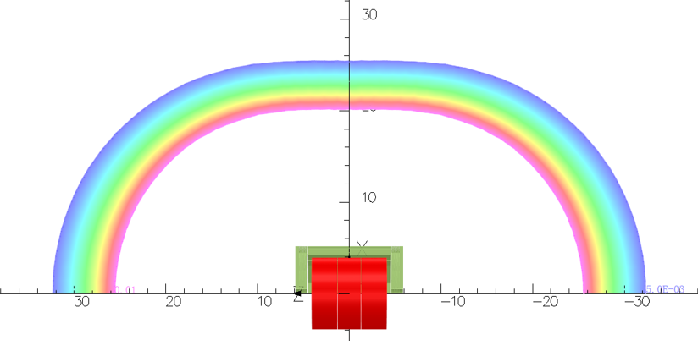
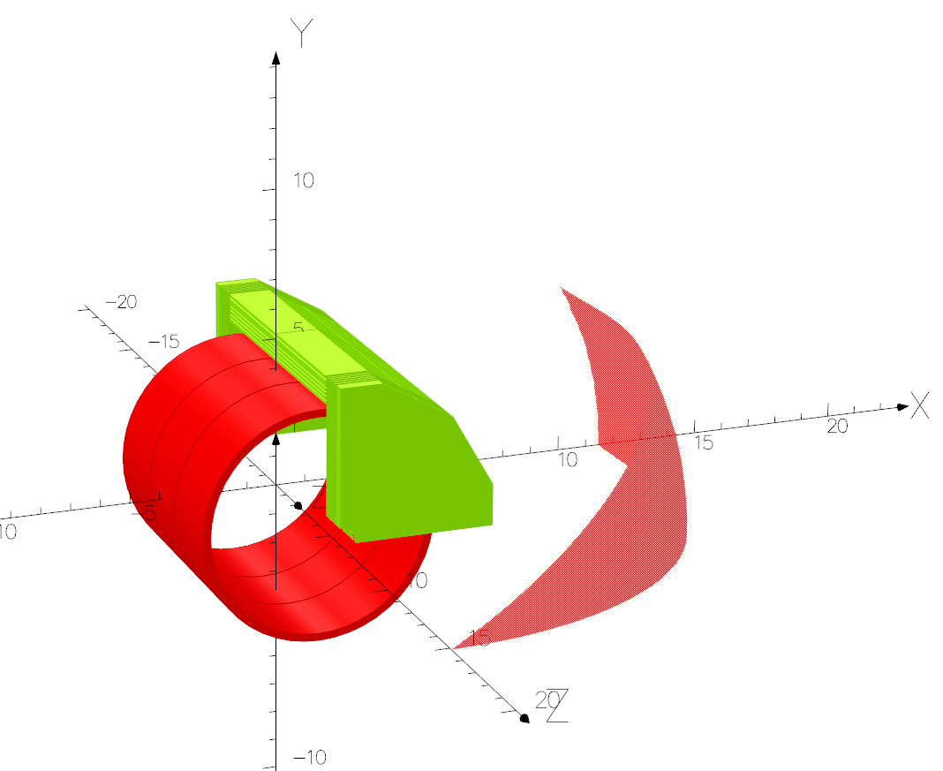
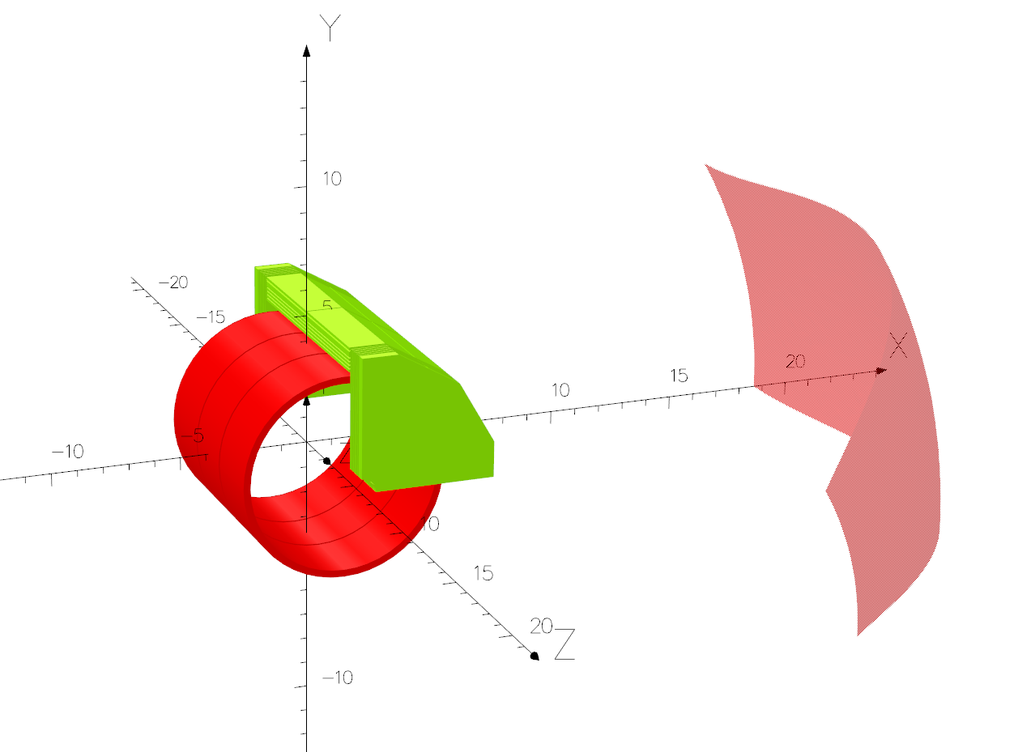
Magnetic field design
Stray field distribution
The position of the 50 and 100 Gauss lines, 100 and 500 Gauss faces.
Stray field |  | Position
50 Gs | R direction | 25.4 m
 | Z direction | 32.3 m
100 Gs | R direction | 20.2 m
 | Z direction | 25.6 m
Notes:
To the left, the distribution of the stray magnetic field is displayed, which includes the 100 gauss lines, 100 gauss surfaces, and 500 gauss surfaces. The 500 gauss surface is located at 15 meters axially and 11 meters radially. However, due to the current lack of specific requirements for stray magnetic fields from other related components, we have not conducted a more detailed leakage magnetic field design as of yet.

Slide 11
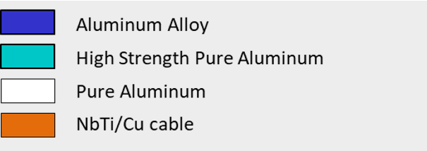
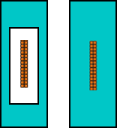
Cable structure and stress
The scheme of the conductor structure
Final selection: Cable size and structure: 56mm*22mm (Box type)
Box type: The best mechanical properties，Secondary co-extrusion process has made certain progress， increase the risk after quench
CMS-like: has been verified as feasible, most expensive and complex manufacturing process: Co-extrusion + electron beam welding
Single Al coating(Old plan): low price, easy to manufacture, but poor mechanical properties
CEPC
(Box type)
Baseline
(CMS-like)
Single Al coating
Notes:
has been verified as feasible, most expensive and complex manufacturing process: Co-extrusion + electron beam welding
and already has the capacity to produce long cables, but has poor mechanical properties
It was adopted in the previous TDR

Slide 12
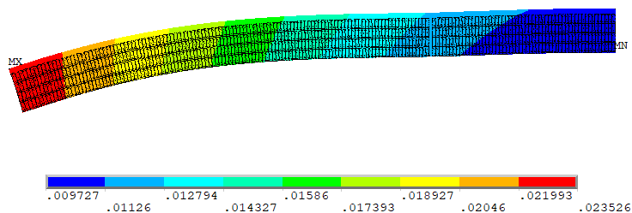
Cable and Stress
The scheme of the conductor structure
Cable parameter | 56*22 Box | 56*22 CMS-like | 68*22 Single Al coating
 | Stress(MPa) | Stress(MPa) | Stress(MPa)
Coil at 4.2 K
NbTi/Cu cable | 177-279 | 170-260 | 174-243
Al Stabilizer | 7.7-20.0 | 7.8-20.5 | 4.4-86.1
Al alloy Reinforce | 7.0-43.3 | 7.0-63.9 | -
Al alloy support | 6.3-36.3 | 5.9-41.2 | 4.6-36.2
Coil at 4.2 K, energized
NbTi/Cu cable | 28-246 | 22-236 | 54.9-221
Al Stabilizer | 14.3-22.5 | 15.2-24.8 | 41.5-95.9
Al alloy Reinforce | 60.8-137 | 70.6-151 | -
Al alloy support | 62.2-127 | 73.2-159 | 43.2-87.4
Materials | Peak stress/MPa | Rp0.25@4.2 K/MPa | Safety margin
NbTi/Cu | 279 | >800 | 65%
4N8 Al | 22.5 | ~34 | 33.8%
5083 Al alloy | 137 | ~200 | 31.5%
Total deformation of the coil is 23.5 mm
Notes:
This table lists the equivalent stress distributions calculated via simulations for coils using different cables subjected to cooling and excitation.
The green column is the cable of the box structure that we used new
Based on this, the safety margin of the material on the conductor can be obtained. Among them, the strength of aluminium is obtained by Multipliedthe test value of the low-temperature coefficient. The strength of 5083 aluminium alloy can reach 200mpa after cold working.

Slide 13
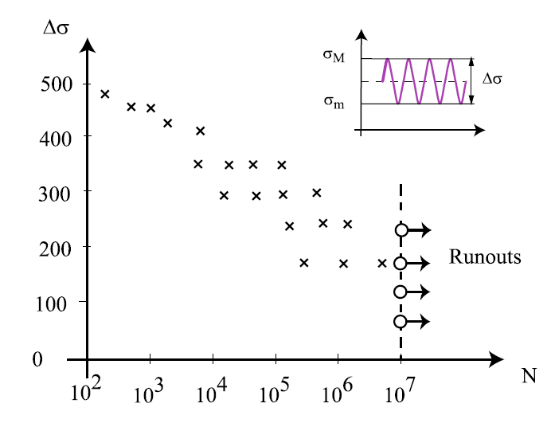
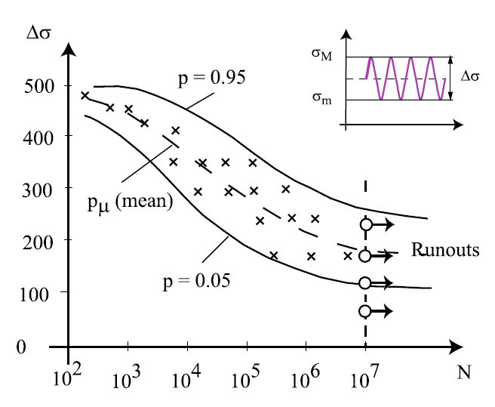
Cable and Stress
IDRC comments: Fatigue of the coil during long-term cyclic use
The circulation process between excitation and demagnetization process is just like a fatigue process.
3 main kinds of fatigue models
Models Used in the Stress Based Approach (S-N)
Models Used in the Strain Based Approach (ε-N)
Models Used in the Fracture Mechanics Approach
The S-N curve method is the approach most widely used to estimate fatigue life.
S or $∆σ \text{means}$ the amplitude of stress range, N means the cycle quantities, P means probability

Slide 14
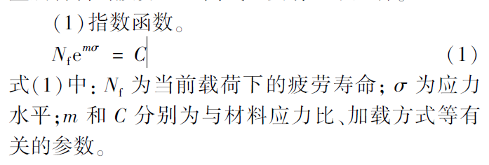
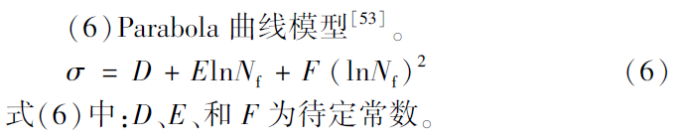
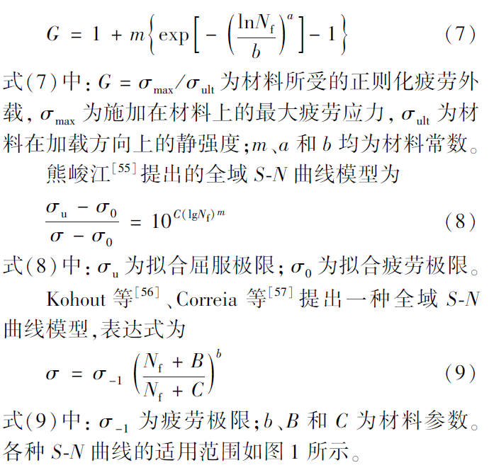
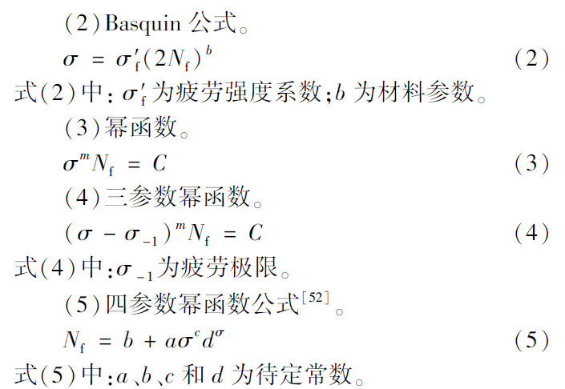
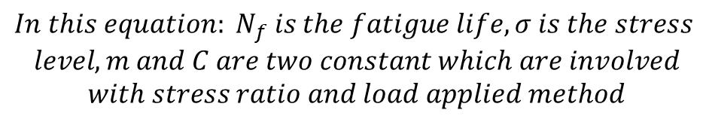
Several kinds of S-N curves equation
Most widely used
$${In this equation: N}_{f} is the fatigue life, σ is the stress$$
$$level, m and C are two constant which are involved$$
$$with stress ratio and load applied method$$

Slide 15
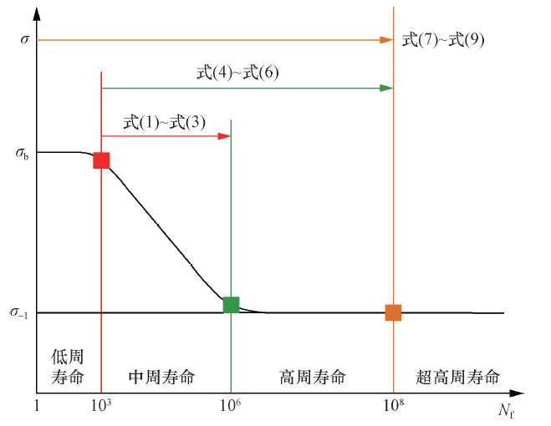
Several kinds of S-N curves equation
(1) Low Cycle Fatigue
Low cycle fatigue life is the range below approx. 1 to 10³ load cycles. It correspond to high stress and low cycles
(2) High Cycle Fatigue
High cycle fatigue life is the range below approx. 10⁶ to 10⁸ load cycles. It correspond to low stress and high cycles
For our coil, it is mostly like low cycle fatigue. And equation (7) to equation (9) is fit for that.
But we lack of several constants in the equations for 5083 aluminum alloy.
Second choice is do some test to obtain the S-N curve for 5083 aluminum alloy.

Slide 16
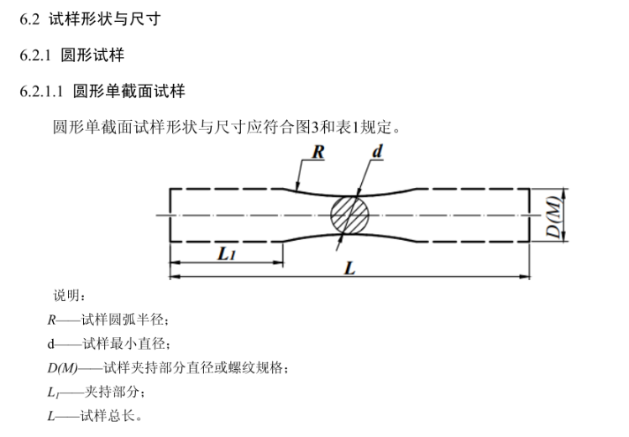
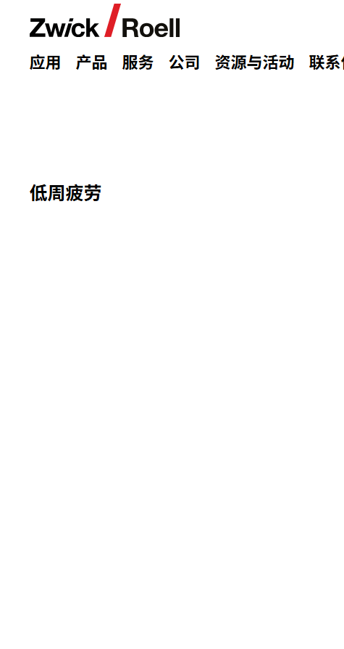
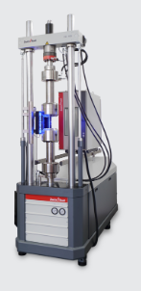
How can we get S-N curve for 5083
(1)We can refer to a standard《 GB/T37616-2019 铝合金挤压型材轴向力控制疲劳试验方法》
Sample
Testing machine
Not in low temperature environment
(2) Test 2：Close to real condition
Using FEA method to get a primary load under which the stress distribution will similar with the right picture at 4.2K
Producing a sample and applied the load on it firstly and then put it into cryostat to simulate the influence of temperature cycles
Assuming a possible cycle number in the future. Just check whether there is crack after this cycle.

Slide 17
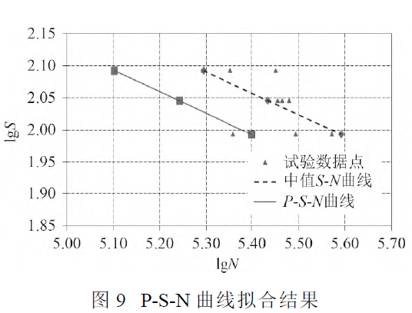
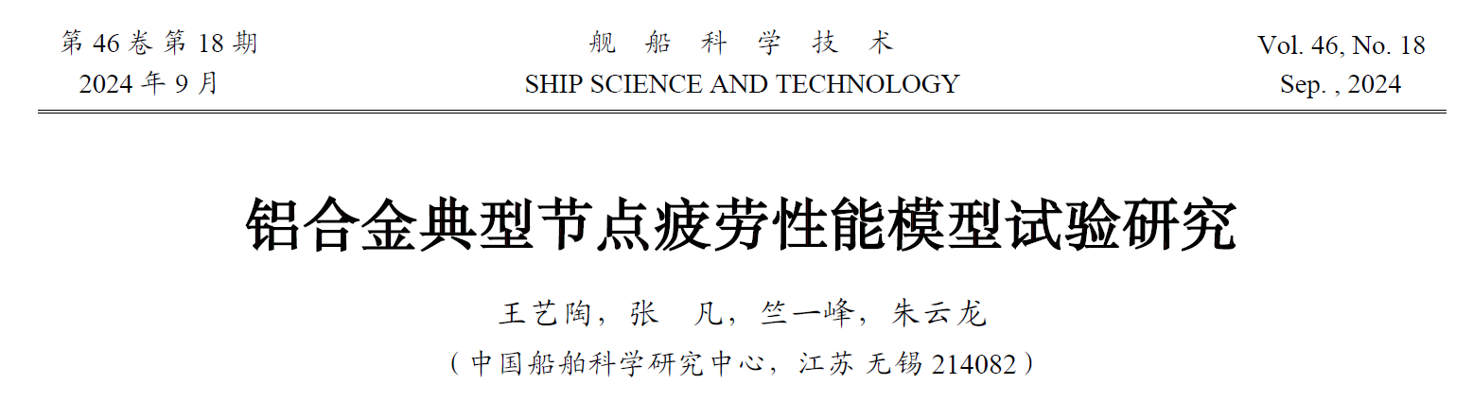


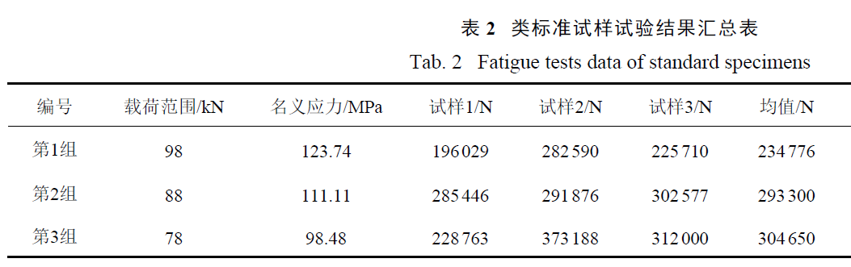
An reference for 5083 aluminum alloy
S-N curve
With a welding joint
When stress is 123.74MPa, the fatigue life is 234776
Peak stress is 137MPa
Notes:
The square structure includes a joint, Perhaps we can infer our fatigue life through this result. This value might be lower, but it should be above hundreds of thousands of times
The strength increases, but it will also be more brittle.

Slide 18
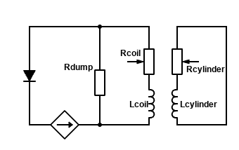
Quench Protection
Quench detection and protection
Quench parameters with Al RRR value=600:
Winding
Quench back
cylinder
Protection
resistor
Parameter | value
Breaker delay time | 2 s
Delay time | 0.03 s
Dump resistance | 50 mΩ
Terminal voltage | 898.53 V
Coil internal voltage | 75.88 V
Final temperature | 60.56 K
Extracted energy ratio | 88.03%
Decay time* | 162 s
Quench detection ：Voltage of the coil
Quench protection ： dump resistor + quench back cylinder
*time when the current is I = I0 /e= 6340 A.
The Al alloy support cylinder is also used for quench back.
Notes:
The quench protection scheme for the coil is based on a dump resistor. After a quench occurs, the current rapidly decreases, depositing most of the energy into the dump resistor outside the Dewar. The external support cylinder, which has good thermal contact with the coil, will also generate eddy current that result in quench back effects, heating the coil and speeding up the quench process.

Slide 19
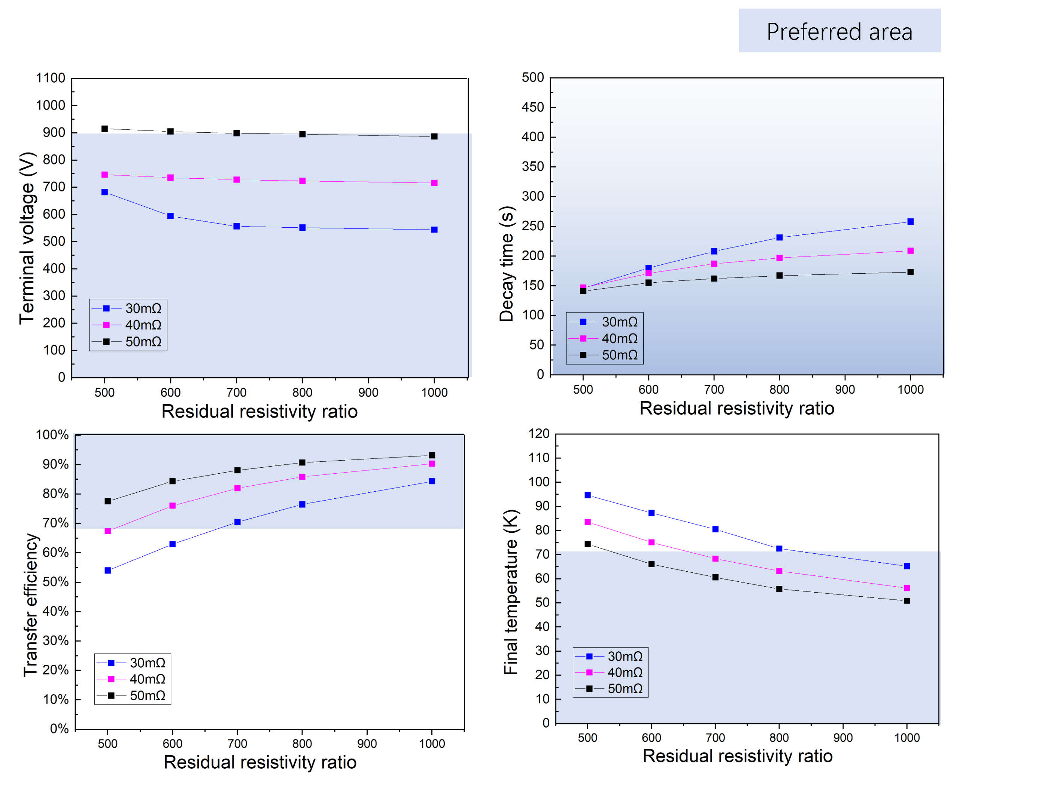
Quench Protection
Quench parameters
The best dump resistance value is 50 mΩ,
The RRR of the cable aluminum stabilizer should be greater than 600. (for 4N8 Al, RRR>800)
With an RRR value of 600, the quench propagation speed of the coil: along the cable 2.514 m/s, axially 0.089 m/s, and radially 0.139 m/s.
Notes:
Here is shown how the parameters in the table just now were obtained,Different resistor values under varying RRR (Residual Resistivity Ratio) conditions for the aluminum stabilizer have been listed, showing that as the RRR increases, the quench voltage decreases. Notably, when the RRR exceeds 300, the impact begins to diminish.
With a resistance value of 50 mΩ and a lower RRR value, there is a risk of exceeding 1000 V for the endpoint voltage. Similarly, as the RRR increases, the energy discharged through the resistors rises significantly, leading to lower coil temperatures. Although longer decay times for the coil currents accompany increased RRR values, this is not a stringent requirement. Hence, I propose that the optimal resistance for energy-dissipating resistors is 50 mΩ, while the RRR of the aluminum stabilizer should exceed 300.

Slide 20
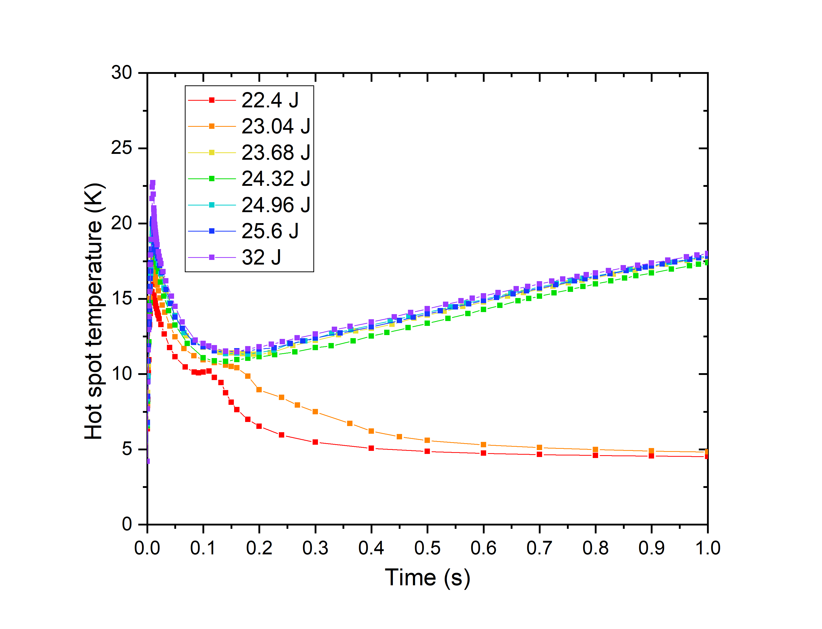
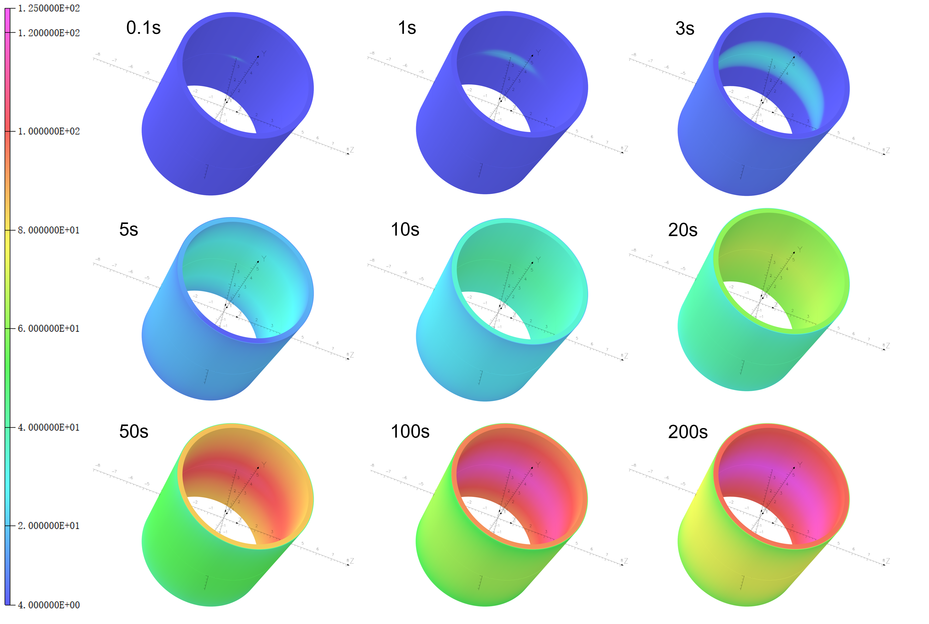
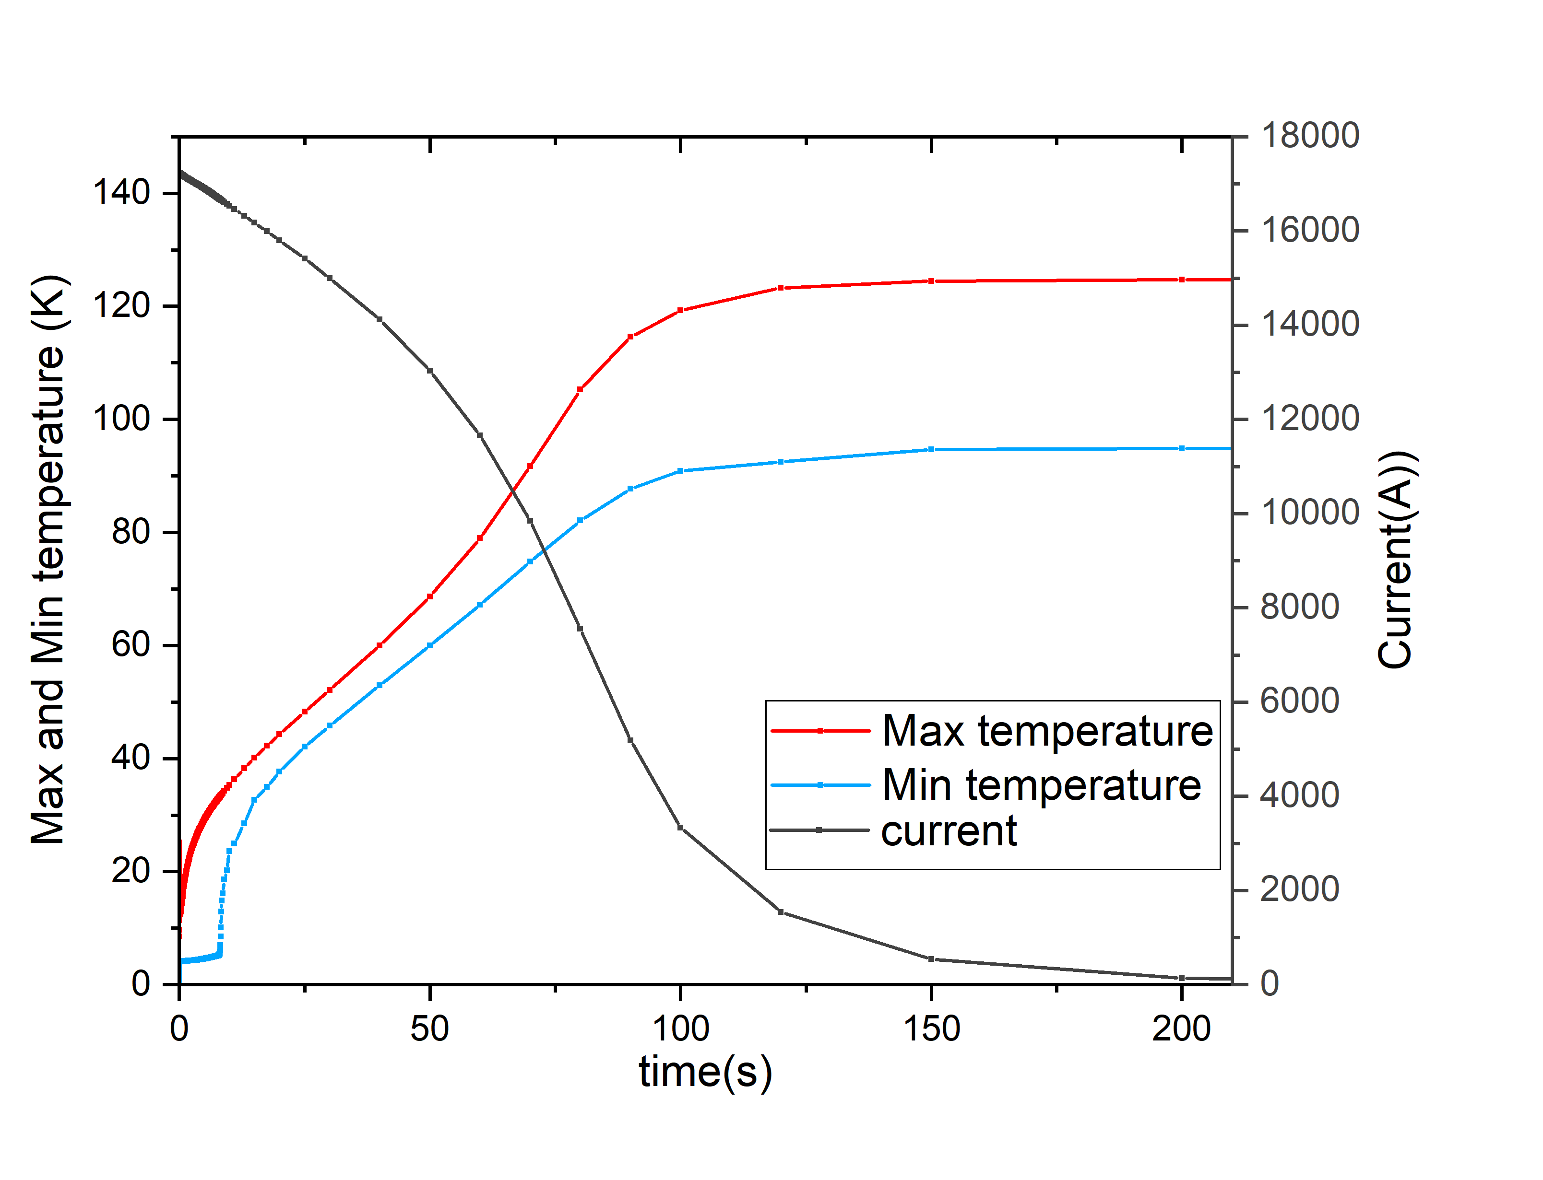
Quench Protection
Quench characteristic
The minimum quench energy (MQE) of the coil is about 23.68J
Quench process of 3D model
The hot spot temperature of the coil reaches 124.6 K, with the maximum temperature gradient across the entire coil being approximately 29.9 K,
Notes:
Here is the decay curve for the coil current and temperature change based on 50 mΩ resistance and an RRR value of 300. The table outlines some quench parameters, with a delay time to activate quench protection set at 30 ms.
Role of the Supporting Cylinders: Additionally, the aluminum alloy support cylinder will play a vital role during the quench process, serving as feedback. Besides providing a protective circuit through the resistor, the support cylinder will also utilize the mutual inductance with the coils to generate eddy currents, thereby heating up and returning heat to the coils, which further accelerates the decay of the coil current. Consideration for practical feedback and detailed quench simulations is currently ongoing.

Slide 21
The main response to the comments
Magnetic field uniformity
  The field uniformity in the TPC region is slightly beyond the requirements, but the current scheme is considered usable by the physics group as long as sufficient magnetic measurement accuracy and density are guaranteed.
The safety margin of cable stress is too small
  We have completely replaced the structural scheme of the conductor with a box type, and the safety margins of each part of the conductor have met the requirements.
Fatigue of the coil during long-term cyclic use
  By investigating the fatigue life of Al 5083, we initially think that the cable can undergo tens of thousands of stress cycles. However, if a more accurate answer is needed, fatigue tests using cable samples can be considered.
.

Slide 22
Thank you
Any advice and suggestions are appreciated !
Menglin Wang, IHEP
wangmenglin@ihep.ac.cn

