Slide 1



Mechanical Design of CEPC Detector Magnet
Hou Zhilong

Slide 2
Contents
Overview & Key Parameters
Magnet Assembly & Suspension
Thermal Management
Mechanical Analysis (FEA)
Challenges & Future plan

Slide 3
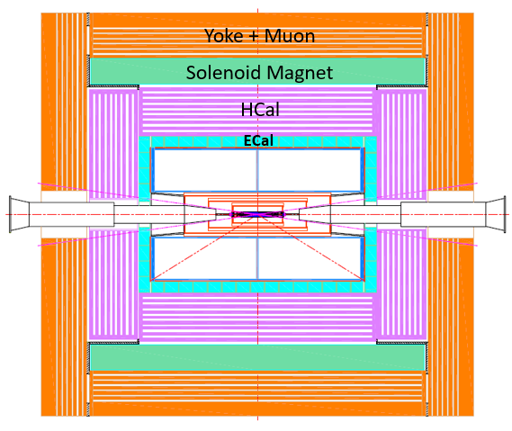
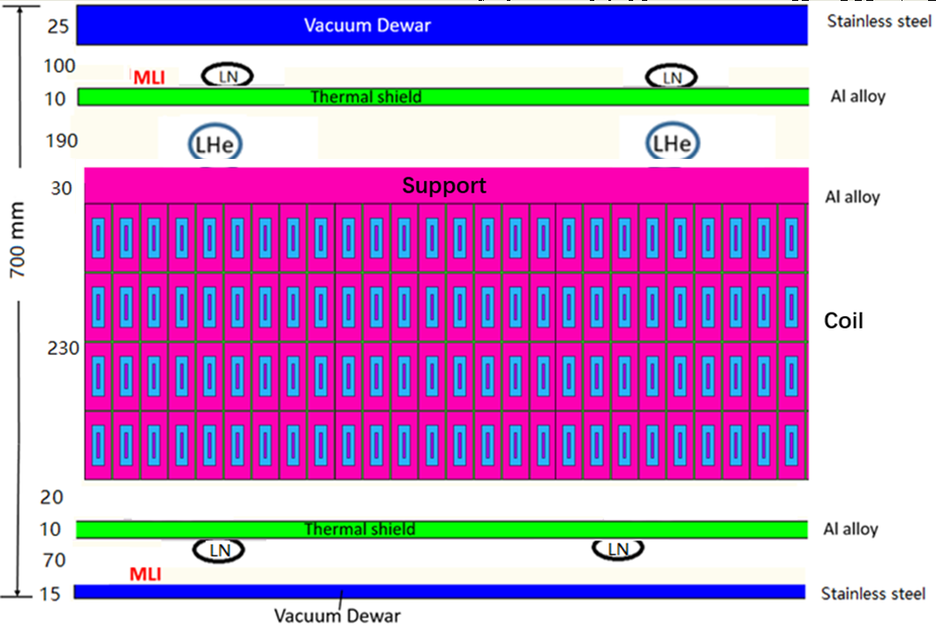
Magnet Overview
Critical Parameters
Position of Magnet in detector
Items | Parameters
Cryostat
Outer Diameter | 8470
Inner Diameter | 7070
Length | 9050
Coil
Outer Diameter | 7916
Inner Diameter | 7300
Length | 8150
Mass of coil | 185 t
Cross section of Magnet

Slide 4
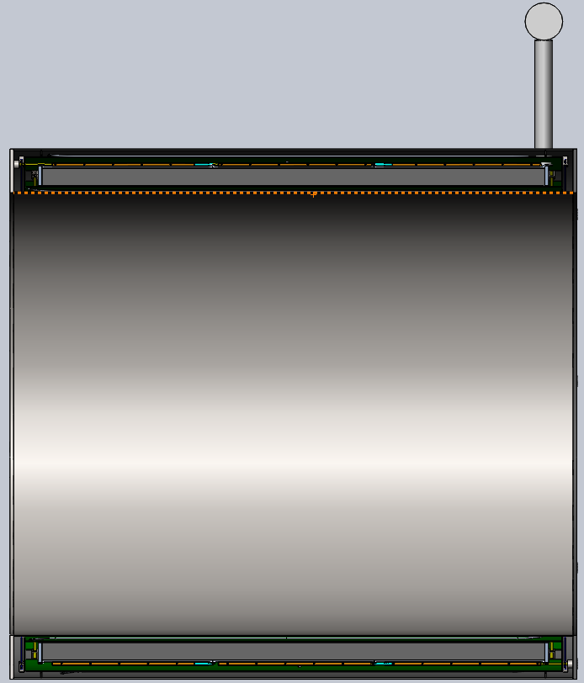
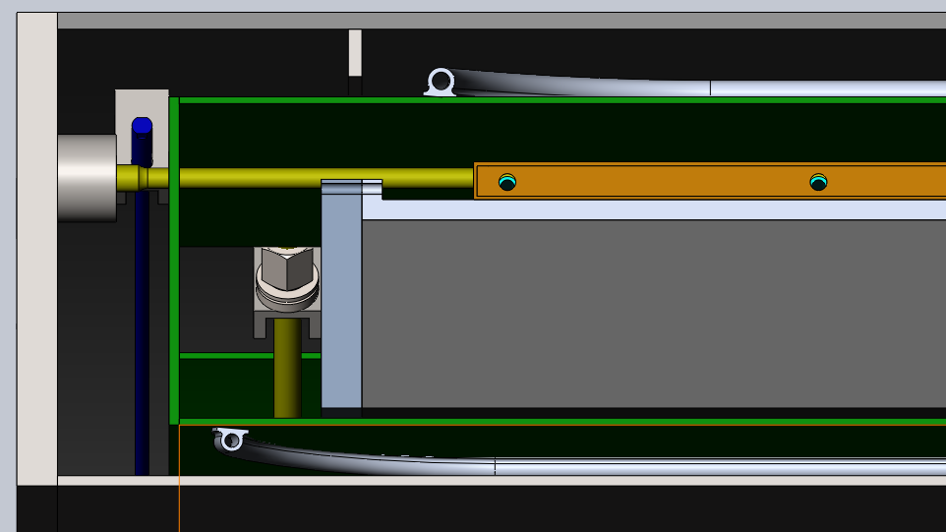
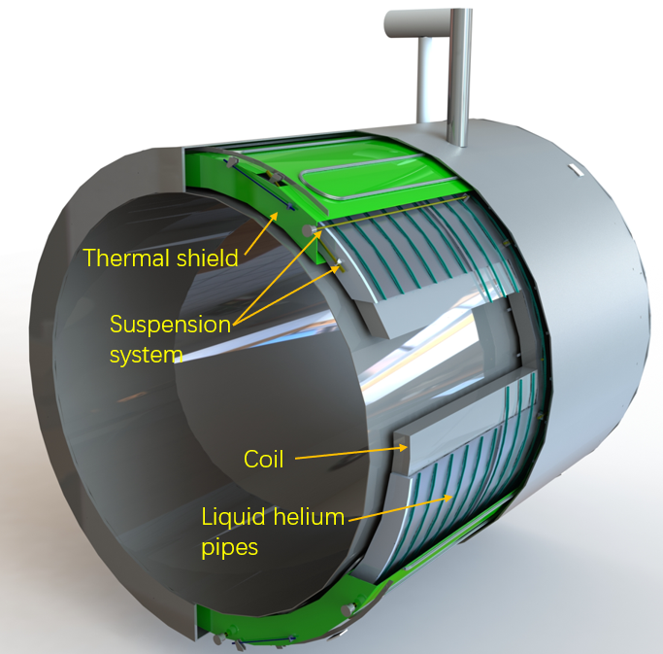
Magnet Overview
Gas-liquid separator
Current leads channel
3D Cross Section of Magnet
Cryostat
Coil suspension
Thermal shield
Coil
Multi-Layer Insulation
  Out coil : 10~15 layers
  Out thermal shield：35~ 40 layers
3D Model of Magnet

Slide 5
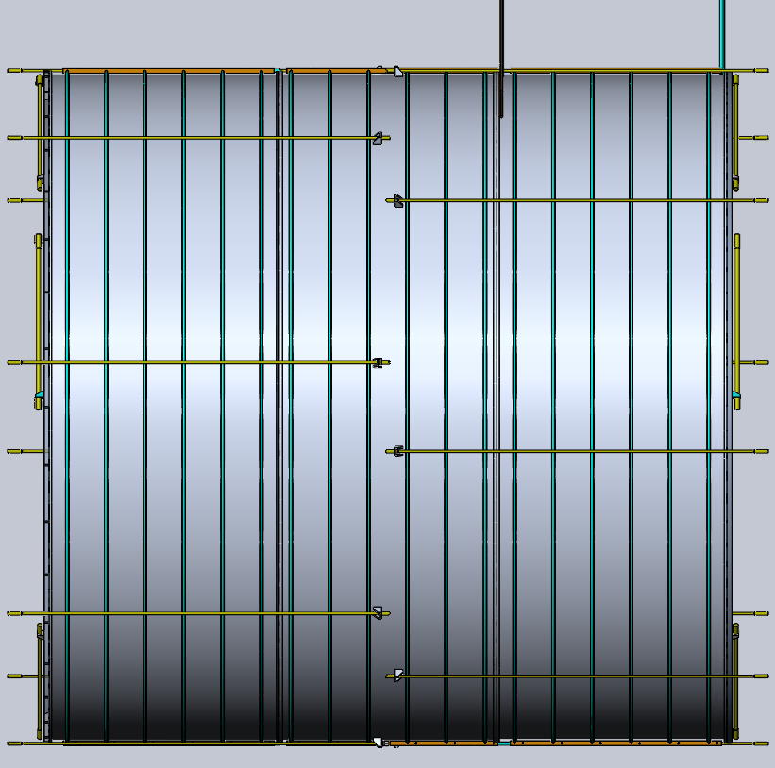
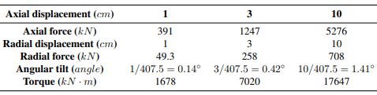
Coil Assembly & Suspension
3D Model of Magnet Coil
Structure:
3-segment assembly (bolted to support cylinder), 10~15 layers MLI
Suspension:
  Axial: 8 tension rods/end
  Radial: 2 upwards + 4 diagonal rods/end
Rod Material: Titanium alloy
Total weight: ~185 t
Helium tank
Helium pipe
Axial rod
Electromagnetic force resulting from coil offset
Upwards rod
Radial rod
Helium tank

Slide 6
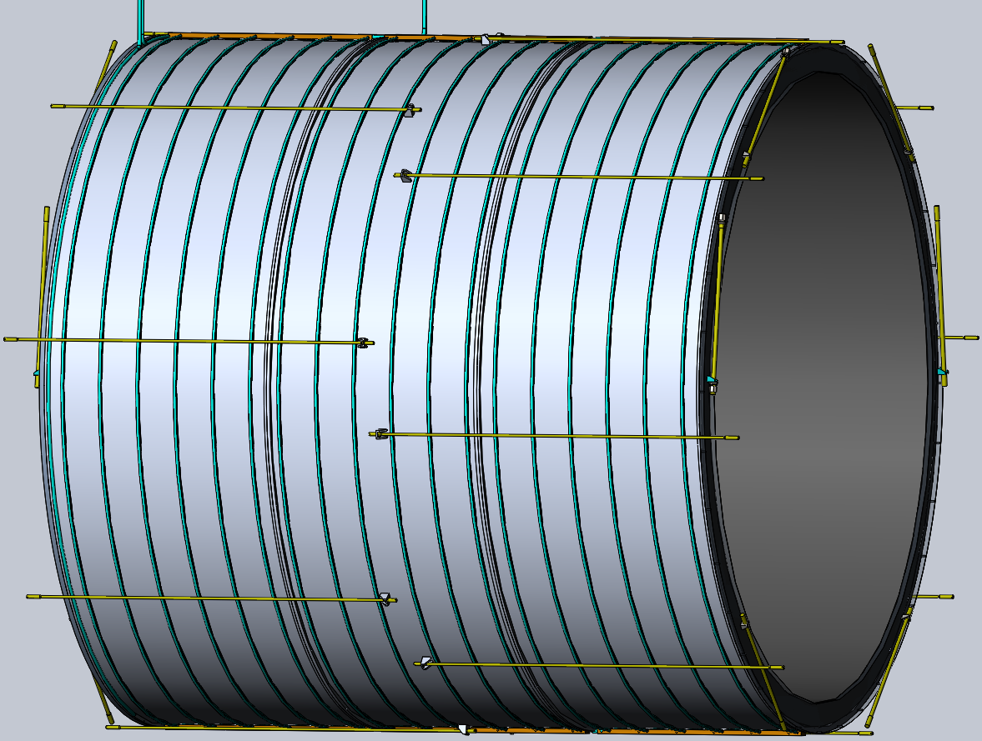
Coil Assembly & Suspension
Axial rods: Slender and long
Load cases:
Cold mass: 185 t
Lifting acceleration: 0.4g (X), 1.5g (Y), 0.6g (Z)
Impact forces: 740 kN, 2775 kN, 1110 kN
Electromagnetic forces (10mm offset: 391 kN; 15mm: 900 kN)
3D Model of Magnet Coil
Parameters of Rod
Rod | Diameter（mm） | Length（mm） | Quantity
Axial | 30 | 4520 | 16
Radial | 32 | 1700 | 8
Upwards | 40 | 1650 | 4
Tensile Stress of Rod
MPa
Rod | Assembly | Cooling | Max Impact
Axial | 50 | 193 | 291
Upwards | 327 | 345 | 513
Radial (Up) | 120 | 224 | 314
Radial (Down) | 20 | 164 | 314
Axial Rod
Upwards Rod
Radial Rod

Slide 7
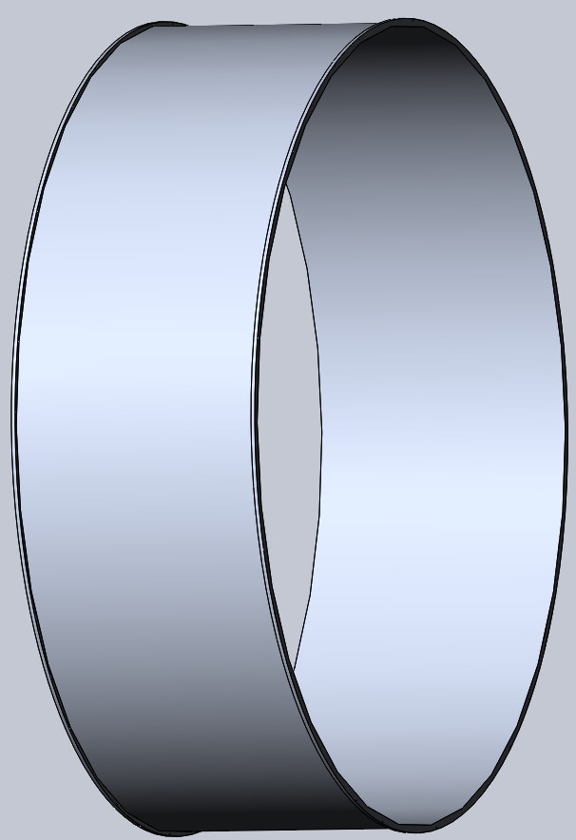
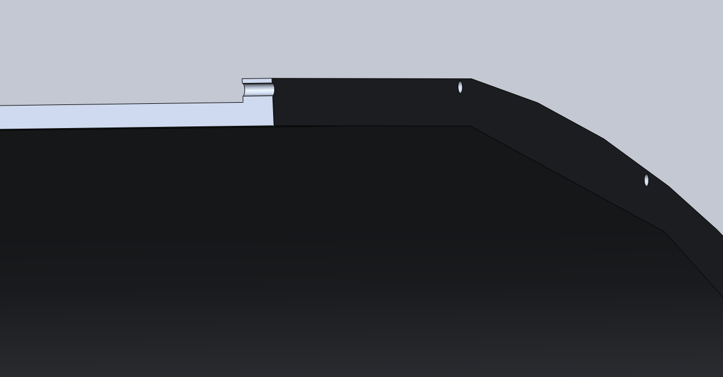
Coil Support Cylinder
Dimensions：Ø7820 mm,30 mm thick,2750 mm length
Material：5083 Aluminum alloy
Challenge: Large diameter + thin walls → Precision manufacturing

Slide 8
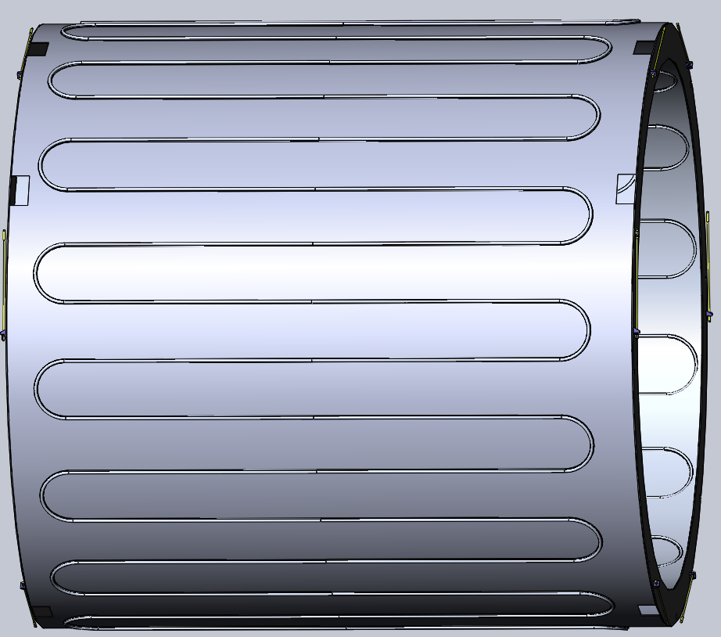
Thermal Shield Design
3D Model of Thermal Shield
Cooling Pipe
Rod
Design: Inner/outer shields with serpentine cooling pipes
Suspension:
  6 diagonal rods/end
  Room temperature end offset towards the center
Rod Material: Titanium alloy
MLI:35~40 layers

Slide 9
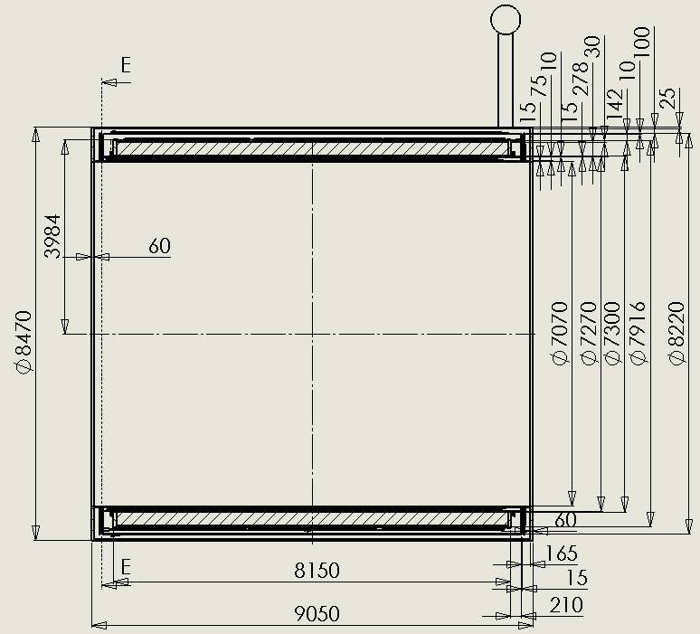
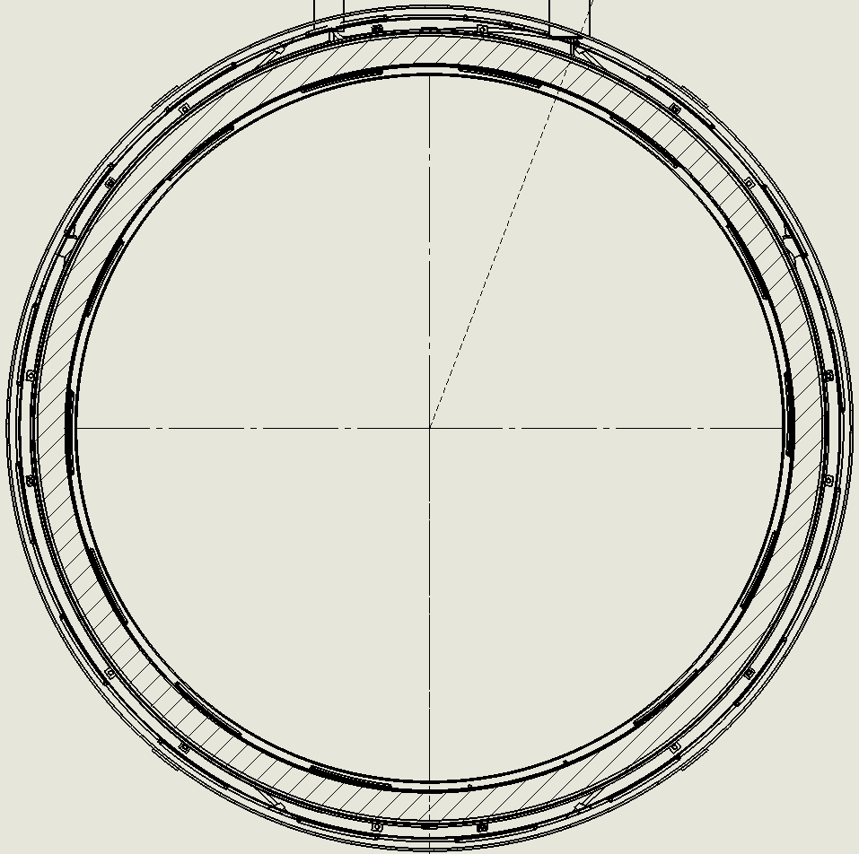
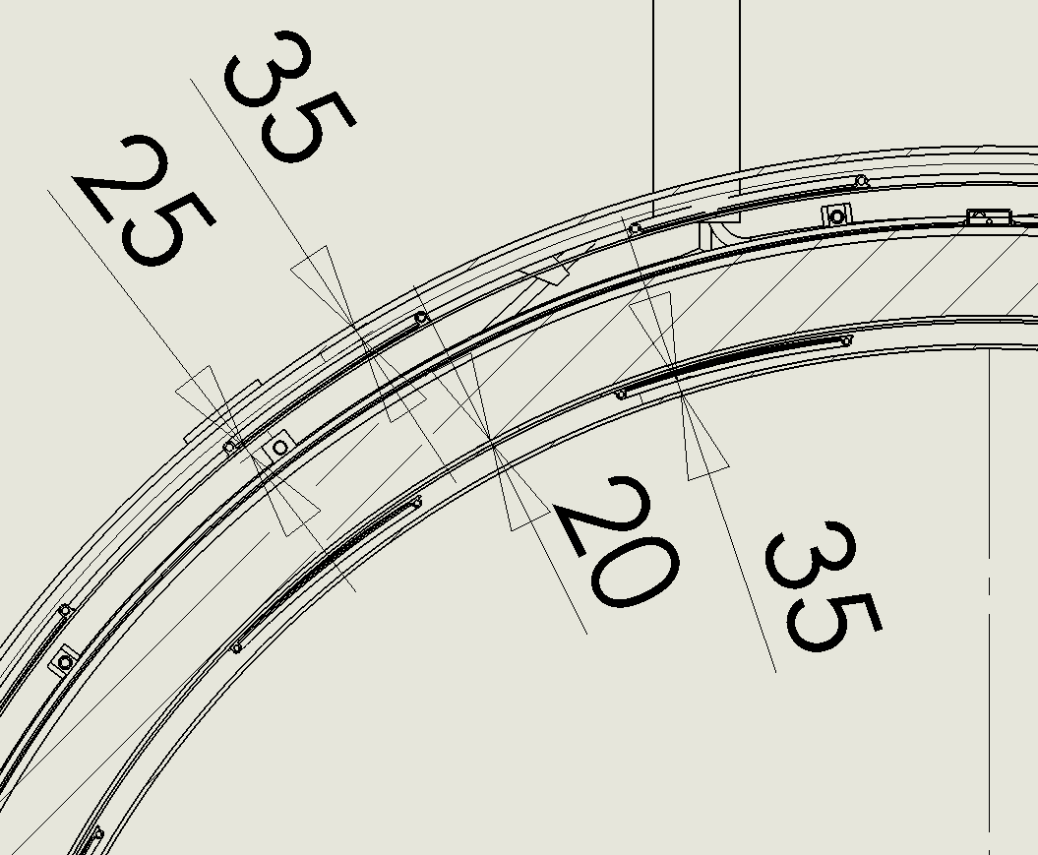
2D Drawing of Magnet

Slide 10
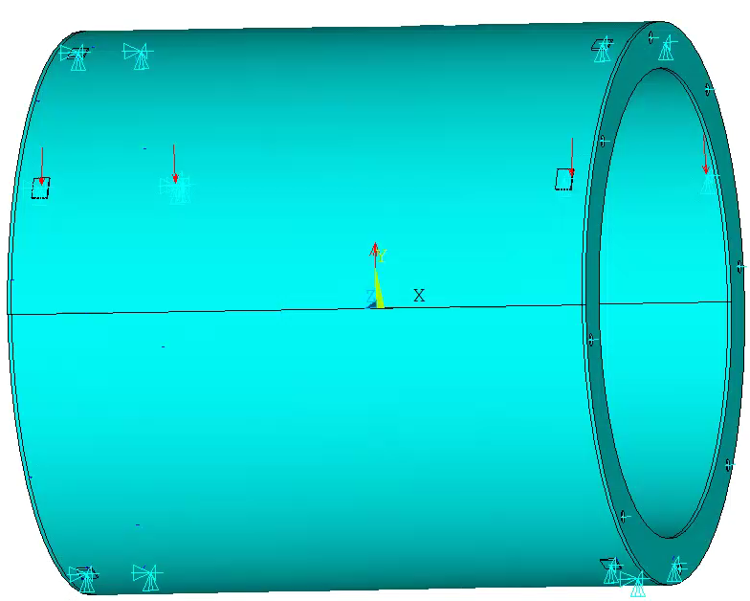
Cryostat Mechanical Analysis (FEA)
FEA Model
Material: Stainless steel
  E=190 GPa,
  µ=0.28,
  σ_{0.2} ≥205 MPa
Boundary conditions:
  Left end: 6 position fixed fully
  Right end: 6 position Horiz/vert fixed, axial free
Load Cases: Gravity, impact force caused by hoisting, vacuum, cooling, EM forces resulting from coil offset

Slide 11
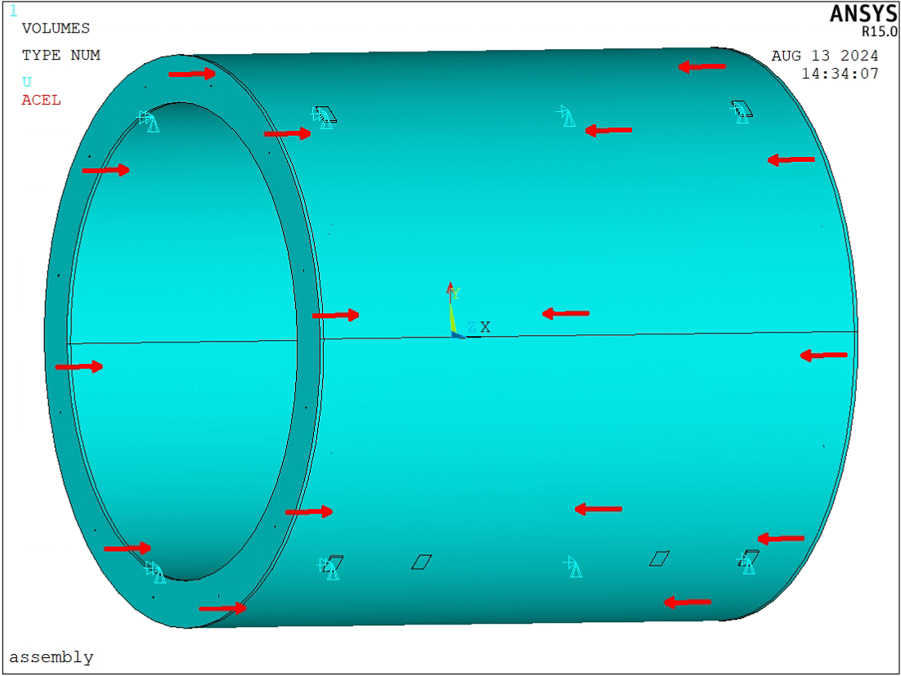
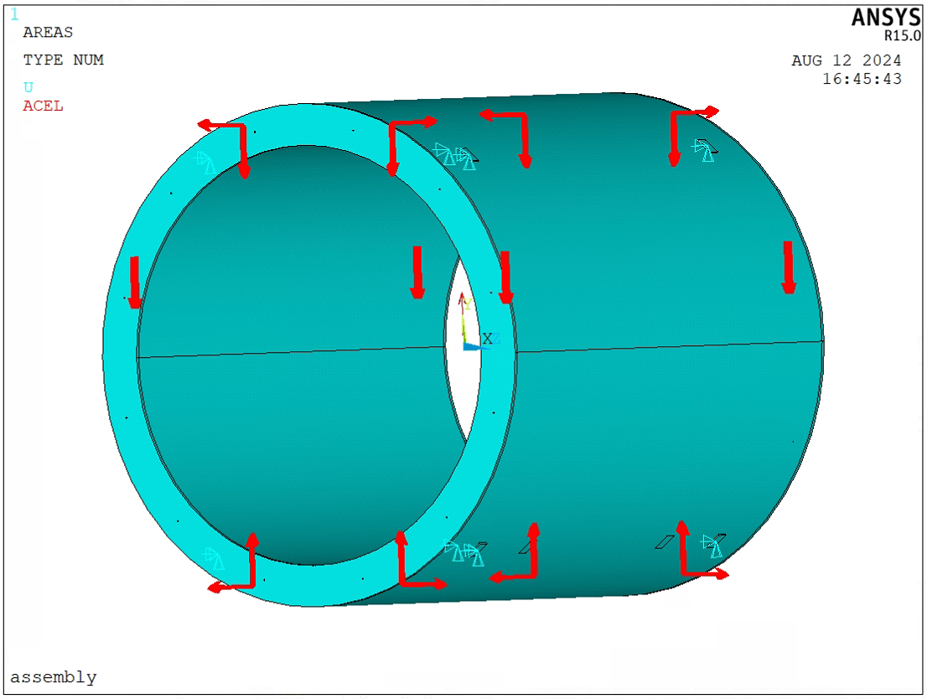
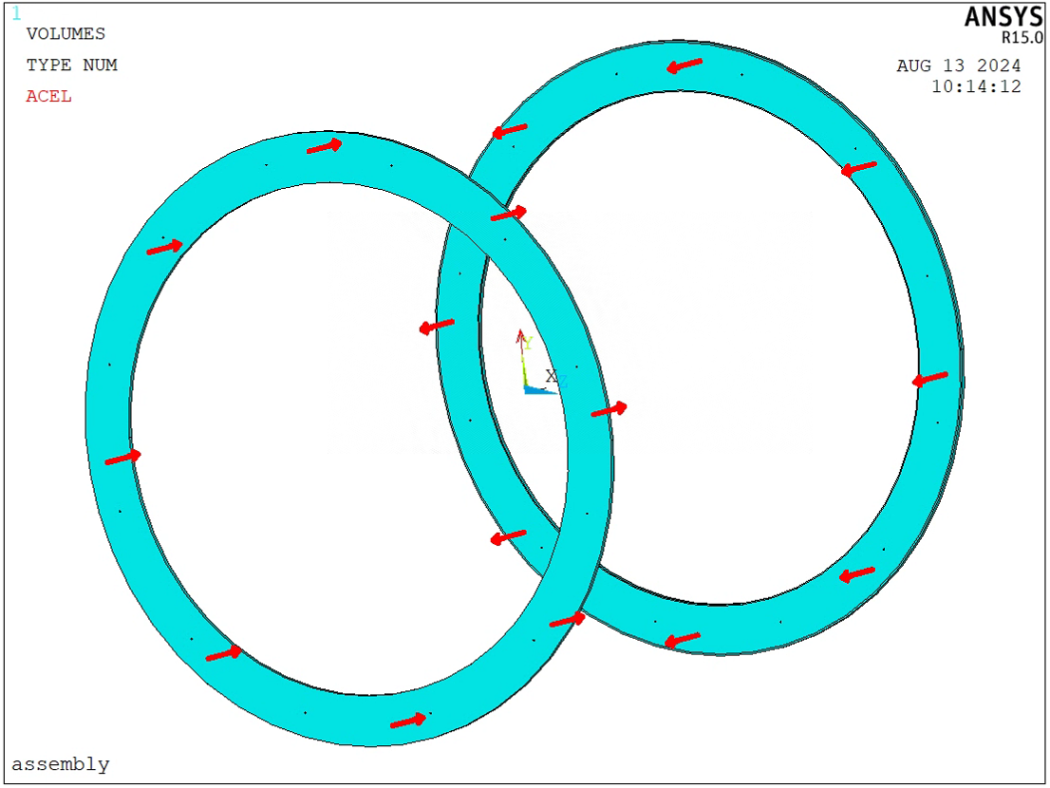
Cryostat Mechanical Analysis (FEA)
Loading
Axial load
Radial load

Slide 12
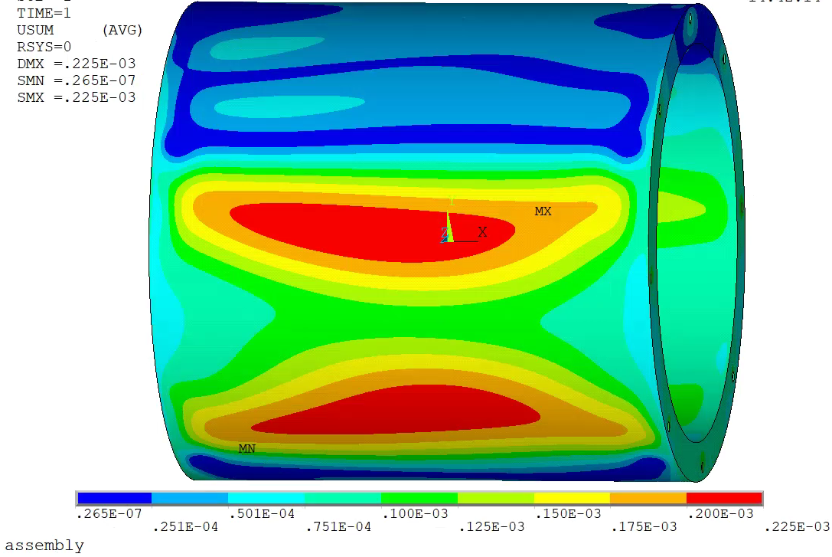
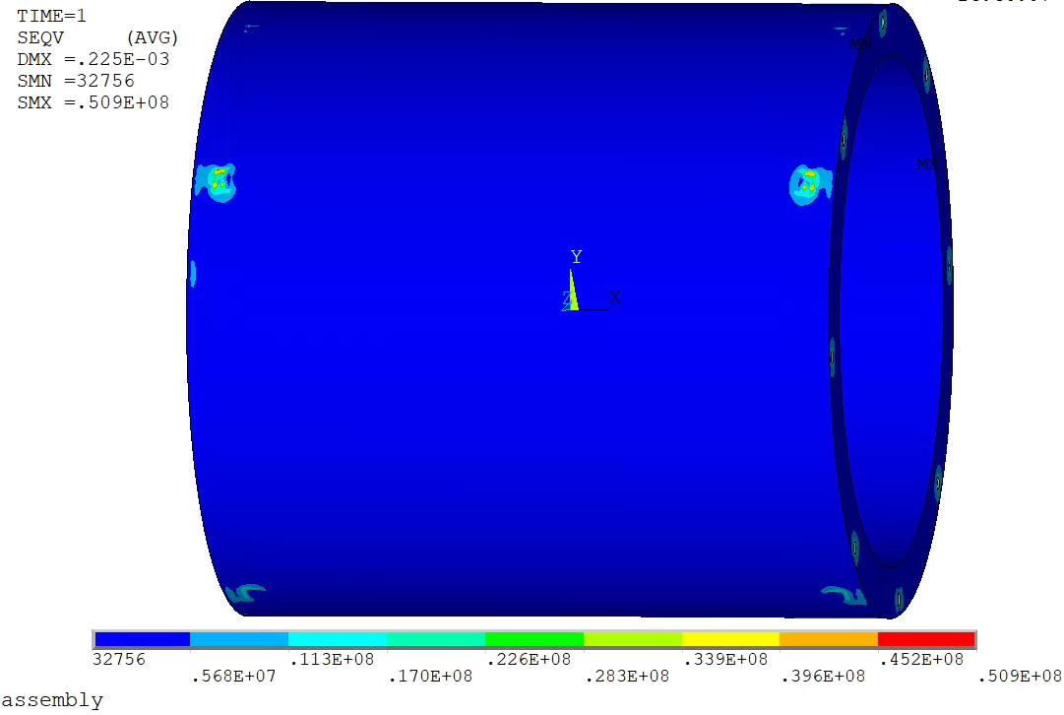
Cryostat Mechanical Analysis (FEA)
Assembly
  Weight of cold mass
  Pre-stress of tie rod
Deformation
Von Mises Stress
Usum_{max}=0.22 mm
Seqv_{max}= 51 MPa

Slide 13
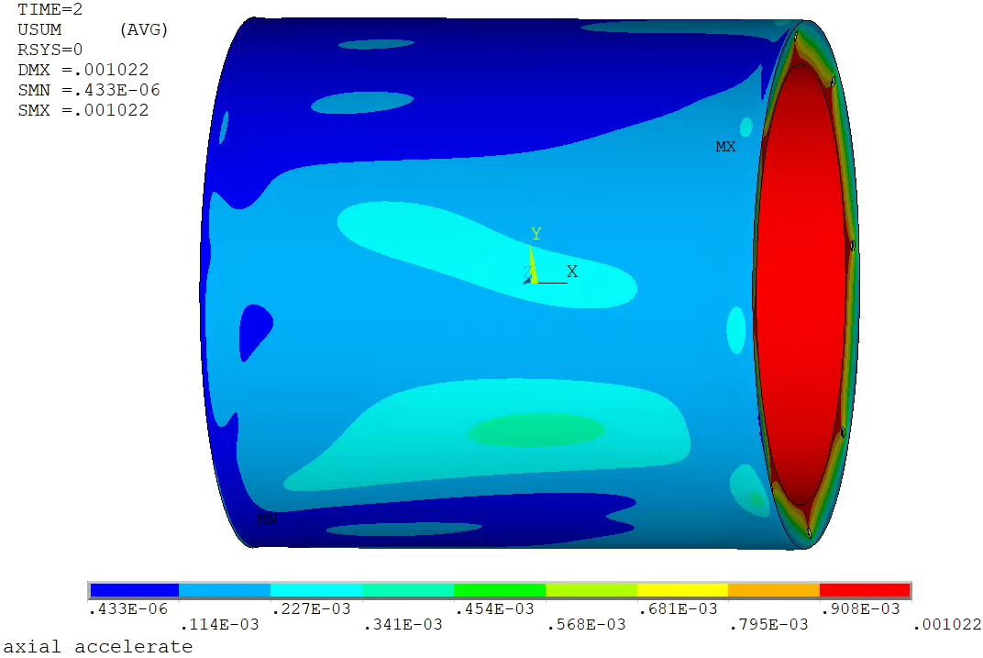
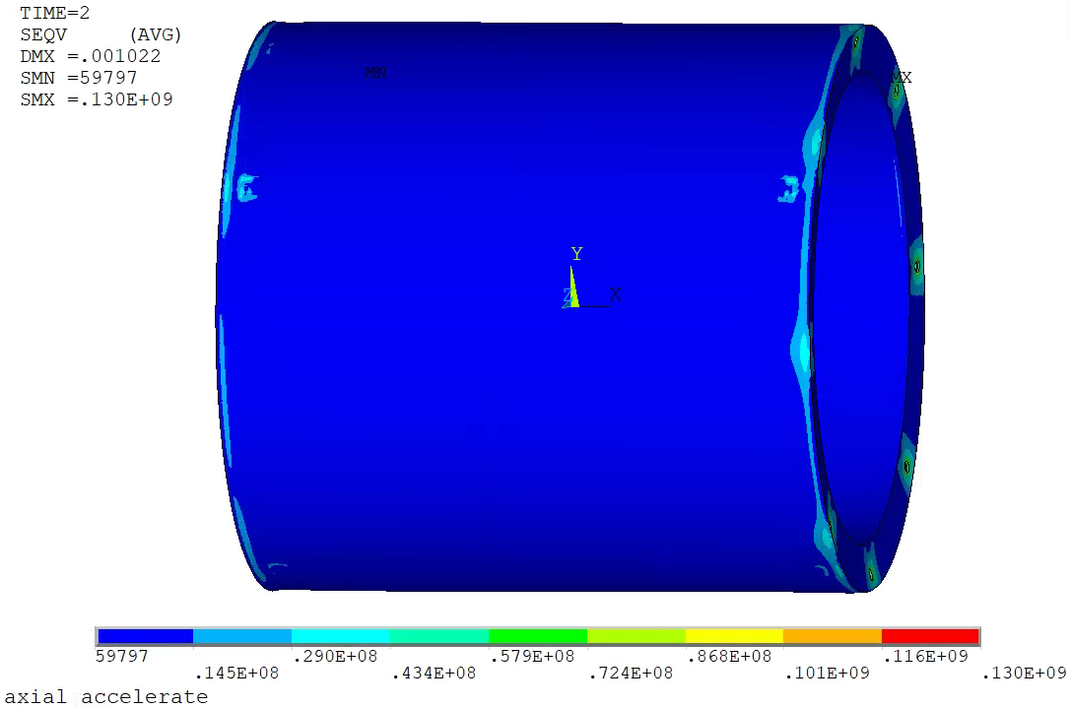
Cryostat Mechanical Analysis (FEA)
Axial accelerated motion
  Weight of cold mass
  Pre-stress of tie rod
  Axial impact force
Deformation
Von Mises Stress
Usum_{max}=1.02 mm
Seqv_{max}= 130 MPa

Slide 14
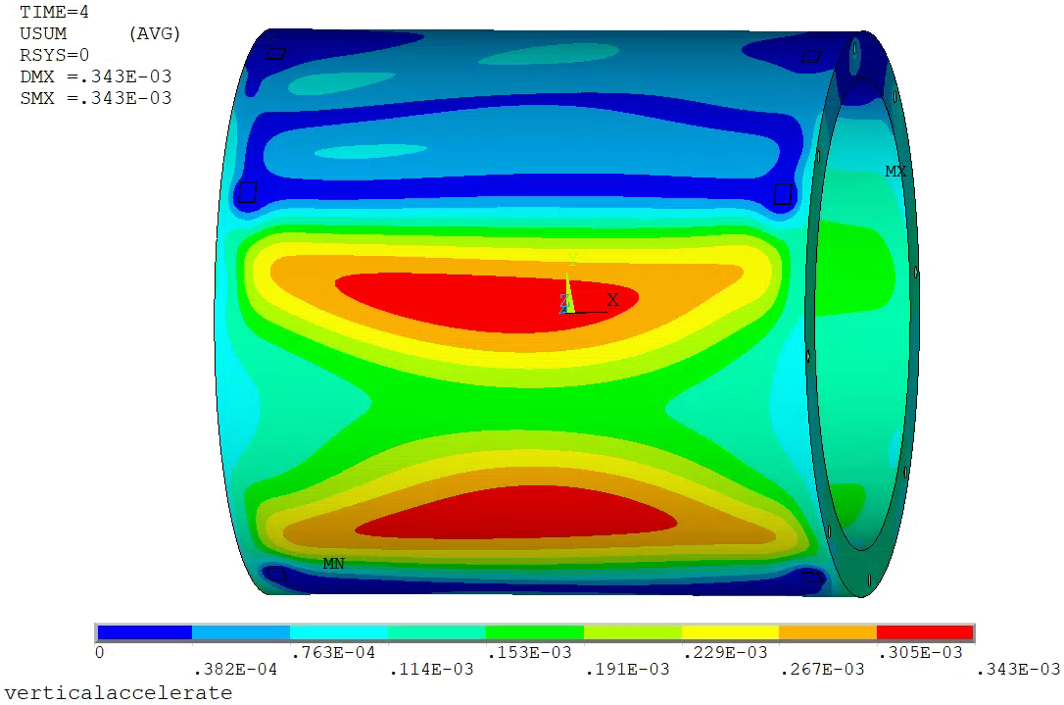
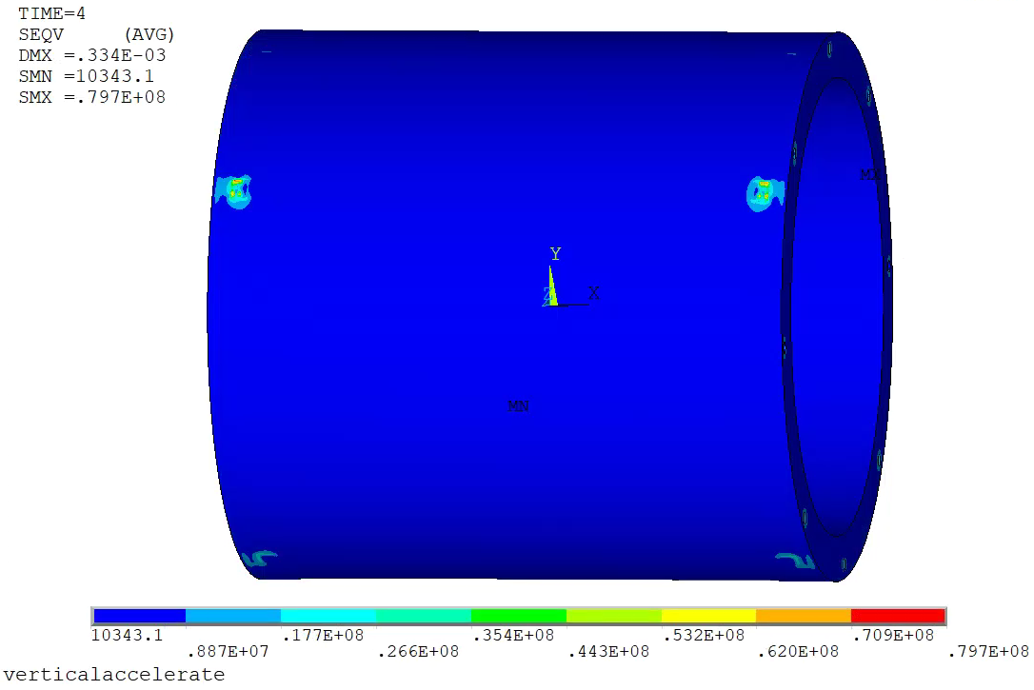
Cryostat Mechanical Analysis (FEA)
Vertical accelerated motion
  Weight of cold mass
  Pre-stress of tie rod
  Vertical impact force
Von Mises Stress
Deformation
Usum_{max}=0.34 mm
Seqv_{max}= 80 MPa

Slide 15

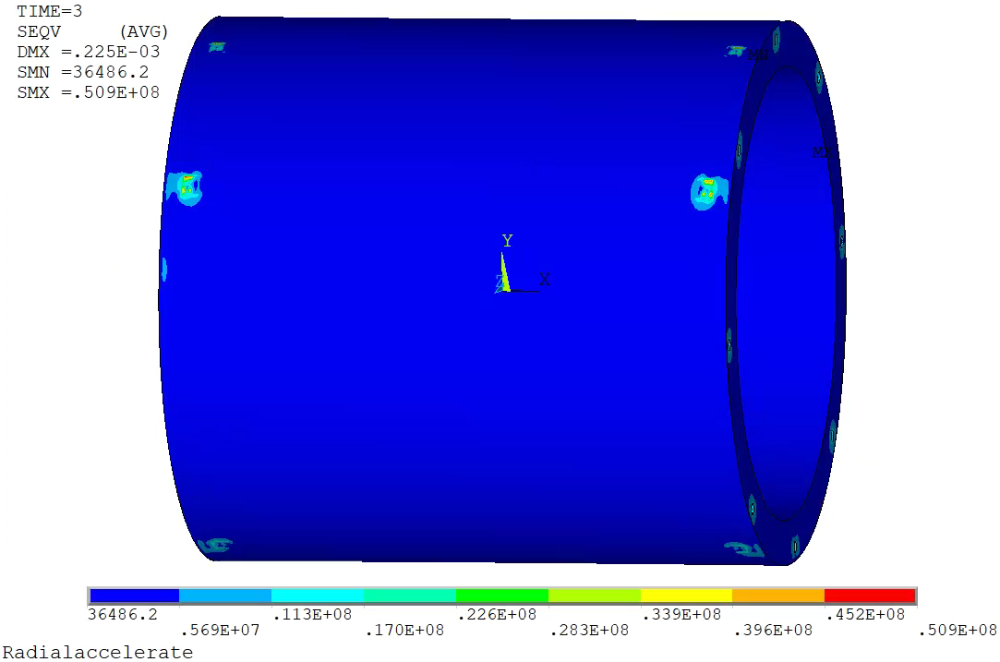
Cryostat Mechanical Analysis (FEA)
Radial accelerated motion
  Weight of cold mass
  Pre-stress of tie rod
  Radial impact force
Deformation
Von Mises Stress
Usum_{max}=0.22 mm
Seqv_{max}= 51 MPa

Slide 16
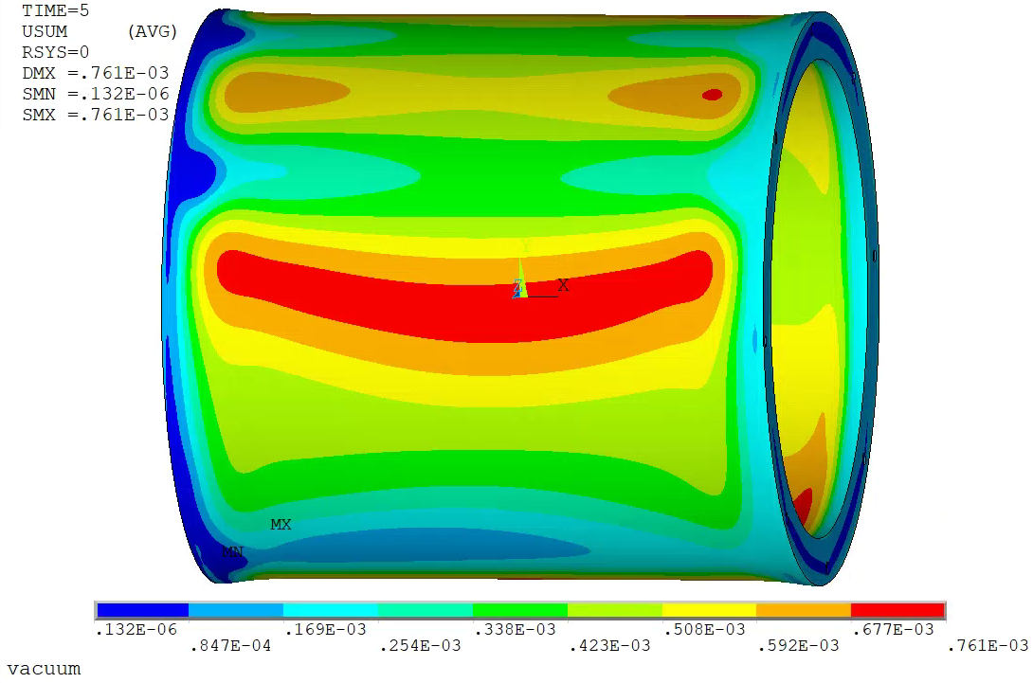
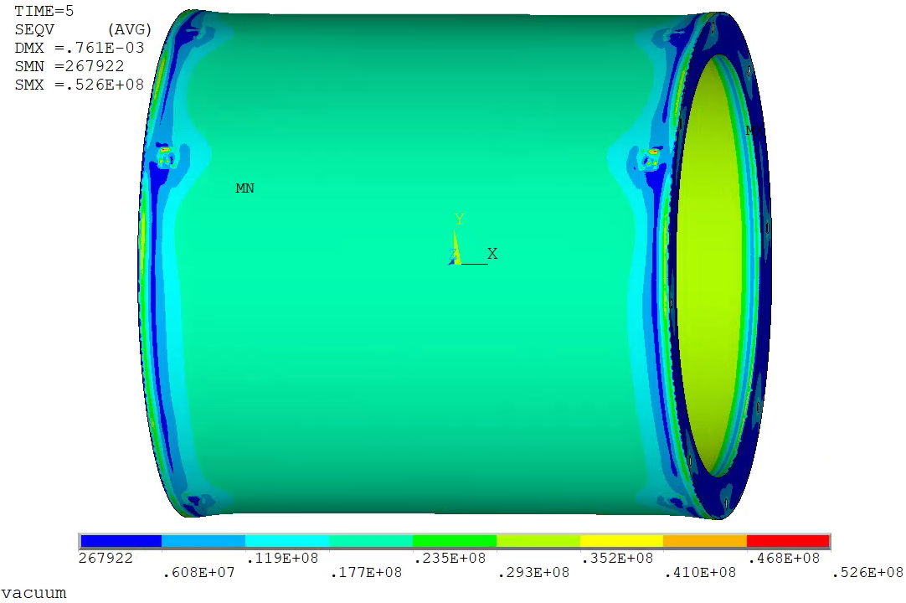
Cryostat Mechanical Analysis (FEA)
Vacuum
  Weight of cold mass
  Pre-stress of tie rod
  Air pressure
Von Mises Stress
Deformation
Usum_{max}=0.76 mm
Seqv_{max}= 53 MPa

Slide 17
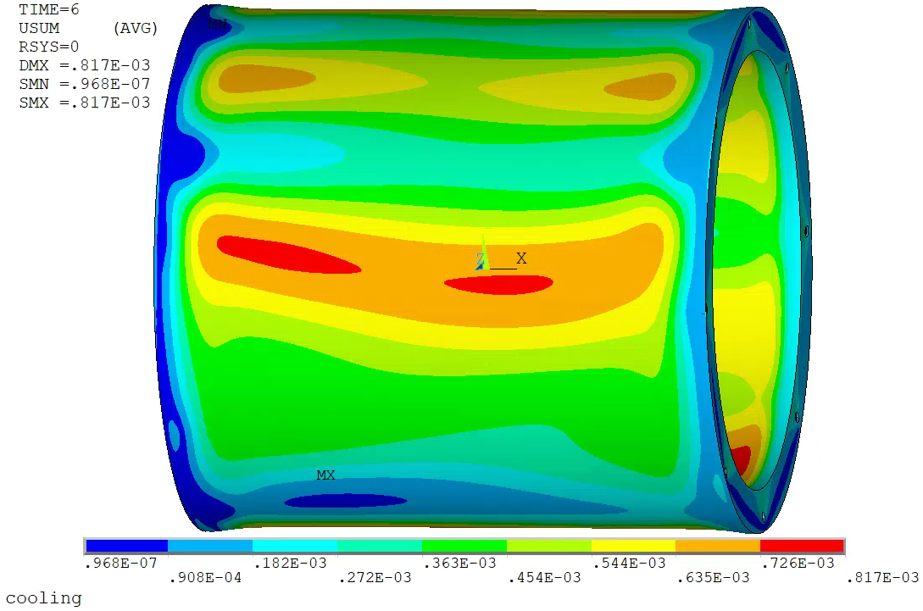
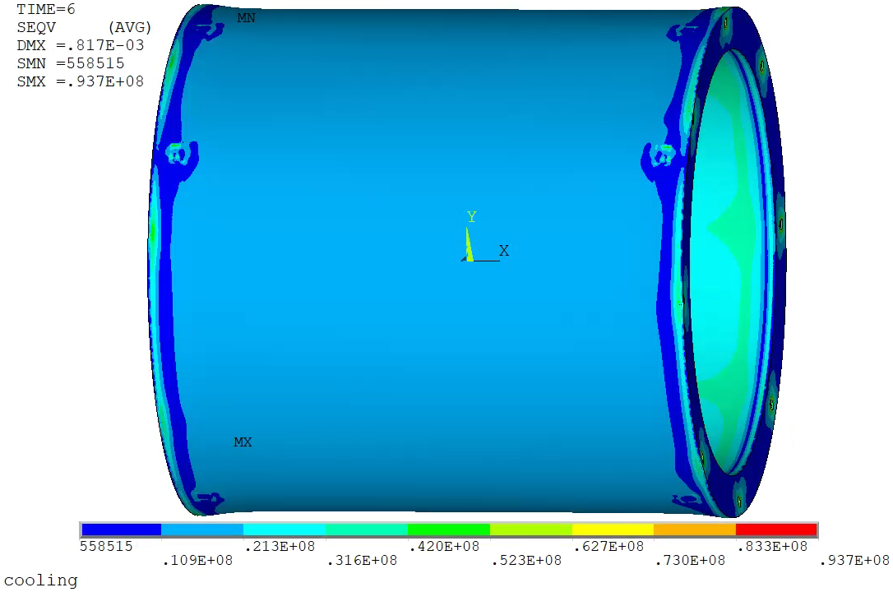
Cryostat Mechanical Analysis (FEA)
Cooling
  Weight of cold mass
  Pre-stress of tie rod
  Air pressure
  Cooling shrink
Deformation
Von Mises Stress
Usum_{max}=0.82 mm
Seqv_{max}= 94 MPa

Slide 18
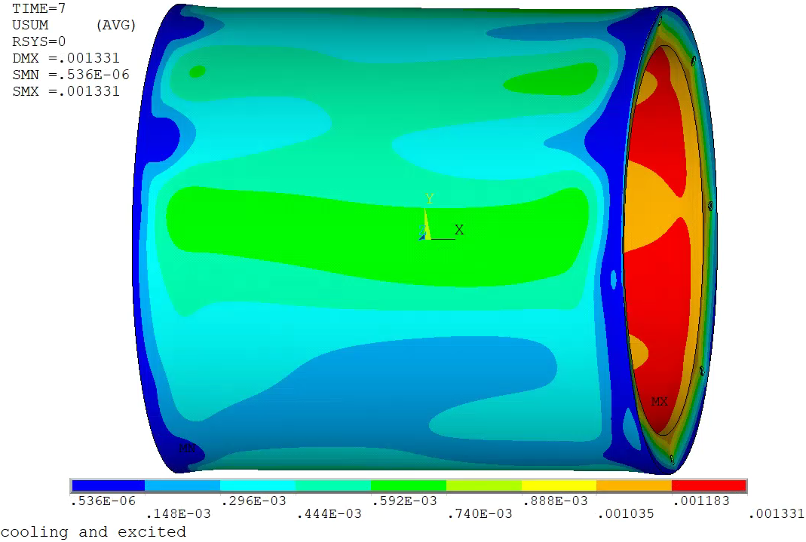
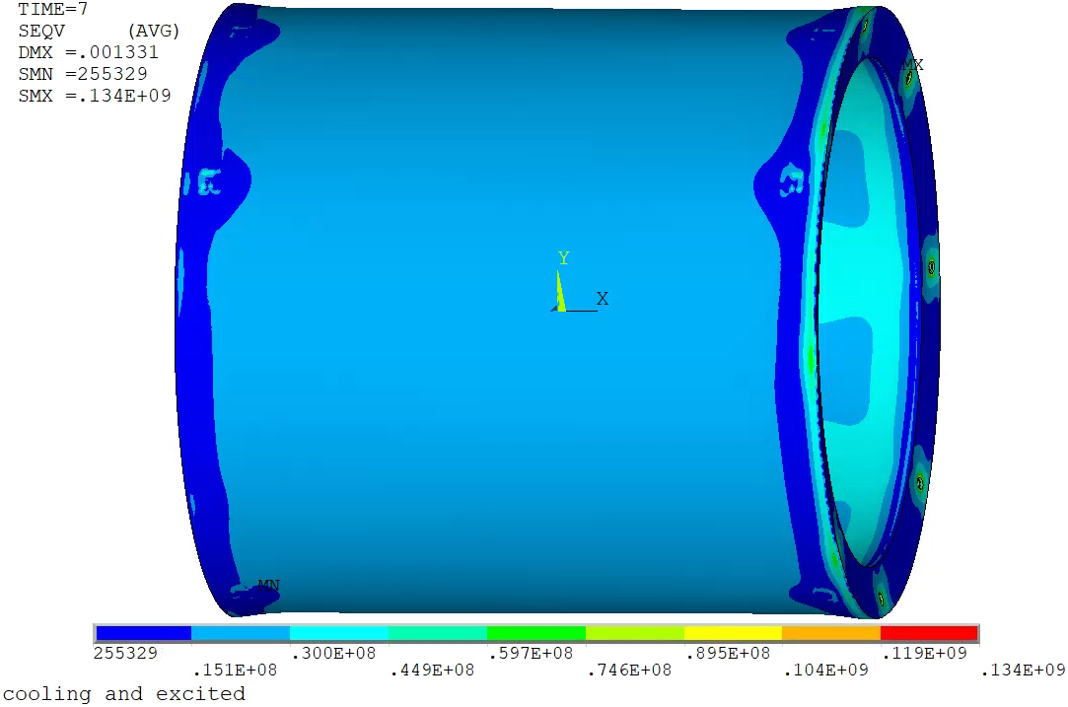
Cryostat Mechanical Analysis (FEA)
Excited , 15 mm misalignment in axial direction
  Weight of cold mass
  Pre-stress of tie rod
  Air pressure
  Cooling shrink
  EM force
Deformation
Von Mises Stress
Usum_{max}=1.3 mm
Seqv_{max}= 134 MPa

Slide 19
Key FEA Results
Deformation and Von Mises Stress
Condition | Max Deformation mm | Max Von Mises Stress Mpa
Assembly | 0.22 | 51
Axial accelerate | 1.02 | 130
Radial accelerate | 0.22 | 51
Vertical accelerate | 0.34 | 80
Vacuum | 0.76 | 52.6
Cooling | 0.82 | 93.7
Excited , 15 mm misalignment | 1.33 | 134

Slide 20
Summary & Future Plan
Key Design Features
Modular Coil Assembly: 3-segment bolted structure, titanium alloy suspension system.
Critical Components: Precision-machined 5083 aluminum support cylinder.
Mechanical Performance
Load Cases: Gravity , impact force, vacuum, cooling, and electromagnetic forces (up to 900 kN at 15mm offset).
Results:
  Max stress: 134 MPa (during excitation with 15mm offset) – well below yield (205 MPa).
  Max deformation: 1.3 mm (within tolerance for detector alignment).
Key Challenges
Manufacturing: Thin-walled cylinder ,and slender suspension rods (L/D > 50).
Future plan
Design Refinement: Optimize rod parameter.
Prototyping: Validate machining processes for titanium rods and aluminum alloy cylinder.
Integration: Finalize cryostat welding and assembly protocols.
Conclusion
The design meets all mechanical requirements for CEPC detector operation. Focus areas include addressing manufacturing tolerances and stress concentrations, with prototyping to de-risk production.

Slide 21

Thanks !

