Slide 1
Design of the Cooling Scheme for the Superconducting Magnets of the CEPC Detector
Zhu Keyu
2025.05

Slide 2
OUTLINE
Background
Comparison of Schemes
2.1 Thermosiphon Scheme 2.2 Forced Flow Liquid Helium Cooling Scheme 2.3 Subcooled Supercritical Helium Cooling Scheme 2.4 Comparison of the Three Schemes
Thermosiphon Scheme
3.1 Thermosiphon Cooling Process 3.2 Heat Load Calculation 3.3 Design of the Cold Shield Cooling Structure 3.4 Design of the Coil Cooling Structure 3.5 Design of the Current Lead Cooling Structure
Summary

Slide 3
1 Background
The CEPC detector is a crucial component of the CEPC project, designed to detect particles generated from collisions, measure their energy, momentum, charge, and other properties, and identify different types of particles to study their behavior and interactions. To achieve precise particle detection and measurement, the CEPC detector requires high-performance detector systems and magnetic field equipment, among which the superconducting magnet is a key technological device.
A superconducting magnet is an electromagnet made from superconducting materials that can achieve a superconducting state at low temperatures, allowing large currents to flow without resistance to generate powerful magnetic fields. In the CEPC detector, superconducting magnets are primarily used to produce strong magnetic fields for deflecting the trajectories of charged particles, measuring their momentum, and identifying their properties. These superconducting magnets must possess high magnetic field strength, stability, and precision to ensure the accuracy and reliability of particle detection.
To maintain the superconducting state, the superconducting magnets require a stable cryogenic environment. Therefore, it is essential to design an appropriate superconducting cooling structure for the detector's superconducting magnets and their associated superconducting equipment. This ensures that the temperature of the superconducting coils remains within the superconducting range and, in extreme cases, guarantees the pressure safety of the primary cooling structure of the coils.

Slide 4
1 Scheme Research
To better design the cooling structure for the superconducting magnets of the detector, we conducted preliminary research on the cooling structures of facilities such as CMS, ATLAS, and the domestic EAST project.
The CMS detector magnet employs the thermosiphon method for cooling. Thermosiphon is a natural circulation heat transfer method that utilizes the density and temperature differences of a liquid to achieve cooling without external mechanical power.
The ATLAS Toroid superconducting magnet uses forced flow cooling, where a pump system drives the circulation of 4.5 K two-phase helium for cooling. Forced convection cooling is a method that relies on the flow of a fluid (typically a liquid or gas) to transfer heat efficiently.
Similarly, the EAST nuclear fusion device also utilizes superconducting magnets for magnetic confinement. The superconducting magnets in EAST operate in the 3.8 K temperature range and employ a forced flow cooling method using 3.5 K–4.5 K (subcooled) liquid helium.
These insights from CMS, ATLAS, and EAST provide valuable references for designing the cooling structure of the CEPC detector's superconducting magnets.
After conducting preliminary research, three cooling schemes were considered for the superconducting magnets of the CEPC detector:
Thermosiphon Cooling Scheme
Liquid Helium Forced-Flow Cooling Scheme
Subcooled Liquid Helium Cooling Scheme
It is necessary to perform calculations, analysis, and comparisons of these schemes to select the most suitable cooling solution.

Slide 5
2.1 Thermosiphon Cooling Scheme
40K GHe inlet
The thermosiphon cooling scheme exhibits strong cooling capacity, with a maximum heat exchange capability of up to 1200 W/m². It relies on the density and temperature differences of the liquid to achieve natural circulation for heat transfer.
In the superconducting magnet, an additional 50 mm of space is required at both the top and bottom to design a liquid collection tank (or gas collection tank).
The thermosiphon scheme necessitates the inclusion of a phase separator at the top. This phase separator must be positioned at a certain distance from the superconducting magnet. Based on the experience of CMS, the bottom of the phase separator should be 10 meters above the bottom liquid collection tank.
LHe inlet
GHe outlet
80K GHe outlet
40K&300K Cooldown
To Compressor
Phase Separator
Current Lead
Chimney
Cryogenic
Chimney
Vacuum Pump
Magnet
Thermal Shield

Slide 6
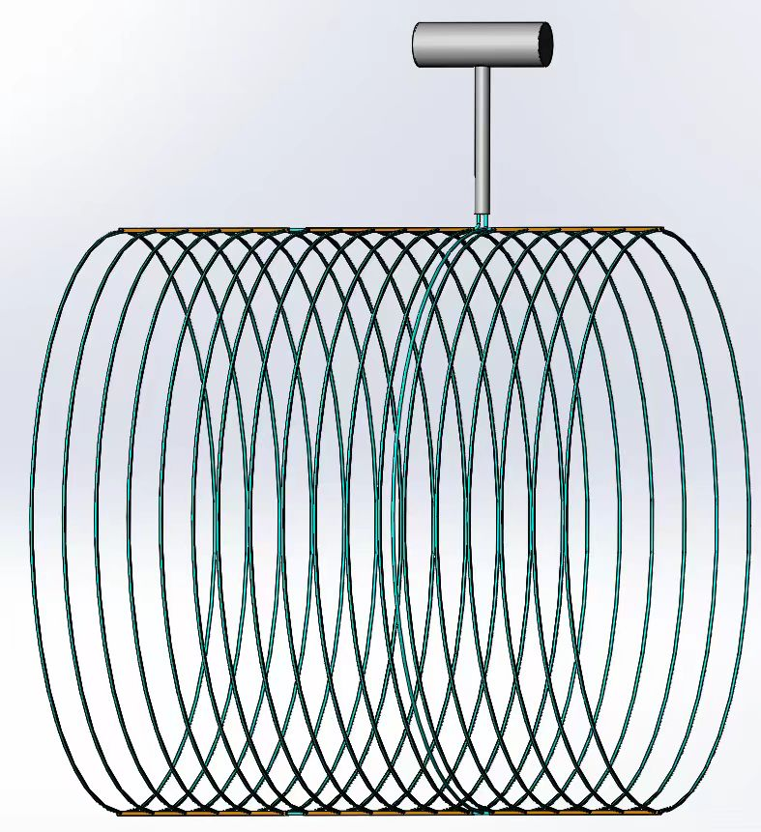
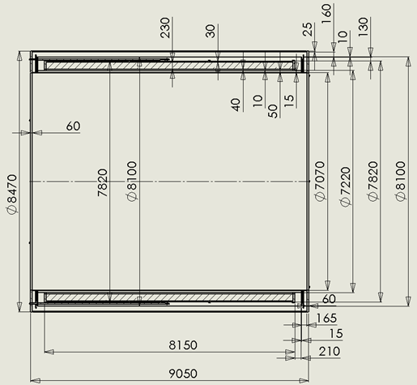
2.1 Thermosiphon Cooling Scheme
Coil Specifications: Length: 8150 mm Inner diameter: 7070 mm Outer diameter: 8470 mm Cold mass: approximately 140 tons.
Cooling Pipe Arrangement: The cooling system is designed with 32 cooling pipes arranged at a spacing of 250 mm between each pipe. The pipes selected are Φ17×1 (inner diameter: 15 mm). Assuming only about 1/3 of the bottom welded area is in contact, the calculated contact width is approximately 10 mm. The total length of the cooling pipes is approximately 784 meters.
Contact Area Calculation:
The total contact area between the cooling pipes and the coil support is calculated as: 7.8 * 3.14 * 0.01 * 32 = 7.84 m².

Slide 7
2.1 Thermosiphon Cooling Scheme
Heat Load Analysis:
With a total heat load of 290 W at 5 K, the corresponding heat flux is:
290 / 7.84 ≈ 36.98 W/m².
This heat flux is significantly lower than the maximum heat exchange capacity of the thermosiphon method (1200 W/m²), ensuring that the cooling task can be effectively accomplished.
The thermosiphon cooling scheme offers strong cooling capacity, but it requires the additional installation of a top phase separator to utilize gravity for driving the circulation of the fluid. The liquid helium inside the phase separator is cooled by the refrigeration system.

Slide 8
2.2 Liquid Helium Forced Flow Scheme
Liquid Helium Forced Flow Scheme: Requires the addition of a cryogenic helium circulation pump to provide the driving force for the forced flow of liquid helium.
A throttle valve is installed before the phase separator to throttle high-pressure two-phase helium back into the local Dewar for reuse.
Main Cost Consideration The primary cost lies in the addition of the cryogenic helium circulation pump.
Challenges of the Forced Flow Scheme The two-phase flow pressure increases as the heat transfer process progresses. The void fraction of liquid helium in the cooling pipes continuously rises, leading to an increase in flow resistance. This imposes higher power requirements on the pump.
Additionally, the throttle valve must be carefully selected based on the flow rate, with considerations for vibration and other operational issues.
This scheme, while effective, requires careful design to address the challenges of flow resistance, pump power, and valve performance.
To Compressor
Phase Separator
Current Lead
Chimney
Cryogenic
Chimney
PUMP
Vacuum Pump
Magnet
Thermal Shield

Slide 9
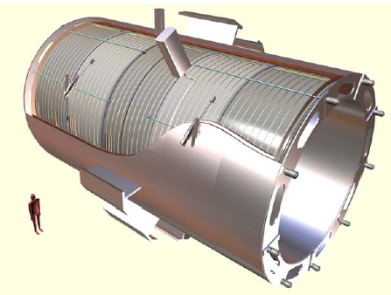
2.2 Liquid Helium Forced Flow Scheme
Coil Specifications: Length: 8150 mm Inner diameter: 7070 mm Outer diameter: 8470 mm Cold mass: approximately 140 tons.
Cooling Pipe Arrangement: Option 1: 32 cooling pipes arranged in parallel. Option 2: 36 straight pipes arranged in a serpentine pattern. Total pipe length remains 784 meters, with an assumed inner diameter of 20 mm.
Heat Load and Flow Requirements: At 5 K, the total heat load is approximately 290 W. The latent heat of vaporization for liquid helium is 23 J/g, requiring a flow rate of 12.6 g/s. To maintain a low void fraction (<20%) and minimize flow resistance, a minimum liquid helium flow rate of 63 g/s is required.
液氦压力（bar） | 对应饱和温度（K）
1.05 | 4.261
1.15 | 4.359
1.25 | 4.453
1.35 | 4.541
1.45 | 4.625
1.75 | 4.855

Slide 10
2.2 Liquid Helium Forced Flow Scheme
Pressure Drop Analysis: For a 20 mm pipe, the pressure drop is 7.05 × 10⁶ Pa (70 bar). For a 25 mm pipe, the pressure drop is 2.18 × 10⁶ Pa (20 bar). These pressure drops are unacceptable, necessitating the division of the flow into multiple streams.
Proposed Solution: Divide the flow into four streams, each with a flow rate of 16 g/s and a pipe length of 196 meters. The calculated pressure drop for each stream is 3.566 × 10⁴ Pa (0.356 bar). This requires pressurized operation of liquid helium and the installation of a cryogenic pump.
Impact of Pressurization:
Pressurizing liquid helium increases its saturation temperature to 1.406 bar, corresponding to a saturation temperature of 4.588 K.
Due to heat conduction, the maximum temperature on the coil rises to approximately 5.383 K, with an average temperature of 4.972 K.
This elevated temperature has a detrimental effect on the cooling efficiency of the coil.
In summary, while dividing the flow reduces pressure drop, the need for pressurized liquid helium and the resulting temperature rise pose significant challenges to the cooling performance of the coil.

Slide 11
2.3 Subcooled Forced Flow Scheme
Subcooled Forced Flow Scheme: The cooling structure is similar to that of the liquid helium forced flow scheme, but there are significant differences in equipment and processes.
Since the liquid helium has a certain degree of subcooling, its cooling performance is superior to that of the pure liquid helium forced flow scheme.
Key Components and Costs: Requires an additional vacuum system to provide a stable and substantial supply of 3.5 K subcooled liquid helium as the cold source, further subcooling the saturated liquid helium.
A cryogenic circulation pump is essential for this scheme.
The main cost increase comes from the cryogenic circulation pump and a complete 3.5 K (470 mbar) vacuum system, estimated at approximately 4 million RMB.
To Compressor
Phase Separator
Cryogenic
Chimney
Current Lead
Chimney
Sub Cooler
Vacuum Pump
Magnet
Thermal Shield

Slide 12
2.3 Subcooled Forced Flow Scheme
Alternative Option: Subcooled Supercritical Helium:
Subcooling 3 bar @ 5 K supercritical helium is also feasible.
This approach still requires the addition of a vacuum system to subcool the supercritical helium.
In summary, the subcooled forced flow scheme offers improved cooling performance but involves higher costs and complexity due to the need for additional equipment such as a vacuum system and cryogenic pump. The alternative use of subcooled supercritical helium further expands the cooling options but requires similar infrastructure investments.
To Compressor
Phase Separator
Cryogenic
Chimney
Current Lead
Chimney
Sub Cooler
Vacuum Pump
Magnet
Thermal Shield

Slide 13
2.4 Compare of 3 Scheme
 | thermosiphon cooling scheme | Liquid Helium Forced Flow Scheme | Subcooled Forced Flow Scheme
Structural | Only need Phase Separator | Need Liquid Helium Circulation Pump | Need Liquid Helium Circulation Pump & Helium Vacuum System
Performance | Strong Liquid Supply Capacity: liquid helium flow rate of 52.2 g/s. Pressure Drop: gravity-driven, almost eliminating the pressure drop issues found in forced-flow cooling systems. Heat Exchange Capacity: Utilizes phase-change heat transfer 1200 W/m². | Liquid Supply Capacity and Pressure Drop: The liquid supply capacity depends on the source pressure and is influenced by the length and arrangement of the pipes. Heat Exchange Capacity: Utilizes convective heat transfer with a capacity of 412.1 W/(K·m²). | Liquid Supply Capacity and Pressure Drop: The liquid supply capacity relies on the source pressure and is closely tied to the length and layout of the pipes. Heat Exchange Capacity: Utilizes convective heat transfer with a capacity of approximately 300 W/(K·m²).
Adwantage | The heat transfer coefficient is high, no source pressure and pressure drop limitations, and benefits from successful experience at CERN. | It does not require additional equipment or structures and has a relatively compact size. | It offers a larger margin, and the cooling effect is superior to that of a non-subcooled forced flow system.

Slide 14
2.4 Compare of 3 Scheme
 | Thermosiphon Cooling Scheme | Liquid Helium Forced Flow Scheme | Subcooled Forced Flow Scheme
Disadvantage | It requires the addition of a phase separator at the top, resulting in a larger overall volume. | The cooling capacity is limited by pressure drop, making it unable to provide a very high flow rate. It requires dividing the flow into four channels and adding a liquid helium pressurization pump to increase the pressure of the liquid helium to 1.405 bar, which raises the saturation temperature to approximately 4.588 K. This is detrimental to the cooling of the coils. For a 25 mm pipe, the pressure drop is 0.356 bar. | The cooling capacity is limited by pressure drop, making it unable to provide a very high flow rate. A multi-channel arrangement is required to reduce the pressure drop.
Cost | The additional costs include the top phase separator and the operational expenses. | It requires the additional installation of a liquid helium pressurization pump and extra cold Shields or similar equipment. | It requires an additional vacuum system and extra cold Shields or similar equipment.

Slide 15
3.1 Thermosiphon Scheme
Analysis and Comparison: After thorough analysis and comparison, the thermosiphon cooling scheme was ultimately selected for the superconducting magnets of the CEPC detector.
Main Hardware for Thermosiphon Scheme: Coil thermosiphon main cooling system，Main valve box, Phase separator, A five-channel pipeline section, A four-channel pipeline section, A current lead cooling tower.
Process Stages:
1. 300K Cooling Stage
2. Cold Shield Cooling Stage
3. Main Circuit Cooling Stage
4. Phase Separator Liquid Accumulation
5. Main Cooling System Liquid Accumulation
6. Stable Operation
7. Warm-Up Stage
This scheme provides a reliable and efficient cooling solution for the CEPC detector's superconducting magnets.
To Compressor
Phase Separator
Current Lead
Chimney
Cryogenic
Chimney
Vacuum Pump
Magnet
Thermal Shield

Slide 16
3.1 Thermosiphon Scheme
Main Hardware for Thermosiphon Scheme: Coil thermosiphon main cooling system，Main valve box, Phase separator, A five-channel pipeline section, A four-channel pipeline section, A current lead cooling tower.
Process Stages:
1. 300K Cooling Stage
2. Cold Shield Cooling Stage
3. Main Circuit Cooling Stage
4. Phase Separator Liquid Accumulation
5. Main Cooling System Liquid Accumulation
6. Stable Operation
7. Warm-Up Stage
This scheme provides a reliable and efficient cooling solution for the CEPC detector's superconducting magnets.
To Compressor
Phase Separator
Current Lead
Chimney
Cryogenic
Chimney
Vacuum Pump
Magnet
Thermal Shield

Slide 17
3.1 Thermosiphon Scheme
40K GHe inlet
Main Hardware for Thermosiphon Scheme: Coil thermosiphon main cooling system，Main valve box, Phase separator, A five-channel pipeline section, A four-channel pipeline section, A current lead cooling tower.
Process Stages:
1. 300K Cooling Stage
2. Cold Shield Cooling Stage
3. Main Circuit Cooling Stage
4. Phase Separator Liquid Accumulation
5. Main Cooling System Liquid Accumulation
6. Stable Operation
7. Warm-Up Stage
This scheme provides a reliable and efficient cooling solution for the CEPC detector's superconducting magnets.
LHe inlet
GHe outlet
80K GHe outlet
40K&300K Cooldown
To Compressor
Phase Separator
Current Lead
Chimney
Cryogenic
Chimney
Vacuum Pump
Magnet
Thermal Shield

Slide 18
3.1 Thermosiphon Scheme
40K GHe inlet
Main Hardware for Thermosiphon Scheme: Coil thermosiphon main cooling system，Main valve box, Phase separator, A five-channel pipeline section, A four-channel pipeline section, A current lead cooling tower.
Process Stages:
1. 300K Cooling Stage
2. Cold Shield Cooling Stage
3. Main Circuit Cooling Stage
4. Phase Separator Liquid Accumulation
5. Main Cooling System Liquid Accumulation
6. Stable Operation
7. Warm-Up Stage
Current Leads Cooling Stage
LHe inlet
GHe outlet
80K GHe outlet
40K&300K Cooldown
To Compressor
Phase Separator
Current Lead
Chimney
Cryogenic
Chimney
Vacuum Pump
Magnet
Thermal Shield

Slide 19
3.2 Thermosiphon Scheme-Thermal Heat Load
The current design structure of the detector magnet coil is shown in the figure on the right.
The specific requirements are as follows:
The temperature of the coil must be maintained at the superconducting level to ensure the superconducting coil remains stable in the superconducting state.
Based on the current structure, the corresponding radiation heat has been calculated:
Radiation Heat (300–60 K):
30 layers of multilayer insulation: 493.15 W
40 layers of multilayer insulation: 372.87 W
50 layers of multilayer insulation: 299.76 W
Radiation Heat (60–5 K):
10 layers of multilayer insulation: 34.3789 W
20 layers of multilayer insulation: 16.9332 W
In addition, the 5 K heat load includes other heat sources such as:
Coil rod joint heating
Dynamic heat load
Total: approximately 250 W
Furthermore, there is an additional 100 W of heat generated by the current leads.

Slide 20
3.2 Thermosiphon Scheme-Thermal Heat Load
Considering the use of 40 layers of multilayer insulation for the cold Shield, the radiation heat at 60 K under these conditions is 372.87 W. In addition, the 60 K heat load includes:
Approximately 500 W from the cold Shield tie rods
Dynamic heat leakage
Radial tie rod heat leakage
Total: approximately 1058.1 W of 60 K heat load.
The 2000 W heat load from the current leads will be cooled separately.
Based on the cryogenic requirements, the dimensions for the cold Shield and coil cooling are determined as follows:
Between the 300 K and 60 K cold Shields, 40 layers of multilayer insulation and a 15 mm cold Shield copper pipe (or aluminum pipe) are added, requiring a total of 40 + 15 + 5 mm.
Between the 60 K cold Shield and the 5 K magnet coil, 10 layers of multilayer insulation are added, requiring a total of 10 + 5 mm.

Slide 21
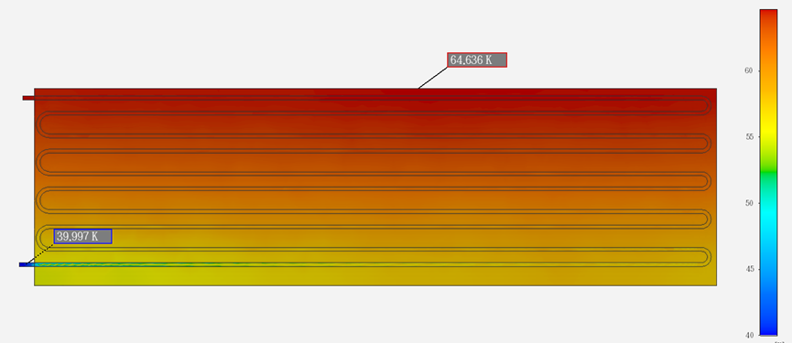
3.2 Thermosiphon Scheme-Thermal Shield
Considering the use of 40 layers of multilayer insulation for the cold Shield, the radiation heat at 60 K under these conditions is 372.87 W. In addition, the 60 K heat load includes approximately 500 W from the cold Shield tie rods, resulting in a total 60 K heat load of about 1058.1 W. The 2000 W heat load from the current leads will be cooled separately.
The cold Shield will be cooled using a forced flow of 3 bar @ 40 K cold helium gas. The inner diameter of the pipes is 15 mm, and considering that only about 1/3 of the welded bottom is in contact, the contact width is approximately 10 mm. In the 40–80 K temperature range, the specific heat of helium gas is about 5.2 J/(g·K). Therefore, a helium flow rate of 1058.1 / (5.2 × (80 40)) = 5.1 g/s is required. Accounting for a safety margin, a total of 8 g/s of cold helium gas will be used as the cooling source for the cold Shield.
The cold Shield will employ an axial serpentine layout, with a total of 20 cooling pipes evenly distributed around the circumference. The total length of the pipes is approximately 180 meters, resulting in a calculated pressure drop of 1.7106 × 10⁵ Pa (1.71 bar), which is relatively high. To reduce the pressure drop, the flow will be divided into two streams, each with a flow rate of 4 g/s and a pipe length of about 90 meters. This reduces the pressure drop to 2.709 × 10⁴ Pa (0.271 bar), enabling effective forced-flow cooling of the cold Shield.
The inlet temperature of the cold shield pipes is 40 K, the outlet temperature is 64.636 K, and the average temperature on the cold shield is 54.26 K.

Slide 22
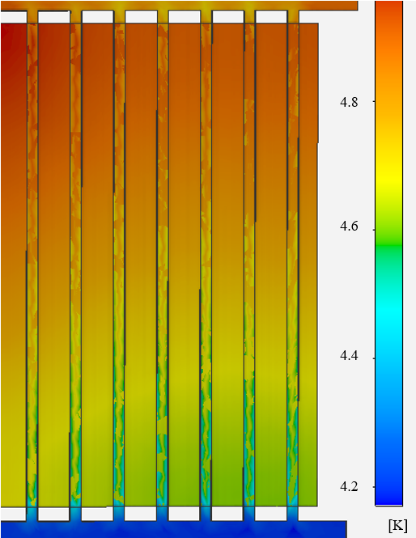
3.2 Thermosiphon Scheme-Coil Cooling Structure
Coil Specifications: Length: 8150 mm Inner diameter: 7070 mm Outer diameter: 8470 mm Cold mass: approximately 140 tons.
Cooling Pipe Arrangement: The cooling system is designed with 33 cooling pipes, divided into three groups of 11 pipes each, spaced at 250 mm intervals. The pipes selected are Φ17×1 (inner diameter: 15 mm).
Assuming only about 1/3 of the bottom welded area is in contact, the calculated contact width is approximately 10 mm. The total length of the cooling pipes is approximately 784 meters.
Contact Area Calculation:
The total contact area between the cooling pipes and the coil support is calculated as: 7.8 * 3.14 * 0.01 * 32 = 7.84 m².
Heat Load Analysis:
With a total heat load of 290 W at 5 K, the corresponding heat flux is: 290 / 7.84 ≈ 36.98 W/m². This heat flux is significantly lower than the maximum heat exchange capacity of the thermosiphon method (1200 W/m²).

Slide 23
3.2 Thermosiphon Scheme-Coil Cooling Structure
Thermosiphon Scheme Performance:
Since the thermosiphon scheme is inherently a boiling heat transfer process, the temperature can be consistently maintained at 4.2 K.
Considering the thermal conductivity of the coil, the maximum temperature on the coil is 4.982 K, and the average temperature is 4.591 K.
In summary, the thermosiphon cooling scheme effectively maintains the coil temperature within the superconducting range, ensuring stable and reliable operation of the superconducting magnet.
Due to the large volume of the CEPC detector magnet, using a serpentine coil layout would result in significant resistance. Moreover, the serpentine coil layout does not align with the direction of gravity, making it unsuitable for thermosiphon cooling in large-volume equipment. Additionally, we have high confidence in our welding techniques and plan to conduct tests in future experiments.

Slide 24
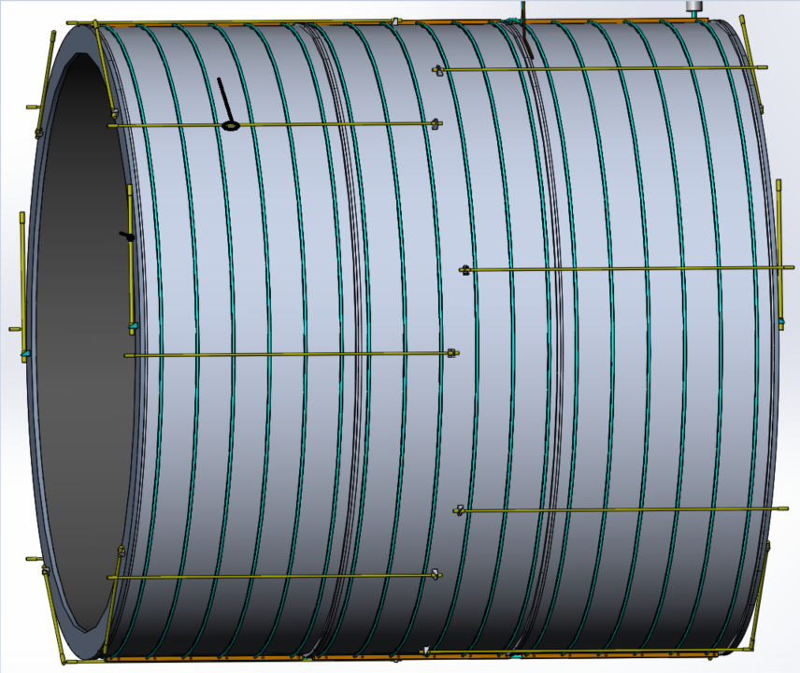
3.2 Thermosiphon Scheme-Coil Cooling Structure
We plan to utilize an existing small-scale magnet and design a corresponding cryostat and cooling structure based on the thermosiphon cooling method. This will be used to verify the accuracy of the aforementioned calculations and to test related engineering processes such as welding and support. The relevant tests are expected to be conducted next year.

Slide 25
3 Thermosiphon Scheme
Coil Cooling Structure Parameters
Ave Temperature | 4.591K
Max Temperature | 4.982K
Tube Space | 250mm
Tube Inner Diameter | 15mm
Work Pressure | 1.05bar
Thermal Shield Parameters
Inlet Temperature | 40K
Outlet Temperature | 64.64K
Ave Temperature | 54.26K
Mass Flow Rate | 8g/s
Tube length | 90m*2
Tube Inner Diameter | 15mm
Work Pressure | 3bar
Pressure Drop（Every Single Line） | 0.271bar
Current Lead Parameters
Mass Flow Rate (4K) | 3g/s
Mass Flow Rate (40K) | 3g/s
Tube Inner Diameter | 8mm

Slide 26
4 Summary
After comparing the three cooling structures and methods, the thermosiphon cooling scheme was ultimately selected. The forced-flow cooling scheme has a high pressure drop, and the increased pressure leads to a higher saturation temperature, which negatively affects the overall coil temperature. The subcooled forced-flow scheme, on the other hand, is overly complex, expensive, and introduces uncertainty into the system.
Based on the thermosiphon cooling scheme, the basic cooling process was designed, enabling functions such as temperature equalization and cooling, cold Shield cooling, main circuit cooling, and current lead cooling at cryogenic temperatures.
The heat load of the detector's superconducting magnet was estimated, and the specific cooling structures for the cold Shield, coil, and current leads were designed according to the corresponding heat load. The cooling conditions and required cooling capacity were calculated, leading to the specification of parameters for the refrigeration system.

