Slide 1
Al-stabilized superconductor development
Ling Zhao
on behelf of Superconducting Magnet Group
2025.5.16

Slide 2
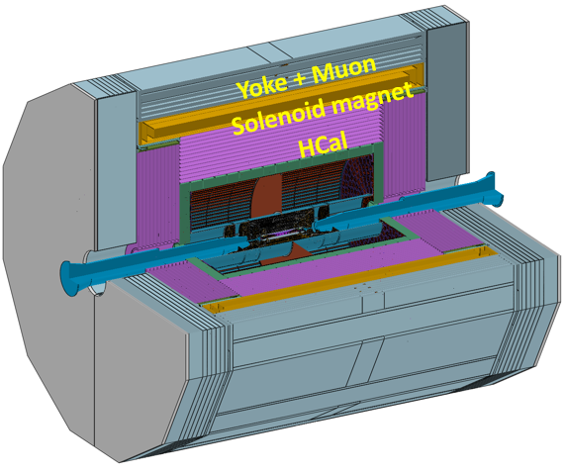
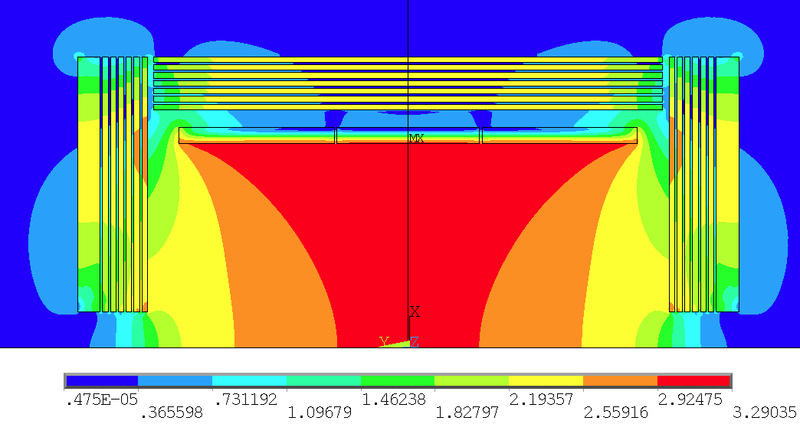
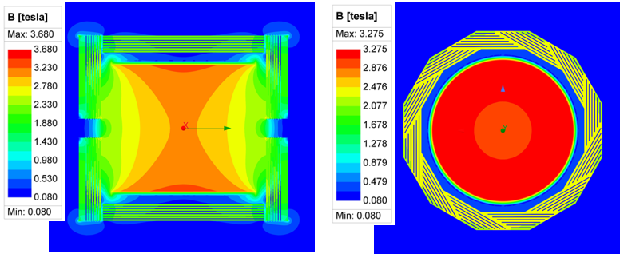
Physical design of the solenoid magnet
Physical design of the magnet
Coil parameters:
Central magnetic field | 3 T
Inner diameter | 7300 mm
coil length | 8150mm
Operating current | 17 kA
Cable length | 33 km
Inductance | 11 H
Stored Energy | 1.54 GJ
Magnet weight | 290 tons
Max field on conductor | 3.8T
2D Magnetic field simulation
3D Magnetic field simulation
2

Slide 3
SC conductor for detector magnets
Aluminum-stabilized NbTi cable is and has been the universal choice until now for the detector magnets
Self-supporting winding turn with Aluminum alloy reinforcement
Progress in the development of aluminum stabilized superconductor (courtesy A. Yamamoto).
Notes:
Ever since practical superconductors appeared they have been used for detector magnets; they were being used for this purpose long before they were first used in accelerators. There is therefore a wealth of experience which has been built up over the years and which should be tapped if you want to make the most efficient design.
The solenoids for the LHC differ from previous solenoids
for colliders, however, in that, due to higher fields, there is higher stress in the winding and it has been
necessary to strengthen the conductor.

Slide 4
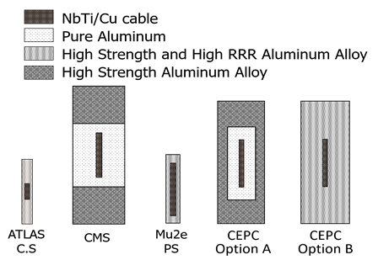
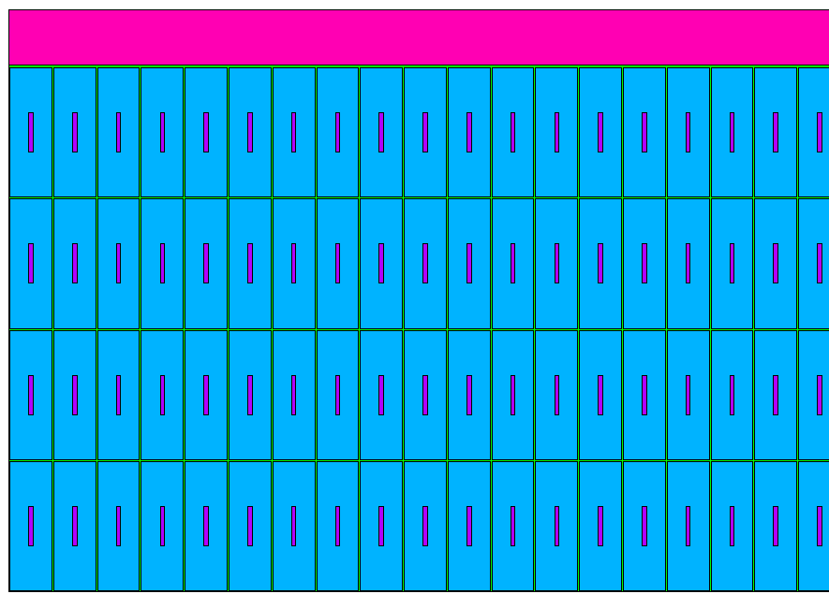
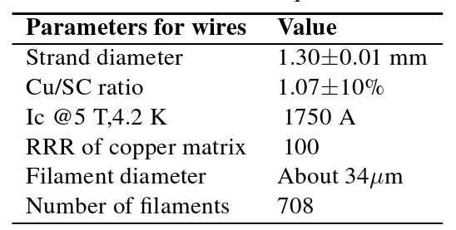
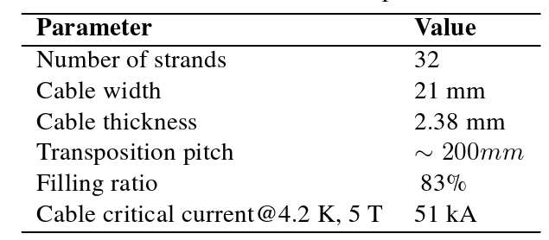
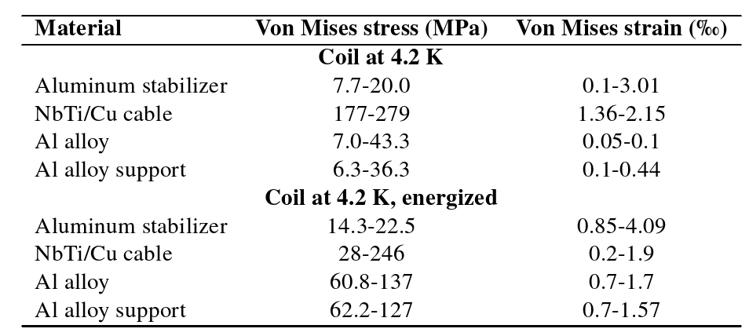
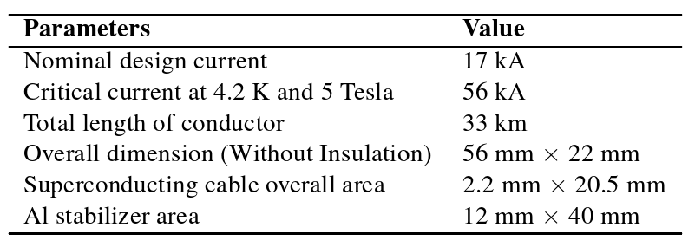
Superconductor design
Cross section of the Coil

Slide 5
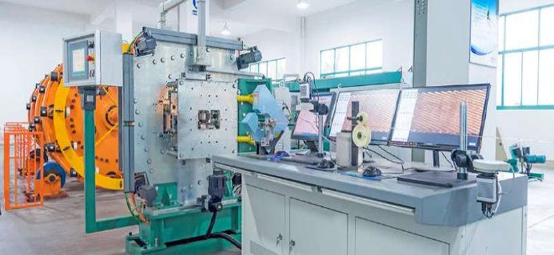
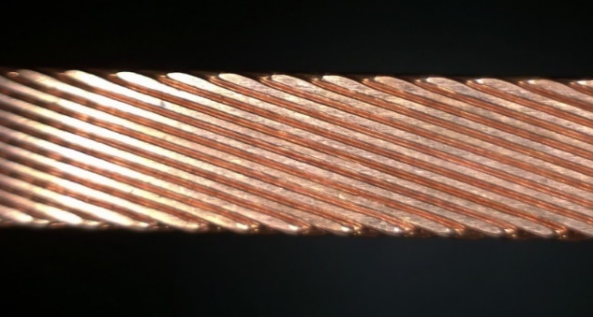
Rutherford Cable development
After stranding, RRR value decreased by about 1/3
Number of strands：32
The decrease of the critical current is less than 7%.

Slide 6
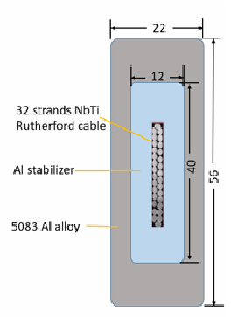
Option A
Pure Al | 22.5 MPa
Rutherford cable | 246 MPa
Al Alloy | 137MPa
Insulation（剪切） | 10.6 MPa
Insulation（等效） | 65 MPa
support | 127MPa
Dimensions：
  Rutherford cable：2.2mm*20.5mm
  Pure Al：12mm*40mm
  superconductor：22mm*56mm
RRR of Pure Al | 1000 | 800 | 700 | 600 | 500
coil temperature/K | 50.83 | 55.76 | 60.56 | 66 | 74.34
coil voltage/V | 886.8 | 895.16 | 898.53 | 905.05 | 915.08
voltage between layers/V | 36.61 | 53.91 | 75.88 | 112.46 | 213.58
time/s | 173 | 167 | 162 | 155 | 141

Slide 7
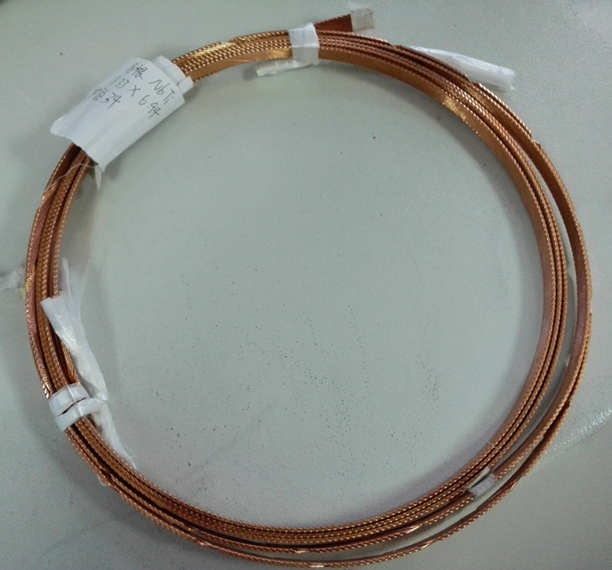
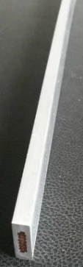
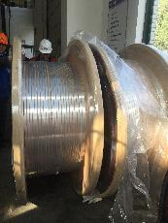
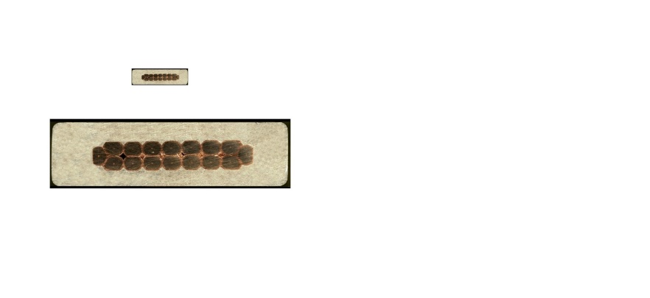
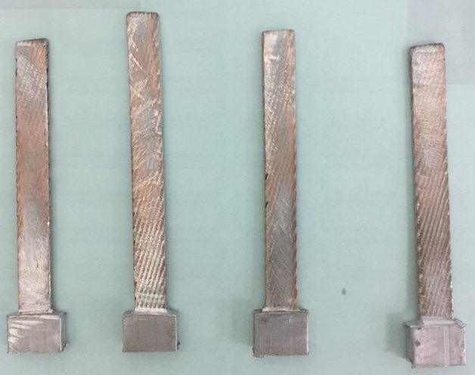
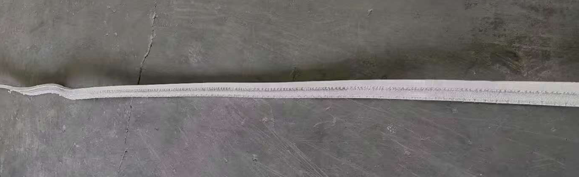
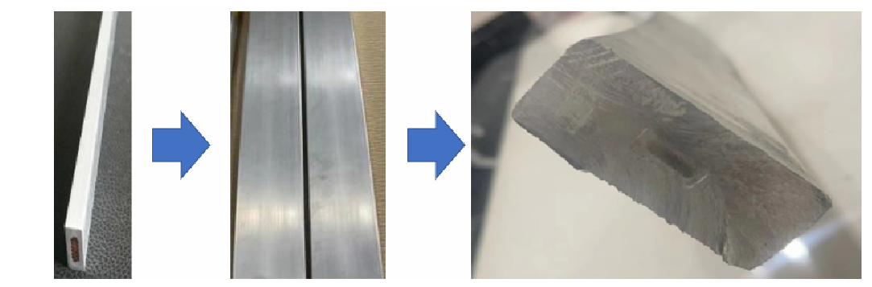
R&D of Option A
small dimension Al-stabilized Conductors
Microsoft view of bonding surface
First extrusion
Rutherford cable
16 strands
Al stabilized cable
4.7mm*15mm
1.5 km long conductor
Second extrusion
Dimensions: 15*4.7mm²
Number of strands ：16
Materiel : Rutherford cable+Al(99.99% purity)
Complete time:2017.8
Shear strength（COPPER &Al）：>35MPa
First extrusion +6061 Al, 5 mter
First extrusion +1100 Al, 10 mter
7

Slide 8
Current Issues and Next steps(1)
Current Issues:
Frequent wire breakage during the secondary extrusion process, despite preheating the core wire. Significant differences in the mechanical properties of alloy aluminum and high-purity aluminum at high temperatures. Stress simulations during extrusion process is ongoing.
Poor surface quality of the cable. Many experience from dummy condutor
Reliance on external partners for critical current testing, causing delays in feedback for equipment parameter adjustments.
Next Steps:
300 meters of Rutherford cable by the end of this month.
Complete high-purity aluminum stabilized superconductor by the end of September.
Box-type samples by the end of this year.

Slide 9
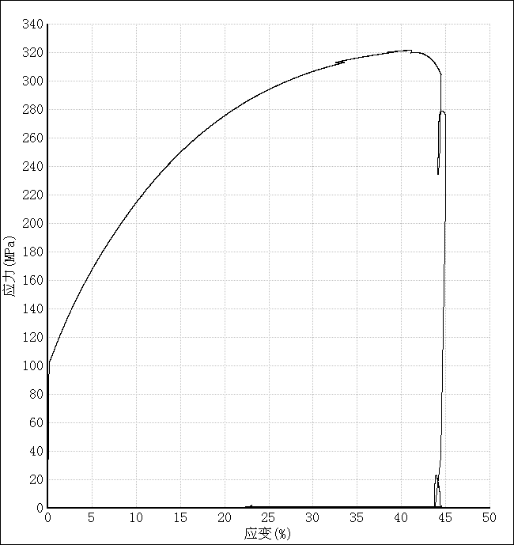
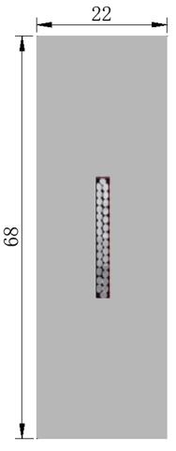
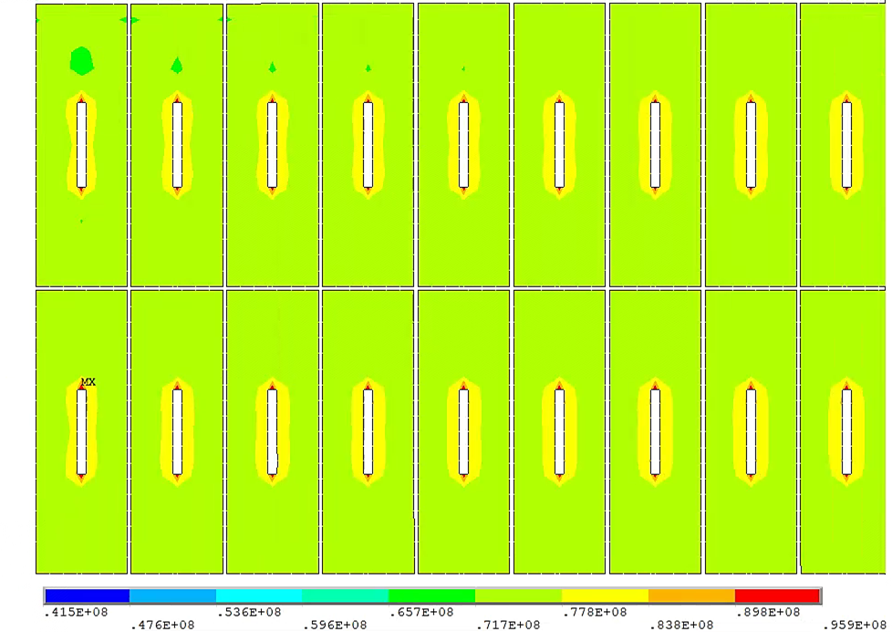
Option B
High-strength high-purity aluminum with measured material parameters:
Yield strength at 4.2K: 105 MPa
Poisson's ratio | 0.33/0.34
Young's modulus | curve
Thermal expansion | 14.23×10⁻⁶ K⁻¹
Rp_{0.25}@4.2K | 105MPa
NbTi Rutherford cable
Material | Von Mises stress (MPa)
Coil at 4.2 K
Aluminum stabilizer | 4.4-86.1
SC cable | 174-243
Al alloy support | 4.6-36.2
Coil at 4.2 K, energized
Aluminum stabilizer | 41.5-95.9
SC cable | 54.9-221
Al alloy support | 43.2-87.4
High strength and High RRR Al stabilizer

Slide 10
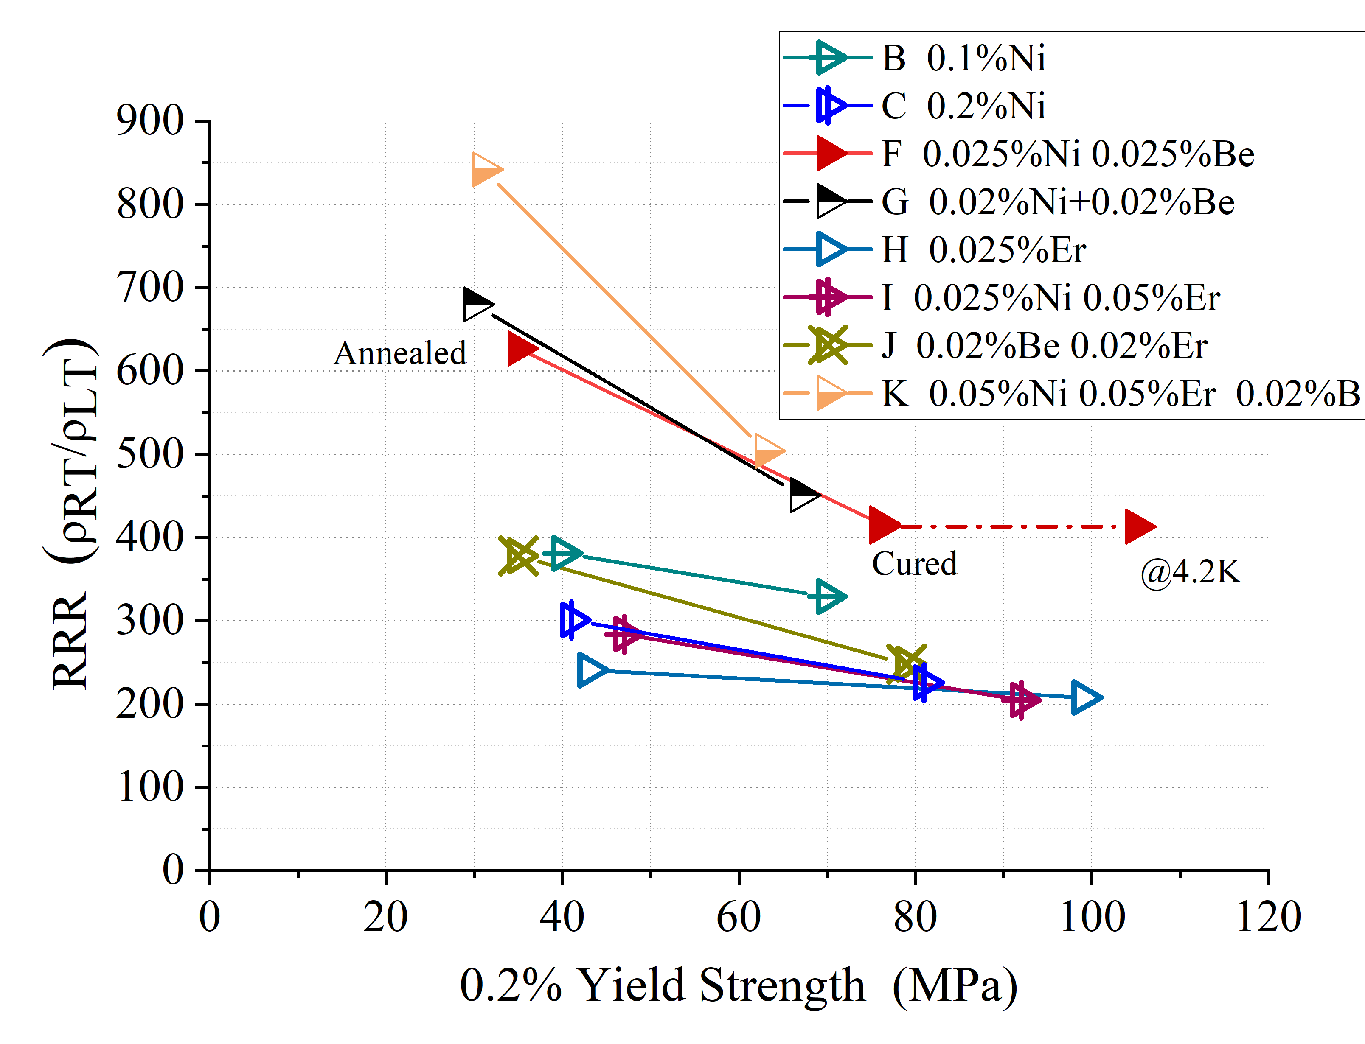
R&D of Option B
Yield strength > 100 MPa@4.2K, 74 MPa at room temperature, RRR value > 400
By doping Ni-0.025% Be-0.025%, annealing, cold-working and curing.
The Al-0.025%Ni-0.025%Be alloy prepared from 4N8-aluminum achieved high 0.2% yield strength of 75MPa (R.T.) with RRR of 417 after cold working of 21% and annealing at 130℃ for 15hrs.

Slide 11
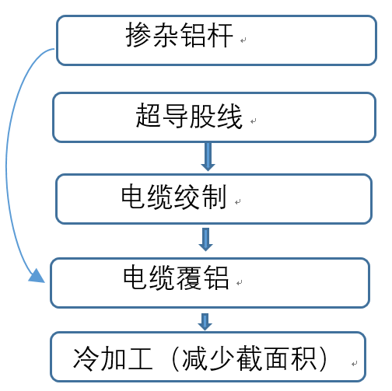
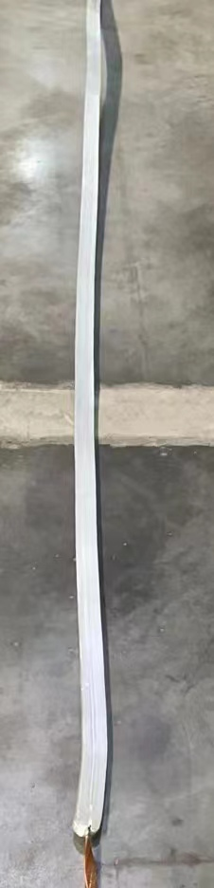
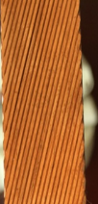
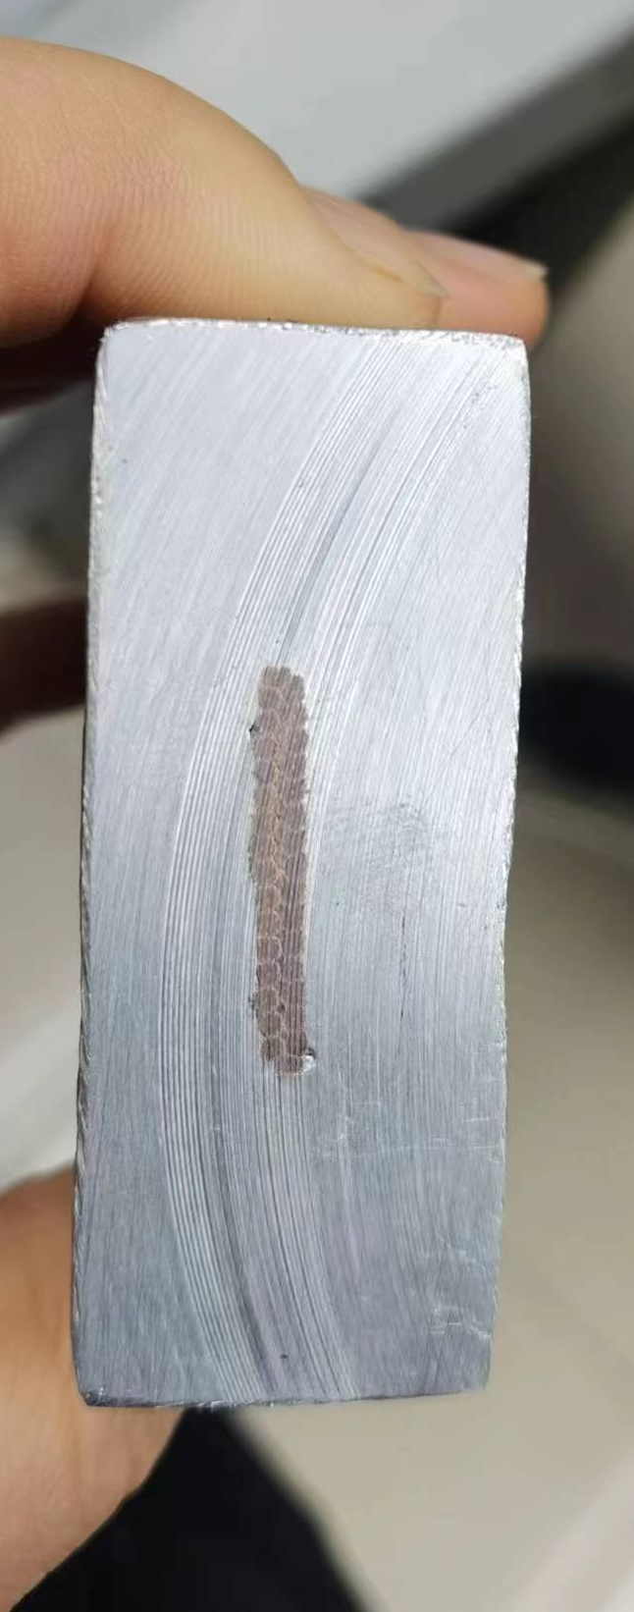
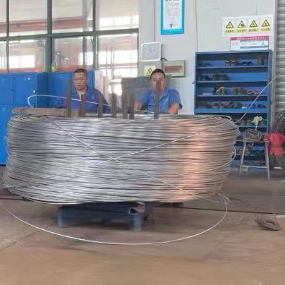
R&D of Option B
High Strength and High RRR Aluminum- Stabilizer meet requirements.
Co-extrusion process is OK.
critical current need to be tested.
How to improve the tensile strength of aluminum stabilizers while maintaining a certain RRR value? (Cold working)
cold working | dimensions | Yield strength，Mpa | Rp0.2 Mpa | RRR
20% | 8.92*13.42 | 71 | 67 | 192
17% | 9.10*13.67 | 73 | 69 | 196
12% | 9.38*14.04 | 67 | 61 | 203
10% | 9.50*14.22 | 67 | 61 | 208

Slide 12
Current Issues and Next steps(2)
Current issues：
MAX stress on the aluminum stabilizer cannot meet the design requirements . Increasing of the conductor cross-sectional area or replacement with higher-strength materials are necessary.
R&D of option B (68×22) are limited by the quipment of Wuxi Toly Co.
Cold working is required to enhance the strength of the aluminum stabilizer, but a partner manufacturer has not yet been identified.
Next step：
Development of aluminum-stabilized materials will continue to pursue higher-strength alternatives.

Slide 13
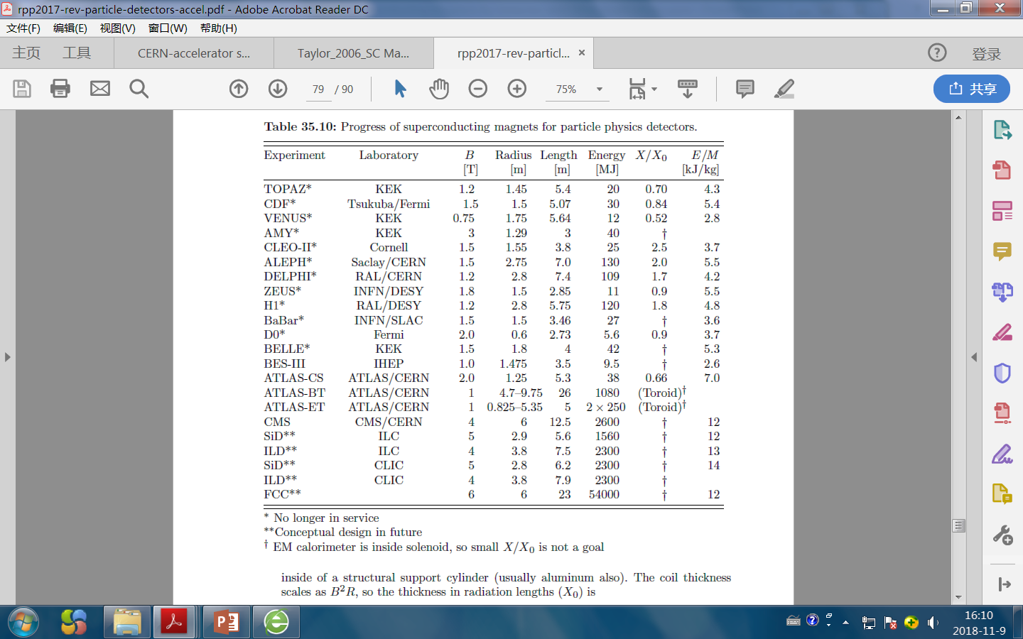
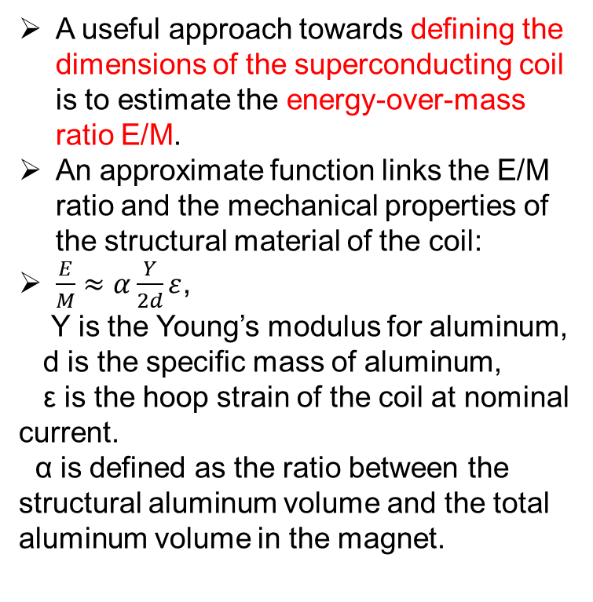
Comparison with other magnets
Main parameters of detector magnets
A useful approach towards defining the dimensions of the superconducting coil is to estimate the energy-over-mass ratio E/M.
An approximate function links the E/M ratio and the mechanical properties of the structural material of the coil:
$\frac{E}{M}≈α\frac{Y}{2d}ε$,
Y is the Young’s modulus for aluminum,
d is the specific mass of aluminum,
ε is the hoop strain of the coil at nominal current.
α is defined as the ratio between the structural aluminum volume and the total aluminum volume in the magnet.
OptionA： 3 7.3 8.15 1540 11
OptionB： 3 7.3 8.15 1540 8.3
Revised August 2017 by Y. Makida (KEK)

Slide 14
Summary
Based on the technical capabilities of Wuxi Toly Co., option A（Box-type） may be the best option.
The CMS conductor option will be the backup，and some short samples （1~1.5meter）will be prepared for trial production in next several months，but there is insufficient funding to support R&D of long superconductor.
The size of option B exceeds the capacity of the extrusion equipment, and cold working is also a difficult problem.
Any suggestions?

Slide 15
CMS conductor consideration
BACKUP
Cross-section of the CMS coil
The results of the FEA carried out so far indicate that the box configuration is potentially the best one. However, in designing this kind of conductor, the manufacturing aspects should be taken into considerations. The block configuration appears as the best compromise between mechanical requirements and feasibility of long lengths.
Different techniques, as coextrusion in one or two steps, were studied in the framework of an R&D program financed by CERN in 1993 through the LHCC Magnet Advisory Group (MAG). They were abandoned because extrusion of the aluminum alloy has to be done at a too high temperature for the superconductor.

Slide 16
Conductor for ATLAS Central Solenoid Magnet
BACKUP
Central Solenoid Magnet: 5.3 long, 2.4 m diameter, 4.5 cm thick, 5 tonne weight, 9 km of superconducting wire
2 tesla (T) magnetic field with a stored energy of 38 megajoules (MJ), 7.73 kiloampere (kA)
Al-0.1wt% Ni alloy
  1. The RRR of the aluminum-stabilizer should be higher than 500 after annealing at 130°C for 15hrs corresponding to the coil curing.
  2. The 12-stranded Cu/NbTi Rutherford cable is placed in the center of aluminum-stabilizer of 4.2/4.3mm x 30mm, and the volume ratio is Al/Cu/NbTi=15.6/0.9/1.
This superconductor has a small keystone angle to make both widths become equal after edge-wise winding. On the other hand, regarding the mechanical properties, 0.2% yield strength of the aluminum-stabilizer was required to be higher than 85MPa at 4.2K after coil curing at 130°C for 15hrs, to have a margin of greater than 40% against the equivalent magnetic force of 62MPa.
K. Wada, et. al. Development of High-Strength and High-RRR Aluminum-Stabilized Superconductor for the ATLAS Thin Solenoid. IEEE TRANSACTIONS ON APPLIED SUPERCONDUCTOR, VOL. 10, NO. 1, 2000

Slide 17
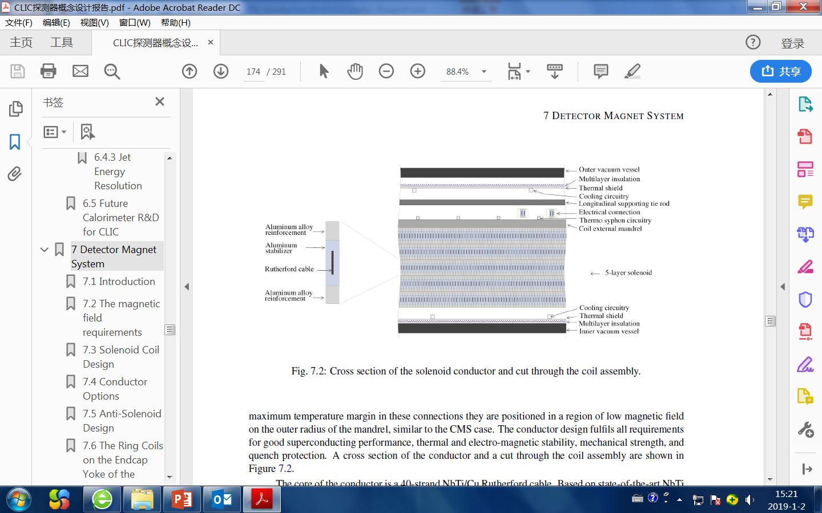
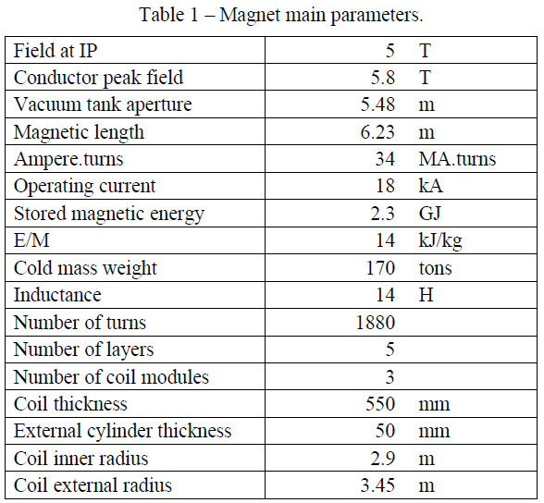
CLIC_SiD conductor
BACKUP
The main parameters of the central solenoid of the CLIC_SiD design are listed in Table 7.2. They are similar to those of the CMS solenoid.
Two designs are available: the CMS conductor-type and the ATLAS Central Solenoid conductor-type. A structural stabilizer, such as the one used for the ATLAS Central Solenoid, appears very promising, and a dedicated R&D program has been started in the framework of the Linear Collider Detector magnet working group.
Study of a 5-Tesla large aperture coil for the CLIC detector
B. CURE, CERN, Switzerland, 2010. LCD-Note-2011-007

Slide 18
Thickness of detector magnets
BACKUP
 | CMS | BESIII | ALEPH | BESS-POLAR | WASA | SDC PROTOTYPE | IDEA* | CEPC
Central field (T) | 4 | 1 | 1.5 | 0.8 | 1.3 | 1.5 | 2 | 3
Operating current (A) | 19600 | 3369 | 5000 | 380 | 900 | 12000 | 20000 | 17000
Inner diameter of coil (mm) | 6360 | 2960 | 5300 | 900 | 553.6 |  | 2200 | 7300
Length of coil (mm) | 12480 | 3520 | 6350 | 1400 | 465 | 1900 | 6000 | 8150
Thickness of cryostat (mm) | 830 | 271 | 440 | 130 | 80 | 306 | 300 | 700
Conductor （mm） | 21.6×64 | 3.7×20 |  |  |  |  |  | 22×56

