Slide 1

21/4/2025
Status Report: H Recoil Mass
Yuji Li

Slide 2

Status
PID applied for muon Selection
PID WP: 90% & 20<p<80 for each muon
Best Z candidate: mimimize the chisquare
Fittings: TwosideDCB for H signal, third order polynomial for bkg
Limitation: Low statistic for fitting in ee->mumu samples
Implementation on GenFilter for 2 muons
Reference: https://code.ihep.ac.cn/wanghan/modify_stdhep

Slide 3
Event Selections
Muon Selection:
Matched with GENMuon(dR<0.1)
20 < p < 80 cos(theta)<0.85 (Barrel only for now)
Best Muon Pair Selection:
The nearest inv. mass to Z pdg mass.
Signal Samples: ZH, H->inclusive
Bkg Samples: ZZ->2l2q, ZZ->2l2v, WW->2l2v, ZZ->4l(4 fermion)
Z->mumu(2 fermion)
Lumi = 20000fb-1

Slide 4
Samples
Name | FinalStates
zz_l0mumu | mumu+vtauvtau
4mu | mumumumu
sznu_l0mumu | mumu+veve
sl0mu_down | mumu+(bb, ss, dd)
sl0mu_up | mumu+(uu,cc)
zzorww_ll | mumu+vmuvmu
2fermion | mumu(isr)

Slide 5
Event Selections: Summary and cutflow(PID)
Process | zz_l0mumu | 4mu | sznu_l0mumu | sl0mu_down | sl0mu_up | zzorww_ll | 2fermion | H->incl.
xs | 19.38 | 15.56 | 43.32 | 136.14 | 87.39 | 221.1 | 5332.71 | 6.77
input | 40000 | 40000 | 40000 | 40000 | 40000 | 40000 | 40000 | 40000
2 muons | 10179 | 14600 | 6304 | 9889 | 8940 | 11117 | 4056 | 30691
110<recoil mass<150 | 2156 | 5166 | 2048 | 2166 | 2008 | 4221 | 1544 | 29961
MissingEZ<50 | 1264 | 3470 | 1355 | 1951 | 1760 | 3446 | 557 | 29586
E_ll<110 | 1137 | 3145 | 1222 | 1762 | 1581 | 2399 | 464 | 29396
20<P_ll<60 | 778 | 1926 | 855 | 1144 | 999 | 1454 | 90 | 26347
50<m_ll<120 | 772 | 1696 | 845 | 918 | 767 | 1413 | 90 | 26324
selected | 390 | 1696 | 845 | 918 | 767 | 1413 | 90 | 26324
eff | 0.0193 | 0.0424 | 0.0211 | 0.0229 | 0.0192 | 0.0353 | 0.002 | 0.658

Slide 6
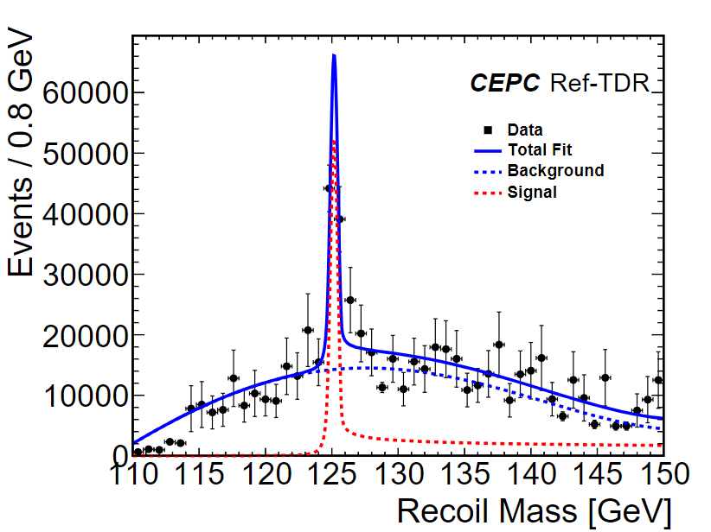
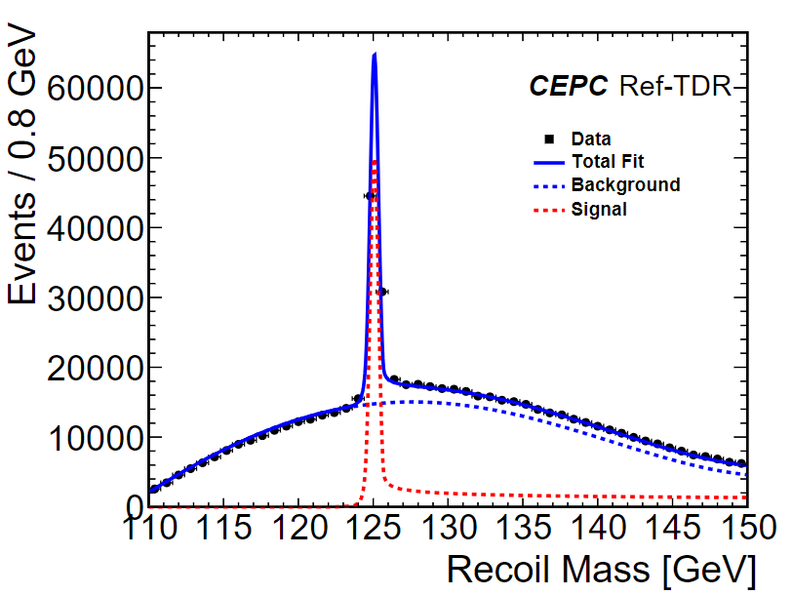
Fitting performance in MuID, Error(mH=125)=1.7MeV
simulation
ToyMC(Fix mH=125)

Slide 7
GenFilter Selections
Reco-level | Gen-level
2 muons (20<p<80) | 2 muons (18<p<82)
110<recoil mass<150 | 108<recoil mass<152
MissingEZ<50 | -
E_ll<110 | E_ll<112
20<P_ll<60 | 18<P_ll<62
50<m_ll<120 | 48<m_ll<122
Inputs: /cefs/data/stdhep/CEPC240/2fermions/E240.Pe2e2.e0.p0.whizard195/

Slide 8

GenFilter outputs
Adding MissingEZ cut in reco-level, ~5000 evts left.
For 50 bins, ~100 evts in each bin, will give better statistic errors.
Will produce new samples with the filted ee->mumu samples.

