Slide 1
Group meeting
2025.5.9

Slide 2
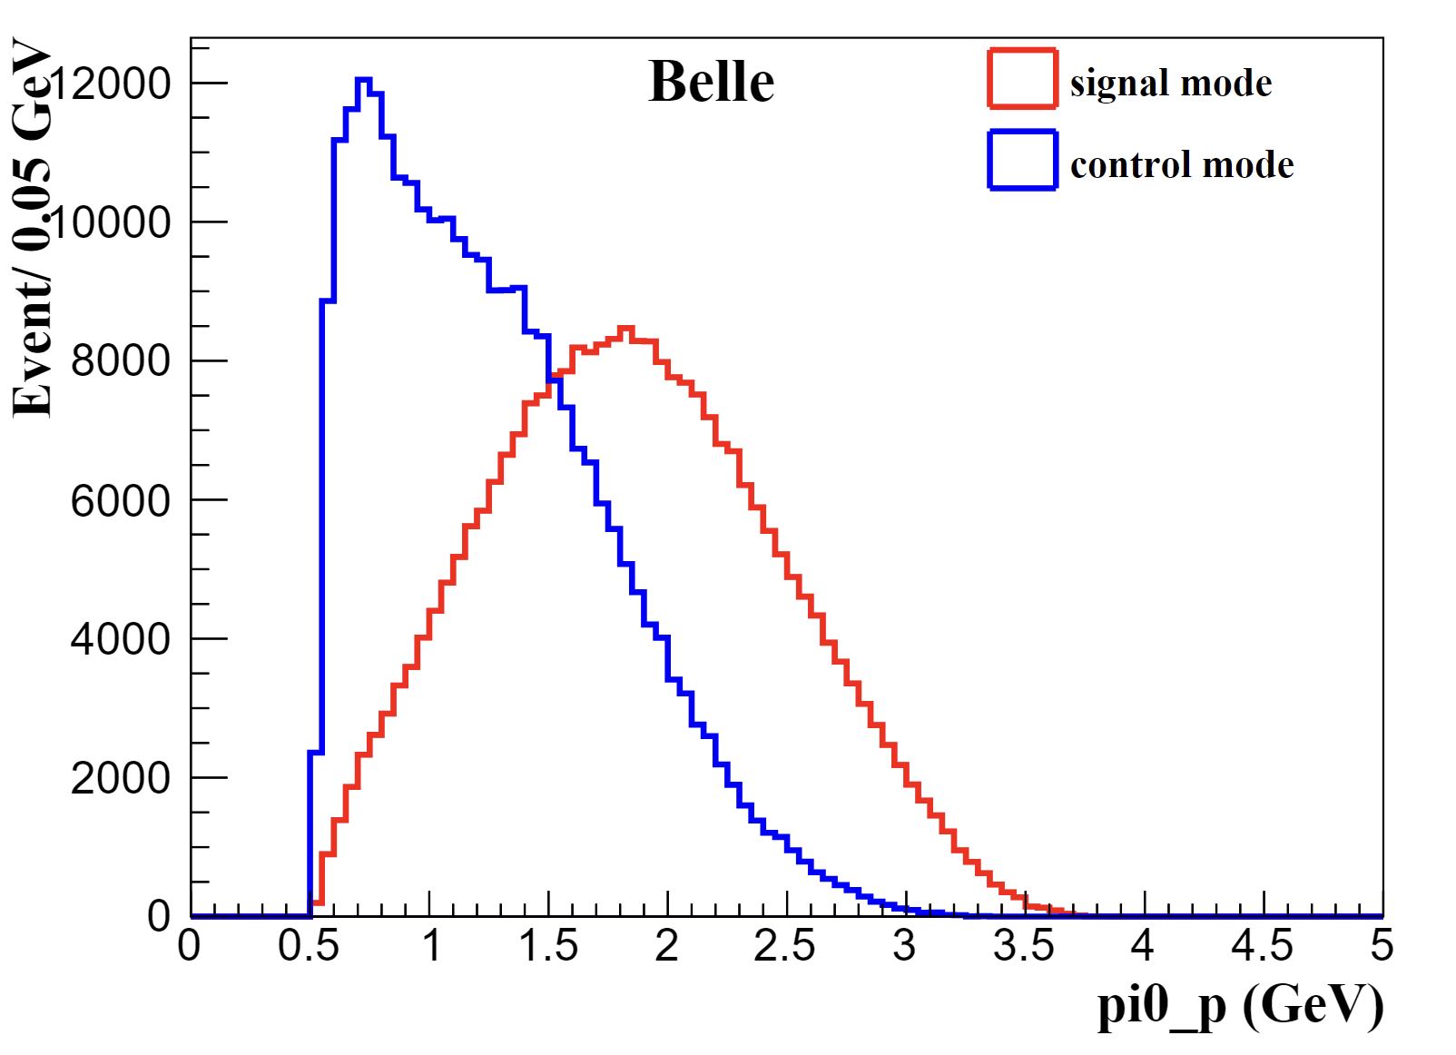
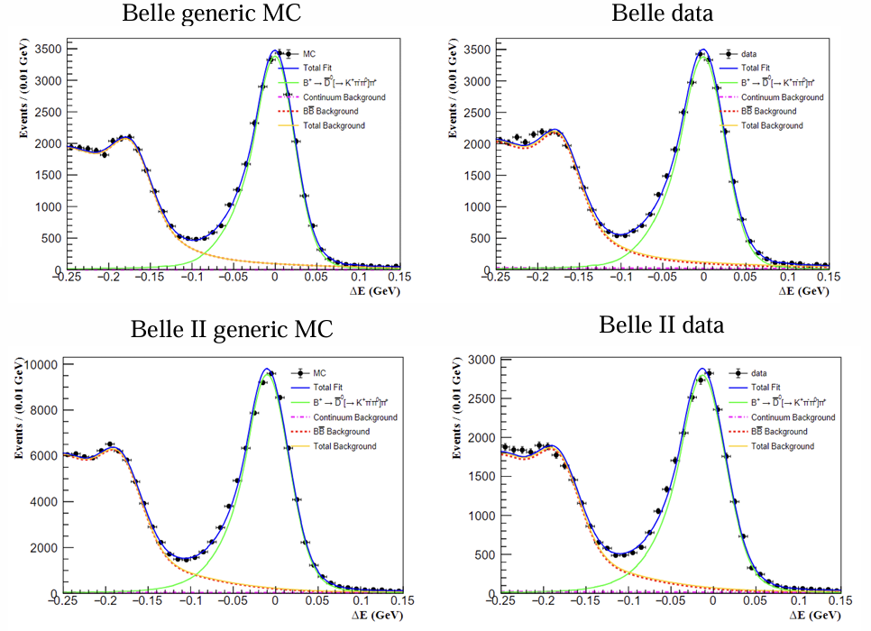
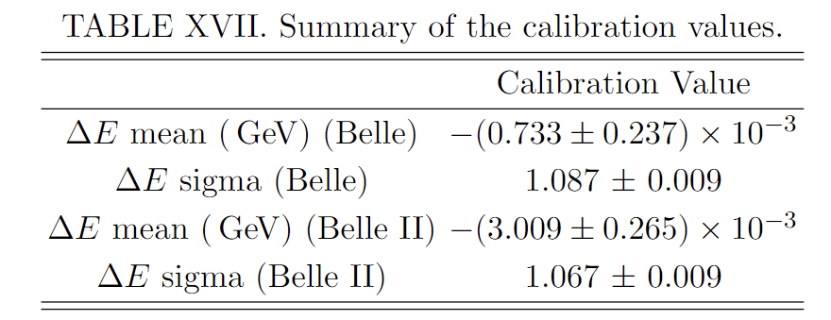
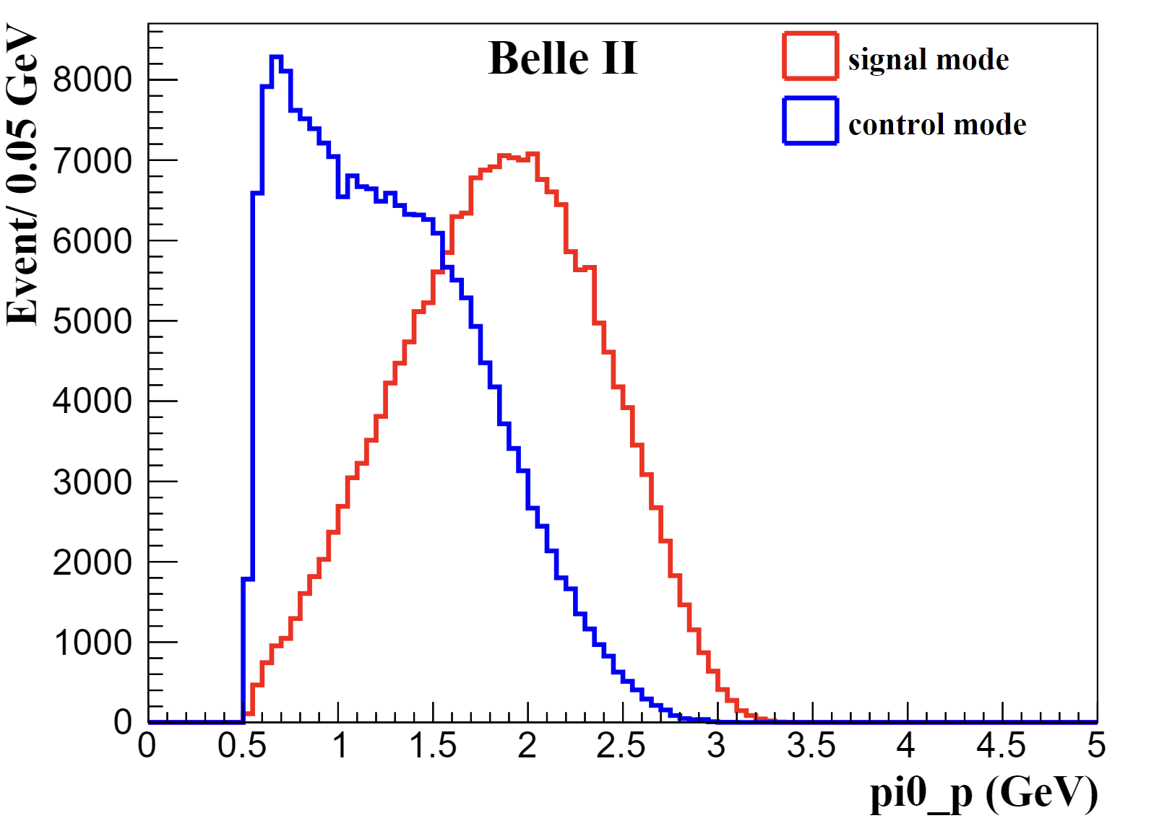
Calibration factors extraction
Sec.10.1: The pi0 momenta in your signal channel and control channel are quite different resulting in different deltaE distributions. Have you studied the effect of of this? E.g. you could re-weight the pi0 momentum in your control channel to match your signal channel.

Slide 3
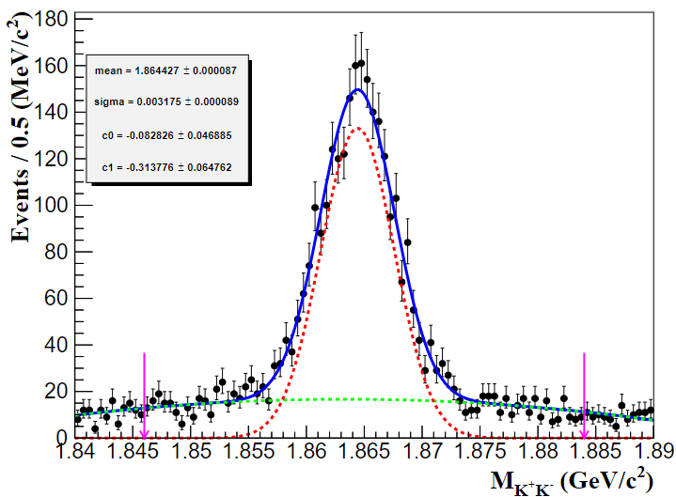
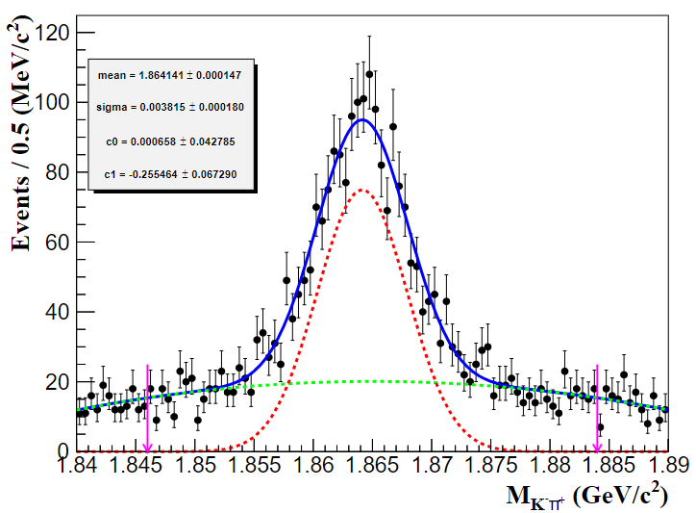
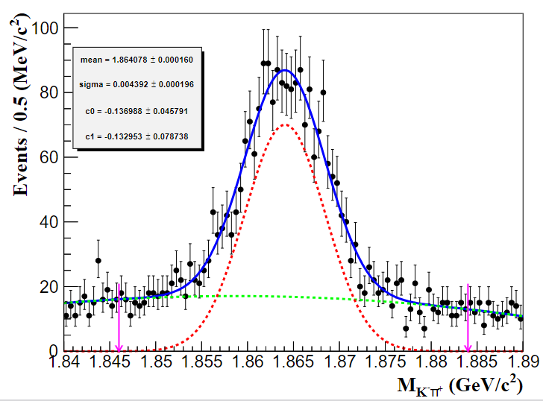
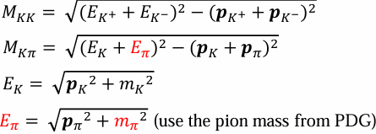
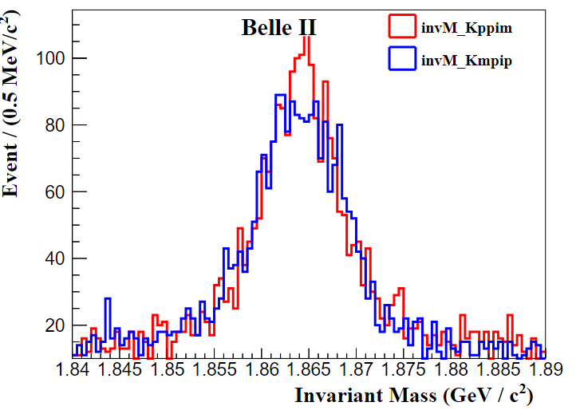
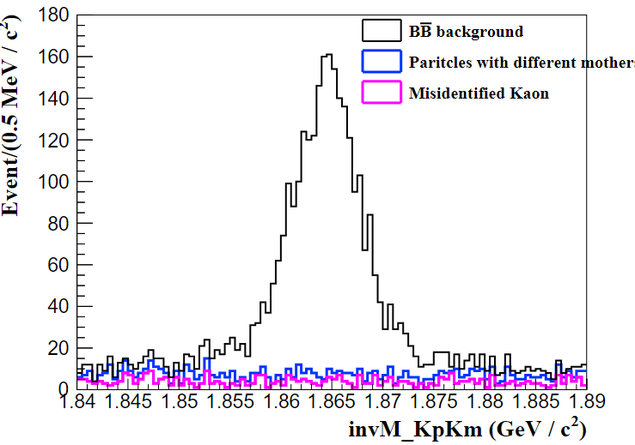
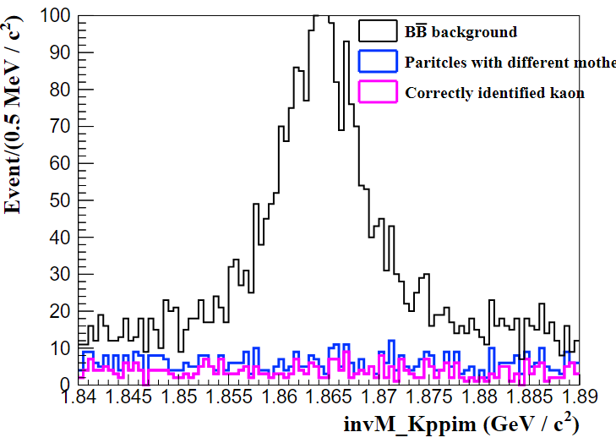
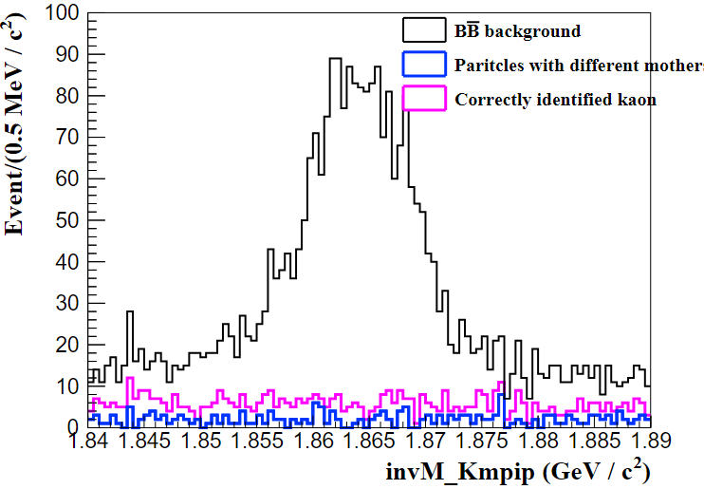
Charm veto window
Fig.23: What is the dashed green component? Is there some pollution from other decays?

Slide 4
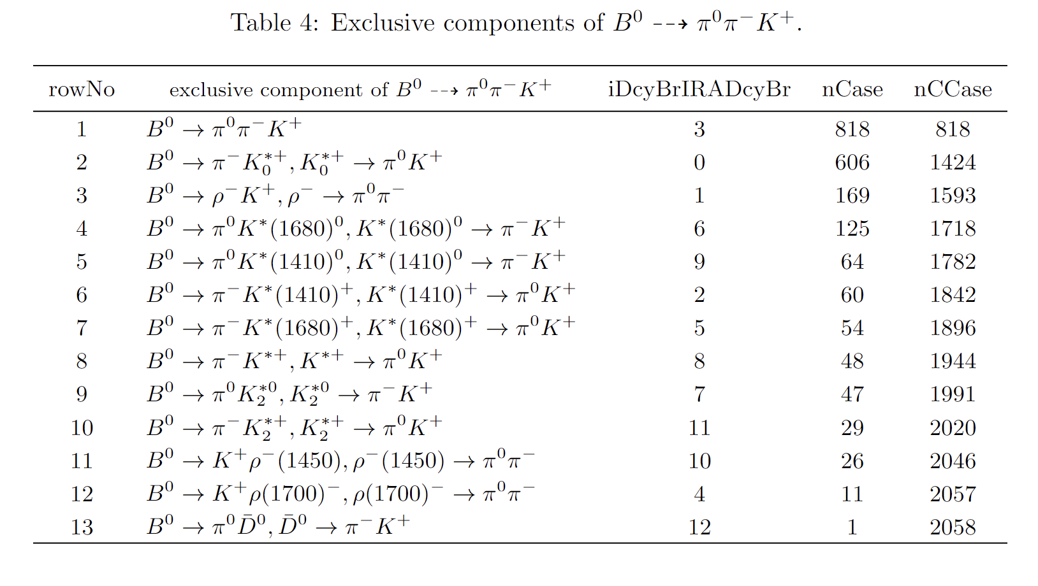
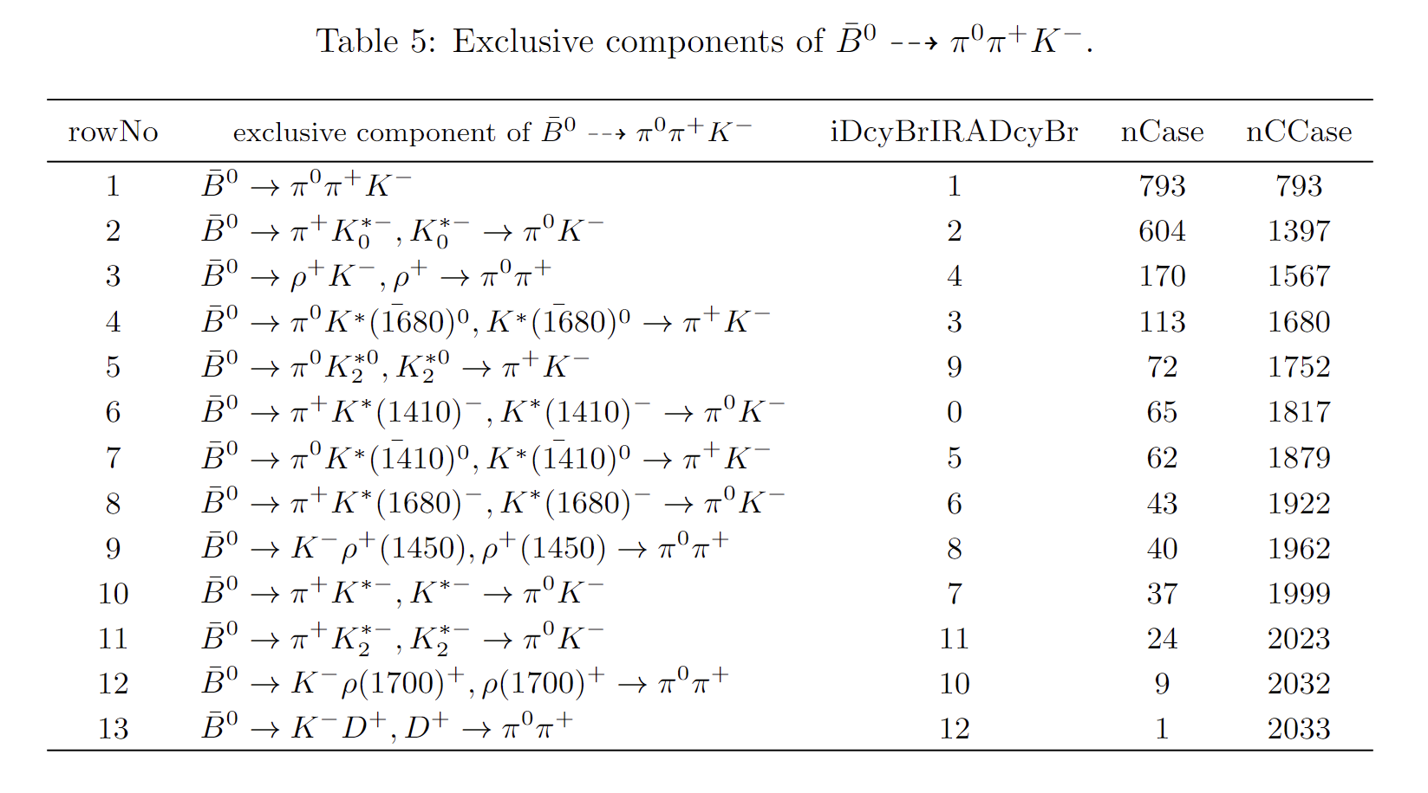
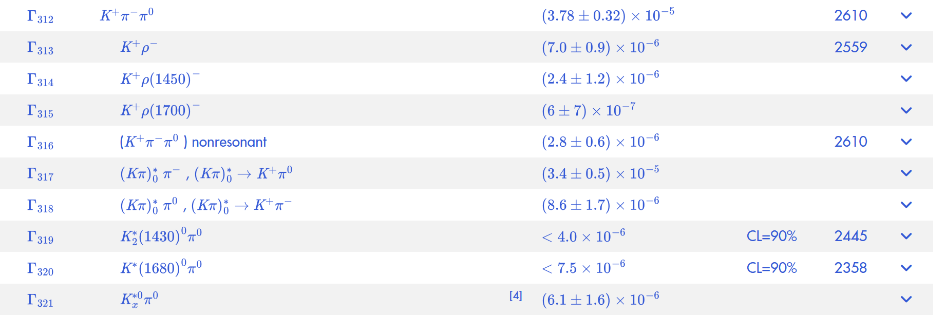
Peaking background mismodel
how is peaking Kpipi0 modeled in MC? do you consider posible effect of non-correct MC model on the efficiency in the systematics?
Belle:

Slide 5
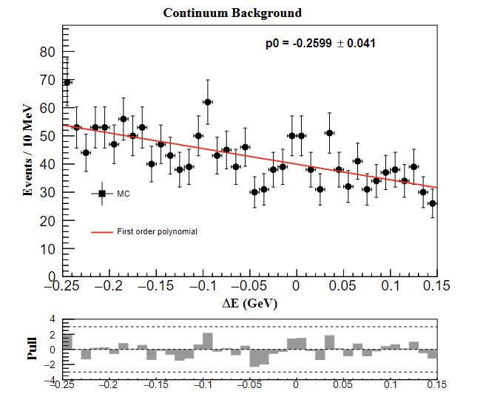
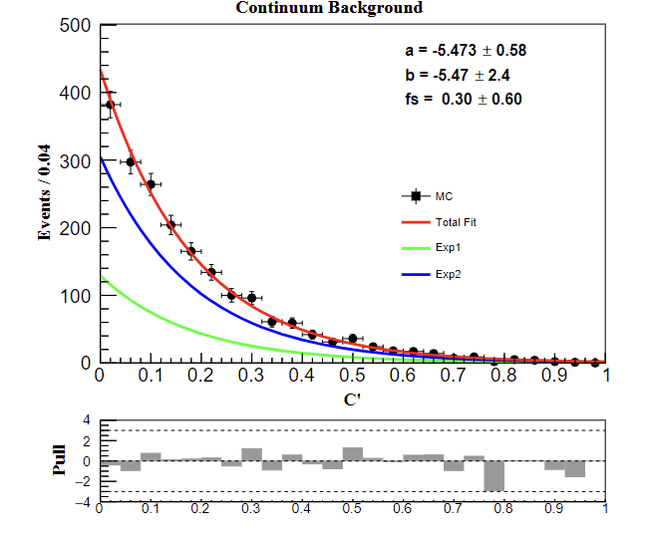
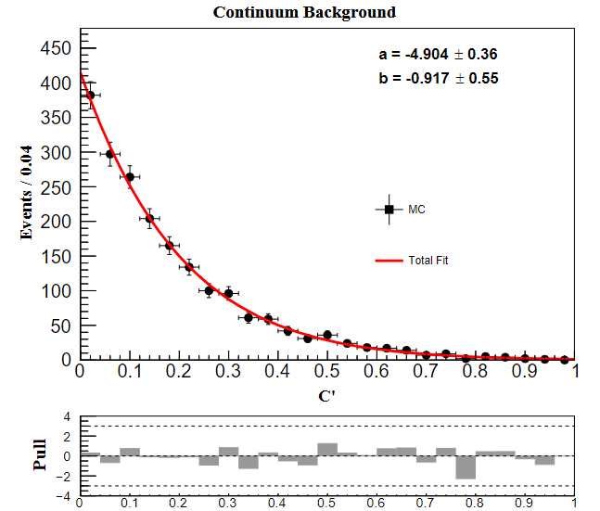
Continuum background modeling
l.326: Do you get biased results if you completely float the continuum shape? Or why do you fix it?
1st Chebyshev polynomial (floated)
2Exp (currently, float the fraction $fs$ but fix $a \& b$)
Test on Exp(ax + bx^2)

Slide 6
BB background PDF
3.Consider a sideband or control sample to validate BBbar background’s PDF. About PDF’s systematic uncertainty, check if any one or two PDFs contribute majority.

Slide 7
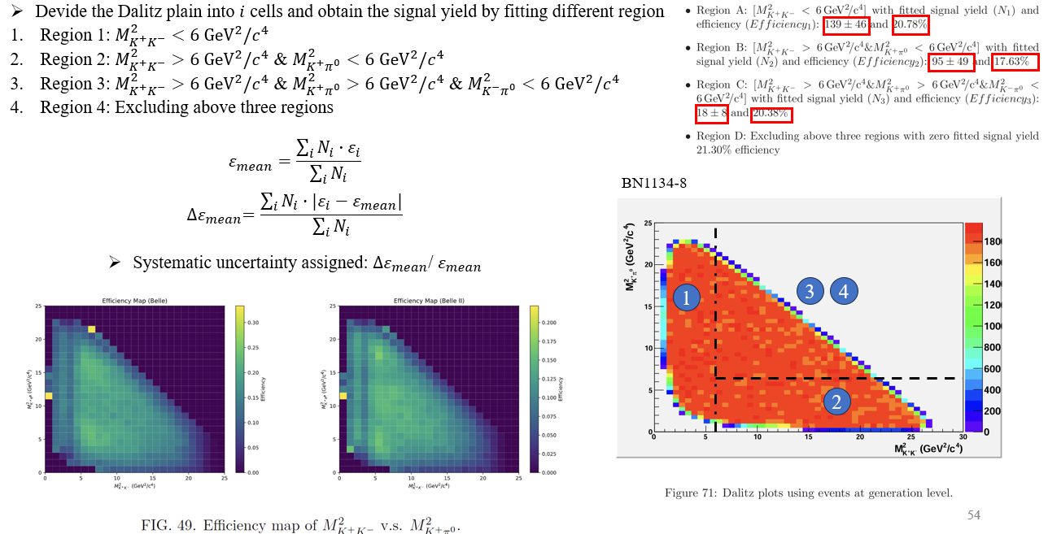
Systematic uncertainties on efficiency variation over Dalitz plot
4.Consider the binning scheme strategy, to improve the statistical uncertainty.
Motivation of binning strategy?

