Slide 1
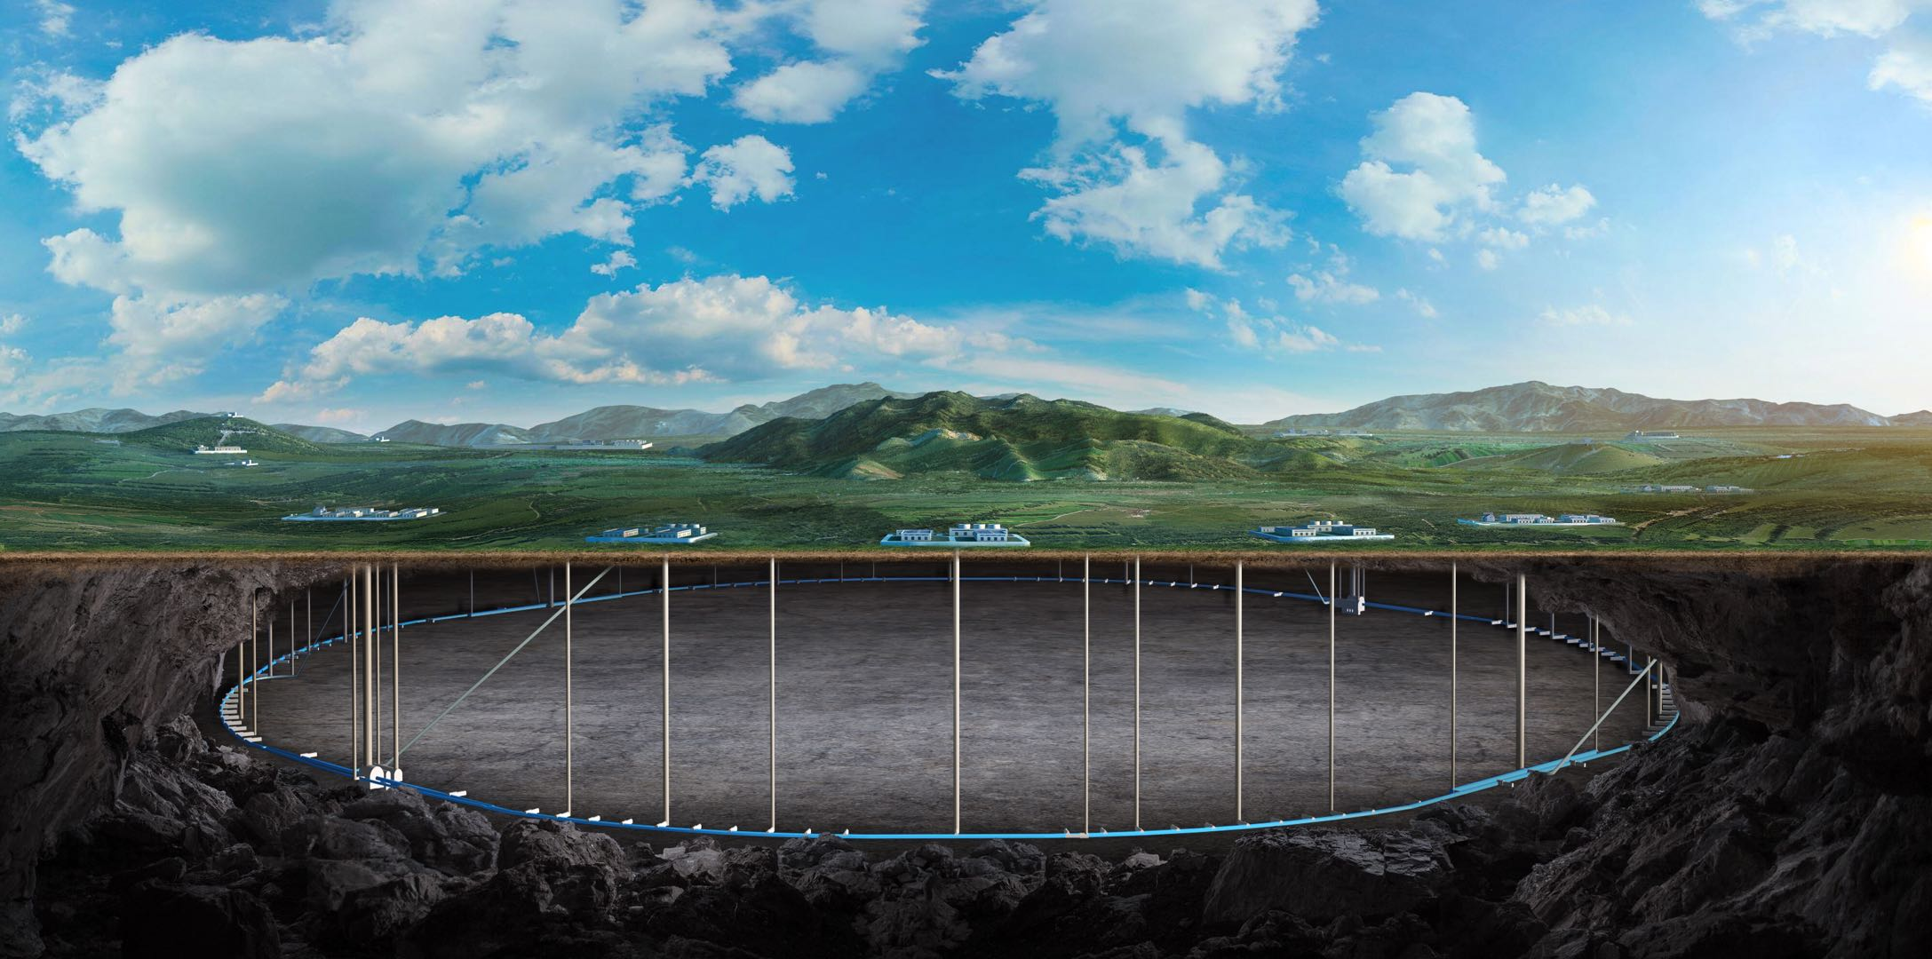
CEPC vertex Detector
Zhijun Liang
(On behalf of the CEPC physics and detector group)
Apr. 15th , 2025, CEPC Detector Ref-TDR Review

Slide 2
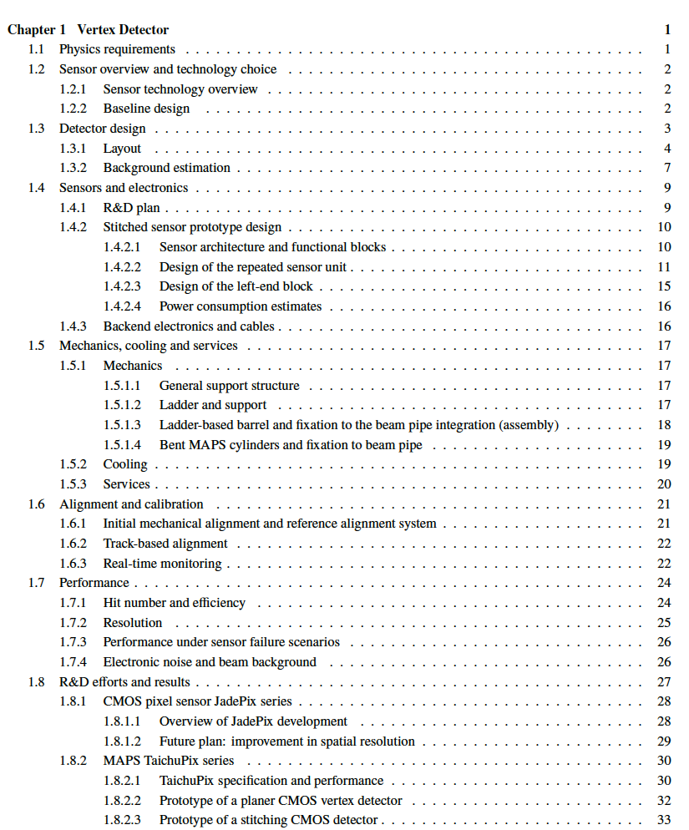
Update on TDR
Reduce the text from 65 pages to 36 pages
R & D results moved to the end of the chapter

