Slide 1
Fast Luminosity Monitor
Transient Simulation with Schottky Contact
Wang Yilun (Nanjing University) Zhang Jialiang(Nanjing University)
Zhang Xiaoxu(Nanjing University) Zhang Lei (Nanjing University)

Slide 2
Contents
Introduction
Geometry & Doping
I-V Characteristic Curve
Transient Simulation
Conclusion

Slide 3
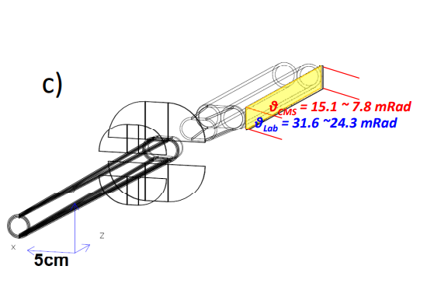
Introduction
Fast Luminosity Monitor is used to give bunch luminosity at CEPC
Integrated event rates along z-position can help monitoring z-position at IP
Polar angle $θ\sim 10 mrad$, highest radiation field at CEPC
Detect small angle Bhabha events
Electron showers generated in the copper beam pipe
Diamond is used for detector
Single crystal Chemical Vapor Deposition (sCVD), reducing defect densities
High carrier mobility : $2000\sim 2800 {cm}^{2}V^{−1}s^{−1}$
Wide bandgap, low dark noise : $5.47 eV$
Strong covalent bonds, high radiation hardness
Notes:
首先是介绍，在CEPC上，快速亮度探测器用于测量每个束团的亮度，为束流的校准提供信息。快速亮度探测器位于质心系下theta约为10毫弧度位置，探测小角度Bhabha散射粒子在铜束流管上产生的簇射。使用sCVD金刚石作为探测器的主要材料，其具有高载流子迁移率，和较宽的能隙，并具有很强的共价键，抗辐照能力较好

Slide 4
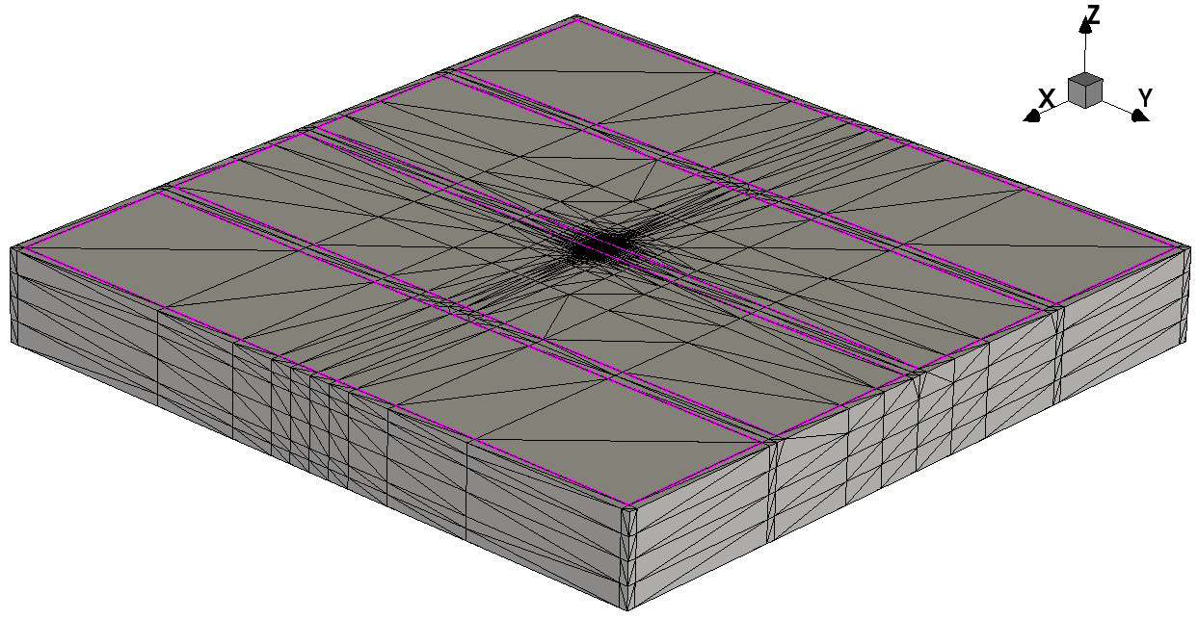
Geometry
Design for transient simulation testing later
$4000×4000×500 μm (x−y−z)$
4 electrodes on front side, each $900×1900 μm (x−y)$
One on back side, $3900×3900 μm (x−y)$
Notes:
用于模拟粒子击中的模型尺寸是4000*4000*500微米，正面4个电极，每个是900*1900微米，背面一个电极，3900*3900微米。

Slide 5
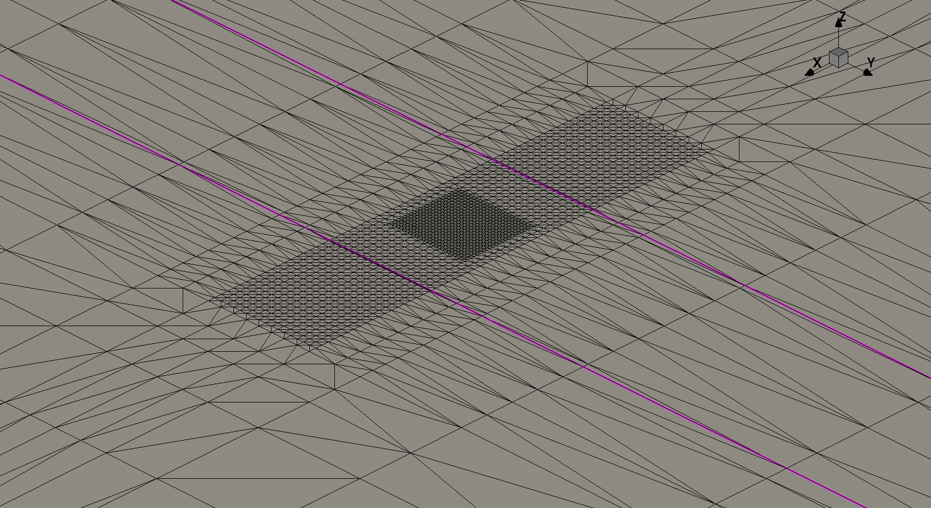
Geometry - Meshing
Meshing focus on the center of detector
Smaller mesh around hit position
Region 1 $\left(x−y−z\right) (μm)$
$2×2×2 \sim 5×10×5$
$2×0.5×2\sim 5×2×5$ around electrode
Region 2 $\left(x−y−z\right) (μm)$
$1×1×1 \sim 2×5×2$
$1×0.5×1 \sim 2×1×2$ around electrode
Region 2
Region 1
Notes:
将网格设置在探测器中心区域，粒子击中的部分增大网格密度，较外围的区域1网格大小为2*2*2um到5*10*5um，靠近电极10um的区域为2*0.5*2~5*2*5um，区域2网格大小为1*1*1um到2*5*2um，靠近电极处减小为1*0.5*1~2*1*2um

Slide 6
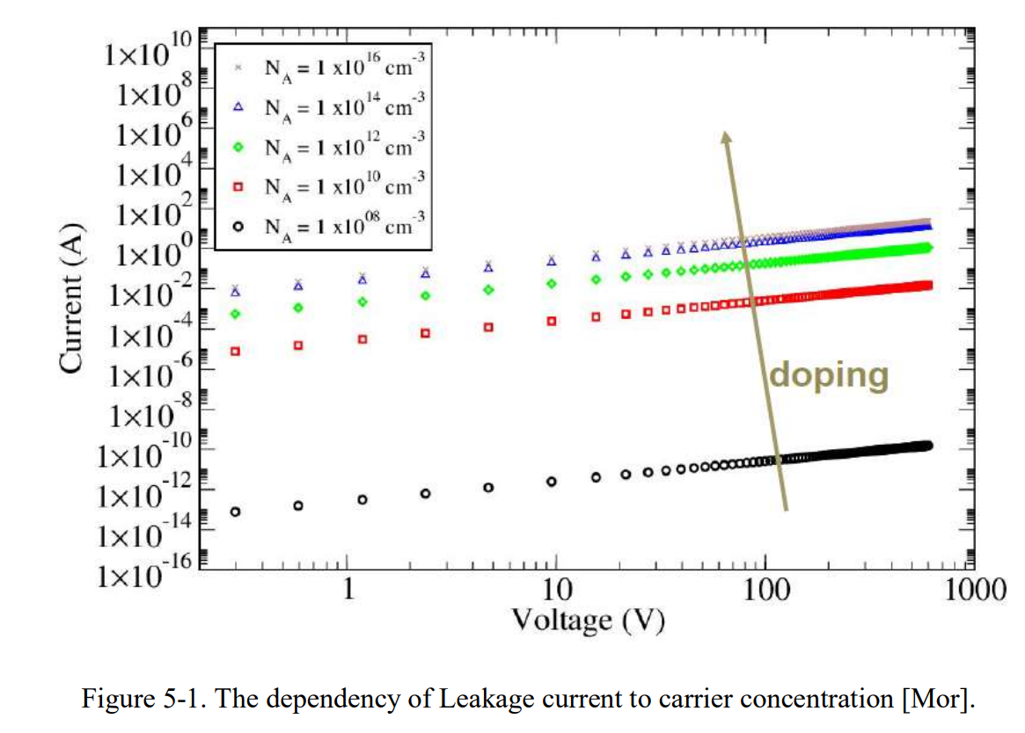
Doping
During CVD process, Boron and Nitrogen are common impurities
Boron Concentration $≠$ Carrier Concentration (Boron Active Concentration )
Add ${10}^{10}$ Boron Active Concentration
Notes:
模拟的载流子浓度依旧暂取10的10次方每立方厘米

Slide 7
Schottky Contact
Electrode {
{ Name = "front.0" Voltage = 0 Schottky Barrier = 4.35}
{ Name = "front.1" Voltage = 0 Schottky Barrier = 4.35}
{ Name = "front.2" Voltage = 0 Schottky Barrier = 4.35}
{ Name = "front.3" Voltage = 0 Schottky Barrier = 4.35}
{ Name = "back" Voltage = 0 Schottky Barrier = 4.35}
}

Slide 8
I-V Characteristic Curve

Slide 9
I-V Characteristic Curve - Physics
Physics {
EffectiveIntrinsicDensity( OldSlotboom ) # doping bandgap narrowing effect
Mobility(
-ConstantMobility # do not use ConstantMobility model
DopingDep
HighFieldSaturation( Eparallel )
Enormal # mobility degradation at interfaces
)
Recombination(
SRH( DopingDep ) # doping dependent Shorkley-Read-Hall recombination
Avalanche
)
Temperature=298
Hydrodynamic
}
Notes:
这是使用的物理模型，有掺杂禁带变窄模型，迁移率模型，迁移率模型中关闭固定迁移率模型，使用依赖掺杂浓度的迁移率模型，高场饱和模型，界面散射模型。然后是依赖掺杂浓度的SRH复合和雪崩击穿模型。

Slide 10
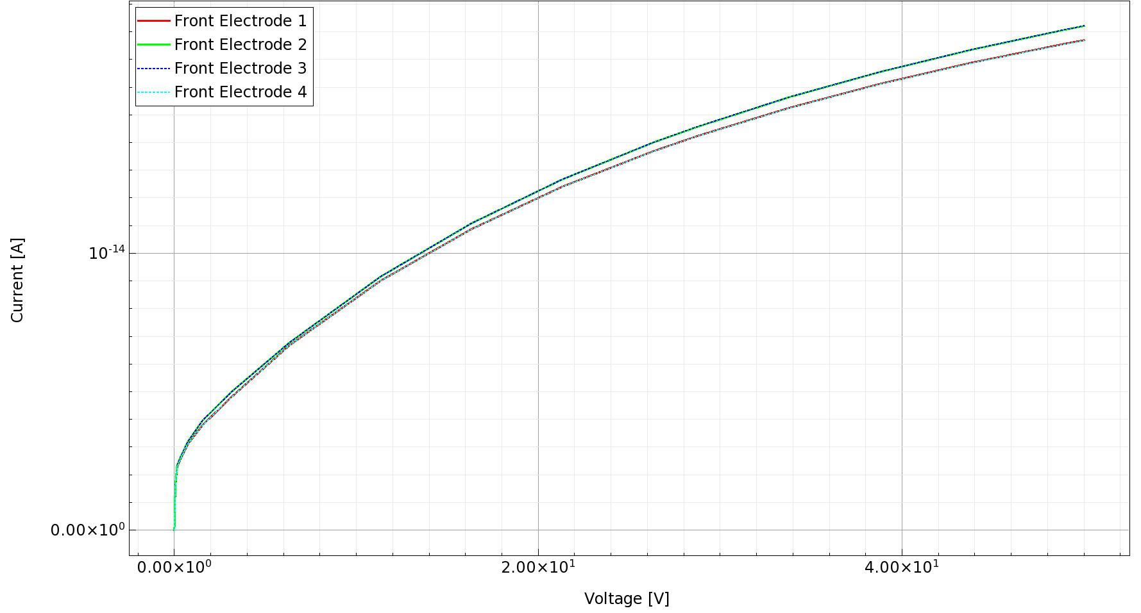
I-V Characteristic Curve
Doping : ${10}^{10} {cm}^{−3}$ Boron (Boron Active Concentration)
Notes:
这是掺杂浓度为10的10次方每立方厘米时的IV曲线，接触改为肖特基接触后电流明显减小，在反面的电极电压为50V时，正面的电极每个暗电流约为 18 fA

Slide 11
Transient Simulation

Slide 12
Transient Simulation - Physics
Physics {
EffectiveIntrinsicDensity( OldSlotboom )
Mobility(
-ConstantMobility
DopingDep
HighFieldSaturation( Eparallel )
Enormal
)
Recombination(
SRH( DopingDep )
Avalanche
)
HeavyIon(
Direction = (0,0,1)
Location = (0,0,-260)
Time = 1e-9
Length = 520
Wt_hi = 1
LET_f = 5.767e-6
Gaussian
PicoCoulomb
)
}
Simulation of electron hit
From (0, 0, -260) to (0, 0, 260), penetrate the detector
Wt_hi : radius
$1 μm$
LET_f : linear energy transfer
$5.767×{10}^{−6} pC/μm$
“Gaussian” : uses Gaussian distribution instead of exponential distribution
“PicoCoulomb” : specifies the unit to be $μm$ and $pC/μm$ for Wt_hi and LET_f respectively
same as IV simulation
$$5.767×{10}^{−6}\frac{pC}{μm}×500 μm≈2.88 fC$$
Notes:
瞬态模拟的物理模型是在之前的稳态模拟的基础上增加了HeavyIon。将电离半径设置为1微米，能量转移为5.767*10的-6次方皮库伦每微米，粒子从底部正射入并穿过探测器。总电离电荷约为2.88 fC

Slide 13
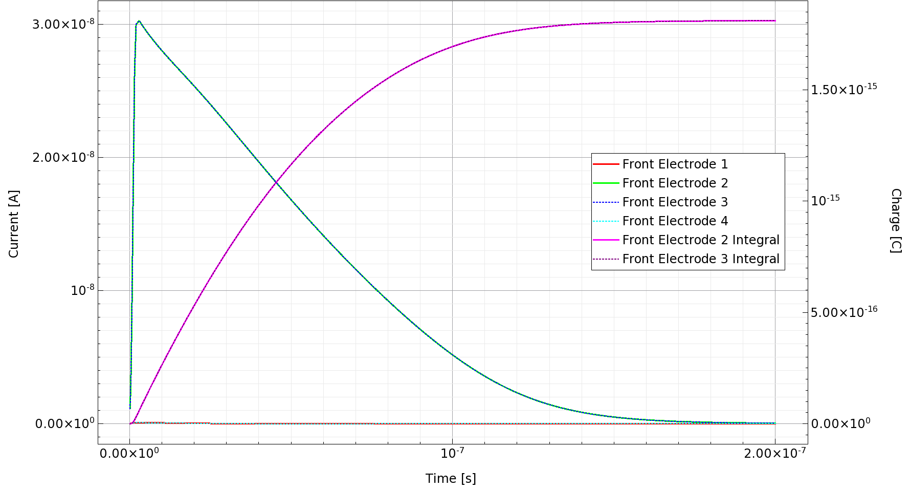
10 V
Notes:
这是电压为10V时粒子击中的电流曲线，最下面两条几乎水平的线为靠边缘的两个电极，在左侧有峰值的曲线为中间两个电极，而一直上升后趋于平缓的是对中间两电极电流的积分，也就是收集到的电荷

Slide 14
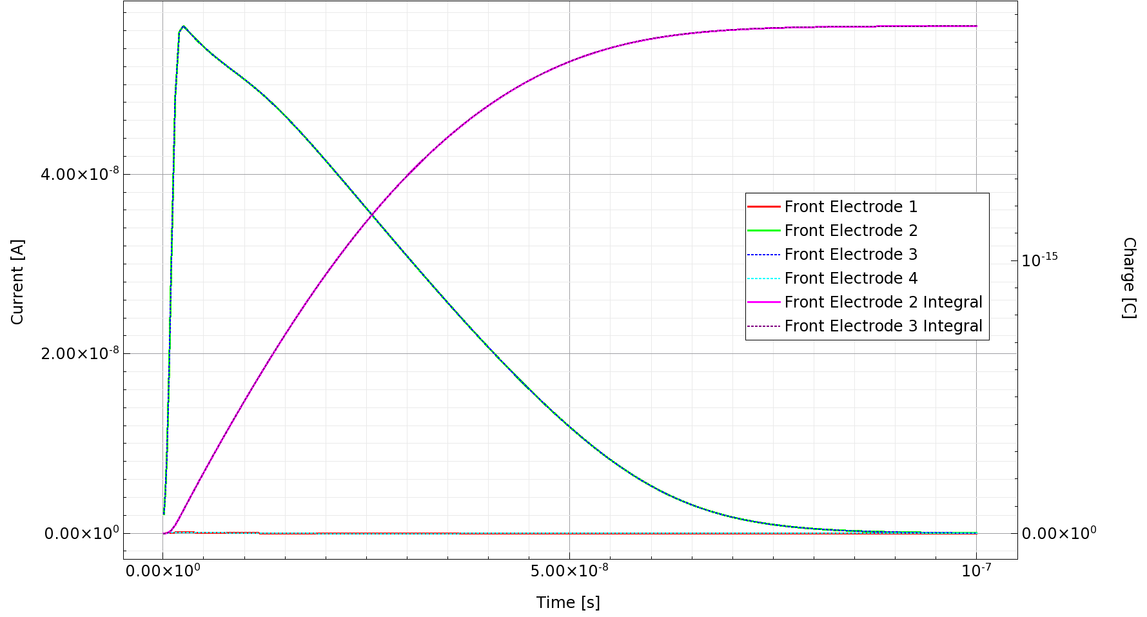
20 V
Notes:
这是20V时的结果，由于信号时间变短，减小了模拟时间，从200ns改为100ns，之后的图为50ns

Slide 15
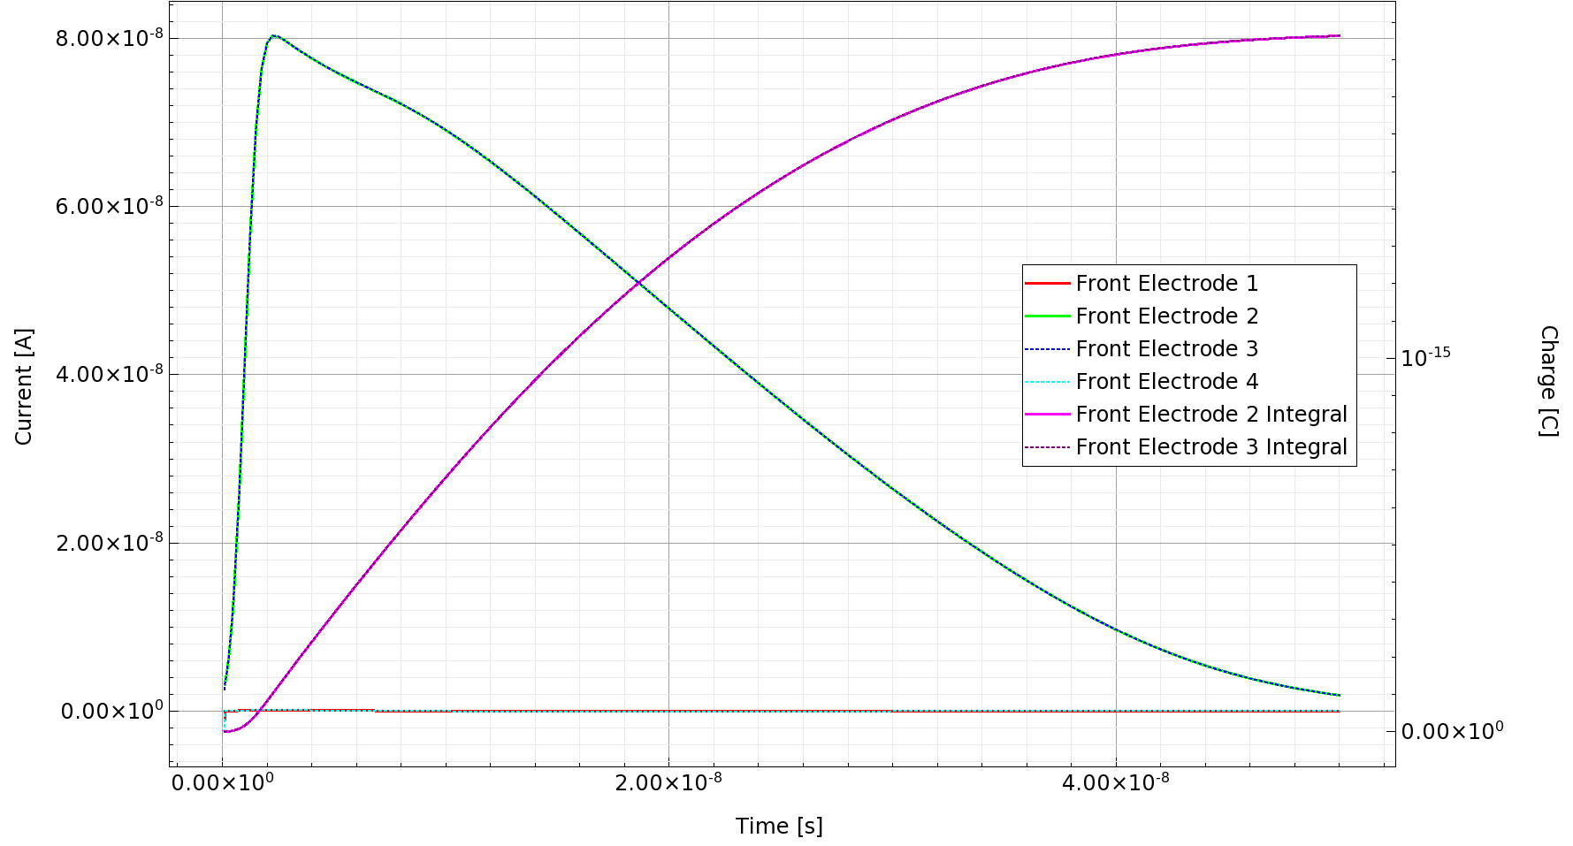
30 V

Slide 16
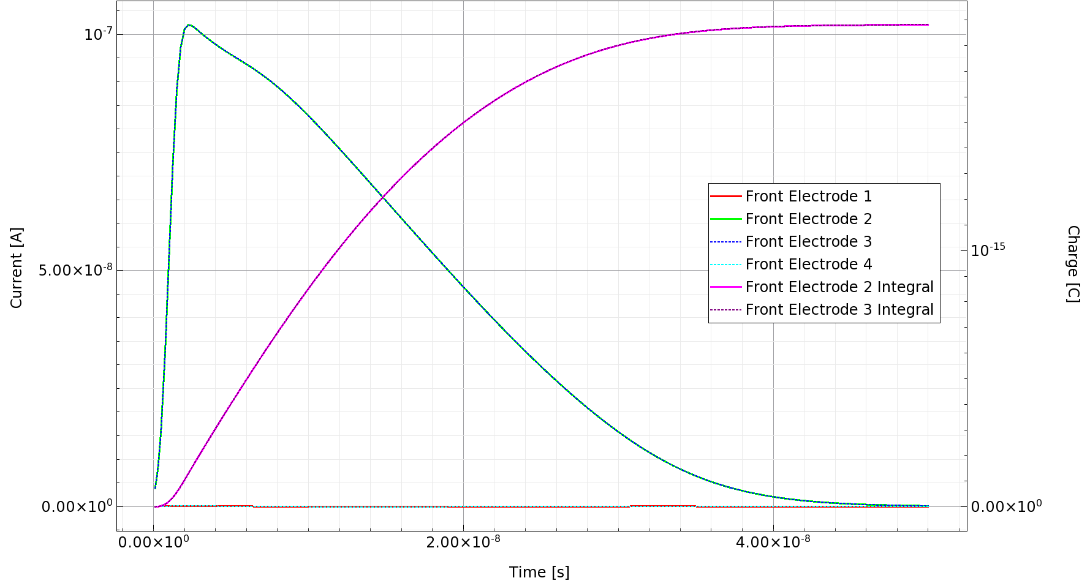
40 V

Slide 17
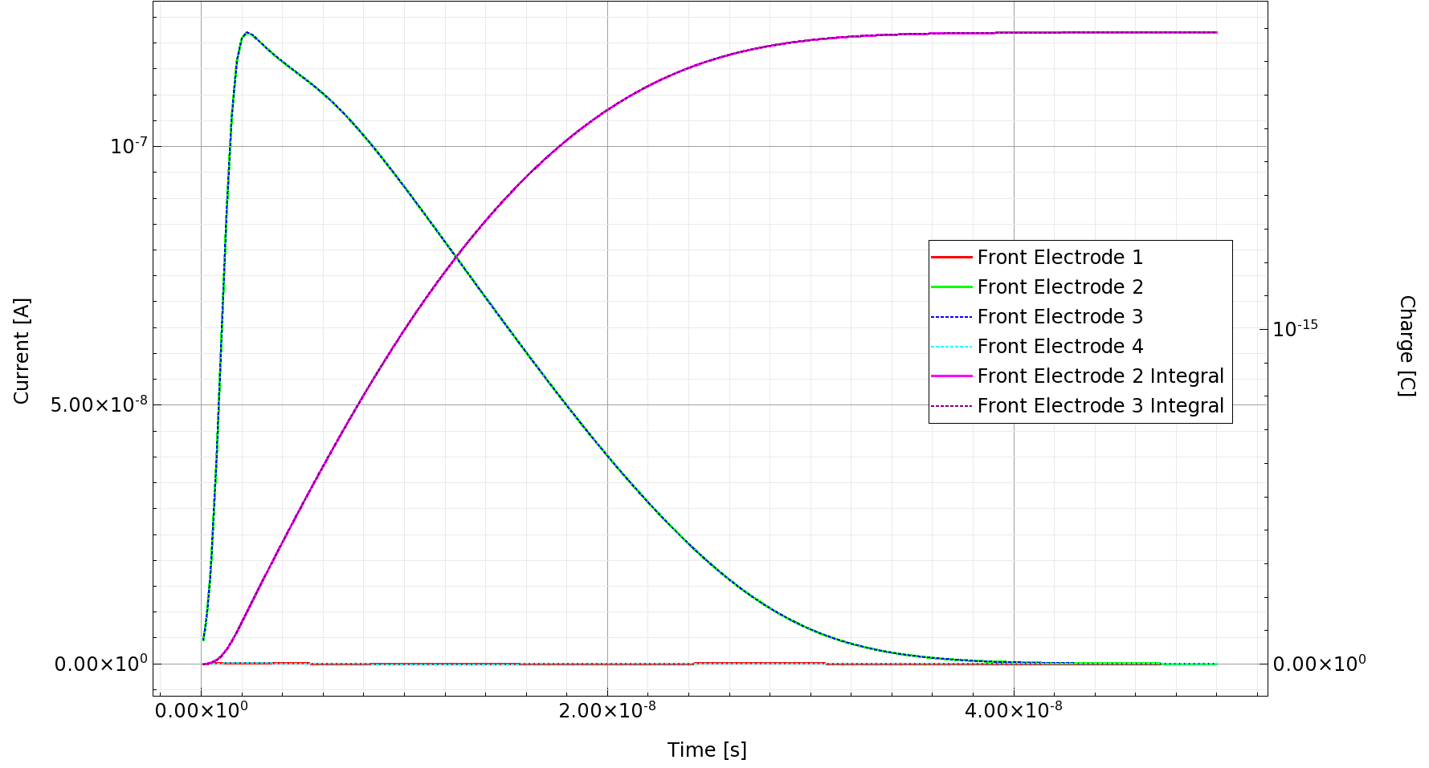
50 V

Slide 18
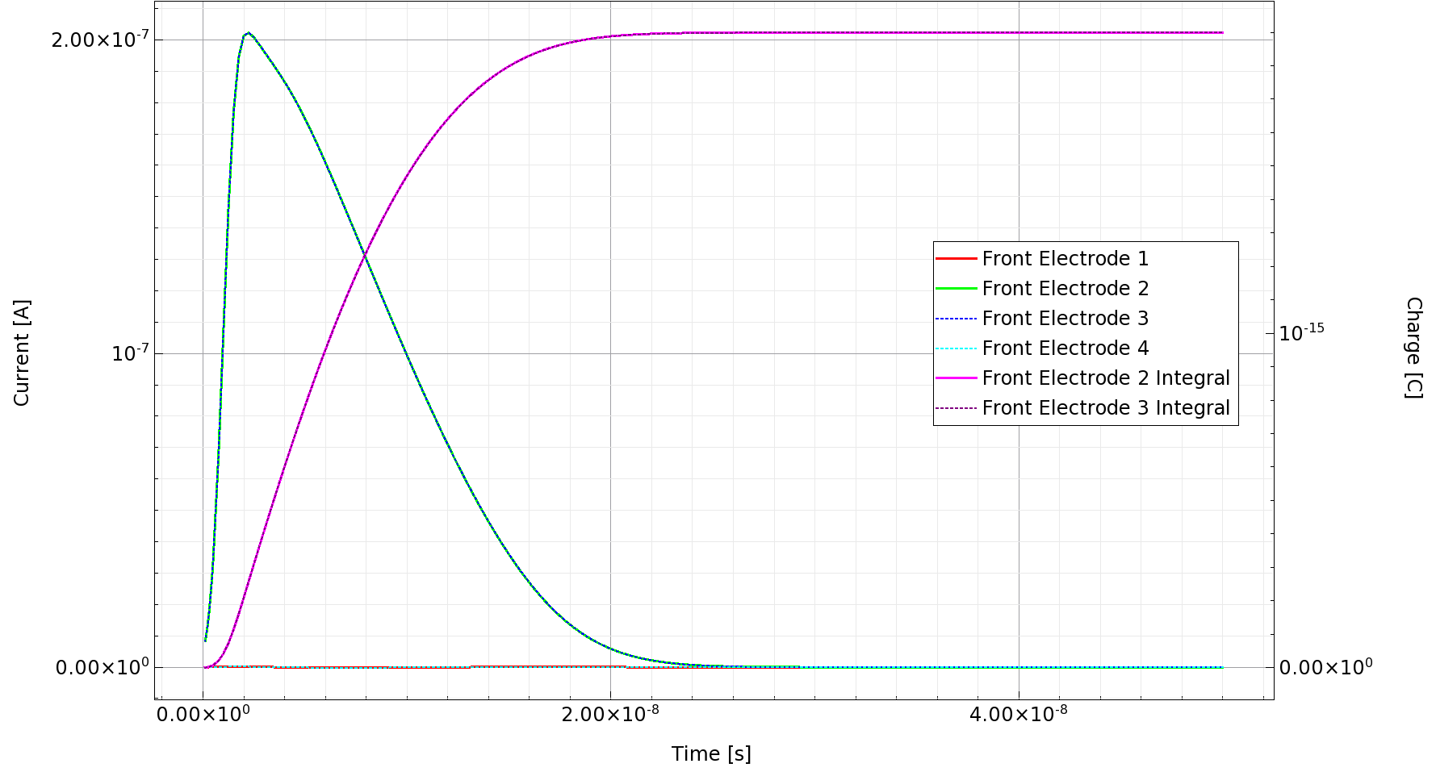
100 V

Slide 19
Voltage [V] | Peak Current [nA] | FWHM [ns] | Charge per Electrode [fC]
10 | 30.3 | 56 | 1.81
20 | 56.6 | 26.5 | 1.85
30 | 80.5 | 20.5 | 1.88
40 | 102 | 18 | 1.88
50 | 122 | 15 | 1.89
100 | 203 | 9 | 1.90

Slide 20
HeavyIon(
Direction = (0,0,1)
Location = (1,0,-260)
Time = 1e-9
Length = 520
Wt_hi = 1
LET_f = 5.767e-6
Gaussian
PicoCoulomb
)

Slide 21
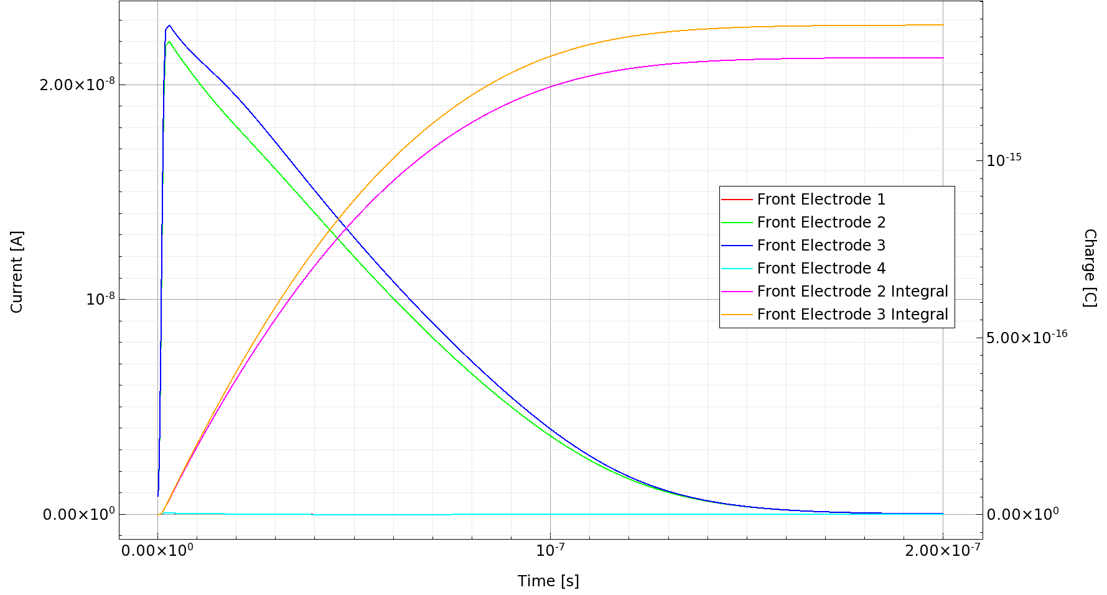
10 V

Slide 22
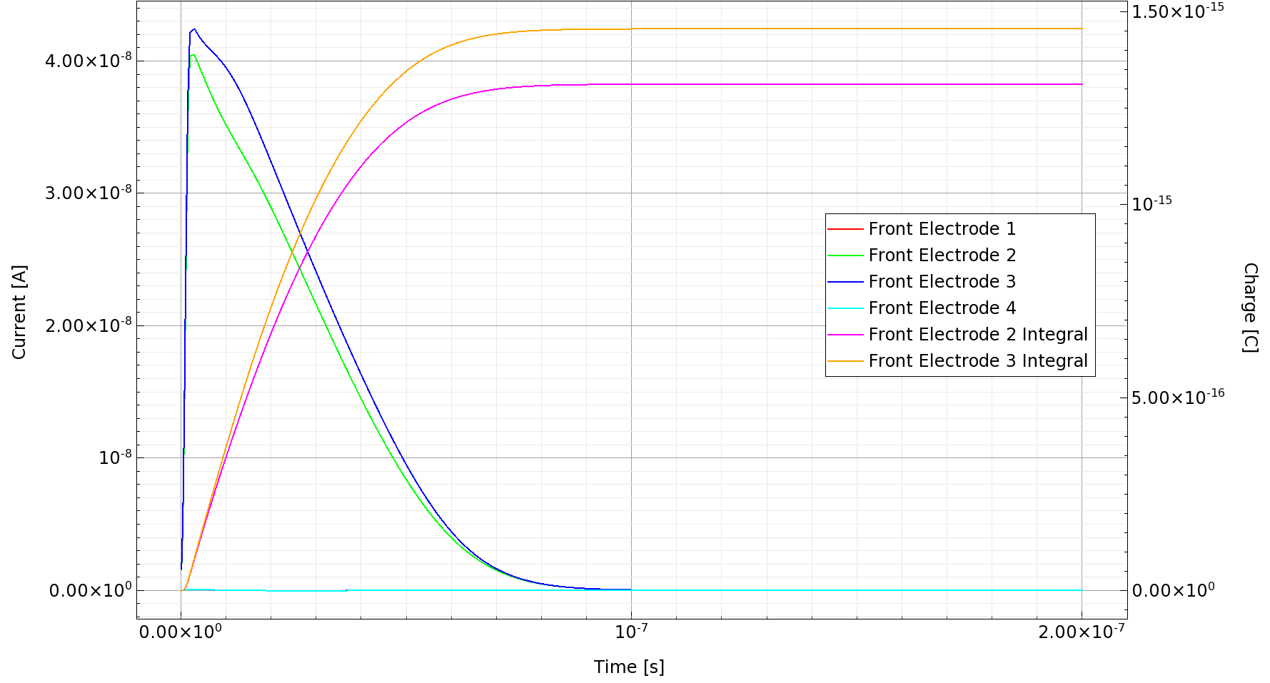
20 V

Slide 23
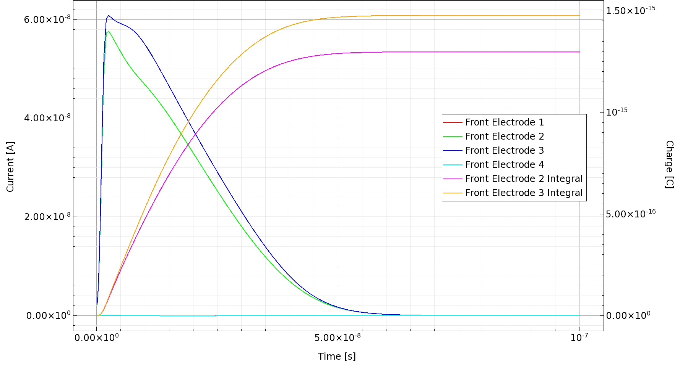
30 V

Slide 24
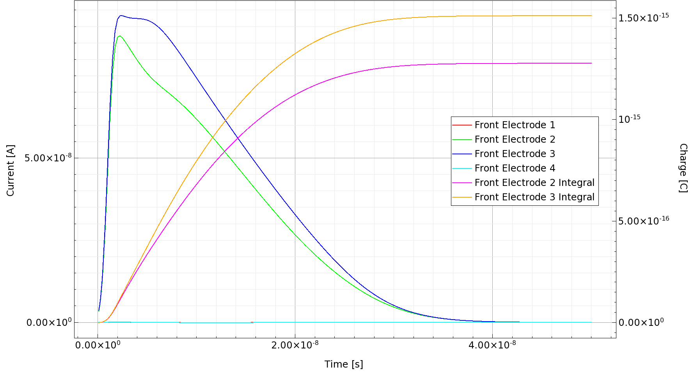
50 V

Slide 25
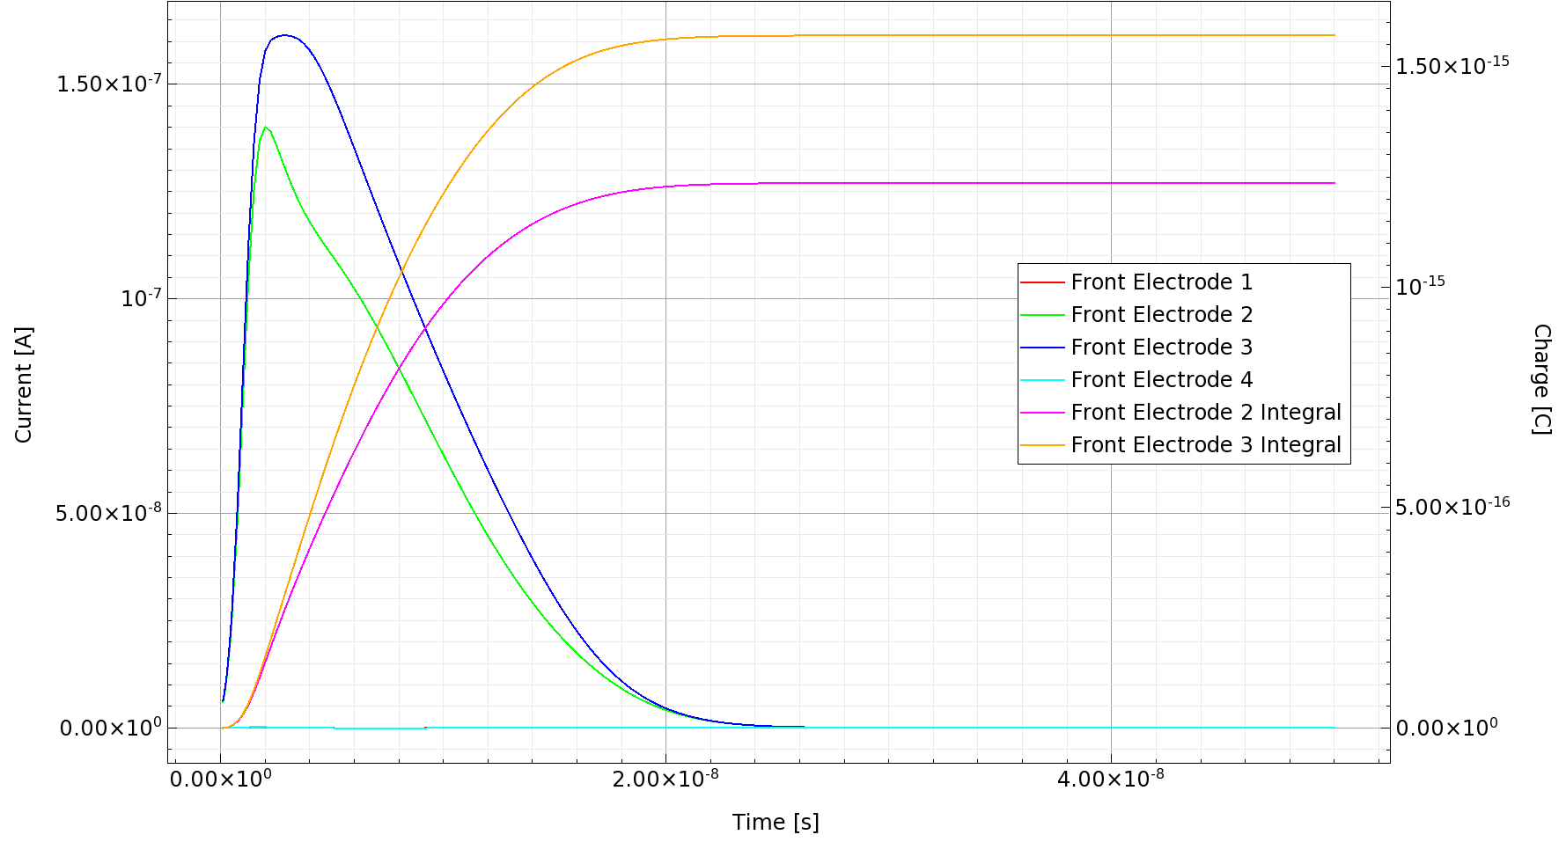
100 V

Slide 26
Voltage [V] | Charge 2 [fC] | Charge 3 [fC] | Difference [fC]
10 | 1.28 | 1.37 | 0.09
20 | 1.31 | 1.46 | 0.15
30 | 1.30 | 1.48 | 0.18
50 | 1.27 | 1.52 | 0.25
100 | 1.23 | 1.57 | 0.34

Slide 27
Conclusion
Fast luminosity monitor uses sCVD diamond, for its high carrier mobility, wide bandgap and high radiation hardness
The geometry of detector for particle hit simulation is built, while doping is set to ${10}^{10} {cm}^{−3}$
I-V characteristic curves are drawn
Transient simulations of particle hitting the detector are performed, the signal produced is drawn, higher voltage results in higher peak voltage, shorter signal duration, and slightly higher charge
Charge collected is ~25% higher than ionized by electron hit
Notes:
总结，快速亮度探测器以气相沉积金刚石为材料，因其具有高载流子迁移率，宽能带和高抗辐照能力。构建了用于粒子击中模拟探测器的几何结构，并加入了10的10次方的硼掺杂。绘制了金刚石探测器的IV特性曲线，比较了加入流体力学物理模型与否的效果。对粒子击中进行了瞬态模拟，绘制了信号的曲线。电压越大，峰值电流越大，信号持续时间越短，电荷也略微增加。收集到的电荷比电子击中电离的多约25%

