Slide 1
Wire-Cell eLEE Run4/5 Updates
Jianghong Wang
Nankai University
Osc/LEE Group Meeting

Slide 2
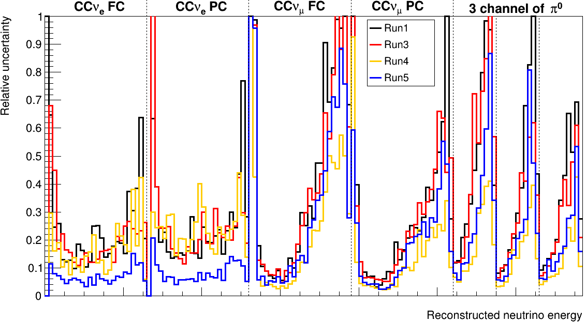
Previous result: Detector relative uncertainty
nueCC channels
Run4
Run5
Details in Docdb-43590.
Inconsistent behavior of run4/5 detector systematics in $ν_{e}$ and $ν_{μ}$ channels
Det. Syst. of all seven channels of Run5 are smaller than those of Run1/3.
Det. Syst. of non-$ν_{e}$ channels of Run4 are smaller than the result of Run1/3.

Slide 3
Detector systematics sample of intrinsic nue
POT information
Item | Run1 | Run3 | Run4 | Run5
LYDown LYRayleight Recomb2 SCE WireModThetaXZ WireModThetaYZ WireModX LYAttenuation | ~$5× {10}^{22}$ | ~$5× {10}^{22}$ | ~$12× {10}^{22}$ | ~$13× {10}^{22}$
WireModYZ | ~$5× {10}^{22}$ | ~$5× {10}^{22}$ | $$\sim 0.4× {10}^{22}$$ (old) | ~$13× {10}^{22}$
Recent New Run4 WireModYZ is increased to $\sim 12× {10}^{22}$ POT.

Slide 4
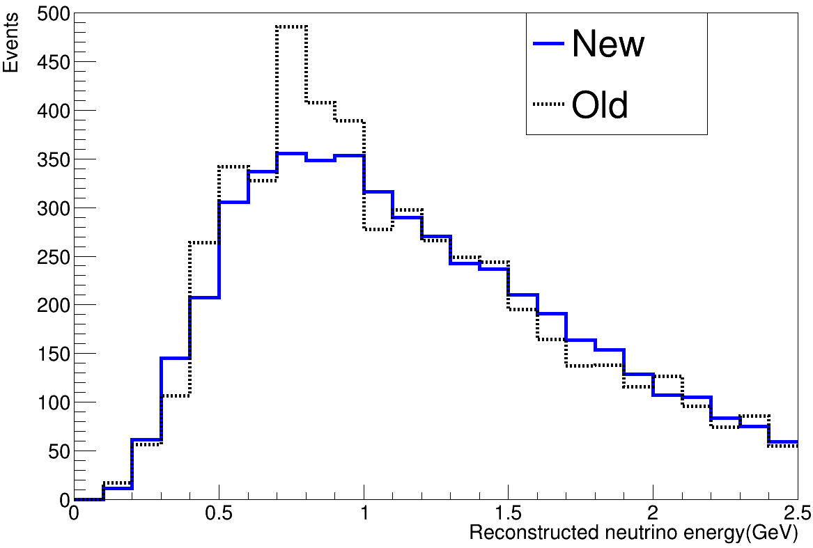
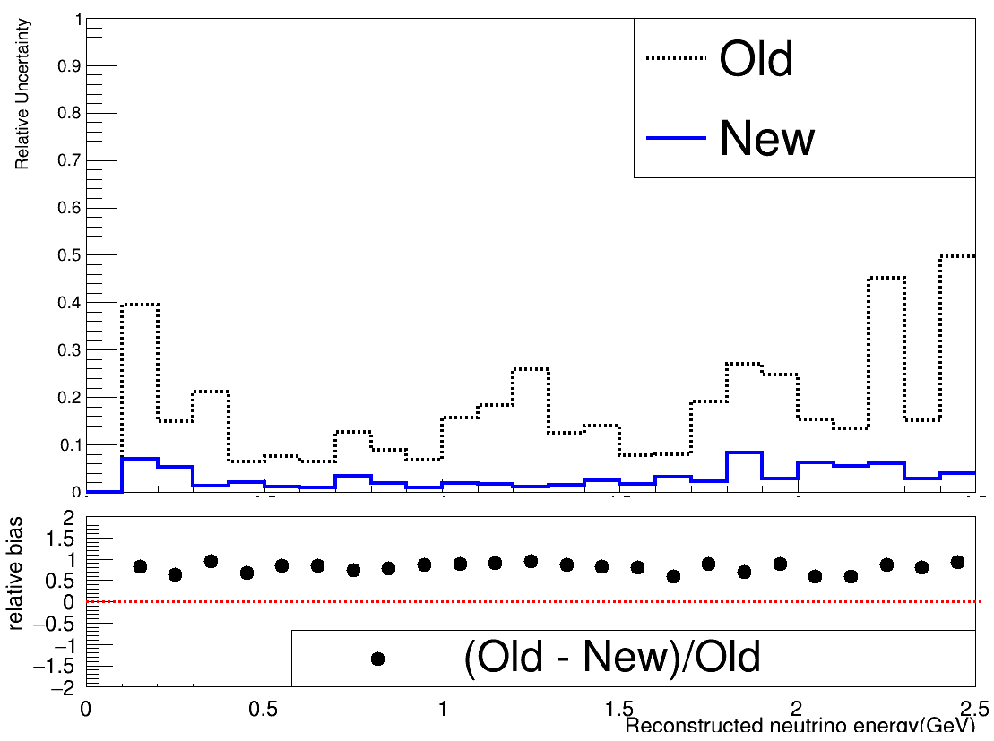
Update for Run4 $ν_{e}$ WMYZ sample
nueCC FC
Relative uncertainty
nueCC FC: Spectrum
Normalized to same POT
By recovering WMYZ detvar sample statistics, distribution of new sample shows smoother distribution than old sample.
Relative uncertainty of new sample is lower than old sample.

Slide 5
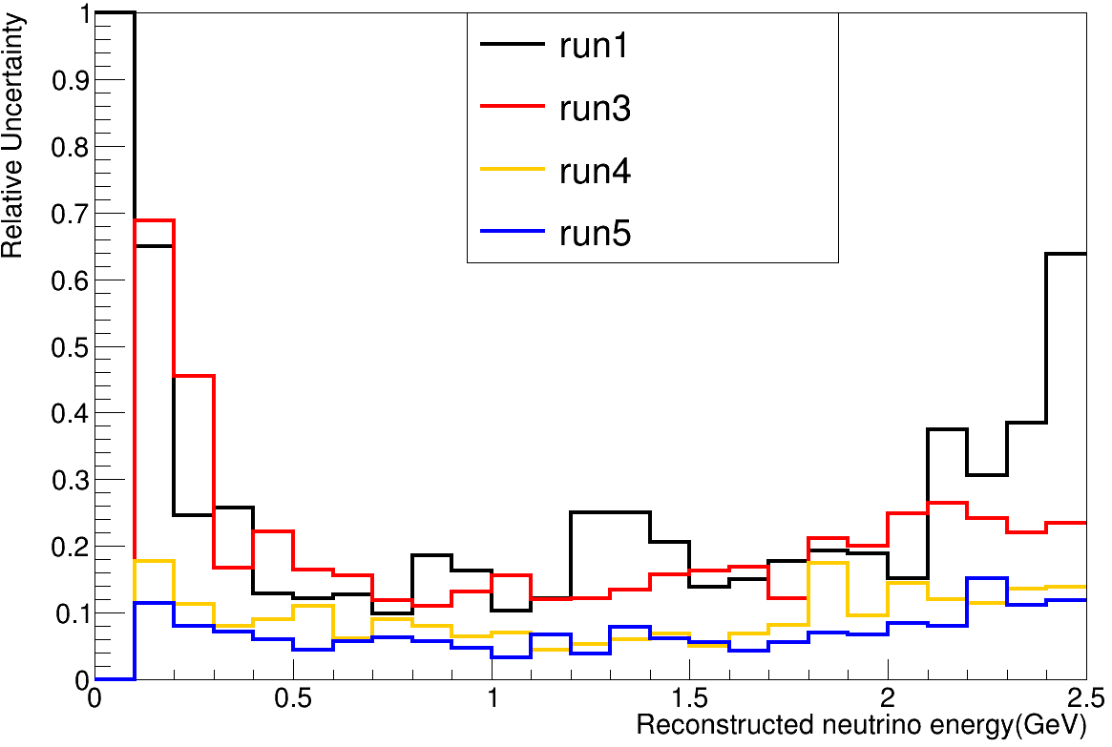
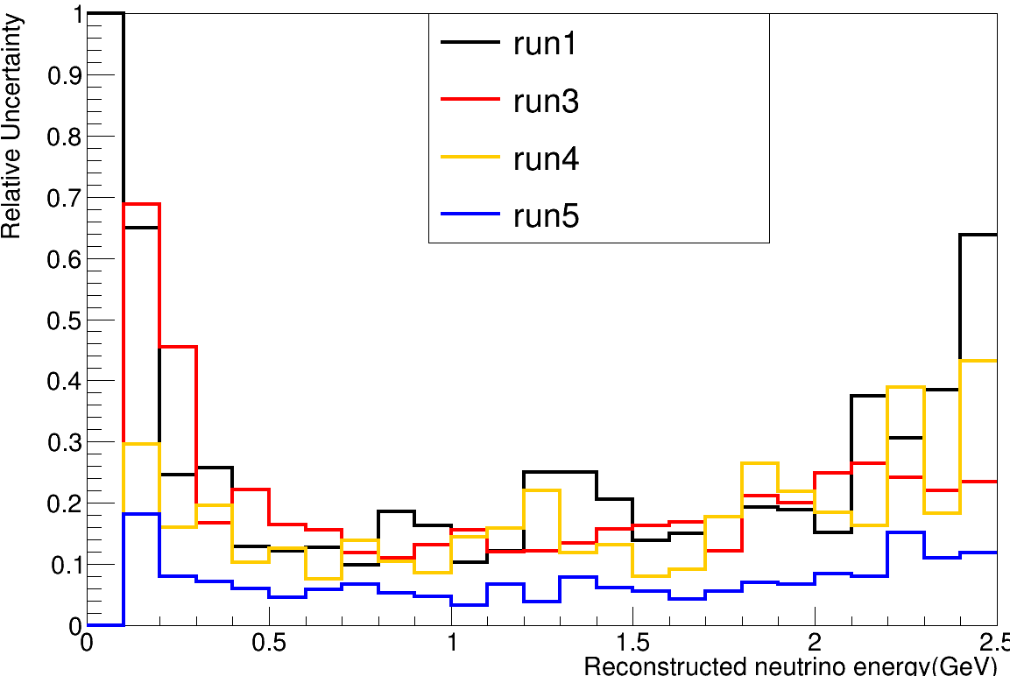
$ν_{e}$CC FC: Detector relative uncertainty
new sample
Run4
old sample
With recovered statistics, run4 detector systematics is similar with run5.

Slide 6
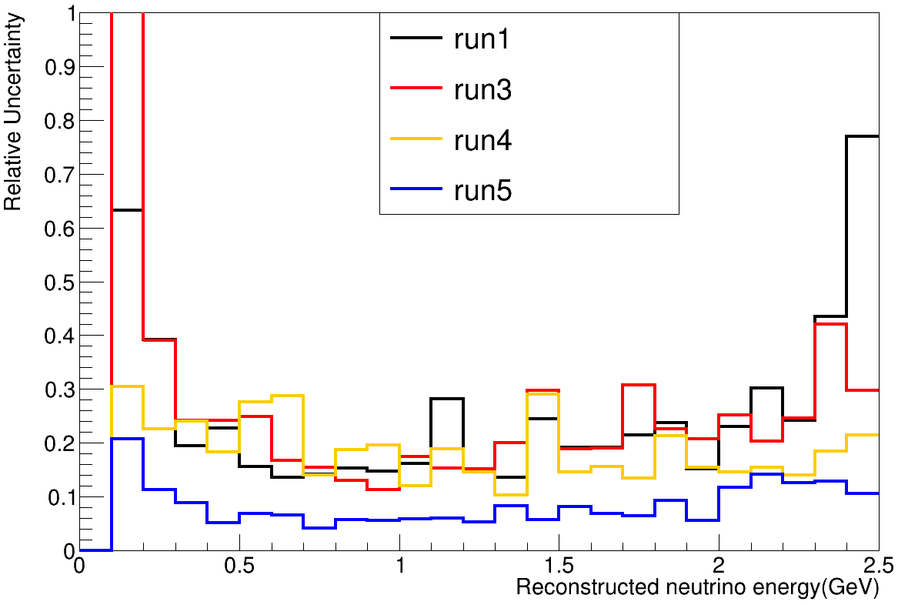
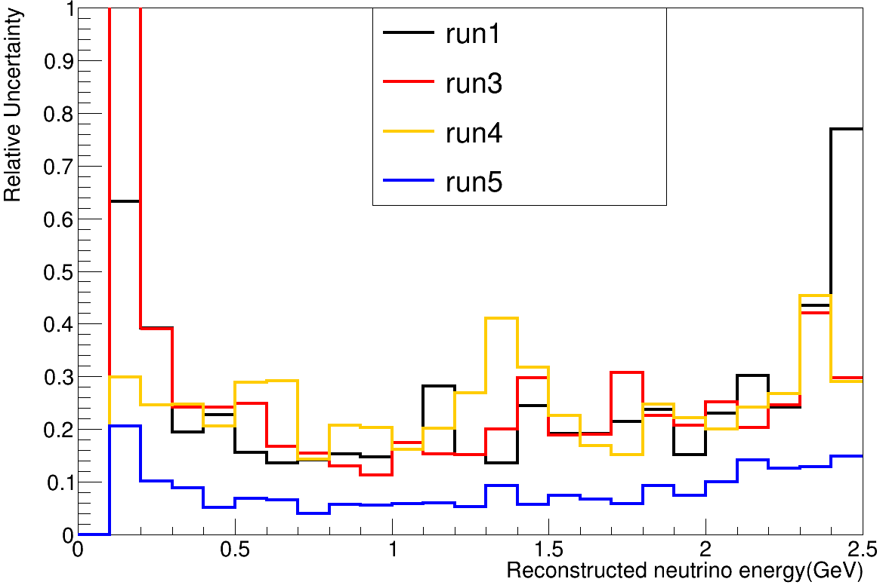
$ν_{e}$CC PC: Detector relative uncertainty
new sample
old sample
However, Run4 nueCC PC new(sample) uncertainty is still similar to the old one. It dose not decrease with recovered statistic. this is strange. we are investing it.

Slide 7
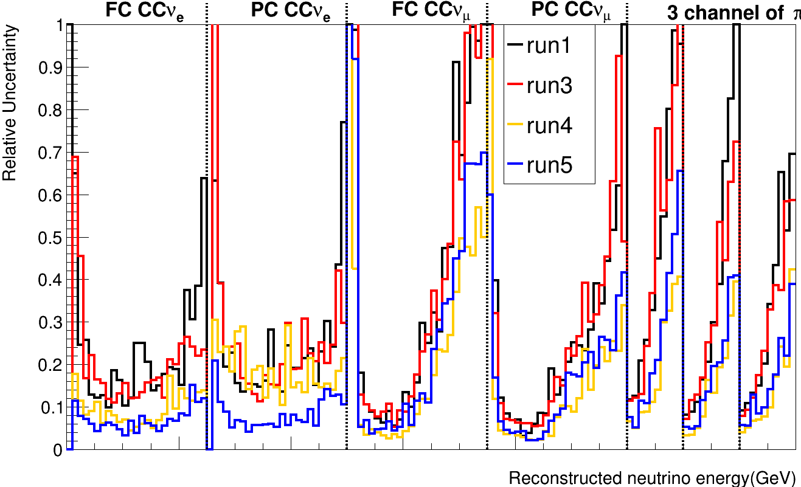
Detector relative uncertainty
1000
2000
1000
2000
1000
2000
1000
2000
1000
1000
1000
Det. Syst. of all seven channels of Run5 are smaller than those of Run1/3.
Det. Syst. of remaining six channels except nueCC PC are smaller than those of Run1/3.

Slide 8
Back Up

Slide 9
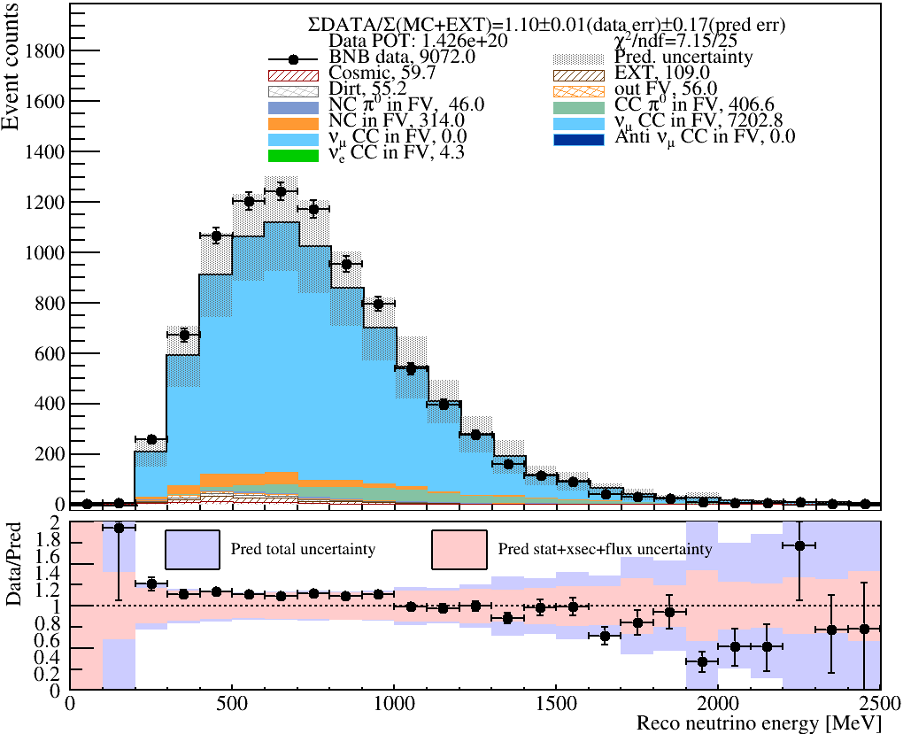
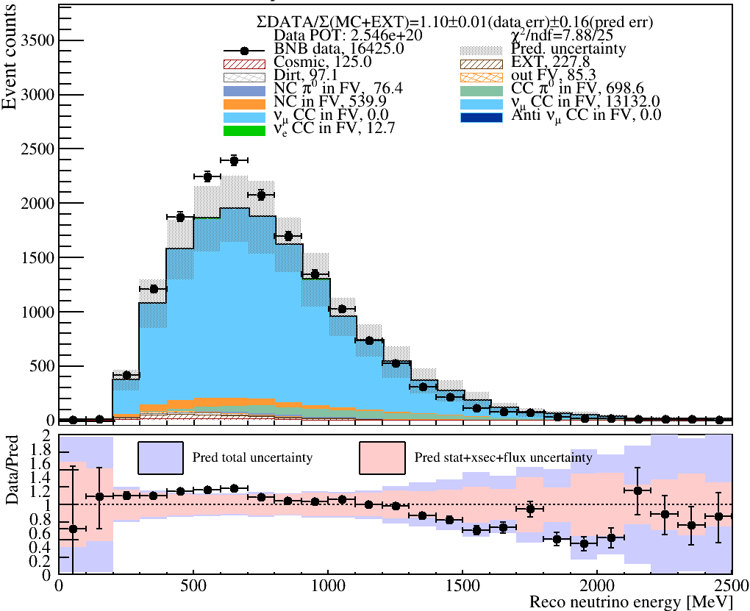
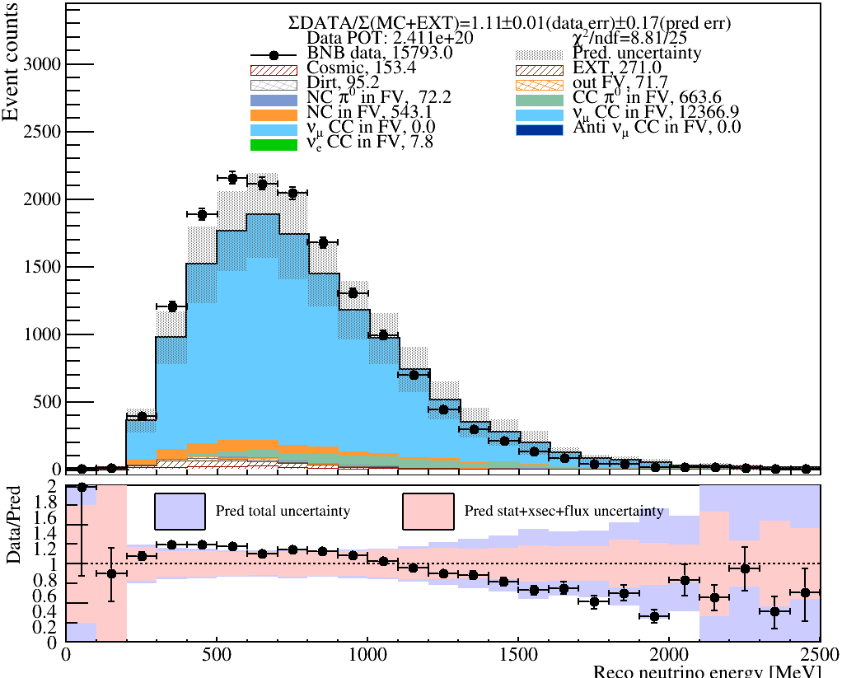
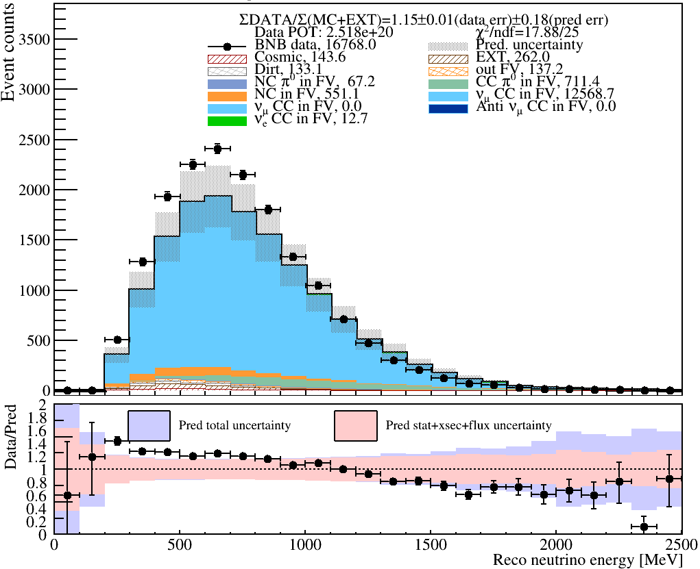
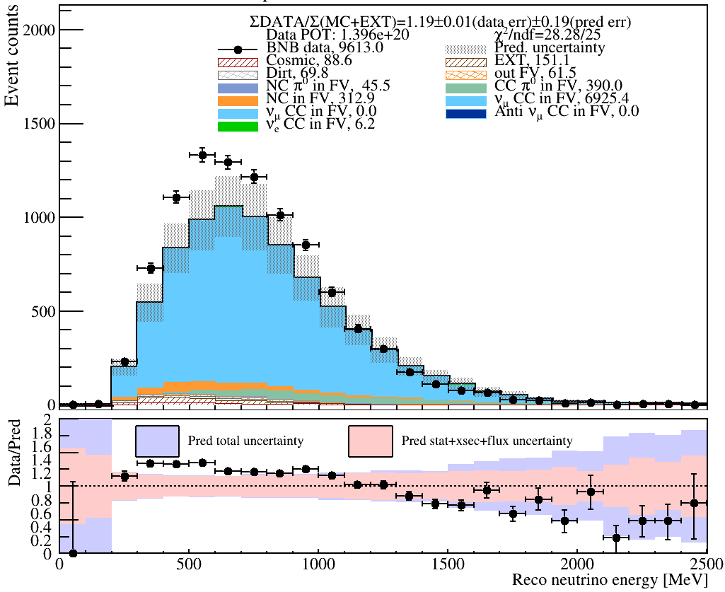
Run1
Run2
Run3
$ν_{μ}CC$ FC: spectrum
Run4
Run5

Slide 10
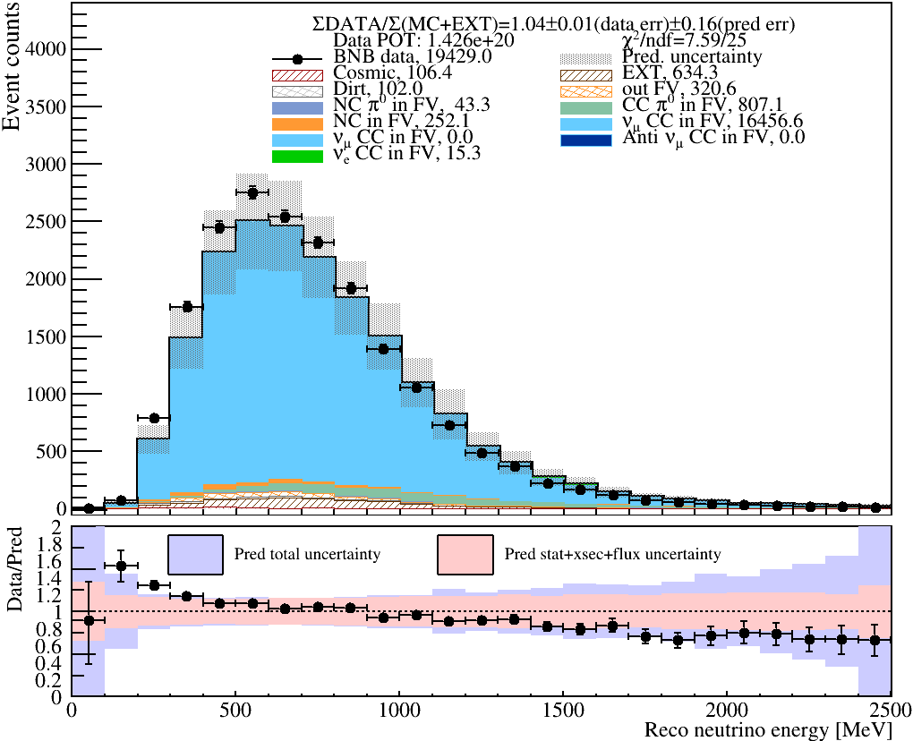
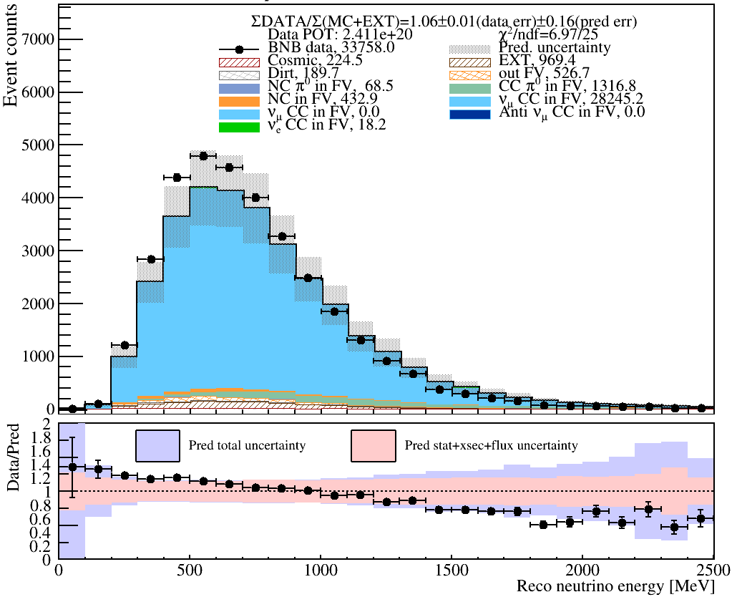
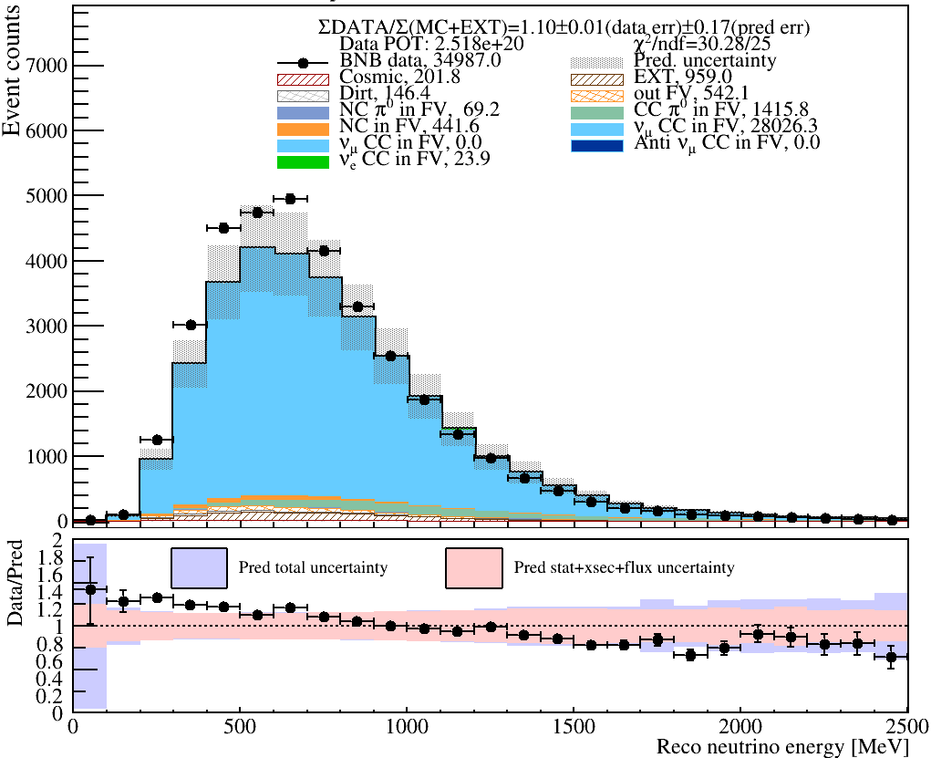
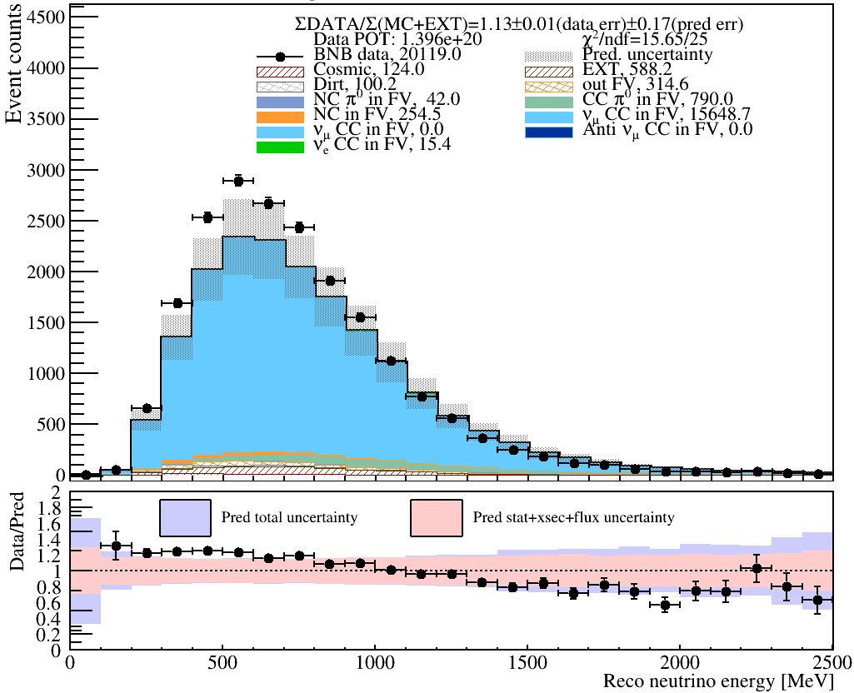
Run1
Run2
Run3
$ν_{μ}CC$ PC: spectrum
Run4
Run5

Slide 11
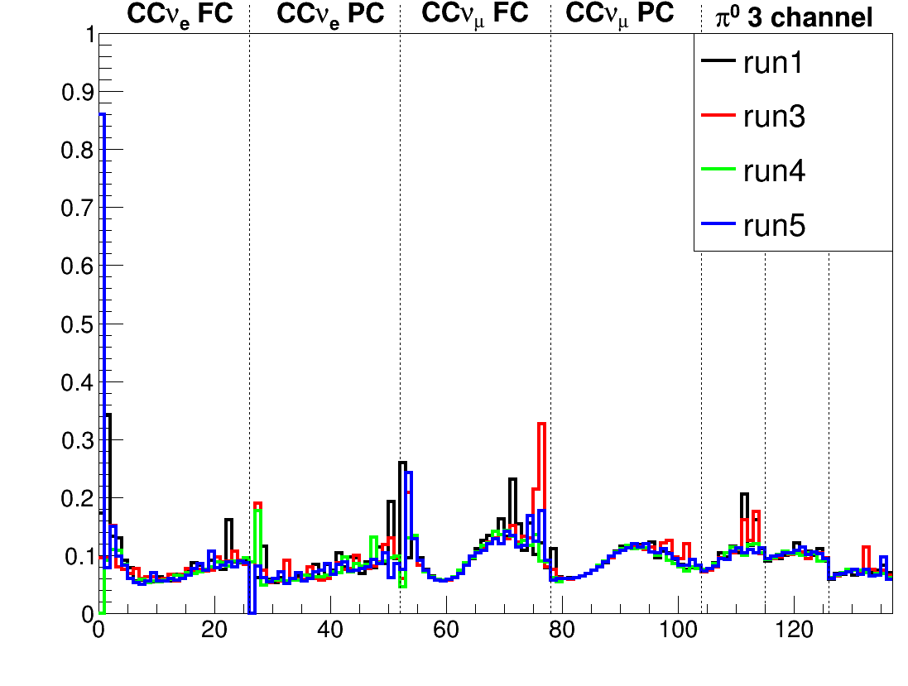
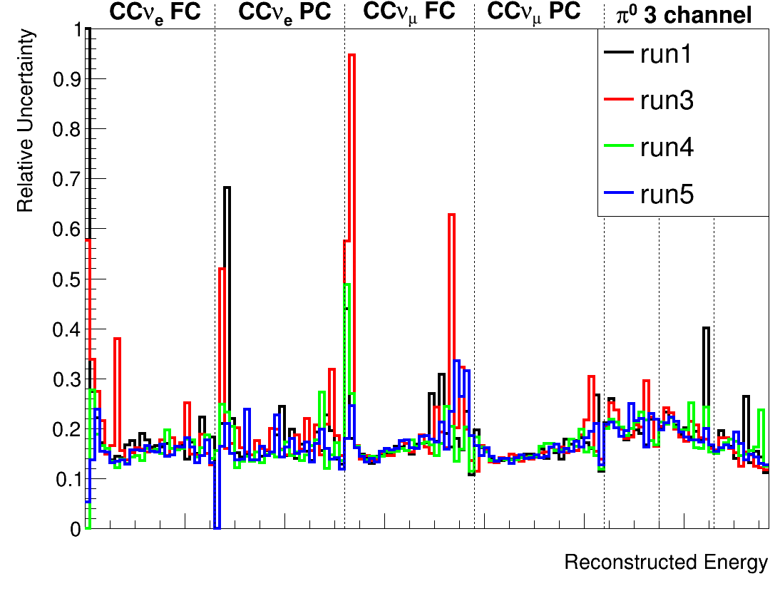
Previous result: Flux and Cross section Result
Flux uncertainty
Cross section uncertainty
Flux
Cross section
MC statistics
Systematic uncertainties of Run4/5 are well consistent with Run1/3.
Details in Docdb-43590.

Slide 12
$χ^{2}$ with full systematic uncertainty
Channel | $χ^{2}$ without constraint (p-value)
 | Run1 | Run2 | Run3 | Run4 | Run5
FC $ν_{μ}$CC(25 bin) | 7.15 (0.9998) | 7.88 (0.9996) | 8.81 (0.9988) | 17.88 (0.8474) | 28.28 (0.2951)
PC $ν_{μ}$CC(25 bin) | 7.59 (0.9997) | 7.60 (0.9997) | 6.97 (0.9999) | 30.28 (0.2140) | 15.65 (0.9249)
Chi2/ndf values are higher in Run4/5 compared to Run1-3, indicating data-MC compatibility is not as good in Run4/5.
It’s still within 1.3 sigma (Run4 PC $ν_{μ}$CC) so data and MC still agrees reasonably well in Run4/5.
But this run-dependence is somewhat concerning.

Slide 13
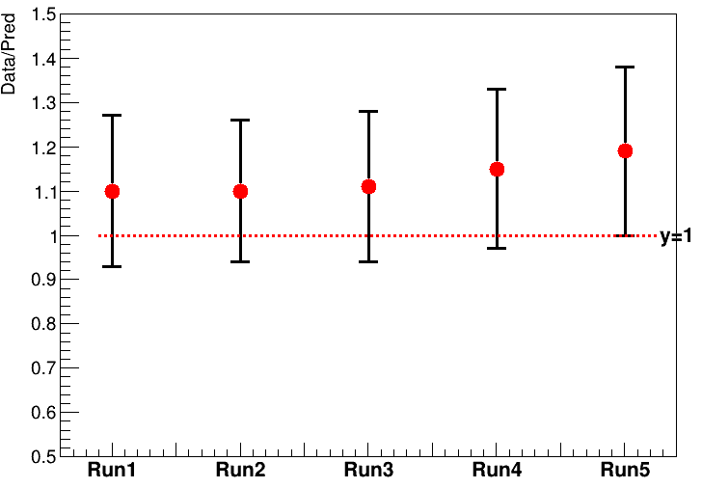
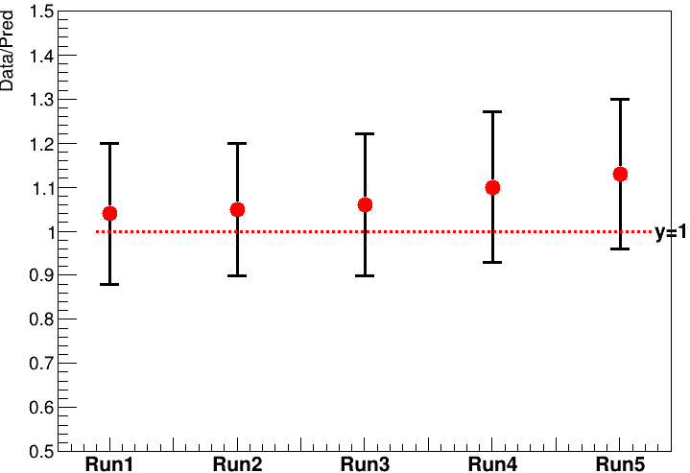
$ν_{μ}CC: \frac{Data}{Pred}$ratio vs. Run
FC $ν_{μ}CC$
PC $ν_{μ}CC$
Error bar from statistical error and full systemic uncertainty.
Run4 and Run5 ratio are slightly higher than Run1-3.

Slide 14
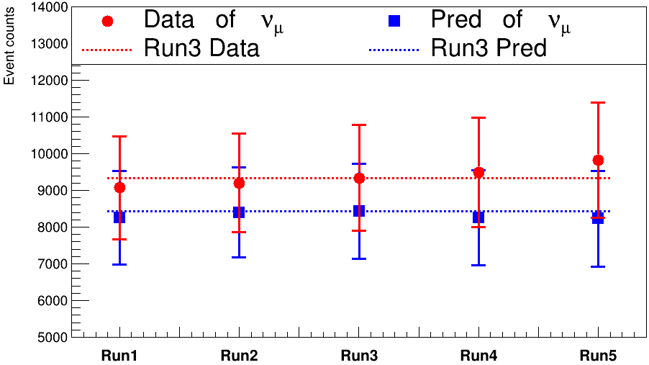
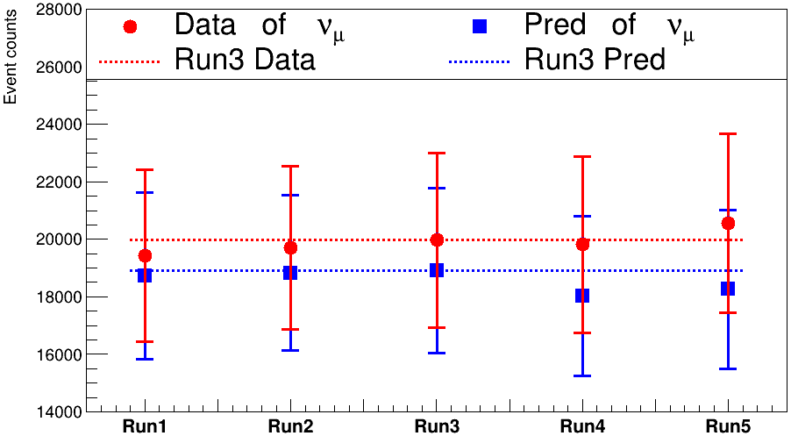
$ν_{μ}$CC: normalized data and pred vs. Run
FC $ν_{μ}CC$
PC $ν_{μ}CC$
Data and Pred at different runs are normalized to same POT(1.4e20).
Data error bar from statistical uncertainty and full systemic uncertainty.
Pred error bar from full sys uncertainty.
Selected numuCC data in Run5 is slightly higher than Run1-3 in average.

Slide 15
Summary
New detector variation sample with full POT leads to more consistent detector relative uncertainty for Run4/5.
High stat nature of Run4/5 detvar samples makes det systematics lower than Run1/3.
Run4/5 chi2/ndf show higher values than Run1-3, which seems to be due to higher $\frac{Data}{Pred}$ of Run4/5.
The data-MC still agrees within systematics in Run4/5.

