Slide 1
Design of electromagnetic components at MACE and Muon beamline MuST
Guihao Lu, Shihan Zhao
International Workshop on MuonPhysics at the Intensity and Precision Frontiers
MIP2025
11 May 2025

Slide 2
Contents
The MACE positron transport system (PTS)
I. Motivations
II. Solenoid system and Electrostatic acceleration module
III. Performance
The capture front-end design in MuST
I. Beamline introduction
II. Radiation-resistant capture solenoid (RCS) design
III. Electromagnetic, irradiation, and cooling research
Summary

Slide 3
Contents
The MACE positron transport system (PTS)
I. Motivations
II. Solenoid system and Electrostatic acceleration module
III. Performance
The capture front-end design in MuST
I. Beamline introduction
II. Radiation-resistant capture solenoid (RCS) design
III. Electromagnetic, irradiation, and cooling research
Summary

Slide 4
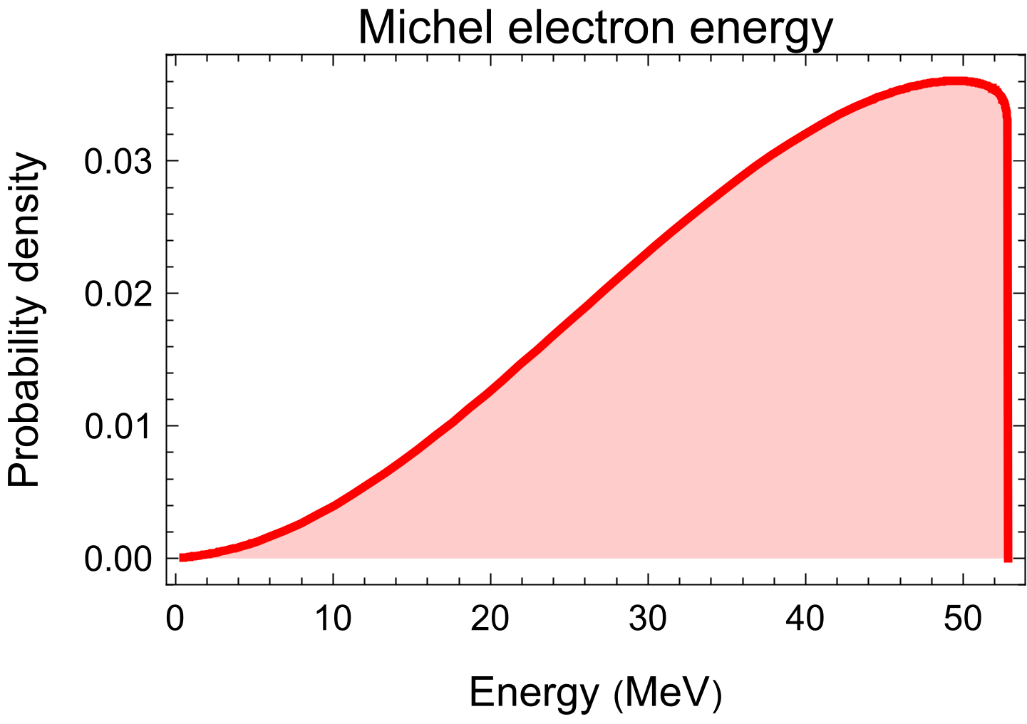
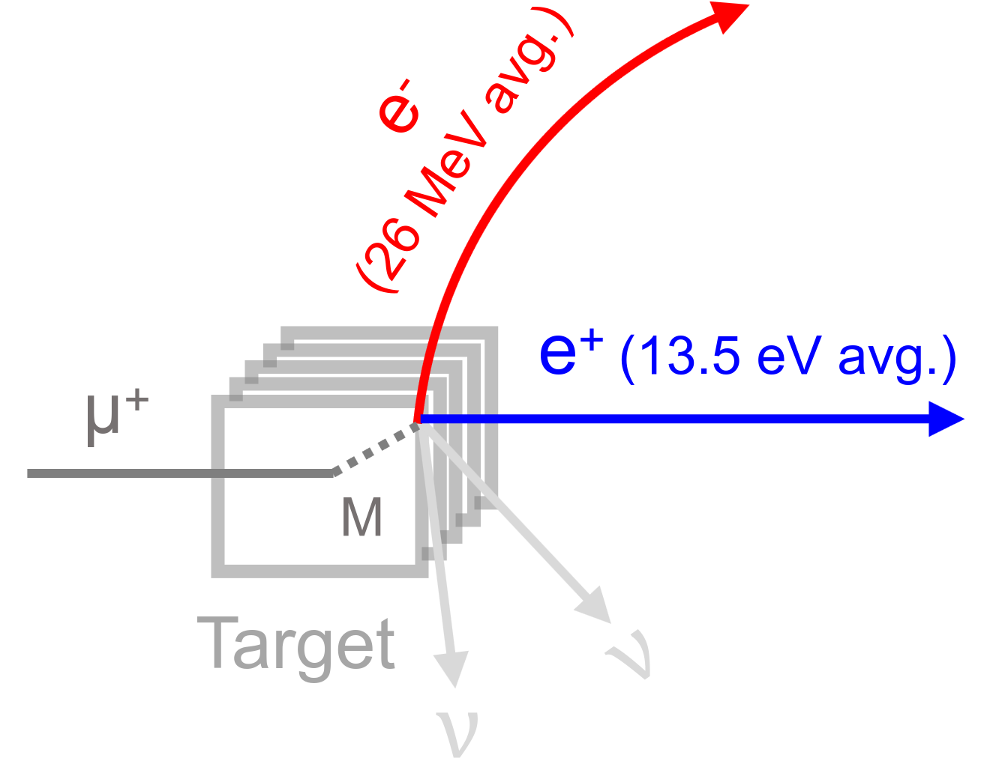
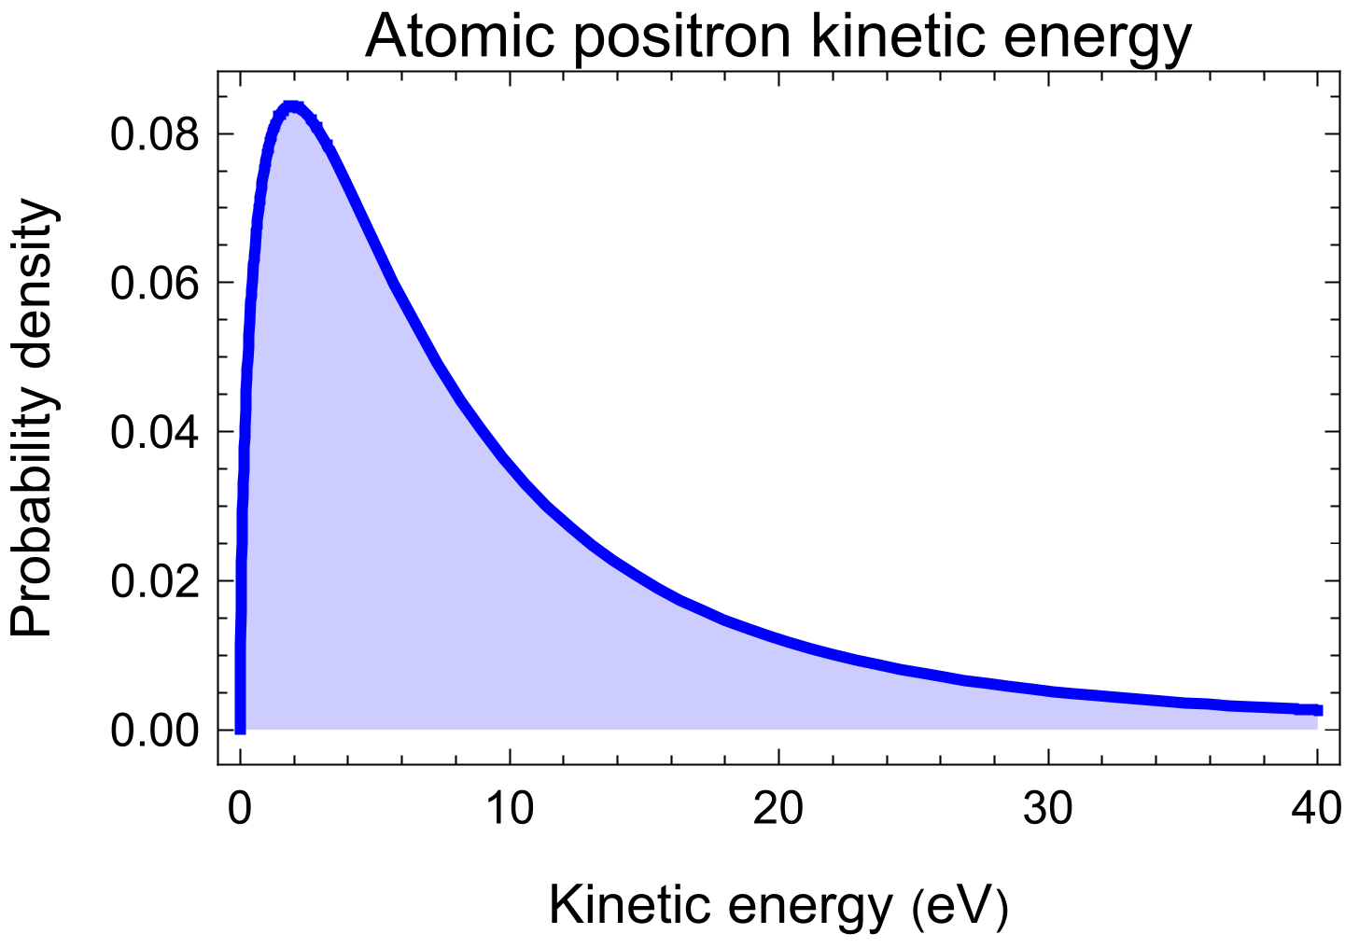
Design goals of PTS
Transmitting signal from cLFV Process
$M→e^{+}{\overline{ν}}_{μ}ν_{e}e^{−}$
fast $e^{−}$ + slow $e^{+}$
Momenta for Atomic positron (PTS)
I. Isotropic
II. Mean kinetic energy of 13.5 eV
Electrostatic accelerator with ~500 eV
Transmitting signals

Slide 5
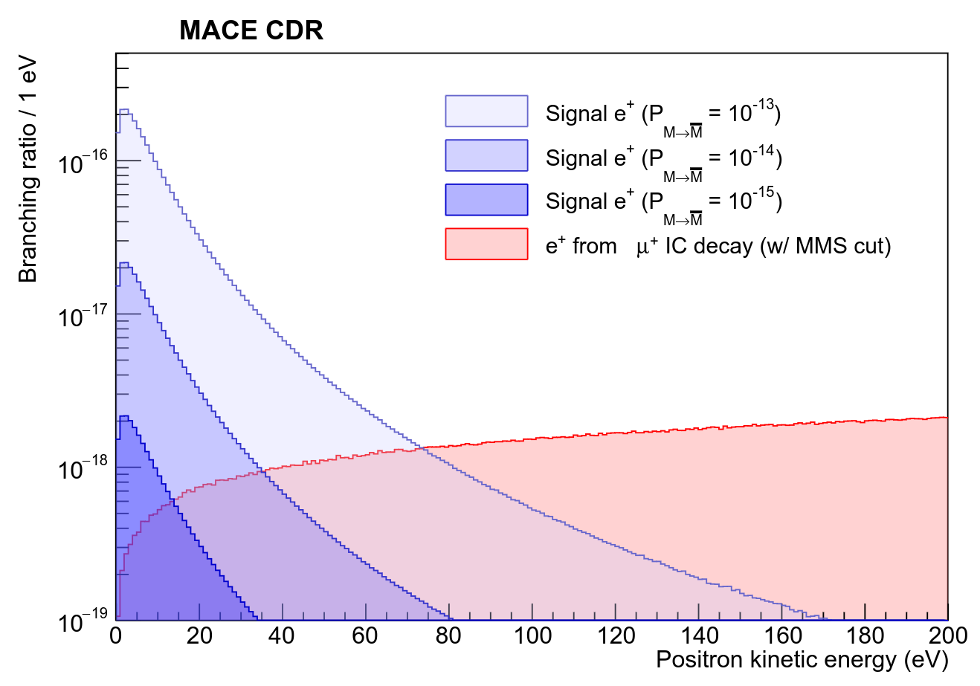
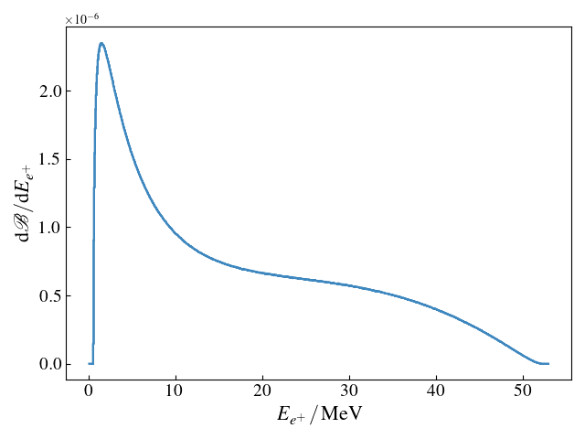
Design goals of PTS
Reduce background from IC decay
$$μ^{+}→e^{+}e^{−}e^{+}{\overline{ν}}_{μ}ν_{e}$$
fast $e^{−}$ + slow $e^{+}$
$e^{+}$ energy spectrum of
$μ^{+}→e^{+}e^{−}e^{+}{\overline{ν}}_{μ}ν_{e}$
A positron momentum selector design
TOF coincidence
Collimator
Reduce backgrounds
$$BR(μ→eeeνν)= 3.4×{10}^{−5}$$
$$BR(μ→eeeνν | E_{k}^{1e^{+}}<100 eV)= 3×{10}^{−12}\text{ (}\text{LO} \text{prediction}\text{)}$$

Slide 6
Contents
The MACE positron transport system (PTS)
I. Motivations
II. Solenoid system and Electrostatic acceleration module
III. Performance
The capture front-end design in MuST
I. Beamline introduction
II. Radiation-resistant capture solenoid (RCS) design
III. Electromagnetic, irradiation, and cooling research
Summary

Slide 7
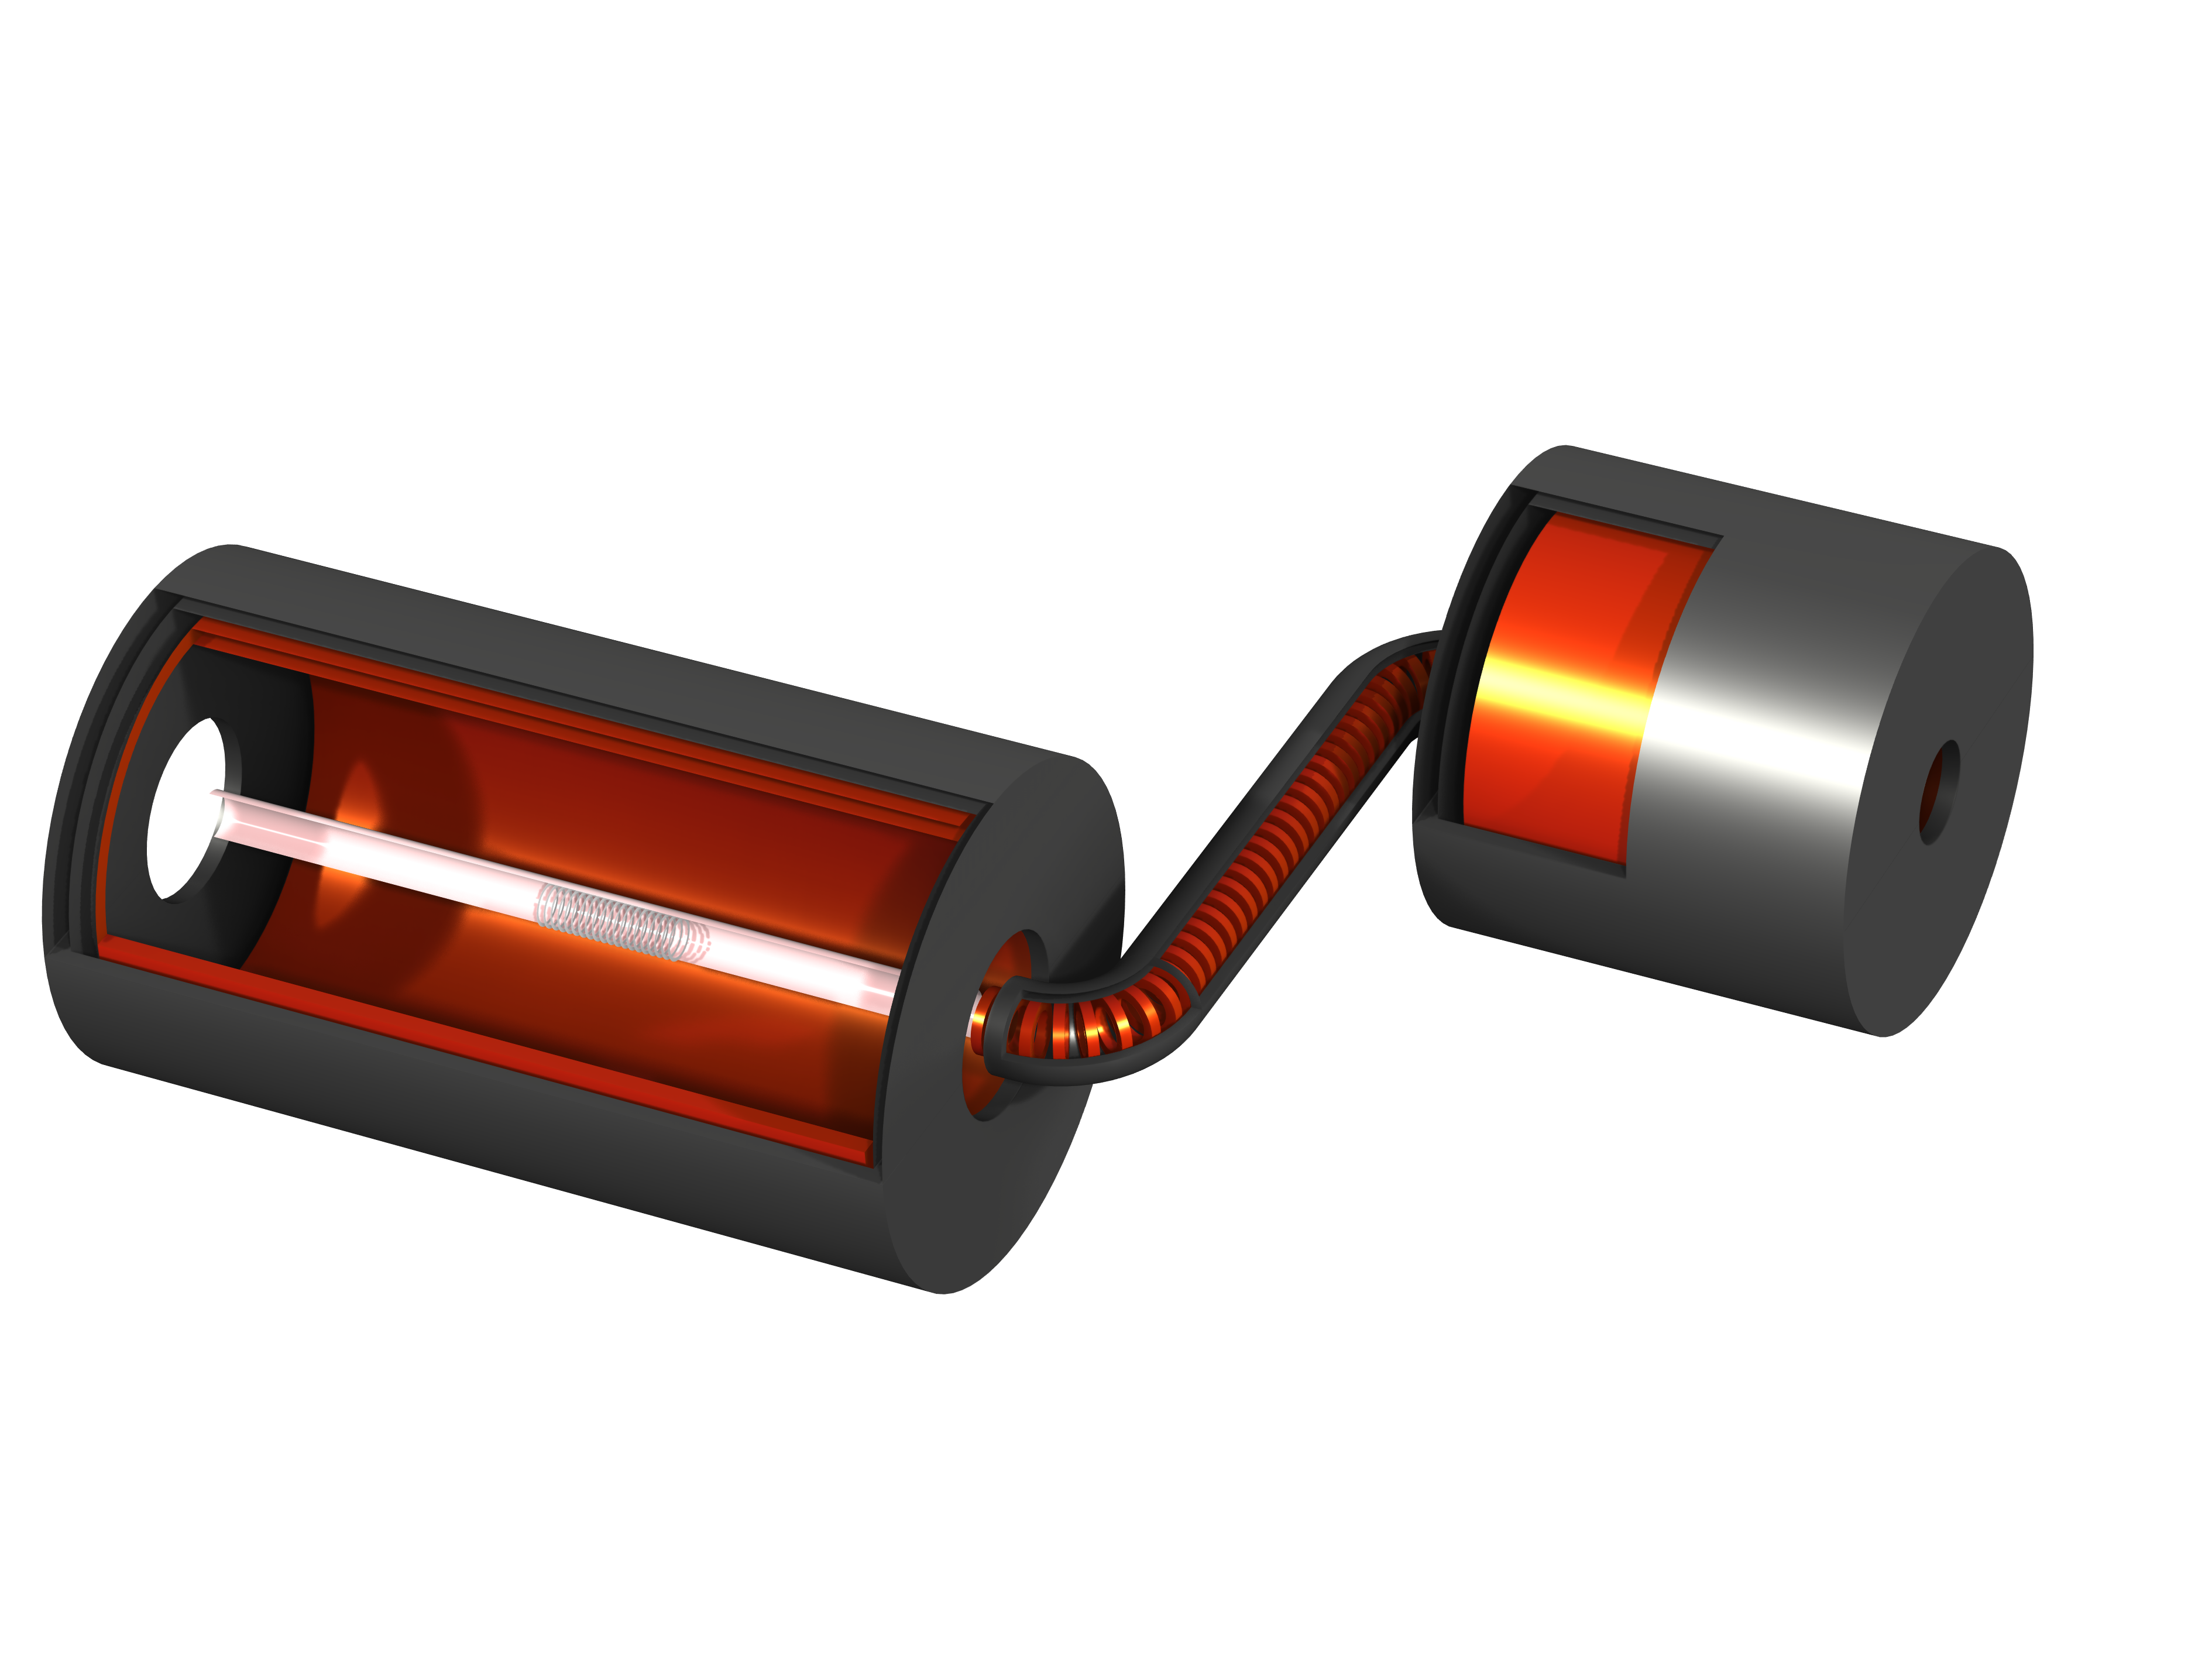
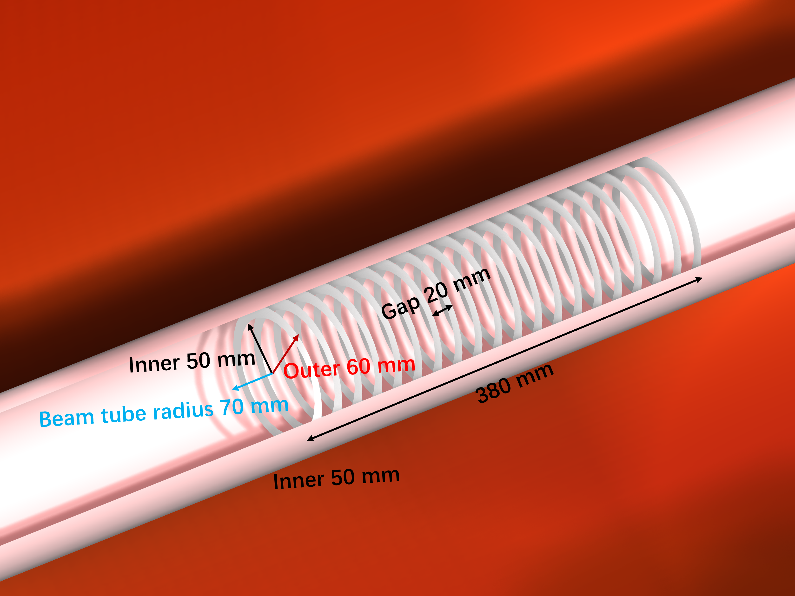
Design of PTS for MACE
The design of the MACE positron transport system (PTS)
I. Electrostatic accelerator
II. Solenoid system
1. MMS solenoid
2. TS solenoid
3. ECal solenoid
PTS performance
I. Transmission efficiency: 65.8%.
II. Flight time: 322 ns.
III. Flight time FWHM: 6.9 ns.
IV. Spatial resolution: 0.088 mm $×$ 0.102 mm
Beam Pipe
Yoke Iron
T3
T2
Accelerator
ECal
1.4 m
3.16 m
MMS
B2
B1
T1
4.20 m

Slide 8
Schematic of PTS geometry
Beam Pipe
Yoke Iron
T3
T2
Values for solenoid system
Accelerator
ECal
Main | Component | Length/ Radius (mm) | Inner Radius (mm) | Thickness (mm) | Quantity
MMS Solenoid | Solenoid | 2200 | 550 | 50 | 1
 | Yoke | 2400 | 650 | 50 | 1
 | Windows | 250 |  | 250 | 2
TS Solenoid | TS coils | 30 | 60 | 30 | 37
 | T1/T3 | 150 | 60 | 30 | 2
 | B1/B2 | 250 | 60 | 30 | 2
 | T2 | 1314.6 | 60 | 30 | 1
 | Yoke | 3185.35 | 100 | 130 | 1
ECal Solenoid | Solenoid | 1000 | 500 | 50 | 1
 | Yoke | 1200 | 600 | 50 | 1
 | Windows | 130 |  | 130 | 2
3.16 m
MMS
1.4 m
B2
B1
T1
4.20 m

Slide 9
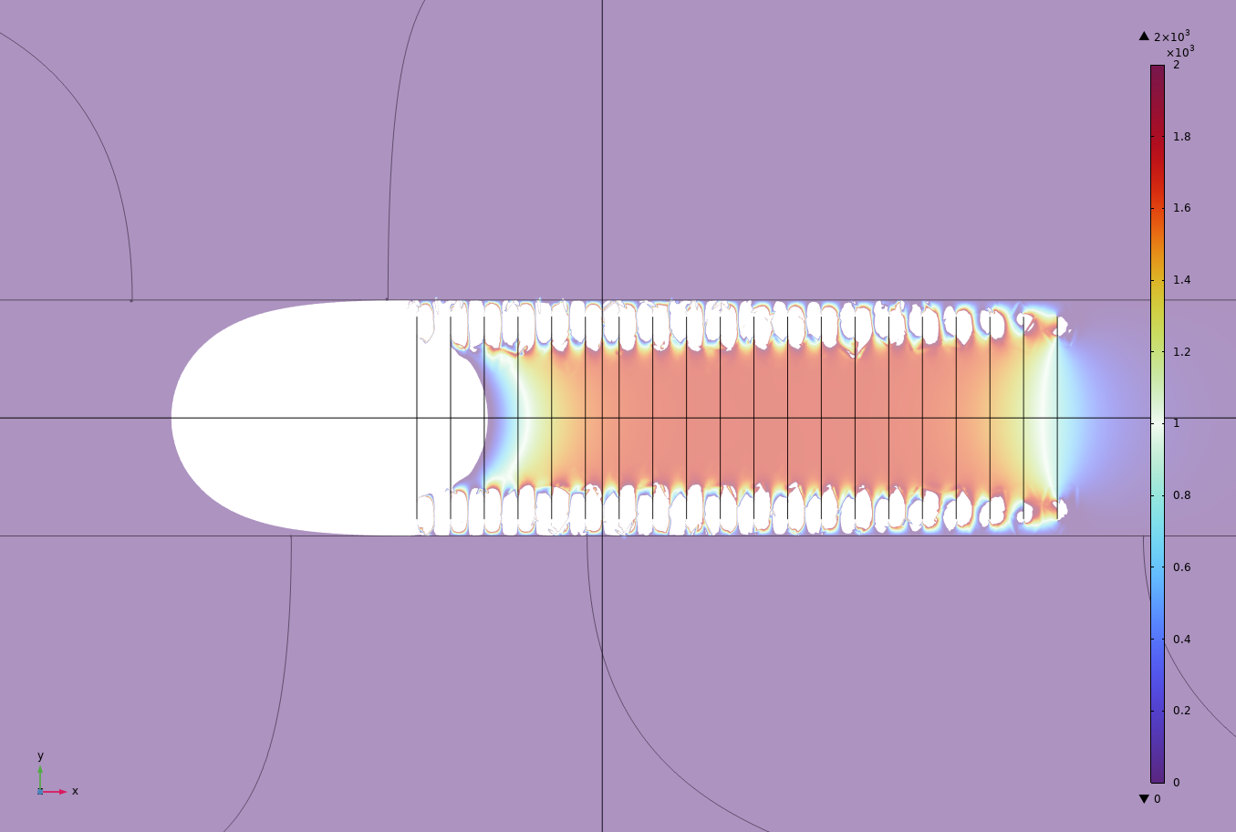
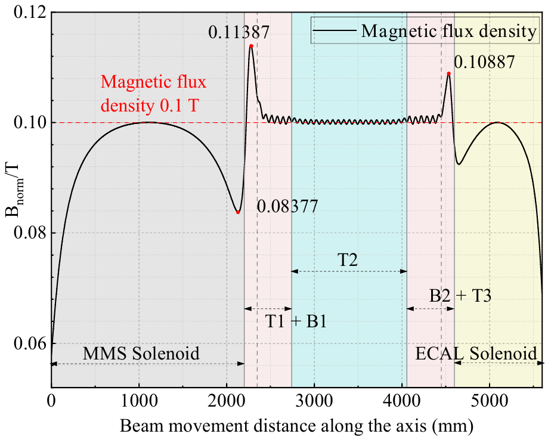
Electromagnetic field characteristics
Design were performed in g4beamline, and electromagnetic field simulation was performed using COMSOL
Target region
Schematic diagram of the electric field distribution
The blank is the region where the electric field is reversed
Provides signal energy of ~500 eV
Considering the MMS performance and sensitivity, the magnetic field of the MMS solenoid should be 0.1 T
Due to the low kinetic energy of antimuonium, the positron production region is the target region.

Slide 10
Contents
The MACE positron transport system (PTS)
I. Motivations
II. Solenoid system and Electrostatic acceleration module
III. Performance
The capture front-end design in MuST
I. Beamline introduction
II. Radiation-resistant capture solenoid (RCS) design
III. Electromagnetic, irradiation, and cooling research
Summary

Slide 11
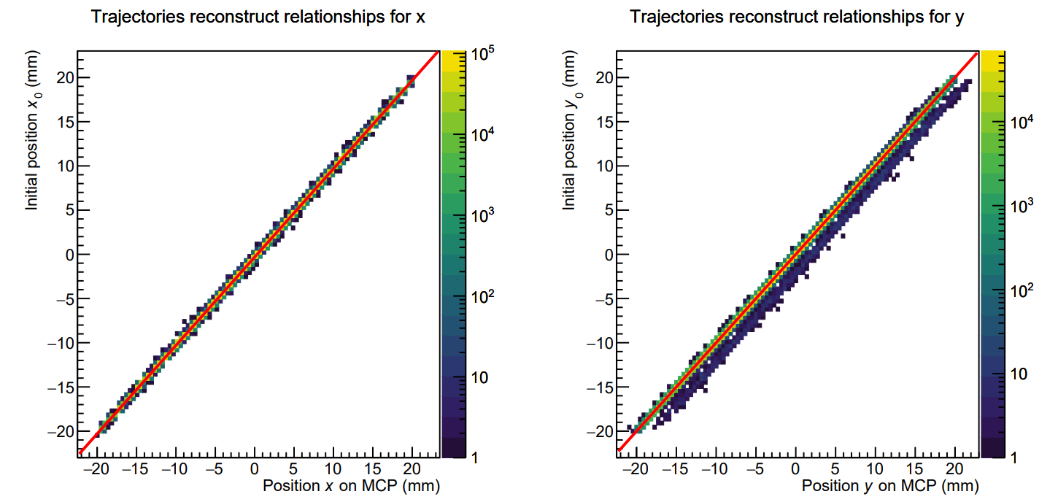
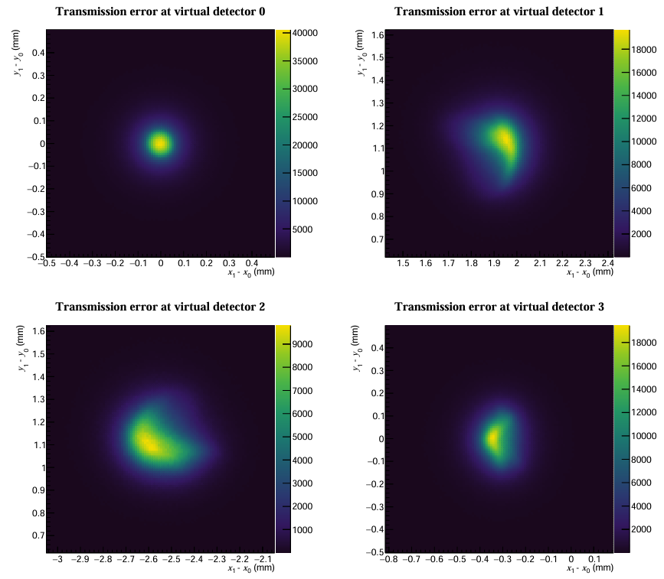
PTS Performance for signal transmission
Relative displacement during transmission.
The coordinates of x, y are (x₁ - x₀), (y₁ - y₀), where x₁, y₁ is the position measured by the virtual detector, and x₀, y₀ is the initial position, not beam spot.
Signal transmission efficiency: 65.8%
Transport efficiency is defined as the proportion of positron transport resulting from the decay of antimuonium.
Spatial resolution: 0.088(1) mm × 0.102(1) mm
This value is equivalent to std dev and represents the error during transmission.
Transmission offset: 0.315(1) mm × 0.003(1) mm
Represents the displacement of the average position during the transmission.
Flight time and FWHM: 322.4 ns & 6.9 ns
Represents the time from signal generation to transmission completion, where FWHM can be used as TOF information to reduce background

Slide 12
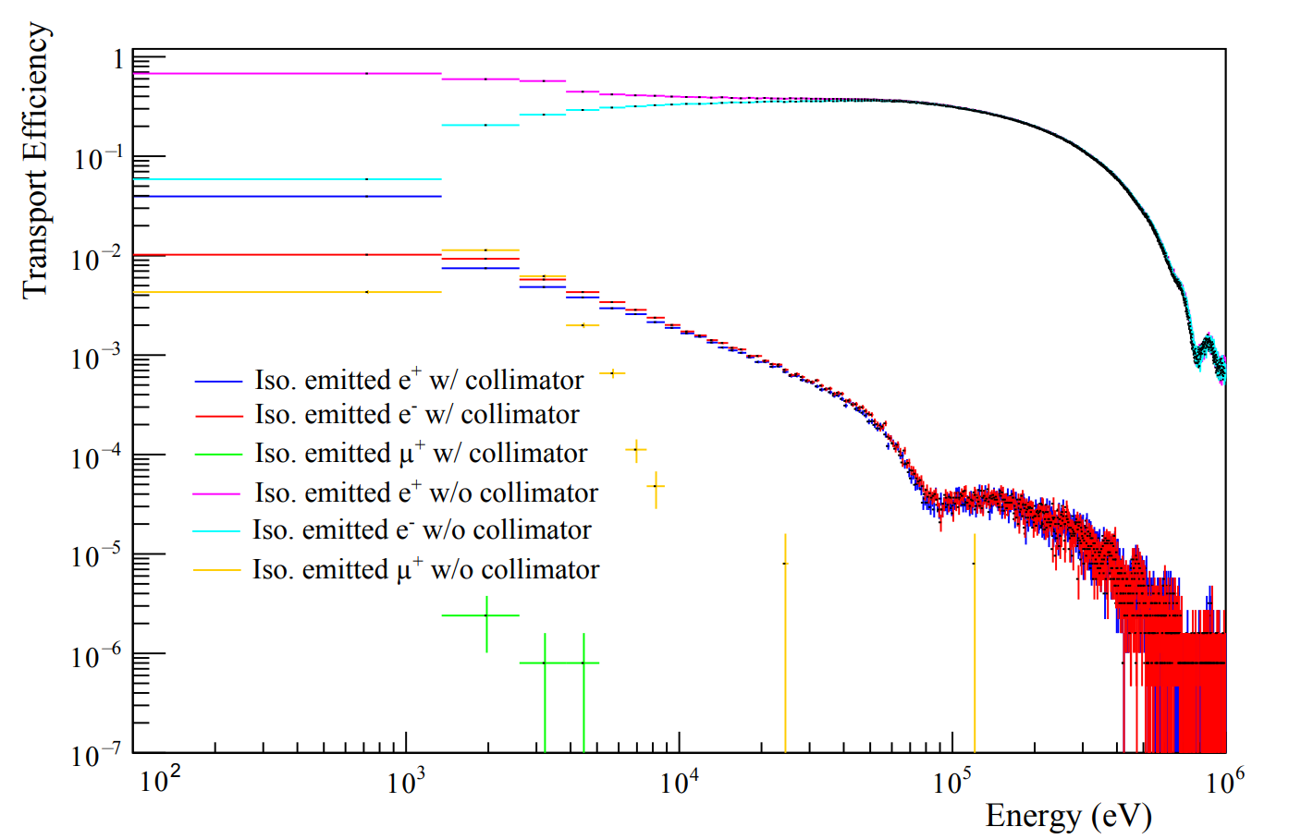
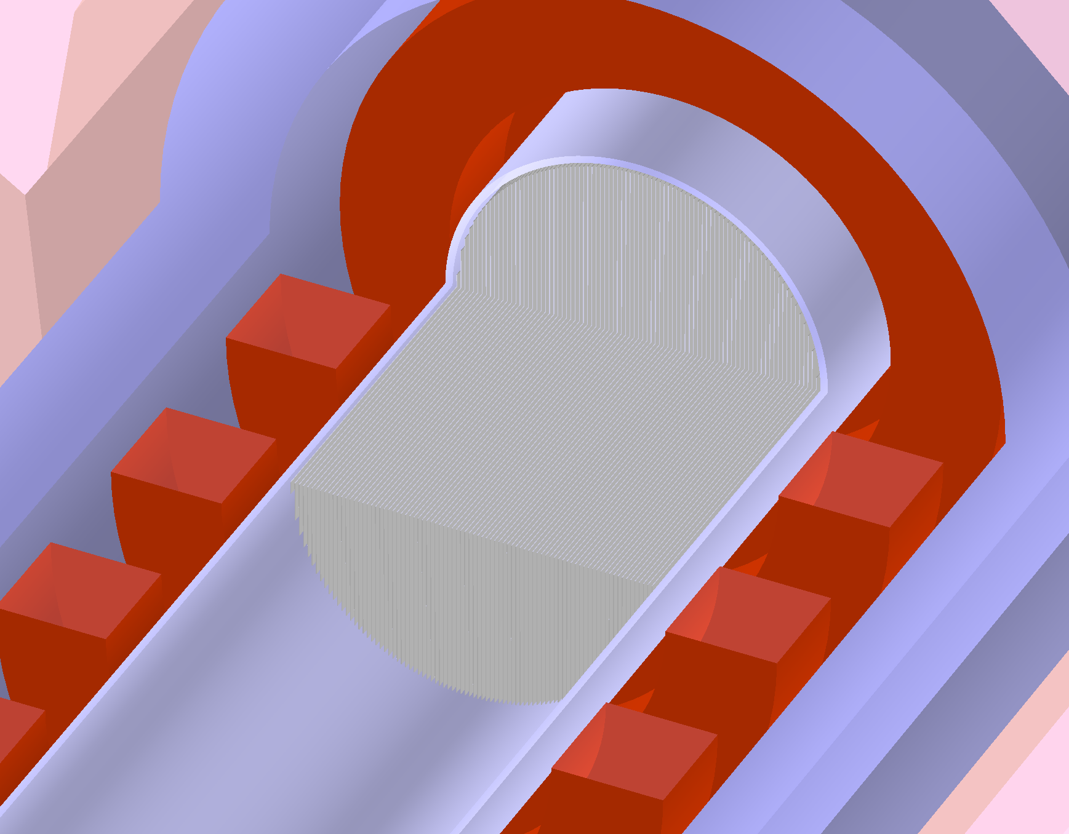
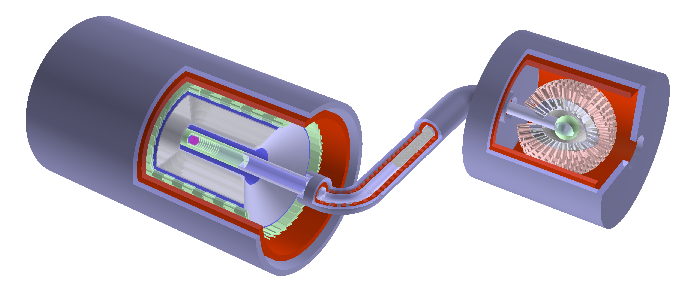
PTS Performance for background suppression
Collimate has a strong filter ability
Optimal pitch: 1.15 mm → $p_{xy}^{max}⁡$=14 keV/𝑐
0.2 mm
1.15 mm
Collimator
1
2
4
3
Calculating IC Decay depression levels: $\overline{ε}=Σ_{i=0}ε_{i}{P(E}_{i})$
Set different regions: 1, 2, 3, 4
$$8.51×{10}^{−7}+4.31×{10}^{−6}+9.92×{10}^{−6}+3.53×{10}^{−7}=1.54×{10}^{−5}$$

Slide 13
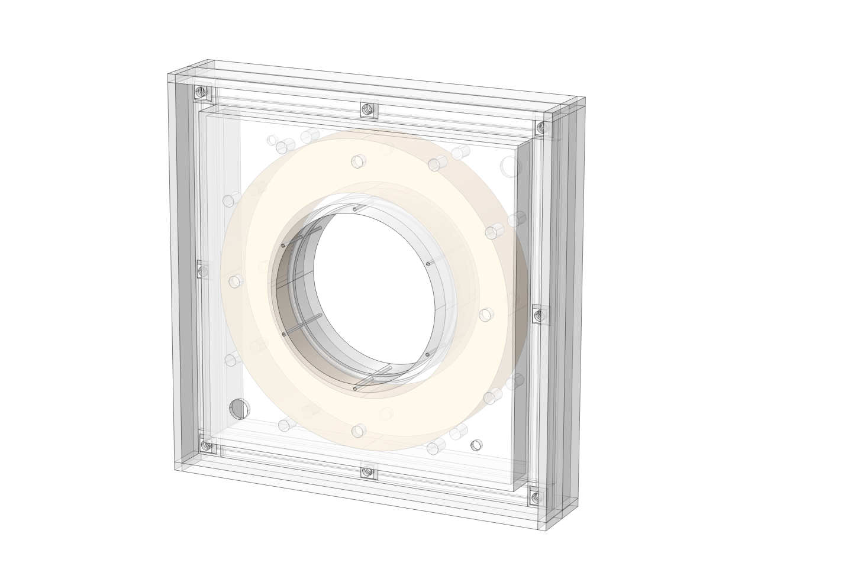
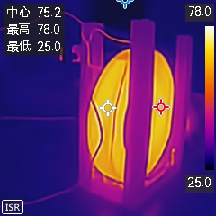
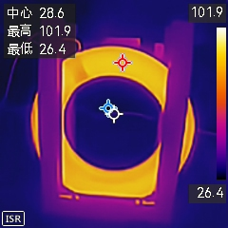
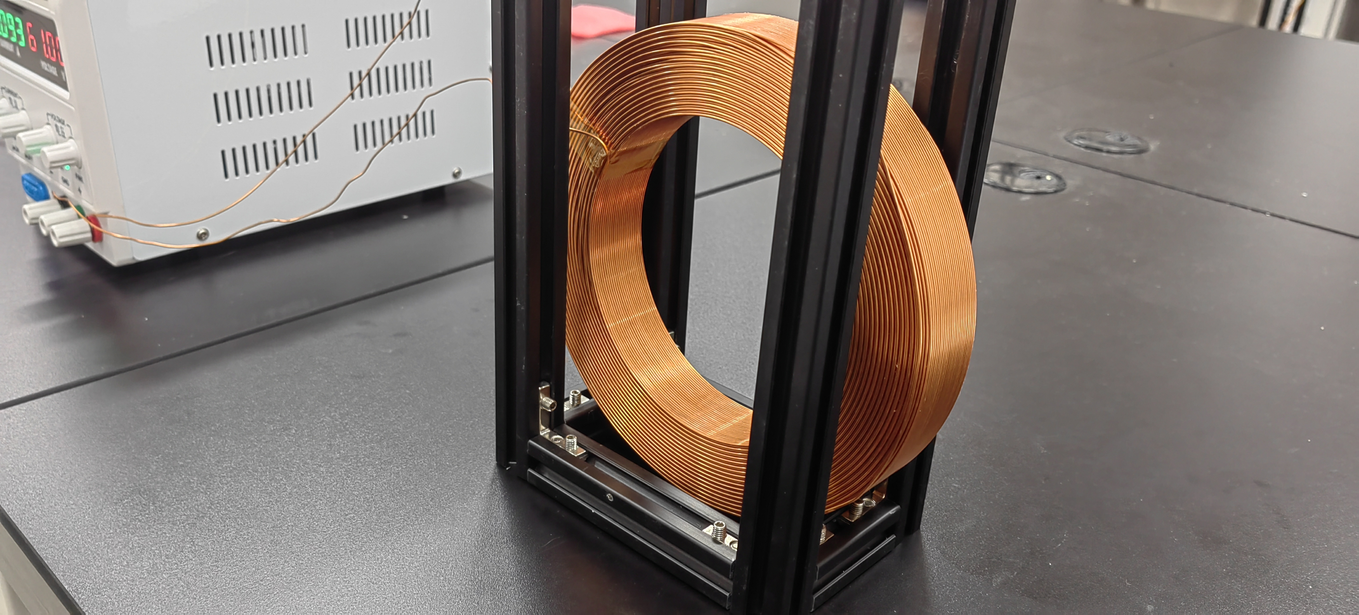
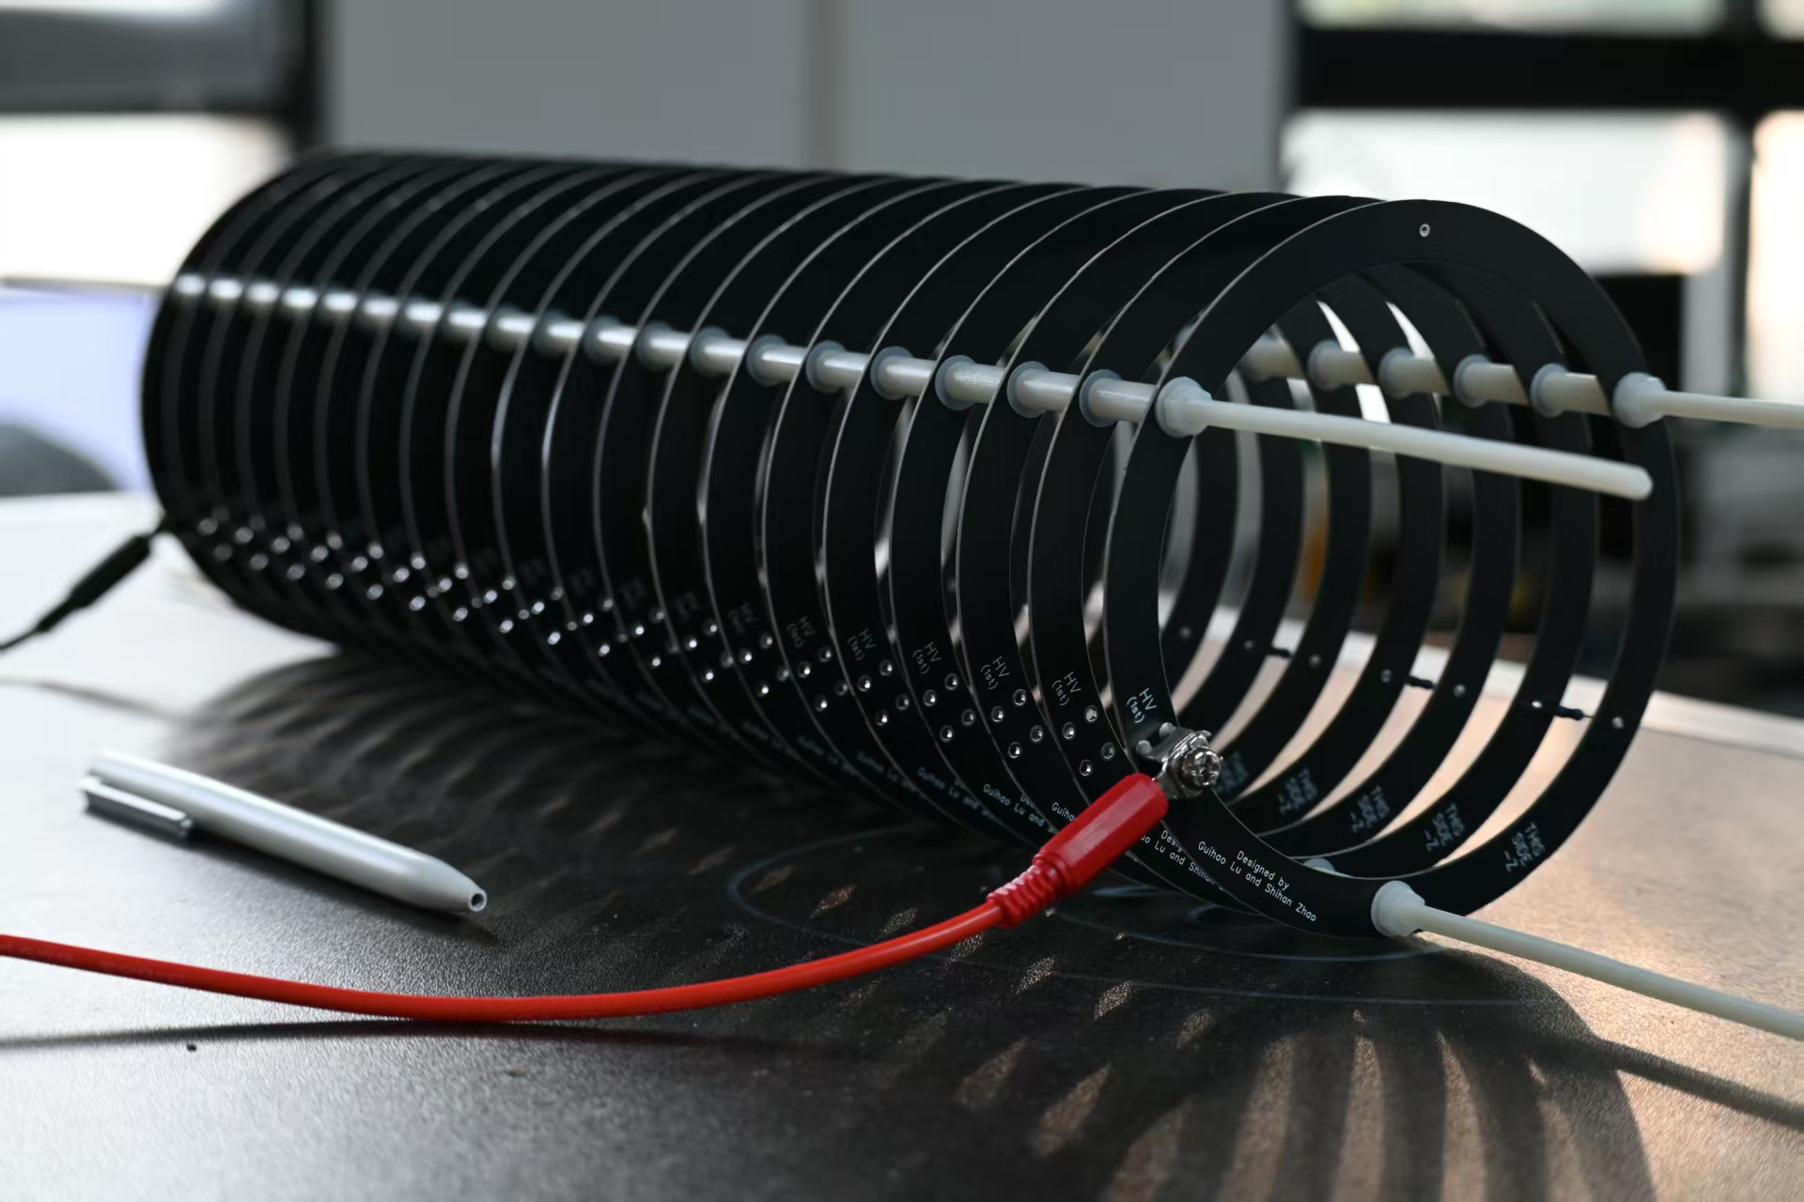
PTS in the next
PTS validation
Testing with TS solenoids and accelerator module
Coil feasibility verification
Water cooling coil test
Detector Chamber
Ionization Vacuum Gauge
Venting Valve
Verification system
Particle Source
Roughing Valve
Accelerator module prototype
Multi-layer PCB
High voltage > 2 kV
Thermocouple Vacuum Gauge
High Vacuum Gate Valve
Foreline Valve
Dry Mechanical Pump
Molecular Pump

Slide 14
Contents
The MACE positron transport system (PTS)
I. Motivations
II. Solenoid system and Electrostatic acceleration module
III. Performance
The capture front-end design in MuST
I. Beamline introduction
II. Radiation-resistant capture solenoid (RCS) design
III. Electromagnetic, irradiation, and cooling research
Summary

Slide 15
Thanks

Slide 16
PTS Performance for charged particles
The previous simulation is performed on the signal of antimuonium, and the main parameters obtained are:
Transmission efficiency: 65.8%
Spacial resolution: 0.088(1) mm × 0.102(1) mm
Transmission offset: 0.315(1) mm × 0.003(1) mm
In order to measure the ability of the PTS system to filtered the high-energy background, a variety of charged particles with flat energy spectra are simulated
$$e^{+}, e^{−}, π^{+}, π^{−}, μ^{+}, μ^{−}$$

Slide 17
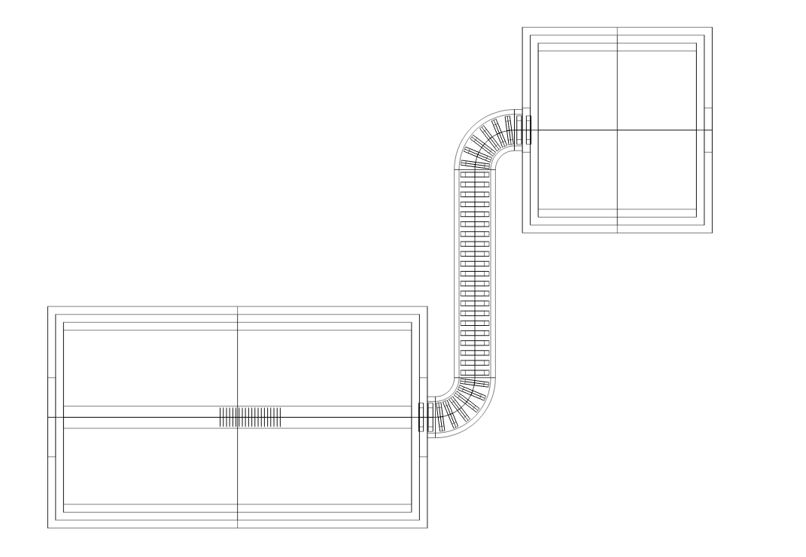
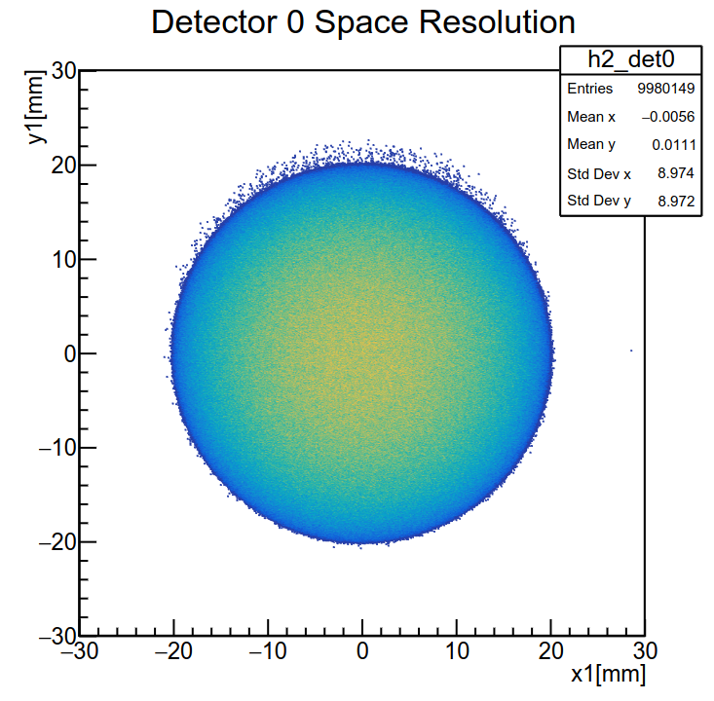
PTS Performance for signal
Import the field file into Geant4 for simulation
A program for PTS simulation developed based on the existing MACE offline software framework
Parameter
Simulate particle distribution: Ellipsoid
Radius of distribution: 30 mm × 20 mm × 20 mm
Signal Initial Particle: Antimuonium
The total number of simulated events: 10⁷
Virtual detector 3
Virtual detector 2
Virtual detector 1
Virtual detector 0
Virtual detector 0: After the electrostatic accelerator accelerates
Virtual detector 1: After B1
Virtual detector 2: After collimator(Inside S2)
Virtual detector 3: At the middle of ECal solenoid(Location of the MCP)
The shape of the beam spot after passing through the electrostatic accelerator

Slide 18
R&D route
I.
I. Experimental design
Verify design feasibility.
II. Electromagnetic field calculations
Debugging, analysis, electromagnetic fields in close proximity to reality and use simulation results to verify with previous experiments
III. Export the field file for calculations
Import the field file into the beam simulation software for calculation
IV. Final simulation of the physical design
Integrate the MACE framework to perform calculations using field files
G4beamline
II.
Verify design
Geometry
COMSOL
Verify field file
III.
Field file
G4beamline
Field file
IV.
Geant4-MACE
Verify
Output

Slide 19
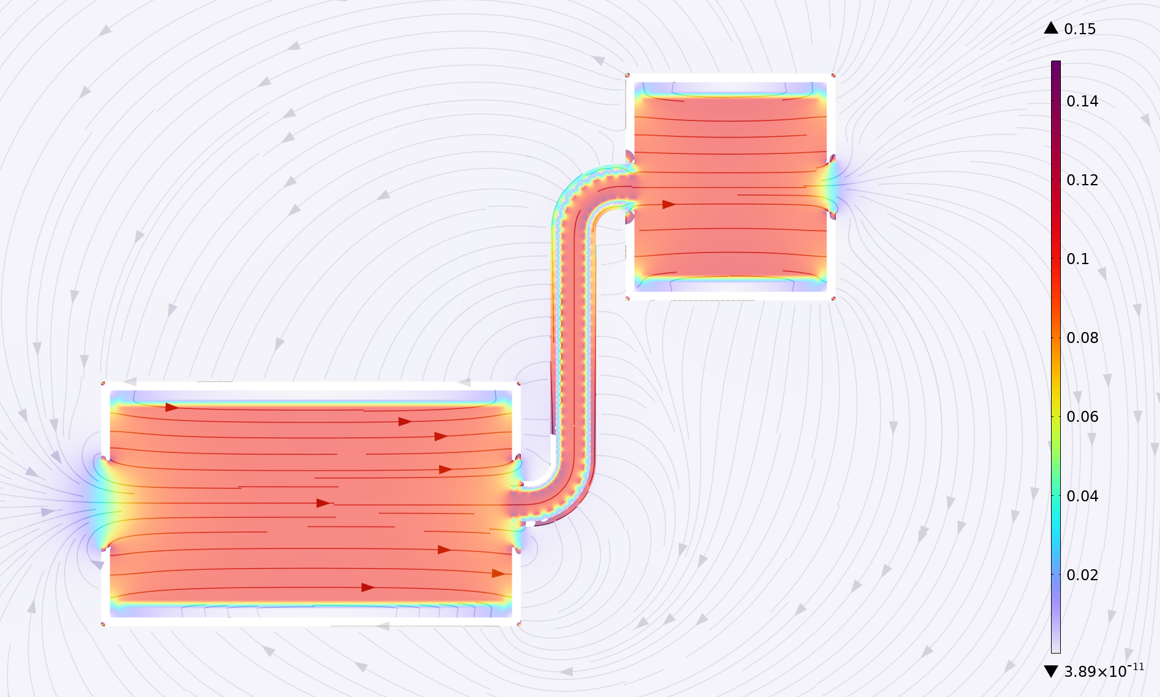
Electromagnetic field characteristics -II
Distribution of the overall magnetic field across the cross-section of the PTS simulation, with magnetic field lines also depicted.
B2+T3
MMS solenoid
ECal solenoid
T2
T1+B1
PTS is the bridge between MMS and PDS
PTS is capable of trajectory reconstruction, linking PDS and MMS
Considering the MMS performance and sensitivity, the magnetic field of the MMS solenoid should be 0.1 T
Due to the low kinetic energy of antimuonium, the positron production region is the target region.

Slide 20
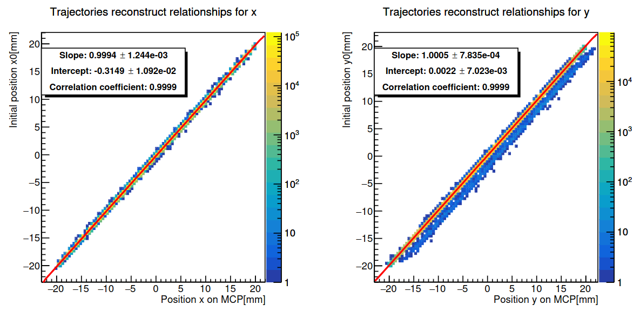
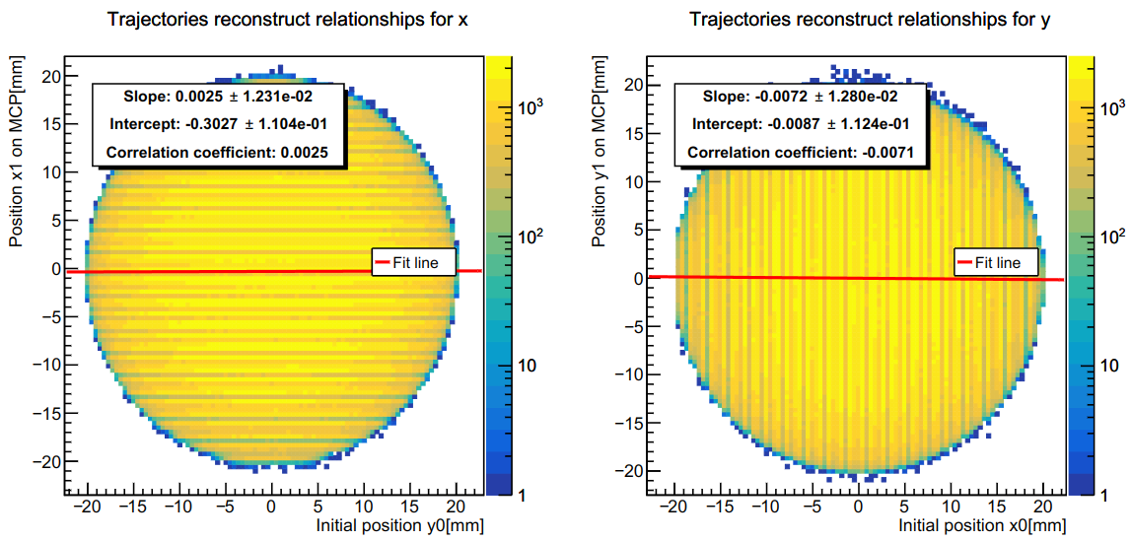
PTS Performance for signal
Data from the last virtual detector at PDS
The diagram represents the relationship between positron coordinates after a complete transmission
The slope of the fit for the corresponding coordinates is approximately 1
During spot transport, only translational transformations occur and there is almost no stretching.
Offset in the vertical beam direction: 0.31(2) mm × 0.002(8) mm
This result is related to the bins, and the subsequent calculation of the signal will give more reasonable results
The correlation between non-corresponding coordinates is poor
Trajectory reconstruction only needs to take into account the offset of the corresponding coordinates

Slide 21
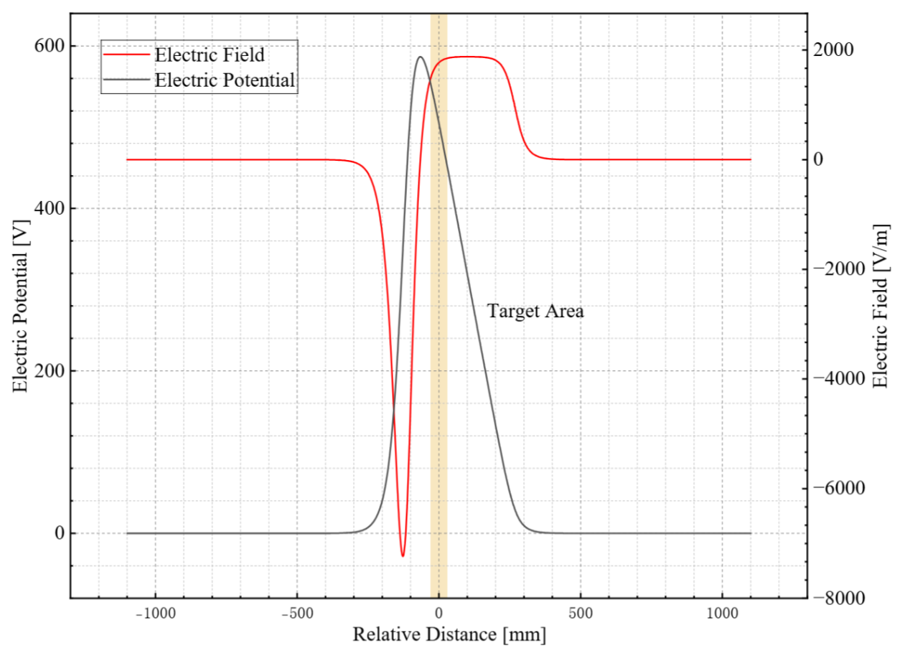
Electromagnetic field characteristics -I
Schematic diagram of the electric field distribution
the blank is the region where the electric
field is reversed
Target region
The electrostatic accelerator needs to cover the entire target region.
Due to the low kinetic energy of antimuonium, the positron production region is the target region.
Electromagnetic field parameters in the region.
Target region: 60 mm × 50 mm × 50 mm
Electric field: 1473 ~1850 V/m
Potential: 450 ~554 V
The electric potential field distribution in the
axial beam direction.

Slide 22
Engineering achievability
Since the magnetic field strength is 0.1 T, the current required is small, there is no need to use a superconducting coil.
Main | Component | Copper wire $φ$ (mm) | Current (A) | Power (kW) | Current Density (A/mm²) | Voltage (V)
MMS Solenoid |  | 15 | 894.5 | 68.7 | 5.1 | 40
TS Solenoid | T1/T3 | 1.8 | 64.8 (16.2 × 4) | 0.96 (0.24 × 4) | 6.4 | 14.8
 | B1/B2 | 1.8 | 224.8 (20.4 × 12) | 4.58 (0.38 × 12) | 8.0 | 18.7
 | T2 | 1.8 | 401.1(19.1 × 21) | 7.01 (0.33 × 21) | 7.5 | 17.5
ECal Solenoid |  | 10 | 77.7 | 6.32 | 1.0 | 81.3

