Slide 1
Check on cosmic-ray without magnetic field in March
Run: 84713, 84714, 84716
With Previous Alignment

Slide 2
Content
Residual
Efficiency
Residual:
X(-3,3)mm
V(-5,5)mm
Z(-5,5)mm
Efficiency:
Window: $±10σ$
Layer1: 4 hits in the outermost two layers as a track selection criterion
Layer2&Layer3: 3 hits in the outermost two layers as a track selection criterion

Slide 3
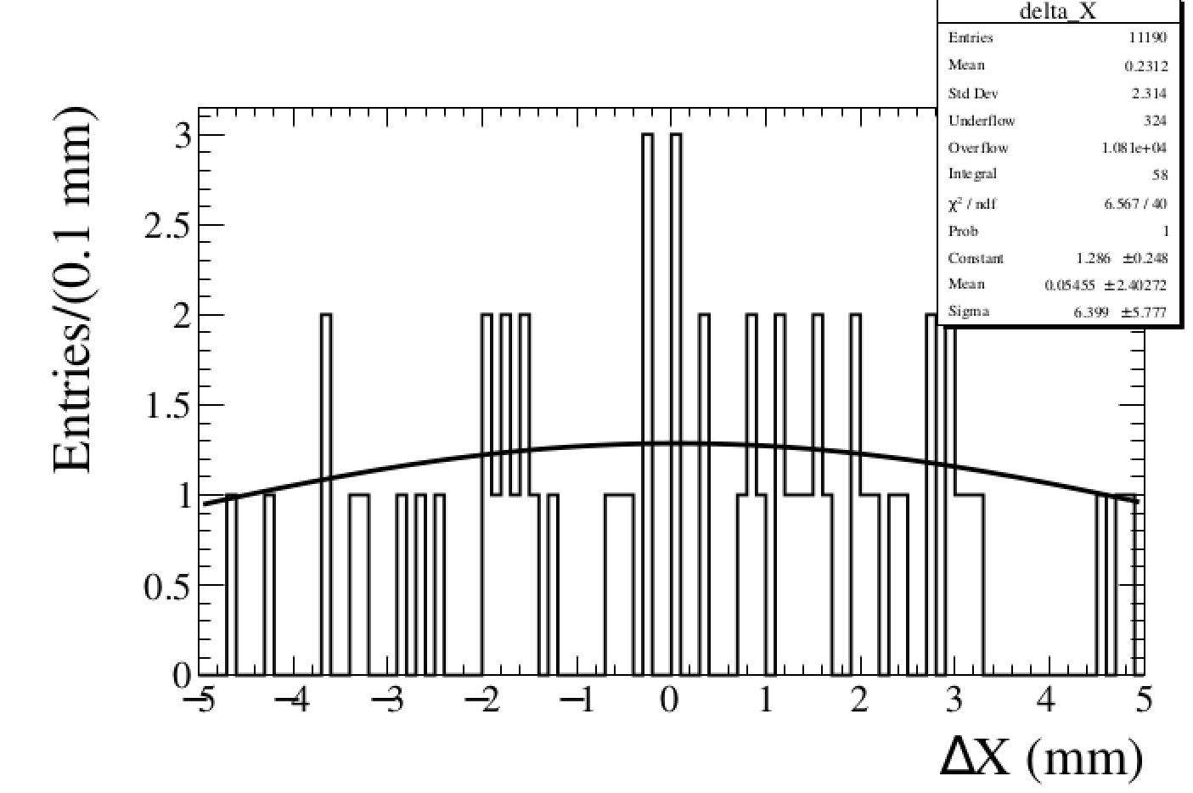
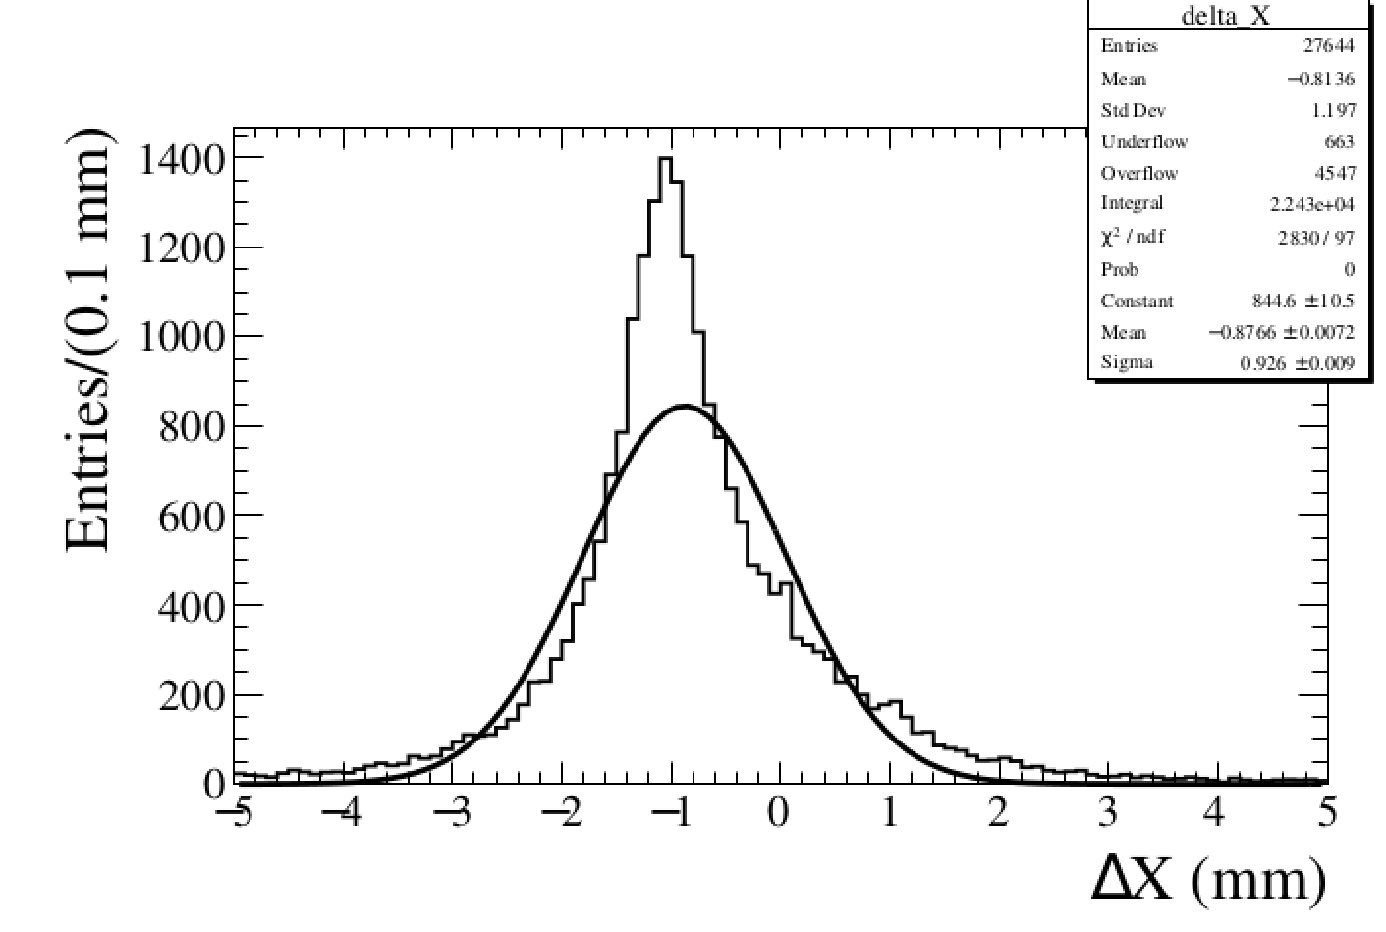
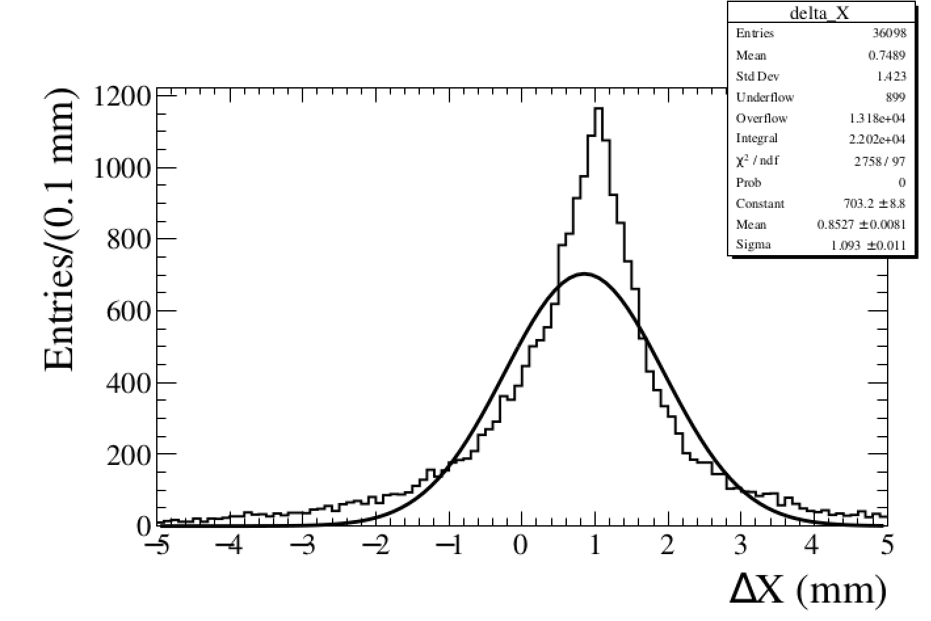
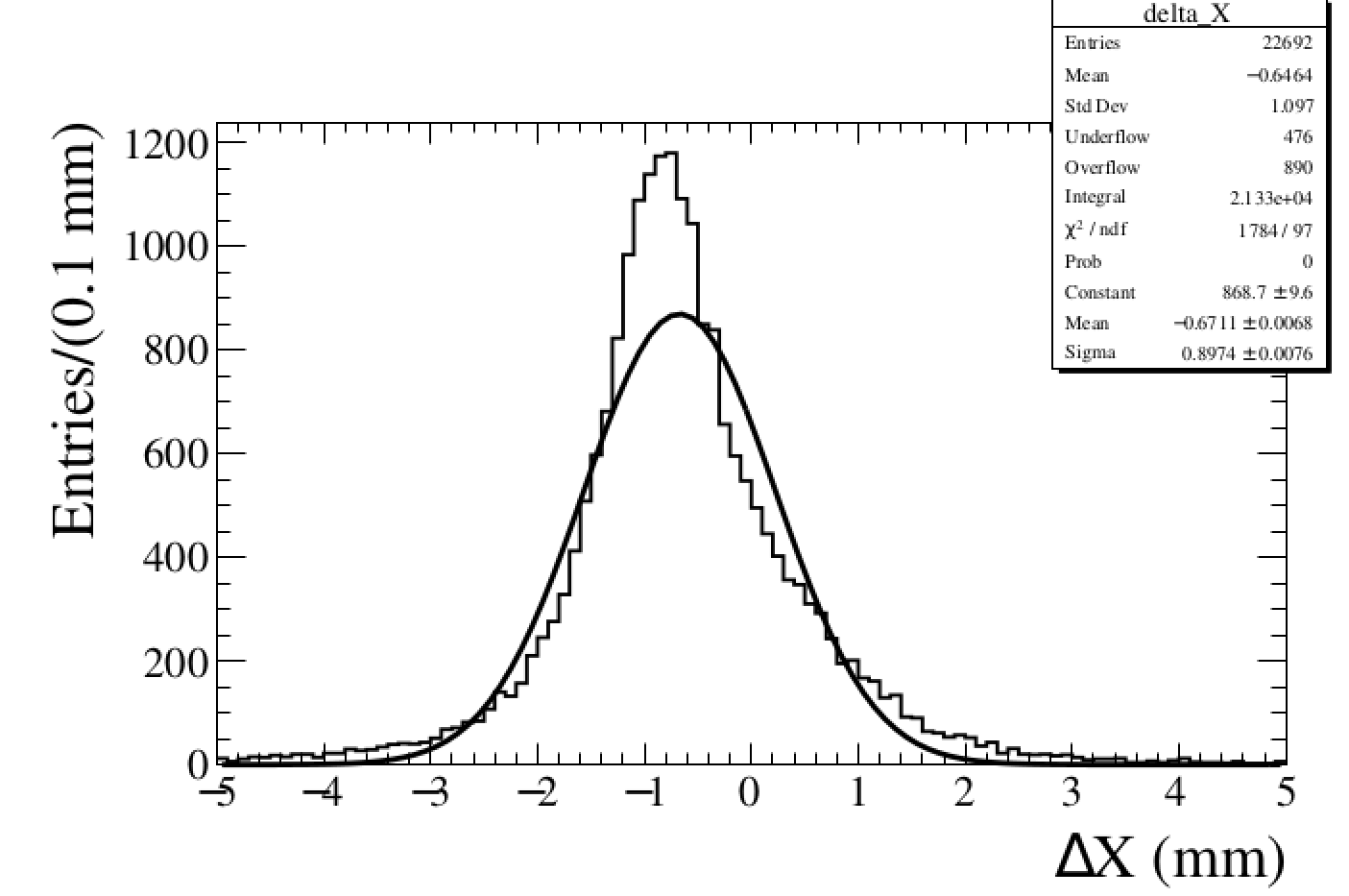
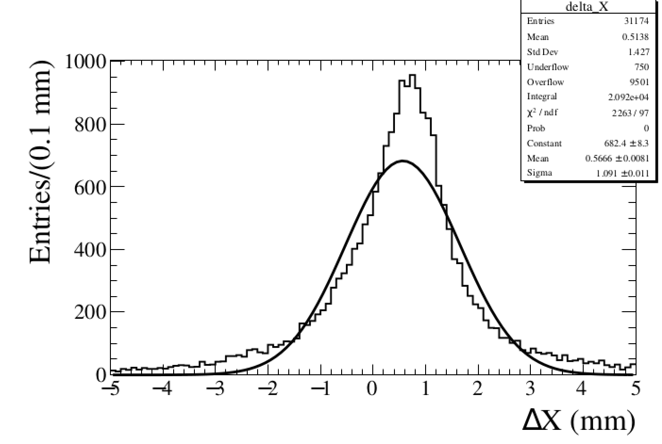
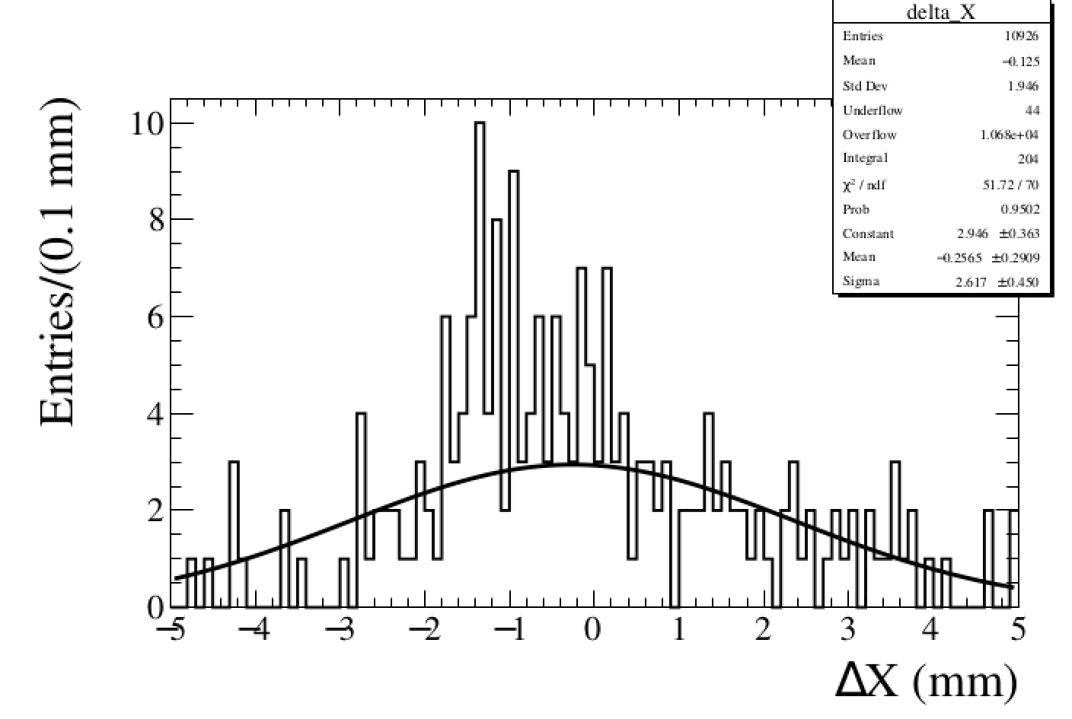
Residual: X
Layer1 Top
Layer2 Top
Layer3 Top
Layer1 Bot
Layer2 Bot
Layer3 Bot

Slide 4
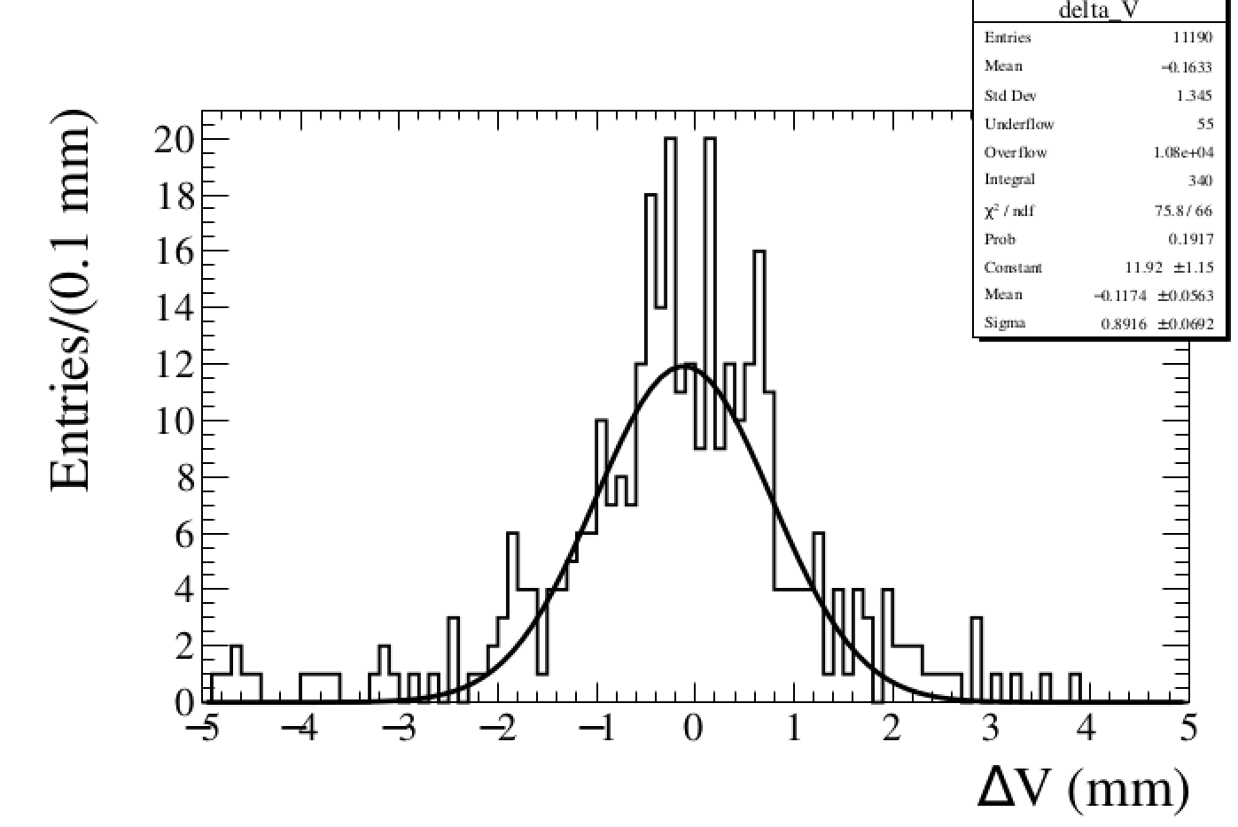
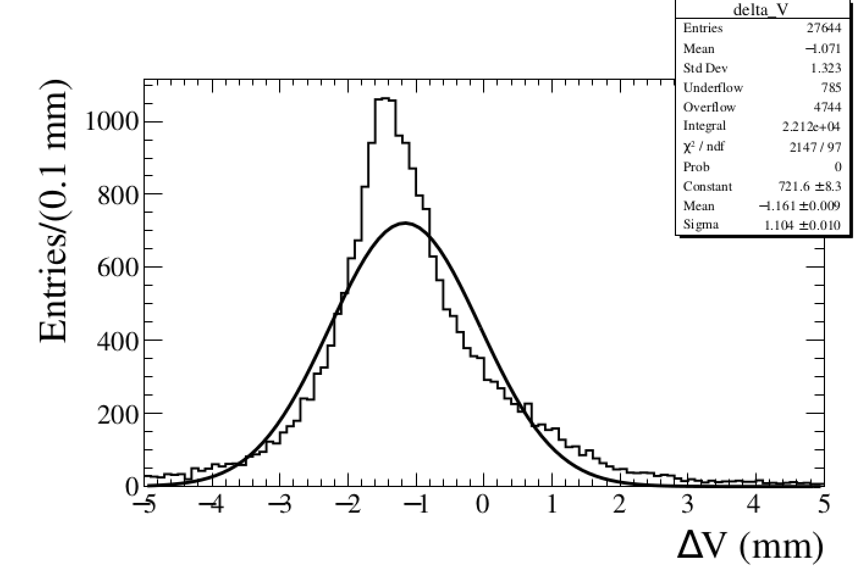
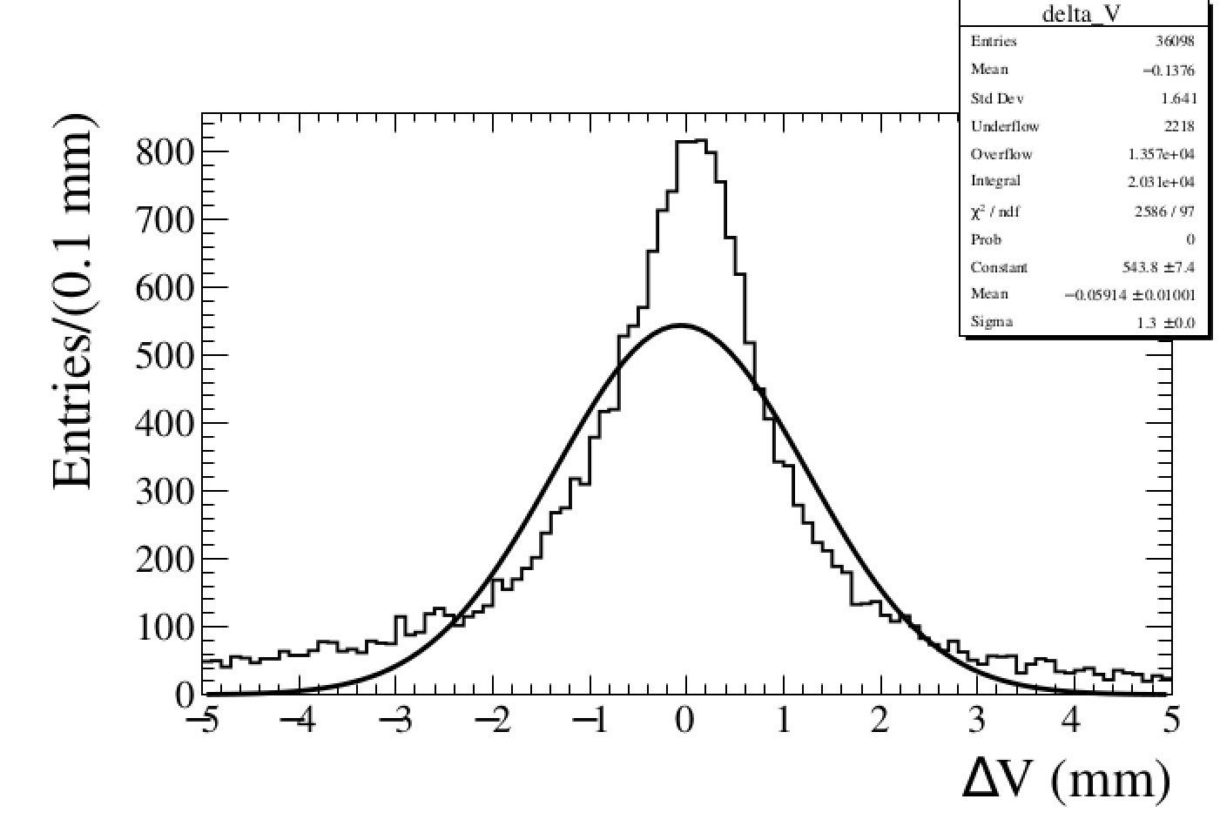
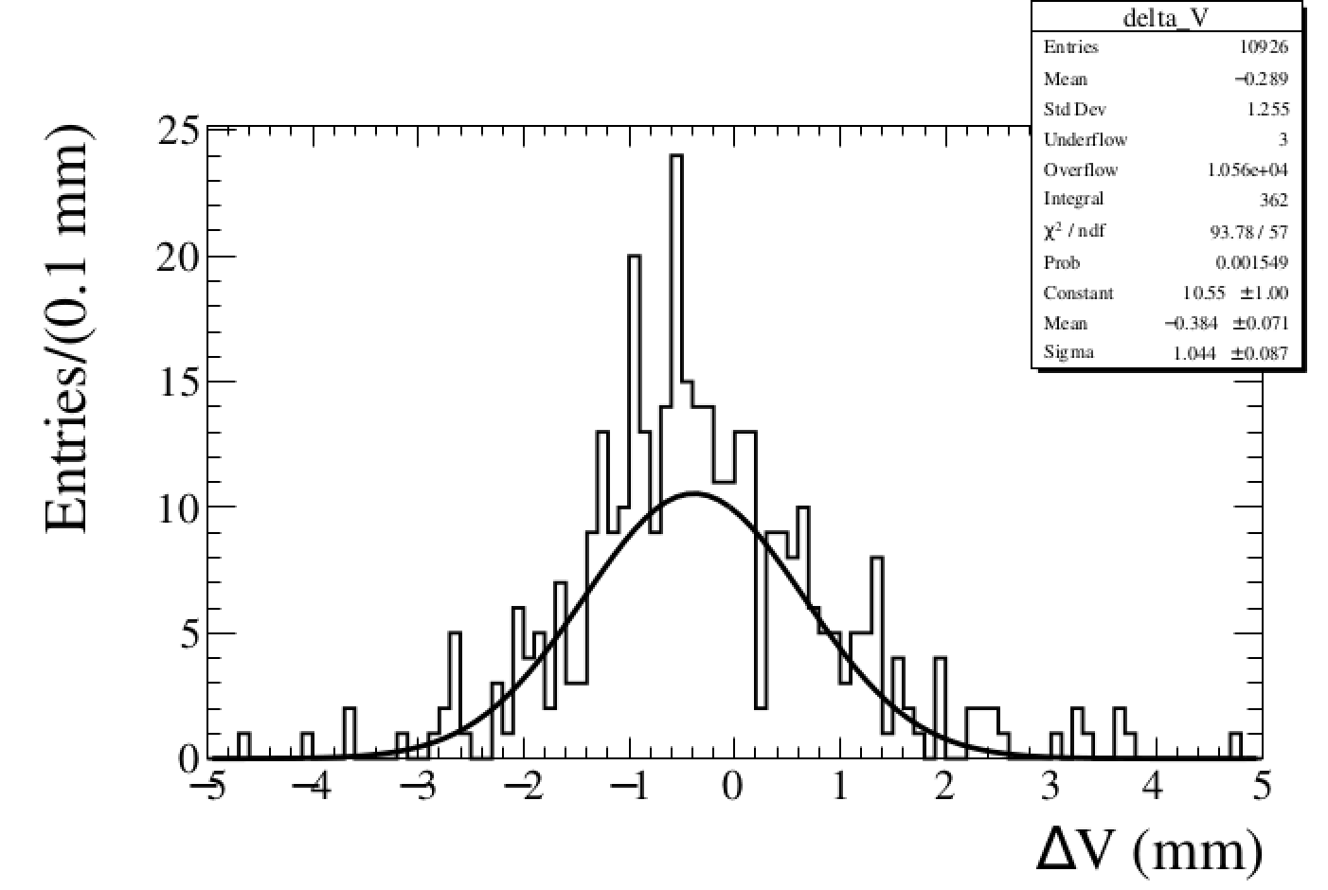
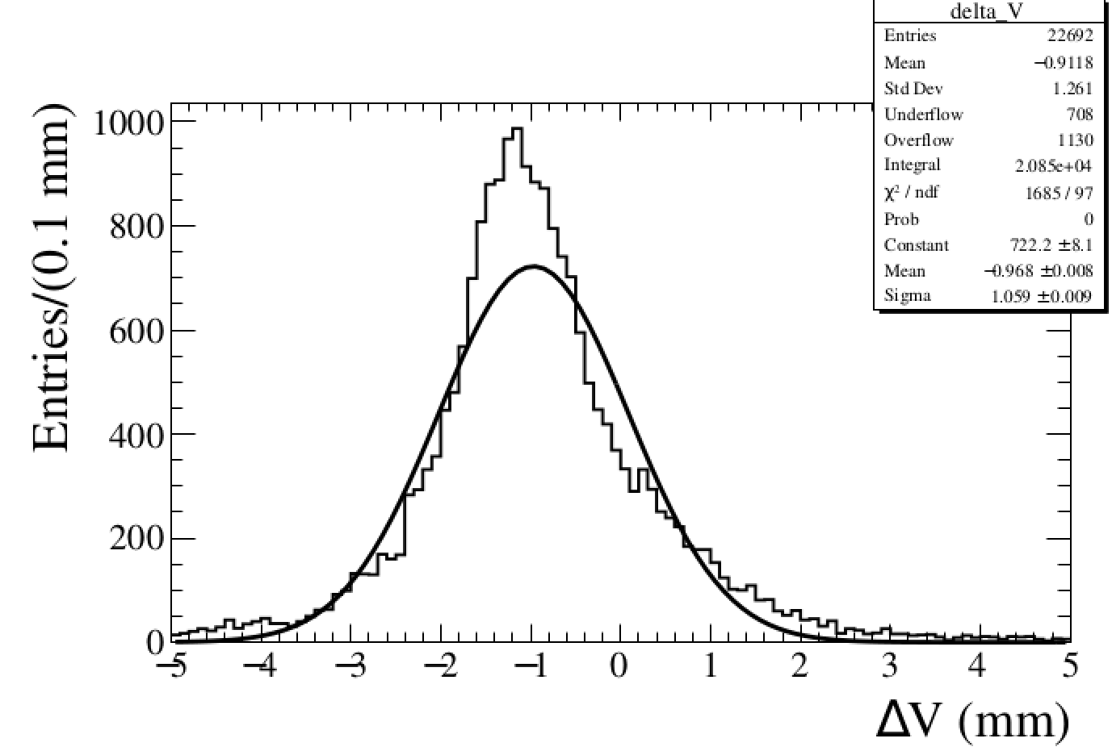
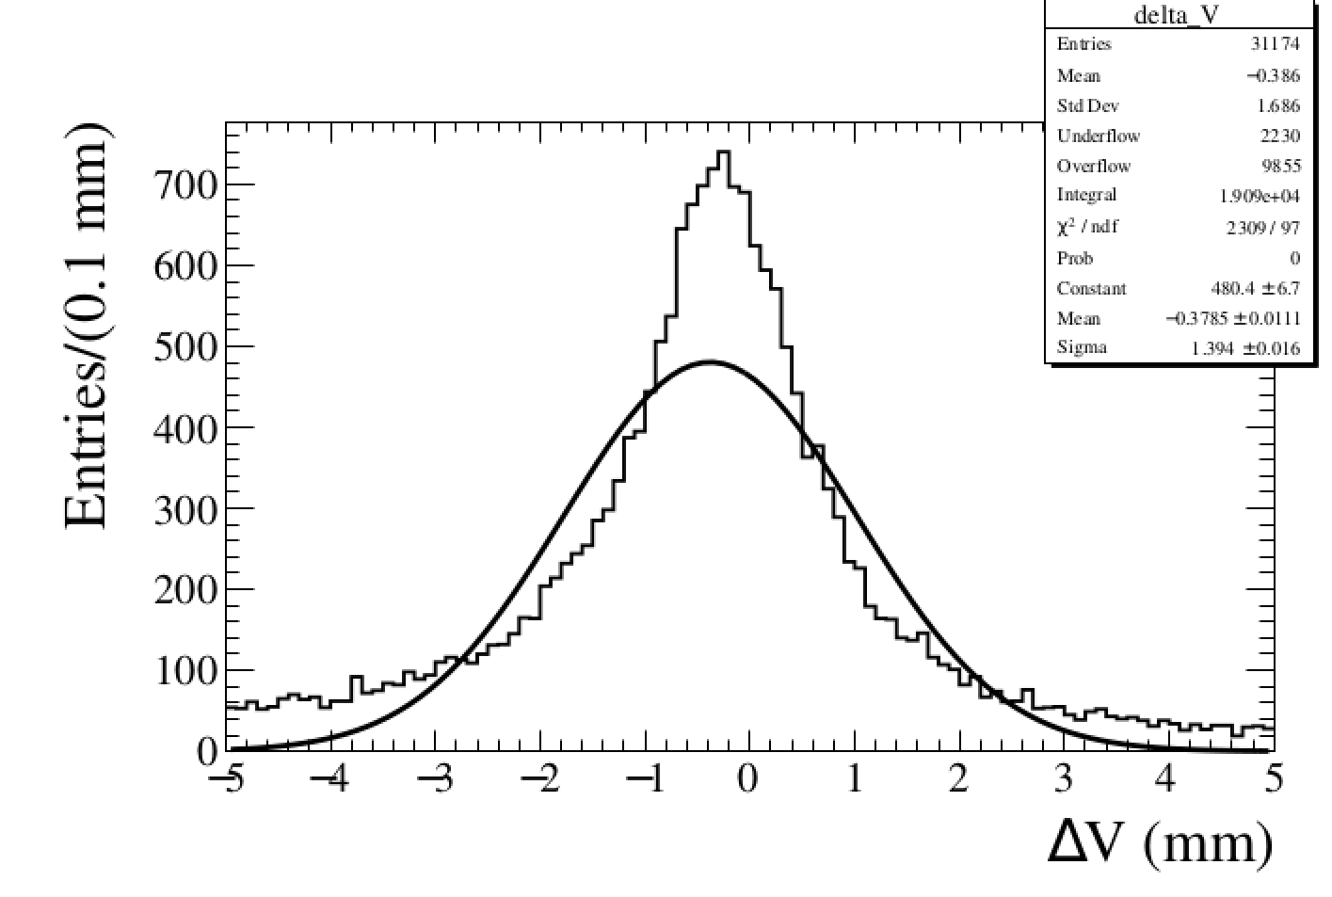
Residual: V
Layer1 Top
Layer2 Top
Layer3 Top
Layer1 Bot
Layer2 Bot
Layer3 Bot

Slide 5
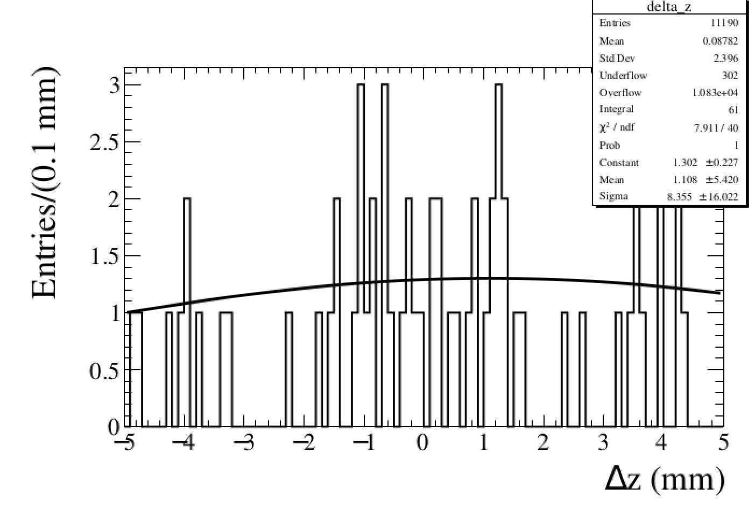
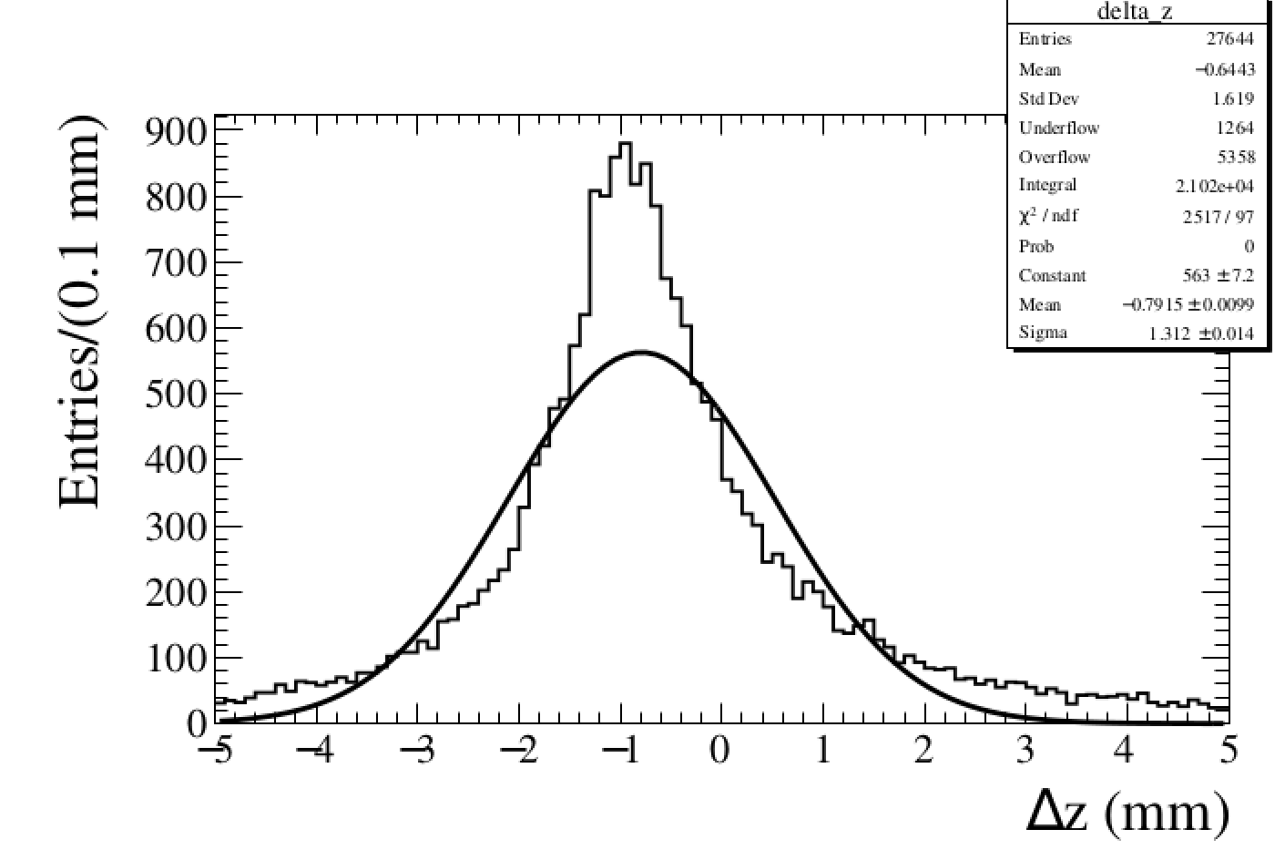
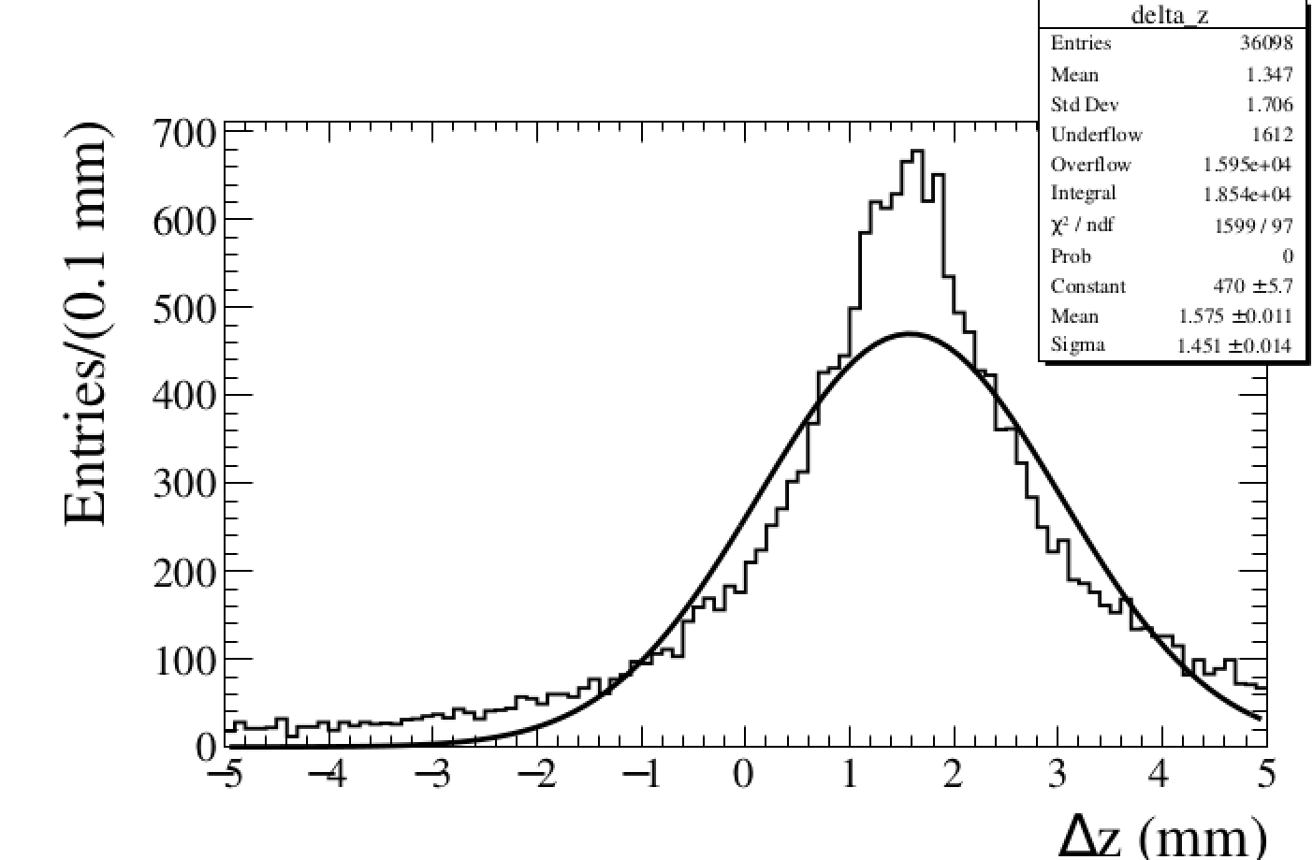
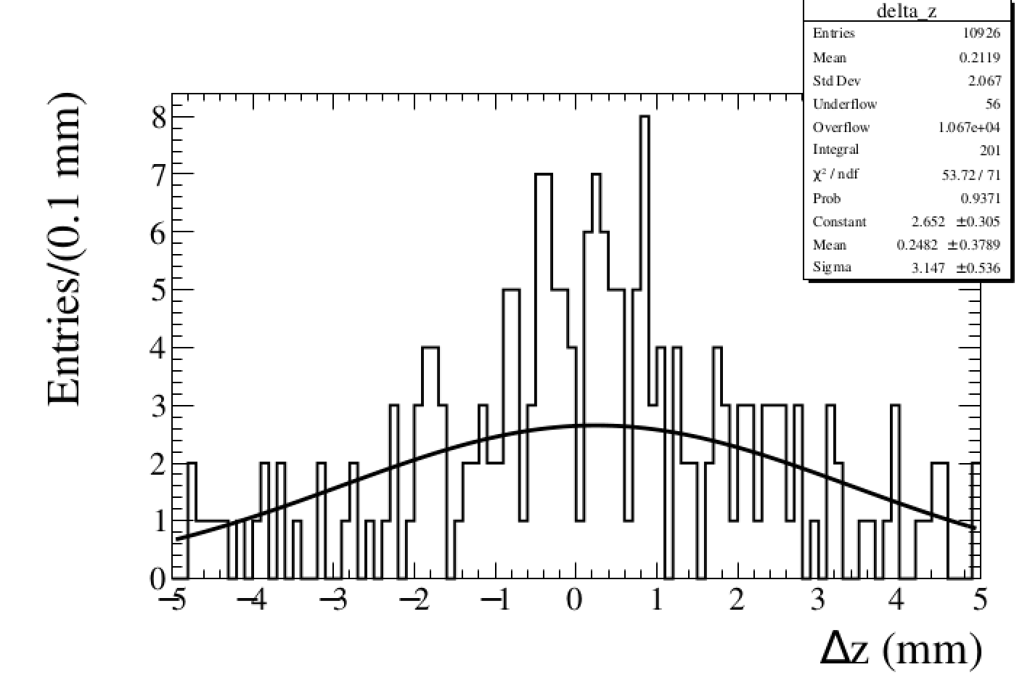
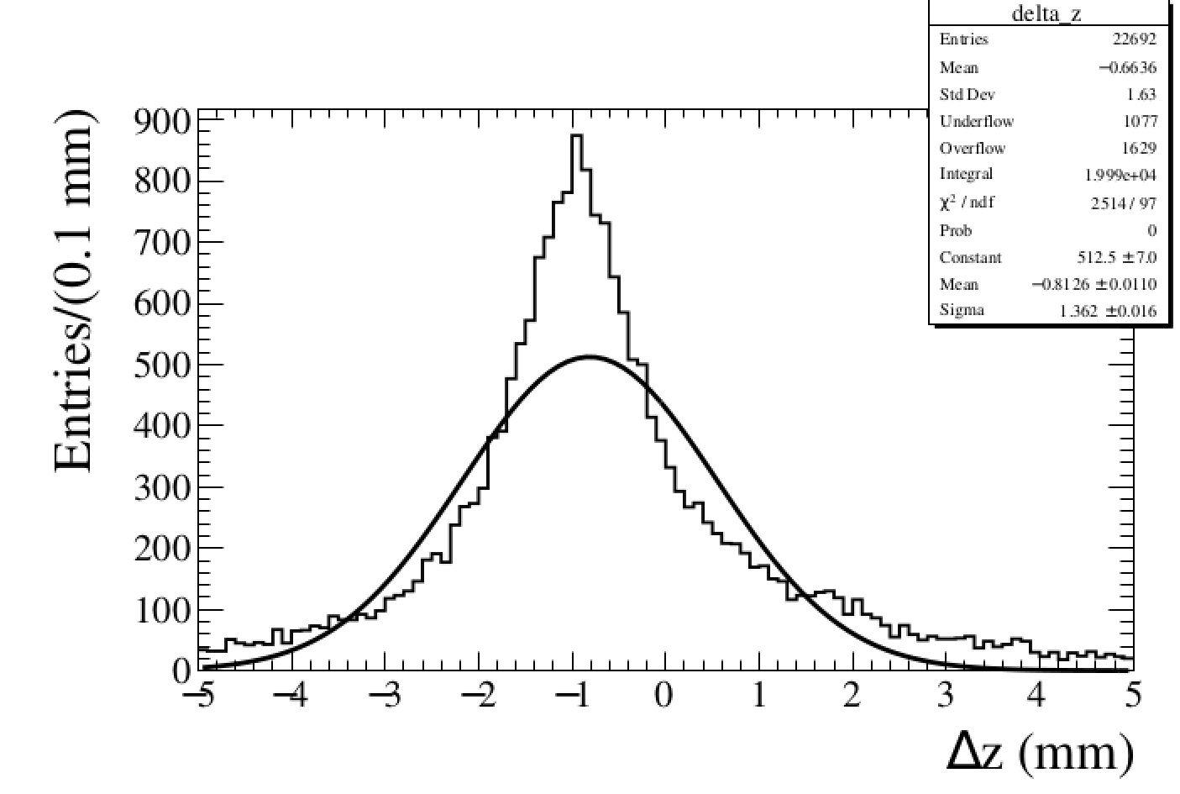
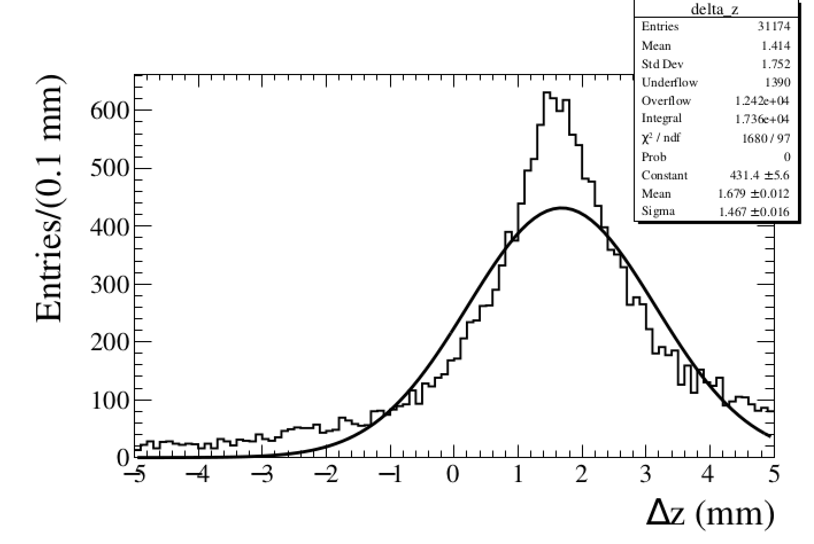
Residual: Z
Layer1 Top
Layer2 Top
Layer3 Top
Layer1 Bot
Layer2 Bot
Layer3 Bot

Slide 6
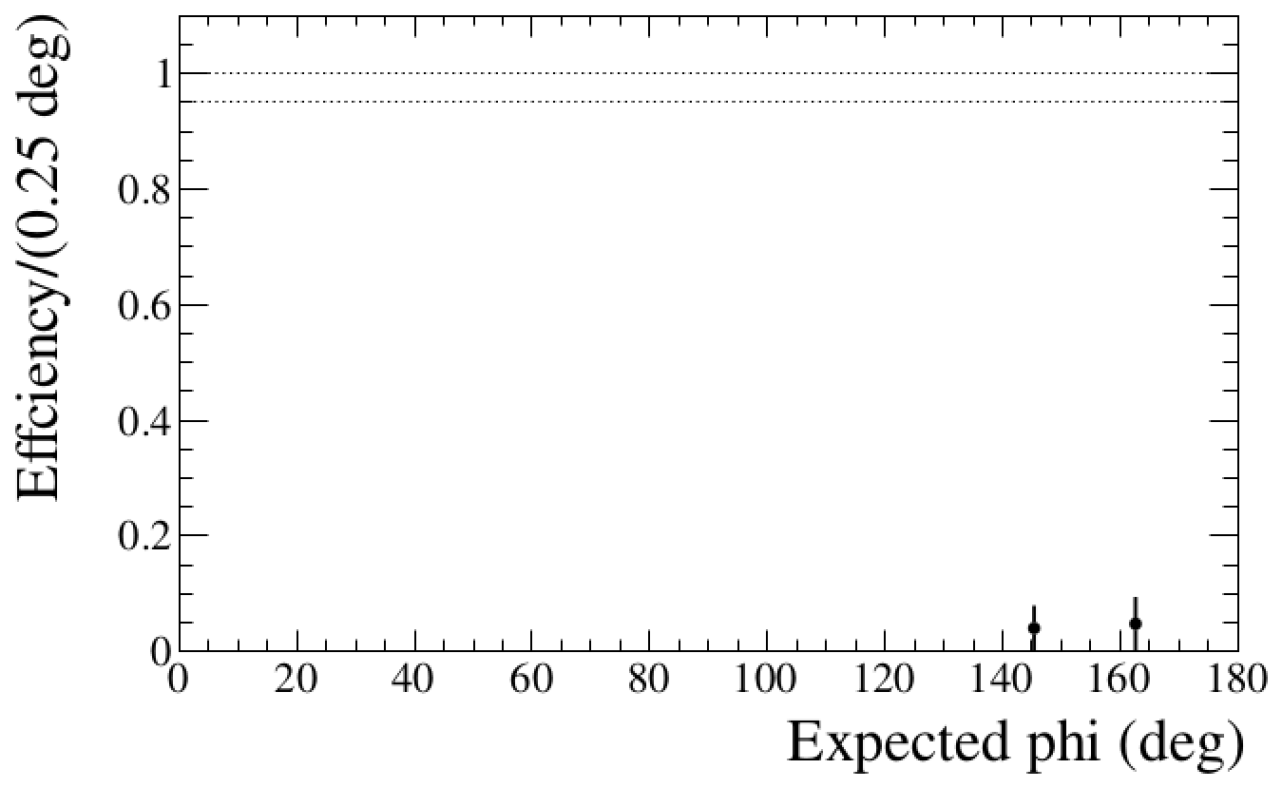
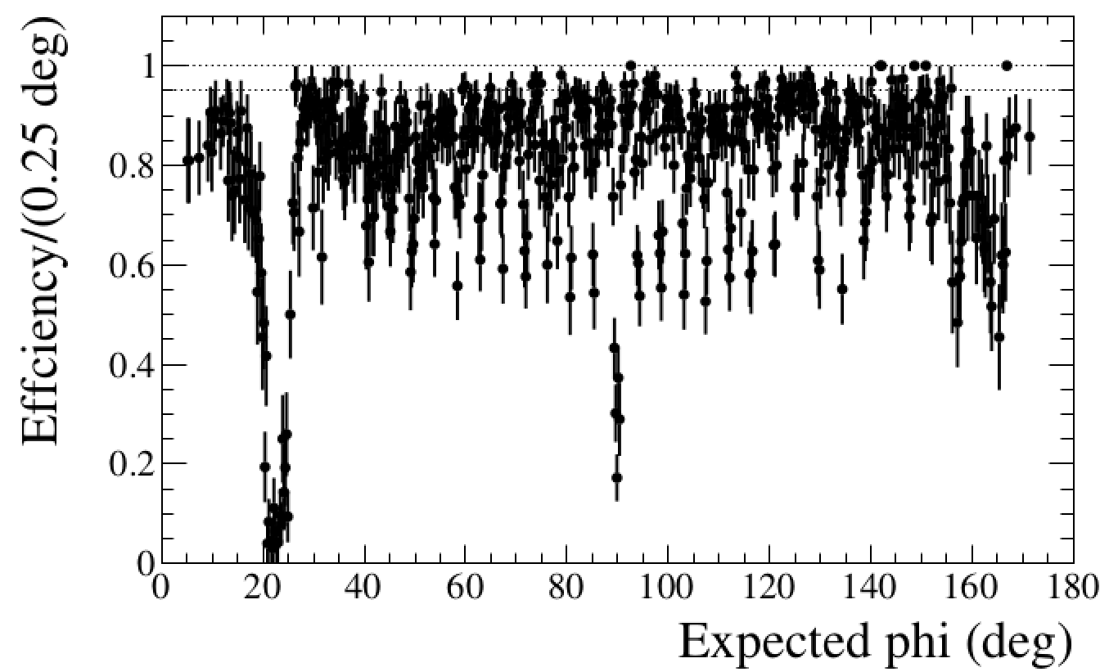
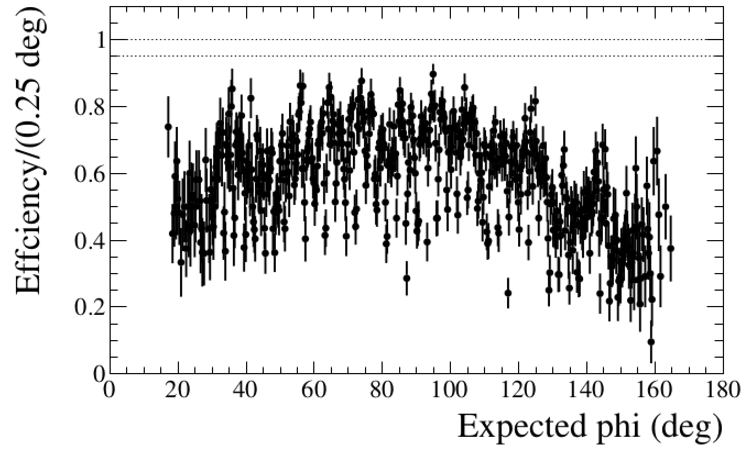
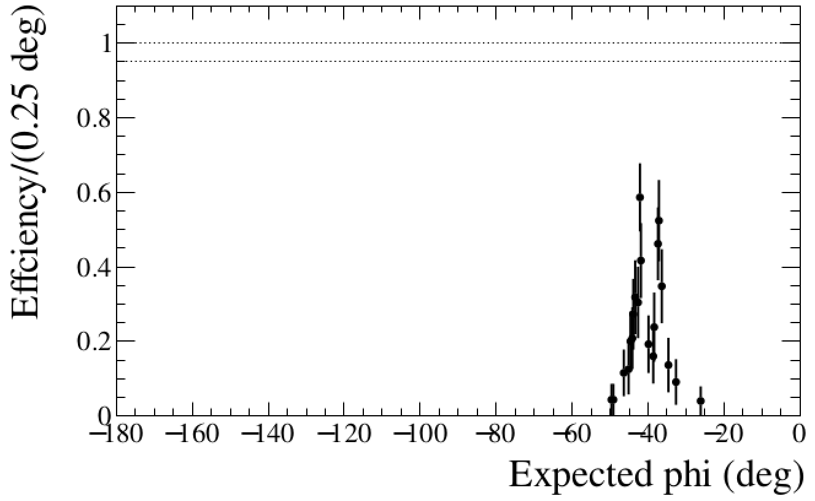
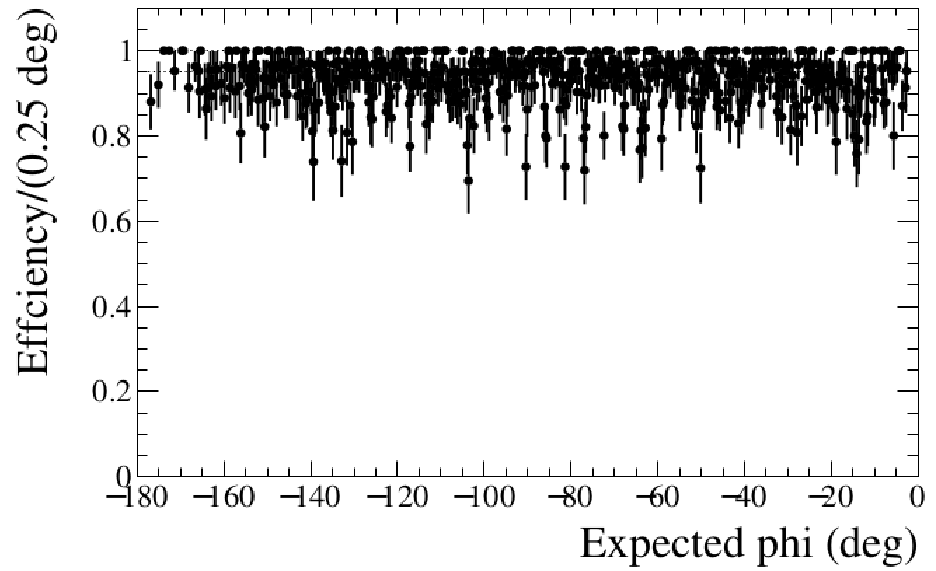
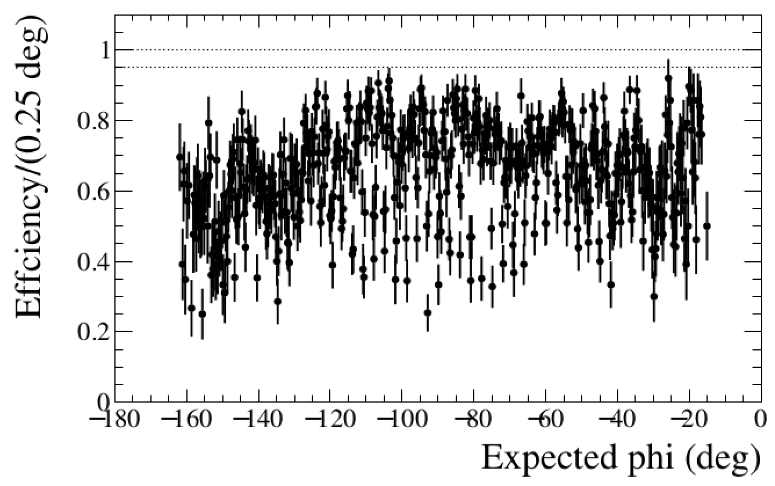
2D cluster Efficiency vs X
Layer1 Top
Layer2 Top
Layer3 Top
Layer1 Bot
Layer2 Bot
Layer3 Bot

Slide 7
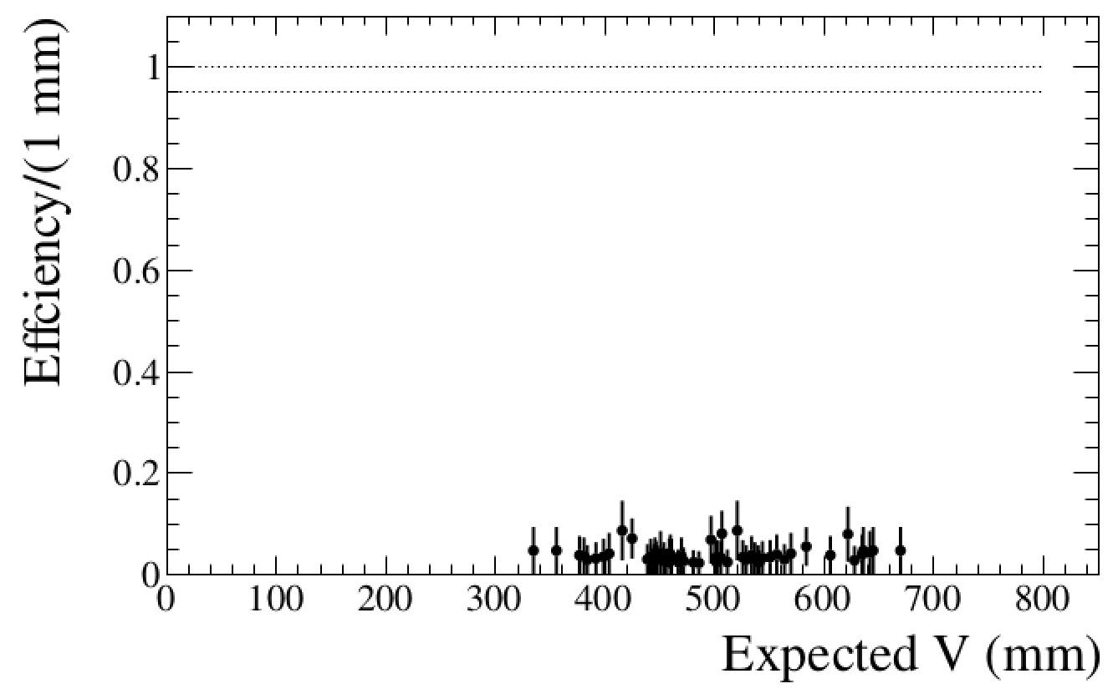
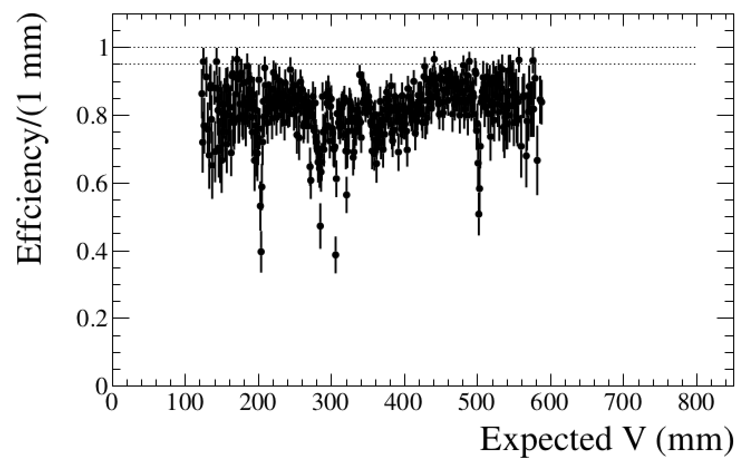
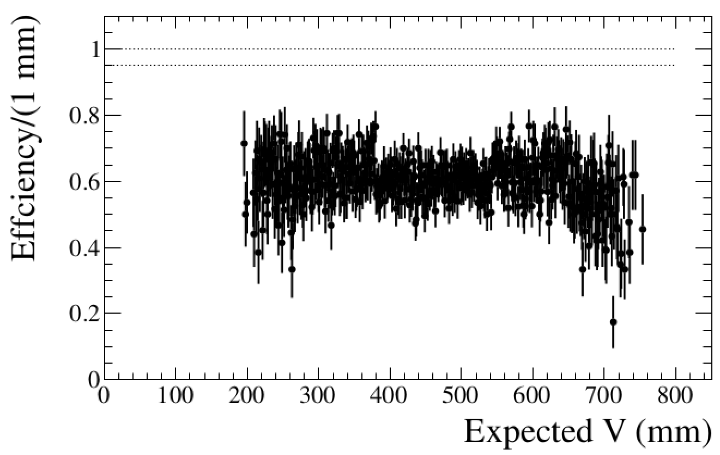
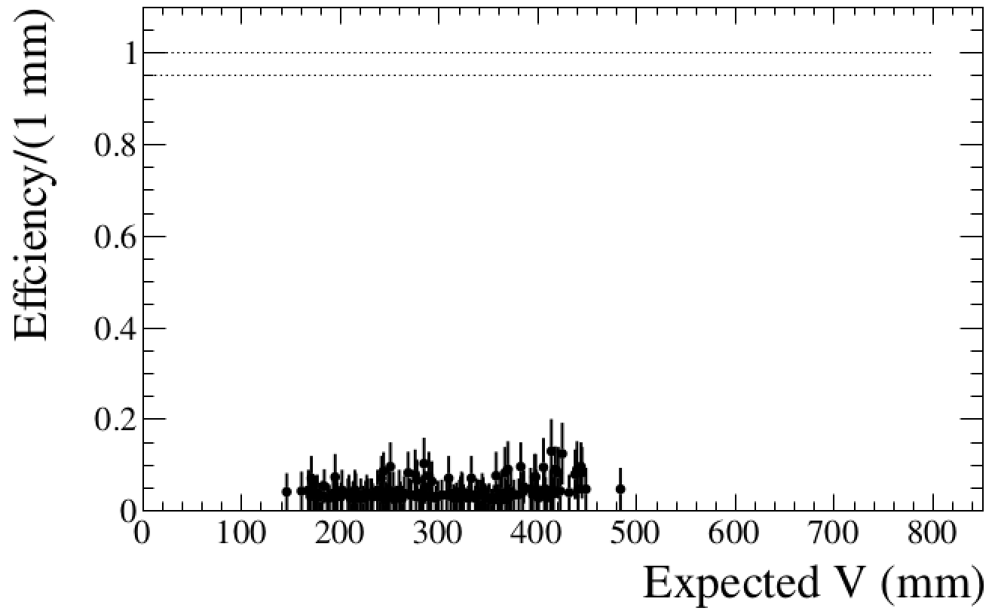
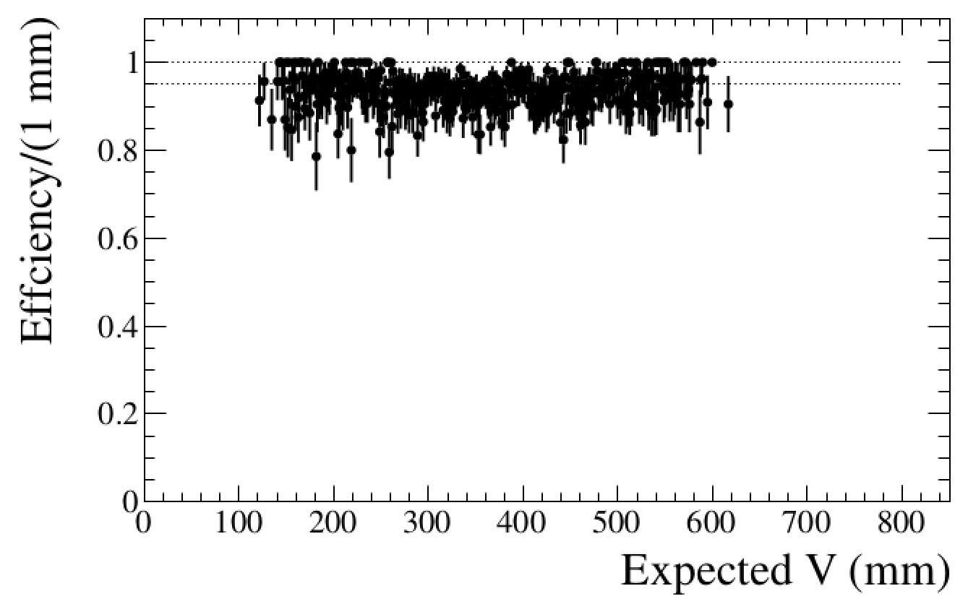
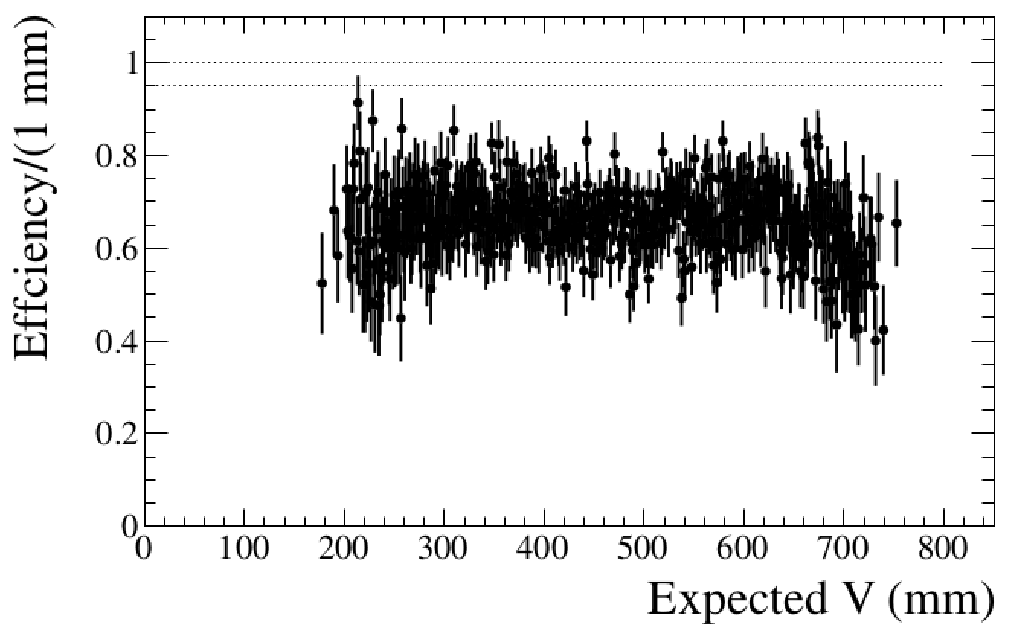
2D cluster Efficiency vs V
Layer1 Top
Layer2 Top
Layer3 Top
Layer1 Bot
Layer2 Bot
Layer3 Bot

Slide 8
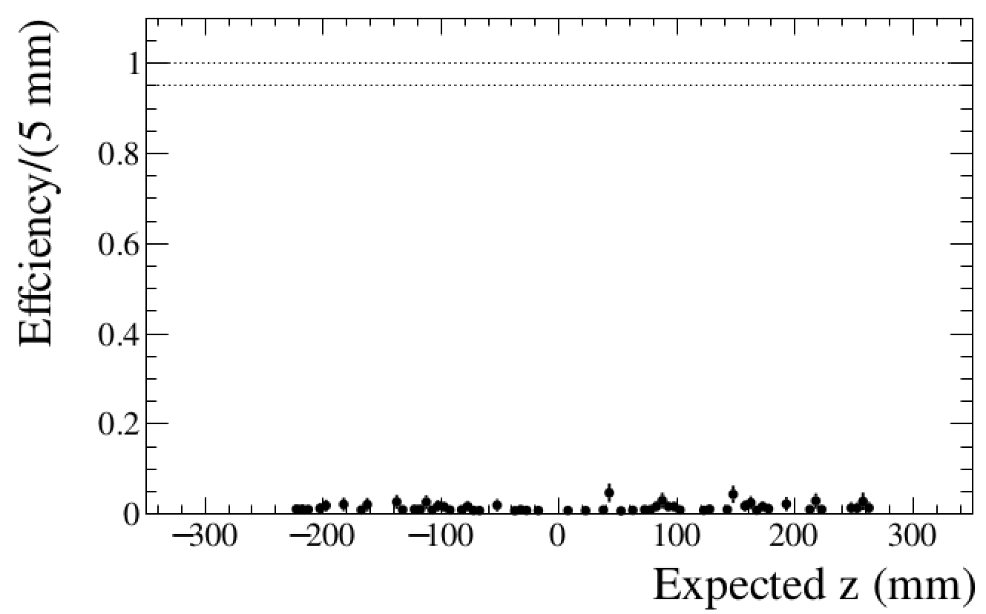
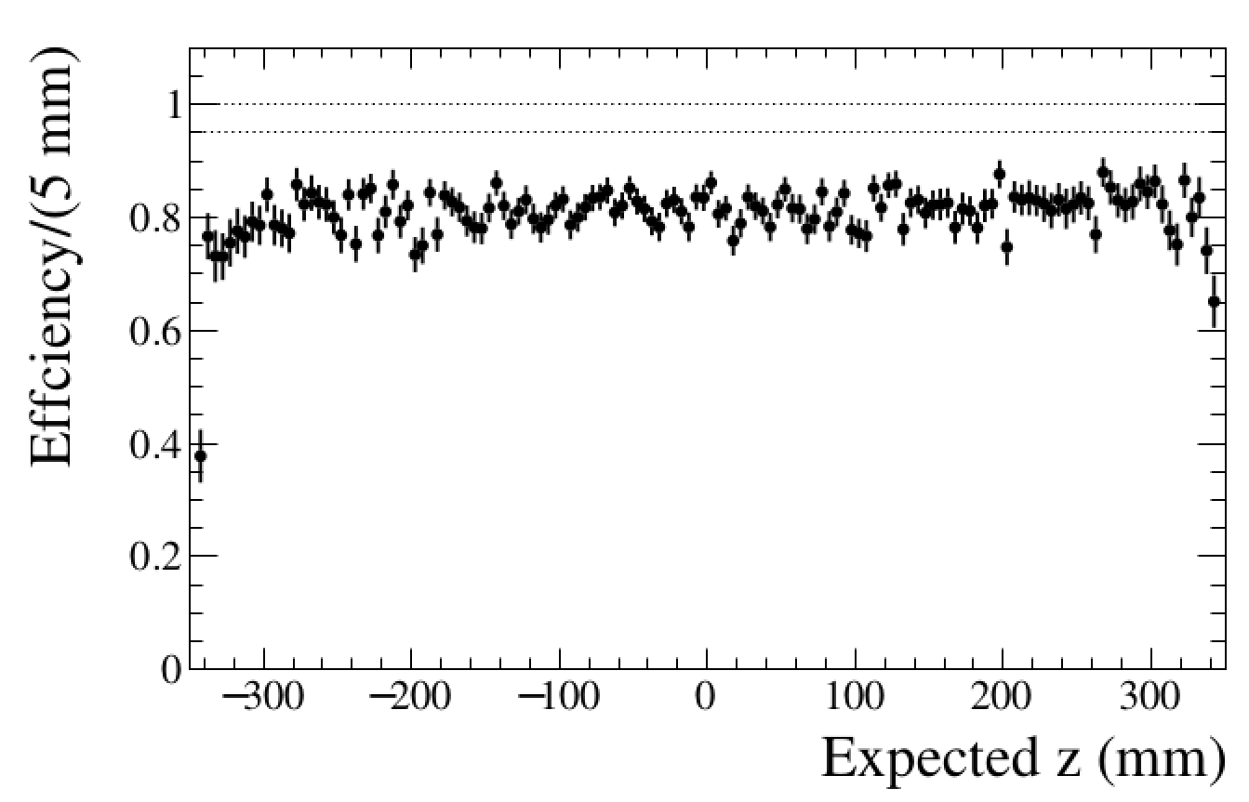
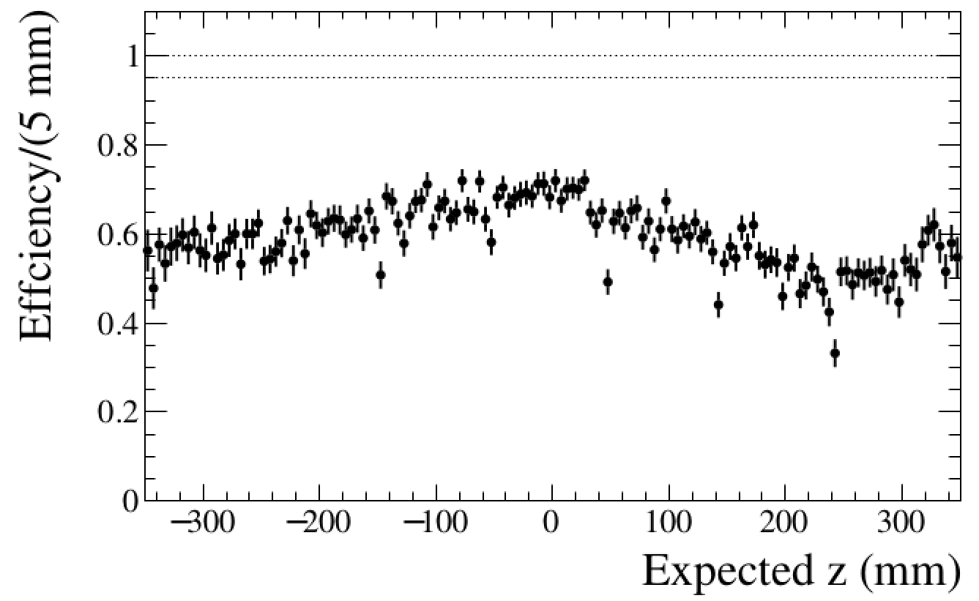
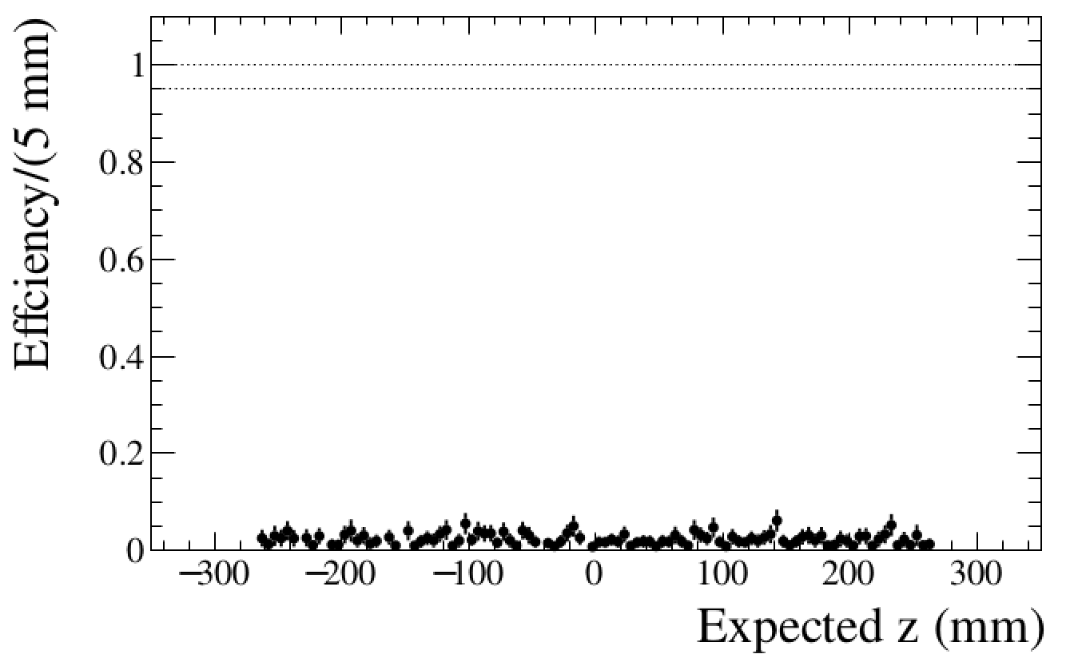
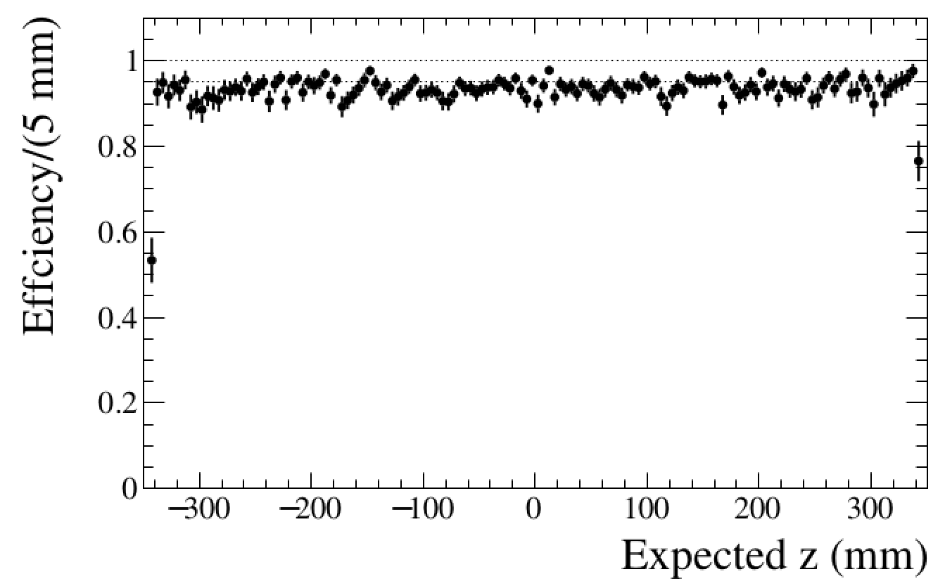
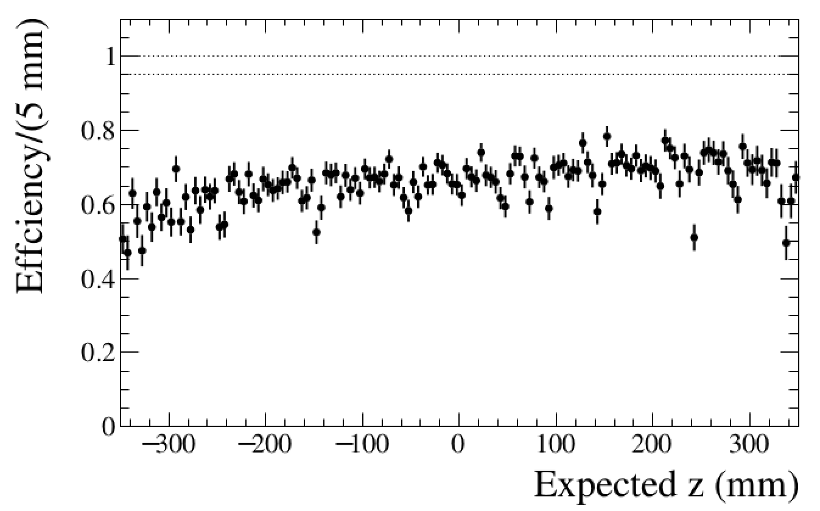
2D cluster Efficiency vs Z
Layer1 Top
Layer2 Top
Layer3 Top
Layer1 Bot
Layer2 Bot
Layer3 Bot

Slide 9
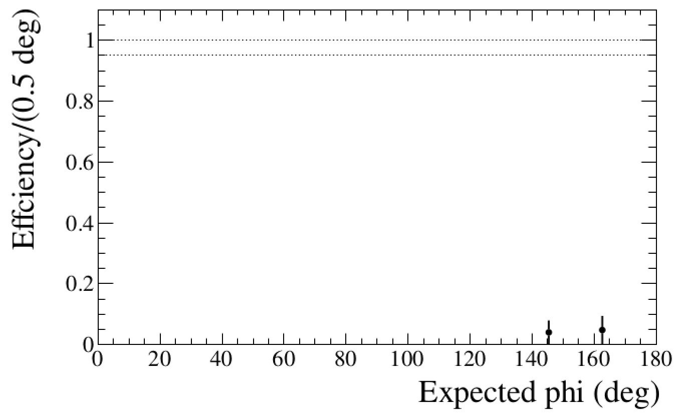
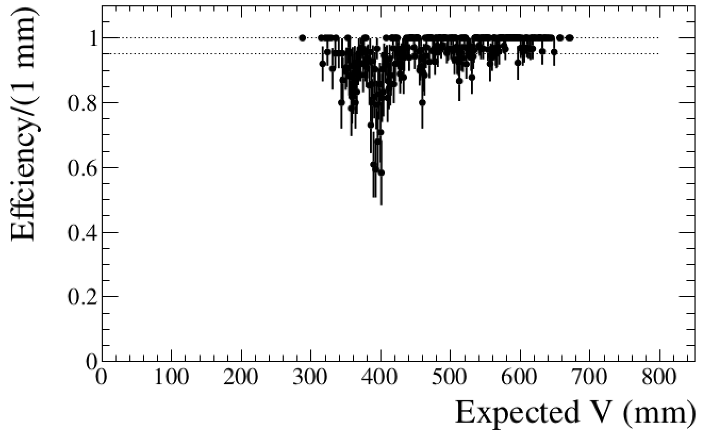
Efficiency for 1D clusters of Layer1 Top

Slide 10
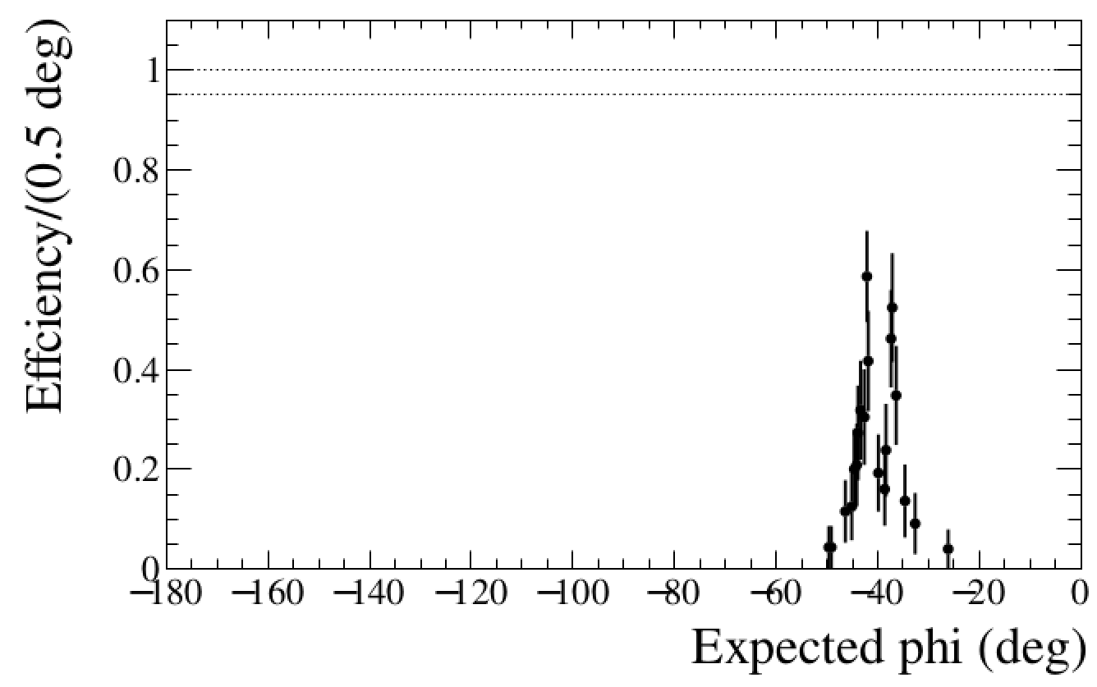
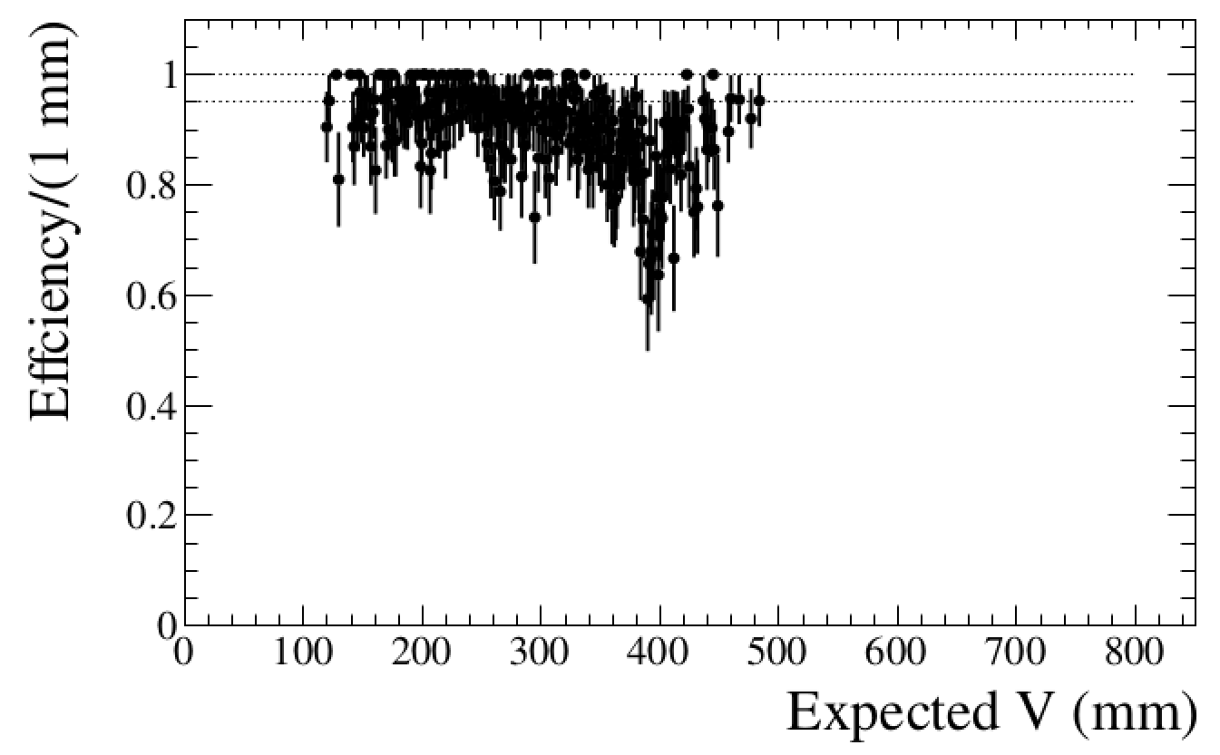
Efficiency for 1D clusters of Layer1 Bot
Notes:
数字化耗时统计
有磁场、无磁场 参考McHit的残差及效率
在有磁场角度下的Grids效应

