Slide 1

Radiation hard SiPM development for CEPC calorimeter
Zhijun Liang, Yong Liu
liangzj@ihep.ac.cn
liuyong@ihep.ac.cn
Notes:
重点报告内容：（1）未来5年拟开展的研究工作，包括主要研究方向、关键科学问题与研究内容；（2）研究方案，包括骨干成员之间的分工及合作方式、学科交叉融合研究计划、年度工作计划与目标等；（3）五年预期目标和可能取得的重大突破等。

Slide 2
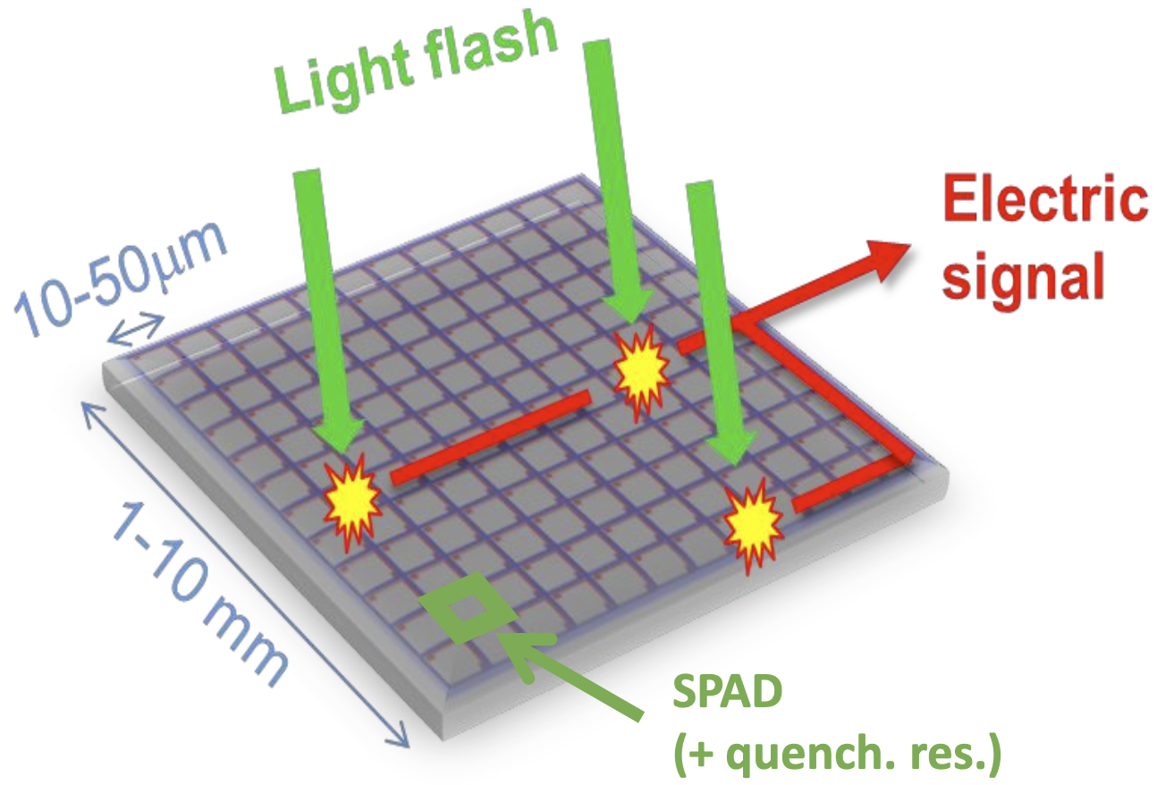
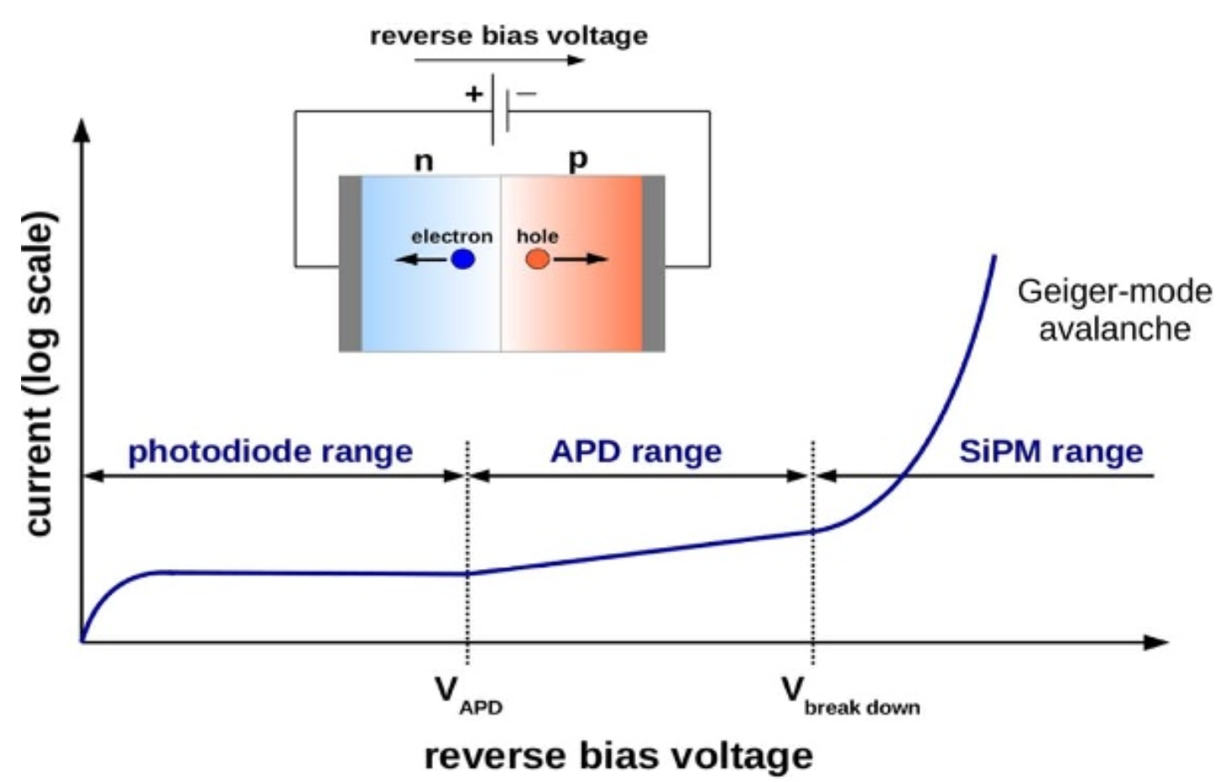
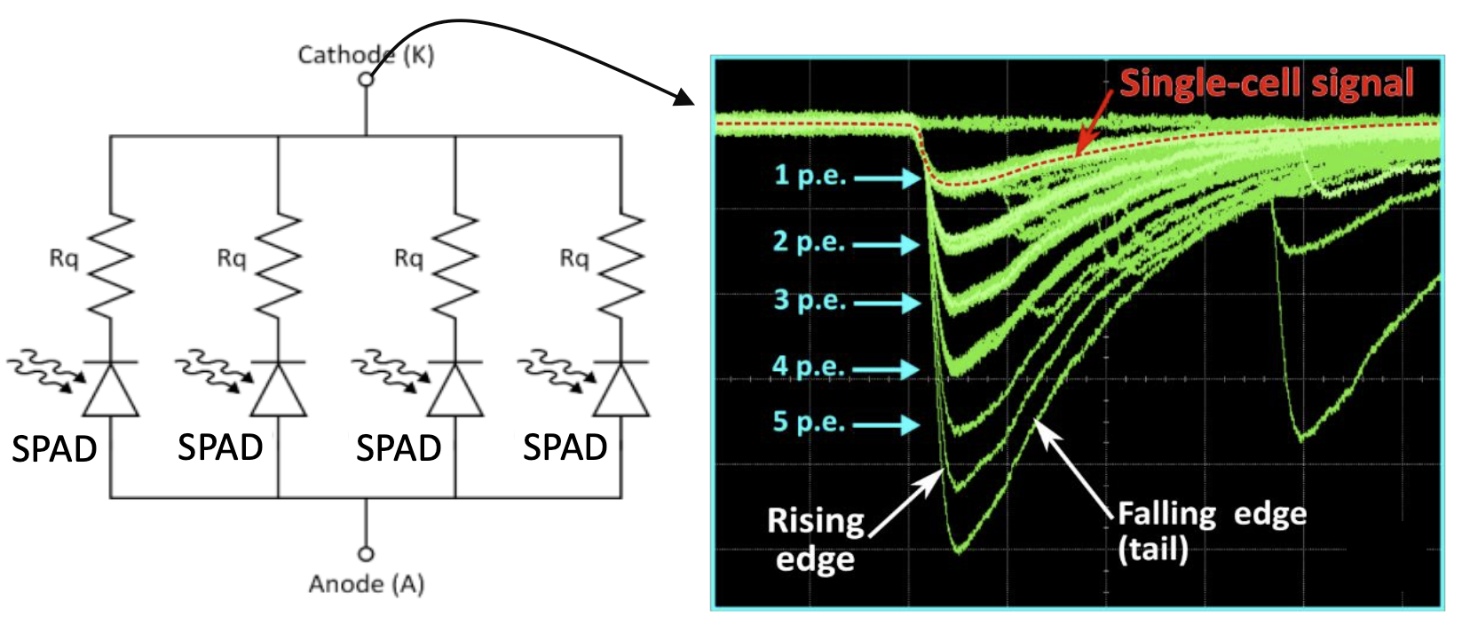
SiPM introduction
SiPM--silicon photomultiplier: advantage:
  High resolution
  Single photon counting
The goal is to develop Radiation hard SiPM

Slide 3
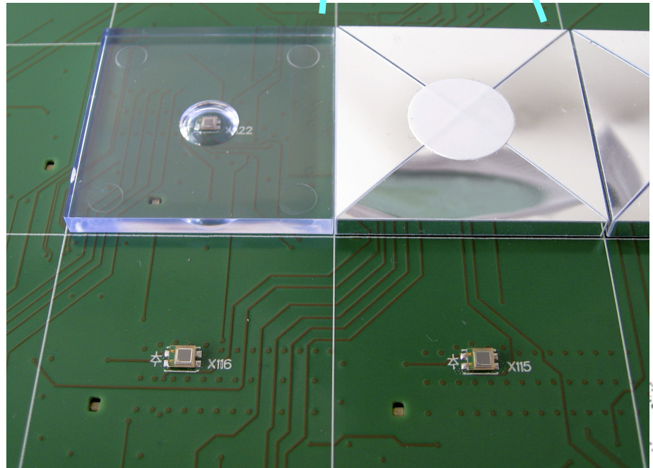
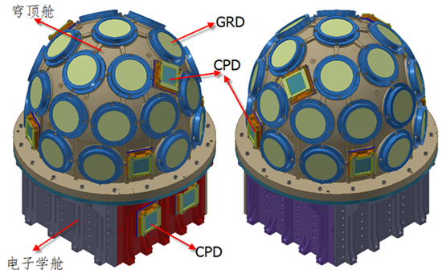
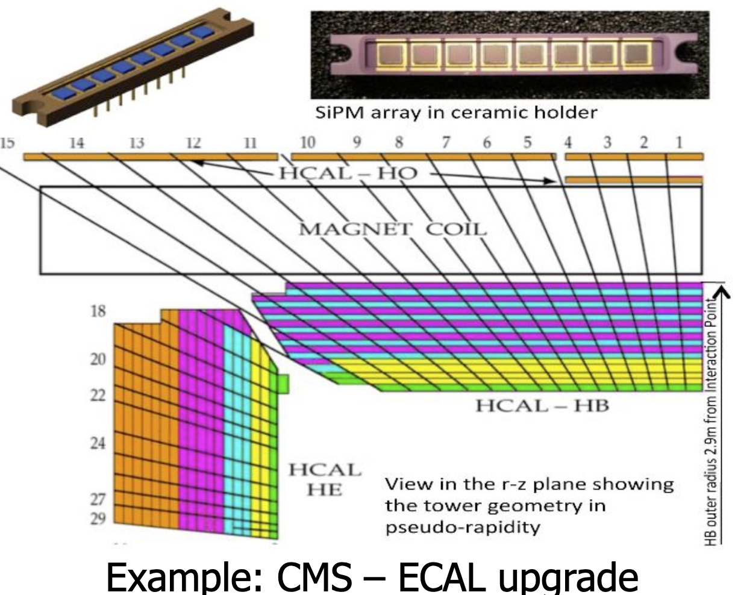
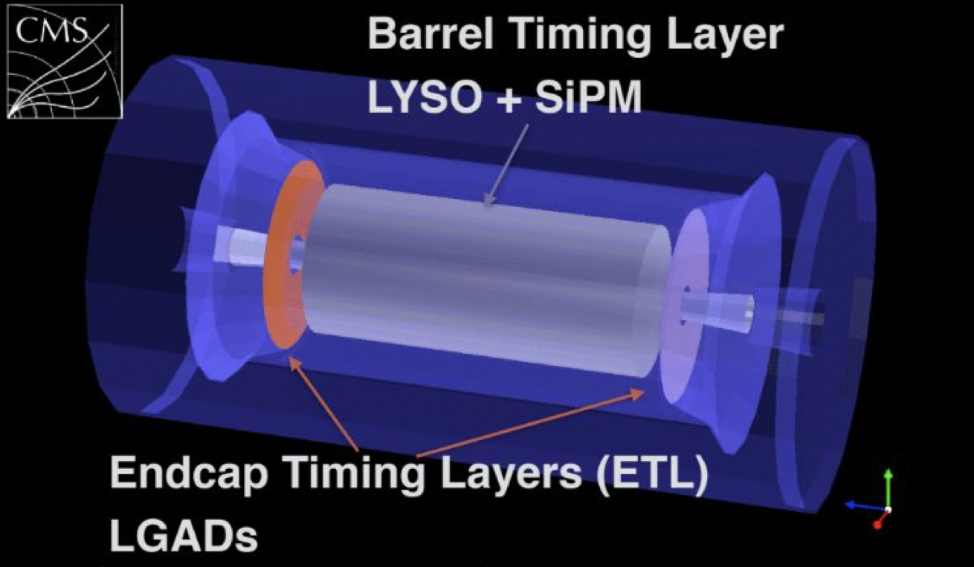
Radiation SiPM application
Astrophysics: Space station scientific experiment (Herd …)
Collider physics: calorimeter application
  CMS timing layer, calorimeter
  CEPC calorimeter and time of flight detector
GECAM
CEPC PFA
calorimeter
prototype
CMS MIP timing detector
CMS Calorimeter

Slide 4
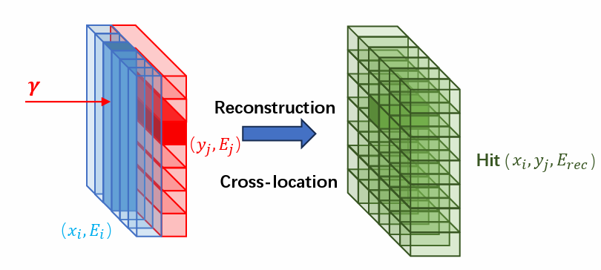
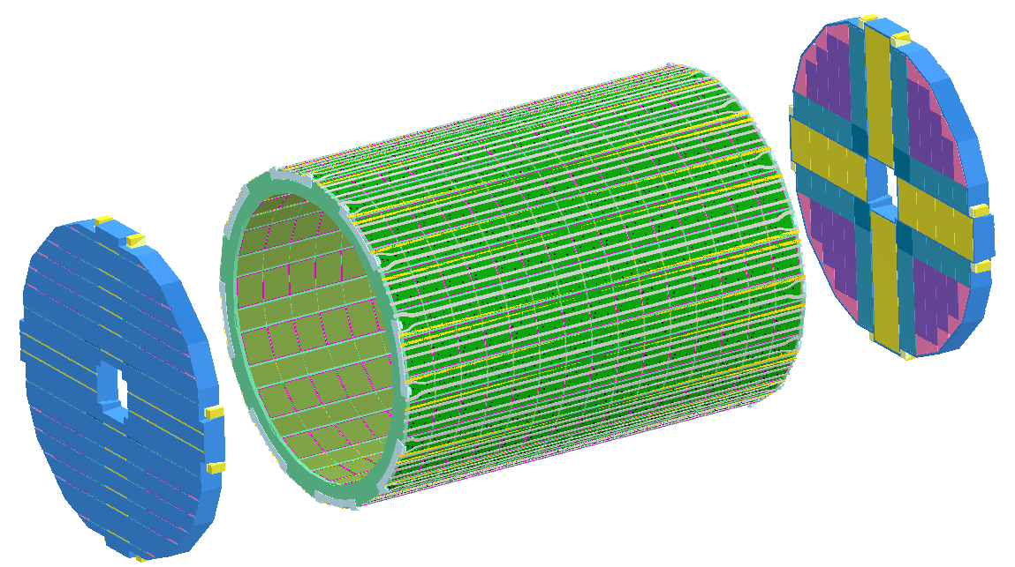
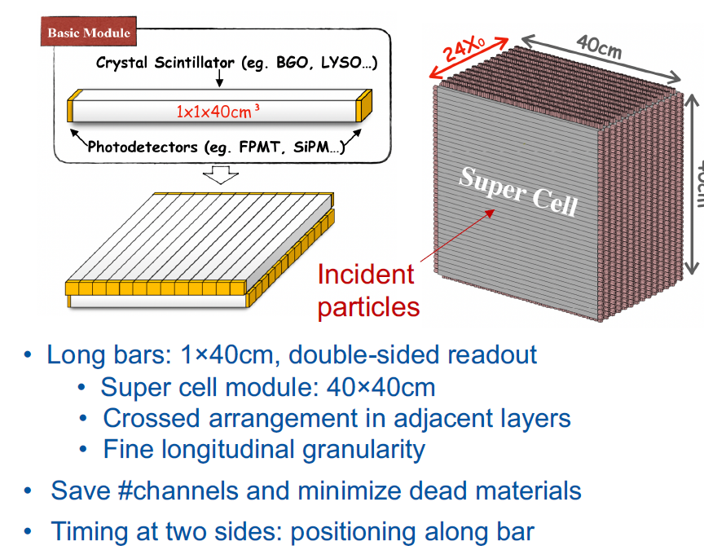
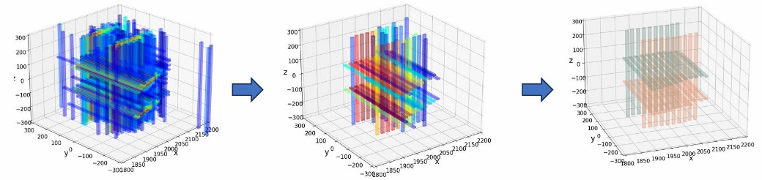
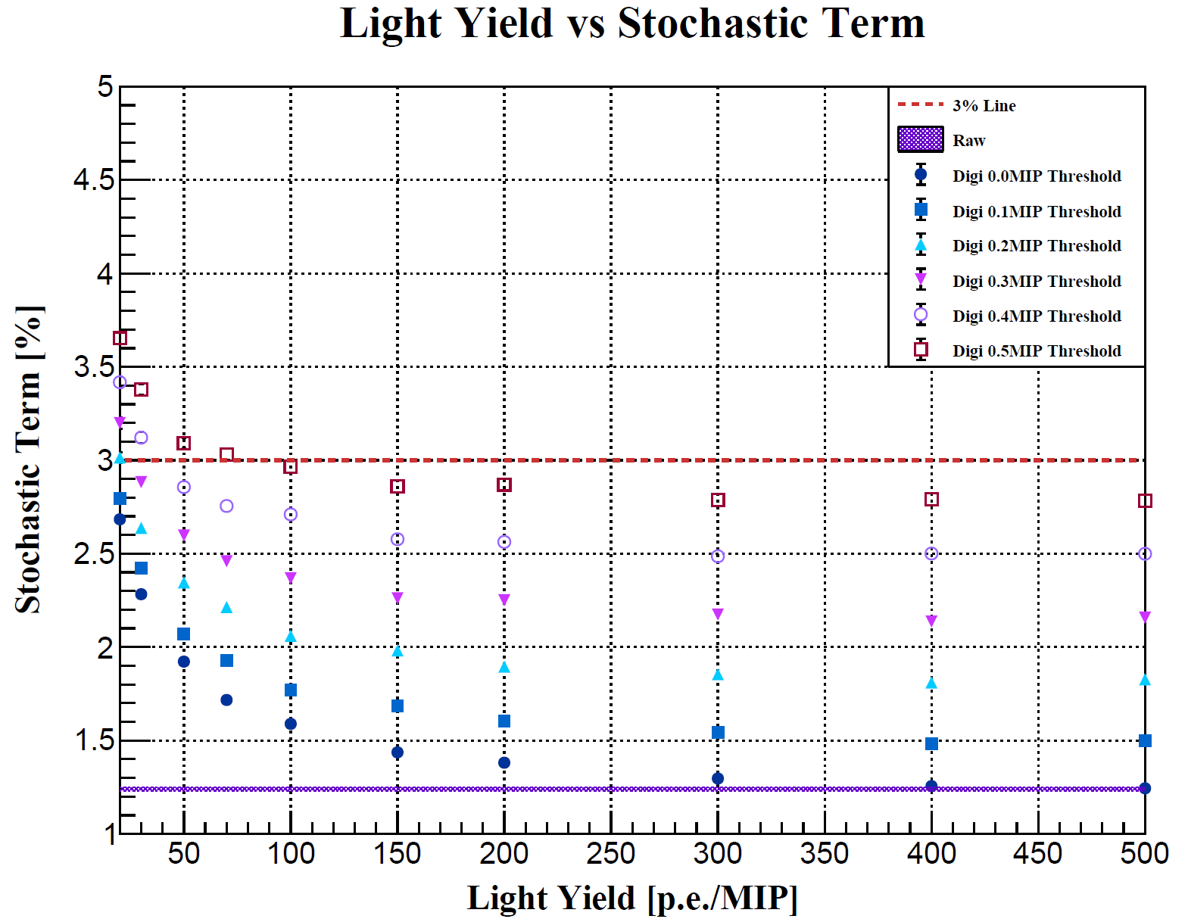
CEPC ECAL: High-granularity crystal calorimeter
Crystal ECAL with long-bar configuration
Simulation studies on design specifications
Dedicated reconstruction software under development
  Pattern recognition for particle-flow
Hardware developments: crystal-SiPM characterizations, crystal modules and beamtests

Slide 5
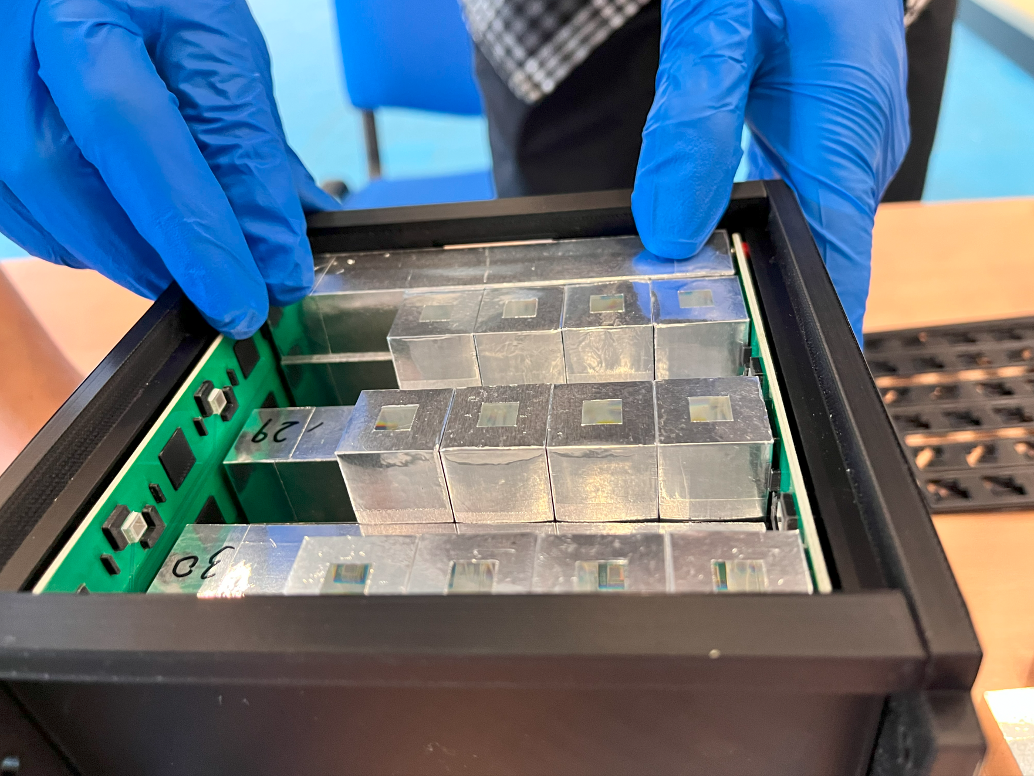
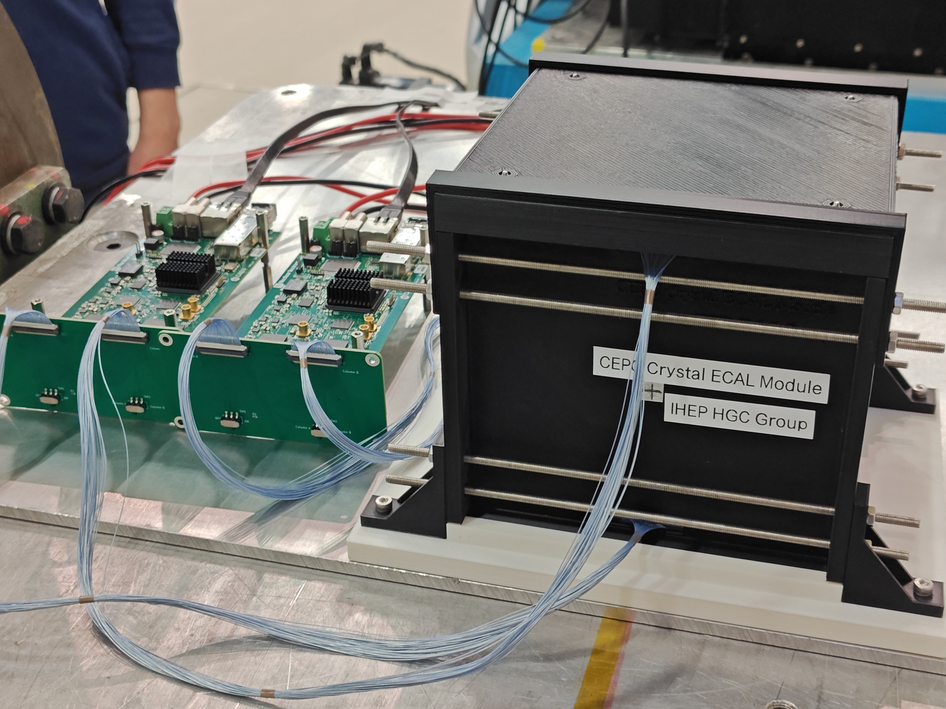
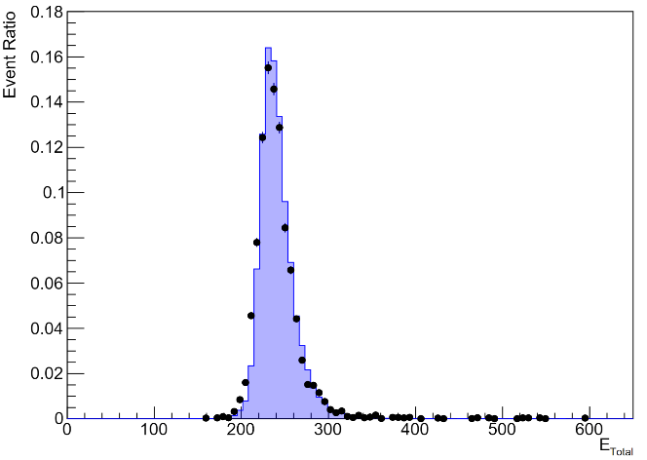
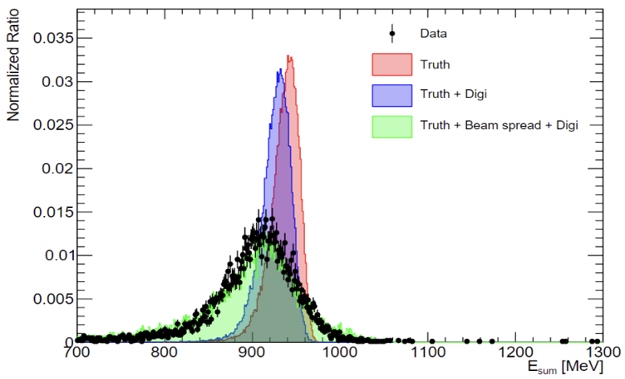
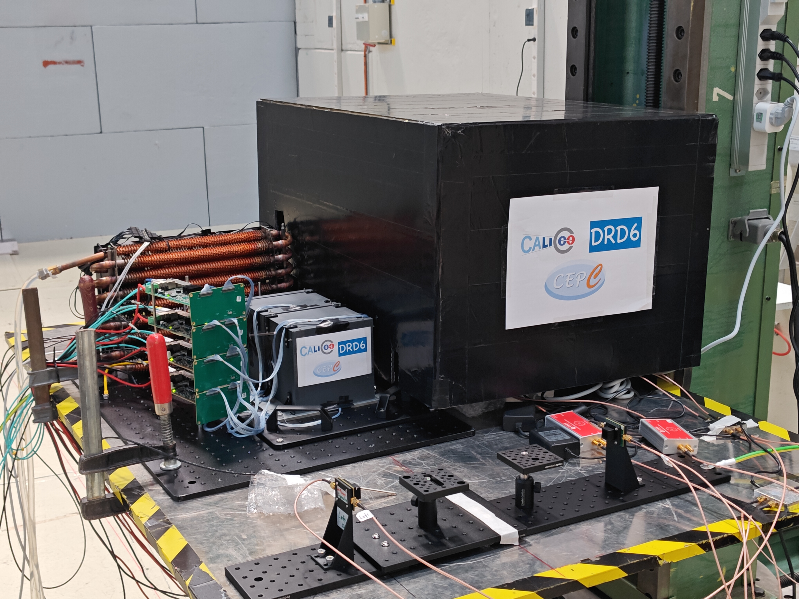
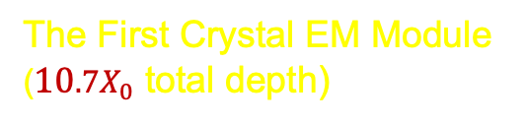
Crystal calorimeter prototypes and beam tests
CERN beamtest: parasitic runs at PS-T09 (May 16-23, 2023)
Work in Progress
Work in Progress
The First Crystal EM Module
($10.7X_{0}$ total depth)
5 GeV muons
1 GeV electrons
Crystal calorimeter prototype: key issues
  System integration and EM performance
Extensive studies in beam tests at CERN and DESY
  Muons for MIP calibration
  Electrons for EM shower studies
  Data sets for validation of simulation + digitisation

Slide 6
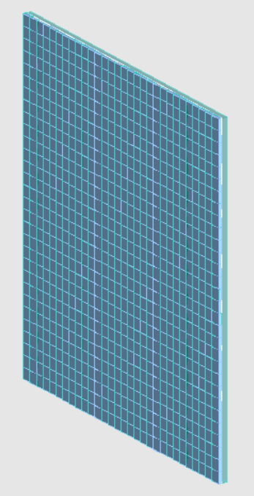
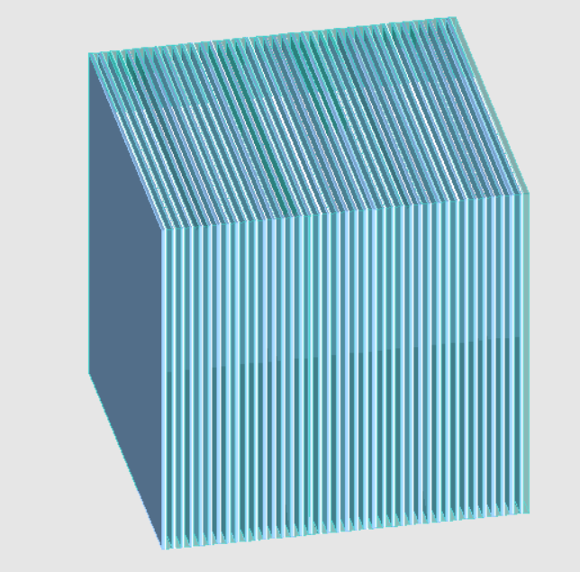
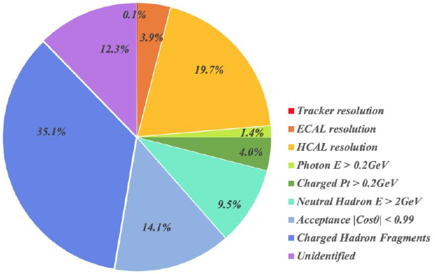
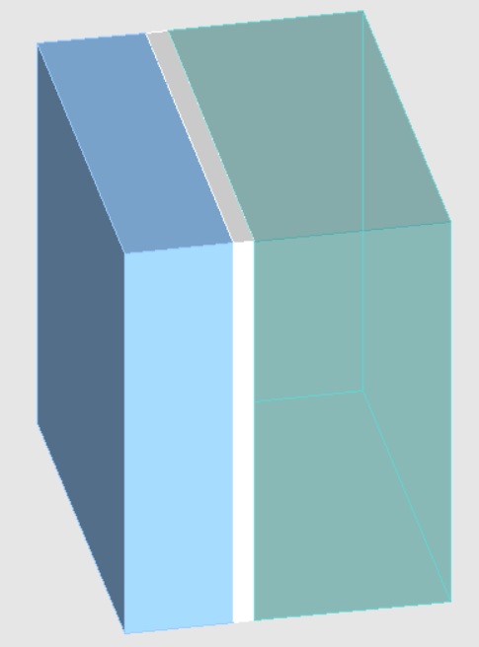
CEPC ScintGlass HCAL overview
ScintGlassHCAL: PFA-oriented sampling hadron calorimeter
  A variant option of CALICE-AHCAL: scintillator-SiPM, steel
  Sensitive layer: dense and bright scintillating glass tiles
  Aim to further improve hadron energy resolution, which is a major factor for precision jet energy measurements
BMR factorization based on PFA
Glass
10mm
Steel
PCB 2mm
BMR=Boson Mass resolution

Slide 7
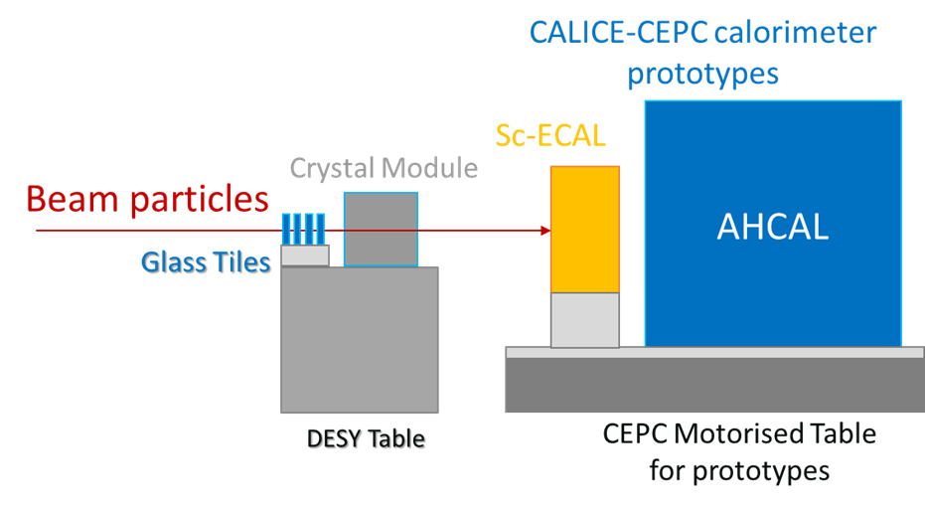
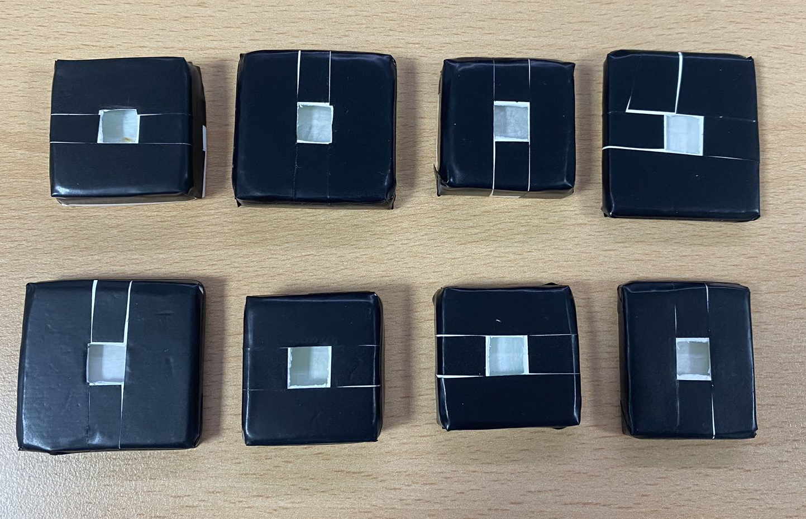
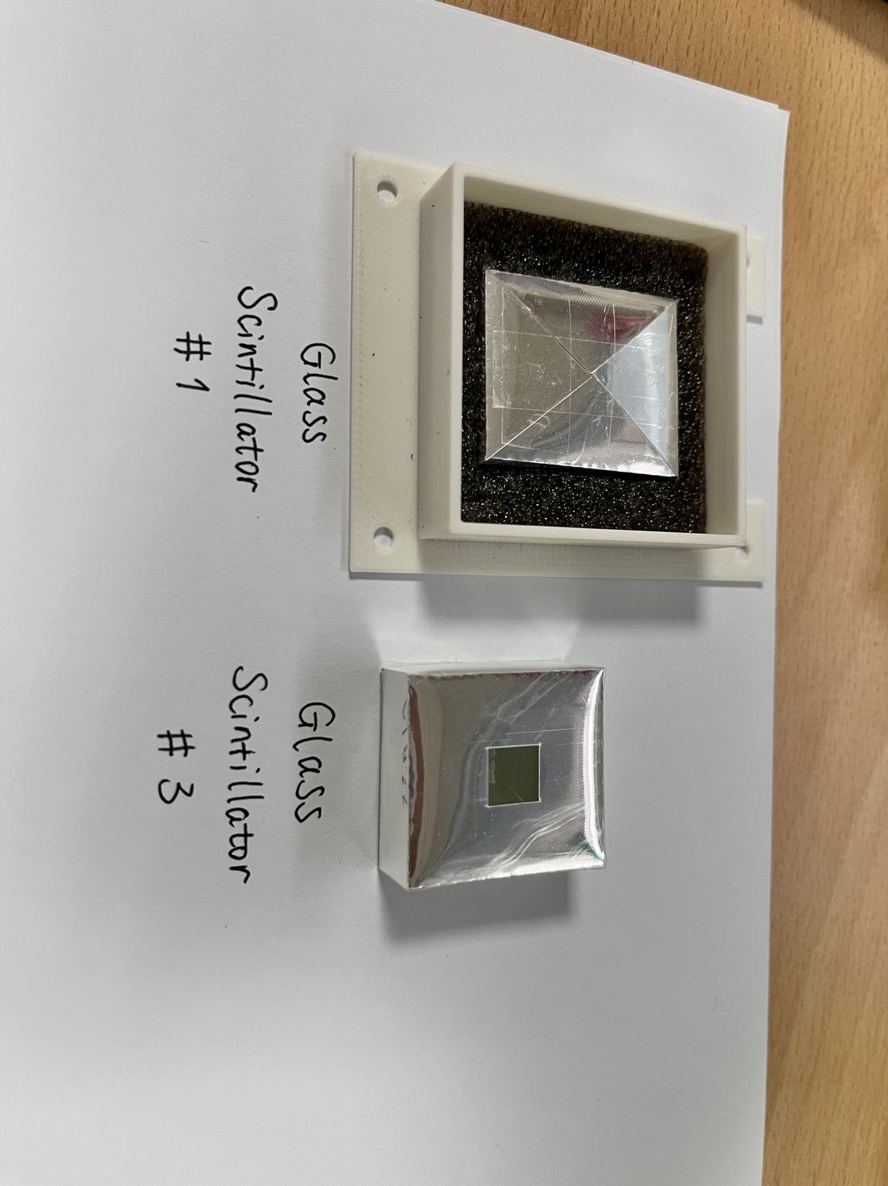
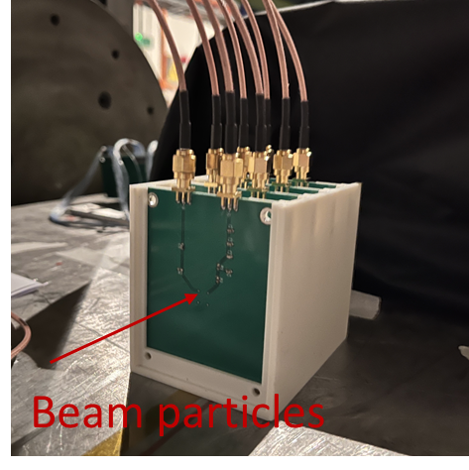
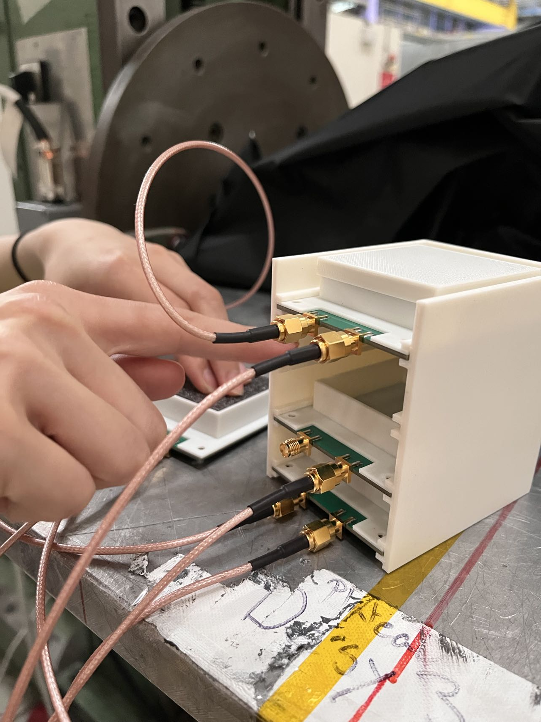
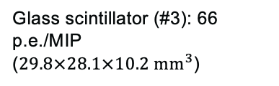
Scintillator glass tiles: CERN beamtest in 2023
Successful beamtest with scintillator glass tiles
  Combined tests with CEPC calorimeter prototypes
  11 pieces of large-area glass tiles: the first batch produced by the “Glass Scintillator Collaboration”
  Clear MIP signals in all 11 glass samples with 15 GeV muons
  3 glass tiles showed promising MIP response
Glass scintillator (#3): 66 p.e./MIP
($29.8×28.1×10.2 {mm}^{3}$)

Slide 8
CEPC ECAL and HCAL: SiPM requirement
  ECAL : Small pixel size (6um*6um), large dynamic range
  HCAL: High PDE Sipm (PDE>60-70%)
 | SiPM for CEPC ECAL | SiPM for CEPC HCAL
Wavelength | 350 – 600 nm | 350 – 600 nm
Size | 3 mm× 3mm | 3 mm× 3mm
Pixel size | 6 μm × 6 μm | 50 μm × 50 μm or larger
PDE | >= 30% (at ~420nm) | >= 60% (at ~400nm)
Number of SiPM | ~1 Million | ~5 Million

Slide 9
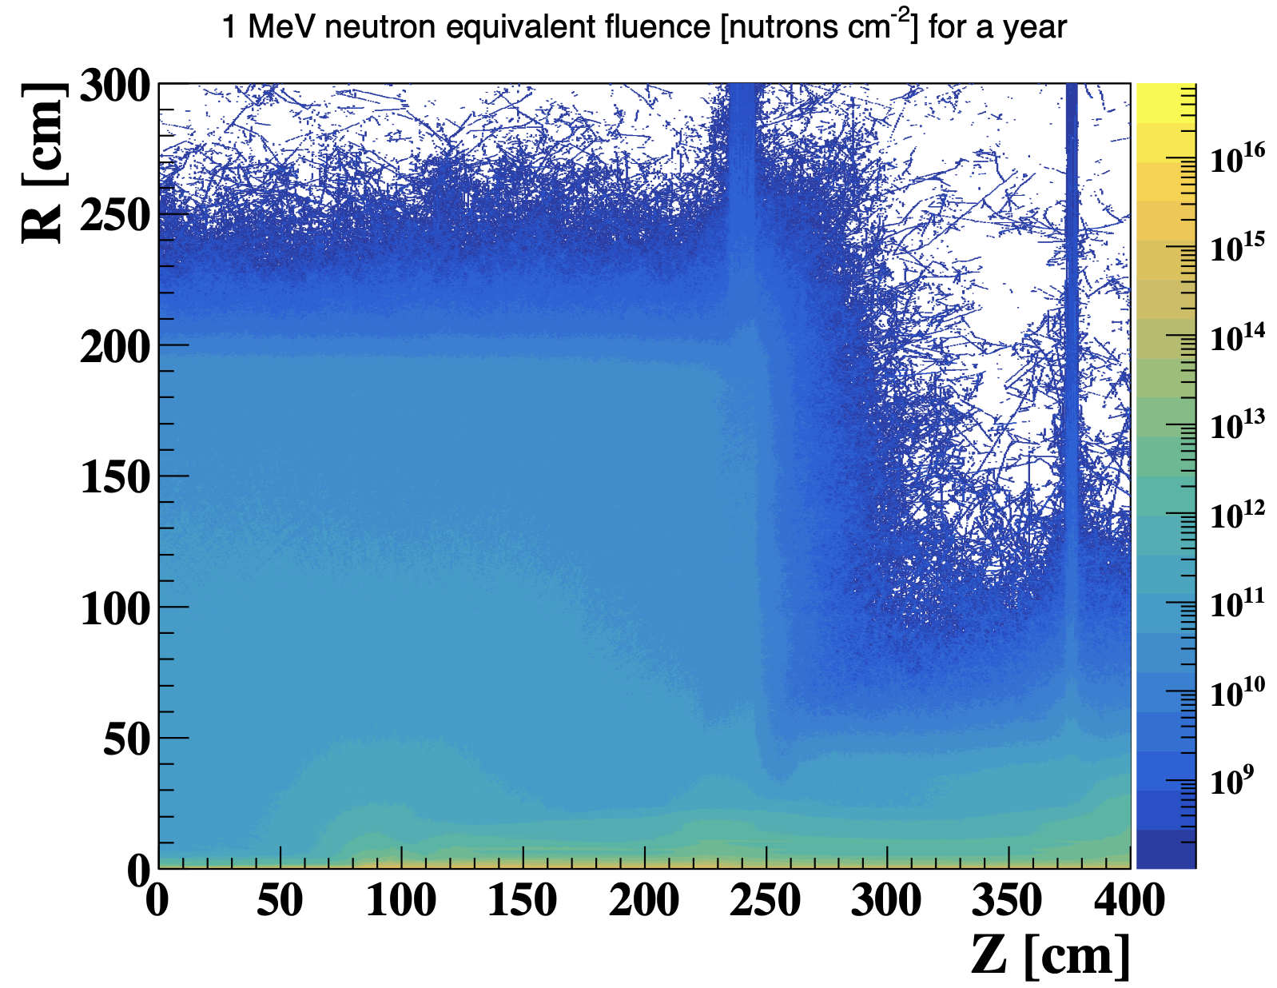
SiPM radiation hardness challenge
After 10 year operation of CEPC, fluence is above 10¹³ n_{eq}/cm²
SiPM typically work below 1krad or 10⁹ n_{eq}/cm² fluence
  Performance drop after 1krad or 10⁹ n_{eq}/cm²
  In great need to develop radiation hard SiPM
 | Long term Satellite or Space station application | CEPC requirement
TID does | 100 krad | >100 krad
Fluence | ~10¹⁰ n_{eq}/cm² | >10¹³ n_{eq}/cm²
Fluence in ZH run（240GeV）

Slide 10
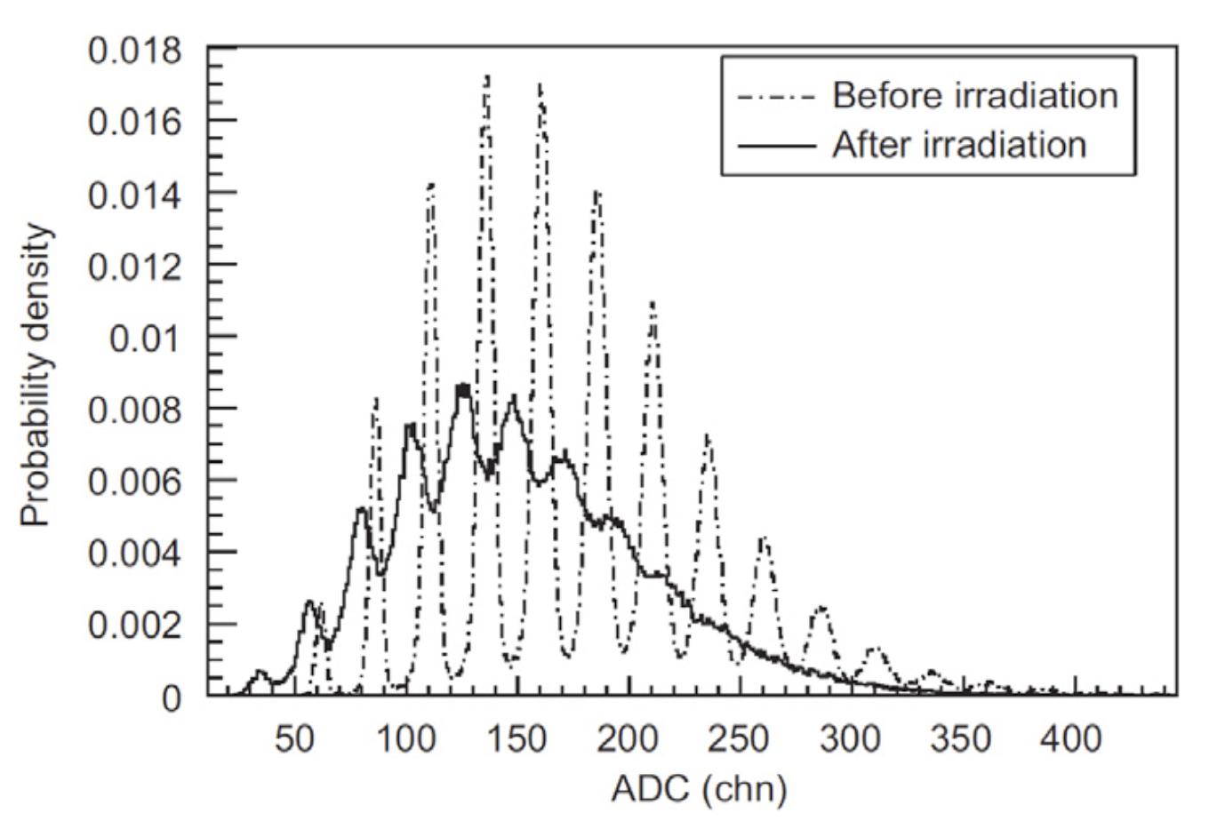
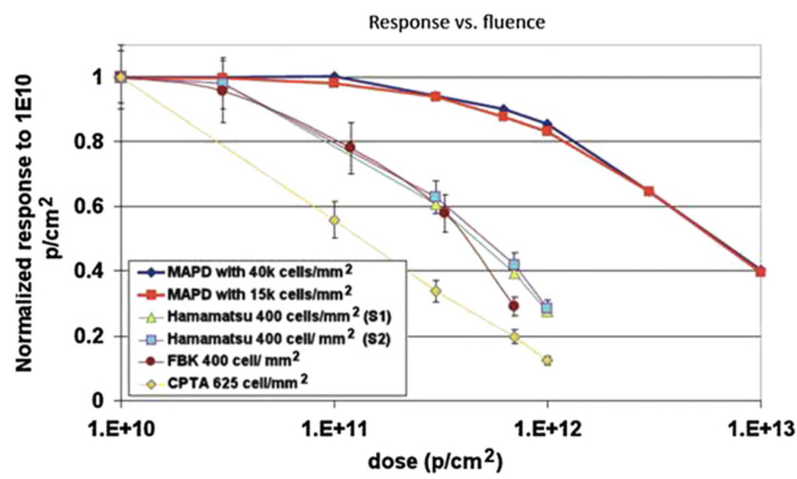
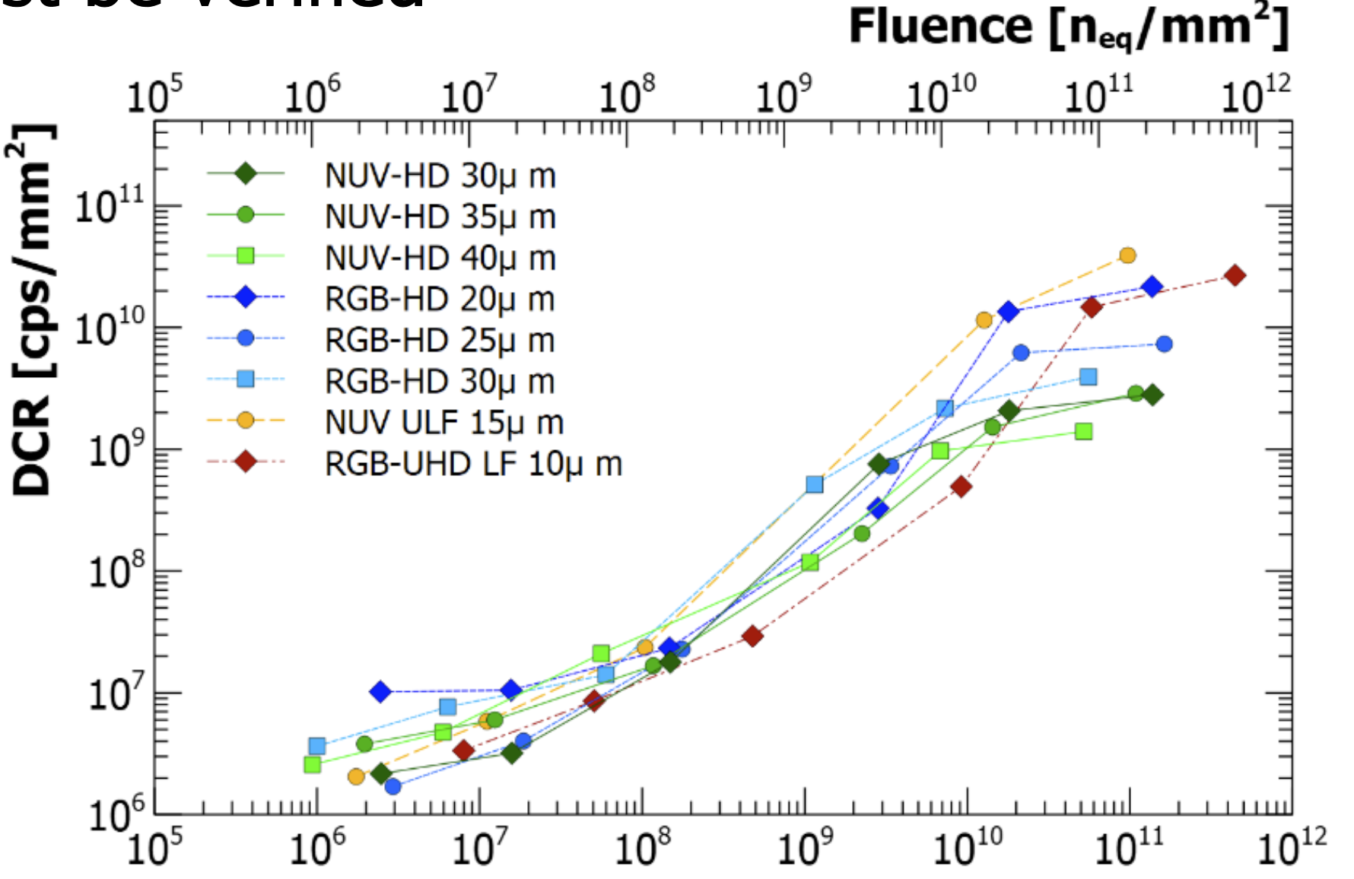
SiPM Radiation hardness
Energy resolution
before/after irradiation
After 10¹⁰ n_{eq}/cm² or 10Krad dose
  Signal gain decrease
  Energy resolution decrease
  Dark count increase
SiPM gain VS Dose
SiPM dark count VS Fluence

Slide 11
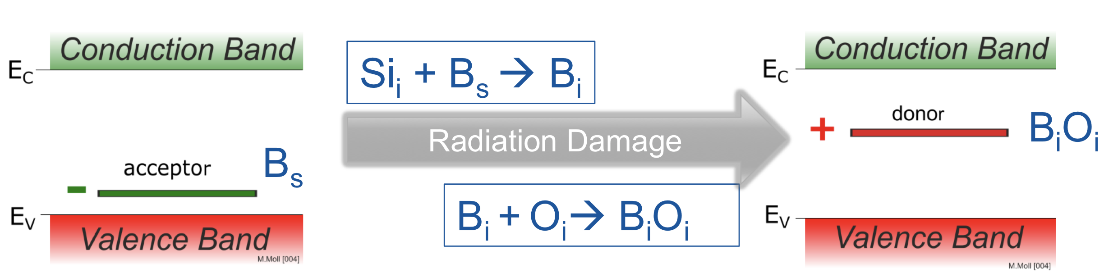
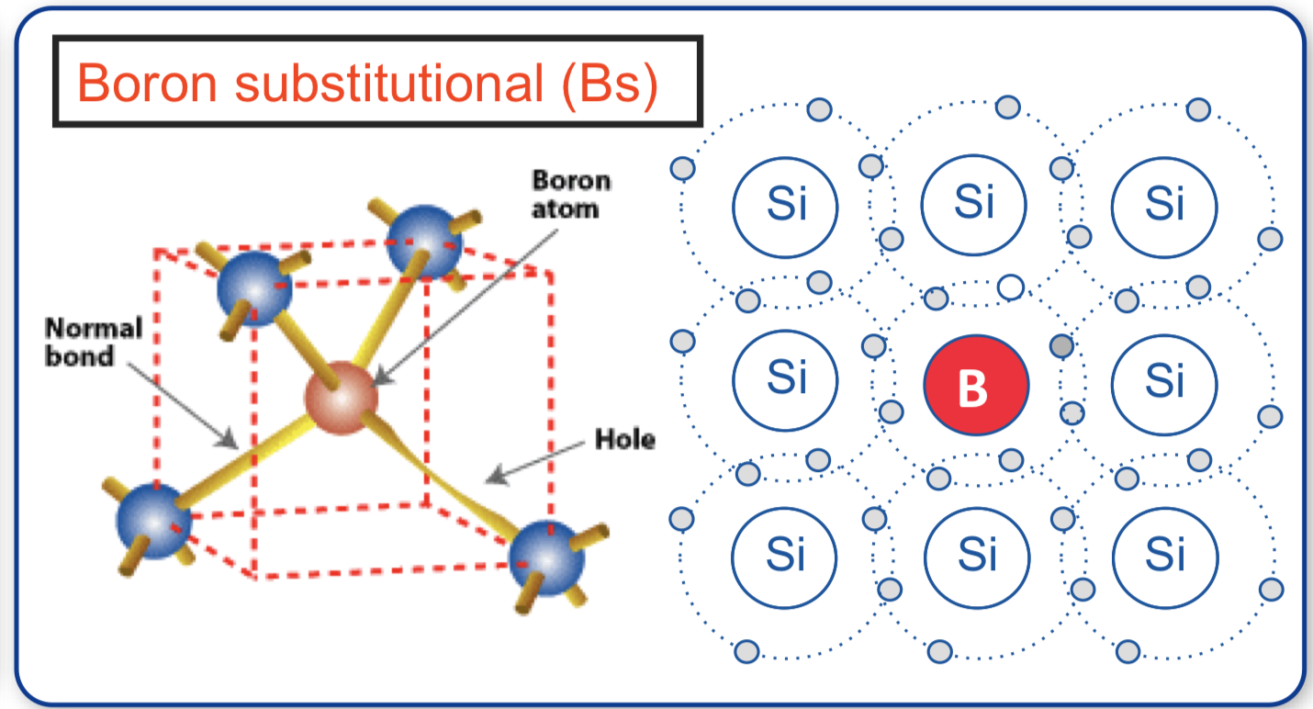
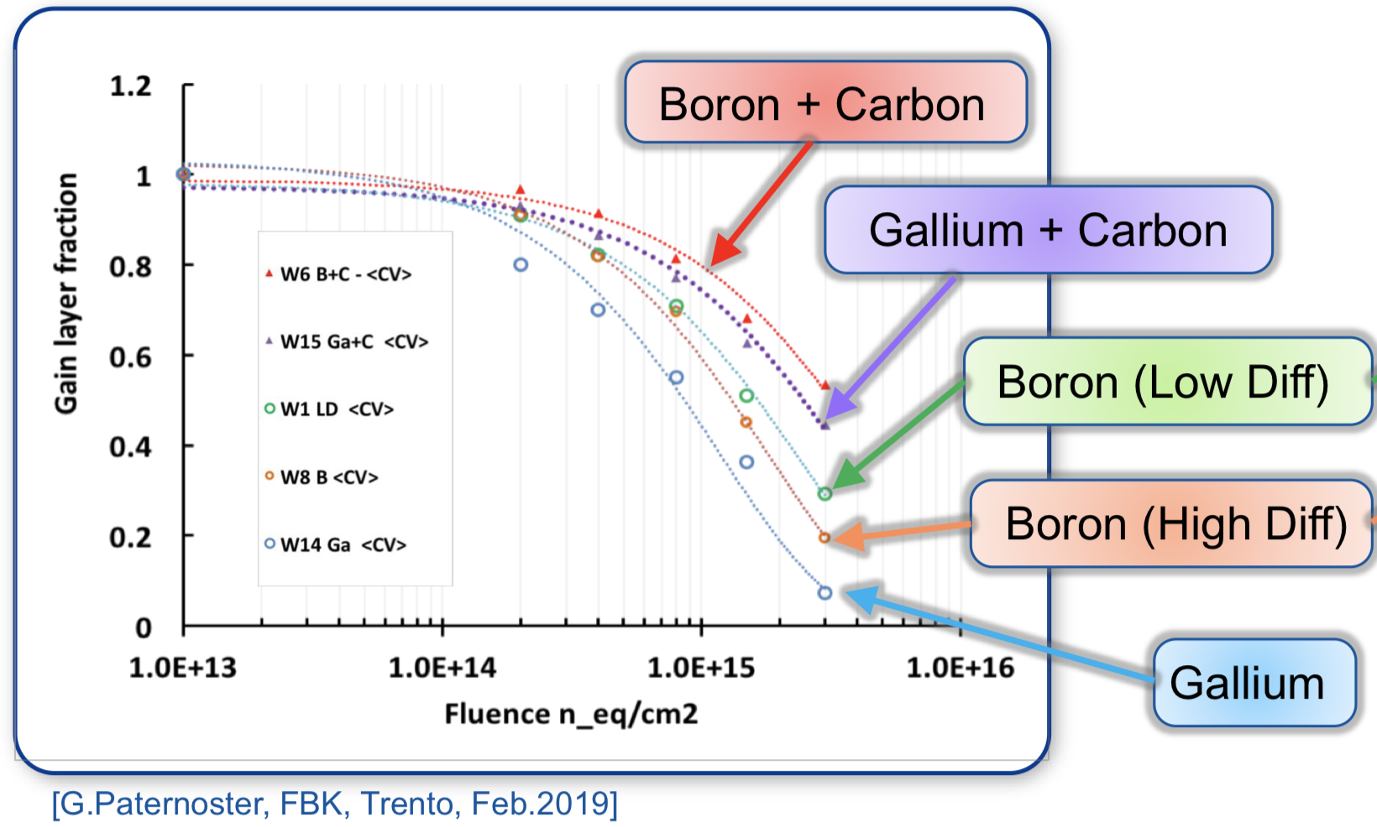
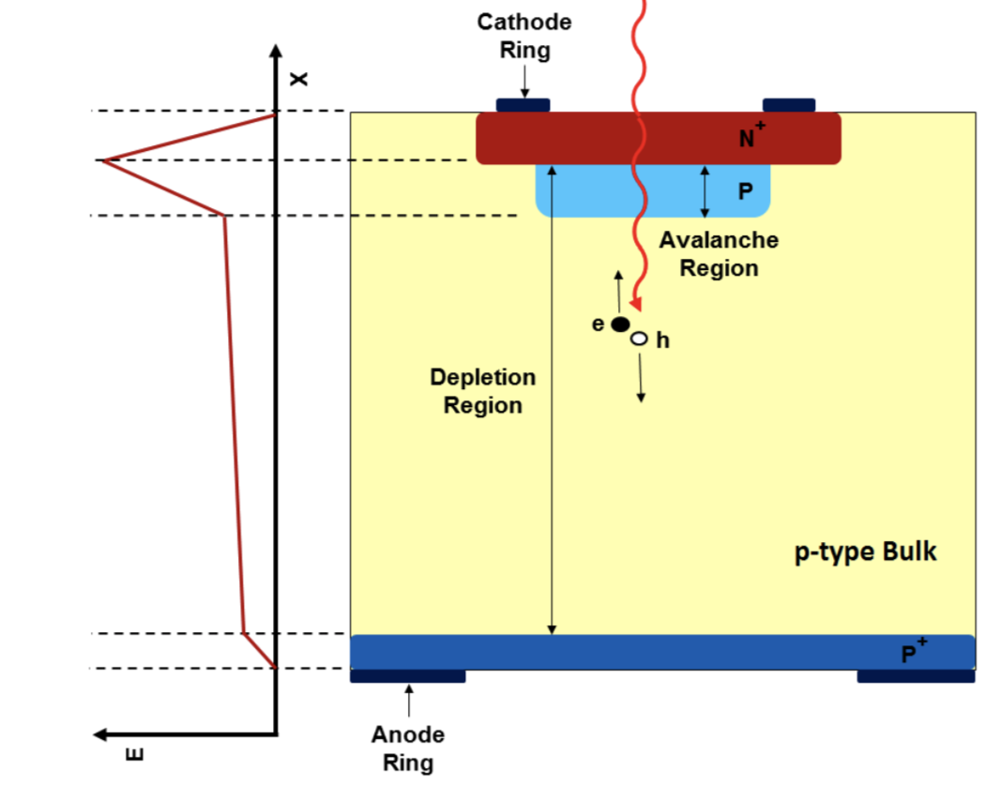
SiPM radiation hardness theory
SiPM signal gain decreased after irradiation （ p+ acceptor removal ）
Acceptor removal

Slide 12
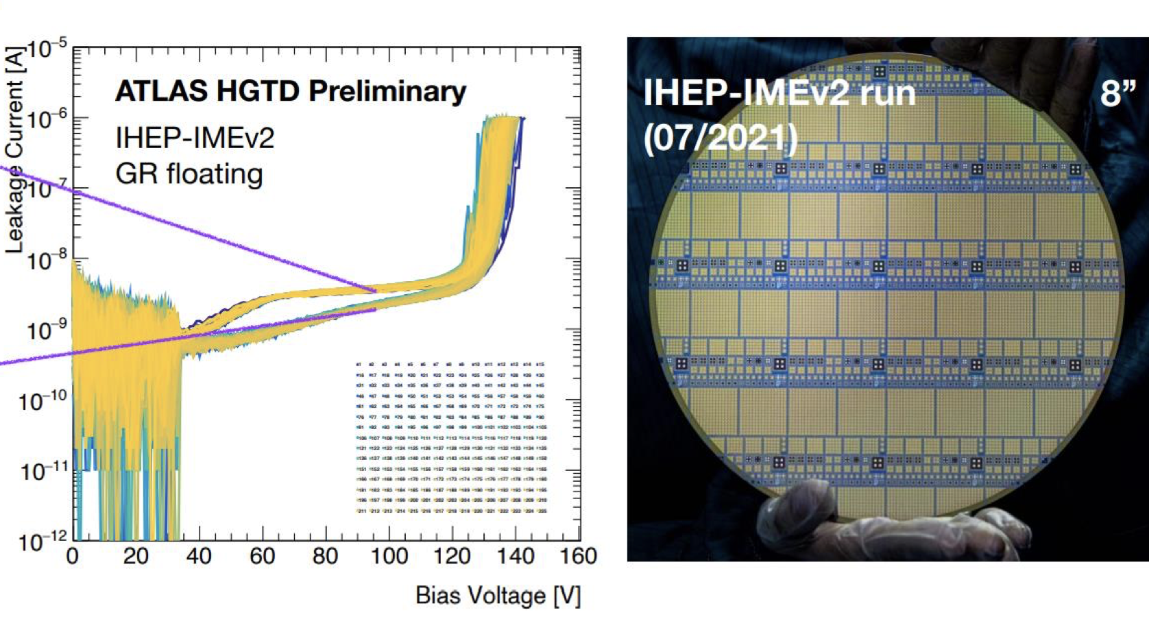
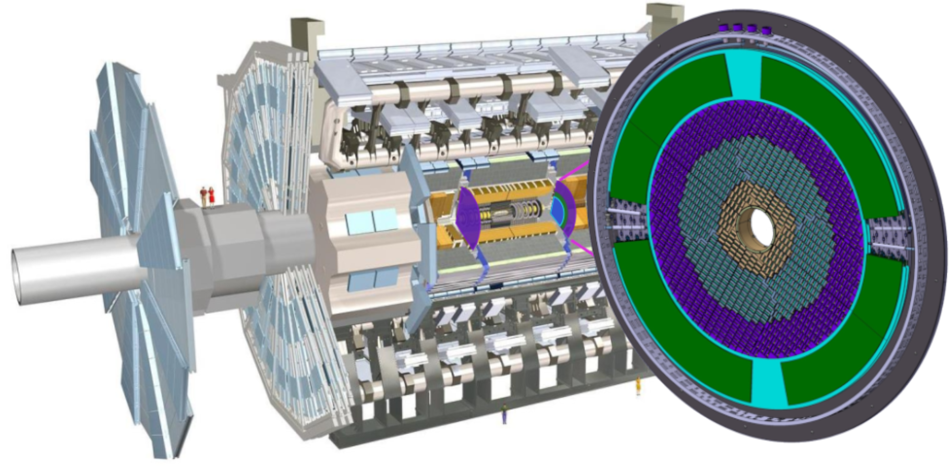
Radiation hard Low Gain Avalanche Detectors (LGAD)
IHEP developed radiation hard Low Gain Avalanche Detectors (LGAD)
Developed for ATLAS high granularity timing detector
LGAD and SiPM has similar structure
  Good foundation for radiation hard SiPM development
LHC ATLAS experiment
High granularity timing detector
LGAD sensor developed by

Slide 13
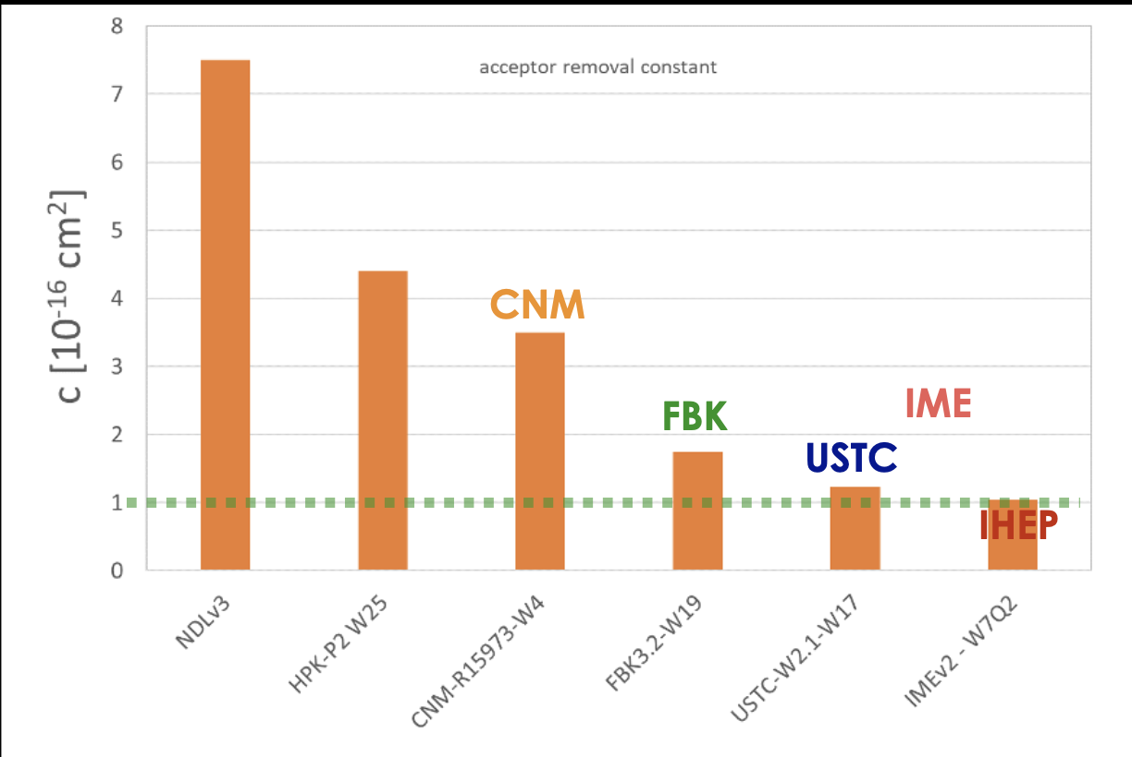
LGAD sensor after Irradiation
IHEP-IME LGAD with carbon-enriched doping
  Significantly lower acceptor removal ratio, the most irradiation hard LGAD sensor by far
After 2.5×10¹⁵ n_{eq}/cm² , IHEP LGADs were operated at voltages below 350 V, avoid HV breakdown
  Test beams at CERN and DESY, confirm the feasibility of LGAD timing detector for HL-LHC
  IHEP made a leading contribution to radiation hard LGAD sensors
Acceptor Removal Ratio
Lower ratio, more radiation hard
70 ps

Slide 14
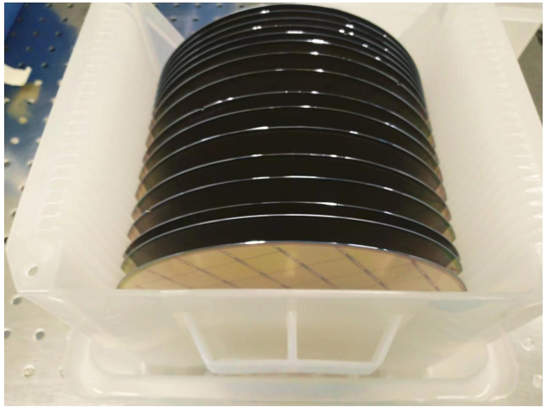
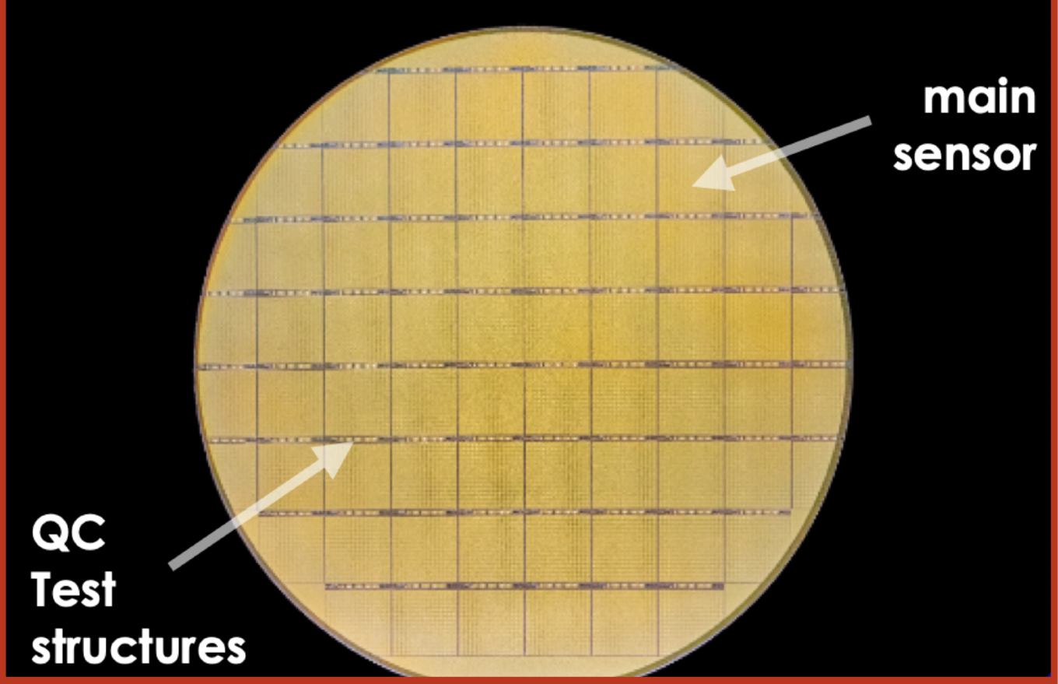
LGAD pre-production for ATLAS experiment
IHEP-IME sensor Won CERN tendering for ATLAS timing detector
  1.7k good sensor fabricated in pre-production, PRR passed at July 25, 2024
  Production contract signed in Feb 2025.
The first time that Chinese irradiation hard sensor used at LHC experiment
Pre-production LGAD sensors from China

Slide 15
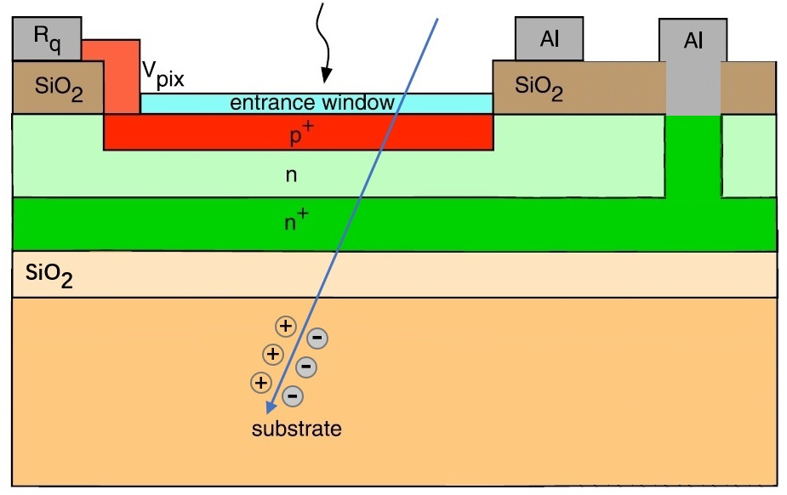
SiPM dark count after irradiation
Bulk damage after irradiation → dark count increased
Potential Solution:
  Design a special wafer to isolate the dark current from bulk damage
Special wafer

Slide 16
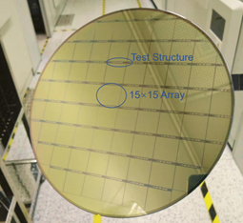
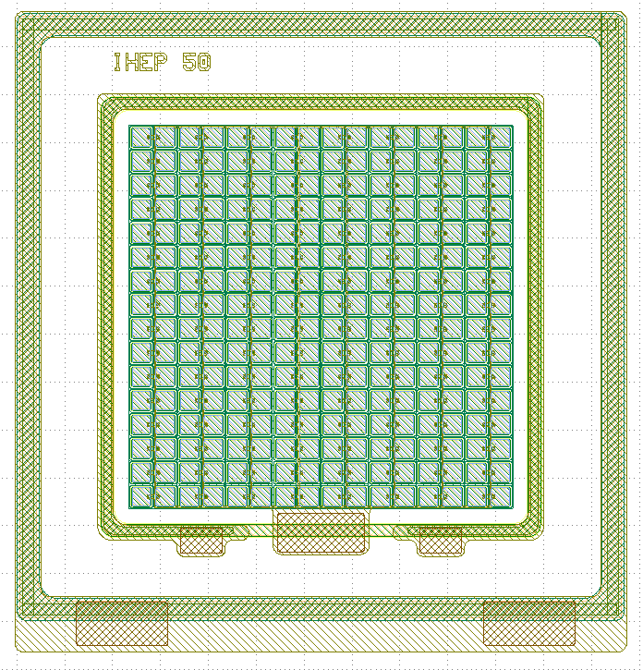
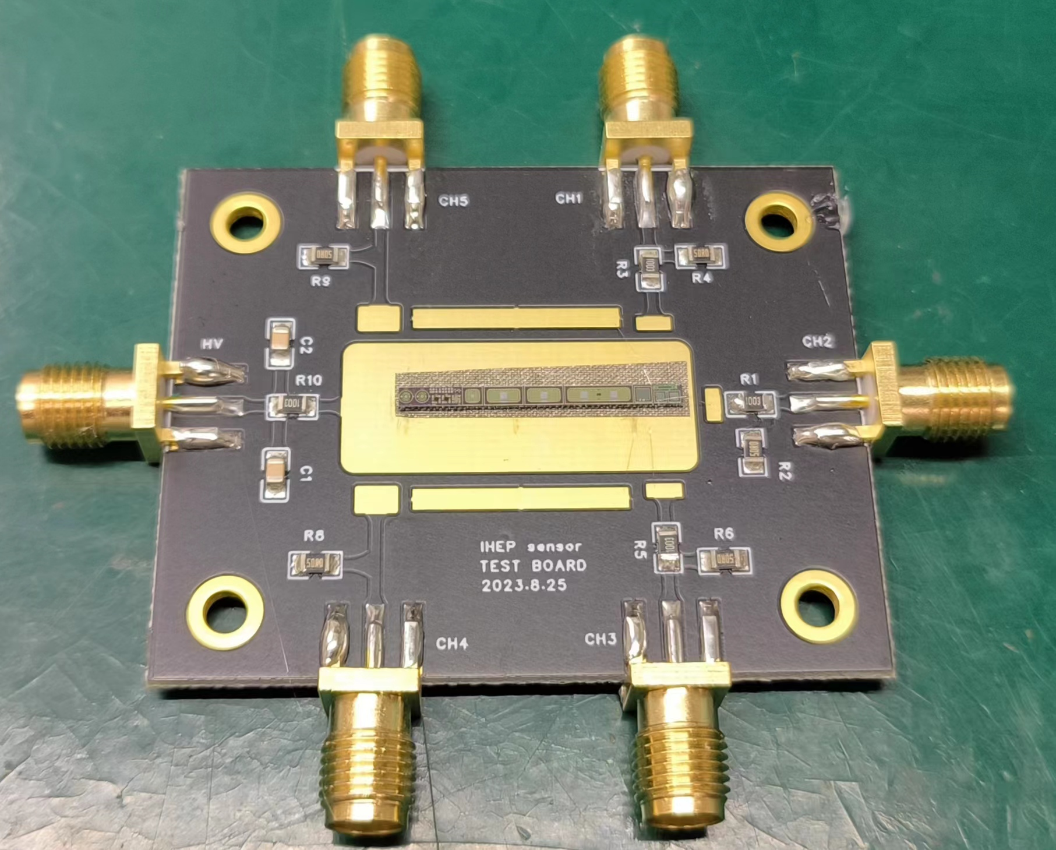
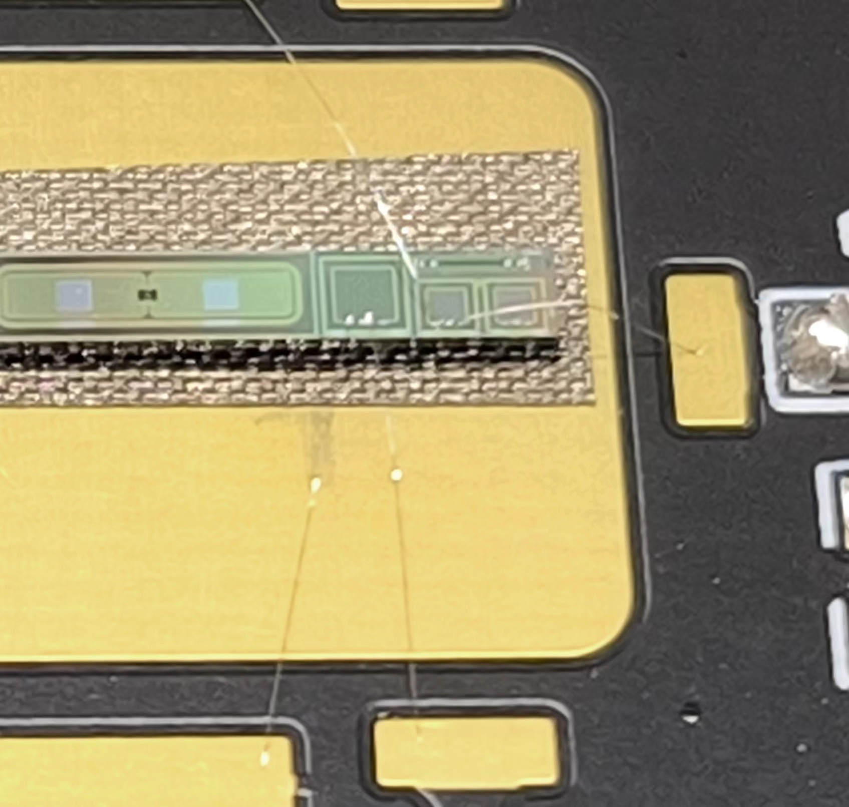
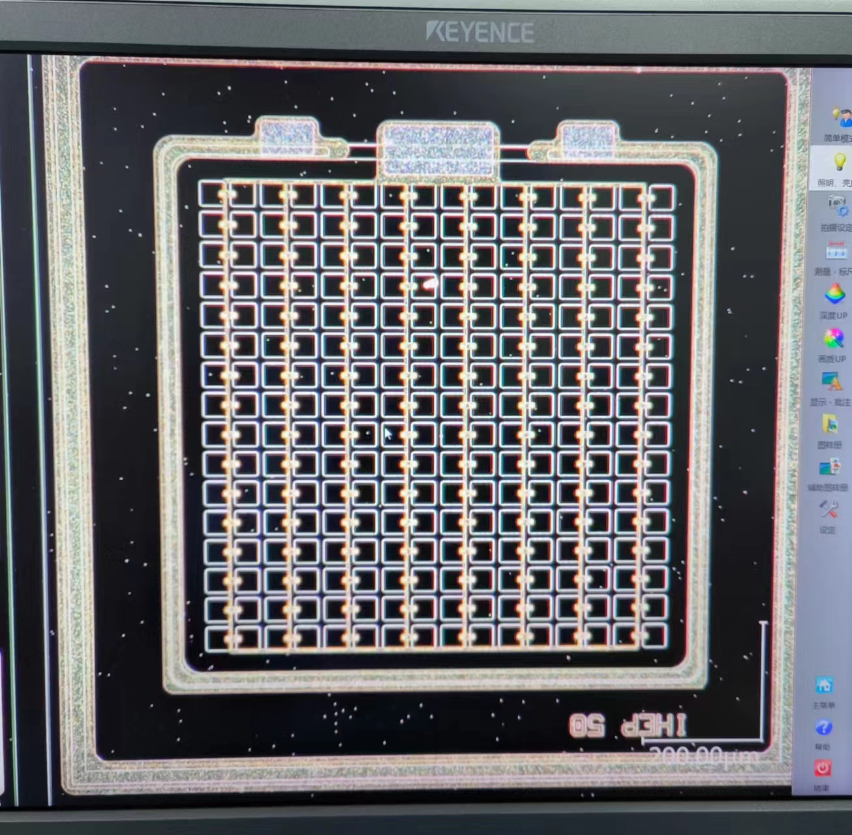
      SiPM sample from 1st trial MPW run
SiPM
We prototyped a small SiPM design
Pixel size： 50μm
16 x 16 pixels

Slide 17
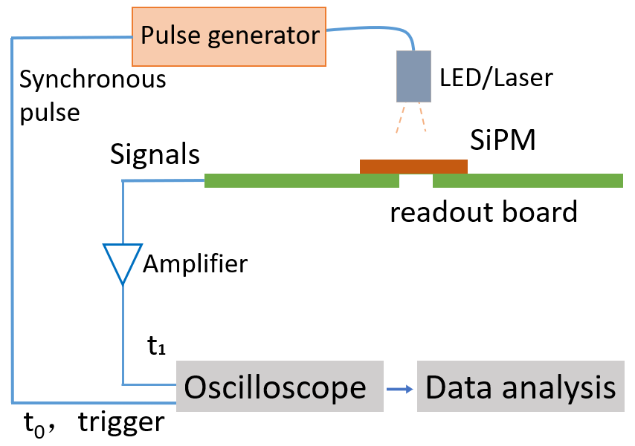
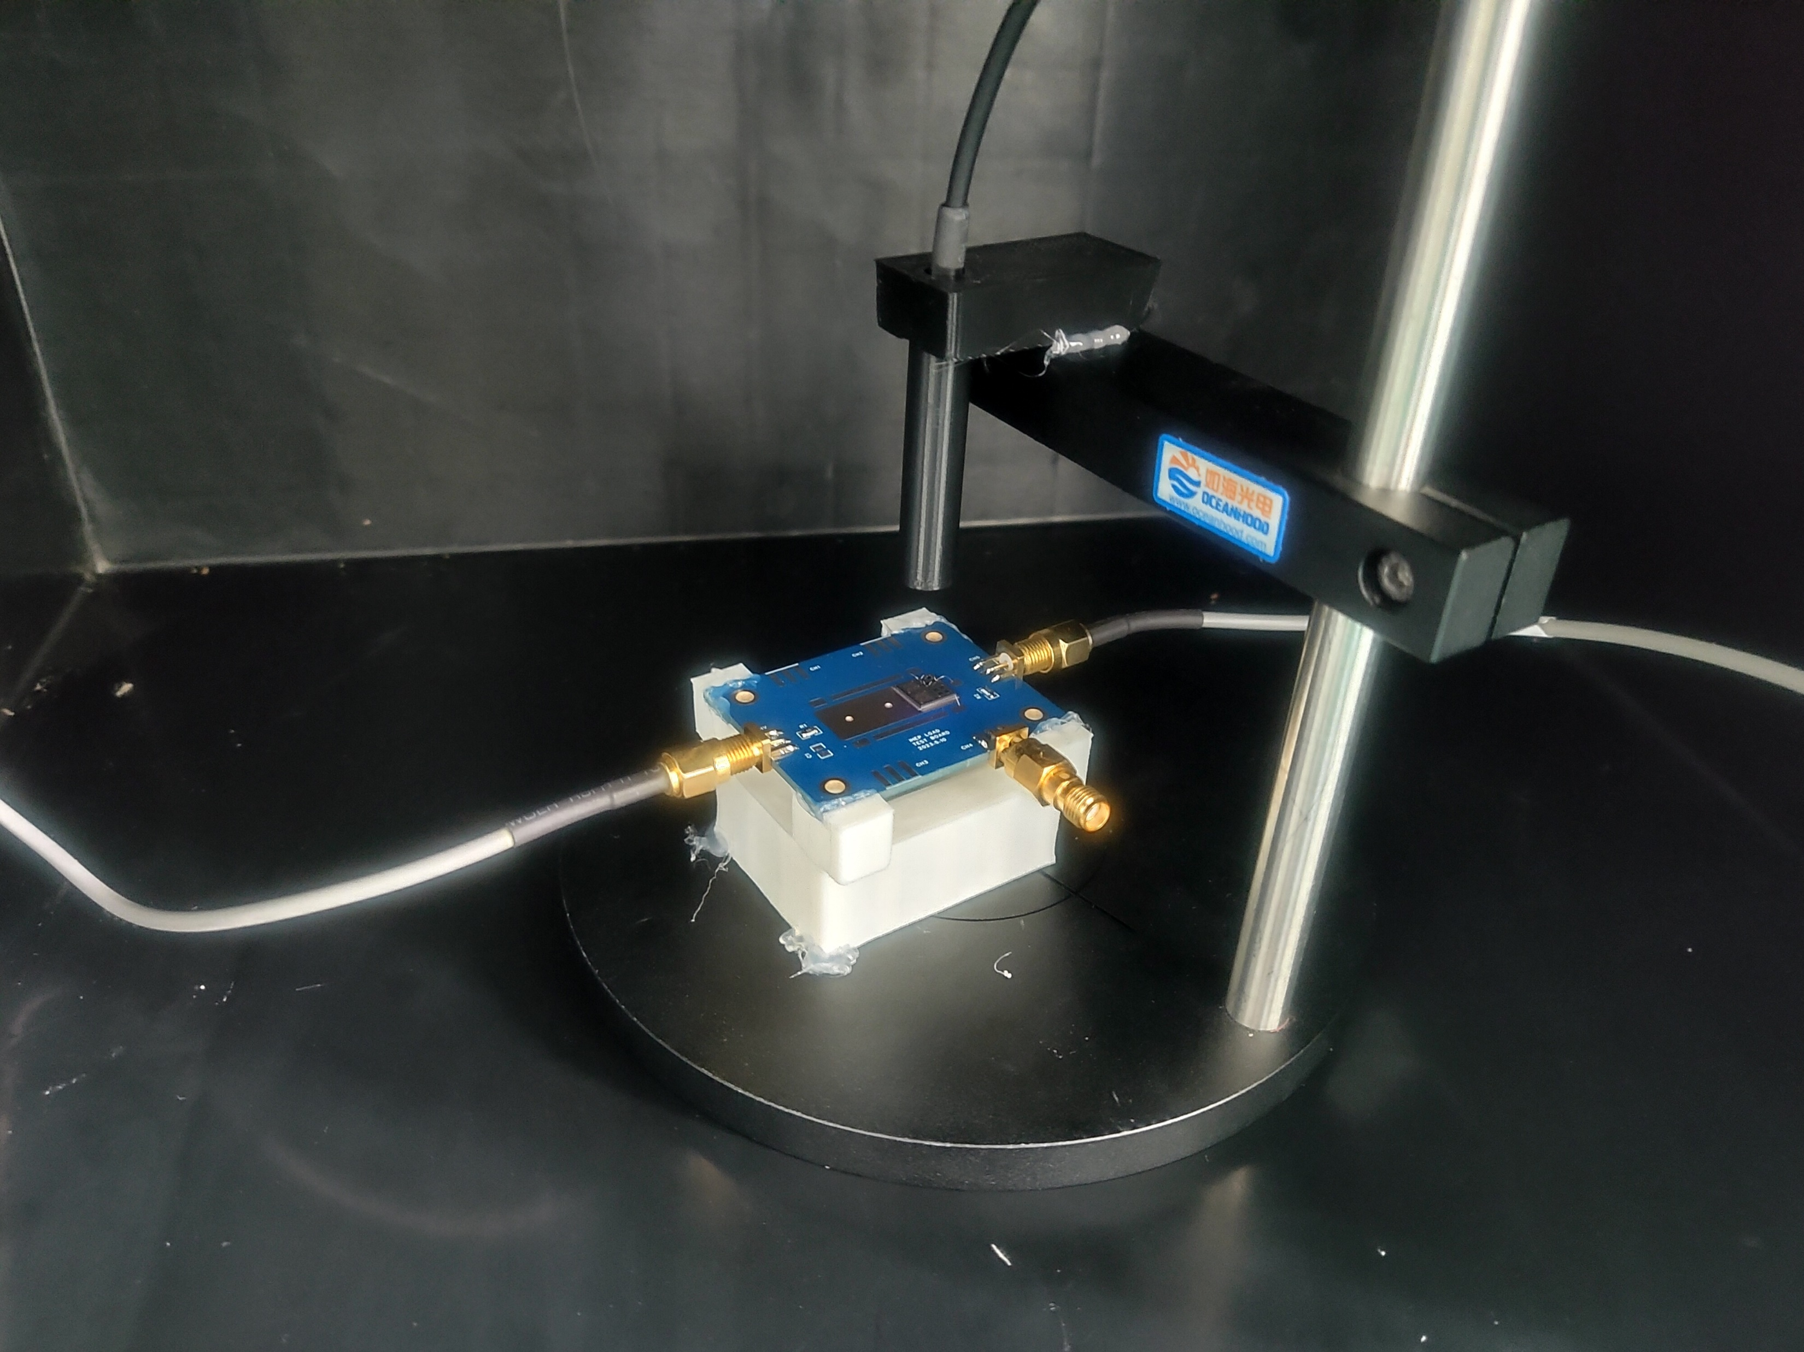
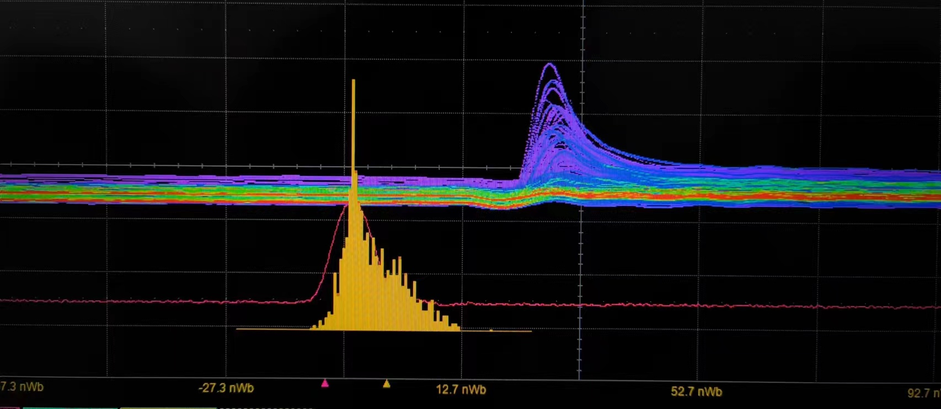

      SiPM sample from 1st trial MPW run
SiPM test system
Typical SiPM signal
Found a bug in design
SiPM读出板
SiPM Leakage current is a bit high in 1st trial run
Pstop and GR design has some issue
Optimized the design for engineering runs
SiPM layout and process has been validated

Slide 18



Leakage current of Sipm after irradiation
First trial of this special wafer idea in LGAD development
Indication that IHEP Sipm has potential to be irradiation hard
  After 2E10 n_{eq}/cm2, IHEP SiPM leakage current increased by ~10
  After 2E10 n_{eq}/cm2, HKP sipm increase by 2-3 order of magnitude

Slide 19




Dedicated SiPM engineering run
Dedicated radiation hard SiPM run will be submitted next month
  Various SiPM size: 1*1mm, 3*3mm, 5*5mm
  Various Pixel size: 10um ,20um, 50um
SiPM designed for LACT
单像素参数：
Pixel size 50um
Quenching resistance 200KΩ
anode
GR
IHEP SiPM 版图
cathode
LACT 专用 SiPM：
7.6 mm X 7.6 mm
152 x 152 pixels
Pixel size： 50um
Fill factor 64%

Slide 20



Time line for radiation hard SiPM
2025 :SiPM irradiation hard design validated in LGAD engineering run
  Two type of radiation hard Sipm
  ECAL : Small pixel size (6um*6um), large dynamic range
  HCAL: high PDE Sipm (PDE>60-70%)
2026: built prototype for ECAL and HCAL
仿真与探索各种工艺参数
SiPM的多次流片，确定工艺参数
2023
2024
2025

Slide 21
Summary
Development for radiation hard SiPM
  Aim for CEPC and Astrophysics application
Key technology has been validated in ATLAS HGTD detector project
  Radiation hard LGAD sensor developed by IHEP team
  First domestic Radiation hard silicon sensor used in LHC experiment
Radiation SiPM R & D project
  1st trial run has been submitted, and preliminary result obtained
  Dedicated engineering run by this year
  Integrate into ECAL and HCAL prototyping in 2026

