Slide 1
RCS BPM Re-Mapping: Motivation and strategy
R. Yang
20/05/2025

Slide 2
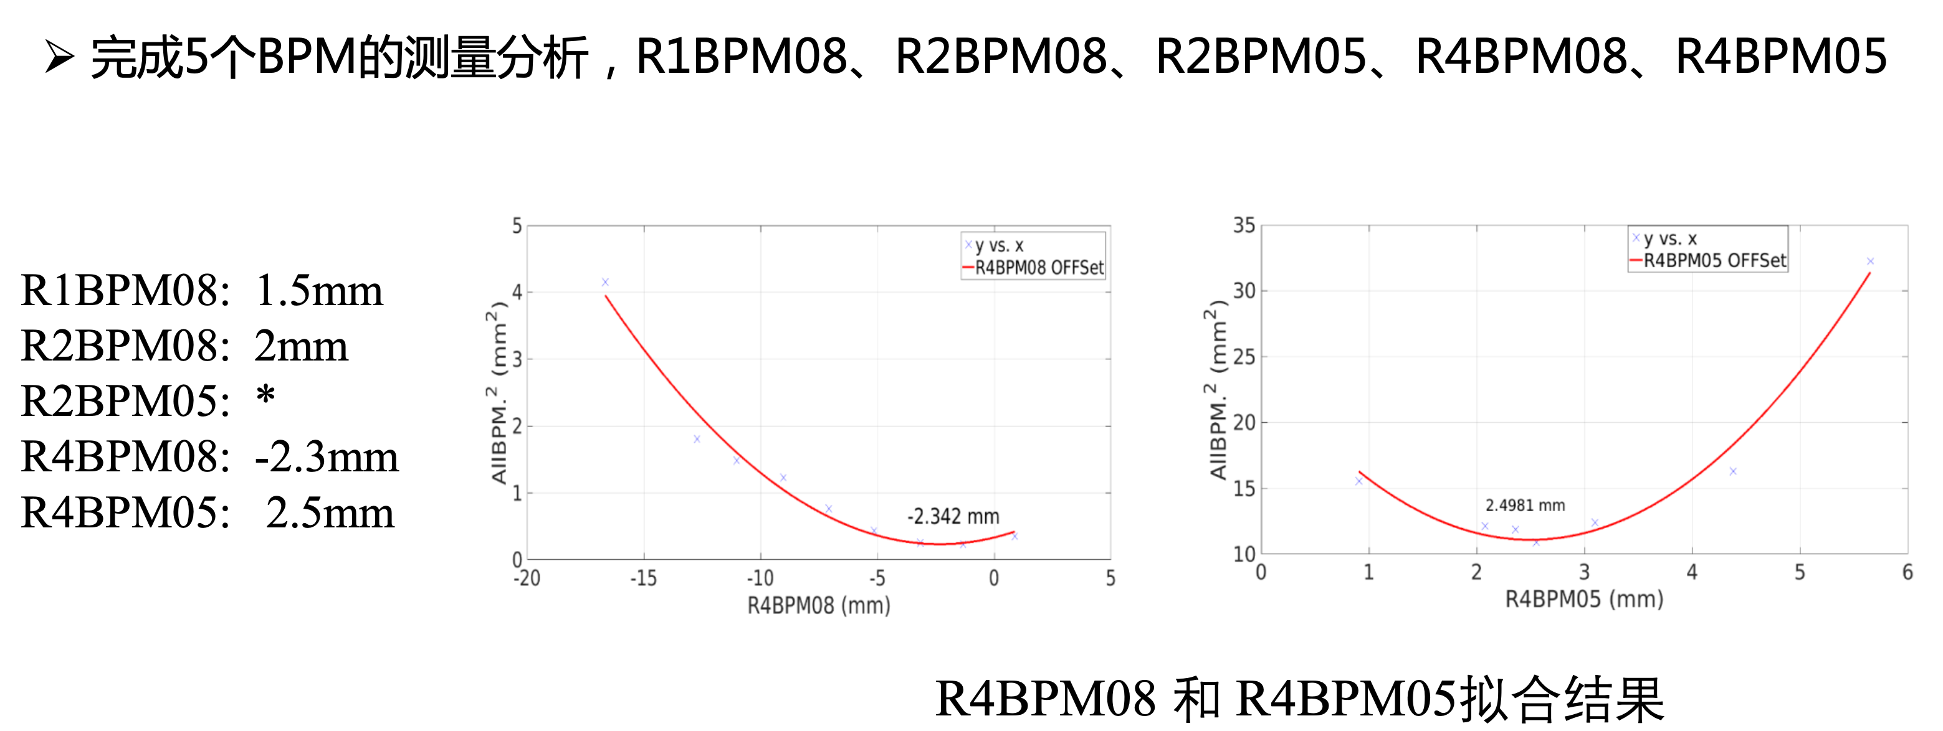
Motivation
Abnormal offset of the RCS BPM has been pointed out this February
The possible error sources: calibration system, BPM electronics (timing window, baseline, channel unbalanced, … (Naïve)
M. Huang, March 04, 2025

Slide 3
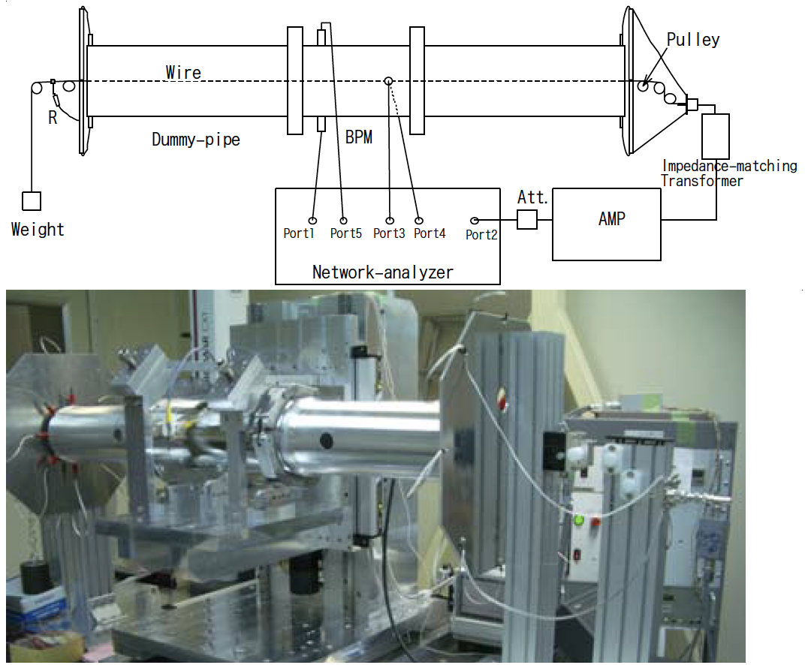
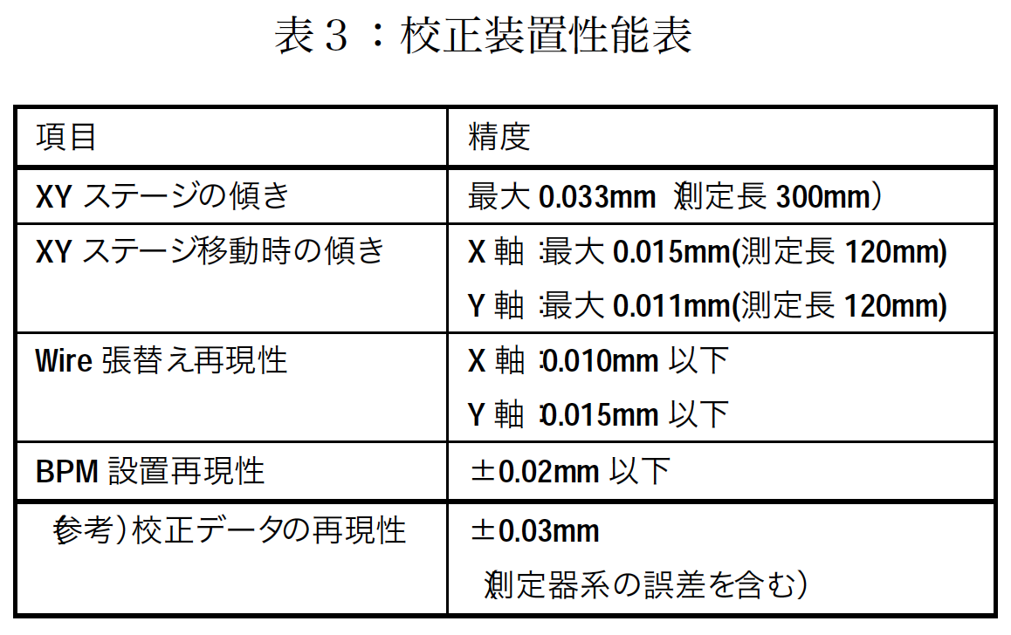
BPM calibration system 1/3
* K. Hanamura et al., PASJ meeting (2006)
** T. Miura et al., PASJ meeting (2006)
*** Y. Hashimoto et al., PASJ meeting (2007)
Machine accuracy: ±0.05 mm (achieved)
Components
Wire: cupper, $ϕ$0.26 mm, 35 N
Dummy pipe between pickup and pulley
Network analyser to apply sin wave and measure transmission coefficients
Work temperature: 20-21 $°$C (same to tunnel temperature) IMPORTANT!!!
XY stage tilt
XY stage tilt w/ different Δx/Δy
Wire position error
Calibration accuracy ≤0.05 mm
pickup position error
calibration data repeatability

Slide 4
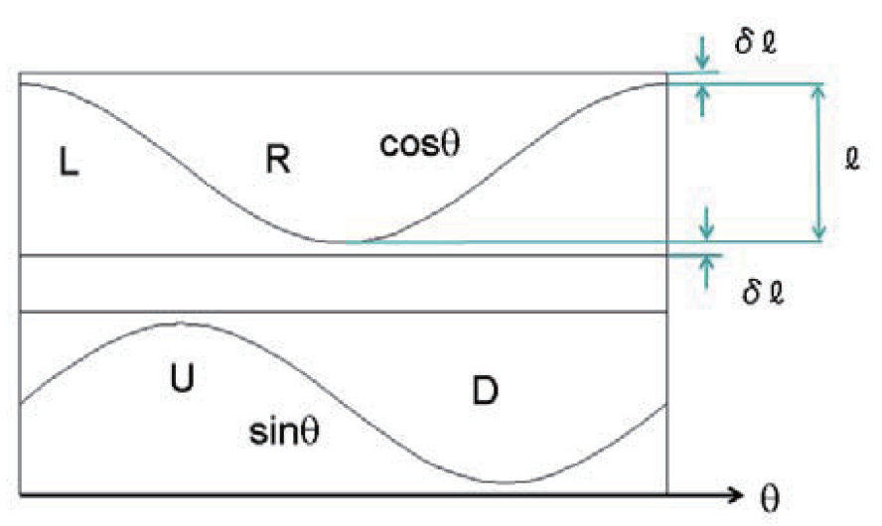
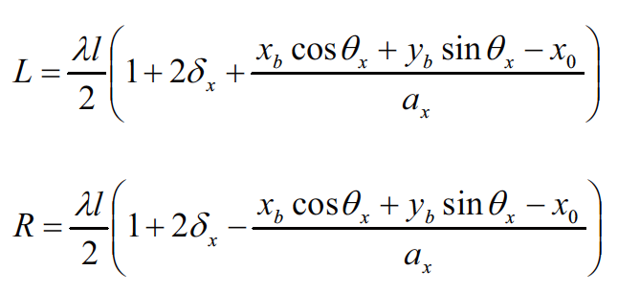
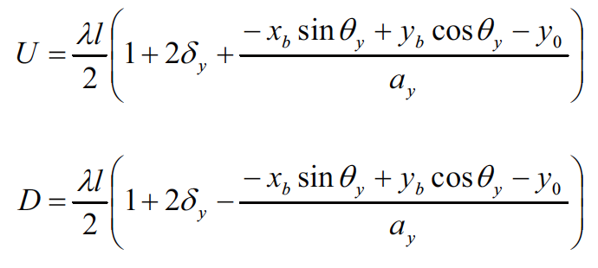
BPM calibration system 2/3
The measured beam/wire position could be expressed as
$$\left({xm \atop ym}\right)=\left(\begin{matrix}gLR & 0 \\ 0 & gUD\end{matrix}\right)\left\{\left(\begin{matrix}cosθx & sinθx⁡ \\ −sinθy & cosθy\end{matrix}\right)\right.\left.\left({xb \atop yb}\right){− \atop }\left({xΔ \atop yΔ}\right)\right\}$$
where $x_{m}$ and $y_{m}$ are the measured beam/wire positions, $gLR$ and $gUD$ characterize the position sensitivities, $θx$ and $θy$ electrode rotation errors, $x_{b}$ and $y_{b}$real beam/wire positions, $x_{Δ}$and $y_{Δ}$ the electrical center offsets. $gLR$ and $gUD$ are given by
$$gLR=\frac{1}{ax(1+2δx)}$$
$$gUD=\frac{1}{ay(1+2δy)}$$
and $ax$ and $ay$ are half-aperture, $δxl$ and $δ_{y}l$ are the lengths of the extensions of L/R and U/D electrodes, as

Slide 5
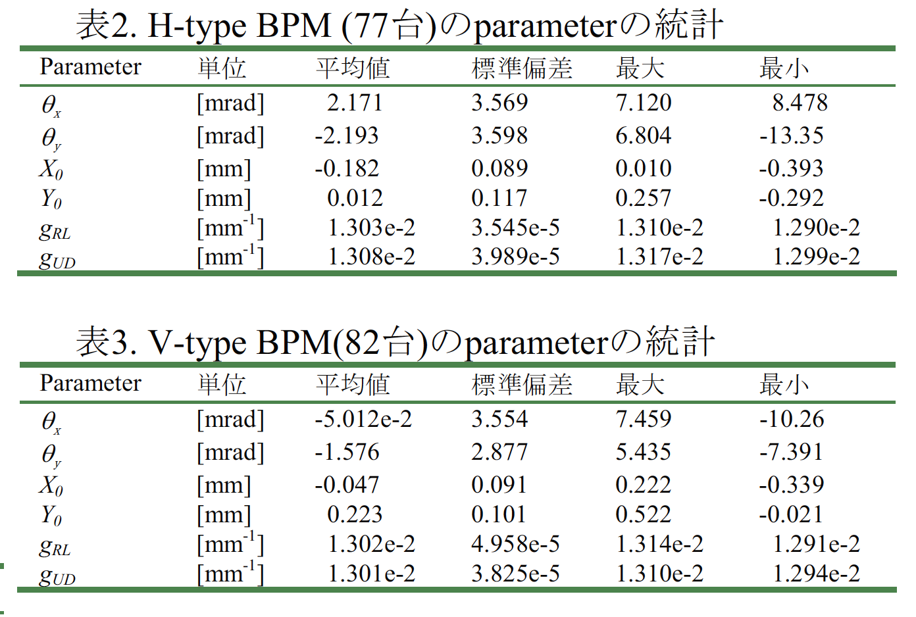
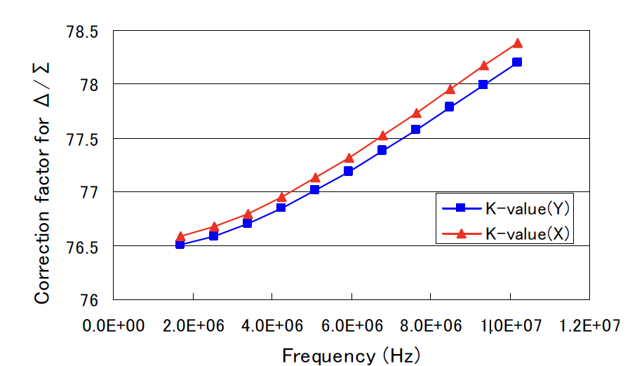
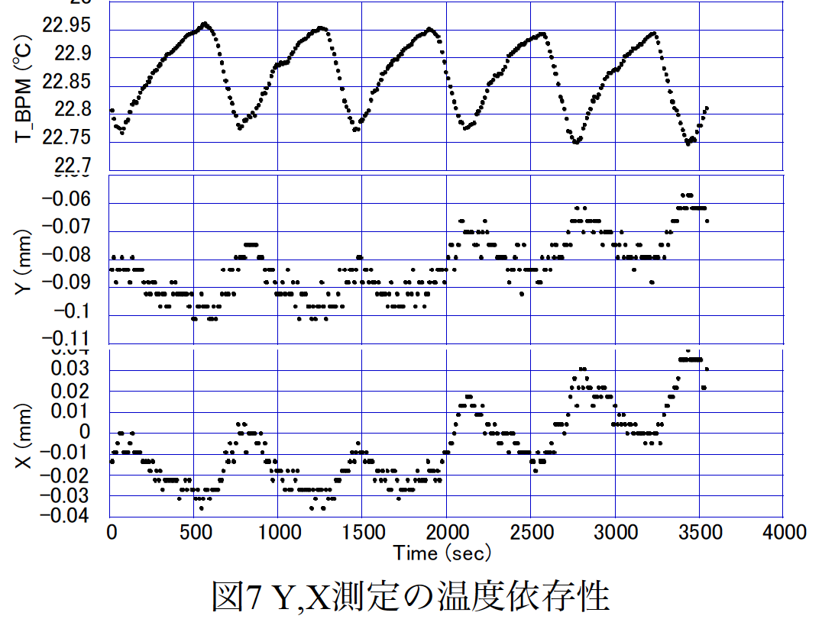
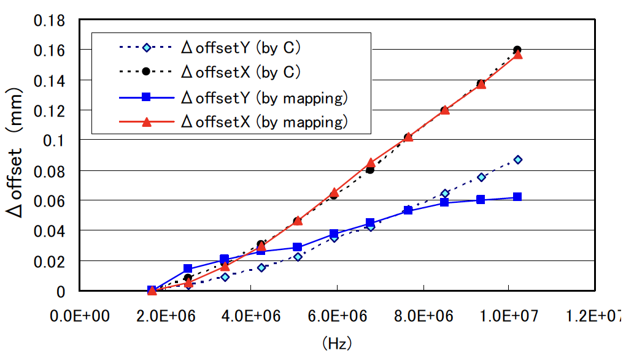
BPM calibration system 3/3
* K. Hanamura et al., PASJ meeting (2006)
** T. Miura et al., PASJ meeting (2006)
*** Y. Hashimoto et al., PASJ meeting (2007)
Calibration results
Pickup electrode rotation + Electrical center offset + Gain error
Comments: correction coef. from the mapping data should includes all these errors !?
1. Both correction coef. and electrical center are correlated to the freq.
2. Measured wire position varies versus BPM tempurature~0.15 mm/ °C (d130 mm BPM)
➔ How about the CSNS BPM??
Comments:
Electrical center offsets seems reasonable, <0.3 mm (rms.) !! The differences between pickups is ~0.1 mm ➔ calibration every pickup to approach the goal ±0.1 mm accuracy requirement

Slide 6
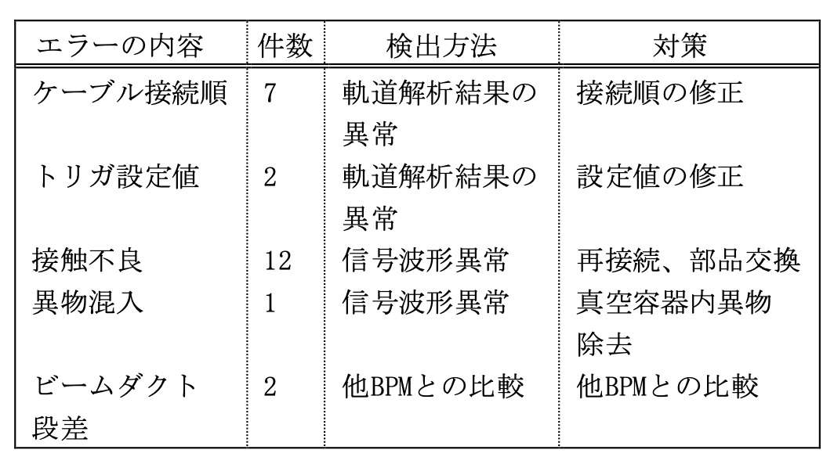
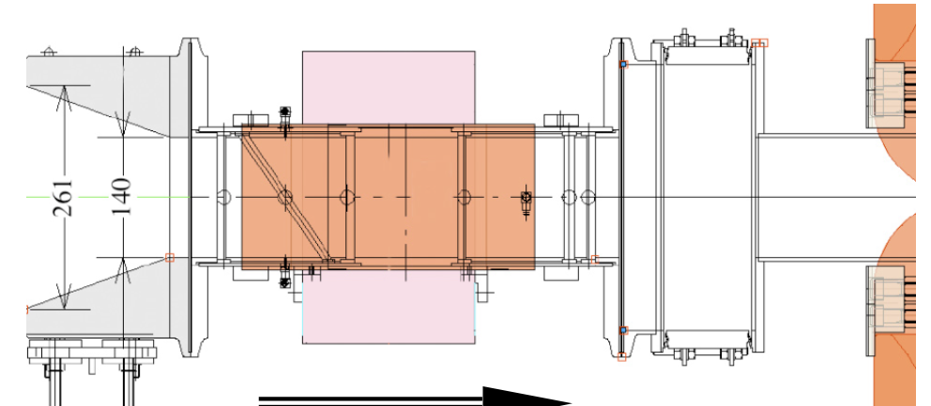
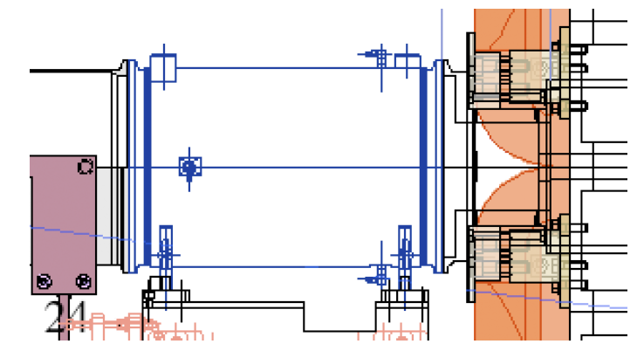
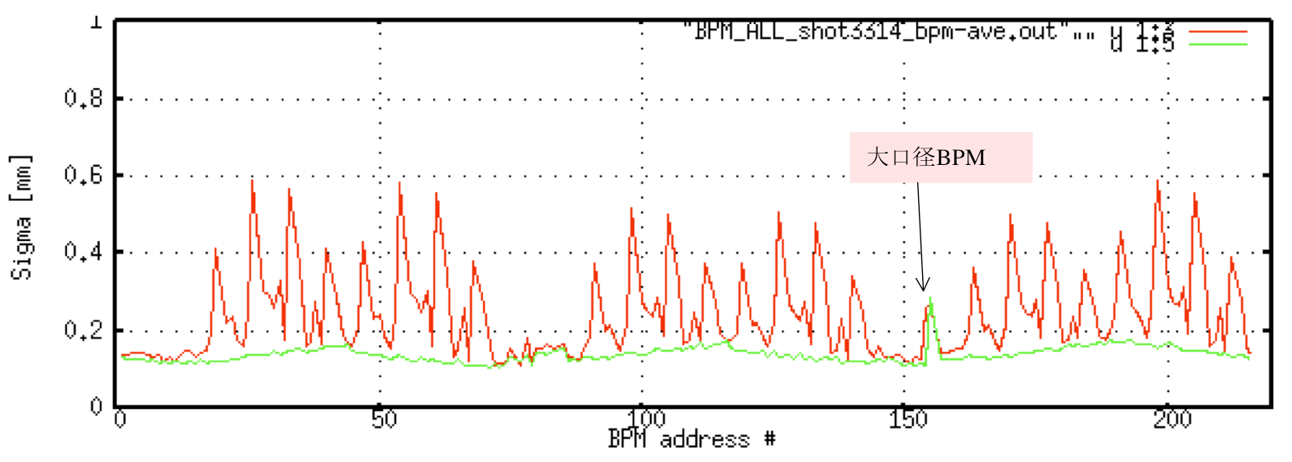
Lessons learnt at J-Parc MR
Taper
Small aper.
Large aper.
* T. Toyama et al., PASJ2009
cable order
Result large offsets and gain errors!
trigger timing
poor contact
Large aper.
Small aper.
beam duct step error
Resolution measurement@4x1011 ppp, 3 GeV
shot by shot resolution (TbT): ~350 μm (hor., synchrotron oscillation) and ~100 μm (ver.)
Averaged position resolution (1000 shots, COD): ≤30 μm
=> position accuracy is still to be quantified

