Slide 1
Investigation of Diagonal Cut-Plane BPM Performance in the CSNS RCS
M. A. Rehman, Xu Zhihong, Qiu Ruiyang, Renjun Yang, Yang Rui, Weiwen Chen
2025-05-20
CSNS-BI

Slide 2
Content
Reveal the Edge Effect in RCS BPM
The EM field of the beam is distorted in the vicinity of the edges of the BPM [1]
J-PARC MR also reported a similar issue [2, 3]
Simulations
CST simulations to reveal the edge effect
Calibration of the BPM with wire mapping
Frequency Dependence
Wire Mapping without Dummy pipe
Wire Mapping with Dummy pipe
Temperature influence on BPM
[1] J. H. Cupérus, NIM145 (1977) 233-243
[2] T. Toyama, IPAC10 MOPE012
[3] ] T. Toyama, OHO School 2009 (Japanese)

Slide 3
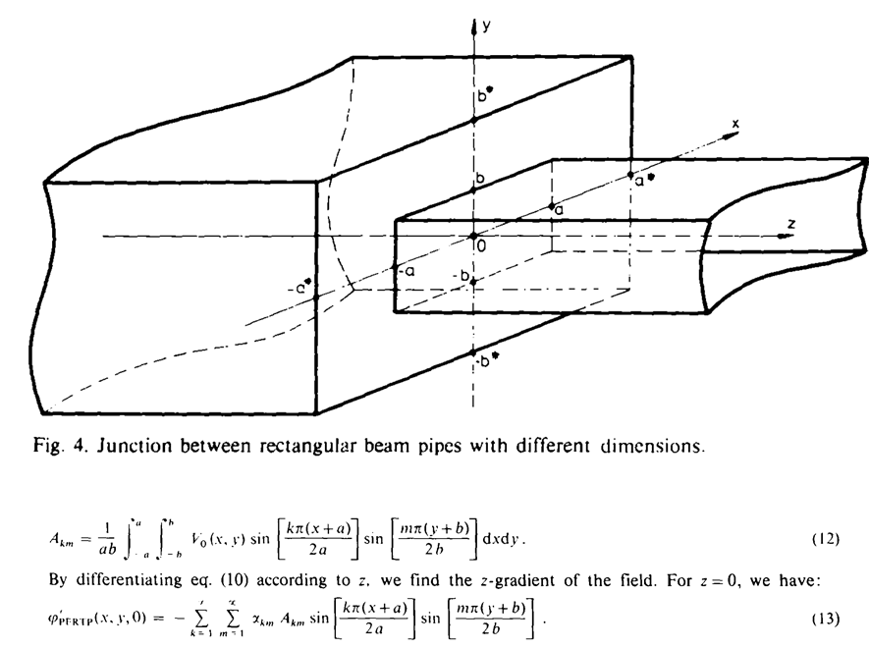
Edge Effect in BPM
If the beam pipe and BPM cross sections/shapes are different
The EM field of the beam is distorted in the vicinity of the edges of the BPM
Design a BPM in such a way as to prevent the edge effect
Guard rings in an upstream and downstream direction
The longitudinal space is limited!
Wire Mapping
The wire is a constant-potential surface
For the beam, the potential along its length depends on the charge of the beam and the cross-section of the beam pipe
Underestimate the edge effect
Mapping with Beam [only one at ANL ZGS (J. R. Simanton, 1969)]!
Expensive and difficult to realize the installation
Analytical formulae
Less accurate, valid only for simple geometries
FEM simulations (CST)
Wake field solver line charge only→ few weeks!
PIC solver beam transverse cross-section→ few months
J. H. Cupérus, NIM145 (1977) 233-243

Slide 4
CST Simulation

Slide 5
CST Simulations
Only BPM
Bunch charge 1 µC, Bunch Length 7000 mm/1σ (24 ns/1σ ), β = 1
¼ Region, 0 to x/y:60 mm, with 10 mm step
BPM with Upstream Bending Magnet Pipe (Exaggerated Condition)
Bunch charge 1 µC, Bunch Length 7000 mm, β = 1
¼ Region, 0 to x:60 mm, y: 40 mm, with 10 mm step
BPM with Upstream Bellows and Bending Magnet Pipe (Realistic)
Bunch charge 1 µC, Bunch Length 7000 mm, β = 1
¼ Region, 0 to x:60 mm, y: 40 mm, with 10 mm step

Slide 6
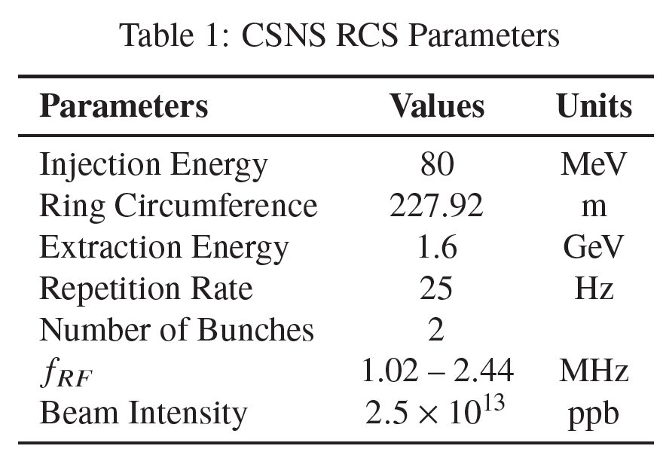
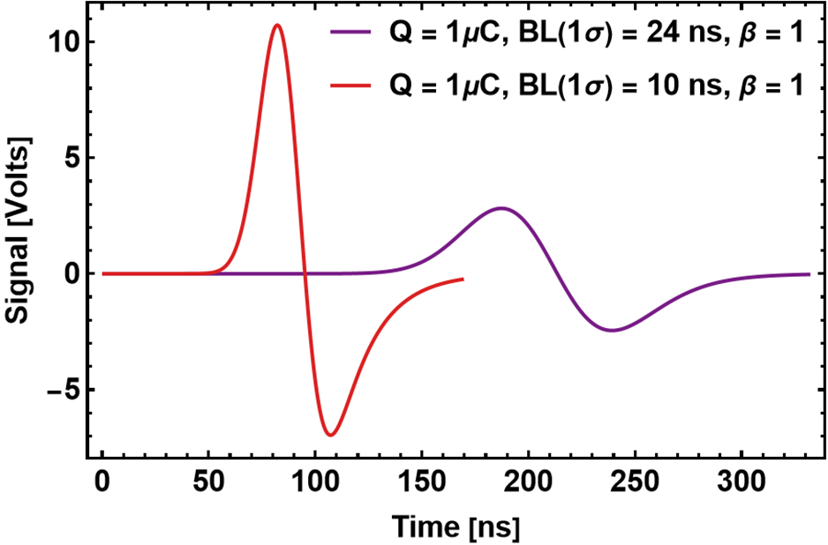
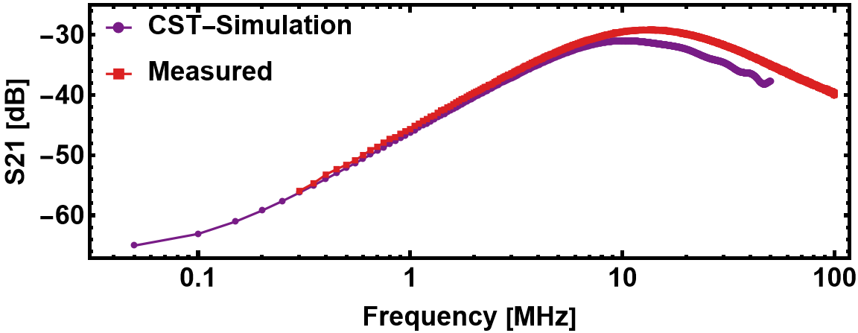
CST Simulations: Capacitance and S-Parameters
RCS BPM Model
226 mm
220 mm
Electrode Isolation
Capacitance Matrix
(
(
C11 C12 C13 C14
C21 C22 C23 C24
C31 C32 C33 C34
C41 C42 C43 C44
296.62 pF -8.56 pF -3.07 pF -1.40 pF
-8.56 pF 300.1 pF -7.50 pF -3.07 pF
-3.07 pF -7.50 pF 300.44 pF -8.54 pF
-1.40 pF -3.07 pF -8.54 pF 296.60 pF
=

Slide 7
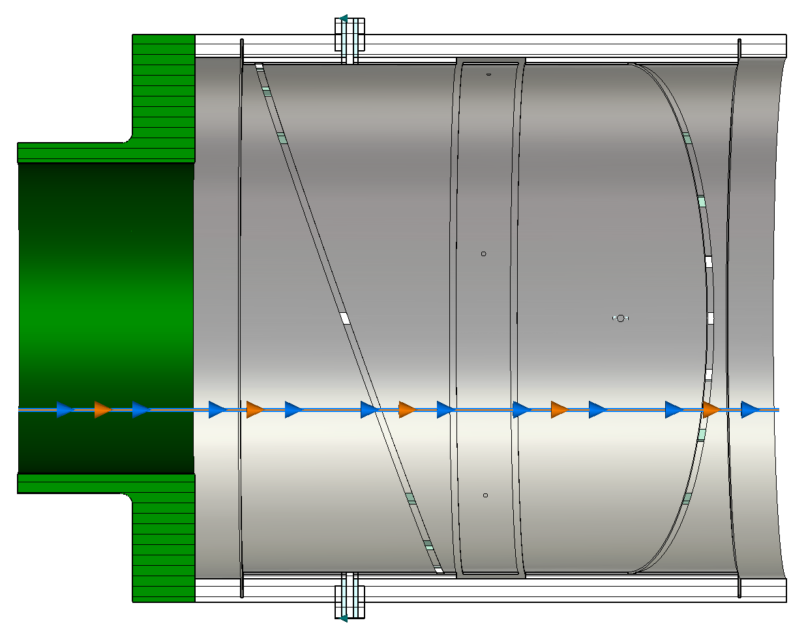
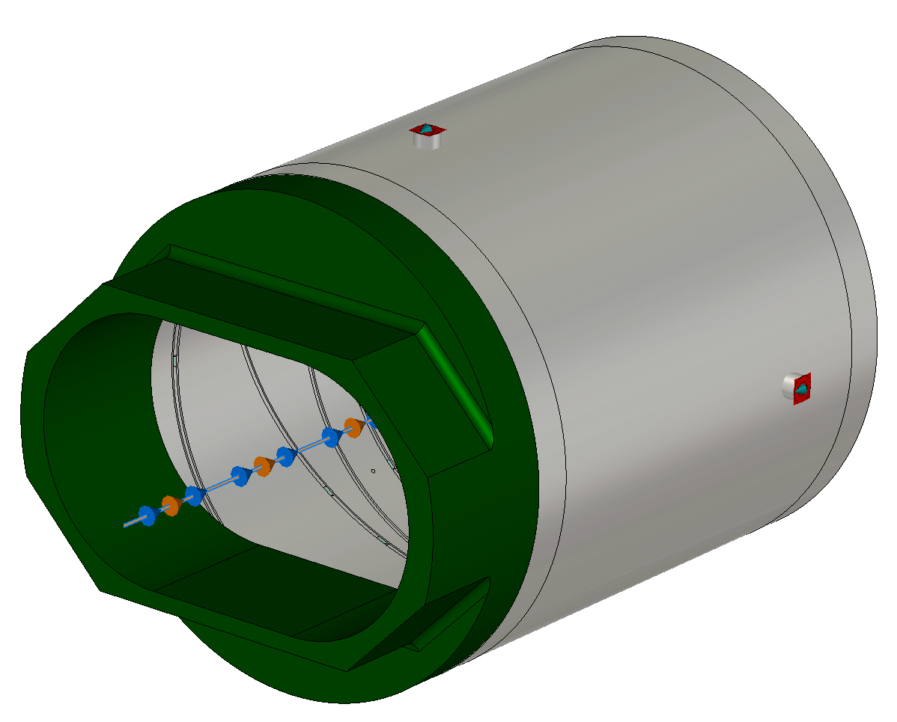
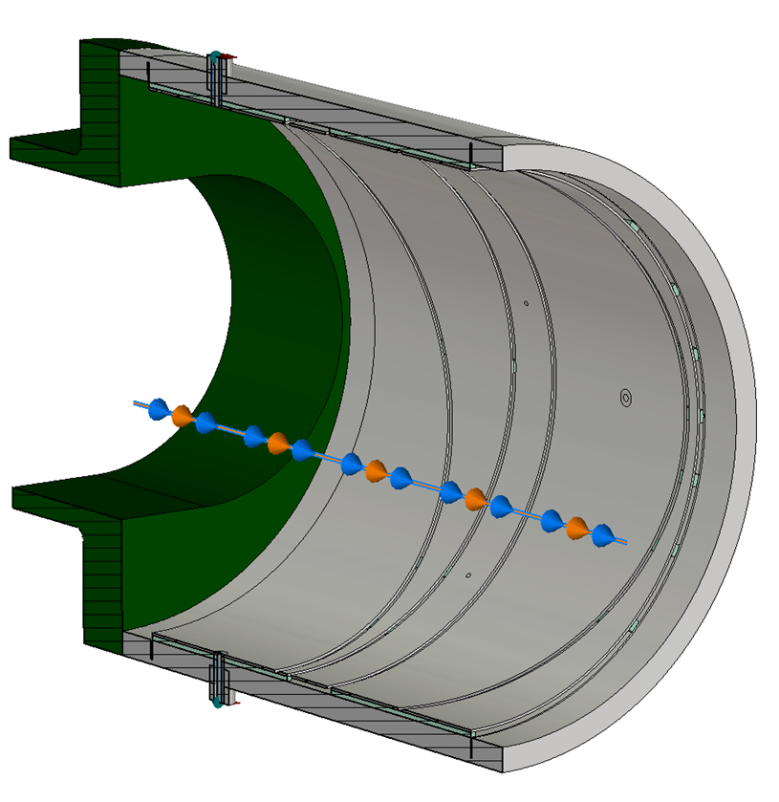
CST Simulated Models
BPM with Pipe only
Simple but not realistic
Only BPM
135 mm
3 mm
83.96 mm
77 mm
226 mm
24 mm
220 mm
218 mm

Slide 8
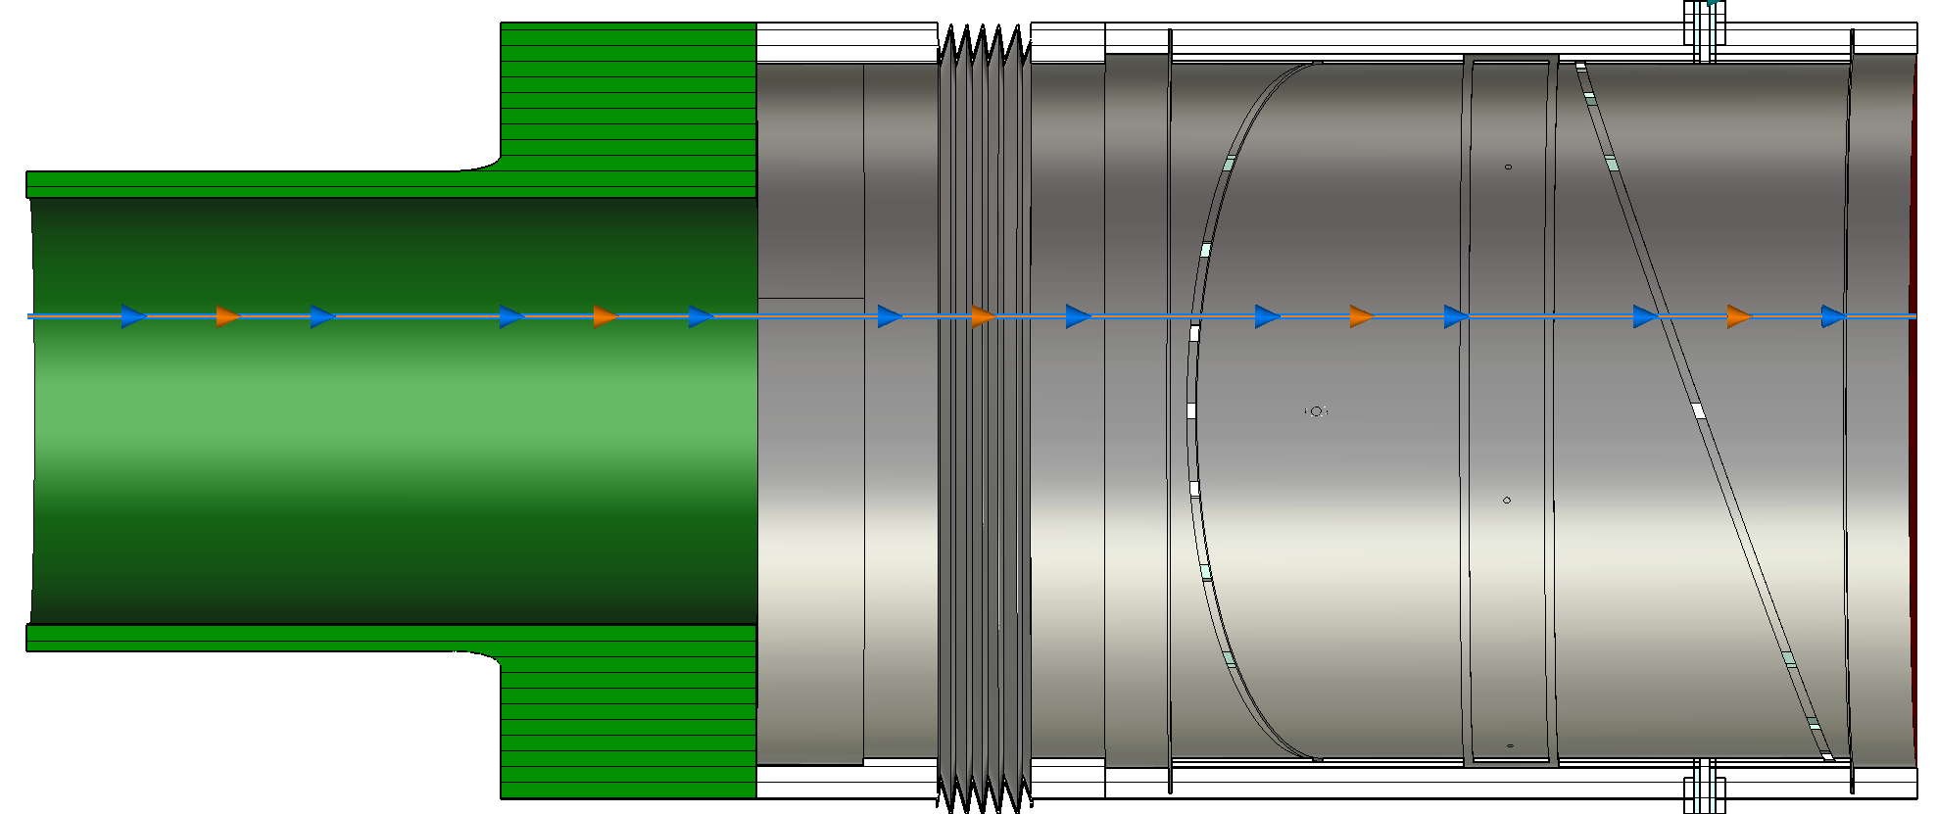
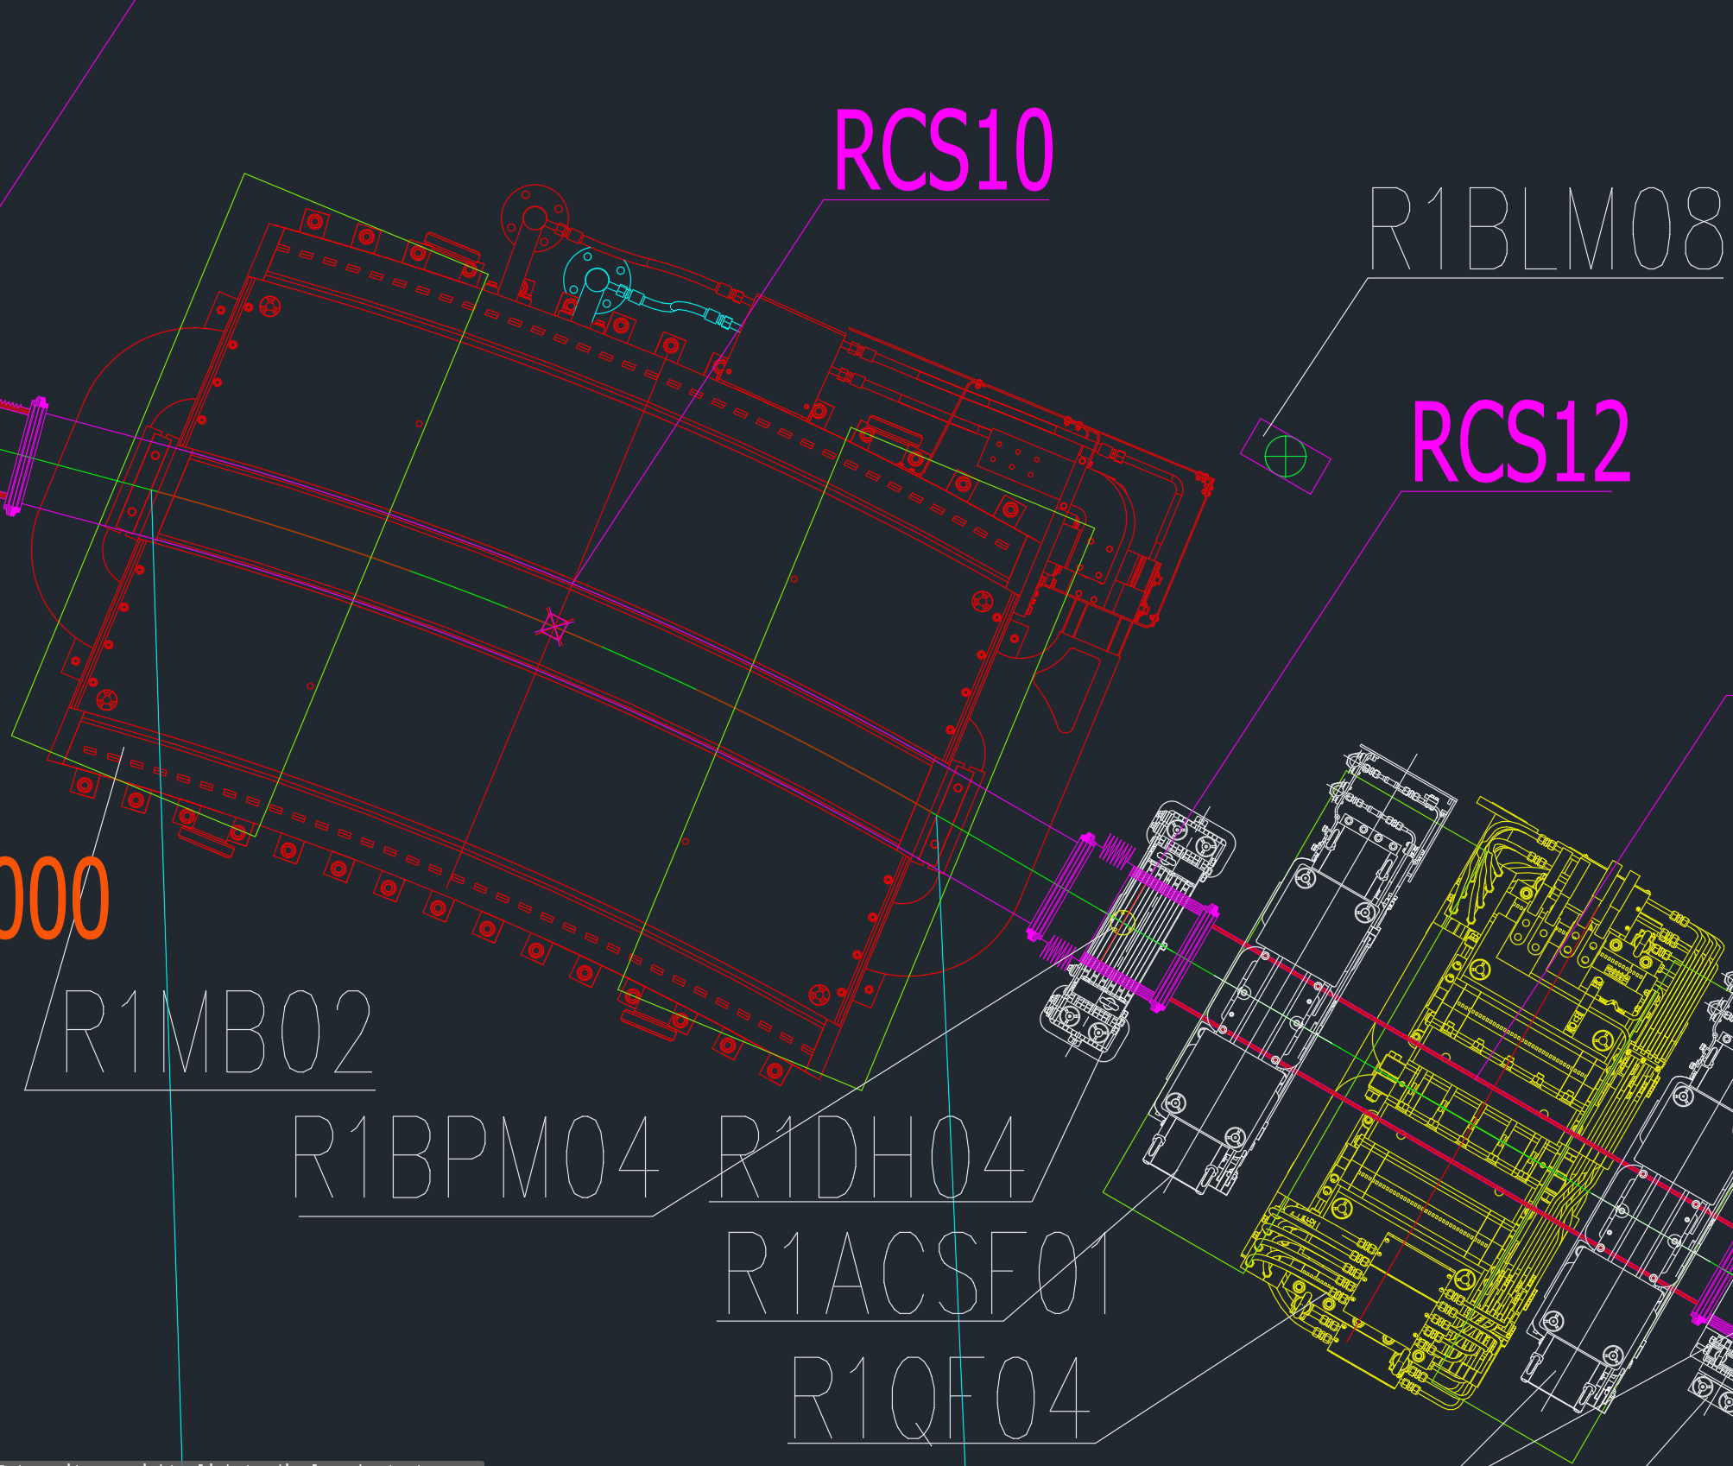
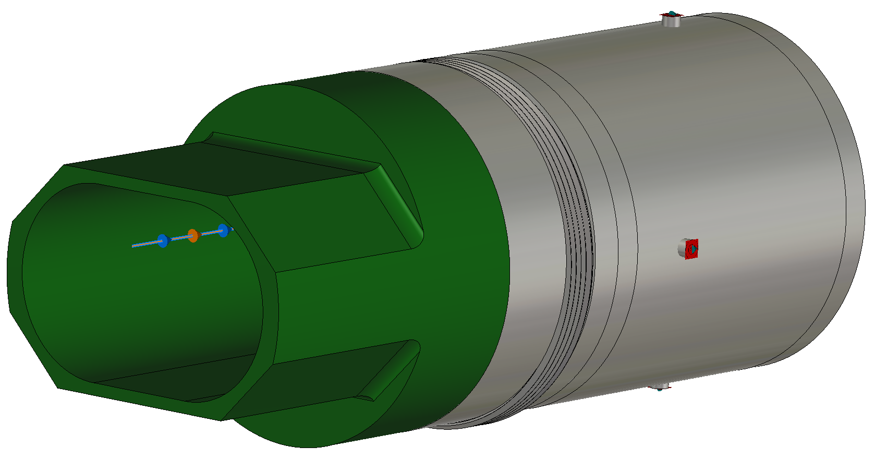
Realistic Model
BPM + Pipe + Bellows
Dipole
Magnet
Pipe
231 mm
110.5 mm
Dipole
Magnet
Bellows
BPM
Dipole
Magnet
Vacuum Duct
Bellows
BPM

Slide 9
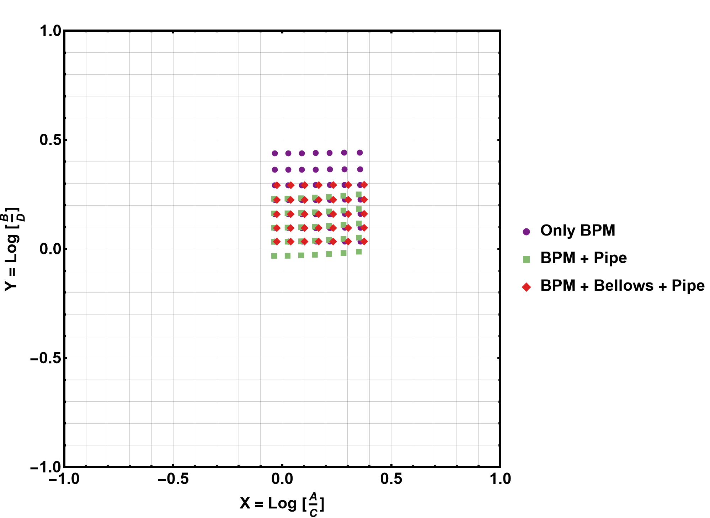
CST Mapping
a
b
a. Mapping in CST Only with BPM
Similar condition with the Mapping setup
In the CST simulation, Ports are closed at the upstream and downstream ends. However, in Mapping, no dummy is used! Details will come later
b. Exaggerated condition!
Amplify Edge effect! Due to an abrupt change in the Beam Duct Diameter. No Linearities and a large offset are observed
c. Realistic Case as in RCS!
c
Each case results in a different offset!
The mapping function obtained from each case will be Different!

Slide 10
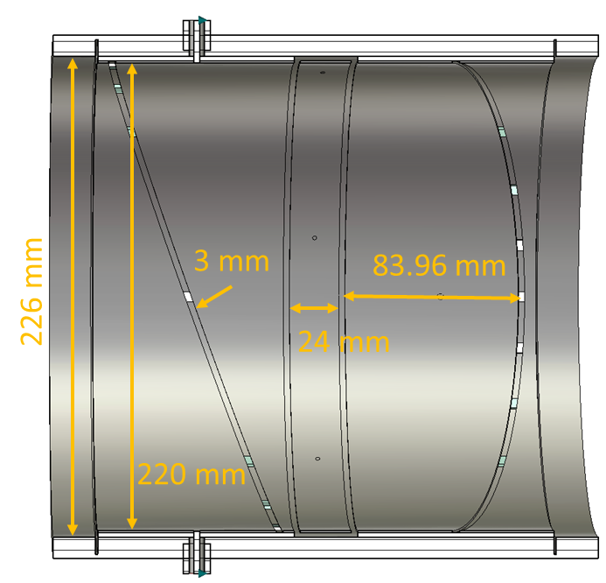
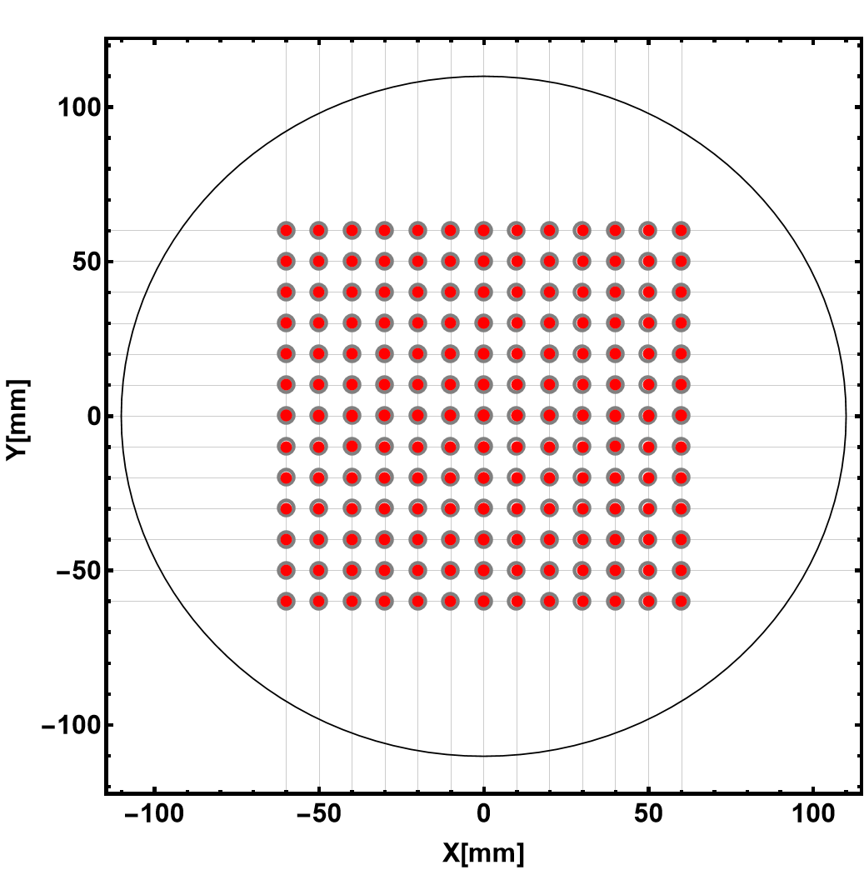
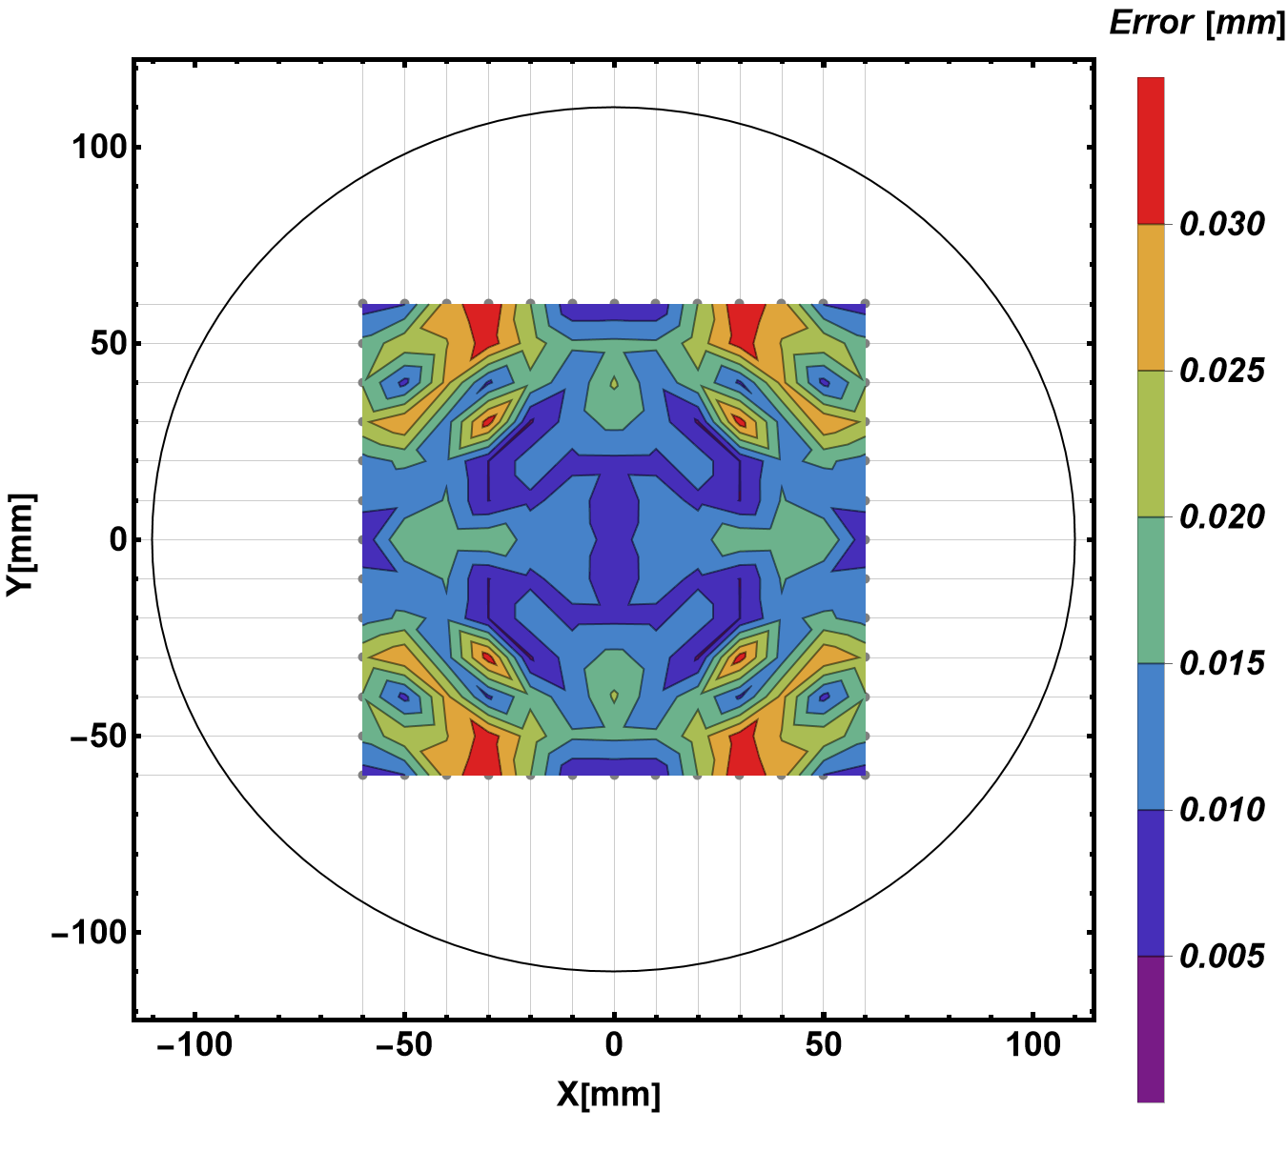
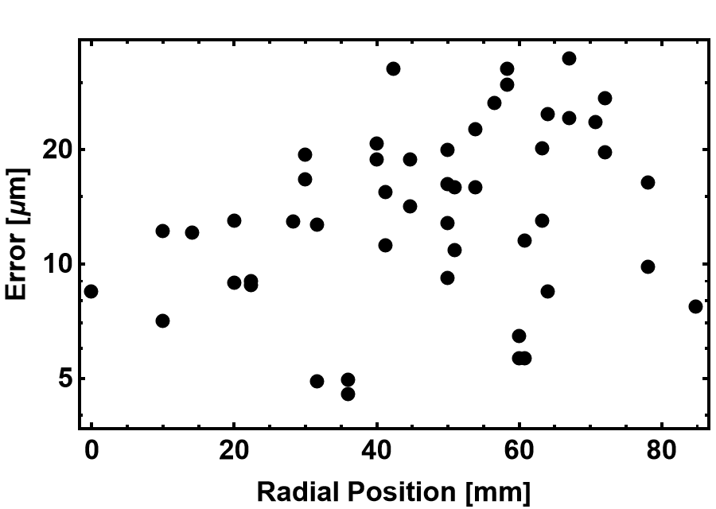
CST Mapping: Only BPM
Fitting with 3rd Order Polynomial
C_{00,x} [mm] | C_{00,y} [mm] | C_{10,x} [mm] | C_{01,y} [mm]
5.45 | -5.42 | 161.30 | 161.73
BPM’s Intrinsic transverse offset correction with a polynomial fit is about 5.5 mm.
Transverse offsets are nearly symmetric

Slide 11
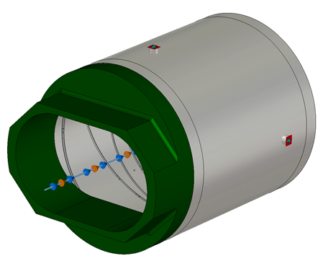
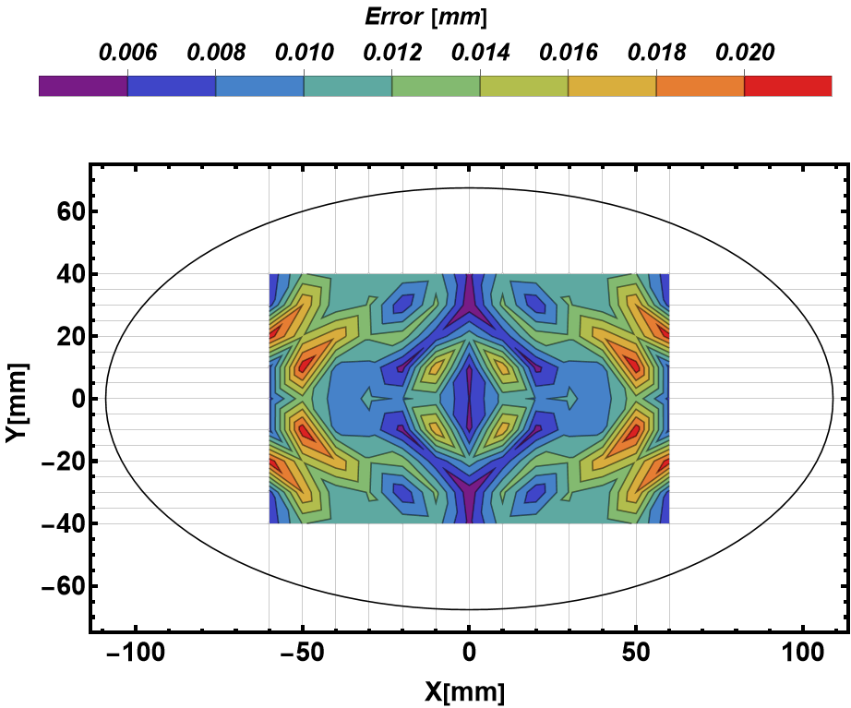
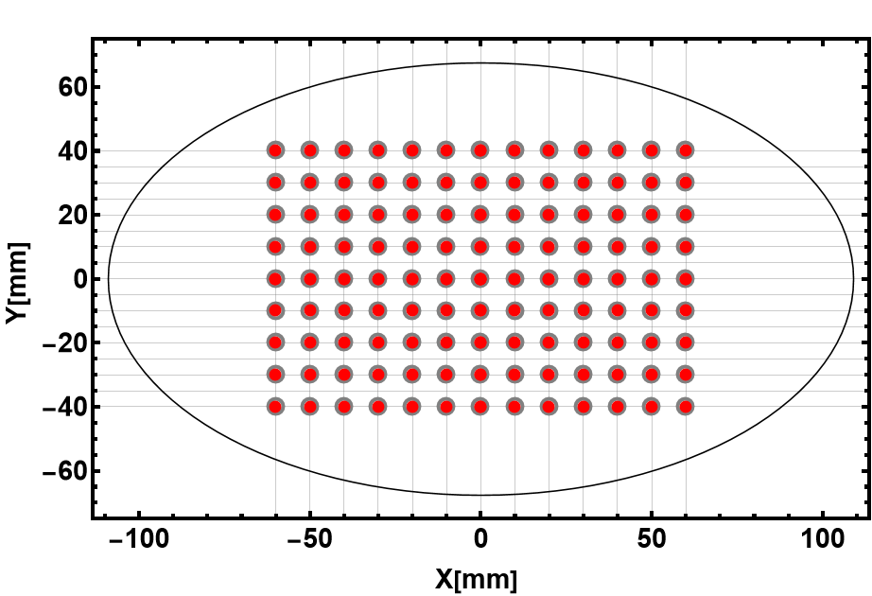
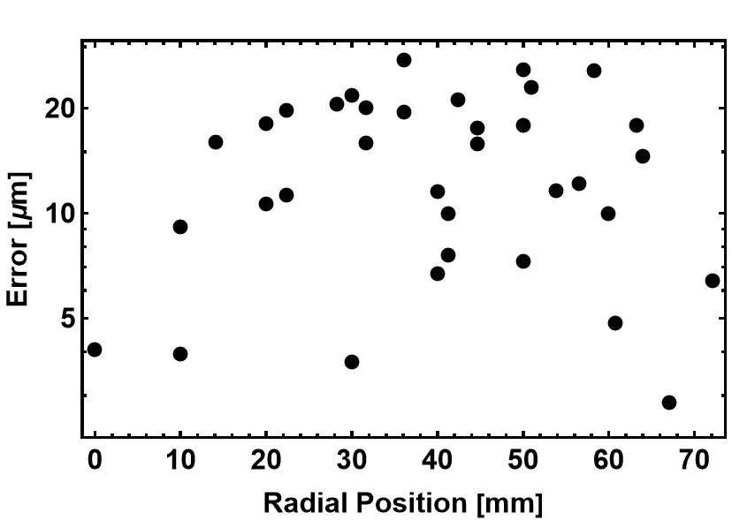
CST Mapping: BPM and Pipe (Exaggerated Condition)
C_{00,x} [mm] | C_{00,y} [mm] | C_{10,x} [mm] | C_{01,y} [mm]
6.05 | 4.88 | 162.11 | 155.02
Transverse offsets are NOT Symmetric!
Due to the upstream vacuum duct!!

Slide 12
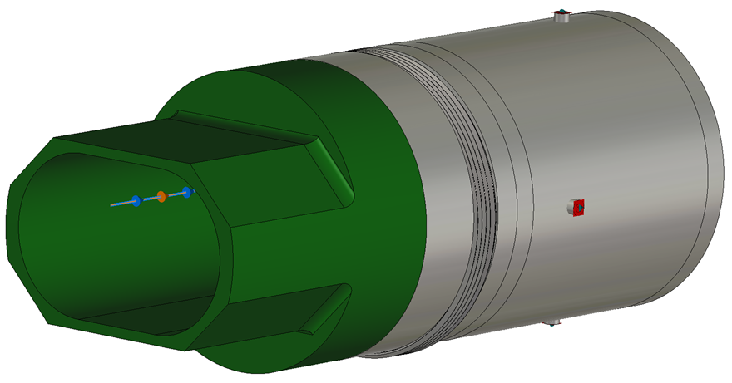
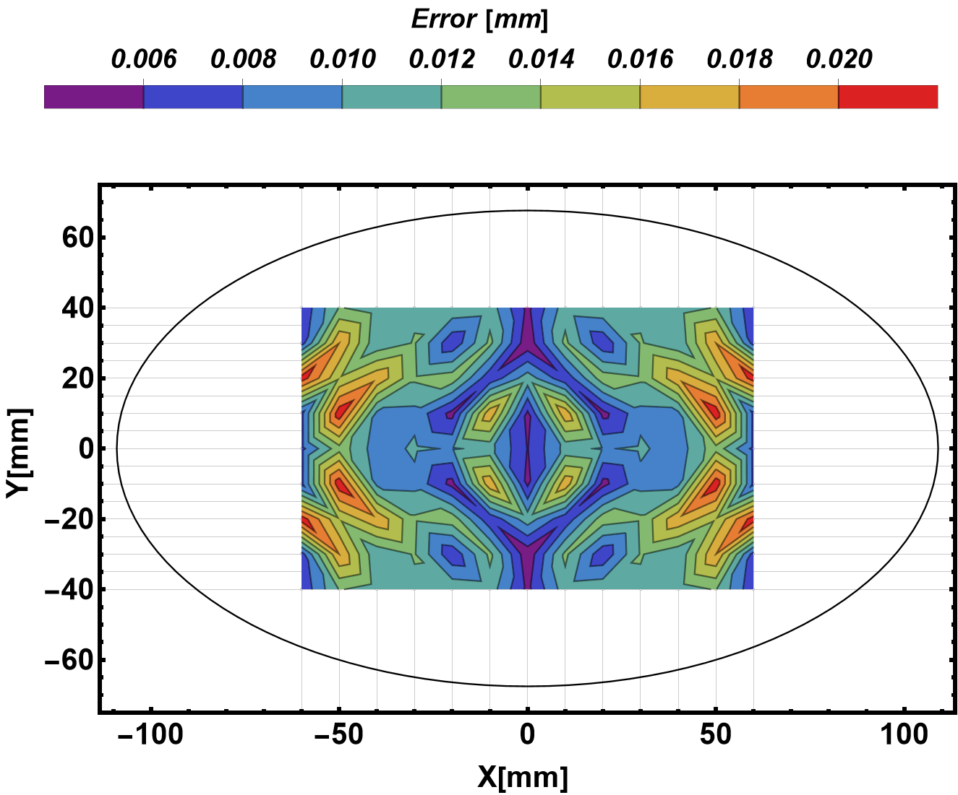
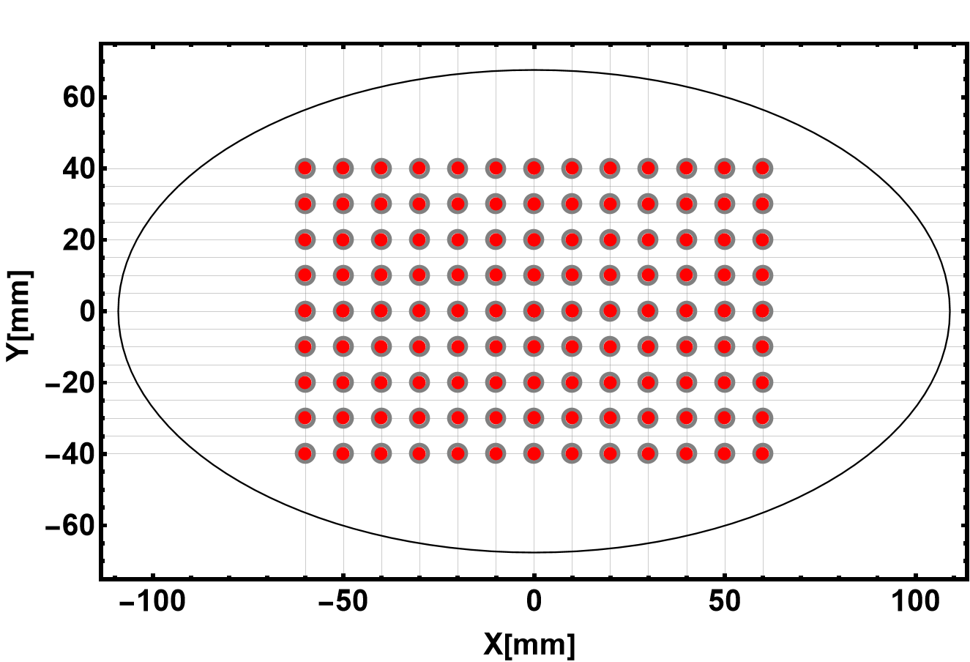
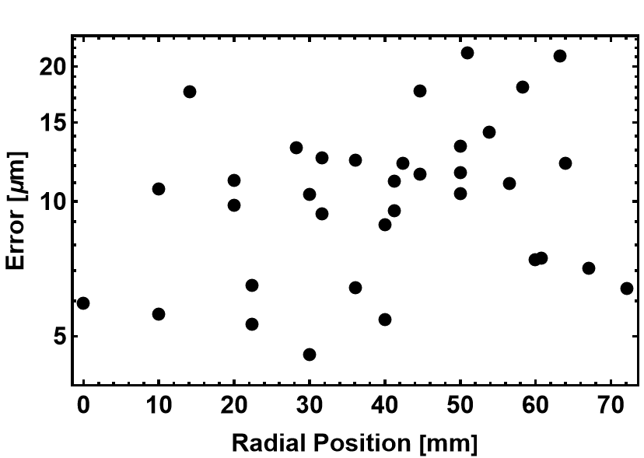
CST Mapping: BPM, Bellows and Pipe (Realistic Condition)
C_{00,x} [mm] | C_{00,y} [mm] | C_{10,x} [mm] | C_{01,y} [mm]
3.94 | -5.54 | 157.91 | 165.11
Transverse offsets are NOT Symmetric!
Due to the upstream vacuum duct!!

Slide 13
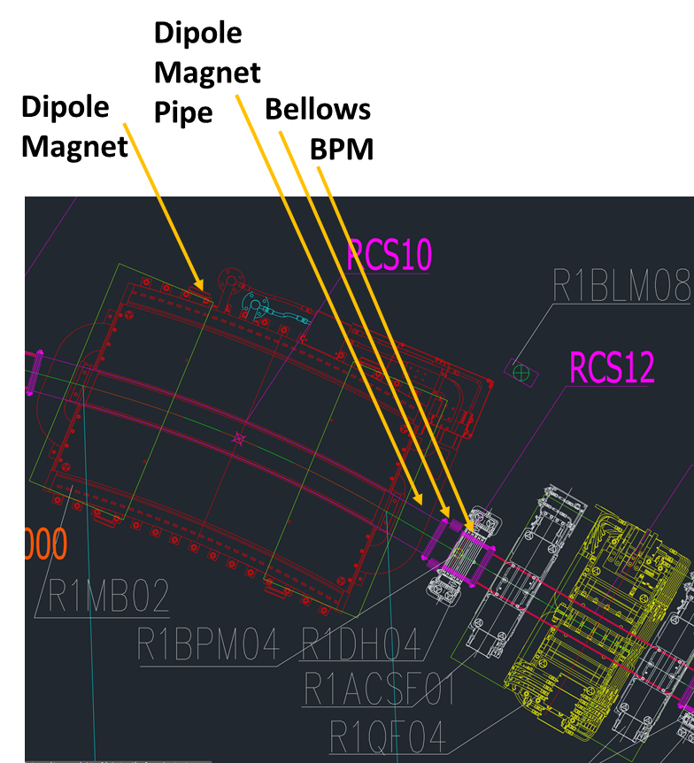
What do we measure at RCS?
The mapping function obtained from the wire mapping ignores the BM pipe!
The edge effect due to the vacuum duct shape is ignored
Results in huge errors?
To estimate these errors in the CST Simulation
Let’s consider the X_{raw} = Log[A/C] and Y_{raw} = Log[B/D] from the case BPM + Bellows + Pipe
But the Fitting function from the BPM only!!
 | C_{00,x} [mm] | C_{00,y} [mm] | C_{10,x} [mm] | C_{01,y} [mm]
BPM | 5.45 | -5.42 | 161.30 | 161.73
BPM + Pipe | 6.05 | 4.88 | 162.11 | 155.02
BPM + Bellows + Pipe | 3.94 | -5.54 | 157.91 | 165.11

Slide 14
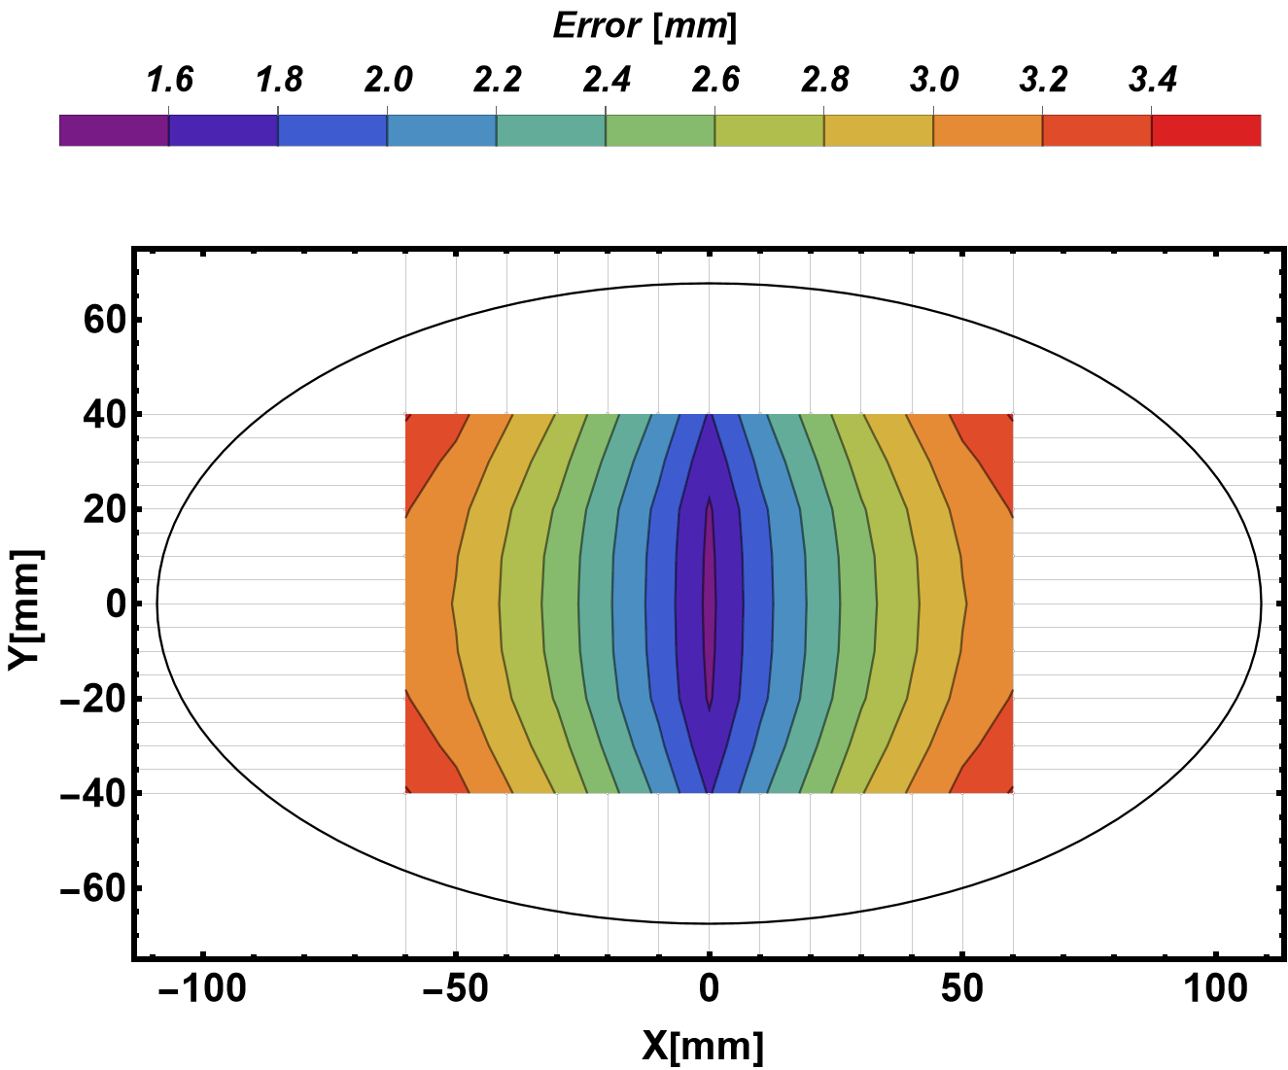
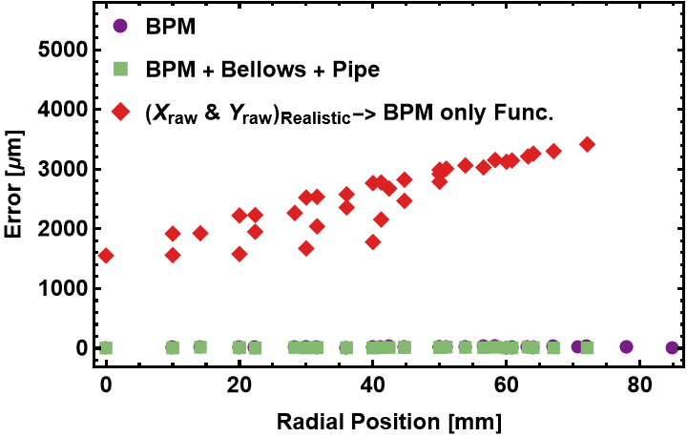
Error estimation: CST Simulation
X_{raw} and Y_{raw} from the realistic case
but the Fitting function from the BPM only!!
The error is 1.6 mm to 3.5 mm within the measurement range from 0 mm to ±55 mm

Slide 15
Wire Mapping

Slide 16
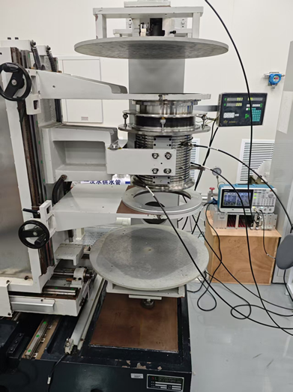
Wire Mapping System
BPM and wire (Molybdenum: Ø_{d}=100 µm) aligned with accuracy of 100 µm
Meaning: The mechanical center of BPM is known within 100 µm uncertainty
Transverse mover precision is 5 µm (Measured)
Transverse mapping range is ±60 mm
Tektronix signal generator (AFG31000)
V_{pp}=5 V, Frequency = 1 MHz (Varied)
Bergoz-BB Electronics is used
Dynamic range: -70 dBm to +5 dBm
BW: 10 MHz
ADC Bit: NI Digitizer 16-bit
A thermocouple is attached to the outer body of BPM to monitor temperature
Bellows
BPM
X/Y Mover

Slide 17
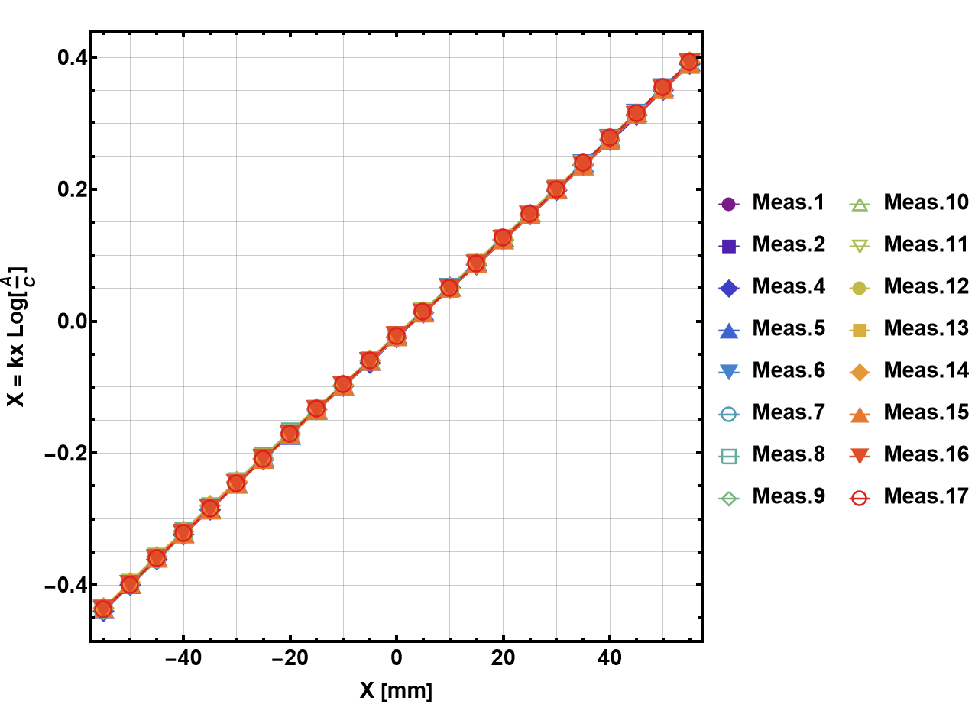
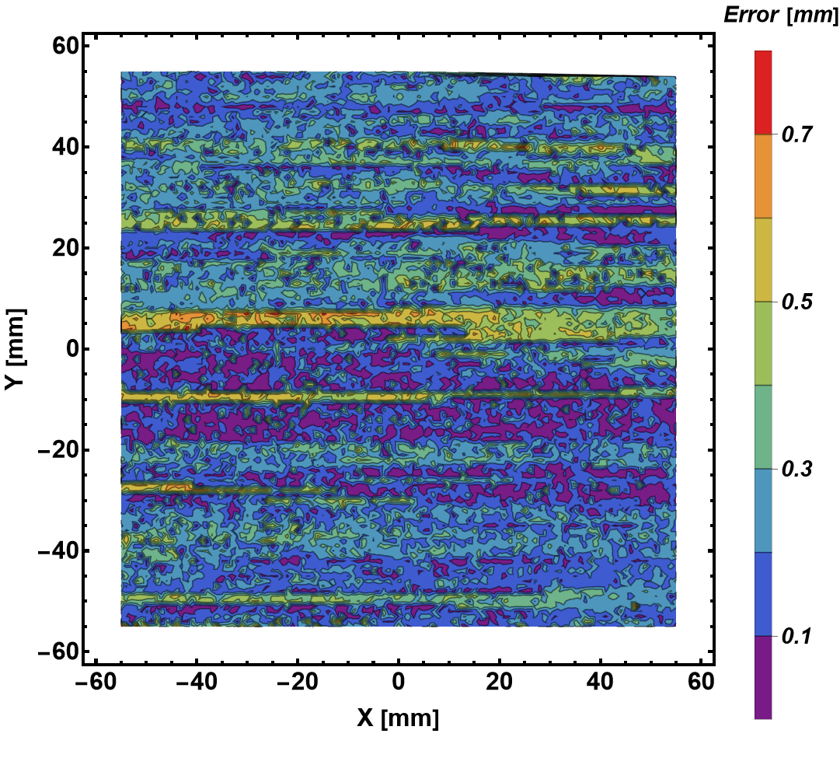
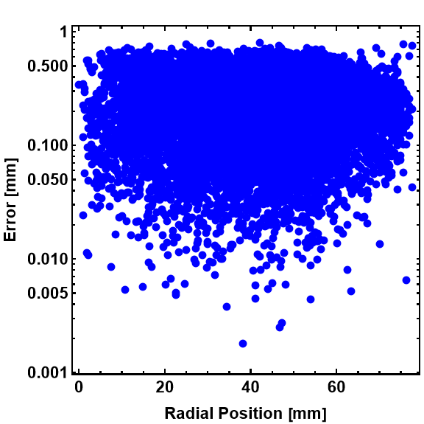
Wire Mapping: 17× Repetition
Step size: 1 mm
Frequency: 1 MHz
Repeat 17 Times
C_{00,x} [mm] | C_{00,y} [mm] | C_{10,x} [mm] | C_{01,y} [mm]
$$3.23±0.06$$ | $$5.95±0.19$$ | $$135.74±0.07$$ | $$136.20±0.30$$

Slide 18
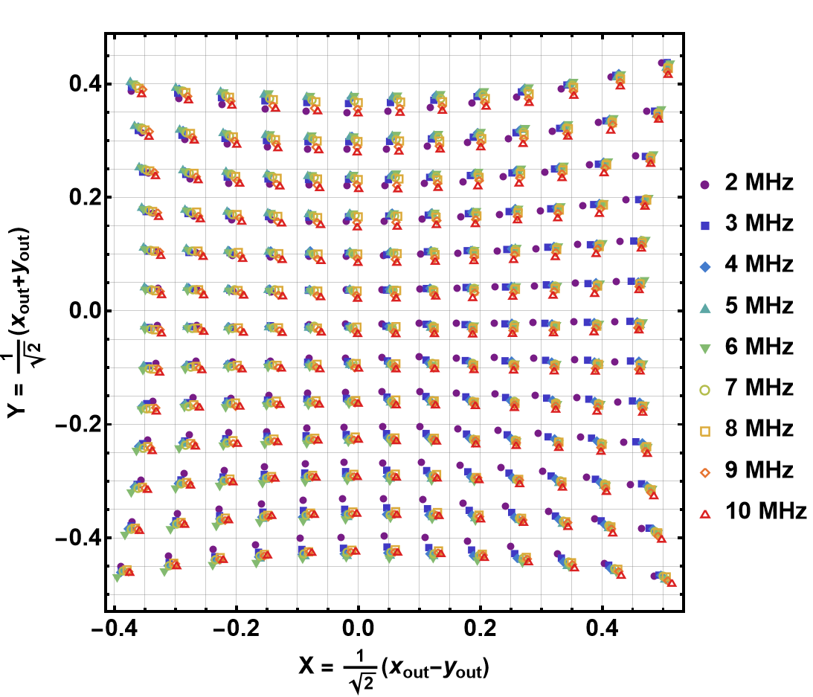
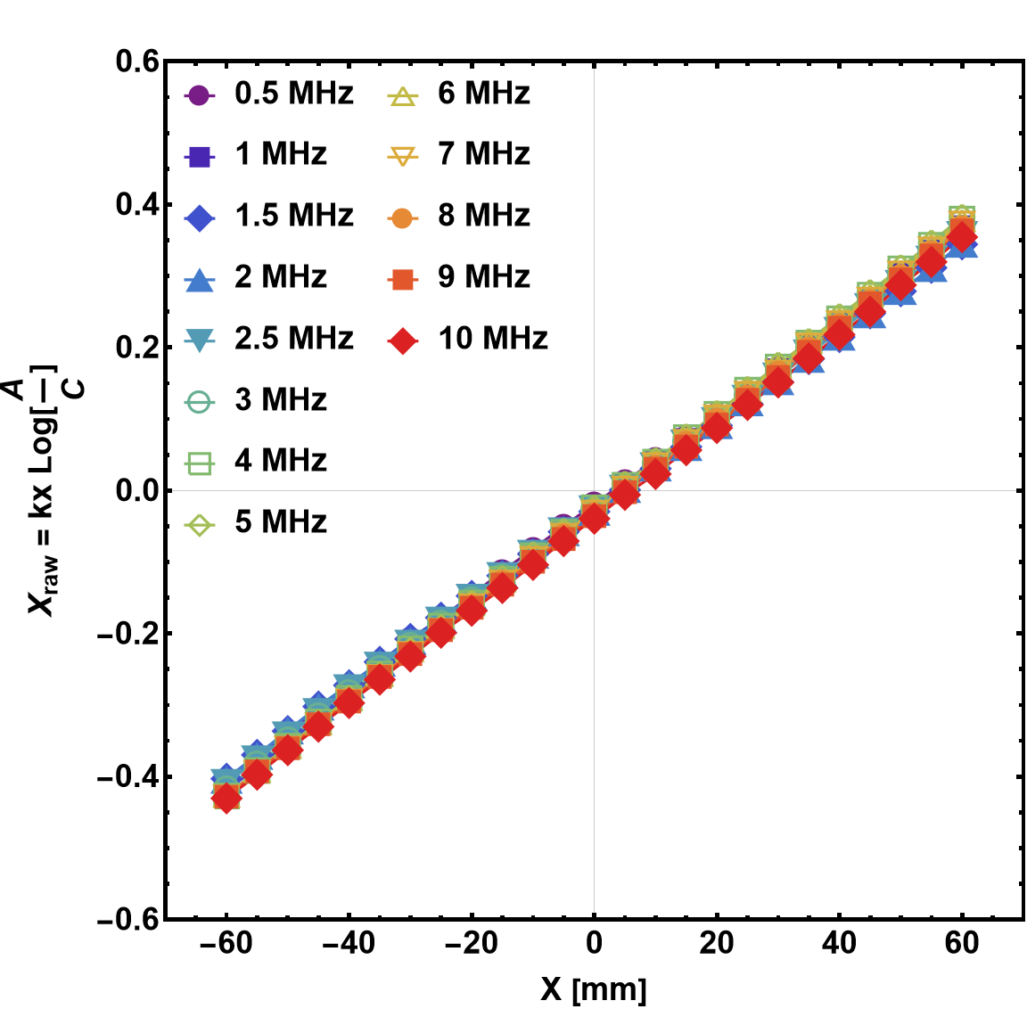
Wire Mapping: Frequency Dependence

Slide 19
Temperature Logging during mapping
Temperature variation within one measurement is 0.1 ^{O}C

Slide 20
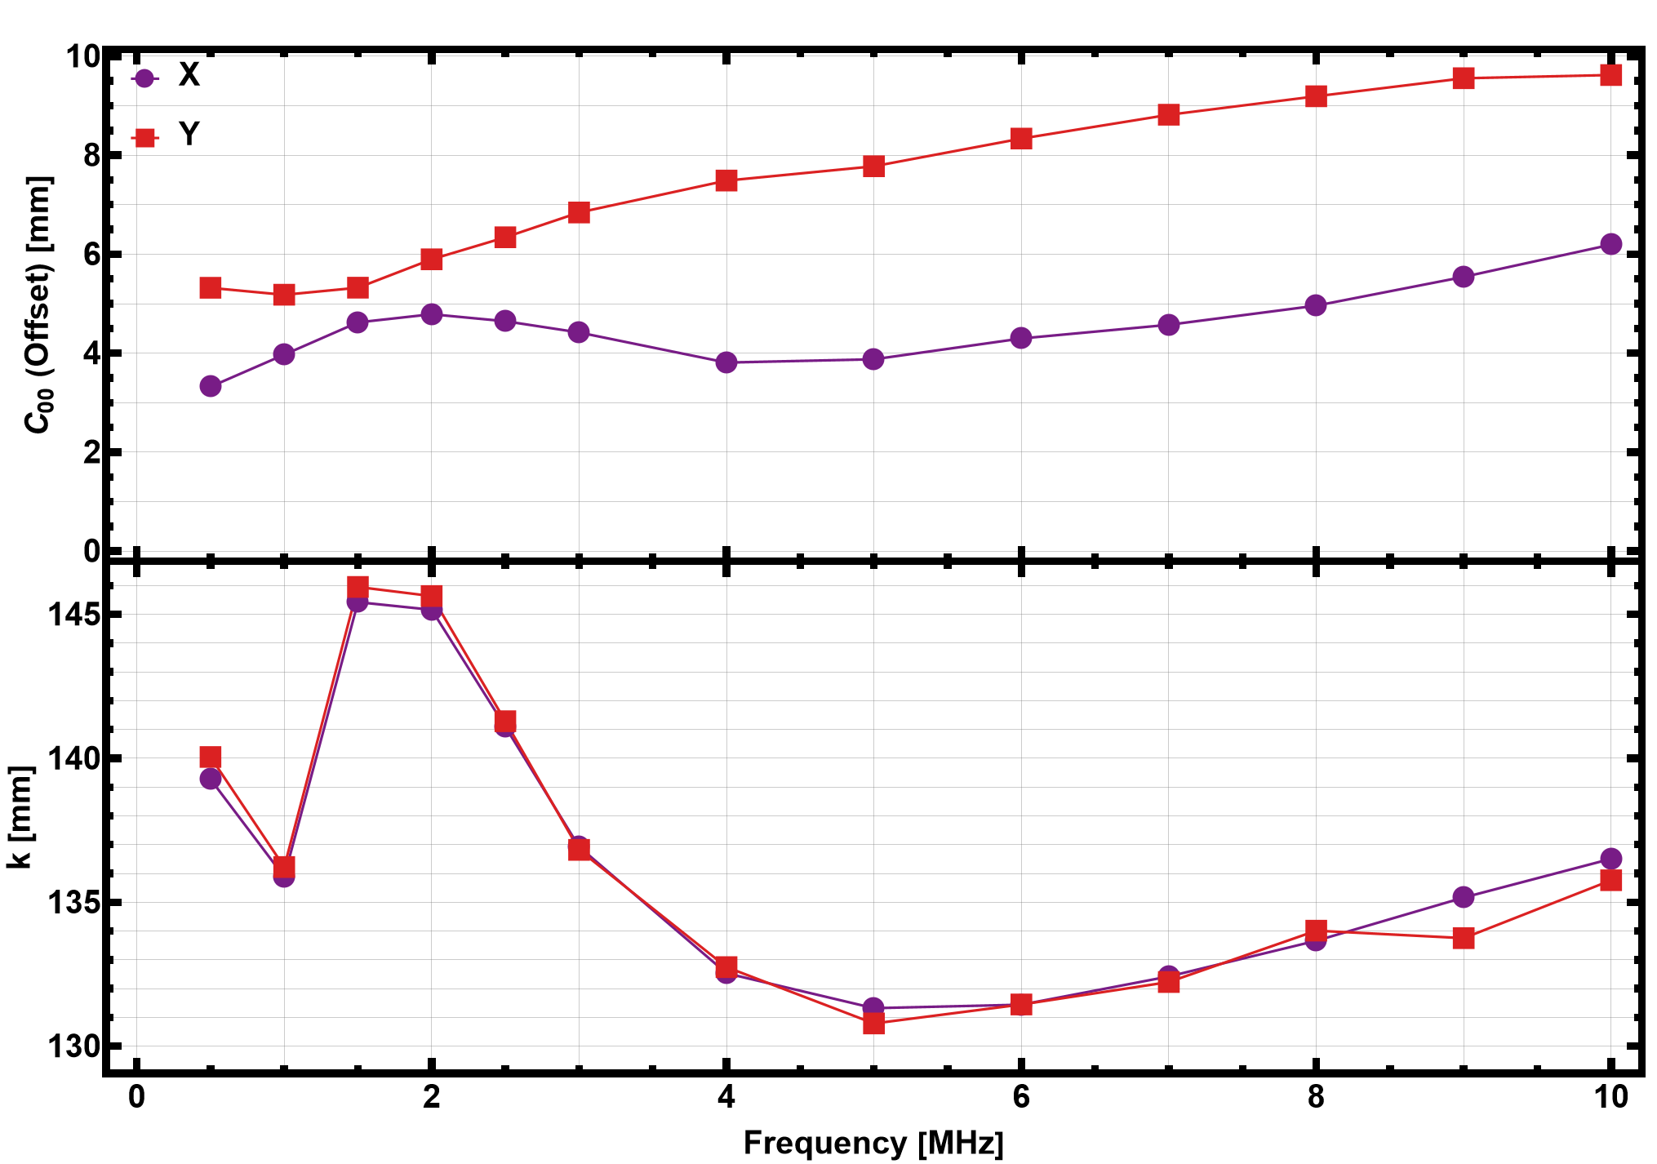
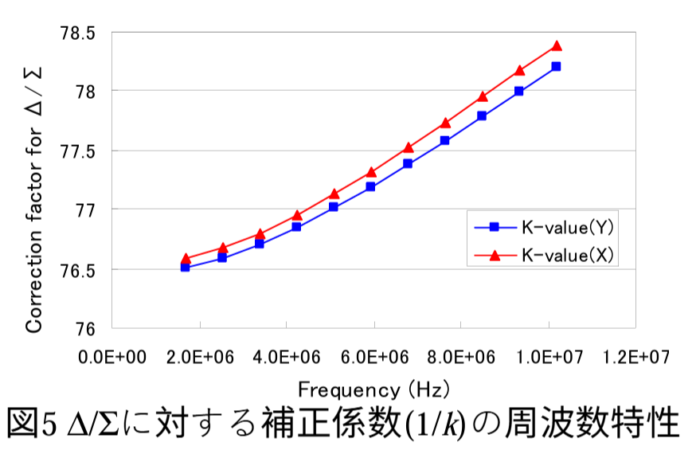
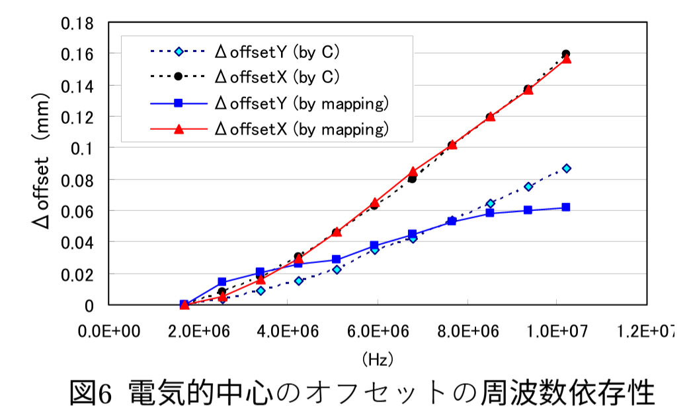
Wire Mapping: Frequency Dependence
3rd order Polynomial Fit
f_{RF} varies from 1.02 to 2.44 MHz
Signal Generator Freq. varied to measure the BPM response
Strong frequency dependence is observed
Offset(y) varies from 5.5 to 10 mm in Freq. range 0.5 to 10 MHz
T. Miura, PASJ2006, WP67
High frequency results in reduced isolation between electrodes
Consequently, a bigger transverse offset
Asymmetric, transverse offset due to the bellows in the horizontal direction

Slide 21
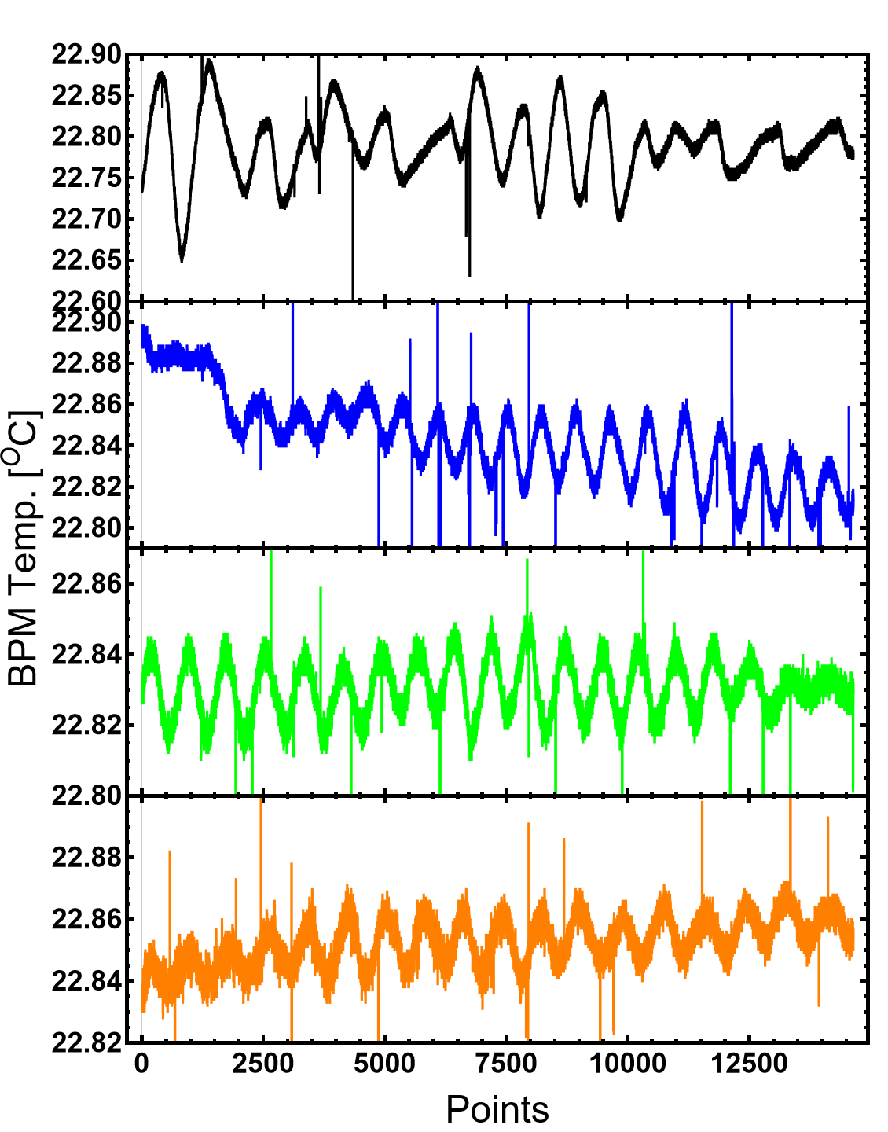
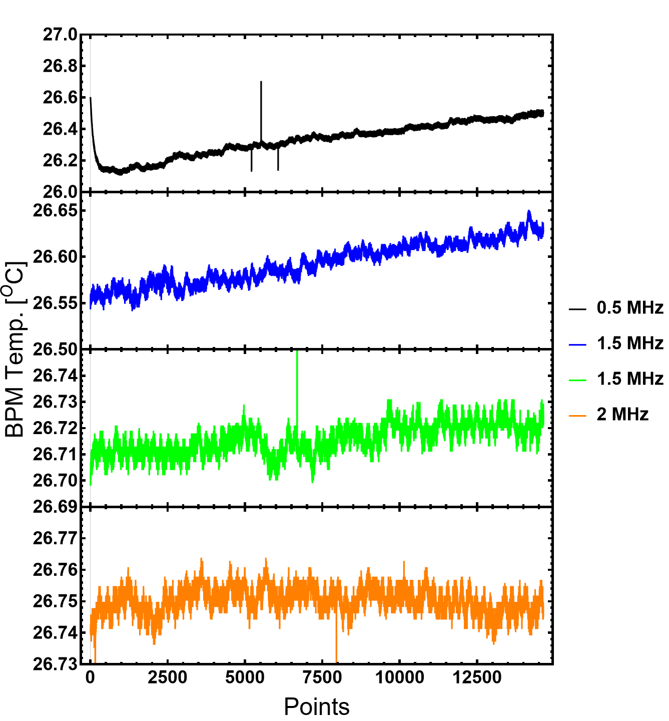
Room Temperature Variation influence on BPM!
Room Temperature
23^{O}C
Room Temperature
27^{O}C
26.33±0.11 ^{O}C
22.79±0.04 ^{O}C
22.84±0.02 ^{O}C
26.59±0.02 ^{O}C
26.71±0.02 ^{O}C
26.75±0.004 ^{O}C
One measurement

Slide 22
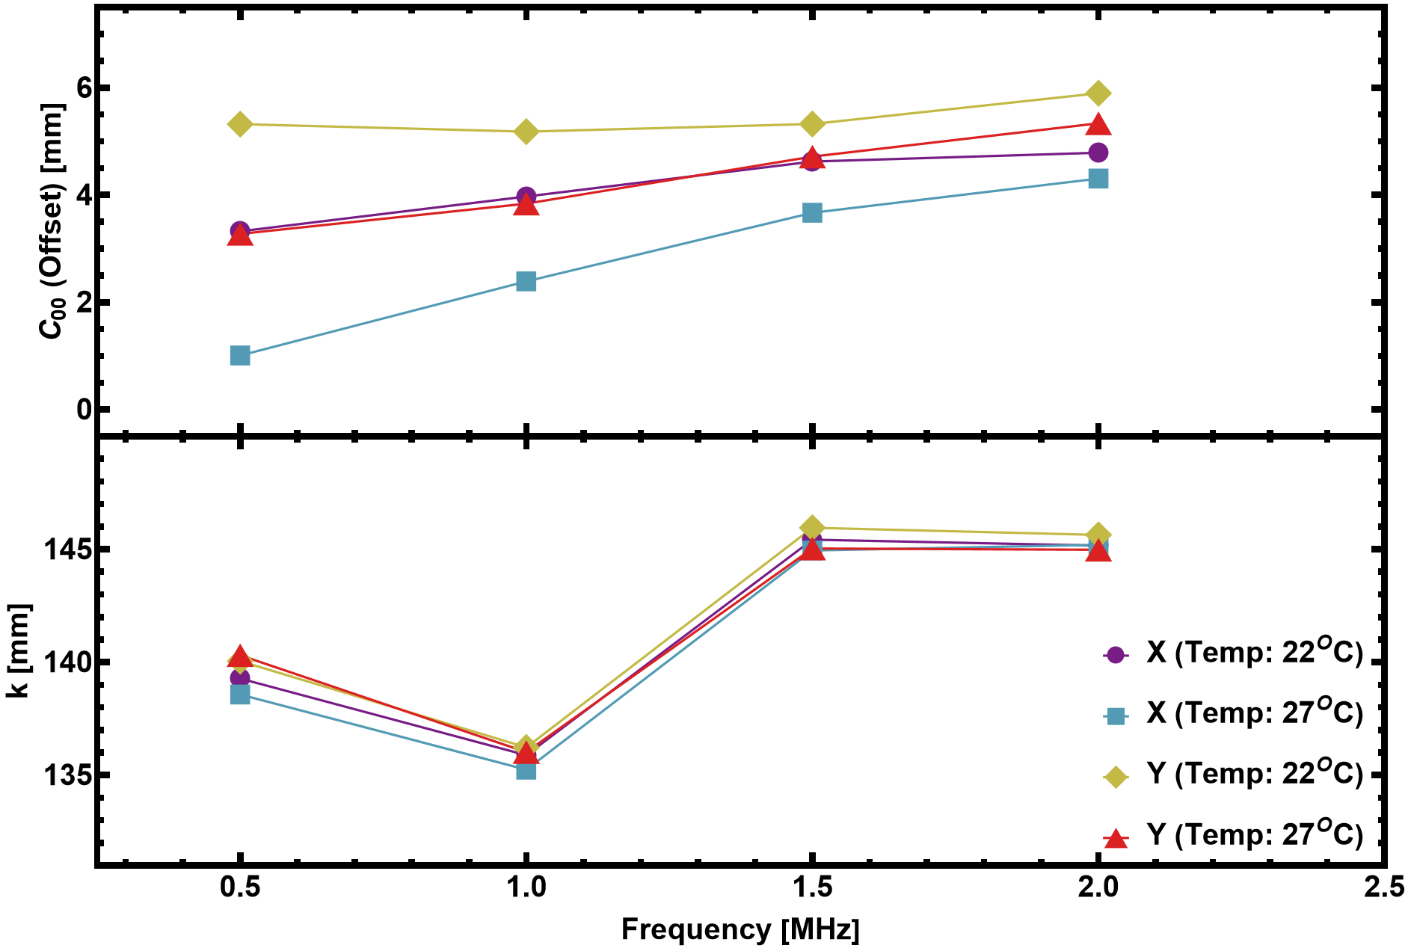
Room Temperature Variation Influence on BPM!
A Very Drastic Effect has been observed in the Transverse offset (especially in the low-frequency region) due to
Influence of temperature rise on BPM electrodes and body
Influence of temperature rise on Electronics

Slide 23
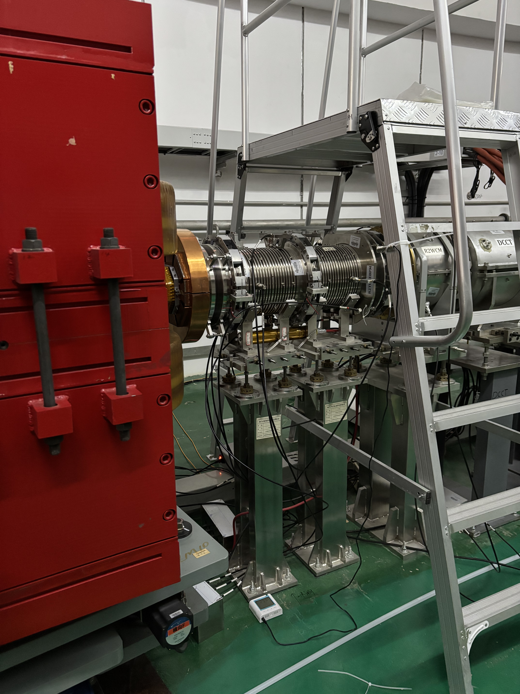
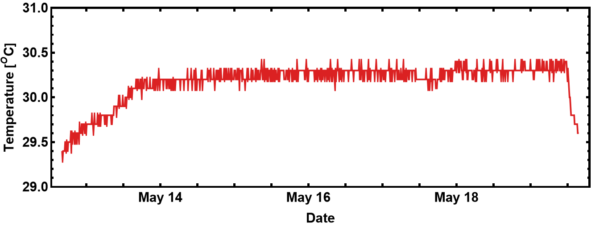
Bending Magnet
Near BPM Temperature in Tunnel
BPM
The temperature sensor is about 0.5 meters away from the BPM
Temperature sensor
30.26±0.07 ^{O}C
Beam ON
Temperature sensor Readout

Slide 24
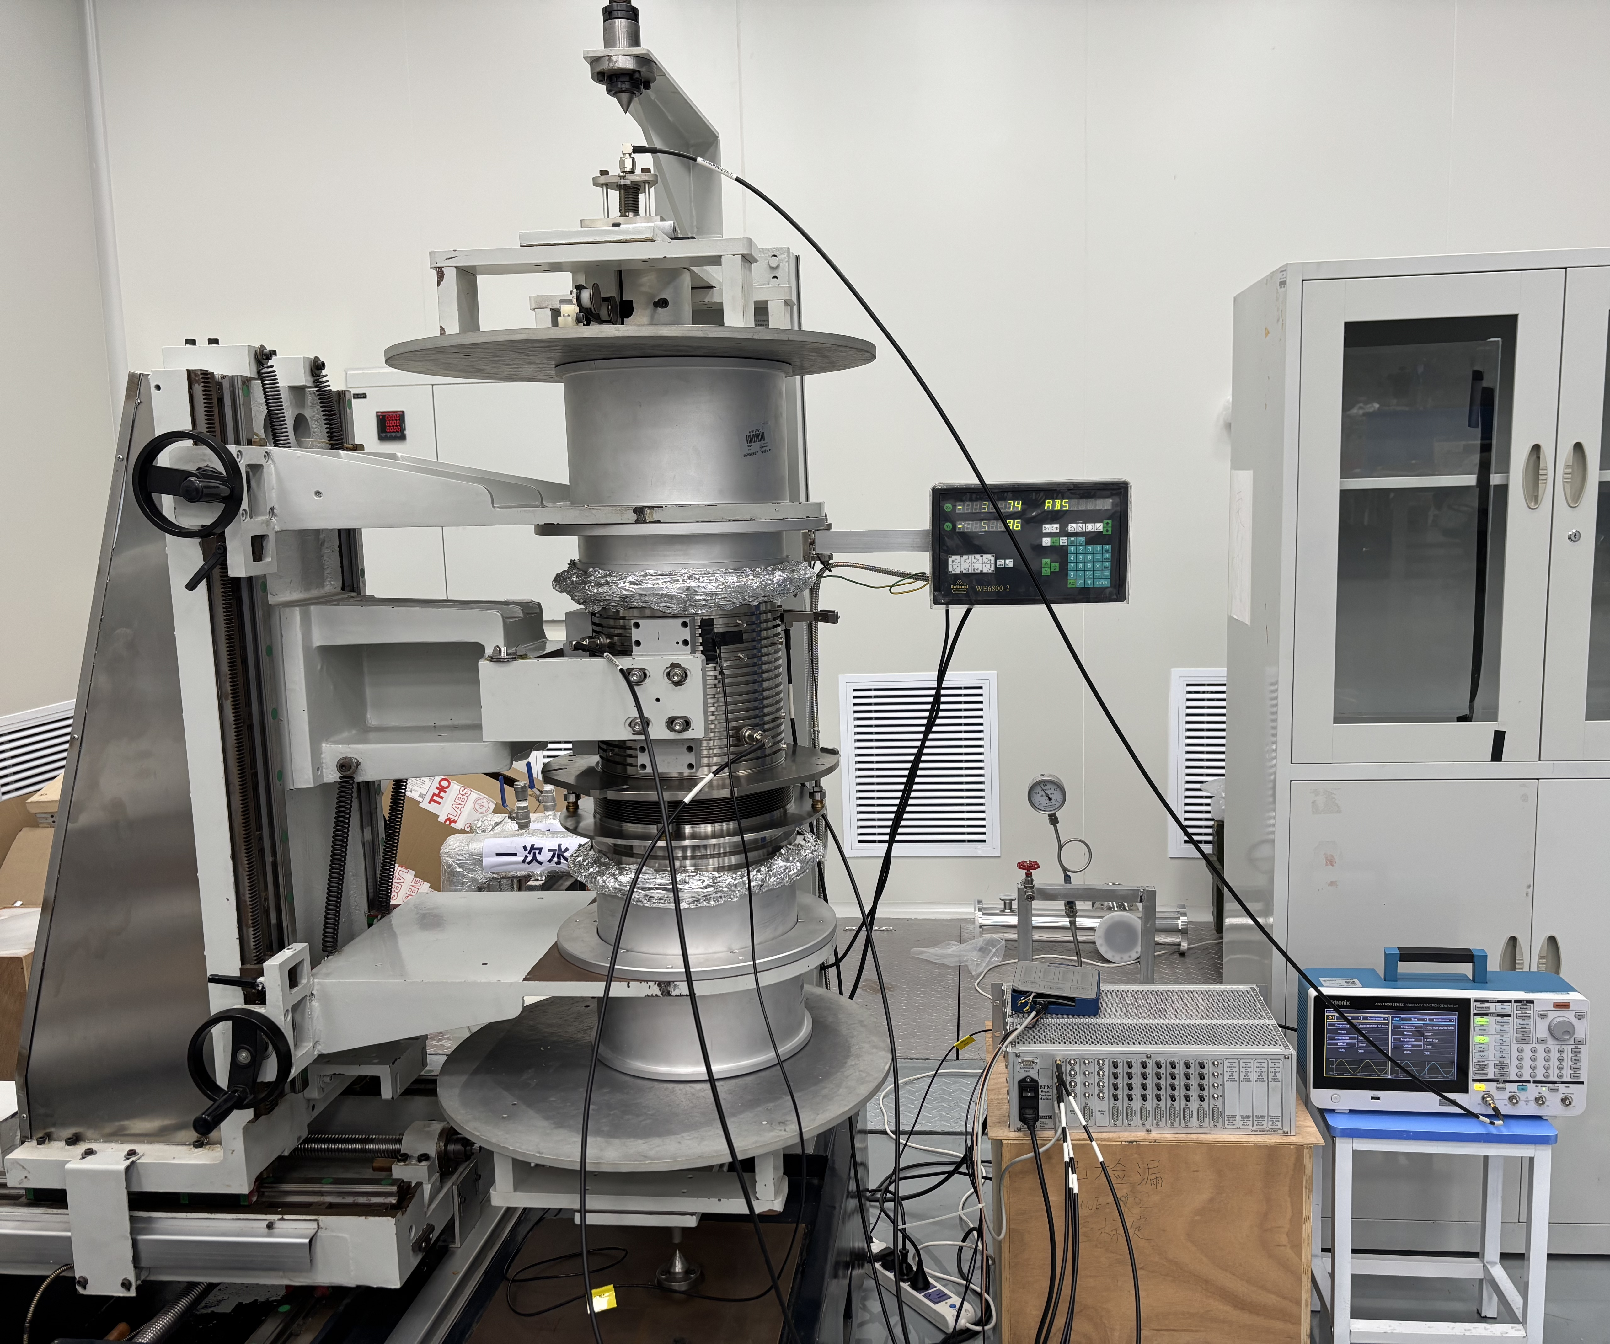
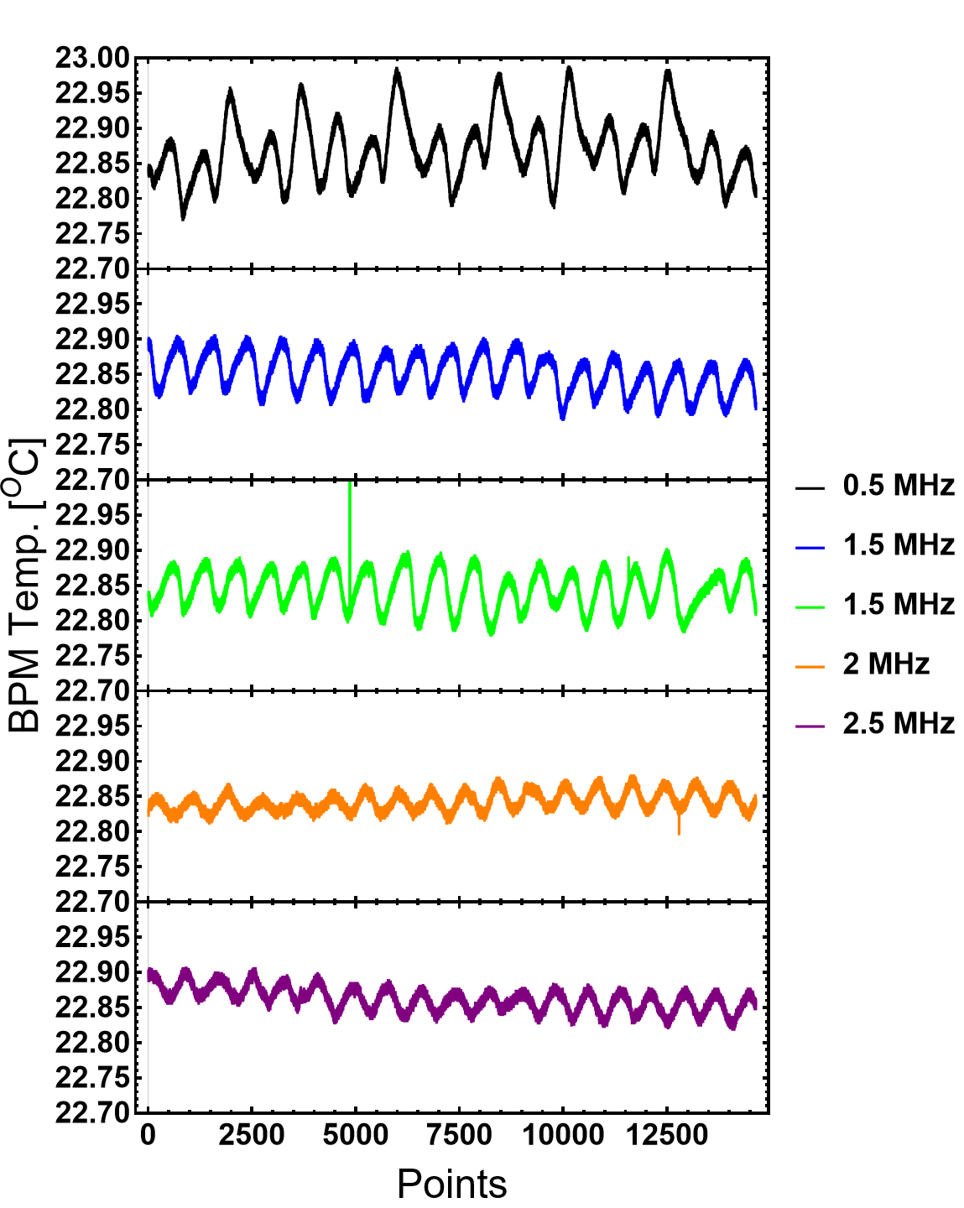
Dummy-pipe (Edge Effect) influence on BPM!
Dummy Pipe
BPM
Dummy Pipe

Slide 25
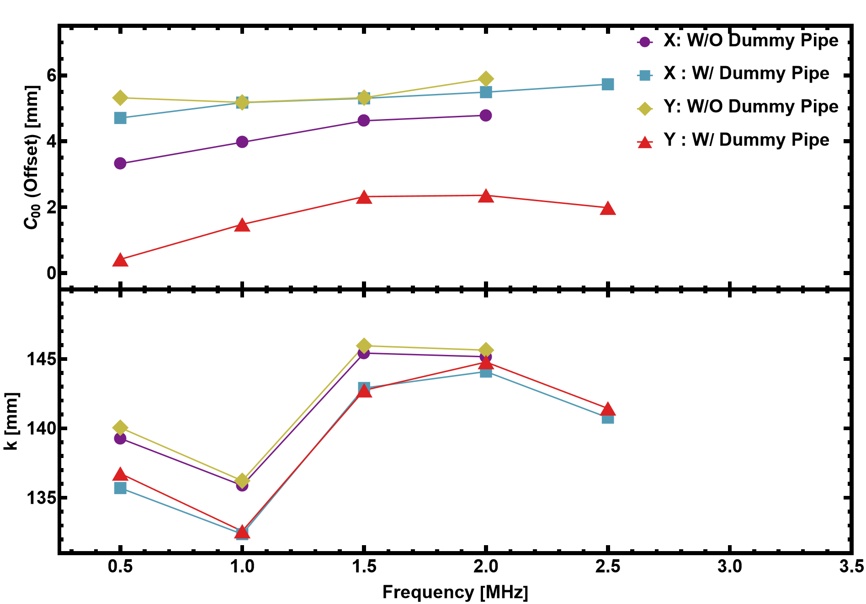
Dummy-pipe (Edge Effect) influence on BPM!
A Very Drastic Effect has been observed in the Transverse

Slide 26
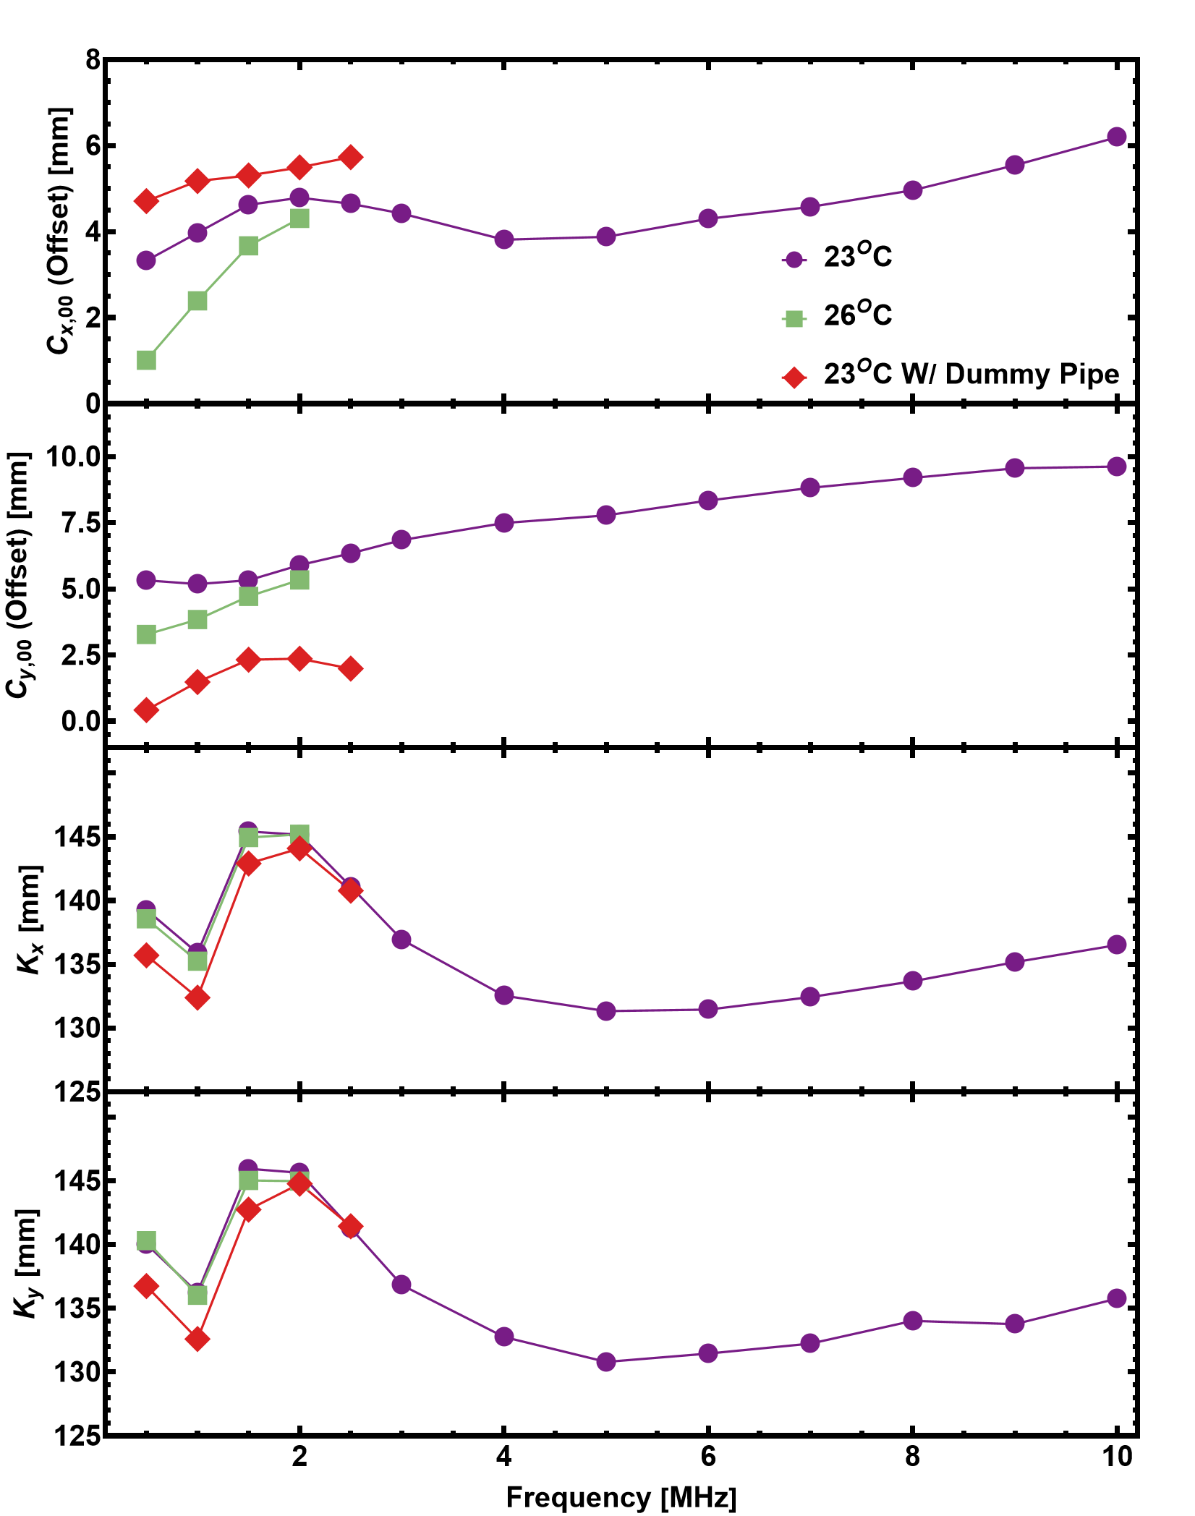
Summary
C_{x,00}
Frq [MHz]
23^{O}C
26^{O}C
23^{O}C W/ Dummy Pipe
C_{y,00}
Frq [MHz]
23^{O}C
26^{O}C
23^{O}C W/ Dummy Pipe
Very strong dependence of the calibration constant
Frequency
Temperature

Slide 27
Back up

