Slide 1
Design of Strip-line BPMs for Superconducting section of CSNS-II
M. A. Rehman
CSNS ACBI Group
2023-04-13

Slide 2
Content
Introduction
Requirements and Mechanical Constraints
Electromagnetic Design
Position Analysis
Mechanical Design
Cables/Readout Electronics
Preparation for Beam test
Cost, Schedule and Responsibilities
Summary

Slide 3
1.1 Introduction
In CSNS-II, Superconducting Cavities (SC) will be installed to boost the LINAC energy from 80 MeV to 300 MeV
The quadrupole magnets doublet will be placed between two cryomodules of SC
The strip-line type Beam Position Monitors (BPM) are planned to be installed in one of the quadrupole magnet doublets regarding a compact transfer line design
Ten BPMs will be installed in the Spoke Cavity region and 8 BPMs in Elliptical Cavity region
Spoke Cavity Region
10 BPMs
Elliptical Cavity Region
8 BPMs
The major function of the BPMs is the beam position and phase measurement
Time of Flight measurement will provide energy of the beams
The shorted-type strip-line BPM has been chosen for CSNS-II owing to its rigid structure and high S/N ratio

Slide 4
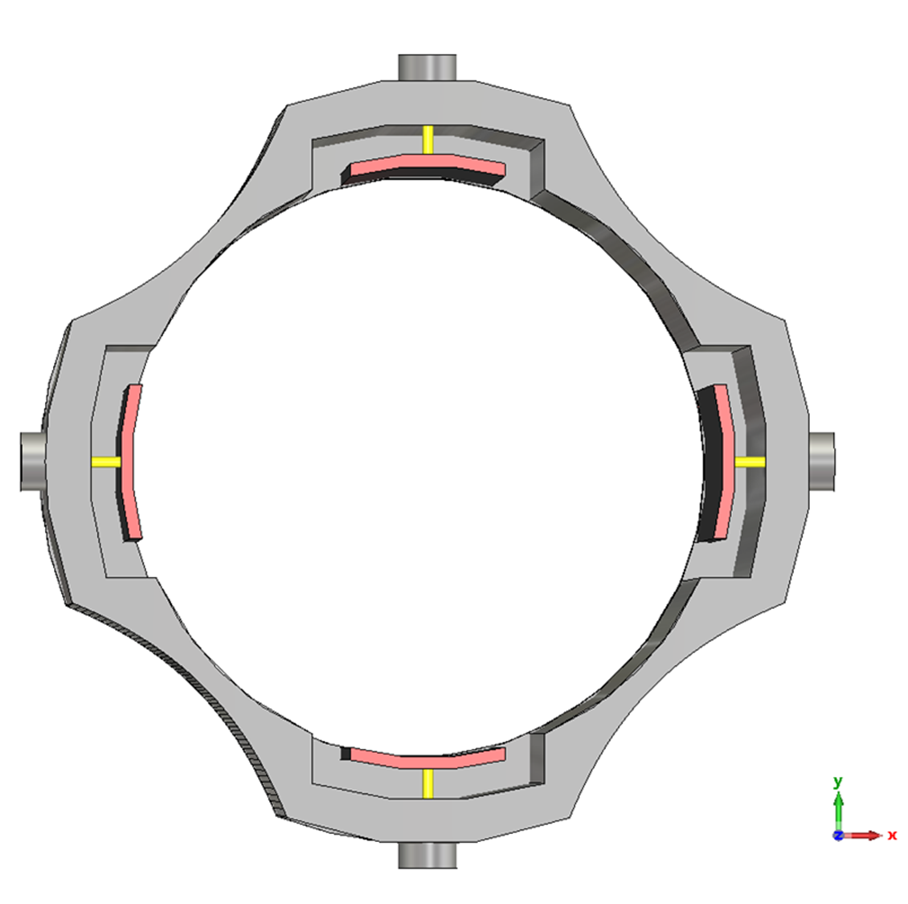
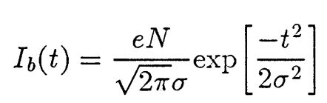
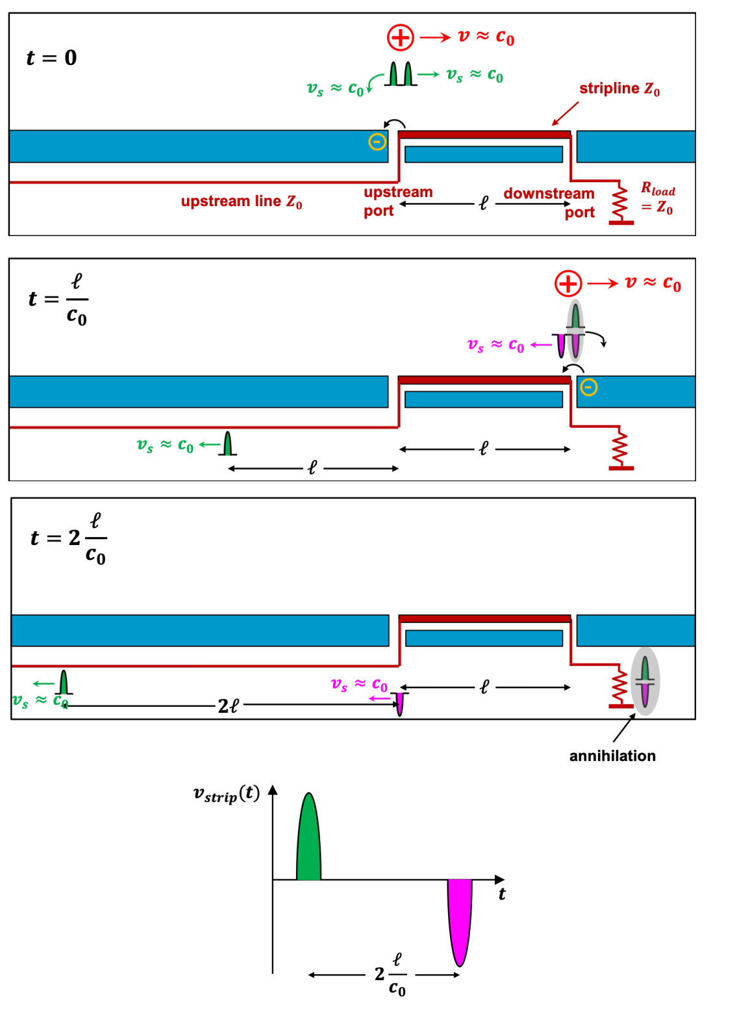
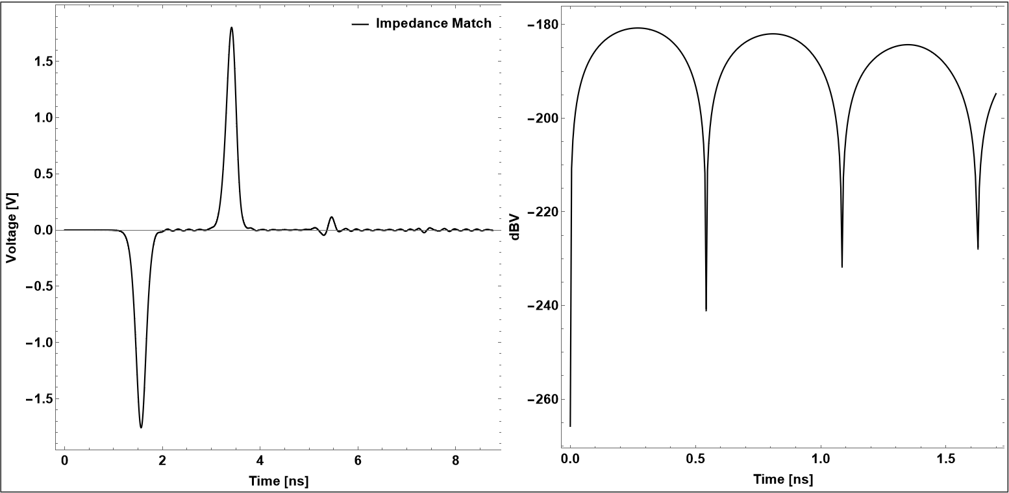
What is Strip-line BPM?
1.2 Introduction
y
1. When charged particle beam passes through the conductive beam pipe, an image current on the wall of vacuum chamber induce
Elect.
R
J_{w}
Φ
I_{beam}
r
B
-
A
2. The asymmetry of charge distribution on the wall of electrode gives the transverse position of the beam
φ
α
x
Strip-line BPM principle
CST Simulation
Picture from
BPM Systems: A brief Introduction to Beam Position Monitoring by M. Wendt, Page#22

Slide 5
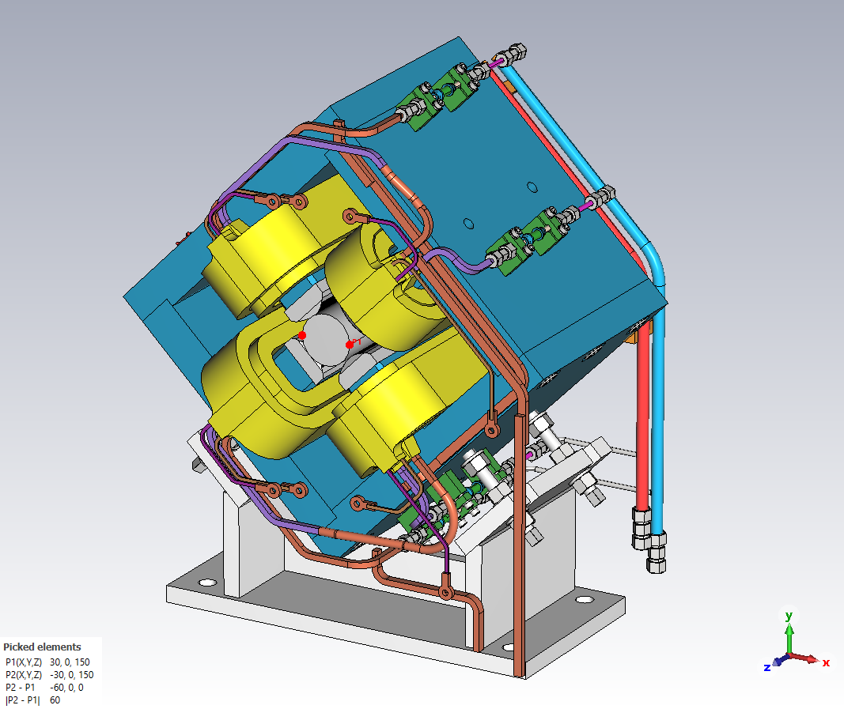
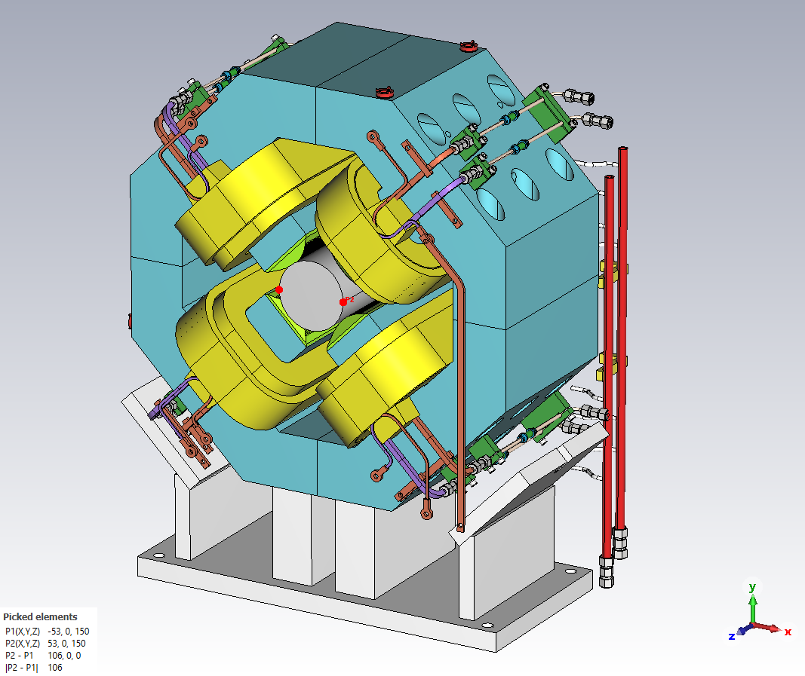
2. Requirements and Mechanical Constraints
Due to the stringent space restriction in the SC section of LINAC, BPMs have to embed inside quadrupole magnet
Transverse and longitudinal size and shape of the BPMs are strictly restricted
Material of BPM electrodes and body must be non-magnetic (SUS316L, permeability<1.02)
Quadrupoles in Spoke Cavity Region
Quadrupoles in Elliptical Cavity Region
Parameter | Values, CSNS-II
Beam Energy | 80-300 [MeV]
Bunch Charge | 0.154 [nC]
Bunch Length | 17-8.4 [ps]
Position Accuracy | 100 [µm]
Position Resolution | 20 [µm]
Phase accuracy | 1 degree
Phase resolution | 0.2 degree
Meas. Range | R/2
Signal Frequency | 324 MHz
Spoke Cavity Region BPM-Quad BPM-1 | Quad Mag Para. | Value [mm]
 | Bore Dia./Rad | 60/30
 | Beam duct Dia./Rad | 50/25
 | Iron Yoke Length | 280
Elliptical Cavity Region BPM-Quad BPM-2 | Bore Dia./Rad | 106/53
 | Beam duct Dia./Rad | 96/48
 | Iron Yoke Length | 270
In order to preserve the acceptance of vacuum duct, the electrode of strip-line BPMs has to be fit inside the gap of quadrupole magnet poles.

Slide 6
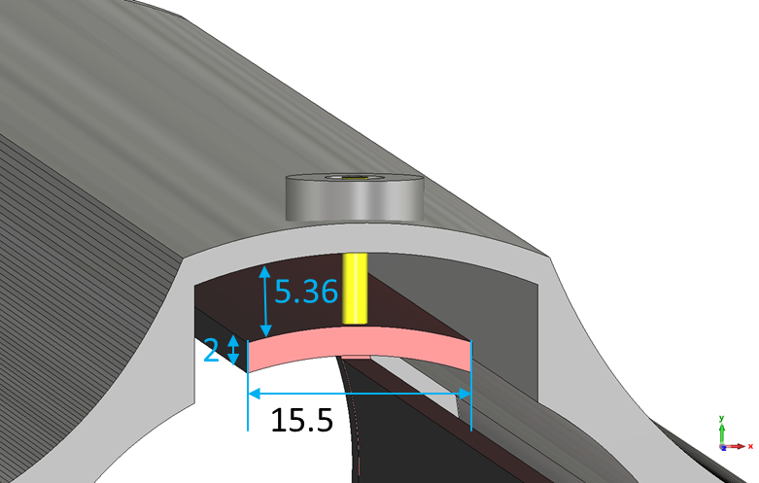
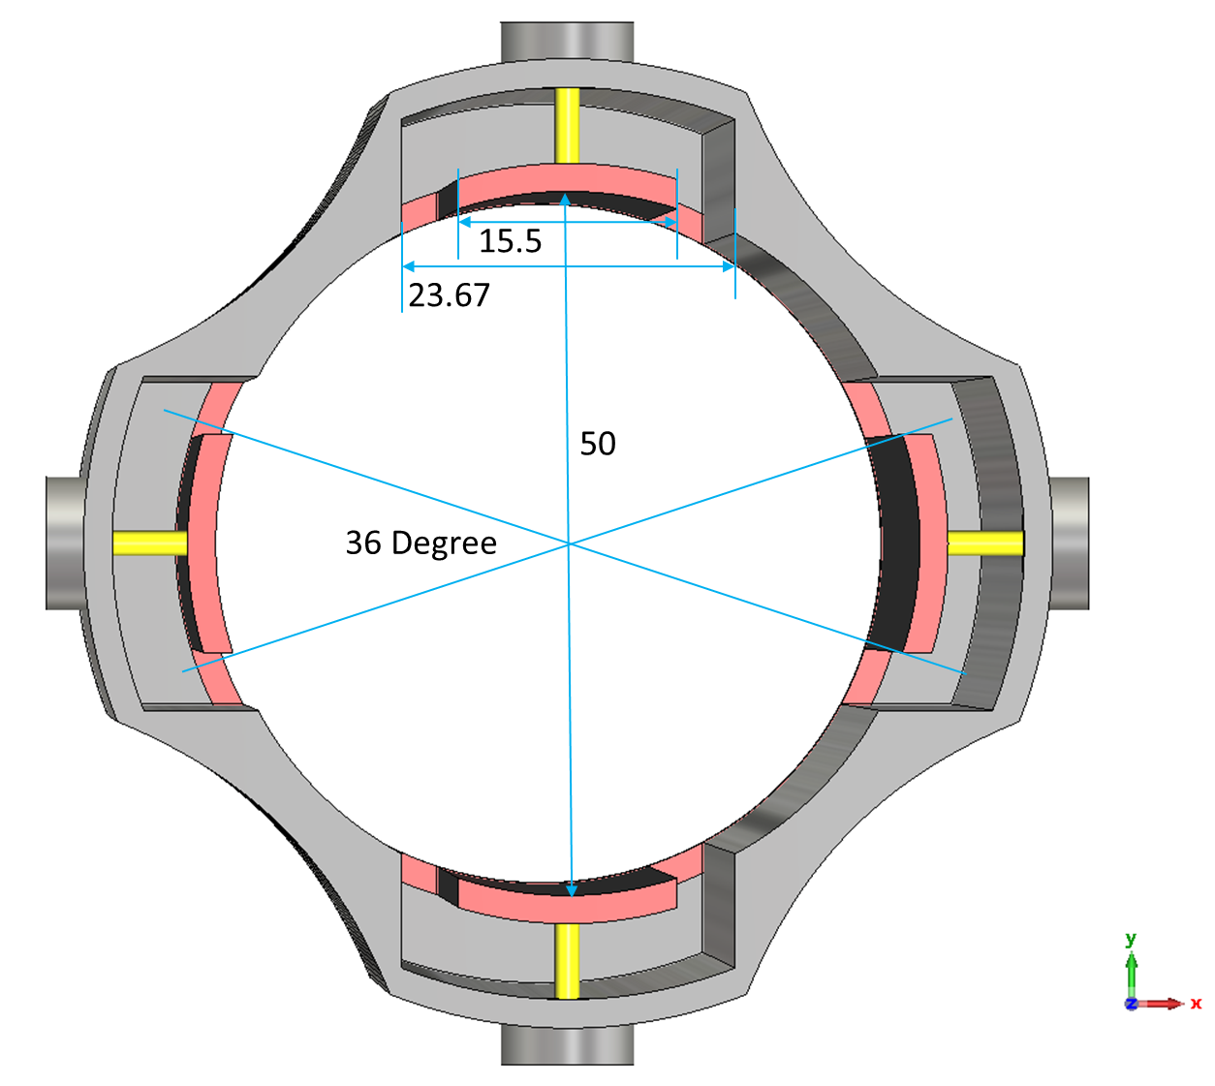
3.1 Electromagnetic Design
Characteristics Impedance Matching Between Strip-line and Feedthrough
In order to transmit beam induced signal on stripline electrode to readout feedthrough the characteristics impedance of stripline electrodes (Z_{strip} = 50 Ohm) must match with the feedthrough (Z_{feed} = 50 Ohm).
Z_{strip}
Z_{feed}
Z_{feed} = Z_{strip}
Z_{strip} ^{SPOKE Cavity Reg. BPM}
Feedthrough
Simplified Model Feedthrough
For CST-MW Simulation
Z_{feed}
Z_{strip}
Z_{strip} ^{Elliptical Cavity Reg. BPM}
$$\text{Z}\text{feed}=138Log\left[\frac{D(4.1)}{d(1.8)}\right]=49.33\sim 50 Ohm$$
Very Good Agreement b/w analytical and Sim.

Slide 7
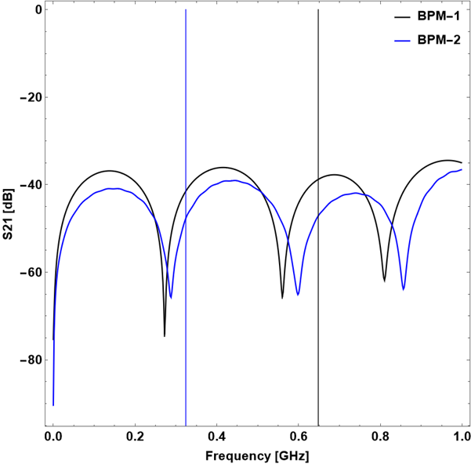
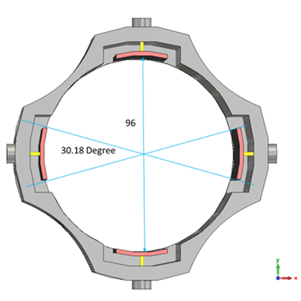
3.2 Electromagnetic Design
Characteristics Impedance Matching Between Strip-line and Feedthrough
^{BPM-2}
Inter-Electrode Coupling
BPM | S21 [db]
BPM-1 | -41.49
BPM-2 | -47.11
This couplings between the electrodes results in bad linearity of the pick-up voltage.
In our case the opening angle is determined by the available space in quadrupole magnets
CST-MW was used to determine the coupling between the electrodes
Thanks to the structure of BPM, EM coupling is tiny between neighboring electrodes

Slide 8
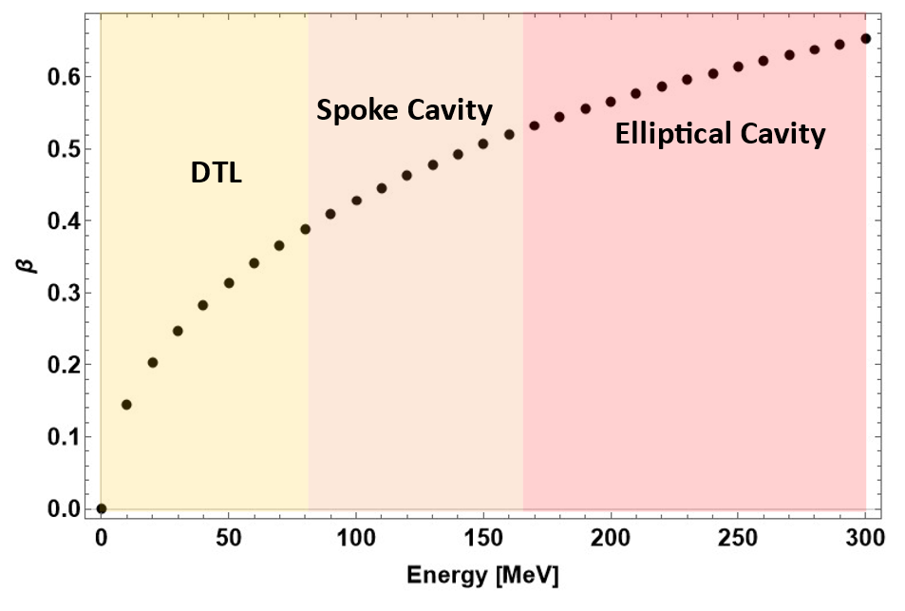
3.3 Electromagnetic Design
Length of strip-line electrode
The optimized electrode length at given beam velocity is given as:
$$V\left(t\right)=\frac{Z_{strip}}{2}\frac{φ}{2π}\left(e^{\frac{{−t}^{2}}{2σ^{2}}}−e^{\frac{{−\left(t−l.∗\left(\frac{1}{c}+\frac{1}{v}\right)\right)}^{2}}{2σ^{2}}}\right)I_{0}$$
$$l=\left(\frac{π c v}{ω\left(c+v\right)}\right)$$
Since the velocity of the beam continuously changes in SC section
A constant length of strip-line electrodes
Average value of $β$ in spoke and elliptical cavities are 0.46 and 0.6 respectively
The average $β$ values to get the optimal length of the strip-line electrodes
146 mm and 172 mm for spoke and elliptical cavities regions, respectively
^{BPM-1}
^{BPM-2}

Slide 9
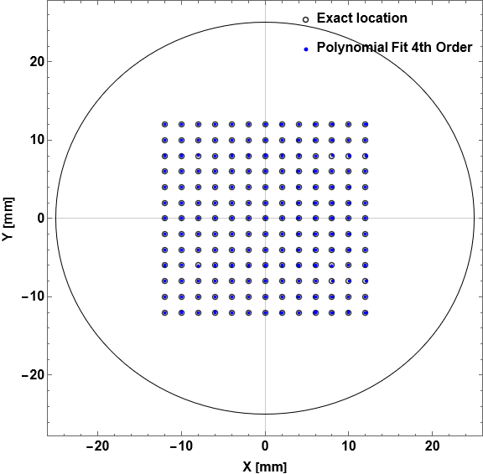
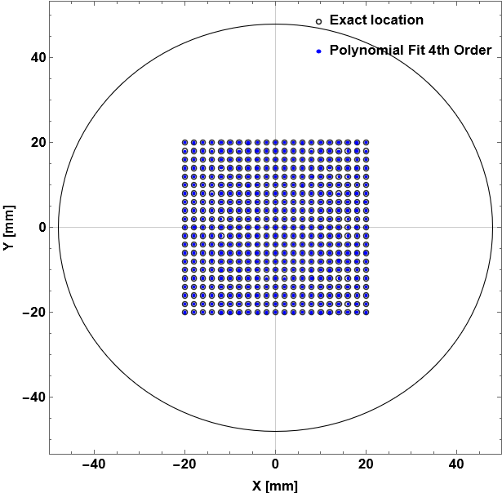
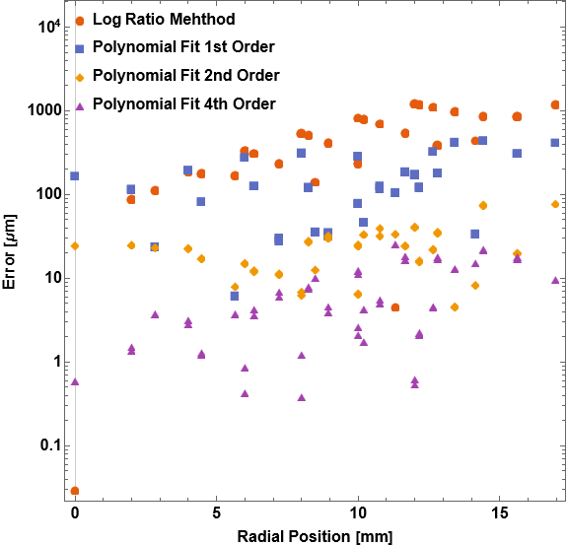
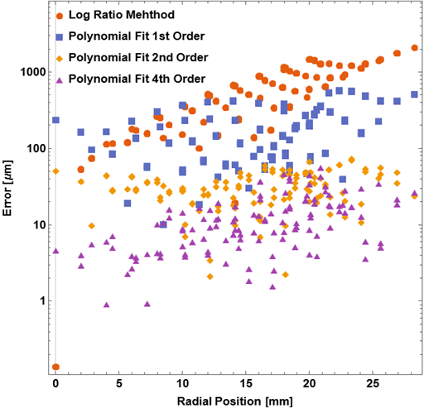
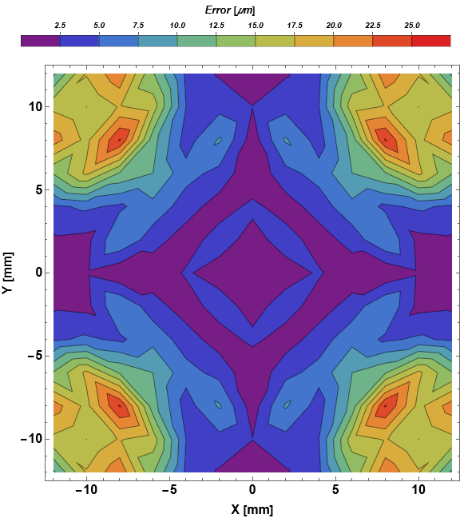
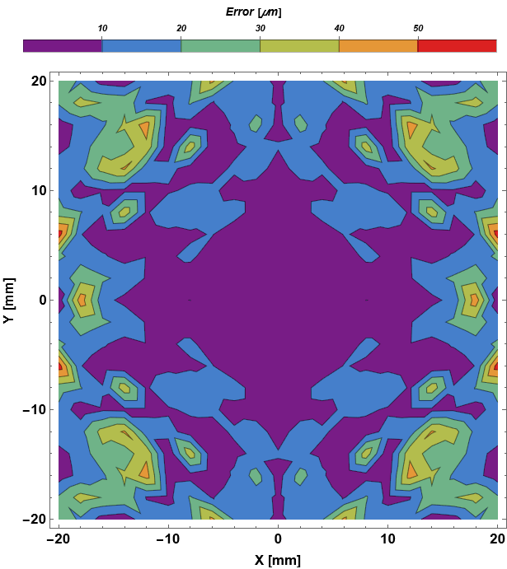
4.1 Position Analysis
The log ratio method will be used to determine the transverse position of the beam.
$$\left(\frac{I_{R}}{I_{L}}\right)=\frac{160}{\ln\left(10\right)}\left(1+G\right)\frac{\sin\left(\frac{φ}{2}\right)}{φ}\frac{x}{r}+higher order terms$$
$G=0.139{\left(\frac{ωr}{βγc}\right)}^{2}−{0.0145\left(\frac{ωr}{βγc}\right)}^{3}$
To better account for the non-linearities of the normalized position behavior a calibration with higher order polynomials can be applied.
The Maximum error at R/2 with poly fit of order 4 is 50 µm.
BPM-1
BPM-2

Slide 10
5. Mechanical Design
Parameters | BPM-1 | BPM-2
Stripline Opening Angle | 36.12º | 25.3º
Stripline Width | 15.5 [mm] | 21.0 [mm]
Stripline Length | 146.0 [mm] | 172.0 [mm]
Stripline Vertical Gap to Vacuum Duct [g_{h}] | 6.1 [mm] | 7.0 [mm]
Stripline Horizontal Gap to Vacuum Duct [g_{w}] | 4.08 | 8.35 [mm]
Stripline width | 2.0 [mm] | 2.0 [mm]
Inner Diameter | 50.0 [mm] | 96.0 [mm]
BPM-2
BPM-1
BPMs are off-center from poles of Quad; for convenient connection of cable to feedthrough.

Slide 11
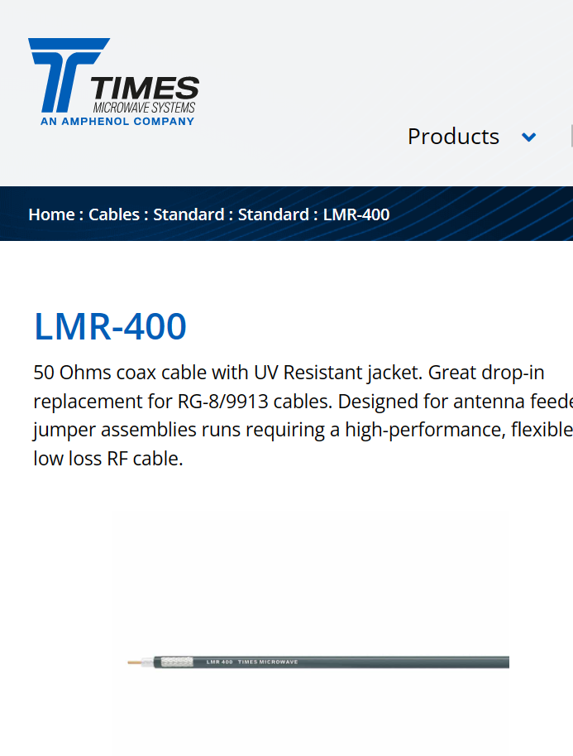
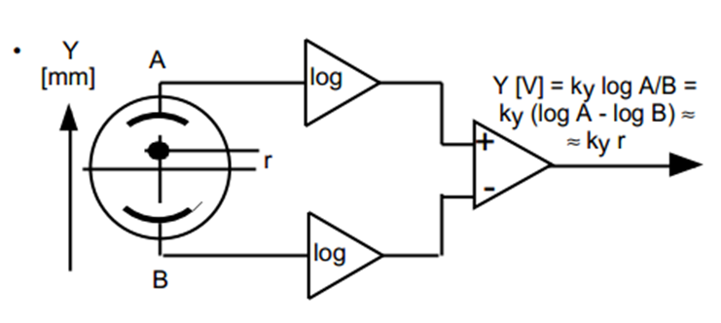
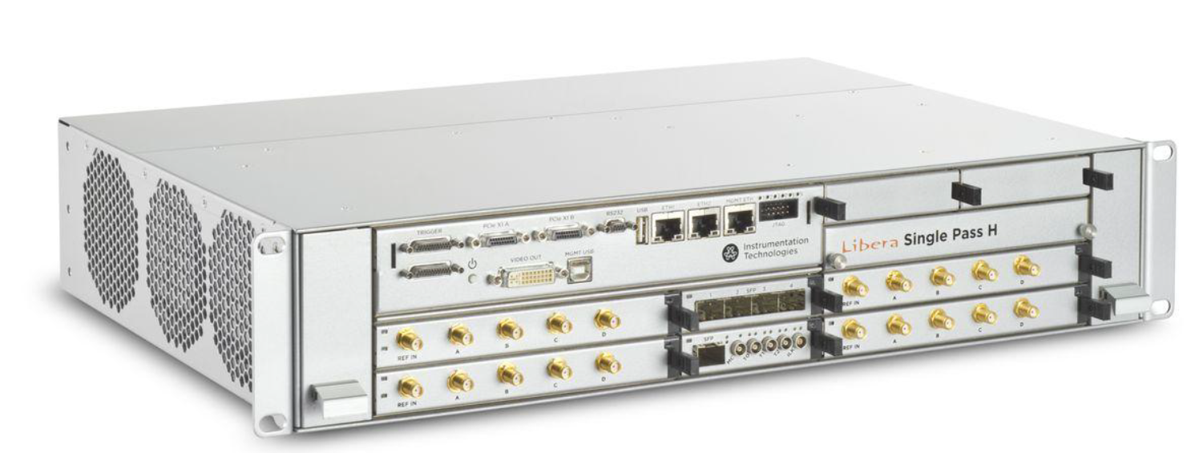
6. Cable and Readout Electronics
The connectors of the BPM pick-ups are SMA type in order to fit inside the quadrupole yoke gaps
The cables to the electronics are low attenuation, with relative large diameters
LMR-400 cable satisfies our requirements
Cable Parameters | Values,
Inner Conductor (Copper) | 2.74 [mm]
Dielectric (foam PE) | 7.24
Char. Impedance | 50 Ohm
Operating Frequency Range | DC – 3 GHz
Voltage withstanding | 2500 [V]
Capacitance | 23.9 [pF/m]
Cable Att. | 13.7 dB/100 m
Based on LIBERA BPM electronics good performance and requirement of position and phase resolution same system will be used for the CSNS-II
Parameter | Values, CSNS-II
RF Frequency | 324/648 [MHz]
Trigger Repetition | 100 Hz
Phase Meas. Range | +/- 180
Position Accuracy | 100 [µm]
Position Resolution | 20 [µm]
Phase accuracy | 1 degree
Phase resolution | 0.2 degree
Meas. Range | R/2
Signal Frequency | 324 MHz

Slide 12
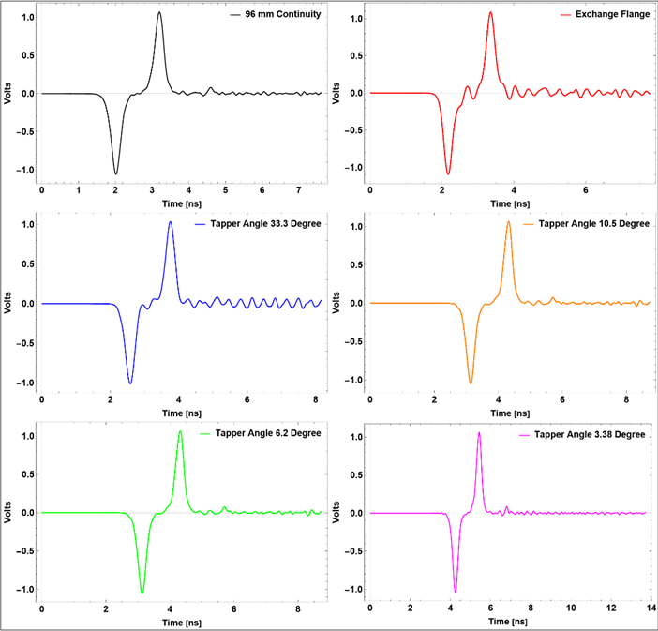
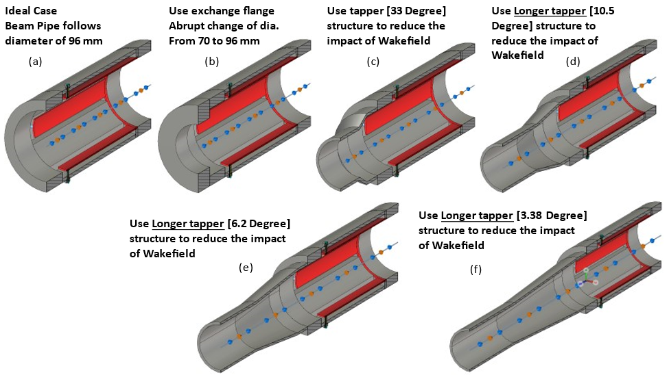
7.1 Preparation for Beam test
Motivation
Thousands of consecutive bunches exist in a single beam pulse
The head and tail of induced signal of one bunch could overlap with the ones from adjacent bunches,→ Bunch by bunch position and phase measurement
Challenges for beam test
However, for CSNS-II LRBT the dia. of beam duct is 70 mm
Only BPM of 96 mm dia. could be tested
taper structure will used to avoid signal deform.
(a)
(b)
Different taper structures in sim. in CST to observe signal deformation
(c)
(d)
(e)
(f)

Slide 13
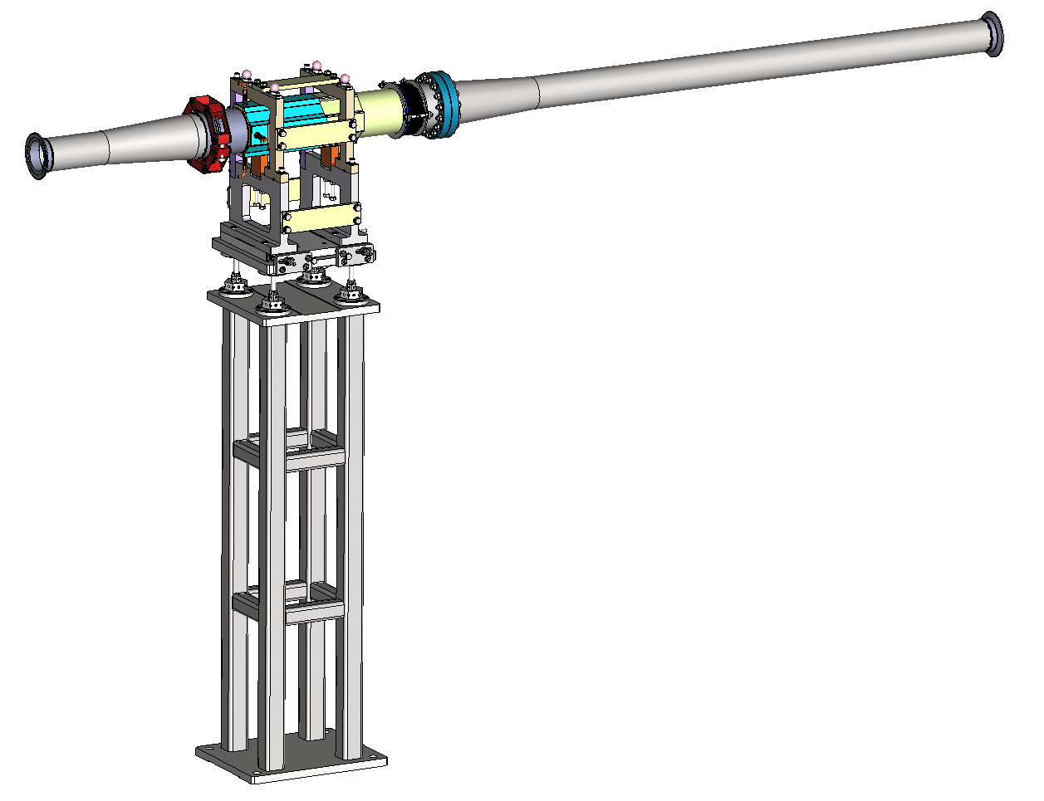
7.2 Preparation for Beam test
1269 mm
BPM-2
Taper
Taper
KF-Flange
Vacuum Duct: Only Drift
CF-Flange
Taper structures are added in downstream and upstream direction to avoid signal deformation due to abrupt change of beam duct diameter.
KF-Flange
Possible location for the beam tests downstream of WS01.
Support Structure
for BPM

Slide 14
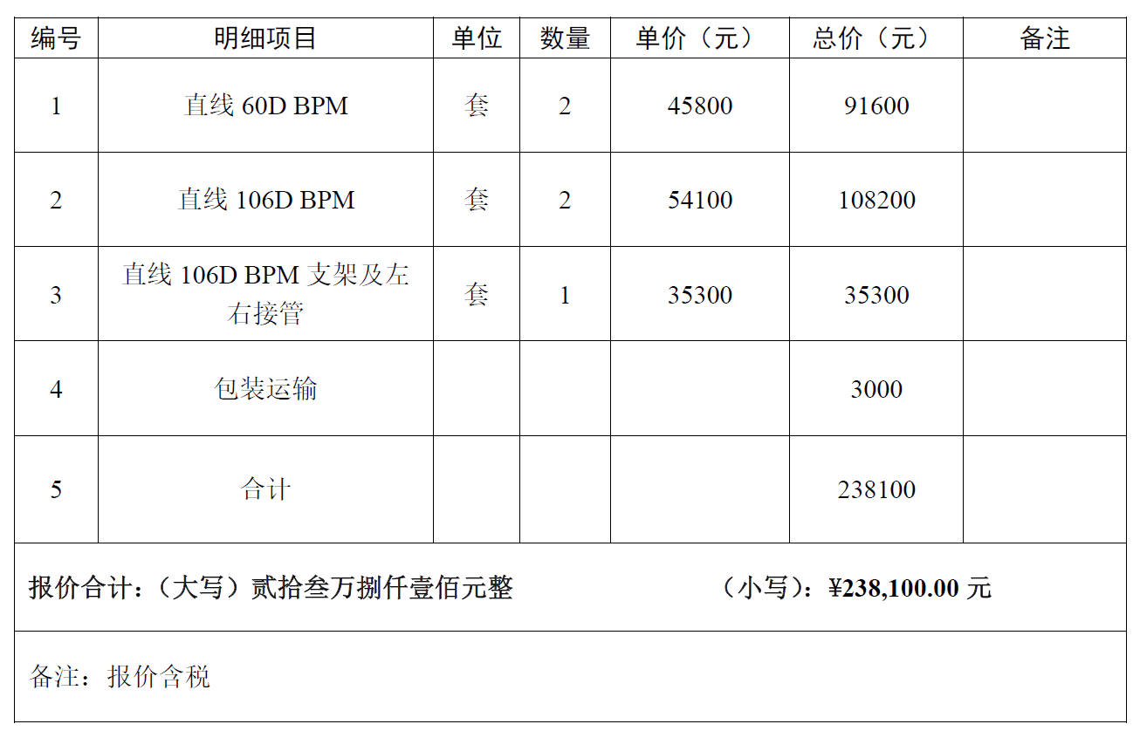
8.1 Cost, Schedule and Responsibilities
The price of single BPM sensor is about 50,000 CNY → 1 prototype for each BPM (~14 W)
The price of LMR-400 cable per 4 x 100 m about 20,000CNY
The price of LIBERA single pass H about 127,000 CNY [already existed at CSNS]
To be decided,
Depend up Acc. Schedule
Responsibilities
M. A. Rehman and Renjun Yang; BPM Simulation/Design, Cold/Beam Test
Xu Zhihong; Readout Electronics + phase measurement
Liu Renhong; Mechanical Drafts/Drawings
Peng Jun; Beam Optics/Parameters

Slide 15
9.1 Summary
Quad-BPM Assembly
BPM-Quad assembly electrical and mechanical design for spoke/Elliptical cavity region is done
Basic characteristics of BPM are determined with analytical formulas and numerical codes
Technical drawing are prepared, and first prototype will be prepared
Beam test of BPM is under discussion and schedule will be finalized soon

Slide 16
Backup

Slide 17
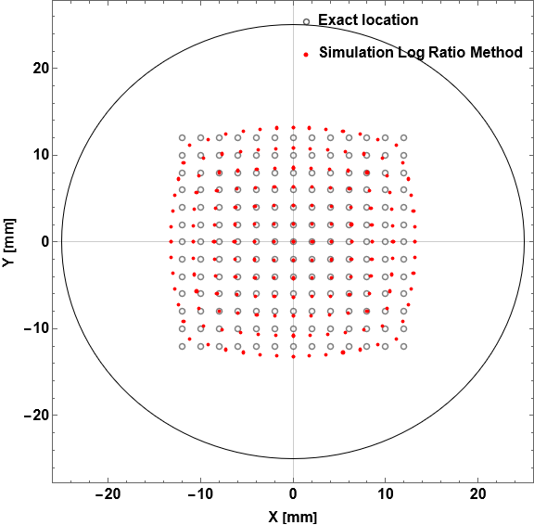
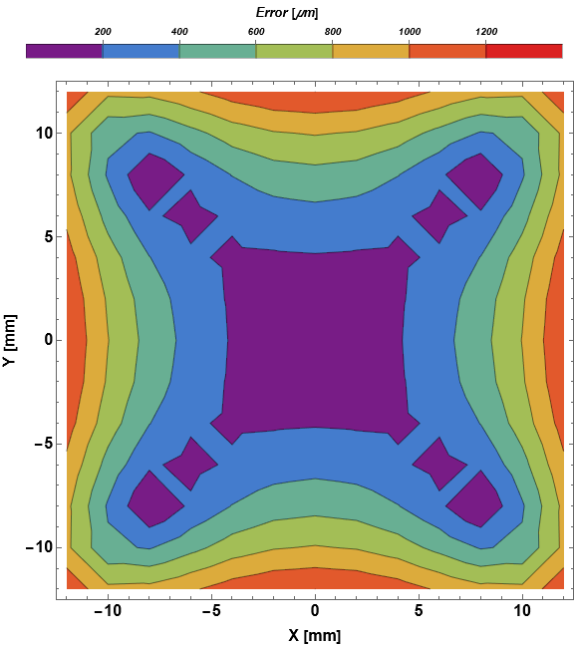
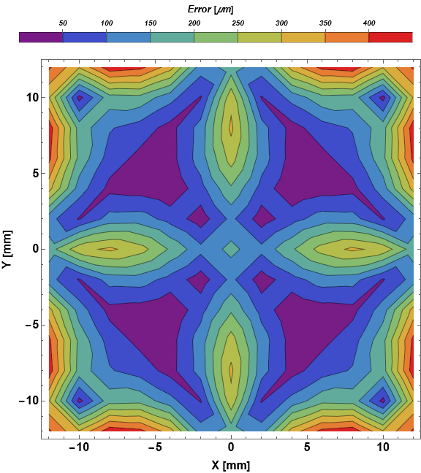
2.2 Position Analysis Spoke Cavity Region BPM
$$Err=\sqrt{{(x_{set}−x_{sim.})}^{2}+{(y_{set}−y_{sim.})}^{2}}$$
Accuracy: Difference between true value and measured values.
The Maximum error at R/2 with poly fit of order 4 is 25 µm.

Slide 18
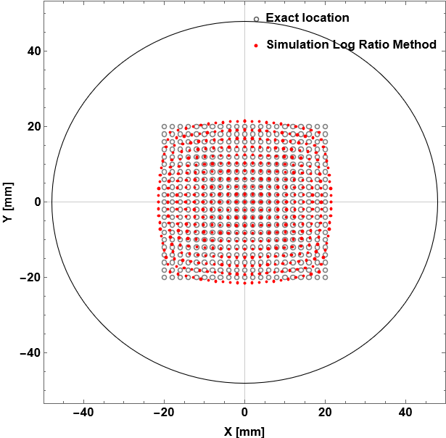
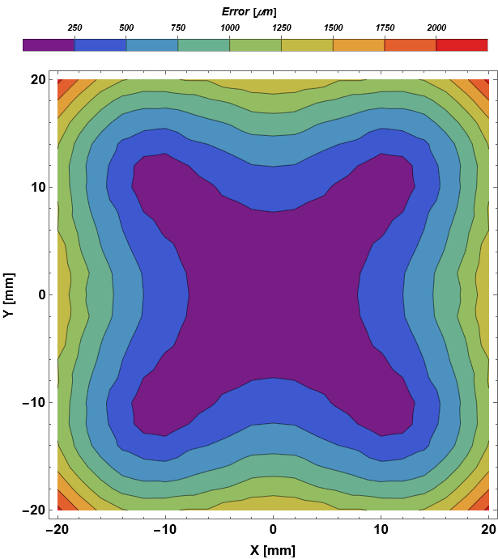
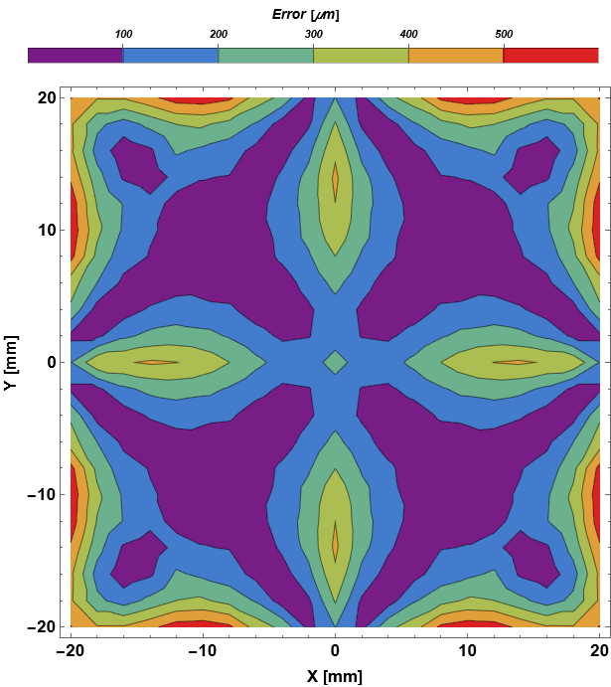
2.3 Position Analysis Elliptical Cavity Region BPM
$$Err=\sqrt{{(x_{set}−x_{sim.})}^{2}+{(y_{set}−y_{sim.})}^{2}}$$
The Maximum error at R/2 with poly fit of order 4 is 50 µm.

