Slide 1
2.6-2.8激光丝剖面测量实验

Slide 2
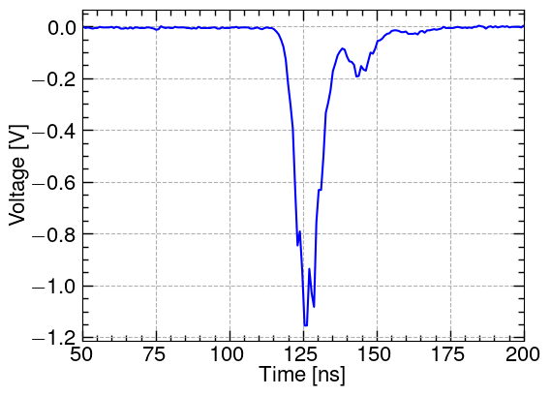
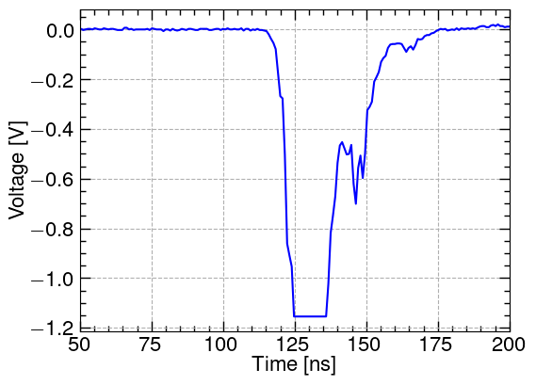
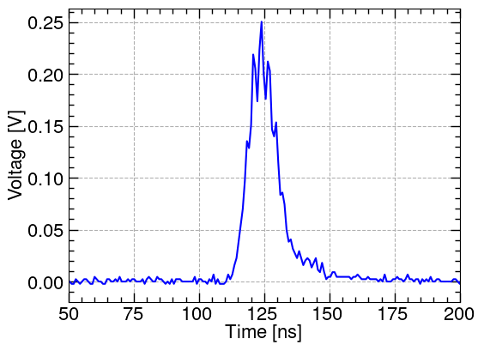
原始信号
C2放大器
Laser Power: 5%
Magnet Current: 5.9A
Focus Lens: 0mm
X Position: 0mm
C2放大器
Laser Power: 50%
Magnet Current: 5.9A
Focus Lens: 0mm
X Position: 0mm
C1放大器
Laser Power: 50%
Magnet Current: 6.9A
Focus Lens: 0mm
X Position: 0mm
采样率，示波器？

Slide 3
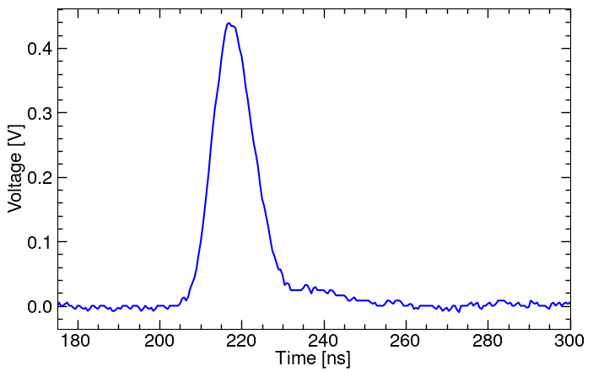
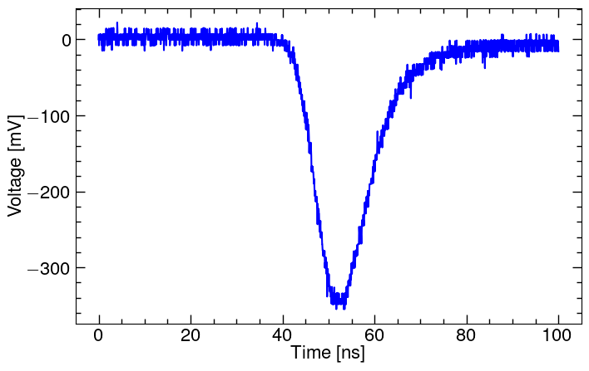
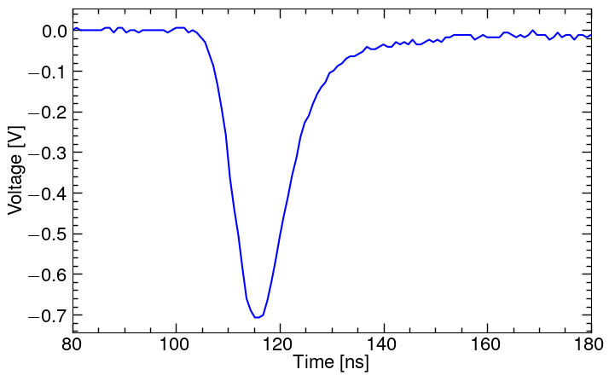
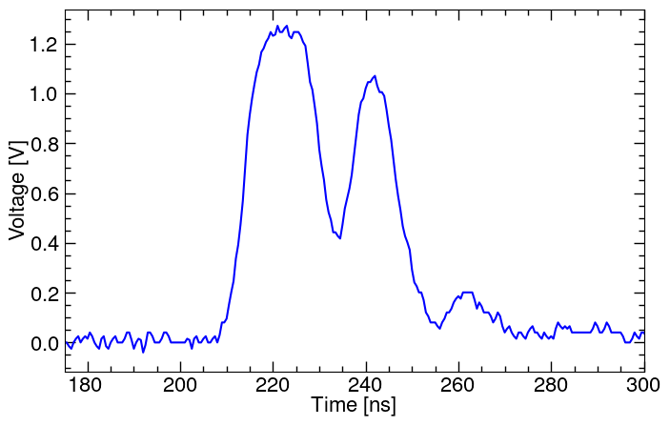
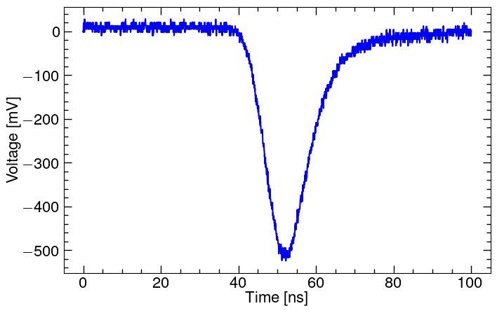
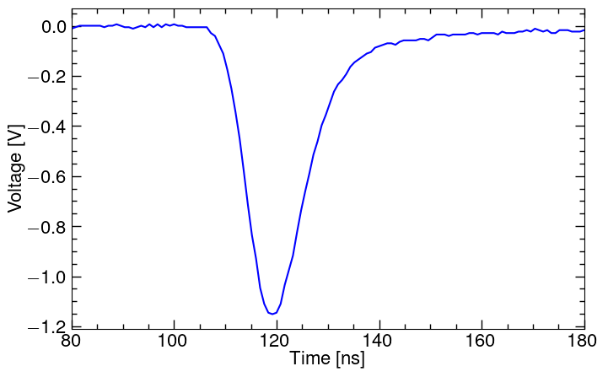
原始信号
Rising time：
~10ns
With C1
Laser Power: 50%
Magnet Current: 4.4A
MCP Voltage: 700V，1000V
Beam Current: 13.3mA
Beam Pulse : 85us
Focus Lens: 0mm
Without C1 by oscilloscope
Laser Power: 50%
Magnet Current: 5.50A, 5.96A
MCP Voltage: 700V
Beam Current: 14mA
Beam Pulse: 85us
Focus Lens: 0mm
Without C1 by PXIe-5160
Laser Power: 10%, 50%
Magnet Current: 5.9A
MCP Voltage: 700V
Beam Current: 14mA
Beam Pulse: 85us
Focus Lens: 0mm

Slide 4
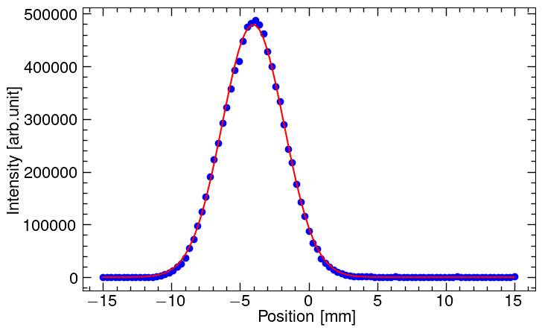
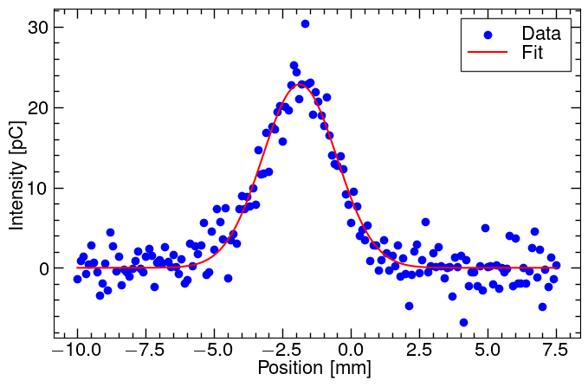
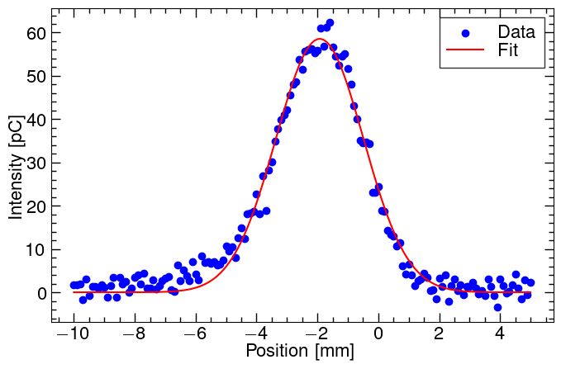
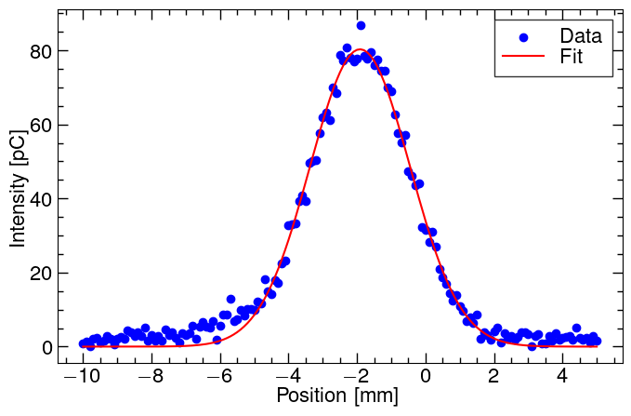
剖面测量
FWS
Laser Power:5%
Laser Power:40%
Laser Power:100%

Slide 5
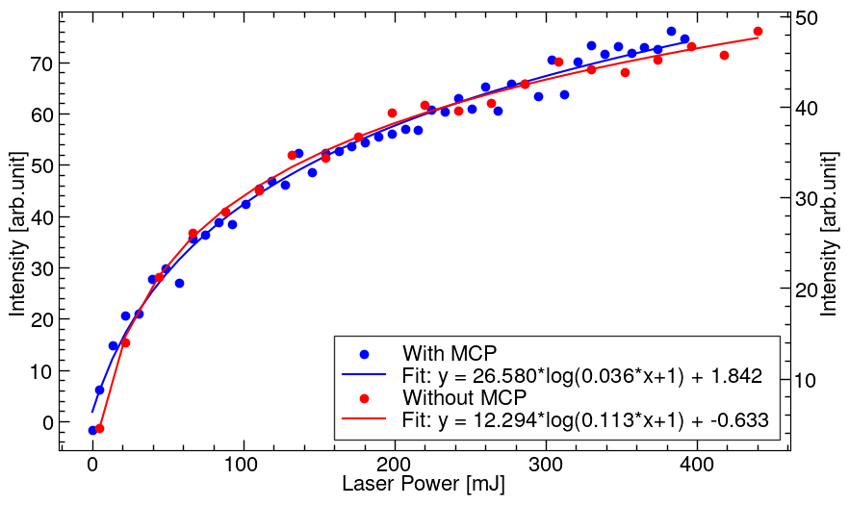
激光功率与能量的关系
With MCP
Magnet Current: 5.9A
MCP Voltage: 650V
Y profile Position: 0mm
F Position: 0mm
With C1
Magnet Current: 6.9A
Y profile Position: 0mm
F Position: 0mm

Slide 6
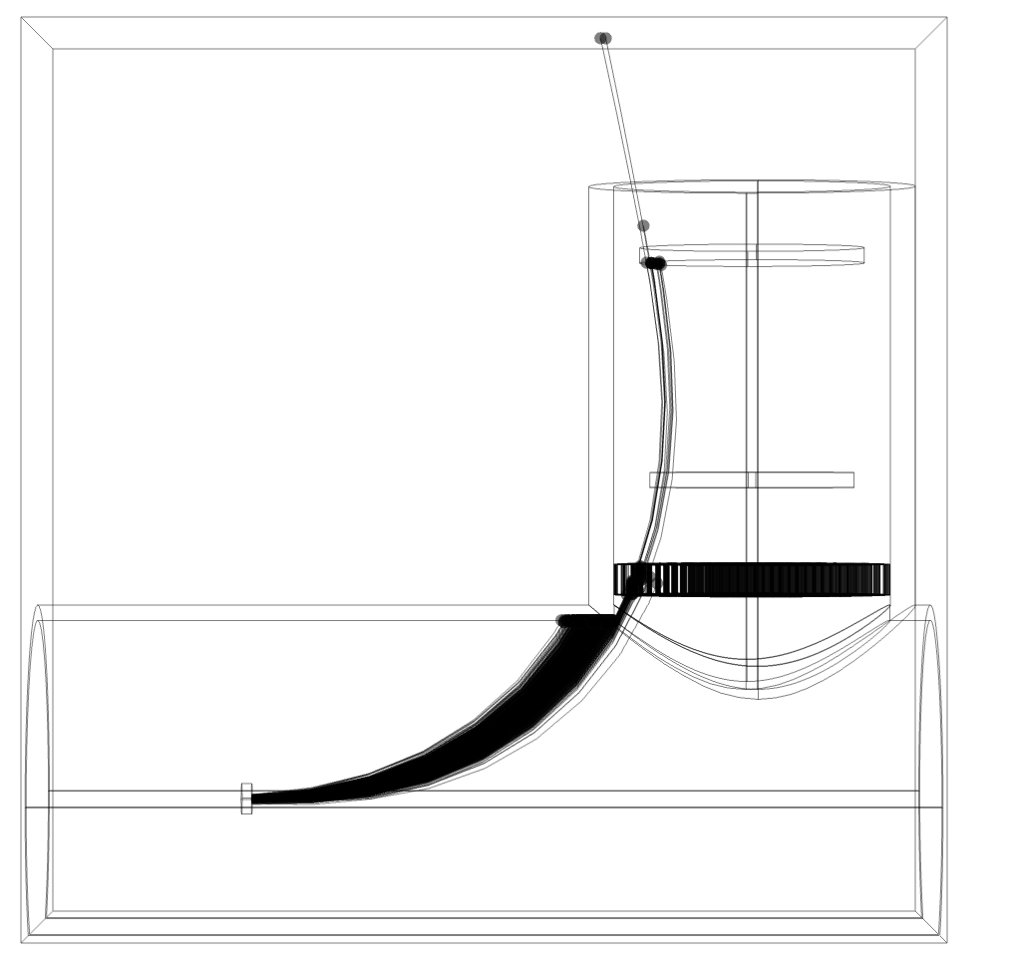
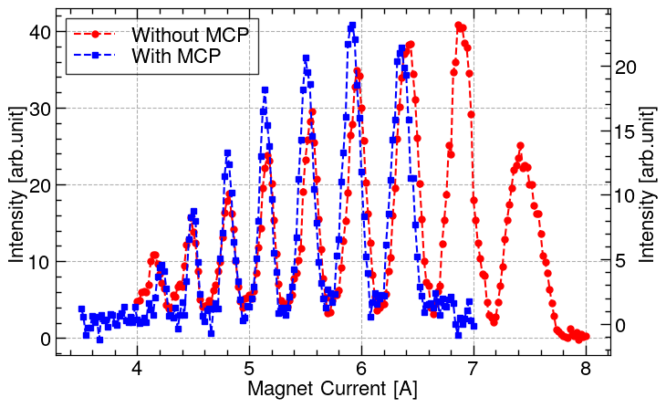
磁铁扫描
With MCP
Laser Power: 50%
MCP Voltage: 650V
Y profile Position: 0mm
F Position: 0mm
With C1
Laser Power: 40%
Y profile Position: -4mm
F Position: 0mm
Simulation magnet current: 6.6A
外部磁场使电子束过偏转

Slide 7
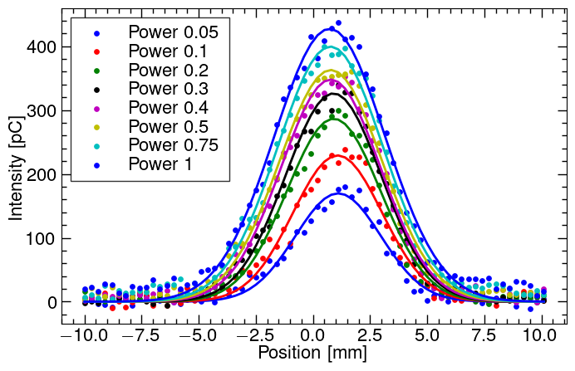
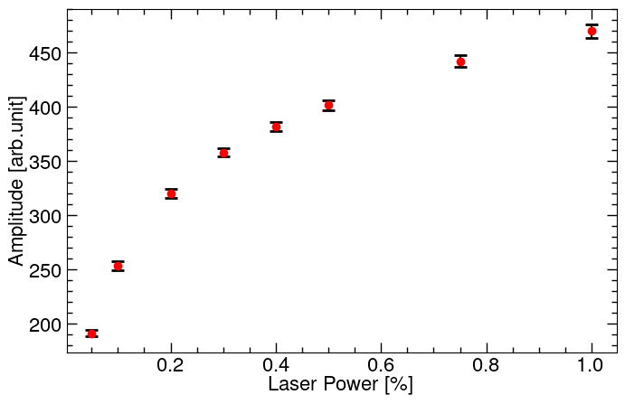
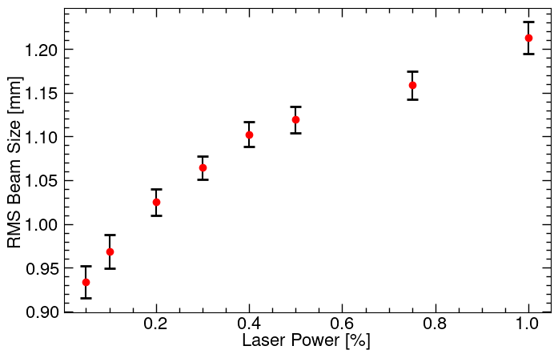
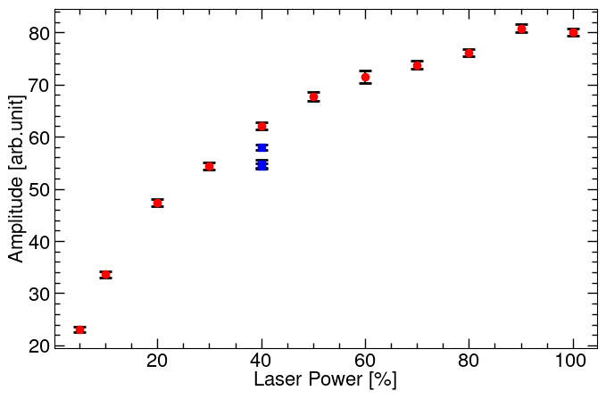
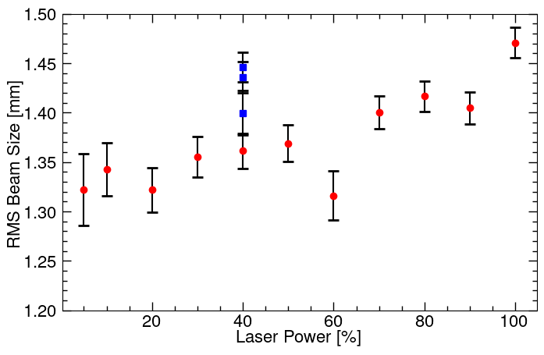
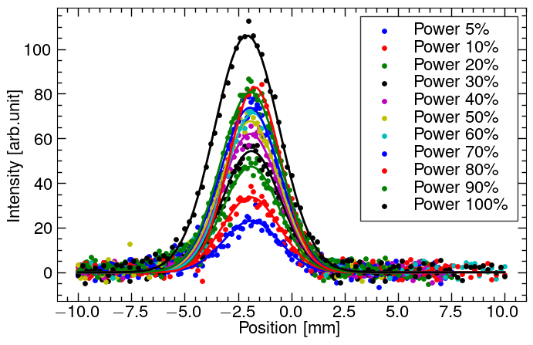
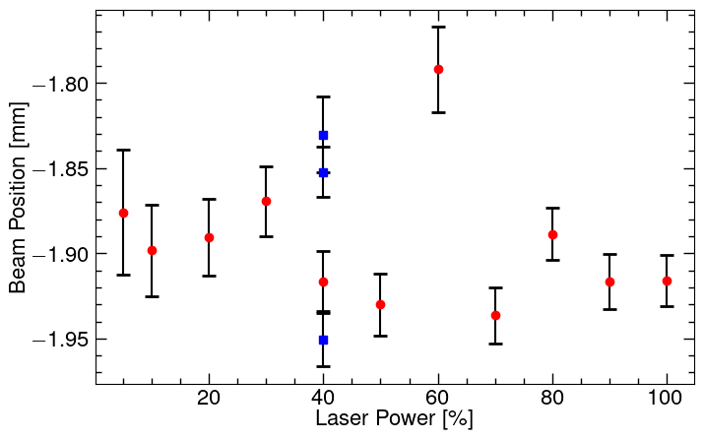
剖面随激光能量变化
With MCP
Magnet Current:5.9A MCP Voltage:725V Beam Current:8mA Beam Pulse: 85us Focus Lens: 0mm
Without MCP
Magnet Current:6.9A MCP Voltage:725V Beam Current:8mA Beam Pulse: 85us Focus Lens: 0mm

Slide 8
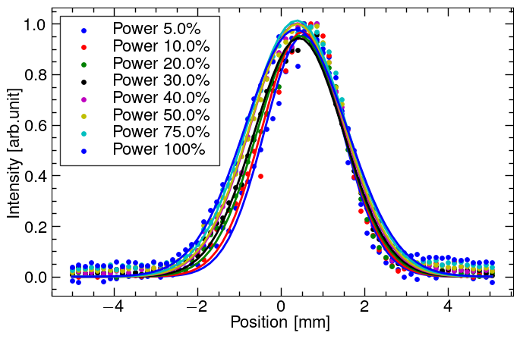
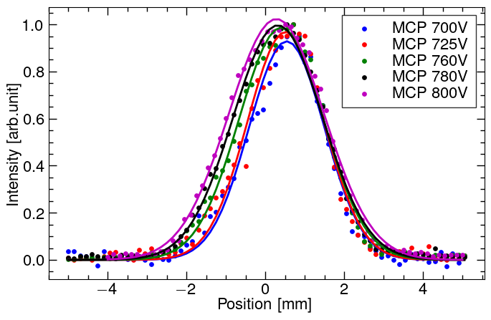
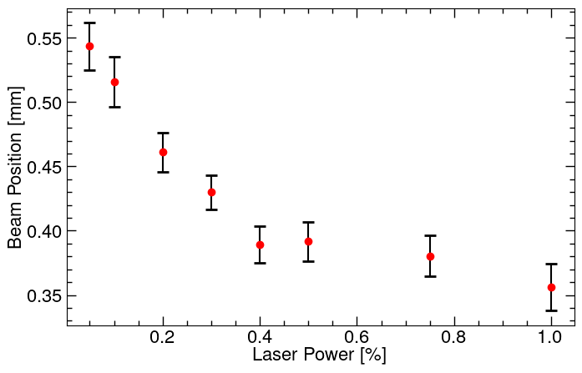
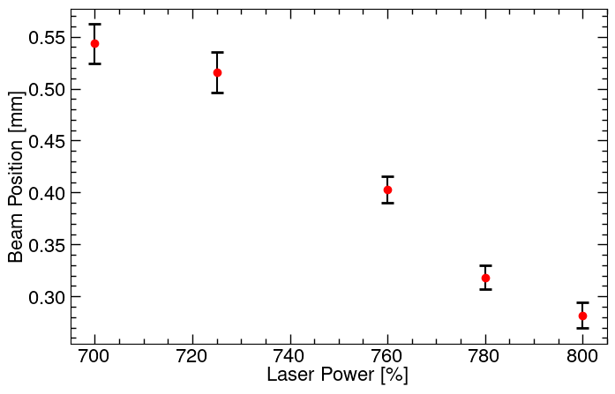
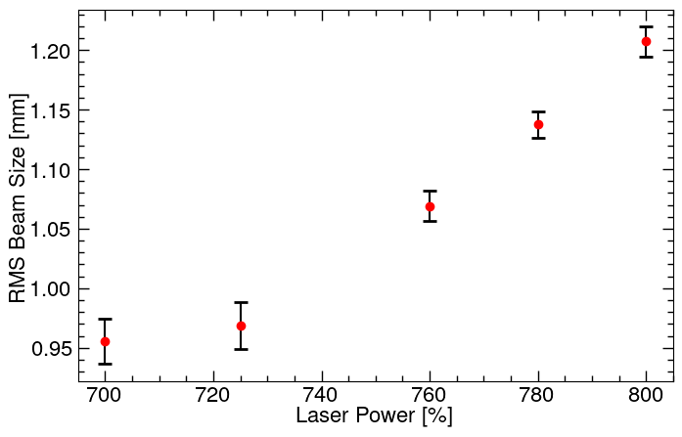
激光丝测量束流位置与剖面关系
Magnet Current: 5.9A
MCP Voltage: 725V
Beam Current: 8mA
Beam Pulse: 85us
Focus Lens: 0mm
Magnet Current: 5.9A
Laser Power: 10%
Beam Current: 8mA
Beam Pulse: 85us
Focus Lens: 0mm
不同磁铁电流下扫描剖面？

Slide 9
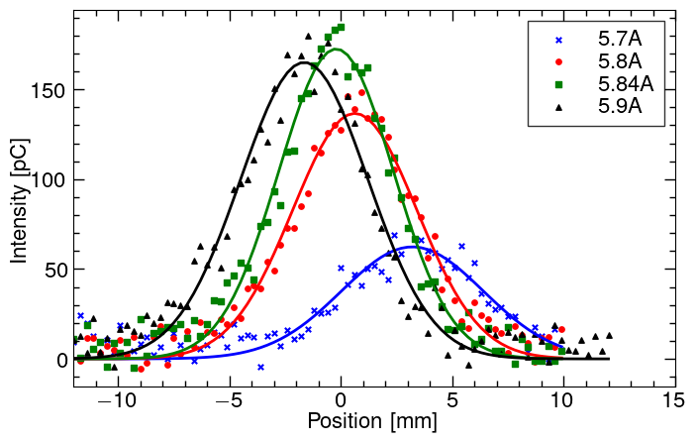
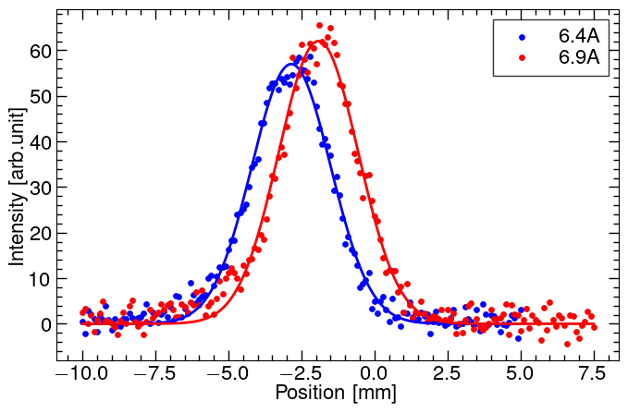
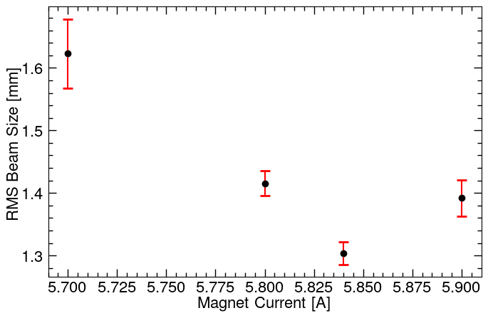
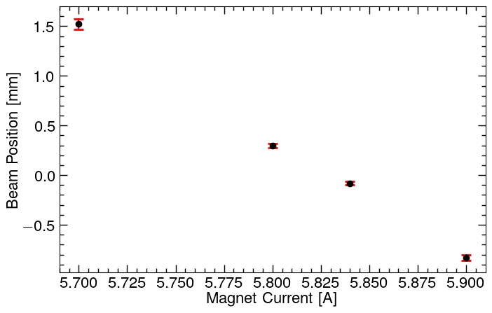
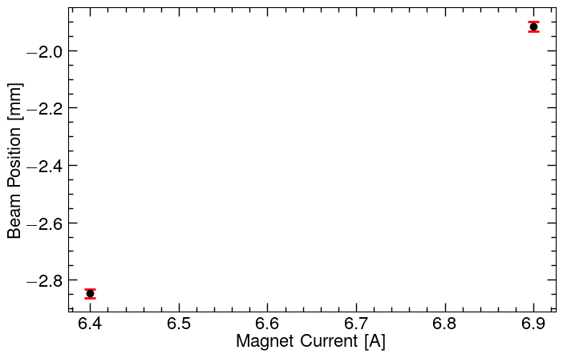
激光丝测量磁铁电流与剖面关系
Laser Power: 50%
MCP Voltage: 650V
Beam Current: 8mA
Beam Pulse: 85us
Focus Lens: 0mm
Without MCP
Laser Power: 40%
Beam Current: 16mA
Beam Pulse: 85us
Focus Lens: 0mm

Slide 10
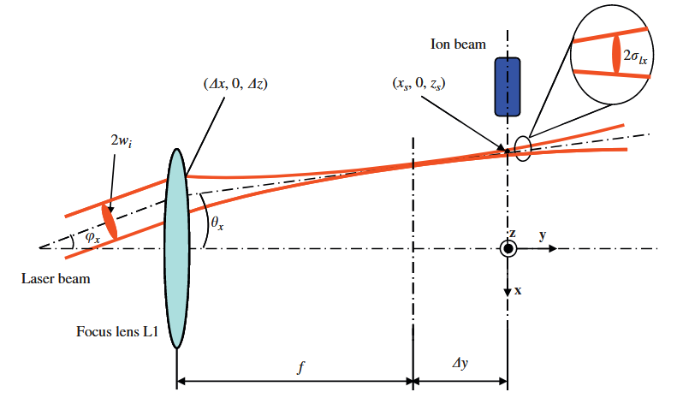
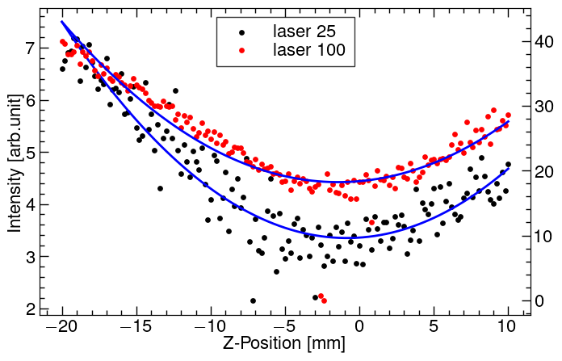
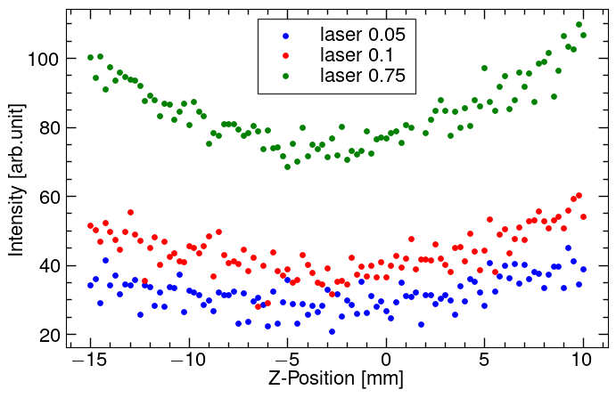
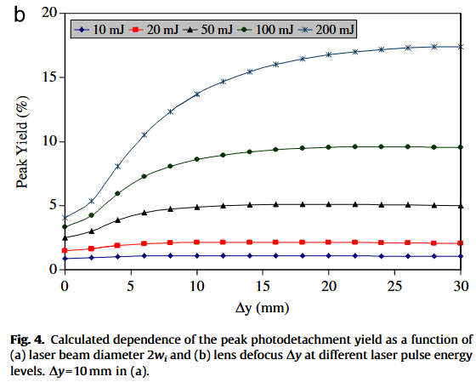
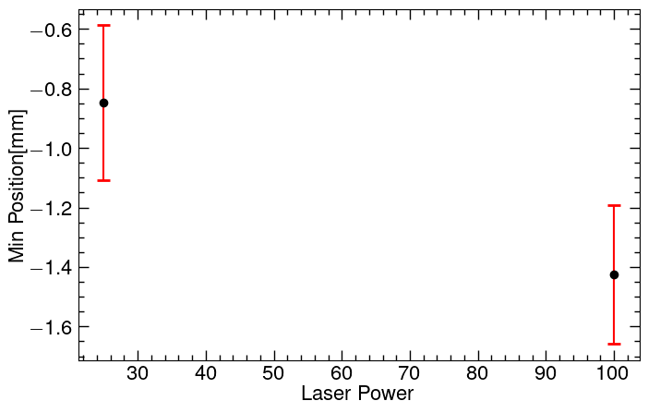
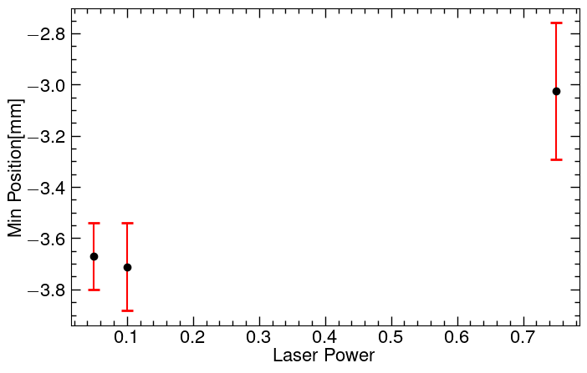
Z-Scan 表征及剥离效率
Laser Power: 220mJ
Magnet Current: 5.9A
MCP Voltage: 650V
X Position: 0mm
Y.Liu, Laser wire beam profile monitor in the spallation neutron source (SNS) superconducting linac,2010.

Slide 11
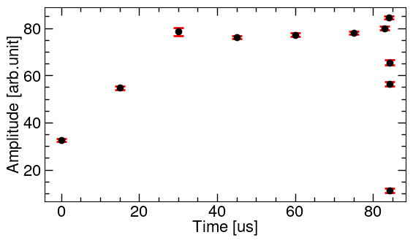
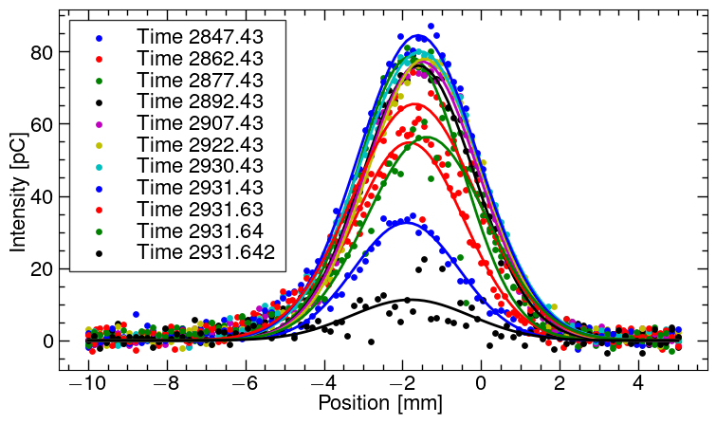
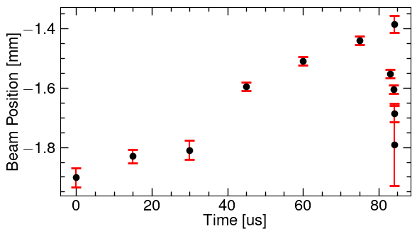
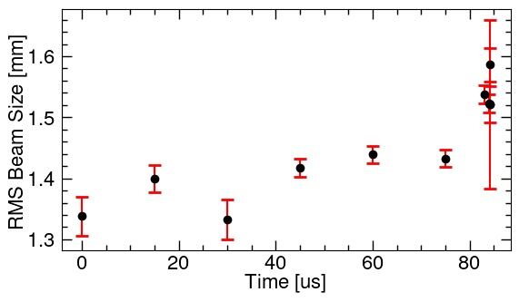
束内扫描
Laser Power:176mJ
Magnet Current:6.9A
Z Position: 0mm

Slide 12
实验总结

Slide 13
后续计划
后续实验：
1.采用示波器观察记录原始信号。
2.改变磁铁电流的蜂窝网扫描（CST）。

