Slide 1
Experiment of Laser wire profile monitor at CSNS
Biao Zhang
17 March 2025

Slide 2
Contents
Motivation
Discuss about the result of our LW experiment.
Seek advice for future upgrades.
Experiment setup
CSNS linac
Laser
Results
Experiment
Simulation

Slide 3
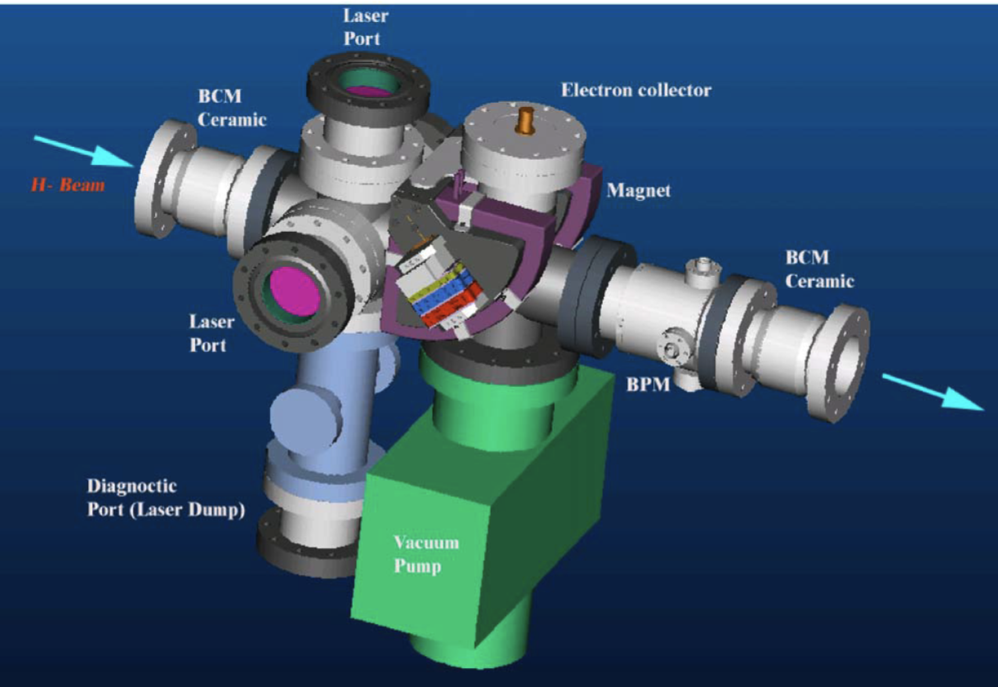
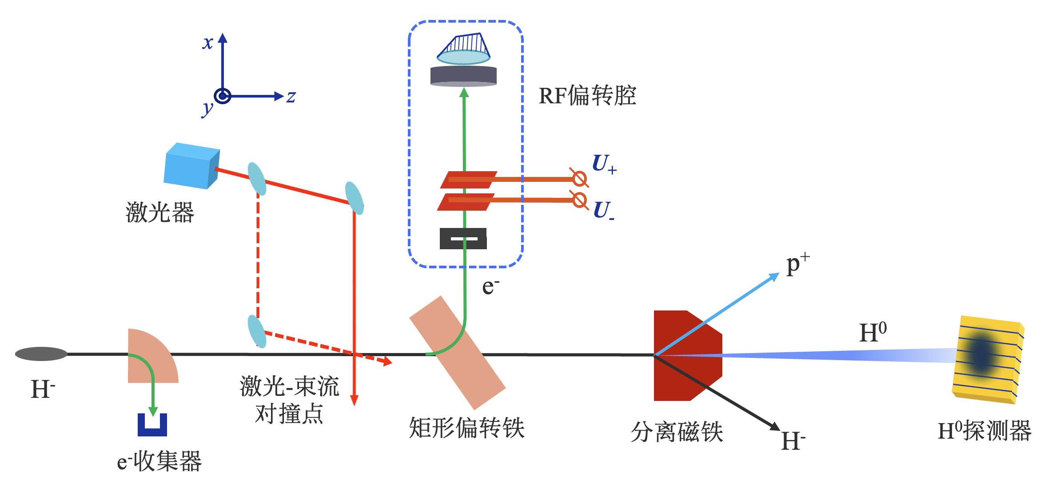
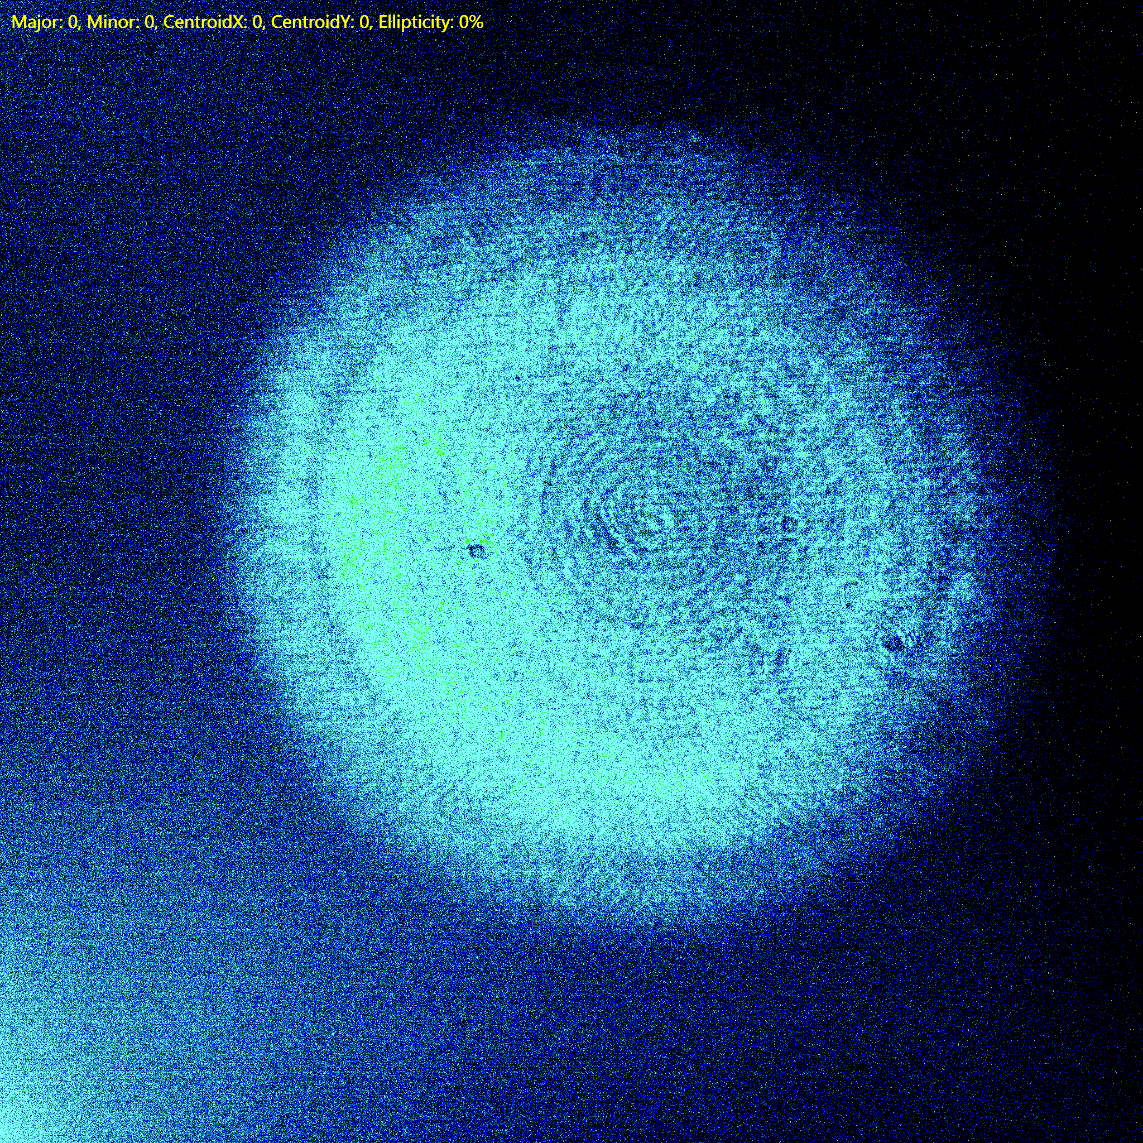
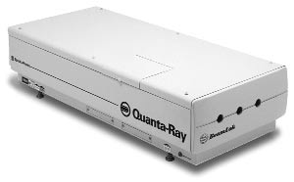
China Spllation Neutron Source
Beam Profile Monitor
Multidimensional phase space distribution measurement
The linac beam energy will be increased from 80 MeV to 300 MeV employing a new superconducting accelerating section.
DTL
SRF cavities
HEBT
5 mm
1064 nm laser
Main international H- linear accelerator parameters
 | Energy（MeV） | Current（mA） | Pulse width, repetition frequency
CERN LINAC4 | 160 | 40 | 400 μs@0.83 Hz
SNS | 1000 | 26 | 1 ms@60 Hz
RHIC | 200 | 60 | 590 μs@6.67 Hz
J-PARC | 400 | 50 | 500 μs@25 Hz
CSNS | 80 (300) | 12 (50) | 540 μs@25 Hz
PIP-II | 800 | 2 | 540 μs@20 Hz

Slide 4
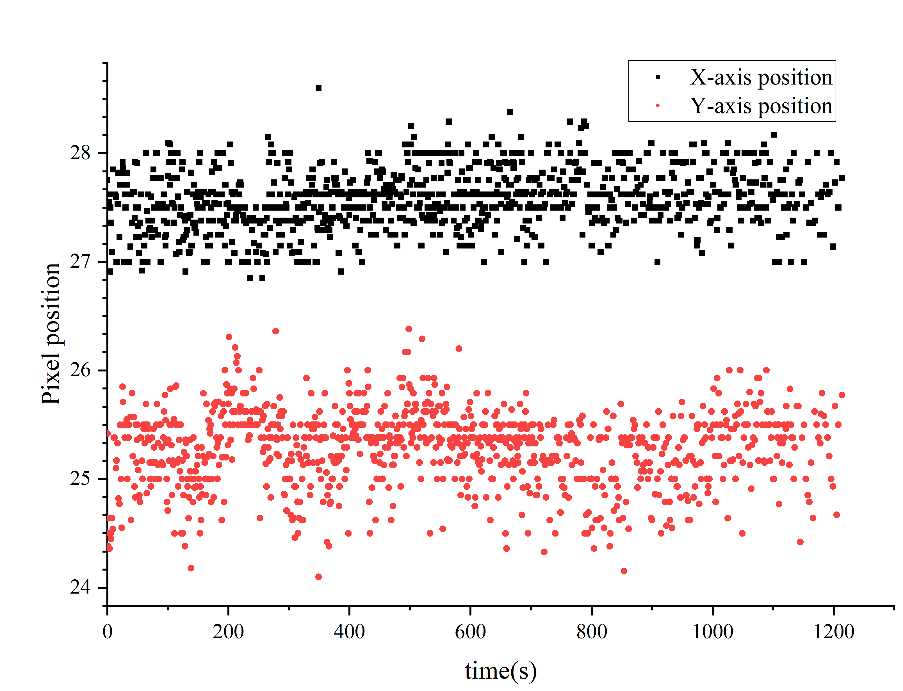
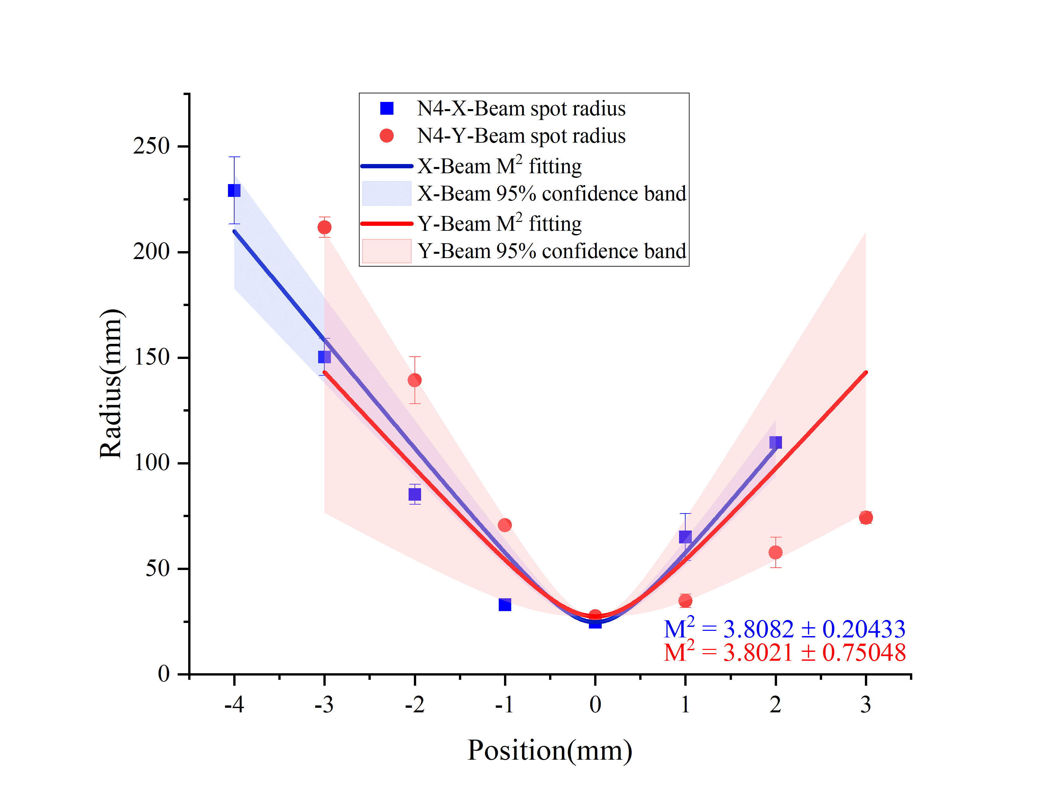
Laser Parameters
Nimma-900 Laser generator：
Wavelength：1064nm
Repetition frequency：1-10 Hz
Single pulse energy：~900 mJ
Energy stability：RMS ≤ 0.7%
Pulse width：FWHM ≤ 9 ns
Pulse width jitter： ≤ 0.5 ns
Beam spot size：7~9 mm
Divergence angle： ≤ 0.6 mrad
Pointing stability：≤ 30 μrad
Polarization：Horizontal
σ=1.52042
σ=1.94117
M² = 3.81 ± 0.20
M² = 3.80 ± 0.75
Interaction Pointing stability
Transmission performance:
Energy@after-expander: 591±3 mJ
Energy@~60m: 400±3.39 mJ
Transmission efficiency：~67.7%
Laser beam quality factor M²: < 4
Minimum spot size: ~40 µm
Pointing stability: < 8 µm
Spot diameter variation within ±3 mm range: 72.4 ~ 195.25 µm
1
This laser is expanded three times and transmitted over 60 m.

Slide 5
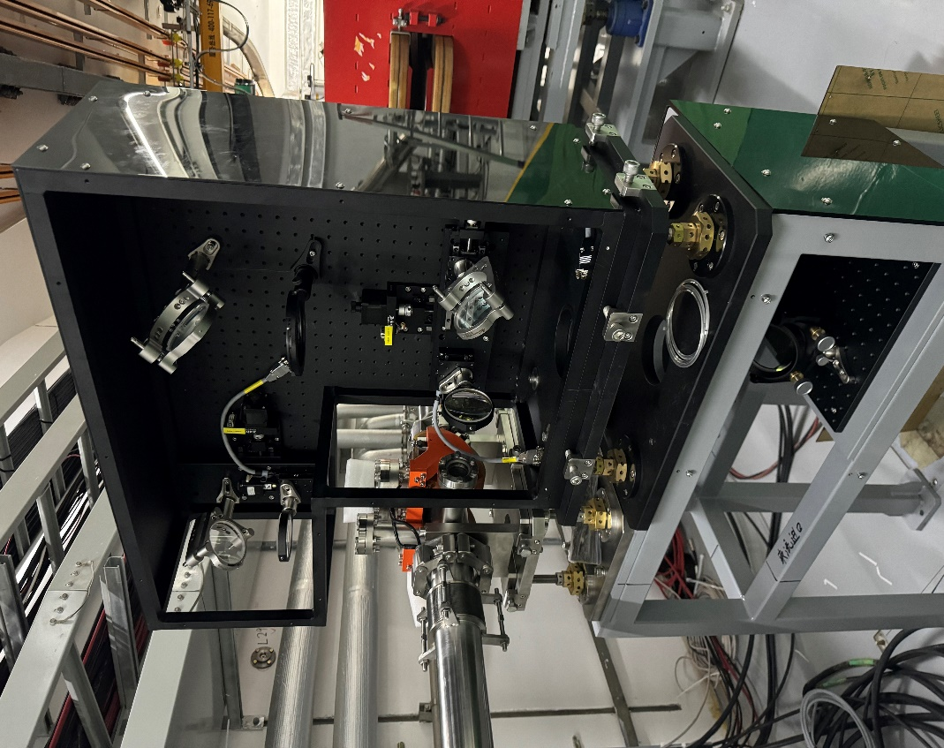
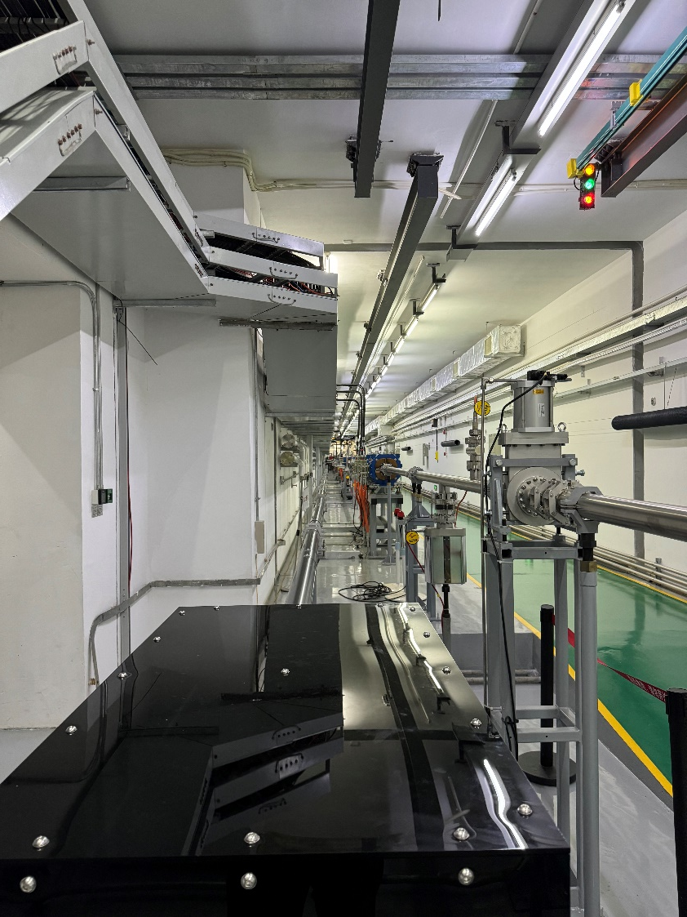
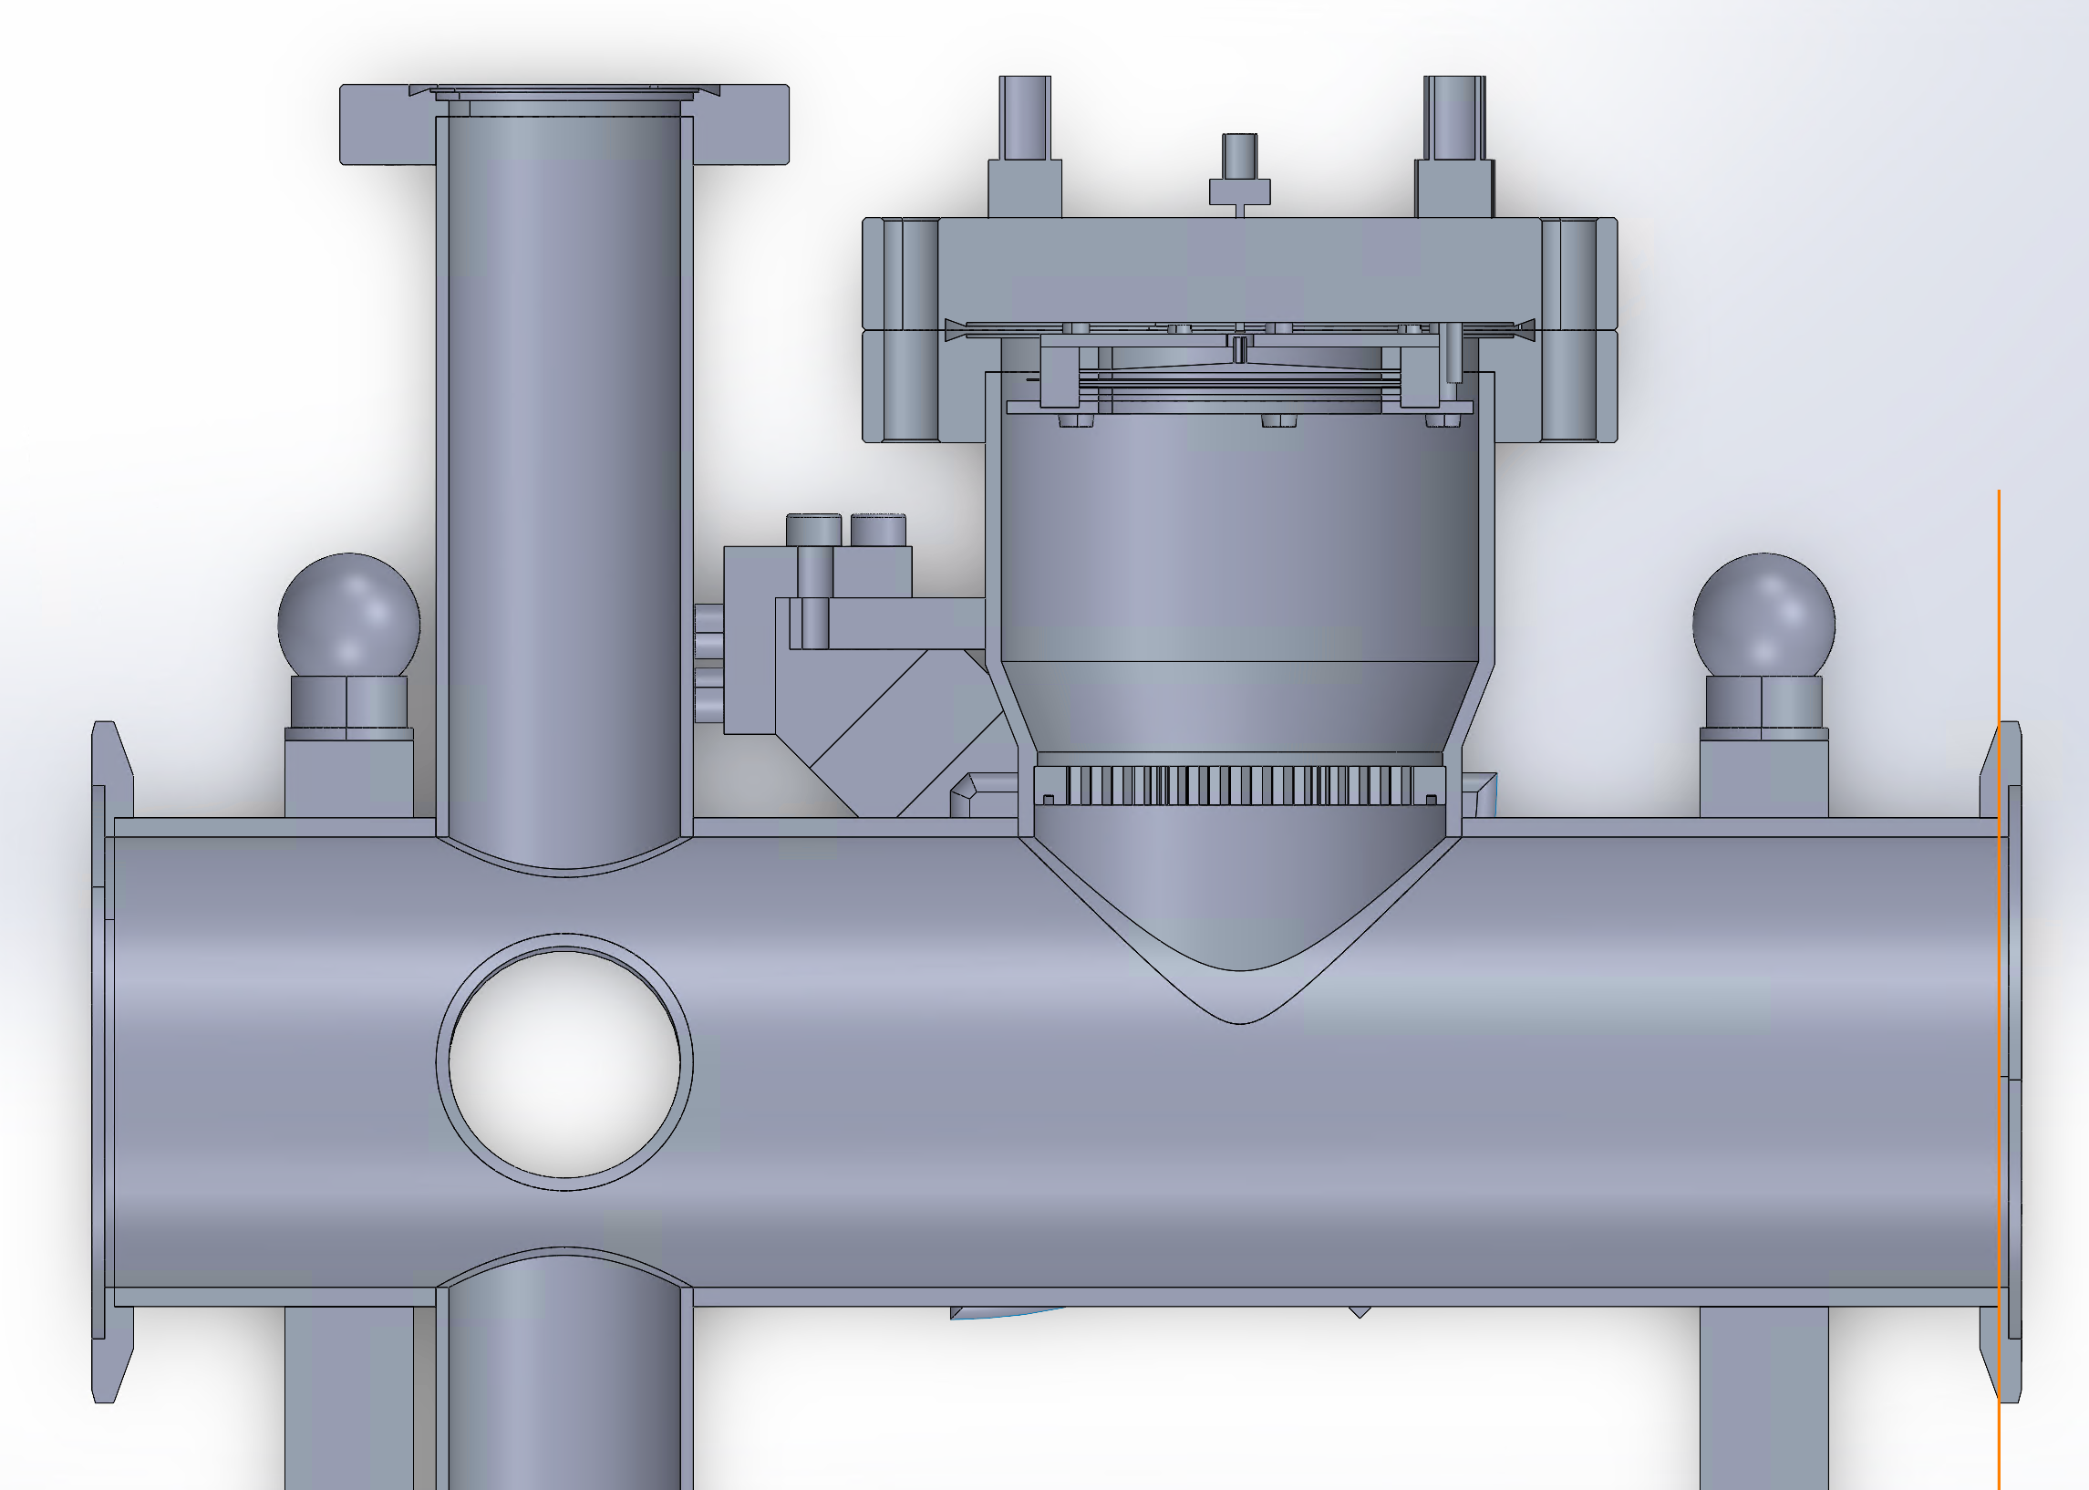
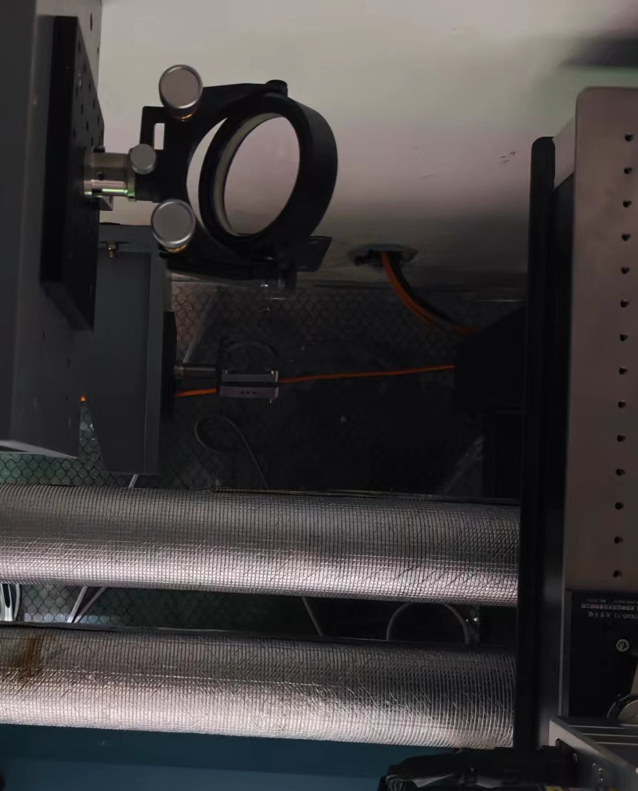
Laser Wire Set-up
3
4
MCP
Y
photodiode
X
Switching the optical path allows the laser to scan the beam along the X or Y direction.
The stripped electrons are bent by a sector magnet, amplified by an MCP, and collected by a Faraday cup.
A honeycomb is placed under the Faraday cup to shield against beam electromagnetic interference.
1
2

Slide 6
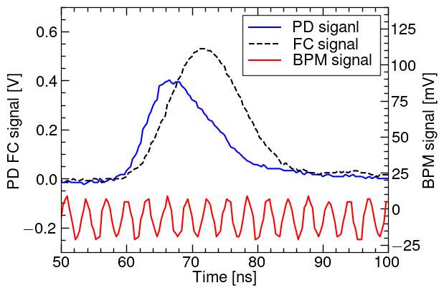
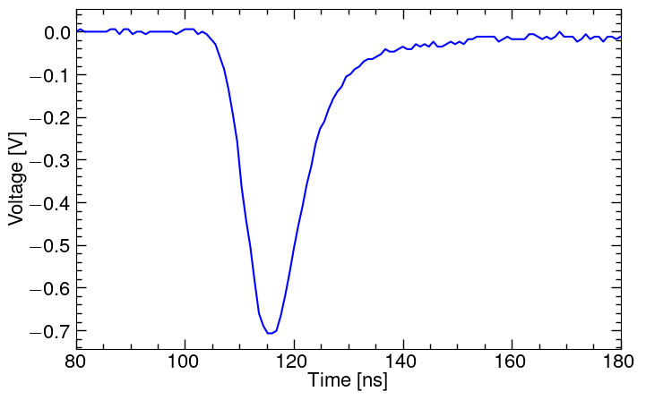
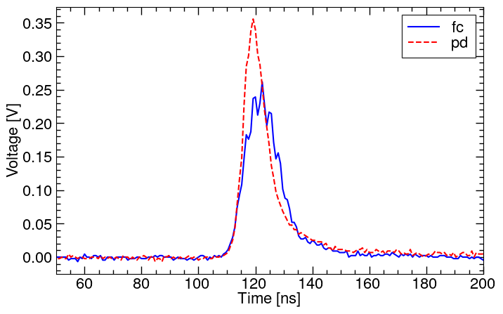
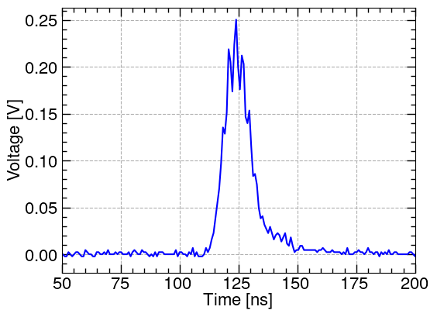
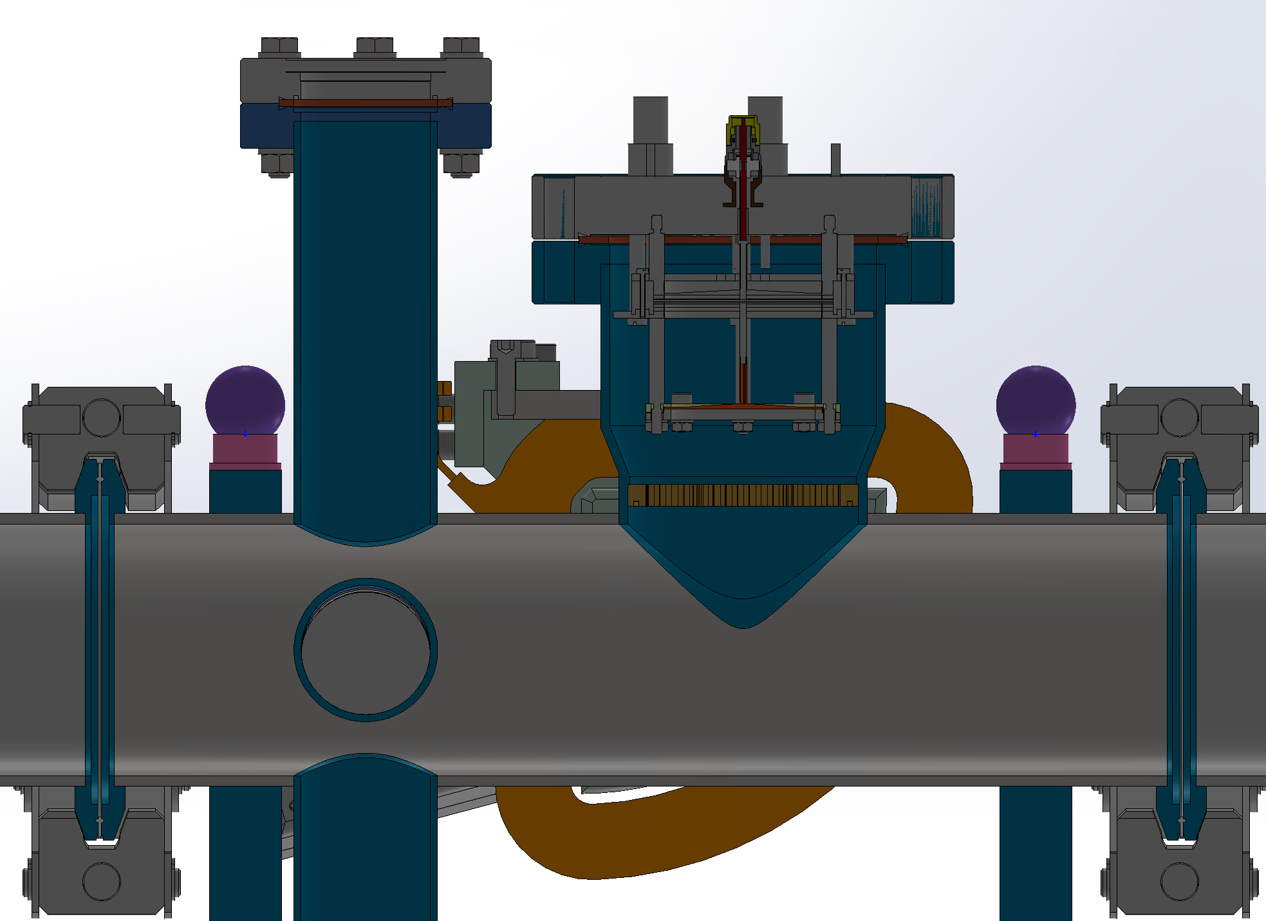
Raw Signal
Interaction chamber upgrade: Replacing MCP amplification with a preamplifier, while lowering the Faraday cup.
MCP
Some longitudinal structures of the bunches can be observed. In the future, a fast Faraday cup is planned for longitudinal measurement.
Rising time：
~10ns
With MCP by Oscilloscope
With MCP by PXIe-5160
20dB
amplifier
readout
With preamp by PXIe-5160
With preamp by PXIe-5160

Slide 7
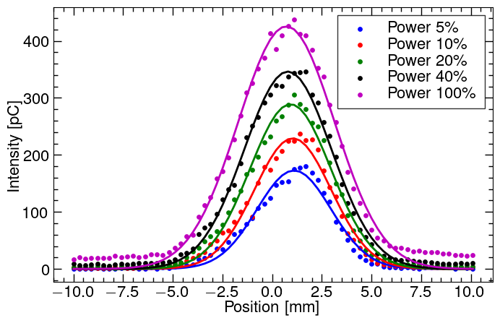
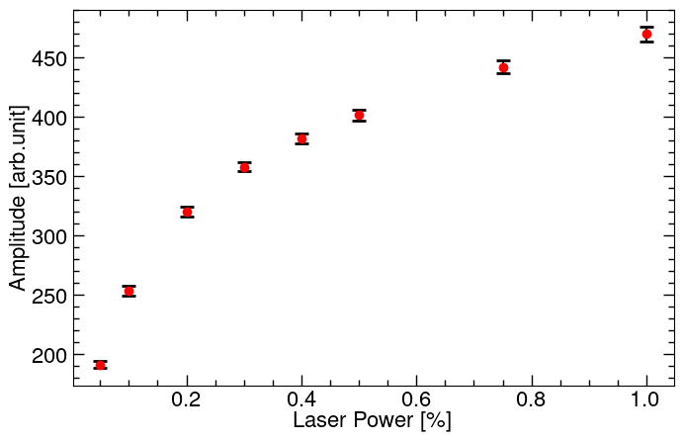
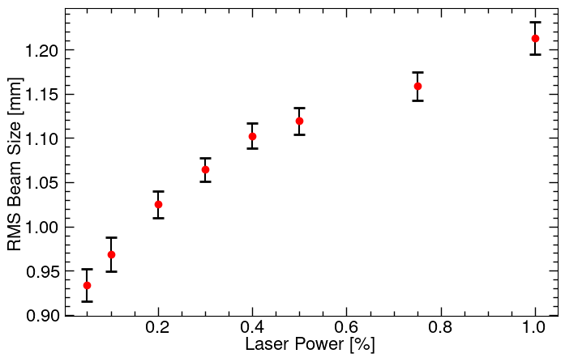
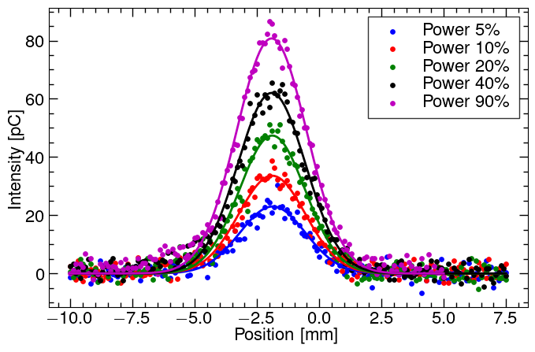
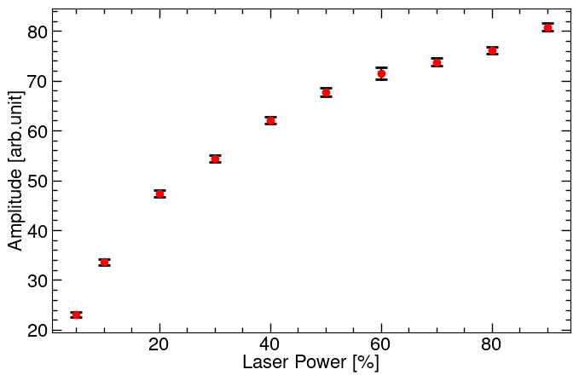
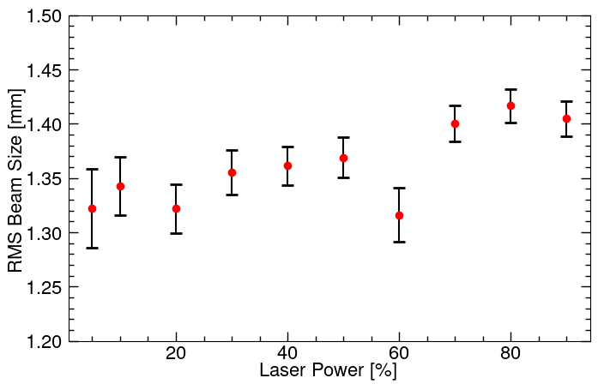
Y-Profile
The saturation effect of the MCP can cause errors in profile measurements.
With MCP
Magnet Current:5.9A MCP Voltage:725V Beam Current:8mA Beam Pulse: 85us Focus Lens: 0mm
Without MCP
Magnet Current:6.9A Beam Current:8mA Beam Pulse: 85us Focus Lens: 0mm

Slide 8
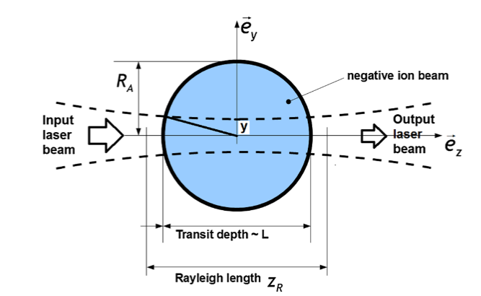
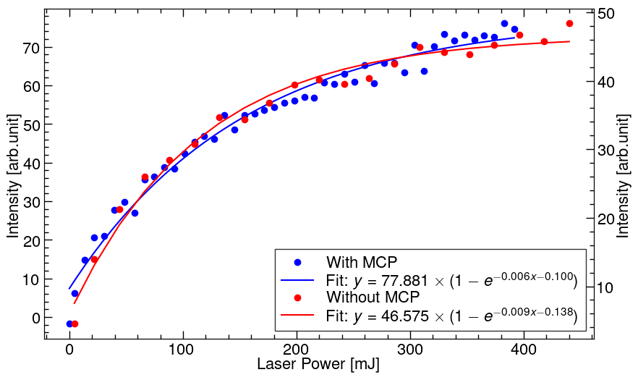
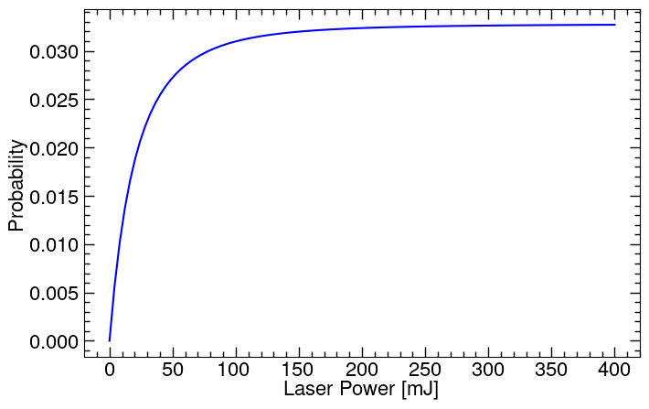
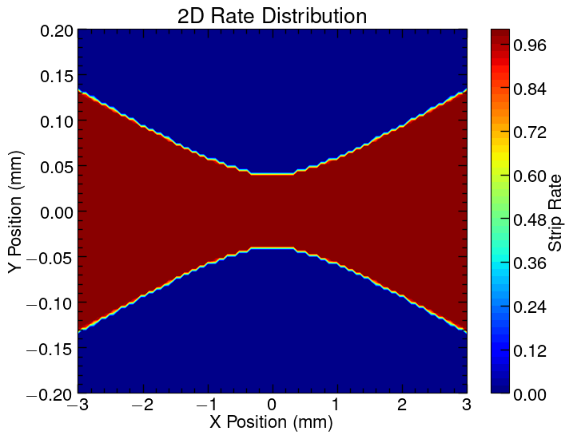
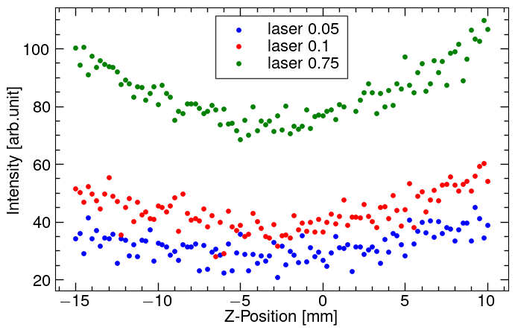
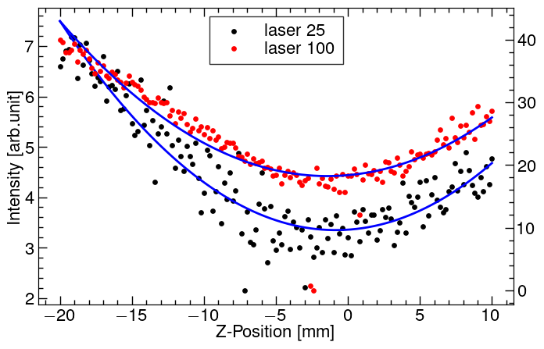
Laser Power Scan & Z Scan
Assuming identical conditions for each bunch, The probability of negative hydrogen stripping reactions is approximately as follows:
When the laser waist and the beam center coincide, the fewest stripped electrons are produced.
Philippe Babilotte, Mickael Vandevraye.Photodetachment cross-section evaluation using asymptotic considerations

Slide 9
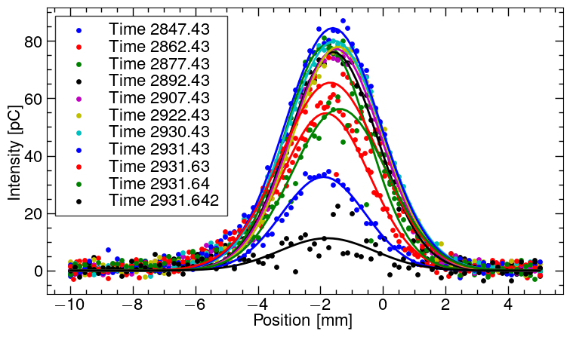
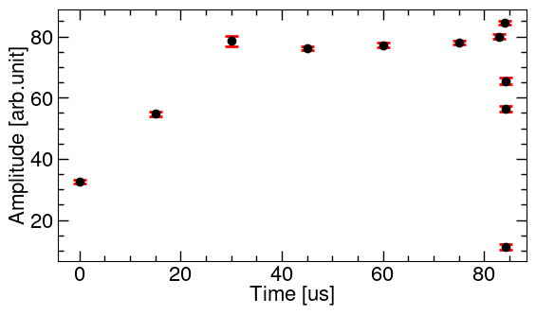
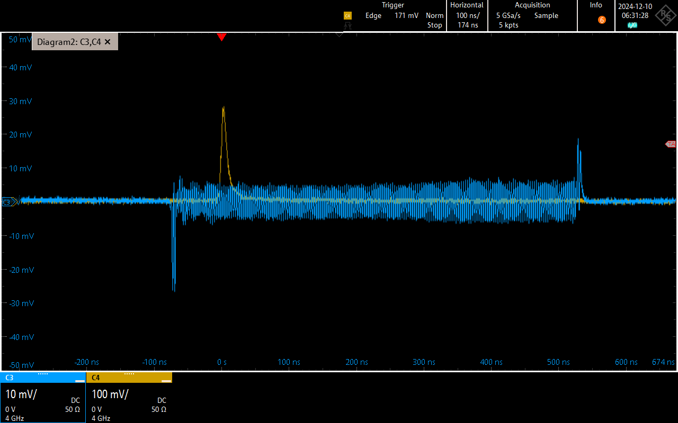
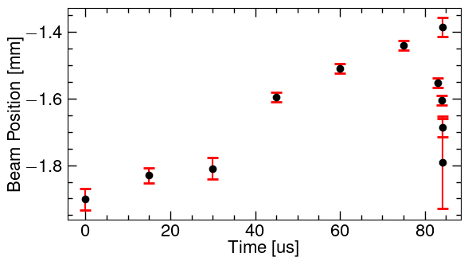
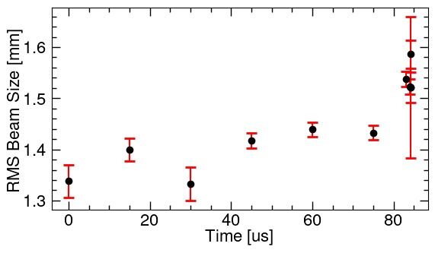
Longitudinal Scan in a Macropulse
By changing the laser trigger time, the beam distribution within the macropulse is measured.
Laser Power:176mJ
Magnet Current:6.9A
Z Position: 0mm

Slide 10
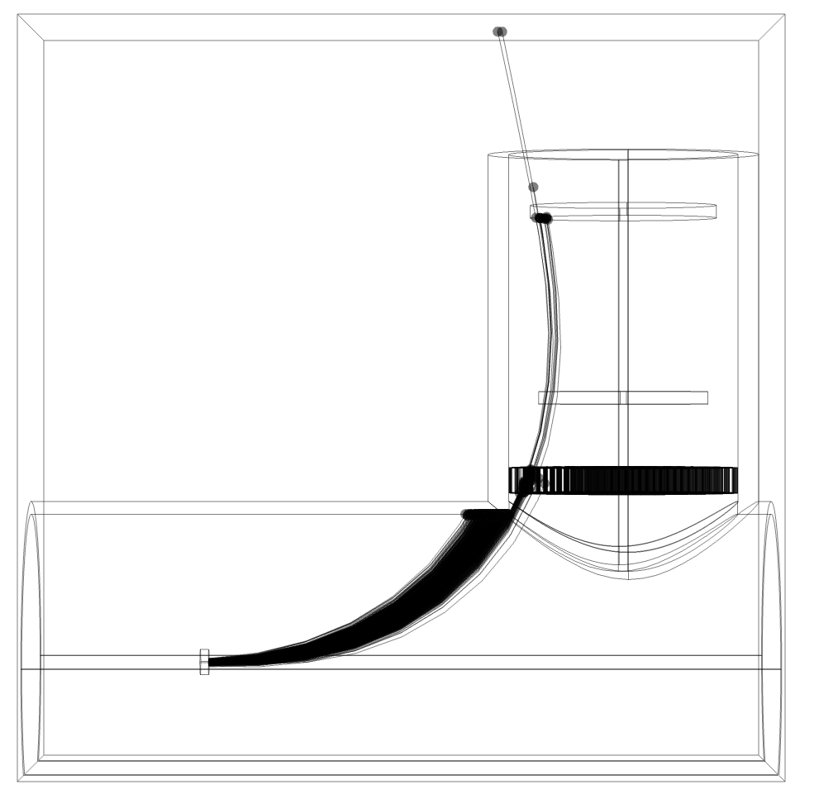
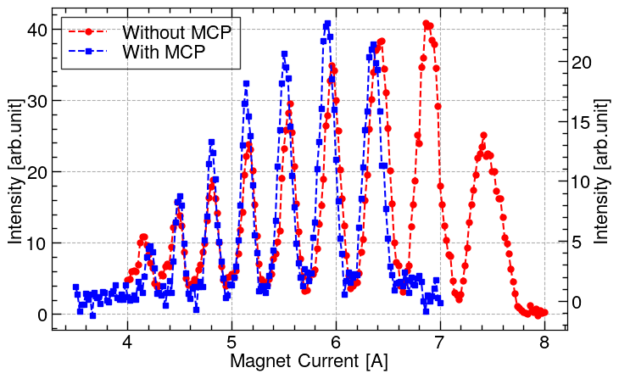
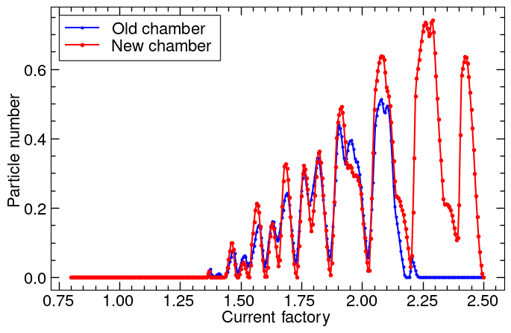
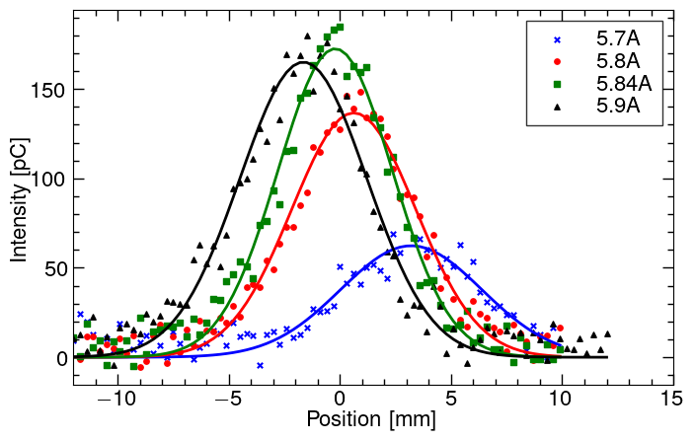
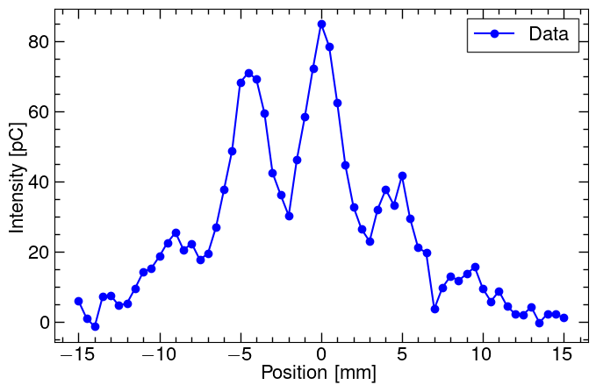
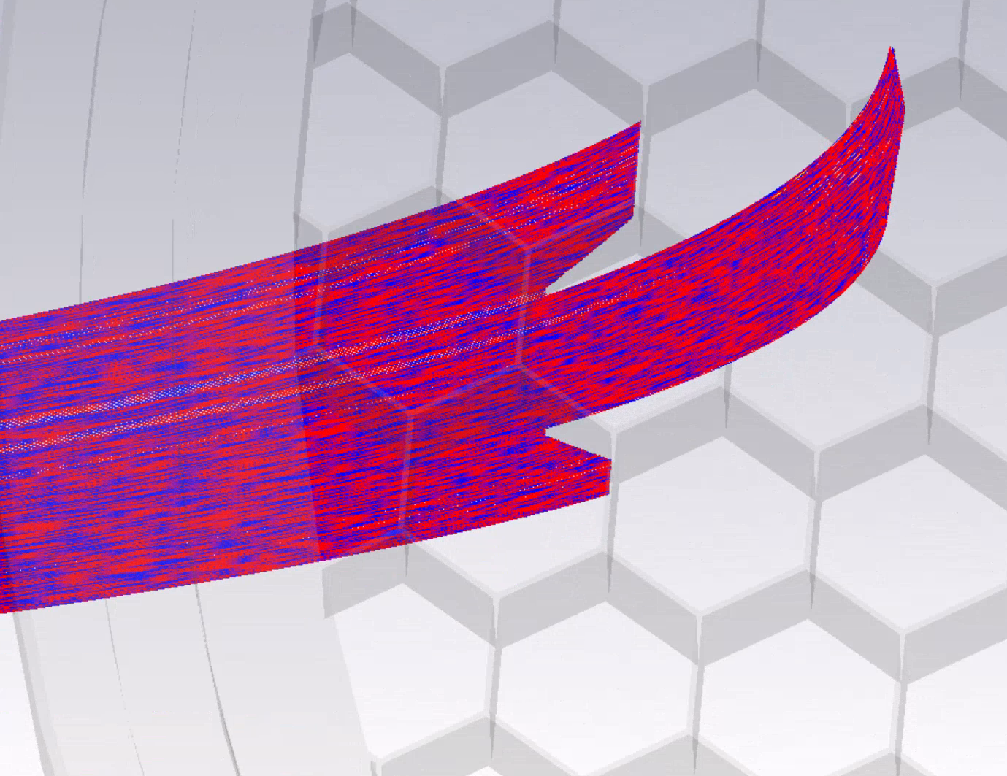
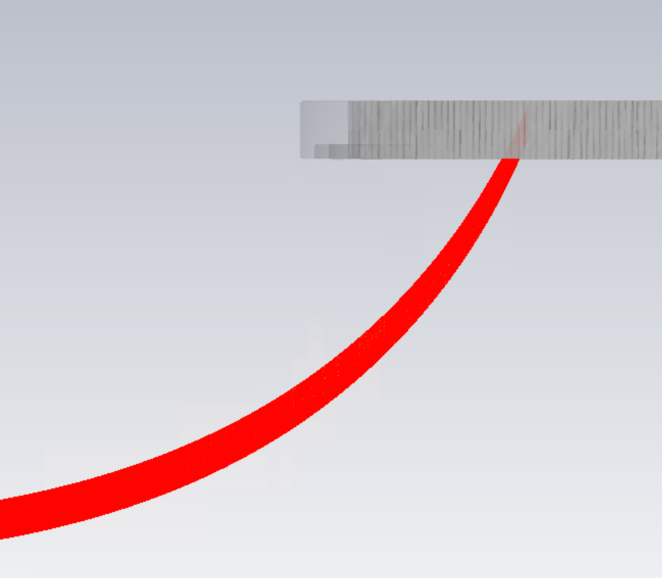
Magnet Current Scan
The electron beam is over-deflected by the magnetic field, and the honeycomb causes the multi-peak structure.
The profile scan may have some issues.
Experiment
Simulation
X - Profile
Y - Profile
X - Profile
Y - Profile

Slide 11
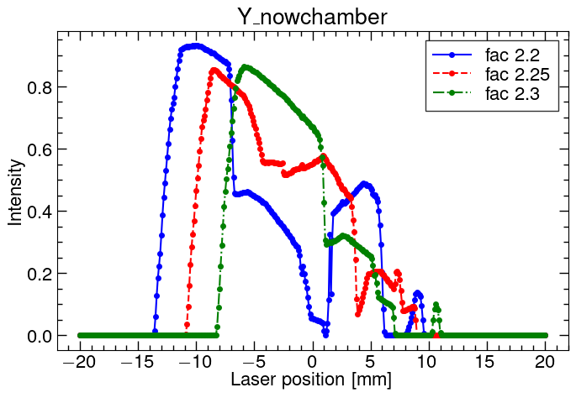
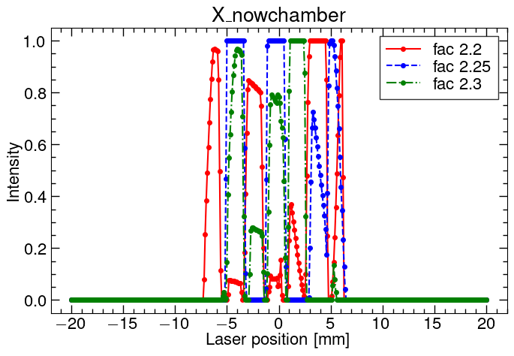
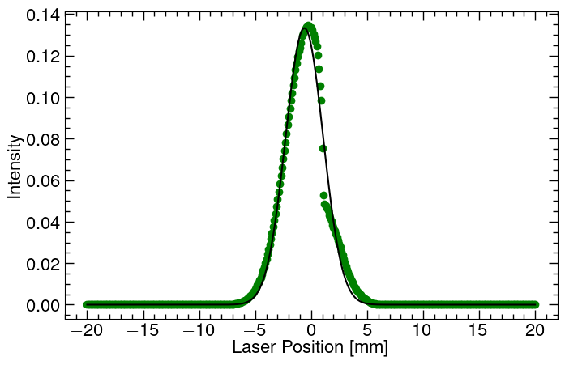
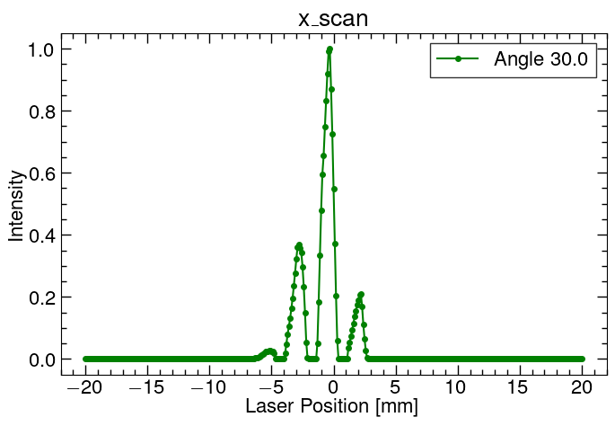
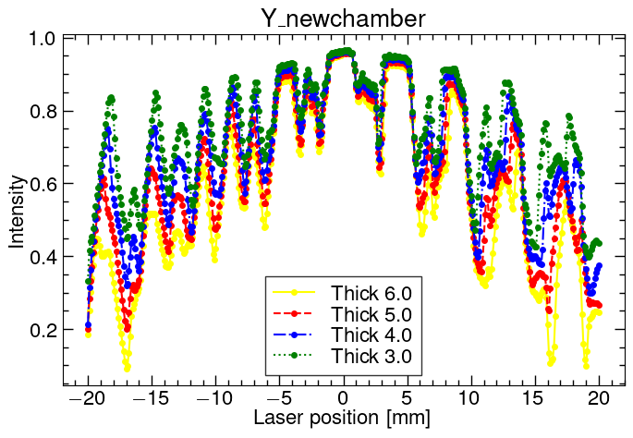
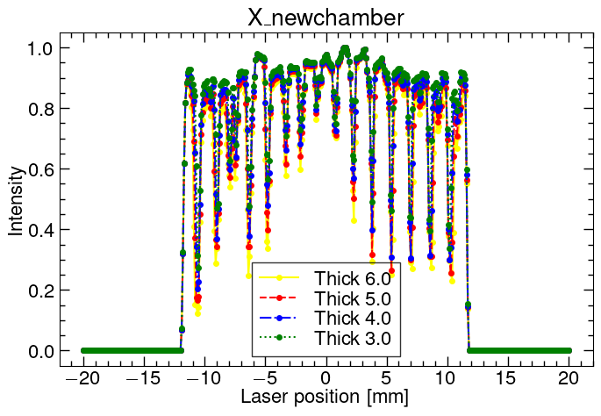
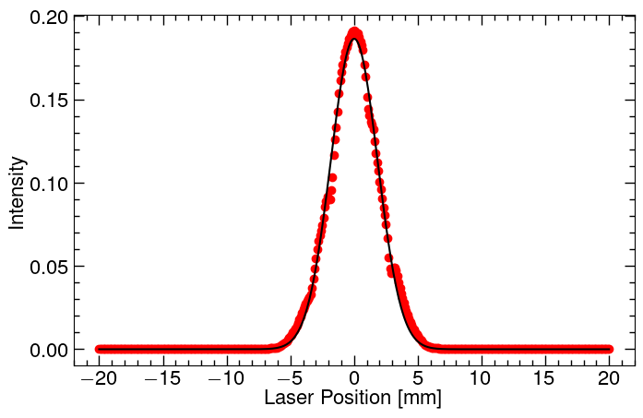
Simulation of Future Design vs Current Design
Scanning the laser position, the transmission rate of stripped electrons through the honeycomb is:
Move the honeycomb closer to faraday cup
HC Thickness | 6mm | 5mm | 4mm | 3mm
Stddev | 1.809 | 1.837 | 1.865 | 1.890
HC Thickness | 6mm | 5mm | 4mm | 3mm
Stddev | 1.940 | 1.953 | 1.963 | 1.967

Slide 12
Conclusion
Some questions:
Other way to shield beam electromagnetic interfence?
Does the method of moving the honey comb closer to faraday cup work?
Next steps:
Update the interaction chamber.
Longitudinal scan in a macropulse.
Use FFC to detect the longitudinal length of the bunch.
Measure beam energy divergence.

