Slide 1
Weekly Report
Minghao Li 2025.05.20

Slide 2
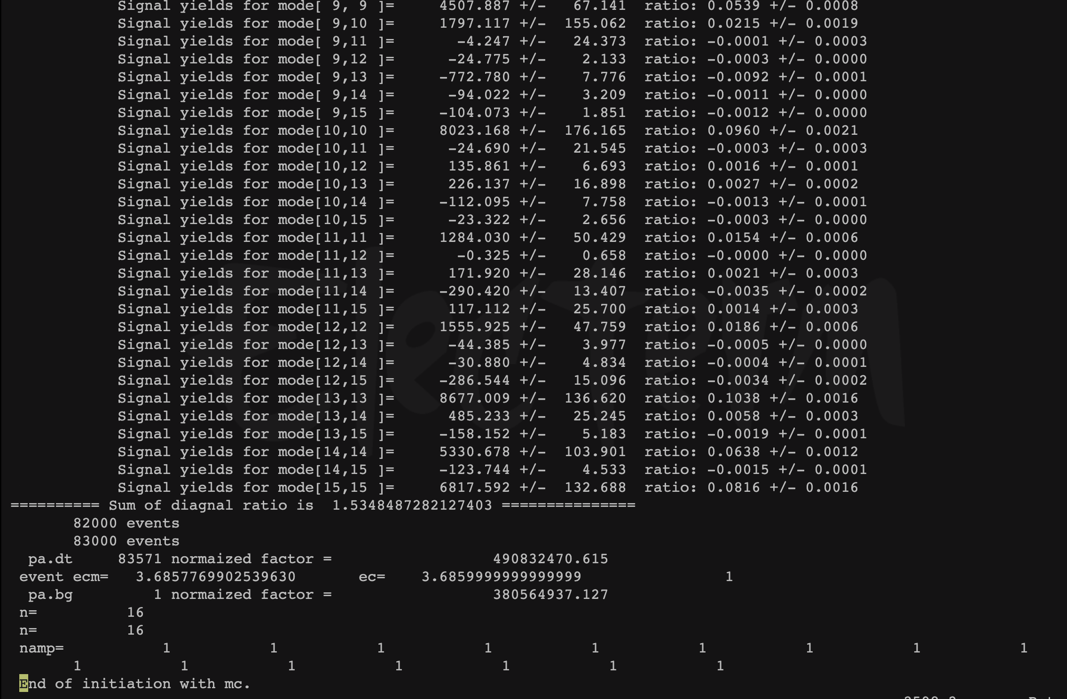
$$ψ\left(3686\right)→pK^{−}\overline{Λ}+c.c.$$
Uncertainty due to background is estimated by removing it from PWA, the difference of center value is taken to be its uncertainty.
Based on the previous program fitting, this time we release the mass and width of X(2085).

Slide 3
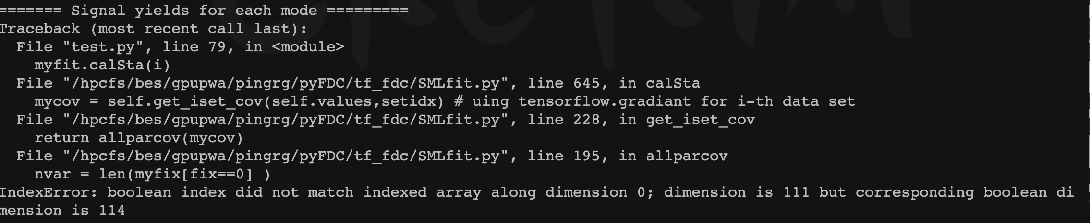
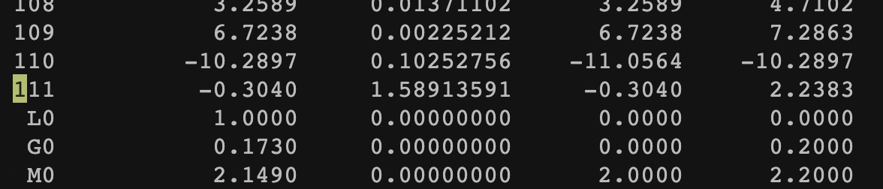
$$ψ\left(3686\right)→pK^{−}\overline{Λ}+c.c.$$
Uncertainty due to background is estimated by removing it from PWA, the difference of center value is taken to be its uncertainty.
Through the output file, we can see an error prompt, which might be a problem with parameter reading. After discussing with Professor Ping, we conducted a fitting test again.

