Slide 1

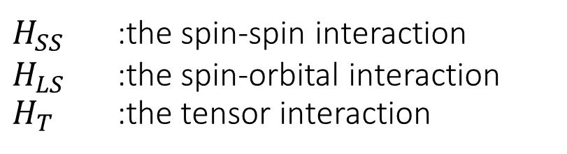
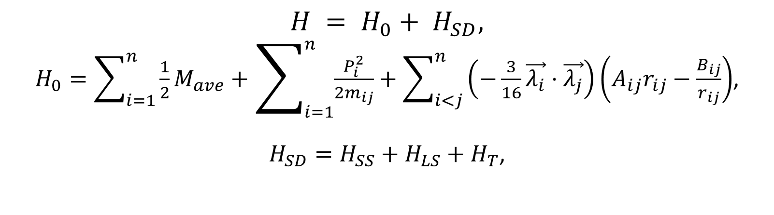
  Hamiltonian
$$H = H_{0}+ H_{SD},$$
$H_{0}=\sum_{i=1}^{n}{\frac{1}{2}M_{ave}}+\sum_{i=1}^{n}{\frac{P_{i}^{2}}{2m_{ij}}}+\sum_{i<j}^{n}{\left(−\frac{3}{16}\vec{λ_{i}}⋅\vec{λ_{j}}\right)}\left(A_{ij}r_{ij}−\frac{B_{ij}}{r_{ij}}\right)$,
$H_{SD}=H_{SS}+H_{LS}+H_{T}$,
$M_{ave}$ :the spin-averaged mass of meson
$m_{ij}$ :the reduced quark masses between $i$ and $j$
$A$ :a parameter of linear potential
$B$ :a parameter of the Coulomb’s potential
$\vec{λ_{i}}$ :The quark color operator
$H_{SS}$ :the spin-spin interaction
$H_{LS}$ :the spin-orbital interaction
$H_{T}$ :the tensor interaction

Slide 2
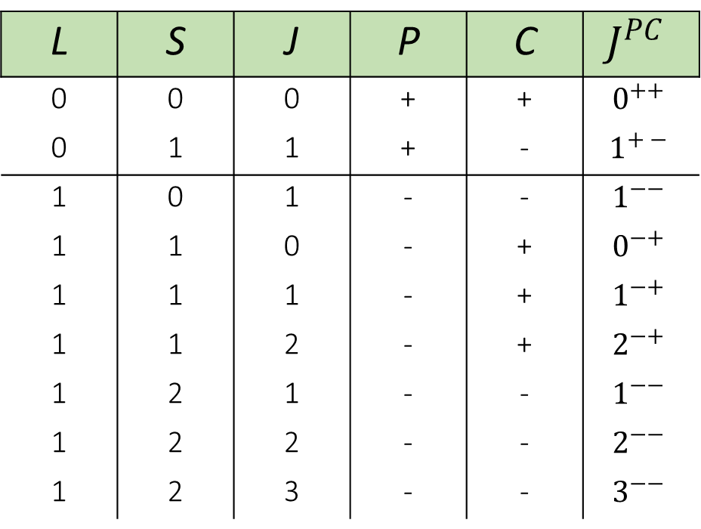
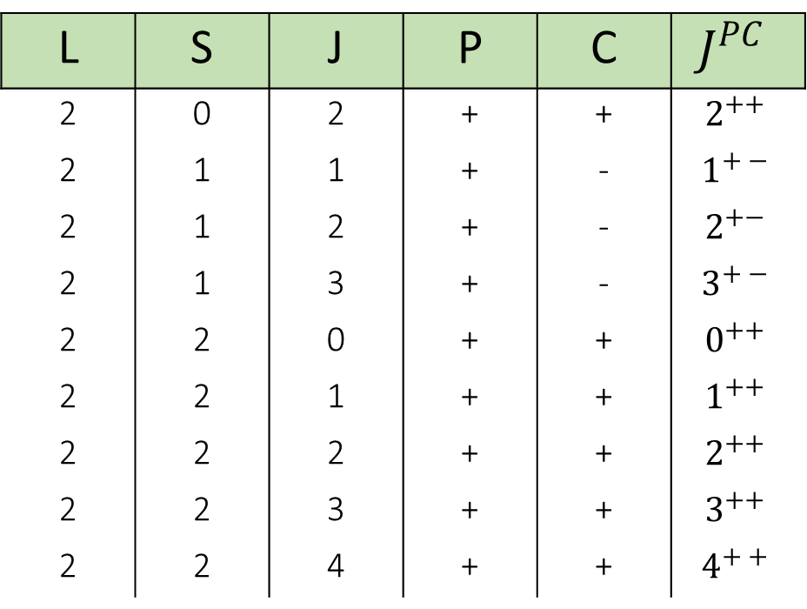
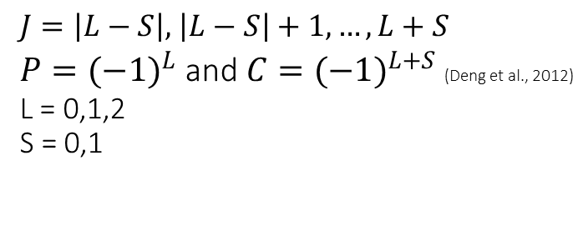
$J^{PC}$ quantum number for charmonium-like tetraquark $qc\overline{q}\overline{c}$
$J=\left|L−S\right|,$ $\left|L−S\right|+1, …, L+S$
${P=(−1)}^{L}$ and ${C=(−1)}^{L+S}$ (Deng et al., 2012)
L = 0,1,2
S = 0,1
L | S | J | P | C | $$J^{PC}$$
0 | 0 | 0 | + | + | $$0^{++}$$
0 | 1 | 1 | + | - | $$1^{+ −}$$
1 | 0 | 1 | - | - | $$1^{−−}$$
1 | 1 | 0 | - | + | $$0^{−+}$$
1 | 1 | 1 | - | + | $$1^{−+}$$
1 | 1 | 2 | - | + | $$2^{−+}$$
1 | 2 | 1 | - | - | $$1^{−−}$$
1 | 2 | 2 | - | - | $$2^{−−}$$
1 | 2 | 3 | - | - | $$3^{−−}$$
L | S | J | P | C | $$J^{PC}$$
2 | 0 | 2 | + | + | $$2^{++}$$
2 | 1 | 1 | + | - | $$1^{+ −}$$
2 | 1 | 2 | + | - | $$2^{+−}$$
2 | 1 | 3 | + | - | $$3^{+ −}$$
2 | 2 | 0 | + | + | $$0^{++}$$
2 | 2 | 1 | + | + | $$1^{++}$$
2 | 2 | 2 | + | + | $$2^{++}$$
2 | 2 | 3 | + | + | $$3^{++}$$
2 | 2 | 4 | + | + | $$4^{+ +}$$

Slide 3
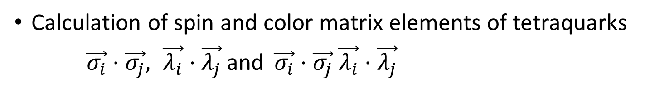
Calculation of spin and color matrix elements of tetraquarks
$\vec{σ_{i}}⋅\vec{σ_{j}}, \vec{λ_{i}}⋅\vec{λ_{j}}$ and $\vec{σ_{i}}⋅\vec{σ_{j}} \vec{λ_{i}}⋅\vec{λ_{j}}$

Slide 4
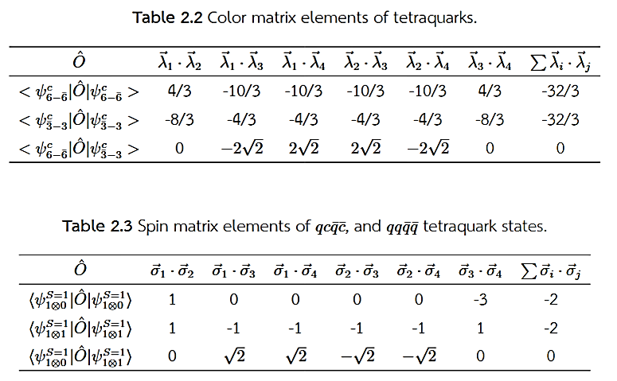
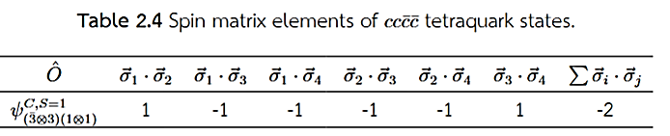

Slide 5
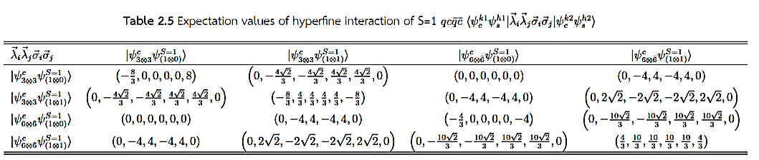

Slide 6
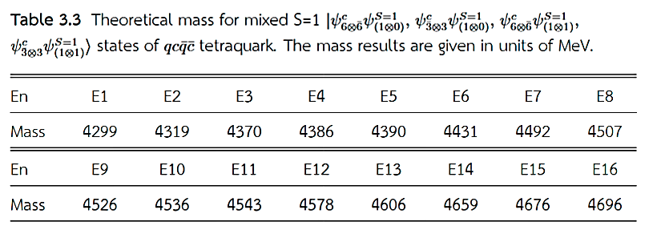

Slide 7


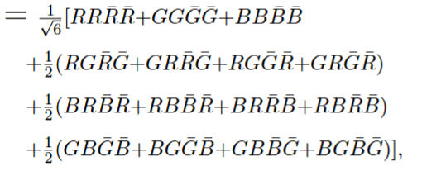

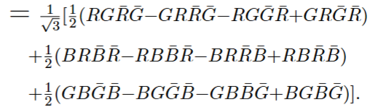
Note
Spin configurations
Color wave functions

Slide 8
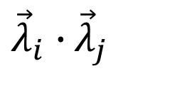
${\vec{λ}}_{i}∙$ ${\vec{λ}}_{j}$

Slide 9
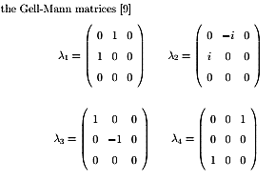
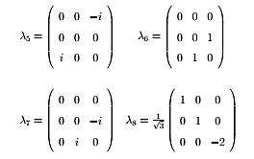

Meson
$$\left\langle ψ^{c}\left|{\vec{λ}}_{1}⋅{{\vec{λ}}_{2}^{∗}}\right|ψ^{c}\right\rangle =−\frac{16}{3}$$
Baryon
$\left\langle ψ^{c}\left|{\vec{λ}}_{i}{⋅\vec{λ}}_{j}\right|ψ^{c}\right\rangle =−\frac{8}{3}$, i=1,2,3, i<j
$\sum_{ⅈj}{{\vec{λ}}_{i}{⋅\vec{λ}}_{j}}$= ${(\vec{λ}}_{1}{⋅\vec{λ}}_{2}$)+ ${(\vec{λ}}_{1}{⋅\vec{λ}}_{3})$+ ${(\vec{λ}}_{2}{⋅\vec{λ}}_{3})$
Y. Yan, Applied Group Theory in Physics (Suranaree University of Technology, Nakhon Ratchasima, Thailand, 2020)

Slide 10
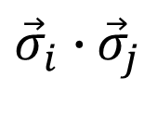
${\vec{σ}}_{i}∙$ ${\vec{σ}}_{j}$

