Slide 1
Group meeting
2025.5.23

Slide 2
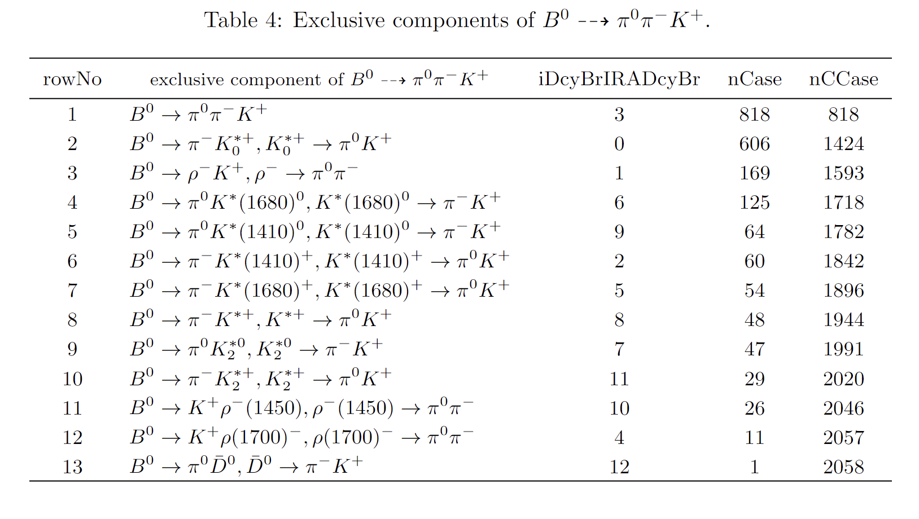
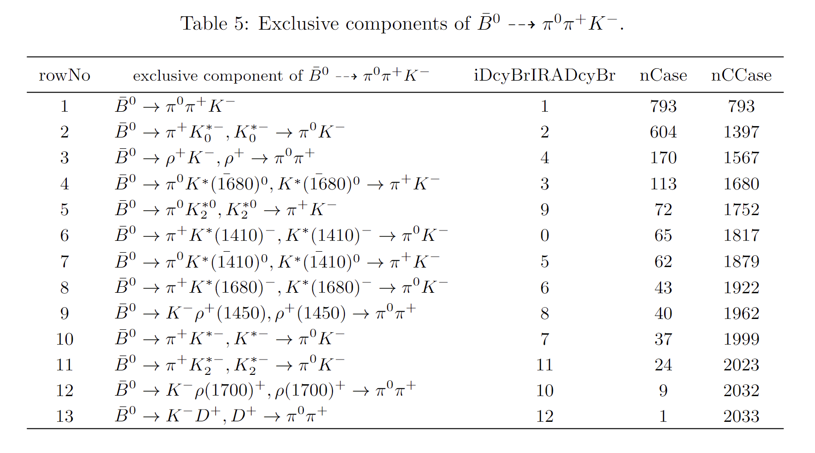
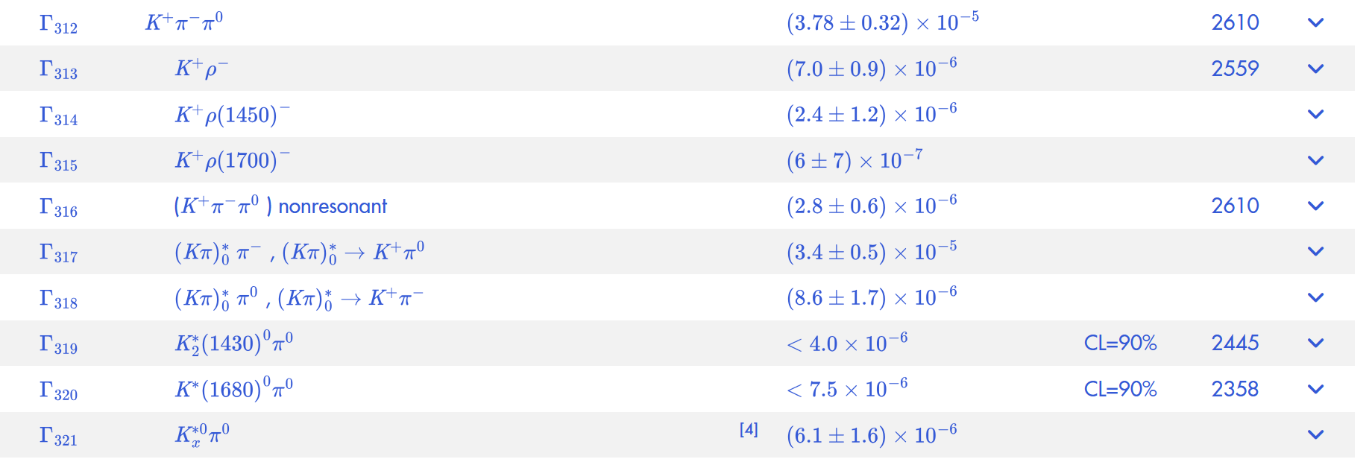
Peaking background mismodel
how is peaking Kpipi0 modeled in MC? do you consider possible effect of non-correct MC model on the efficiency in the systematics?
Belle:

Slide 3
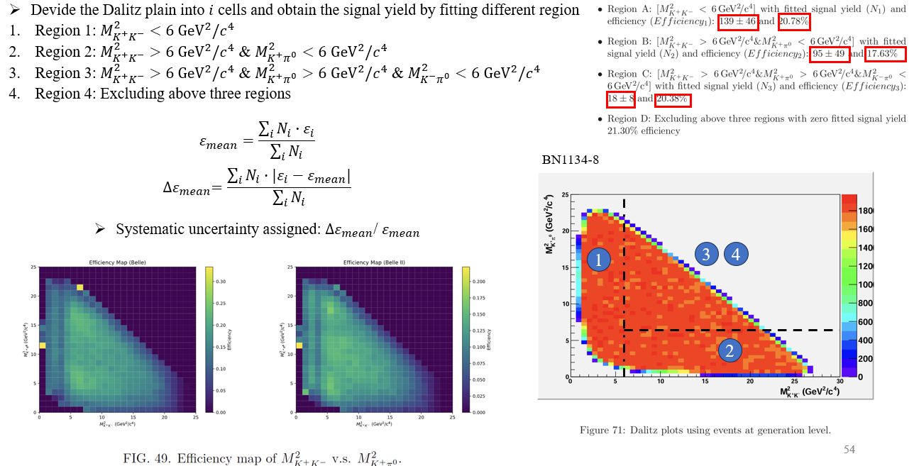
Systematic uncertainties on efficiency variation over Dalitz plot
l.464: Have you tested this already on MC to make sure you have a solid strategy?
Motivation of binning strategy?
4.Consider the binning scheme strategy, to improve the statistical uncertainty.

Slide 4
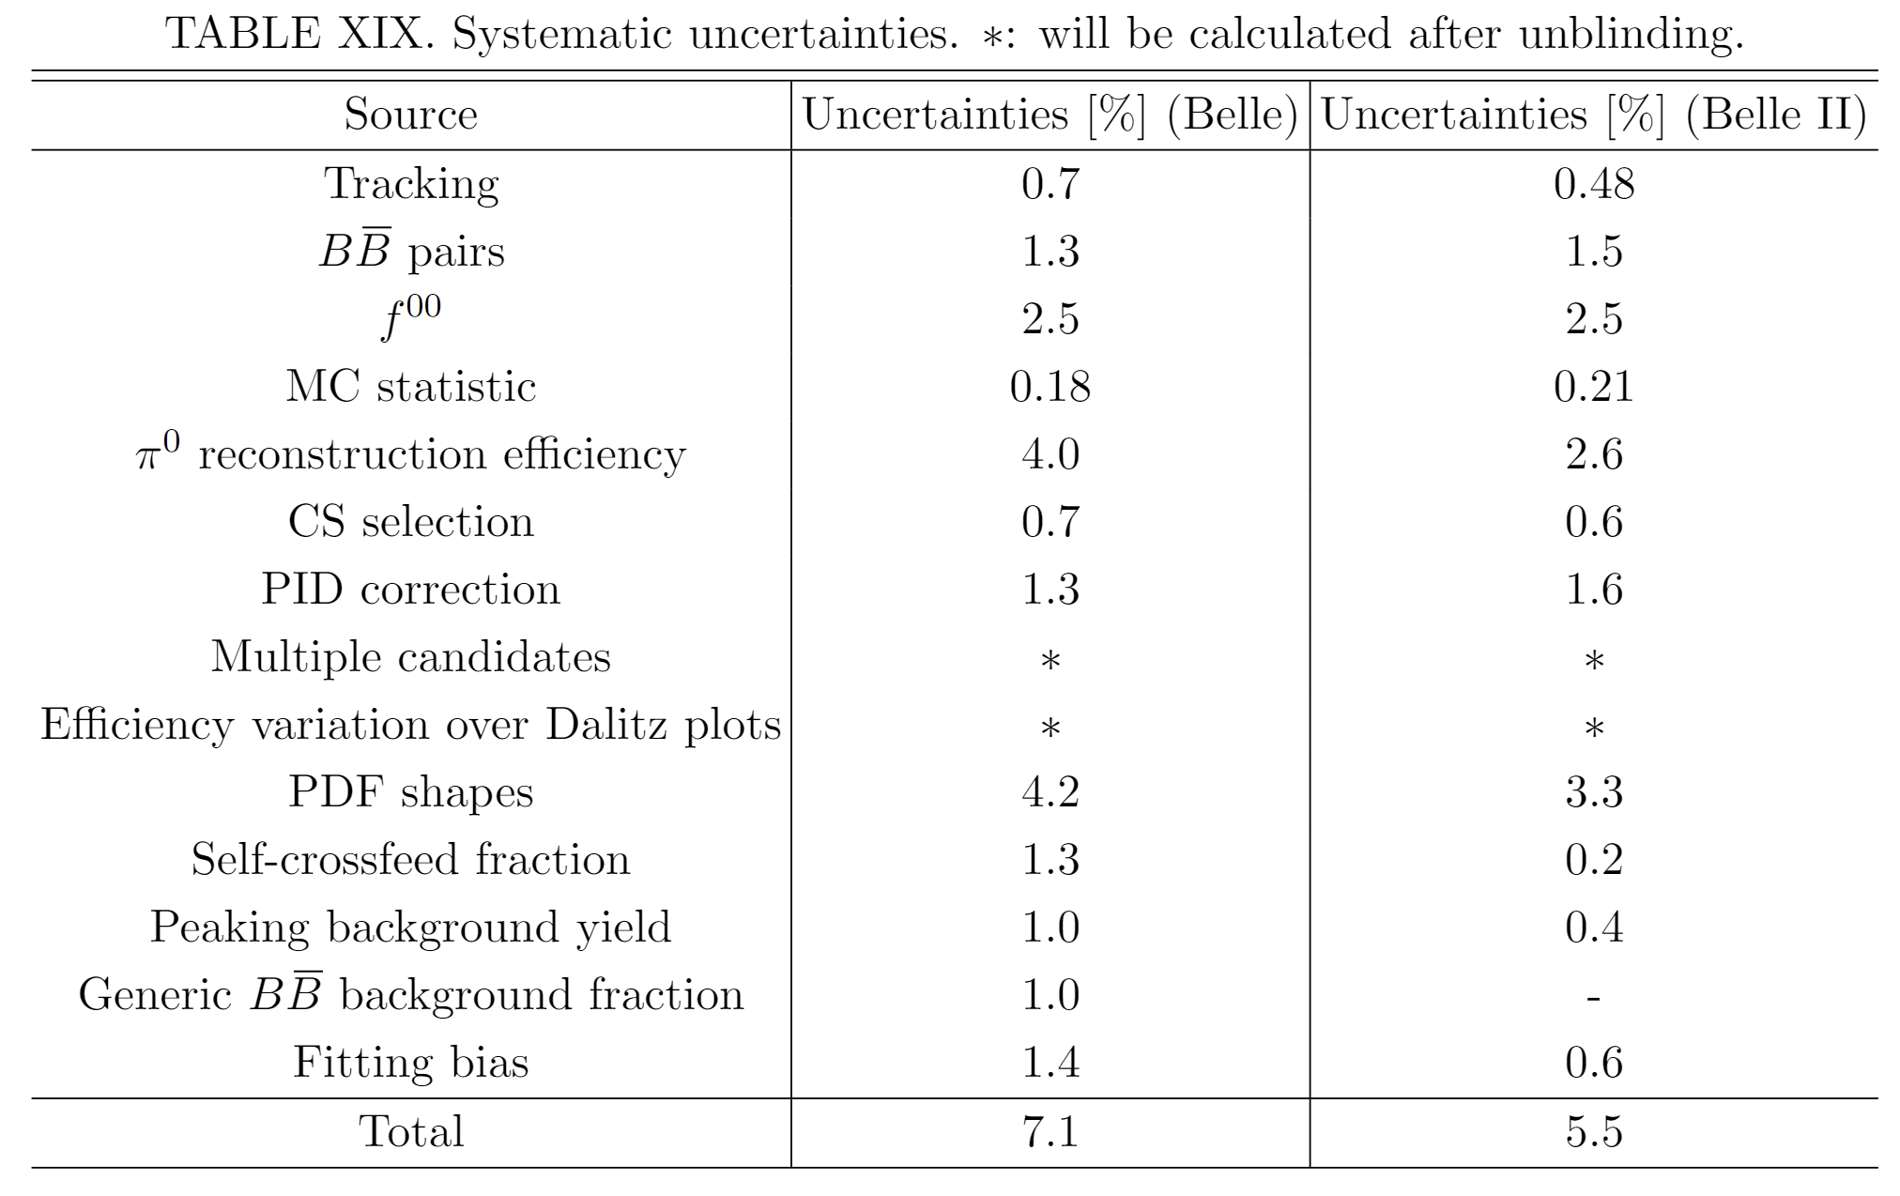
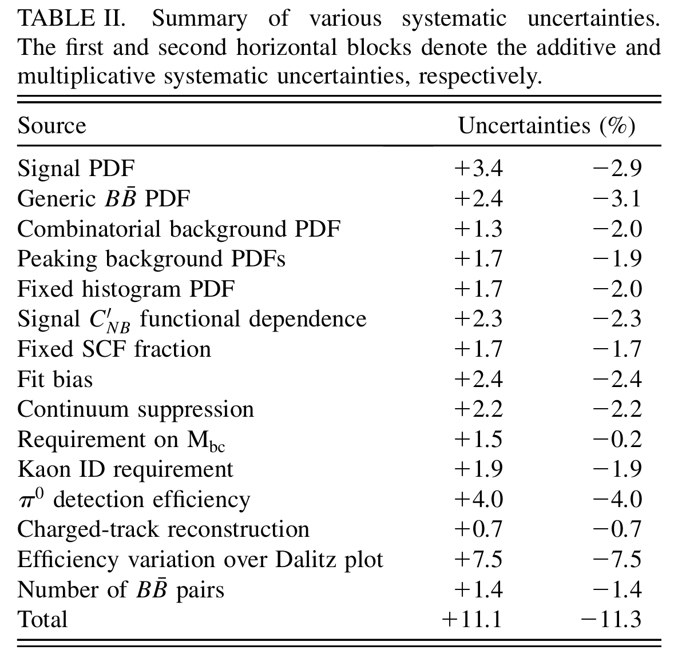
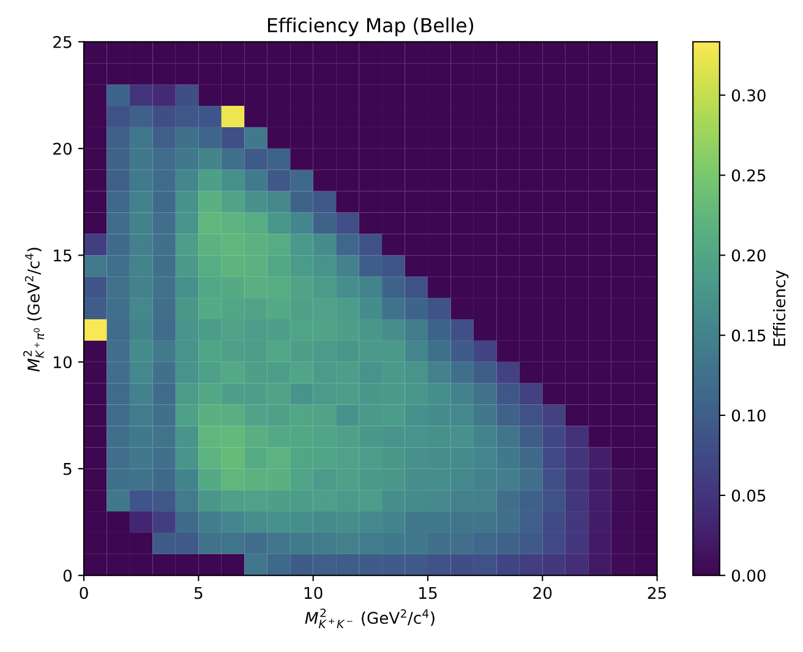
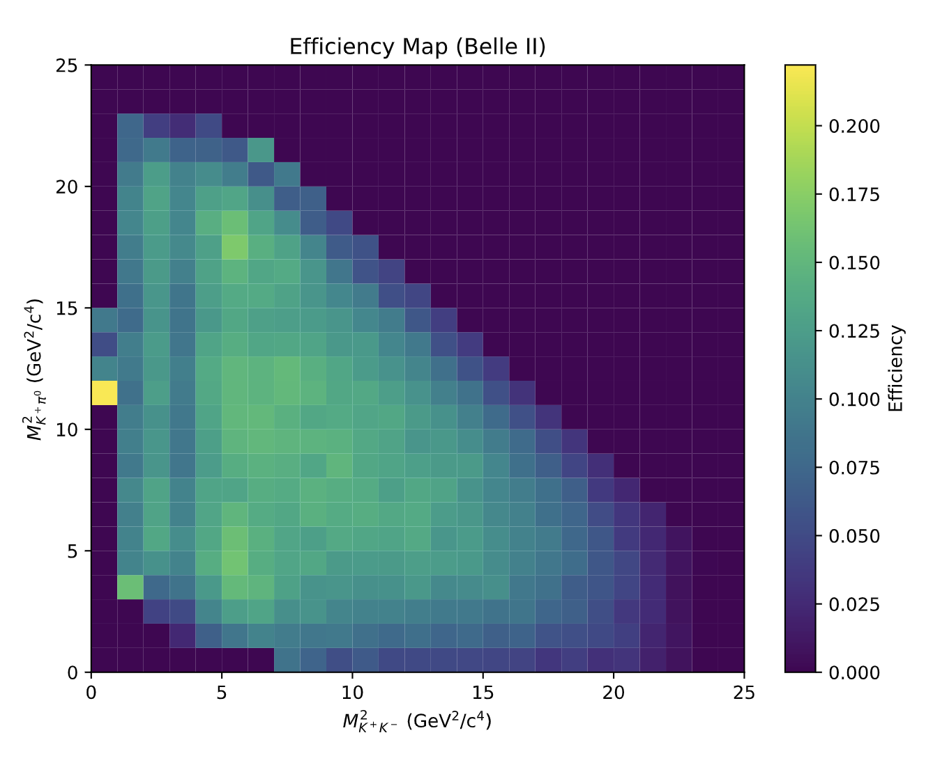
Systematic uncertainties
Efficiency variation over Dalitz plots
We plan to obtain the signal yield distribution over the Dalitz plot by fitting different regions and calculate the weighted signal reconstruction efficiency based on the efficiency map. The mean value is used to obtain the branching fraction and the error is taken as the systematic uncertainty.
$$ε_{mean}=\frac{\sum_{i}{N_{i}}∙ε_{i}}{\sum_{i}{N_{i}}}$$
$${∆ε}_{mean}=\frac{\sum_{i}{N_{i}}∙{|ε}_{i}−ε_{mean}|}{\sum_{i}{N_{i}}}$$
Systematic uncertainty assigned: ${∆ε}_{mean}$/ $ε_{mean}$
Former Belle work
3
4
3
4
1
2
1
2

Slide 5
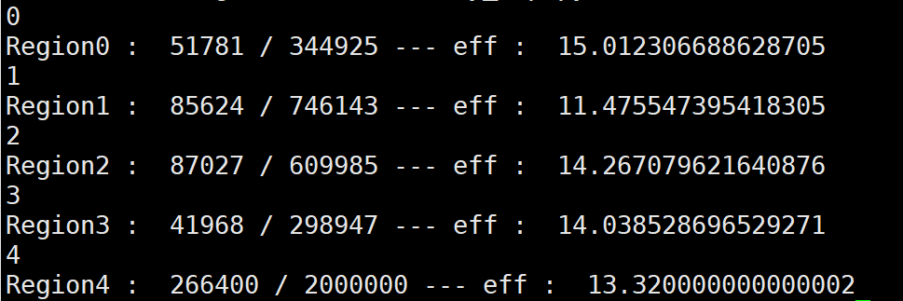
Belle
Devide the Dalitz plain into $i$ cells and obtain the signal yield by fitting different region
Region 1: $M_{K^{+}K^{−}}^{2}≤9 {GeV}^{2}/c^{4}$ & $M_{K^{+}π^{0}}^{2}≤9$ ${GeV}^{2}/c^{4}$ (eff: 15.01%)
Region 2: $M_{K^{+}K^{−}}^{2}>9 {GeV}^{2}/c^{4}$ & $M_{K^{+}π^{0}}^{2}≤9$ ${GeV}^{2}/c^{4}$ (eff: 11.48%)
Region 3: $M_{K^{+}K^{−}}^{2}≤9 {GeV}^{2}/c^{4}$ & $M_{K^{+}π^{0}}^{2}>9$ ${GeV}^{2}/c^{4}$ (eff: 14.27%)
Region 4: $M_{K^{+}K^{−}}^{2}>9 {GeV}^{2}/c^{4}$ & $M_{K^{+}π^{0}}^{2}>9$ ${GeV}^{2}/c^{4}$(eff: 14.04%)
Efficiency read from MC entries : 13.32%
3
4
$$ε_{mean}=\frac{\sum_{i}{N_{i}}∙ε_{i}}{\sum_{i}{N_{i}}}$$
1
2
$${∆ε}_{mean}=\frac{\sum_{i}{N_{i}}∙{|ε}_{i}−ε_{mean}|}{\sum_{i}{N_{i}}}$$
Systematic uncertainty assigned: ${∆ε}_{mean}$/ $ε_{mean}$
Region1: $32±13;$ Region2: $78±1$5
Region3: $77±19;$ Region4: $38±12$
$ε_{mean}$= 13.37%
${∆ε}_{mean}$= 1.31%
${∆ε}_{mean}$/ $ε_{mean}$ = 9.8%

Slide 6
Belle II
Devide the Dalitz plain into $i$ cells and obtain the signal yield by fitting different region
Region 1: $M_{K^{+}K^{−}}^{2}≤9 {GeV}^{2}/c^{4}$ & $M_{K^{+}π^{0}}^{2}≤9$ ${GeV}^{2}/c^{4}$ (eff: 11.97%)
Region 2: $M_{K^{+}K^{−}}^{2}>9 {GeV}^{2}/c^{4}$ & $M_{K^{+}π^{0}}^{2}≤9$ ${GeV}^{2}/c^{4}$ (eff: 7.72%)
Region 3: $M_{K^{+}K^{−}}^{2}≤9 {GeV}^{2}/c^{4}$ & $M_{K^{+}π^{0}}^{2}>9$ ${GeV}^{2}/c^{4}$ (eff: 11.52%)
Region 4: $M_{K^{+}K^{−}}^{2}>9 {GeV}^{2}/c^{4}$ & $M_{K^{+}π^{0}}^{2}>9$ ${GeV}^{2}/c^{4}$(eff: 9.56%)
Efficiency read from MC entries : 9.89%
3
4
1
2
$$ε_{mean}=\frac{\sum_{i}{N_{i}}∙ε_{i}}{\sum_{i}{N_{i}}}$$
$${∆ε}_{mean}=\frac{\sum_{i}{N_{i}}∙{|ε}_{i}−ε_{mean}|}{\sum_{i}{N_{i}}}$$
Systematic uncertainty assigned: ${∆ε}_{mean}$/ $ε_{mean}$
Region1: $13±8;$ Region2: $26±8$
Region3: $28±10;$ Region4: $12±6$
$ε_{mean}$= 10.07%
${∆ε}_{mean}$= 1.68%
${∆ε}_{mean}$/ $ε_{mean}$ = 16.7%

Slide 7
Systematic uncertainties
Efficiency variation over Dalitz plots
Devide the Dalitz plain into $i$ cells and obtain the signal yield by fitting different region
Region 1: $M_{K^{+}K^{−}}^{2}≤9 {GeV}^{2}/c^{4}$ & $M_{K^{+}π^{0}}^{2}≤9$ ${GeV}^{2}/c^{4}$ (eff: (15.01%) (11.97%))
Region 2: $M_{K^{+}K^{−}}^{2}>9 {GeV}^{2}/c^{4}$ & $M_{K^{+}π^{0}}^{2}≤9$ ${GeV}^{2}/c^{4}$ (eff: (11.48%) (7.72%)))
Region 3: $M_{K^{+}K^{−}}^{2}≤9 {GeV}^{2}/c^{4}$ & $M_{K^{+}π^{0}}^{2}>9$ ${GeV}^{2}/c^{4}$ (eff: (14.27%) (11.52%))
Region 4: $M_{K^{+}K^{−}}^{2}>9 {GeV}^{2}/c^{4}$ & $M_{K^{+}π^{0}}^{2}>9$ ${GeV}^{2}/c^{4}$(eff: (14.04%) (9.56%))
Efficiency read from MC entries : 13.32% (9.89%) for Belle (Belle II)
Belle (100 bootstrap samples):
Region1: $32±13;$ Region2: $78±1$5
Region3: $77±19;$ Region4: $38±12$
$$𝓑_{Belle}=(2.16±0.28) ×{10}^{−6}$$
$ε_{mean}$= 13.37%
Belle II (100 bootstrap samples):
Region1: $13±8;$ Region2: $26±8$
Region3: $28±10;$ Region4: $12±6$
$$𝓑_{Belle}=(2.15±0.47) ×{10}^{−6}$$
$ε_{mean}$= 10.07%
$ℬ\left(B^{0}→K^{+}K^{−}π^{0}\right)=\frac{\sum_{i}{{N_{i}}/{ε_{i}}}}{N_{B\overline{B}}}$
3
4
3
4
$$ℬ_{Belle}=(2.20 ±0.53) ×{10}^{−6}$$
$$ℬ_{Belle II}=(2.14±0.82)×{10}^{−6}$$
In this way we can also obtain the correct Branching fraction
1
2
1
2

Slide 8
Backup

Slide 9
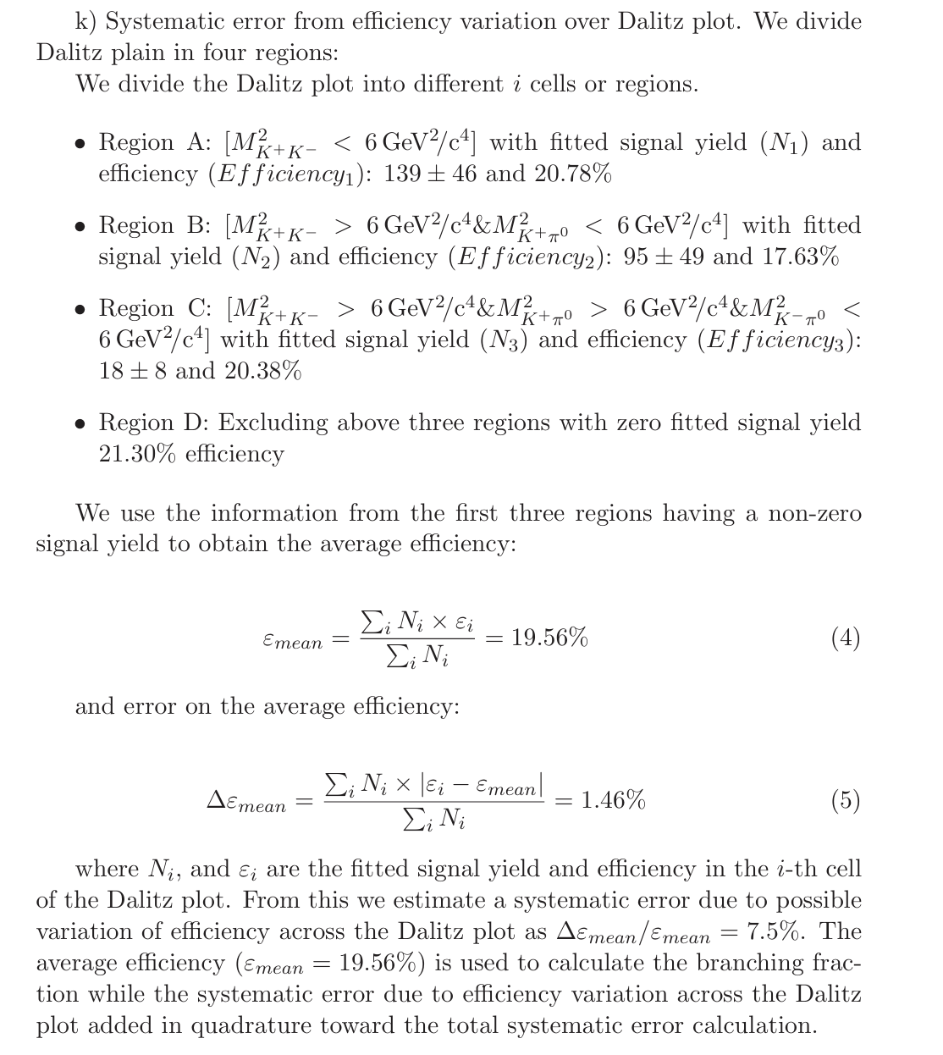
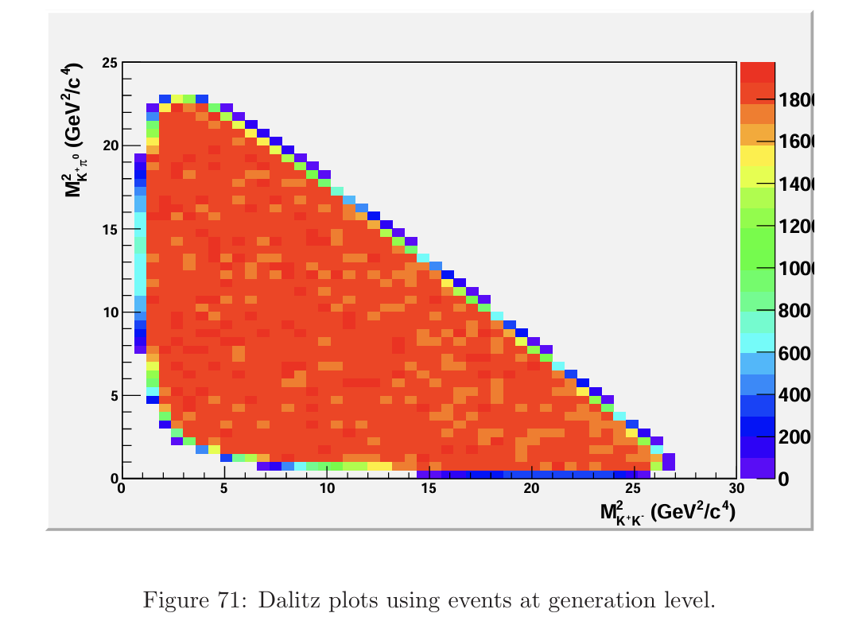
Efficiency variation over Dalitz plot
9

