Slide 1
Bergoz-BB tests
Rehman, Weiwen, Qiu, Xu, Renjun, YangRui, ChenMing

Slide 2
Bergoz BB electronics Check
Devices
Input Generator: RIGOL DG922Pro (200 MHz, 1.25 GS/s)
Input signal: Sine wave
Keysight oscilloscope DSOX3054A, 500 MHz, 4 Gsa/s
Averaging: 64
RF Splitter 4 Way Minicircuit DC-8.4 GHz, ZFRSC-4-842-S+
Attenuator: Minicircuit, VAT2+,3+,10+,20+
Measurement
The RF splitter and attenuator frequency dependence were checked
Independent of frequency (checked range: 0.5 MHz to 10 MHz)
Bergoz BB electronics
Linearity check (vary the attenuator at fixed frequency) @ 27^{O}C and 23^{O}C
No significant dependence of linearity on temperature was observed
Frequency dependence (Vary the frequency at fixed attenuator )
No frequency dependence of the Bergoz-BB module was observed
No significant dependence of frequency on temperature was observed

Slide 3
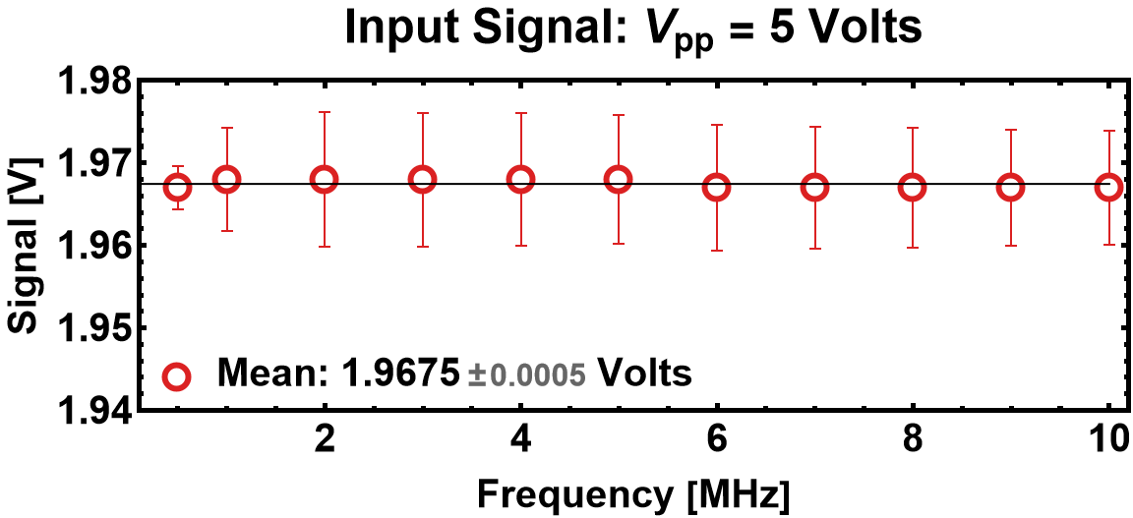
Attenuator Test

Slide 4
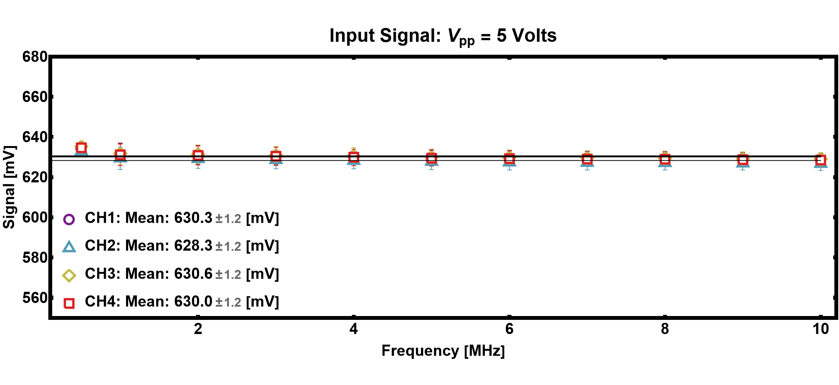
RF Splitter Test

Slide 5
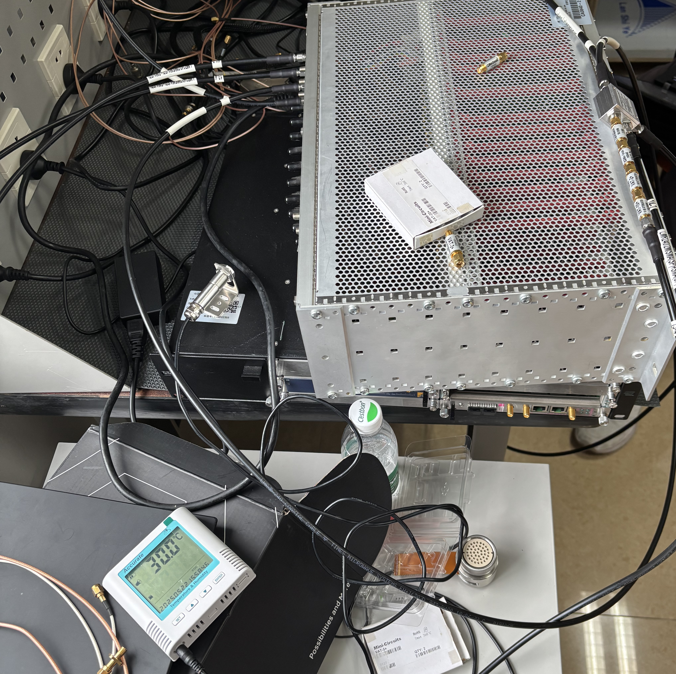
Laboratory Temperature
The Set Laboratory Temperature was 27°C
Measured Temperature near BB Module was 30°C
The Set Laboratory Temperature was 23°C
Measured Temperature near the BB Module was 27°C

Slide 6
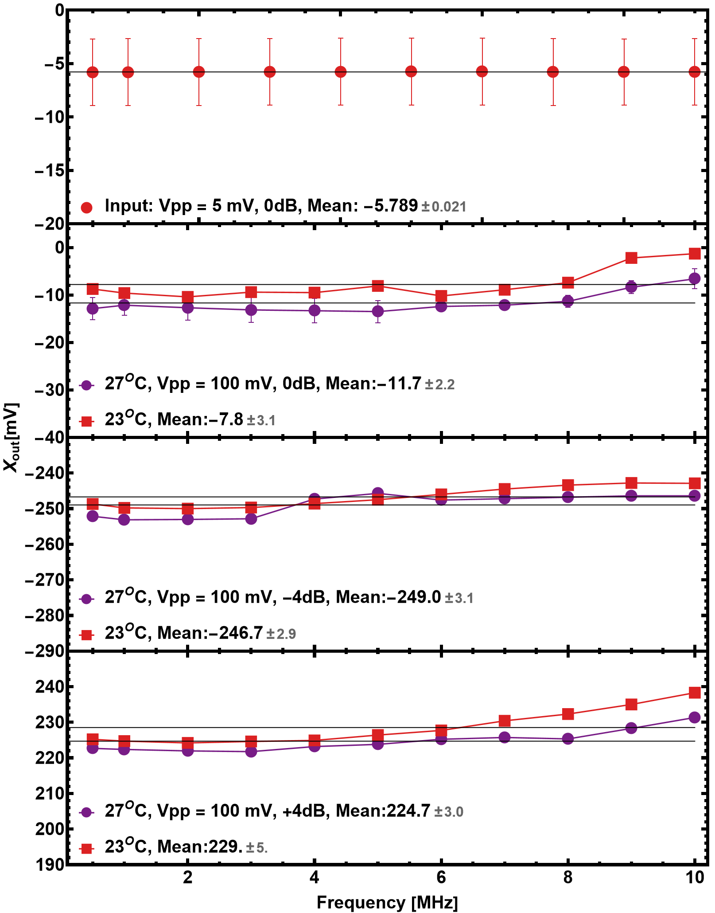
Bergoz-BB Frequency dependence Check
Bergoz-BB have a BW of 10 MHz
So, it should be independent of the signal up to 10 MHz
Data was obtained
Vpp: 5 mm, Frequency 0.5 MHz to 10 MHz @ 27 °C
No dependence on Frequency
Vpp: 100 mm, Frequency 0.5 MHz to 10 MHz @ 27^{O}C and 23^{O}C, - 4 dB att.
No dependence on Frequency or Temperature
Vpp: 100 mm, Frequency 0.5 MHz to 10 MHz @ 27^{O}C and 23^{O}C, +4 dB att.
No dependence on Frequency or Temperature

Slide 7
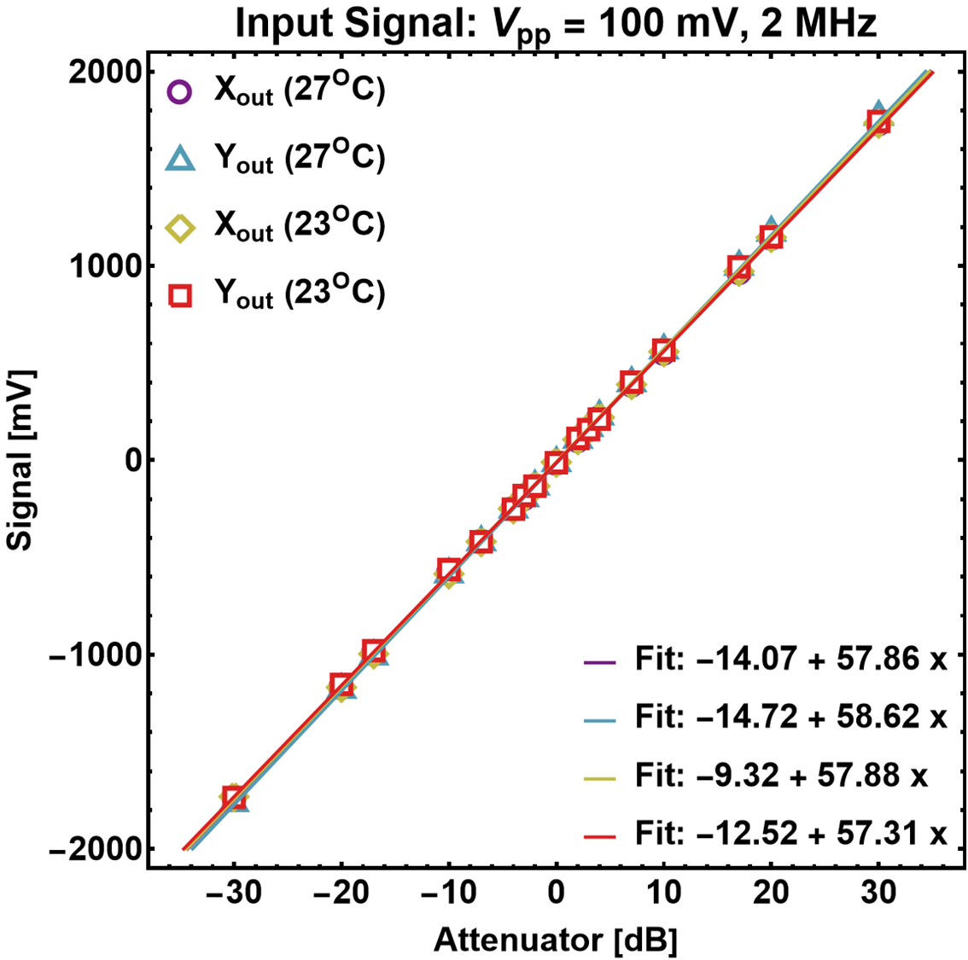
Bergoz-BB Linearity Check
Bergoz-BB possesses a dynamic range of dBm
The difference between the two different temperatures is less than 2%
No significant dependence on temperature

Slide 8
Structural Deformation
under vacuum
The electrodes are body of the BPM is only 1.5 mm thin (made of Ti-alloy)
Rib structure is used to preserve mechanical stability
Stress analysis has been carried out in CST simulation to estimate the mechanical deformation under vacuum condition
The deformation under vacuum condition is only 15.6 µm!
Negligible!

Slide 9
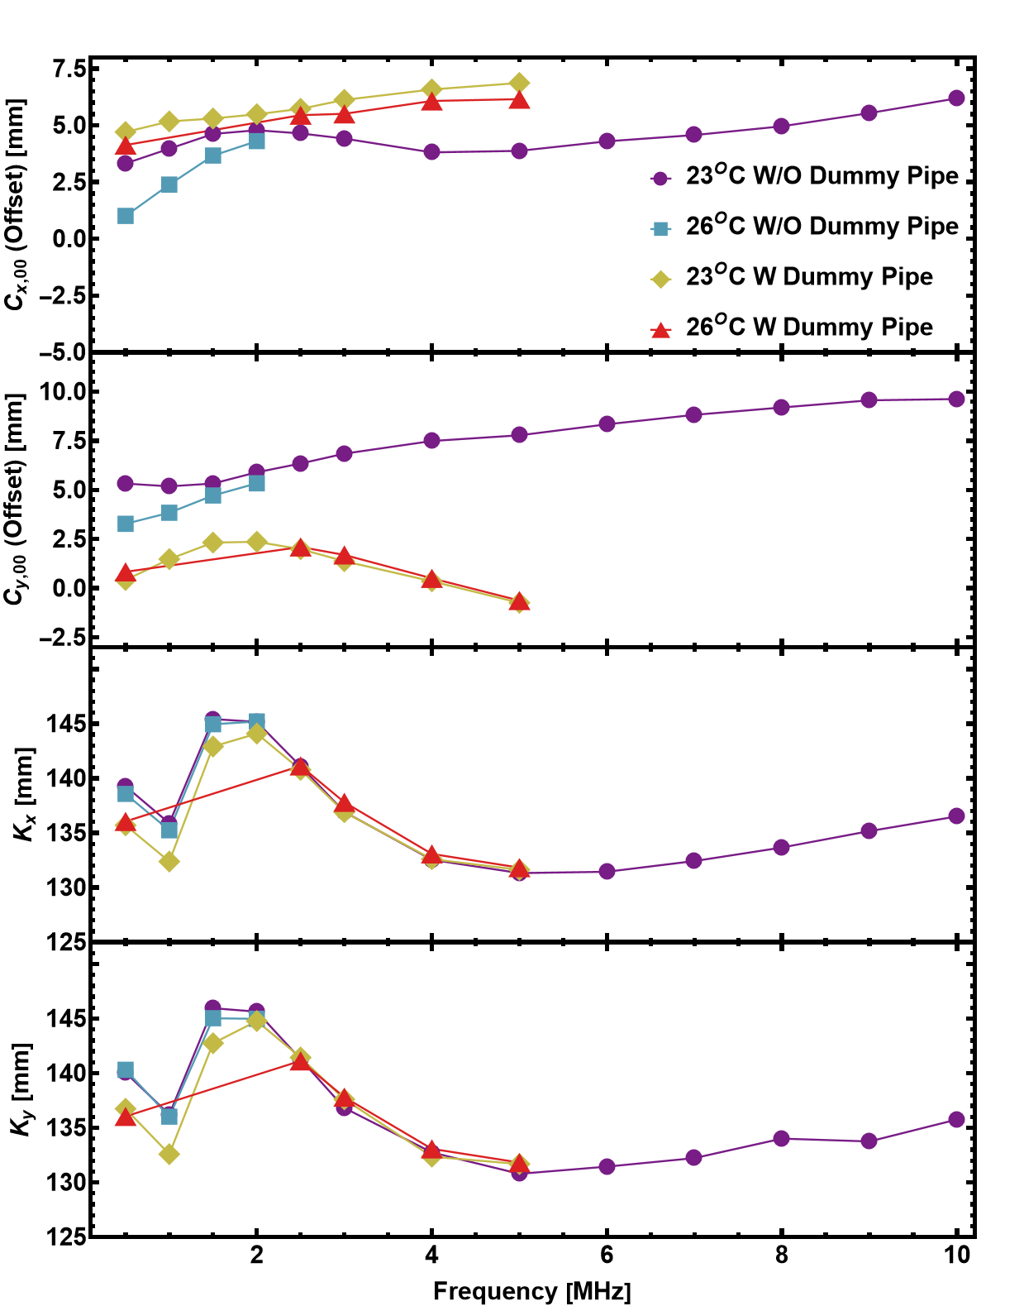
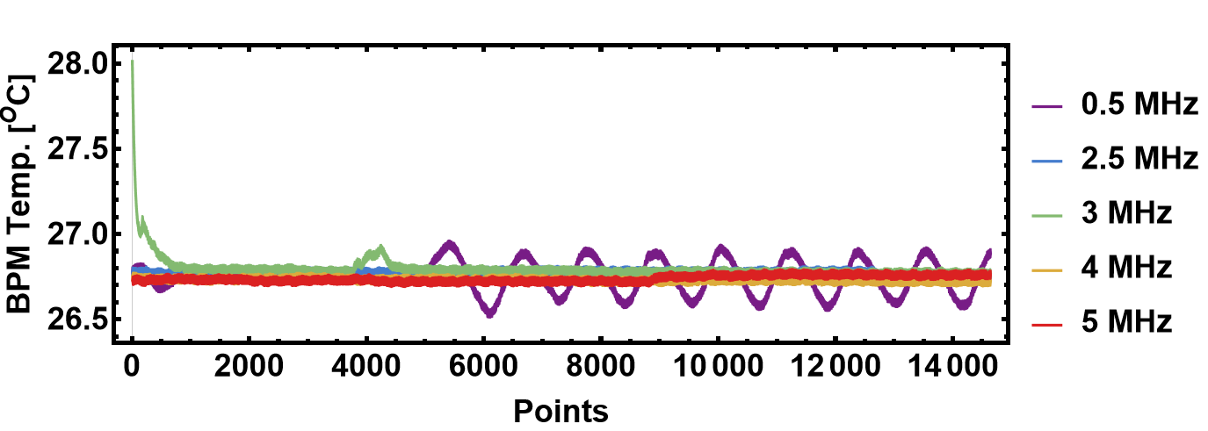
Mapping with Dummy Pipe and Higher Temperature

Slide 10
