Slide 1
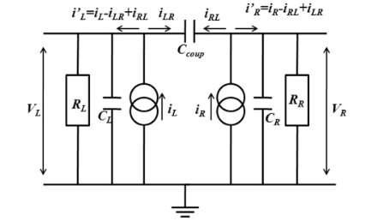
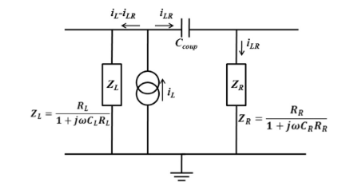
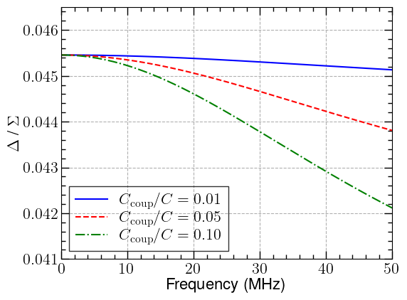
Simplified
Capacitance Matrix
(
C11 C12 C13 C14
C21 C22 C23 C24
C31 C32 C33 C34
C41 C42 C43 C44
(
C | 296 pC
R | 50 Ω
x | 10 mm
b | 220 mm
=
296.62 pF -8.56 pF -3.07 pF -1.40 pF
-8.56 pF 300.1 pF -7.50 pF -3.07 pF
-3.07 pF -7.50 pF 300.44 pF -8.54 pF
-1.40 pF -3.07 pF -8.54 pF 296.60 pF

