Slide 1
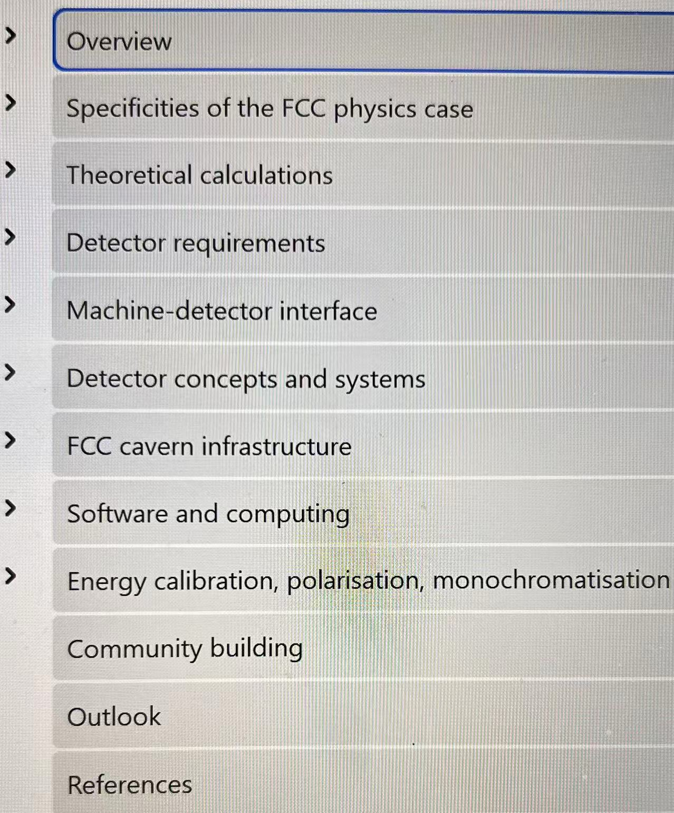

Slide 2
←The message
Thanking team,
organizations →

Slide 3
← Acknowledging
leadership and advisers

Slide 4
The intellectual norms are followed

Slide 5
The participants at three levels

Slide 6
The endorsement and more messages

Slide 7
The contents broad; detectors limited

Slide 8
The contents broad; detectors limited

Slide 9
The contents broad; detectors limited
The real money is on the
accelerator, the site, tunneling and the infrastructure

