Slide 1
Weekly Report
Minghao Li 2025.05.27

Slide 2
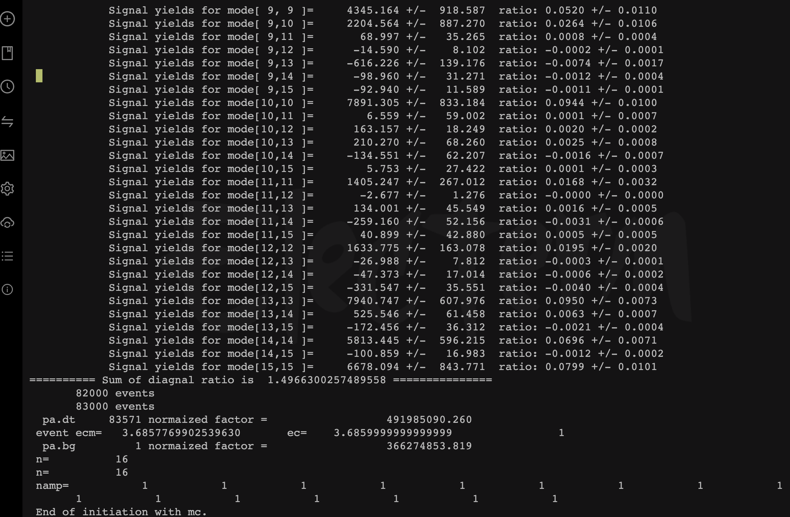
$$ψ\left(3686\right)→pK^{−}\overline{Λ}+c.c.$$
Uncertainty due to background is estimated by removing it from PWA, the difference of center value is taken to be its uncertainty.
After discussing with Professor Ping, this time we release the mass and width of X(2085), found that the fitting was successful.

Slide 3
$$ψ\left(3686\right)→pK^{−}\overline{Λ}+c.c.$$
Uncertainty due to background is estimated by removing it from PWA, the difference of center value is taken to be its uncertainty.
 | mass(MeV/c²) | Width(MeV/c²)
Before | 2149 | 173
Now | 2196 | 200
difference | 47 | 27
Through the output file, we can see the mass and width of X(2085). We found that the differences in mass and width were 47 MeV and 27 MeV respectively. Currently, it seems that the differences are relatively large.

Slide 4
$$ψ\left(3686\right)→pK^{−}\overline{Λ}+c.c.$$
Uncertainty due to background is estimated by removing it from PWA, the difference of center value is taken to be its uncertainty.
Event by event
Through Professor Ping's discussion, we consider the problem of using the Boxfill method. Therefore, we use the event by event method for fitting.

