Slide 1
Week’s Situation

Slide 2
Summary of last week
Participating in the graduation defense
Reading non-line optics
Learning usage of MatLab
Reading non-line optics literature

Slide 3
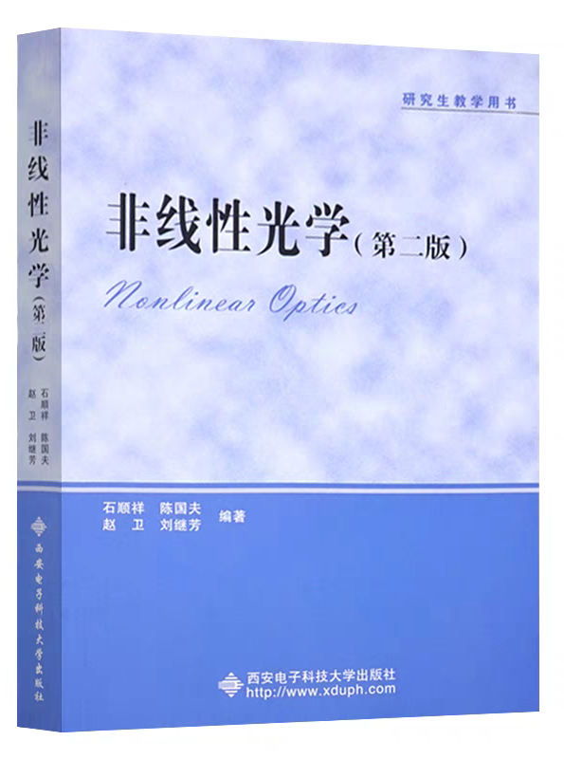
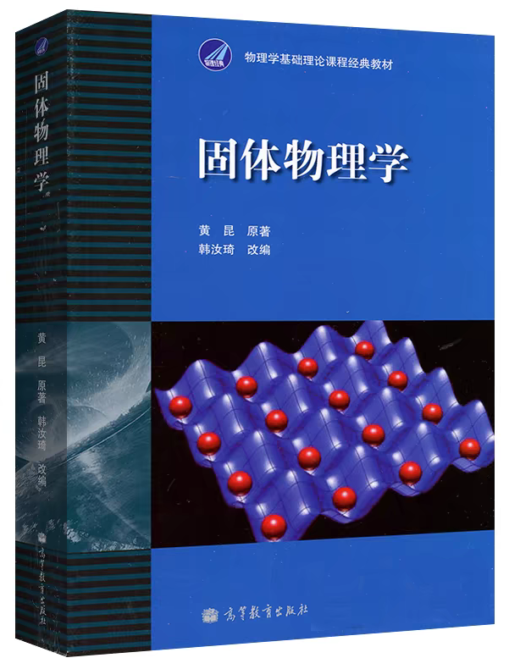
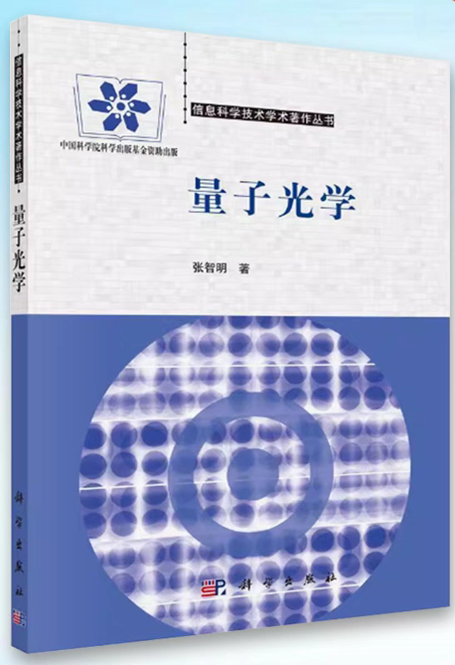
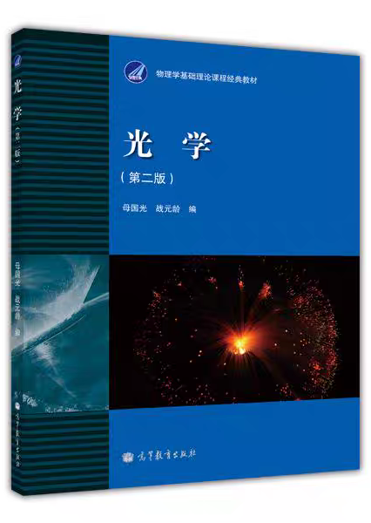
Plan on optical books
Ongoing
(20/453)
Next
Future
reading non-line optics is the first thing(expected to end by the end of June)
Solid state physics will help me to understand crystal(optical materials)
Others book will be read if it is necessary.

Slide 4
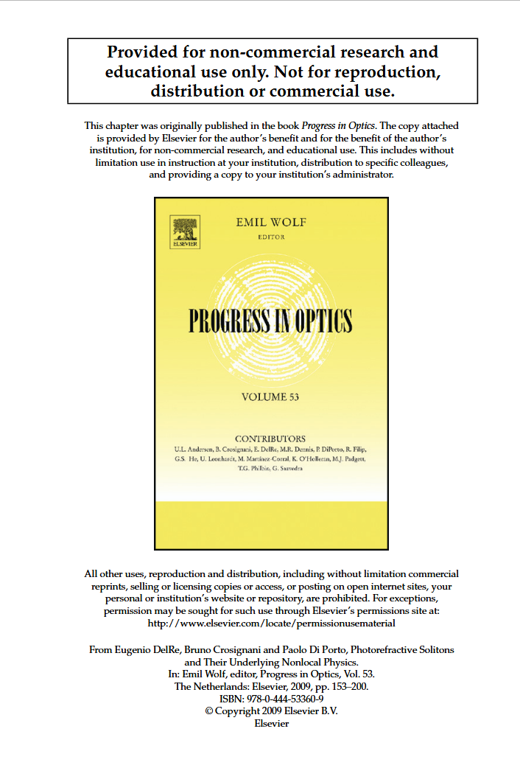
Plan on non-line optics
Ongoing
Will be carried out simultaneously

Slide 5
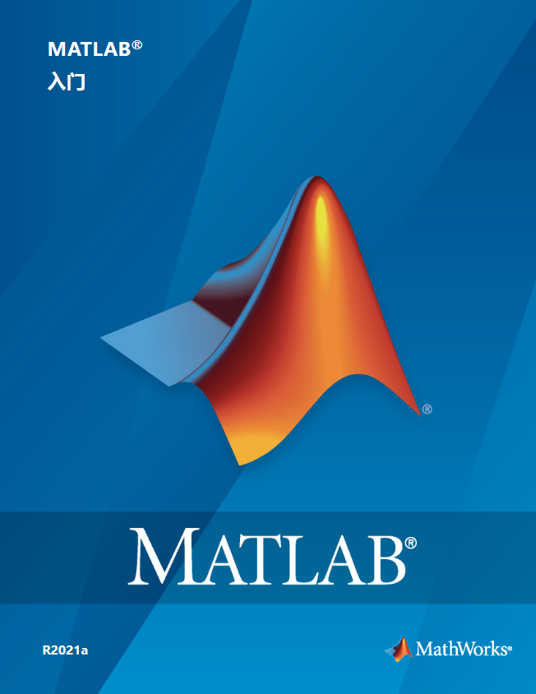
Plan on MatLab
Reading the MatLab manual(expected to end on June 10th)
learning Pro. Xin’s code to do optical calculation

