Slide 1
2025.5.27 weekly group meeting
Yunhe Yang¹,
¹NanKai University

Slide 2
Plan two：
All hadron terminal states with trace numbers greater than 4 are used as control samples.

Slide 3
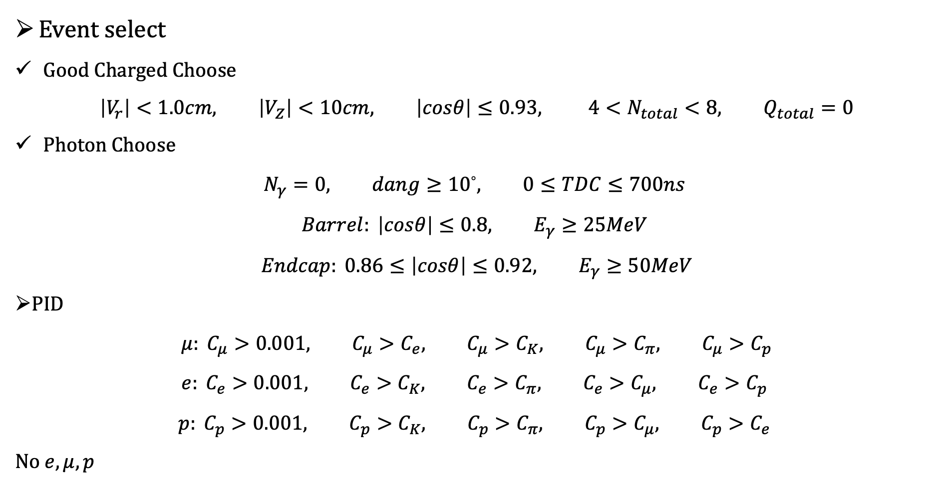
Event select
Good Charged Choose
$$\left|V_{r}\right|<1.0cm, \left|V_{Z}\right|<10cm, \left|cosθ\right|≤0.93, {4<N}_{total}<8, Q_{total}=0$$
Photon Choose
$$N_{γ}=0, dang≥{10}^{◦}, 0≤TDC≤700ns$$
$$Barrel: \left|cosθ\right|≤0.8, E_{γ}≥25MeV$$
$$Endcap: 0.86≤\left|cosθ\right|≤0.92, E_{γ}≥50MeV$$
PID
$$μ: C_{μ}>0.001, C_{μ}>C_{e}, C_{μ}>C_{K}, C_{μ}>C_{π}, C_{μ}>C_{p}$$
$$e: C_{e}>0.001, C_{e}>C_{K}, C_{e}>C_{π}, C_{e}>C_{μ}, C_{e}>C_{p}$$
$$p: C_{p}>0.001, C_{p}>C_{K}, C_{p}>C_{π}, C_{p}>C_{μ}, C_{p}>C_{e}$$
No $e, μ, p$

Slide 4
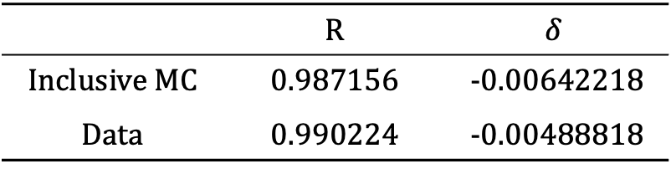
Result
 | R | $$δ$$
Inclusive MC | 0.987156 | -0.00642218
Data | 0.990224 | -0.00488818

